Slide 1
Progress of HERD Simulation
Ming XU (徐明), IHEP
2013.12.02
HERD 2nd Workshop, IHEP, Beijing

Slide 2
The HERD Mission
A space mission devoted to CR physics, DM search and gamma ray astronomy
Scientific goals of the mission:
DM search
$γ$ rays from 30GeV to TeV region, searching for spectrum anomalies that might result from DM annihilation
CR nucleon
CR chemical components spectrum measurement from z = 1 to 26 for energies form hundreds of GeV To PeV with large geometry factor, study the origin, propagation and acceleration of CR
CR electron
Spectrum measurement from 100GeV–10TeV with high energy resolution, show the possible cutoff and different components of different origins

Slide 3
Mission Requirement
$γ$ smoking gun from DM annihilation
energy resolution
PID
CR nuclei detection requirement
geometry factor
detector thickness
electron detection
energy resolution
PID

Slide 4
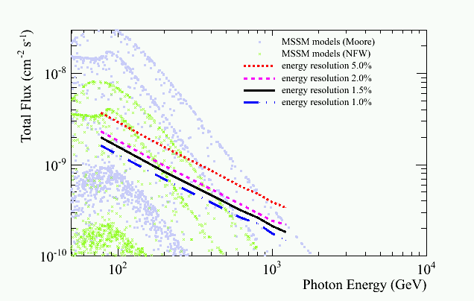
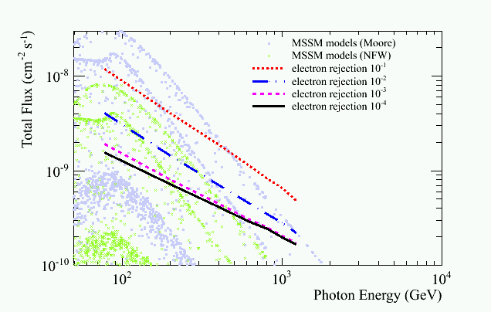
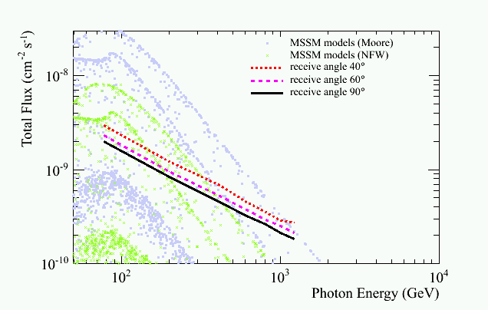
$γ$ Smoking Gun from DM Annihilation Requirement
σ_{E}
$γ$ / e
Configuration of standard detector:
exposure time | 1 year
area | 1m²
energy resolution | 1.5%
FOV | 90°
$γ$ / e | 10⁻⁴
$γ$/ p | 10⁻⁷
5.0%
ϒ / e
10⁻³
10⁻¹
2.0%
10⁻²
1.5%
10⁻³
1.0%
10⁻⁴
γ/p
$γ$/ p
_{FOV}
$γ$ / p
10⁻⁶
10⁻⁴
10⁻⁵
40°
10⁻⁶
FOV > 60°
60°
10⁻⁷
90°

Slide 5
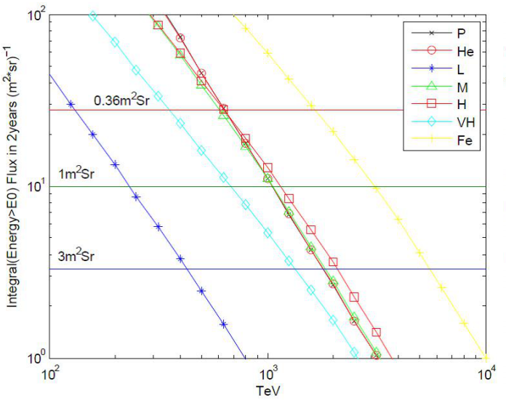
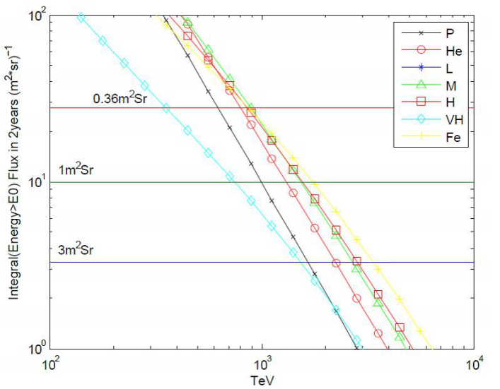
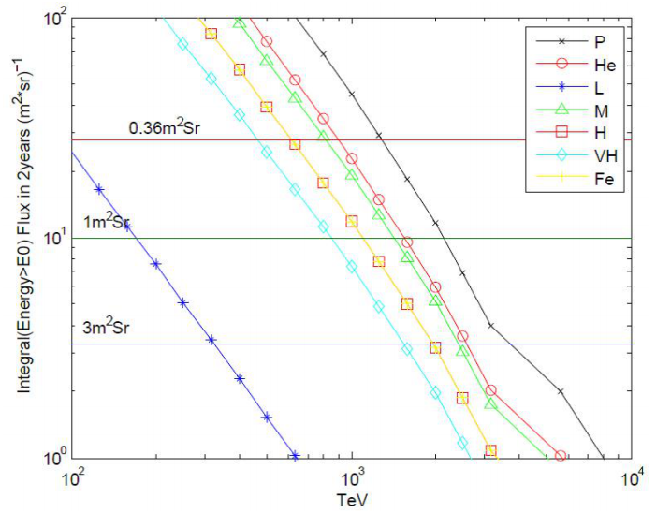
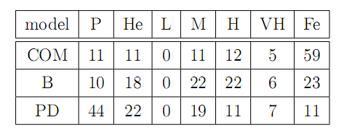
CR Nuclei Requirement: Geometry Factor
heavy-dominated model
model B
proton-dominated model
the integrated flux curve in 2 years
P (Atomic mass: ~ 1)
He(A: ~ 4)
L (A: ~ 8) 3≤Z≤5
M (A: ~ 14) 6≤Z≤9
H ( A: ~ 25) 10≤Z≤19
VH (A: ~ 35) 20≤Z
Fe (A: ~ 56)
parallel line means observe 10 events with different geometry factor
suppose GF=1m²sr, and detection efficiency=100%，the table shows the number of observed events beyond PeV in 2 years
HD

Slide 6
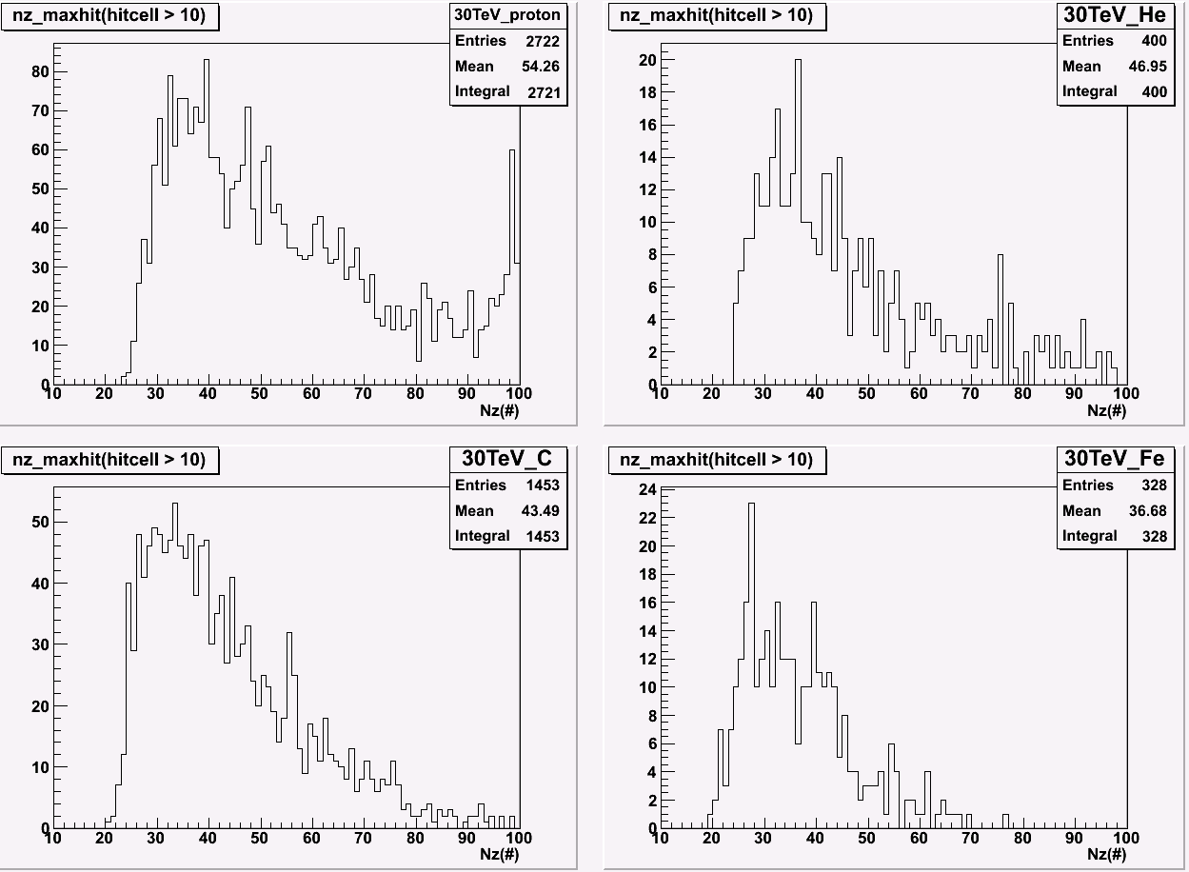
CR Nuclei Requirement: Detector Thickness
define 50% events of the distribution as the minimum length we need in a certain energy range
shower maximum distribution of different nuclei(proton, helium, carbon and iron)@30TeV

Slide 7
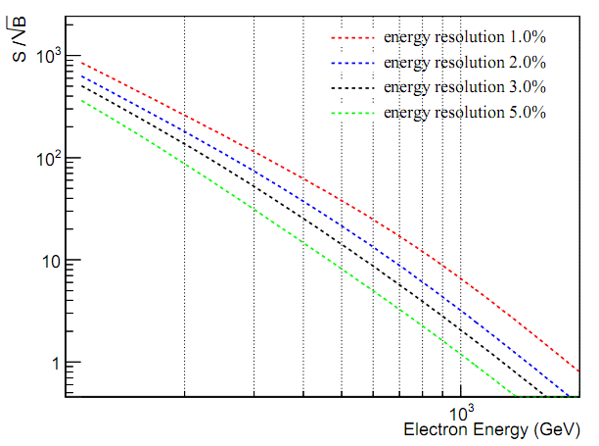
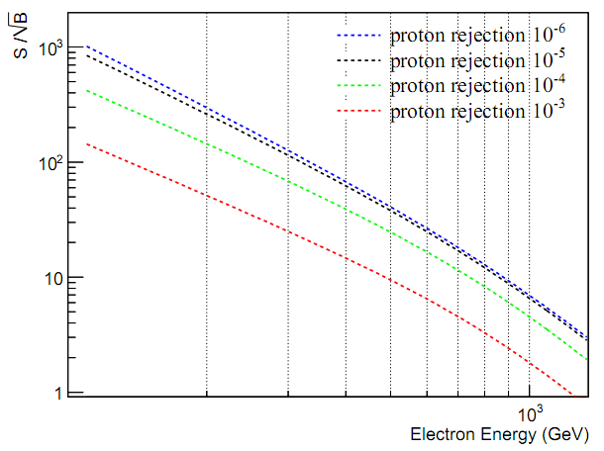
Electron Requirement

Slide 8
Mission Requirement: Summary
Large geometry factor (some m²sr)
Good nucleon energy measurement (2 nucl.inter.length)
Good electron and gamma energy resolution(~1%)
Good e/p separation power (<${10}^{−5}$)

Slide 9
Baseline Design

Slide 10
Simulation Setup: Only CALO
 | type | size | X0,λ | unit | read out
CALO | 9261 LYSO cubes 1.85 tons | 63 cm × 63 cm × 63 cm | 55 X0 3 λ | 3 cm × 3 cm × 3 cm | wls fiber + ICCD
Fine segmented (no gap)
Weighs nothing (no mechanical support)
simple readout chain, no saturation
energy deposition with Poisson sampling (energy to N p.e.)
GEANT4
version 4.9.2
electron (50GeV-1TeV)
gamma (50GeV-1TeV)
proton (100GeV-5TeV)
QGSP model
FLUKA
version 2011.2
proton (TeV to PeV)
heavy nuclei (He, C, Fe, 100GeV to PeV)
DPMJET3 model

Slide 11
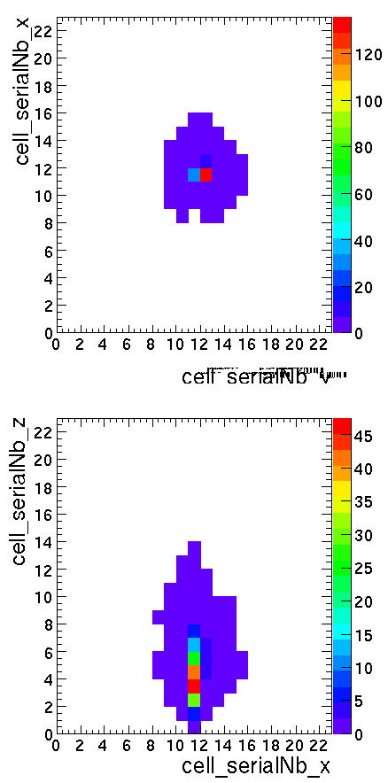
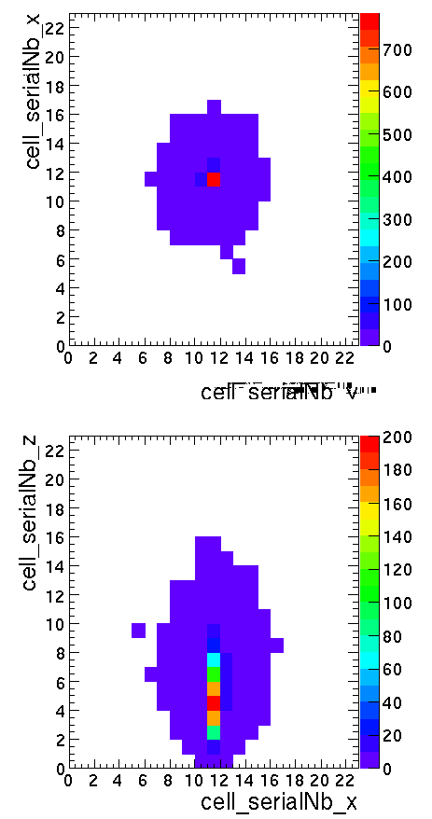
Electron Hit Map
200GeV
1TeV
cell > 0.1 MIP

Slide 12
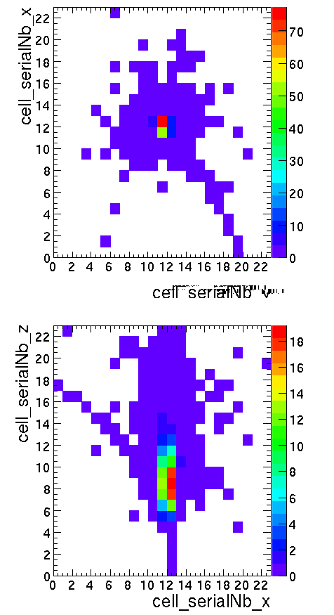
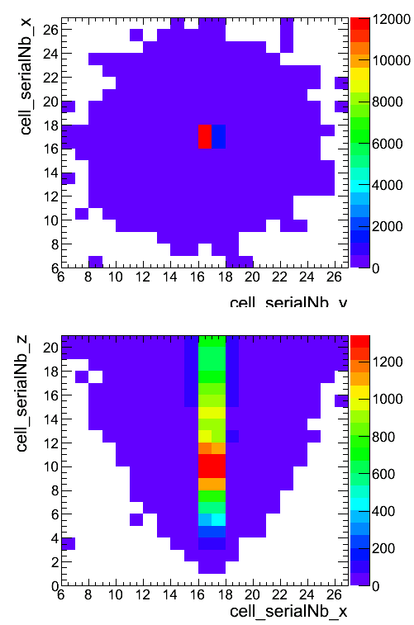
Proton Hit Map
200GeV
50TeV

Slide 13
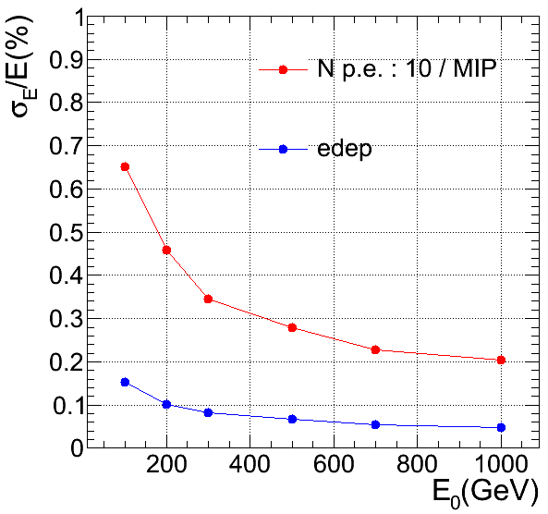
Electron ($γ$) Energy Detection
EM resolution is parameterized as:
$$\frac{σ_{E}}{E}=\frac{a}{\sqrt{E}}⊕\frac{b}{E}⊕c$$
$a$: stochastic term
Fluctuations is signal generation process
$b$: noise term
Due to readout electronics
$c$: constant term
Non-uniform response
Channel to channel inter-calibration
Energy leakage
Energy lost in dead material

Slide 14
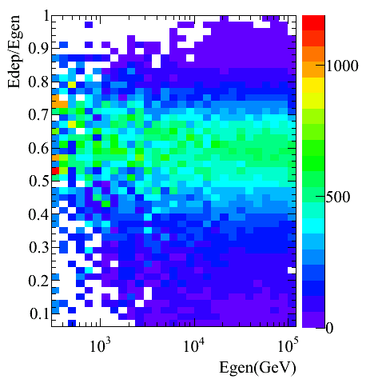
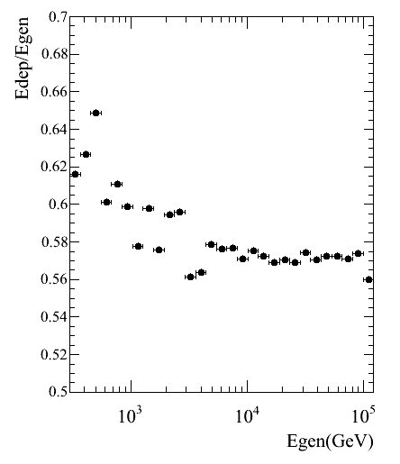
Proton Interactions in CALO
$p+N→π^{0}π^{±}pn…$
$π^{±}→μ^{±}ν$ energy escape
$π^{0}→γγ$ EM shower

Slide 15
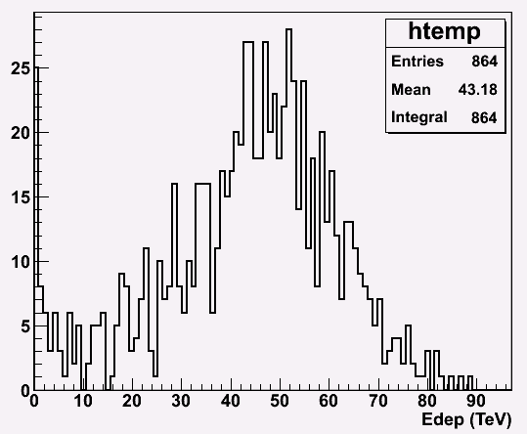
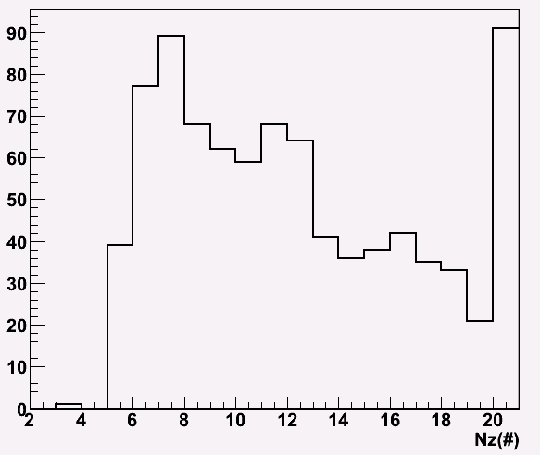
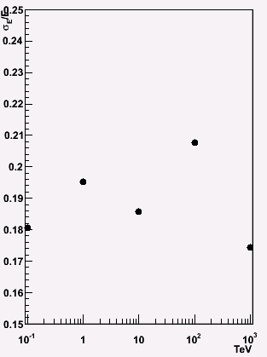
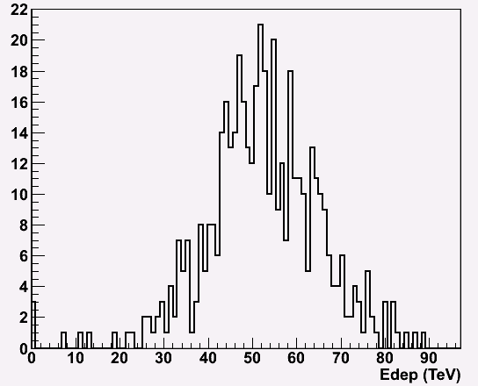
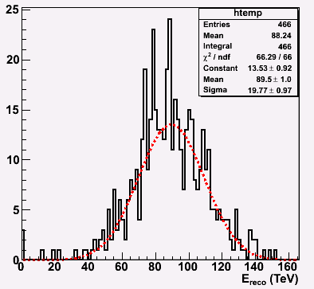
Proton Energy Reconstruction(100TeV)
with shower max cut
Reconstructed with liner function

Slide 16
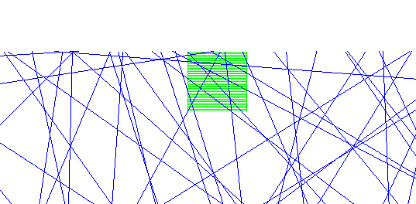
Effective Geometry Factor
effective geometry factor means the counting efficiency:
$$N_{obs}={F× G}_{eff.}×T_{exp.}×η_{pid}×η_{reco}$$
$N_{obs}: number of observed events$
$F: Absolute flux(m^{−2}{sr}^{−1}s^{−1})$
$G_{eff}: effictive geometry factor(m^{2}sr)$
$T_{exp}: exposure time(s)$
$η_{pid}: particle ID efficiency$
$η_{reco}: reconstruction efficiency$
Toy MC method: using the counting ration between flat panel and CALO to estimate the CALO GF
$$G_{eff}(CALO)={ G}_{generated}×\frac{N_{passed}}{N_{generatd}}$$
${ G}_{generated}$ of a flat panel is easy to know: $πS$
$N_{passed}$:
earth + atmosphere block
minimum path length

Slide 17
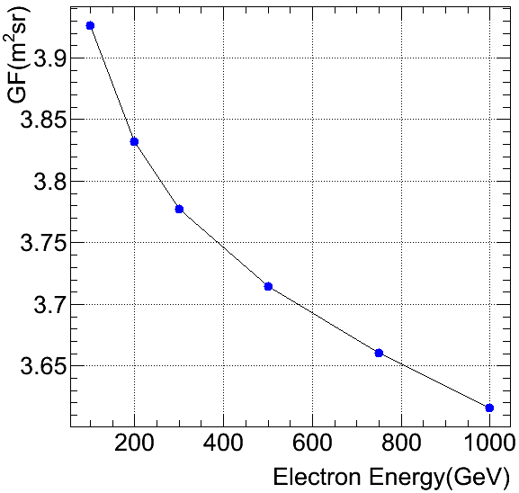
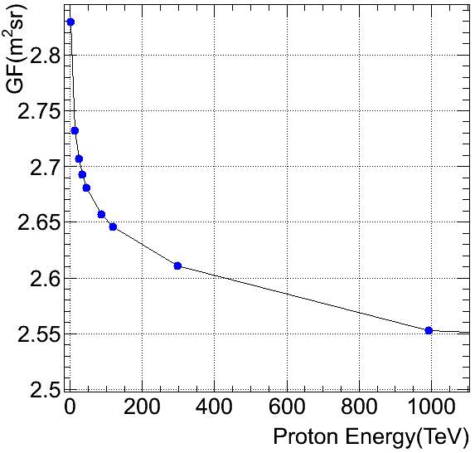
Effective Geometry Factor

Slide 18
The CALO Structure
CR nuclei detection capability is related to energy resolution and GF. Under the weight constraint (totally 2t):
good resolution，need “thick” CALO，but GF decrease
bigger GF，need “flat” CALO，but worse resolution
smear (folding) and unfolding method to get the reconstructed spectrum affected by these two factors, and the residual of reconstructed spectrum and input spectrum tells which factor dominate in CR nucleon measurement.
thick
flat
structure cm×cm×cm | nucl.inter.length | GF (m²sr) @100TeV | resolution
63×63×63 | 3 | 2.6 | 20%
77×77×42 | 2 | 3 | 30%

Slide 19
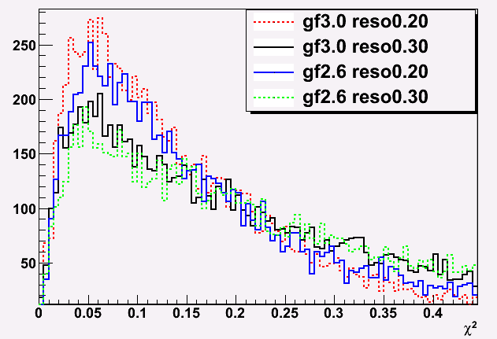
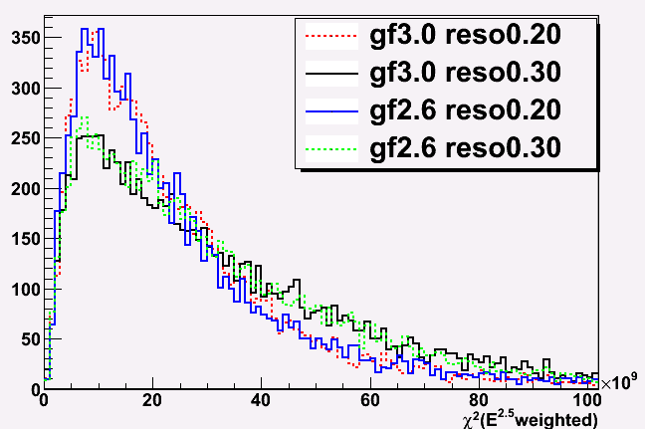
Goodness of Unfolding Test
$$truth→truth∗E^{2.5}$$
$$unfolded→unfolded∗E^{2.5}$$
energy resolution is more important
in CR nuclei spectrum measurement

Slide 20
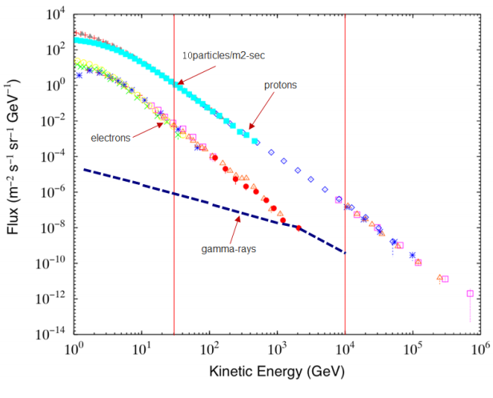
Flux of Each Components
to identify$γ$ rays and electrons, excellent capability of proton rejection power is necessary

Slide 21
PID: MVA Method
Define 8 parameters for a shower in CALO
Var 3
Var 1
Var 2
Var 4
Var 5
Var 6
Signals: electrons
Background: protons
.
Var 8
Var 7

Slide 22
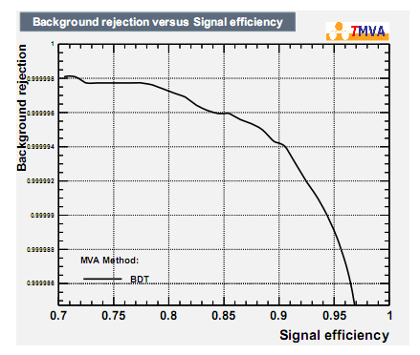
e/p Separation (TMVA)
6.0×10⁻⁶

Slide 23
Expected Performance of HERD CALO
γ/e energy range (CALO) | tens of GeV-10TeV
nucleon energy range (CALO) | up to PeV
γ/e energy resolution (CALO) | <1%@200GeV
proton energy resolution (CALO) | 20%
e/p separation power (CALO) | <10⁻⁵
electron eff. geometrical factor (CALO) | 3.8 m²sr@200 GeV
proton eff. geometrical factor (CALO) | 2.6 m²sr@100 TeV

Slide 24
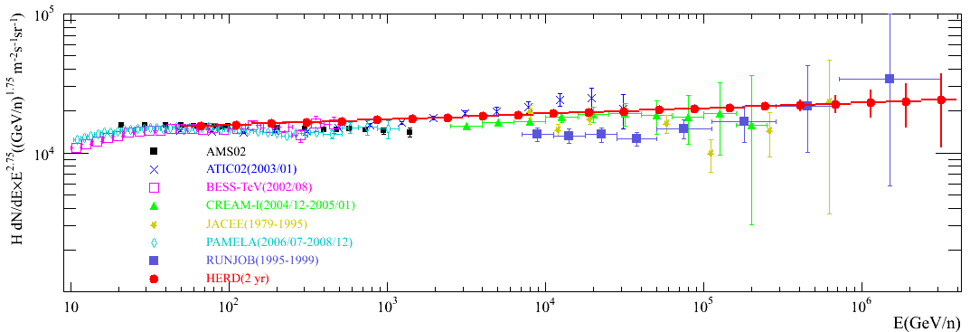
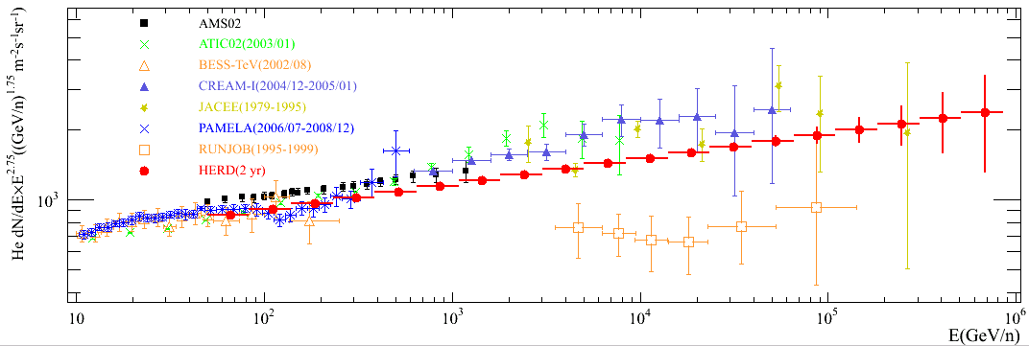
Expected HERD Proton and He Spectrum
Horandel model as HERD input
Only statistical error
Notes:
新添加了AMS02的质子和氦核测量数据，AMS02公布的能谱最后一个点都在1TeV附近
对AMS的结果，选取了从几十GeV开始到其公布的上限，每个谱选了均匀挑选了15个数据点，放在图中一并比较

Slide 25
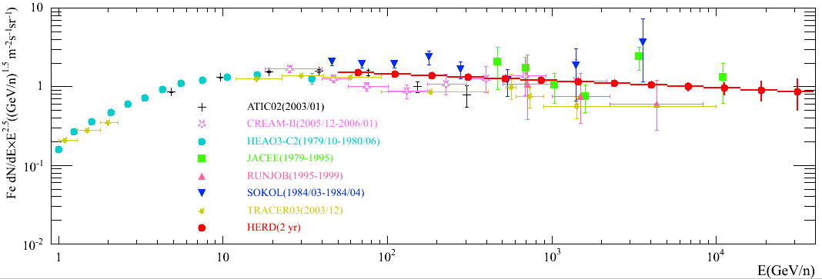
Expected HERD of Abundant Heavy Nuclei

Slide 26
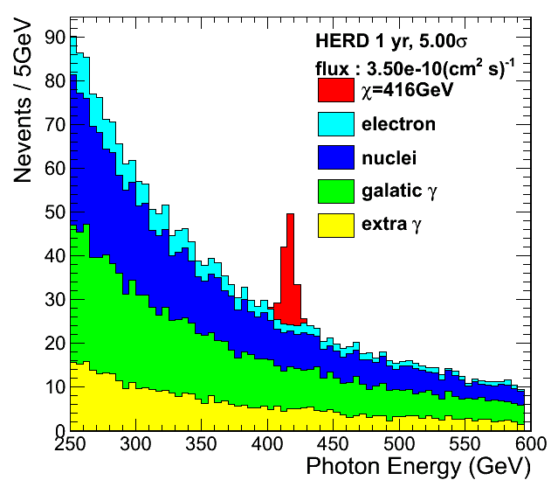
About DM: The$γ$ Ray Line Spectrum

Slide 27
Dynamic Range and Readout Sensor Requirement
Dynamic range estimation
cell MIP response (LYSO, 3cm cube) ~ 30MeV
cell MAX Energy deposit response(PeV shower) ~ 20TeV
dynamic range = 20TeV / (1/3 MIP) = $2×{10}^{6}$
Dual fiber readout for one cell (high/low gain) is a possible solution
Readout sensor (ICCD frame requirement)
Trigger Threshold (GeV) | Counting Rate (Hz) | Detection Efficiency (200 frame) | Detection Efficiency (500 frame) | Detection Efficiency (1000 frame)
20 | 300 | 42% | 63% | 78%
30 | 100 | 70% | 85% | 92%
50 | 50 | 83% | 92% | 96%
see Zhi-Gang WANG’s talk for details

Slide 28
Summary
Large effective geometry factor
> 3m²sr for electron
> 2m²sr for proton
Good nucleon energy measurement (proton, 20%)
Good electron and gamma energy measurement (~1%)
Good e/p separation power (<10⁻⁵)
These factors are quite advanced and essential for CR spectrum measurement and the searching of DM.
Thank You!

Slide 29
Backup

Slide 30
The LYSO Crystal
Crystal | CsI(Na) | BGO | PWO | LYSO
Density (g/cm3) | 4.51 | 7.13 | 8.3 | 7.4
1 X0 (cm) | 1.86 | 1.12 | 0.89 | 1.14
1 λ (cm) | 39.3 | 22.8 | 20.7 | 20.9
Decay time (ns) | 690 | 300 | 30 | 40
Light yield (%) | 88 | 21 | 0.3 | 85
Cerium-doped Lutetium Yttrium Orthosilicate
$({Lu}_{1.8}Y_{0.2}{SiO}_{5})$ Simulation Configuration
Element | Mass Fraction(%)
Lu | 71.44
Y | 4.03
Si | 6.37
O | 18.14
Ce | 0.02

Slide 31
Earth Atmosphere Cover Effect
atmosphere（km） | blocked（°） | remained（°）
0 | 70 | 20
100 | 73 | 17
200 | 76 | 14
300 | 80 | 10
orbit @400km(H=400km) R(earth) = 6370km
R+H
R
R+h

Slide 32
Effective GF under Different Condition

Slide 33
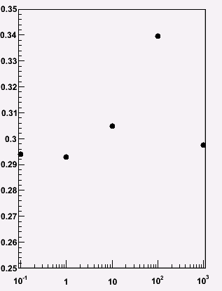
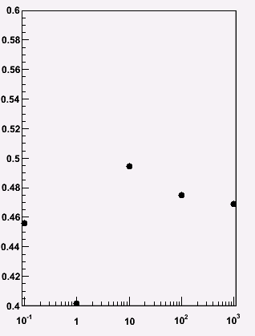
Proton Energy Resol vs Detector Thickness
GF@
100 TeV
2.6
GF 2.0
GF 3.0
➔63*63*63cm
3 nucl.inter.length,
20% resolution
➔77*77*42cm
2 nucl.inter.length,
30% resolution
➔90*90*31cm
1.5 nucl.inter.length,
50% resolution
CALO weight: 1850 kg

Slide 34
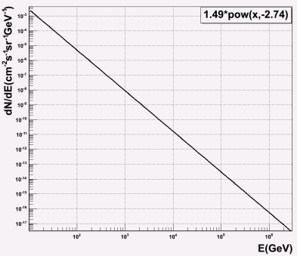
Unfolding Workflow
training truth
power law gauss
Integral the convoluted function with GF, resolution, obs_time and energy
response matrix
measured data
sample from power law function(500GeV-5PeV)
Nsample depends on obs_time and GF
training truth with gaussion smearing
goodness of unfolding test
RooUnfold
training measured
unfolded distribution
and errors

Slide 35
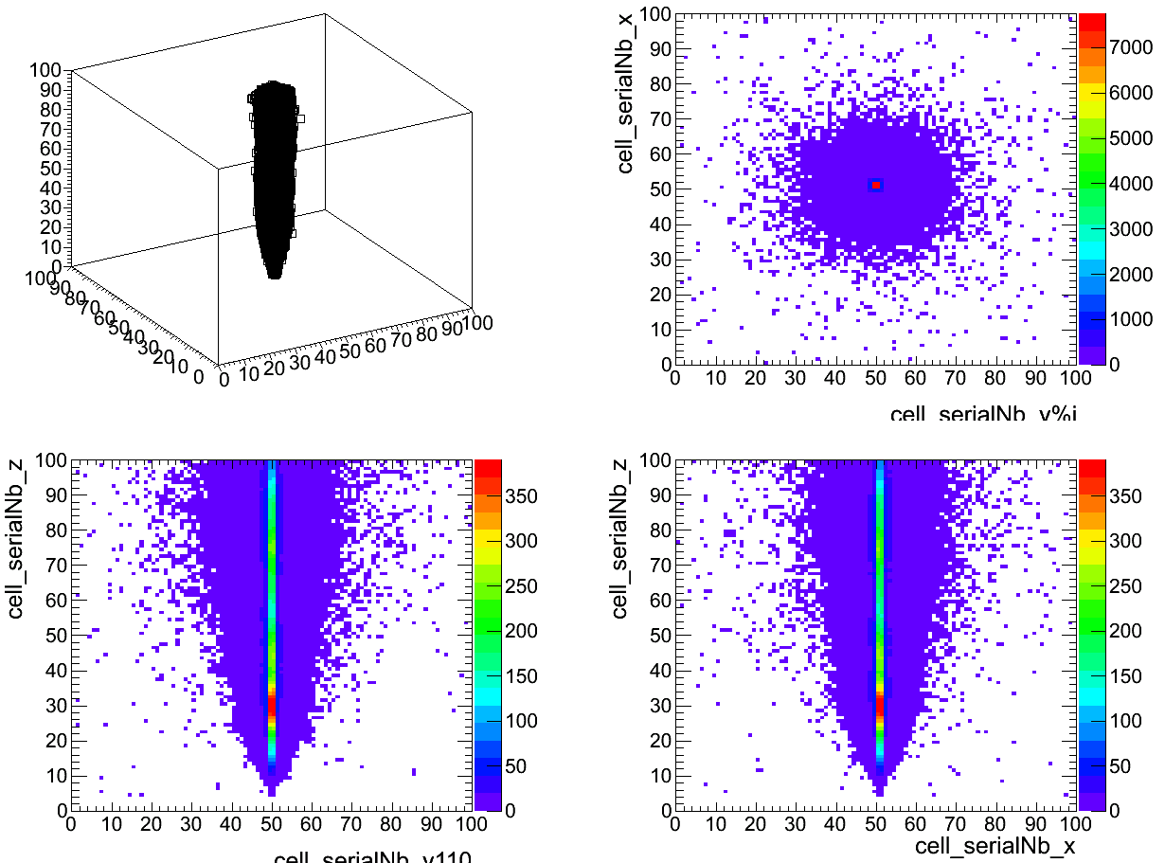
proton, 53TeV, 1cm cell, 100cm3, hit map

