Slide 1
The High Energy cosmic Radiation Detection (HERD) facility
onboard China’s Space Station
Shuang-Nan Zhang (张双南)
zhangsn@ihep.ac.cn
Center for Particle Astrophysics
粒子天体物理中心
Institute of High Energy Physics
Chinese Academy of Sciences

Slide 2
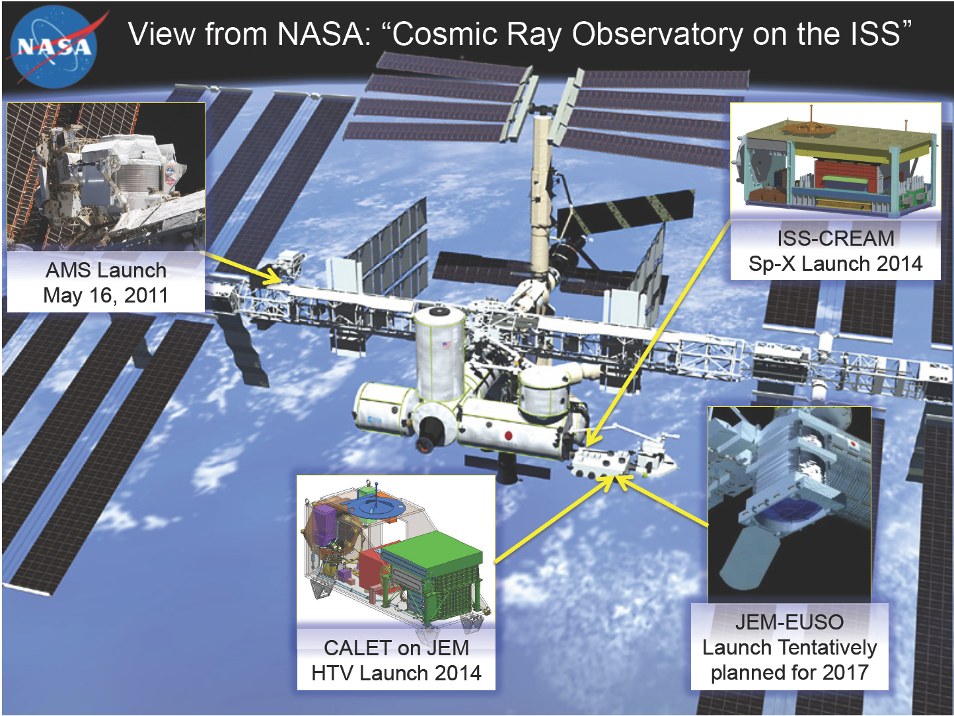

Slide 3
China’s Space Station Program
Three phases
  1st phase: so far 7 Chinese astronauts have been sent out and returned back successfully; many space science research has been done. Completed successfully.
  2nd phase: spacelab: docking of 3 spaceships with astronauts delivering and installing scientific instruments. 1st launch on Sept. 29, 2011.
  3rd phase: spacestation: several large experimental cabins with astronauts working onboard constantly. 1st launch ~2018.
International collaborations on space science research have been and will continue to be an important part.

Slide 4
Cosmic Lighthouse Program: China’s Space Station
Candidate Projects | Main Science Topics
Large scale imaging and spectroscopic survey facility (approved) | Dark energy, dark matter distribution, large scale structure of the universe
HERD (concept) | Dark matter properties, cosmic ray composition, high energy electron and gamma-rays
Soft X-ray-UV all sky monitor (?) | X-ray binaries, supernovae, gamma-ray bursts, active galactic nuclei, tidal disruption of stars by supermassive black holes
X-ray polarimeter (?) | Black holes, neutron stars, accretion disks, supernova remnants
Galactic warm-hot gas spectroscopic mapper (?) | The Milky Way, interstellar medium, missing baryons in the Universe
High sensitivity solar high energy detector (?) | Solar flares, high energy particle acceleration mechanism, space weather
Infrared spectroscopic survey telescope (?) | Stars, galaxies, active galactic nuclei

Slide 5
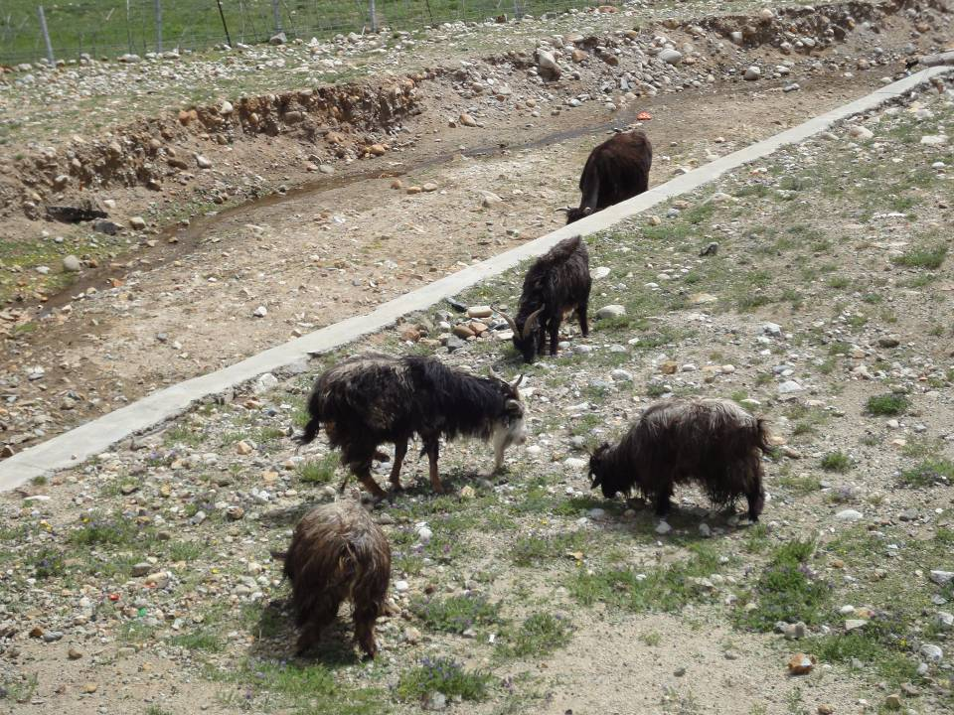
background
Gamma-ray
HERD
electron
proton
He
Dark matter particle
5/35
Notes:
5

Slide 6
HERD: High Energy cosmic-Radiation Detector
Science goals | Mission requirements
Dark matter search | R1: Better statistical measurements of e/γ between 100 GeV to 10 TeV
Origin of Galactic Cosmic rays | R2: Better spectral and composition measurements of CRs between 300 GeV to PeV* with a large geometrical factor
Secondary science: monitoring of GRBs, microquasars, Blazars and other transients.
*complementary to LHAASO
Notes:
6

Slide 7
HERD Cosmic Ray Capability Requirement
P (<A> ~ 1)
He (<A> ~ 4)
L (<A> ~ 8)
M (<A> ~ 14)
H (<A> ~ 25)
VH (<A> ~ 35)
Fe (<A> ~ 56)
Model 2
Heavy Model
Model 1
Light model
PeV
PeV
Detection limit: N = 10 events
Except for L, up to PeV spectra feasible with GF~2-3 in ~years: discriminate between models.
PeV
PeV
N(E>E0; 2 yr)
HERD
HERD
TeV
TeV

Slide 8
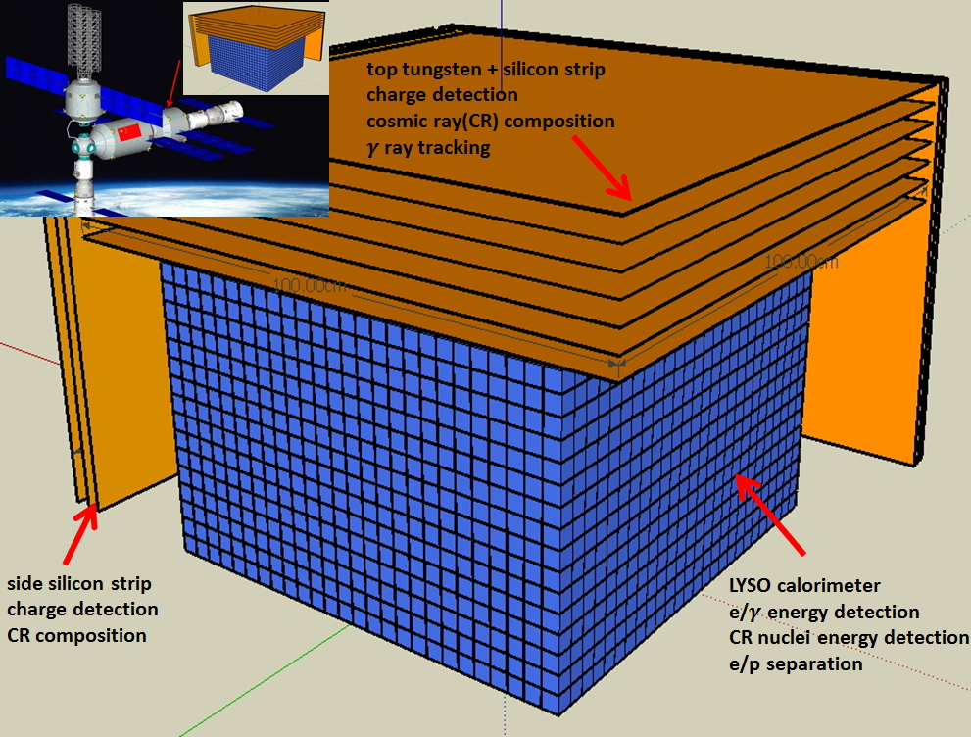
Baseline design of HERD

Slide 9
Characteristics of all components
 | type | size | X0,λ | unit | main functions
tracker (top) | Si strips | 70 cm × 70 cm | 2 X0 | 7 x-y (W foils) | Charge Early shower Tracks
tracker 4 sides | Si strips | 65 cm × 50 cm | -- | 3 x-y | Nucleon Track Charge
CALO | ~10K LYSO cubes | 63 cm × 63 cm × 63 cm | 55 X0 3 λ | 3 cm × 3 cm × 3 cm | e/γ energy nucleon energy e/p separation
Total detector weight: ~2000 kg

Slide 10
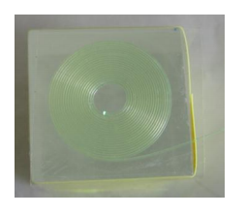
Why LYSO detectors?
Crystal | CsI(Na) | BGO | PWO | LYSO
Density (g/cm3) | 4.51 | 7.13 | 8.3 | 7.4
1 X0 (cm) | 1.86 | 1.12 | 0.89 | 1.14
1 λ (cm) | 39.3 | 22.8 | 20.7 | 20.9
Decay time (ns) | 690 | 300 | 30 | 40
Light yield (%) | 88 | 21 | 0.3 | 85
crystal + wls fiber

Slide 11
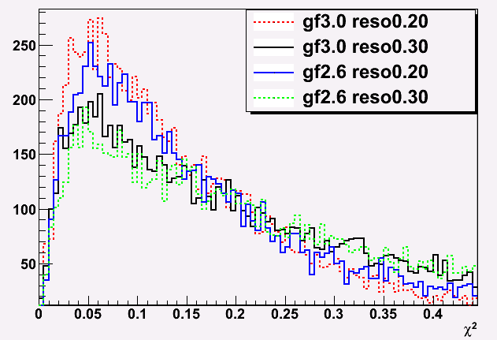
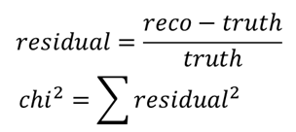
HERD reconstruction vs. energy resol.
Under the weight limitation of 2 tons, resolution is more important for spectral reconstruction, based on the current design.

Slide 12
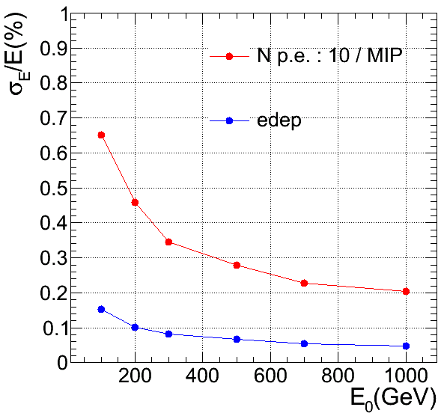
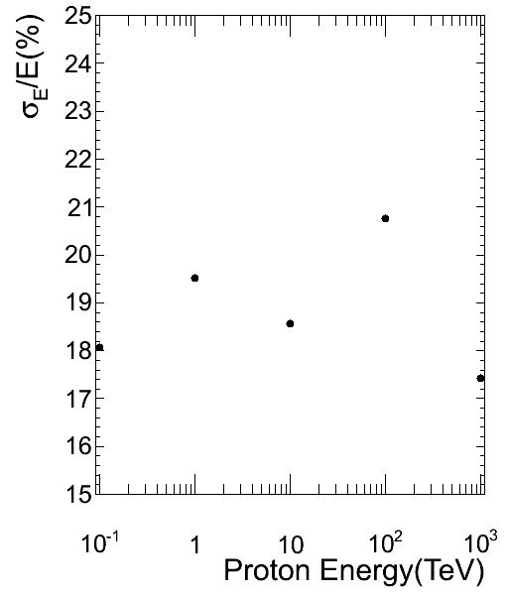
Simulation results: energy resolutions
Protons
Electrons
Electron < 1%; Proton: ~20%
Essential for spectral features!

Slide 13
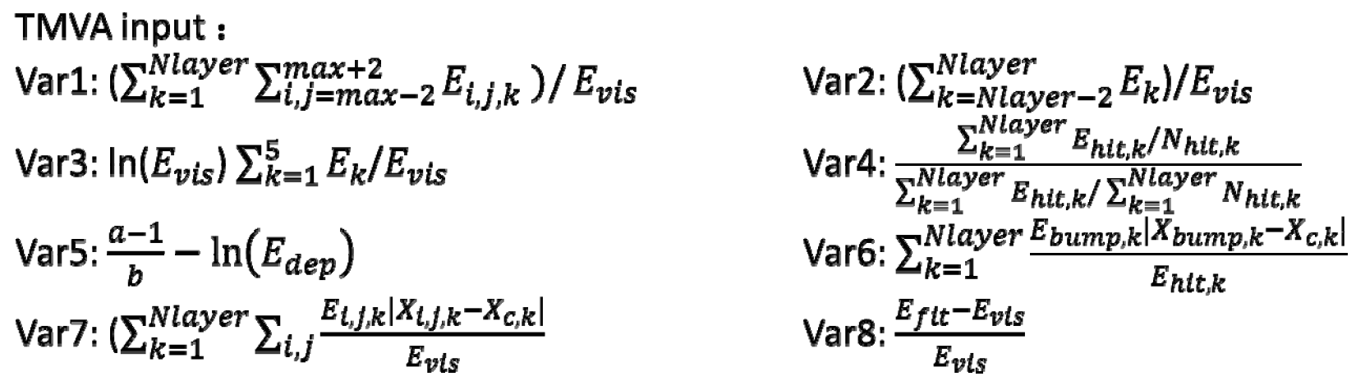
TMVA: Multi-Variable Analysis
Define 8 parameters for a shower in CALO

Slide 14
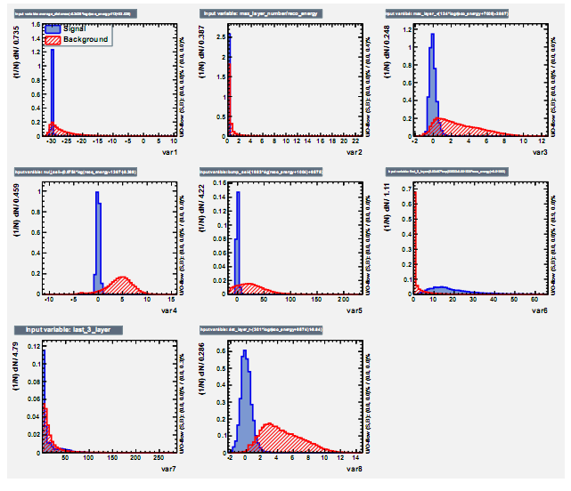
Distributions of the 8 parameters
Var 3
Var 1
Var 2
Var 4
Var 5
Var 6
Signals: electrons
Background: protons
.
Var 8
Var 7

Slide 15
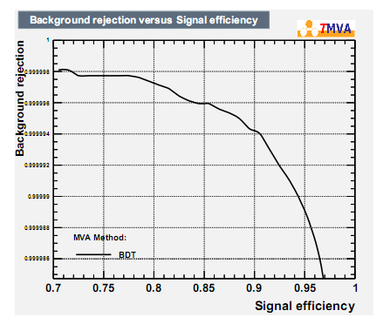
e/p separation (TMVA)
6.0×10⁻⁶

Slide 16
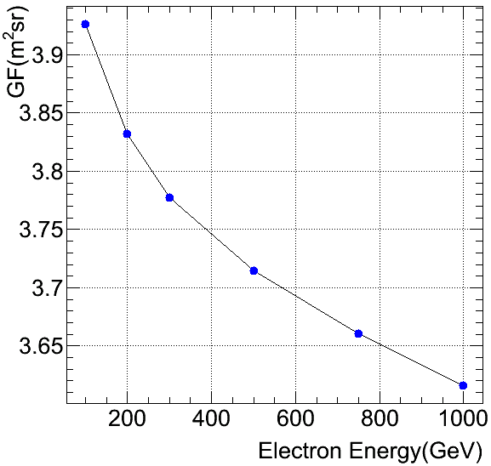
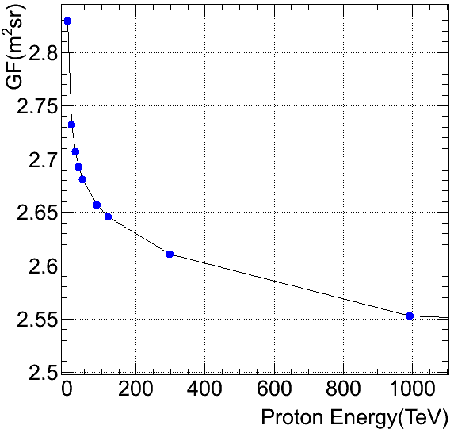

HERD Eff. Geometrical Factor: CALO
All five sides
All five sides

Slide 17
Expected performance of HERD
γ/e energy range (CALO) | tens of GeV-10TeV
nucleon energy range (CALO) | up to PeV
γ/e angular resol. (top Si-strips) | 0.1º
nucleon charge resol. (all Si-strips) | 0.1-0.15 c.u
γ/e energy resolution (CALO) | <1%@200GeV
proton energy resolution (CALO) | 20%
e/p separation power (CALO) | <10⁻⁵
electron eff. geometrical factor (CALO) | 3.7 m²sr@600 GeV
proton eff. geometrical factor (CALO) | 2.6 m²sr@400 TeV

Slide 18
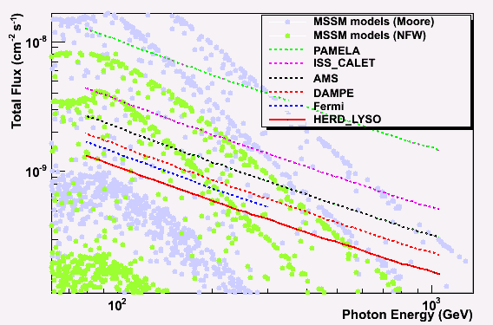
HERD sensitivity to gamma-ray line
HERD 1 yr
PAMELA: 2006-2016 CALET: 2015-2020; AMS: 2011-2021; DAMPE: 2015-2020; Fermi: 2008-2018; HERD: 2020-2021

Slide 19
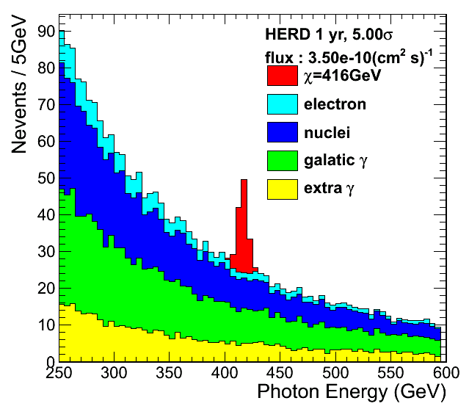
DM annihilation line of HERD

Slide 20
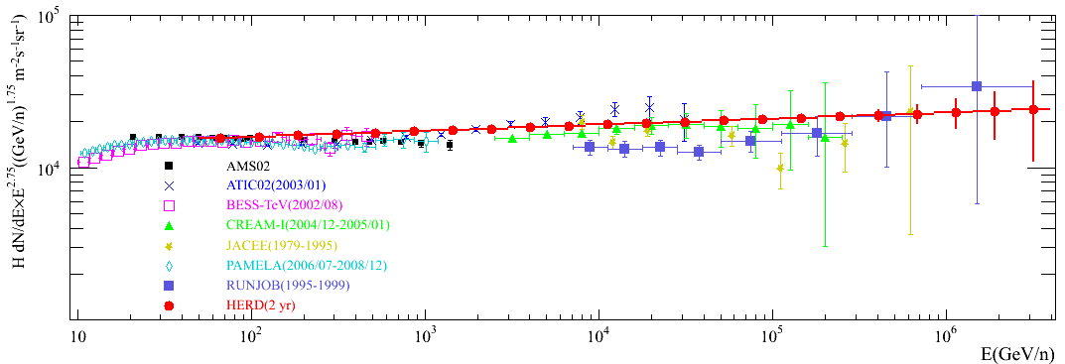
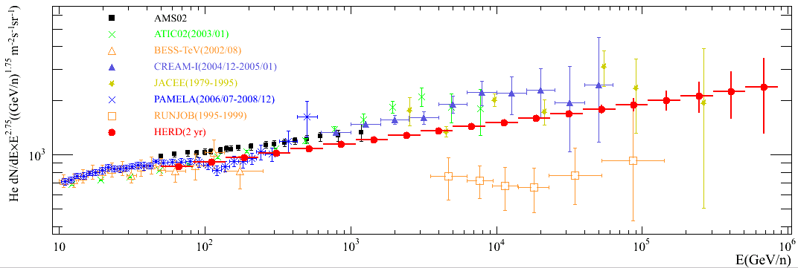
Expected HERD Proton and He Spectra
Horandel model as HERD input
Only statistical error
Notes:
新添加了AMS02的质子和氦核测量数据，AMS02公布的能谱最后一个点都在1TeV附近
对AMS的结果，选取了从几十GeV开始到其公布的上限，每个谱选了均匀挑选了15个数据点，放在图中一并比较

Slide 21
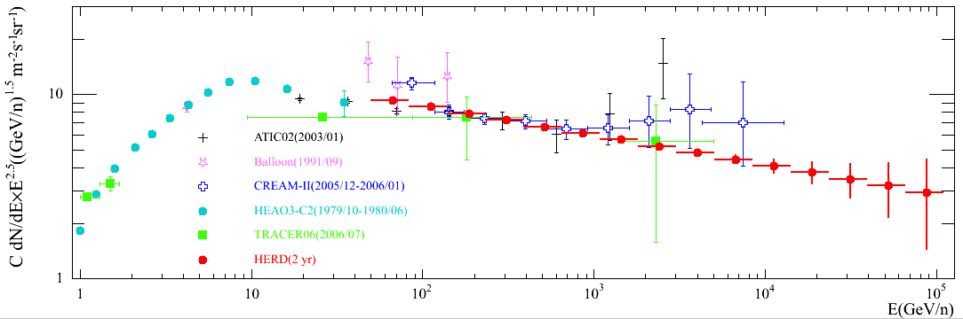
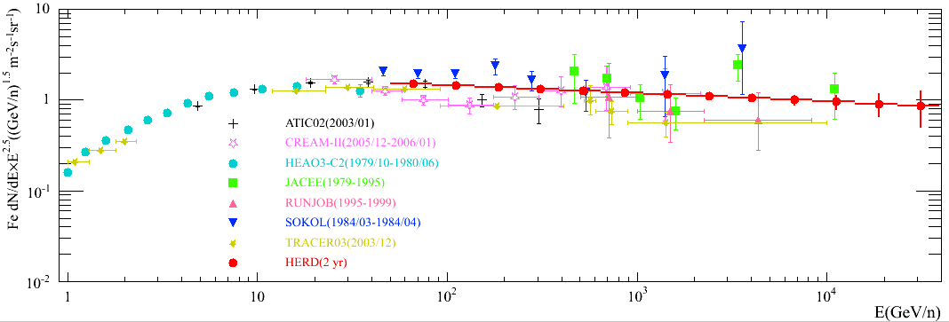
Expected HERD Spectra of C and Fe

Slide 22
New calorimeter readout technique: ICCD
Direct Coupling
PD, APD, SiPM:
Complicated system,
high power consumption
MAPMT, SiPM: high power consumption
CCD: No single photon detection
EMCCD, EBCCD: no ns gate control
ICCD: no above
problems, but premature
Wavelength shifter
fiber readout
Only ONE CCD chip needed!

Slide 23
Summary
Advantages of HERD: competitive ~2020
  geometrical factor 10-20 X larger than all other experiments before 2020
  Cosmic ray composition & spectra up to PeV energy with 20% energy resolution
More talks on HERD
  Ming XU (IHEP): CALO simulations
  Xin Wu (Geneva U.): silicon tracker simulations
  Jing HUANG (IHEP): cosmic ray physics
  Zhigang WANG (IHEP): CALO lab test
  Bingliang HU (XIOPM): CALO ICCD readout

