Slide 1
CEPC Machine Optimization and Final Focus Design
International Workshop on Future High Energy Circular Colliders
Dou Wang, Jie Gao, Ming Xiao,
Yiwei Wang, Sha Bai
December 16-17, 2013
IHEP, Beijing, China

Slide 2
Outline
50 km CEPC optimized design
70 km CEPC optimized design
CEPC final focus design

Slide 3
50 km Circular electron-positron Collider (CEPC) design

Slide 4
Constraints from IP
Beam-beam parameter limit coming from beam emittance blow-up
Gao’s theory:
Beam lifetime limit due to beamstrahlung
Valery Telnov’ theory
Extra energy spread due to beamstrahlung

Slide 5
luminosity of circular collider
Number of IPs
SR power

Slide 6
Beam parameters calculation
Input parameters
Energy E₀ | Circumference C₀ | Goal luminosity L₀ | IP number N_{IP} | SR power /beam P₀ | Bending radius ρ | aspect ratio r | Coupling κ_{ε} | Energy acceptance η
120GeV | 50 km | 1∼6×10³⁴ cm⁻²s⁻¹ | 1∼2 | 50 MW | 5∼6.2 km | 200 | 0.005 | 5%∼12%

Slide 7
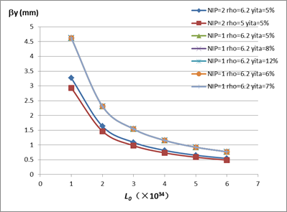
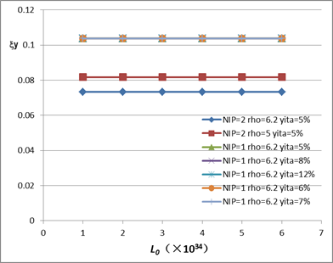
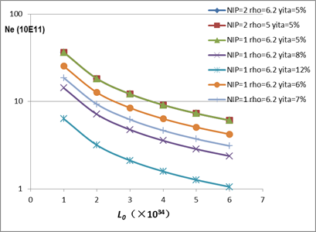
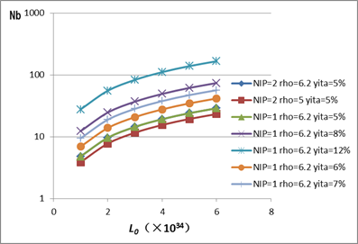
Beam parameter scan-1

Slide 8
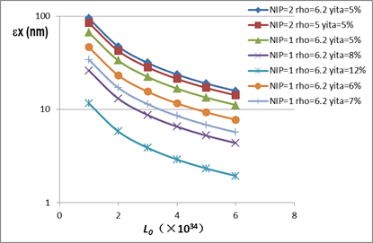
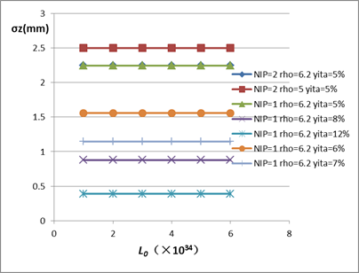
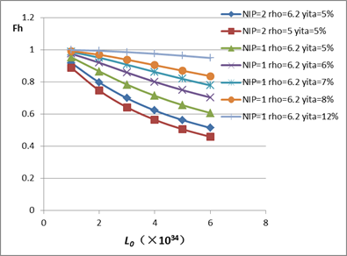
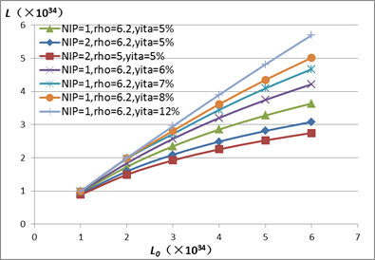
Beam parameter scan-2

Slide 9
Machine parameter choice
Less IP give higher luminosity
N_{IP}=1 →maximum luminosity efficiency (L/IP)
keep 2 IPs to get larger total luminosity (=$√2$* L/IP)
Larger bending radius give higher luminosity
choose ρ=6.2 m （80% filling factor for bending dipoles）
Higher momentum acceptance give higher luminosity
How to choose η?
decided by RF parameters

Slide 10
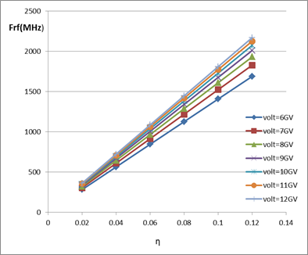
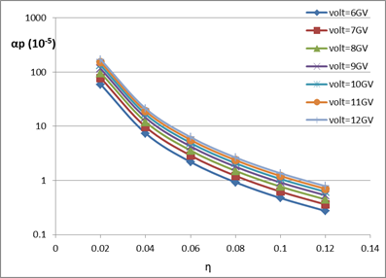
Constraints from RF system
Synchrotron radiation loss per turn
ρ=6.2 m
Synchrotron phase
Nature bunch length
ρ=6.2 m
Momentum acceptance

Slide 11
Choice for RF technology
the maximum luminosity which we can obtain is decided by the RF technology (frequency). Higher RF frequency will give larger luminosity.
From the beam dynamics point of view, lower RF frequency is a better choice because the cavities with lower frequency have larger aperture and hence lower impendence which is a favor for the collective instabilities.
there are still technical difficulties to directly use ILC 1.3 GHz SC technology on storage rings, it’s better to choose the frequency lower than 1GHz. 700 MHz is a good candidate with better gradient and lower impedance.
the requirement of enlarging energy acceptance is translated to design a low momentum compaction lattice and also larger RF voltage will relax this tolerance and lose the difficulties of lattice design. So we need to make a reasonable choice for the total RF voltage while balancing the constraints from the RF frequency and momentum compaction.

Slide 12
Optimization Parameter Design of CEPC
 | 350 MHz (LEP2-like) technology | 700 MHz technology |  | 1.3 GHz (LEP3-like) technology
Number of IPs | 1 | 1 | 2 | 1
Energy (GeV) | 120 | 120 | 120 | 120
Circumference (km) | 50 | 50 | 50 | 50
SR loss/turn (GeV) | 2.96 | 2.96 | 2.96 | 2.96
N_{e}/bunch (10¹²) | 1.61 | 0.79 | 1.12 | 0.33
Bunch number | 11 | 22 | 16 | 53
Beam current (mA) | 16.9 | 16.9 | 16.9 | 16.9
SR power /beam (MW) | 50 | 50 | 50 | 50
B₀ (T) | 0.065 | 0.065 | 0.065 | 0.065
Bending radius (km) | 6.2 | 6.2 | 6.2 | 6.2
Momentum compaction (10⁻⁴) | 0.43 | 0.38 | 0.38 | 0.21
β_{IP} x/y (m) | 0.2/0.001 | 0.2/0.001 | 0.2/0.001 | 0.2/0.001
Emittance x/y (nm) | 29.7/0.15 | 14.6/0.073 | 29.1/0.15 | 6.1/0.03
Transverse σ_{IP} (um) | 77/0.38 | 54/0.27 | 76/0.38 | 35/0.17
ξ_{x}/IP | 0.103 | 0.103 | 0.073 | 0.103
ξ_{y}/IP | 0.103 | 0.103 | 0.073 | 0.103
V_{RF} (GV) | 4.1 | 6 | 6 | 9.3
f _{RF} (MHz) | 350 | 704 | 704 | 1304
σ_{z} (mm) | 4.6 | 2.2 | 2.2 | 0.95
Energy spread (%) | 0.13 | 0.13 | 0.13 | 0.13
Energy acceptance (%) | 3.5 | 5 | 5 | 7.7
γ_{BS} (10⁻⁴) | 9.7 | 13.8 | 13.8 | 21.3
n_{γ} | 0.86 | 0.6 | 0.6 | 0.39
δ_{BS} (10⁻⁴) | 4.3 | 4.3 | 4.3 | 4.3
Life time due to beamstrahlung (minute) | 30 | 30 | 30 | 30
F (hour glass) | 0.49 | 0.68 | 0.68 | 0.87
L_{max}/IP (10³⁴cm⁻²s⁻¹) | 2.2 | 3.1 | 2.2 | 4.0

Slide 13
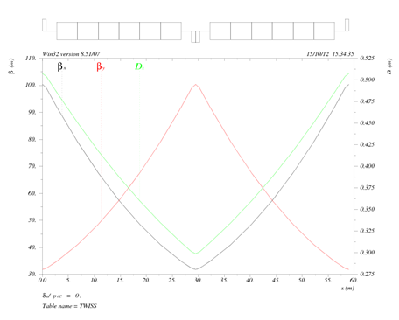
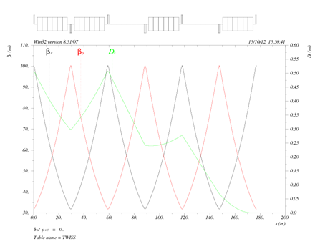
Linear lattice design
Dispersion suppressor
60° FODO cells in arc
16-fold symmetry
SC cavities and other cryogenic system are inserted in 14 linear sections.

Slide 14
Lower power design of CEPC
 | Baseline | Low power design
Number of IPs | 1 | 1 | 1 | 1
Energy (GeV) | 120 | 120 | 120 | 120
Circumference (km) | 50 | 50 | 50 | 50
SR loss/turn (GeV) | 2.96 | 2.96 | 2.96 | 2.96
N_{e}/bunch (10¹²) | 0.79 | 0.38 | 0.33 | 0.28
Bunch number | 22 | 23 | 21 | 19
Beam current (mA) | 16.9 | 8.45 | 6.76 | 5.07
SR power /beam (MW) | 50 | 25 | 20 | 15
B₀ (T) | 0.065 | 0.065 | 0.065 | 0.065
Bending radius (km) | 6.2 | 6.2 | 6.2 | 6.2
Momentum compaction (10⁻⁴) | 0.38 | 0.38 | 0.38 | 0.38
β_{IP} x/y (m) | 0.2/0.001 | 0.071/0.00048 | 0.056/0.00042 | 0.041/0.00035
Emittance x/y (nm) | 14.6/0.073 | 9.5/0.035 | 9.1/0.031 | 8.9/0.026
Transverse σ_{IP} (um) | 54/0.27 | 25.9/0.13 | 22.7/0.11 | 19.2/0.096
ξ_{x}/IP | 0.103 | 0.076 | 0.069 | 0.06
ξ_{y}/IP | 0.103 | 0.103 | 0.103 | 0.103
V_{RF} (GV) | 6 | 6 | 6 | 6
f _{RF} (MHz) | 704 | 704 | 704 | 704
σ_{z} (mm) | 2.2 | 2.2 | 2.2 | 2.2
Energy spread (%) | 0.13 | 0.13 | 0.13 | 0.13
Energy acceptance (%) | 5 | 5 | 5 | 5
γ_{BS} (10⁻⁴) | 13.8 | 13.8 | 13.8 | 13.8
n_{γ} | 0.6 | 0.6 | 0.6 | 0.6
δ_{BS} (10⁻⁴) | 4.3 | 4.3 | 4.3 | 4.3
Life time due to beamstrahlung (minute) | 30 | 30 | 30 | 30
F (hour glass) | 0.68 | 0.48 | 0.45 | 0.41
L_{max}/IP (10³⁴cm⁻²s⁻¹) | 3.1 | 2.31 | 1.97 | 1.58
AC power for RF source/two beam (MW) | 200 | 100 | 80 | 60

Slide 15
CEPC low power scheme with recovered luminosity
 | Baseline – 50 MW | Low power design – 25 MW
Aspect ratio (coupling factor) | ~200 | ~200 | ~550 | ~1200
Number of IPs | 1 | 1 | 1 | 1
Energy (GeV) | 120 | 120 | 120 | 120
Circumference (km) | 50 | 50 | 50 | 50
SR loss/turn (GeV) | 2.96 | 2.96 | 2.96 | 2.96
N_{e}/bunch (10¹²) | 0.79 | 0.38 | 0.51 | 0.079
Bunch number | 22 | 23 | 17 | 111
Beam current (mA) | 16.9 | 8.45 | 8.45 | 8.45
SR power /beam (MW) | 50 | 25 | 25 | 25
B₀ (T) | 0.065 | 0.065 | 0.065 | 0.065
Bending radius (km) | 6.2 | 6.2 | 6.2 | 6.2
Momentum compaction (10-4) | 0.38 | 0.38 | 0.38 | 0.38
β_{IP} x/y (m) | 0.2/0.001 | 0.071/0.00048 | 0.13/0.00024 | 0.11/0.0001
Emittance x/y (nm) | 14.6/0.073 | 9.5/0.035 | 9.4/0.017 | 9.4/0.0073
Transverse σ_{IP} (um) | 54/0.27 | 25.9/0.13 | 34.9/0.063 | 32.4/0.027
ξ_{x}/IP | 0.103 | 0.076 | 0.103 | 0.016
ξ_{y}/IP | 0.103 | 0.103 | 0.103 | 0.103
V_{RF} (GV) | 6 | 6 | 6 | 6
f _{RF} (MHz) | 704 | 704 | 704 | 704
σ_{z} (mm) | 2.2 | 2.2 | 2.2 | 2.2
Energy spread (%) | 0.13 | 0.13 | 0.13 | 0.13
Energy acceptance (%) | 5 | 5 | 5 | 5
γ_{BS} (10⁻⁴) | 13.8 | 13.8 | 13.8 | 13.8
n_{γ} | 0.6 | 0.6 | 0.6 | 0.6
δ_{BS} (10⁻⁴) | 4.3 | 4.3 | 4.3 | 4.3
Life time due to beamstrahlung (minute) | 30 | 30 | 30 | 30
F (hour glass) | 0.68 | 0.48 | 0.32 | 0.18
L_{max}/IP (10³⁴cm⁻²s⁻¹) | 3.1 | 2.31 | 3.1 | 4.1
AC power /two beam (MW) * | 200 | 100 | 100 | 100
Technology Maturity

Slide 16
Parameter comparison with exist machine
Parameters | PEP-X | ESRF | SSRF | Swiss Light Source | Diamond | PETRA III Positron Machine | NSLS-II | Spear-III | TLS | TPS | NSRL | CEPC-25MW
 |  |  |  |  |  |  |  |  |  |  |  | β_{IP} x/y (m)
 |  |  |  |  |  |  |  |  |  |  |  | 0.071/0.00048 | 0.13/0.00024 | 0.11/0.0001
E(GeV) | 4.5 | 6.03 | 3.5 | 2.4 | 3 | 6.0 | 3 | 3 | 1.5 | 3 | 0.8 | 120 | 120 | 120
Circumference(m) | 2199.32 | 844 | 432 | 288 | 561.6 | 2304 | 620 | 234.126 | 120 | 518.4 |  | 50 | 50 | 50
Emittance(nm-rad) | 0.094 | 4/0.025 | 3.9 | 4.8 | 2.74/0.0274 | 1/0.01 | 1.5/0.008 | 18.6 | 25.5(nature) | 1.7(nature) |  | 9.5/0.035 | 9.4/0.017 | 9.4/0.0073
γ (E/m₀c²) | 8806.26 | 11800.39 | 6849.32 | 4696.67 | 5870.84 | 11741.68 | 5870.84 | 5870.84 | 2935.42 | 5870.84 | 1565.56 | 234833.66 | 234833.66 | 234833.66
Normalized Emittance (nm-rad) | 827.79 | 47201.56/295.01 | 26712.348 | 22544.03 | 16086.10/ 160.86 | 11741.68/ 117.42 | 8806.26/ 46.97 | 109197.62 | 74853.21 | 9980.43 |  | 2230919.77/ 8219.18 | 2207436.39/ 3992.17 | 2207436.39/1714.29
κ(Coupling Factor) |  | 160 |  |  | 100 | 100 | 187.5 |  |  |  |  | 271.43 | 552.94 | 1287.67
Momentum compaction factor(E-4) | 0.472 |  |  | 7 | 1.7 | 12 | 3.7 | 11.3 | 67.8 | 2.0 |  | 0.38 | 0.38 | 0.38
Energy loss per turn(keV) | 3270 |  |  | 512 | 1250 | 20.9 | 286.4 | 912 | 128 | 853 |  | 2960000 | 2960000 | 2960000
Energy spead(%) | 0.112 |  |  | 0.09 |  | 0.1 | 0.094 | 0.097 | 0.0756 |  |  | 0.13 | 0.13 | 0.13
Beam current(mA) |  | 200 | 300--500 | 400 | 300(500) |  |  |  |  |  |  | 8.45 | 8.45 | 8.45
Beam life time (h) |  |  | >10 | <10 | >10(20) |  |  |  |  |  |  | 0.5 | 0.5 | 0.5

Slide 17
70 km Circular electron-positron Collider (CEPC) design

Slide 18
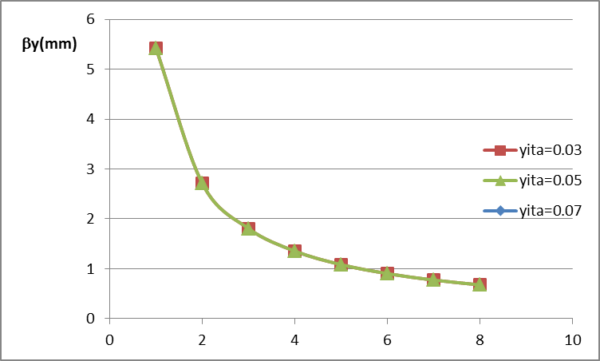
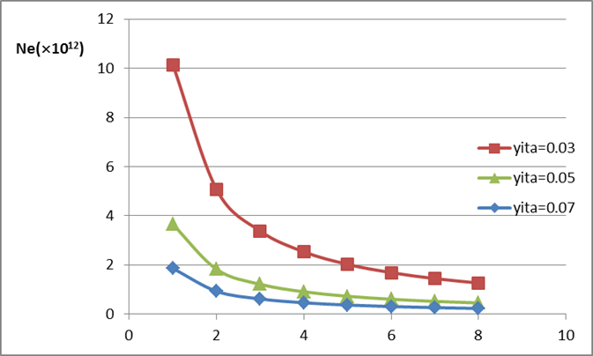
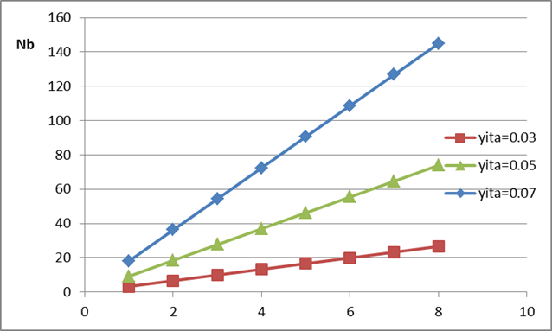
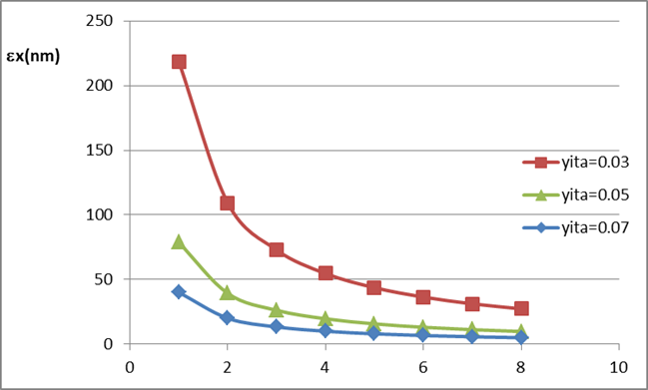
Beam parameter scan -1
L₀
L₀
L₀
L₀

Slide 19
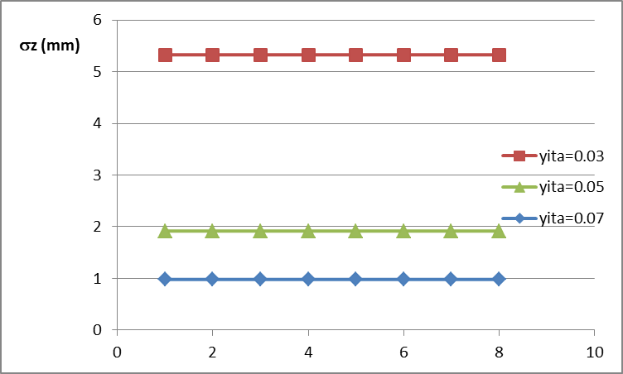
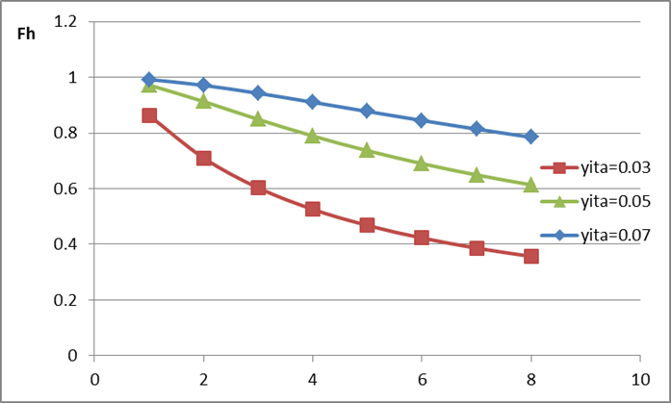
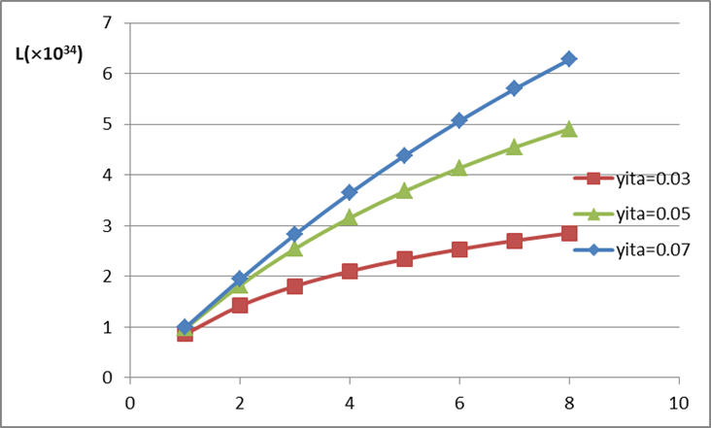
Beam parameter scan -2
L₀
L₀
L₀

Slide 20
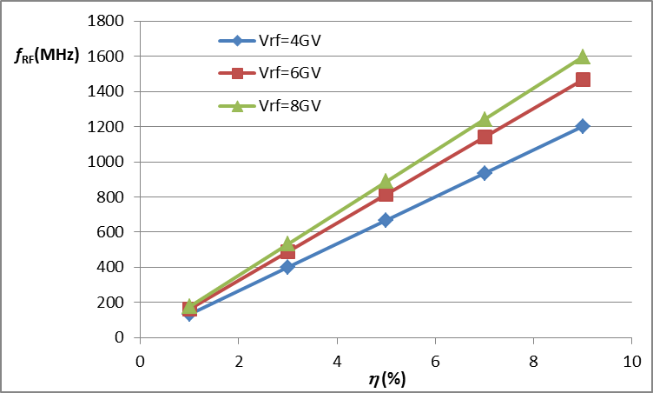
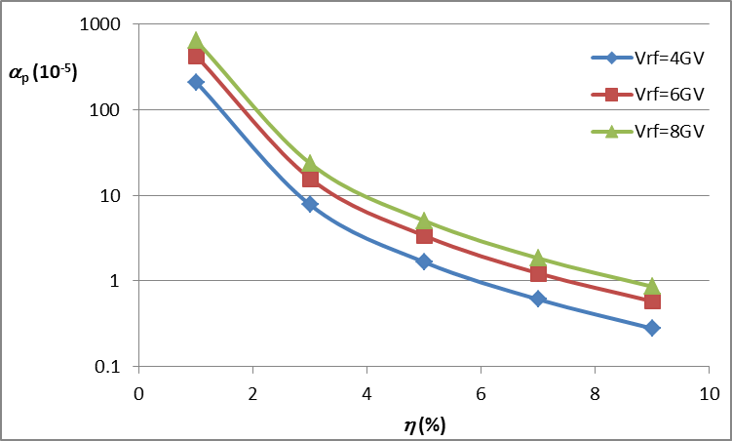
RF parameter scan for 70km CEPC

Slide 21
Optimized machine parameters for 70km CEPC
 | Baseline design |  | Low power design
Number of IPs | 1 | 2 | 1 | 2
Energy (GeV) | 120 | 120 | 120 | 120
Circumference (km) | 70 | 70 | 70 | 70
SR loss/turn (GeV) | 2.14 |  | 2.14
N_{e}/bunch (10¹²) | 0.43 | 0.49 | 0.43 | 0.45
Bunch number | 78 | 69 | 39 | 37
Beam current (mA) | 23.3 | 23.3 | 11.7 | 11.7
SR power /beam (MW) | 50 |  | 25
B₀ (T) | 0.047 |  | 0.047
Bending radius (km) | 8.56 |  | 8.56
Momentum compaction (10⁻⁵) | 4.7 |  | 4.7
β_{IP} x/y (m) | 0.1/0.001 | 0.1/0.001 | 0.1/0.0005 | 0.1/0.0005
Emittance x/y (nm) | 9.4/0.094 | 11.3/0.19 | 9.4/0.047 | 10.3/0.094
Transverse σ_{IP} (um) | 30.7/0.31 | 34.9/0.43 | 30.6/0.15 | 32.1/0.22
ξ_{x}/IP | 0.087 | 0.082 | 0.088 | 0.083
ξ_{y}/IP | 0.088 | 0.062 | 0.088 | 0.062
V_{RF} (GV) | 5.8 |  | 5.8
f _{RF} (MHz) | 708 |  | 708
σ_{z} (mm) | 2.5 |  | 2.5
Energy spread (%) | 0.11 |  | 0.11
Energy acceptance (%) | 4.4 |  | 4.4
γ_{BS} (10⁻⁴) | 12.2 | 12.2 | 12.2 | 12.2
n_{γ} | 0.58 | 0.58 | 0.58 | 0.58
δ_{BS} (10⁻⁴) | 3.7 | 3.7 | 3.7 | 3.7
Life time due to beamstrahlung (minute) | 30 | 30 | 30 | 30
F (hour glass) | 0.65 |  | 0.47
L_{max}/IP (10³⁴cm⁻²s⁻¹) | 3.5 | 2.5 | 2.3 | 1.8
AC power for RF source/two beam (MW) | 200 |  | 100

Slide 22
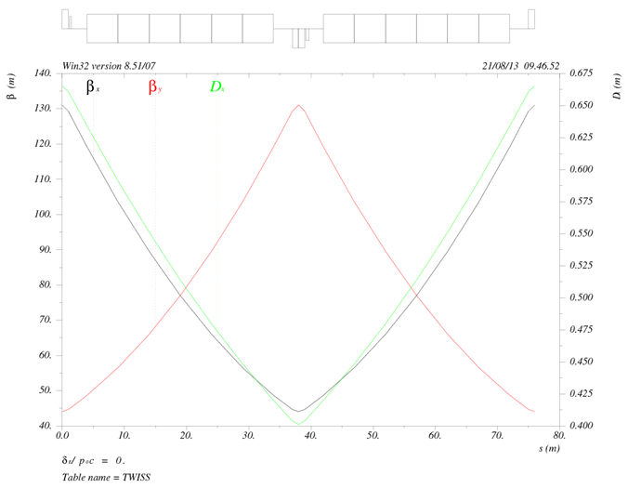
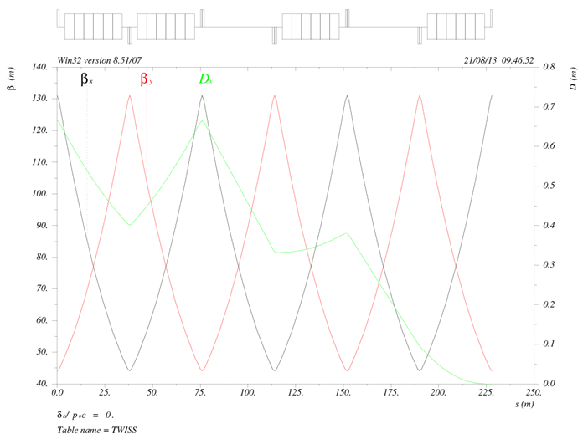
Lattice design for 70km CEPC
Dispersion suppressor
60° FODO ARC cell
Parameters from lattice design:
ρ=8.56 km
ε_{x}=9.5 nm
α_{p}=4.7×10⁻⁵

Slide 23
3. CEPC final focus design

Slide 24
Procedure & Method
The CEPC design parameters :
three cases of β_{y}=1mm, β_{y}=0.35mm and β_{y}=0.1mm .
FFADA program
Matching section, CCS, Final Doublet.
Non-local chromaticity correction scheme.
Local correction was combined in 0.35mm and 0.1mm lattice.

Slide 25
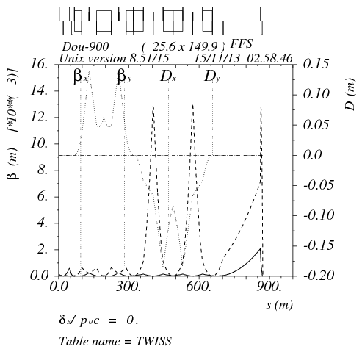
1mm-baseline design
IP beta=
0.2m/0.001m
L_{QD0}=5.4 m
L_{QF1}=2.8 m
K_{QD0}=K_{QF1}=0.08
L=870 m, L*=2.5 m

Slide 26
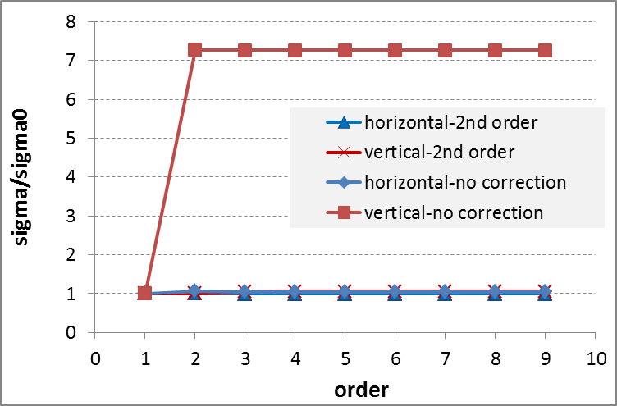
Beam size after second order correction
Beam size order-by-order analysis by MAPCLASS.
2nd order correction is enough!

Slide 27
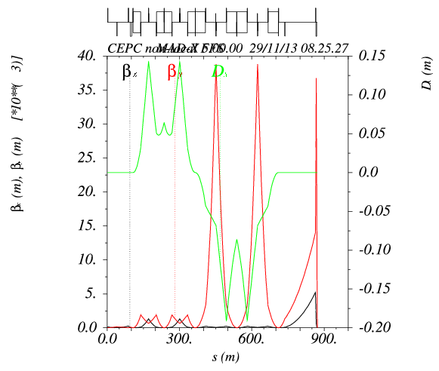
0.35mm lattice-low power design (15MW)
Add two sextupoles
IP beta=
0.041m/0.00035m
LQD0=3.5 m
LQF1=2.0 m
KQD0=KQF1=0.15
L*=2.5m
Maximum beam size is at QF1.
Maximum pole strength at 20σ is 8.0 T.
8 sextupoles in dispersion section to correct higher order aberration.
Additional sextupoles were added at final doublet (local correction).

Slide 28
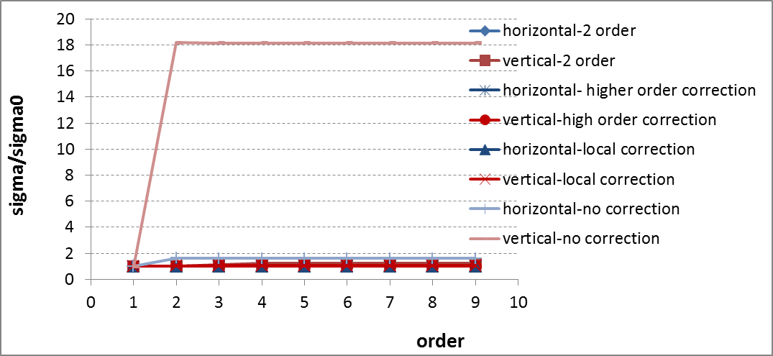
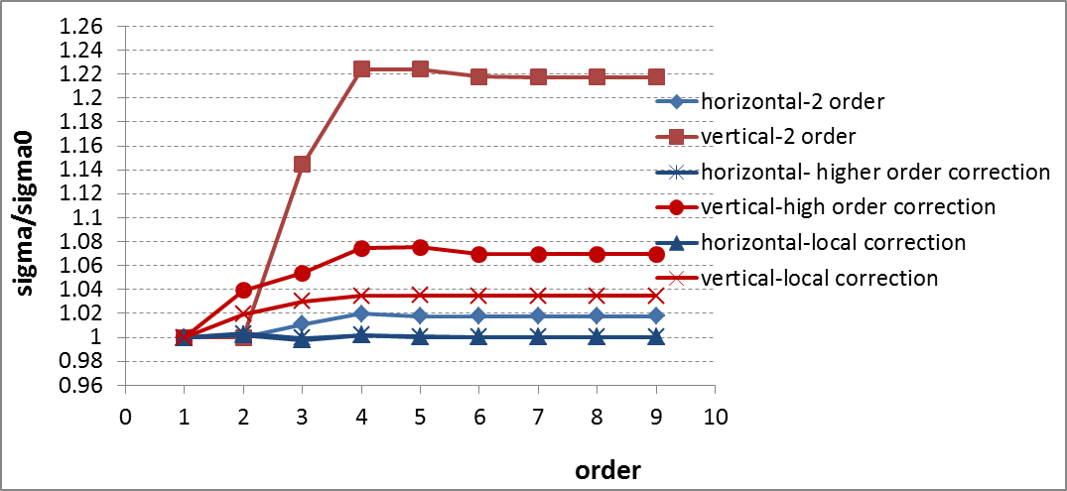
Beam size order-by-order analysis

Slide 29
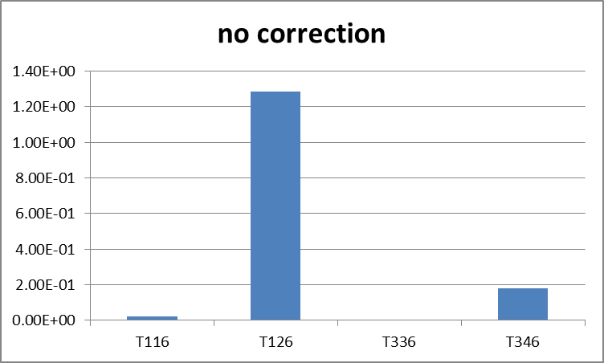
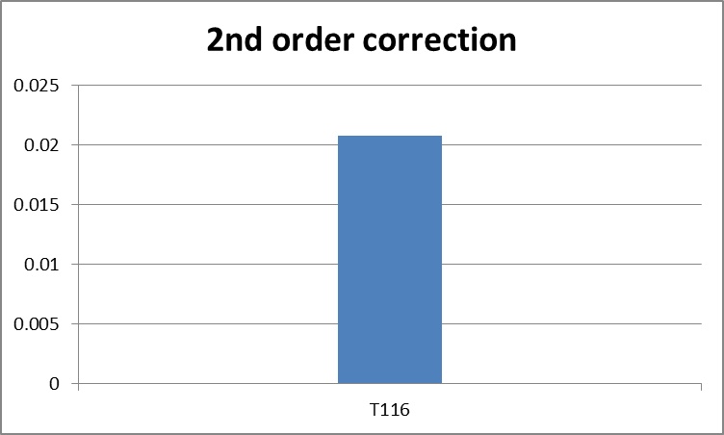
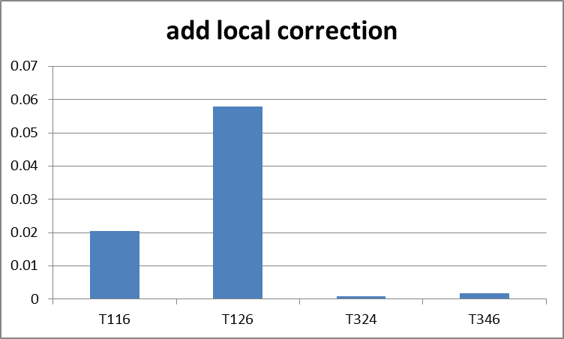
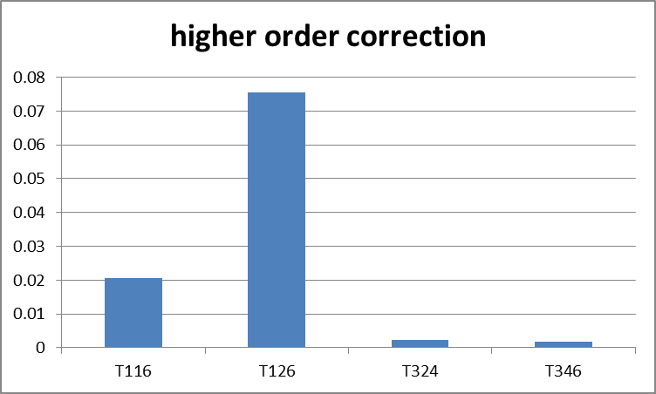
2nd order contributions to beam size

Slide 30
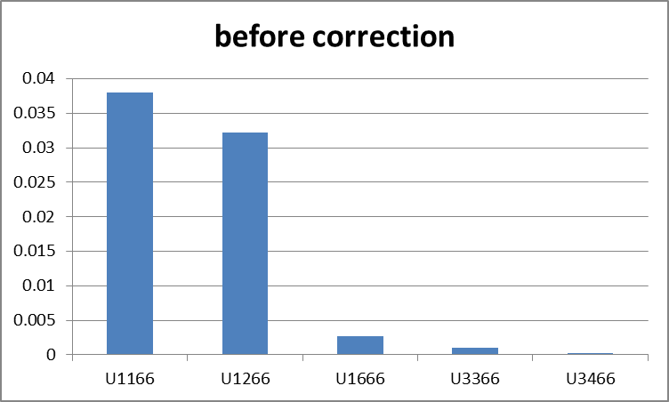
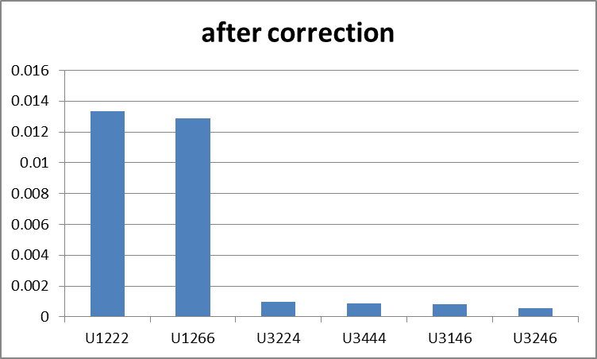
3rd order contributions to beam size

Slide 31
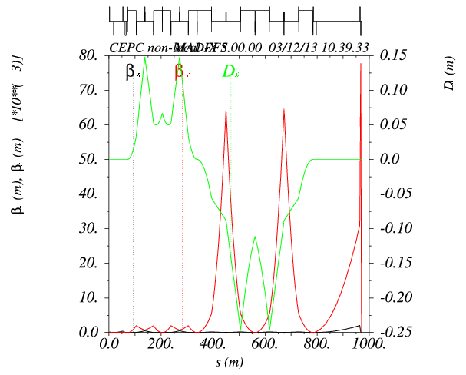
Trial of 0.1mm lattice
IP beta=
0.11m/0.0001m
LQD0=4.3 m
LQF1=2.0 m
KQD0=KQF1=0.15
L*=1.3m
Total length: 970m
Maximum beam size is at QF1.
Maximum pole strength at 20σ is 5.6 T.

Slide 32
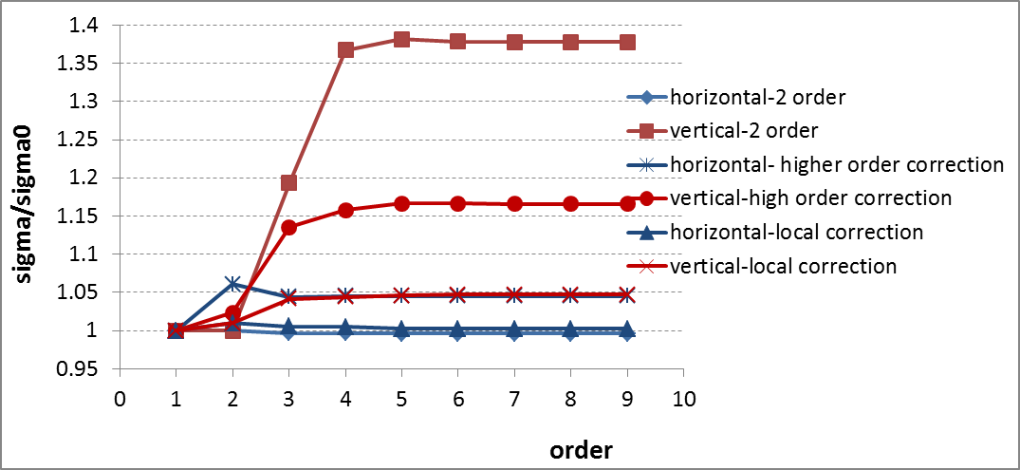
Beam size order-by-order analysis
Beam size order-by-order analysis by MAPCLASS.
Local chromaticity correction is essential!

Slide 33
Summary
A general method of how to make an optimized parameter design of a circular e+e- Higgs Factory was given.
Based on beam parameters scan and RF parameters scan, a set of optimized parameter designs for 50 km Circular e-e+ Collider (CEPC) with different RF frequency and different IP number were proposed.
In order to reduce the total AC power, we decrease the SR power from 50 MW (baseline design) to 25 MW even to 15 MW (low power design) .
Luminosity: 3.1→2.3 ×10³⁴ cm⁻²s⁻¹
Recover the luminosity to the baseline design (3.1 ×10³⁴ cm⁻²s⁻¹) by the low power scheme. But we undertake the challenge of technology (ultra-low β* and ultra-flat beam).
70km CEPC optimized design was done.
Luminosity: 3.5×10³⁴ cm⁻²s⁻¹ (baseline) 2.3×10³⁴ cm⁻²s⁻¹ (low power)
Design FFS for three different betay requirement. For each case, the IP beam dilution can be controlled after chromaticity correction
Next step: insert FFS in the ring, check DA and momentum acceptance …

Slide 34
References
J. Gao, “emittance growth and beam lifetime limitations due to beam-beam effects in e+e- storage rings”, Nucl. Instr. and methods A533（2004）p. 270-274.
V. Telnov, “Restriction on the energy and luminosity of e+e- storage rings due to beamstrahlung”, arXiv:1203.6563v, 29 March 2012.
V. Telnov, “Limitation on the luminosity of e+e- storage rings due to beamstrahlung”, HF2012, November 15, 2012.
Dou Wang, Jie Gao et al., “Optimization parameter design of a circular e+e- Higgs factory”, Chinese Physics C Vol. 37, No. 9 (2013).
Dou Wang, Ming Xiao, Jie Gao, “CEPC low power design”, IHEP-AC-LC-Note2013-015, 7 Aug. 2013.
Dou Wang, Ming Xiao, Jie Gao, “CEPC low power scheme with ultra-low betay”, IHEP-AC-LC-Note2013-020, 9 Sep. 2013.
Dou Wang, Ming Xiao, Jie Gao, “CEPC low power scheme with recovered luminosity”, IHEP-AC-LC-Note2013-022, 16 Sep. 2013.
Dou Wang, Ming Xiao, Jie Gao, “70 km CEPC optimized design”, IHEP-AC-LC-Note2013-018, 23 Aug. 2013.

Slide 35
Thank you!

