Slide 1
ILC TPC and Related Study in China
Yulan Li
On behalf of CEPC Tracker Subgroup
2013-12-16

Slide 2
Contents
ILC TPC
  LP1 study
  The ILD TPC implementation in DBD
TPC related study in China
  TU-TPC
  nTPC based on TU-TPC
Our plan towards CDR
  Our plan
  Silicon or Gas tracker?
  If TPC, does the design of ILC TPC work for CEPC?

Slide 3
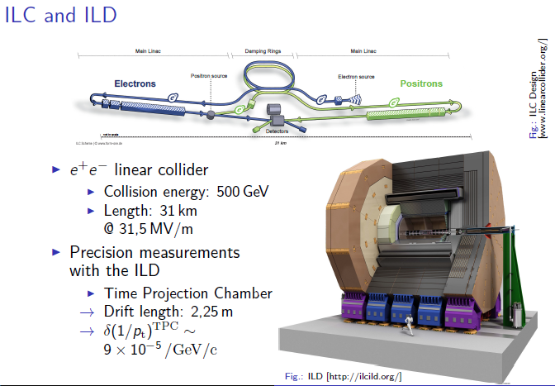
ILC, ILD and TPC
Notes:
I believe everybody here knows that:
ILC is a e+ e- linear collider with collision energy up to 500GeV;
Two detector designs have been developed. One is ILD, which has a TPC as the central tracking detector

Slide 4
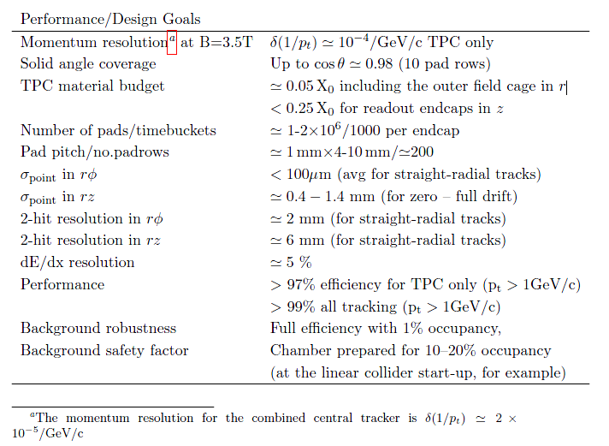
Goals for performance and design parameters for the TPC
Notes:
From here, we can see that the requirement on TPC is unprecedented. Its momentum resolution is an order of magnitude better than any of the collider detectors to date.

Slide 5
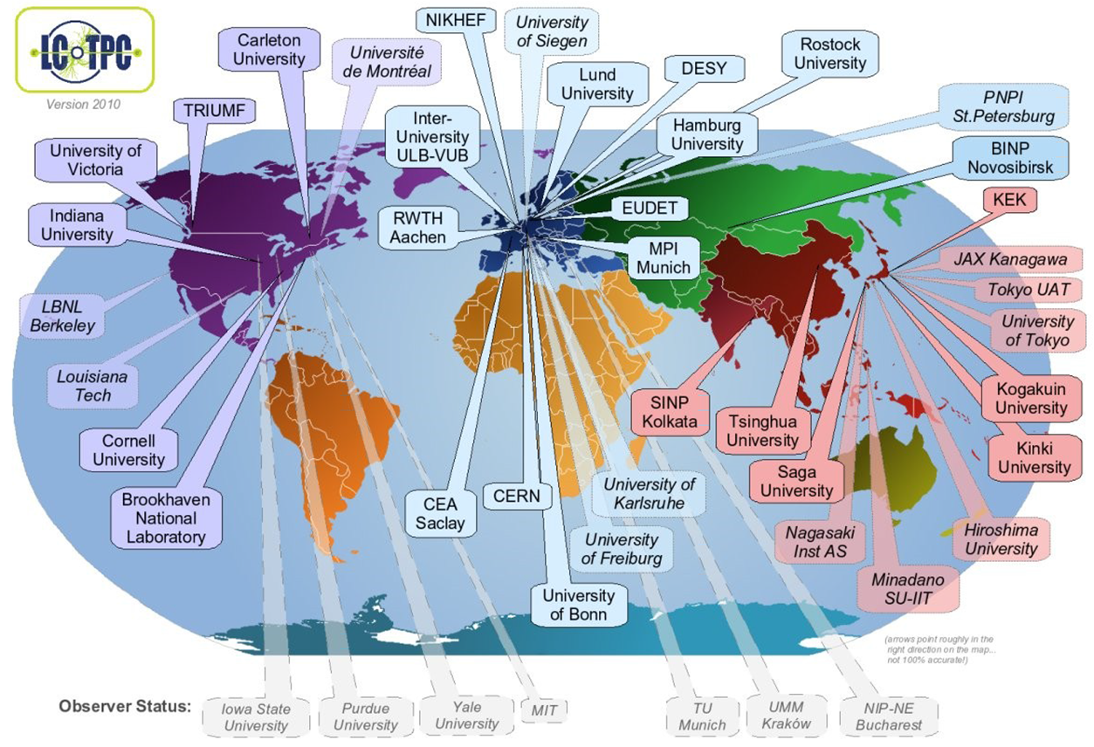
LCTPC Collaboration
Notes:
To study its feasibility, a LPTPC collaboration is setup

Slide 6
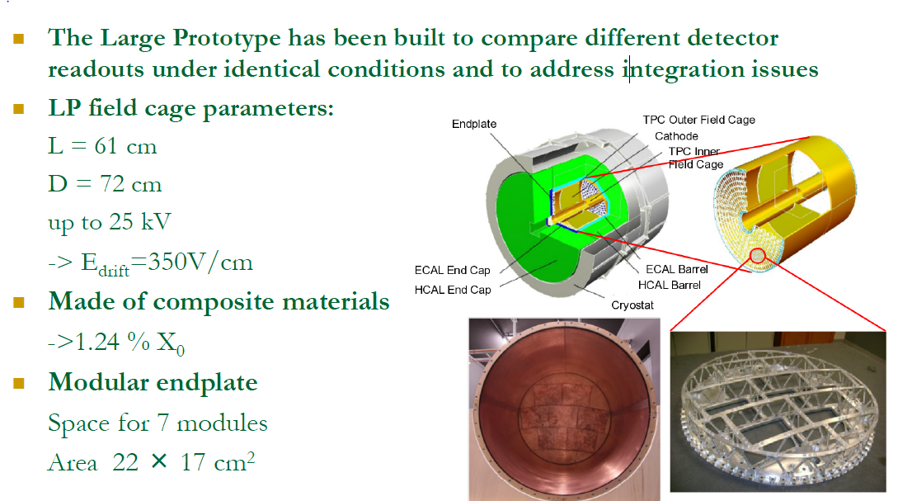
Large Prototype
Notes:
Besides many small prototype, the study in recent year mainly was carried on LP prototype.
It was built to compare…

Slide 7
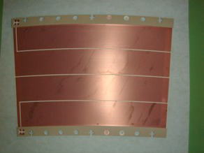
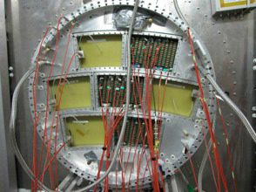
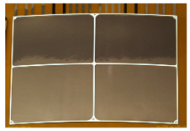
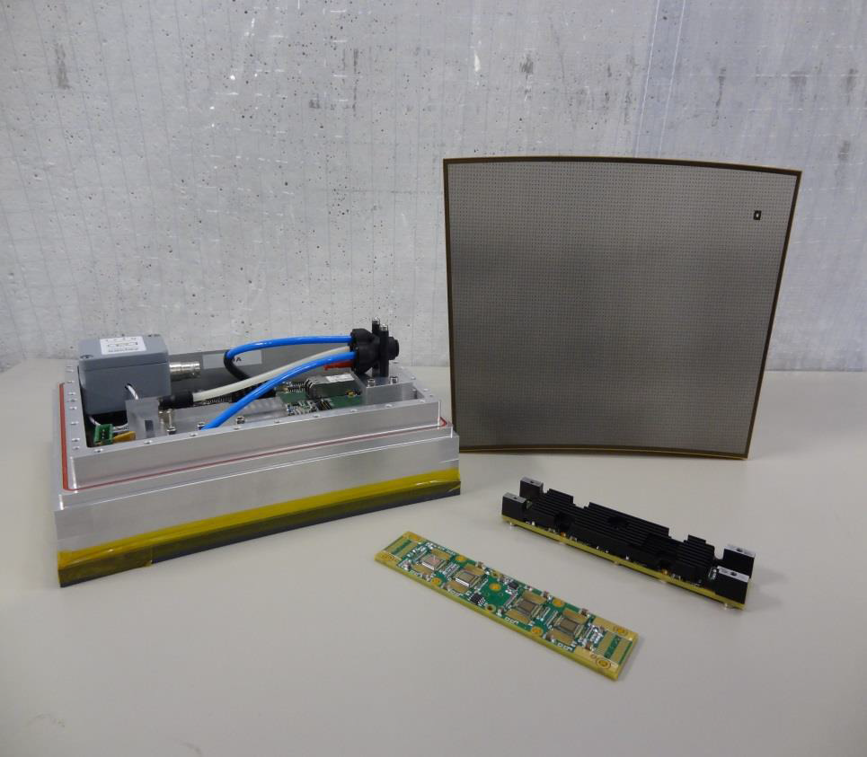
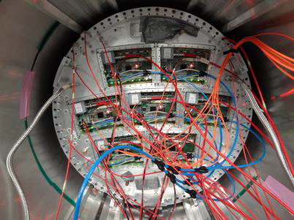
LP readout
Readout |  | Pad size | Electronics | Groups
MPGDs | Double GEM (Laser-etched) | 1×6mm² | ALTRO | Asia
 | Triple GEM (wet-etched) |  |  | DESY
 | Micromegas (Resistive anode) | 3×7mm² | AFTER | Saclay-Carleton
GEM
Micromegas
Notes:
The diffusion in the amplification region is much less for the Micromegas

Slide 8
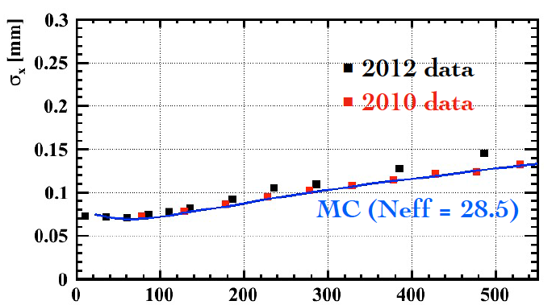
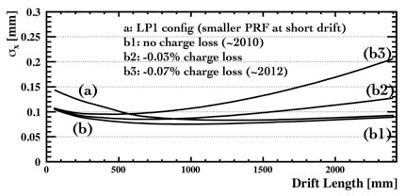

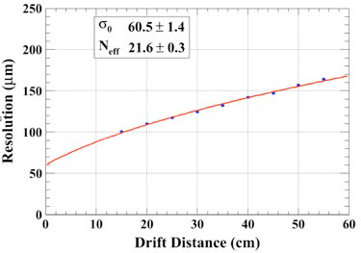
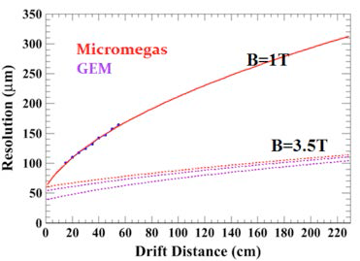
Spatial Resolution
T2K gas, GEM
T2K gas
T2K gas, Micromegas

Slide 9
Summary
Through series of test beam experiments using a Large Prototype TPC and through development of an analytic resolution formula to understand their results, the basic principles to determine the spatial resolution is clarified.
Both the GEM and the restive anode readout Micromegas modules meet the ILC’s σ_{rφ} requirement.

Slide 10
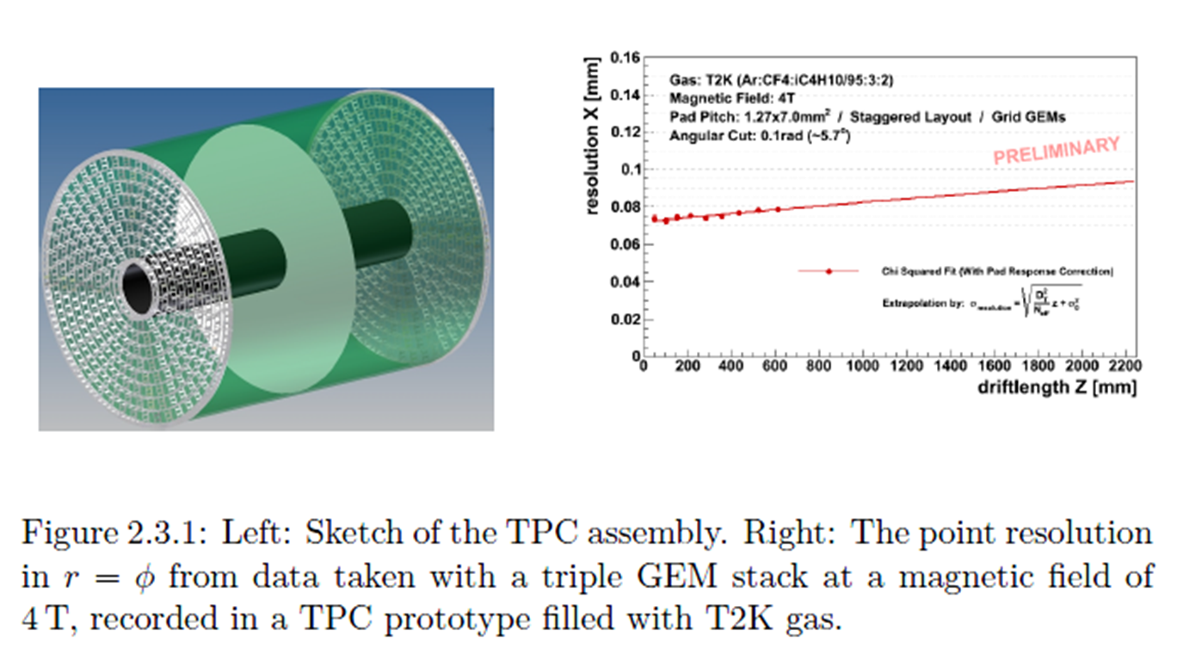
The ILD TPC Implementation
Notes:
INTERNATIONAL LINEAR COLLIDER,Technical Design Report - Volume 3,Physics and Detectors,Detailed Baseline Design (DBD) was finished in the December last year.
The main features of TPC implementation are lightweight endcaps mounted on a
fieldcage, the endcaps being read out by a system of micropattern gas detectors
with either traditional pad-based readout or a novel highly granular pixelated system.
The idea is to have concentric rows of modules, which are integrated with
amplication and readout and mounted as a unit on the endplate.

Slide 11
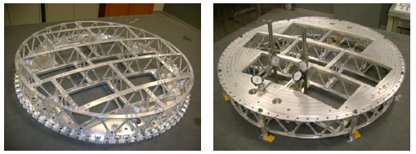
The ILD TPC Implementation (Cont.)
Gas Amplification System:
  Either GEM or Micromegas
  wires: ruled out
Gas:
  has a small value of transverse diffusion in the high magnetic field.
  T2K gas: Ar-CF4(3%)-isobutane(2%)
Endplate
  a thinned aluminum structure stabilized by a system of adjustable struts

Slide 12
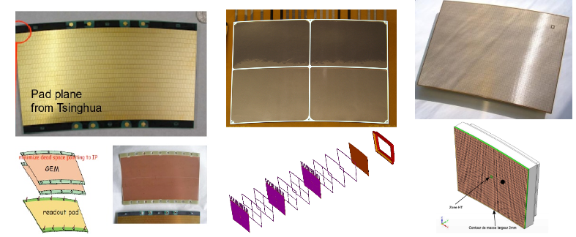
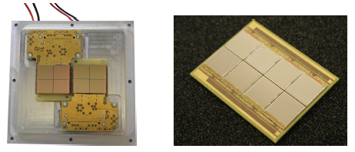
Readout Module
Two quad boards used with triple GEM
“Octopuce”
board with eight Ingrids

Slide 13
ASIC
Current version: ALTRO
  for ALICE TPC,
  used in GEM modules in LP
Next version: S-ALTRO:
  fully-integrated analog-digital chip more compact than the original ALTRO,
  allows for power pulsing,
  available within next 1 or 2 years
Next step: GdSP(Gaseous detector Signal Processor)
  Higher density(64-128 channel/chip)
  Lower power consumption
  A programmable DSP instead of hard-wired digital processor
  Joint effort with CMS
  Aiming to be ready by 2014-15

Slide 14
Power Management
Power pulsing
  Demonstrated for the S-ALTRO16
  Not yet for the GdSP and the whole electronics chain
Cooling
  Two-phase CO2 cooling is planned
both the cooling and the powering are areas where progress is being made for the LHC upgrade project
  the ILD detector will profit from this work

Slide 15
Fieldcage
Material budget:
  1% X₀ for the inner fieldcage
  3% X₀ for the outer fieldcage
Designs exist for the transition from the fieldcage to the endcap,
add only minimal material in the corner region.
Notes:
The inner and the outer fieldcages will be built using composite materials [76]. A
core made of honey-comb is covered on the inside and outside with a layer of glass-
fibre reinforced epoxy. On the drift-volume side of the inner and outer cylinders,
Kapton sheets with potential strips provide insulation and field-shaping electrodes.
The potential of the strips is defined by a resistive divider mounted inside the gas
volume. Mirror strips on the back of the Kapton sheets shield the field against the
grounds on the inside and outside of the system. On the outside of the TPC, each
cylinder will be covered with grounding sheets.

Slide 16
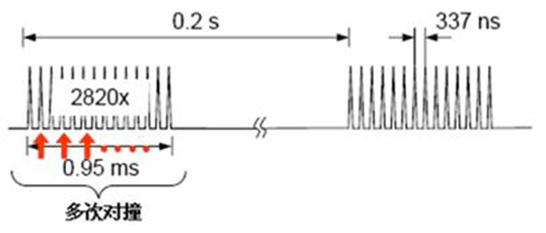
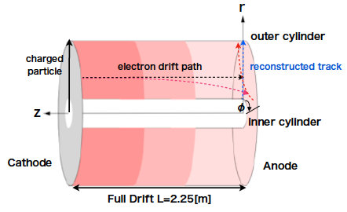
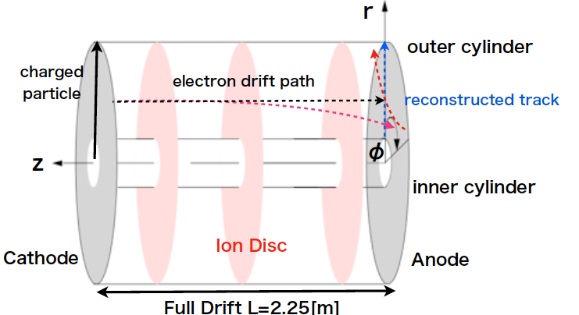
Ion Backdrift - Ion Sheets
The time structure of ILC beam
  The TPC is active during the 1ms bunch followed by a 199ms pause;
  the backflow ions from the amplification region take about 1 s to drift out of the TPC.
Primary Ions
Secondary Ion disks
Notes:
The high precision goals require a careful control of the accumulated charge in the
TPC drift volume.
Studies and detailed simulations have been performed to understand the impact of ions on detector performance which were produced during the primary ionisation and during the amplification phase.
The requirement of continuous operation during an ILC bunch train implies that no gating of positive ions will be possible during a bunch train.

Slide 17
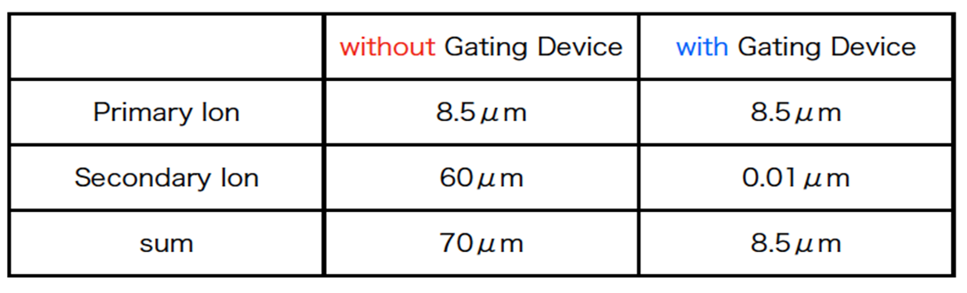
Ion Backdrift - Gating
Distortion due to ion
Gating is needed.
  An ion gate can eliminate a sheet by gating before the ions can enter the drift region.
The current options of the ion gate are limited:
  Wire gate: expected to work, but introduces mechanical complications to the MPGD modules; need to check ExB effect.
  Thin GEM gate: offers the electron transmission of only 50%@ 1T → 30% loss in the point resolution, not good enough.
Notes:
Recent calculations [77] of distortions due to positive ions at a 500 GeV ILC have shown that the eects of primary ions are manageable and that effects from ions between a possible gate and the amplification region are negligible.

Slide 18
Contents
ILC TPC
  LP1 study
  The ILD TPC implementation in DBD
TPC related study in China
  TU-TPC
  nTPC based on TU-TPC
Our plan towards CDR
  Our plan
  Silicon or Gas tracker?
  If TPC, does the design of ILC TPC work for CEPC?

Slide 19
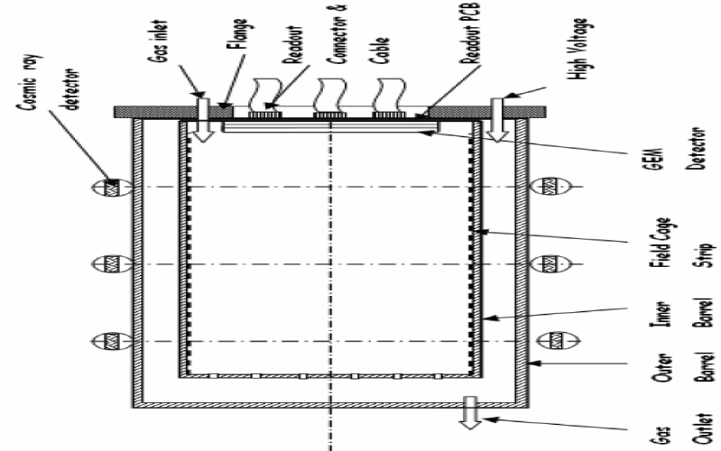
Scheme of TU-TPC prototype
CERN Standard GEM
Triple-GEMs
Active area: 100mm×100mm
Drift length: 500mm

Slide 20
TU-TPC prototype
Readout pad size: 9.5 mm ×1.5 mm
Pitch: 10 mm ×1.6 mm
Staggered 10 x 62 pads placed
Only 10 x 32 pads read out due to the limitation of electronic channel number

Slide 21
Whole system
Charge Resolution：
~10fc
Time Resolution：
~600ps
Charge INL：
~1.0%
Max Counting Rate：
~10⁵/s
PowerPC+VME

Slide 22
Test @ KEK, Japan
1 Tesla
Working Gas:
  P10 (Ar : CH4 = 90 : 10)，
  ISO(Ar : CH4 : iC4H10 = 96 : 3 : 1)

Slide 23
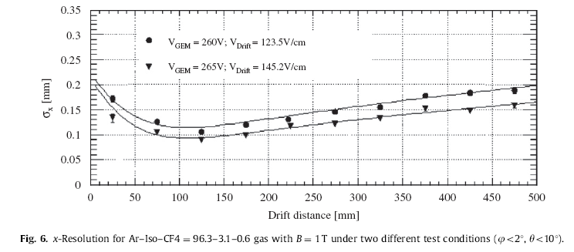
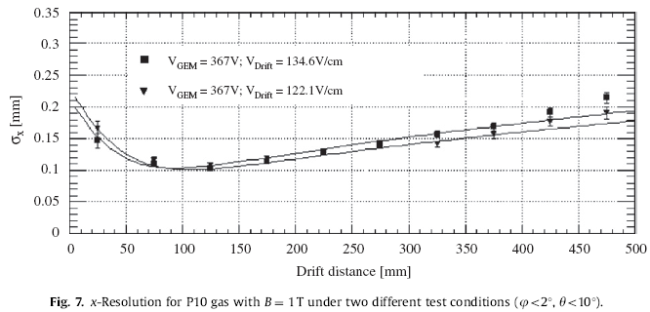
Test Results
Resolution can be as good as 100 μm@ Z ≈100 mm
Measurement points fit the analytical formula very well

Slide 24
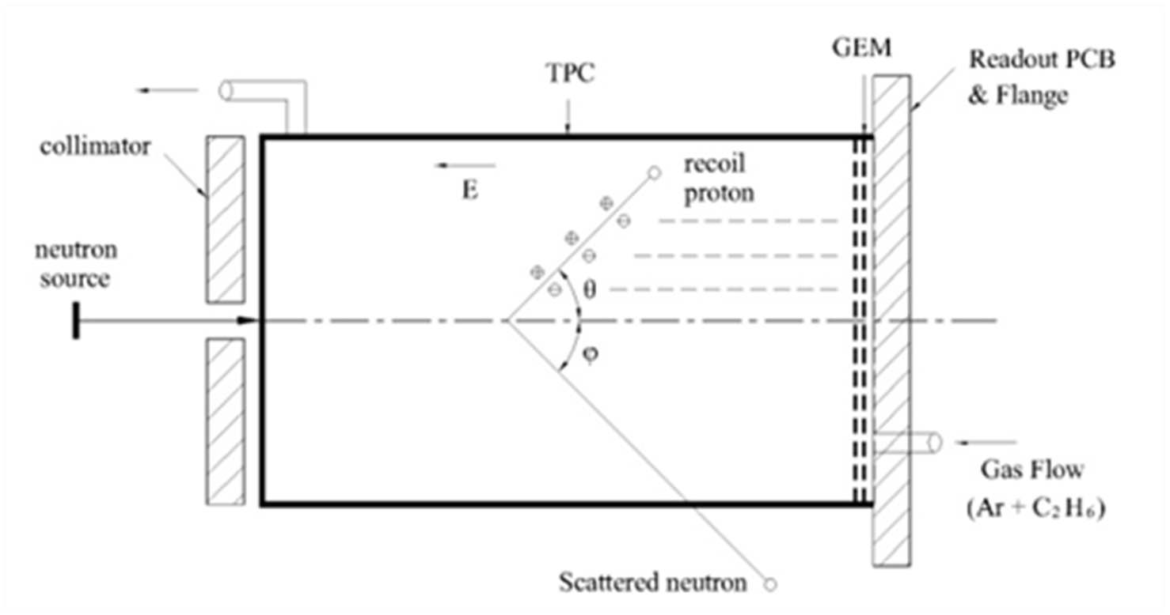

nTPC based on TU-TPC
a fast neutron spectrometer based on TU-TPC
  Readout pads layout
  Scheme of the fast neutron spectrometry

Slide 25
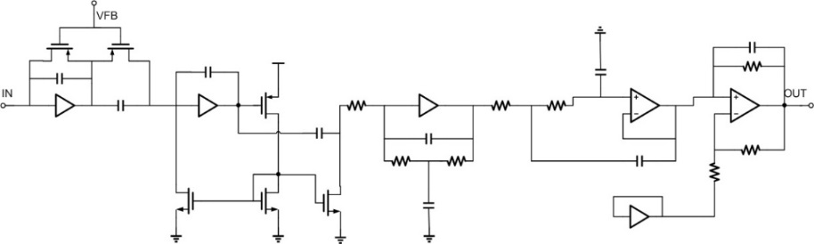
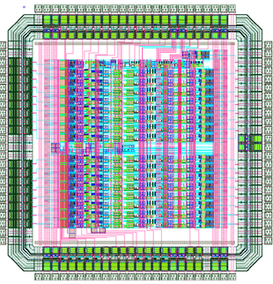
CASA-GEM
CASAGEM: a multi-channel front-end ASIC for GEM detectors
Specifications
Gain | 2/4/20/40 mV/fC
Dynamic Range | Up to 1 pC
Shaper | CR-(RC)⁵
Peaking Time | 100/200/300/400 ns
ENC | <1000 e
INL | <1%
Power Consumption | <10 mW
No. of Channels | 16
Process | 0.35 μm CMOS
Block Diagram
Layout

Slide 26
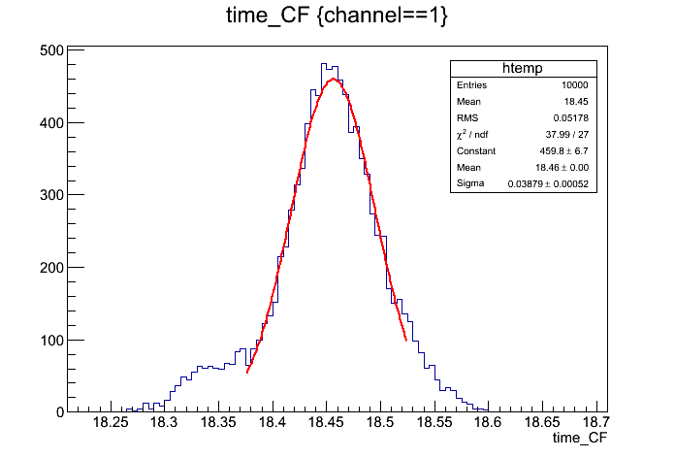
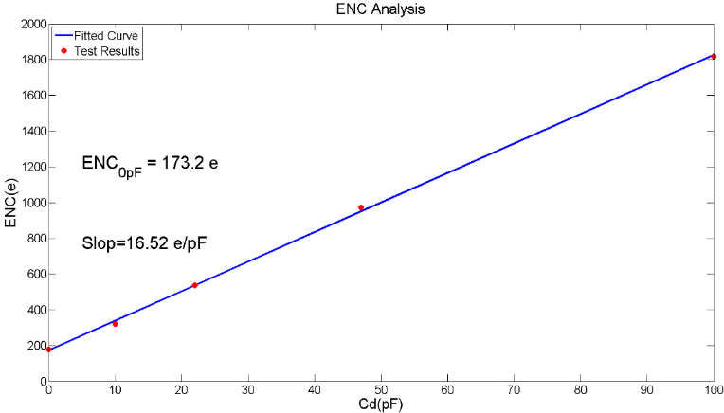
Key Performances
ENC @ tp=400ns
Timing resolution @ tp = 400ns
ENC=173e + 165.e/pF
σ_{t}= 388 ps
INL @ tp=400ns
Fe-55 Spectrum
FWHM=25.7%
INL<0.313%

Slide 27
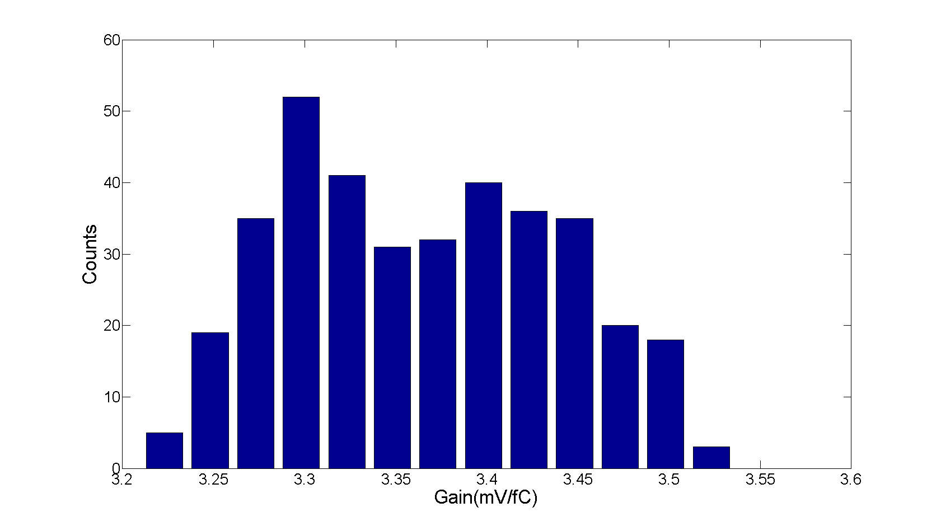
Batch Tests
Parameter | Mean | Max | Min | Std
Gain(mV/fC) | 3.38 | 3.56 | 3.22 | 0.074
Baseline(mV) | 604 | 641 | 569 | 14.1
ENC(e) | 1055 | 1743 | 734 | 118.4
Gain Distribution
2 MPW runs and 100 chips have been produced and NONE failure chip has been found so far!!!

Slide 28
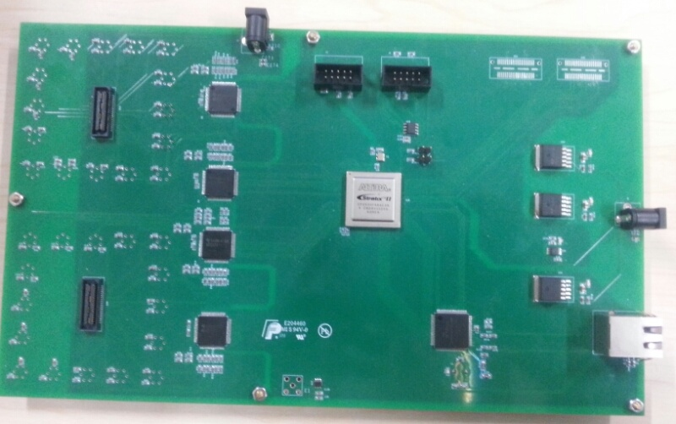
DAQ of nTPC
50Msps
12 bits
704 channels
32 channels per boards, adapt to CASA boards
Totally 22 boards, each boards could become the master boards to communicate with computers
If all the 704 channels communicate with computer through one ethernet cable, the max dead time will be upto 5ms

Slide 29
DAQ of nTPC
… …
Other Boards
Sampling data would be passed on from one board to the next board until the master board
Slave Board
Slave Board
Master Board
32
channels
ADC
FPGA
Local 32 Channel Buffer Rams
System Control & Channel Select
W5300
Ethernet Interface
Sampling data
from slave boards
Pulsed Signal
32channels
CASA
Local Sampling Data

Slide 30
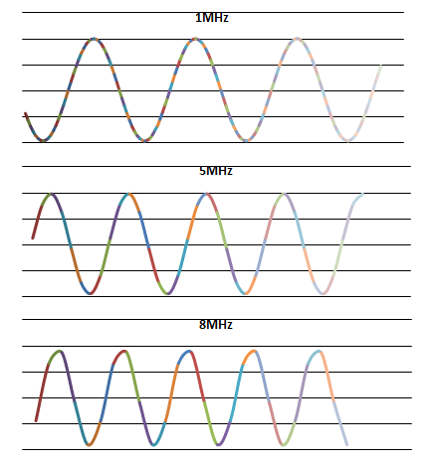
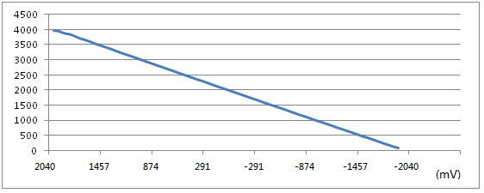
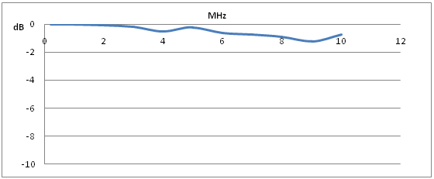
DAQ of nTPC
INL:<1%
-3dB Bandwidth:>10MHz
Sampling result of sine signals Parameters of test channel

Slide 31
Software development of TPC
We join in the software development in the framework of LCTPC Collaboration, and especially work closely with the ILC group of IPNS (KEK).
A Kalman filter based software package, KalTest, has been developed for track fitting in both uniform and non-uniform magnetic field.
A track reconstruction program taking advantage of KalTest has been implemented in MarlinTPC, which is the software framework of LCTPC research. The program is used by the GEM and Micromegas group in their analysis of detector performance from 2010.
Micromegas beam test data on the Large Prototype, 2012
Tracks reconstructed by MarlinTPC for full endplate TPC

Slide 32
The KalTest software package
The structure of KalTest
The comparison of reconstructed results by the original Kaltest and recently updated version for non-uniform magnetic field:
Confidence level
1/P
More details of KalTest can be found at:
http://www-jlc.kek.jp/jlc/en/subg/soft/tracking
Comp. Phys. Comm. (2013), http://dx.doi.org/10.1016/j.cpc.2013.11.003.

Slide 33
Contents
ILC TPC
  LP1 study
  The ILD TPC implementation in DBD
TPC related study in China
  TU-TPC
  nTPC based on TU-TPC
Our plan towards CDR
  Our plan
  Silicon or Gas tracker?
  If TPC, does the design of ILC TPC work for CEPC?

Slide 34
Our Plan Towards the CDR
1st period: 2013/9 – 2013/12
  Collaboration setup
    9 institutes, 22 researchers (students not included)
    Group meeting, Bi-weekly
Tsinghua University | Gao Yuanning, Li Yulan, Li Bo, Deng zhi
IHEP | Li Jin, Qi Huirong, Zhang Yulian
Shandong University | Zhu Chengguang
UCAS | Zheng Yangheng, Liu Qian, Wang Binlong
Lanzhou University | Hu Bitao, Zhang Yi
Nankai University | Fu Chunxu, Yang Yujiao
Shanghai Jiaotong University | Yang Haijun, Fu Changbo
Nanjing University | Zhang Huijun
CIAE | Li Xiaomei, Zhou Shuhua, Zhoujing, Hu Shouyang
  Literature study: mainly based on ILC TDR
  Prepare for the workshop >> this talk

Slide 35
Our Plan Towards the CDR (cont.)
2nd period: 2013/12 – 2014/3
  NSFC grant application
    Figure out the key topics in the R&D task
3rd period: 2014/3 – 2014 /9
  Prepare for the CDR
    Understand the requirement on tracking detector form PR
    Give out the conceptual design of the tracking detector
    Performance simulation
4th period: 2014/9-2014/12
  Finish the CDR

Slide 36
Performance comparison between silicon tracking and TPC (ILC)
 | TPC in ILD | Silicon in SiD
material | 0.05X₀ (vertical) 0.25X₀ (forward) | 0.10-15X₀ (vertical) 0.2-0.25X₀ (forward)
momentum resolution σ(1/pt)= | Next page
magnet filed | 3.5T | 5T
dE/dx | 5% | no
r_in | 329mm | 220mm
r_out | 1808mm | 1220 mm
z | ± 2350 mm | ±1520
cost(no contingency) | 35.9MILCU (Jan 2012 US$) | 95.7 MUS$

Slide 37
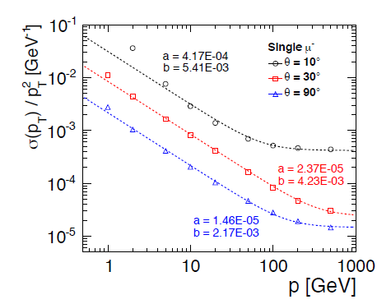
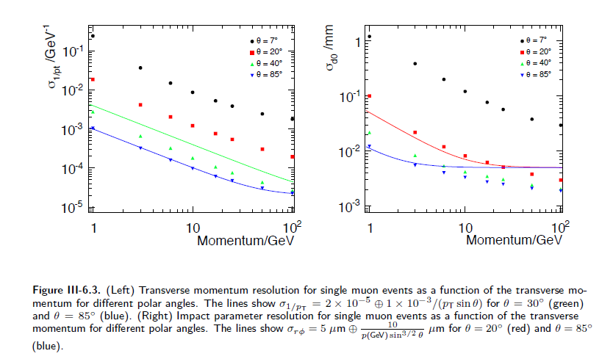

Muon momentum resolution
SiD silicon tracking
ILD TPC+silicon tracking
Transverse momentum resolution for single muon events as a function of the transverse momentum for different polar angles.
The dashed lines indicate a fit to Equation

Slide 38
Summary
TPC:
  Momentum resolution doesn’t lose the comparison.
  Minimum amount of material , less than Silicon
  dE/dx, for low momentum particles, good for calorimeter ( particle flow algorithm)
  Less cost
Silicon
  Continuous data taking, better for data accumulation?
Our background
Final choose: TPC is one of the option, at least?

Slide 39
Does the design of ILC TPC work for CEPC?
In principle, the answer is YES!
Final conclusion should be drawn in the CDR next year.
A lot of issues needed to be addressed:
  The physics goals and its requirement on TPC
    Goals for performance and design parameters
  The time structure of the beam
    How is the ion back flow? Do we need a gating? Is it possible?
  Material budget
    Field cage construction
  Readout electronics
    Power management: pulsing power, cooling
    Performance ~ readout channel
  Magnetic field
    Uniformity requirement
    Calibration
  ……

Slide 40
Thanks a lot !!

Slide 41
Mechanical Design
The TPC support structure will be:
  non-magnetic
  have a low thermal expansion coefficient
  be robust in all directions (x,y,z),
  maintain accuracy and stability over long time periods
  absorb vibrations in particular the z direction
  provide a position accuracy of 100 µm or better.
Present design:
  the TPC endplates are suspended from the solenoid
  the weight is not a problem
The main challenge:
  to provide a mechanism which does not allow the TPC to move in the longitudinal direction
  Under study

Slide 42
Calibration and Internal Alignment
A laser system is foreseen and may be integrated into the field cage
Another possible solution is to illuminate calibration spots on the cathode
  Such a system is being tested at the LP
  Is being used at the T2K experiment
An important future task of the R&D:
  to demonstrate experimentally using the LP that the distortions can be corrected.

