Slide 1
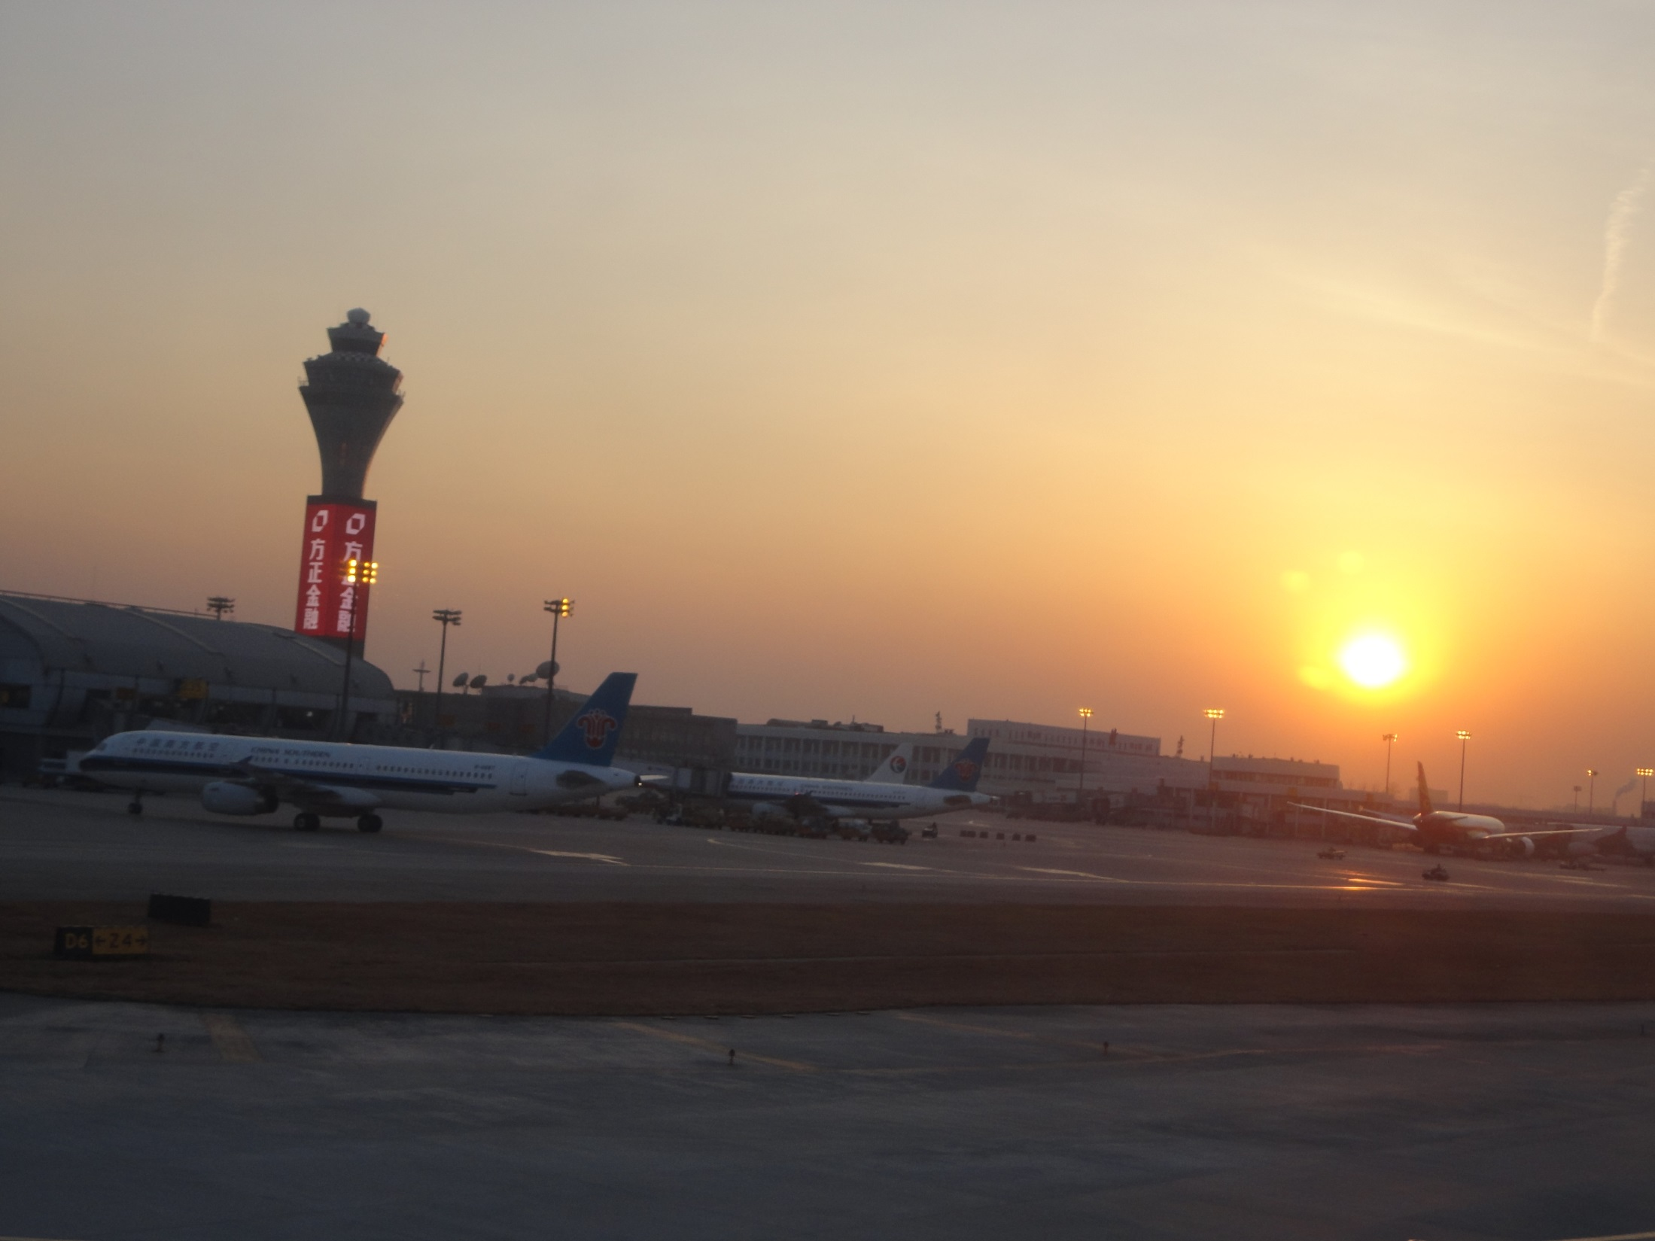
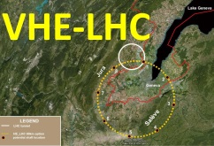

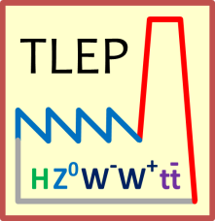



CERN Future Circular Colliders Study
Frank Zimmermann
International Workshop on Future High Energy Circular Colliders
IHEP Beijing,
16 December 2013
Many thanks to Roy Aleksan, Michael Benedikt (FCC Design Study Coordinator), Alain Blondel (FCC Kick-Off LOC Chair), Frederick Bordry (new CERN DAT), Luca Bottura, Francesco Cerutti, John Ellis, Hector Garcia, Cedric Garion,, Bernhard Holzer, Patrick Janot, Erk Jensen, Eberhard Keil, Roberto Kersevan, Max Klein, Mike Koratzinos, Luisella Lari, Eugene Levichev, Nicolas Mounet, Robert Rimmer, Daniel Schulte, Valery Telnov, Rogelio Tomas, Jörg Wenninger
Work supported by the European Commission under Capacities 7th Framework Programme, Grant Agreement 312453

Slide 2
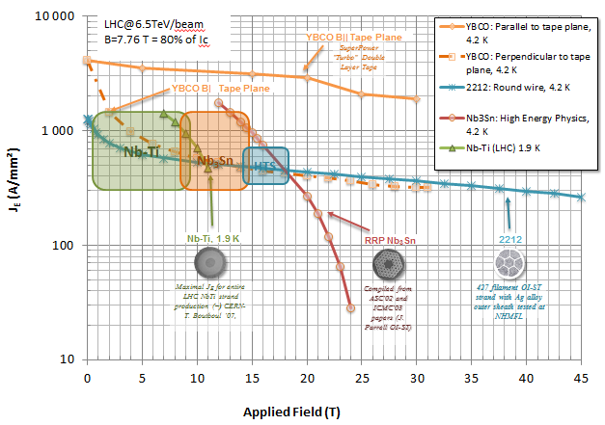
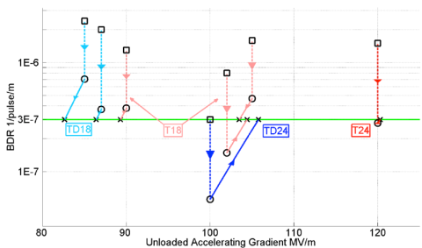
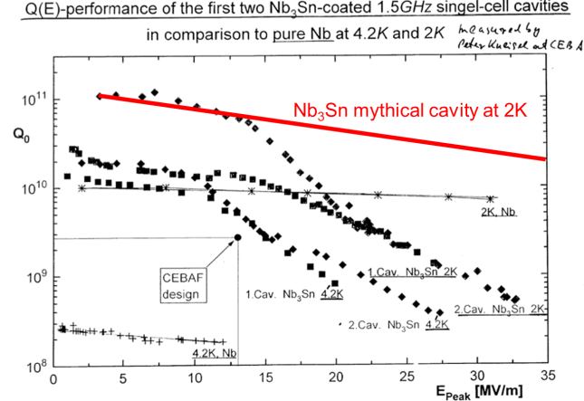
European Strategy Update (ESU) on Particle Physics
Design studies and R&D at the energy frontier
“to propose an ambitious post-LHC accelerator project at CERN by the time of the next Strategy update”:
d) CERN should undertake design studies for accelerator projects in a global context,
with emphasis on proton-proton and electron-positron high-energy frontier machines. These design studies should be coupled to a vigorous accelerator R&D programme, including high-field magnets and high-gradient accelerating structures, in collaboration with national institutes, laboratories and universities worldwide.
high-gradient acceleration:
CLIC and TLEP/FLC
high-field magnets: VHE-LHC/FHC

Slide 3
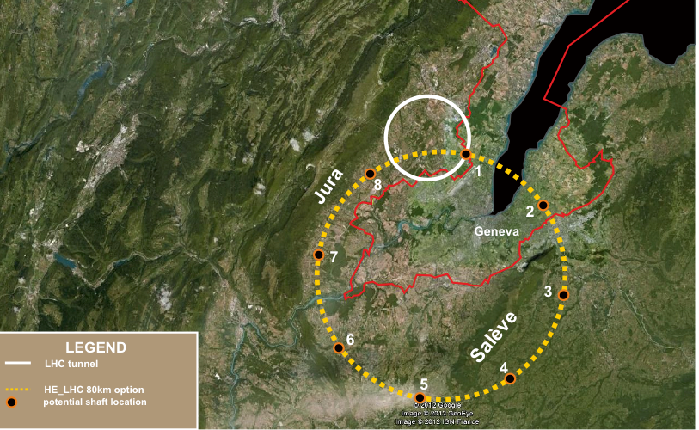
FCC Study (Future Circular Colliders)
CDR and cost review for the next ESU (2018)
80-100 km tunnel infrastructure in Geneva area
design driven by pp-collider requirements
with possibility of e+-e- (TLEP) and p-e (VLHeC)
CERN-hosted study performed in international collaboration
15 T ⇒ 100 TeV in 100 km
20 T ⇒ 100 TeV in 80 km

Slide 4
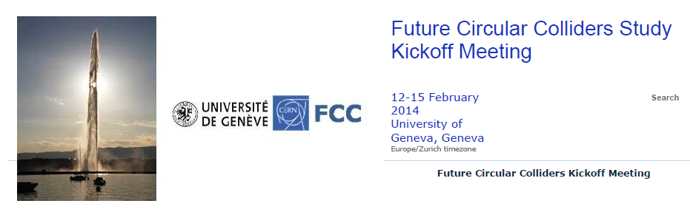
Kick-Off Meeting for FCC Study
To prepare international collaborations, study scope and topics will be discussed in kick-off meeting at U. Geneva 12-15 February 2014
CERN would like to promote global collaboration of future circular collider studies
http://indico.cern.ch/e/fcc-kickoff
Earlier topical workshops on HE-LHC (2010), LEP3/TLEP (6 meetings in 2012-13) and VHE-LHC (2013) in the frame of EuCARD
Kick-off meeting covers accelerator, detectors, physics case, technology, infrastructure & tunnel construction
Total no. of participants limited to 500 (early registration suggested)

Slide 5
FCC Study Scope and Structure
Future Circular Colliders - Conceptual Design Study
for next European Strategy Update (2018)
Infrastructure
tunnels, surface buildings, transport (access roads), civil engineering, cooling ventilation, electricity, cryogenics, communication & IT, fabrication and installation processes, maintenance, environmental impact and monitoring, safety
Hadron injectors
Beam optics and dynamics
Functional specs
Performance specs
Critical technical systems
Operation concept
Hadron collider
Optics and beam dynamics
Functional specifications
Performance specs
Critical technical systems
Related R+D programs
HE-LHC comparison
Operation concept
Detector concept
Physics requirements
e+ e- collider
Optics and beam dynamics Functional specifications
Performance specs
Critical technical systems
Related R+D programs
Injector (Booster)
Operation concept
Detector concept
Physics requirements
e- p option: Physics, Integration, additional requirements

Slide 6
Team preparing FCC Kick-Off & Study
Future Circular Colliders - Conceptual Design Study
Study coordination, host state relations, global cost estimate
M. Benedikt, F. Zimmermann
Hadron injectors
B. Goddard
VL Hadron collider
D. Schulte
Infrastructure, cost estimates
P. Lebrun
e+ e- collider
J. Wenninger
High Field Magnets
L. Bottura
Supercon-ducting RF
E. Jensen
Cryogenics
L. Tavian
Specific Technologies
(MP, Coll, Vac, BI, BT, PO)
JM. Jimenez
Physics and experiments
Hadron physic Experiments, infrastructure
A. Ball, F. Gianotti,
M. Mangano
e+ e- exper., physics
A. Blondel J.Ellis, P.Janot
e- p physics +
M. Klein
e- p option
Integration aspects O. Brüning
Operation aspects,
energy efficiency, OP & mainten., safety, environment.
P. Collier
Planning (Implementation roadmap, financial planning, reporting)
F. Sonnemann

Slide 7
Main Parameters for FHC (VHE-LHC)
Energy 100 TeV c.m.
Dipole field 15 T (baseline) [20 T option]
Circumference ~ 100 km
#IPs 2+2
Beam-beam tune shift 0.01 (total for 2 IPs)
Bunch spacing 25 ns [5 ns option]
Bunch population (25 ns) 10¹¹–2x10¹¹ (beam current 0.5-1 A)
Normalized rms emittance 2.2 μm
Luminosity 5x10³⁴ cm⁻²s⁻¹
β* 1.1 m [2 m conservative option]
Synchroton radiation arc 26 W/m/ap. [arc fill factor 78%]
Stored beam energy 8.3 GJ/beam
Longit. emit damping time 0.5 h
Straight section length 1400-2000 m (8 or 12)
Option: Polarized proton beams (with Siberian snakes)
preliminary

Slide 8
Some FHC Challenges
High-field SC magnet system
Vacuum system & synchrotron radiation heat load
  warm photon absorbers in dipole interconnects? antechamber, higher-T beam screen? Vacuum stability, impedance, e- cloud, bunch spacing
Synchrotron radiation damping
  controlled blow up? shorter bunch spacing? crab waist collisions??
Luminosity limits
  Radiation damage, pile up, bunch spacing, detector technology
Machine protection
  Energy in beam & magnets, dump, collimation; quench protection
Optics
  Maximizing fill factor, IR design & length (&#) of straight section

Slide 9
Cost-Optimized Magnets for FHC
15-T dipole
20-T dipole
beam
pipe
beam
pipe
15 T dipoles + 100 km circumference
→ 100 TeV pp
E. Todesco, L. Rossi, P. McIntyre

Slide 10
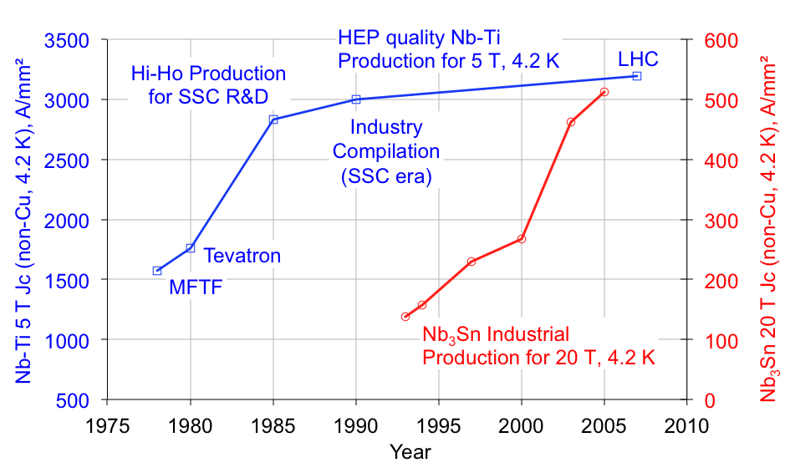
Evolution of Nb-Ti & Nb₃Sn SC Cable
US-CDP
L. Bottura (CERN), J. Parrell (OST)

Slide 11

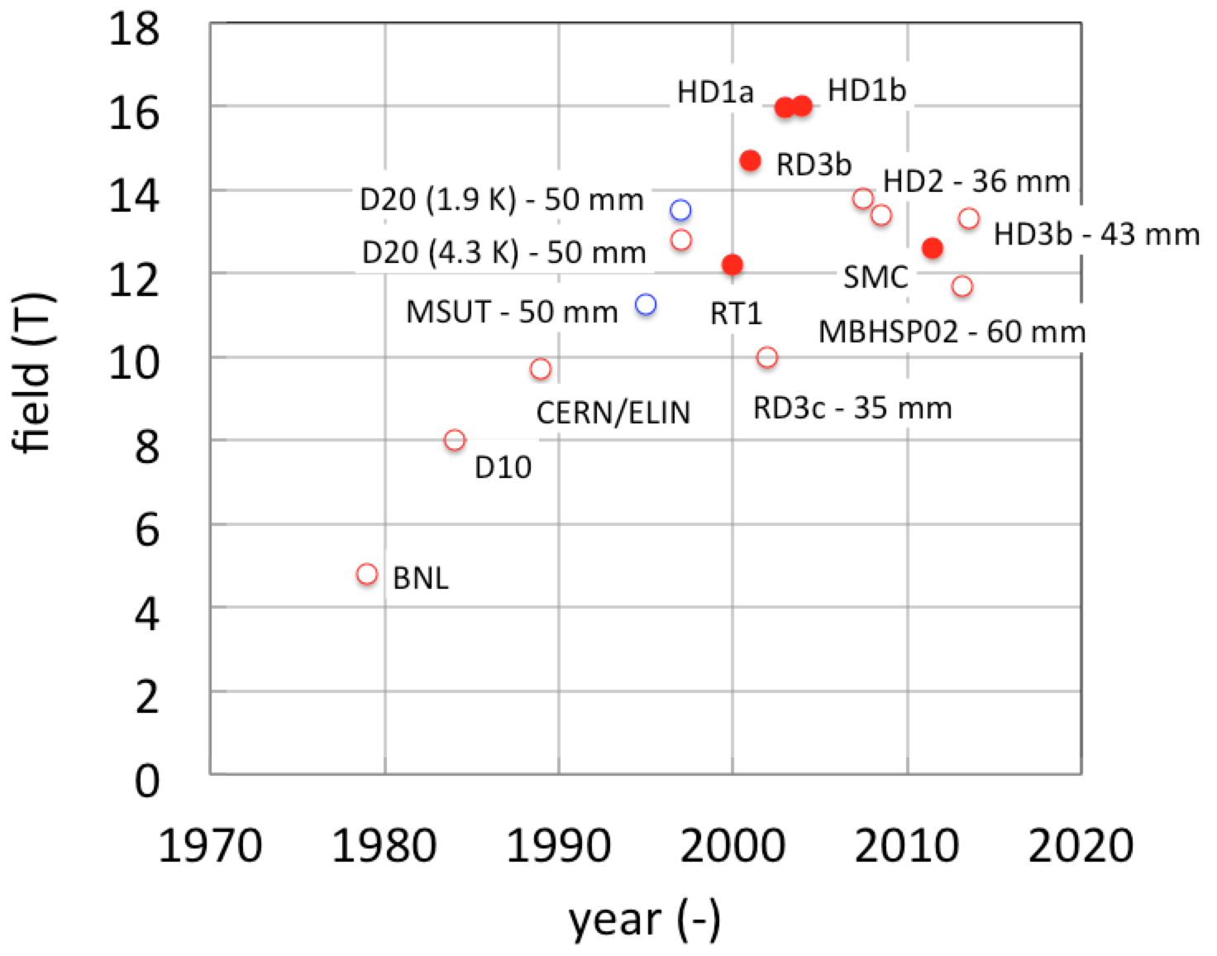
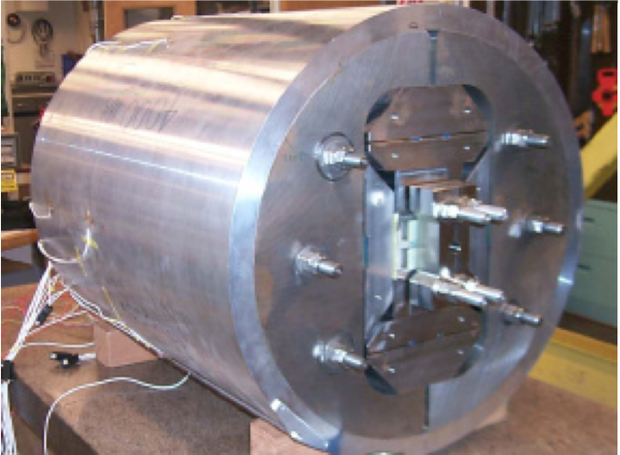
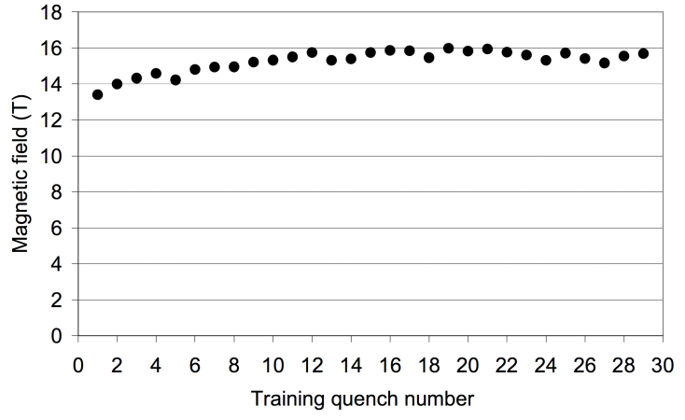
High-Field Dipoles
Record fields
Practical magnets
16 T
Flat racetracks no bore
Data by courtesy of L. Rossi (CERN) and S. Caspi (LBNL)

Slide 12
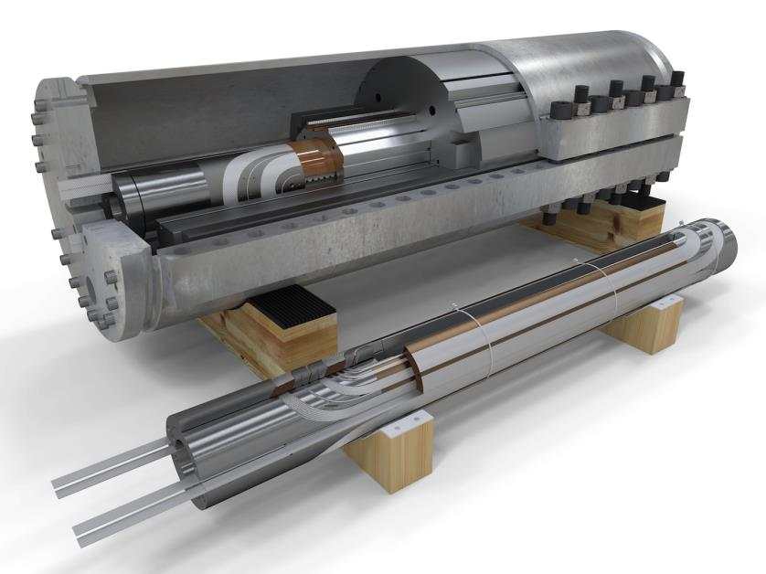
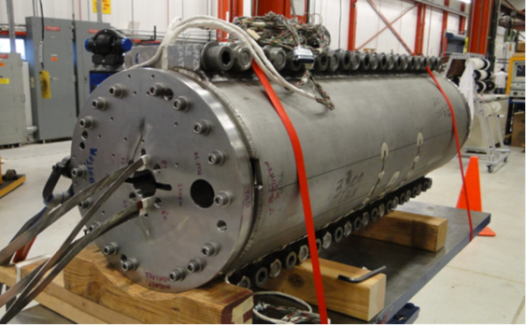
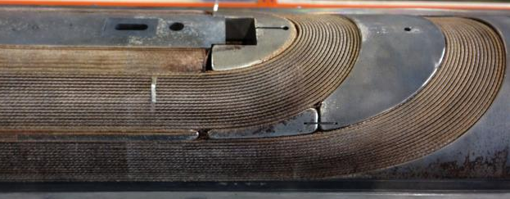
11-T accelerator dipoles for HL-LHC
Demonstrate the required performance (11.25 T at 11850 A)
Achieve accelerator field quality
Study in depth mechanics and manufacturing
Address specific issues such as quench protection
Next 2 years !
FNAL short model
FNAL MBHSP02 ready for test
CERN 54/61 practice coil
CERN coil
NOTE: virtual reality models
L. Bottura (CERN), D. Mitchell, F. Nobrega (FNAL), M. Karppinen (CERN)

Slide 13
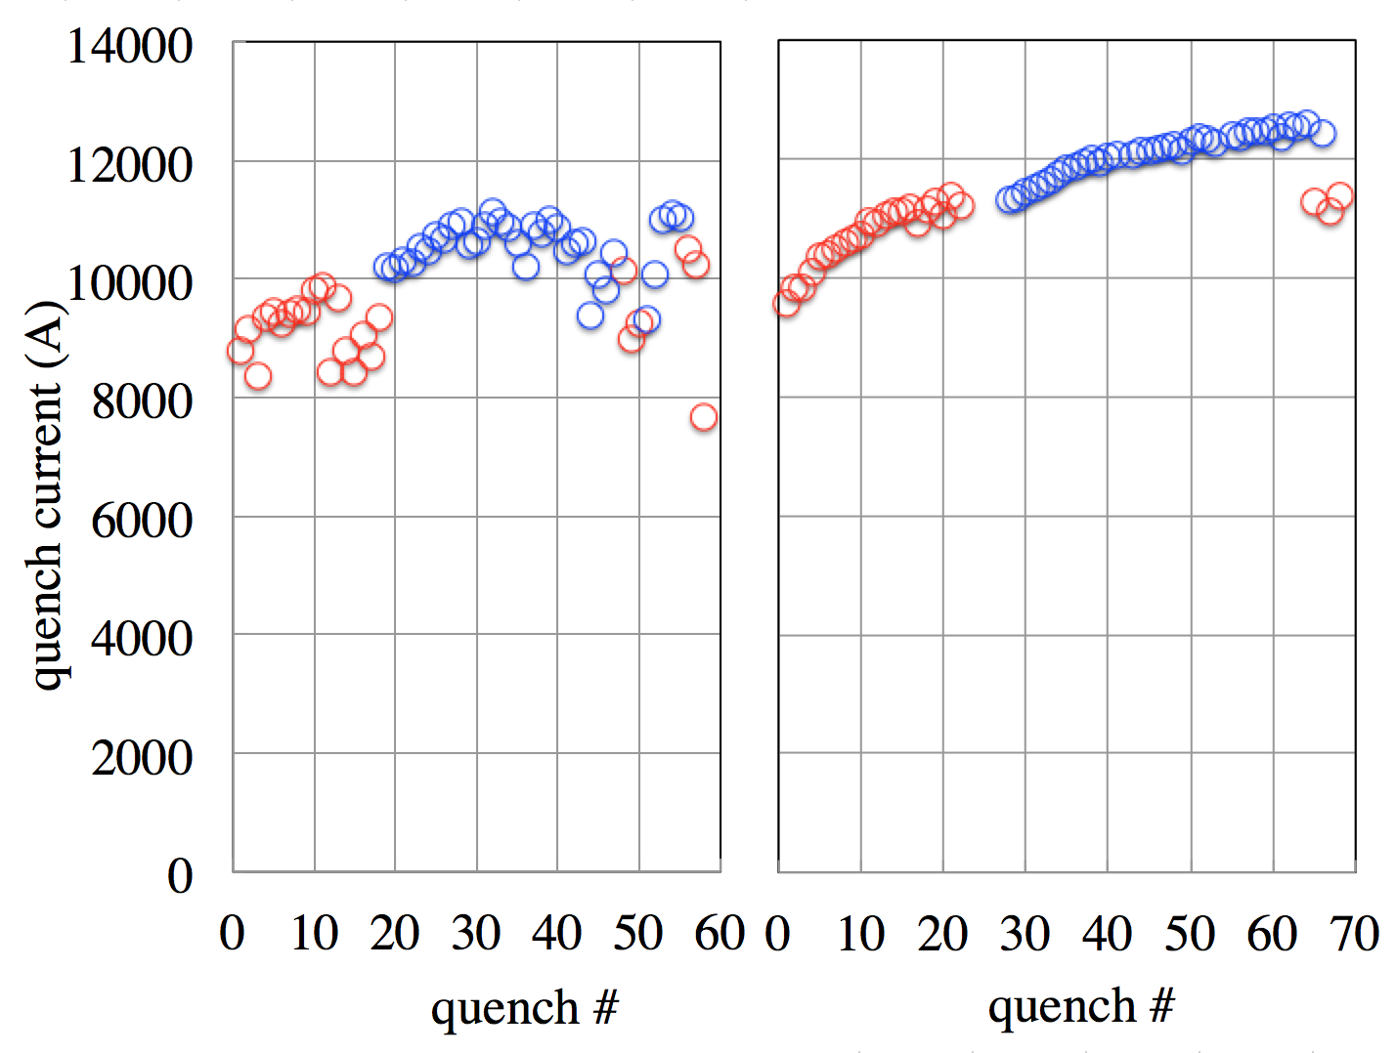
HL-LHC 11-T performance so far
Encouraging results !
  B_{max}= 11.7 T (78% of expected SSL at 1.9 K)
  Improving field quality (reduced sub-element diameter, cored cable)
Future work:
  Ramp-rate quench dependence
  Holding current quenches
  Geometric harmonics
11850 A
1.9 K
4.2 K
MBHSP01
MBHSP02
L. Bottura (CERN), G. Chlachidze, J. Di Marco, images E. Barzi (FNAL)

Slide 14
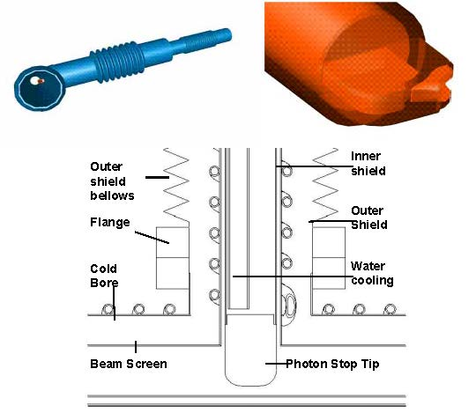
FHC – extracting SR heat
SR heat load 3 MW total;
26 W/m/aperture
one option: dedicated
warm photon stops
in magnet interconnects
as developed by FNAL for VLHC
with or w/o anterchamber
M. Geynisman et al., “Report on the First VLHC Photon Stop Cryogenic Design Experiment,” Advances in cryogenic engineering, Anchorage, AIP Conf.Proc. 710 (2004) 379-388 ;
Also P. Bauer et al., "Report on the First Cryogenic Photon Stop Experiment," FNAL TD-03-021, May 2003

Slide 15
FHC beam power & collimation
Energy stored: 8 GJ per beam (LHC: 0.4 GJ)
  beam dumping system design, interlock system
Collimation
  higher energy density: more robust materials? collimators are first hit by beam in case of failure; LHC collimators made from fibre-reinforced carbon (CFC); for FHC more robust composite materials?
  cleaning efficiency degrading with beam energy collimators minimize beam loss in the cold regions; nuclear processes inside collimator jaw vary with energy (cross section of single-diffractive scattering increases)
  smaller beam sizes and collimator gaps
    Full collimator gaps of 1 mm or less, requiring higher precision in collimator control, setup and reproducibility.
  magnets in cleaning insertion
    warm magnets at the technological limit; shielded superconducting magnets?

Slide 16
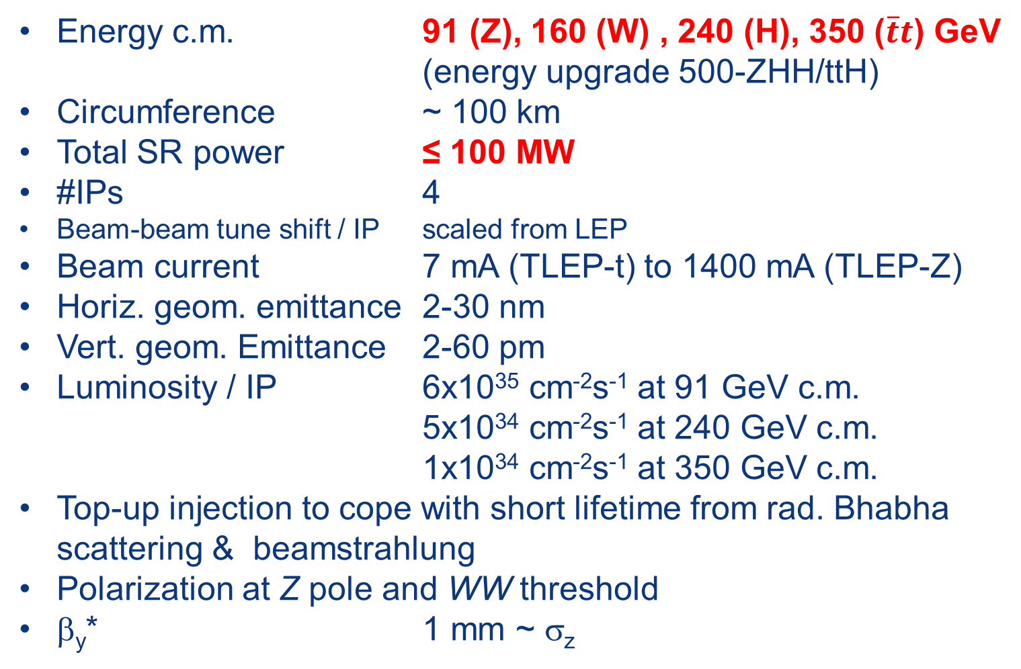
Main Parameters for FLC (TLEP)
Energy c.m. 91 (Z), 160 (W) , 240 (H), 350 ($\overline{t}t$) GeV
(energy upgrade 500-ZHH/ttH)
Circumference ~ 100 km
Total SR power ≤ 100 MW
#IPs 4
Beam-beam tune shift / IP scaled from LEP
Beam current 7 mA (TLEP-t) to 1400 mA (TLEP-Z)
Horiz. geom. emittance 2-30 nm
Vert. geom. Emittance 2-60 pm
Luminosity / IP 6x10³⁵ cm⁻²s⁻¹ at 91 GeV c.m.
5x10³⁴ cm⁻²s⁻¹ at 240 GeV c.m.
1x10³⁴ cm⁻²s⁻¹ at 350 GeV c.m.
Top-up injection to cope with short lifetime from rad. Bhabha scattering & beamstrahlung
Polarization at Z pole and WW threshold
β_{y}* 1 mm ~ σ_{z}
preliminary

Slide 17
Some Challenges for FLC (TLEP)
Lifetime limitation by beamstrahlung from 120 GeV requires robust ring optics with small β*_{y} (~ 1 mm) & large momentum acceptance (≥ 2%).
  Nano-beam / crab waist schemes are considered as options
Reaching small vertical emittance in large machine
Optimization of the machine layout compatible with high currents and larger number of bunches at Z
  Number of rings and size of the RF system
Polarization & precise energy calibration at Z pole, with nat. polarization time ~150 h, & at WW (~5 h)
RF w >50% wall-plug to beam power efficiency
Optics changes with energy; lepton injector chain

Slide 18
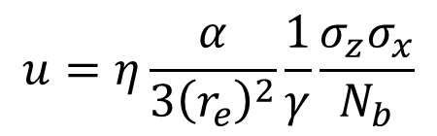
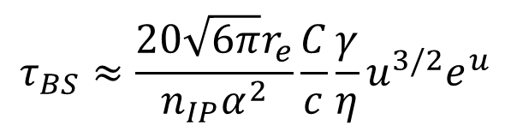
lifetime limit: beamstrahlung (BS)
synchrotron radiation in the strong field of opposing beam
makes some e± emit significant part of their energy
η: momentum acceptance
σ_{x}: horizontal beam size at IP
Note: Many theoretical beamstrahlung studies in 1980’s. Example R. Blankenbecler, S.D. Drell , “A Quantum Treatment of Beamstrahlung,” Phys.Rev. D36 (1987) 277
& then be lost→ limited beam lifetime
$$τ_{BS}≈\frac{20\sqrt{6π}r_{e}}{n_{IP}α^{2}}\frac{C}{c}\frac{γ}{η}u^{3/2}e^{u}$$
$$u=η\frac{α}{3{\left(r_{e}^{}\right)}^{2}}\frac{1}{γ}\frac{σ_{z}σ_{x}}{N_{b}}$$
with
V. Telnov, PRL 110 (2013) 114801
note recent new formula from BINP!
mitigations:
(1) large momentum acceptance η
(2) flat beams [i.e. small ε_{y} & large β_{x}*]
(3) fast top up
→minimize κ_{ε}=ε_{y}/ε_{x,} β_{y}~β_{x}(ε_{y}/ε_{x}) & respect β_{y}≥σ_{z}

Slide 19
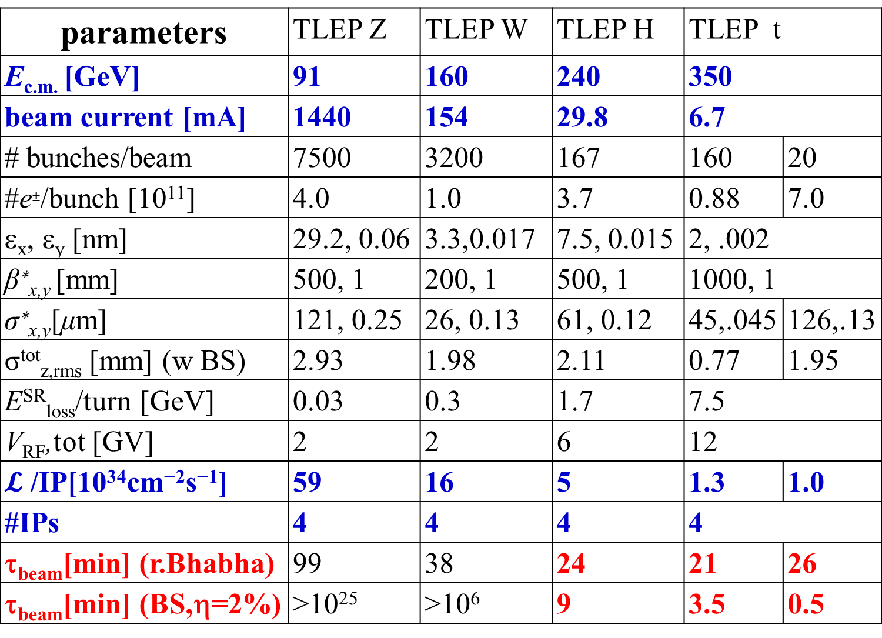
lifetime values (summer 2013 baseline)
parameters | TLEP Z | TLEP W | TLEP H | TLEP t
E_{c.m.} [GeV] | 91 | 160 | 240 | 350
beam current [mA] | 1440 | 154 | 29.8 | 6.7
# bunches/beam | 7500 | 3200 | 167 | 160 | 20
#e±/bunch [10¹¹] | 4.0 | 1.0 | 3.7 | 0.88 | 7.0
ε_{x}, ε_{y} [nm] | 29.2, 0.06 | 3.3,0.017 | 7.5, 0.015 | 2, .002
β∗_{x,y} [mm] | 500, 1 | 200, 1 | 500, 1 | 1000, 1
σ∗_{x,y}[μm] | 121, 0.25 | 26, 0.13 | 61, 0.12 | 45,.045 | 126,.13
σ^{tot}_{z,rms} [mm] (w BS) | 2.93 | 1.98 | 2.11 | 0.77 | 1.95
E^{SR}_{loss}/turn [GeV] | 0.03 | 0.3 | 1.7 | 7.5
V_{RF},tot [GV] | 2 | 2 | 6 | 12
$𝓛$ /IP[10³⁴cm⁻²s⁻¹] | 59 | 16 | 5 | 1.3 | 1.0
#IPs | 4 | 4 | 4 | 4
τ_{beam}[min] (r.Bhabha) | 99 | 38 | 24 | 21 | 26
τ_{beam}[min] (BS,η=2%) | >10²⁵ | >10⁶ | 9 | 3.5 | 0.5
multiple beamstrahlung
increases bunch length
single beamstrahlung
limits beam
lifeitme
based on Telnov formula

Slide 20
short lifetime → booster ring
for top up injection
into collider
A. Blondel

Slide 21
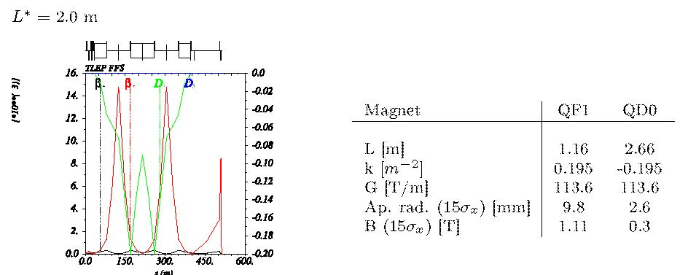
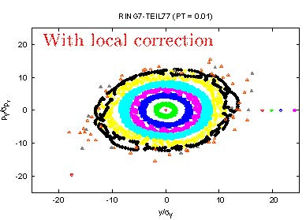
IR Design
(reduced from 4 m)
H. Garcia Moralez, R. Tomas
off-momentum
dynamic
aperture
δ=1%

Slide 22
developing FLC/TLEP parameters …

Slide 23
Parameter | TLEP-Z | TLEP-W | TLEP-H | TLEP-t | LEP2
E (GeV) | 45 | 80 | 120 | 175 | 104
I (mA) | 1400 | 150 | 30 | 7 | 4
N_{b} [10¹¹] | 4.0 | 1.0 | 3.7 | 0.88 | 5.8
σ_{z} [mm] | 2.93 | 1.98 | 2.11 | 0.77 | 16..1
β*_{x/y} (mm) | 500 / 1 | 200 / 1 | 500 / 1 | 1000 / 1 | 1500 / 50
ε_{x,y}(nm, pm) | 30, 60 | 3.3, 17 | 7.5, 15 | 2, 2 | 40,~250
ξ_{x,y}/IP | .068 | .086 | .094 | .057 | .066 (y)
L/IP(10³²cm⁻²s⁻¹) | 5800 | 1600 | 500 | 132 | 1.2
baseline
(analytical)
N_{b} [10¹¹] | 1.5 | 1.0 | 3.0 | 0.88
σ_{z} [mm] | 1.7 | 1.6 | 1.65 | 0.84
ε_{x,y}(nm, pm) | 30, 90 | 4.1, 22 | 8.8, 19 | 2.3, 2.3
ξ_{x,y}/IP | .029/.024 | .068, .051 | .065, .054 | .055, .036
L/IP(10³²cm⁻²s⁻¹) | 2100 | 1150 | 350 | 175
baseline
(simulated
+ opt.)
S. White,
TLEP6 WS
β*_{x/y} (mm) | 500 / 1 | 500 / 1 | 500 / 1 | 500 / 1
N_{b} [10¹¹] | 1.0 | 4.0 | 4.7 | 4.0
σ_{z} [mm] | 5.9 | 9.1 | 8.2 | 6.6
ε_{x,y}(nm, pm) | 0.14, 1 | 0.44, 2 | 1, 2 | 2.1, 4.3
ξ_{x,y}/IP | .032/.175 | .031, .187 | .029, .160 | .024, .077
L/IP(10³²cm⁻²s⁻¹) | 22970 | 3980 | 933 | 129
A.Bogomyagkov, E.Levichev,
D.Shatilov,
TLEP6 WS
nano-beam
option
higher luminosity + much
better beamstrahlung lifetime (>100 min)

Slide 24
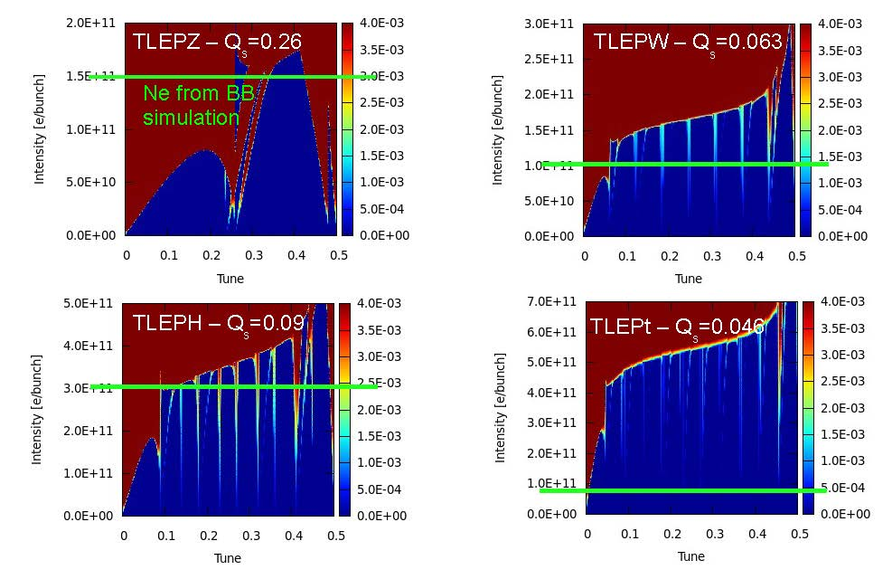
TMCI instability, 3 cm y half aperture, 5.5 m dipole
N. Mounet, S. White, TLEP6

Slide 25
TLEP RF - relevant parameters
Main RF parameters
Synchrotron radiation power: 50 MW per beam
Energy loss per turn: 7.5 GeV (at 175 GeV, t)
Beam current up to 1.4 A (at 45 GeV, Z)
Up to 7500 bunches of up to 4 x 10¹¹ e per ring.
CW operation w. top-up operation, injectors & booster pulsed
Erk Jensen
First look on basic frequency choice & RF system dimension
Frequency range (200-800) MHz with 400 MHz starting point
  Disadvantage lower frequency: mechanical stability, He amount for cooling, size …
  Disadvantage higher frequency: denser HOM spectrum (multi-cell), BBU limit, larger impedance, smaller coupler dimensions
Example scaling from LHC (per beam):
  LHC 400 MHz → 2 MV and ~250 kW per cavity, (total 8 cavities)
  Lepton collider ~500 cavities 20 MV / 100 kW RF → 10 GV / 50 MW

Slide 26
R&D issues for FLC SC RF system
Low cost, highly efficient RF source
  IOT’s, magnetrons, diacrodes, solid state ampliifers?
Higher Q₀
  High temp furnace treatments
  Nb₃Sn
  MgB₂ or something new?
Improved HOM damping (on-cell dampers?)
  First tried on ANL crab cavity, plan to try on JLAB MEIC
  Higher packing factor
Reduced cryomodule costs
  Cheaper materials, reduced labor
Robert
Rimmer,
JLAB

Slide 27
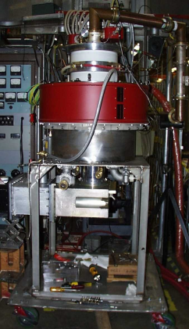
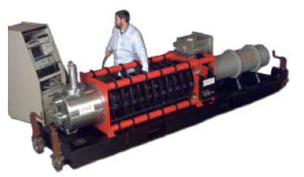
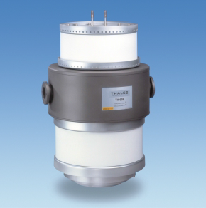

RF power sources – frequency scaling
High efficiency, high power RF sources?
  200 MHz: Tetrodes, Diacrodes;
  probably least expensive/MW;
  efficiency > 70%
  400 MHz, 800 MHz:
      Klystrons: $η\sim 65\%$; R&D for larger $η$ has started
      IOTs: today limited to $<100 kW$;
      R&D on MB IOT ($1.5 MW$ pulsed) has started with ESS!
CPI MB-IOT prototype, 1MW, 700MHz
Erk Jensen
LEP 1.3 MW CW klystron
Thales 1MW diacrode

Slide 28

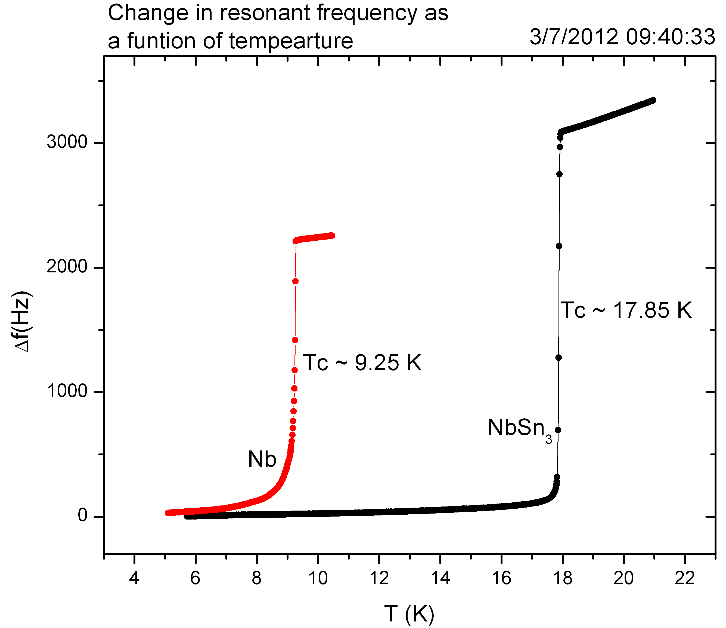
potential of Nb₃Sn for SRF cavities
R&D
progressing
at JLAB
& Cornell
Data from P. Dhakal
Robert Rimmer, JLAB

Slide 29
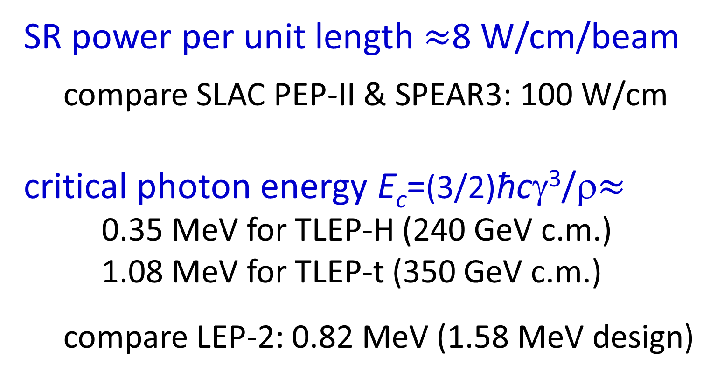
Synchrotron Radiation for FLC (TLEP)
SR power per unit length $≈$8 W/cm/beam
compare SLAC PEP-II & SPEAR3: 100 W/cm
critical photon energy E_{c}=(3/2)ħcγ³/ρ$≈$
0.35 MeV for TLEP-H (240 GeV c.m.)
1.08 MeV for TLEP-t (350 GeV c.m.)
compare LEP-2: 0.82 MeV (1.58 MeV design)

Slide 30
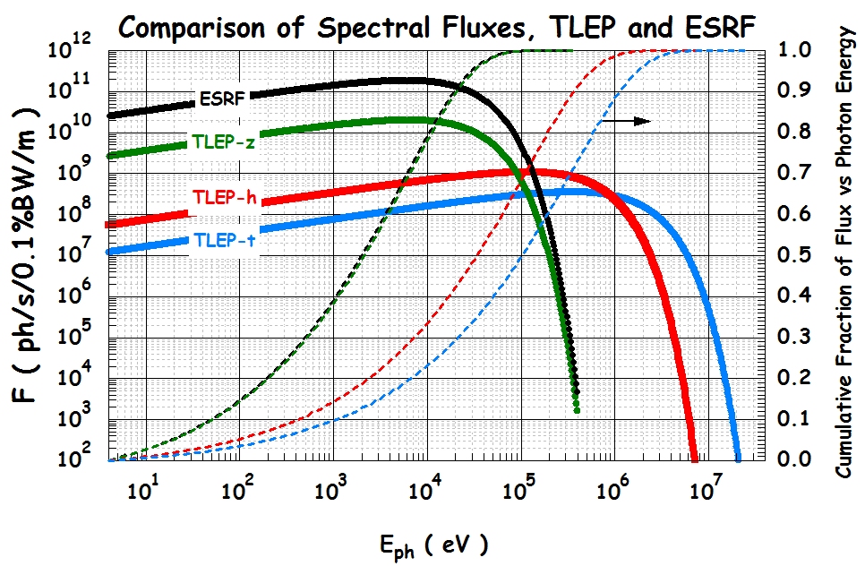
TLEP SR compared with ESRF
R. Kersevan, C. Garion, TLEP6

Slide 31
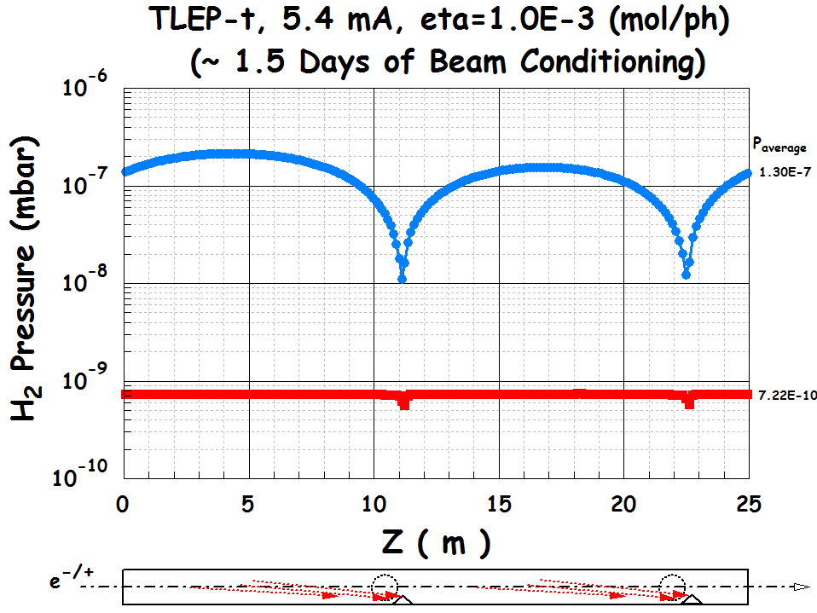
first look at vacuum system
lumped pumps
NEG coating
R. Kersevan, C. Garion, TLEP6

Slide 32
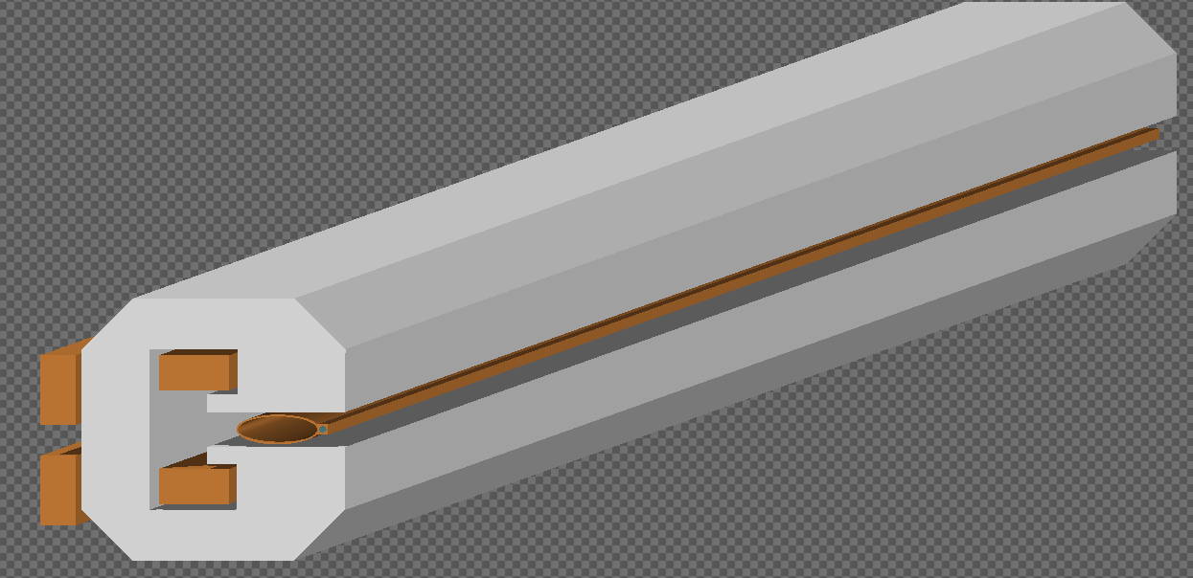
10.5 m long dipole for 1 beam line
FLUKA model for radiation study
TLEP 80 km
Beam pipe without shielding (no lead) but with cooling water channel
L. Lari, TLEP6

Slide 33
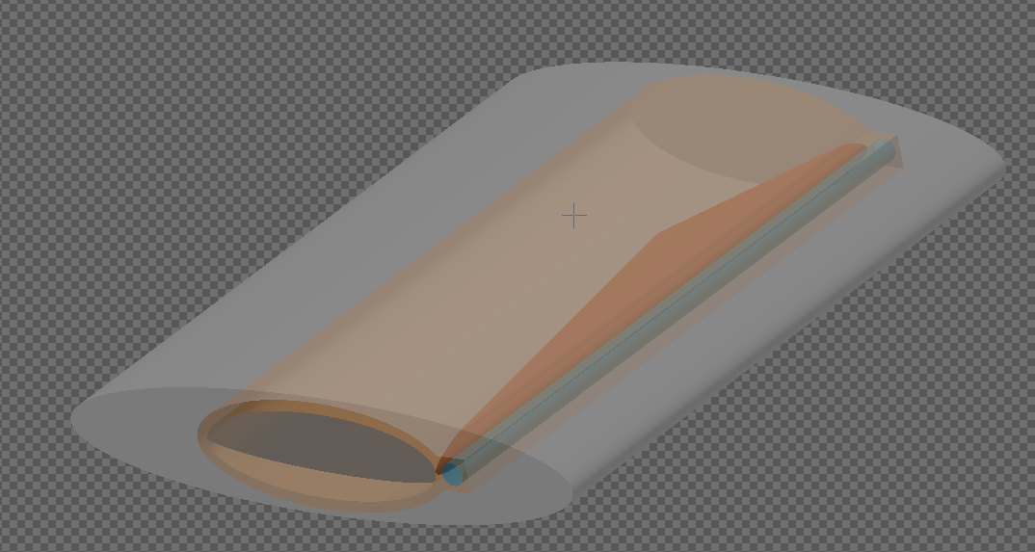

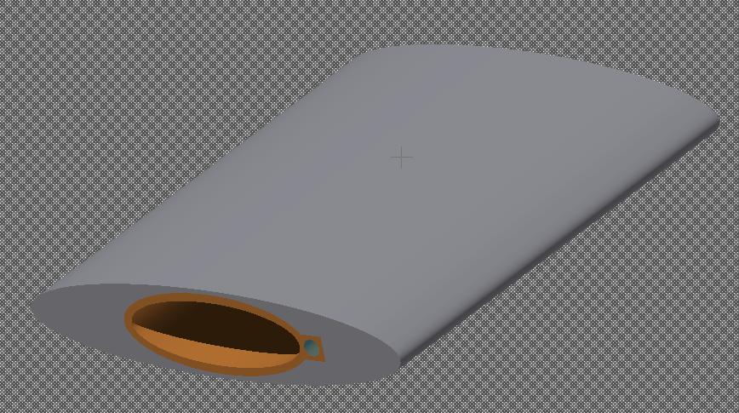
FLUKA model for radiation study
1.5m Quadrupole implemented just as the analytical magnetic field
10.5m Dipole
10.5m Dipole
S
QD
S
Centered
0.3 m
0.3 m
0.3 m
0.3 m
5* 24 cm long Absorbers
Cu-OFS (0.085% Ag)
0.3 m
25 mm
(20:10)
Lead
L. Lari, TLEP6

Slide 34
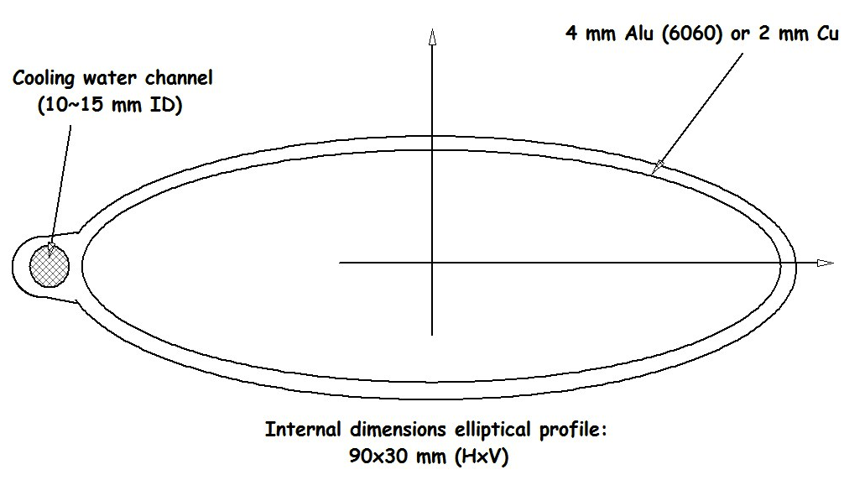
heating of cooling water
Power in H₂0 for all absorbers: 14.7 W (shield) & 4.5 W (no shield)
Power in H₂0 for all magnets: 6.7 W (shield) & 87 W (no shield)
Dipole
Abs
Dipole
Abs
S
Abs
Q
Abs
S
Abs
39 W
42 W
6 W
0.9 W
0.9 W
0.9 W
0.9 W
0.9 W
1.7 W
4.9 W
0.1 W
7 W
7.2 W
0.16 W
0.2 W
0.05 W
Heating of the in-pipe shield: need to move the H2O channel further in ?
L. Lari, F. Cerutti, A. Ferrai, TLEP6

Slide 35
peak dose on the coils
ozone production to be looked at
L. Lari, F. Cerutti, A. Ferrai, TLEP6

Slide 36
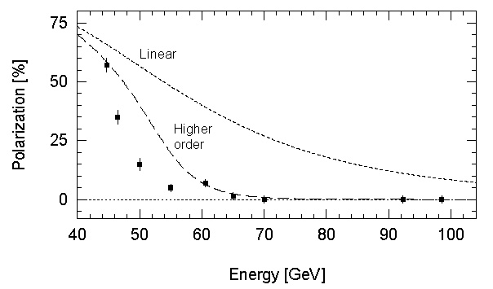
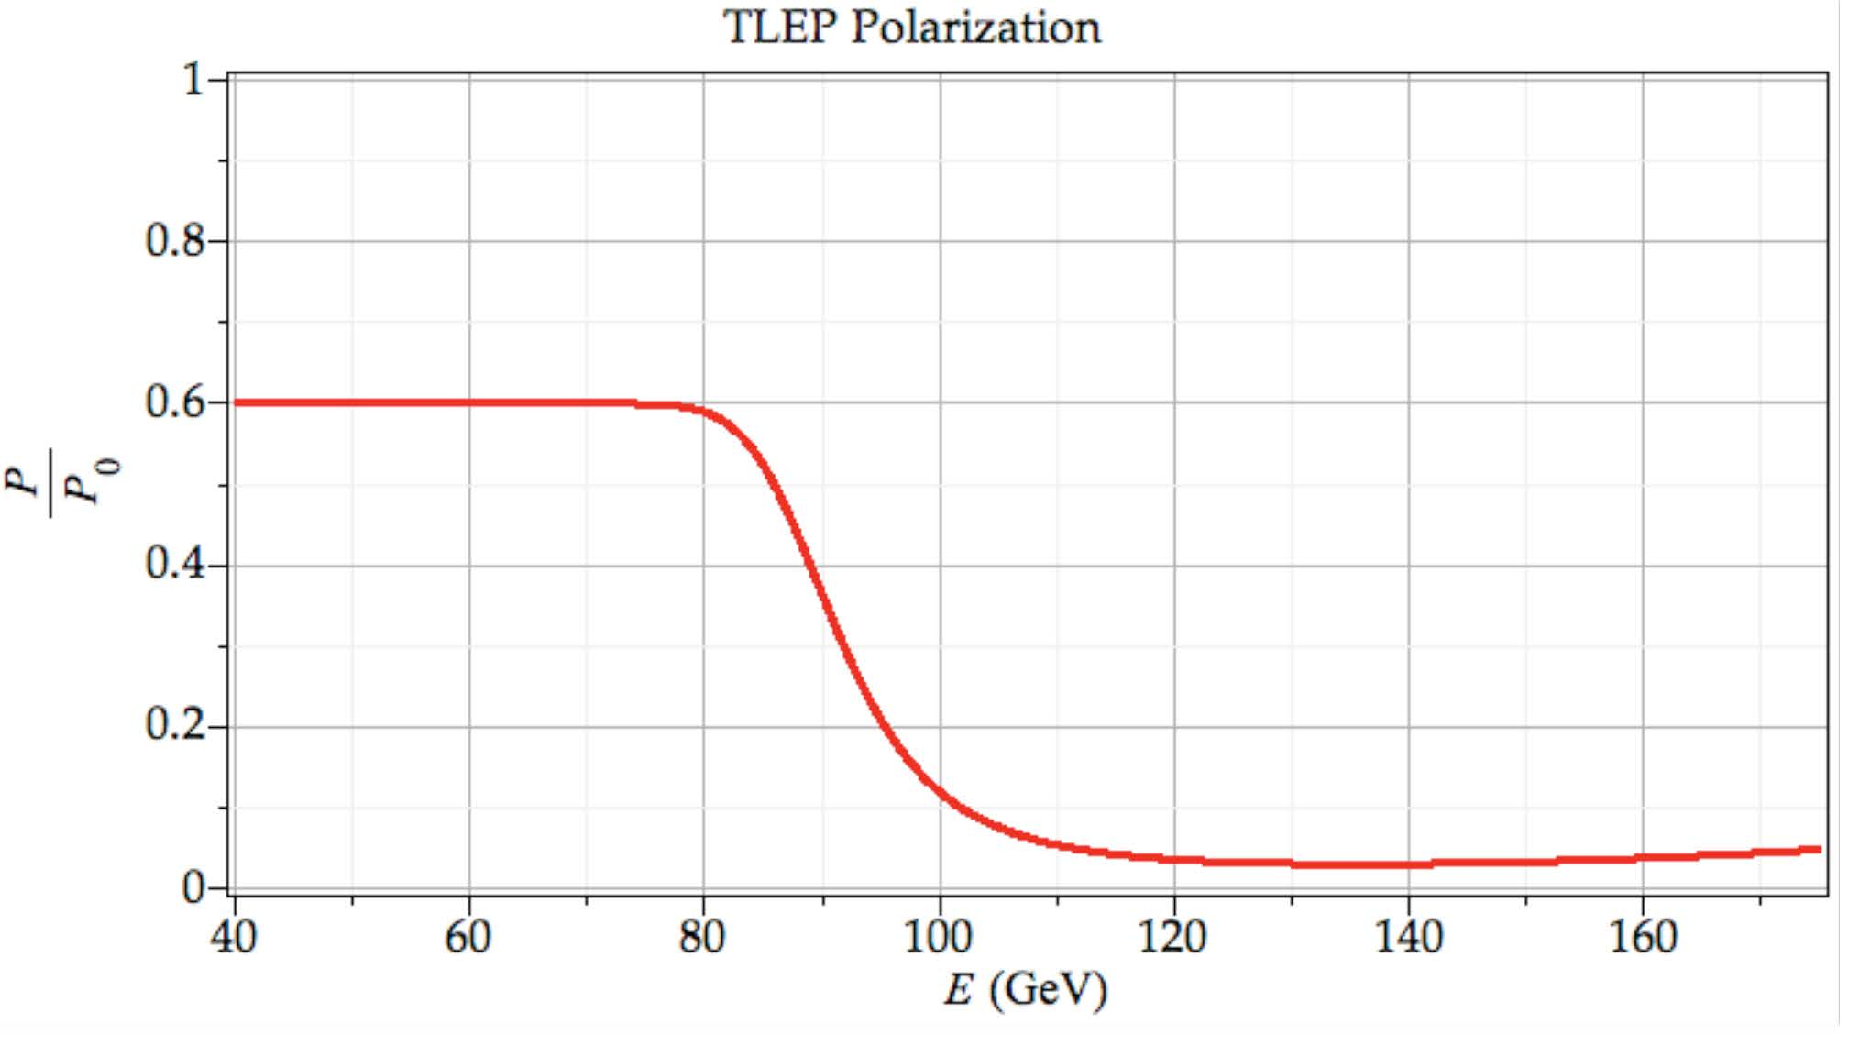
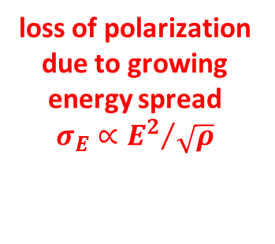
polarization
R. Assmann
LEP
A. Blondel
loss of polarization due to growing energy spread
$$σ_{E}∝{E^{2}}/{\sqrt{ρ}}$$
LEP
observations
+ model predictions
polarization scaling (energy spread!):
LEP at 61 GeV → TLEP at 81 GeV
TLEP
optimized scenario
U Wienands, April 2013
TLEP
➔ 100 keV beam energy calibration by resonant depolarization (using pilot bunches) around Z peak and W pair threshold:
Δm_{Z} ~0.1 MeV, ΔΓ_{Z} ~0.1 MeV, Δm_{W} ~ 0.5 MeV
ρ = 9000 m, C = 80 km
lower energy spread, high polarization up to W threshold

Slide 37
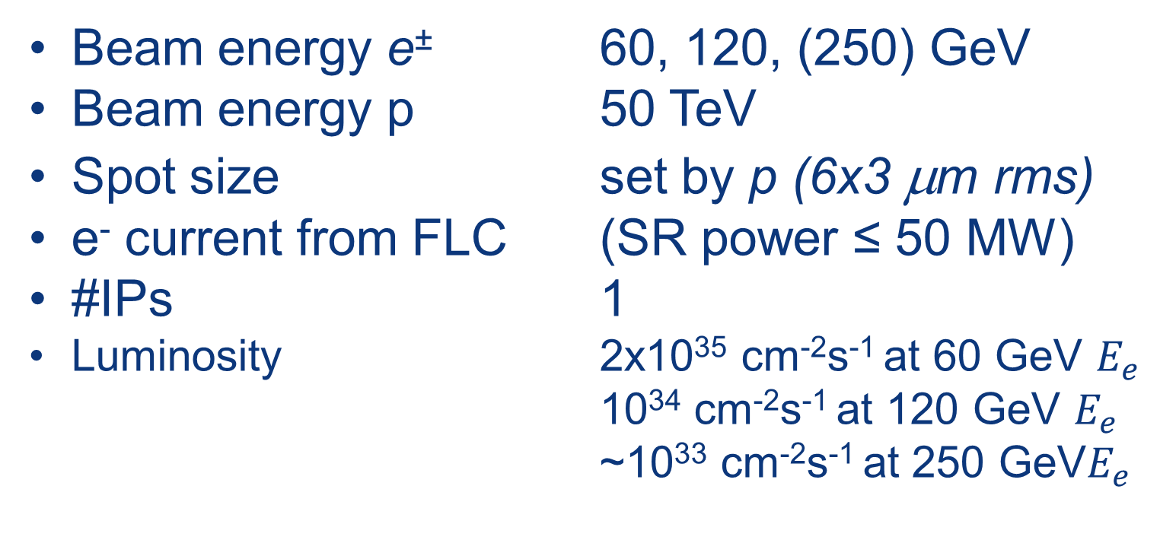
Main Parameters for FLHC (VLHeC)
Beam energy e± 60, 120, (250) GeV
Beam energy p 50 TeV
Spot size set by p (6x3 μm rms)
e⁻ current from FLC (SR power ≤ 50 MW)
#IPs 1
Luminosity 2x10³⁵ cm⁻²s⁻¹ at 60 GeV $E_{e}$
10³⁴ cm⁻²s⁻¹ at 120 GeV $E_{e}$
~10³³ cm⁻²s⁻¹ at 250 GeV$E_{e}$

Slide 38
possible long-term strategy
TLEP (80-100 km,
e⁺e⁻, up to
~350 GeV c.m.)
PSB
PS (0.6 km)
LHC (26.7 km)
SPS (6.9 km)
VHE-LHC/FHC
(pp, up to
100 TeV c.m.)
& e± (120 GeV) – p (7, 16 & 50 TeV) collisions ([(V)HE-]TLHeC)
≥50 years of e⁺e⁻, pp, ep/A physics at highest energies

Slide 39


a tentative time line
1980
1990
2000
2010
2020
2030
2040
LHC
Design,
R&D
Proto.
Constr.
Physics
HL-LHC
Design,
R&D
Constr.
Physics
Design,
R&D
TLEP
Design,
R&D
Constr.
Physics
FCC
VHE-LHC
Design,
R&D
Constr.
Physics

Slide 40
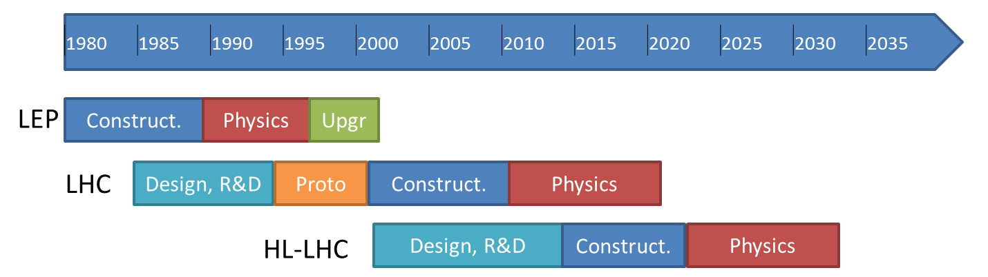

FCC official study milestones
CDR and Cost Review 2018
today
ESU
Project
Kick-off meeting: 11th Nov. 2013 (Daresbury)
FCC
Kick-off meeting
12th-14th February 2014
Study
CDR and Cost Review 2018

Slide 41
FCC Summary
CERN is undertaking an international study for the design of future circular colliders (FCC) in the 100 km range
CDR and cost review for next ESU (2018)
Main emphasis on hadron collider (FHC) with 100 TeV cm at the energy frontier, determining the infrastructure
Study will also consider an e⁺e⁻ collider (TLEP/FLC) as potential intermediate step, and look at an e-p option.
FCC kick-off meeting 12-15 February 2014 in Geneva University
  - Establish international collaborations
  Define WPs and set-up study groups
  International Advisory Committee (IAC)
Collaboration with CepC/SppC/IHEP design study much welcome & important to make progress!

Slide 42
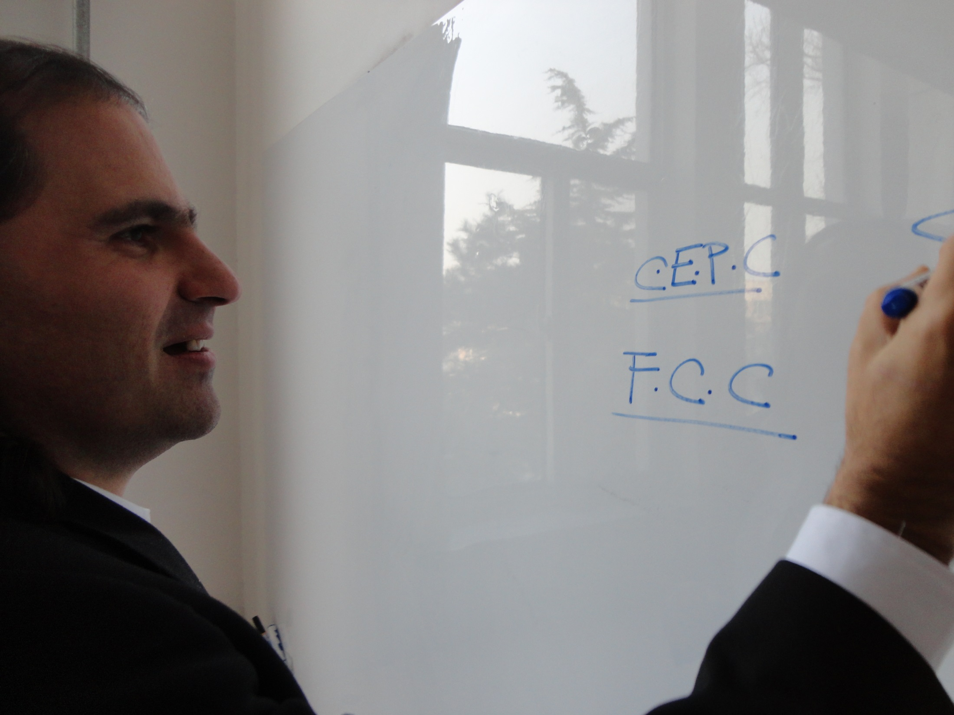
thank you for your attention!

Slide 43
TLEP/FLC past events & references
A. Blondel, F. Zimmermann, “A High Luminosity e⁺e⁻ Collider in the LHC Tunnel to study the Higgs Boson,” arXiv:1112.2518v1, 24.12.’11
K. Oide, “SuperTRISTAN - A possibility of ring collider for Higgs factory,”
KEK Seminar, 13 February 2012
1st EuCARD LEP3 workshop, CERN, 18 June 2012
A. Blondel et al, “LEP3: A High Luminosity e+e- Collider to study the Higgs Boson,” arXiv:1208.0504, submitted to ESPG Krakow
P. Azzi et al, “Prospective Studies for LEP3 with the CMS Detector,”
arXiv:1208.1662 (2012), submitted to ESPG Krakow
2nd EuCARD LEP3 workshop, CERN, 23 October 2012
P. Janot, “A circular e⁺e⁻ collider to study H(125),” PH Seminar, CERN, 30 October 2012
ICFA Higgs Factory Workshop: Linear vs Circular, FNAL, 14-16 Nov. ’12
A. Blondel, F. Zimmermann, “Future possibilities for precise studies of the X(125) Higgs candidate,” CERN Colloquium, 22 Nov. 2012
3rd TLEP3 Day, CERN, 10 January 2013
4th TLEP mini-workshop, CERN, 4-5 April 2013
5th TLEP mini-workshop, 25-26 July 2013, Fermilab
6th TLEP workshop (TLEP6), CERN, 16-18 Oct. 2013
http://tlep.web.cern.ch
http://cern.ch/accnet
http://cern.ch/xbeam

Slide 44
VHE-LHC/FHC past events & references
R. Assmann, R. Bailey, O. Brüning, O. Dominguez, G. de Rijk, J.M. Jimenez, S. Myers, L. Rossi, L. Tavian, E. Todesco, F. Zimmermann, “First Thoughts on a Higher- Energy LHC,” CERN-ATS-2010-177
E. Todesco, F. Zimmermann (eds), “EuCARD-AccNet-EuroLumi Workshop: The High-Energy Large Hadron Collider,” Proc. EuCARD-AccNet workshop HE-LHC’10 , Malta, 14-16 October 2010, arXiv:1111.7188 ; CERN Yellow Report CERN-2011-003
HiLumi LHC WP6 HE-LHC
Joint Snowmass-EuCARD/AccNet-HiLumi meeting `Frontier Capabilities for Hadron Colliders 2013,‘ CERN, 21-11 February 2013
http://hilumilhc.web.cern.ch/HiLumiLHC/activities/HE-LHC/WP16/
https://cern.ch/accnet

Slide 45
Additional slides

Slide 46
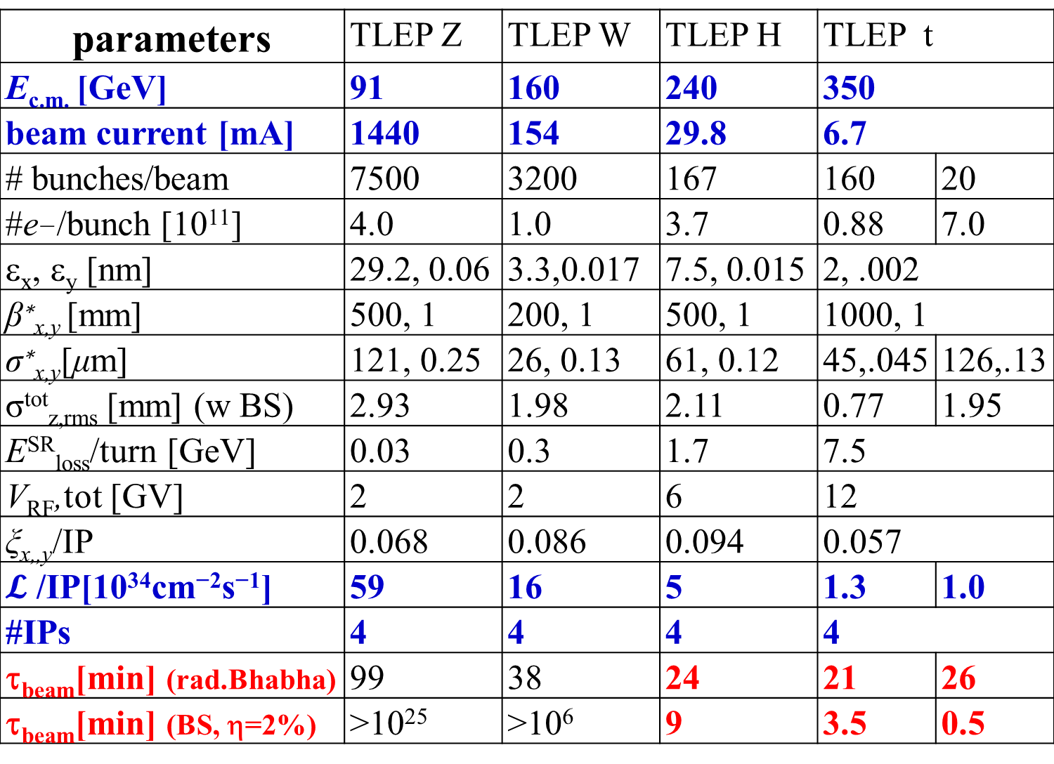
parameters | TLEP Z | TLEP W | TLEP H | TLEP t
E_{c.m.} [GeV] | 91 | 160 | 240 | 350
beam current [mA] | 1440 | 154 | 29.8 | 6.7
# bunches/beam | 7500 | 3200 | 167 | 160 | 20
#e−/bunch [10¹¹] | 4.0 | 1.0 | 3.7 | 0.88 | 7.0
ε_{x}, ε_{y} [nm] | 29.2, 0.06 | 3.3,0.017 | 7.5, 0.015 | 2, .002
β∗_{x,y} [mm] | 500, 1 | 200, 1 | 500, 1 | 1000, 1
σ∗_{x,y}[μm] | 121, 0.25 | 26, 0.13 | 61, 0.12 | 45,.045 | 126,.13
σ^{tot}_{z,rms} [mm] (w BS) | 2.93 | 1.98 | 2.11 | 0.77 | 1.95
E^{SR}_{loss}/turn [GeV] | 0.03 | 0.3 | 1.7 | 7.5
V_{RF},tot [GV] | 2 | 2 | 6 | 12
ξ_{x,,y}/IP | 0.068 | 0.086 | 0.094 | 0.057
$𝓛$ /IP[10³⁴cm⁻²s⁻¹] | 59 | 16 | 5 | 1.3 | 1.0
#IPs | 4 | 4 | 4 | 4
τ_{beam}[min] (rad.Bhabha) | 99 | 38 | 24 | 21 | 26
τ_{beam}[min] (BS, η=2%) | >10²⁵ | >10⁶ | 9 | 3.5 | 0.5

Slide 47
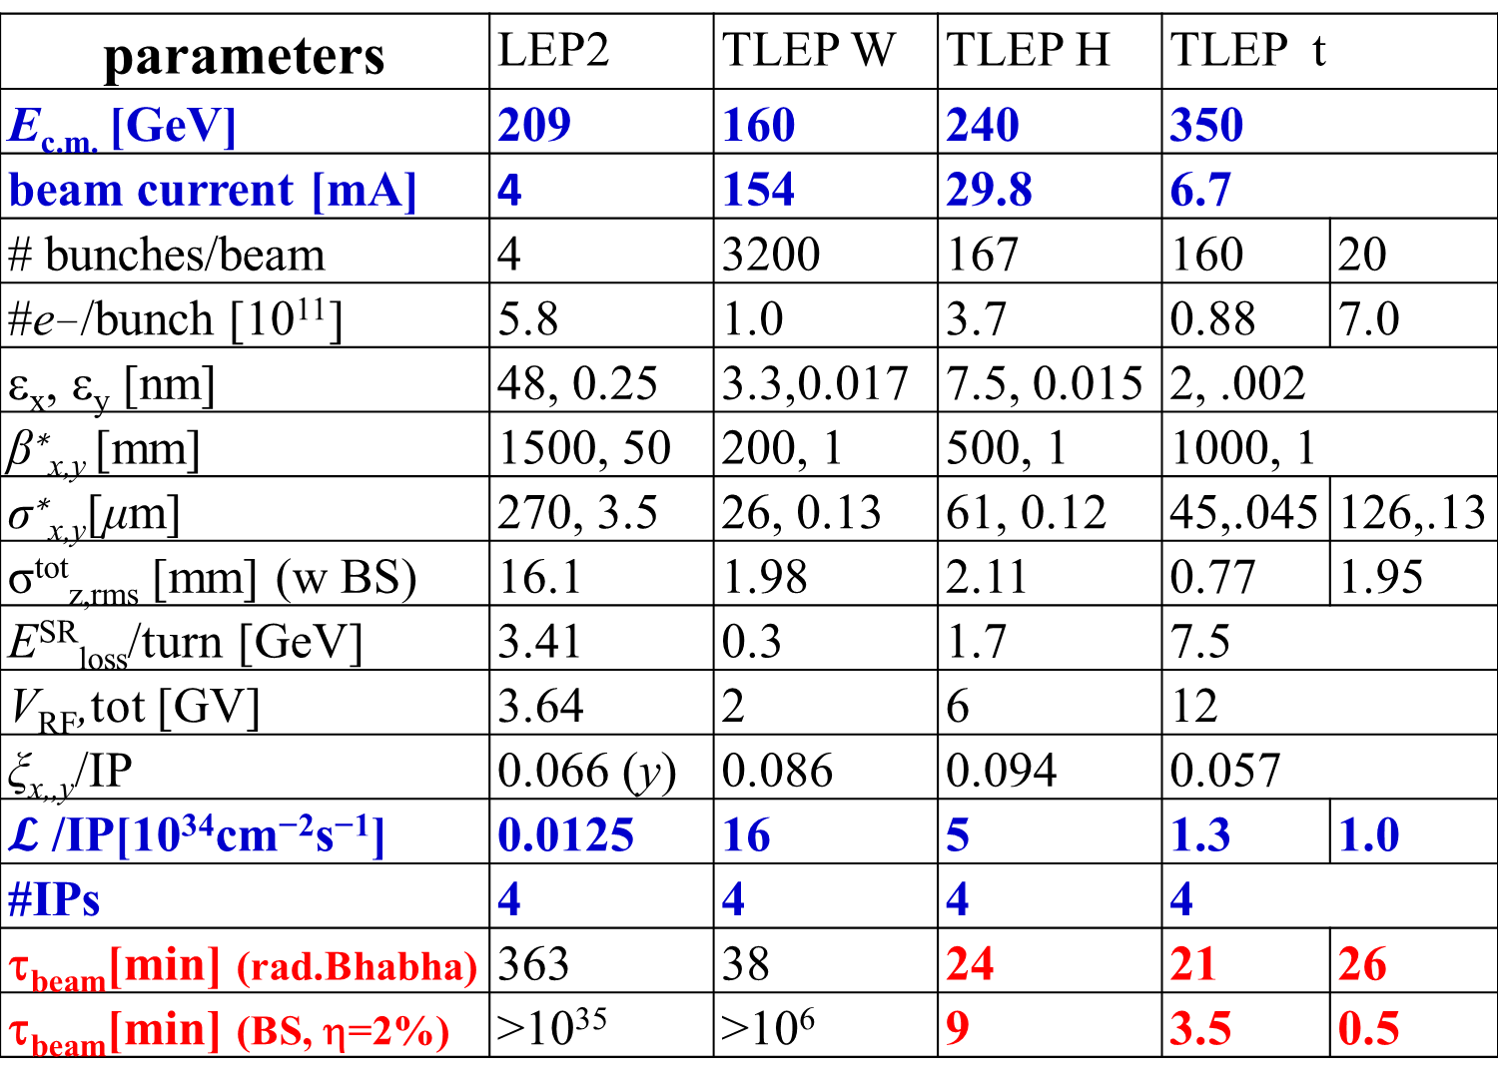
parameters | LEP2 | TLEP W | TLEP H | TLEP t
E_{c.m.} [GeV] | 209 | 160 | 240 | 350
beam current [mA] | 4 | 154 | 29.8 | 6.7
# bunches/beam | 4 | 3200 | 167 | 160 | 20
#e−/bunch [10¹¹] | 5.8 | 1.0 | 3.7 | 0.88 | 7.0
ε_{x}, ε_{y} [nm] | 48, 0.25 | 3.3,0.017 | 7.5, 0.015 | 2, .002
β∗_{x,y} [mm] | 1500, 50 | 200, 1 | 500, 1 | 1000, 1
σ∗_{x,y}[μm] | 270, 3.5 | 26, 0.13 | 61, 0.12 | 45,.045 | 126,.13
σ^{tot}_{z,rms} [mm] (w BS) | 16.1 | 1.98 | 2.11 | 0.77 | 1.95
E^{SR}_{loss}/turn [GeV] | 3.41 | 0.3 | 1.7 | 7.5
V_{RF},tot [GV] | 3.64 | 2 | 6 | 12
ξ_{x,,y}/IP | 0.066 (y) | 0.086 | 0.094 | 0.057
$𝓛$ /IP[10³⁴cm⁻²s⁻¹] | 0.0125 | 16 | 5 | 1.3 | 1.0
#IPs | 4 | 4 | 4 | 4
τ_{beam}[min] (rad.Bhabha) | 363 | 38 | 24 | 21 | 26
τ_{beam}[min] (BS, η=2%) | >10³⁵ | >10⁶ | 9 | 3.5 | 0.5
com-parison
with LEP2

Slide 48
parameters | TLEP W | TLEP H | TLEP t |  | ZHH&ttH
E_{c.m.} [GeV] | 160 | 240 | 350 |  | 500
beam current [mA] | 154 | 29.8 | 6.7 |  | 1.6
# bunches/beam | 3200 | 167 | 160 | 20 | 10
#e±//bunch [10¹¹] | 1.0 | 3.7 | 0.88 | 7.0 | 3.3
ε_{x}, ε_{y} [nm] | 3.3,0.017 | 7.5, 0.015 | 2, .002 |  | 4., 0.004
β∗_{x,y} [mm] | 200, 1 | 500, 1 | 1000, 1 |  | 1000, 1
σ∗_{x,y}[μm] | 26, 0.13 | 61, 0.12 | 45,.045 | 126,.13 | 63, 0.063
σ^{tot}_{z,rms} [mm] (w BS) | 1.98 | 2.11 | 0.77 | 1.95 | 1.81
E^{SR}_{loss}/turn [GeV] | 0.3 | 1.7 | 7.5 |  | 31.4
V_{RF},tot [GV] | 2 | 6 | 12 |  | 35
ξ_{x,,y}/IP | 0.086 | 0.094 | 0.057 |  | 0.075
$𝓛$ /IP[10³⁴cm⁻²s⁻¹] | 16 | 5 | 1.3 | 1.0 | 0.5
#IPs | 4 | 4 | 4 |  | 4
τ_{beam}[min] (rad.B) | 38 | 24 | 21 | 26 | 13
τ_{beam}[min] (BS,η=2%) | >10⁶ | 9 | 3.5 | 0.5 | ~1(η=3%)
TLEP
energy
upgrade?

Slide 49
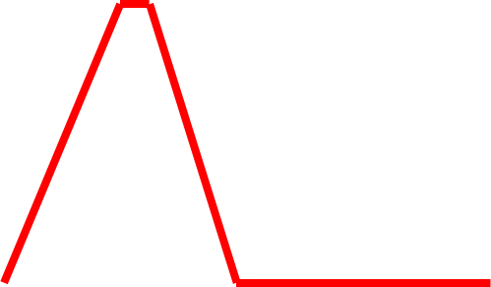
Top-up scheme
beam current in collider (15 min. beam lifetime)
100%
99%
almost constant current
energy of accelerator ring
120 GeV
injection into collider
injection into
accelerator
20 GeV
acceleration time = 1.6 s
(assuming SPS ramp rate)
10 s

Slide 50
parameters for FHLC
collider parameters | e± scenarios |  |  |  | protons
species | e± | e± | e± |  | p
beam energy [GeV] | 60 | 120 | 250 |  | 50000
bunch spacing [μs] | 0.125 | 2 | 33 |  | 0.125 to 33
bunch intensity [10¹¹] | 3.8 | 3.7 | 3.3 |  | 3.0
beam current [mA] | 477 | 29.8 | 1.6 |  | 384 (max)
rms bunch length [cm] | 0.25 | 0.21 | 0.18 |  | 2
rms emittance [nm] | 6.0, 3.0 | 7.5, 3.75 | 4, 2 |  | 0.06, 0.03
β_{x,y}*[mm] | 5.0, 2.5 | 4.0, 2.0 | 9.3, 4.5 |  | 500, 250
σ_{x,y}* [μm] | 5.5, 2.7
b-b parameter ξ | 0.13 | 0.050 |  | 0.056 | 0.017
hourglass reduction | 0.42 | 0.36 |  | 0.68
CM energy [TeV] | 3.5 | 4.9 |  | 7.1
luminosity[10³⁴cm⁻²s⁻¹] | 21 | 1.2 |  | 0.07

Slide 51
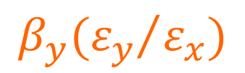
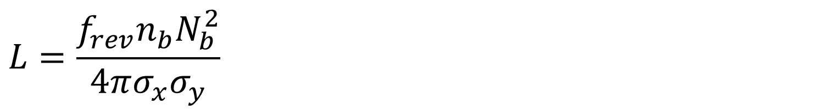

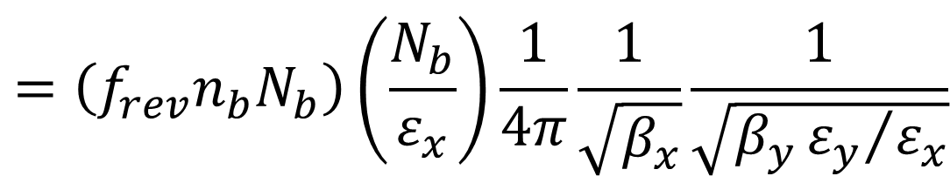
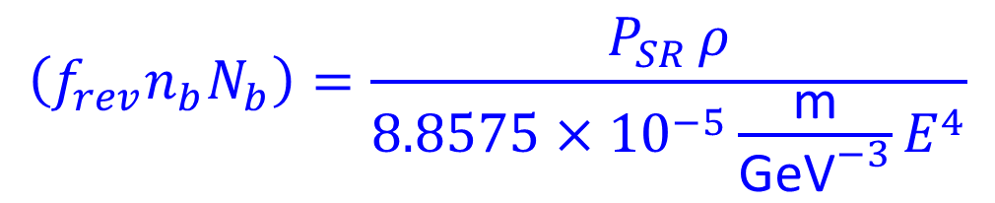

… and in formulae
FLC (TLEP) luminosity formulae
$$L=\frac{f_{rev}n_{b}N_{b}^{2}}{4πσ_{x}σ_{y}}$$
$$=\left(f_{rev}n_{b}N_{b}\right)\left(\frac{N_{b}}{ε_{x}}\right)\frac{1}{4π}\frac{1}{\sqrt{β_{x}}}\frac{1}{\sqrt{β_{y}{ε_{y}}/{ε_{x}}}}$$
$$\left(f_{rev}n_{b}N_{b}\right)=\frac{P_{SR }ρ}{8.8575×{10}^{−5}\frac{\text{m}}{{\text{GeV}}^{−3}}E^{4}}$$
SR radiation
power limit
$$\frac{N_{b}}{ε_{x}}≈\frac{ξ_{x}2πγ}{r_{e}}$$
beam-beam limit
$$β_{x}$$
constrained by beamstrahlung
$${{β_{y}(ε}_{y}}/{ε_{x})}$$
to be reduced as much as possible!

Slide 52




lifetime limit: rad. Bhabha scattering
$$\frac{1}{τ_{b}}=\frac{L}{I_{beam}}σn_{IP}ef_{rev}$$
beam lifetime
at beam-beam limit:
$$τ_{b}=\frac{2r_{e}m_{e}}{n_{IP}σf_{rev}}\frac{β_{y}}{E_{b}ξ_{y}}$$
σ for rad. Bhabha:
$$\frac{dσ}{dk}=\frac{4α{\left(r_{e}\right)}^{2}}{k}\left[\frac{4}{3}−\frac{4}{3}k+k^{2}\right]\left[log\left(4γ^{2}\right)+log\frac{1−k}{k}−\frac{1}{2}\right]$$
→ $σ≈\int_{k_{min}}^{1}{\frac{dσ}{dk}dk}≈0.32 barn$
H. Burkhardt, R. Kleiss,
EPAC1994
LEP2: τ_{beam,LEP2}~ 6 h (~30% suppression: σ∼0.21 barn)
TLEP with L~5x10³⁴ cm⁻²s⁻¹ at 4 IPs:
τ_{beam,TLEP}~21 minutes, unavoidable

Slide 53

luminosity of e⁺e⁻ colliders
TLEP-Z
S. Henderson
TLEP-W
TLEP-H
TLEP-t

Slide 54


optics – TLEP arc cell
Y. Cai,
B. Holzer,
H. Burkhardt
dispersion
beta functions
from LEP to TLEP
ρ=3100 m, L_{cell}=79 m
ρ=9100 m (C=80 km), L_{cell}=50 m
ε_{x}=48 nm at 104.5 GeV → ε_{x}=1.5 nm at 175 GeV
$$ε∝γ^{2}θ_{}^{3}$$
: at lower beam energy increase cell length (“θ”) x2 or x6!

