Slide 1
High Power Proton Beams for Particle Physics
Sergei Nagaitsev
ICFA 2014 Seminar, Beijing
30 October 2014

Slide 2
Outline
Physics Opportunities
Performance Requirements
Design Strategies
Future Facilities
Technology Challenges
Additional information:
http://arxiv.org/abs/1308.4719
2013 US HEP Community Summer Study: High Intensity Secondary Beams Driven by Proton http://www.bnl.gov/swif2013/

Slide 3
Where in the world is the expertise on high-power beams?
Existing facilities:
Asia: J-PARC
Americas: TRIUMF, FNAL, BNL, LANL, and SNS
Europe: CERN, PSI, ISIS, GSI, IHEP (Protvino)
Future facilities: FRIB, MYRRHA, ESS and CSNS

Slide 4
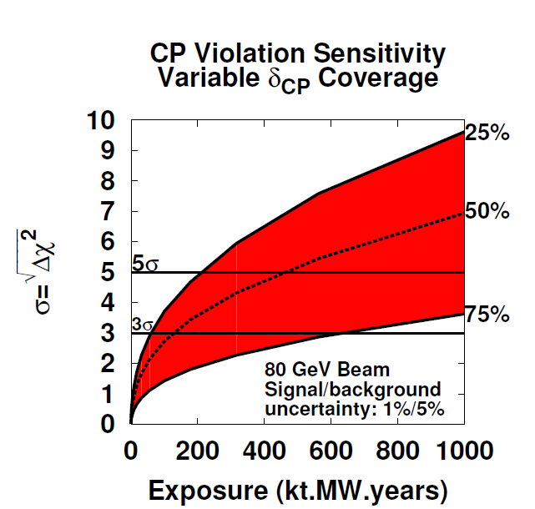
Particle Physics Opportunities
The physics opportunities enabled by high power facilities are largely associated with secondary & tertiary beams
Neutrinos
Mass Hierarchy
CP violation
Muons
Charged lepton flavor violation
BSM anomalies (e.g. g-2)
Kaons
Rare decays
Neutrons
$n↔\overline{n}$ oscillations
Electric dipole moments

Slide 5
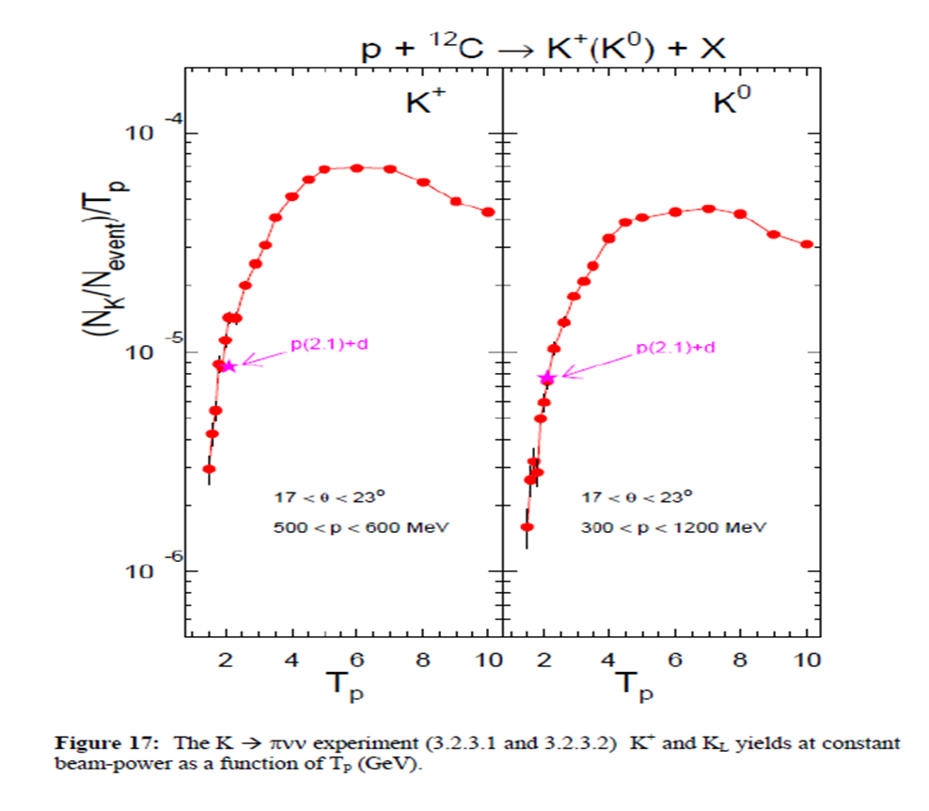
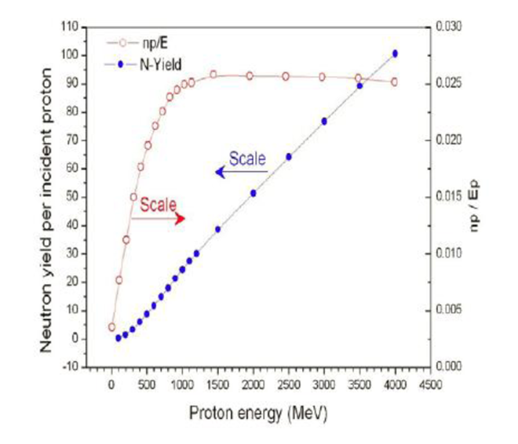
Performance Requirements
The primary performance metric is
Beam power (Energy × particles/time)
Flux of secondary particles is roughly proportional to beam power (once above production threshold)

Slide 6
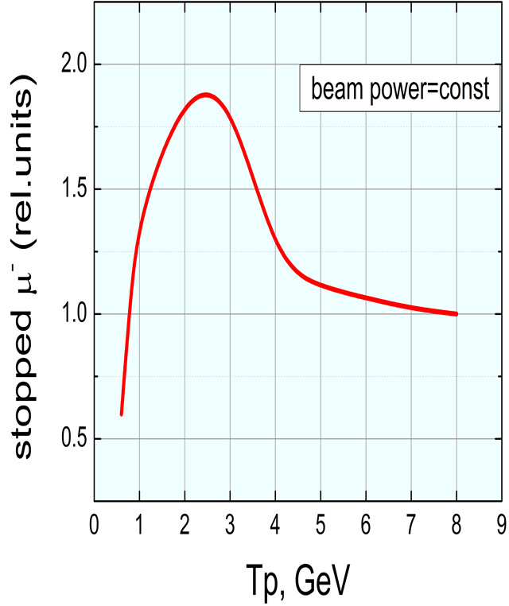
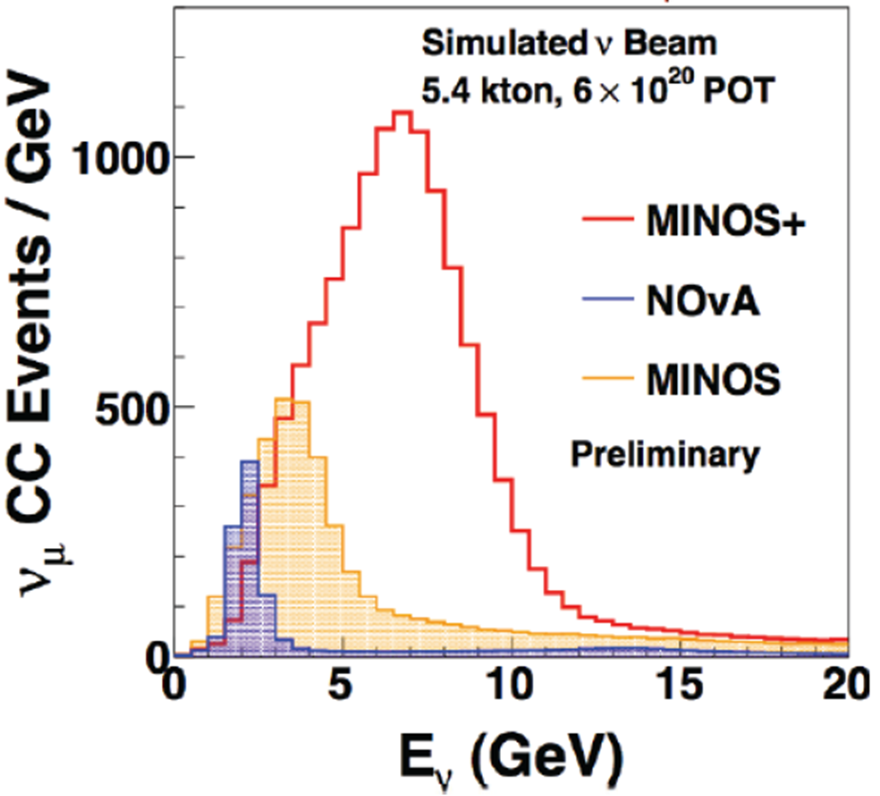
Performance Requirements (Additional considerations)
Beam Energy
May be customized to specific application
Stopped Muons Long Baseline Neutrinos
Duty Factor
Ranges from ~10⁻⁴ (neutrinos) to 1 (muons, kaons)

Slide 7
Design Strategies
Every proton complex that features a circular accelerator is ultimately limited by space-charge forces at injection into the first ring. Space-charge tune shift, typically < 0.3:
$$Δν_{sc}∝\frac{N_{p}}{ε_{N}βγ^{2}}$$
There are three approaches to mitigating this limitation:
Raise the injection energy of the lowest energy ring (βγ²)
Increase the aperture of the lowest energy ring (ε_{N}/βγ)
Eliminate rings, i.e. build a full energy linac
All three strategies are used in existing and future facilities

Slide 8
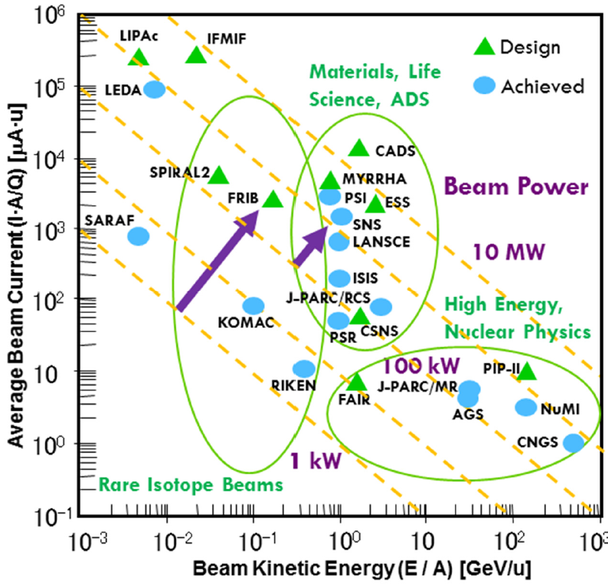
The Facilities Landscape
Two facilities currently operating at >1 MW
PSI (600 MeV cyclotron)
SNS (1 GeV sc linac)
Note: Majority of facilities support research in areas outside of particle physics
Courtesy Jie Wei

Slide 9
Future Facilities for Particle Physics
Future facilities concepts all provide beam power >1 MW
Primarily in support of neutrino experiments
But also capabilities for muons, kaons, neutrons
Most feature modern, superconducting, linacs
Either as injector into existing synchrotrons,; or as
Stand-alone facilities
Most provide opportunities for subsequent enhancements
The primary technical challenges in these facilities are
High performance superconducting rf
(G, Q₀)>(15 MeV/m, few x 10¹⁰)
Loss minimization/mitigation
High performance sources
High power targets

Slide 10
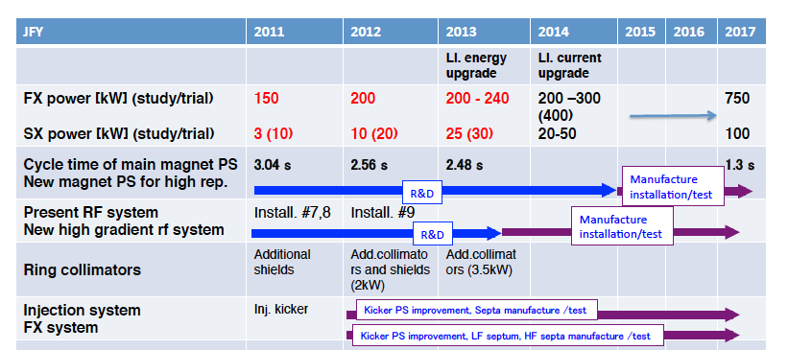
J-PARC: Short –Term Goals
Short-term goal of 0.75 MW at 30 GeV to neutrino program
Increase Main Ring repetition rate (from 0.4 Hz to 0.8 Hz)
Also (but not simultaneous): 0.1 MW slow extraction
courtesy Tadashi Koseki
Notes:
Koseki should review this slide and update as needed
The beam power in red color means "achieved".

Slide 11
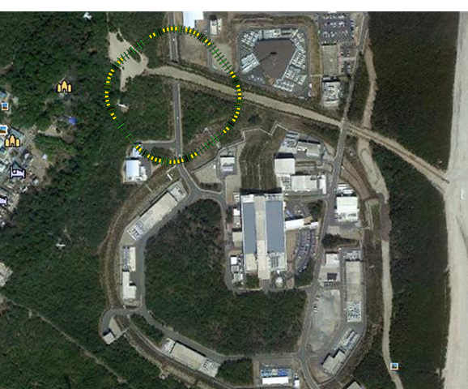
J-PARC High Power Options
All options assume 1 MW operations of existing RCS, and MR operations at 30 GeV
MR larger aperture
123π (H) x 108π (V) mm-mrad
1.3 MW for 1.2 s cycle
RCS energy upgrade: 3.6 GeV
1.2 MW for 1.2 s cycle
New (8 GeV) Booster Ring
MR = 1.6 MW @ 1 s cycle, h=9
MR = 2.8 MW @ 1.16 s cycle, h=18
MR = 3.4 MW @ 1.28 s cycle, h=24
Requires kicker rise time <139 ns
Notes:
Koseki should review this slide and update as needed
In the second option (RCS energy upgrade), the RCS energy should increase to 3.6 GeV (not 3.4 GeV) to keep more margin of beam loss power.

Slide 12
Fermilab 400-kW (now) to 700-kW (2016) complex
Proton Improvement Plan (PIP): increase Booster proton flux,
enable 700-kW beam power
120 GeV synchrotron
Main Injector
8 GeV
Recycler
0.7 MW
target
400 MeV
NC Linac
8 GeV RCS
Booster

Slide 13
Proton Improvement Plan-II (PIP-II, Fermilab)
Goal: Provide >1 MW at the time of LBNF startup (~2023)
800 MeV superconducting pulsed linac + enhancements to existing complex; extendible to support >2 MW operations and upgradable to continuous wave (CW) operations
Builds on significant existing infrastructure
Capitalizes on major investment in superconducting rf technologies
Eliminates significant operational risks inherent in existing linac
Siting consistent with eventual replacement of the Booster as the source of protons for injection into Main Injector
Whitepaper available at
projectx-docdb.fnal.gov/cgi-bin/ShowDocument?docid=1232

Slide 14
PIP-II schematic
120 GeV
Main Injector
8 GeV
Recycler
1.2 MW
target
New 800 MeV
SRF Linac
Existing 8 GeV
Booster

Slide 15
PIP-II Performance Goals
Performance Parameter | PIP-II
Linac Beam Energy | 800 | MeV
Linac Beam Current | 2 | mA
Linac Beam Pulse Length | 0.5 | msec
Linac Pulse Repetition Rate | 20 | Hz
Linac Beam Power to Booster | 13 | kW
Linac Beam Power Capability (@>10% Duty Factor) | ~200 | kW
Mu2e Upgrade Potential (800 MeV) | >100 | kW
Booster Protons per Pulse | 6.4×10¹²
Booster Pulse Repetition Rate | 20 | Hz
Booster Beam Power @ 8 GeV | 120 | kW
Beam Power to 8 GeV Program (max) | 80 | kW
Main Injector Protons per Pulse | 7.5×10¹³
Main Injector Cycle Time @ 120 GeV | 1.2 | sec
LBNF Beam Power @ 120 GeV* | 1.2 | MW
LBNF Upgrade Potential @ 60-120 GeV | >2 | MW
*LBNF beam power can be maintained to ~60 GeV, then scales with energy

Slide 16
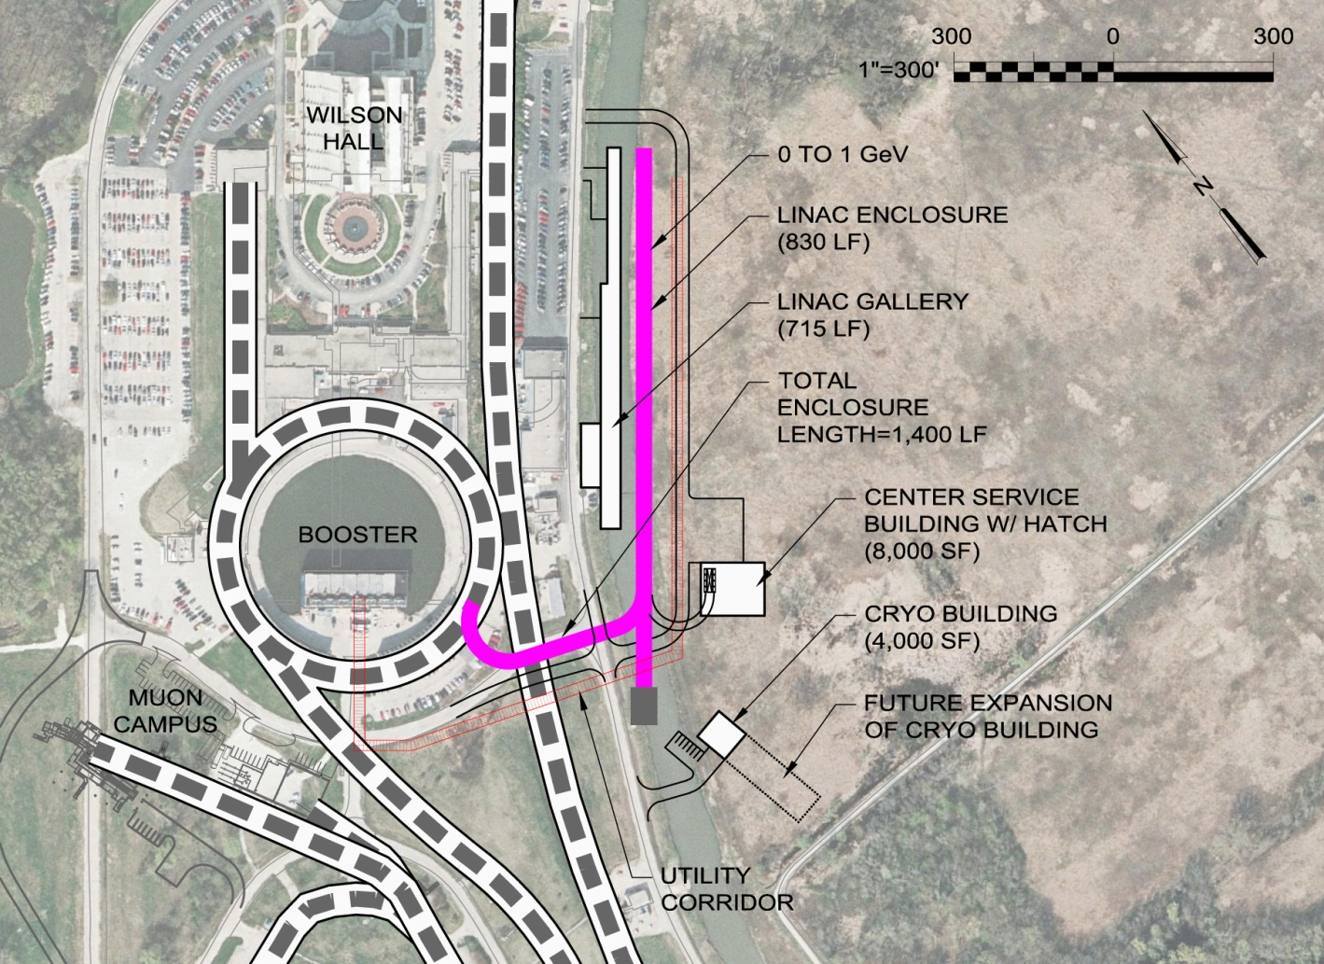
PIP-II Status
Development phase
R&D program supports 2018-2019 construction start
Collaboration with India
Strong support from P5, U.S. DoE, and the Fermilab Director
Five year construction period would support operations startup in 2023

Slide 17
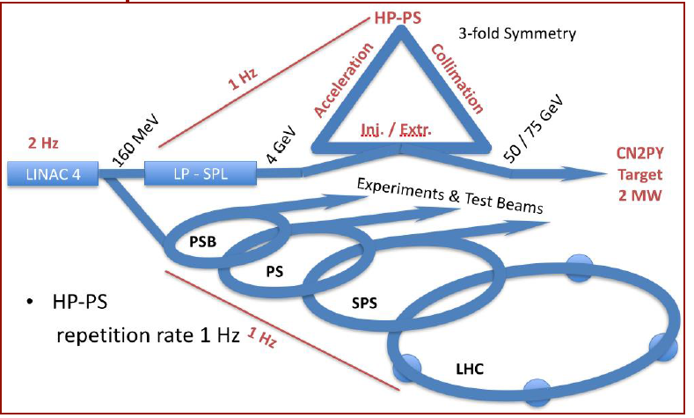
CERN Long Baseline Neutrino Facility (CN2PY)
Phase 1 – coincident with LHC operations
400 GeV proton beam from SPS @ 1/6 Hz
10 μsec beam pulse
750 kW
Phase 2 – independent of LHC operations
50-75 GeV proton beam
from new high power
proton synchrotron @ 1 Hz
Injection from new 4 GeV
superconducting proton linac
4 μsec beam pulse
2 MW
Notes:
Slide should be reviewed and updated as necessary by M. Nessi

Slide 18
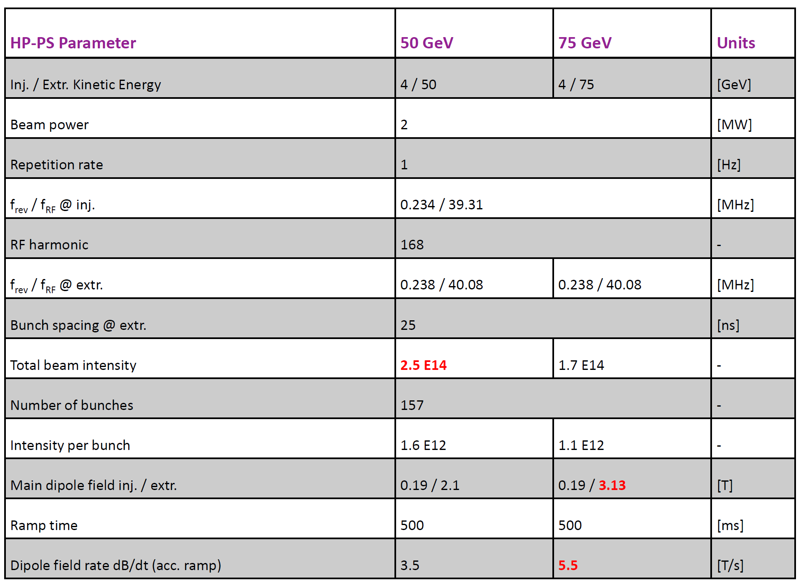
CERN HP-PS Parameters
Notes:
Slide should be reviewed and updated as necessary by M. Nessi

Slide 19
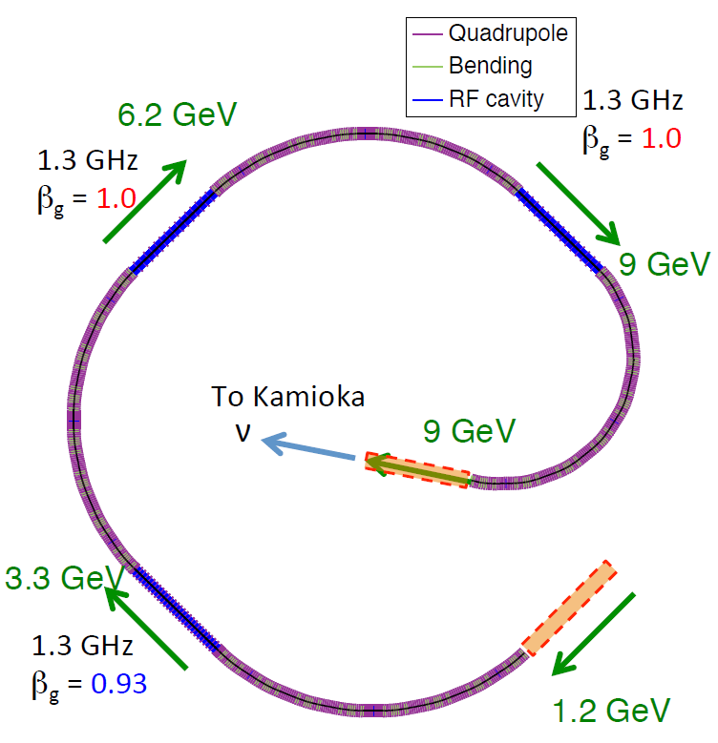
KEK 9-GeV Linac – initial concept
Off axis beam to Super Kamiokande
Alternative to 8 GeV Booster at J-PARC
9 GeV superconducting linac in KEK-B tunnel
800 m of acceleration (straight sections)
2200 m of arcs
ILC accelerating cavities (1.3 GHz) at 30 MV/m
100 mA peak current @ 1% duty factor
9 MW beam power
courtesy Tadashi Koseki
Notes:
Slide should be reviewed and updated as required by T. Maruta

Slide 20
Other Concepts
Particle physics at neutron sources
Concepts for neutrino or cold neutron sources at SNS, ESS, CSNS
Requires either sharing of beam time or repetition rate upgrades
Cyclotrons
PSI: Operational at 600 MeV/1.3 MW
H₂⁺ Cyclotron: multi-MW concepts (Daedulus)
Space-charge × 1/2
Stripping at extraction

Slide 21
R&D toward multi-MW beams and targets at Fermilab
Beyond PIP-II (mid-term)
Strategy after PIP-II depends on the technical feasibility of each option and the analysis of costs/kiloton versus costs/MW
R&D on cost-effective SRF, control of beam losses in proton machines with significantly higher currents (Q_{SC}) and on multi-MW targets
PIP-II

Slide 22
PIP-III “multi-MW” - Option A
120 GeV
Main Injector
8 GeV
Recycler
>2-MW
target
8 GeV SRF Linac
=0.8→3→8

Slide 23
PIP-III “multi-MW” - Option B
120 GeV
Main Injector
8 GeV
Recycler
>2 MW
target
New 8 GeV RCS
(or “greatly upgraded” Booster?)
~2=0.8+1.2 GeV
SRF Linac

Slide 24
PIP-III “multi-MW” - Option C
120 GeV
Main Injector
8 GeV
Recycler ?
>2 MW
target
new 8-12 GeV “smart” RCS
i-Booster
800 MeV
SRF Linac

Slide 25
PIP-III: Intelligent choice requires analysis and R&D
Either increase the performance of synchrotrons by a factor of 3-4:
E.g. space-charge tune shift >1 → need R&D
Space-charge compensation → need R&D
Instabilities/losses/RF/vacuum/collimation
Or reduce the cost of SRF / GeV by a factor of 3-4:
Several opportunities → need R&D
And – in any scenario – develop multi-MW targets:
They do not exist now → extensive R&D needed

Slide 26
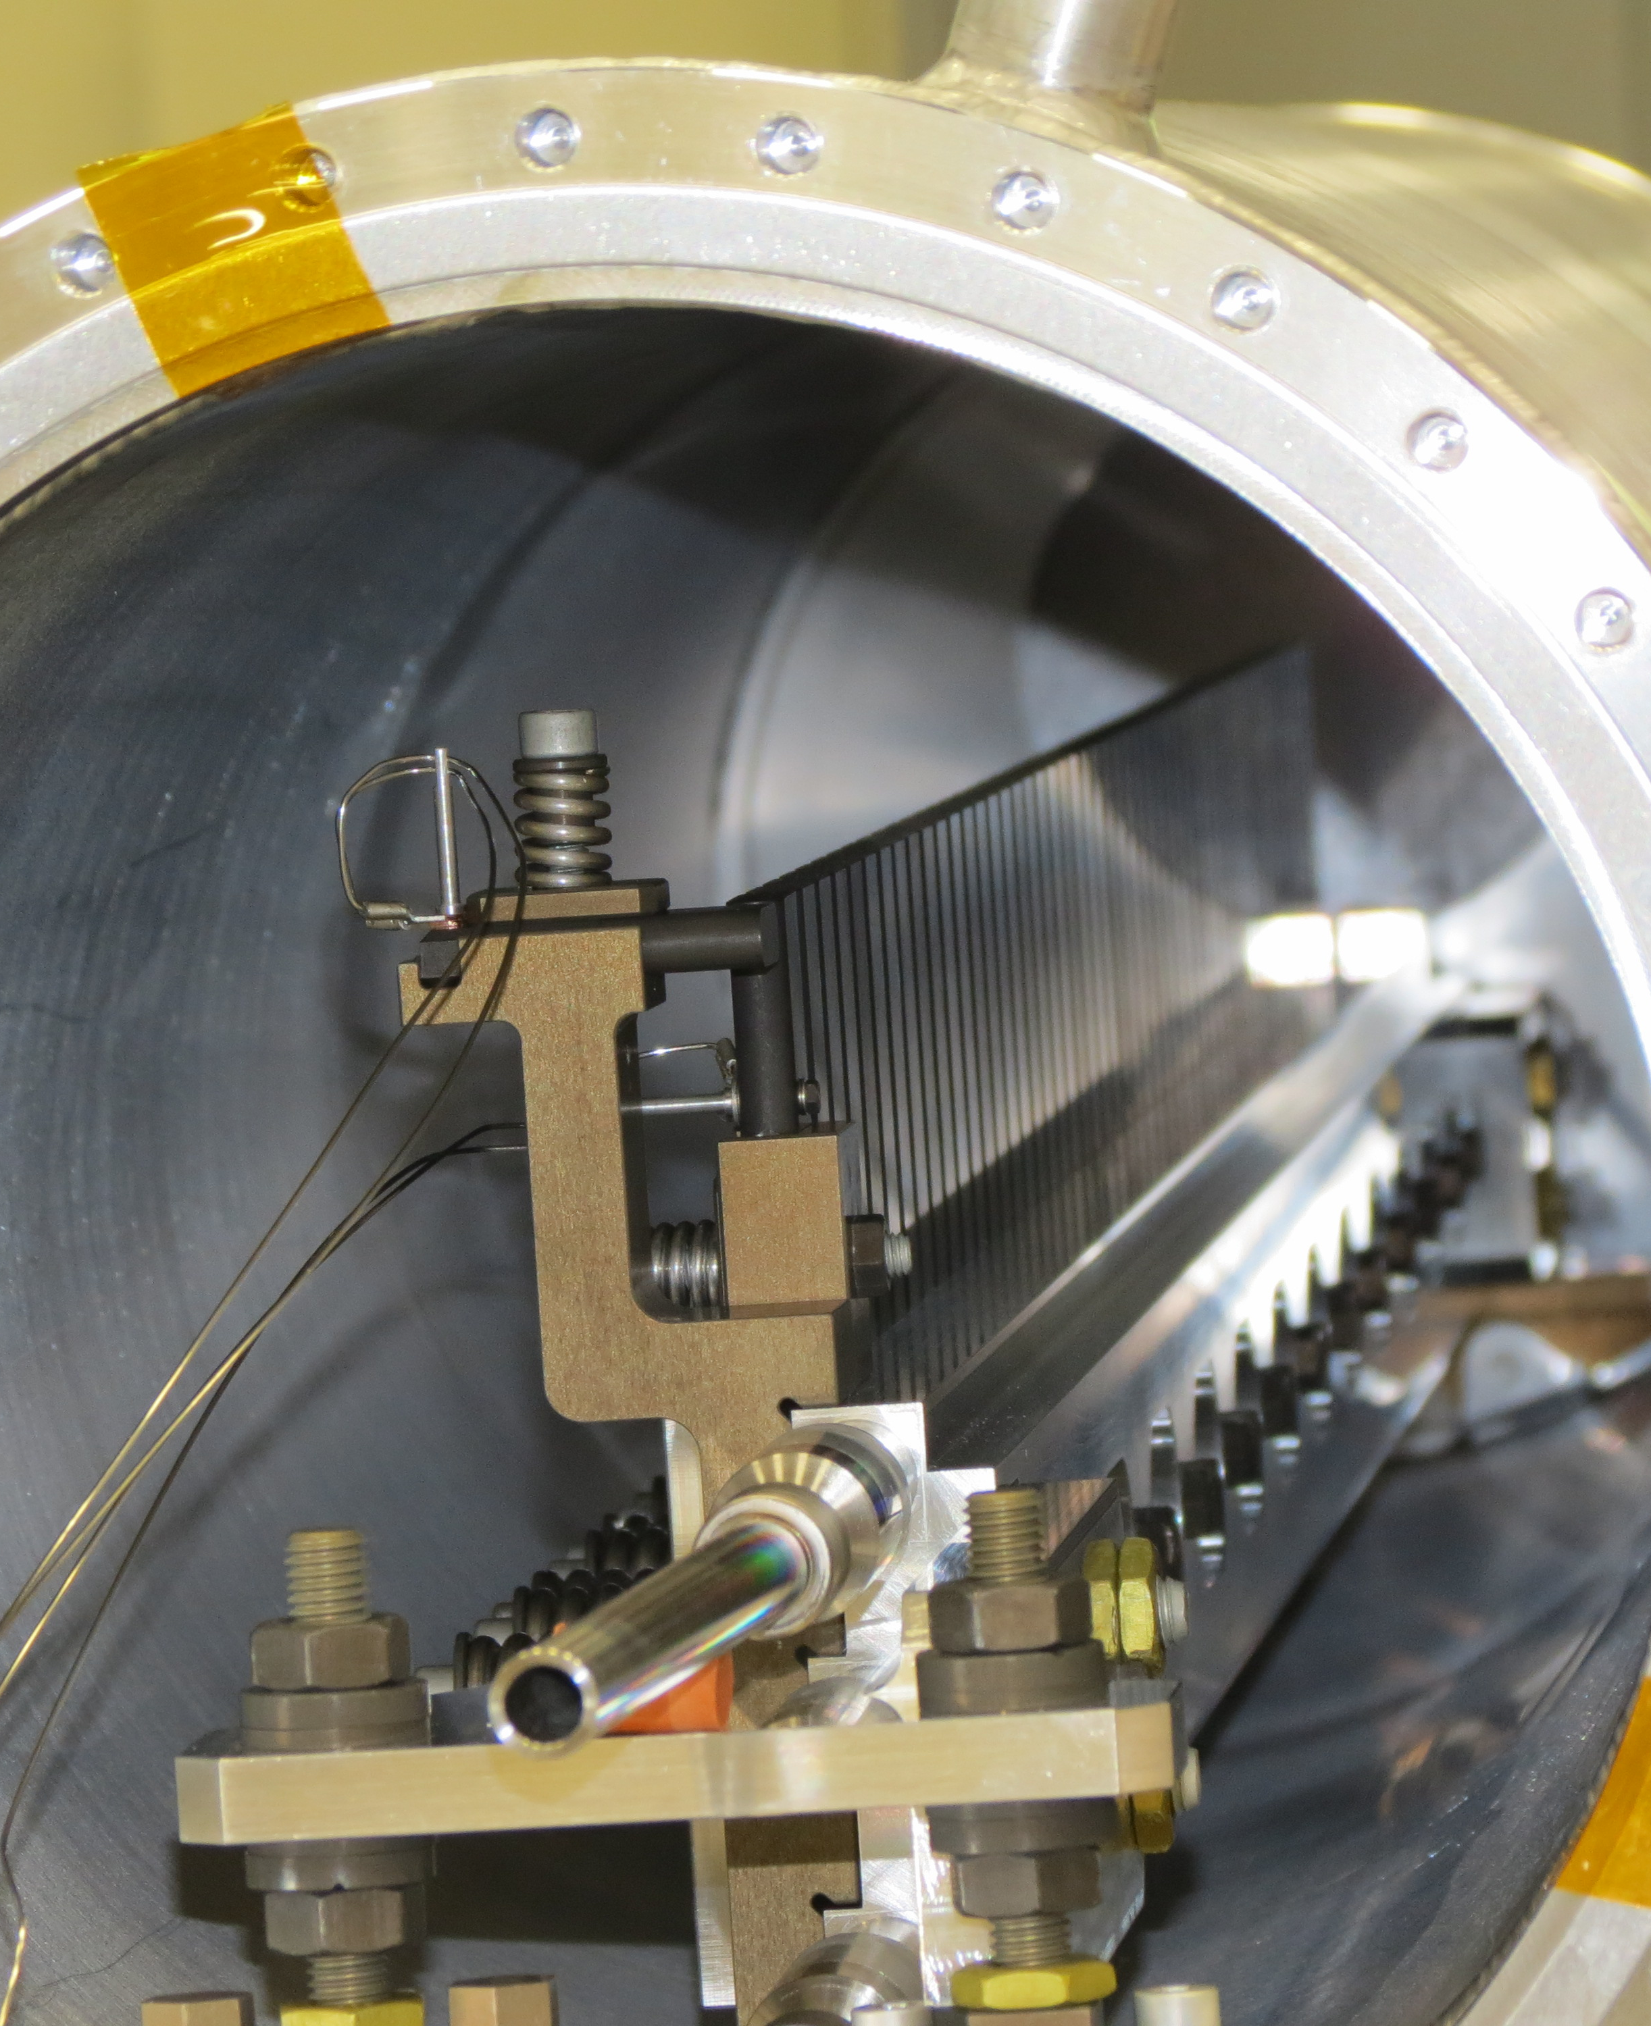
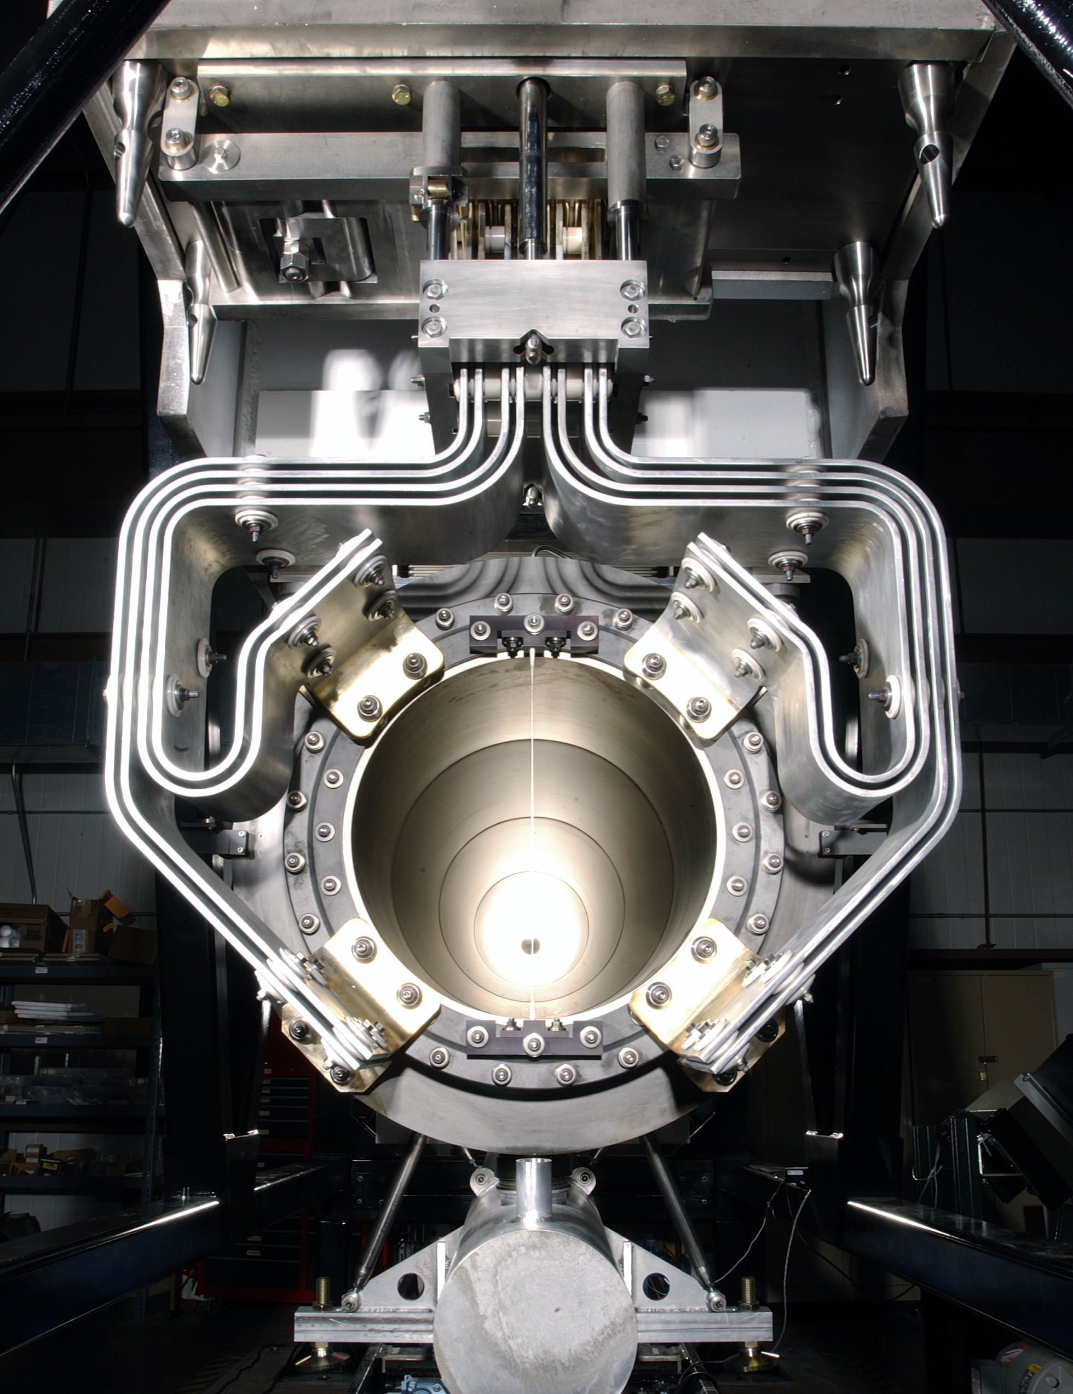
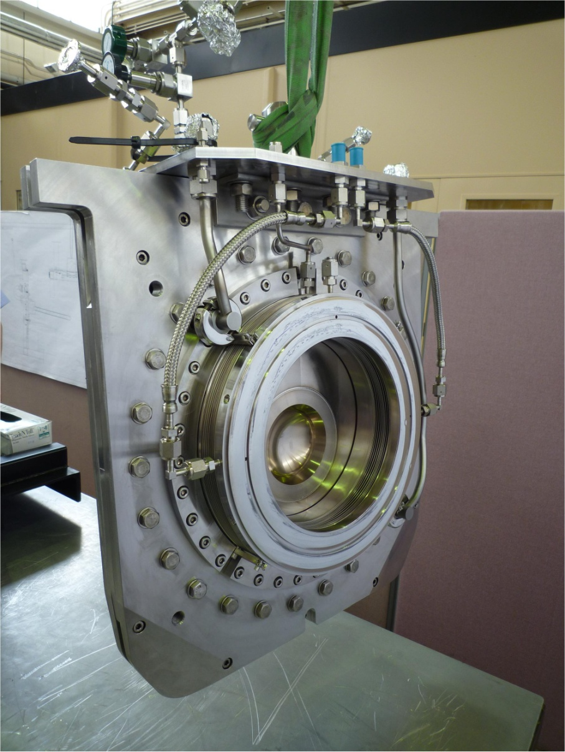
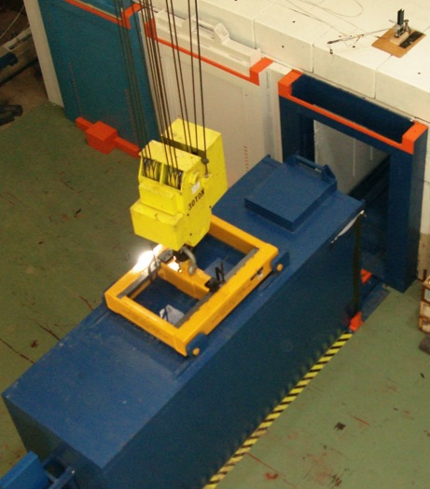
Target R&D
R&D Needed to Support:
Target
Solid, Liquid, Rotating, Rastered
Other production devices:
Collection optics (horns, solenoids)
Monitors & Instrumentation
Beam windows
Absorbers
Facility Requirements:
Remote Handling
Shielding & Radiation Transport
Air Handling
Cooling Systems

Slide 27
Superconducting RF R&D
Focusing on cost reduction
Switch from the “high-gradient” focus of the past ~20 years
Cryogenic costs (capital and operational)
Increase Q => decrease dissipated power in the walls
New materials on the horizon for 4.2K operation
Nb3Sn looks promising
Cavity material and manufacturing costs
Nb/Cu clad or films cavities to save on Nb costs
Cheaper/faster manufacturing techniques
Spinning, hydroforming

Slide 28
Summary
Particle physics research opportunities are driving the design of proton sources with multi-MW capabilities
With duty factors ranging from 10⁻⁴ to 1
Energies from 0.6 to 400 GeV
Most (but not all) concepts incorporate a superconducting linac
Either as the primary particle source or injecting into a synchrotron
As duty factors rise, Q₀ becomes more significant than G
Other technology challenges include:
High power targets
Beam loss reduction and machine protection
High performance proton (and H-) sources
Advanced concepts that can meet these requirements exist and could move into construction in the next few years

Slide 29
Extra slides

Slide 30
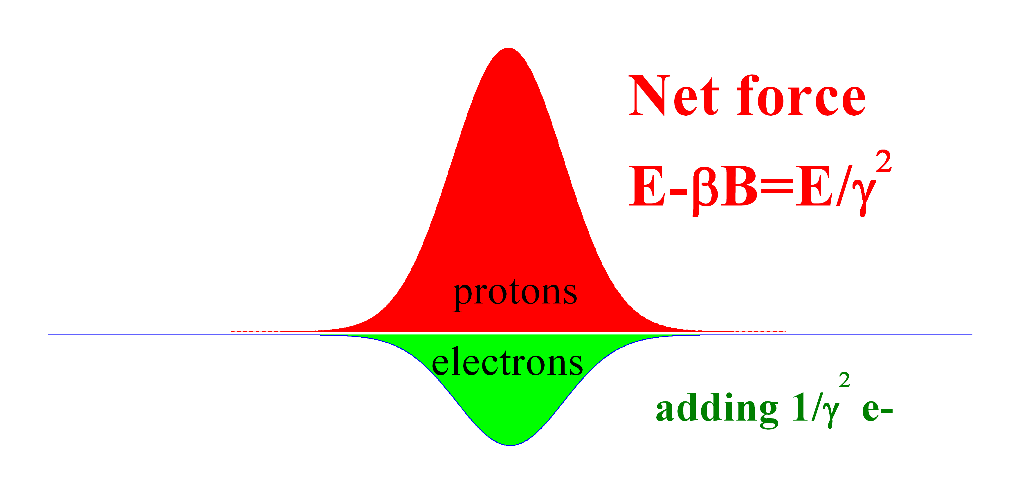
Space Charge Compensation
B=βE
r, across the beam

Slide 31
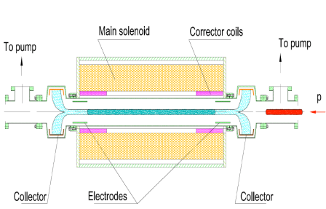
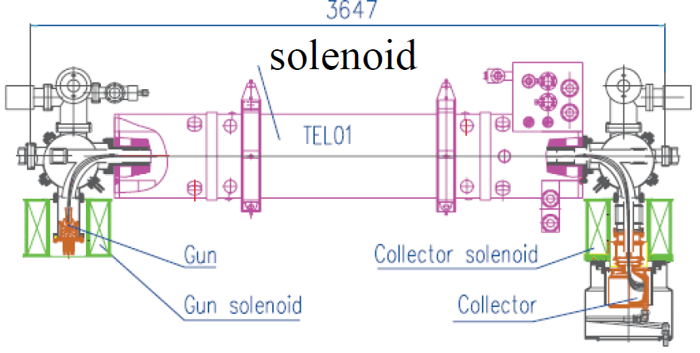
Possible Implementations
E-column concept
E-lens concept
1. The impact of electrons is equal to the total impact of space-charge over the ring
2. The transverse profile of the electron is made the same as that of the proton beam
→ use of solenoid
3. The system of magnetized electrons and protons is now dynamically stable

