Slide 1
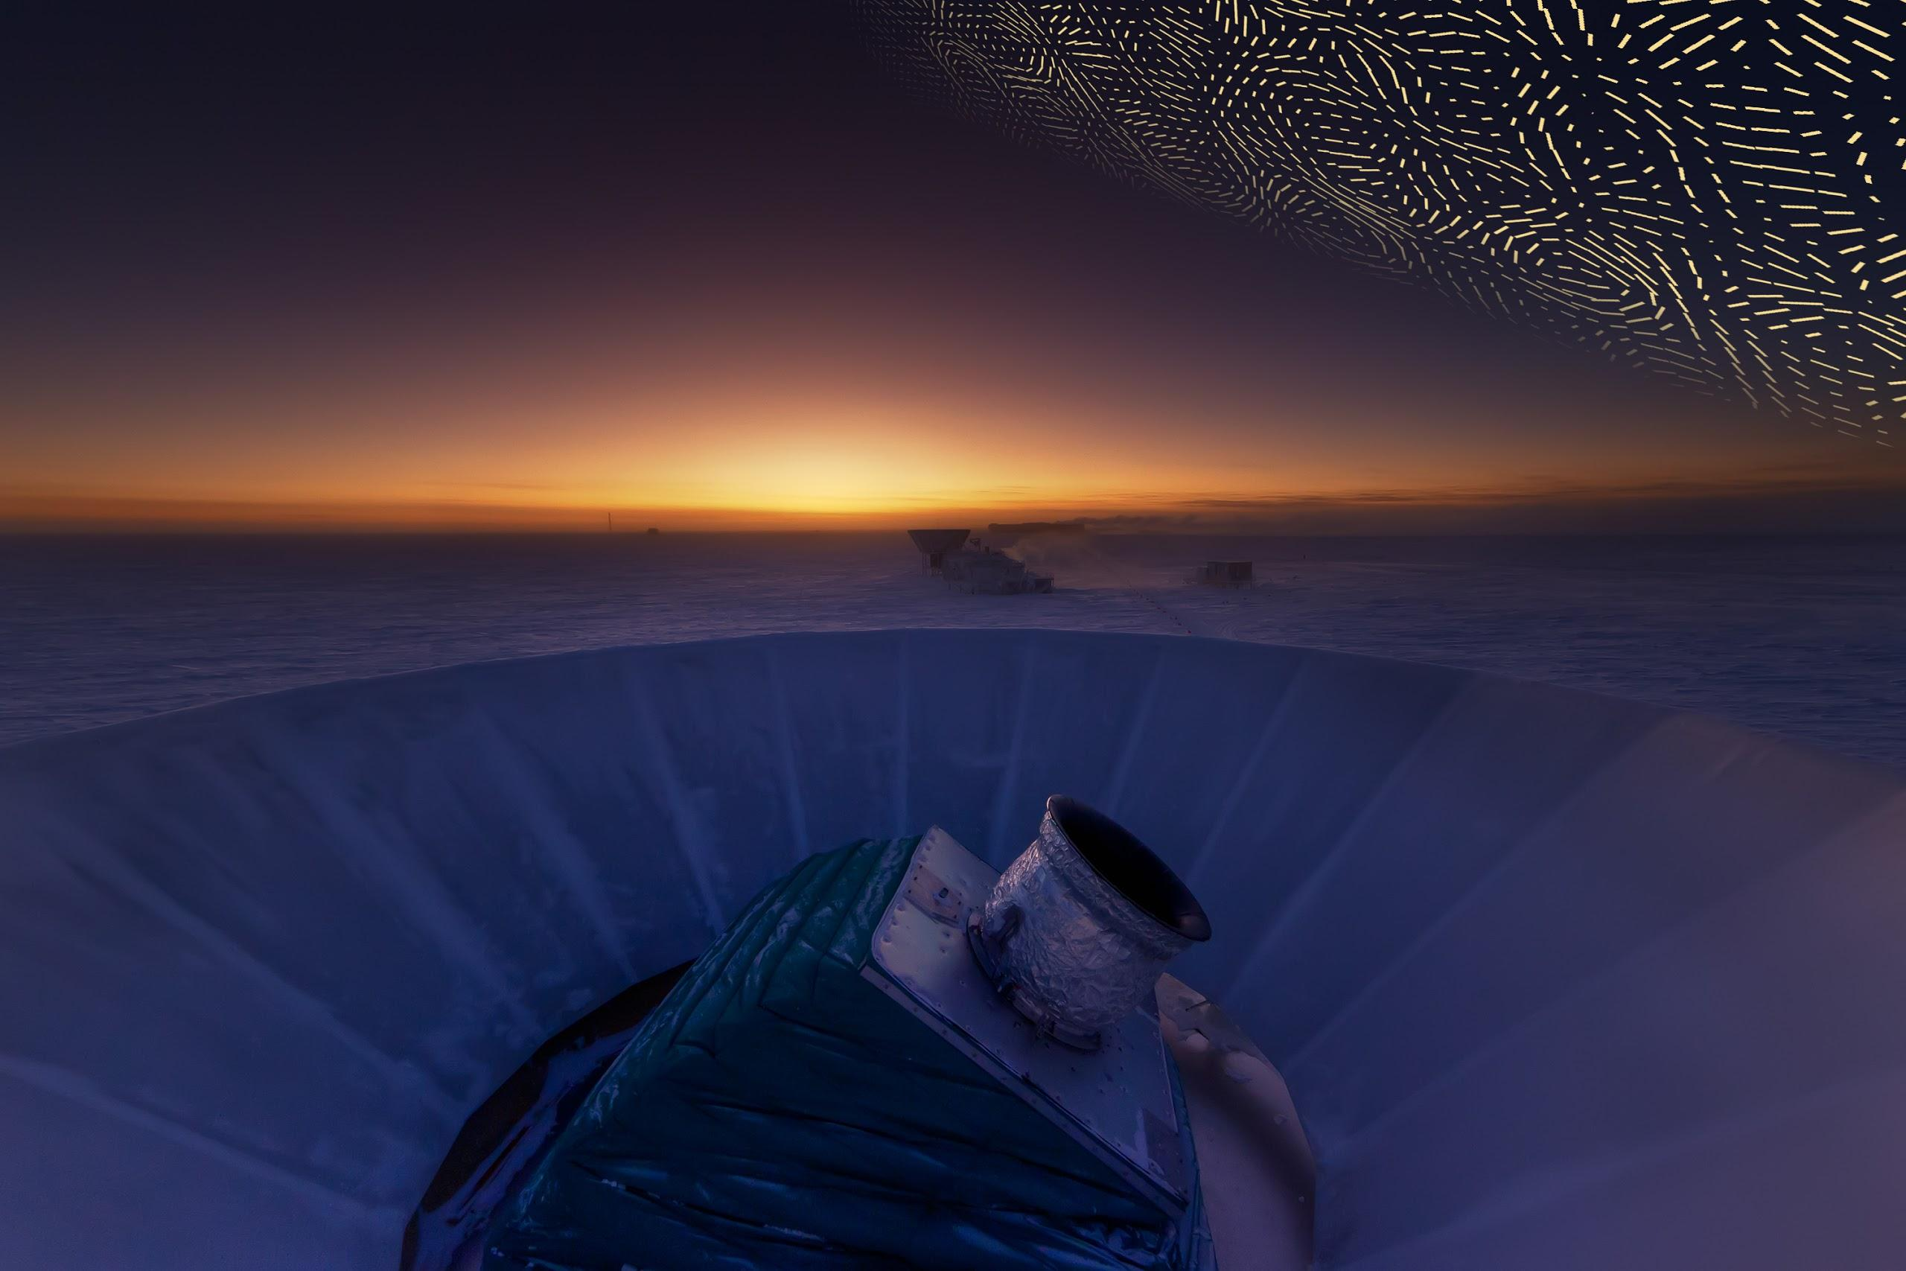
Inflation and CMB
Chao-Lin Kuo
Stanford University
SLAC National Accelerator Lab

Slide 2
Gravitational waves & CMB
Next few slides are placeholders for Chao Lin’s slides on
“ what is inflation, why do we believe it, GWs as smoking gun,
how GW's make the B-mode pattern, it is very faint! (1/20,000,000, i.e.
for every 20,000,000 photons oriented like his, on average you may get
20,000,001 oriented the other.) “

Slide 3
Gravitational waves & CMB
Next few slides are placeholders for Chao Lin’s slides on
“ what is inflation, why do we believe it, GWs as smoking gun,
how GW's make the B-mode pattern, it is very faint! (1/20,000,000, i.e.
for every 20,000,000 photons oriented like his, on average you may get
20,000,001 oriented the other.) “

Slide 4
Gravitational waves & CMB
Next few slides are placeholders for Chao Lin’s slides on
“ what is inflation, why do we believe it, GWs as smoking gun,
how GW's make the B-mode pattern, it is very faint! (1/20,000,000, i.e.
for every 20,000,000 photons oriented like his, on average you may get
20,000,001 oriented the other.) “

Slide 5
Gravitational waves & CMB
Next few slides are placeholders for Chao Lin’s slides on
“ what is inflation, why do we believe it, GWs as smoking gun,
how GW's make the B-mode pattern, it is very faint! (1/20,000,000, i.e.
for every 20,000,000 photons oriented like his, on average you may get
20,000,001 oriented the other.) “

Slide 6
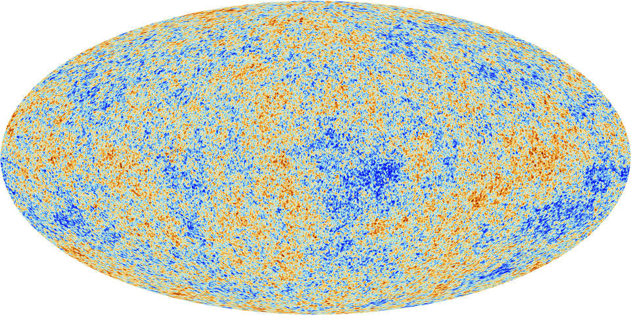
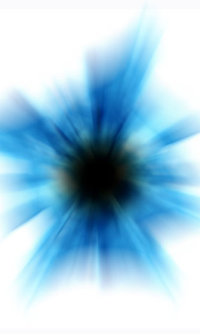
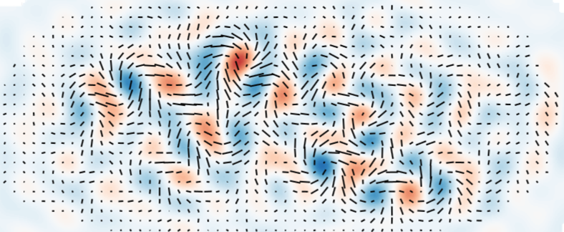
Density perturbations and gravitational waves
Sub-atomic
vacuum fluctuations
of “inflaton”
Density perturbations studied
by Planck, WMAP, SPT, etc.
Inflation
Gravitational waves
Sub-atomic
vacuum fluctuations
of graviton (quanta of gravity)

Slide 7
Generation of scalar/tensor perturbations
Horizon exit
→ two linear wave equations
for scalar /tensor
Time
Mukhanov & Chibisov ‘81
Guth& Pi; Hawking; ‘82; Bardeen et al., ’83, Sasaki ‘83
Grishchuk 74; Starobinsky 79
Rubakov et al, 82; Frabri & Pollock , 82
Quantum fluctuations in the vacuum state of the inflaton/graviton fixes the r.m.s of the linear solutions

Slide 8
Inflationary B-modes, known as the “Holy Grail” of cosmology
Started out as graviton vacuum fluctuations
Energy scale of inflation ~ expansion rate ~ GW amplitude
Alternative models generate no GW
Field range and “UV” completeness

Slide 9
Only gravitational waves can generate B-modes
E
E
Seljak & Zaldarriaga ‘97
Kamionkowski, Kosowsky, Stebbins ‘97
B
B

Slide 10
Polarization pattern caused by Rayleigh scattering is E-mode

Slide 11
This B-mode pattern is
not what you will see
Polarization pattern caused by Rayleigh scattering is E-mode

Slide 12
Density perturb. generate E-mode polarization
Joaquin Carcachi
Steve Burnett
Kyana van Houten

Slide 13
Gravitational waves

Slide 14
How about Gravitational Waves?

Slide 15
Gravitational waves generate E-mode polarization

Slide 16
Gravitational waves generate B-mode polarization
!!!

Slide 17
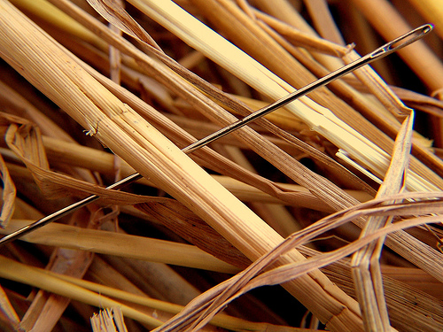
The polarization pattern is unique, but small
Vertical / Horizontal
differ by
1 part in 30,000,000

Slide 18
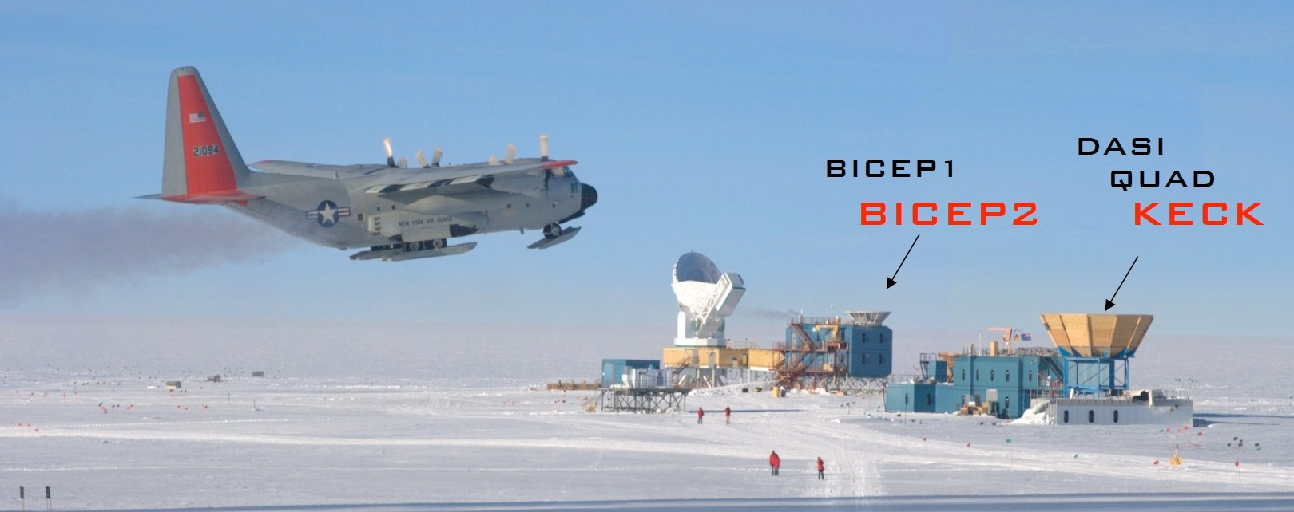
South Pole is the Mecca of CMB research
(BICEP1, BICEP2, Keck Array, BICEP3)
High, dry, cold, low water vapor in the atmosphere
Stable climate for continuous 6 months
Great logistical support (NSF-Office of Polar Program+ Lockheed)
SPT
BICEP3
ACBAR

Slide 19
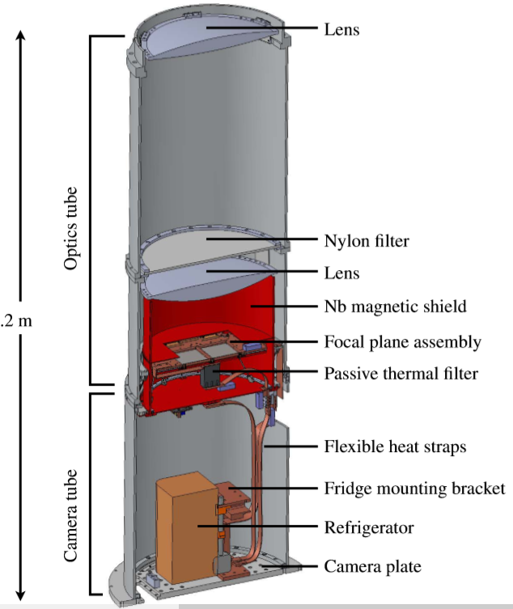
BICEP/Keck series
BICEP1/2/3
Keck Array
microwave (95/150 GHz)
Superconducting sensors
Low temperature physics
(0.25K)
Lithographic detectors
High packing density
Mass production
1

Slide 20
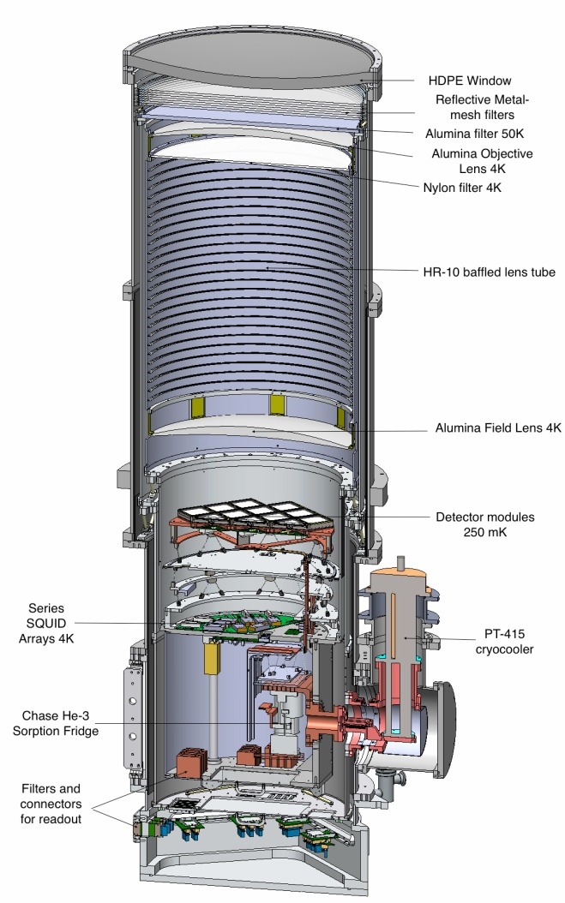
BICEP3
BICEP2/Keck
1

Slide 22
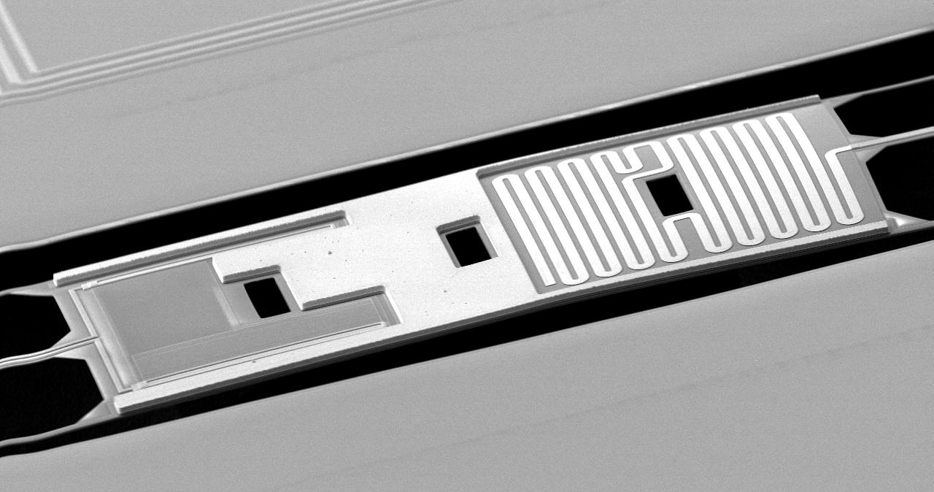
Detecting the CMB radiation
BICEP2 Detector: Transition-Edge Superconductor
CMB light from antenna
Superconducting
thermometer
Radiation
Converted to heat
0.1 mm

Slide 23
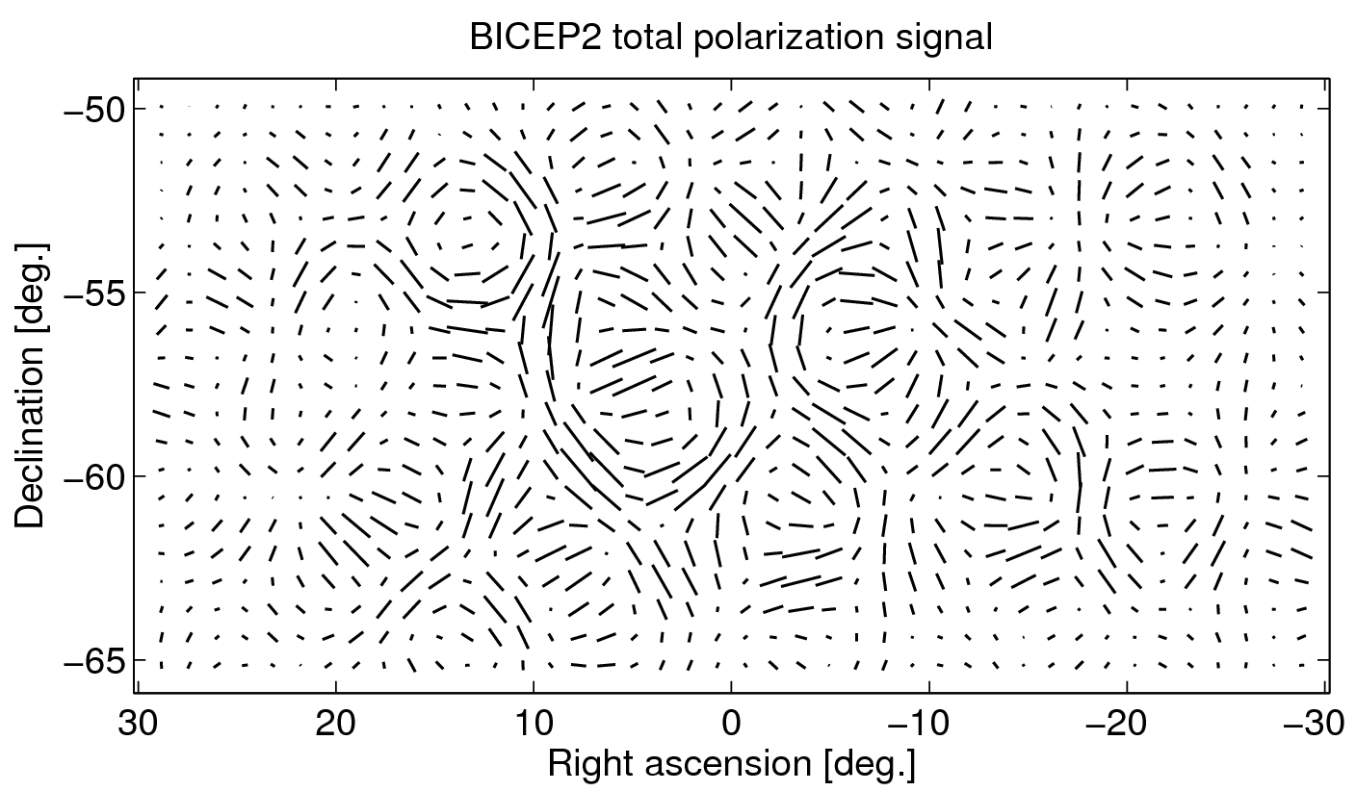
Total polarization
Scale:

Slide 24
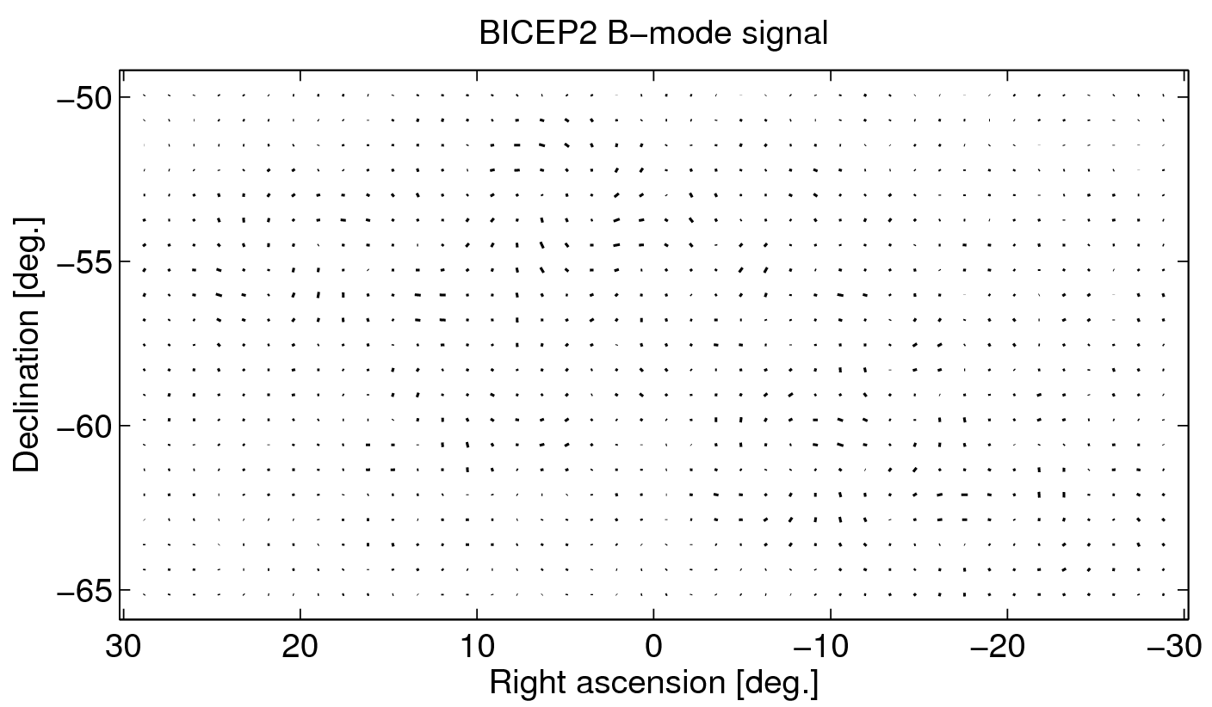
B-mode contribution
Scale:

Slide 25
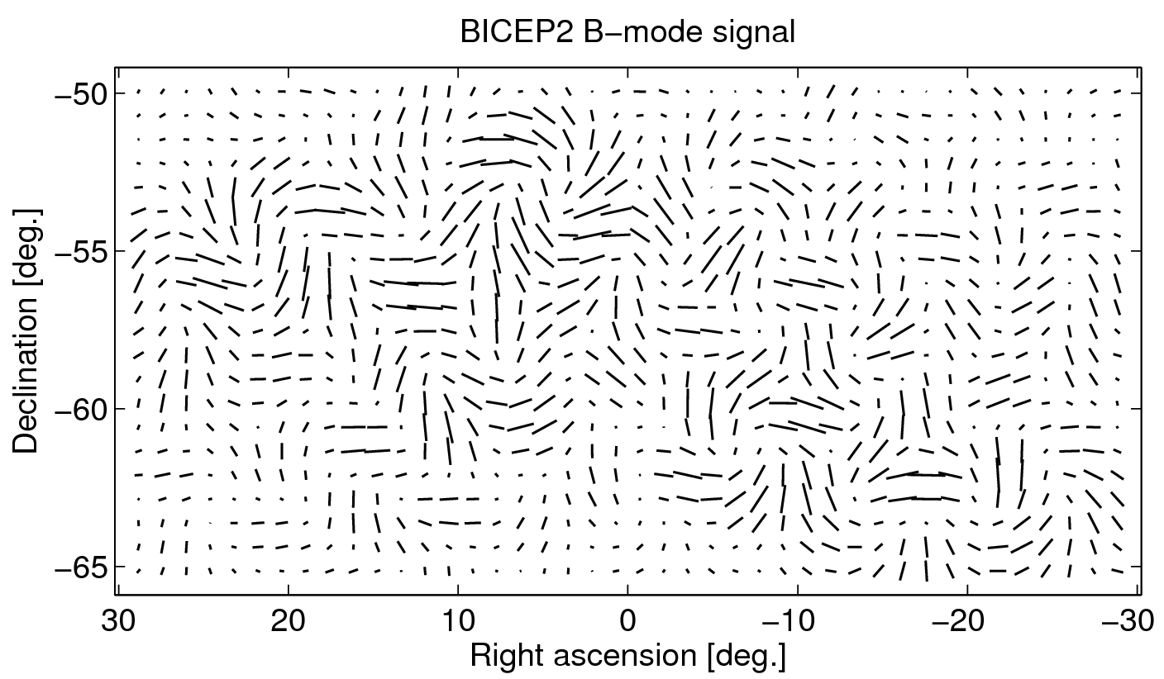
B-mode contribution
Scale:
Notes:
Obviously, the scale more suggests like a contribution of ~1/6

Slide 26
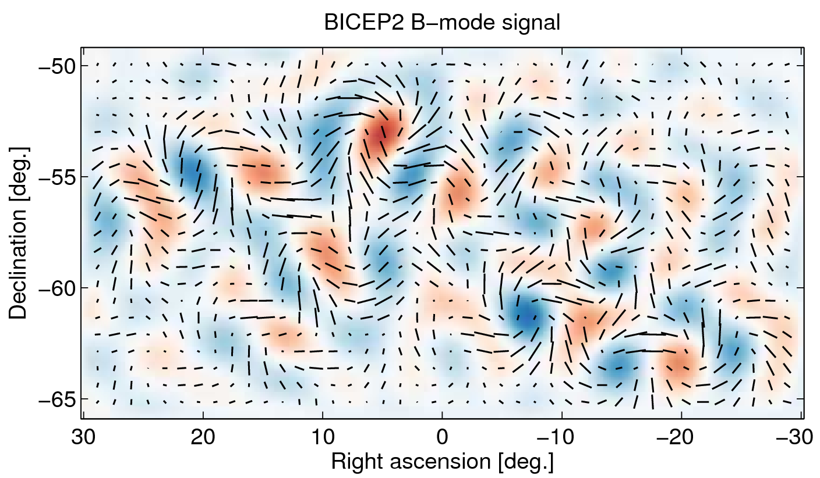
B-mode contribution
Scale:
Notes:
Obviously, the scale more suggests like a contribution of ~1/6

Slide 27
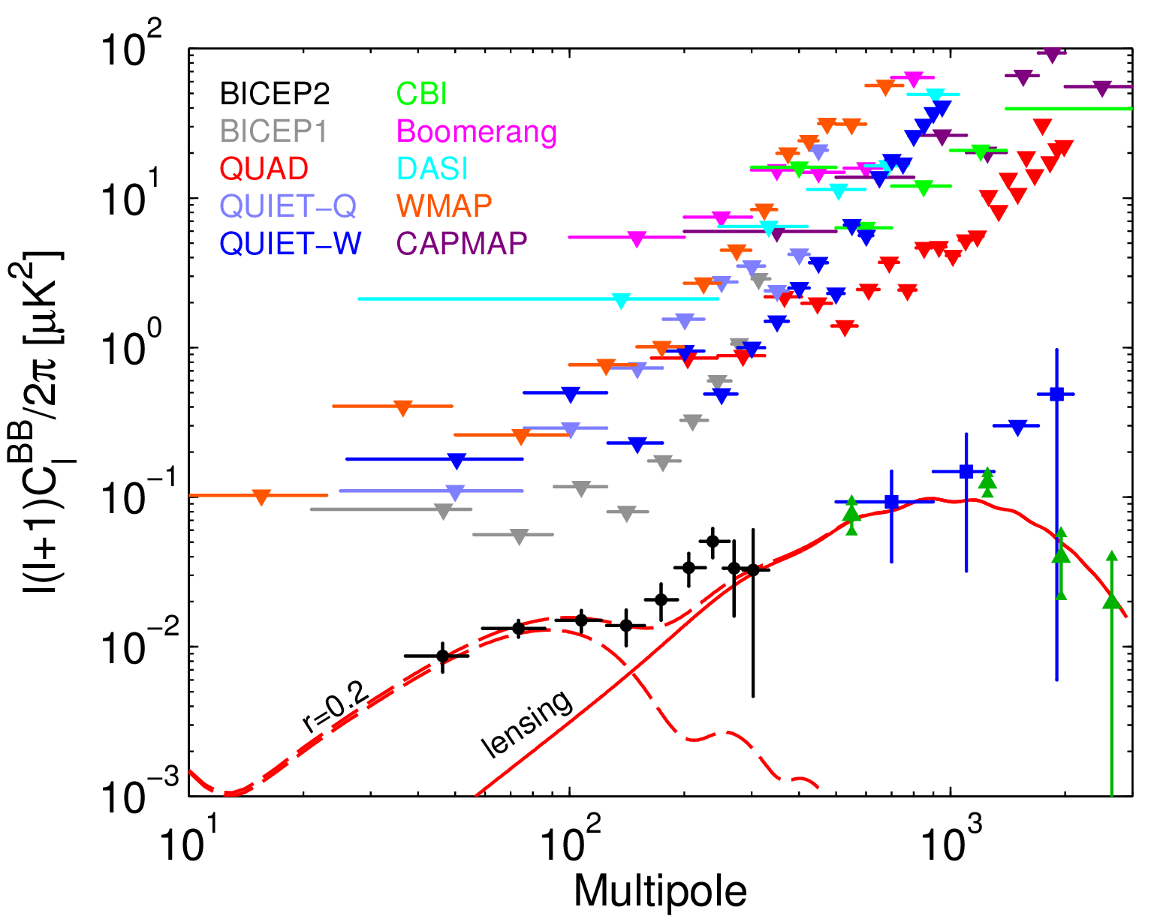
BICEP2 and upper limits from other experiments:
Polarbear
SPT x-corr

Slide 28
BICEP2 and B-modes
BICEP2 sees significant (>5σ) degree-scale B-mode polarization
There is no more question we’ve seen B-modes, but are these from gravitational waves?
Some evidence, such as BICEP2xBICEP1-100, the shape of the power spectrum, and lack of cross correlation with dust model
Since publication, new Planck data has been released that indicates that the scatter in dust polarization across the sky is higher than expected.
The question whether the observed high level of dust does explain all of B2 signal will be answer in cross-correlation analysis (end of November)
BICEP/Keck are in an excellent position to follow this up.
Keck Array is observing at †100GHz with two receivers; BICEP3 will add enormous sensitivity at 100GHz in a few months †much less sensitive to dust than at 150 GHz

Slide 29
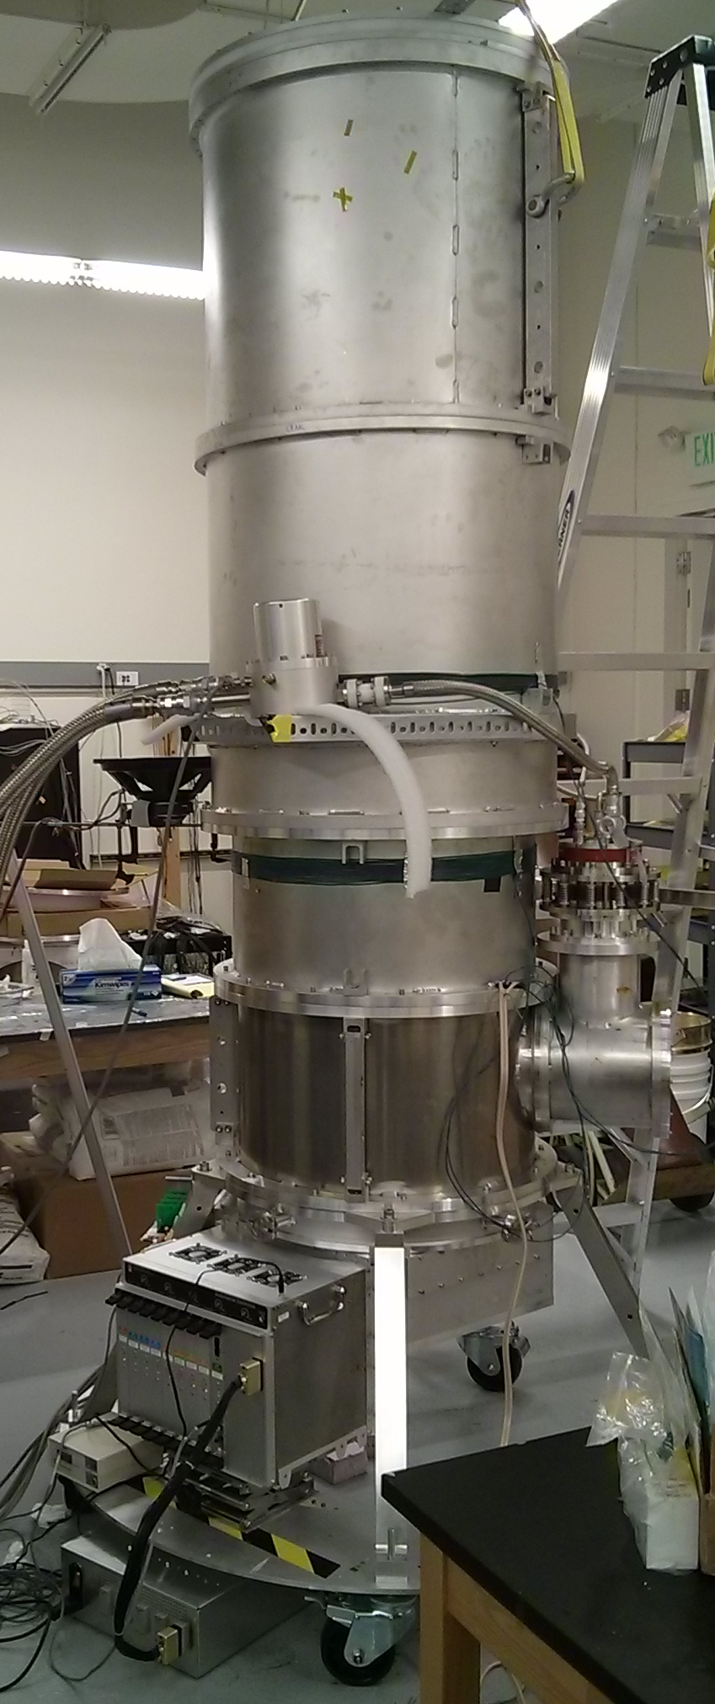
Prospects
BICEP1: 2006, 2007, 2008
BICEP2: 2010, 2011, 2012
Keck Array: 2011, 2012, 2013,
2014 (576 100GHz detectors)…
BICEP3: 2015 –
(another 2560 100GHz detectors)

Slide 30
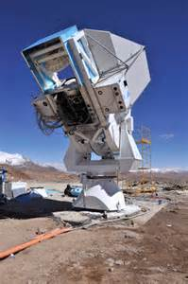
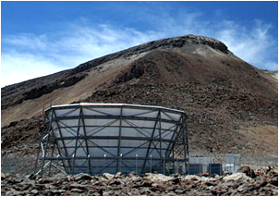
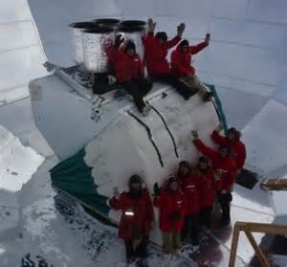
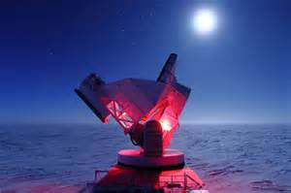
POLARBEAR
Atacama Cosmology Telescope
South Pole Telescope
BICEP/Keck

Slide 31
CMB after
Planck, ACT, SPT, POLARBEAR, BICEP3, ..?

Slide 32
Three fundamental maps of our Universe
Map # 1
(scalar perturbations)
Planck

Slide 33
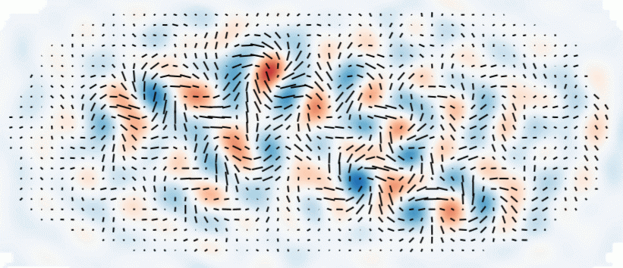
Three fundamental maps of our Universe
Map # 2
(tensor perturbations)
?

Slide 34
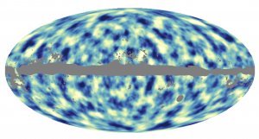
Three fundamental maps of our Universe
Map # 3
(lensing deflection field)
Planck

Slide 35
CMB B-mode polarization
E
B

Slide 36
Snowmass Process (HEP community summer study)
P5 = US Particle Physics Projects Prioritization Panel
May 23, 2014:
“Recommendation 18: Support CMB experiments as part of the core particle physics program. The multidisciplinary nature of the science warrants continued multiagency support.”
Budget for CMB-S4 project is included under all three budget scenarios considered.

Slide 37
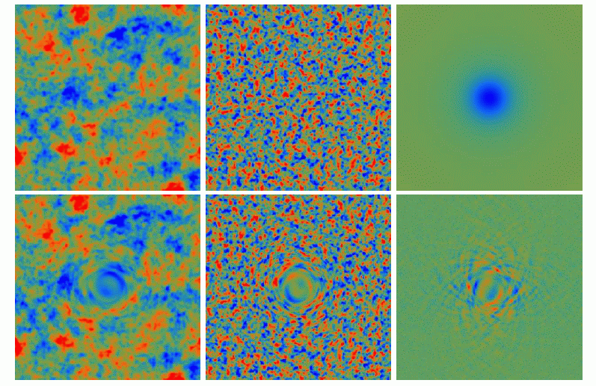
Lensing reconstruction
T
E-polarization
Φ
B-polarization

Slide 38
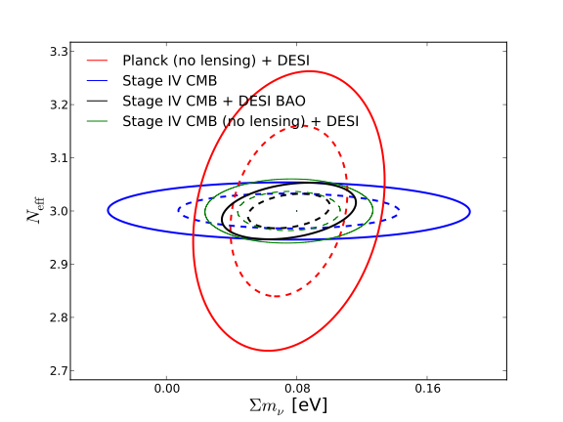
CMB as a probe of neutrinos
Arcminute-measurements of CMB polarization is a probe of cosmic neutrinos
Number of relativistic species N_{eff} (CMB “damping tail” in polarization)
Sum of neutrino masses (∑m_{ν}) suppresses structures (lensing B-modes)

Slide 39
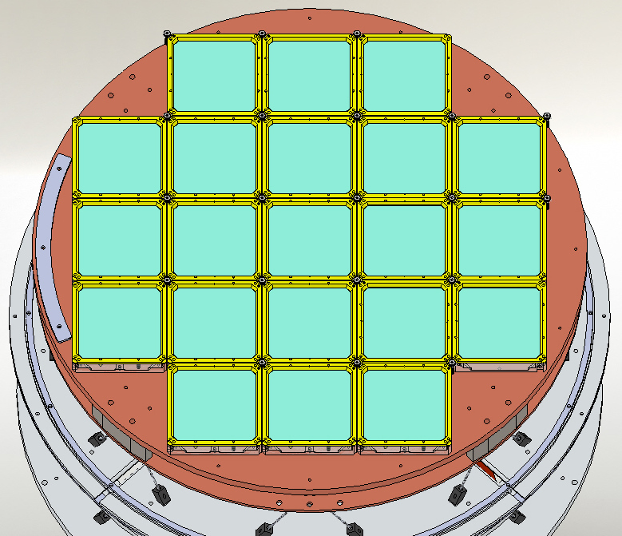
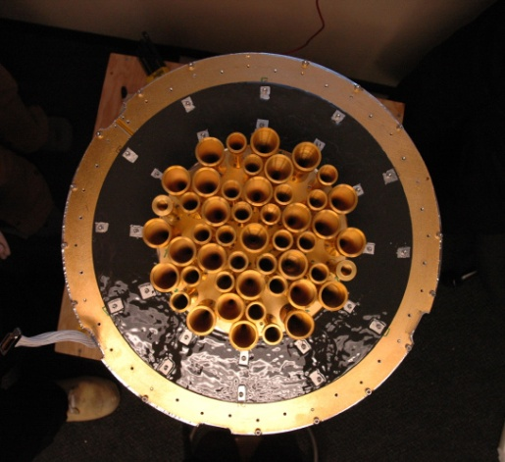
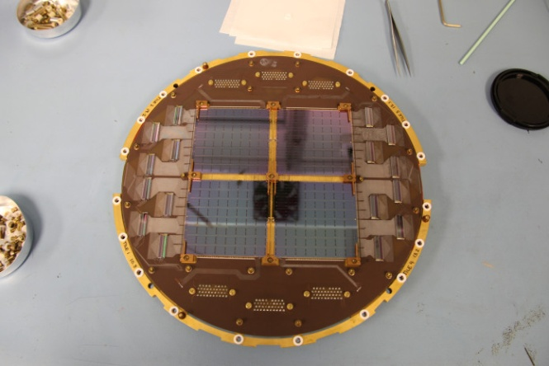
Future of CMB Polarization Experiments
BICEP-3
BICEP-1
BICEP-2
Stage-4
2020+: CMB-S4
200,000+ detectors multiple telescopes
Para. | r ≡ T/S | Neff | ∑m_{ν} (eV)
Now (2013) | <0.70 | 3.3±0.27 | <0.23
CMB-S4† (2020+) | 0.001 | 0.02 | 0.016
†1-σ uncertainty
Background limited detectors: sensitivity ~ detector count

Slide 40
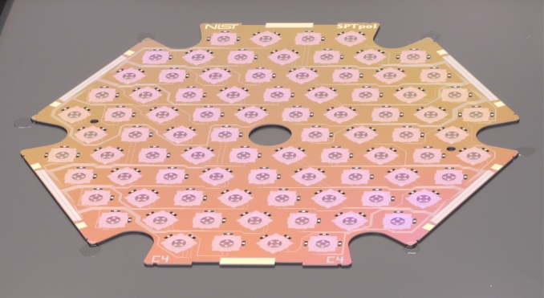
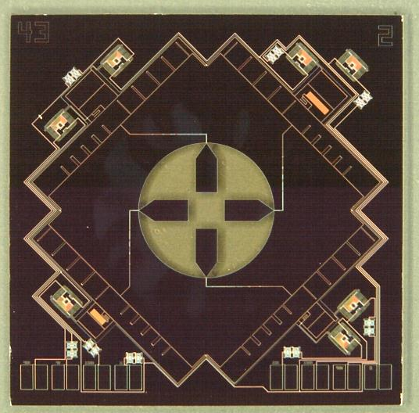
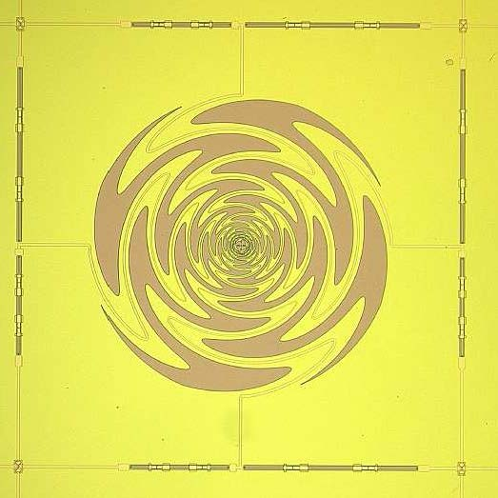
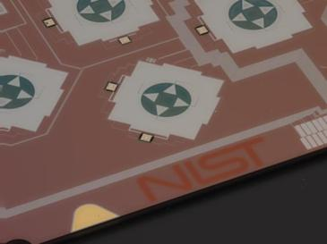
Core Technology: TES Polarimeters
150-GHz feedhorn-coupled TES polarimeters deployed at the South Pole and in the Atacama
Multichroic feedhorn coupled polarimeter
Multichroic lens-coupled polarimeter
The scale and performance of CMB polarimeters must continue to improve to meet the needs of a stage 4 experiment.
New direction: larger arrays of multi-frequency (multi-chroic) CMB polarimeters
New direction: increased integration of sensor and multiplexer components.

Slide 41
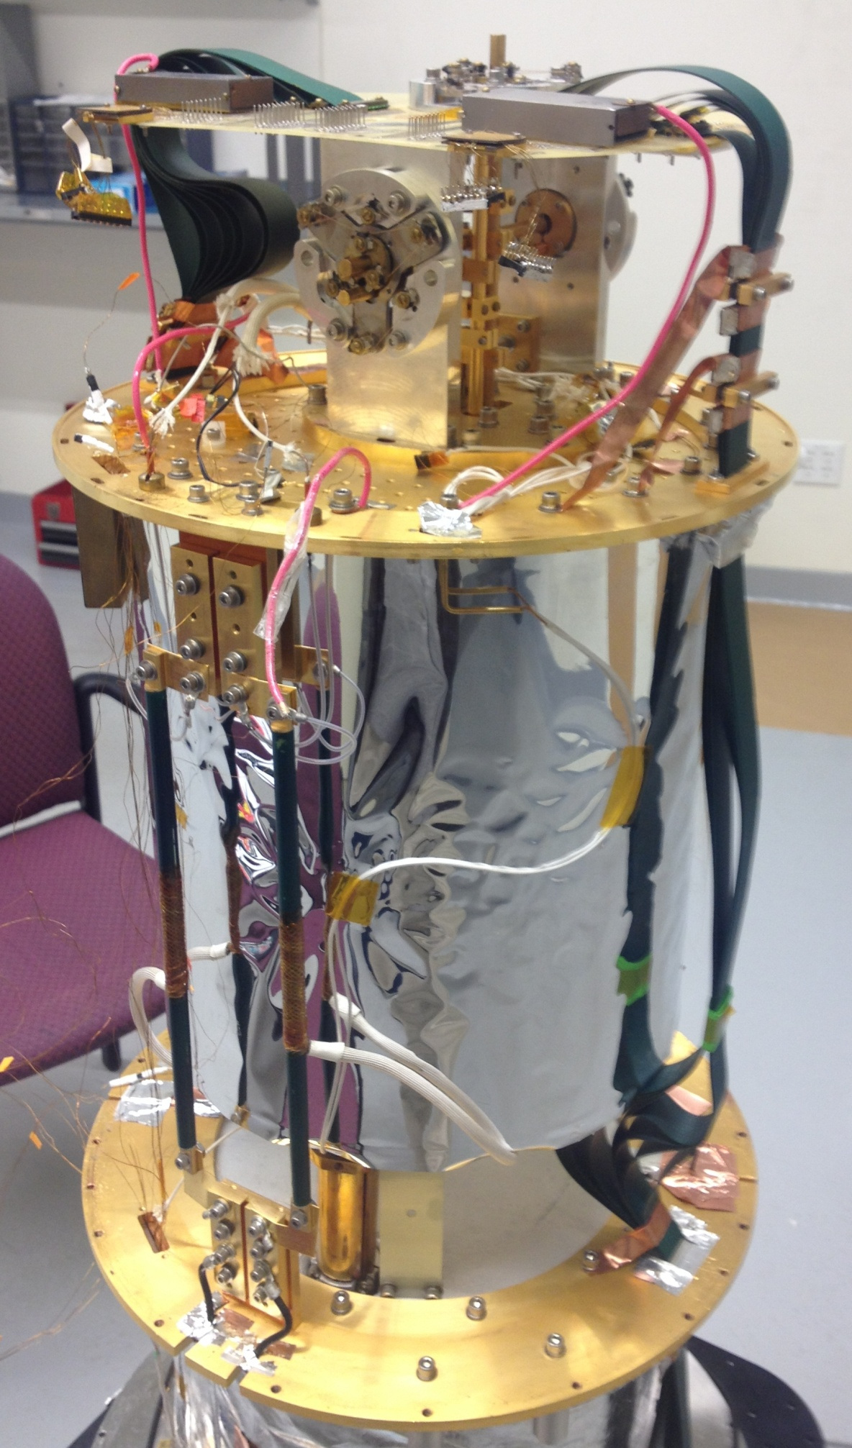
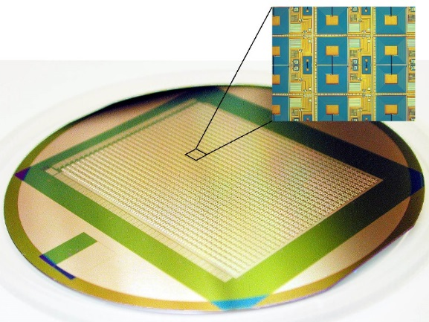
Core Technology: SQUID Multiplexers
Superconducting Quantum Interference Devices (SQUIDs) multiplexers are used to read TES detectors.
Important new direction: multiplexing TESs using SQUIDs in superconducting microwave resonators enables thousands of detectors per output channel. A good goal is a mux factor of 1,000.
SQUIDs for SPTpol and SPT-3G
1,280-channel
SQUID multiplexer
Janis ADR (<50 mK) + VNA, GHz eq.
for microwave SQUID testing

Slide 42
Core Technology: cold optics
Advanced materials (99.6% Al₂O₃)
For large BICEP3 cold optics

Slide 43
Inflation: spectral index

Slide 44
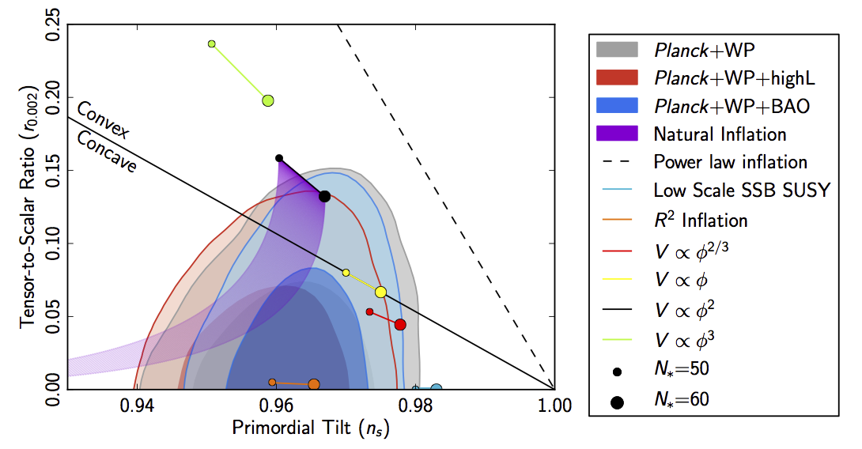
Inflation: spectral index

Slide 45
Inflation: Mean spatial curvature
1σ ~
few x 10⁻³

Slide 46
Thank you !
Keith Vanderlinde

