Slide 1
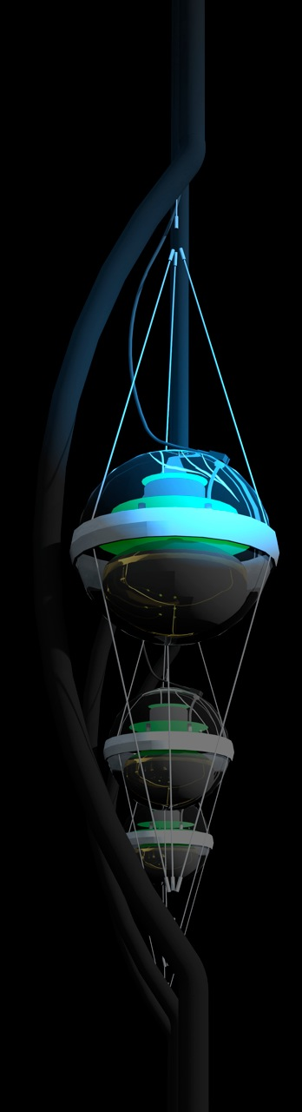

neutrino astrophysics
francis halzen
PeV and EeV neutrinos
dark matter
the search for sterile neutrinos
detecting a Galactic supernova explosion
…
IceCube.wisc.edu/~halzen

Slide 2
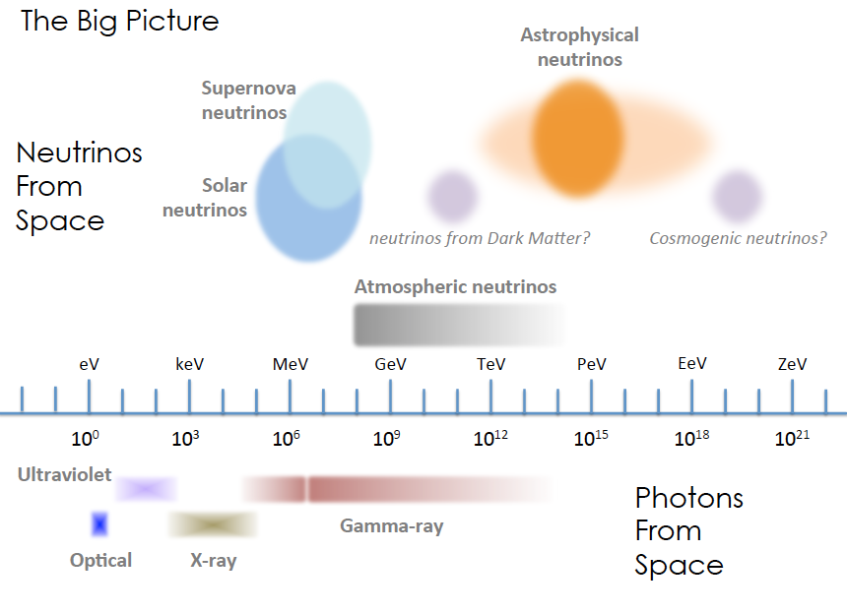

Slide 3
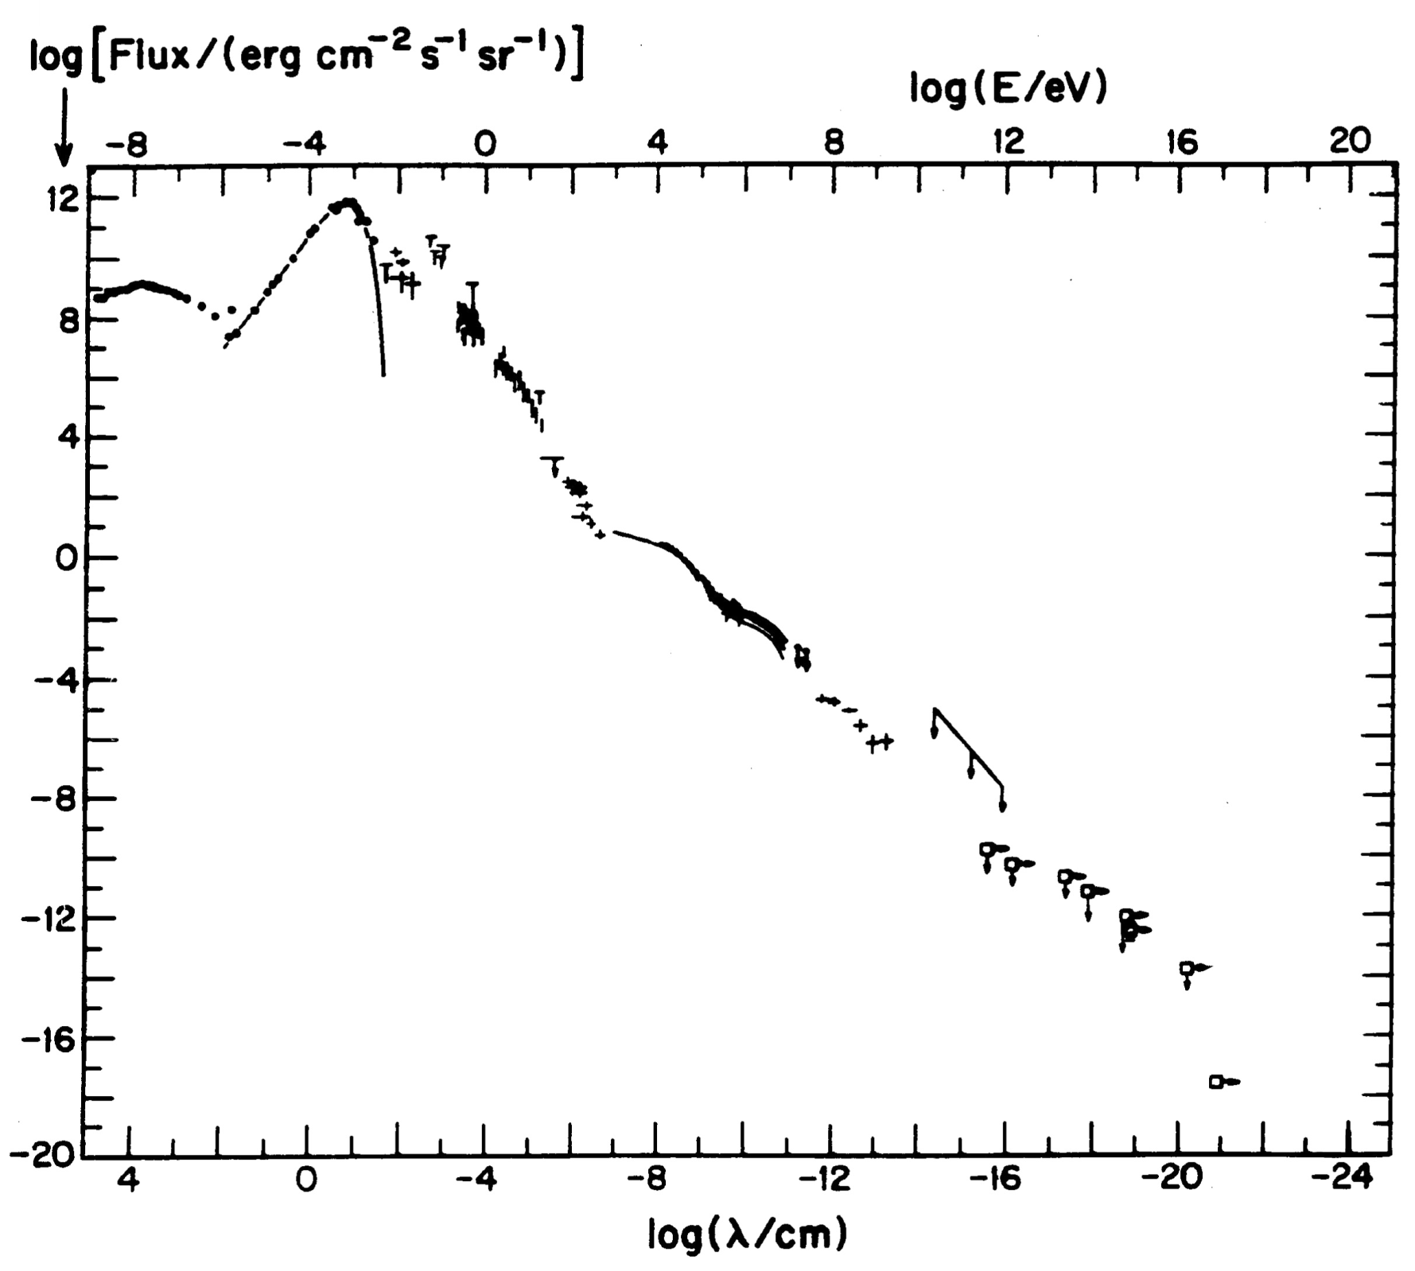
energy (eV)
ν
Radio
CMB
flux
Visible
cosmic
rays
GeV γ-rays

Slide 4

cosmic rays interact with the microwave background
cosmic rays disappear, neutrinos with
EeV (10⁶ TeV) energy appear
1 event per cubic kilometer per year
...but it points at its source!

Slide 5
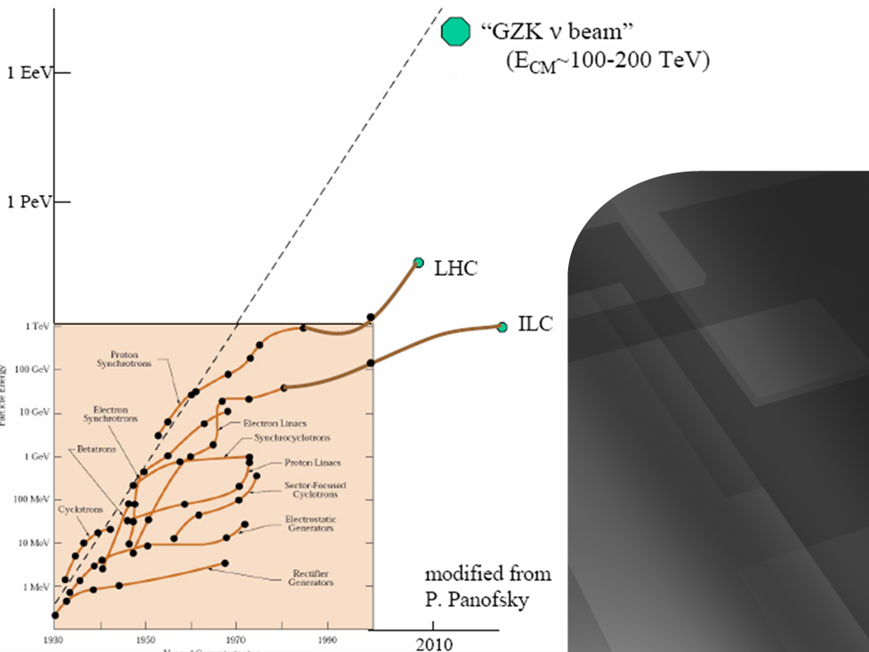
Livingston plot :
energy versus year
cosmogenic neutrino beam
center-of-mass > 100 TeV
PeV neutrinos
→ 1 event per
year in IceCube;
also Auger, ARA → radio/acoustic
domain
→ measure neutrino
cross section:
electroweak
physics at
100TeV

Slide 6
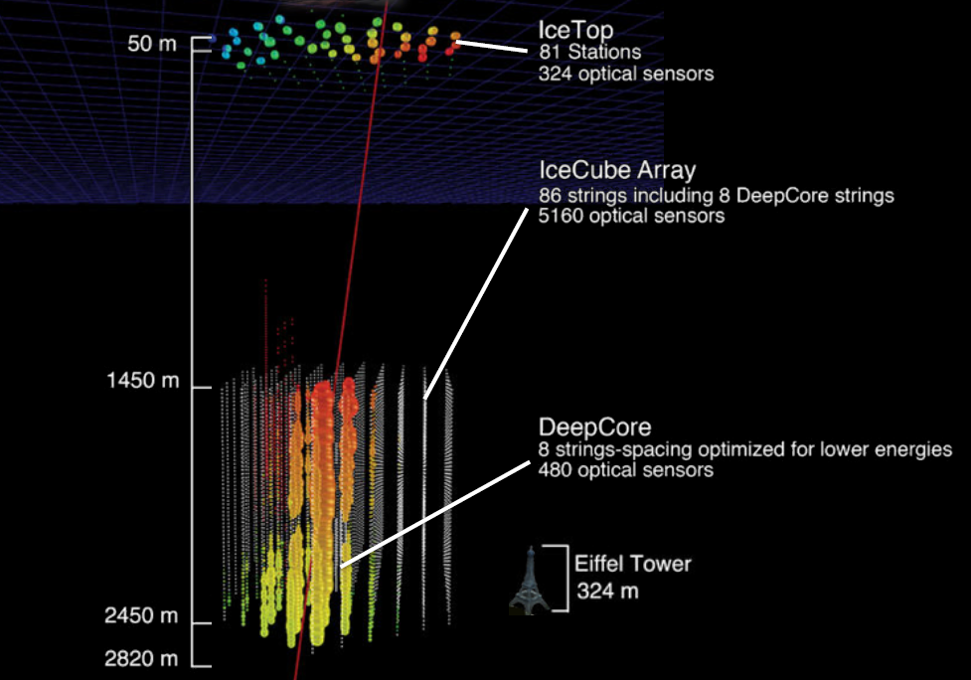
IceCube
5160 PMs
in 1 km³

Slide 7
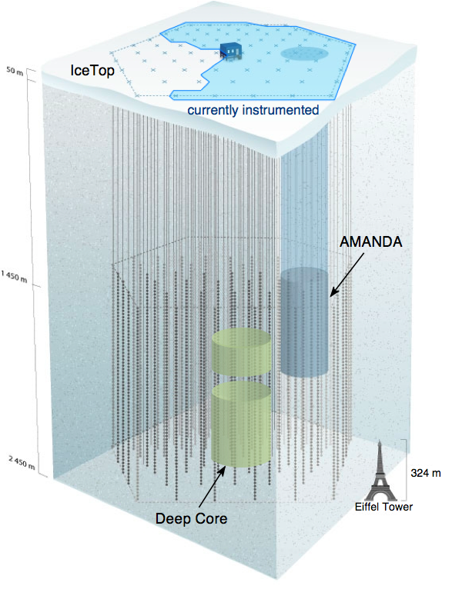
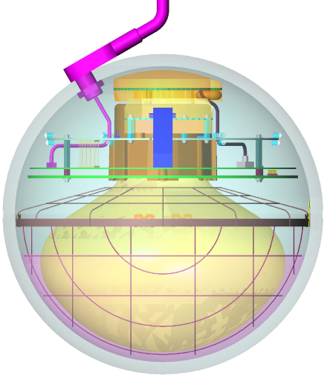
IceCube / Deep Core
completed December 2010
5160 optical sensors
between 1.5 ~ 2.5 km
10 GeV to infinity
< 0.5 degree on-line
< 0.3 degree off line
for muons
(10~15 degrees for
showers)
< 15% energy resolution
Digital Optical Module (DOM)

Slide 8
IceCube events per year:
atmospheric* μ ~ 10¹¹
atmospheric** ν → μ ∼ 10⁵
cosmic ν → μ ∼ 10
[after discovery: closer to 100/yr
using a variety of methods]
* 2700 per second ** 1 every 6 minutes

Slide 9
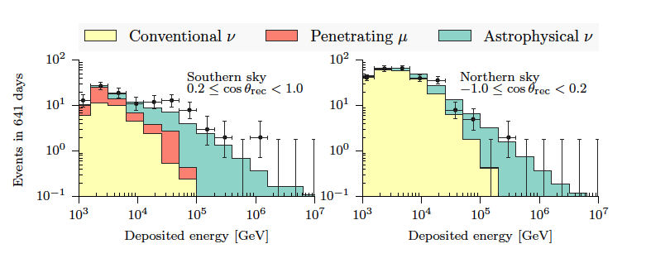
neutrino events starting in IceCube
atmospheric
C.R. muons
cosmic ν
PeV neutrinos
absorbed in the Earth

Slide 10
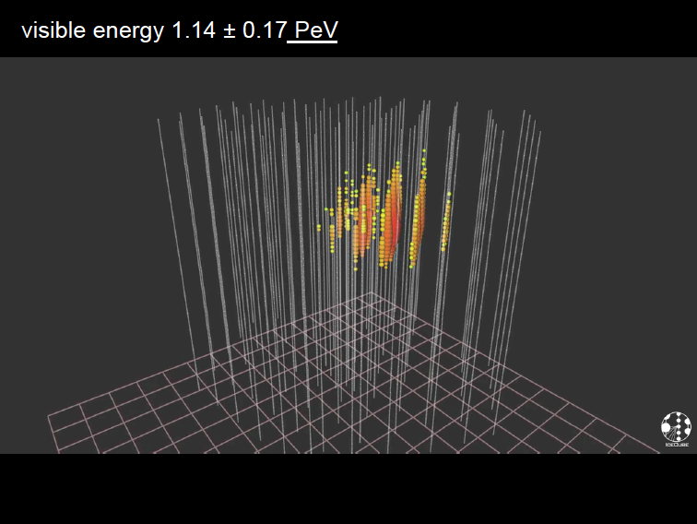

Slide 11
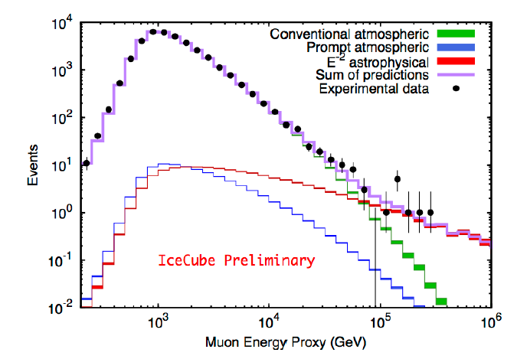
confirmation!
flux of muon neutrinos
through the Earth
neutrinos of all flavors
interacting inside
IceCube

Slide 12
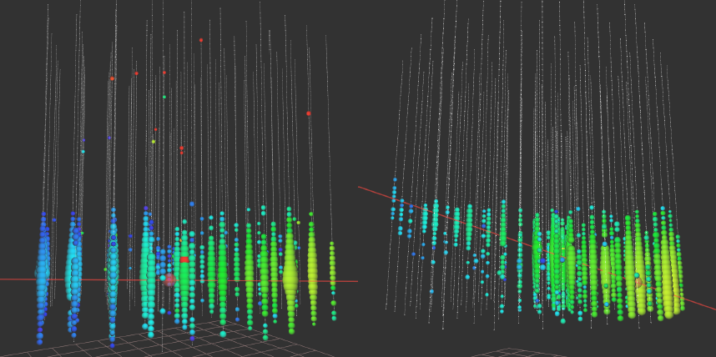
highest energy muon energy observed: 560 TeV
→ PeV energy neutrino

Slide 13
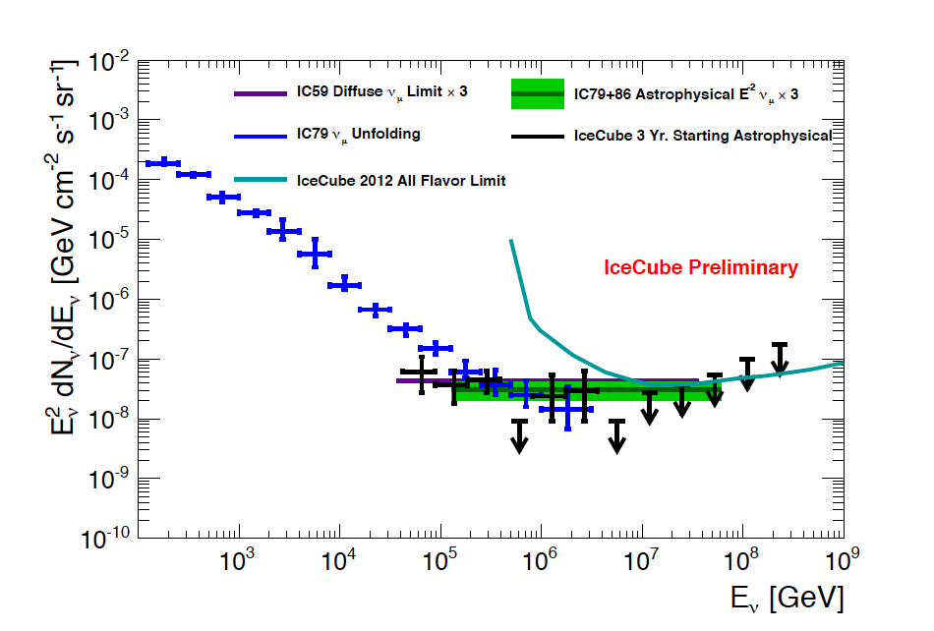
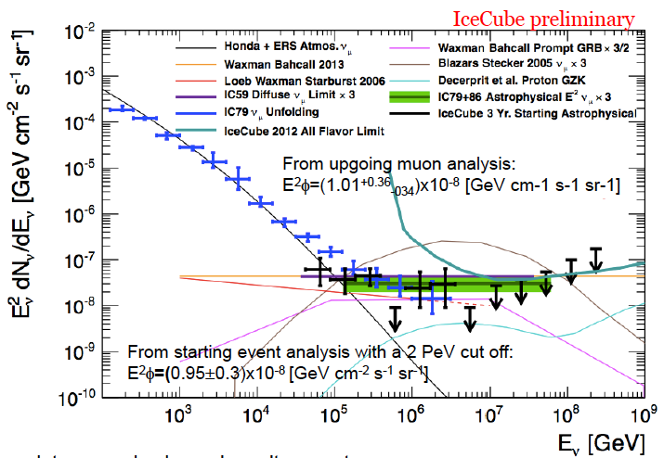
the high energy neutrino flux: atmospheric and cosmic

Slide 14
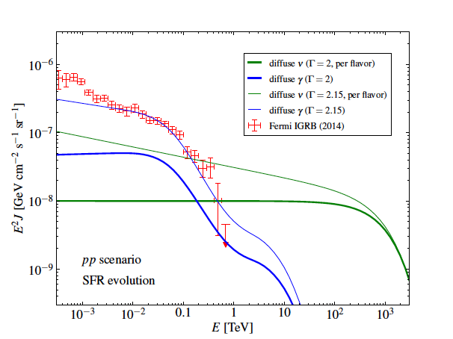
Fermi photons
IceCube
neutrinos
π⁺=π⁻=π⁰

Slide 16
We have observed a flux of neutrinos from the cosmos of PeV (>1,000 TeV) neutrinos that is at the level of the astronomical gamma ray flux. We thus established that neutrinos play a role similar to photons in the high-energy non-thermal universe.
from discovery to astronomical telescopes:
→ an infrastructure for particle physics
and astronomy
→ parallel development in the Mediterranean
ANTARES → KM3NeT

Slide 17
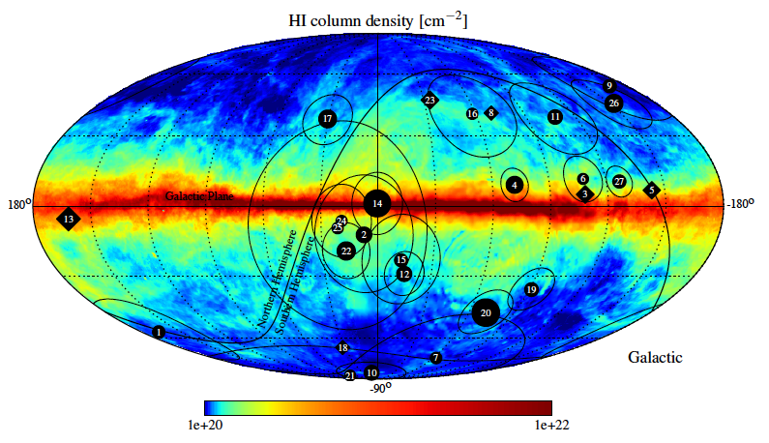
correlation with Galactic plane: TS of 2.8% for a width of 7.5
Galactic
coordinates

Slide 18
the existence of PeV neutrino events yields
dramatic limits on any possible Lorentz
invariance violation: superluminal particles
lose their energy to Cherenkov radiation, even
in vacuum
sensitivity δ increases dramatically with the
distance d and observed energy E→

Slide 19
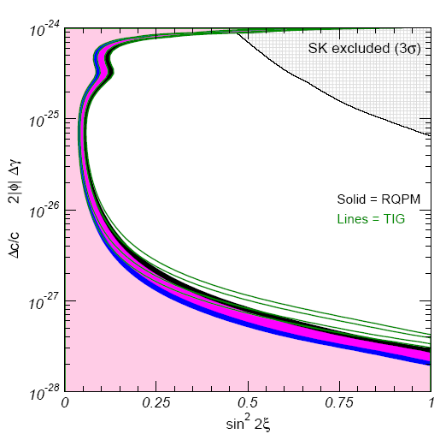
limits on δ from atmospheric neutrinos
Lorentz violation
distorts oscillation
pattern
(relative velocities
only)
test of:
any new neutrino
physics
equivalence
principle
quantum gravity
“general
relativity
will not last
200 years”
M. Turner
AMANDA

Slide 20


quantized space: matter where the geometry is activated

Slide 21

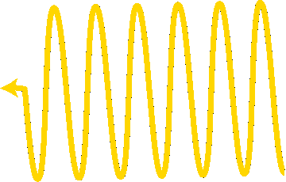
speed of photons and neutrinos depends
on their energy, like photons in a crystal
Notes:
21

Slide 22

Lorentz violation from Planck scale spacetime
violation of Lorentz invariance because of Planck scale physics can be detected through time delays of high energy neutrinos relative to low energy photons
from a source at a distance d; for instance a GRB.
Notes:
Fly in the 3 items in filled-in colored boxes please.

Slide 23
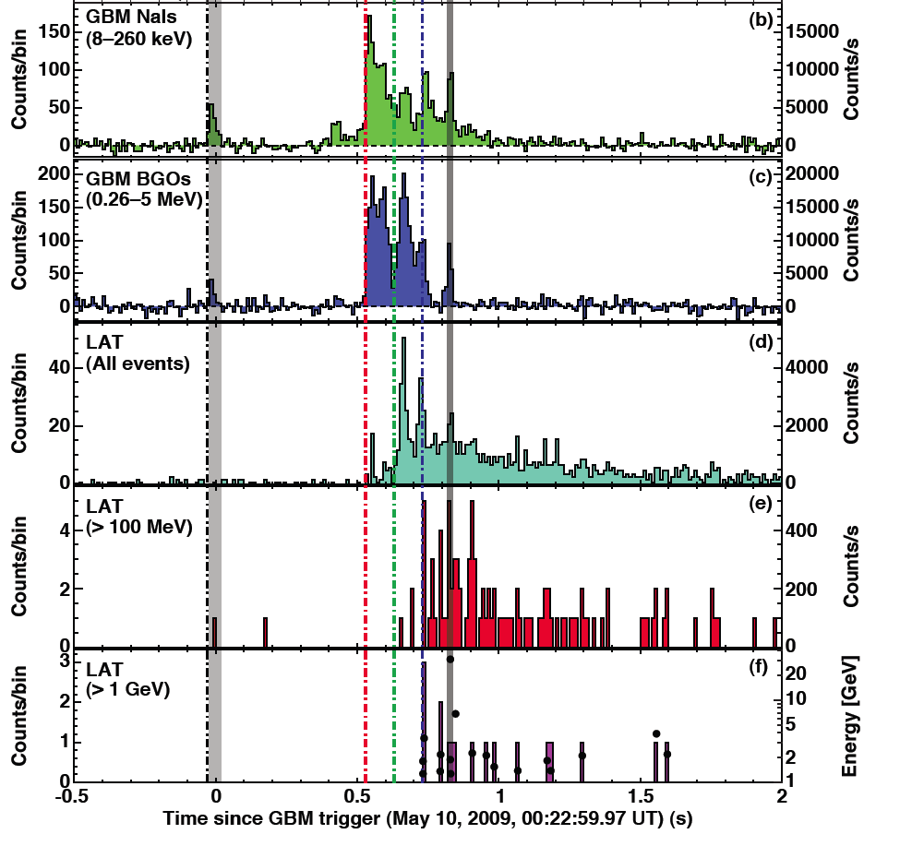
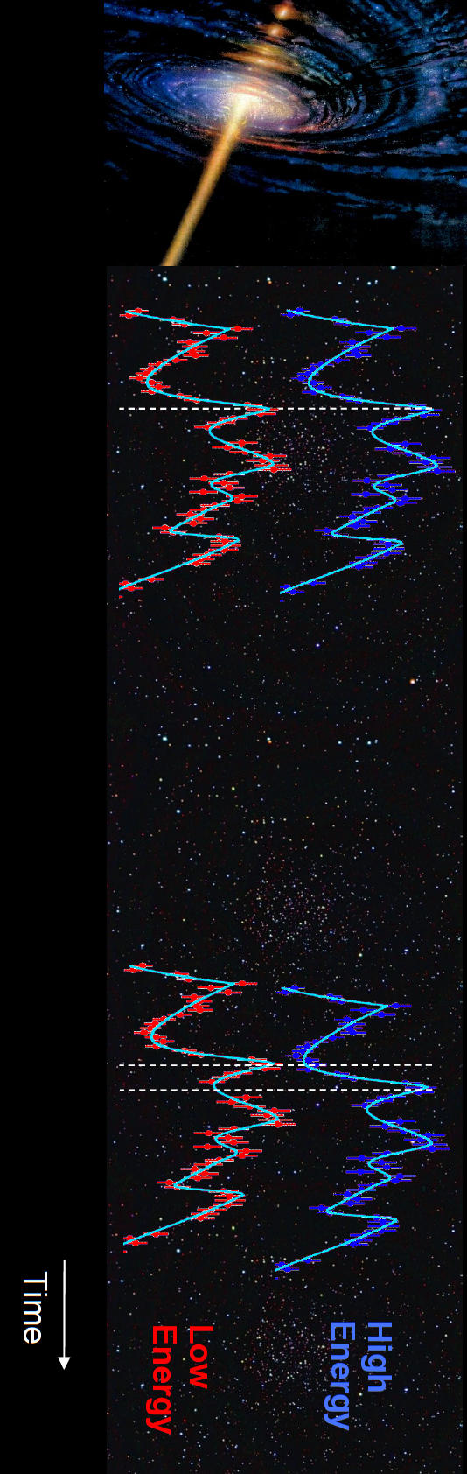
Fermi
GRB 090510

Slide 24
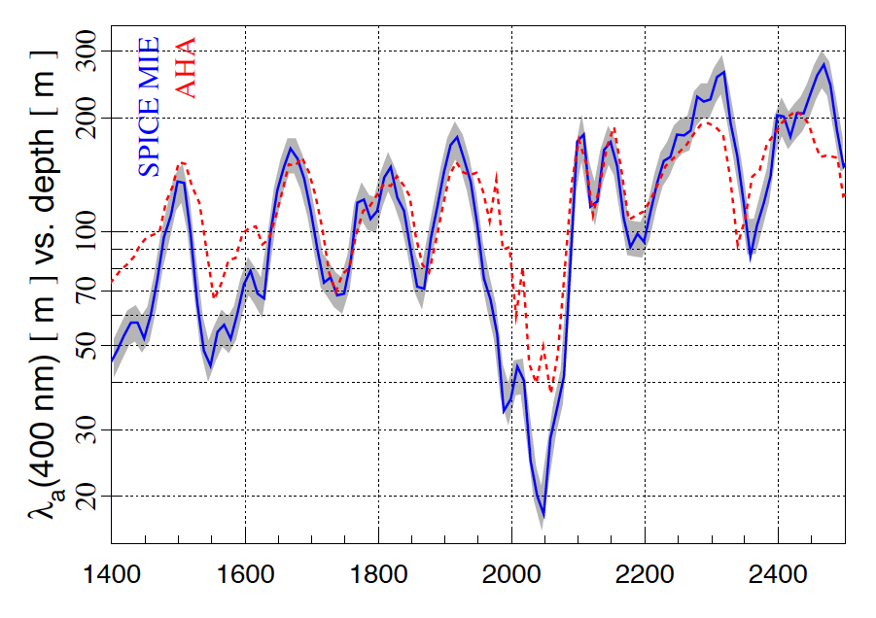
absorption length ← 220m →
most transparent solid
in Nature...or laboratory

Slide 25
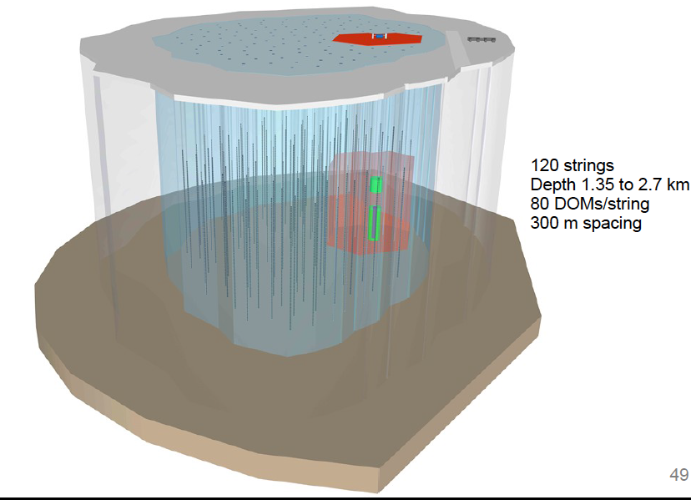
instrumented volume: x 10
same budget as IceCube

Slide 26
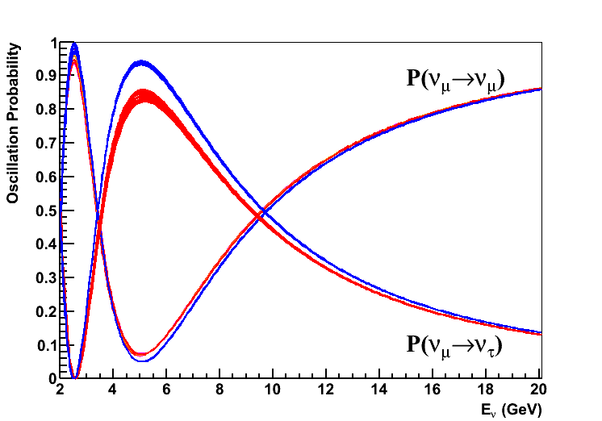
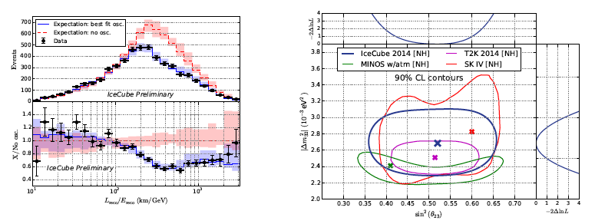
IceCube
DeepCore
PINGU
oscillations at 20 GeV

Slide 27
neutrino astrophysics
francis halzen
PeV and EeV neutrinos
dark matter
the search for sterile neutrinos
detecting a Galactic supernova explosion
…
IceCube.wisc.edu/~halzen

Slide 28
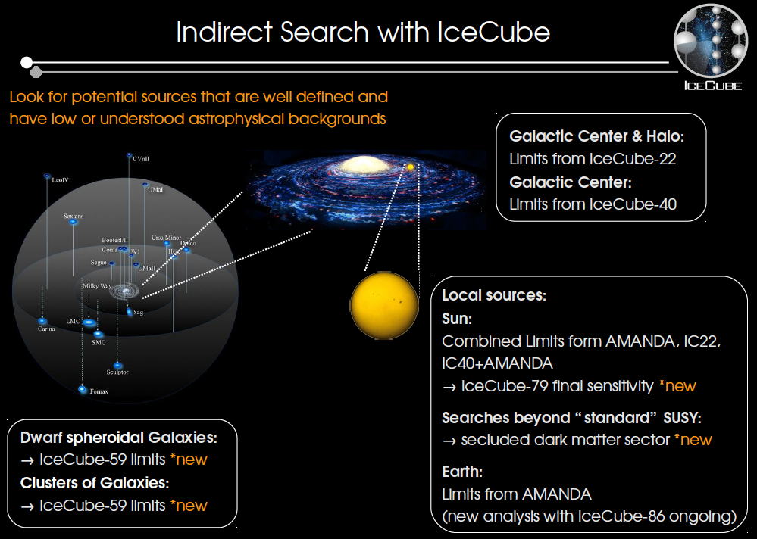

Slide 29
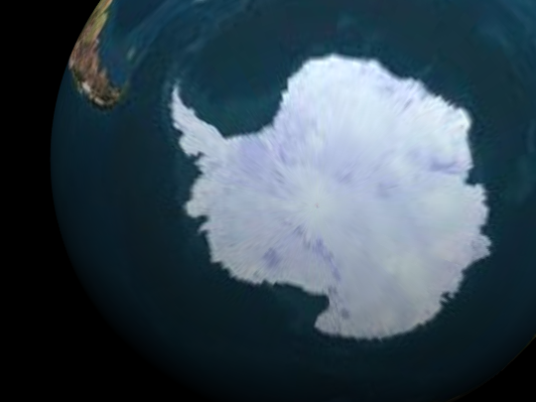

WIMP Capture and Annihilation
χ
n
ν_{μ}
DETECTOR
χ + χ → W + W → ν + ν
b + b → ν + ν

Slide 30
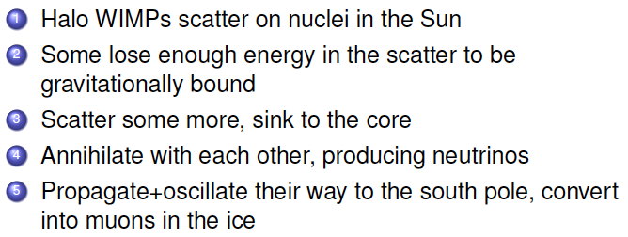

WIMP Capture and Annihilation
χ
n
ν_{μ}
DETECTOR
χ + χ → W + W → ν + ν
b + b → ν + ν

Slide 31
limits on the wimp cross section vs wimp mass
[soft: bb ; hard WW]

Slide 32

indirect dark matter detection in the sun
rates are dictated by the interaction
cross section of WIMPS with protons
in the sun– their number is known.
→ no unknown astrophysics
in the neutrino case there is a direct
connection between theory and
observation and the background is
understood.
Notes:
Fly in the 3 items in filled-in colored boxes please.

Slide 33
neutrino astrophysics
francis halzen
PeV and EeV neutrinos
dark matter
the search for sterile neutrinos
detecting a Galactic supernova explosion
…
IceCube.wisc.edu/~halzen

Slide 34
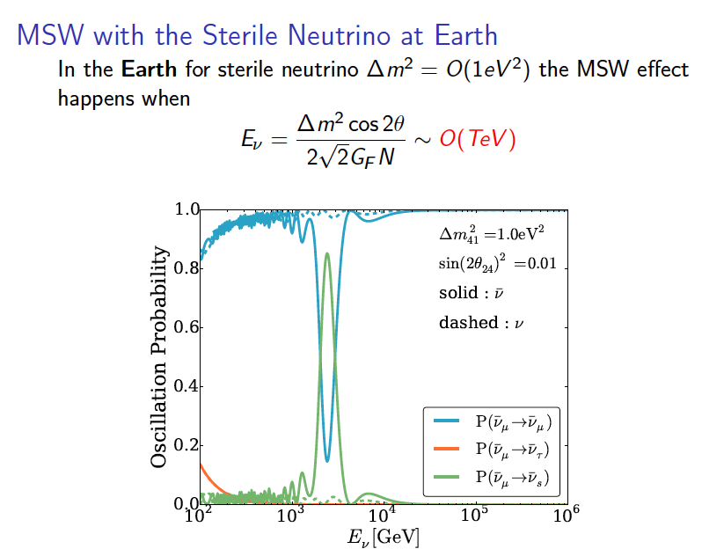
the oscillation into ~1 eV sterile neutrinos affects
the propagation of the electron neutirno in matter
resonance →

Slide 35
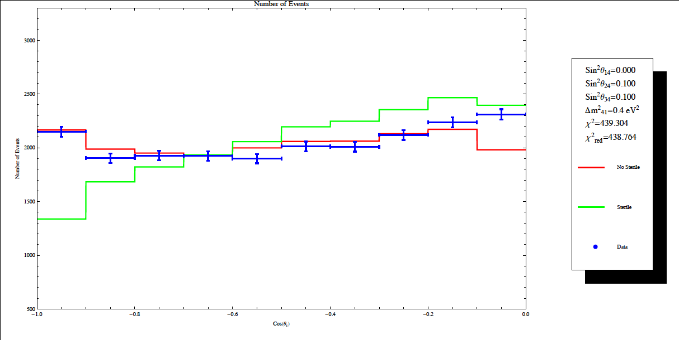
number of ν_{μ} observed versus zenith angle
~ 2000 events per bin

Slide 36
3
3+1
matter effect
of eV sterile ν’s ?

Slide 37
do not try this at home

Slide 38
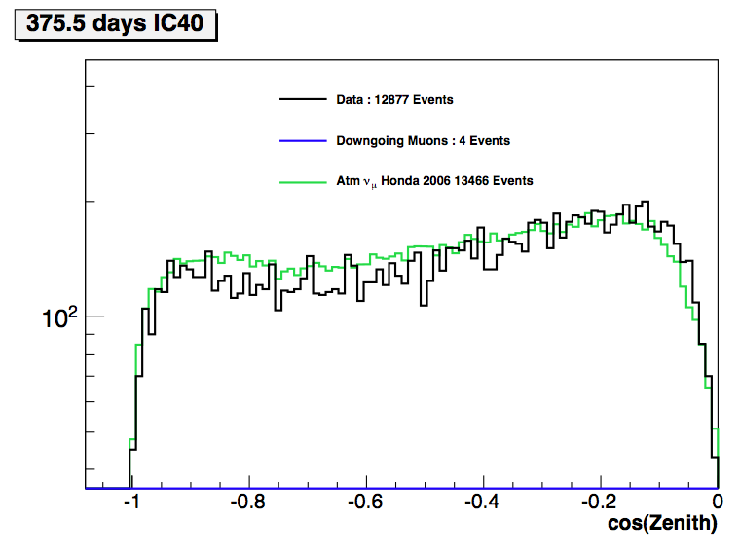
zenith angle
two analyses
SYSTEMATICS !!!
K/π ratio
zenith acceptance of
modules
ice
CR flux,composition
[IceTop helps]
38

Slide 39
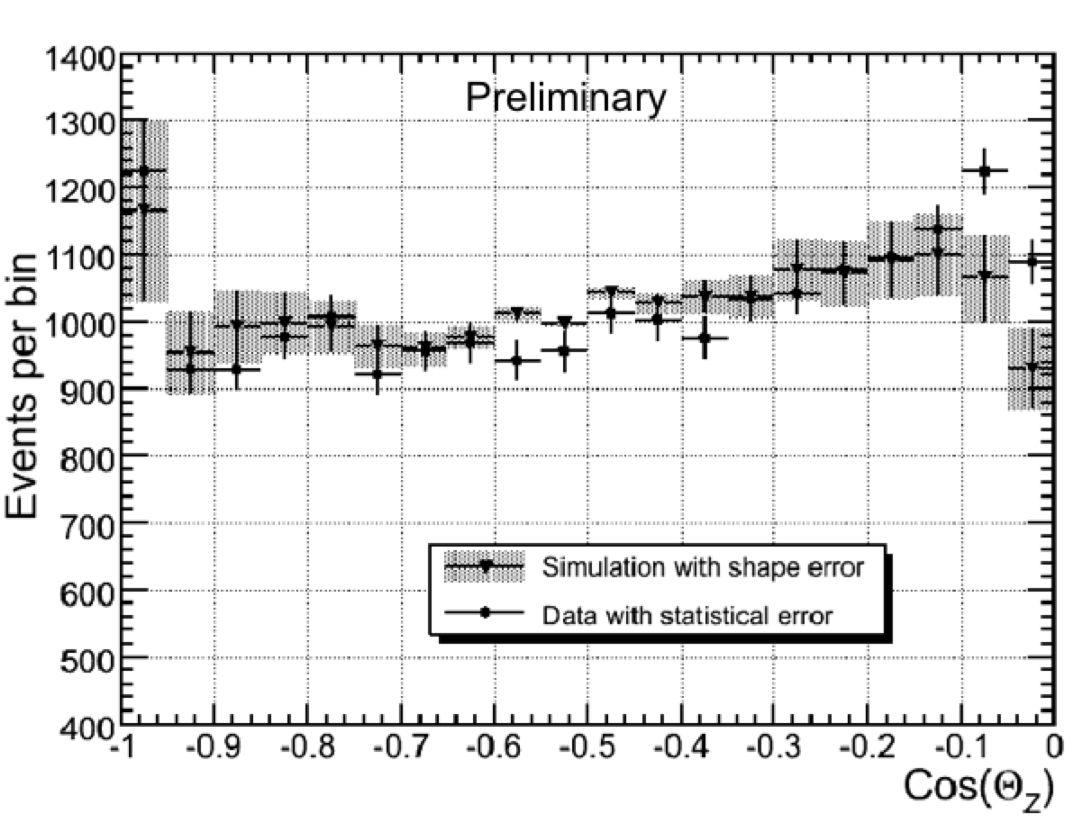
zenith angle distribution 40-string data

Slide 40
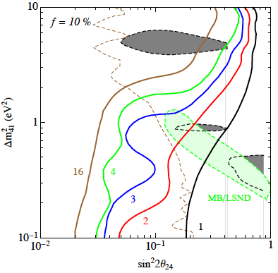
1307.6824

Slide 41
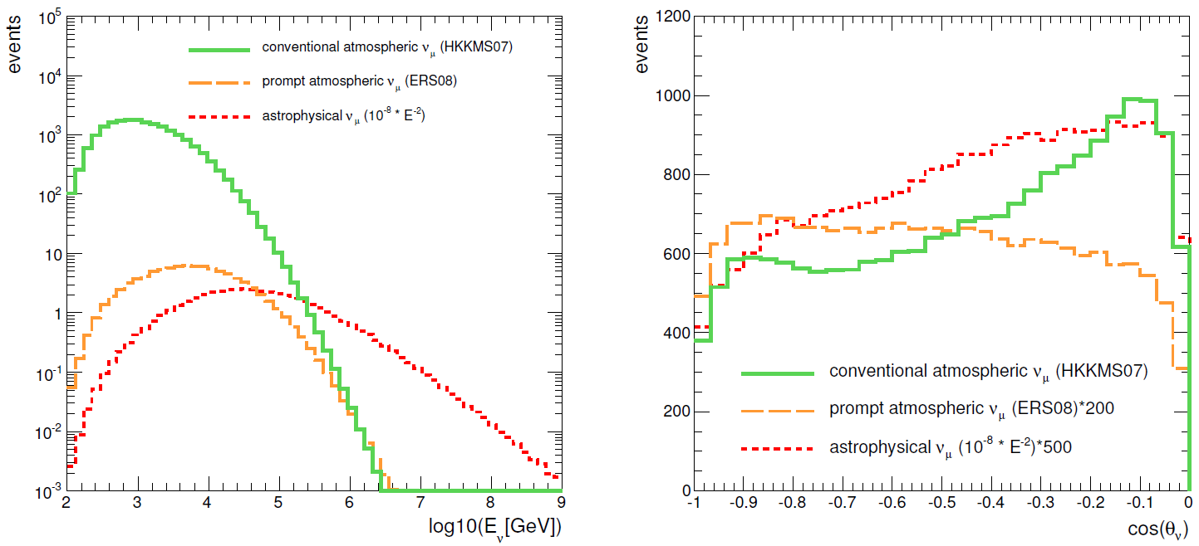
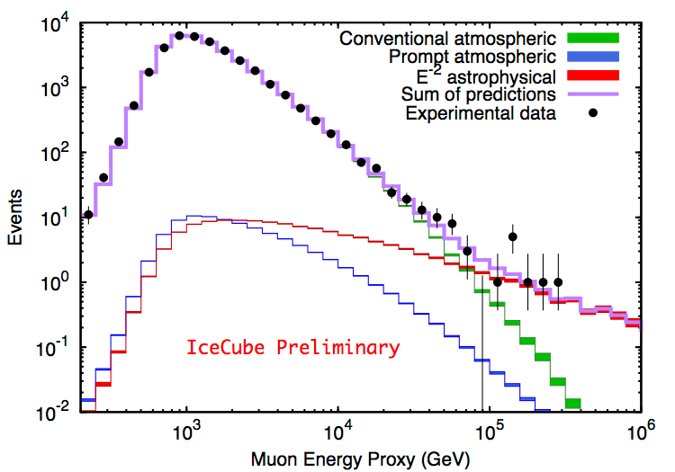
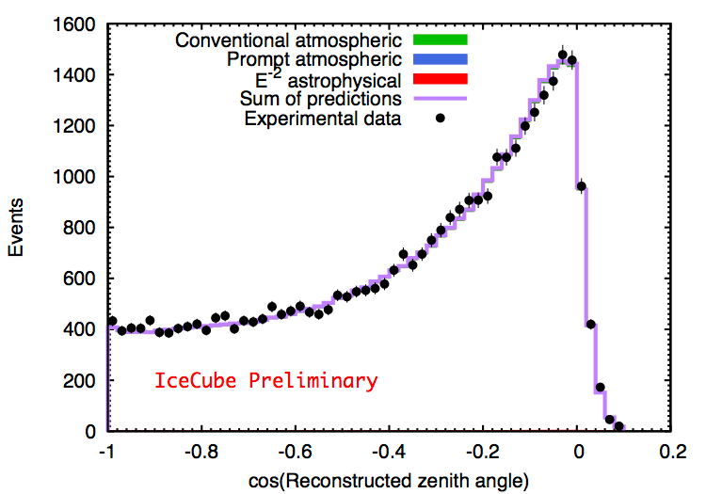
astrophysical and atmospheric ν_{μ}: 86 strings
MC expectations
Data:2010-2012 (2 years) fit results

Slide 42
neutrino astrophysics
francis halzen
PeV and EeV neutrinos
dark matter
the search for sterile neutrinos
detecting a Galactic supernova explosion
…
IceCube.wisc.edu/~halzen

Slide 43
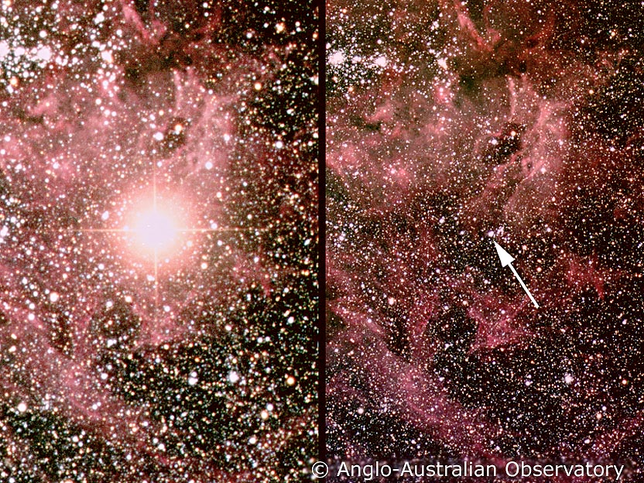
supernova 1987a: 20 neutrinos, thousands of papers

Slide 44
supernova detectors
LVD (S, 300)*
Borexino (S, 100)*
ICARUS (LAr, 60)
SNO+ (S, 300)
HALO (Pb, 85)
Super-K (W, 10⁴)*
KamLAND (S, 300)*
map goes here
Noνa (S, 3000)
LBNF (LAr?, ?)
Hyper-K (W, 10⁵)
Baksan (S, 50)
Mini-BOONE (S, 200)
Key:
Experiment (Type, Approx. Counts @ 10 kpc)
S - Scintillator
LAr- Liquid Ar
W - Water
* - SNEWS Members
DayaBay (S, 35)
Gravitational Wave: LIGO, VIRGO
Running
PINGU (W, 10⁶)
IceCube (W, 10⁶)*
Constr./Plann.

Slide 45
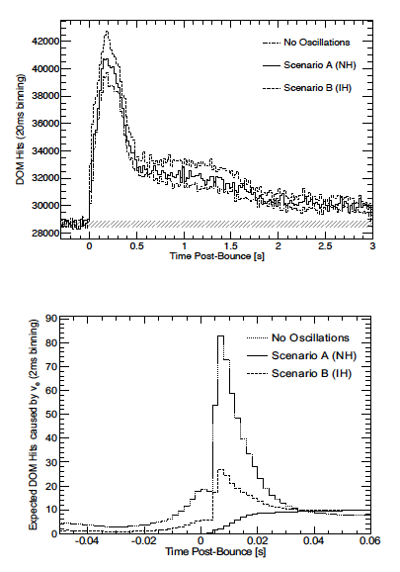
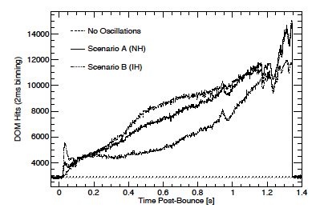
next supernova
and
neutrino oscillations
solar mass
collapse
2 ms binning
collapse to
black hole
IceCube 10 kpc

Slide 46
neutrino astrophysics
prospects
HyperK, IceCube-Gen2,
Mediterranean detectors…
also LIGO, CTA …
next supernova !
physics potential
IceCube.wisc.edu/~halzen

Slide 47
overflow slides

Slide 48
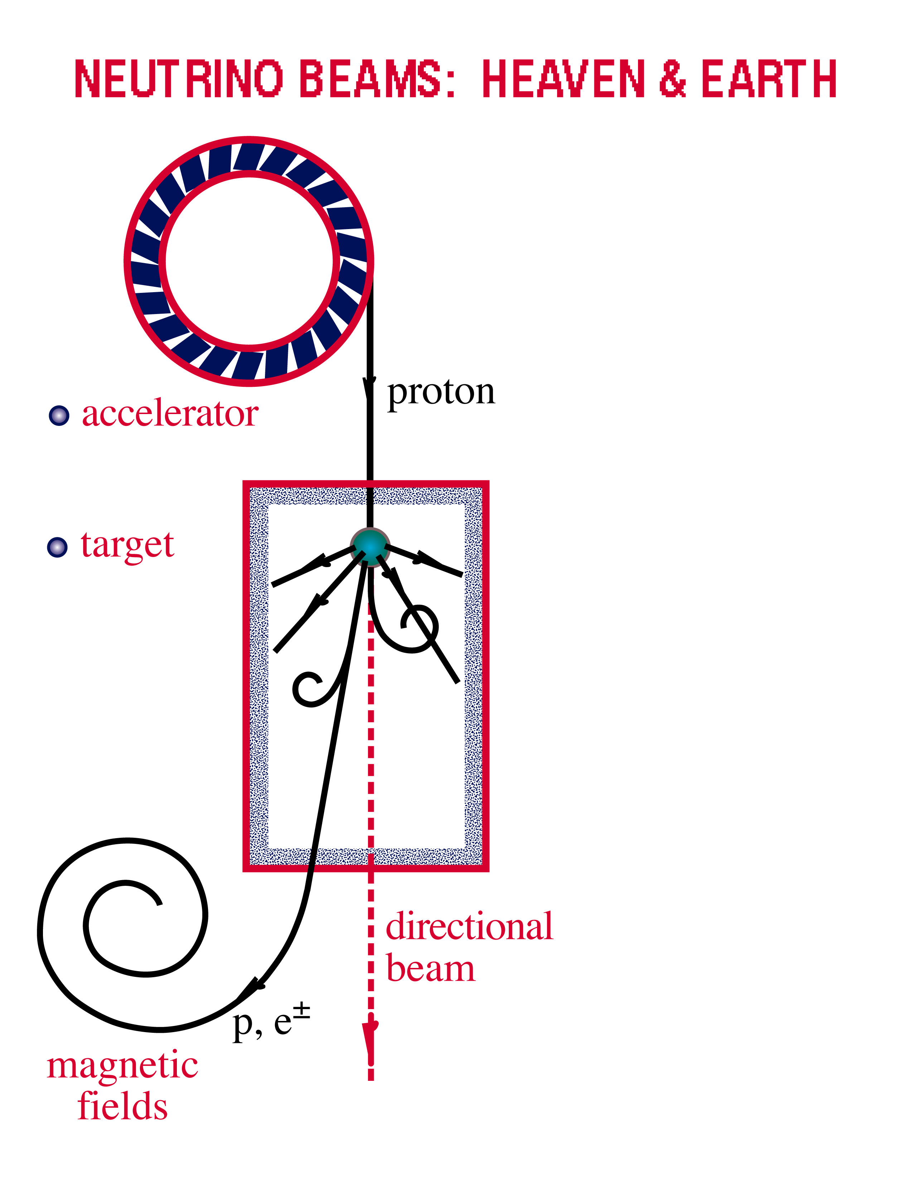
accelerator is powered by
large gravitational energy
Neutrino Beams: Heaven & Earth
ν and γ beams : heaven and earth
NEUTRINO BEAMS: HEAVEN & EARTH
black hole
neutron star
radiation
and dust
p + γ → n + π⁺
^{~ cosmic ray + neutrino}
→ p + π⁰
^{~ cosmic ray + gamma}

Slide 49
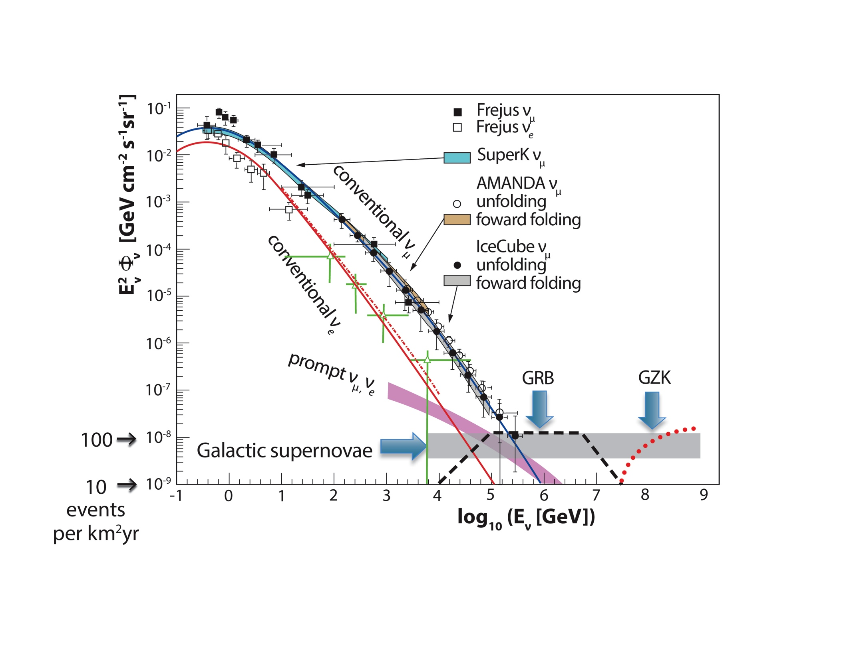
cosmic
neutrinos:
energy
> 60 TeV
atmospheric
background:
1~2 events
per year
atmospheric neutrino cosmic

Slide 50
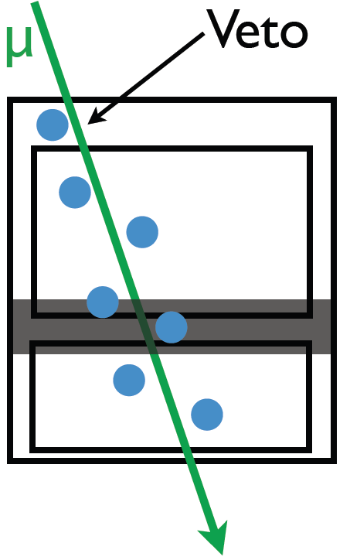
…and then there
were 26 more…
data: 86 strings one year

Slide 51
…and then there
were 26 more…
no light entering the detector
high energy
data: 86 strings one year

Slide 52
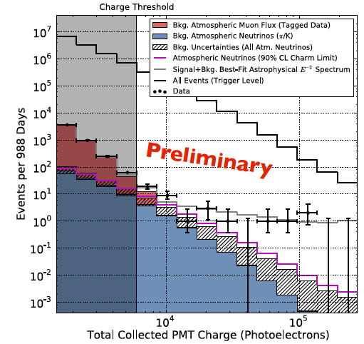
total charge collected
by PMTs of events with
interaction inside the
detector
E²Φ(E) =
(3.6±1.2)·10⁻⁸ GeVcm⁻²s⁻¹sr⁻¹
atmospheric ν
and μ

Slide 53
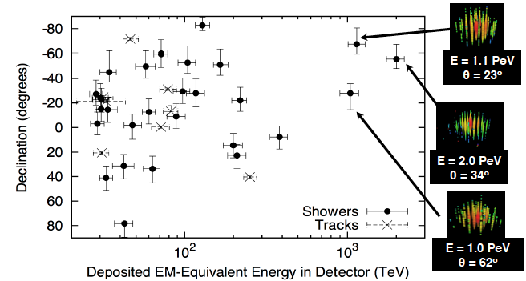
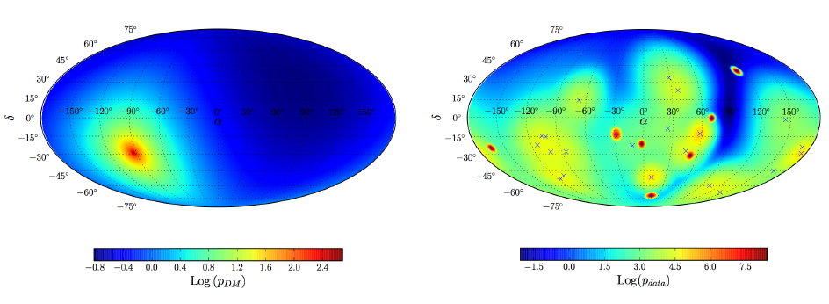
expect surprises: produced by Galactic dark matter halo?
decay of PeV-mass
dark matter
particle

Slide 54
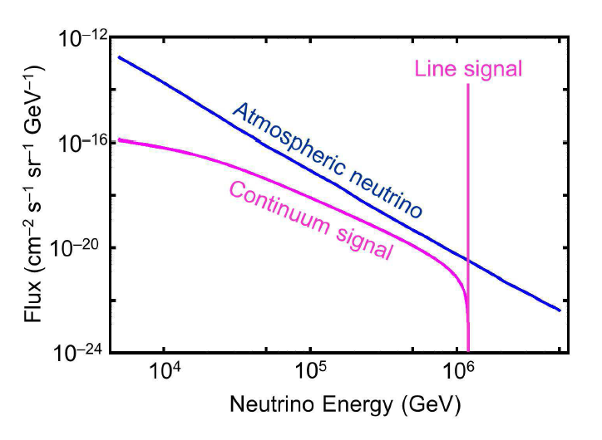

Slide 55
Lorentz violation from Planck scale spacetime
speed of photons and neutrinos depends on their
energy, like photons in a crystal
Planck scale vacuum fluctuations probed by high
energy particles
modification to dispersion relation leads to an energy
dependent speed of light: Lorentz invariance violation
Notes:
Fly in the 3 items in filled-in colored boxes please.

