Slide 1
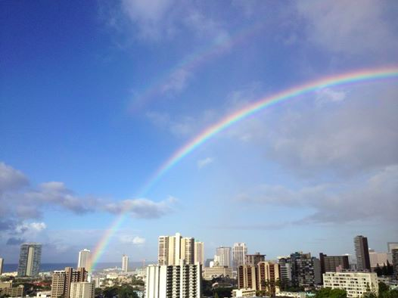
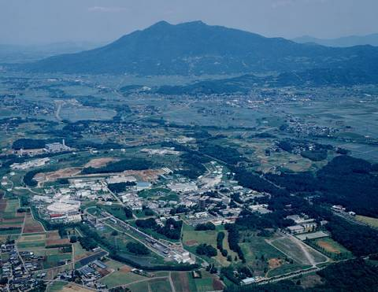
CP Violation, Rare Decays and Future Facilities
Tom Browder (University of Hawaii)
Introduction/Review/Motivation
Complex phases in the weak interaction: V_{td} and V_{ts} and associated CPV asymmetries
-Rare B decays
Honolulu, HI USA
-Connections to the charged Higgs
Flavor Physics, The Next Generation:
Belle II and the LHCb upgrade
Apologies: In the limited time, I cannot cover all the new results from BaBar, Belle, LHCb, CMS, ATLAS, Tevatron …
I have borrowed slides from many excellent physicists
Tsukuba, Japan
Notes:
Add page numbering

Slide 2

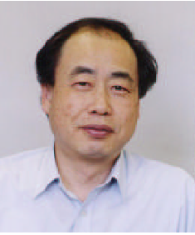

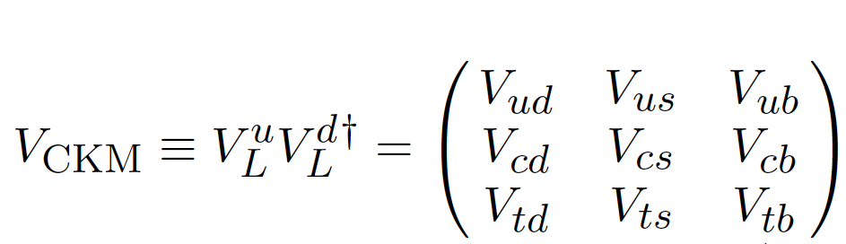
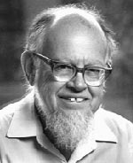
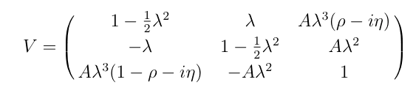
N. Cabibbo
M.Kobayashi
T.Maskawa
Amplitudes and Phases in the Weak Interaction
L. Wolfenstein
Notes:
Let’s now discuss amplitudes and phases in the weak interaction. Weak interaction eigenstates are rotated versions of flavor eigenstates. Cabibbo et al realized that upper left portion of the mixing matrix is a rotation matrix. However, to accommodate CP violation, which was first observed 50 years ago,
Kobayashi and Maskawa realized that one needed three generations of quarks (only two were known at the time).
Wolfenstein provided a phenomenological parameterization of the mixing matrix. His version makes it crystal clear that the complex parts, which give raise to CP violation are in the corners (V_td and V_ub). N.B. that V_ts does NOT have a complex phase.

Slide 3
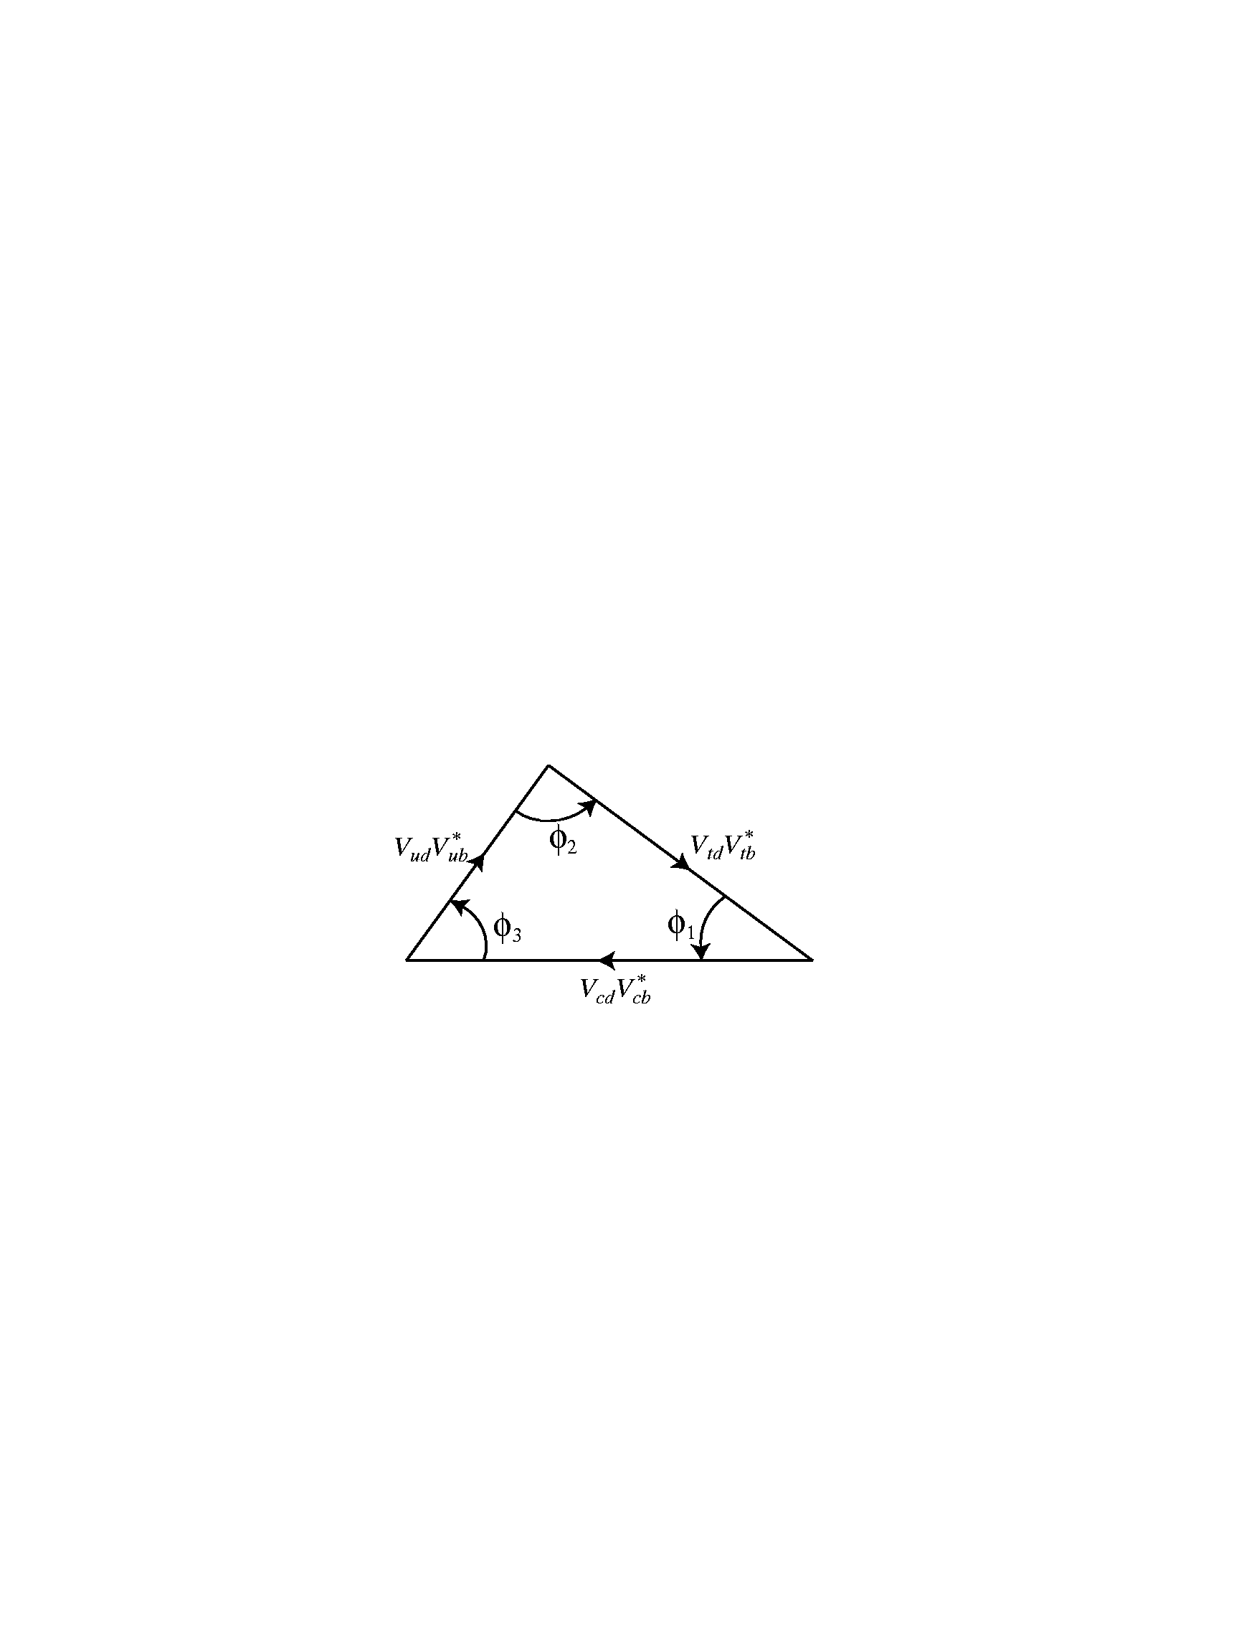
Three Angles: (φ₁,φ₂,φ₃) or (β, α, γ)
New Belle result on π⁰ π⁰
B⁰ → π⁻ π⁺
Unitarity implies that the weak couplings and phases form a triangle in the complex plane.
New LHCb results on CPV in B_{s}→D_{S}⁻ K⁺ (ICHEP, CERN courier)
B⁰→Ψ K_{s},Ψ K_{L}
B⁻ →D_{CP} K⁻
Big Questions: Are determinations of angles consistent with determinations of the sides of the triangle ? Are angle determinations from loop and tree decays consistent ?
Notes:
Check order of animations

Slide 4
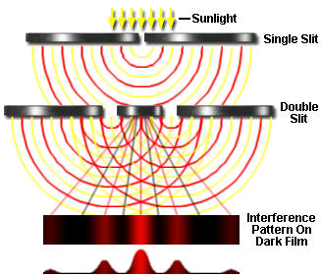
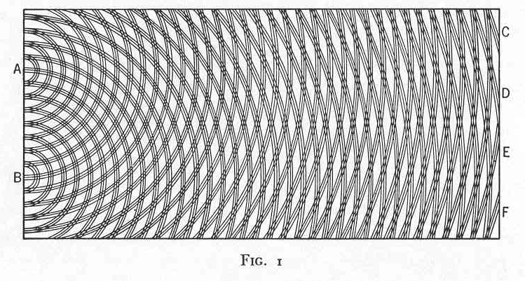
Time-dependent CP violation is
“A Double-Slit experiment” with particles and antiparticles
QM interference between two diagrams
box diagram + tree diagram
tree diagram
V_{td}
b
c
J/ψ
b
t
d
d
K_{S}
c
+
s
s
K_{S}
c
J/ψ
d
d
d
t
b
c
V_{td}
Measures the phase of V_{td} or equivalently the phase of
B_{d} –anti B_{d} mixing.
Notes:
Sometimes HEP physicists outside of our sub-field become lost in the formalism. What are we really doing ?

Slide 5
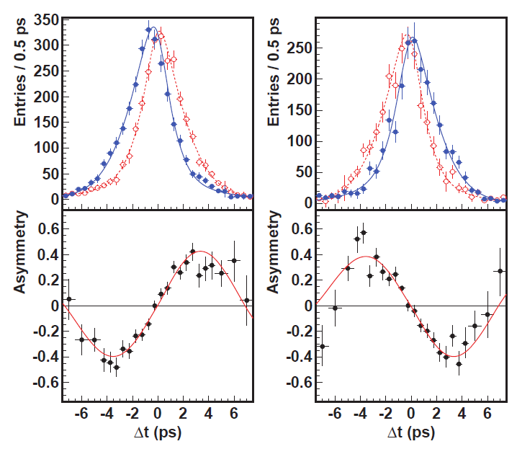
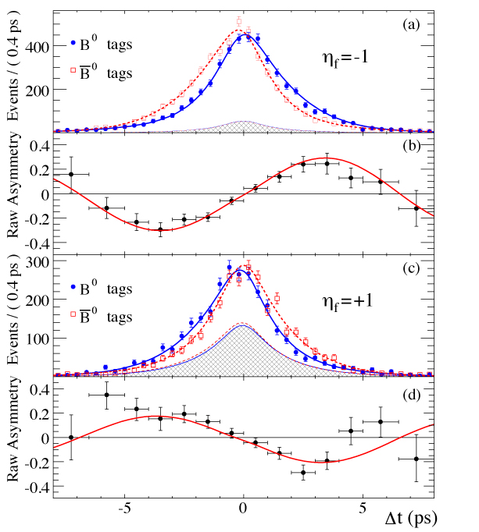

Measurement of sin(2φ₁)/sin(2β) in Charmonium K⁰ modes
(cc)K_{S}
J/ψK_{S}
J/ψK_{L}
J/ψK_{L}
sin2φ ₁=0.667±0.023±0.012
A_{f}=0.006±0.016±0.012
PRL108,171802 (2012)
sin2φ₁=0.687±0.028±0.012
A_{f}=-0.024±0.020±0.016
PRD79,072009 (2009)
Overpowering evidence for CP violation (matter-antimatter asymmetries). >>>> The phase of V_{td} is in good agreement with Standard Model expectations

Slide 6
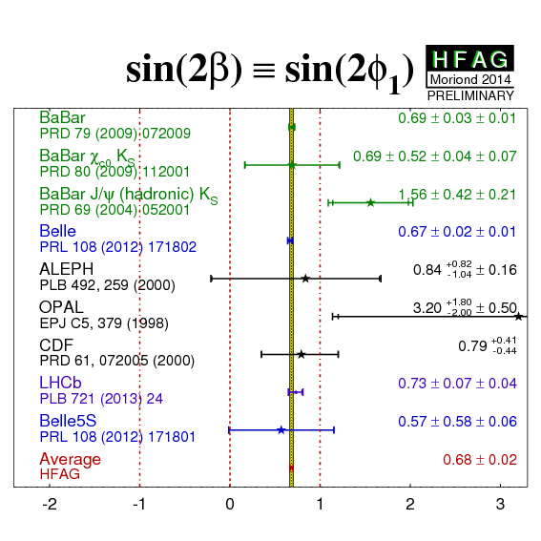
B factories: High precision CPV measurement and a calibration for NP.
2013: LHCb has joined the game.
J. Bernabeu et al point out that by comparing decays with
t_tag > t_decay and vice versa, one could check for T violation at the B factories. N.B. This does not assume the CPT theorem.
BaBar did this and found a 14σ signal for T violation !
Notes:
Pronounced “Bernabeou”

Slide 7
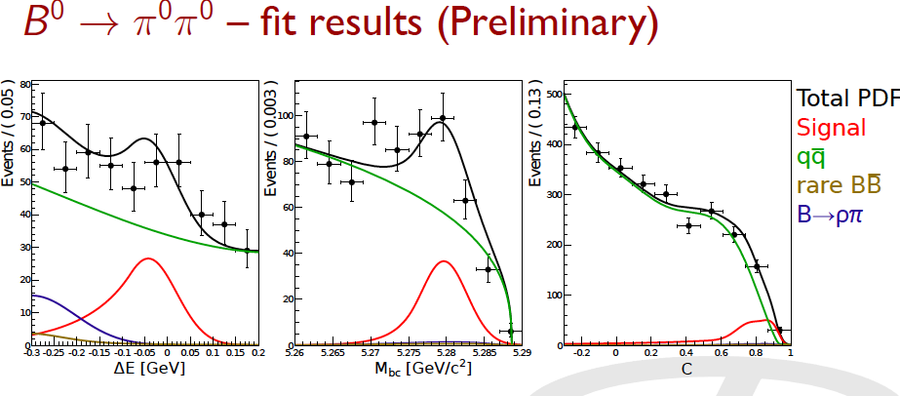
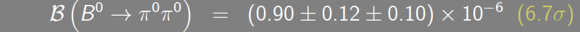
2014: new Belle result on B→π⁰ π⁰
Timing eliminates calorimeter pile-up bkg
A difficult mode for hadron colliders

Slide 8
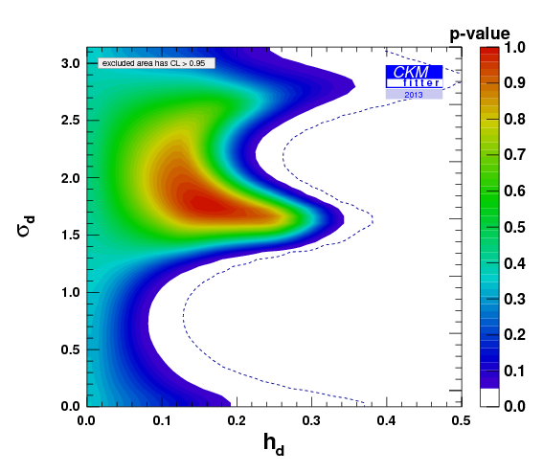
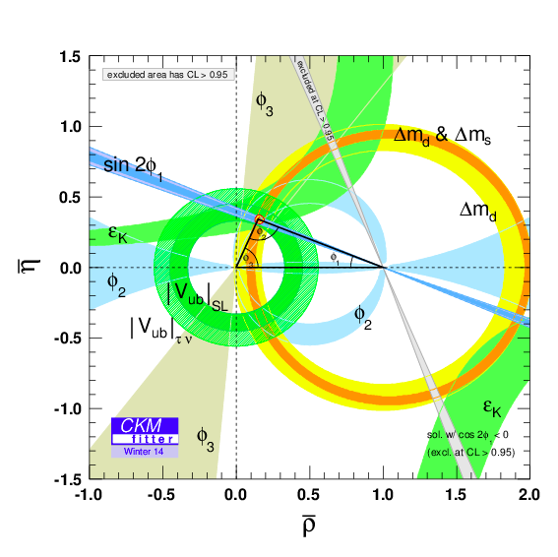
Results from Global Fits to Data (CKMFitter Group)
Great progress on ϕ₃ or γ (first from B factories and now in the last two years from LHCb). These measure the phase of V_{ub} [CKM2014, K. Trabelsi review: ±7⁰]
Similar results from UTFIT as well from G. Eigen et al.
NP Phase
NP/SM amplitude ratio
But a 10-20% NP amplitude in B_{d} mixing is perfectly compatible with all current data.
Looks good
(except for an issue with |V_{ub} |)
Notes:
So what does this triangle mean ? Is NP completely ruled out ?

Slide 9
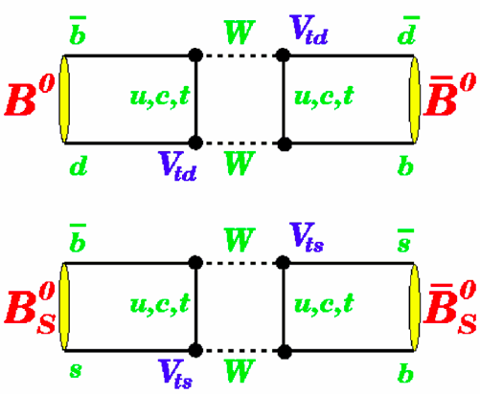

Boxes
Although B factories can run on the Upsilon(5S), LHCb dominates here
No phase expected from SM but possible from NP particles

Slide 10
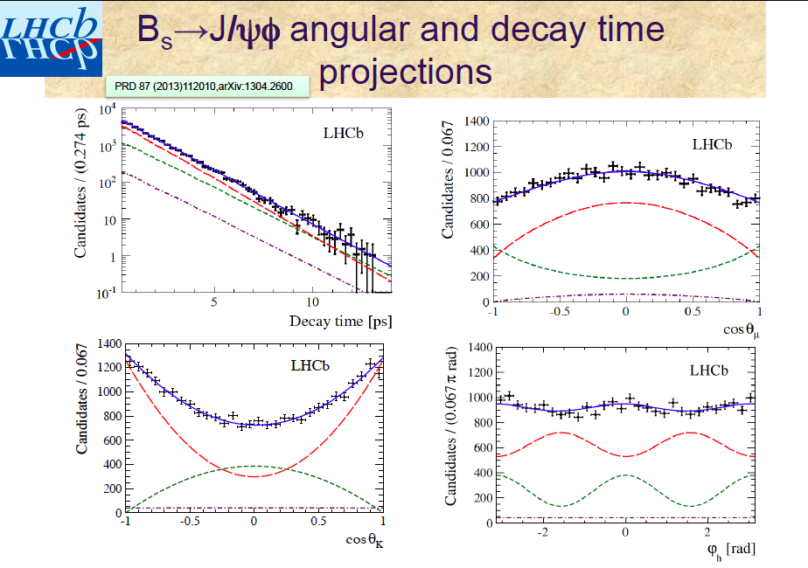
Phase of V_{ts}➔
Φ_{s}=70±90±10 mrad (1 fb⁻¹ sample)
B_{s} →J/ψϕ is a pseudo-scalar to V V decay (mixture of two CP eigenstates). This requires multi-dimensional angular analysis.
Notes:
0- →1- 1- . Hence relative S, P, D waves are possible.

Slide 11

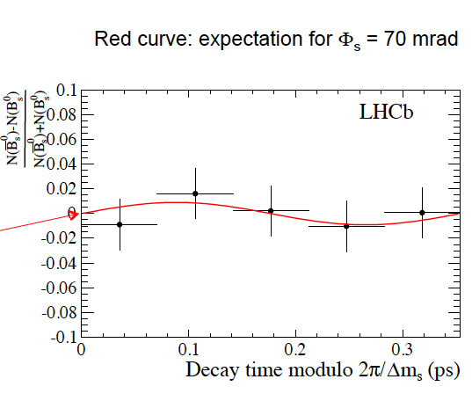
However, B_{s} →J/ψ f₀(980) is a pure CP eigenstate since the f₀ (980) is a scalar.
Stone & Zhang pointed out that this mode provides more statistics and a more straightforward analysis. Phys. Rev. D79 (2009) 074024.
Asymmetry
arXiv: 1405.4140
Notes:
Amplitude of asymmetry consistent with zero.

Slide 12
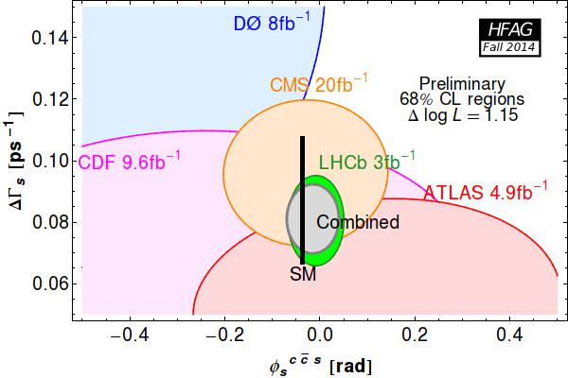
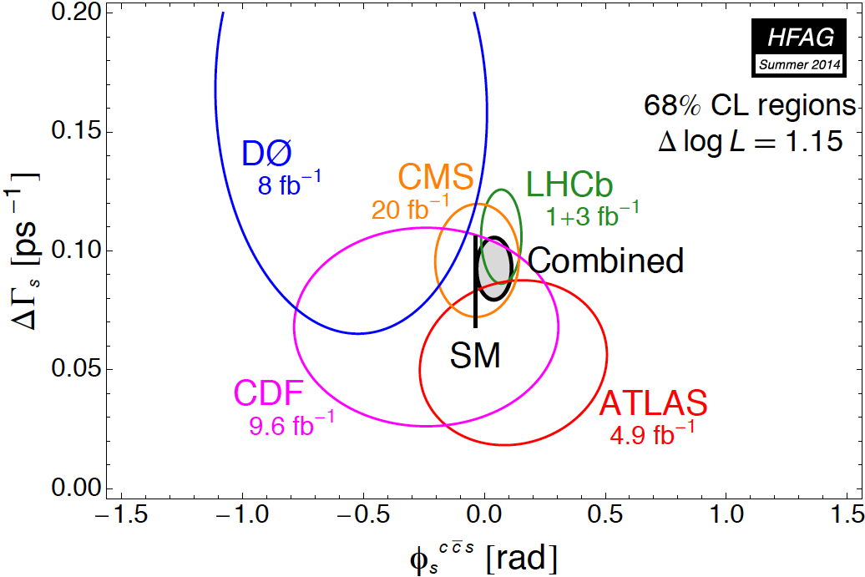
Results on the phase of B_{s}-anti B_{s} mixing (i.e. phase of V_{ts})
(Includes the most recent LHCb prelim result, giving -10 ±40 mrad)

Slide 13
Boxes
No phase expected from SM but possible from NP particles

Slide 14
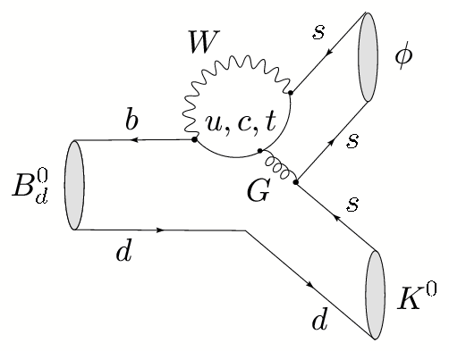
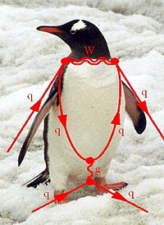
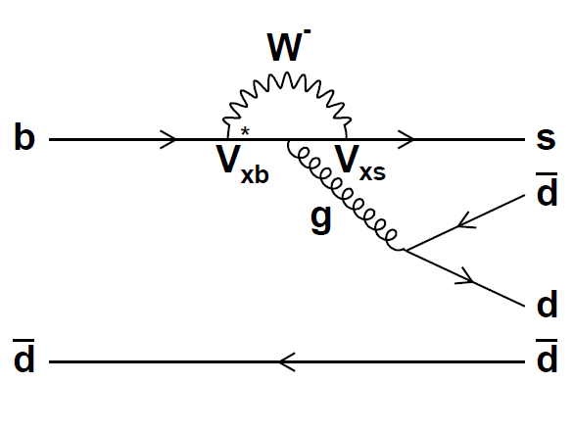
Phase of V_{ts}
Recent Belle results on B→ω K_{S},
B→η’ K_{S}
Notes:
In the loop, NP particles can contribute to the phase.

Slide 15
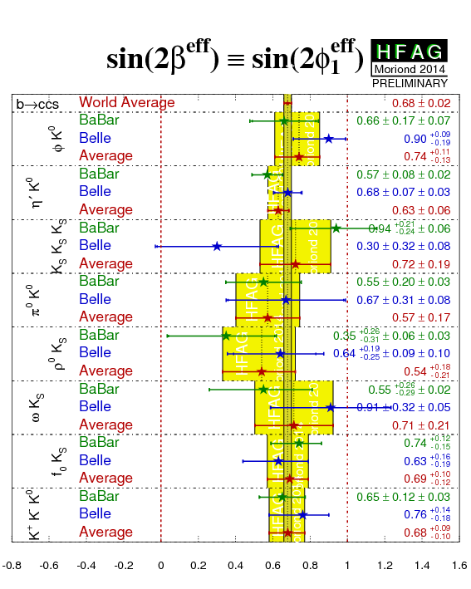
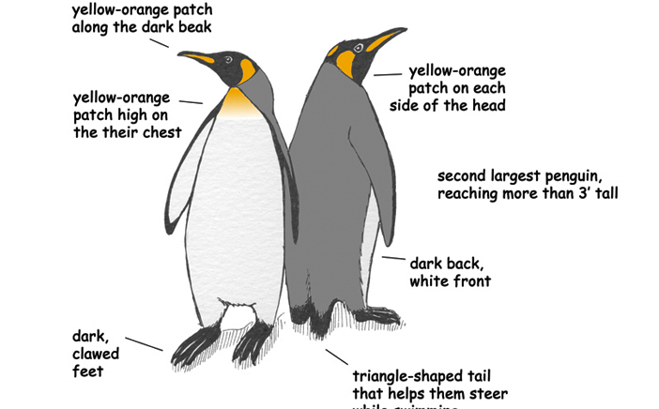
New Physics Phases in Penguin b→s decays
No evidence for NP at current level of sensitivity
LHCb is absent from this game (lower K_{S} eff and flavor tagging eff) but contributes in Bs modes.
Notes:
Here we compare the phase to the phase of b->c cbar s decays. If the effective value of sin(2 beta) agrees with the J/psi K_S decays,
Then we conclude there is no phase from New Physics.

Slide 16
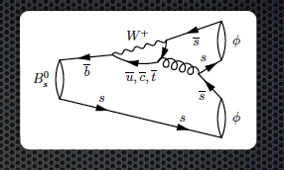
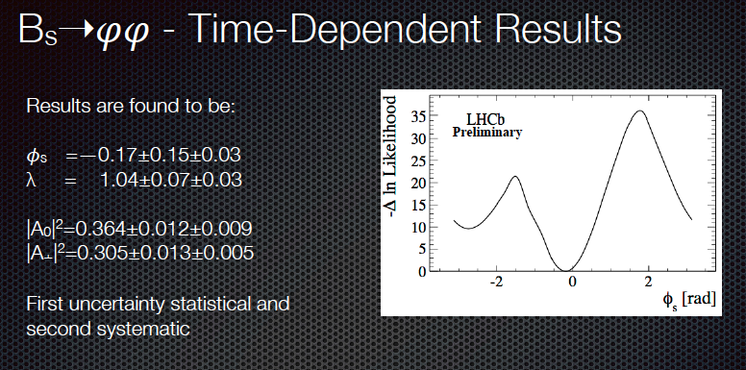
But LHCb dominates these B_{s} modes
Again, NP Penguin phase is found to be consistent with zero

Slide 17
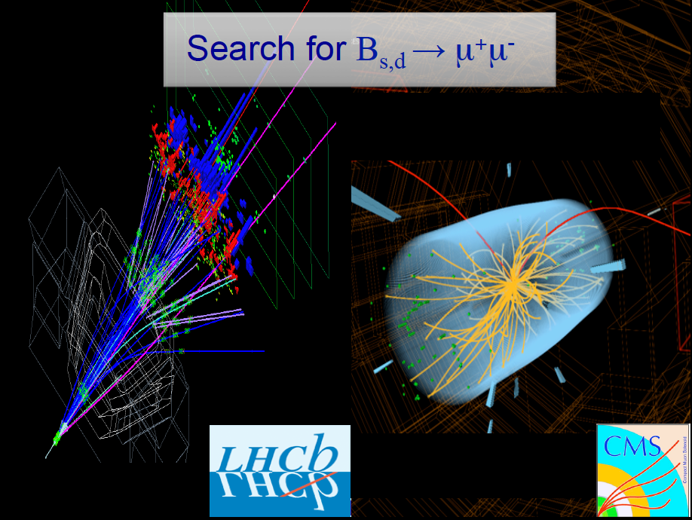
Rare B Decays
J. Albrecht

Slide 18
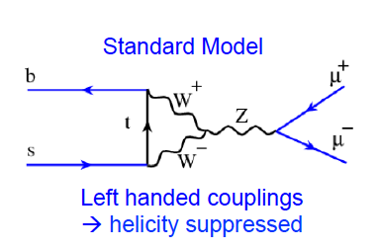
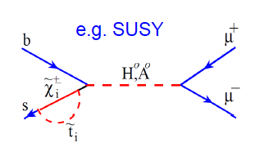
LHC found the rarest B decay; B_{s}→μ+ μ-
BF ~O( 10⁻⁹)
N. B. Here and in b→s l⁺ l⁻ all the heavy particles of the SM enter as virtual particles in the Feynman diagrams

Slide 19
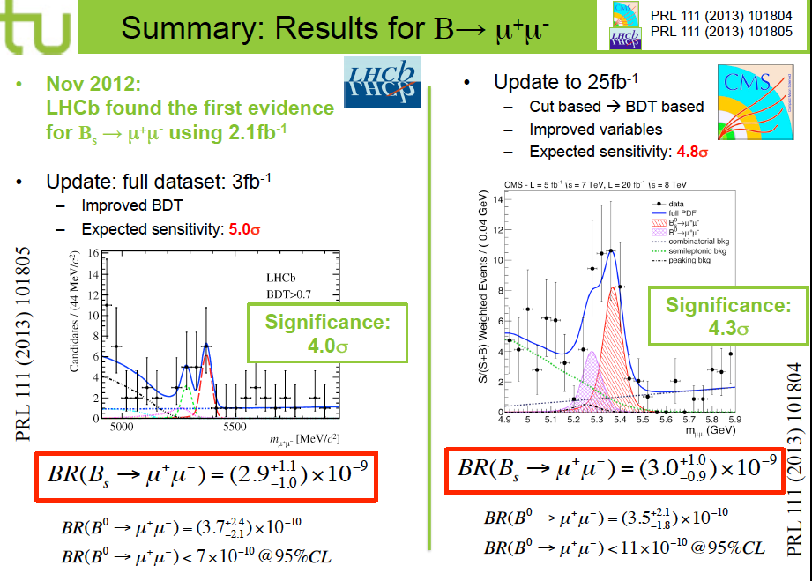

Slide 20
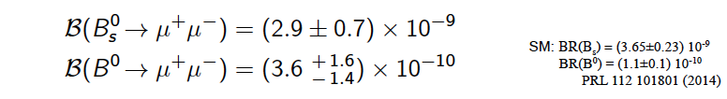
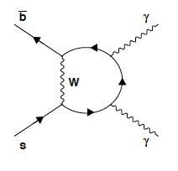
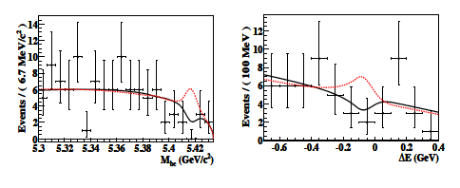

?
Combining evidence from two LHC experiments (LHCb and CMS), B_{s}→μ⁺ μ⁻ is observed with 6.2σ significance. The corresponding B_{d} decay is not seen yet.
NP constraints in talk by Monica D'Onofrio
BF (B_{s}→γγ) <3.1 x 10⁻⁶
Complementarity [needs Upsilon(5S) data]

Slide 21
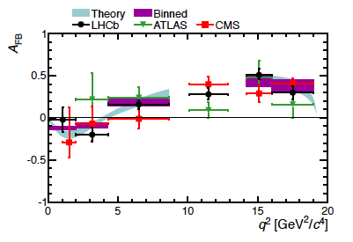
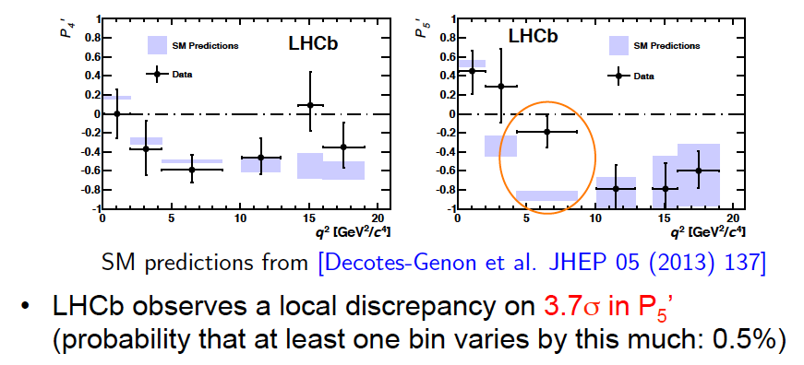
Forward-backward asymmetry in B→K*l⁺l⁻ vs q² due to γ-Z interference.
Complementarity: a super B Factories can do this measurement for inclusive b→s l⁺l⁻
Other observables

Slide 22
“Missing Energy” Decays

Slide 23

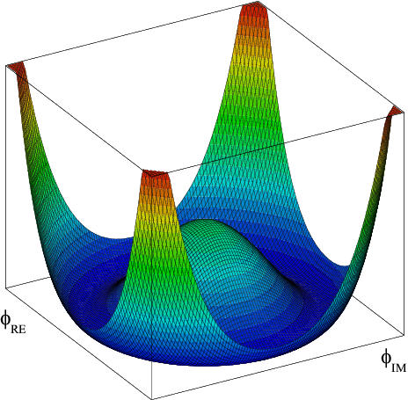
The BEH boson is now firmly established by experimental results from ATLAS and CMS. Now planning for Higgs factory facilities (e.g FCC, ILC, H-LHC).
.
Does the GP (Brout-Englert-Higgs particle) have a “brother” i.e. the charged Higgs ?
Measurements at B factories and direct searches at hadron colliders take complementary approaches to this important question.
Notes:
This prompted Leon Lederman to write a new book entitled “Beyond the God Particle”
Sensitivity from tau nu, D(*) tau nu decays and b→s gamma.
Hadron colliders directly search for H+ →tau nu.

Slide 24
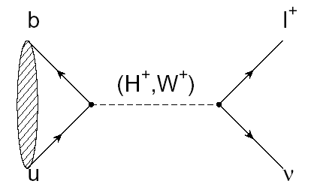
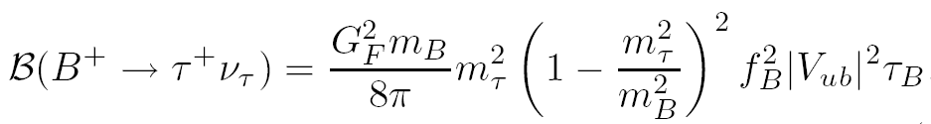

B→τ ν
(Decay with Large Missing Energy)
Sensitivity to new physics from a charged Higgs
W.S.Hou,. PRD 48, 2342 (1993)
The B meson decay constant, determined by the B wavefunction at the origin
(|V_{ub}| taken from indep. measurements.)

Slide 25
Consumer’s guide to charged Higgs
Higgs doublet of type I (couples with equal strength to upper and lower generations)
Higgs doublet of type II (couples with different strength to u and d-type quarks, tan(β) = v_{u}/v_{d} (favored NP scenario e.g. MSSM)
Higgs doublet of type III (not type I or type II; anything goes)

Slide 26
Why measuring B⁺→τ⁺ν is non-trivial
e⁺
ϒ(4S)
B⁻
B⁺
Most of the sensitivity is from tau modes with 1-prongs.
ν
ν_{e}
B⁻→X
ν_{e}
The experimental signature is rather difficult: B decays to a single charged track + nothing
(This may be hard at a hadron collider)

Slide 27
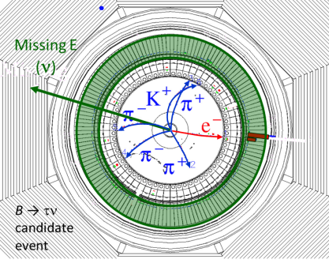
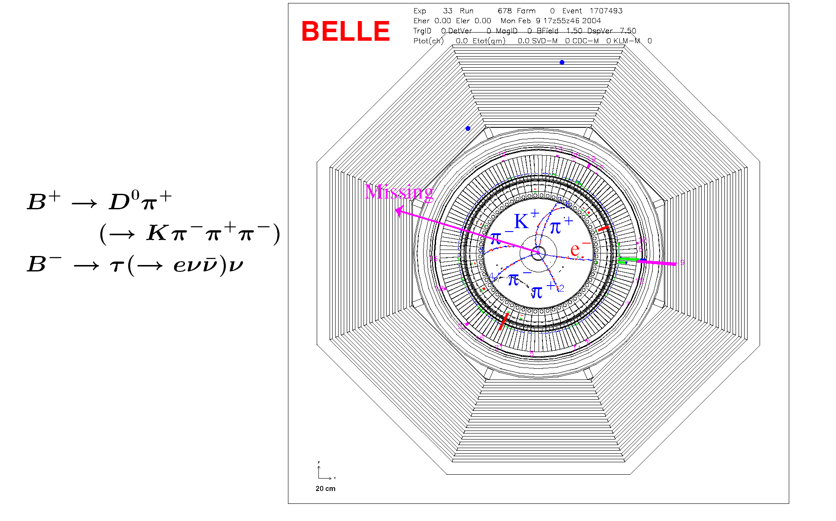
Example of a Missing Energy Decay (B→τν) in Data
The clean e+e- environment makes this possible

Slide 28
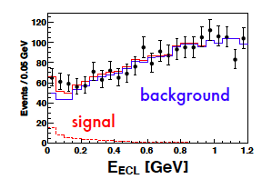
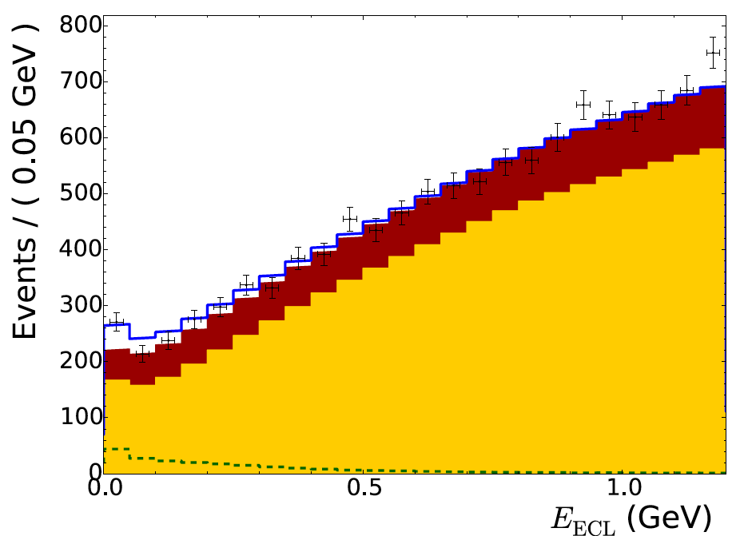
Example: Belle B→τν results with full reprocessed data sample and either hadronic or semileptonic tags (new arXiv: 1409.5269)
Hadronic tags: 63±22.5 (3σ)
Idea: With the “single B meson beam”, we look for a single track from a τ, missing energy/momentun and extra calorimeter energy close to zero.
Semileptonic tags:
222±50 (3.8σ)
With the full B factory statistics only “evidence”. No single observation from either Belle or BaBar.
The horizontal axis is the “Extra Calorimeter Energy”
Notes:
The signal peaks at zero

Slide 29
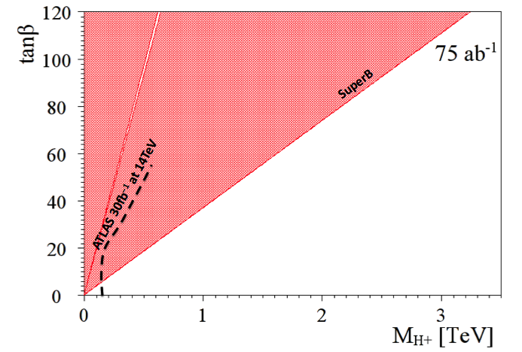
Complementarity of e+ e- factories and LHC
(Slide adapted from A. Bevan)
The current combined limit places a stronger constraint than direct searches from LHC exps. for the next few years.
1 ab⁻¹
Belle II
Currently inclusive b to sγ rules out m_{H+} below ~400 GeV/c² range (independent of tanβ)
This region is allowed
http://arxiv.org/abs/1208.2788

Slide 30
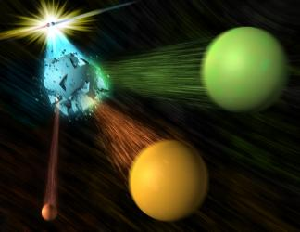
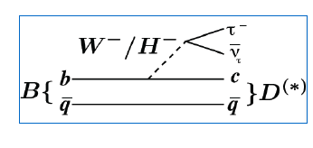
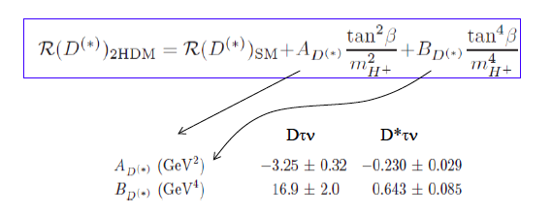

Slide adapted from A. Soffer

Slide 31
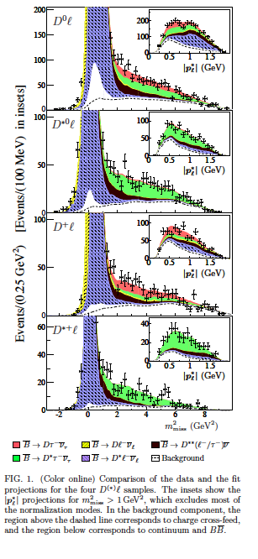
Example from a recent BaBar paper
Signals in B→D^{(*)} τν (489±63, 888±63)
Missing mass variable:
m_{miss}² =p_{miss}²=(p[e⁺e⁻]-p_{tag}-p_{D(*)}-p_{l})²
P_{l}* = momentum of lepton in B rest frame
Production of B meson pairs at threshold is critical to the separation of backgrounds from the missing energy/ momentum signal.

Slide 32
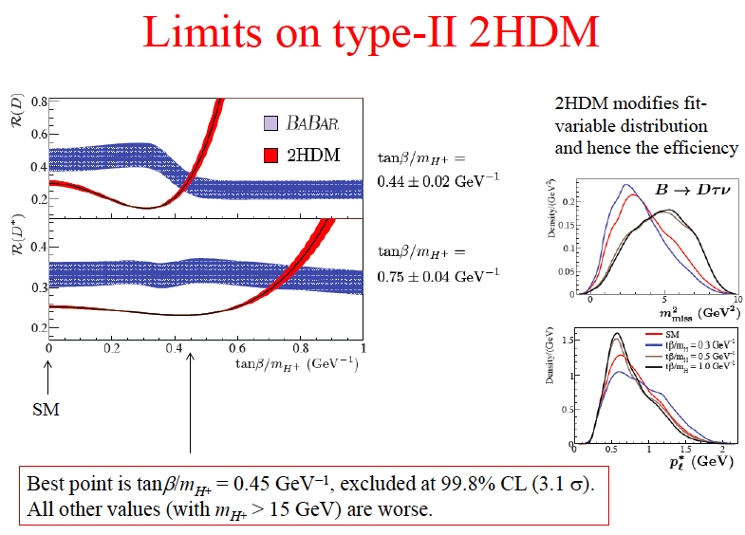
Notes:
The two best points disagree with each other

Slide 33

BaBar collaboration, Phys. Rev. Lett. 109, 101802 (2012)
“However, the combination of R(D) and R(D*) excludes the type II 2HDM charged Higgs boson with a 99.8% confidence level for any value of tan(β)/m_{H+}”
In other words, found NP but killed the 2HDM NP model.
A few points:
(0) Still waiting for the Belle update (PRD 82,.072005 (2010))
(1) If the R values fluctuate back down in the future, this will allow NP from type II charged Higgs to be viable.
(2) It is obvious that we need two orders of magnitude of data to solve these issues related to the charged Higgs.
Notes:
Add the R picture again

Slide 34



The Next Generation
Belle II and the LHCb upgrade
2014 is the 50th anniversary of the discovery of CP violation in the kaon sector [see http://pprc.qmul.ac.uk/research/50-years-cp-violation
US P5 report (p. v): “Explore the unknown: new particles, interactions, and physical principles”

Slide 35

Physics Reach of Belle II and the LHCb upgrade

Slide 36


SuperKEKB luminosity profile
Belle/KEKB recorded ~1000 fb⁻¹ . Now change units to ab⁻¹
Also see talks by A. Suzuki,
Y. Sakai
Goal of Belle II/SuperKEKB
Integrated luminosity
(ab⁻¹)
9 months/year
20 days/month
Commissioning starts
in late 2015. Physics in late 2017
Peak luminosity
(cm⁻²s⁻¹)
Calendar Year
Notes:
Commissioning starts in Dec 2015, first without final focus superconducting quads then with quads. These first two phases of background commissioning are referred to as Phase I and Phase II. After Phase II is completed, the vertex detectors are installed and physics running begins (probably in late 2017 or early 2018).

Slide 37
Compare the Parameters for KEKB and SuperKEKB
 | KEKB Design | KEKB Achieved : with crab | SuperKEKB Nano-Beam
Energy (GeV) (LER/HER) | 3.5/8.0 | 3.5/8.0 | 4.0/7.0
β_{y} * (mm) | 10/10 | 5.9/5.9 | 0.27/0.30
β_{x} * (mm) | 330/330 | 1200/1200 | 32/25
ε_{x} (nm) | 18/18 | 18/24 | 3.2/5.3
ε_{y} /ε_{x} (%) | 1 | 0.85/0.64 | 0.27/0.24
σ_{y}(mm) | 1.9 | 0.94 | 0.048/0.062
σ_{y} | 0.052 | 0.129/0.090 | 0.09/0.081
σ_{z} (mm) | 4 | 6 - 7 | 6/5
I_{beam} (A) | 2.6/1.1 | 1.64/1.19 | 3.6/2.6
N_{bunches} | 5000 | 1584 | 2500
Luminosity (10³⁴ cm⁻² s⁻¹) | 1 | 2.11 | 80
Nano-beams are the key (vertical spot size is ~50nm !!)
This is not a typo
Notes:
The jump from CESR to the B factories (PEP-II, KEKB) was not significant in per bunch parameters. However, the number of bunches and the beam currents were much larger. There is greater than an order of magnitude reduction in beam size and emittance.

Slide 38











Talk by Y. Sakai at ICFA2014
Colliding bunches
New superconducting final focusing magnets near the IP
e⁺ 3.6A
e⁻ 2.6A
KEKB to SuperKEKB
Redesign the lattice to reduce the emittance (replace short dipoles with longer ones, increase wiggler cycles) (all magnets installed 8/2014)
Nano-Beam scheme
extremely small β_{y}*
low emittance
Beam current X 2
Reinforce RF systems for
higher beam currents
40 times higher luminosity
2.1x10³⁴ → 8x10³⁵ cm⁻²s⁻¹
Replace beam pipes with TiN-coated beam pipes with antechambers (85% installed)
Improve monitors and control system
Injector Linac upgrade
Upgrade positron capture section
DR tunnel
Low emittance
RF electron gun
New e+ Damping Ring
constructed
Notes:
Construction is nearly complete. Commissioning of SuperKEKB will start in 2015. Refer to Kanazawa pàrallel talk.

Slide 39
Belle II Detector
KL and muon detector:
Resistive Plate Counter (barrel outer layers)
Scintillator + WLSF + MPPC (end-caps , inner 2 barrel layers)
EM Calorimeter:
CsI(Tl), waveform sampling (barrel)
Pure CsI + waveform sampling (end-caps)
Particle Identification
Time-of-Propagation counter (barrel)
Prox. focusing Aerogel RICH (fwd)
electrons (7GeV)
Beryllium beam pipe
2cm diameter
Vertex Detector
2 layers DEPFET + 4 layers DSSD
positrons (4GeV)
Central Drift Chamber
He(50%):C2H6(50%), small cells, long lever arm, fast electronics
Notes:
Reuses the structure, solenoid and CsI(Tl) crystals and part of the barrel RPCs. Most other components are new.
We must prepare for backgrounds a factor of 10-20 higher. Hence the use of DEPFET pixels for inner vertexing and a new silicon vertex detector with the APV2.5 readout chip from CMS. The PID is based on Cherenkov counters. For the barrel, the Cerenkov light is totally internally reflected to an array of pixelated PMTs. High precision timing and position information is used to distinguish kaons from pions.

Slide 40


Barrel PID
A GEANT4 event display of a 2 GeV pion and kaon interacting in a TOP quartz bar. (Japan, US, Slovenia, Italy)
Incoming track
Vertexing/Inner Tracking
Beampipe r= 10 mm
DEPFET pixels (Germany, Czech Republic…)
Layer 1 r=14 mm
Layer 2 r= 22 mm
DSSD (double sided silicon detectors)
Layer 3 r=38 mm (Australia)
Layer 4 r=80 mm (India)
Layer 5 r=115 mm (Austria)
Layer 6 r=140 mm (Japan)
FWD/BWD Italy
+Poland, Korea
Notes:
Pion is green and kaon is red

Slide 41


“Missing Energy Decay” in a Belle II GEANT4 MC
B→τν, τ→eνν B→Dπ, D→Kπππ
Zoomed view of the vertex region
e

Slide 42

Also see ICFA talk by P. Allport

Slide 43

Notes:
N.B. Trigger-less read-out !!

Slide 44

LHCb upgrade schedule
Run at ~4 x 10³² /cm² /sec
Expect (1-2) x 10³³ /cm² /sec
[Also see talk of Frederick Bordry]
Upgraded trigger and DAQ is the key feature

Slide 45
Conclusion/Next Generation
2014 is the 50th anniversary of the discovery of CP violation in the kaon sector.
The e+ e- B factories confirmed that the KM phase is responsible for most of the observed CPV.
LHCb has ruled out large CPV phases from NP in the B_{s} sector. LHC exps (CMS, LHCb) measured B_{s}→μ⁺ μ⁻
Nevertheless, 10-20% NP effects are consistent with all current data.
“Missing energy decays” provide important constraints on the charged Higgs.
Belle II physics runs in late 2017 and the LHCb upgrade in ~2020. These facilities will inaugurate a new era of flavor physics and the study of CP violation.

Slide 46

Backup slides

Slide 47


See Y. Sakai-san’s talk earlier in the day (session 9) for details.

Slide 48
New Reference for the Next Generation
The Physics of the B Factories
http://arxiv.org/abs/1406.6311
This work is on the Physics of the B Factories. Part A of this book contains a brief description of the SLAC and KEK B Factories as well as their detectors, BaBar and Belle, and data taking related issues. Part B discusses tools and methods used by the experiments in order to obtain results. The results themselves can be found in Part C.
Comments: 928 pages
Subjects: High Energy Physics - Experiment (hep-ex); High Energy Physics - Phenomenology (hep-ph)
Report number: SLAC-PUB-15968, KEK Preprint 2014-3

Slide 49


The scene at KEK in June 2014
Fuji Hall
Tsukuba Hall
Central Drift Chamber
Belle II detector with barrel KLM upgrade and forward muon endcap upgrade now installed. Next is the backward KLM upgrade.

Slide 50
More backup

Slide 51

J. Bernabeu and F. Martinez-Vidal, to appear in RMP 2014

Slide 52

Comparison of BaBar and Belle (not updated)

Slide 53
New CMS Bs mixing result

Slide 54


Slide 55


Slide 56
New LHCb γ results

Slide 57


Slide 58

W. Qian at ICHEP2014

Slide 59

W. Qian@ICHEP2014

Slide 60

W. Qian @ICHEP2014

Slide 61

M.Needham@ICHEP2014
But LHCb dominates on these B_{S} modes

Slide 62
Belle results on γ at ICHEP2014

Slide 63

Y. Onuki @ICHEP2014

Slide 64

Y. Onuki @ICHEP2014

Slide 65

Y. Onuki @ICHEP2014

Slide 66
New BaBar result on CPV in B→K* π

Slide 67


Slide 68


Slide 69


Slide 70

Belle charm mixing and CPV results at ICHEP 2014

