Slide 1
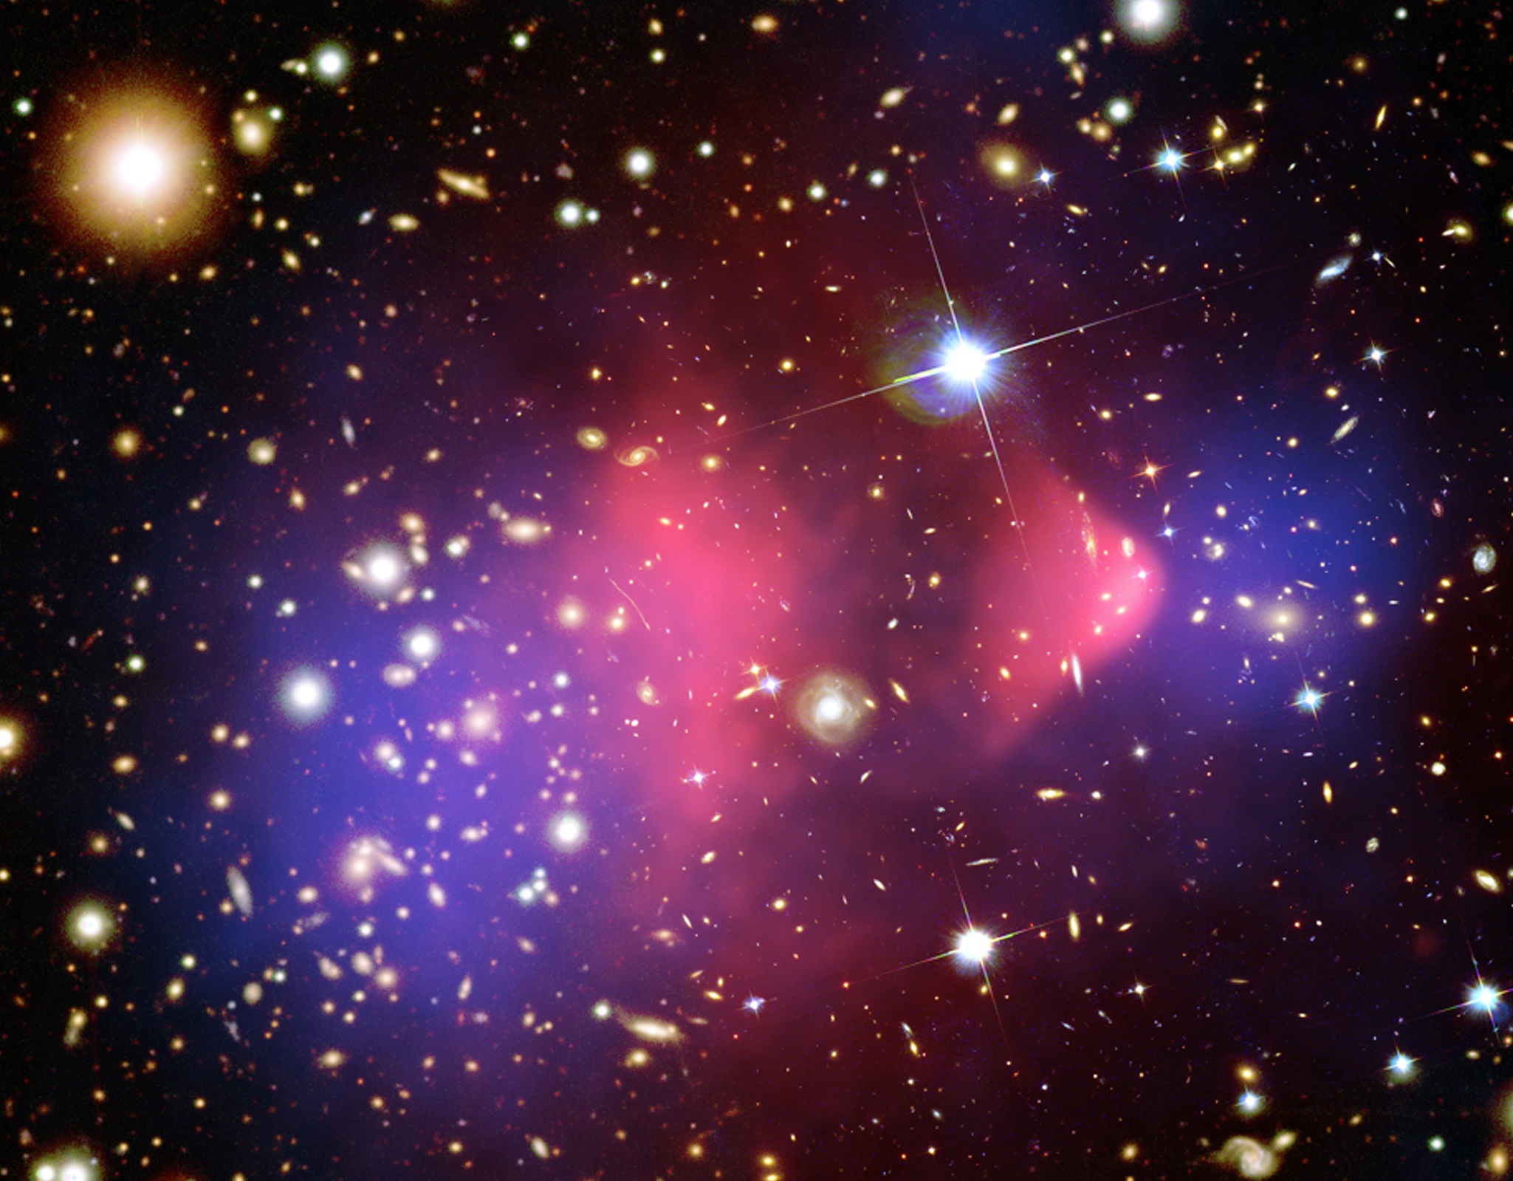
Dark Matter Searches
Bullet Cluster
Long Lived
Not produced at accelerators
New quantum #? Very Massive? Feeble coupling to our particles?
Harry Nelson
LUX, LZ Spokesperson
October 29, 2014
ICFA Seminar Beijing

Slide 2
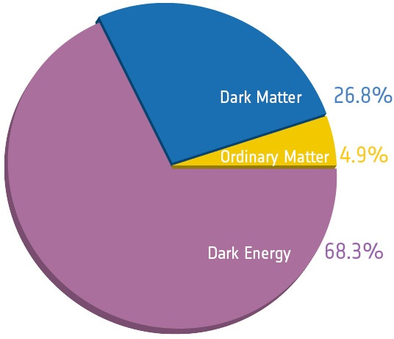
Components of the Universe
Planck
Notes:
PLANCK

Slide 3
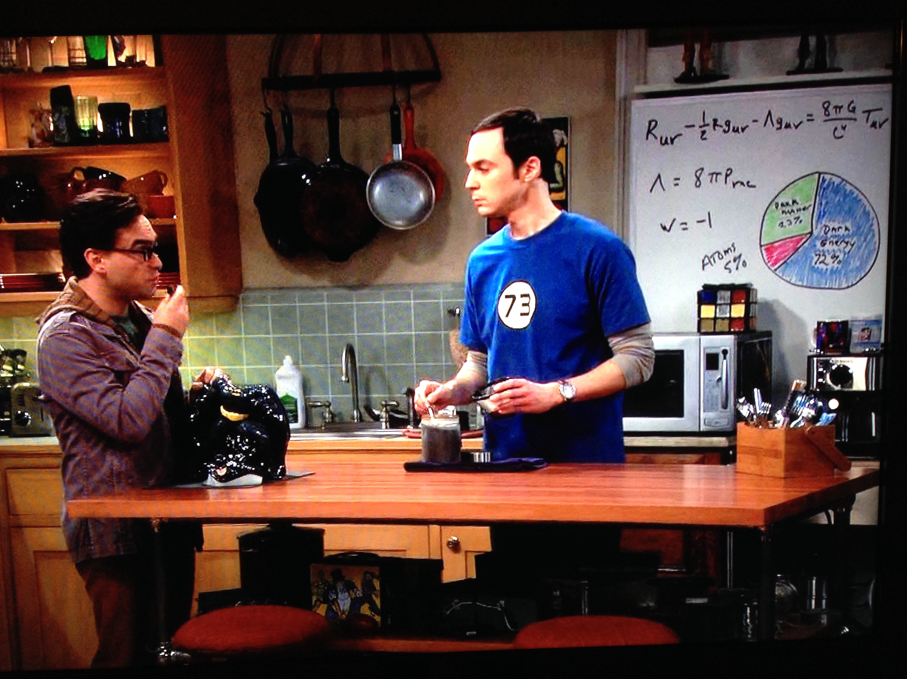
Kitchen Whiteboard
Notes:
Weakly Interacting, as cools

Slide 4
Some of Our Lamposts
Interaction(s) | Describes | Candidate
Weak | Ω_{dark matter} (equilibrium, SUSY) | WIMP (Neutralino) M≈M_{weak}≈100 GeV
Dark Sector (tiny mixing with our sector) | Complexity commensurate with our sector’s | Heavy Dark Light
Strong | Absence of CP violation | axion
M≈5M_{proton}≈5 GeV
Notes:
PLANCK

Slide 5
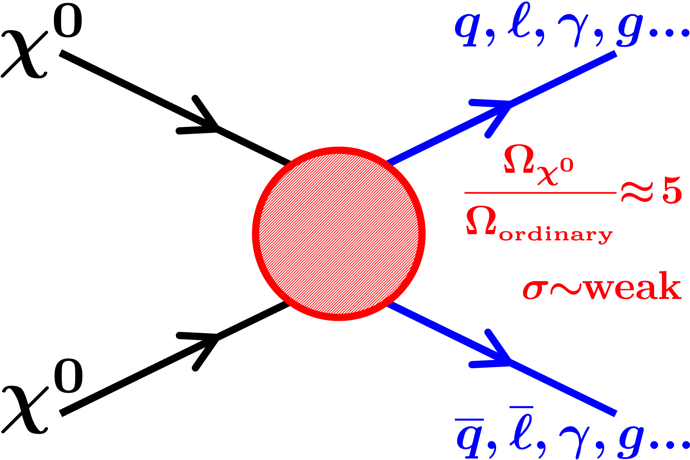
WIMPs during the Big Bang…
Indirect Detection: same process today.
Notes:
Weakly Interacting, as cools

Slide 6
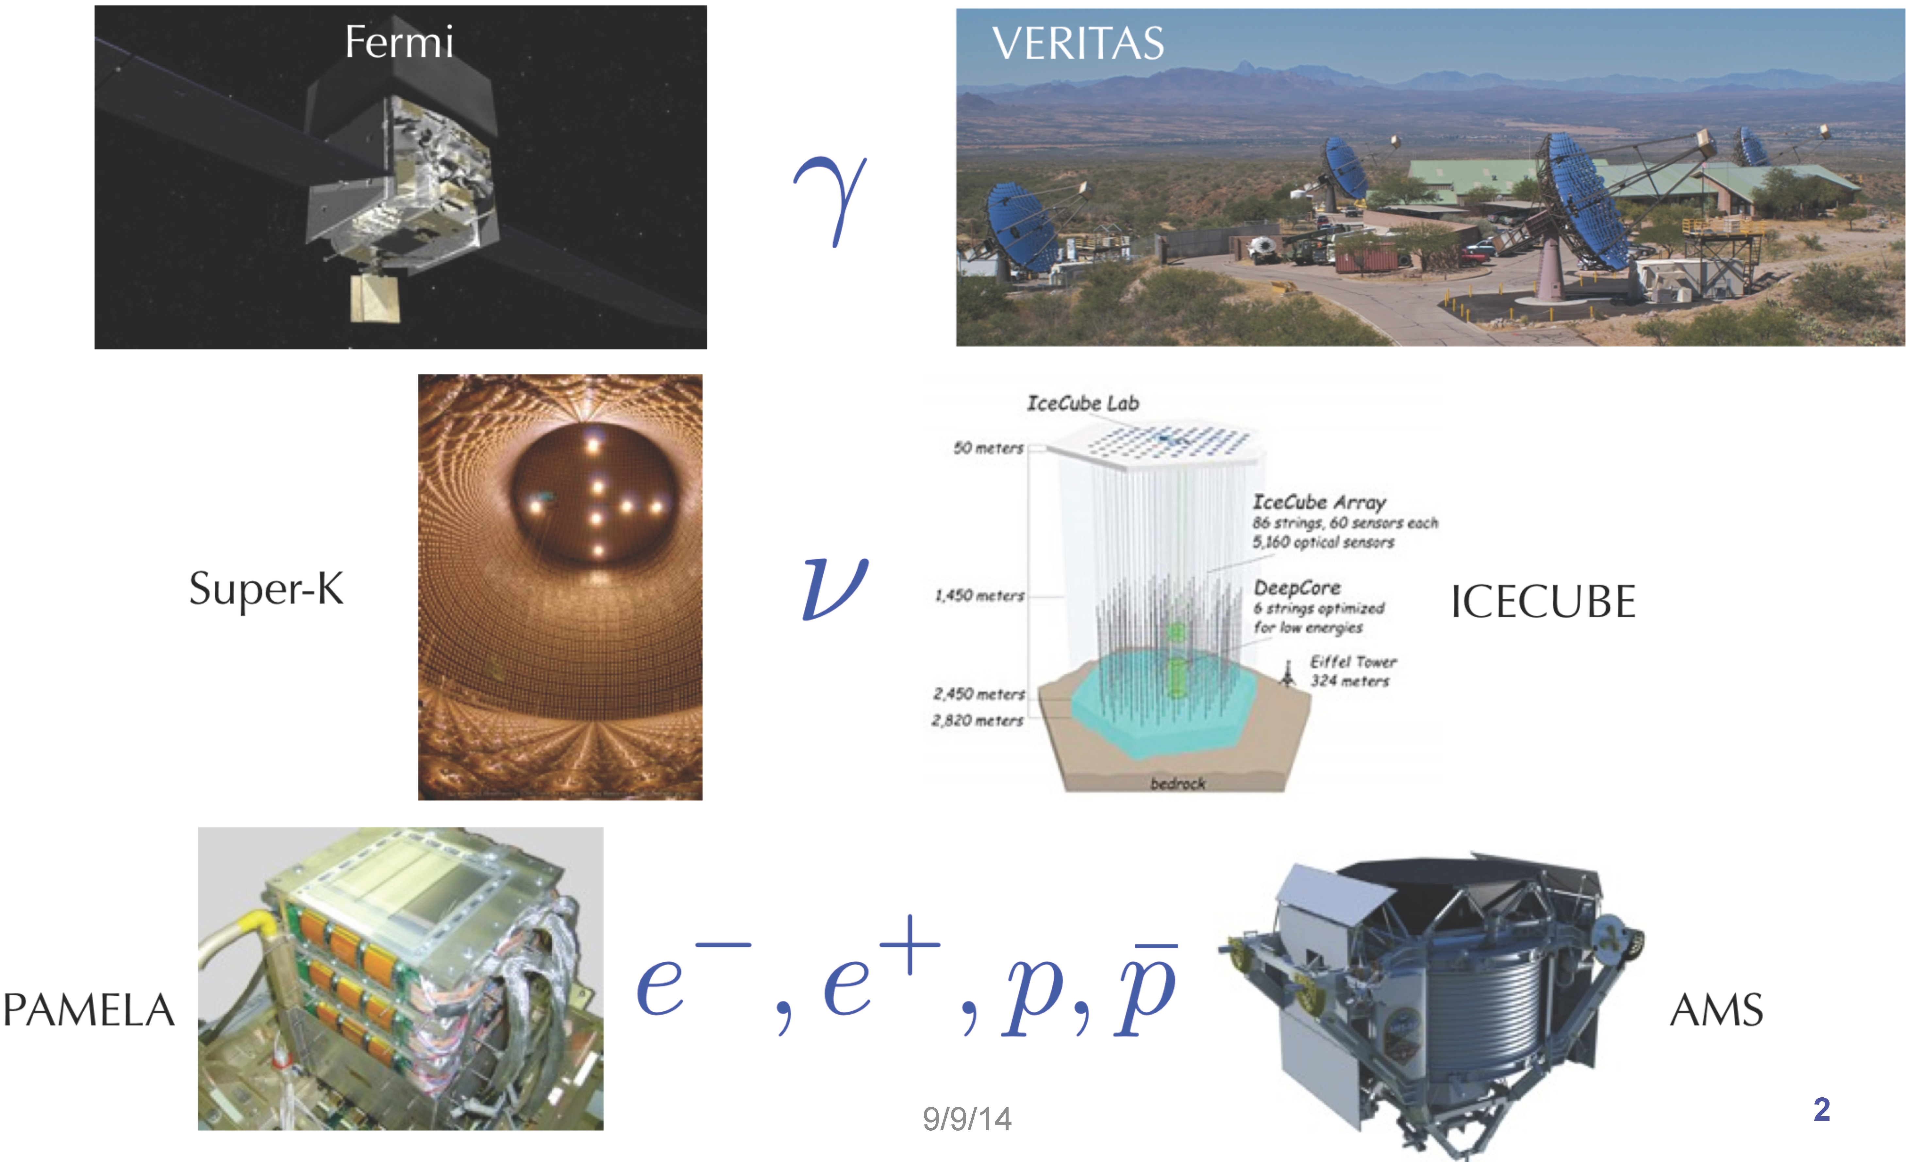
Indirect Detection
From Matthew Wood, SLAC
Notes:
Weakly Interacting, as cools

Slide 7
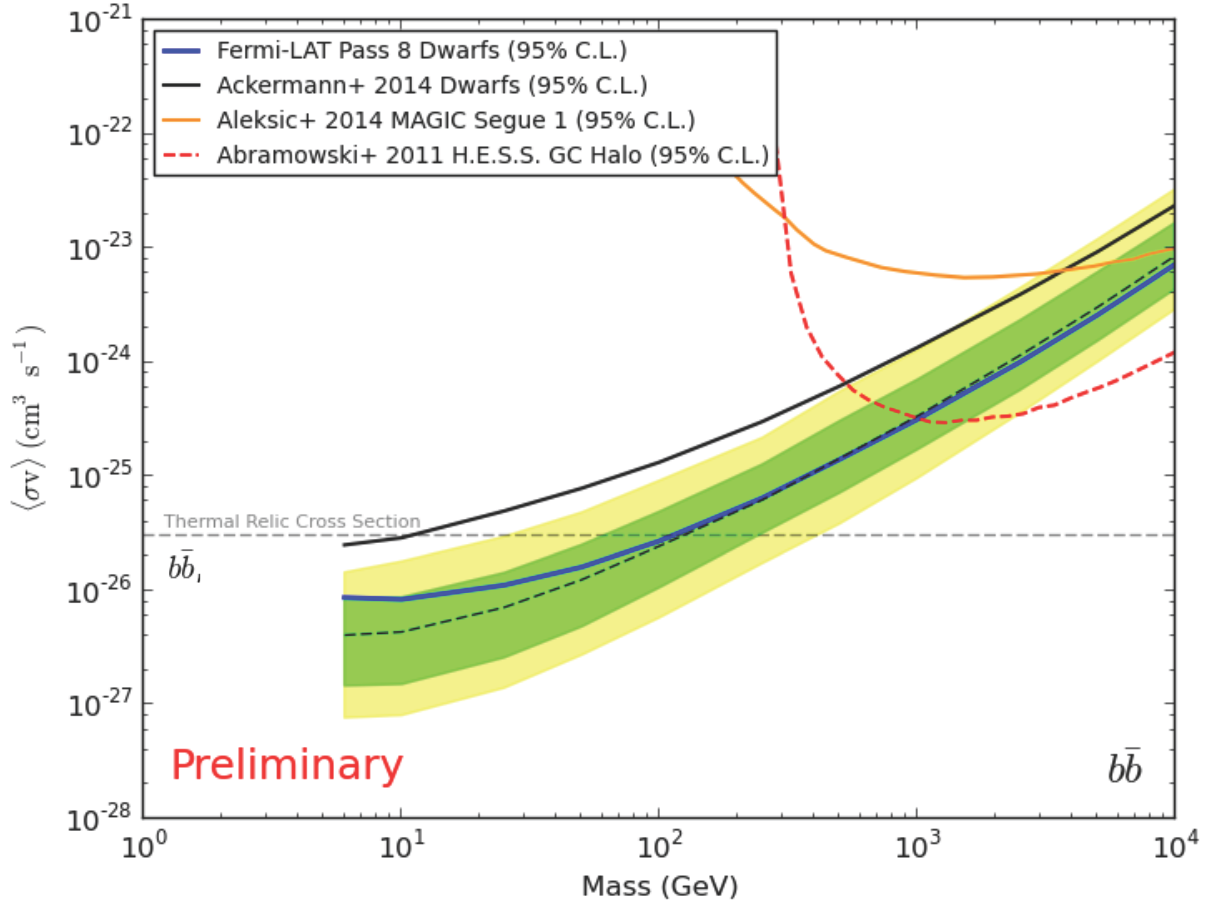
New Fermi-LAT results from 15 nearby dwarf galaxies
`Pass 8’ reprocessing:
much better acceptance <100 MeV
improved resolution
5.8 years… nearly bkgd free
MAGIC
1 Dwarf
H.E.S.S.
Galactic Center
From Brandon Anderson, Stockholm
Notes:
Weakly Interacting, as cools

Slide 8
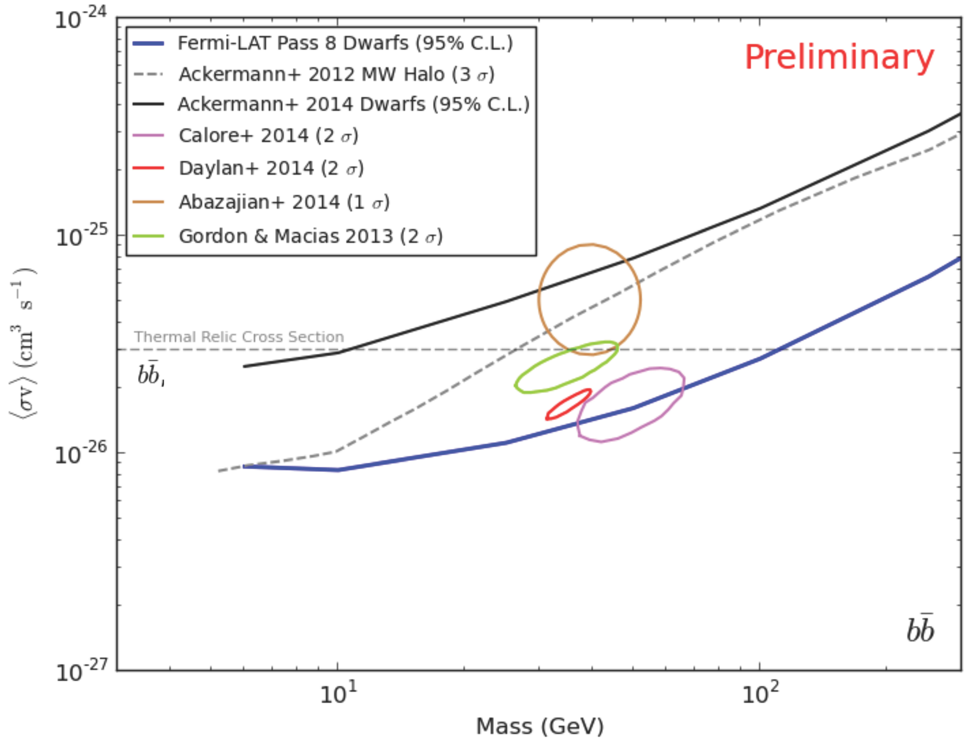
Fermi-LAT: Dwarfs v. GC
Various ROI
Understanding of the Galactic Center progressing
From Brandon Anderson, Stockholm
Notes:
Weakly Interacting, as cools

Slide 9
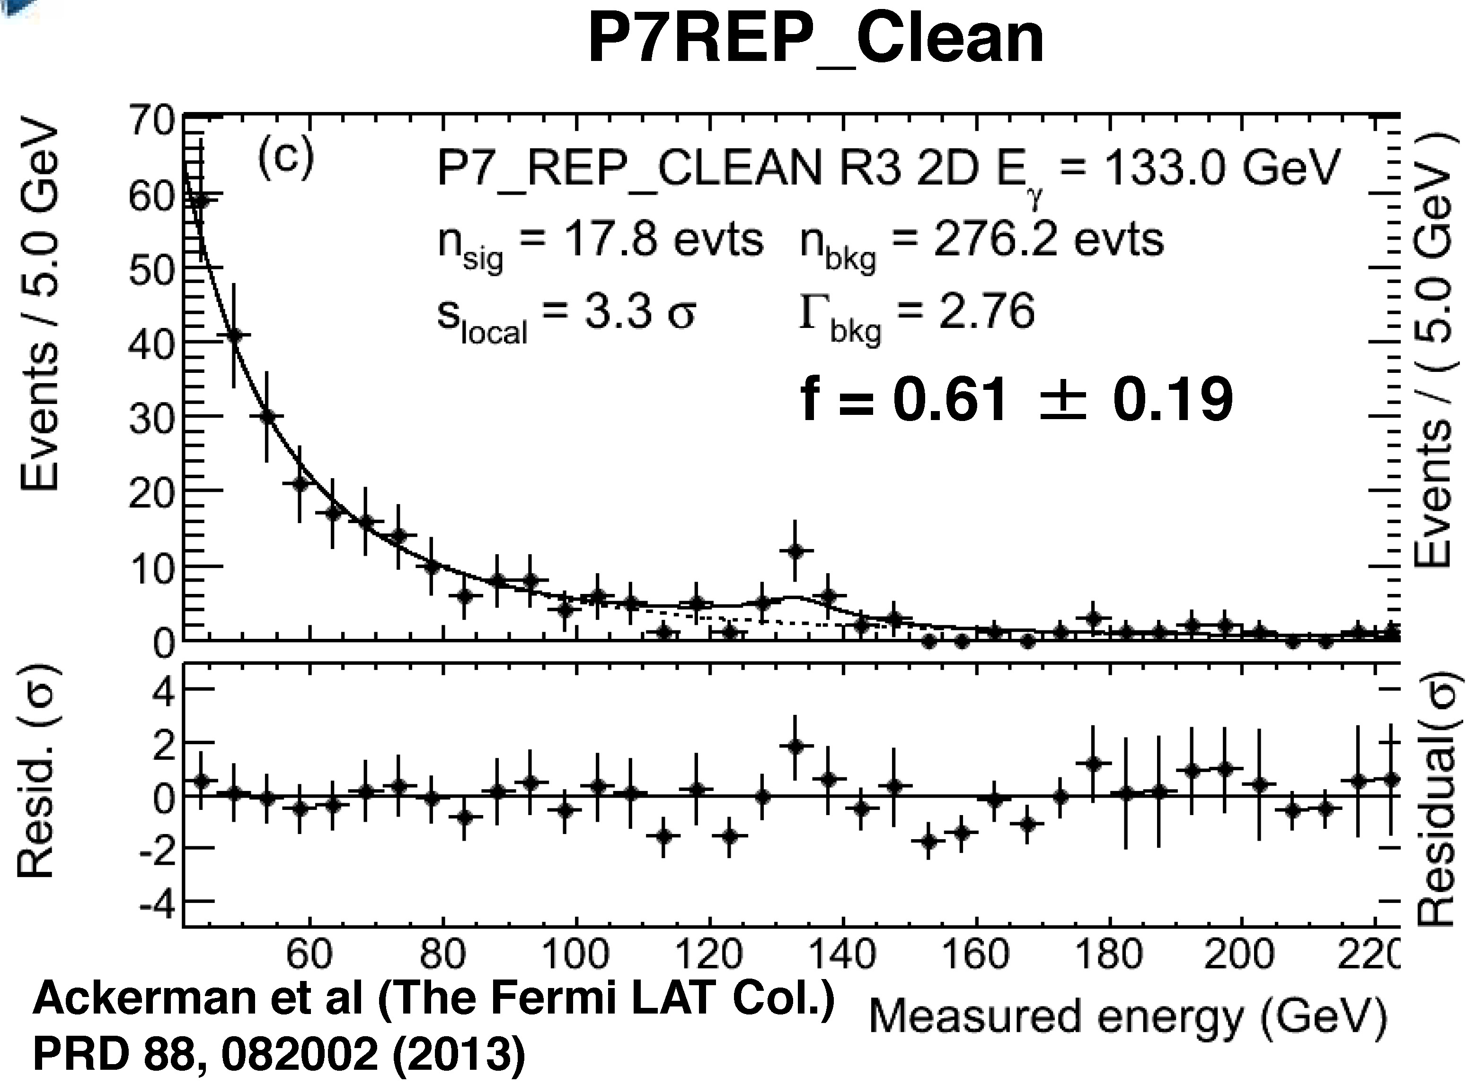
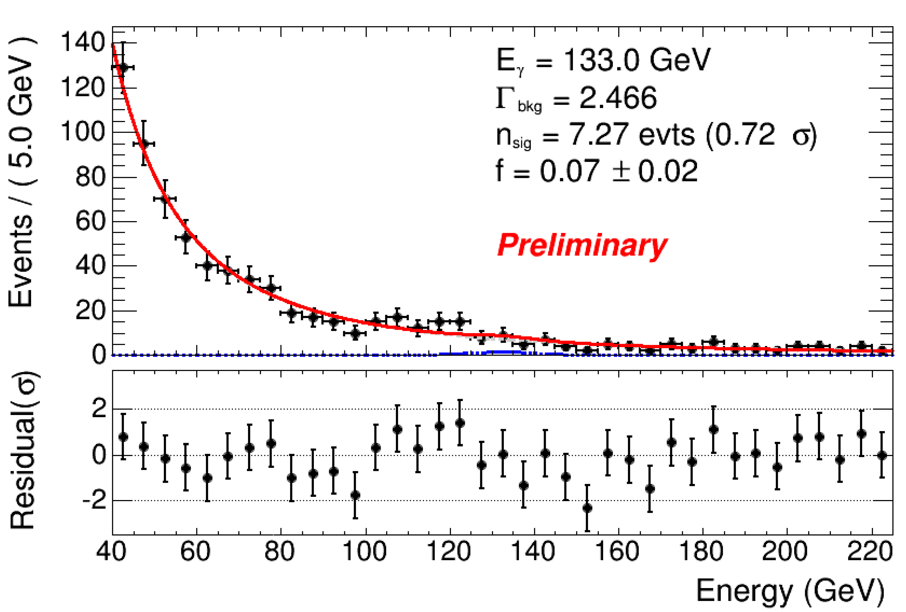
133 GeV Line
3° around Galactic Center
3.7y
5.8y
Andrea Albert, SLAC
Notes:
Weakly Interacting, as cools

Slide 10
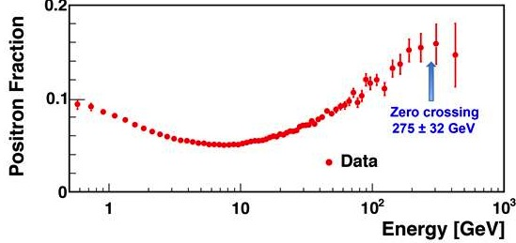
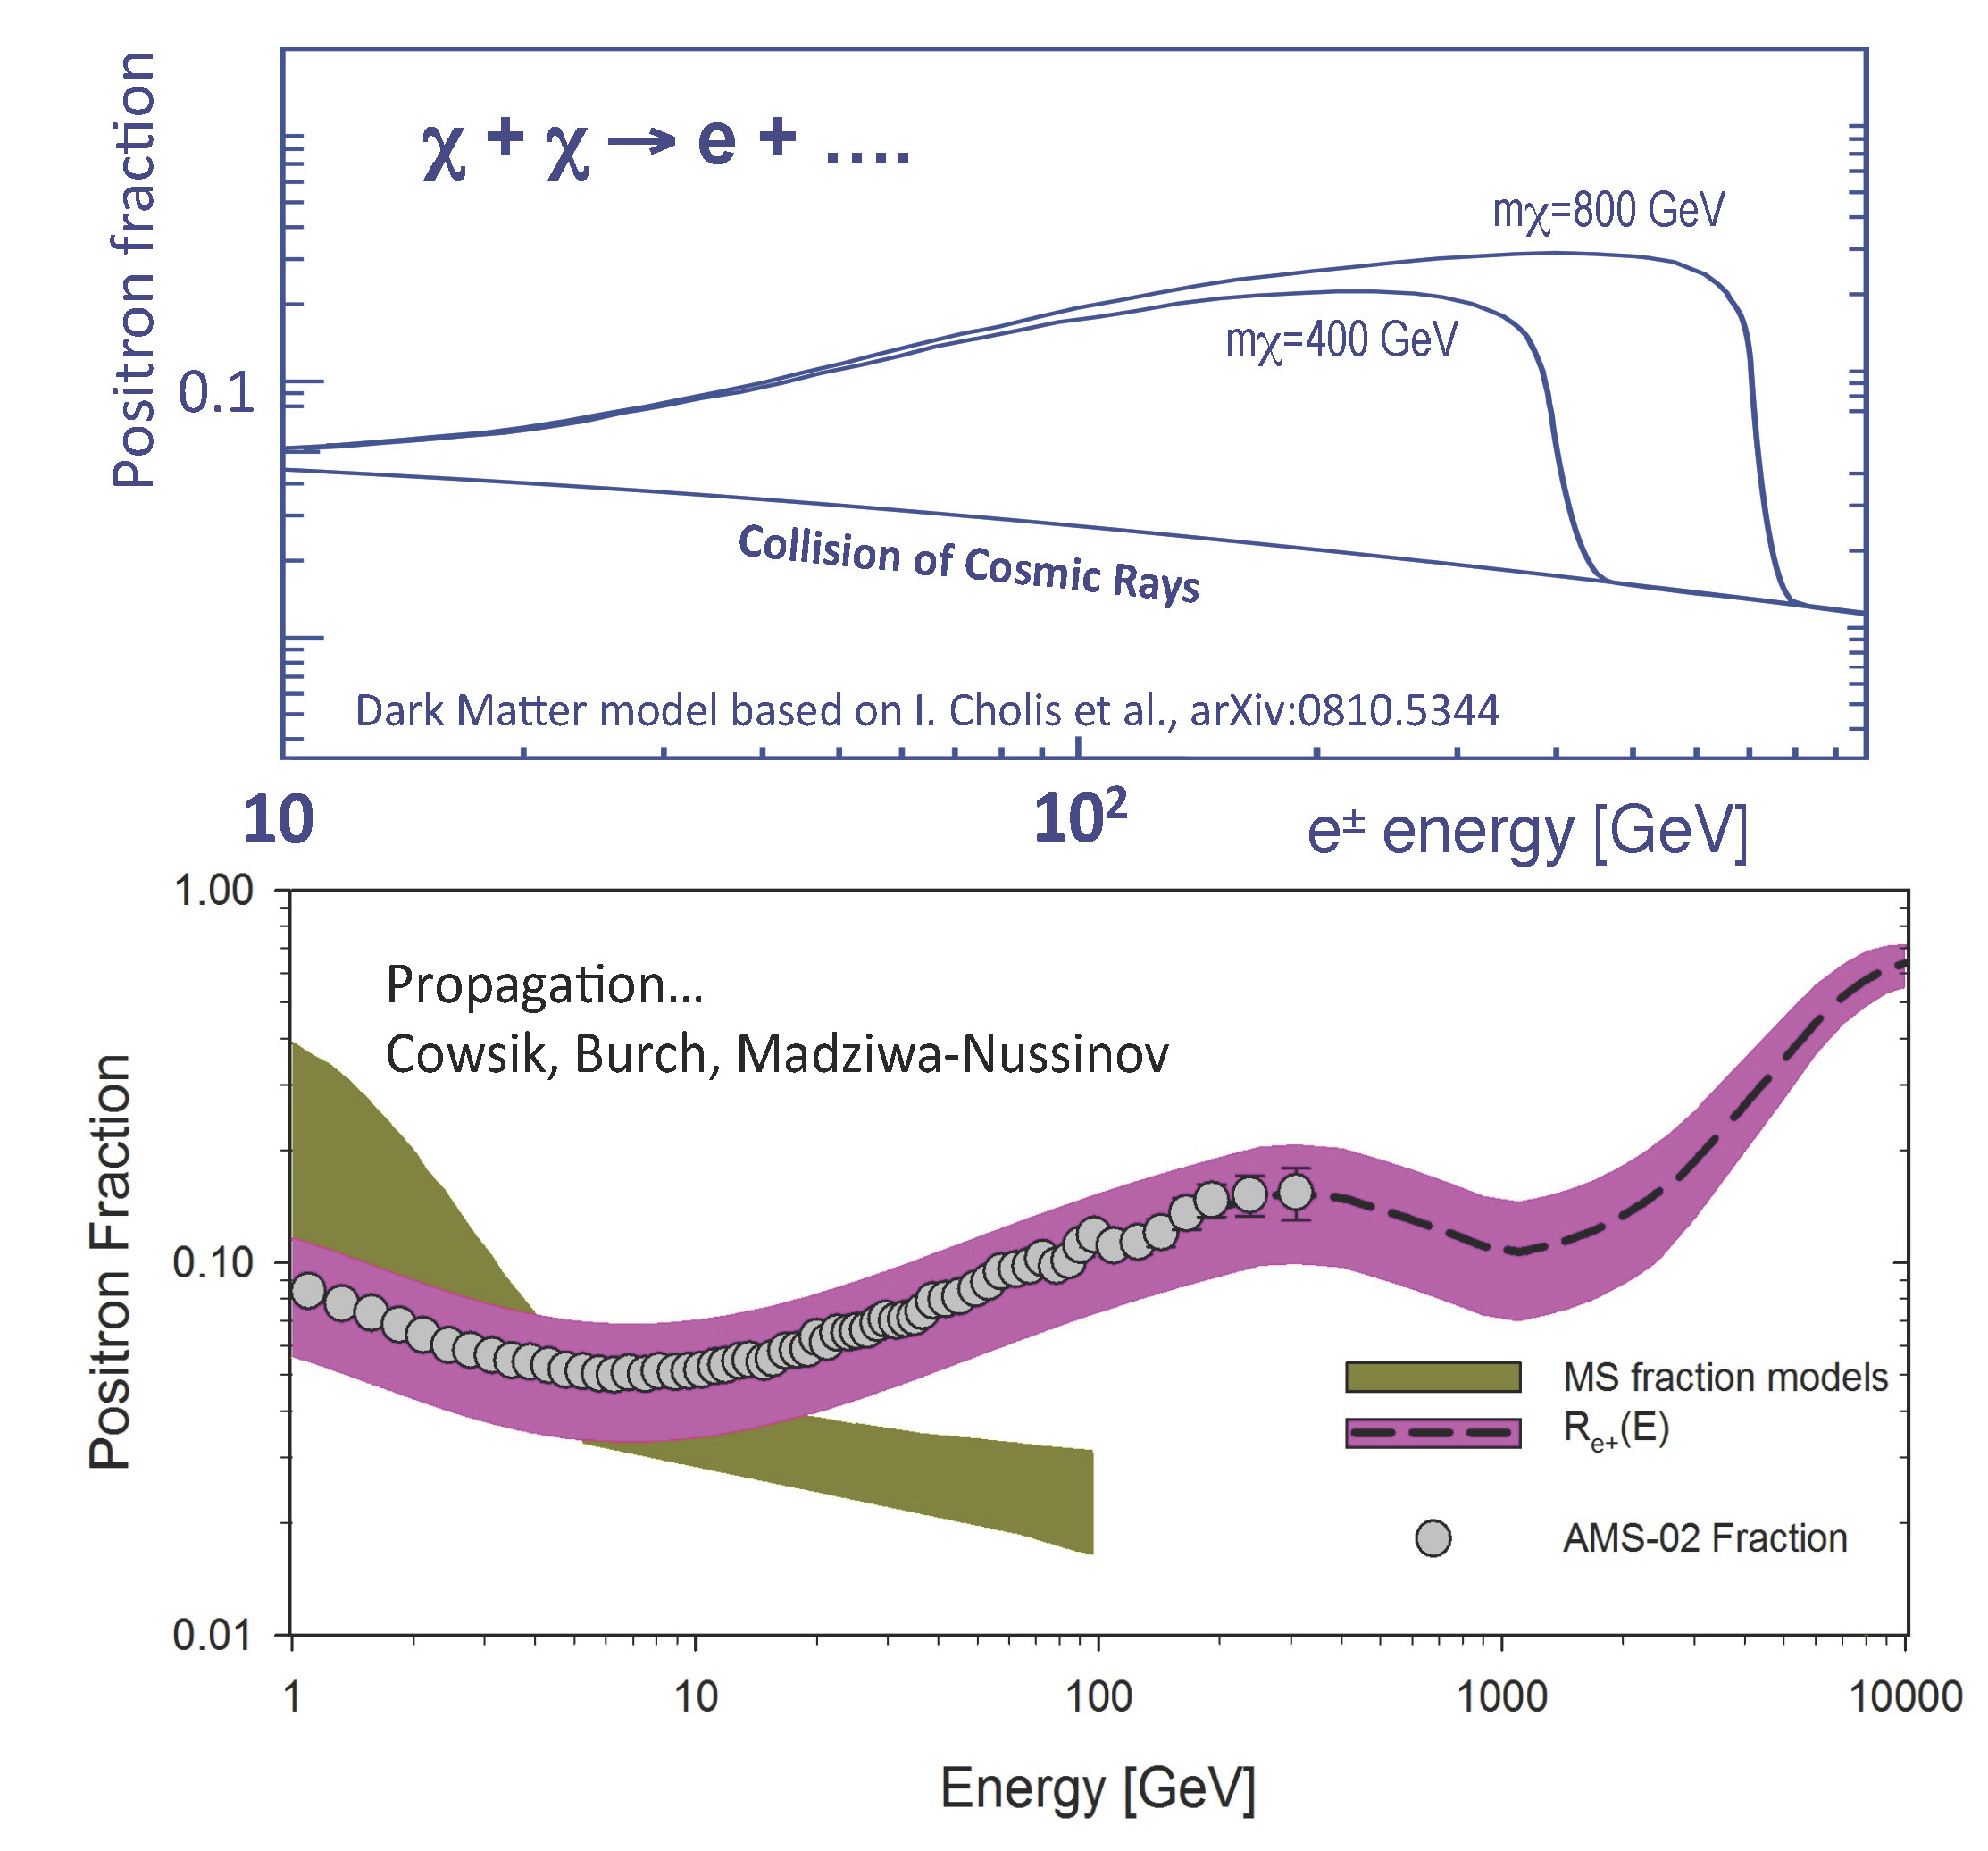
AMS Positron Fraction
(horizontal scales different)
Data… fantastic quality
1 10 10² 10³ GeV
WIMP annihilation
Purple… Cosmic Ray propagatin, old AMS Data
Notes:
Weakly Interacting, as cools

Slide 11
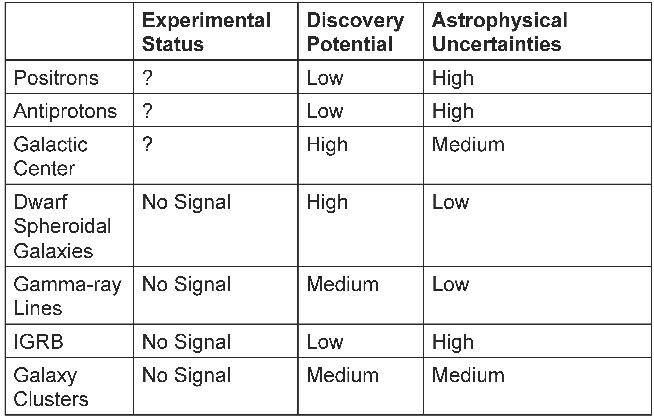
Scorecard
Neutrinos fr. Earth, Sun
No Signal
High
Low
From Matthew Wood, SLAC
Notes:
Weakly Interacting, as cools

Slide 12
Cross the Diagram
Notes:
Weakly Interacting, as cools

Slide 13
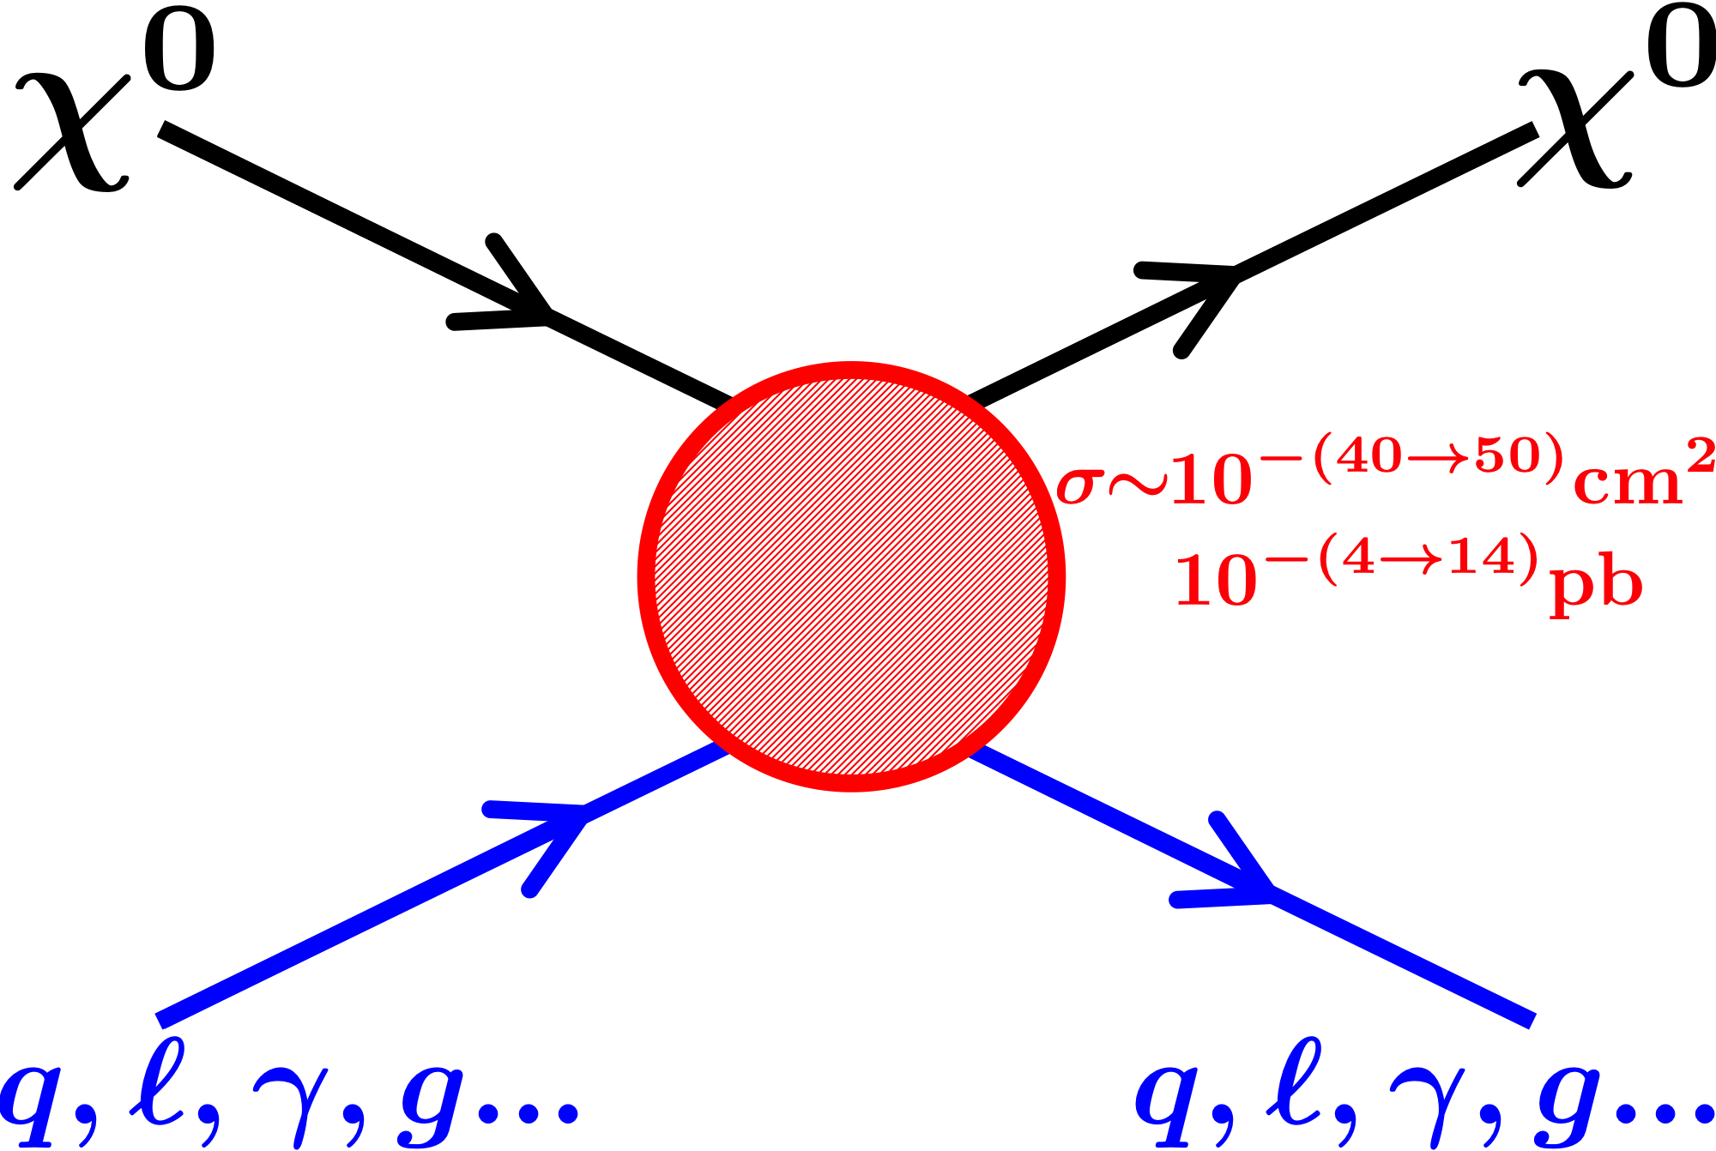
Direct Detection

Slide 14
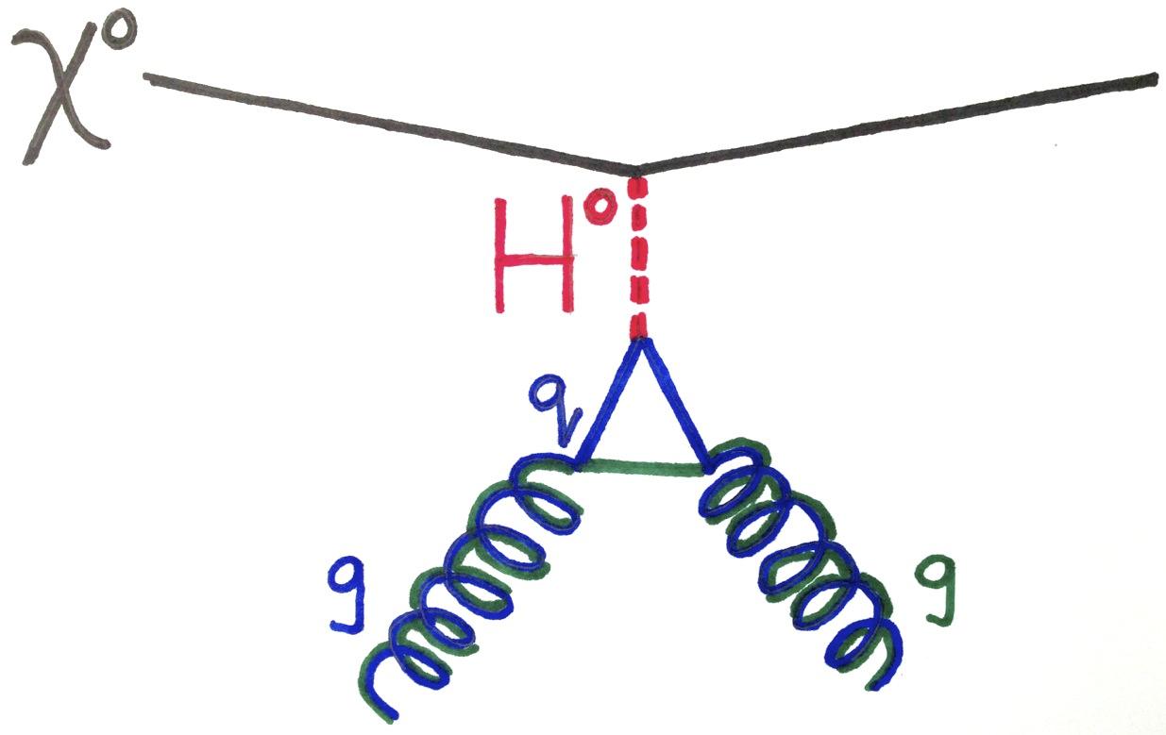
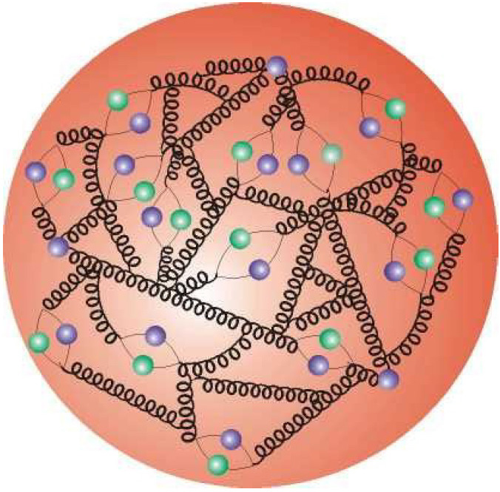
Benchmark Process
Spin-Independent
coherent, σ ≈ A⁽²⁻⁴⁾
High A Favored (Xenon)
Nucleon
n/p same
Notes:
Z0 TOO

Slide 15
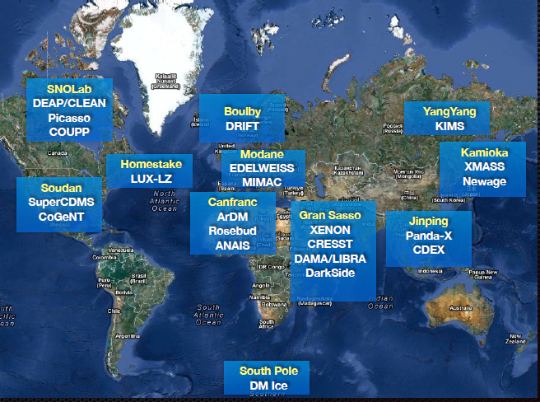
Dark matter searches
Elena Aprile through Nigel Lockyer
Notes:
Complicated

Slide 16
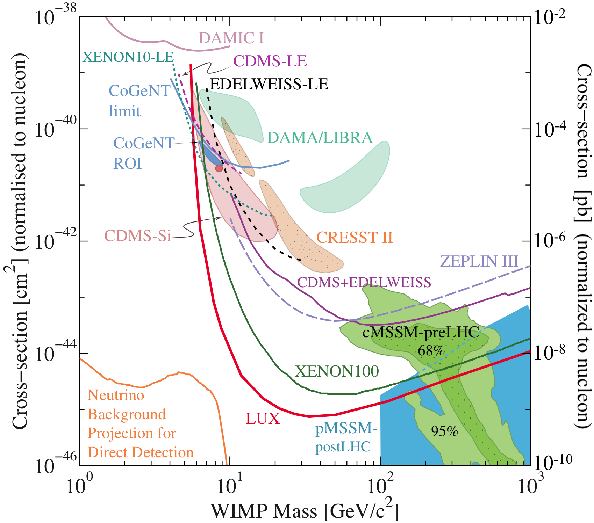
As of RPP 2014 (>4 since!)
Notes:
Complicated

Slide 17
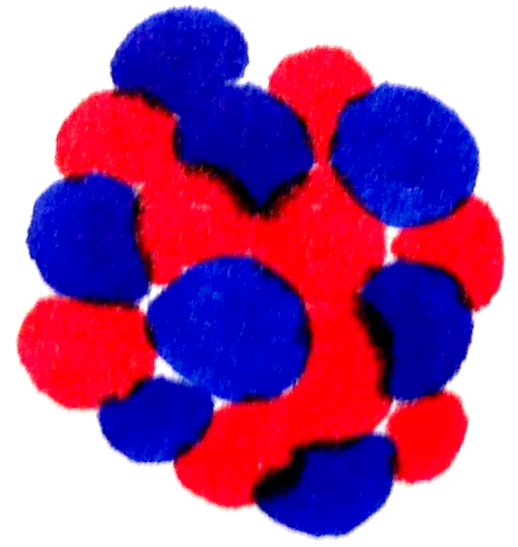
As of RPP 2014 (>3 since!)
Little energy transfer
(threshold-inos)
Flux declines
Notes:
Complicated

Slide 18
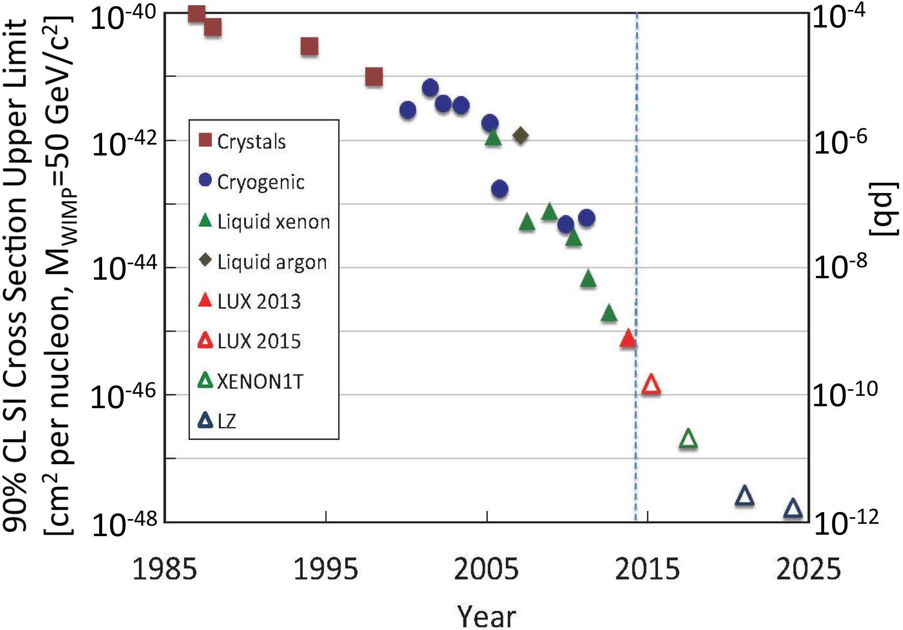
Race to the Bottom
Ge, NaI no discrimination
Ge, w/discrim.
ZEPLIN
LXe, w/discrim.
LUX
XENON 1T
LZ
As simple as possible, but no simpler

Slide 19
Signal and Background
Nucleus
Recoils
Electron
Recoils
E_{r}≈30 keV_{nr}
v/c ≈ 0.8×10⁻³
E_{r}≈ 30 keV_{ee}
v/c ≈ 0.3
χ⁰ (calibrate: neutron)
γ, e⁻ (calibrate: tritium injection)
Discrimination – detector’s ability to distinguish these

Slide 20
LUX has excelled at calibration
Background calibration
Now Cleaner… tagged neutrons in-situ
Signal Calibration
Notes:
Complicated

Slide 21
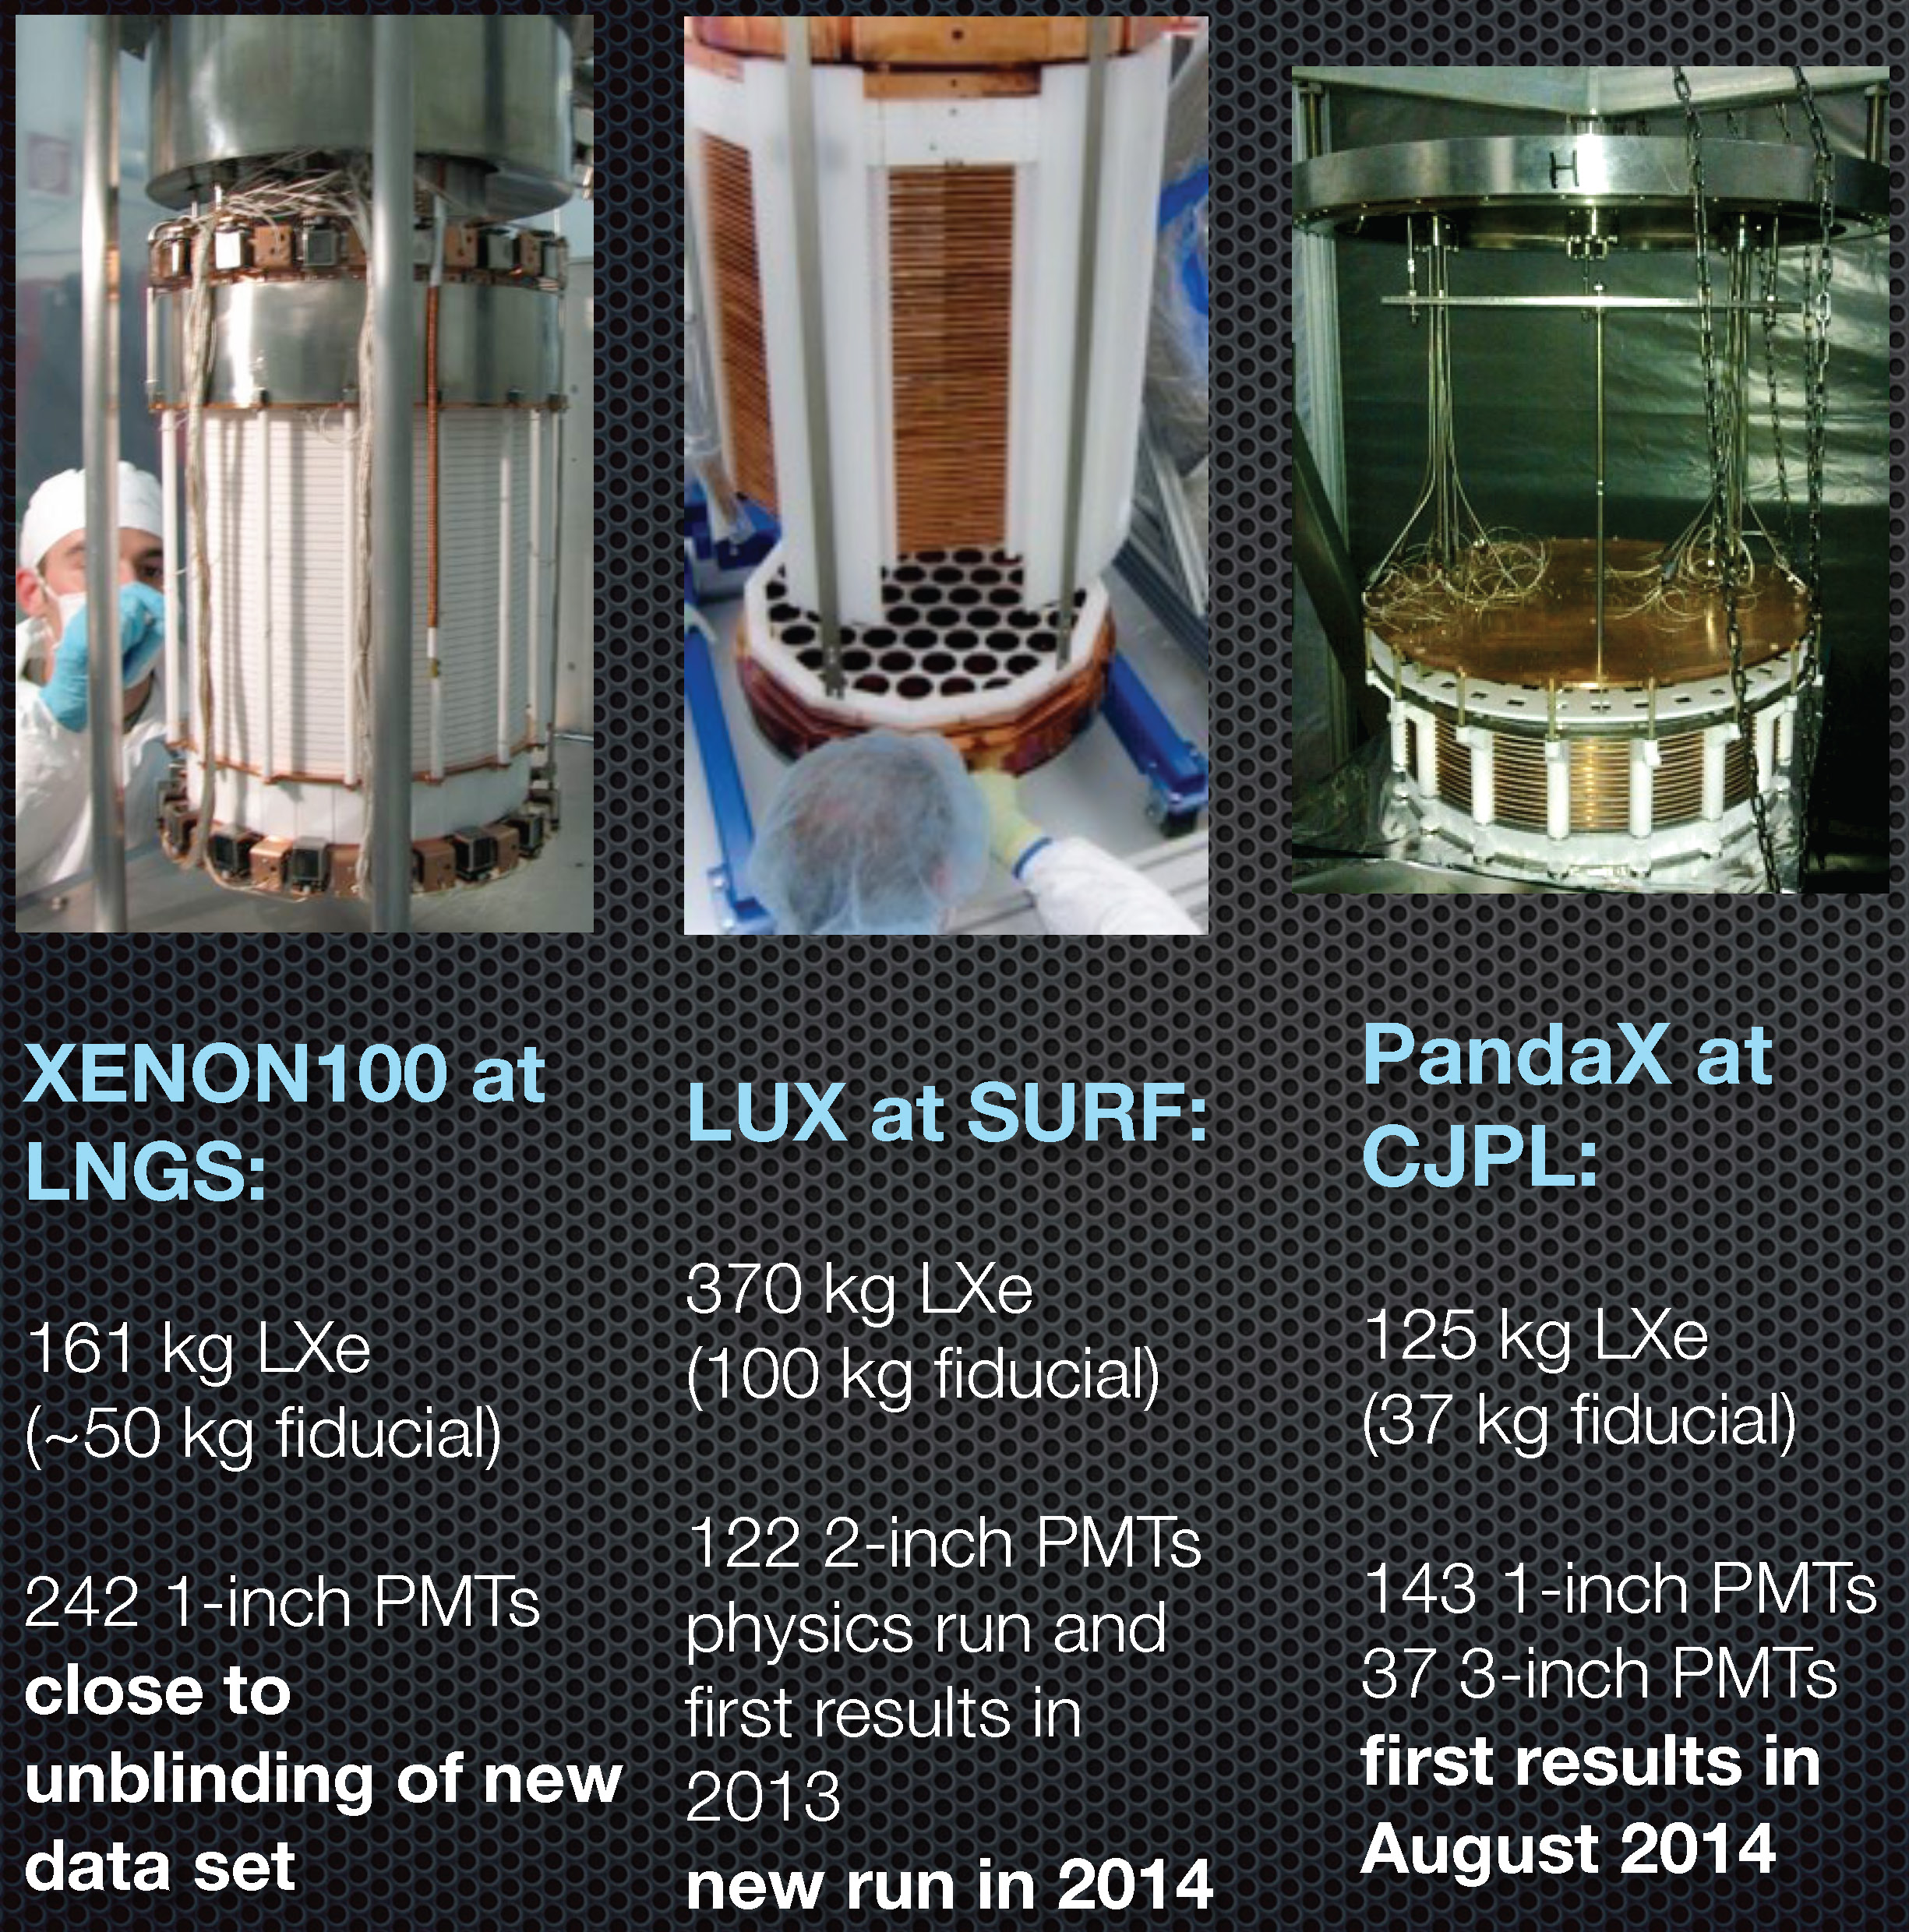
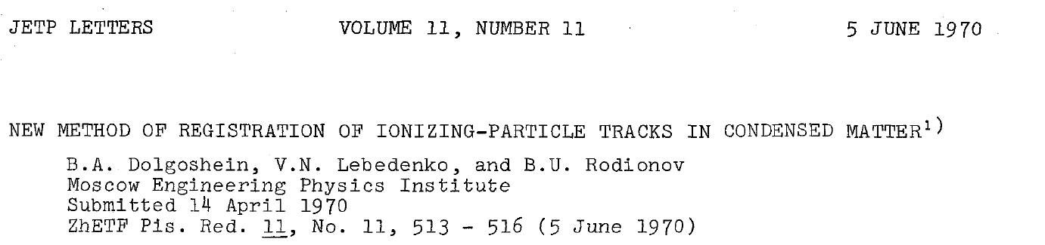
(1-phase, 2-phase)×(Argon, Xenon) large homogenous volumes
Xenon 2-phase TPCs in the lead
  Xenon-100 (66 kg) to LUX (250 kg) to Panda-X (500 kg) to Xenon-1T to LZ
Xenon Advantages:
A=131, density 3 gm/cm³
No dangerous isotopes
Scint light soft UV – 175nm
2-phase Advantages:
TPC fiducialization
Laura Baudis

Slide 22
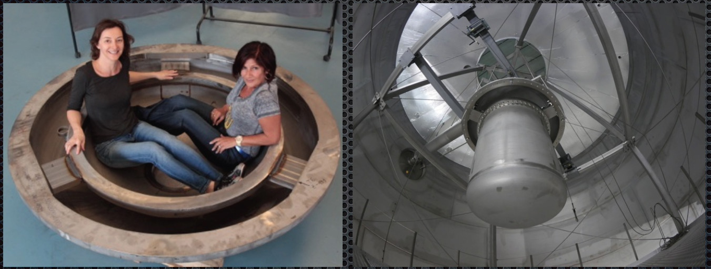
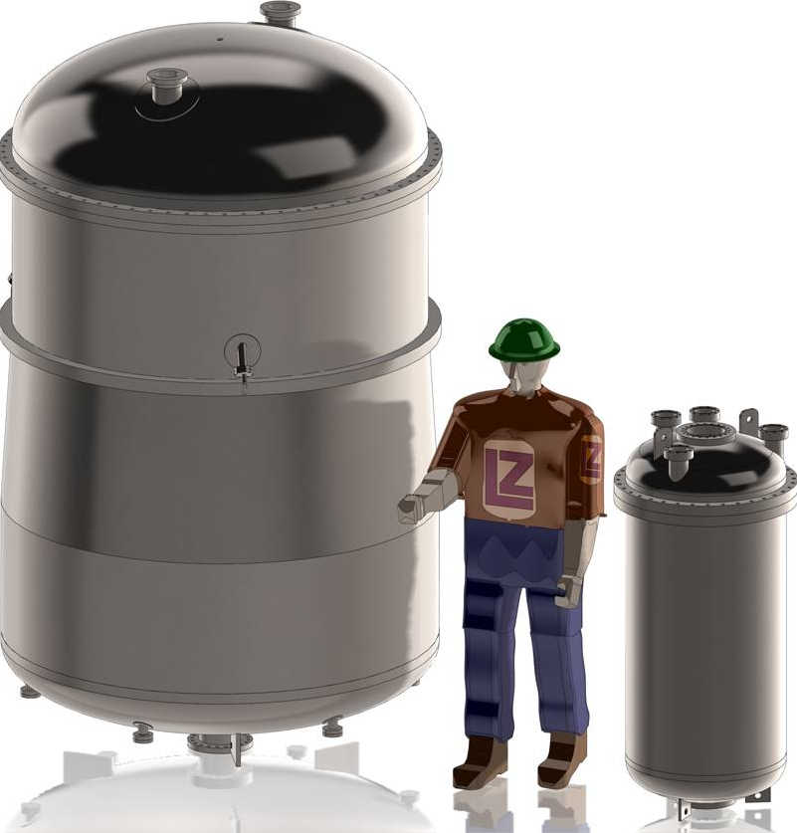
Xenon Future
Xenon 1T- 2t active Xe; LZ – 7t active Xe (G2)
Xenon-1T
2015
From Laura Baudis
LZ
2018
LUX

Slide 23
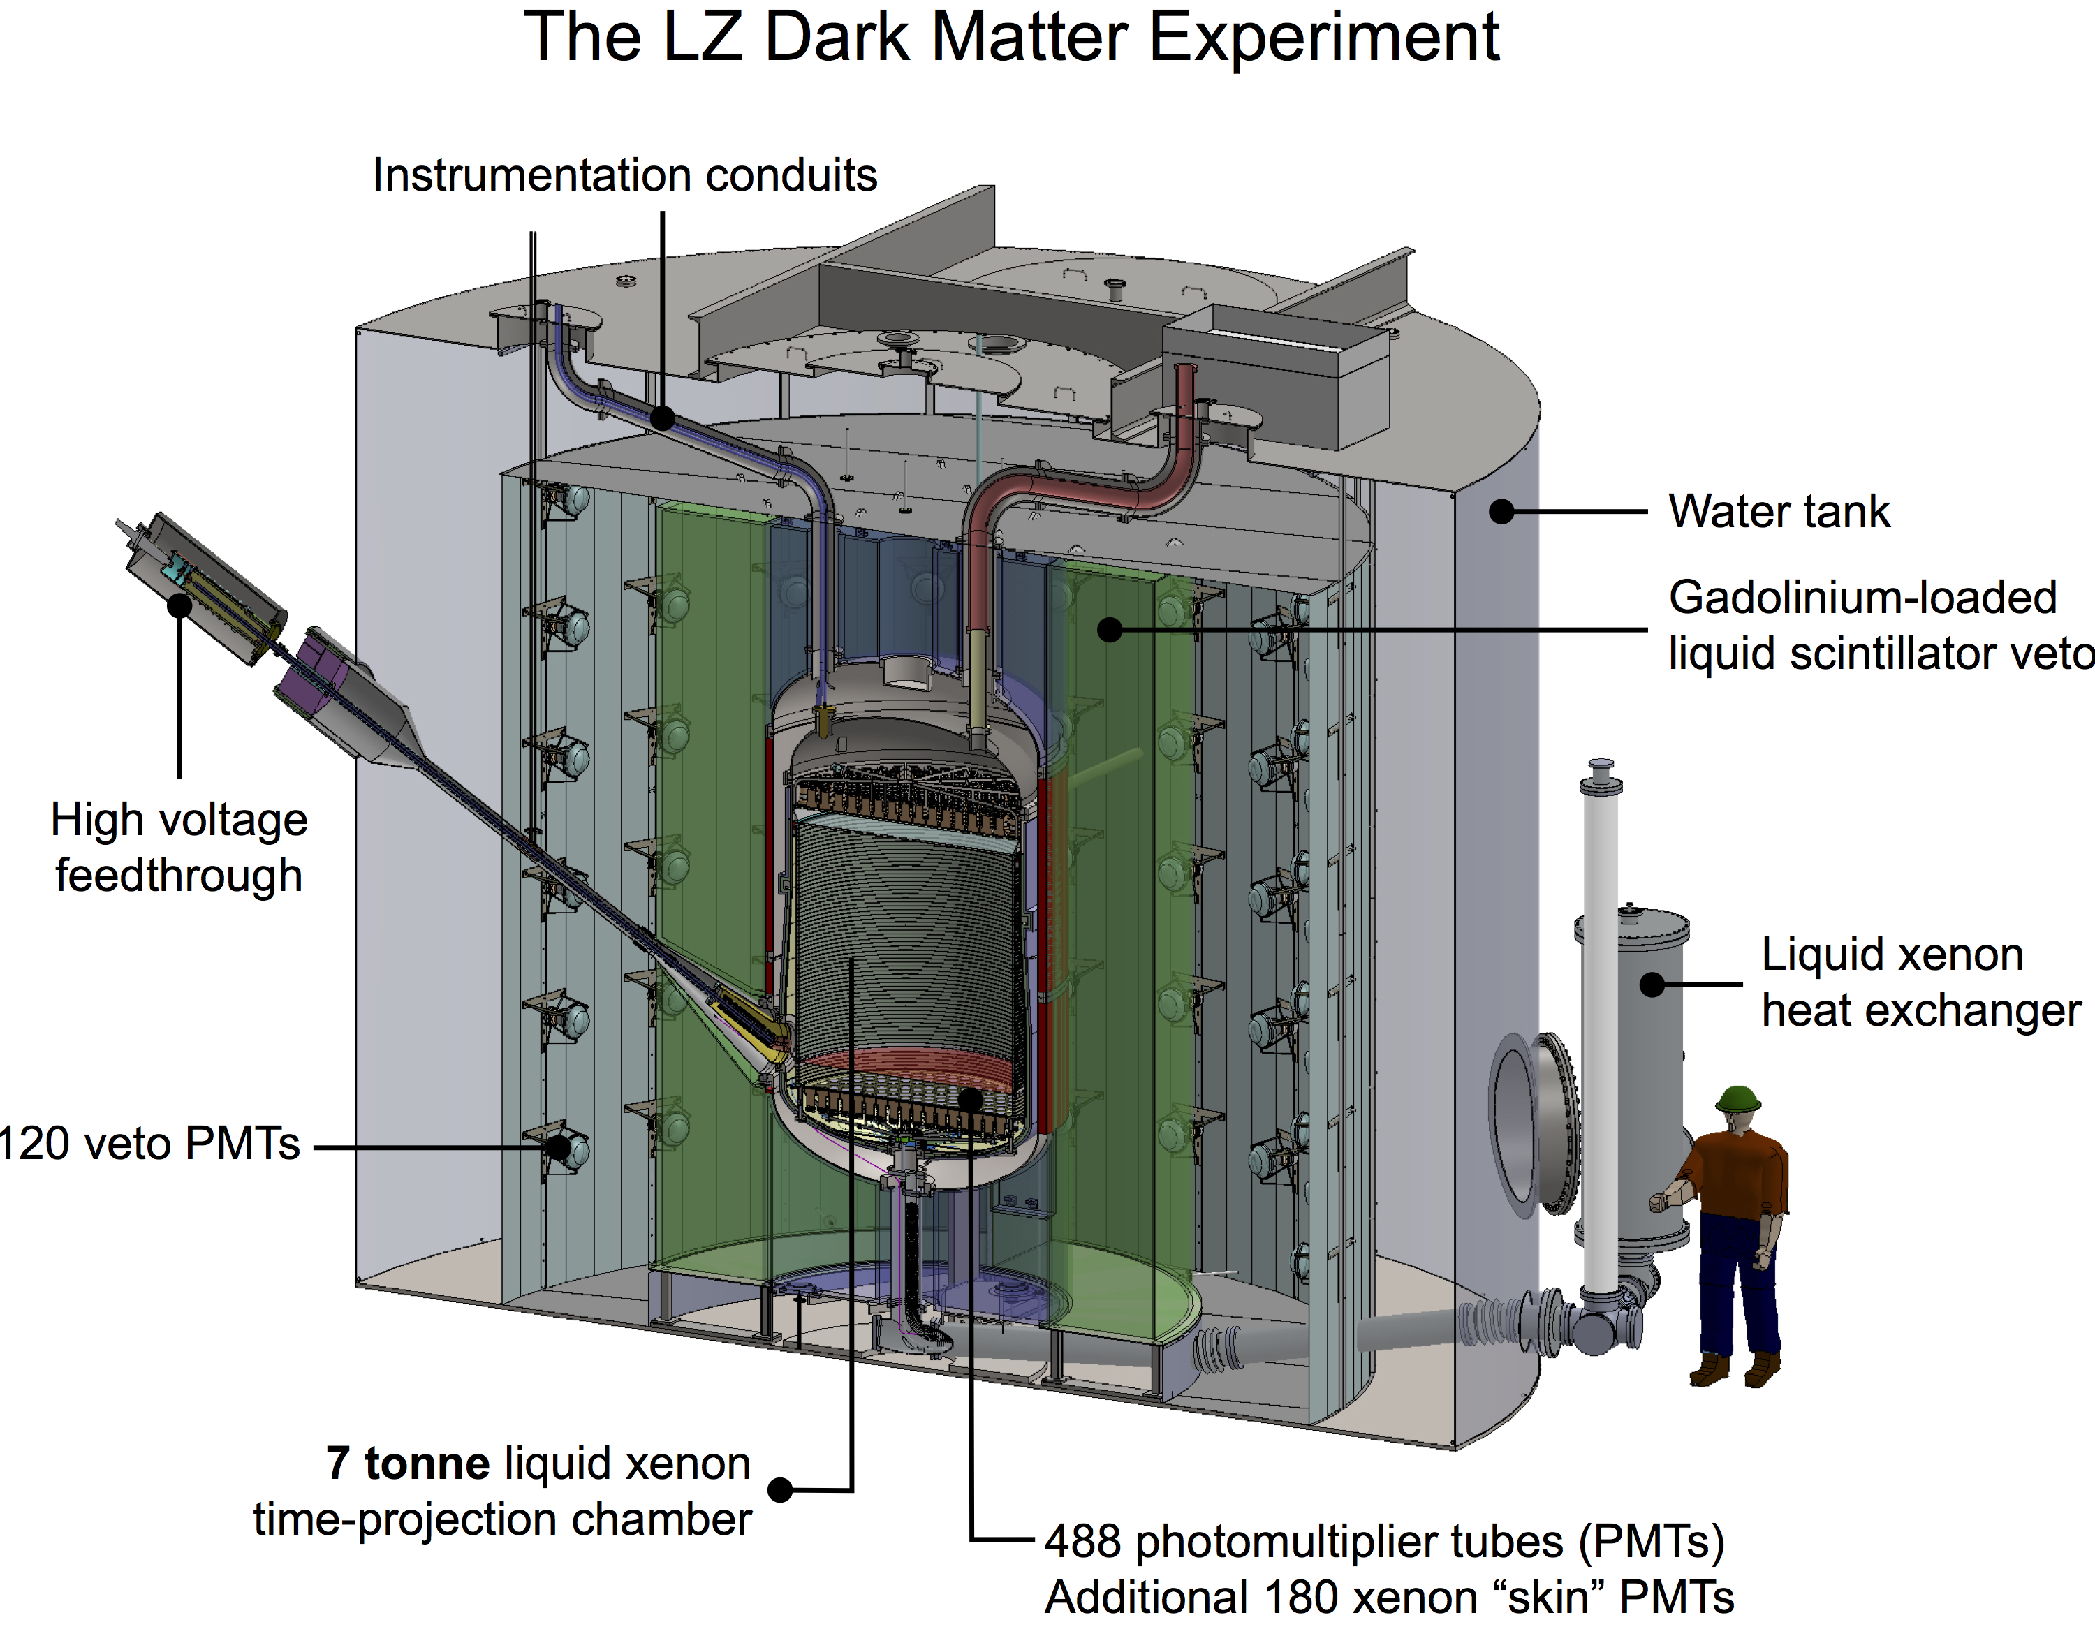
LZ Design Overview
Notes:
SKIN, OD CHARACTERIZE BACKGROUND

Slide 24
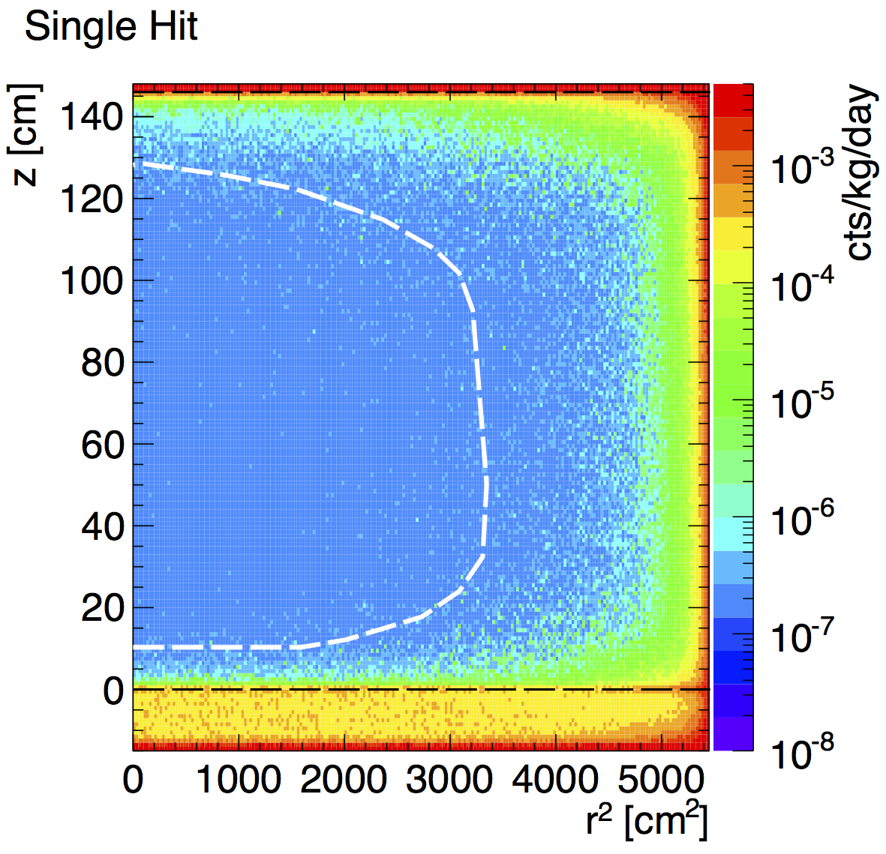
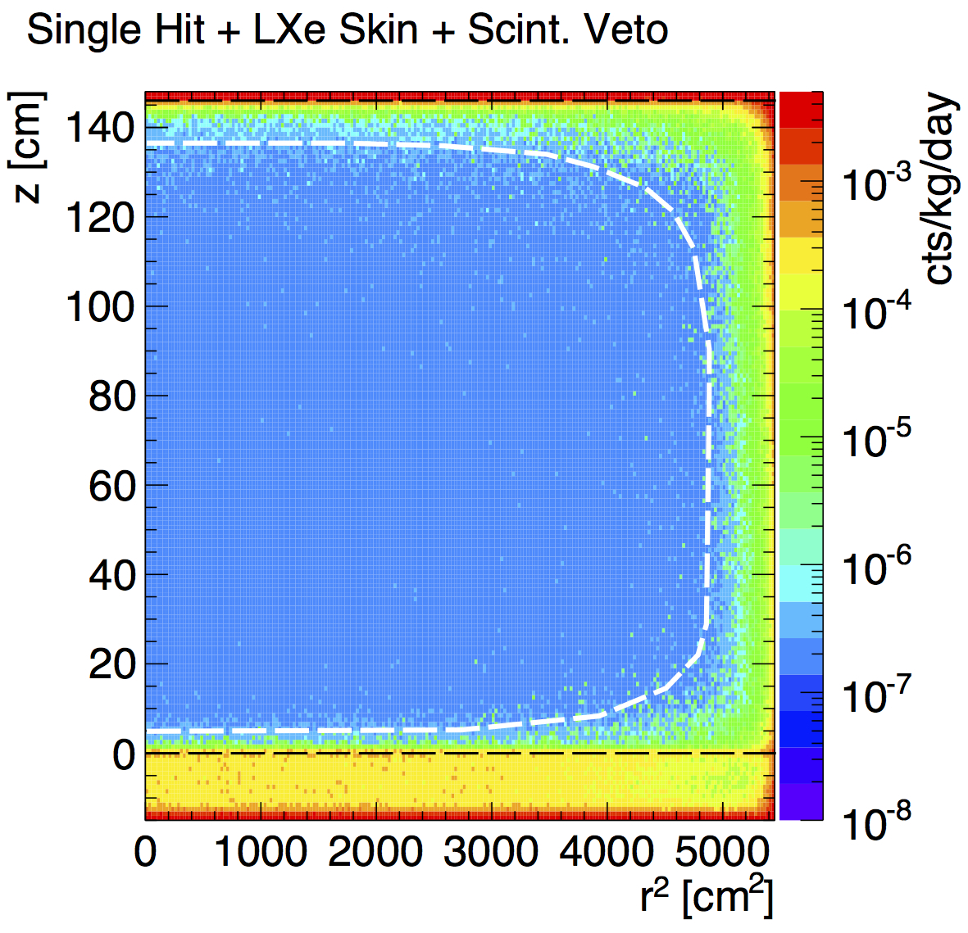
LZ Background Modeled
Just Liq. Xenon TPC
Use LXe skin, Outer Det.
3.3 T
(1/10 pp ν)
5.6 T
(1/10 pp ν)
1.9 bkg events, 1,000 days
0.3 coherent neutrino
Notes:
TEMPERATUR PLOT of BACKGROUND

Slide 25
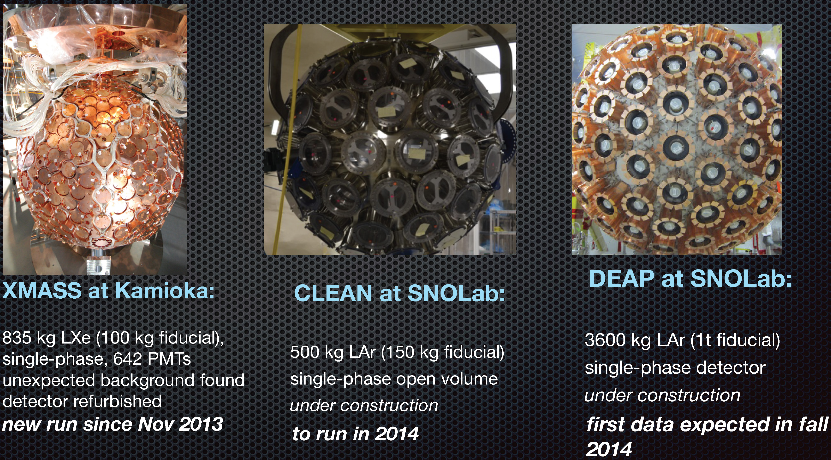
Single Phase
Simpler.
Laura Baudis
… LAr has extraordinary discrimination based on pulse shape. And needs it, because of ³⁹Ar.

Slide 26
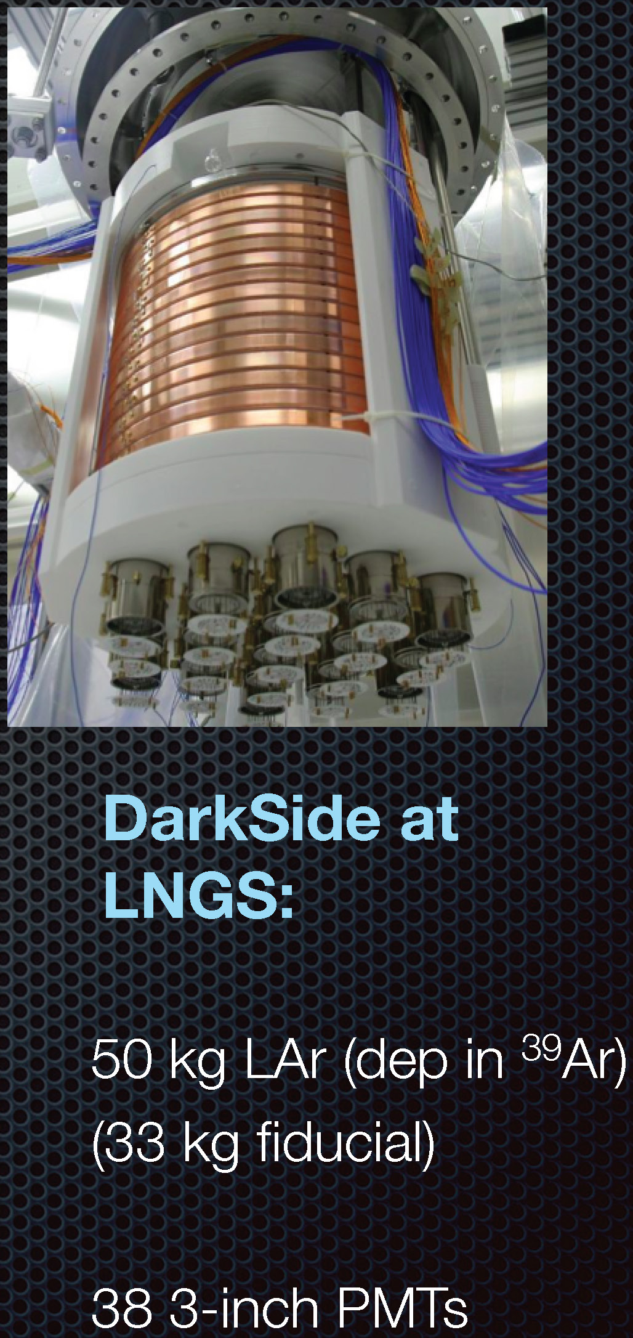
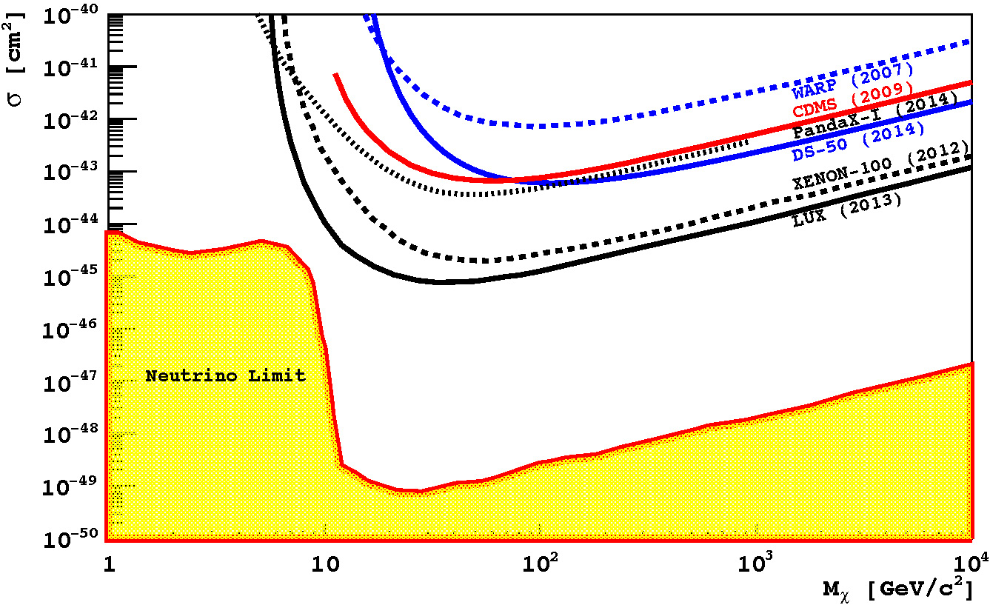
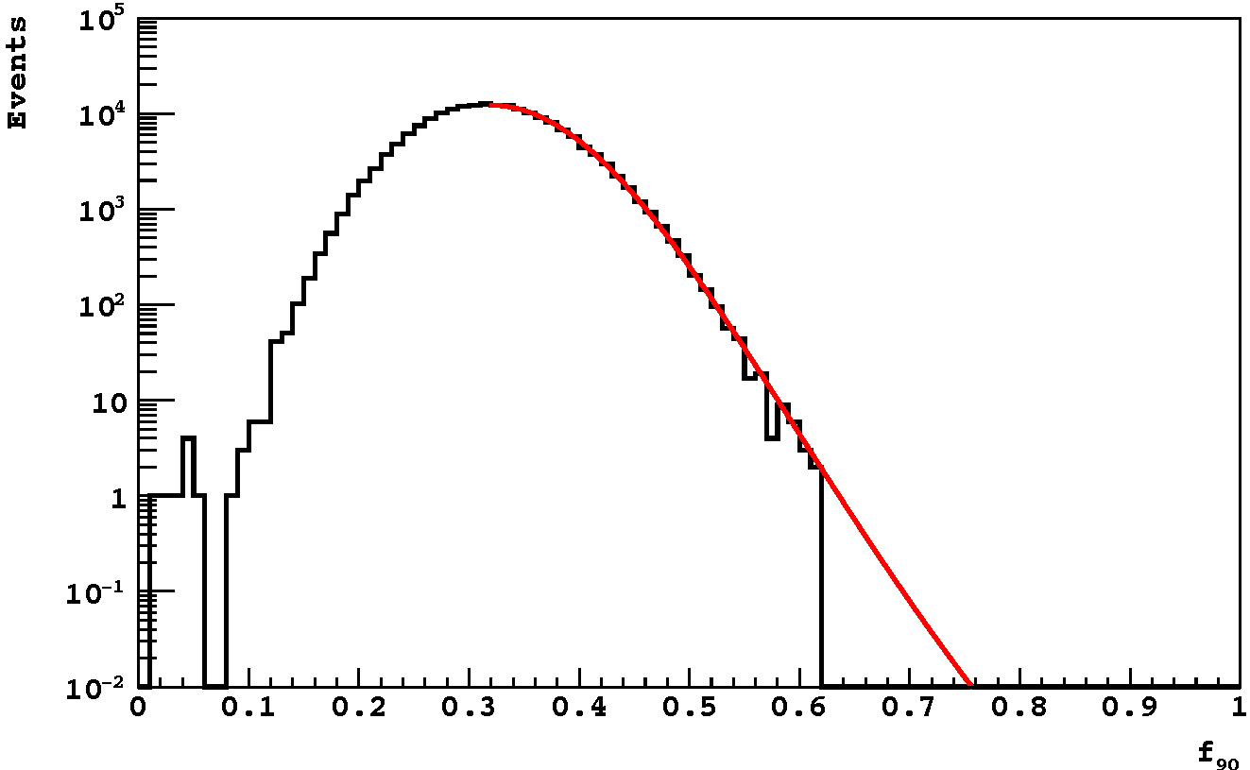
Darkside Result: 2 Phase L Argon
Signal Region
(50% Accep)
Background
(0.5 t-y depleted)
38-40 keV_{nr}
Fraction of light in first 90 ns

Slide 27
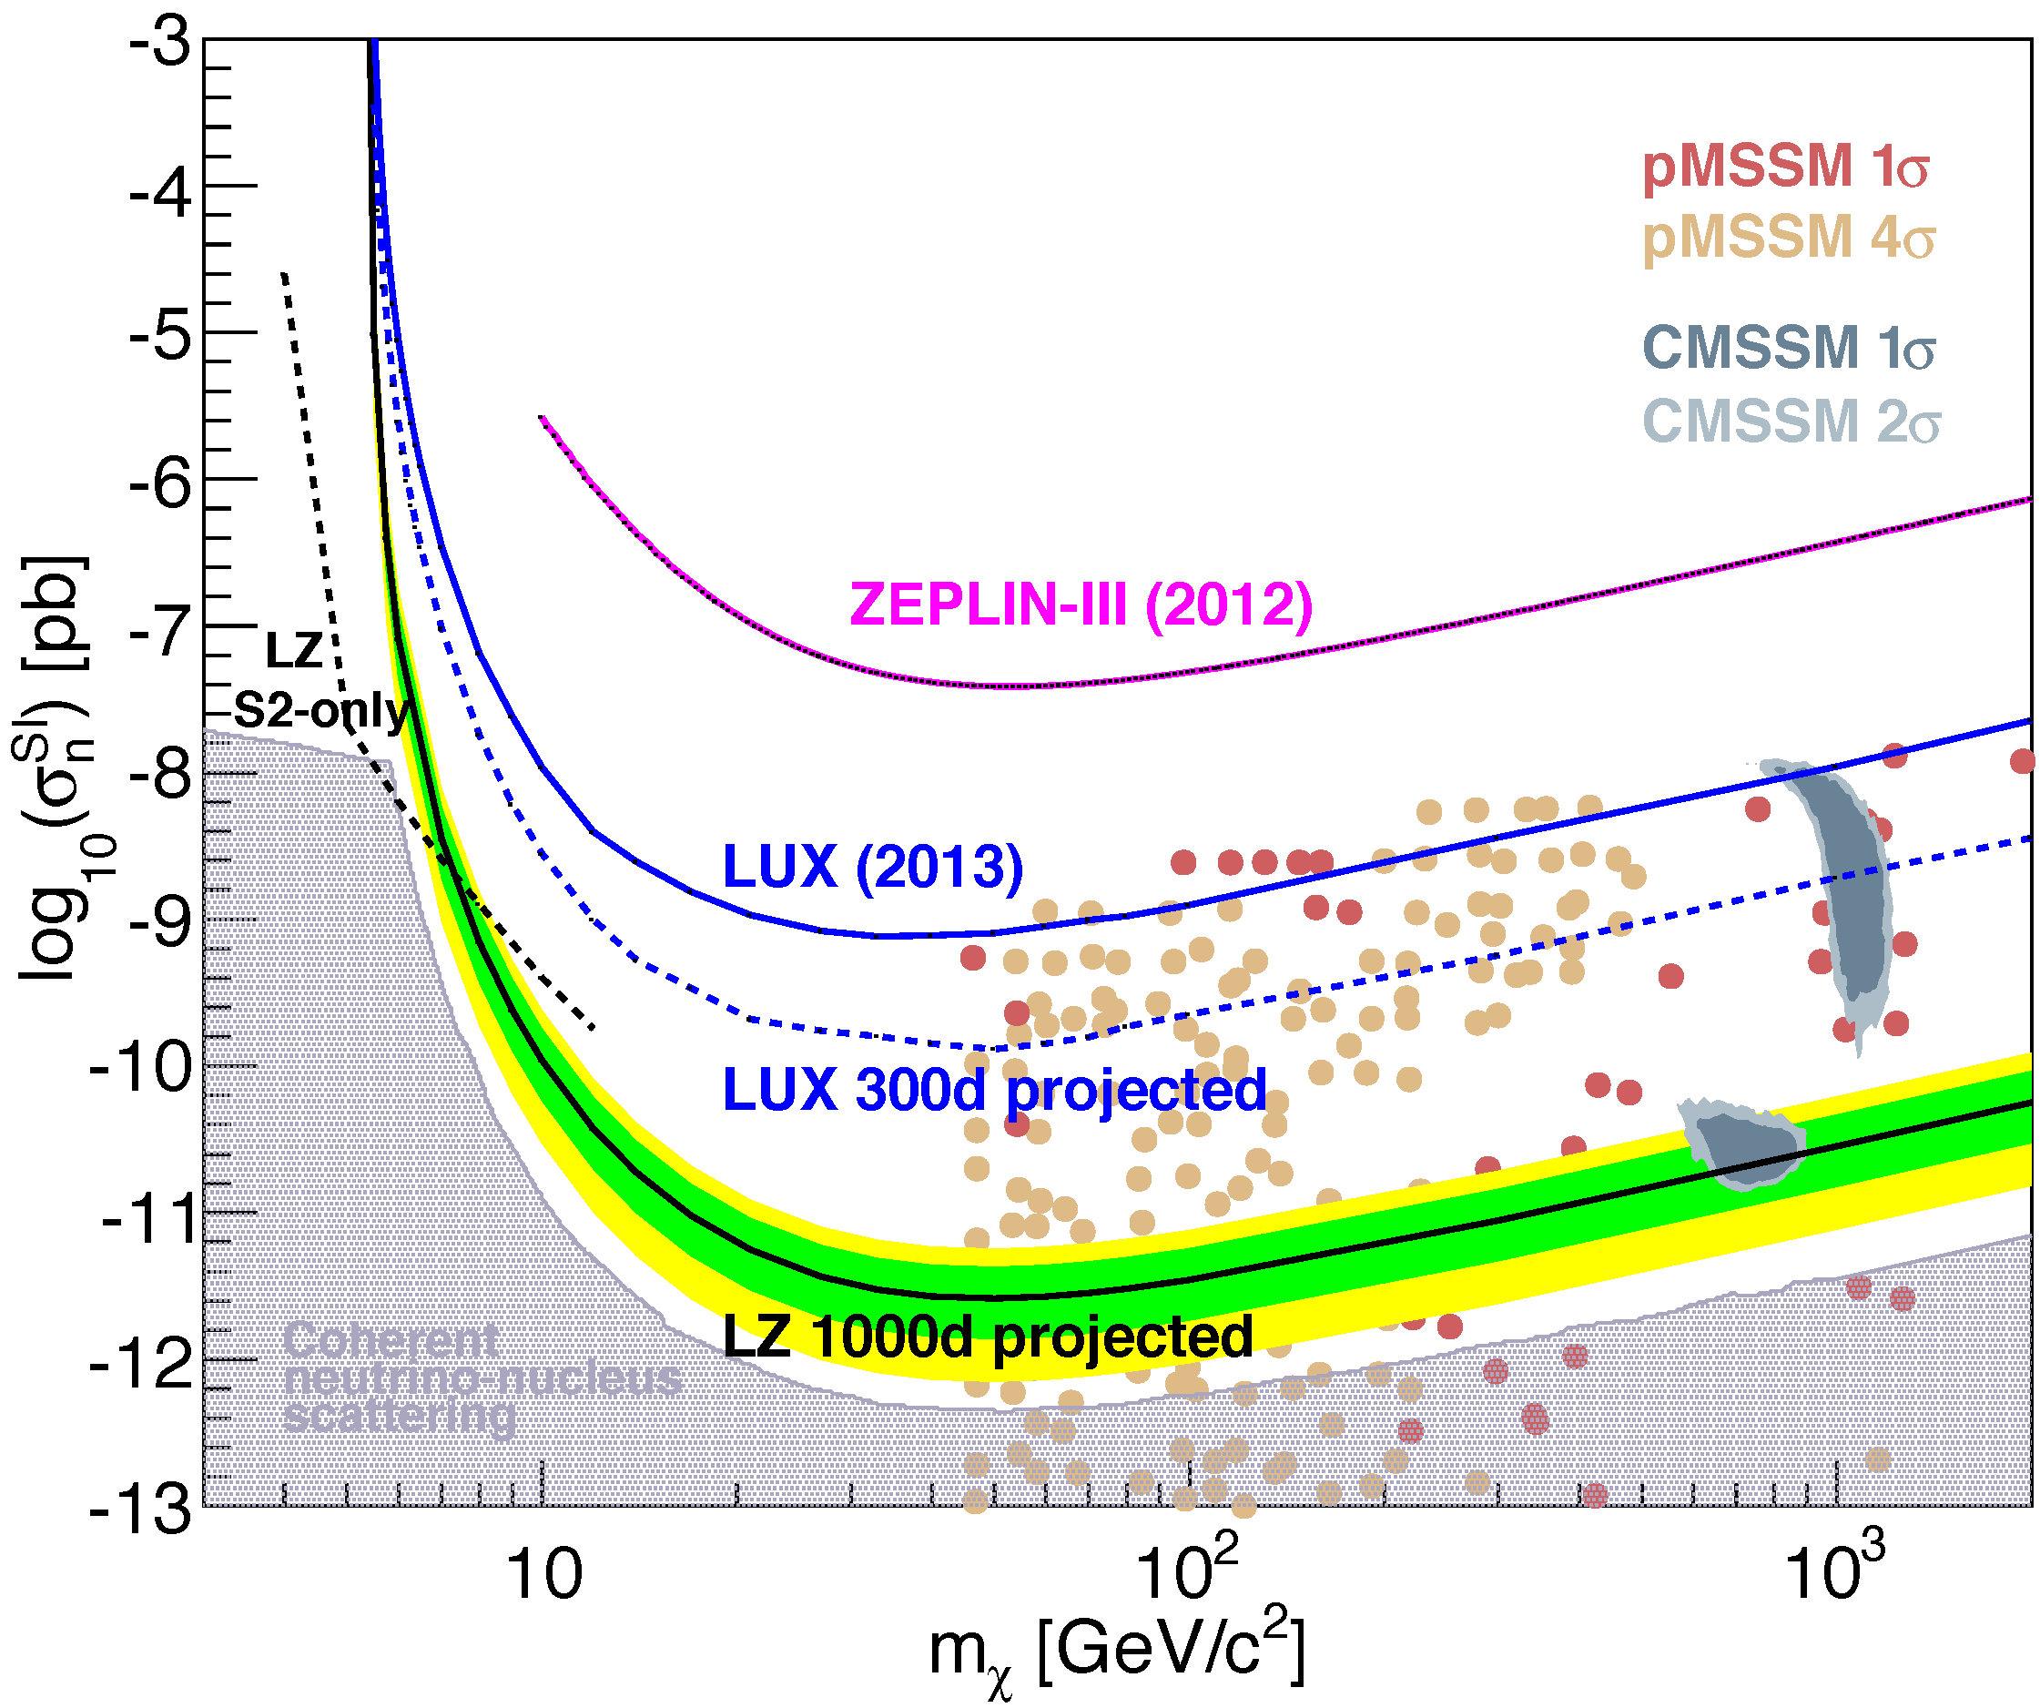
Future of Xenon 2-phase
Panda-X
Xenon 1T
Darwin

Slide 28
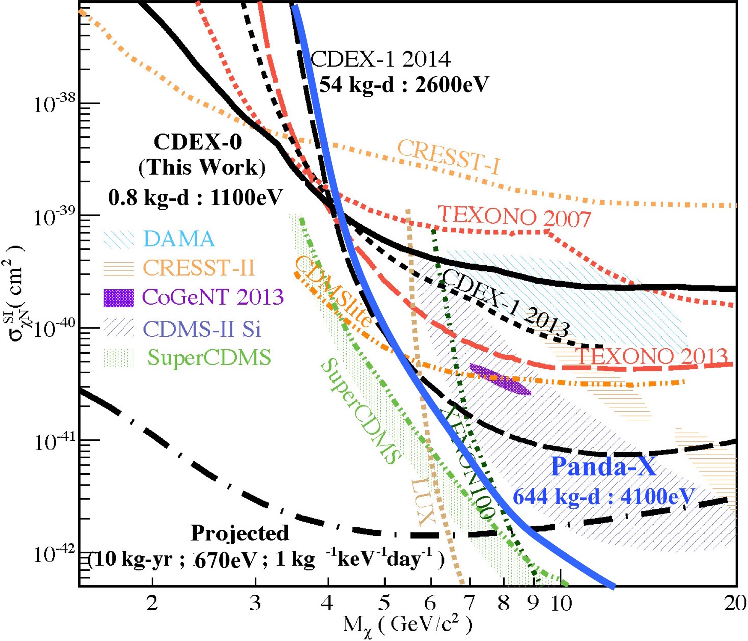
Low Mass Frontier
Germanium
Ionization
10⁻⁴⁰
cm²

Slide 29
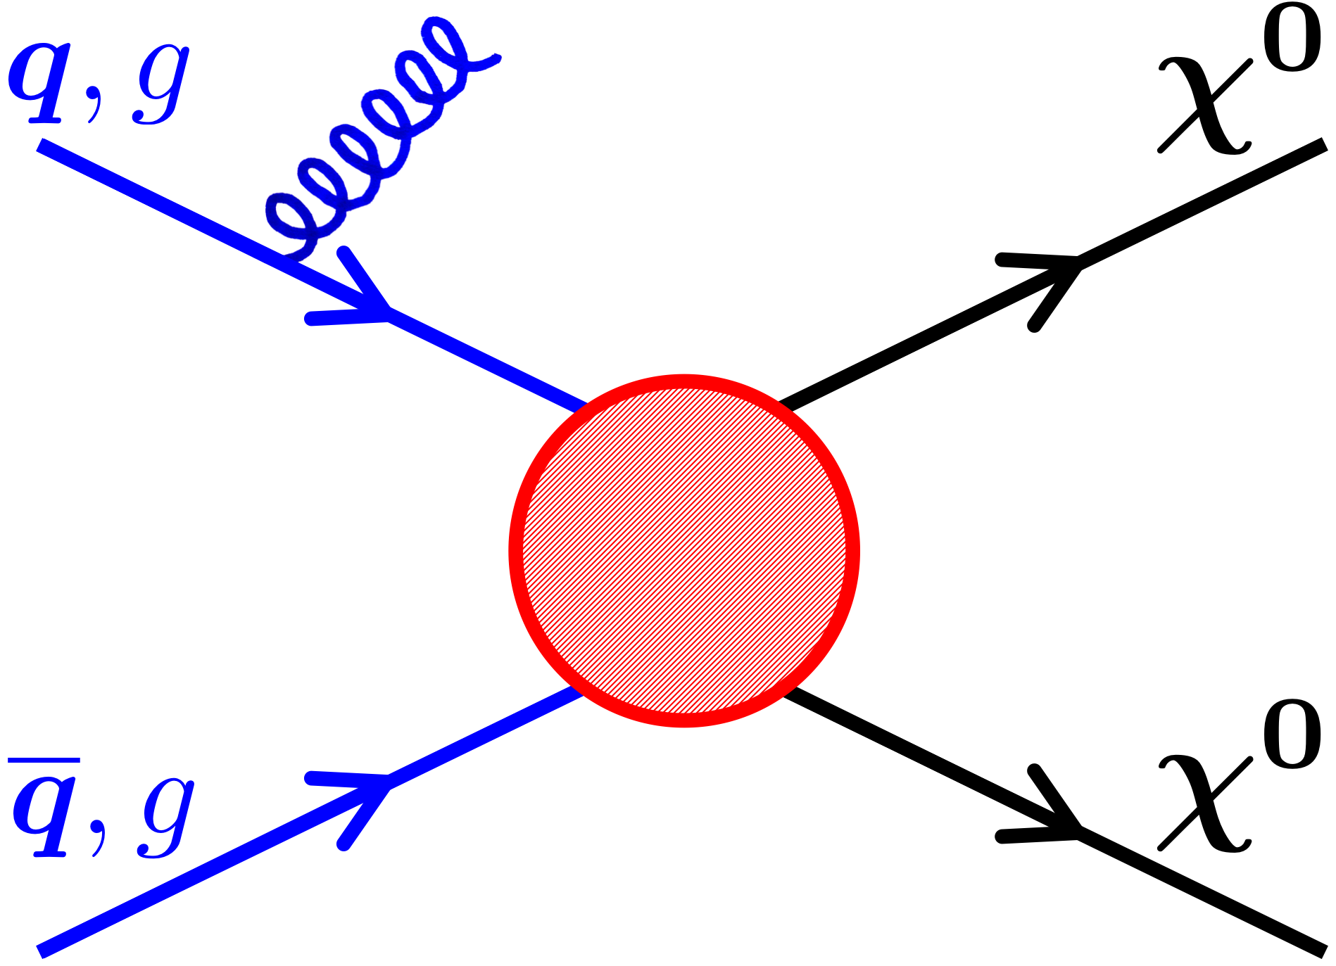
Tension with LHC
Notes:
Weakly Interacting, as cools

Slide 30
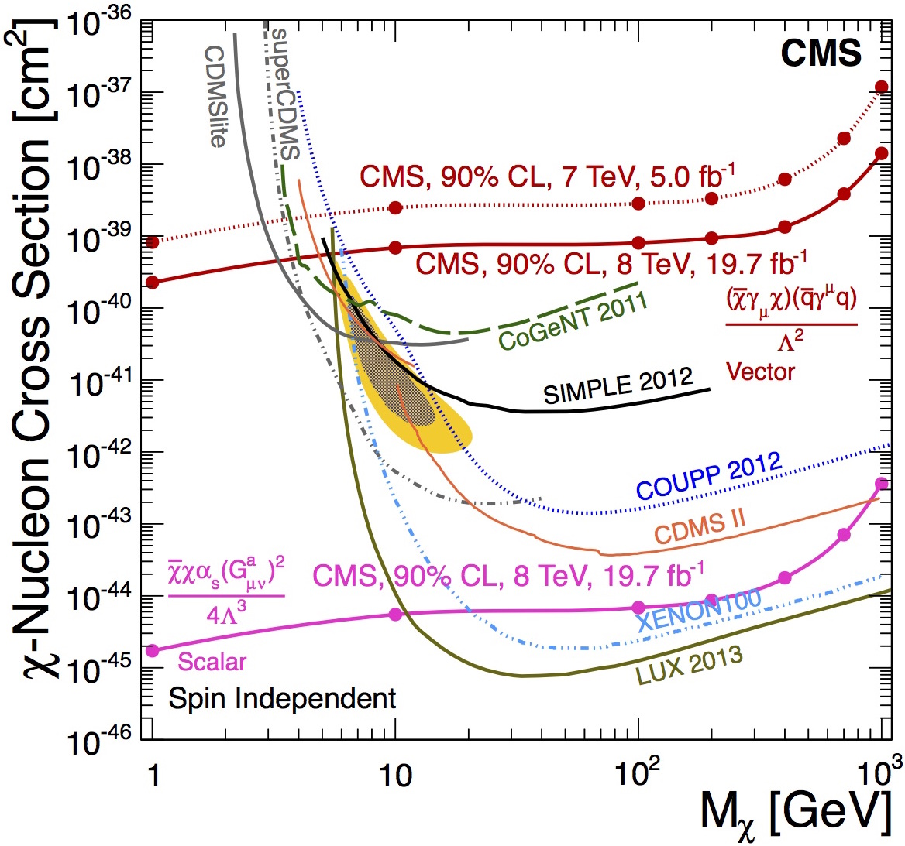
Spin Independent
Dirac
10⁻⁴⁰
cm²
Majorana
… evade with a very light mediator
Notes:
Weakly Interacting, as cools

Slide 31
The Near Term Future
10⁻⁴⁰
cm²
G2
SuperCDMS
G2
Notes:
Weakly Interacting, as cools

Slide 32
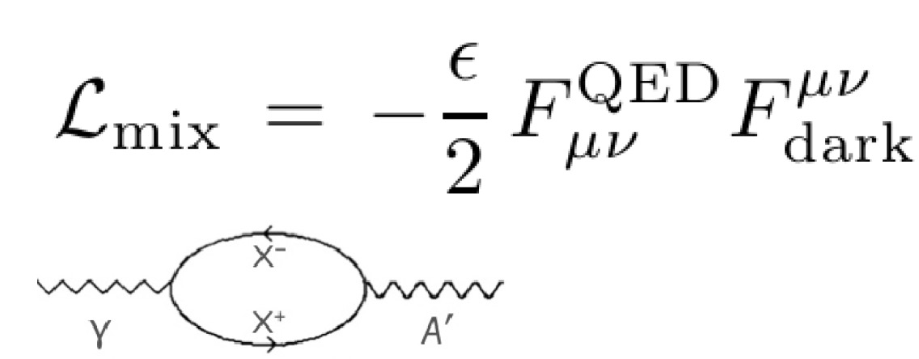
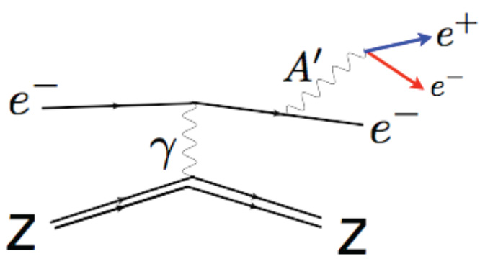
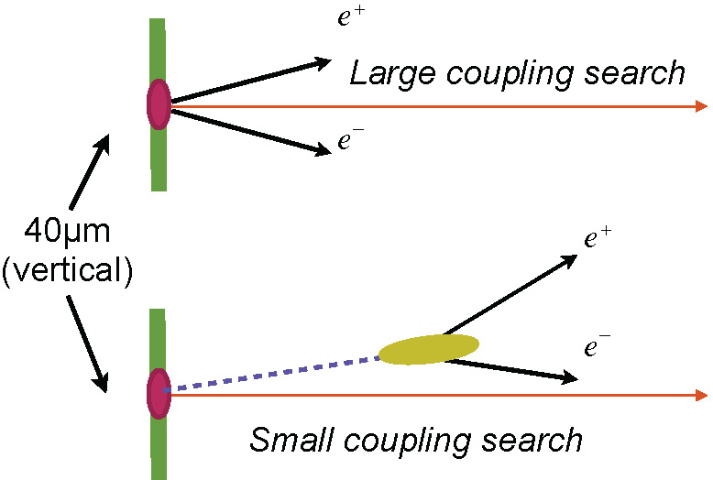
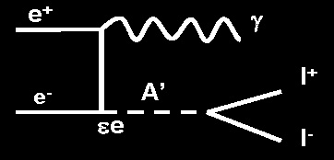
Dark Heavy Light
JLAB, Mainz
e⁻
e⁻
e⁺e⁻ colliders
Notes:
Weakly Interacting, as cools

Slide 33
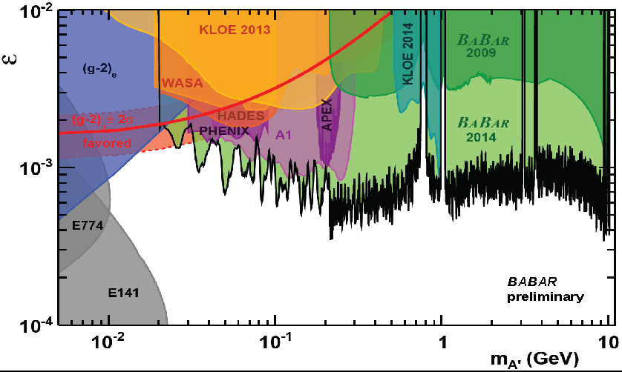
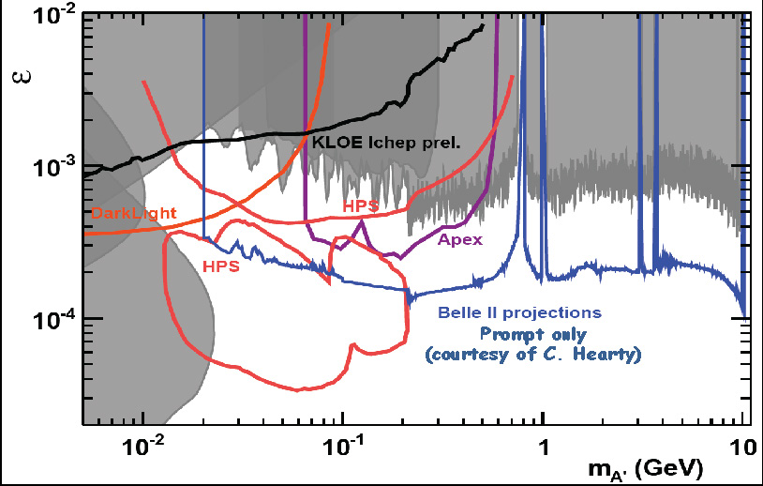
Current and Future
DarkLight, HPS, Apex
all at JLAB
old beam dump
From Bertrand Echenard
Notes:
Weakly Interacting, as cools

Slide 34
The DAMA Perplex
From Rick Gaitskell
Notes:
Weakly Interacting, as cools

Slide 35
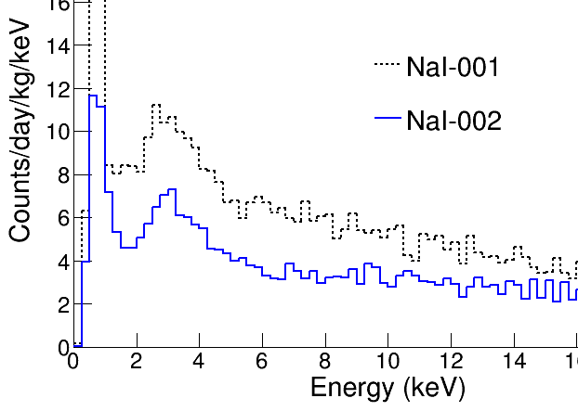
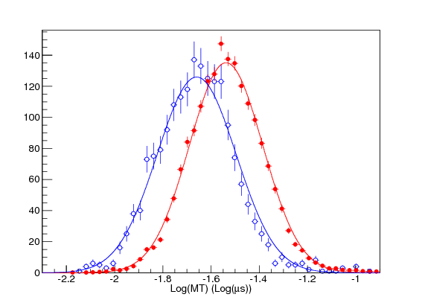
Other Experiments
KIMS-NaI (Center Underg. Phys.)
Check DAMA using new NaI(Tl) crystals.
Goal
  Lower background than DAMA.
  Lower threshold than DAMA
Utilize PSD (Good PSD first time)
200kg run starts in the end of 2015.
Princeton Effort
DM-Ice at South
NaI 5-6 keV
n
γ
Fitzpatrick, Haxton, Katz, Lubbers, Xu 2013
Notes:
Weakly Interacting, as cools

Slide 36
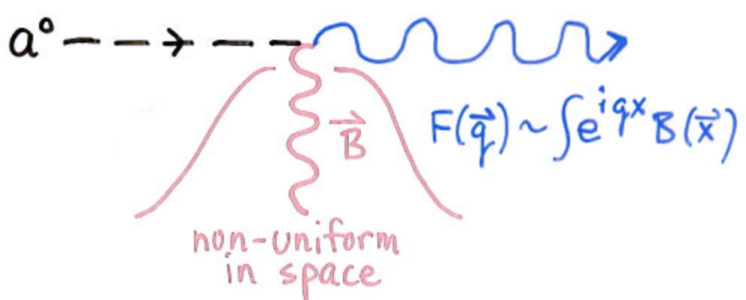
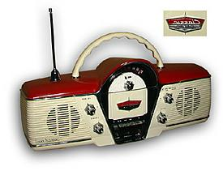
Dark Matter Axion Detection
Convert a to photon – 1 GHz
Axions… could be produced in the Big Bang with sufficient numbers to to be the dark matter, for axion masses in the 1-100 μeV range
DOE/NSF process selected ADMX at Univ Washington as G2

Slide 37
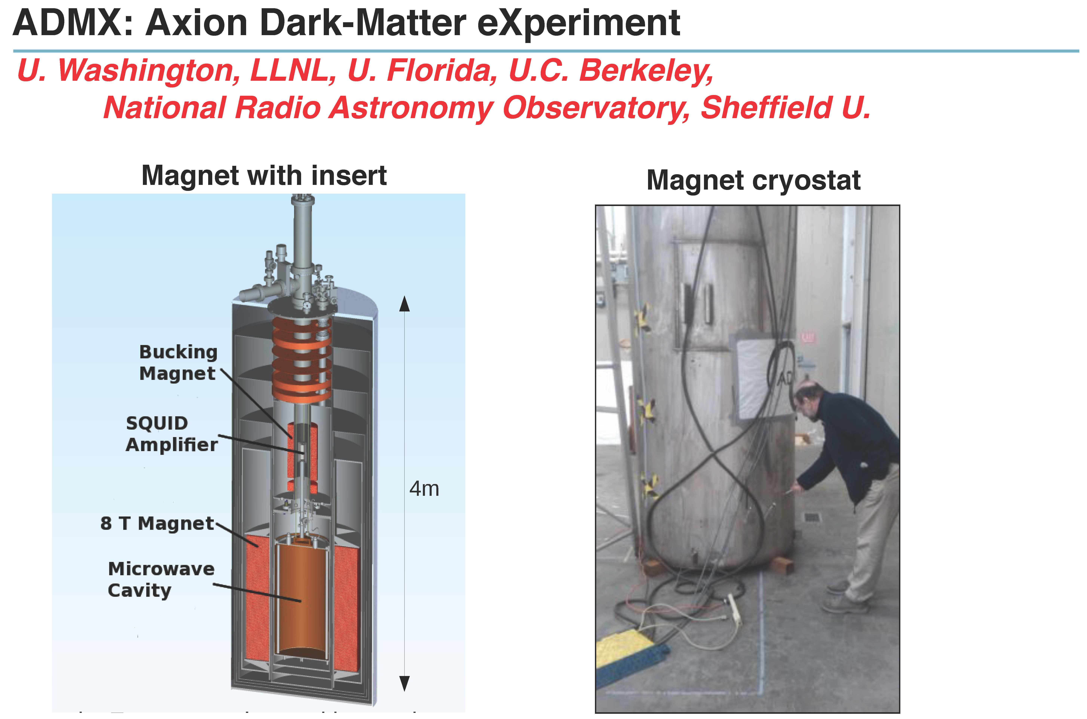
ADMX

Slide 38
Sensitivity
High mass/frequency
Small cavity size

Slide 39
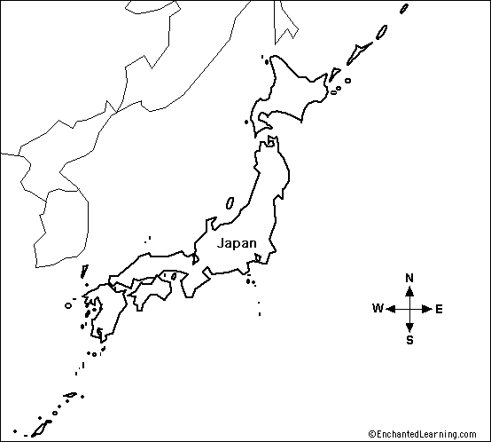
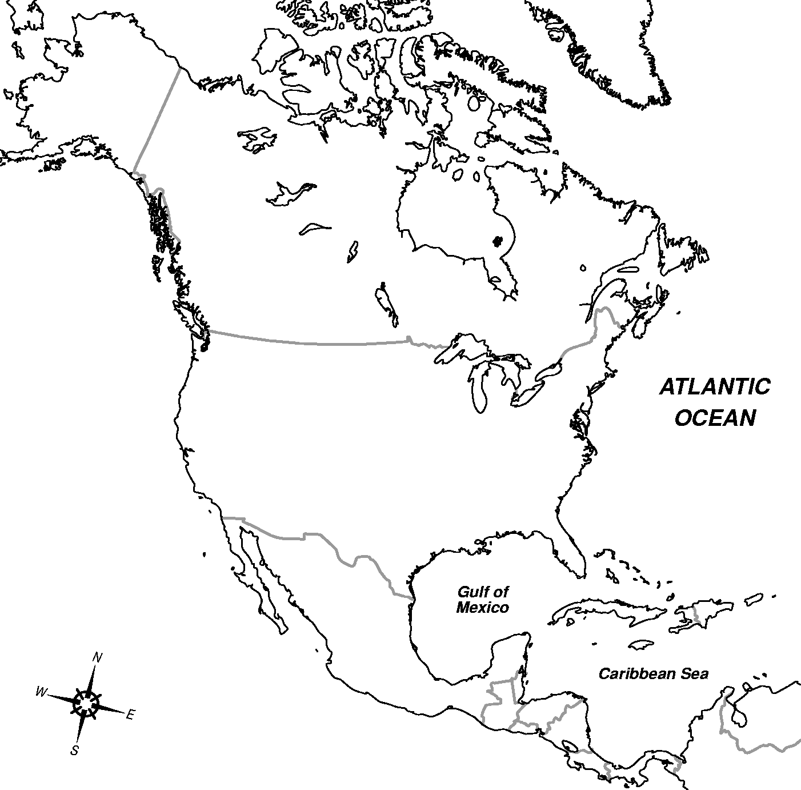
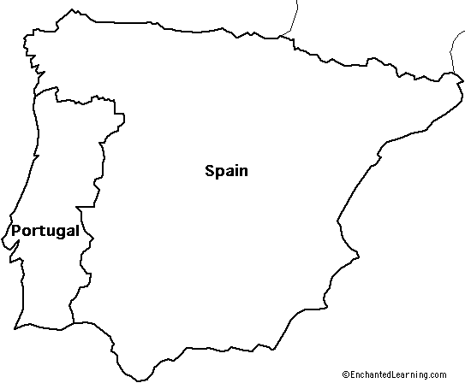
Columbus
12,000 km (Talavera Panel, accurate)
5,000 km (Columbus, fudged systematics)
Portugal/Spain
Japan (Cipangu)

