Slide 1
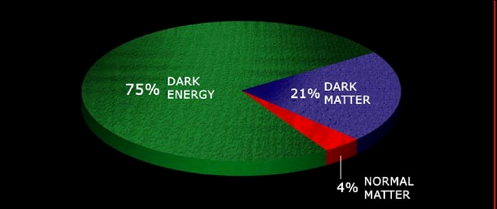
Dark Energy
From the perspective of an American theorist fresh from the recent Dark Energy Survey Collaboration Meeting

Slide 2
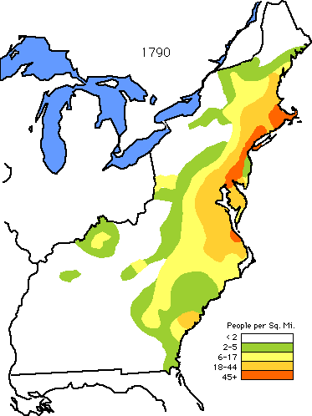
Consider the United States in 1790
Over-densities of order 50
Concentrated in East
Vast Voids with low density

Slide 3
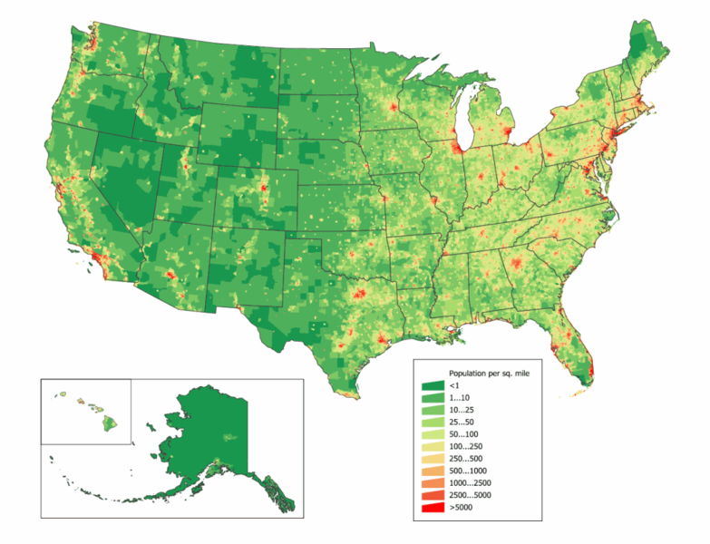
Consider the United States Today
Over-densities of order 10,000
Concentration in coasts
Traces of primordial density (Boston-Washington; East > West)
Vast Voids

Slide 4
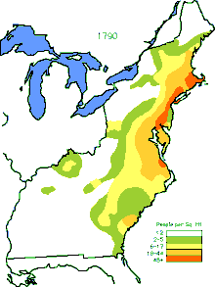

The story of this evolution is the story of the United States
When we understand the evolution from one map to another, we can understand
the sociological, economic, and political forces acting on the US
the people, or the constituents, of the US

Slide 5
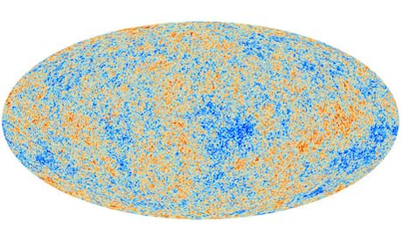
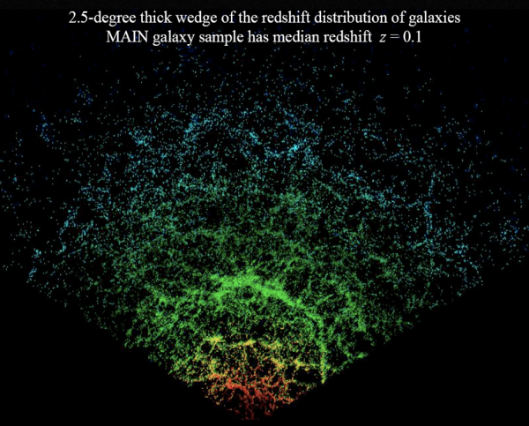
One of the great success stories of modern science
Map of the universe when it was 400,000 years old: smooth, with inhomogeneities of one part in 10⁴
Map of the universe today: very inhomogeneous

Slide 6
One of the great success stories of modern science
Map of the universe when it was 400,000 years old: smooth, with inhomogeneities of one part in 10⁴
Where did the initial fluctuations come from? How did they evolve into the structure we see today?
Map of the universe today: very inhomogeneous

Slide 7
Three epochs, each dominated by new physics, are required to explain these maps
t~10⁻³⁵ sec: Early acceleration, Inflation
300,000 years < t < 7.7 Byrs: Growth of Structure, fueled by Dark Matter
t > 7.7 Byrs: Late Acceleration, associated with Dark Energy

Slide 8
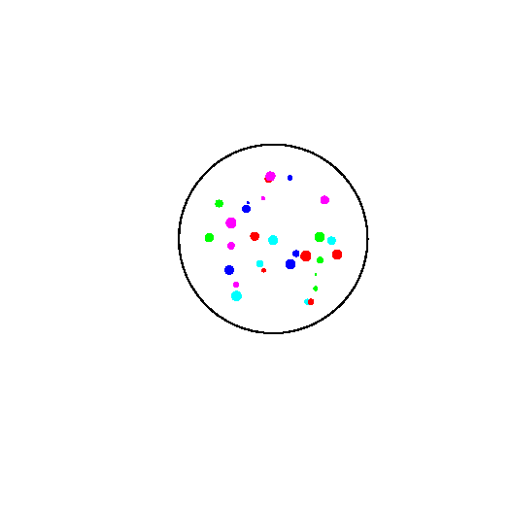
Late-Time Acceleration
GEOMETRY
ENERGY
=
Expansion Rate
Gravitational Potential Energy, proportional to density
Observed late-time acceleration points to dark energy
that remains roughly constant

Slide 9
One possibility: Cosmological Constant
Energy associated with empty space
Energy density is constant
Expect non-zero contribution to the vacuum energy due to quantum fluctuations
Amplitude is too large (by 120 orders of magnitude!)
Is there something missing from our understanding of quantum corrections?

Slide 10
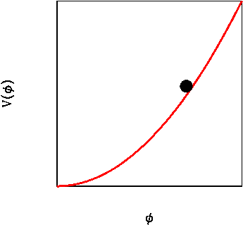
Another possibility : Scalar Field
Require roughly constant energy density
Potential energy larger than kinetic energy
Mass must be very small: m<10⁻³³ eV (Hubble rate today) or else field oscillates
Slowly rolling field has equation of state w different from -1

Slide 11
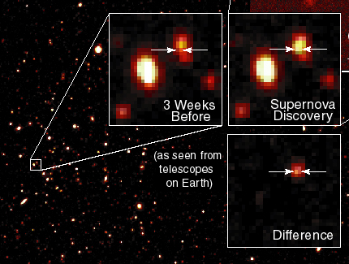
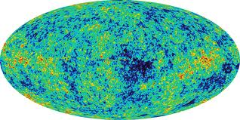
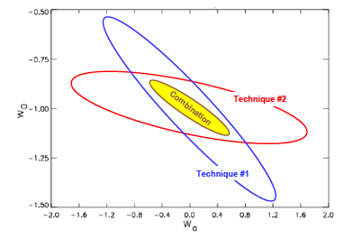
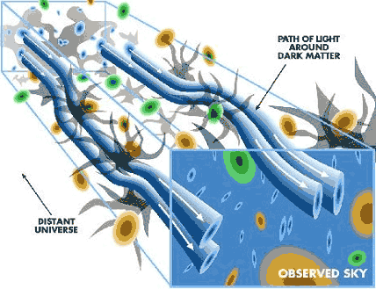
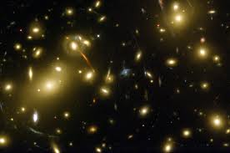
Dark Energy Task Force (2006)
Supernova
Brightness
Cosmic Microwave Background
Baryon Acoustic Oscillations
Gravitational
Lensing
w
Galaxy Cluster Abundance
w’

Slide 12
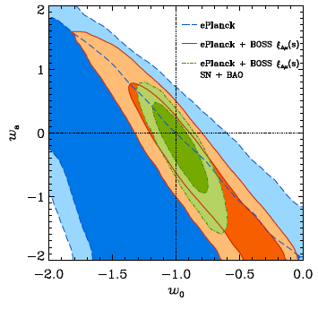
Measure Equation of State of Dark Energy
BOSS 2014
w’
w
An important goal of upcoming surveys is see whether the cosmological constant (w=-1; w’=0) drives acceleration: decrease size of allowed region [FoM=1/(area of ellipse)]

Slide 13
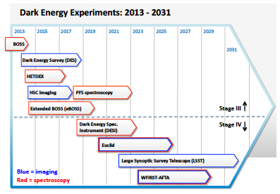
Ambitious plans to increase our understanding of the mechanism driving acceleration
+ CMB: “Support CMB experiments as part of the core particle physics program.” (P5)

Slide 14
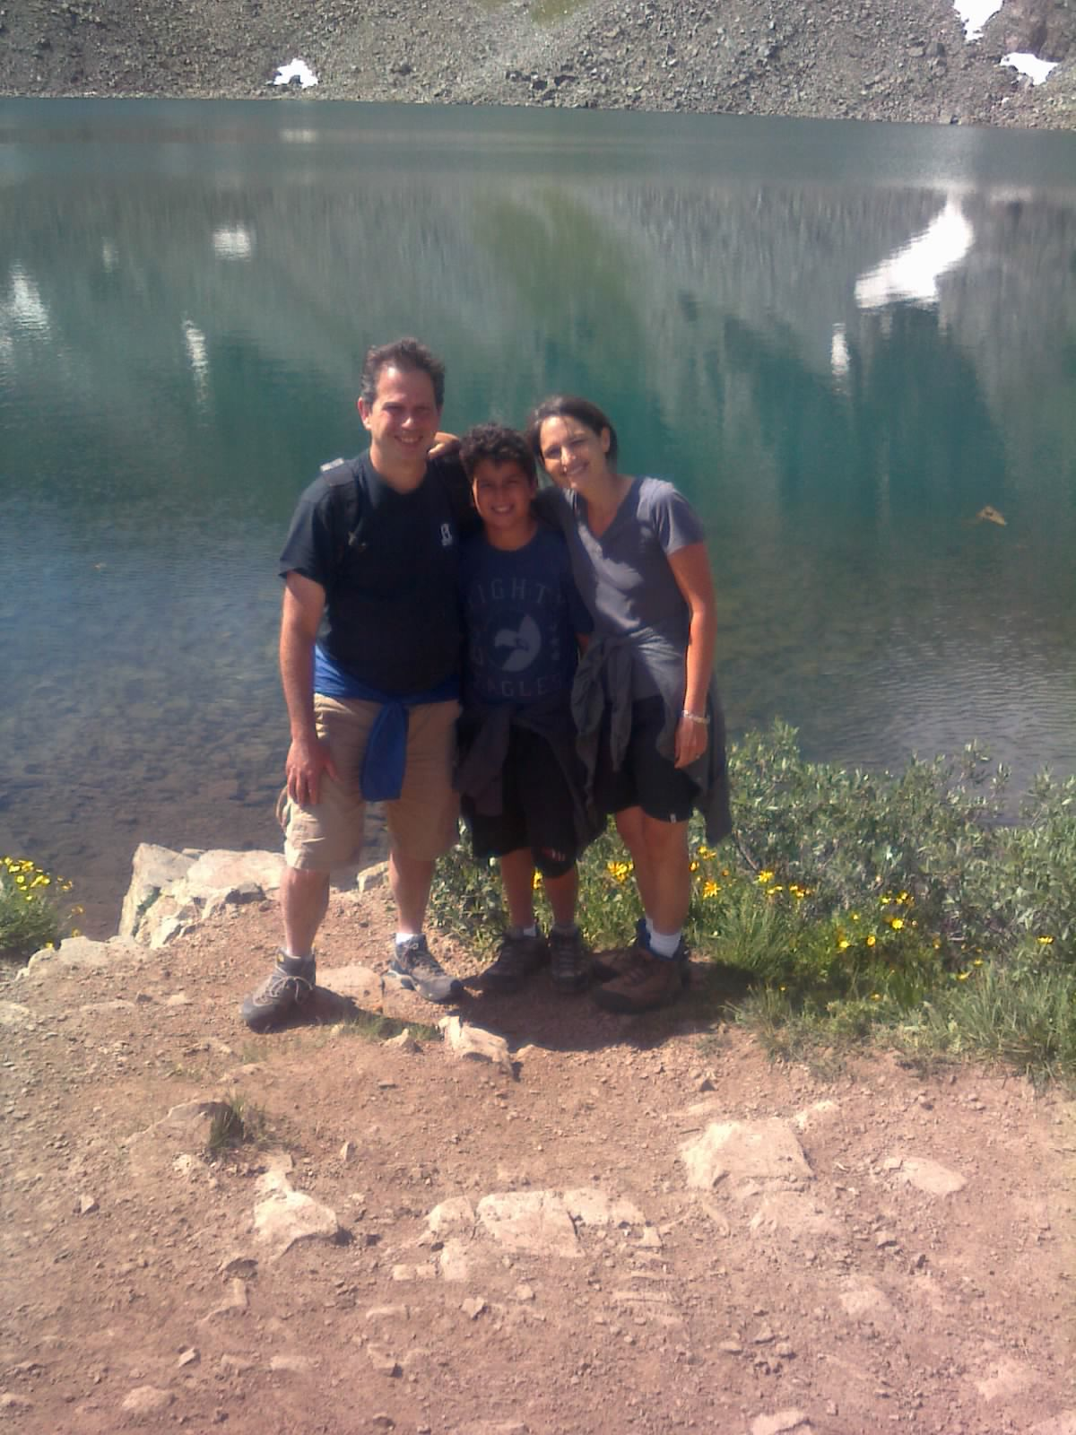
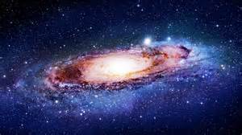
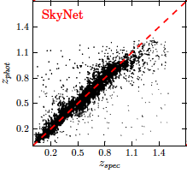
Photometric Surveys
Use galaxy colors to estimate redshifts (distances)
Pneumonic: in Fourier space, get all k_{x},k_{y}, but miss high k_{z} modes --
shaped like a disk
DES: Sanchez et al. (2014)

Slide 15
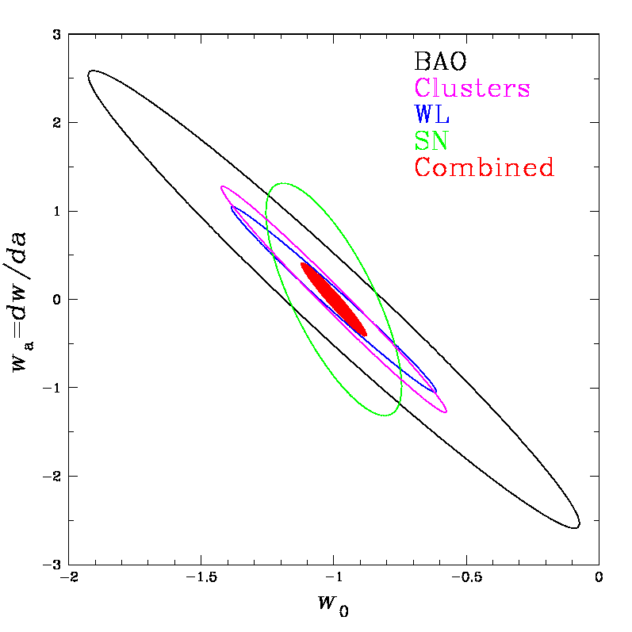
DES, DESI, LSST
Dark Energy Survey will measure fluxes in 5 bands to map the Universe out to ~10⁷ Light-yr away (z=1) in 2.5 dimensions (photometric)
Will map 5000 square degrees with more than 10⁸ galaxies
Clusters, SN, WL, 2.5D BAO
Increase Figure of Merit by ~3-5

Slide 16
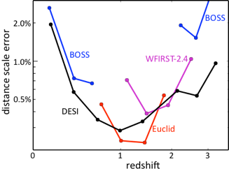
DES, DESI, LSST
Dark Energy Spectroscopic Instrument will measure spectra of galaxies out to z=2 and map the Universe in 3 dimensions (spectroscopic)
Map 14000 square degrees with 30 million galaxies
Sub-percent level distance measurements from BAO + Redshift Space Distortions
Increase Figure of Merit to ~few 100 (10 today)

Slide 17
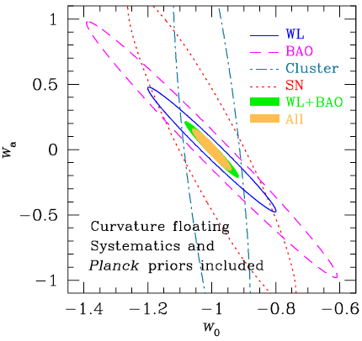
DES, DESI, LSST
Large Synoptic Survey Telescope will measure fluxes of galaxies in 6 bands in 0.2’’ pixels out to z=3 and map the Universe in 2.5 dimensions (photometric)
Map 20000 square degrees with 4 Billion galaxies
All 4 probes + more
Figure of Merit by 2030 will be close to ~1000

Slide 18
Ambitious plans to increase our understanding of the mechanism driving acceleration
Two relatively new developments suggest that we will learn even more from this ambitious program
+ CMB: “Support CMB experiments as part of the core particle physics program.” (P5)

Slide 19
1. Maybe Einstein was wrong
General Relativity can be modified …
For the cosmological metric, the acceleration equation generalizes to:
Get acceleration if these terms are positive

Slide 20
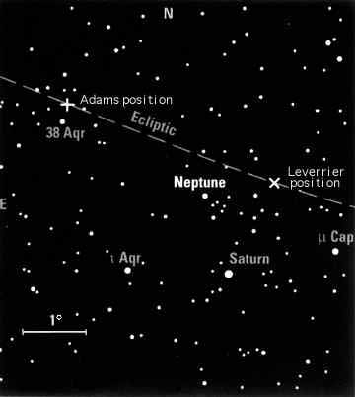
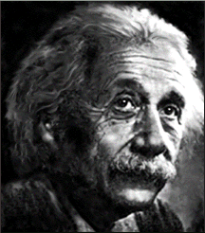
Age-old dispute
Anomalous orbit of Uranus due to DARK SECTOR (Neptune)
Anomalous precession of Mercury’s perihelion due to MODIFIED GRAVITY

Slide 21
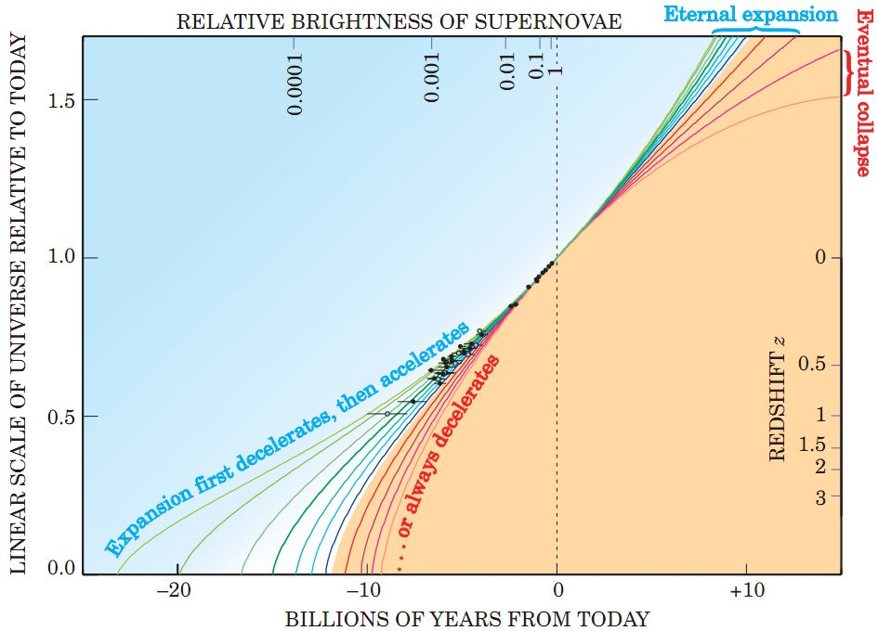
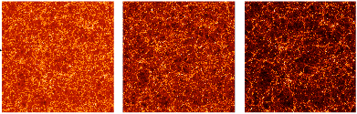
How will we tell?
Expansion History:
BAO, SN
Perlmutter
Growth of Structure:
Lensing, Clusters, Redshift Space Distortions
Huterer et al. 2014

Slide 22
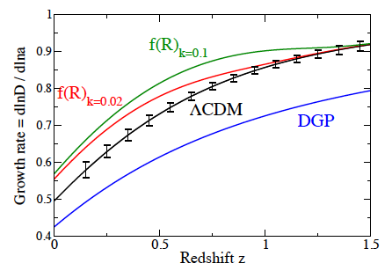
Measure expansion history, then use growth of structure
Dark energy models (with expansion history fixed) make zero parameter prediction for growth as a function of time
Projected constraints from DESI
Huterer et al. 2014

Slide 23
Can vary as a function of space as well as time
Dark energy models (with expansion history fixed) make zero parameter prediction for growth as a function of time … and space
Space

Slide 24
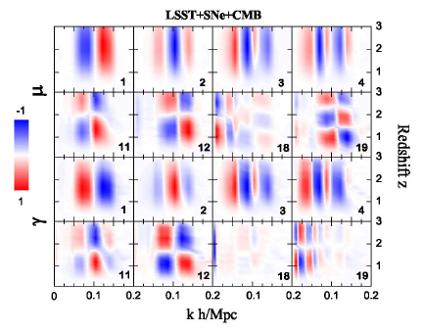
LSST will measure dozens of these modes
Hojjati et al. 2012
Failure in any one of these modes will signal a breakdown of the cosmological constant/dark energy paradigm

Slide 25
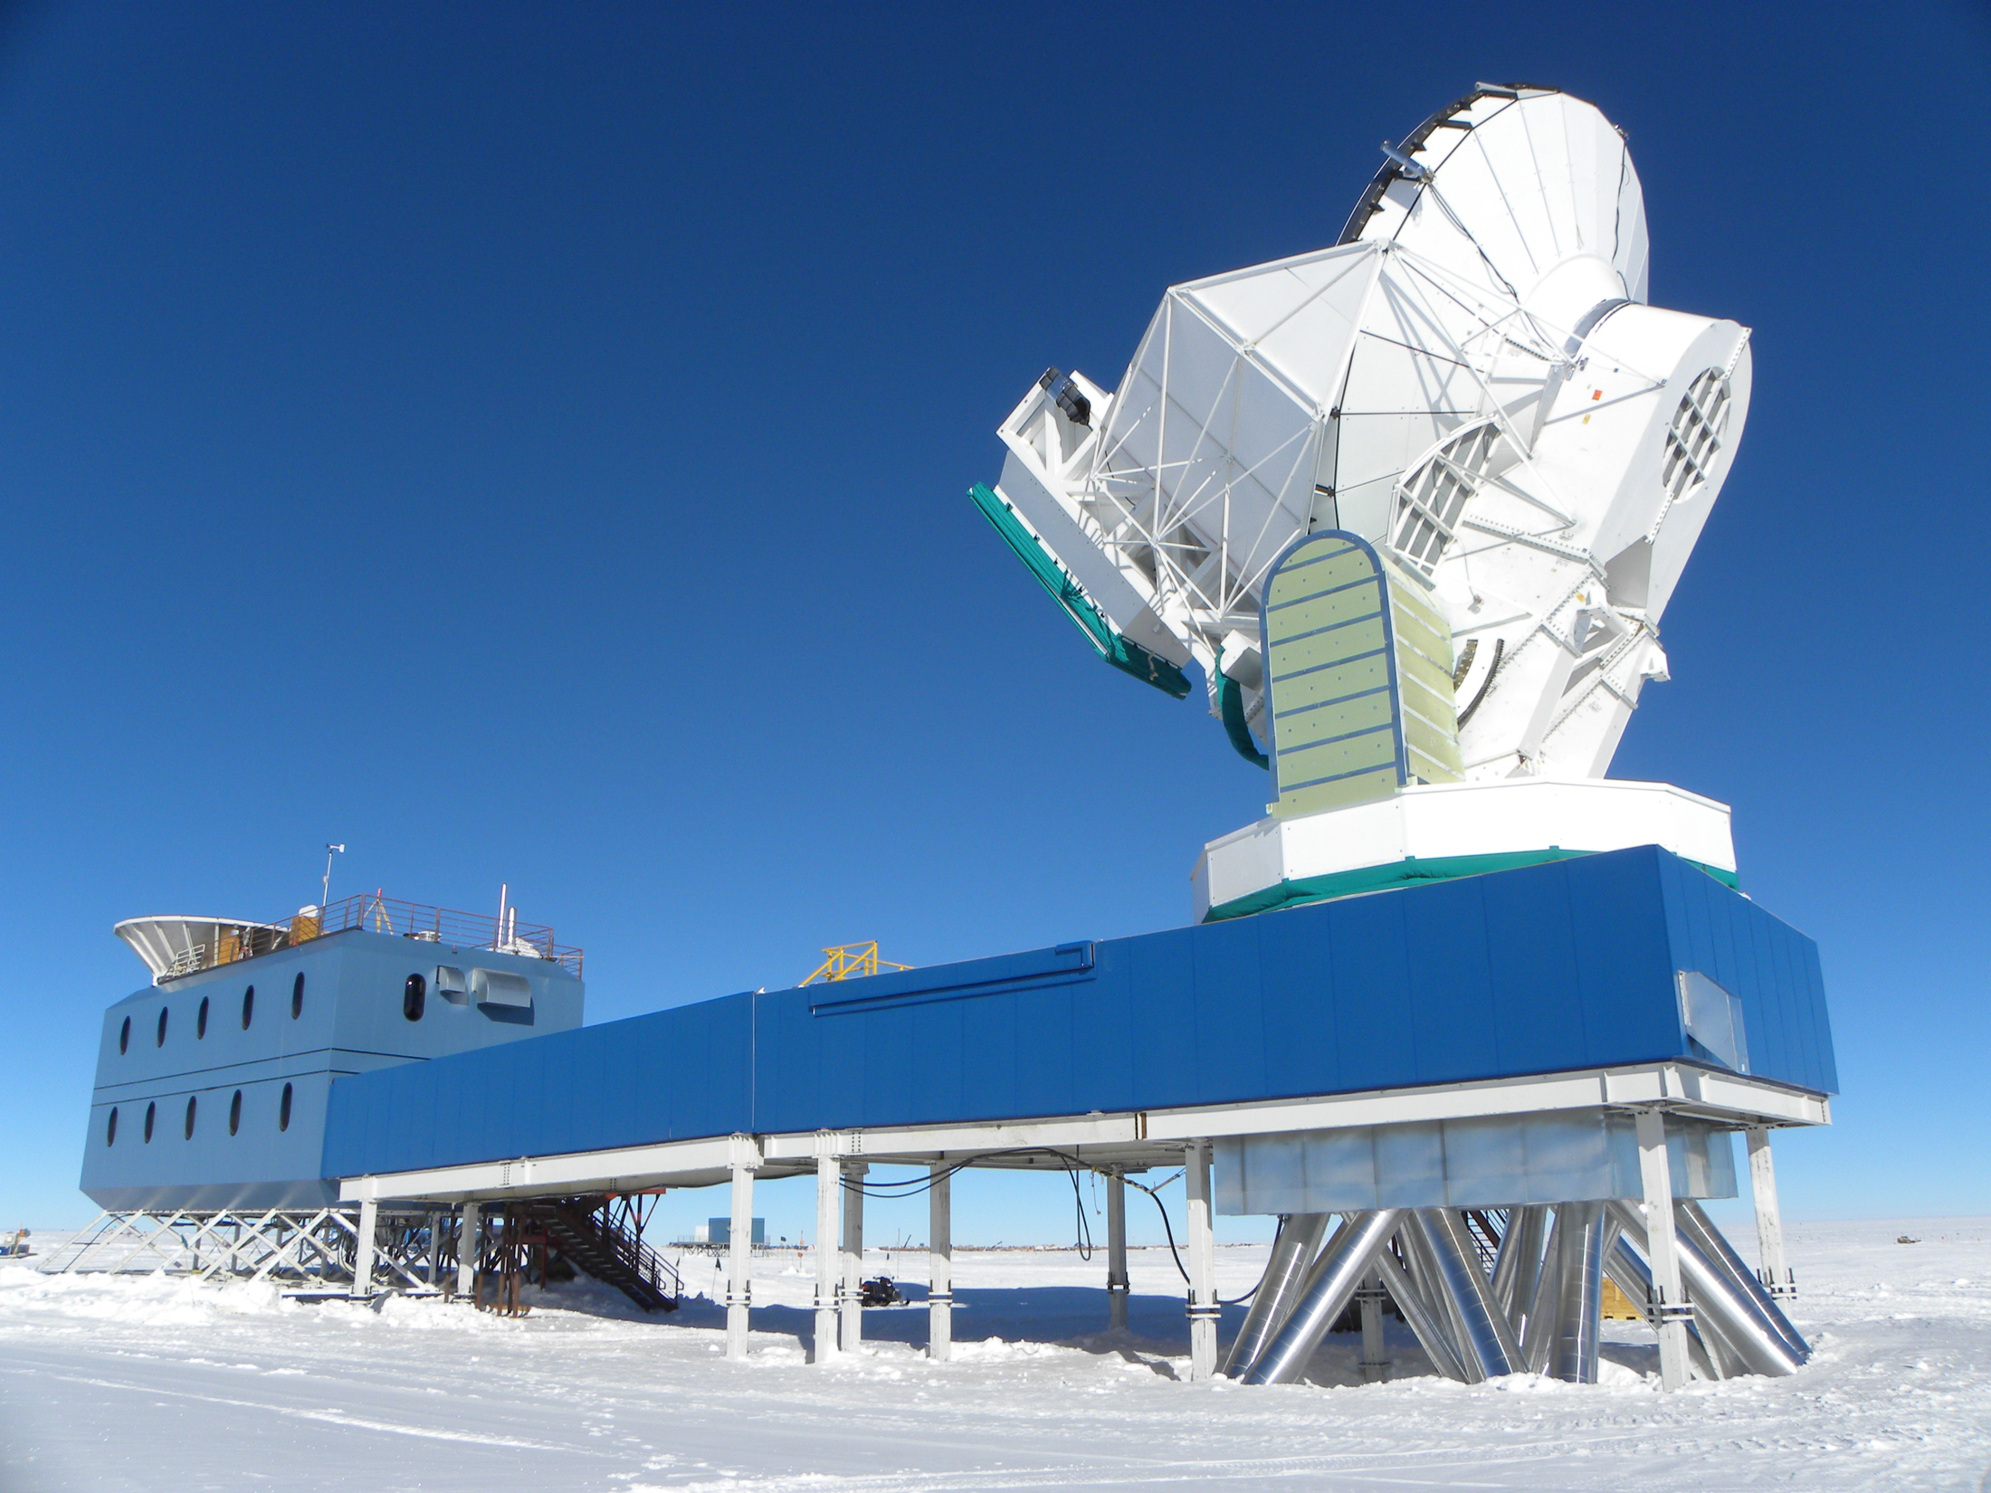
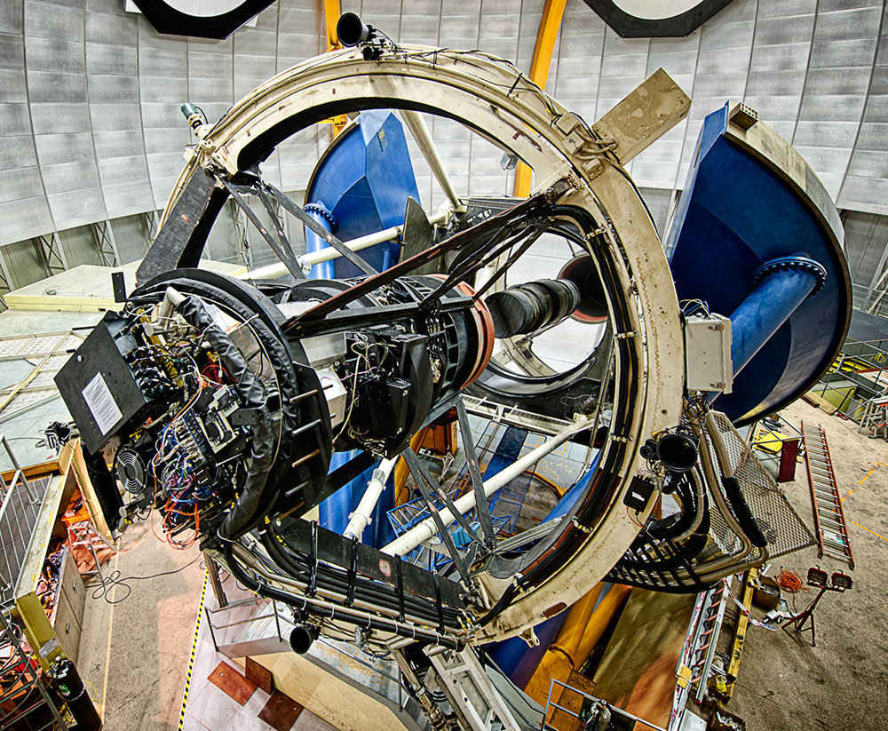
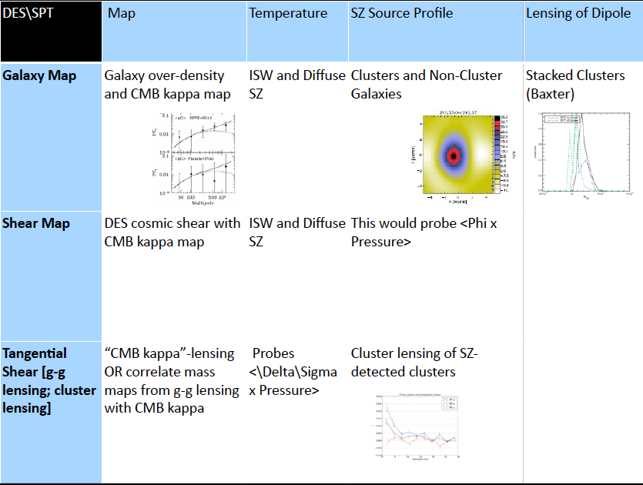
2. Probes are not independent

Slide 26
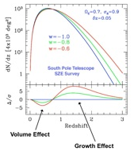
Example of why it matters: Cluster Abundance
Abundance of massive galaxy clusters as a function of redshift constrains expansion history and growth
Key systematic is estimating cluster masses
Multi-wavelength approach emerging:
-- optical richness
-- Sunyaev-Zel’dovich signal -- gravitational lensing of background galaxies

Slide 27
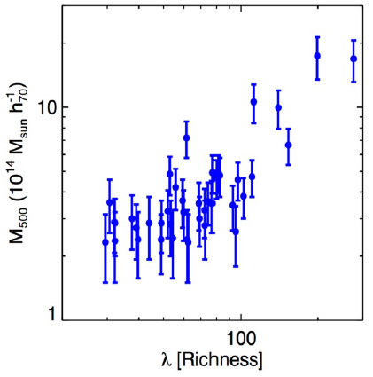
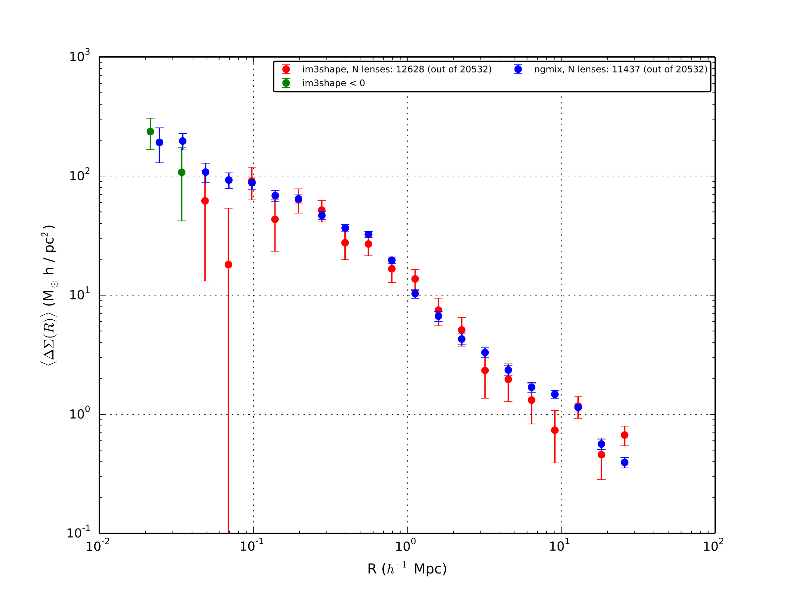
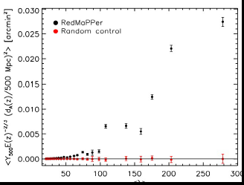
Early DES X SPT results
Saro, Benson, Rozo, Bleem …
DES selected clusters detected in SPT and mass indicator (SZ) measured
Rozo, Dietrich, Sheldon, Melchior…
SPT selected clusters detected in DES and mass indicator (richness) measured
Saro, Benson, Rozo…
SPT selected clusters weighed in DES with lensing

Slide 28
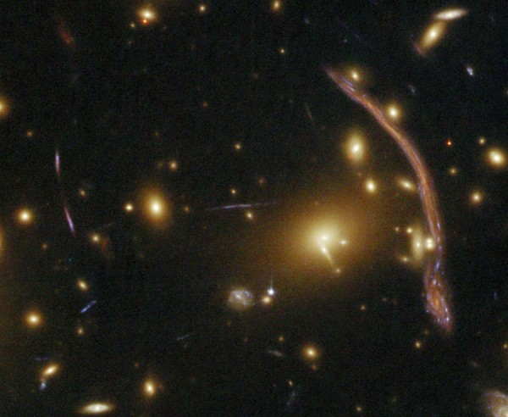

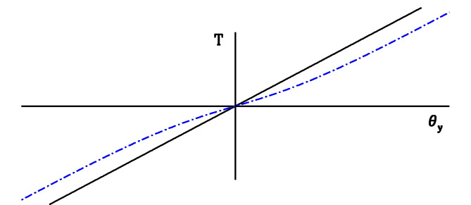
Lensing of the CMB by Galaxy Clusters
Hot spots cooler when lensed and cool spots hotter
Lensed
Seljak & Zaldarriaga 2001
Unlensed
Notes:
-1d seljak zal figure, people have known about it for 15 years
-is it true that cmb would be unchanged?
-emphasize that quadratic estimator is different – lensing that has been detected so far is by lss
-lensing has been detected before, but by lss. We’re looking around individual objects
M_200 10^15 h^(-1) M_sun cluster

Slide 29
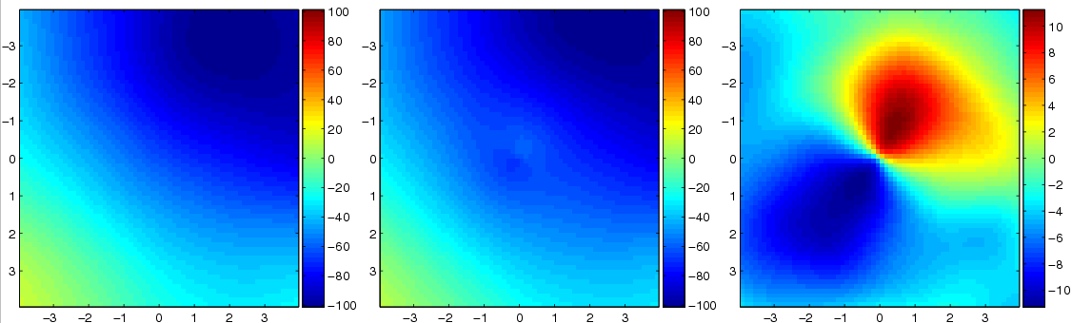
Lensing of the CMB by Galaxy Clusters
Unlensed CMB
Lensed CMB
Difference
μK
Lewis and Challinor, 2006
Notes:
-1d seljak zal figure, people have known about it for 15 years
-emphasize that quadratic estimator is different – lensing that has been detected so far is by lss
-lensing has been detected before, but by lss. We’re looking around individual objects
M_200 10^15 h^(-1) M_sun cluster

Slide 30
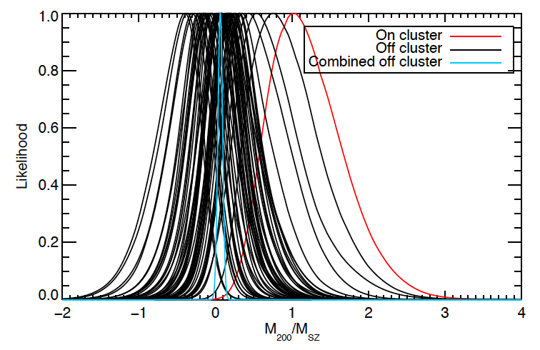
First Detection (preliminary) by South Pole Telescope
SPT: Baxter, et al.
~4-sigma detection
Mass estimates agree with those from SZ
Opens up another tool to measure cluster masses

Slide 31
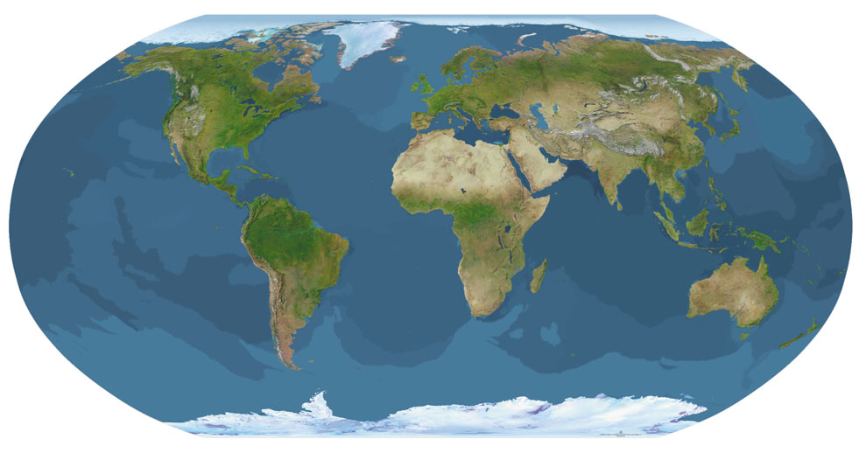
There is a lot left to explore
So far, the fraction of available information obtained from cosmic surveys is ~the fraction of the Earth’s surface area occupied by …

Slide 32
There is a lot left to explore
So far, the fraction of available information obtained from cosmic surveys is ~the fraction of the Earth’s surface area occupied by … Wales

