Slide 1
XAL Applications Development in CSNS
Weibin Liu for AP Group of CSNS
Yuwen An, Mingyang Huang, Mingtao Li, Yong Li, Zhiping Li, Yudong Liu, Jun Peng, Jing Qiu, Na Wang, Yuanyuan Wei, Shouyan Xu, Yue Yuan, Sheng Wang
Institute of High Energy Physics, CAS, Beijing, China
The 12th Symposium on Accelerator Physics, Lanzhou, 13th and 15th August 2014

Slide 2
Outline
Introduction of XAL
XAL Applications Development in CSNS
Summary

Slide 3
1. Introduction of XAL

Slide 4
XAL
XAL is a framework (software package) designed to provide an accelerator physics programming interface to the accelerator. About ten years ago, XAL was developed in Java by SNS firstly. Now it is used and developed by many accelerator laboratories, e.g. SNS, ORNL, LANL, SLAC, FRIB, etc.

Slide 5
Application level
Database
Physicist and Operator
EPICS Channel Access
XML
TCP/IP Network
Accelerator hardware interface
……
Overall relationship of the XAL application framework

Slide 6
It is convenient to develop physics applications with XAL from the standpoint of physicist or commissioner.
Much of the underlying connections to the EPICS control system are hidden from the user.
Some basic accelerator physics calculations are packaged.
Use of this framework allows writing general-purpose applications that can be applied to various parts of the accelerator. Also the accelerator structure is initiated from a database, so introduction of new beamline devices or signal modifications are immediately available for all XAL applications.

Slide 7
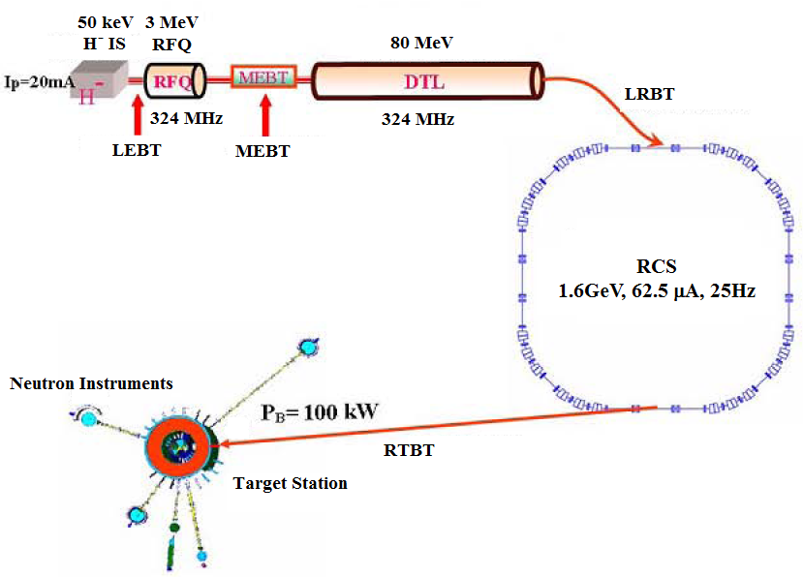
XAL Accelerator
The gov.sns.xal.smf.Accelerator is the highest level interface of an real accelerator.
An Accelerator may consist of many sequences. A sequence represents a part of the accelerator and contains many nodes which stores the device hardware and physics information.

Slide 8
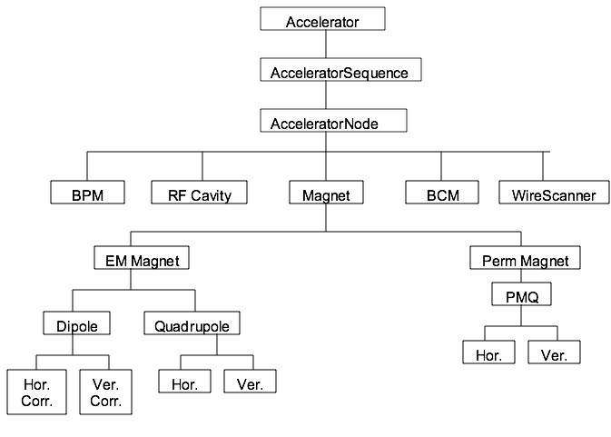
Accelerator hierarchy from the accelerator physicist point-of-view

Slide 9
Some XAL Node Types
Bend BLM BPM CCL CurrentMonitor CvgGauge Dipole DTLTank Electromagnet ExtractionKicker GenericNode HDipoleCorr IonGauge Magnet MagnetMainSupply MagnetPowerSupply MagnetTrimSupply Marker
NeutronDetector PermanentMagnet PermQuadrupole ProfileFit ProfileMonitor Quadrupole ReBuncher RfCavity RfGap RingBPM SCLCavity Sextupole Solenoid TrimmedQuadrupole Vacuum VDipoleCorr

Slide 10
XAL Configuration File
In XAL, XML files are used to describe an accelerator. Physics and hardware device information are all include in these XML files.
For example, the lattice of CSNS contains following files:
main_csns.xal files description of the lattice
csns.xdxf optics and devices file
csns.impl map of device type and java class
model.params description of the beam
timing_pvs.tim channel suite of timing PVs
hardware_status.xdxf hardware status
and two .dtd files for the definition of xml.

Slide 11
XAL Main Configuration File
The main_csns.xal file is the beginning of the XAL configuration. It simply points to the other configuration files.
<?xml version = '1.0' encoding = 'UTF-8'?>
<!DOCTYPE sources SYSTEM "xdxf.dtd">
<sources>
<deviceMapping_source name="deviceMapping" url="csns.impl"/>
<optics_source name="optics" url="csns.xdxf"/>
<hardware_status name="Hardware Status" url="hardware_status.xdxf"/>
<timing_source name="timing" url="timing_pvs.tim"/>
<tablegroup_source name="modelparams" url="model.params"/>
</sources>

Slide 12
The XAL Optics File
The csns.xdxf file contains a complete description of all accelerator physics, hardware and connection process variables.
<?xml version = '1.0' encoding = 'UTF-8'?>
<!DOCTYPE xdxf SYSTEM "xdxf.dtd">
<xdxf date="Thursday, August 22, 2013 3:28:33 PM GMT+08:00" system="csns" ver="0.1">
<comboseq id="RTBT">
<sequence id="RTBT1" />
<sequence id="RTBT_FODO" />
<sequence id="RTBT_Match" />
</comboseq>
<comboseq id="RDBT">
<sequence id="RTBT1" />
<sequence id="RTBT_RDump" />
</comboseq>
……

Slide 13
The XAL Optics File
<sequence id="RTBT_FODO" len="55.377">
<attributes>
<sequence predecessors="RTBT1" />
</attributes>
<node id="Begin_Of_RTBT_FODO" len="0" pos="0" type="MARKER" />
<node id="RTBT_Mag:RTB01" len="1.9" pid="RTB01" pos="1.1" status="true" type="XBEND">
<attributes>
<magnet bendAngle="13.063438" dfltMagFld="0.944049" dipoleEntrRotAngle="6.531719" dipoleExitRotAngle="6.531719" len="1.9" pathLength="1.9" polarity="+1" />
<aperture shape="1" x="130" y="128" />
<align pitch="0" roll="0" x="0" y="0" yaw="0" z="0" />
</attributes>
<ps main="RTBT_Mag:PS_RTB01" />
<channelsuite name="magnetsuite">
<channel handle="fieldRB" settable="false" signal="RTBT_Mag:RTB01:B" />
</channelsuite>
</node>
……

Slide 14
The XAL Optics File
A Node can have a “ChannelSuite” – a collection of control system channels associated with this node
Each element of the suite is a handle-signal pair, where the handle is used in XAL, and the pair is created in the XML file
Thus if a control system channel is changed, the XAL software does not have to change
<ps id="RTBT_Mag:PS_RTB01" type="main">
<channelsuite name="pssuite">
<channel handle="I" signal="RTBT_Mag:PS_RTB01:I" />
<channel handle="I_Set" signal="RTBT_Mag:PS_RTB01:I_Set" />
<channel handle="fieldSet" signal="RTBT_Mag:PS_RTB01:B_Set" />
<channel handle="psFieldRB" signal="RTBT_Mag:PS_RTB01:B" />
……
</channelsuite>
</ps>

Slide 15
Model Parameters
The model.params file contains the description of the beam parameters at the beginning of each sequence.
<record name="MEBT" coordinate="x" alpha="-1.77262" beta=" 0.23310" emittance="+2.671101376e-006"/>
<record name="MEBT" coordinate="y" alpha=" 0.63921" beta=" 0.07337" emittance="+2.629758337e-006"/>
<record name="MEBT" coordinate="z" alpha=" -0.36631" beta=" 0.52198" emittance="+4.511688e-006"/>
<record name="DTL1" coordinate="x" alpha="-0.27863" beta=" 0.4940" emittance="+2.972815e-006"/>
<record name="DTL1" coordinate="y" alpha="-0.12576" beta="0.1714" emittance="+2.992733e-006"/>
<record name="DTL1" coordinate="z" alpha="-0.19196" beta="0.27333962" emittance=“+5.298983e-006"/>
……
<record name="MEBT" species="HMINUS" W="3.0258E6"/>
<record name="DTL1" species="HMINUS" W="3.0258E6"/>
<record name="DTL2" species="HMINUS" W="21.6686E6"/>
……

Slide 16
Getting Accelerator from Files in XAL
Some methods are provided by class gov.sns.xal.smf.data.XMLDataManager to parse accelerator lattice.
// Getting an Accelerator from a given path
Accelerator acc = XMLDataManager.acceleratorWithPath("./src/csns/xal_xmls/main_csns.xal");
// Getting default Accelerator
Accelerator acc = XMLDataManager.loadDefaultAccelerator();
// Getting a sequence from an Accelerator
AcceleratorSeq sequence = acc.getComboSequence("RTBT");

Slide 17
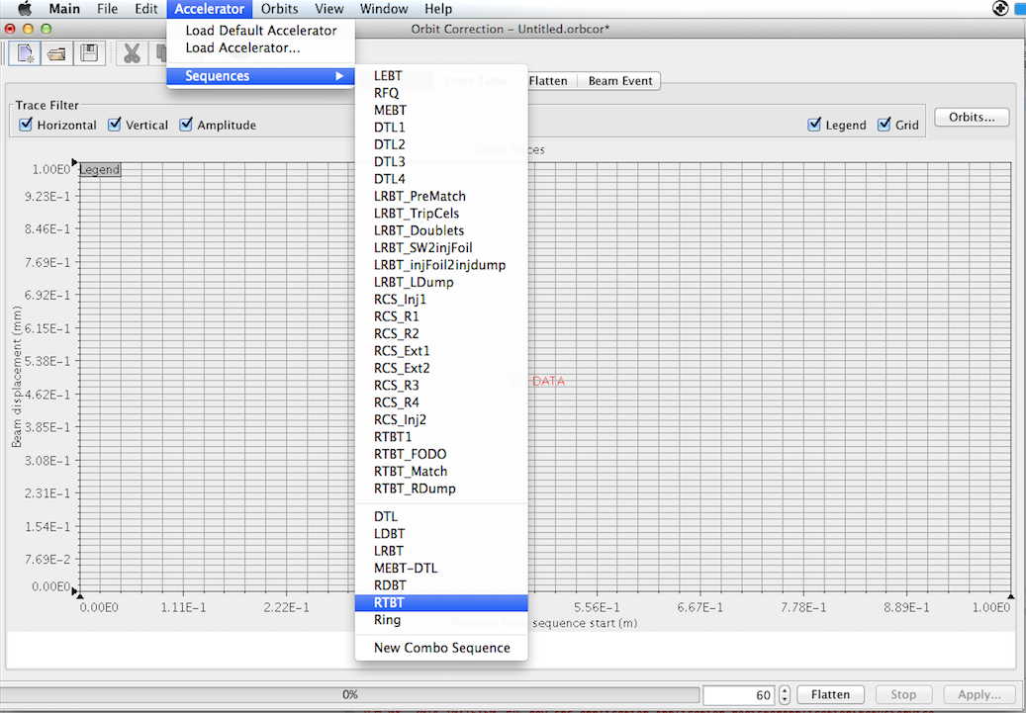
General interface for loading lattice is provided by XAL. When a lattice is used, the device channels are connected automatically at the same time. This makes the job of programming focusing on the accelerator physics and graphical user interface (GUI).

Slide 18
Getting Value from PV
Many node types have convenient methods to get information directly from the machine without using Channel Access.
Magnets: getField(), setField()
BPMs: getXAvg(), getYAvg()
// Getting a sequence from an Accelerator
AcceleratorSeq sequence = acc.getComboSequence("RTBT");
AcceleratorNode node = sequence.getNode("RTBT_Mag:RTQF01”)
Channel channel = node.getChannel("fieldRB");
double value = channel.getValueRecord().doubleValue();
// or
double = ((Quadrupole) node).getFieldReadback();

Slide 19
Calculation of Lattice
EnvTrackerAdapt envTracker = new EnvTrackerAdapt( sequence );
final EnvelopeProbe probe = ProbeFactory.getEnvelopeProbe( sequence, envTracker );
Scenario scenario;
try {
scenario = Scenario.newScenarioFor( sequence );
scenario.setProbe( probe );
//scenario.setSynchronizationMode( Scenario.SYNC_MODE_RF_DESIGN );
scenario.resync();
scenario.run();
Trajectory traj = scenario.getProbe().getTrajectory();
ProbeState state = traj.stateForElement(“RTBT_Mag:RTQF27");
System.out.println(state);
System.out.println(((EnvelopeProbeState) state).getResponseMatrix());
} catch (ModelException e) {
e.printStackTrace();
}

Slide 20
Virtual Accelerator
This application provides a PV server for other physics application development. The PVs include all the PVs described in the optics file, e.g. magnetic field, BPM value. The values of the PVs are created according to the optics calculation result. And noise is added to these values to simulate the real situation. Other applications can communicate with virtual accelerator via EPICS, just similar to the control room.

Slide 21
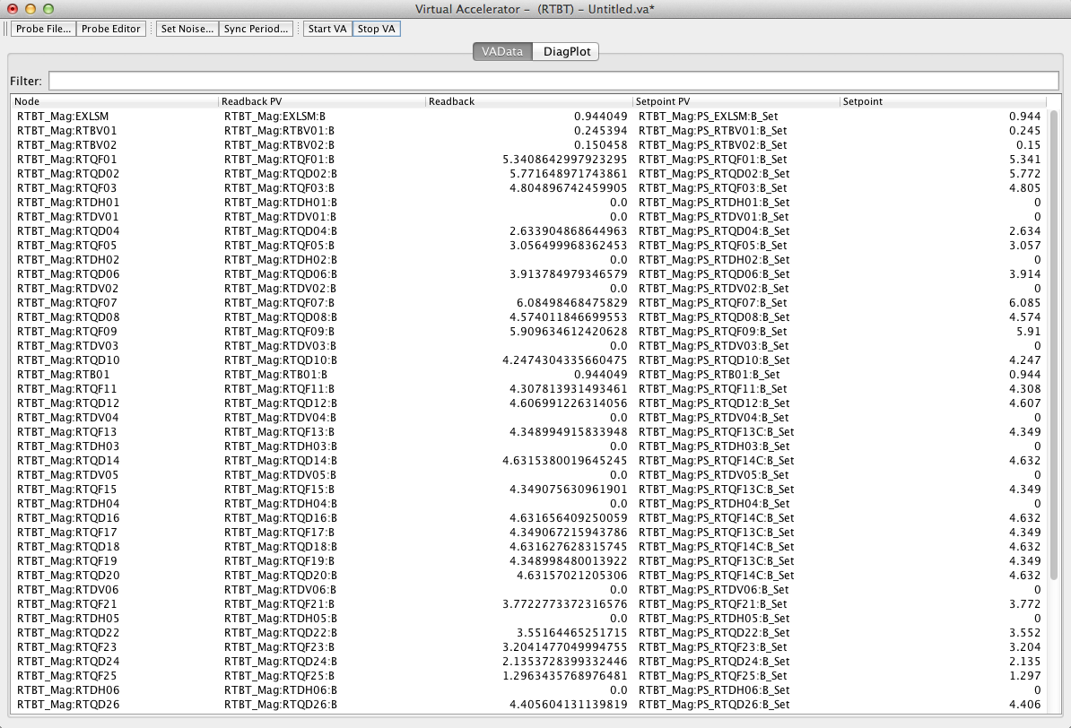

Slide 22
2. XAL Applications Development in CSNS

Slide 23
Two years ago, XAL was introduced to CSNS as the physics application software. The XAL project is a large project. It is hard to finish the porting and developing work with several people. And then the CSNS accelerator physics group of CSNS began to work on the development of XAL. Most of the people do not good at programming, especially using Java and EPICS. We started the porting work from learning JAVA and EPICS. After two years work, we ported some general applications from XAL. And also we developed some specific applications for CSNS.

Slide 24
Developing XAL with Git
XAL is a large Java project. Many people write codes for this project at the same time. Version control system is used for XAL developing to avoid conflict and repetition. In CSNS, we chose GIT - a version control software to manage XAL project developing. A combination of SNS and SLAC version XALs is used as the basis of CSNS version XAL.

Slide 25
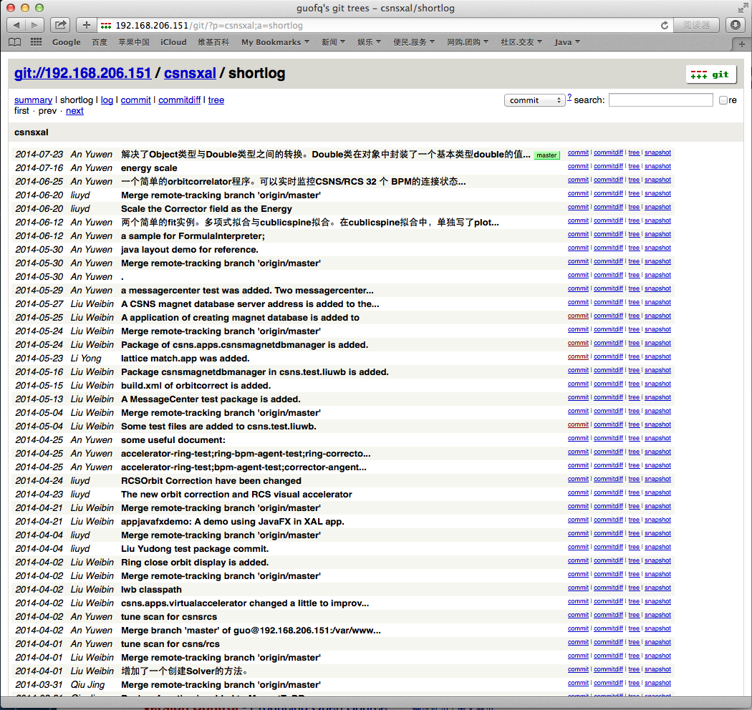
Browsing the Developing History of XAL

Slide 26
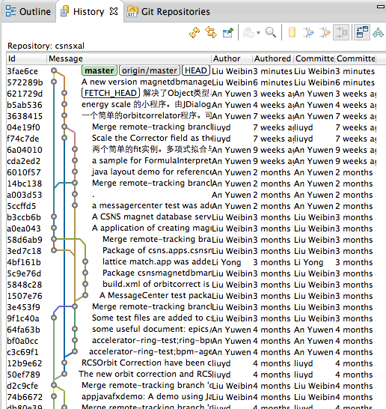

Slide 27
The XAL Optics File for CSNS
The XAL optics file is a very large file. It is a very important file for the development of XAL. Several applications were written to create the optics file from survey files.
LinacSurveyToXAL.java
LRBTSurveyToXAL.java
RCSSurveyToXAL.java
RTBTSurveyToXAL.java
The application extLatGenerator.java which converting from XAL optics to MAD and TRACE 3D lattice file is also created for the convenience of using.

Slide 28
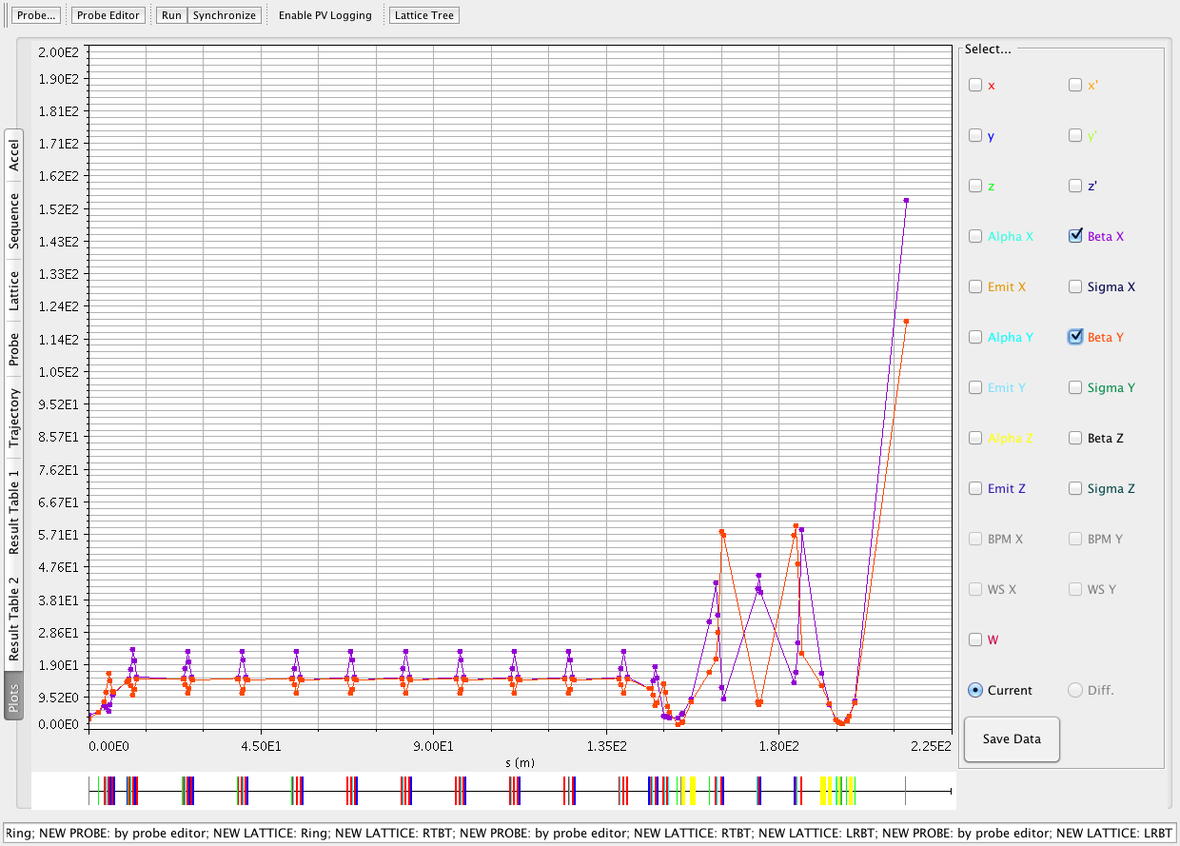
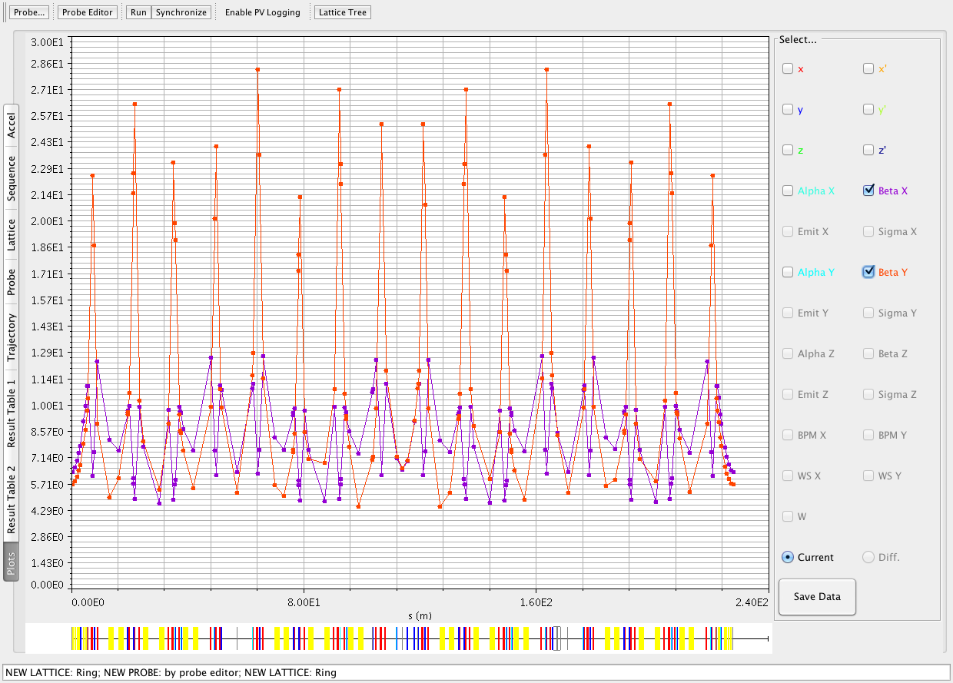
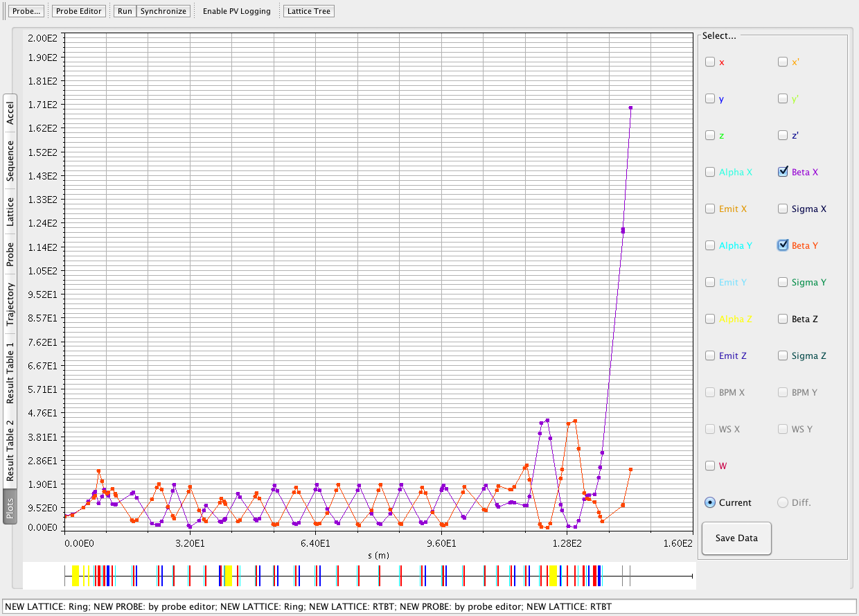
Optics Calculation with MPX
Beta function plots of LRBT, RCS
and RTBT.

Slide 29
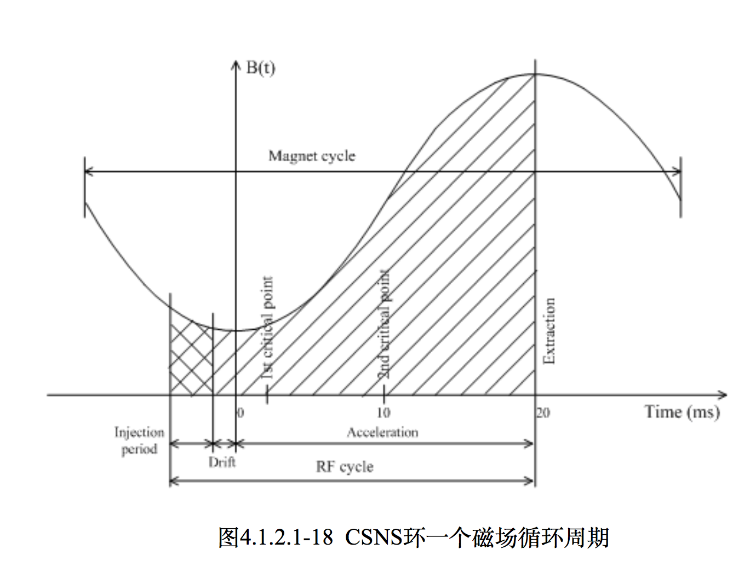
Orbit Correction for CSNS
The orbit correction application in XAL can be used for linac and transport line of CSNS. But it can’t be used for the RCS of CSNS directly. In one period of the RCS, beam energy increases from 80 MeV to 1.6 GeV. The beam runs about 20,000 turns. The beam diagnosis system provides 20 sets of orbit in one period. The orbit correction for RCS become a little complex because 20 orbits at different energy need correction.

Slide 30
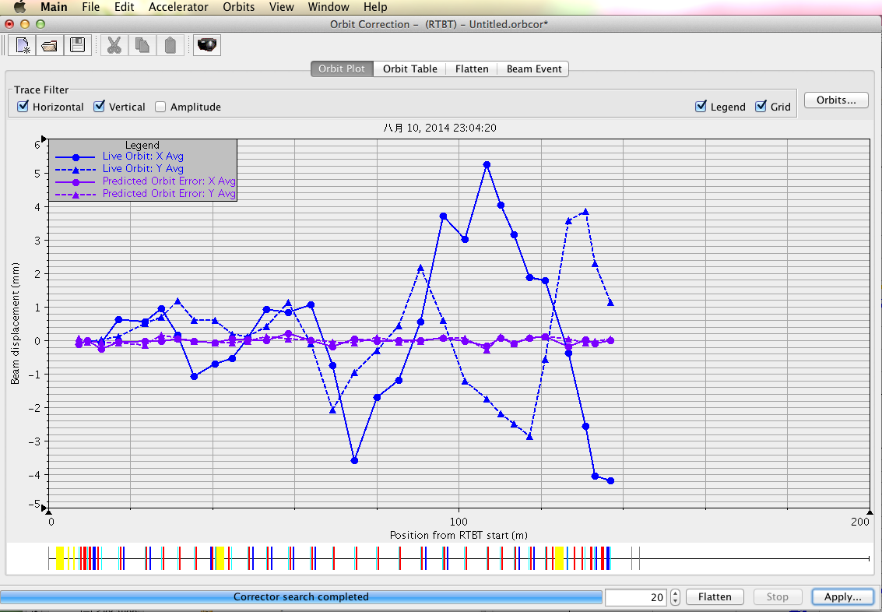
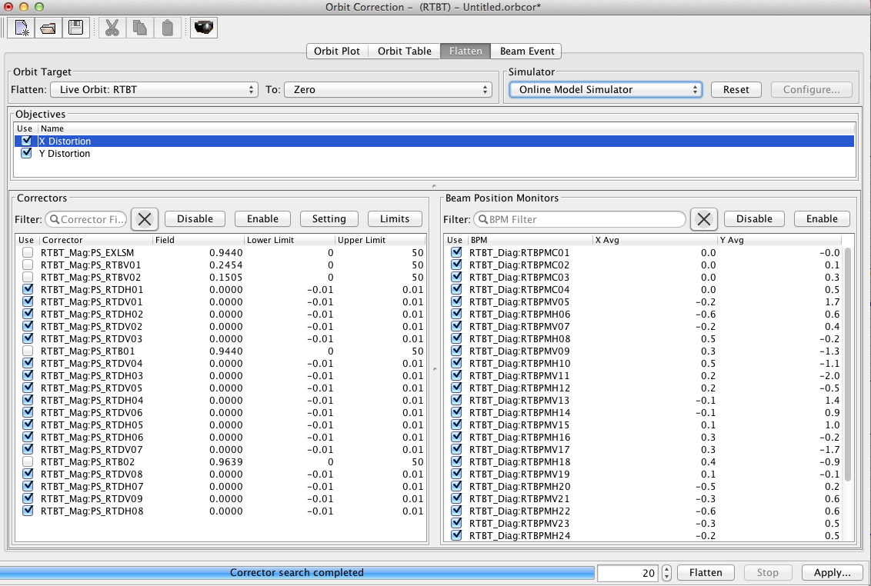
An orbit correction example of RTBT.

Slide 31
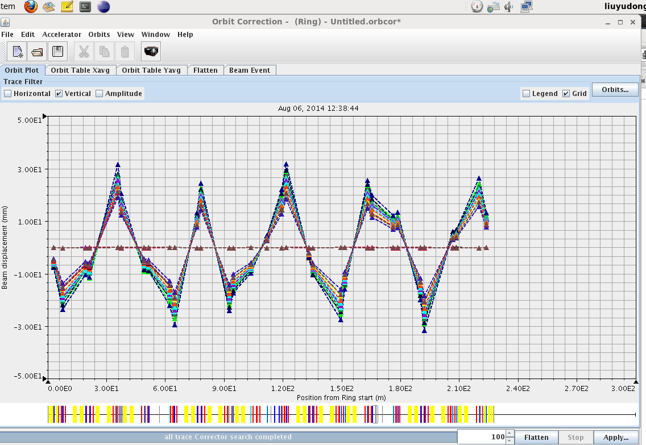
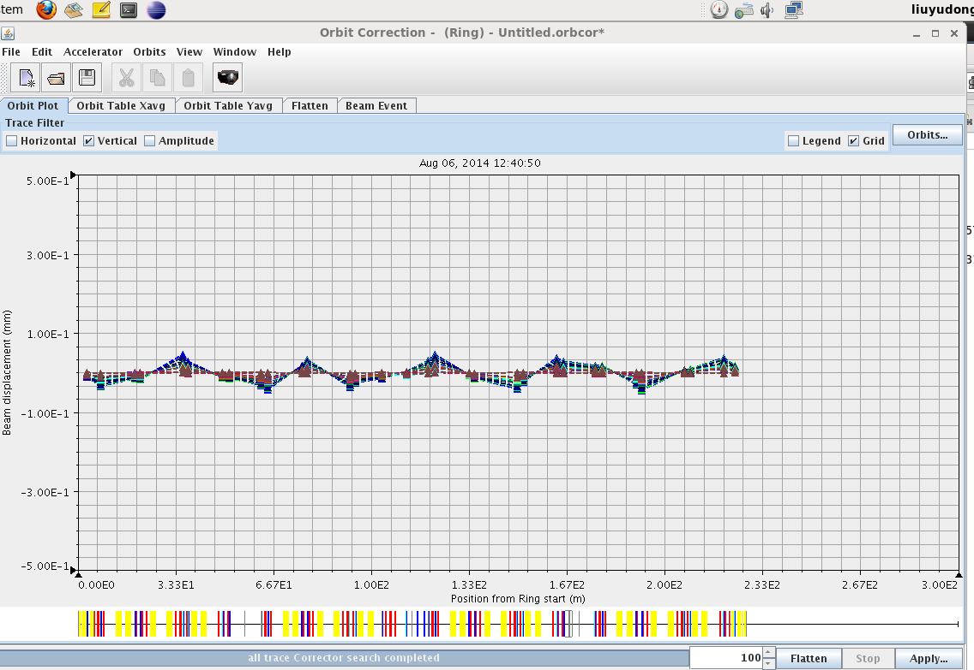
Measured vertical closed orbit in different energy
Predicted vertical orbit after correction
Measured vertical closed orbit in different energy after correction
An orbit correction example
for RCS.

Slide 32
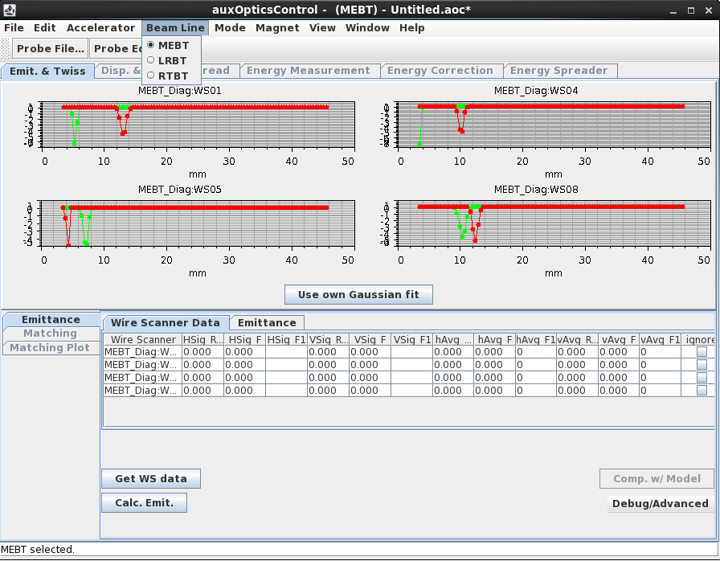
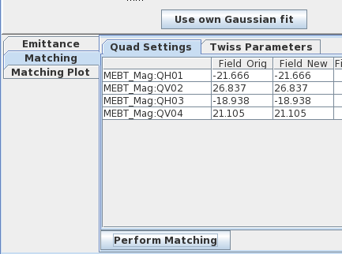
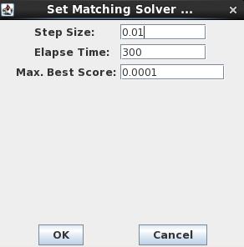
Auxiliary Optics Control (AOC)
Several wire scanners are located at linac, LRBT and RTBT. These wire scanners can be used for emittance measurement. With the measurement result, the optics can be optimized.

Slide 33
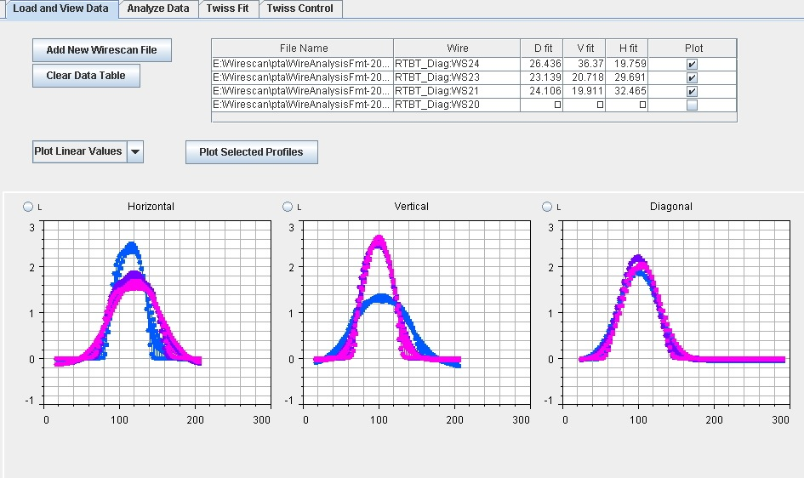
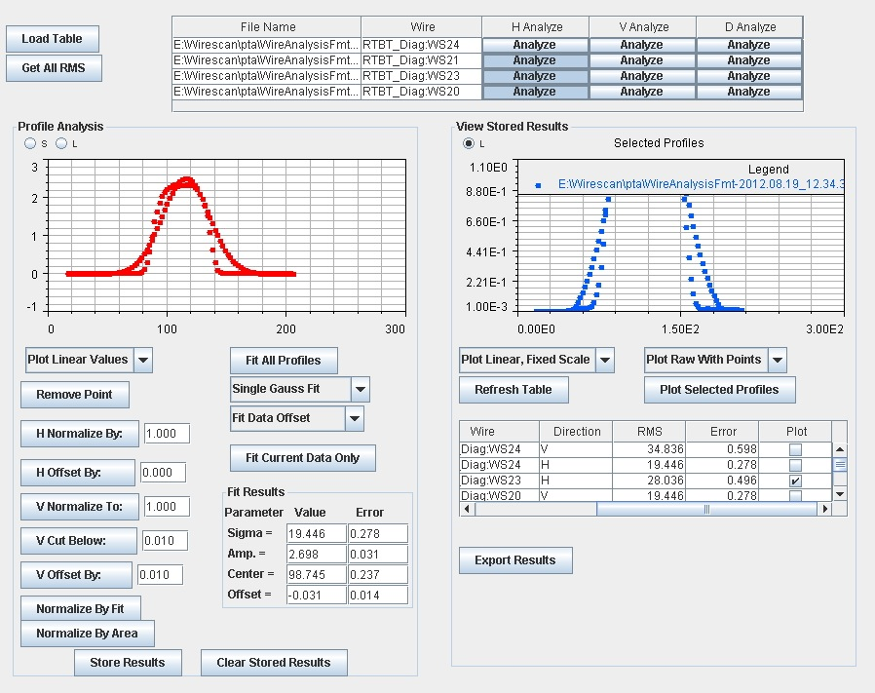
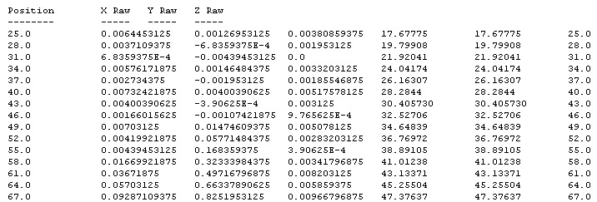

Slide 34
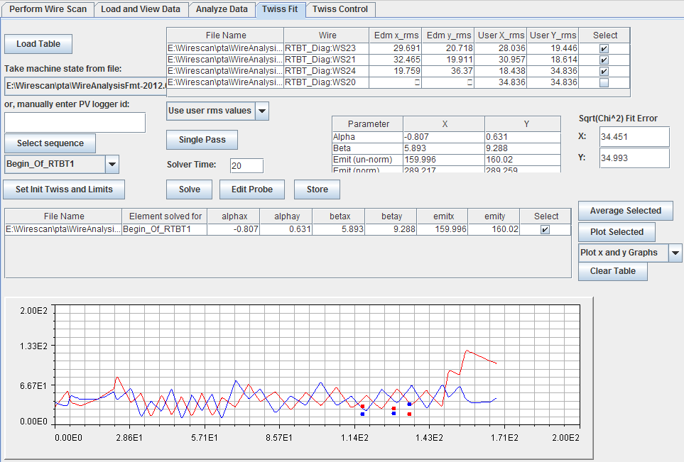
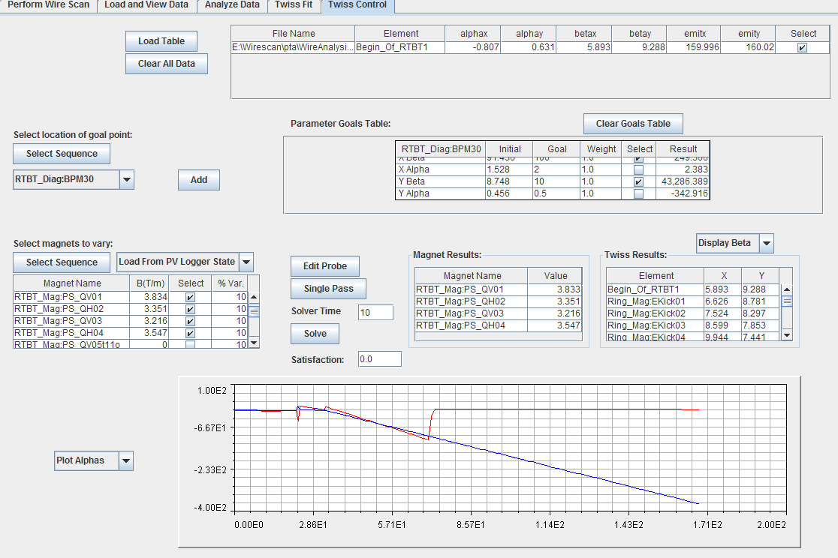
Twiss parameters at any position can be calculated with the emittance measurement result. Optics match function is also added.

Slide 35
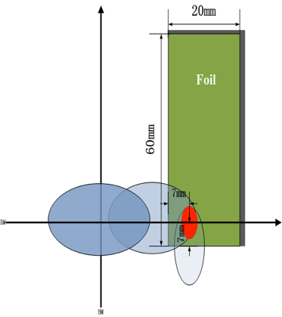
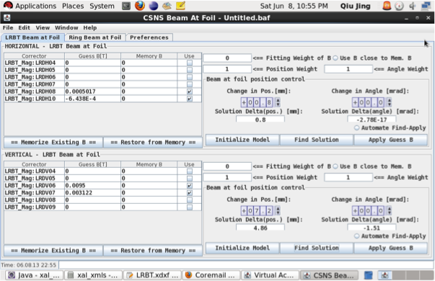
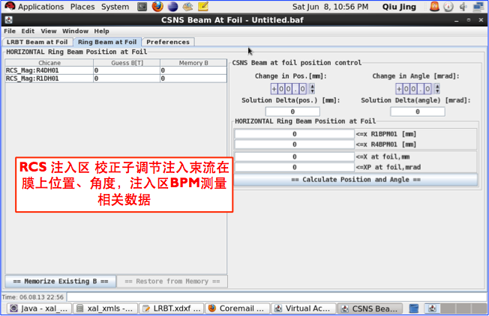
Beam at Foil
The position and angle of the beam from LRBT can be adjusted with this application. The close orbit of RCS can be adjusted also.

Slide 36
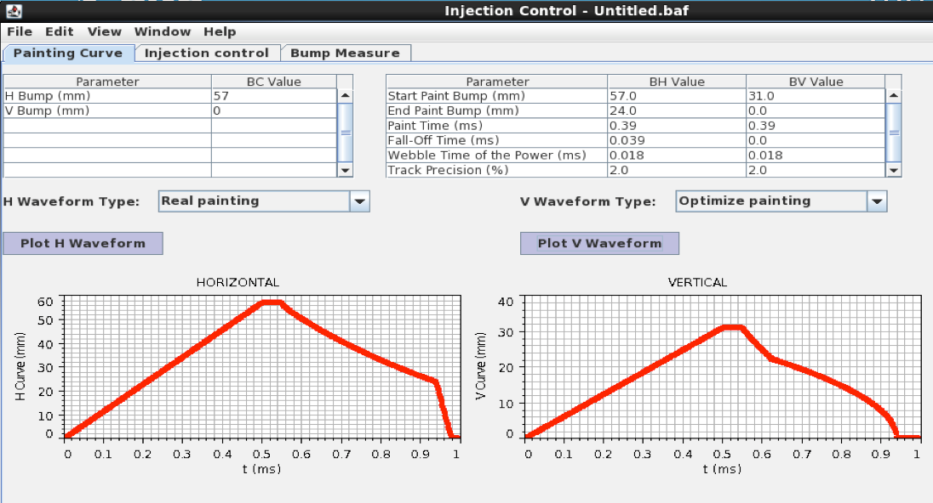
Application for Beam Injection painting
With this application, the injection painting curve can be displayed, adjusted and saved.

Slide 37
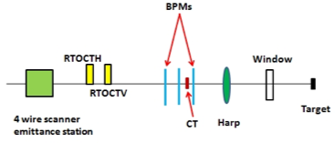
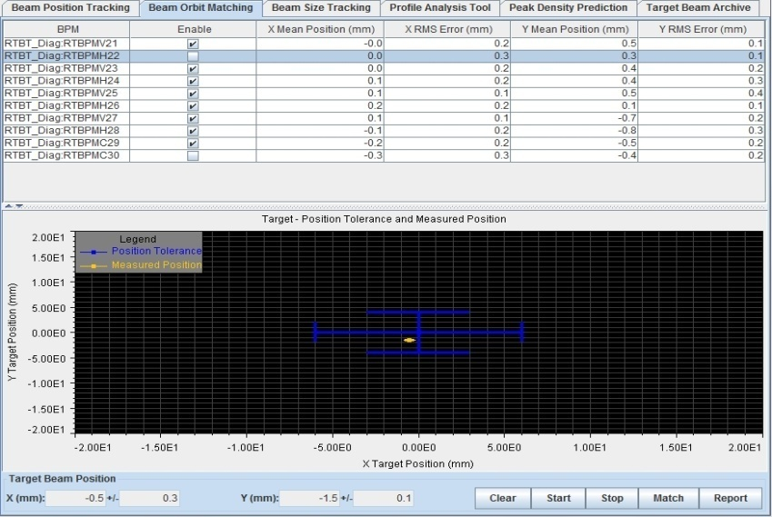
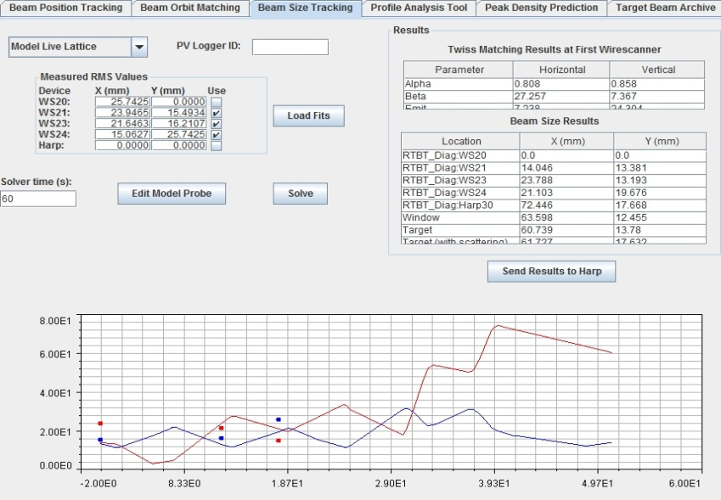
RTBT Wizard
Beam loss must be constrained strictly. Beam size and position can be adjusted with this application.

Slide 38
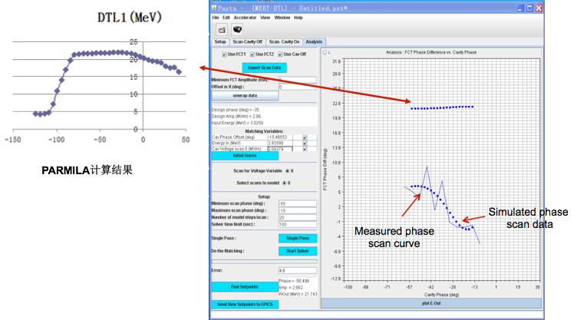
Pasta - an RF phase scan and tuning application
Two FCTs are used to measure the beam energy in this application.

Slide 39
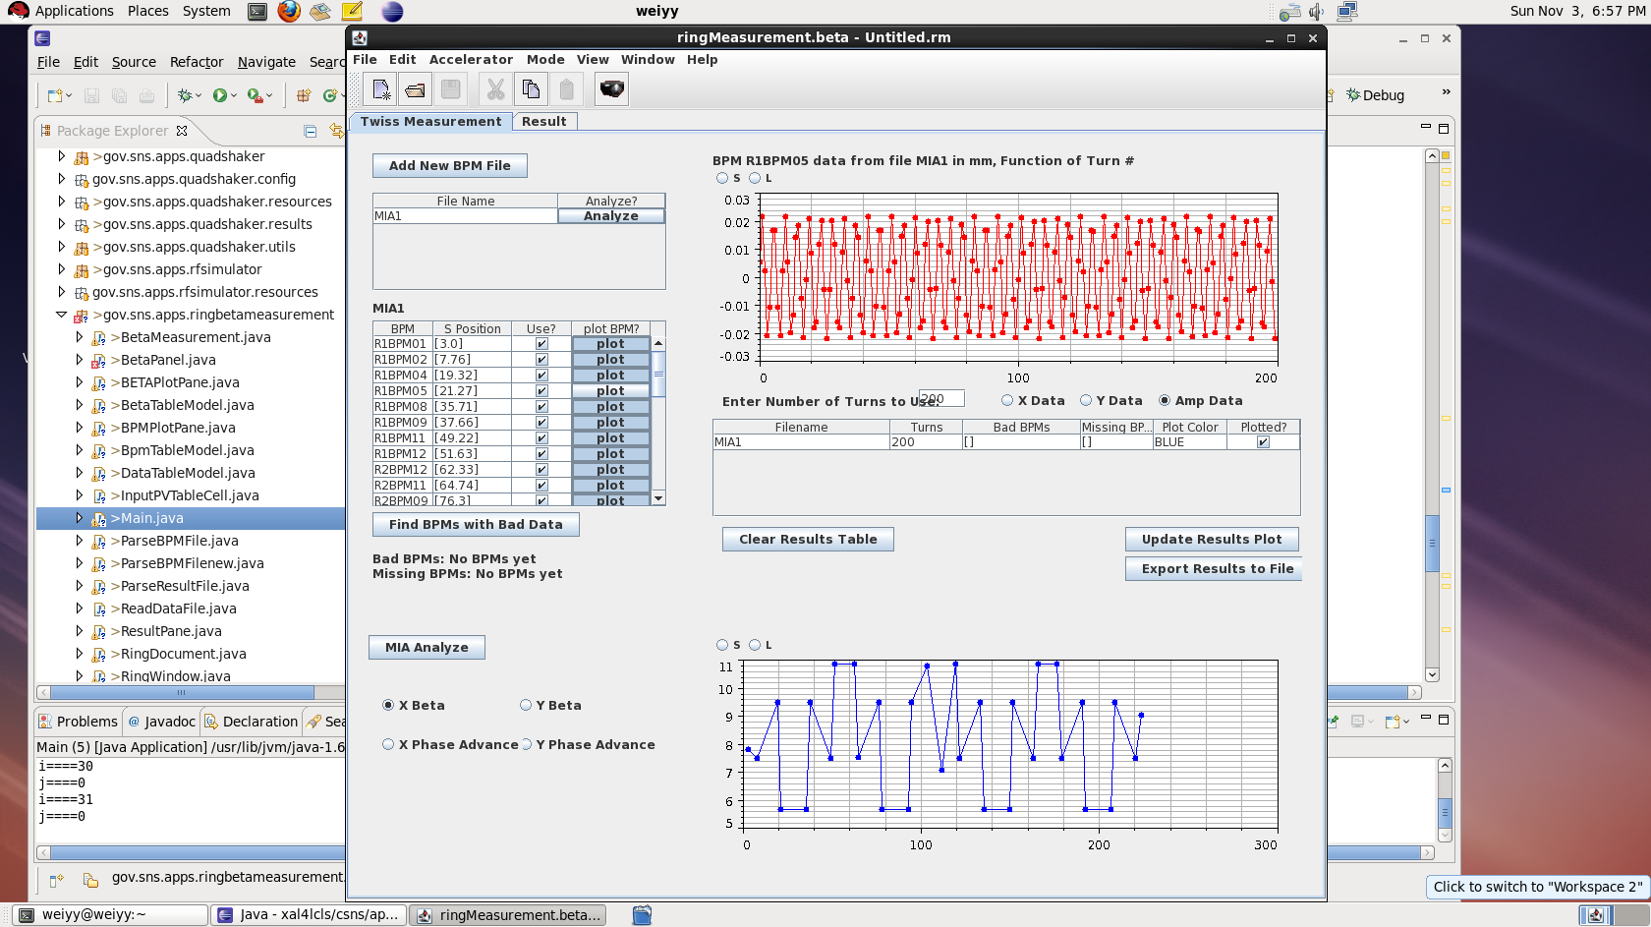
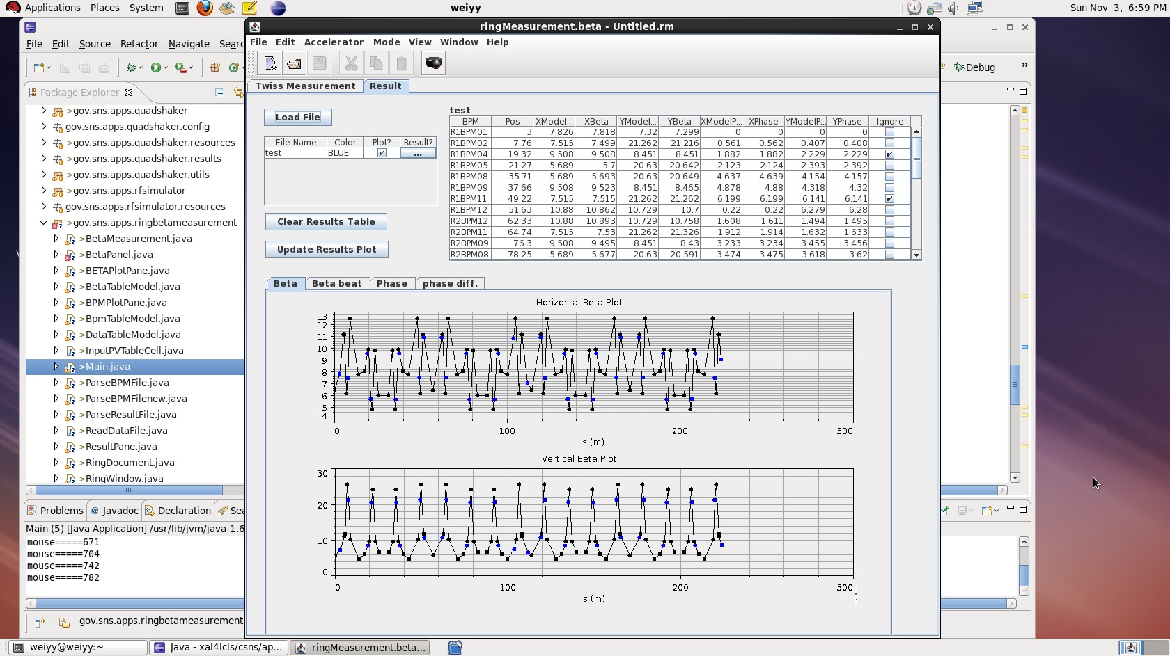
Application for RCS Parameter measurement

Slide 40
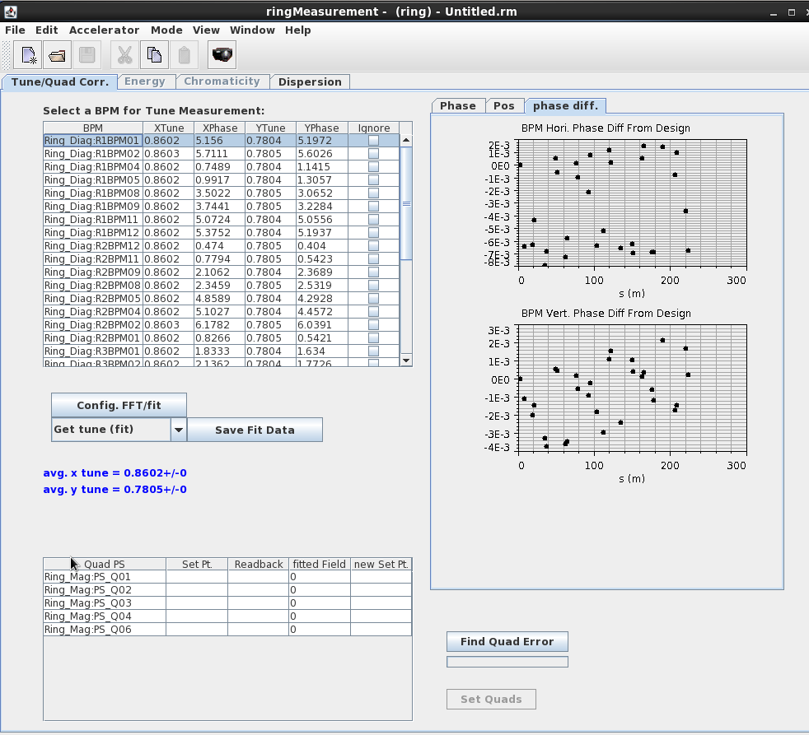
Tune and Phase advance measurement
Dispersion measurement
BPM TBT data is from AT simulation
Cosine fit or FFT method is adopted for tune and phase advance measurement
The results are consistent with the AT simulation

Slide 41
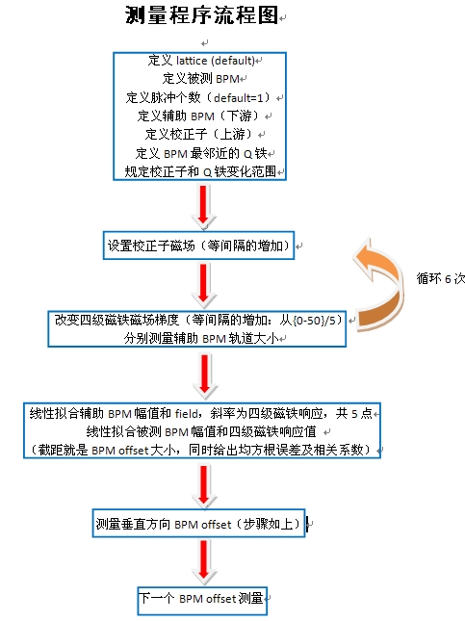
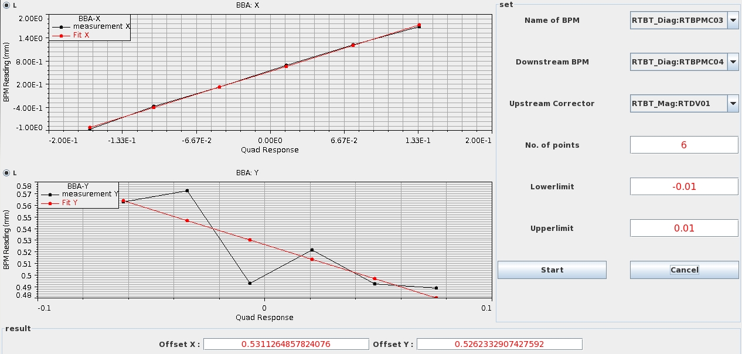
BBA Measurement for CSNS Transport Line

Slide 42
Model Management of CSNS
Loading and saving models are often used for operation and commissioning of an accelerator. For CSNS, model management is a little complex because of the RCS (Rapid Cycling Synchrotron). A CSNS model not only include the normal optics model, but also include painting curve model for injection, orbit correction model for different energy in one period, RF model (amplitude and phase curve), kicker model (amplitude) for extraction, magnet harmonic injection model.

Slide 43
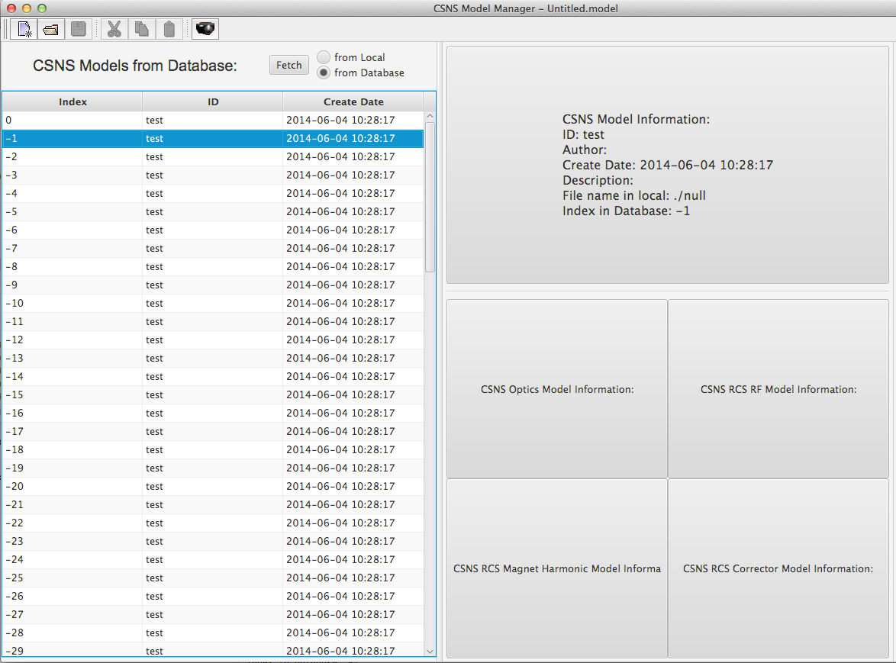
Preliminary Interface for CSNS Model Manager

Slide 44
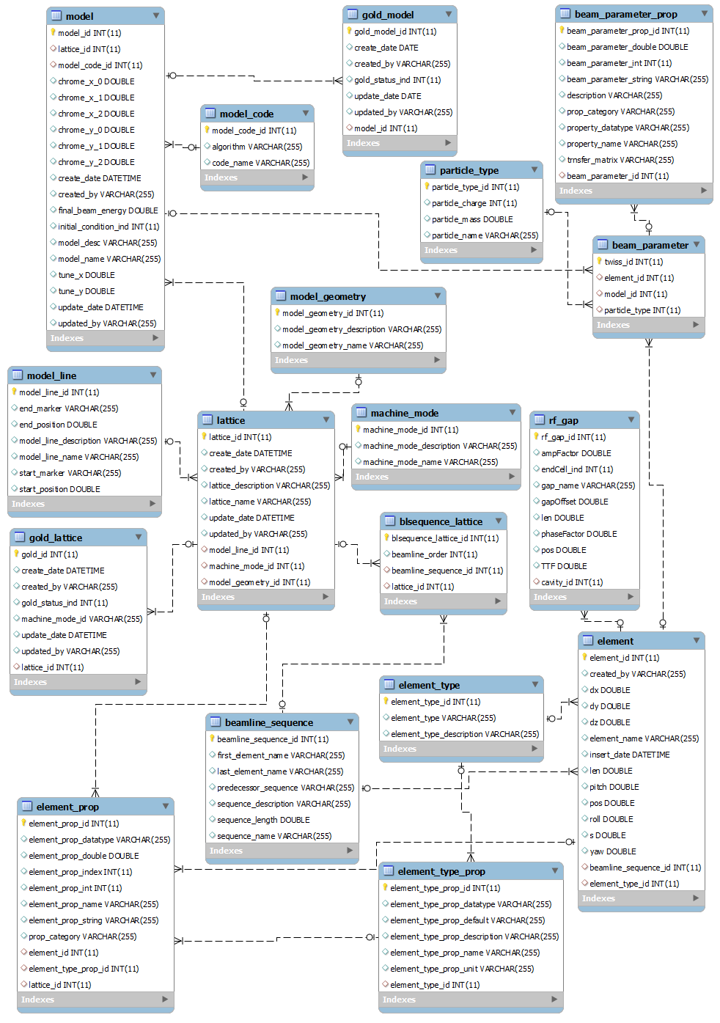
Database for Optics Model

Slide 45
Magnetization Curve Database and Magnet Manager
A magnetization curve mysql database was created for the storage of magnet measurement result in CSNS. A application named Magnet Manager could upload and download the magnet data. This application could get the polynomial function I(B) and B(I) by a fitting method. The polynomial function I(B) and B(I) will be used to control the current of magnet power supplies and getting the real magnetic fields from power supply currents.

Slide 46
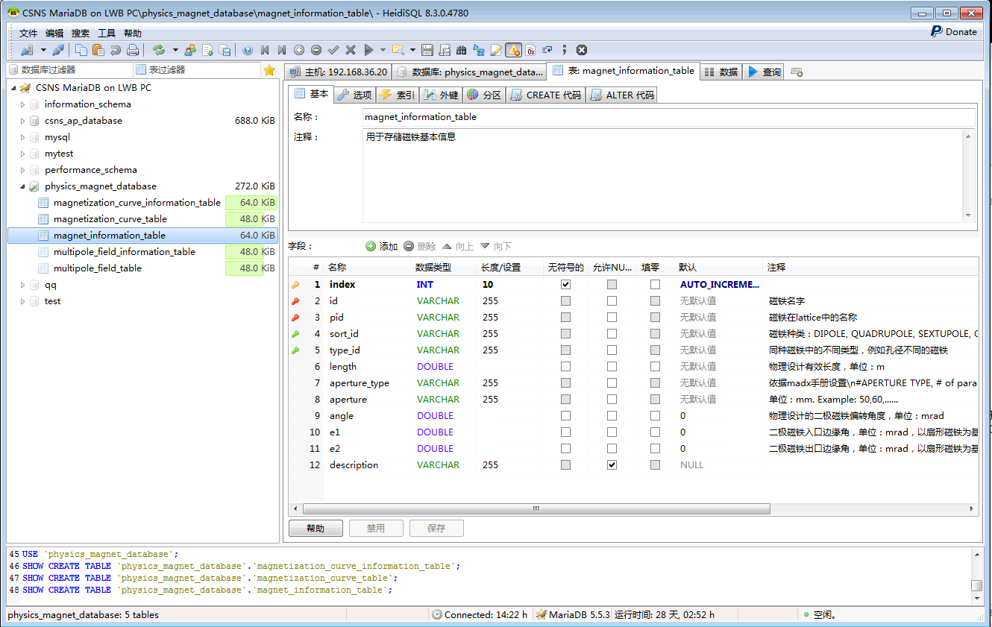

Slide 47
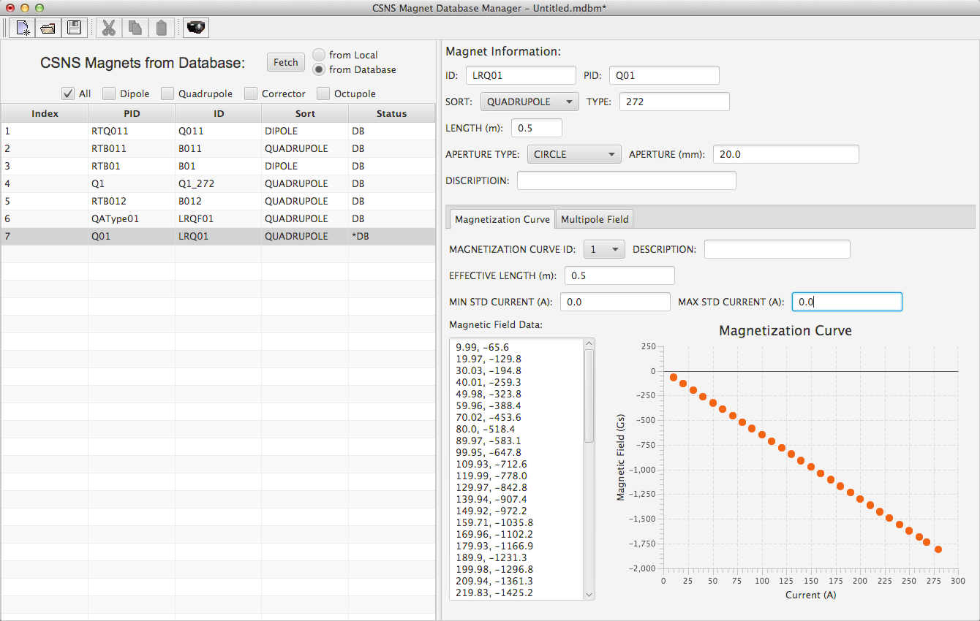

Slide 48
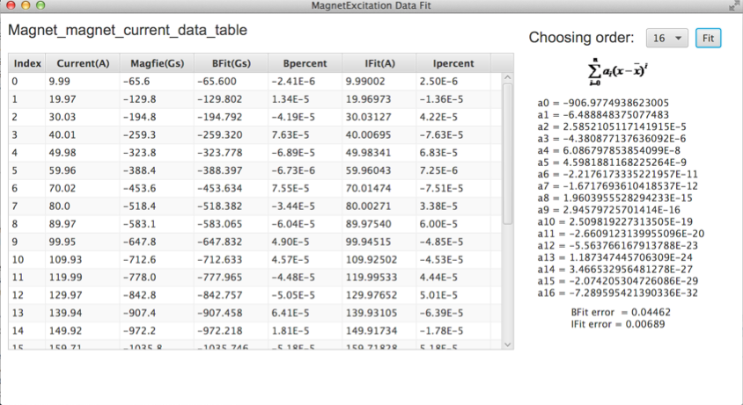

Slide 49
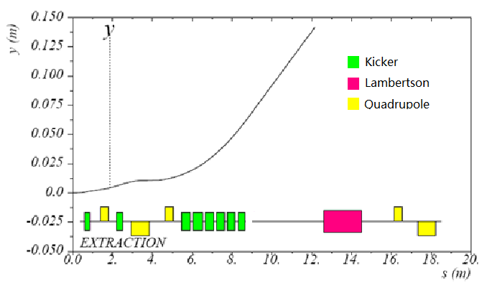
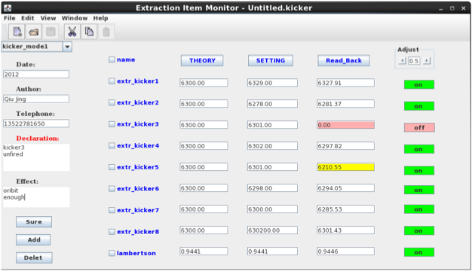
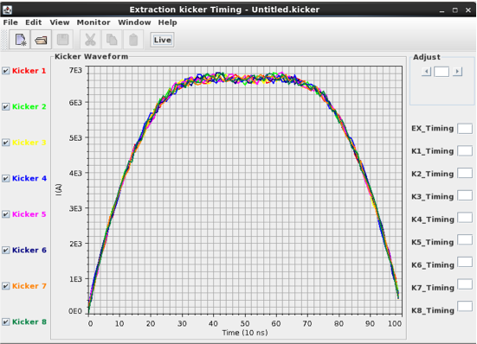
Application for settings of Kicker
8 kickers are used for the beam extraction from the RCS. The amplitude and timing of the kickers need be optimized to minimize the vertical orbit of the extraction beam.

Slide 50
3. Summary
A development environment of XAL was built at CSNS.
Some general applications are ported to CSNS, e.g. optics calculation, orbit correction, some simple applications, etc.
Some specific applications for CSNS are developed based on the XAL applications. For example orbit correction of RCS, emittance measurement, BBA, etc.
Some applications which use database are developing, e.g. magnet manager, model manager, etc.
The next work in the future is to improve and test the applications finished.

Slide 51
Thanks for Your Attention!

