Slide 1
Advances in RF Deflector and
Pulse Compression System
Juwen Wang 王聚文
SLAC National Accelerator Laboratory
加速器物理学术交流会
August 15, 2014
Lanzhou, China

Slide 2
Outline
Basics on RF Deflector and Its Application
Various Pulse Compression Systems
3. Design of a Super-Compact SLED
for LCLS Deflector System

Slide 3
Basics on RF Deflector
and Its Application
Principles
Application at LCLS, SLAC

Slide 4
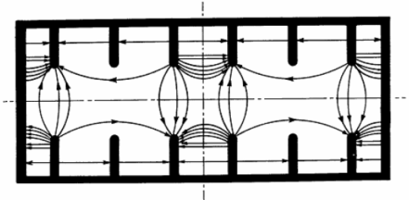
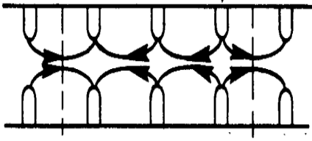
RF Deflector versus Accelerator
The RF deflectors are special types of microwave structures in which the charged particles interact with transversely deflecting modes for a variety of purposes.
In 1960’s, SLAC built several RF deflectors called LOLA named by the designers: Gregory Loew, Rudy Larsen and Otto Altenmueller.
For fifty years since then, the RF deflectors have been extensively studied and widely used in the accelerator field for the high energy physics research and beam diagnostics of FEL and many other projects.
Snapshot of RF Electrical Field
TM Longitudinally Accelerating Mode HEM Transversely Deflecting Mode

Slide 5
RF Deflector Applications
Three Types and 7 Examples
- Time-resolved electron bunch diagnostics for the LCLS
- Measurement of bunch time jitter at LCLS
- Bunch longitudinal profile diagnostics at DESY
- Ultra short e- and x-ray beams temporal diagnostics for LCLS
  - Drive/witness bunch longitudinal profile diagnostics for PWFA at FACET
- Increase slice energy spread σ_{E} as well as measure of slice parameters for Upgrade ECHO-7
- Separator for High Energy Physics Experiments

Slide 6
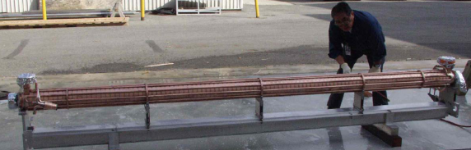
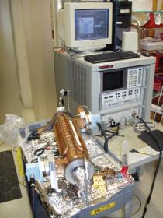
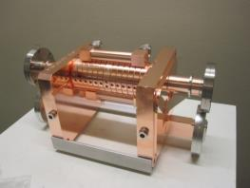
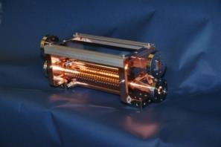
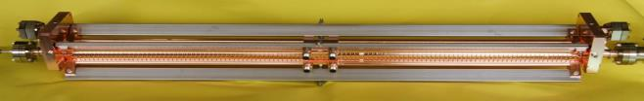
What the RF Deflectors Look Like?
A LOLA-IV
Ready for Sending to DESY
A Short 13-Cell S-Band LOLA Structure Under Measurement for LCLS Injector
Two Short X-Band Deflectors for ECHO-7
Final Assembly
of a 1m X-Band Deflector for LCLS

Slide 7
Principle of TW RF Deflector
Panofsky-Wenzel Theorem
As a measure of the deflecting efficiency, the transverse shunt impedance r┴ is defined as:
where z and r are longitudinal and transverse axes respectively, E_{z} is the electrical field amplitude for the dipole mode with angular frequency ω, and P is the RF power as function of z.
Using the simulation codes for electromagnetic field in RF structures, the transverse shunt impedance can be calculated from:

Slide 8
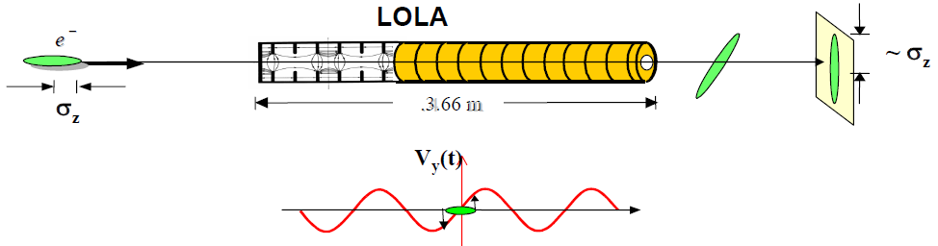
Application Example
Maximum Kick of 33 MV for LCLS Bunch Length Measurement
2.44 m
.
In order to characterize the extremely short bunch of the LCLS project, we need to extend the time-resolved electron bunch diagnostics to the scale of 10-20 fs. The peak deflecting voltage necessary to produce a temporal bunch resolution Δt is:
where E is the electron energy and the transverse momentum of the electron at time Δ t (with respect to the zero-crossing phase of the RF) is p_{y} = eV┴/c, n is the kick amplitude in the unit of nominal rms beam size, λ is the RF wavelength, εN is the normalized rms vertical emittance, c is the speed of light, and β_{d} is the vertical beta function at the deflector. This is for an RF deflector, which is π/2 in betatron phase advance from a downstream screen.

Slide 9
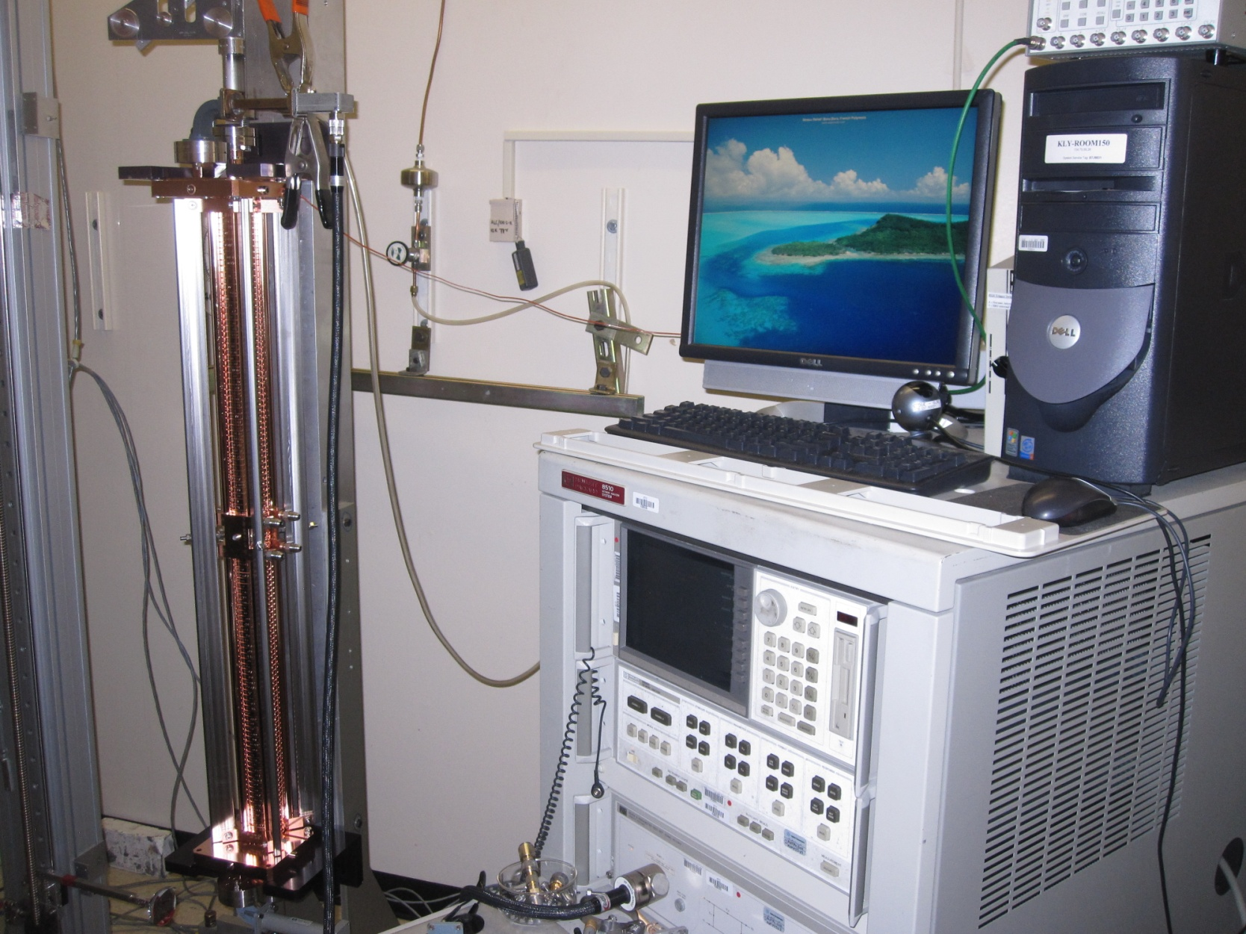
Microwave Tuning and Measurement
with a Dielectric Bead Attached String

Slide 10
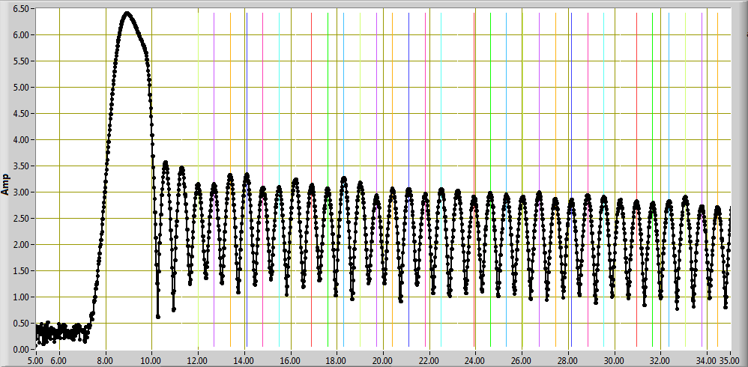


RF Electric Field Amplitude along the Central Axis of the Deflector.
Relative Electrical Field Amplitude
1E-10
5 10 15 20 25 30 35
Relative scaling
35 40 45 50 55 60 65
Relative scaling
65 70 75 80 85 90 95
Relative scaling

Slide 11
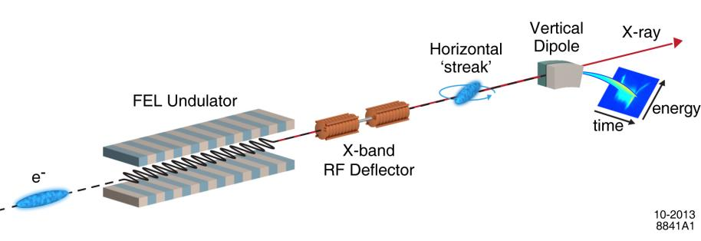
System Layout for Deflector Usage at LCLS
XTCAV streaks horizontally;
Dipole bends vertically.
Frequency | 11.424 GHz
Maximum kick | 45 MeV/c
length | 2 x 1 m
Measured time resolution
HXR (10keV) | ~ 4 fs rms
SXR (1keV) | ~ 1 fs rms
High resolution, ~ few fs;
Applicable to all FEL wavelength;
Single shot;
Noninvasive to operation;
Both e-beam and x-ray profiles.

Slide 12
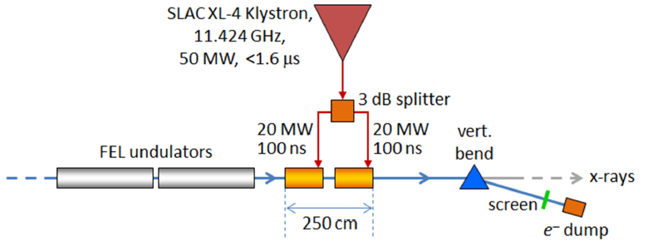
Layout of Deflector RF System
after the LCLS Undulators
RF Direction
Beam Direction

Slide 13
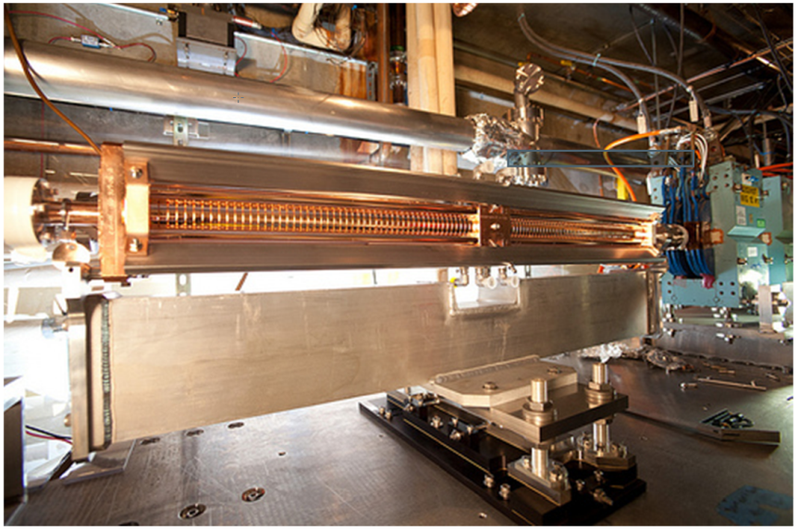
Two Deflector Section
Installed on Strongback

Slide 14
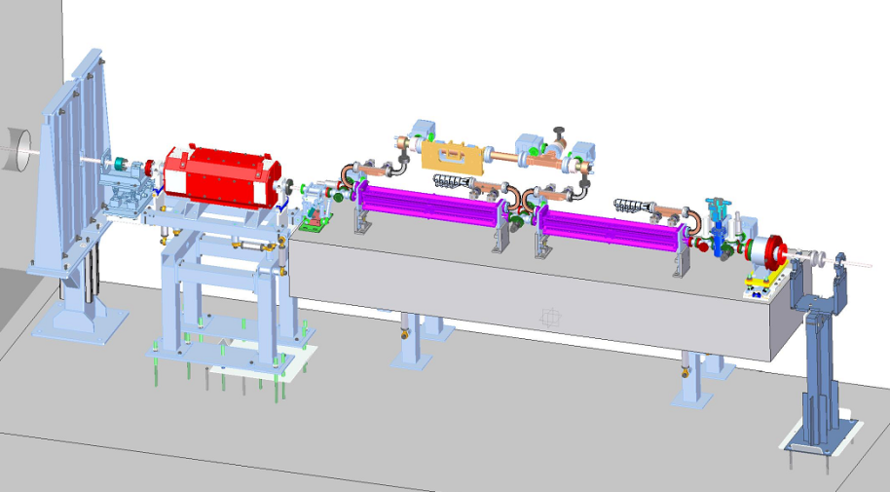
Directions of Electron Beam and RF Wave
RF Direction
Beam Direction

Slide 15
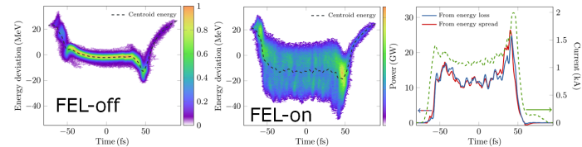
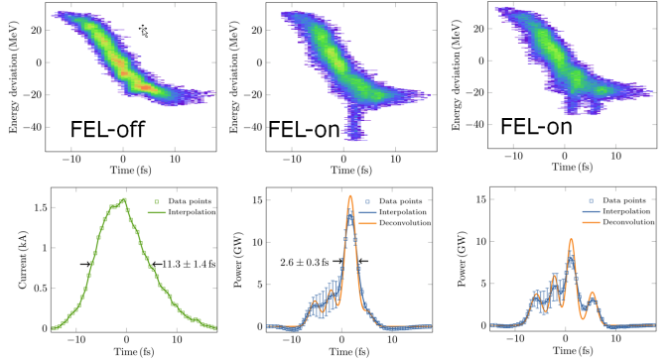
Deflector Measurement for Soft X-Ray
Soft X-Ray
1keV, 150pc
Soft X-Ray
1keV, 20pc
Ding, Yuantao

Slide 16
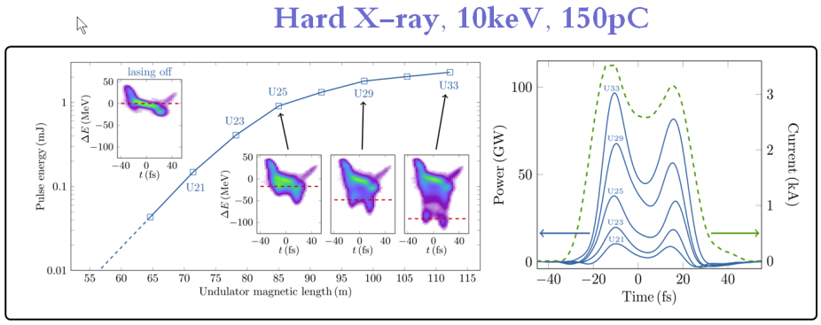
Deflector Measurement for Hard X-Ray
Ding, Yuantao

Slide 17
2. Various Pulse Compression Systems
SLED
SLED-II
Others
New Development

Slide 18
Strong Demand for the Pulse Compression System
In June 1974, forty years ago, a clever invention named “SLED” by Perry B. Wilson, David Z. Farkas and Harry A. Hoag for “SLAC Energy Development” was announced at the laboratory. The goal of the invention was to come up with an affordable scheme that would eventually double the energy of the electrons and positrons accelerated by the SLAC three-kilometer linac. The increase of the peak RF power is in exchange for the RF pulse length reduction by a passive technique called “pulse compression”.
The first 1.7 microsecond part of the 2.5 microsecond klystron pulse was stored in two low-loss cylindrical tuned cavities installed downstream of the klystron. For the remaining 0.8 microsecond, the phase of the klystron was reversed by 180 electrical degrees, and the sum of the power now being discharged by the cavities plus the direct klystron power resulted in a net power gain.
RF amplifier
RF energy storage element

Slide 19
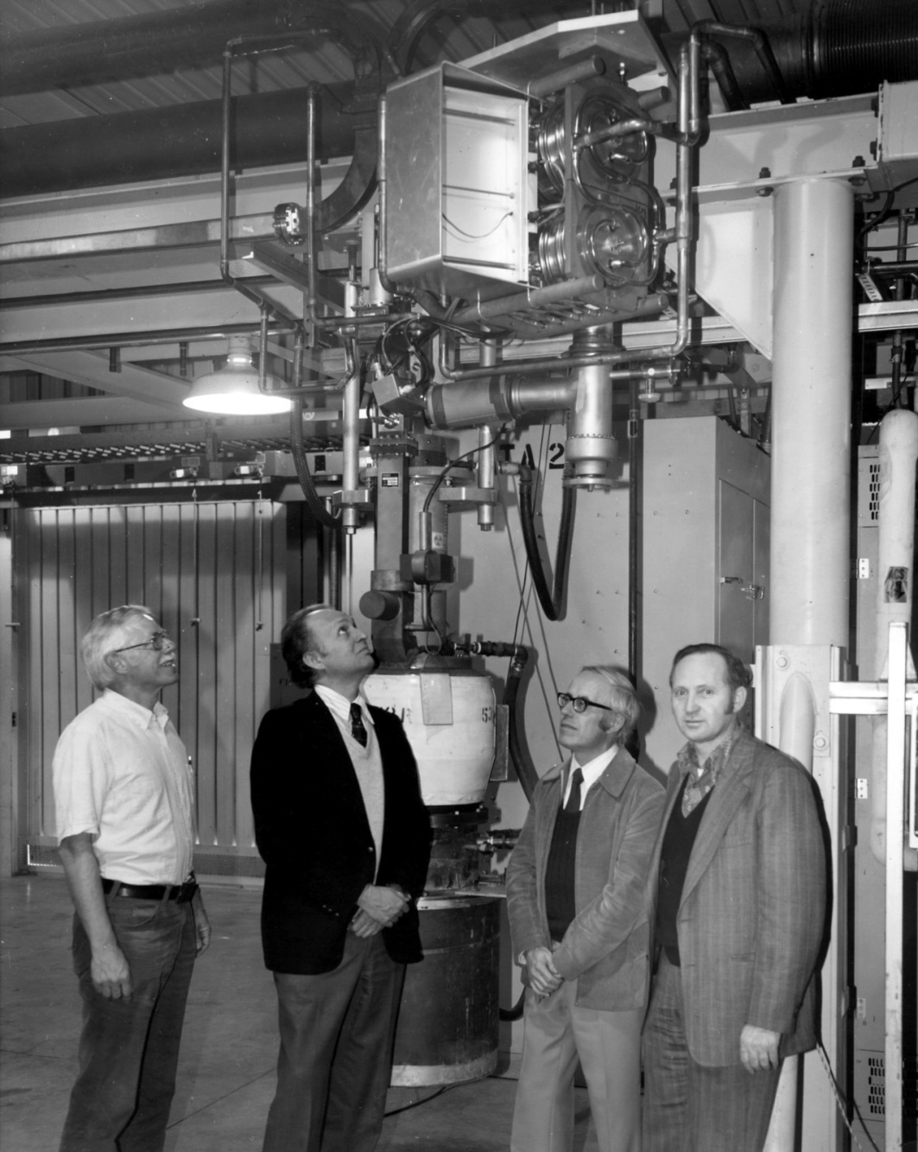
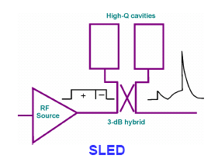
Forty-Year Anniversary
of S-Band SLED System in SLAC
3db
Coupler
Two SLED Cavities,

Slide 20
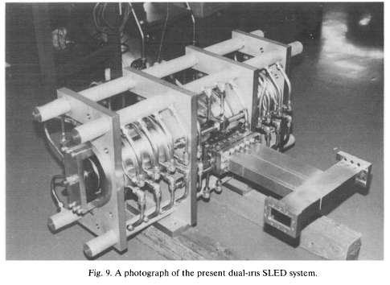
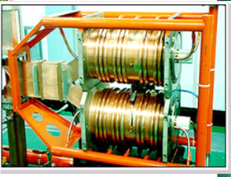
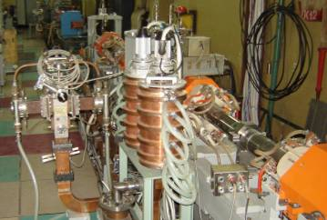
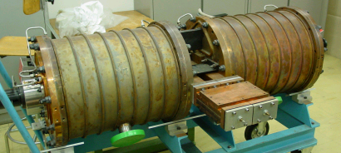
SLED System Application Worldwide
Forty Years Anniversary of the Invention, Several Hundreds of S-Band SLED Systems Operated
Pohang, Korea, 1994
KEK, ATF&KEKB, Japan 1992.
CERN 1985 at CTF3, CERN
BINP, Novosibirsk, Russia, 2000

Slide 21
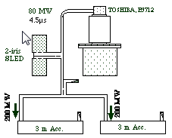
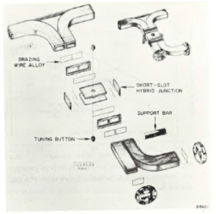
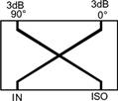
Key Microwave Components –
3db 90° Hybrid Coupler and SLED Cavities
Four-port device: two cross-over transmission lines over a length of one-quarter wavelength, corresponding with the center frequency of operation. When power is introduced at the IN port, half the power (3dB) flows to the 0° port and the other half is coupled (in the opposite direction) to the 90° port.
Feed for regular 2 x 2 regular accelerator sections
Reflections from mismatches sent back to the output ports will flow directly to the ISO port and cancel at the input.
Feed for two cylindrical TM₁₁₅ SLED cavities through a 3db coupler
3 dB, 90° degree hybrids are also know as quadrature hybrids because a signal applied to any input, will result in two equal amplitude signals that are quadrant (90° apart)..

Slide 22
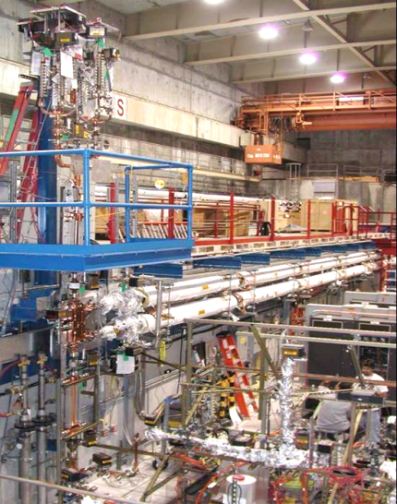
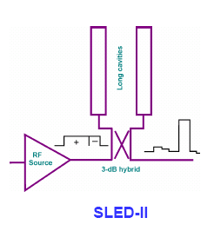
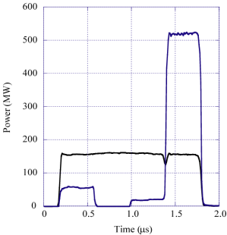
SLED-II - Type of Resonate Delay Lines

Slide 23
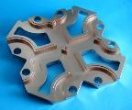
Evolution of SLED-II System at SLAC
2 Klystrons each with
75 MW for 2.4 µsecs
Completed at the end of calendar 2002 to demonstrate dual-mode capability and test DLDS components in 2003.
Cross-Potent
(Cold Test Model)
“Single-Feed”
Test Section
600 MW for 400 nsec
Dual-Mode
SLED-II
S.Tantawi

Slide 24
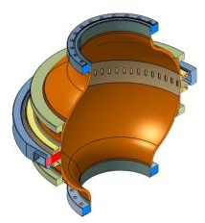
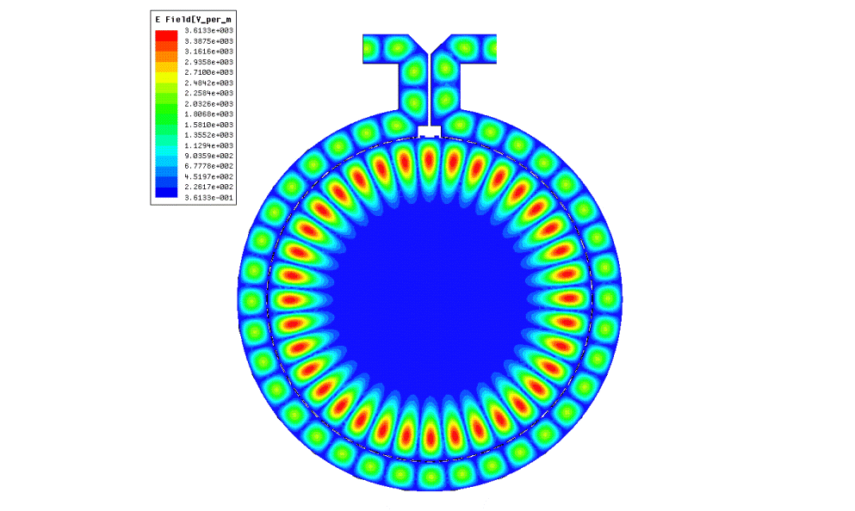
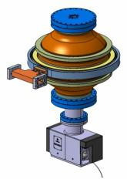

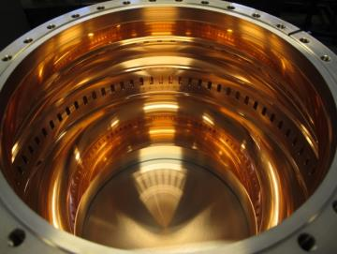
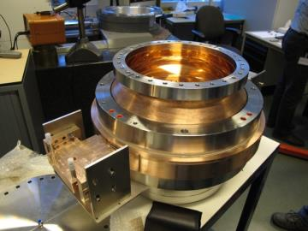
5.7 GHz BOC RF pulse compressor for PCI (2012)
Barrel
Open
Cavity RF pulse compressor
BOC’s unloaded Quality factor
Goal: ≥ 190000
Measured: 204000
Beta: 9.4
Igor Saratchev

Slide 25
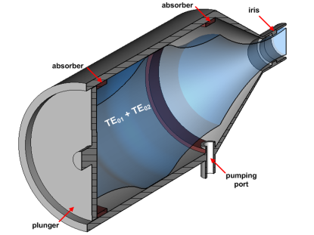
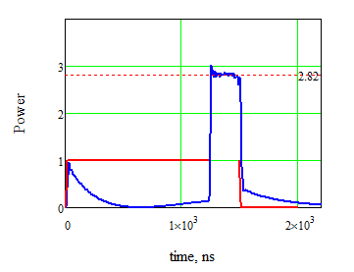
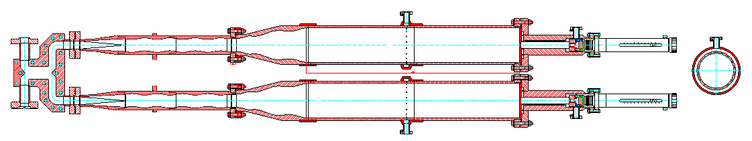
SLED with beating modes in cavity (BMC)
2009 (GYCOM, Russia).
First BMC is now successfully operated at XBOX #1.
Measured Q₀ ~ 1.6x10⁵ (expected ~ 2x10⁵ )
Tuning plungers heating up problem.
Backlashes problem with plungers movement.
Q₀ ~ 2x10⁵
3-db hybrid
H10->H01 mode converter
Mode mixing taper
Beating wave cavity

Slide 26
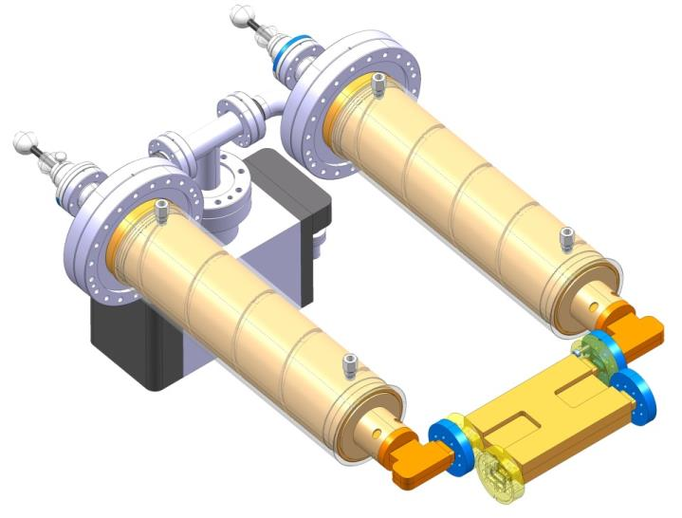
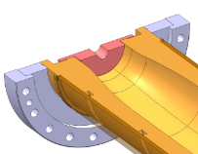
X-Band SLED Pulse Compressor at 2013
Manual resonant frequency de-tuners
Cavity operating mode H_{0,1,32}
Integrated cooling
Common vacuum circuit
Compact mode launcher
Fixed tuners
Double-height -3dB hybrid, made at CEA/CERN
Compact (inexpensive) RF design
Relaxed fabrication tolerances
Fixed frequency tuners (frequency control by temperature)
Detuning option.
Igor Saratchev

Slide 27
3. Design of a Super-Compact SLED
for LCLS Deflector System
Motivation
Basic Design
Technical Challenges
R&D Program

Slide 28
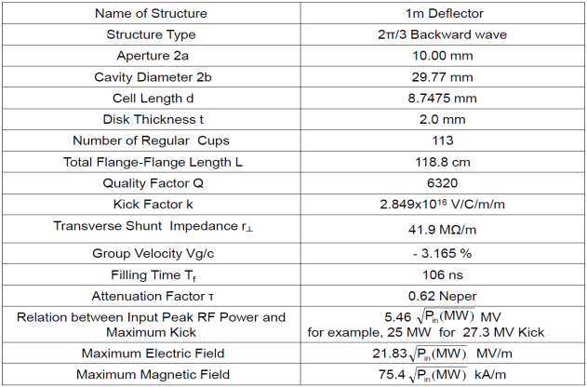
Motivation
Maximum Kick for one 1m Section: 5.46 (Pin is Peak RF Power)
Limited by an Old Klystron of 35 MW Peak, little more than 40 MV Kick obtained.
In Order to Reach Higher Resolution,
The SLED System is under Design to Double the Kick to more than 80MV.
The work started last November, S. Tantawi, Chen Xu and G. Bowden actively paticipated.

Slide 29
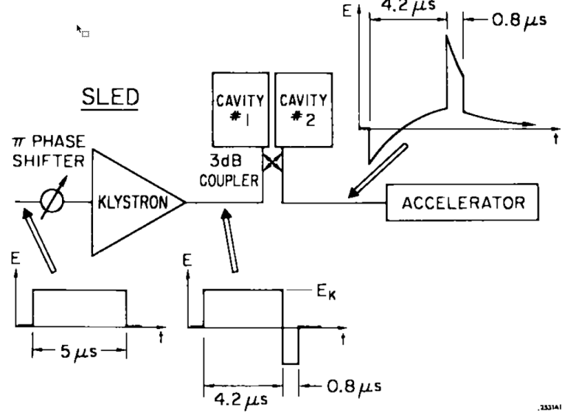
SLED RF System
1.394μs3
0.106μs3
DEFLECTOR
1.5μs3
0.106μs3
1.394μs3

Slide 30
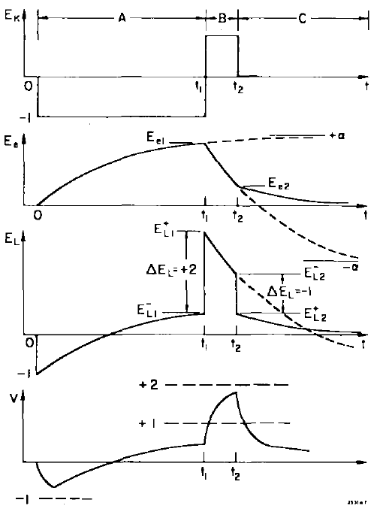
SLED RF System Waveforms
Direct wave E_{k}
Emitted wave E_{e}
Net load wave E_{L}
Normalized energy
Gain V

Slide 31
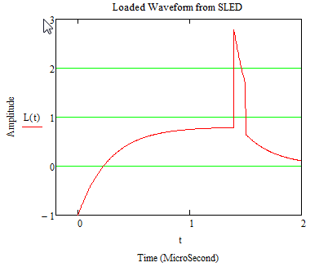
Calculation of Loaded Waveform from SLED
SLED Cavity Parameters
Q_{o} =10⁵
β=P_{e}/P_{c}=Q₀/Q_{e}
Optimization Needed
Tc=2Q_{L}/ω=2Q₀/ω(1+β)

Slide 32
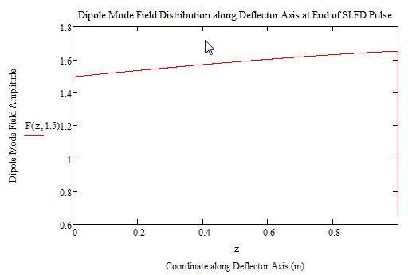
Dipole Mode Field Distribution along Deflector Axis at the End of SLED Pulse
Deflector Parameters
Structure Length L=1.0 m
Transverse r┴= 41.9 MΩ/m
(Constant Impedance)
Group Velocity Vg/c=- 3.165 %
Filling Time T_{f}=106 ns
Attenuation Factor τ=0.62 Neper
If the pulse is flat
without SLED E=e^{-τz/L}
Beam Direction
RF Feeding Direction
1.0

Slide 33
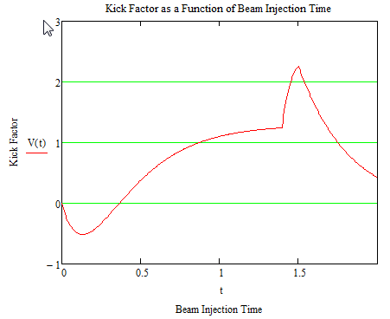
Kick Factor as a Function of
Beam Injection Time for β=9

Slide 34
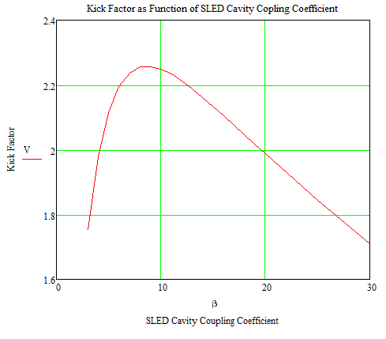
Kick Factor as a Function
of SLED Cavity Coupling Coefficient
Optimized
β = 8 – 9
for a gain larger than factor of 2.2

Slide 35
New Super Compact SLED System
  Unified 3db Coupler/Mode Convertor/Polarizer
  Single High Q Sphere Cavity Studies
  HE₁₁ Mode Cavity Studies

Slide 36
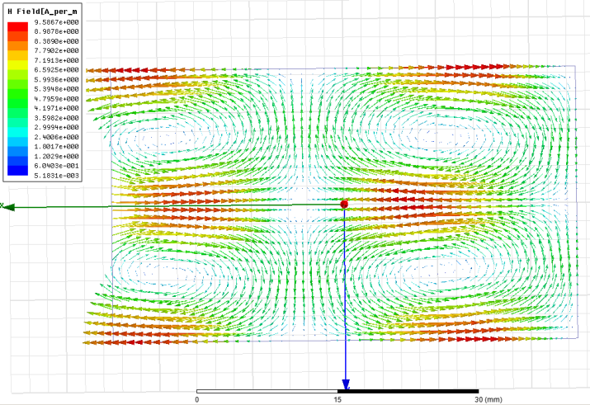
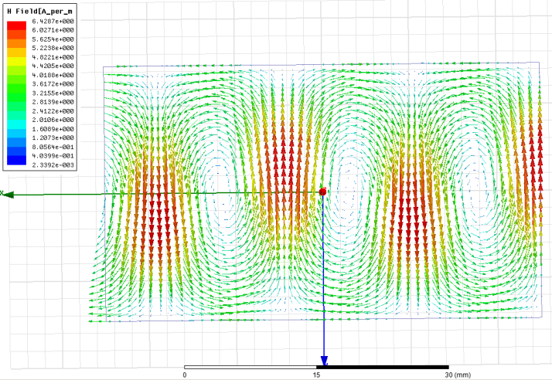
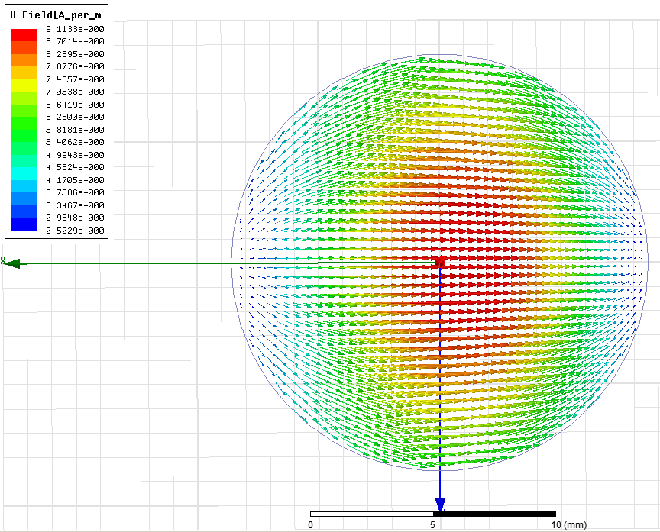

    Two Rectangular Waveguide Modes Couple
    to two Polarized Circular Waveguide Modes
    TE20-> TE11
    TE10-> TE11
36

Slide 37

  Movie to animate
  the Unified 3db Coupler/Mode Convertor/Polarizer
Superposition of Two Linear Polarized TE11 Modes with 90° quadrature
TE10 Mode input from WR90 Waveguide
Mixed TE10 and TE20 Modes
Notice:
Circular port is a matching port without reflection in this simulation
TE10 Mode output to Deflectors via WR90 Waveguide

Slide 38

  Geometry of the New SLED System
Sphere Cavity for Energy Storage
Integrated
3db Coupler/Mode Convertor/Polarizer

Slide 39

Some TE Modes in a Sphere at 11424 MHz
Magnetic field lines

Slide 40

Some TM Modes in a Sphere at 11424 MHz
Electric field lines

Slide 41




TE Modes in Sphere Cavity - I
Wave potential of TE Modes
Where Ĵ_{n} is sphere Bessel Function and P_{n}^{m} is associated Legendre Polynomials
1st interesting property:
Sphere Radius a is independent with mode index m, there are numerous degeneracies because Ĵ_{n} (u_{np}) is independent with m.
For TE mode, the E_{φ} = H_{θ} = 0 at surface r=a.
It means Ĵ_{n} (u_{np})=0. The following table shows the lower order modes.
Sphere Radius can be calculated using wave propagation constant k and value of u_{np} (cm)

Slide 42




TE Modes in Sphere Cavity - II
Practically, let’s choose TEm14 modes. There are three possible modes:
For perfect sphere cavity, these three modes have the same mode patterns except that they are rotated 90° in space from each other.
In reality, they can be slightly distinguished in frequencies due to the perturbation from the different coupling in the coupler port. The TE014 mode is higher and could not be excited by the feeding orientation.
2nd interesting properties:
Q₀ is only depend with sphere radius, and independent with the mode type.
Quality Factor for TE Modes
δ is the skin depth (for Copper 0.61μm)
Examples:
For TE₀₁₄ mode a=5.8749 cm Q = 0.963x10⁵ SLED Gain 2.248 (β= 8-9)

Slide 43


Examples for TE Mode Studies
Where the Legendre Function P^{m} _{n} has m≤n
If we select TE_{0np} mode, the degeneracy possibility is only 0 and 1

Slide 44




Other Modes Studies
for TE034 R=7.06865 cm Sphere

Slide 45




Coupling Simulation to the Sphere Cavity
Nearest mode is TE014 mode which is much undercoupled
One of the two TE114 mode

Slide 46


Two Polarized SW TE114 modes
With perfect coupler TE114 modes are 10 MHz lower than TE014, they are well separated.

Slide 47


Coupling Simulation to the Sphere Cavity
Put iris 2x5.8=11.6 mm aperture Sweep 50/2500 =0.02 MHz / point
S11 = 0.915 db or 0.803
β=9.15 -- it is almost the optimized design goal for SLED system
Q_{L}=9556
Δf=1.2 MHz
Q₀=97000

Slide 48

Movie to animate the SLED System
TE10 Mode input from WR90 Waveguide
TE10 Mode output to Deflectors via WR90 Waveguide

Slide 49
Studies on Tuning and Detuning
Both tuning and detuning by using plunger inside a circular waveguide
Push-pull deformation
Circular ridge for fine machining
Temperature control for tuning

Slide 50




Field Patterns with Different Tuners

Slide 51


Add Iris in Tuner Waveguide Limits the Field
and β Change, but no Much Tuning Range

Slide 52


Extreme of Tuning Ridge Sizes

Slide 53



to avoid several possible complications: field and β change, plunger heating, multipacting.
Conservative Fixed Tuner
18mm x 1.5 mm
indentation (-1.8 MHz)

Slide 54


Detuner Studies(1.5 mm Detuning Rod)

Slide 55

Sketch of a Coming X-Band SLED Assembly

Slide 56
Technical Challenges
This is a brand new device, certainly there will be some new design and manufacture problems, but there are no predictable difficulties, which could not be resolve easily.
Tolerances
  The Coupler/Mode convertor is a broad band microwave component
  The Sphere cavity is a high Q₀ , but low Q_{L} cavity. If we add proper push-pull tuning studs, the tuning should not be problem.
Manufacturability
  Several kinds of X-Band mode convertors have been successfully designed, built and operated.
  There are many sphere parts were applied like X-Band and S-Band Race-track cavities and L-Band regular cavities
  With TE modes, the sphere cavity does not have cooling problem due to very loss, but temperature stabilization is needed.

Slide 57
R&D Program
Precision simulation served for mechanical design
Further studies for more broad applications
  The scheme can be easily used for S-Band, L-Band …
  It opens a door for flat top SLED pulse for multi-bunch train operation with degenerating higher order mode
Mechanical design for fabrication under way
Fabrication will be in September or earlier
Microwave measurement confirmation
LLRF control design and testing
Final assembly and microwave check
Commissioning

Slide 58
Wish You All
Great Success in your Career!

