Slide 1
Suppression of the Emittance growth induced by CSR in a single achromatic cell
Speaker: Cui Xiaohao
Jiao Yi, Cui Xiaohao, Xu Gang, Huang Xiyang
Institute of High Energy Physics, Beijing, CHINA

Slide 2
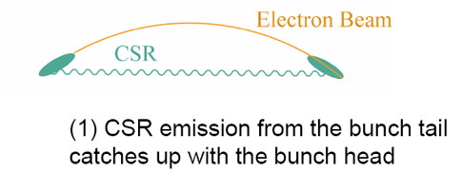
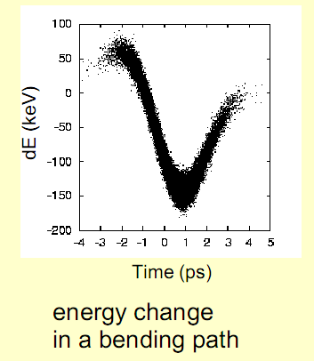
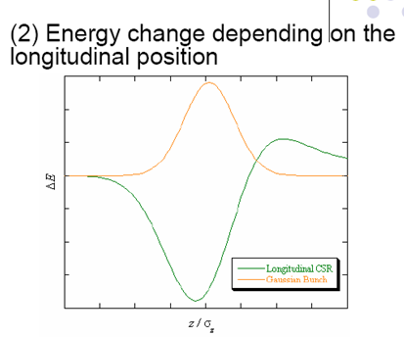
Mechanism of emittance growth due to CSR effect

Slide 3
CSR study paper selection
Theoretical studies
  Y. Derbenev, et al., TESLA-FEL 95-05, 1995
  B. Carlsten and T. Raubenheimer, Phys. Rev. E 51, 1453 (1995)
  Y. Derbenev and V. Shiltsev, SLAC-PUB-7181, 1996
  E. Saldin, E. Schneidmiller, and M .Yukov, Nucl. Instrum. Methods Phys. Res., Sec A 398, 373 (1997)
Experimental support
  M. Dohlus, and T. Limberg, Nucl. Instrum. Methods Phys. Res., Sec A 393, 494 (1997)
  H. Braun, F. Chautard, R. Corsini, T. Raubenheimer, and P. Tenenbaum, Phys. Rev. Lett. 84, 658 (2000)
  S. Mitri, et al., Phys. Rev. ST Accel. Beams 15, 020701 (2012)
CSR cancellation studies
  D. Douglas, JLAB-TN-98-012, 1998
  R. Hajima, Nucl. Instrum. Methods Phys. Res., Sec A 528 (2004) 335-339
  S. Mitri, m. Cornacchia, and S. Spampinati, Phys. Rev. Lett. 014801 (2013)

Slide 4
Linear Approximation of CSR effect
Bending path
Bunch length
Bending radius
If we assume that:
The bunch length σ_{z} doesn’t change a lot along the transport line
The Transient CSR effect if not large (uniform bending field)
Bending angles of the dipoles are not very large, < 10°
The CSR induced energy spread growth can be linearized
If with const. ρ

Slide 5
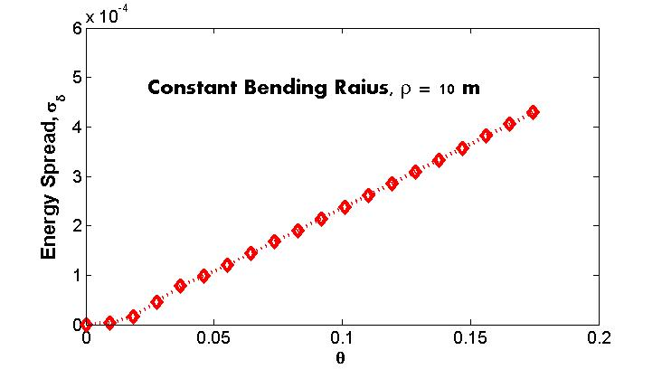
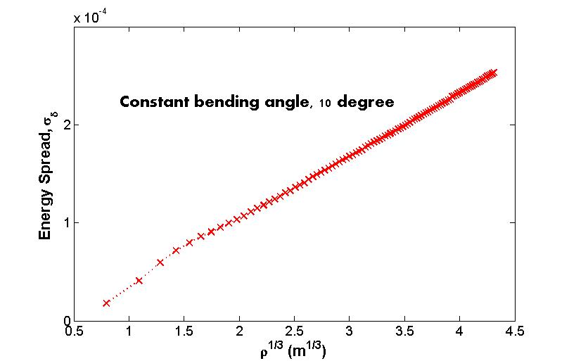
Linear Approximation of CSR effect
If with const. ρ
In the cases 1.5°< θ < 10°，4 m < ρ < 80 m, this approximation applies well.

Slide 6
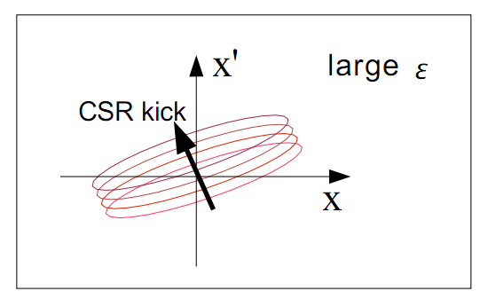
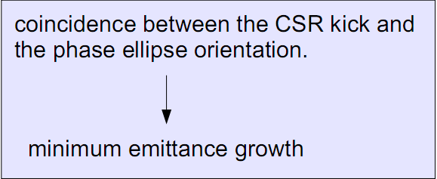
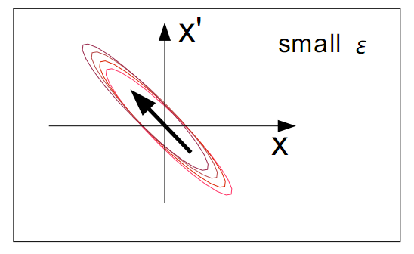
Envelope matching method
The concept of envelope matching is introduced by Dr. Hajima. In this method, the emittance growth in a achromatic cell can be considered as a stretch of the transverse phase space.

Slide 7
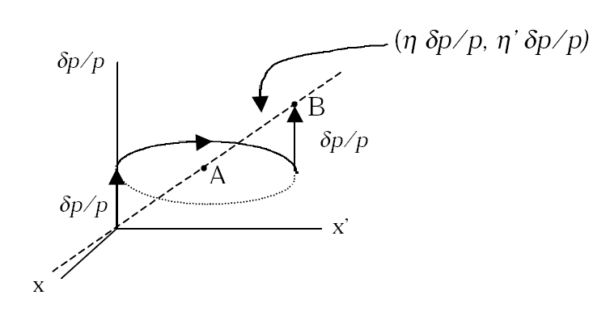
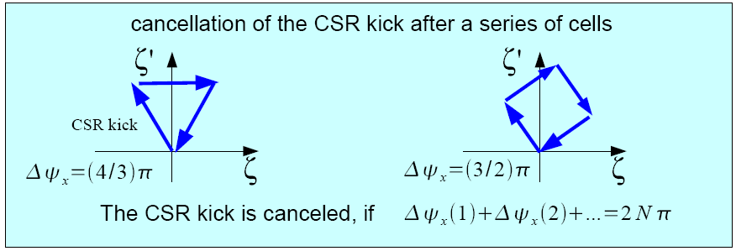
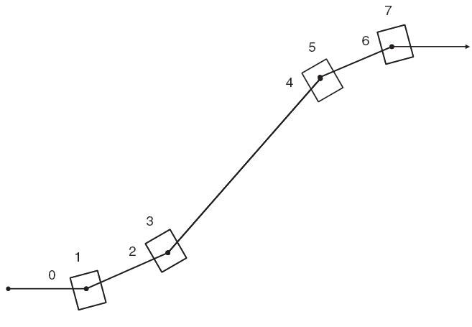
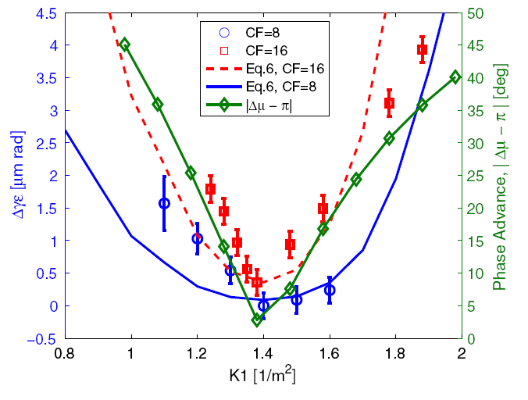
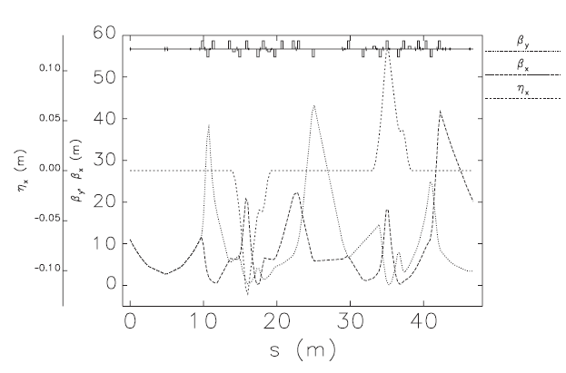
Cell-to-cell phase matching method
Periodic transport, with half integer phase advance between two identical periods. Electrons experience the same CSR kicks at two periods. With –I transportation, the CSR kicks are cancelled.
  D. Douglas, JLAB-TN-98-012, 1998
Or cancellation after a series of periodic cells
FERMI Two DBA spreader
R. Hajima, 2005
DBA
DBA
μ_{x} = π
When the phase advance between two DBAs is π, the CSR induced emittance growth can be minimized.
S. Mitri, et al., PRL, 014801, 2013

Slide 8
Envelope Matching method
Phase Matching method
1. Strong constraints on the Twiss parameters
1. It requires identical cells, and special layout
2. Accurate phase advance between cells
2. Its effects relies on the shape of the phase ellipse

Slide 9
The kind of optics design method we need
1. The CSR induced emittance growth can be suppressed within a single achromatic module
2. Constraints on the magnets rather than on the twiss parameters
3. Easy to design and use

Slide 10
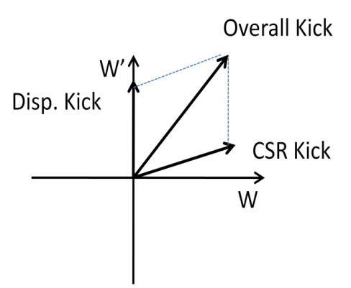
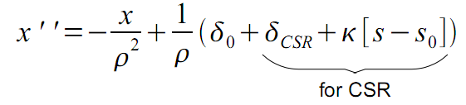
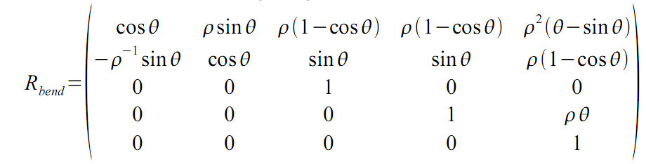
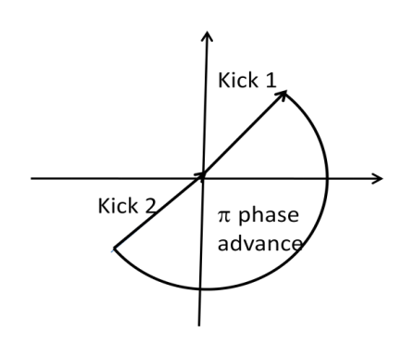
Methods to treat the linearized CSR
Matrix analysis
Single kick discription

Slide 11
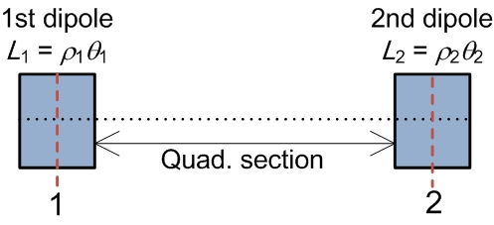
Two-dipole achromat
μ_{x}
β₁, α₁
Horizontal phase advance between point 1 and 2
β₂, α₂
β₀, α₀
β_{f}, α_{f}
Through straightforward derivation, one can find that the Achromatic Condition is
μ_{x} = π (modulus 2π) if the dipoles deflect beam in the same direction,
μ_{x} = 0 (modulus 2π) if the dipoles deflect beam in the opposite direction.

Slide 12
CSR-cancellation condition in linear regime
Solutions of r₁₅ = r₂₅ = 0
A
B
The matrix between the centers of the dipoles
c ≡ S₂/S₁, S₁ = sin(θ₁/2),
S₂ = sin(θ₂/2), C₁ = cos(θ₁/2),
C₂ = cos(θ₂/2)

Slide 13
One example
θ₁ = 6 degrees, θ₂ = 4 degrees, and ρ₁ = 8 m
c ≅ 2/3, r* ≅ 27/8, ρ₂* ≅ 27 m, and M*_{c2c} (2, 1) ≅ 30/π
Fixing r = r*
Fixing M_{c2c} (2, 1) = M*_{c2c} (2, 1)
If only condition A (r = r*, L₁θ₁² = L₂θ₂²) is fulfilled (dashed lines in left plot)

Slide 14
Two identical bending magnet cases
A
B
If the Twiss parameters are also symmetric, we can get:
β₁=-1/6α₁L

Slide 15
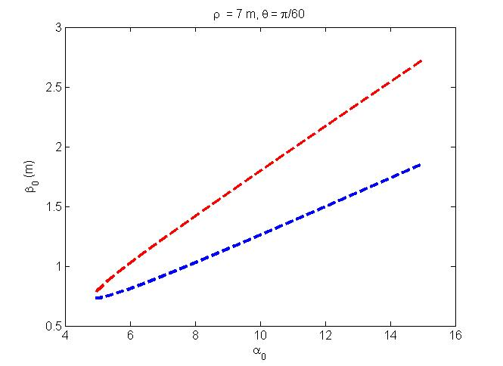
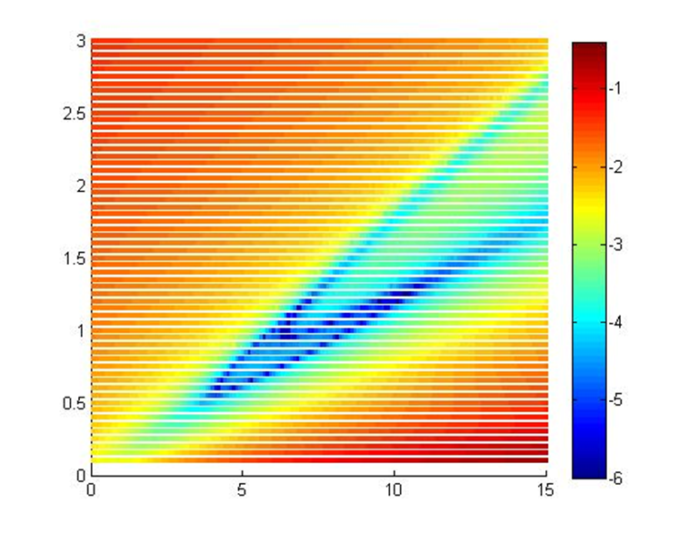
Theoretical and Numerical simulation results
Initial emittance: 2 μm.rad, bunch length 30 mm, peak current 5000 A
The CSR cancellation constraints on the Twiss parameters at the entrance of the DBA cell.

Slide 16
CSR cancellation vs. Envelop matching
The proposed conditions have higher efficiency in CSR-suppression than envelope matching method (black line).
Initial emittance ε₀ = 2 μm, ρ = 6 m, θ = 3 degrees, E₀ = 1 GeV, I_{p} = 5000 A, σ_{z} = 30 μm, σ_{δ} = 0.05%.

Slide 17

CSR cancellation vs. Phase matching
The proposed conditions have higher efficiency in CSR-suppression than envelope matching method (green lines).
Two identical DBAs, Δμ is the phase advance between two DBAs.
Δμ
Green lines: (β₀, α₀) far away from the β_{0,1} curve
Blue lines: (β₀, α₀) near the β_{0,1} curve
Red lines: (β₀, α₀) on the β_{0,1} curve

Slide 18
Thanks for your attention!

