Slide 1
Experimental Studies of Electron Emissions and Breakdowns in RF Guns
Wei Gai
For ANL/THU/SLAC collaboration
Symposium Accelerator Physics,
August 15
XinglongShan, Gansu, China

Slide 2
Breakdown in RF cavities
Extremely complicated physical phenomenon
May involve localized field emission, eddy current, plasma formation, metal
fatigue, crystallographic defects, etc. Has been studied for decades.
Dependence on E, B, Sc, ΔTp, Power flow …
Sets of breakdown experiments are trying to isolate some of the contributing
effects.
Anyway to shed lights on the physics of RF breakdowns?
  Direct Dark current measurement;
  Work function;
  Local heating;
  Laser-triggered RF breakdown
  SEM surfaces
  …….
Provide a controllable and flexible method for breakdown studies.

Slide 3
An s-band rf photocathode gun: 2 configurations
Tsinghua U has an rf gun facility available to study copper surfaces
S-band RF gun
50 – 70 MV/m
Laser
alignment
cathode
photocathode
Faraday Cup
ICT
Dark Current Measurements
UV Laser
400 nm, ~ 1 mJ, 0.1 – 3 ps
Schottky Enabled Photo-electron Emission Measurements

Slide 4
Schottky Enabled Photo-electron Emission Measurements
ICT
Data 2010-10-04
First results
from Tsinghua
e-
γ
Should not get
photoemission
Experimental parameters
  work function of copper = φ₀ = 4.65 eV
  energy of λ=400nm photon = hν= 3.1 eV
  Laser pulse length
    Long = 3 ps
    Short = 0.1 ps
  Laser energy ~1 mJ (measured before laser input window)
  Field (55 – 70 MV/m)

Slide 5
→Long Laser Pulse (~ 3ps)
→E=55 MV/m@ injection phase=80 ➔ 55sin(80)=54
First results
from Tsinghua
Data 2010-10-04
Q I
single photon emission
Q(pC)
laser energy (mJ)
photocathode input window

Slide 6
→Short Laser Pulse (~ 0.1ps)
→E=50 MV/m@ injection phase=30 ➔ 50sin(30)=25
First results
from Tsinghua
Data 2010-10-04
Q aI + bI²
multiphoton emission
Q(pC)
laser energy (mJ)
photocathode input window

Slide 7
Dark Current Measurements
S-band RF gun
50 – 70 MV/m
cathode
Faraday Cup
First results
from Tsinghua
Experimental parameters
  work function of copper = φ₀ = 4.65 eV
  Field (57– 73 MV/m)
  Note: field could be lowered more but Faraday Cup signal was too weak to measure current

Slide 8
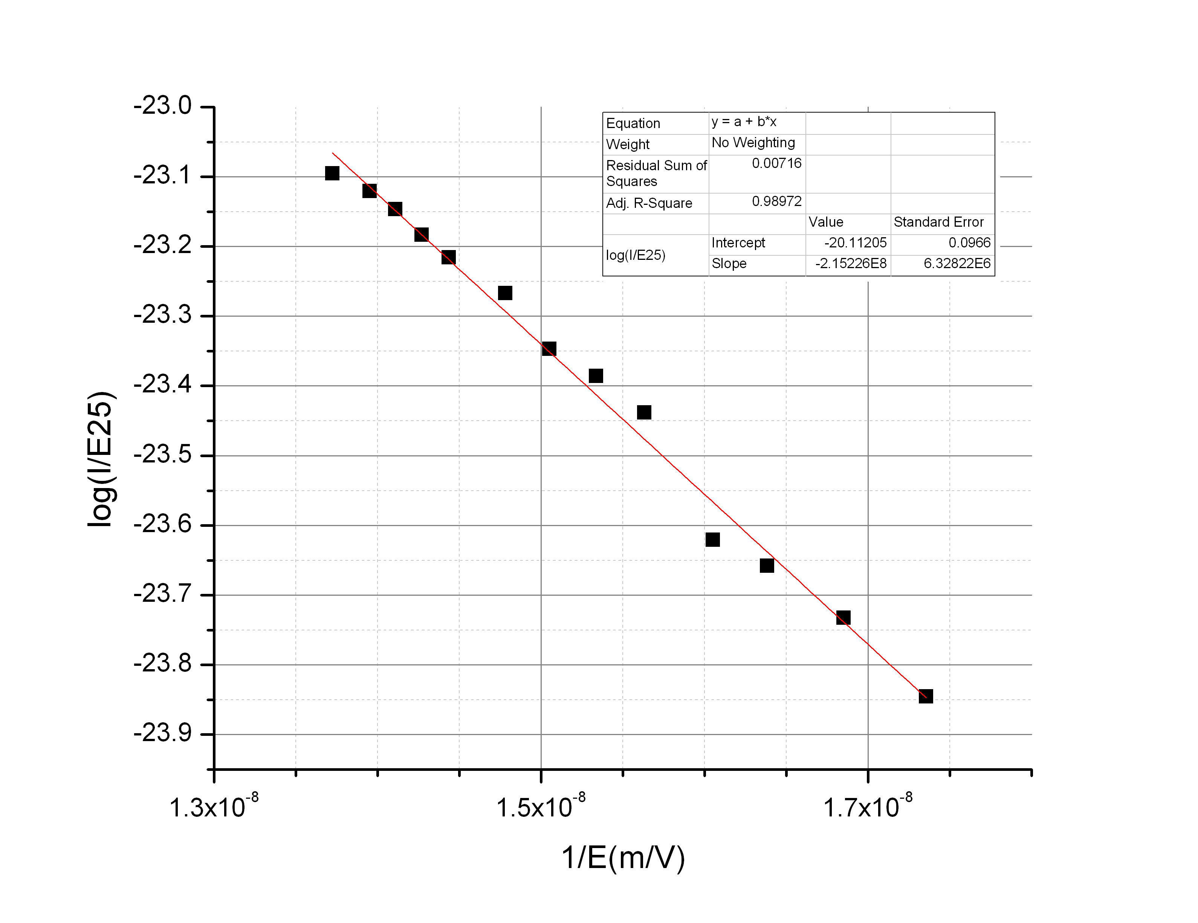
Fowler Nordheim plot of dark current data
First results
from Tsinghua
Data 2010-10-04
Copper work function Φ₀=4.6 eV
Fit: β ~ 130
Field (57– 73 MV/m)

Slide 9
Summary of the first measurements
Schottky Enabled Photo-electron Emission Measurements
  Schottky enhanced emission observed at all the field levels measured.
    hν =3.1 eV, φ₀=4.6 eV ➔ ΔΦ=1.5eV (Schottky effect required)
    The lowest field 25 MV/m
      → (Schottky effect)
      → implies β>=60
    note: also observed emission at lower fields, but data was noisy. This implies even larger β exists or lower work functions at some points on cathode.
Dark current measurements
  β is 130.
Some possibilities/speculation …
Alternative interpretation of Fowler-Nordhiem plots

Slide 10
Electron emission
Fowler Nordheim Law (RF fields):
I_{FN}
(β, φ₀, A_{e}, E₀)
High field enhancements (β) can field emission.
Low work function (φ₀) in small areas can cause field emission.
typical picture ➔
geometric perturbations (β)
alternate picture ➔
material perturbations (φ₀)
grain
boundaries
peaks
oxides
cracks
Copper surface
inclusions
(suggested by Wuensch and colleagues)

Slide 11
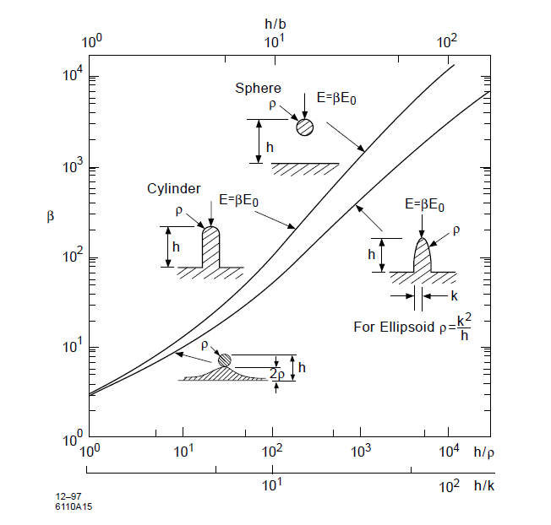
Field emission enhancement factor
β=130 may be unphysical → h/ρ ~ 100
fresh surfaces machines to ~10nm roughness
h=10 nm, ρ=0.1 nm (“a tower of single atoms”)

Slide 12
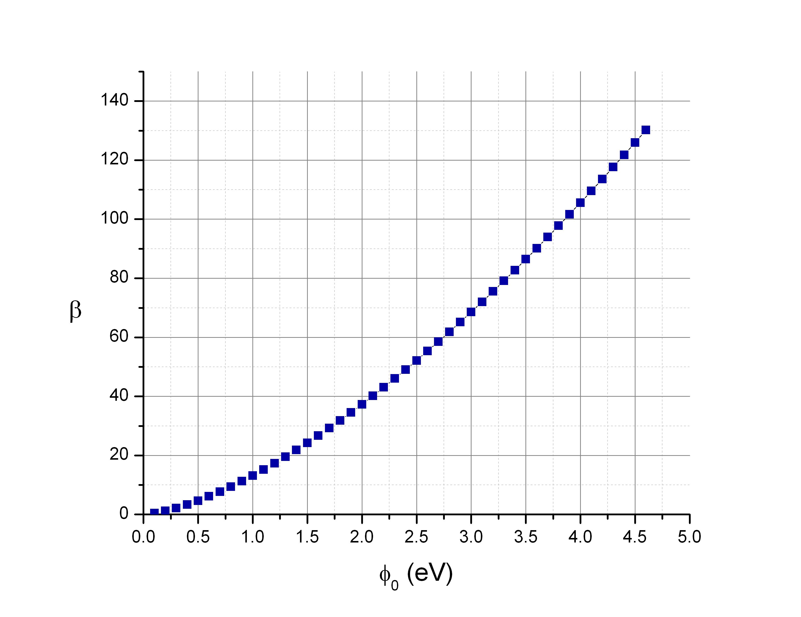
β from Fowler-Nordheim plot
(β=5, Φ₀ =1.2 eV)???
(β=130, Φ₀ =4.66 eV)
Raw Data
  Field emitted current
  E-field on surface
Fit
  Different combinations of β and φ₀ can fit the same raw data
  Can we find a way to measure what role each effect plays?
Notes:
WG: beta=130 is unphysical

Slide 13
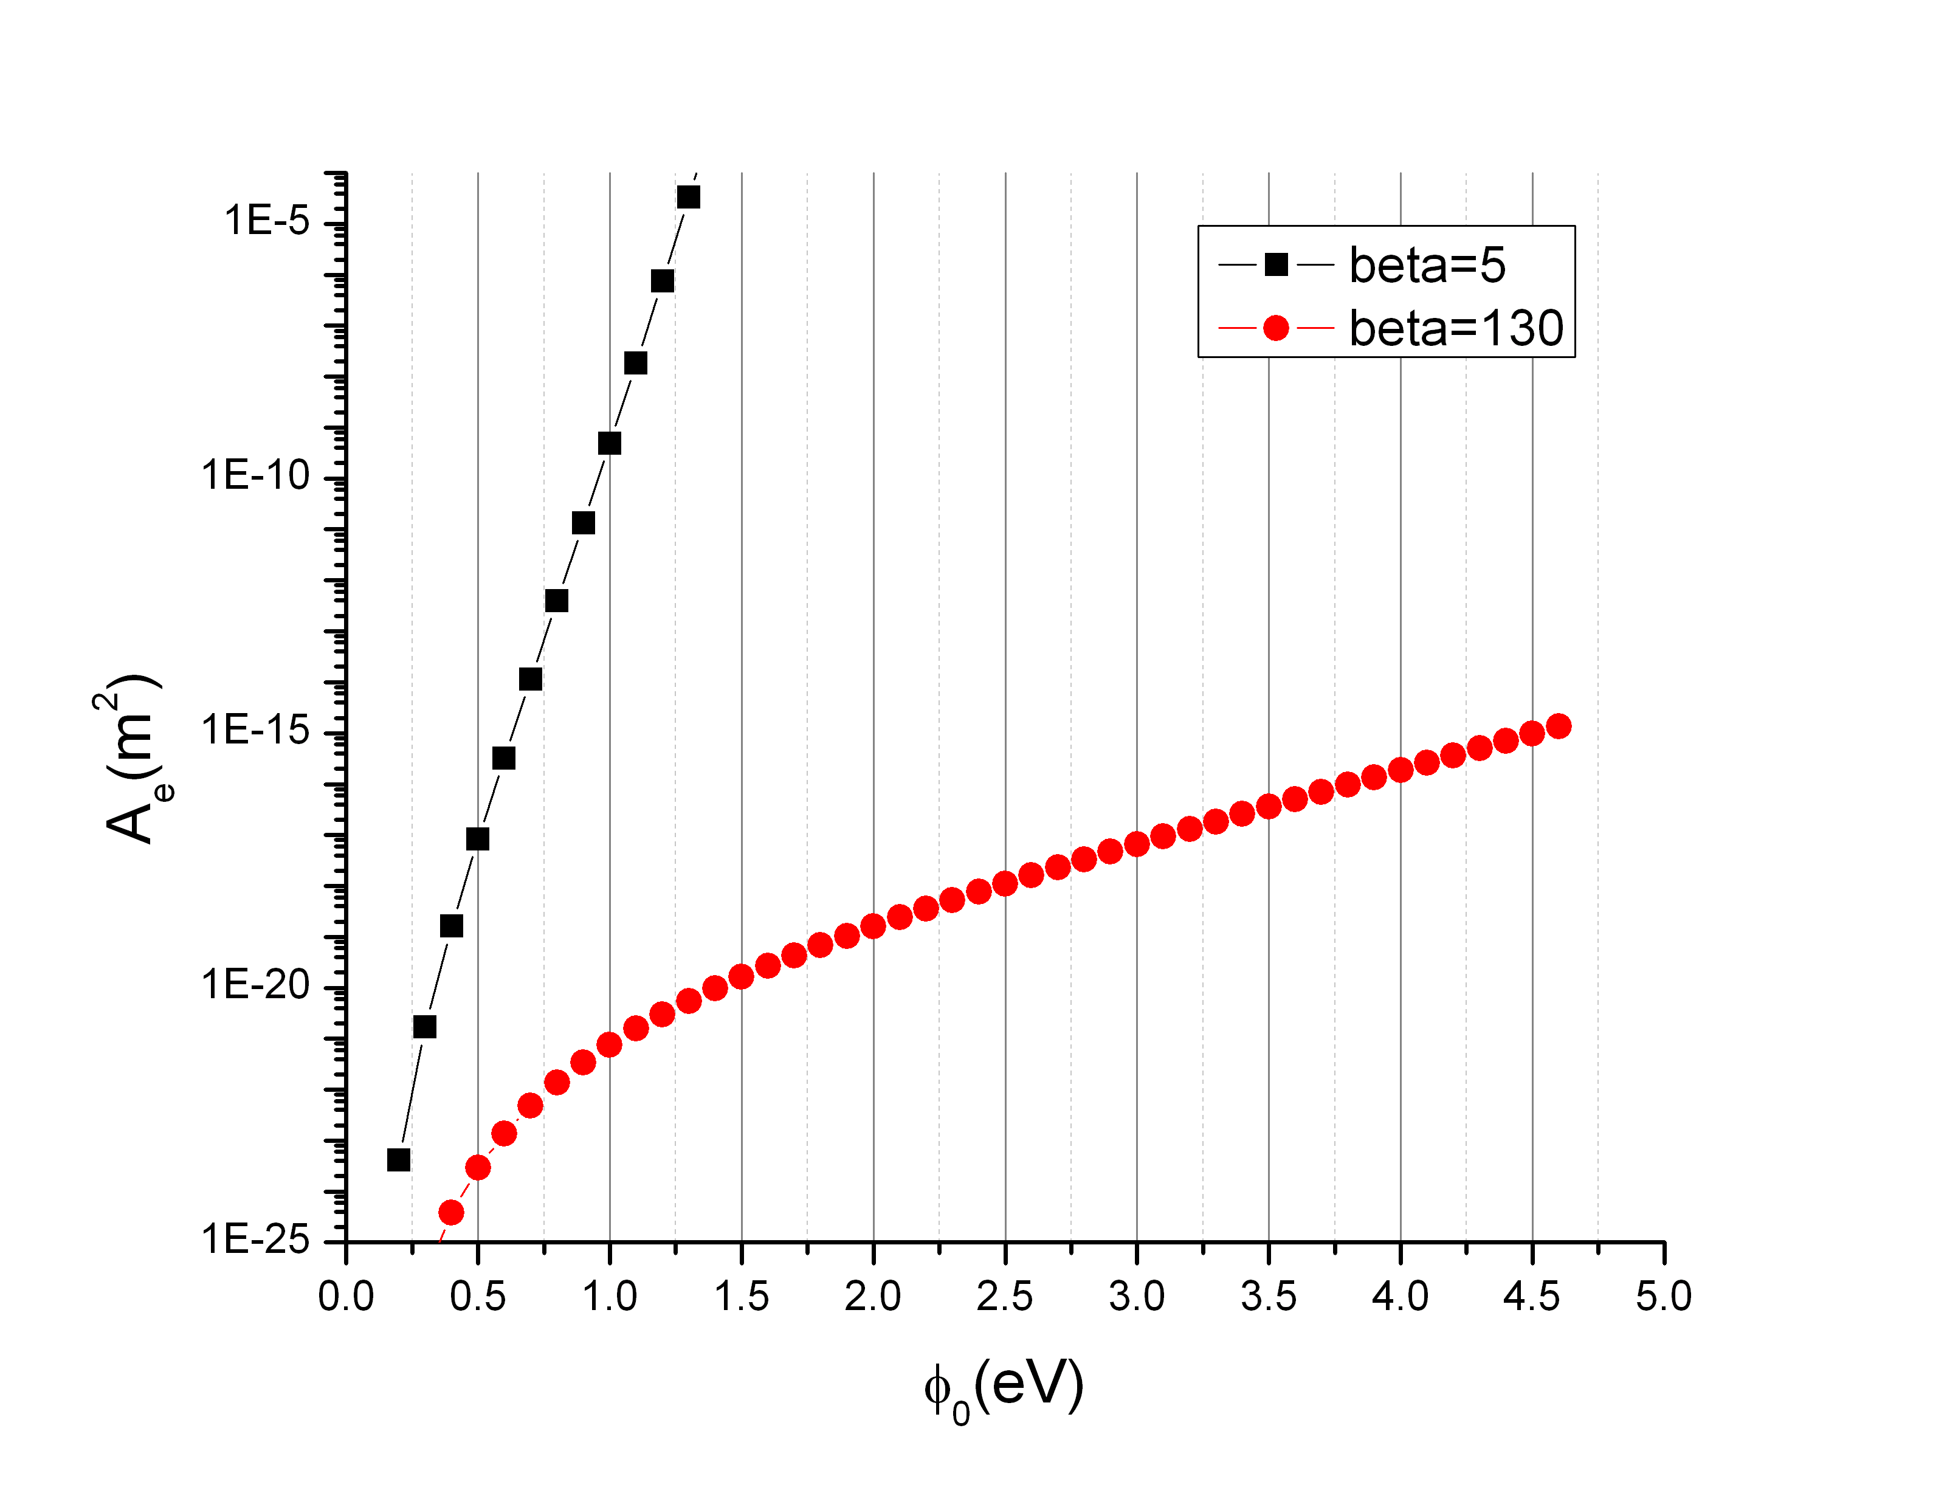
A_{e} from Fowler-Nordheim plot
Raw Data
  Field emitted current
  E-field on surface
Fit
  Typical fits give areas so small that they are difficult/impossible to measure.
  Does this give us a way to probe
  whether β or φ₀ dominates?

Slide 14
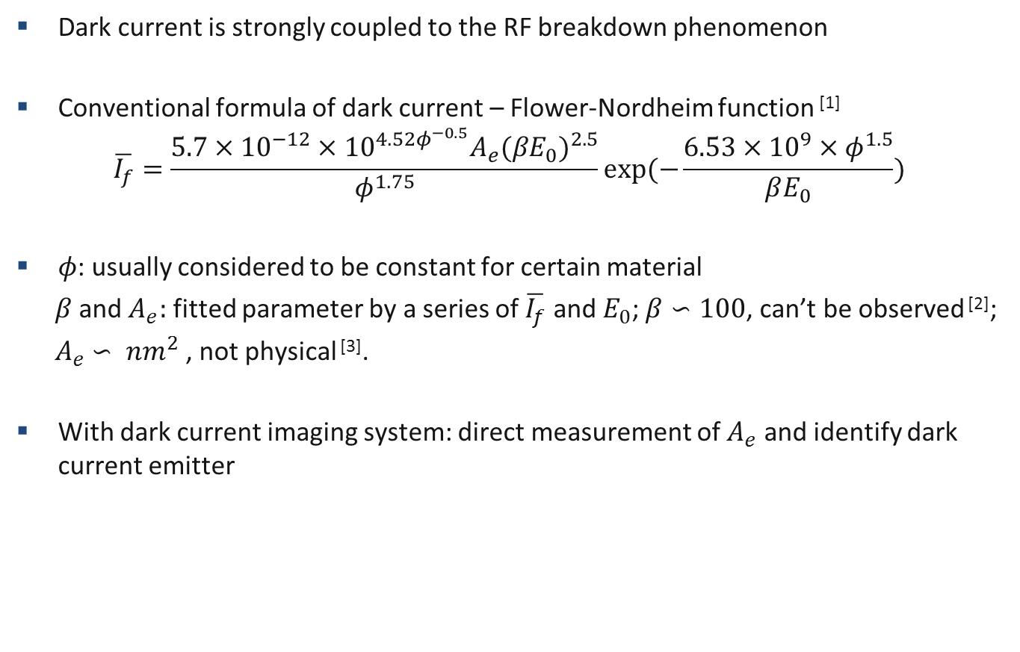
Dark current imaging experiment
Dark current is strongly coupled to the RF breakdown phenomenon
Conventional formula of dark current – Flower-Nordheim function ^{[1]}
$$\overline{I_{f}}=\frac{5.7×{10}^{−12}×{10}^{4.52φ^{−0.5}}A_{e}{(βE_{0})}^{2.5}}{φ^{1.75}}exp⁡(−\frac{6.53{×{10}^{9}×φ}^{1.5}}{βE_{0}})$$
$φ$: usually considered to be constant for certain material
$β$ and $A_{e}:$ fitted parameter by a series of $\overline{I_{f}}$ and $E_{0}$; $β∽100$, can’t be observed ^{[2]};
$A_{e}$ $∽ {nm}^{2}$, not physical ^{[3]}.
With dark current imaging system: direct measurement of $A_{e}$ and identify dark current emitter

Slide 15
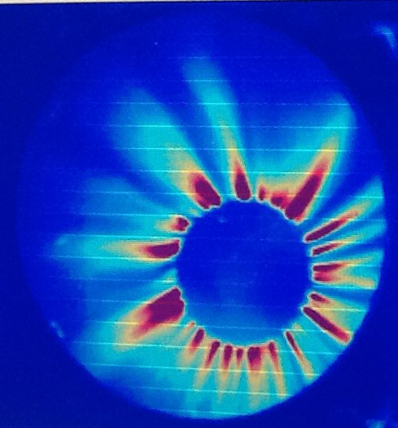
Wide energy spectrum of dark current causes blurred image
Initial emitter on the cathode
After the solenoid
Different focusing for different energy
After the solenoid, certain energy
Experiment results:
To get clear image, need to select dark current with certain energy
Notes:
The four points plots are from PARMELA simulation. The lower right one is from our experiment result without collimator.

Slide 16
Energy selection by a collimator
Solenoid
RF gun
Collimator
YAG
Smaller the hole, dimmer but clearer the image

Slide 17
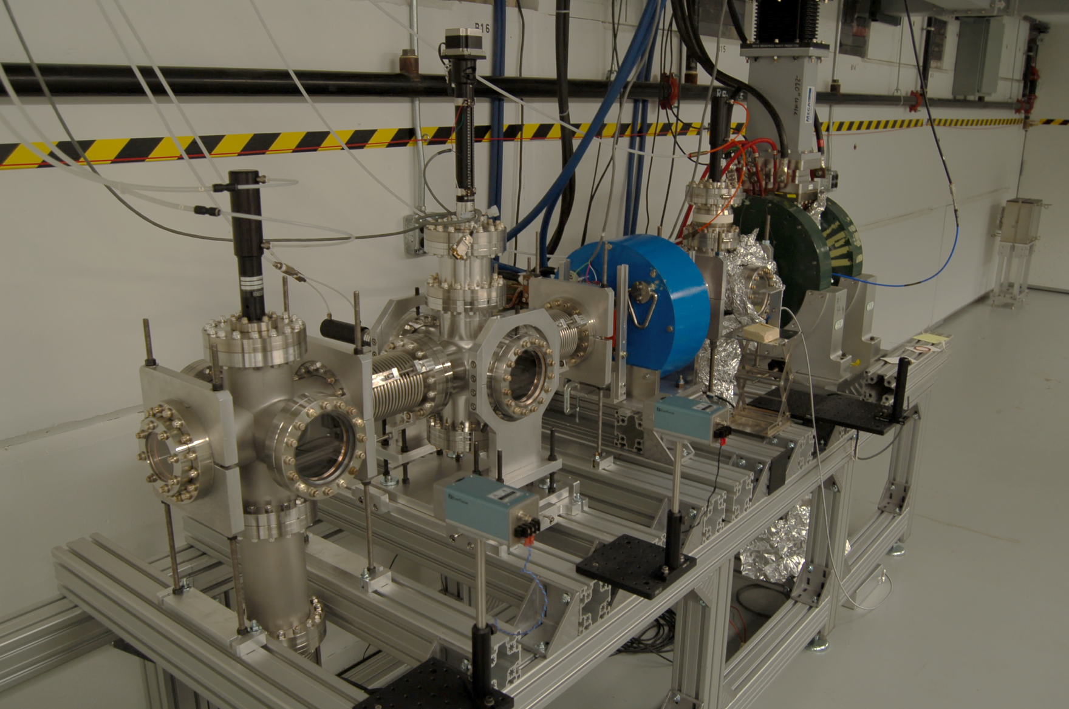
Experiment setup
Gun with mountable
cathode
Solenoid
Collimator
YAG
L-band single cell gun. Maximum E-field 100 MV/m with 2 MW input power.
Three size of collimator: φ 0.02”, φ 0.0135”, φ 0.0075”.

Slide 18
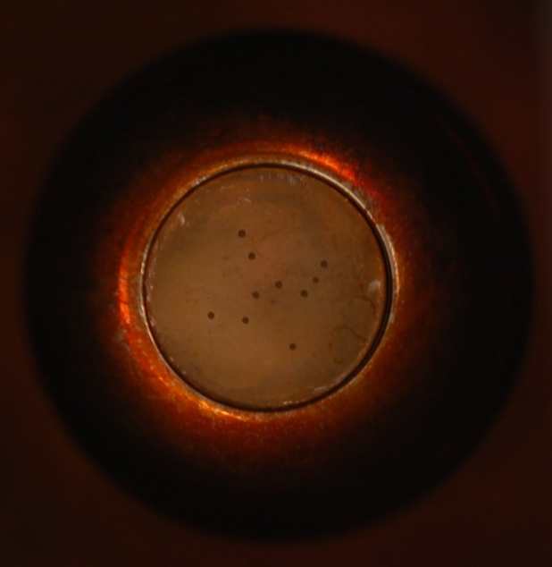
Experiment results
Cathode edge
Edge
Edge: E-field is 20% higher than the center, may be further enhanced by the gap
Pattern: created by sandblasting, 30~40 um roughness (cathode base polished to 1 um)
Cathode center
Pattern
Φ 0.02”
Φ 0.0135”
Φ 0.0075”
Edge
Edge
Edge
Pattern ?
Reflection

Slide 19
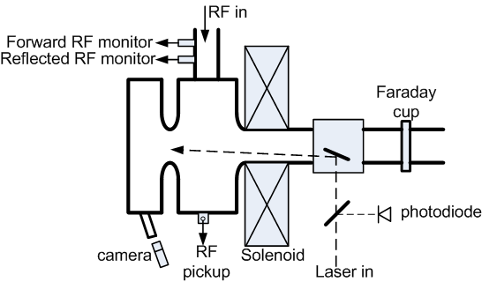
Laser Triggered Experiment setup (at Tsinghua University)
Oscilloscope
12 GHz bandwidth
50 G/s sample rate
RF gun
1.6-cell S-band 2856MHz
Solid, demountable cathode
55 MV/m at cathode center with
4.8 MW input power
Laser
Ti:Sapphire, 266 nm UV
1.2 ps pulse duration
1mm² spot size on the cathode
2 mJ max energy
~5% energy jitter

Slide 20
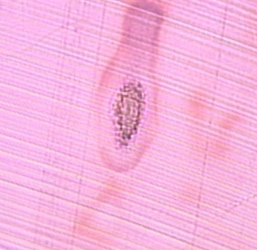
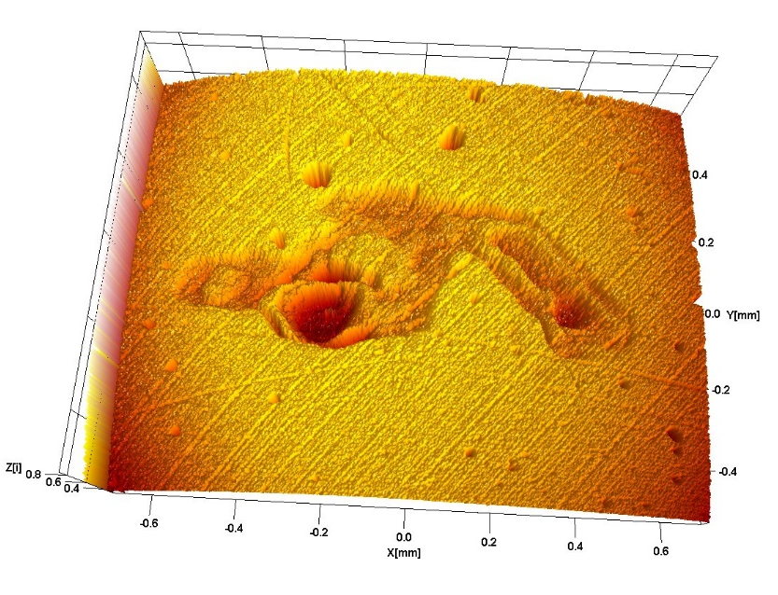
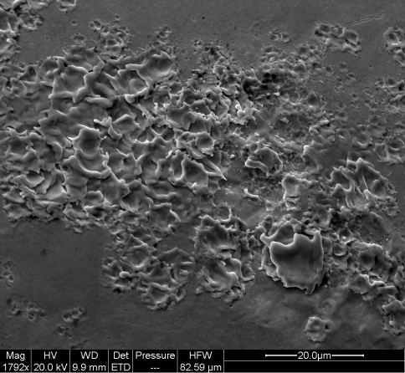
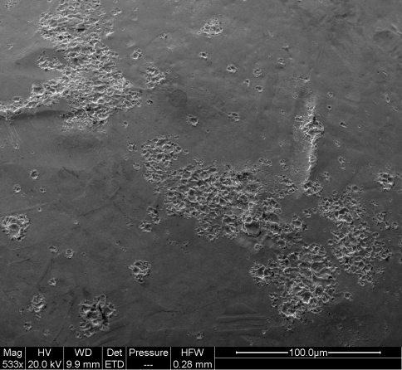
Comparison of the laser damage on the surface and RF breakdown
Laser damage spot
Average intensity 6 mJ/cm²
In air
Non-uniform distribution causes ablation
White light interferometry
500 um
20 um
20 um
Ablation spot
SEM of breakdown spot
melting
ablation
100 um
SEM of laser damage spot
500 um
20 um

Slide 21
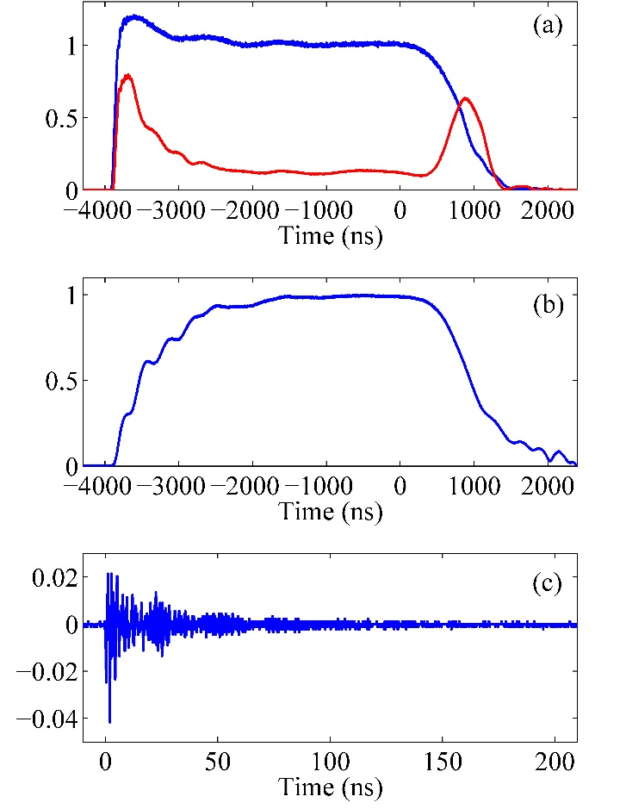
Normal operation of the gun
laser
<0.5 mJ/cm², no breakdown
Forward and reflection
RF pickup
Photoelectron current:
Damped oscillation due to ringing in the data acquisition system
Faraday cup

Slide 22
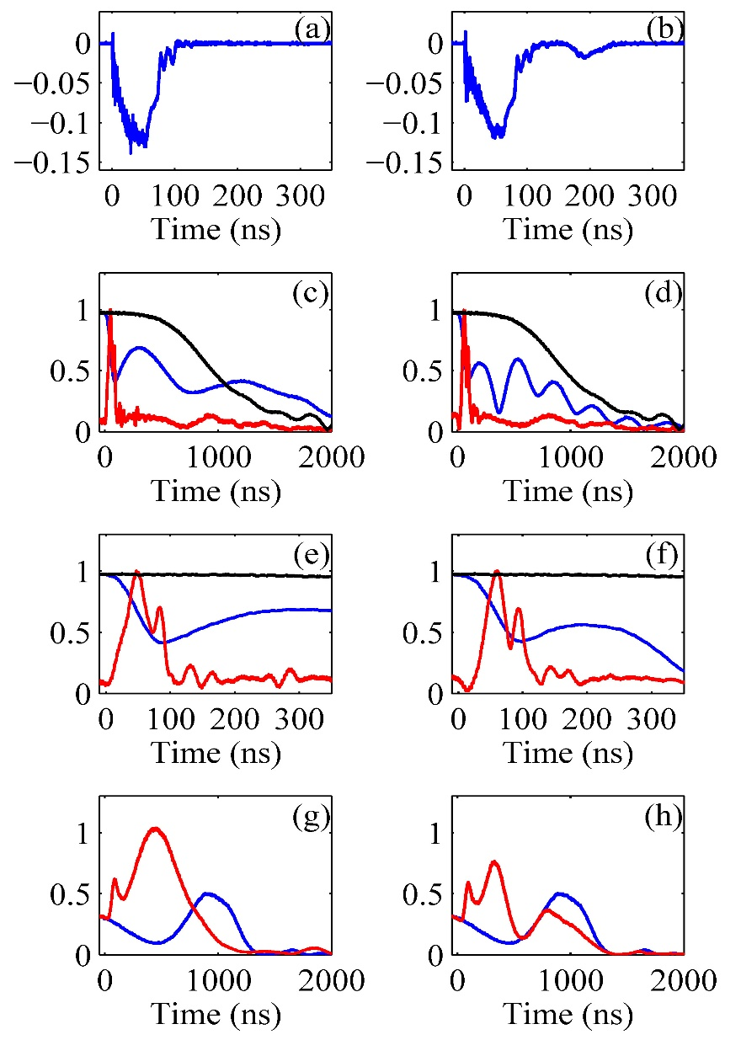
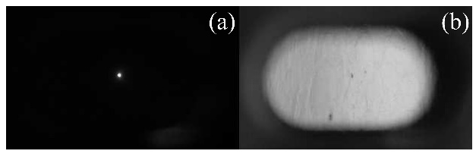
Laser-triggered RF breakdown
>10 mJ/cm², breakdown at almost every RF pulse
High emission current
Single-BD (>99%) and multi-BD (<1%)
Excitation of 8.6 GHz HOM with collapse of the fundamental mode
Bright spot observed during BD,
damage found at the same position afterward
Notes:
RF breakdown without laser trigger of single-breakdown event (left) and multi-breakdown event (right).
(a-b) The Faraday cup signal in Amperes. (c-d) Normalized FFT amplitude of the pickup signal in different frequency bands as a function of time, including the fundamental mode without breakdown (black line), the fundamental mode with breakdown (blue line), and the 8.6 GHz HOM with breakdown (red line). (e-f) Same signals in (c-d) with a zoom in view around 0 ns. (g-h) Normalized FFT amplitude of the reflection signal, including the fundamental mode without breakdown (blue line) and with breakdown (red line).
Note the possibility of single-BD and multi-BD in red.
The picture was taken by the camera looking through the viewport on the half cell.

Slide 23
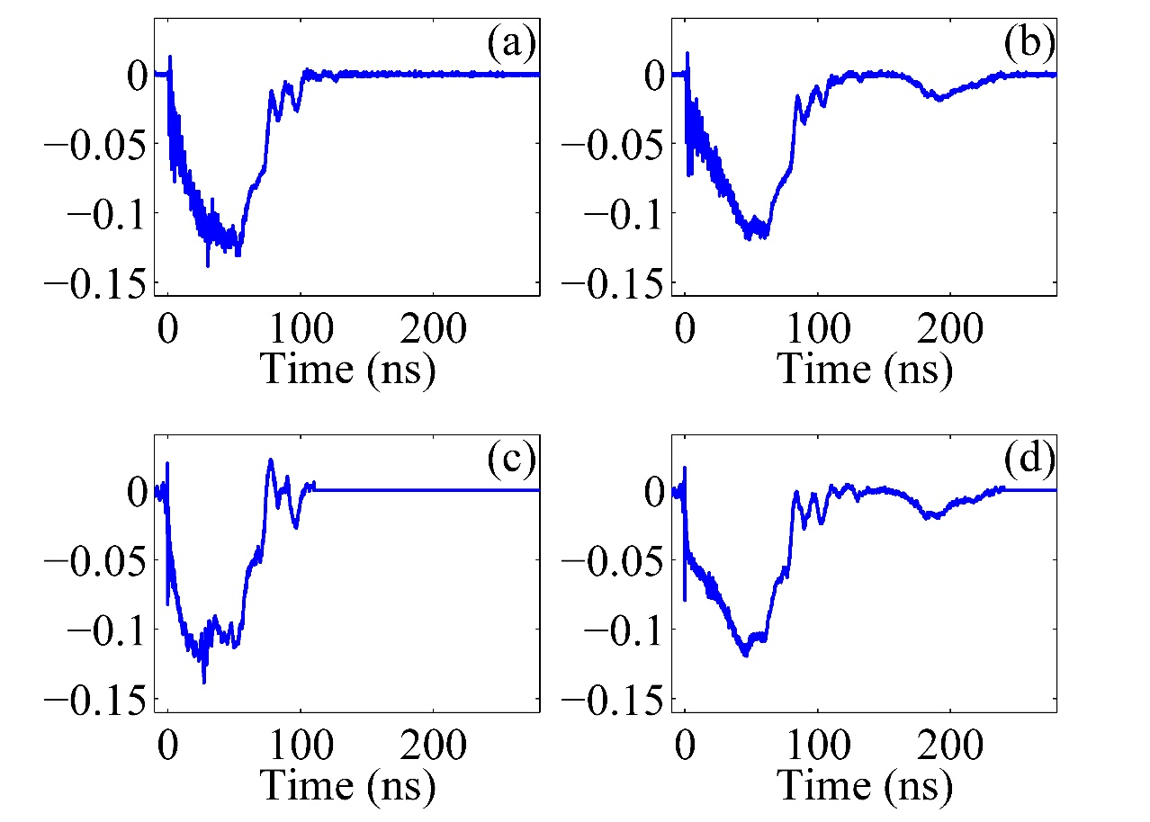
De-convoluting of breakdown current
photoelectron
photoelectron
BD current
BD current
Three stages of BD current: increasing electron emission (20∼50 ns); steady state emission (20∼40 ns); and decreasing emission (20∼30 ns).
Shape varies between pulses due to fluctuation of laser intensities, etc.
Notes:
The damped oscillation signal is used as the system function of the whole Faraday cup system.

Slide 24
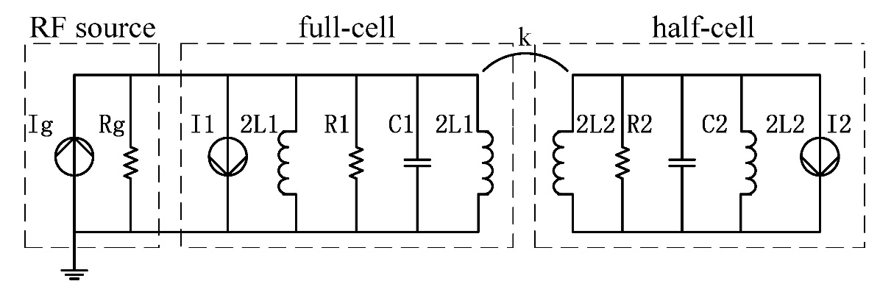
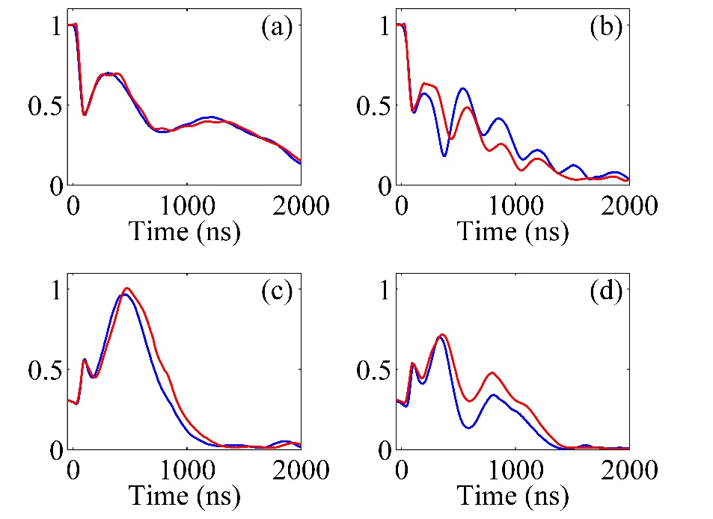
Circuit model
BD current
Frequency detune are also introduced to both cells after the emission
18 A BD current in both cells; 3.2 MHz and 0.9 MHz frequency downshift for the half cell and full cell respectively
Notes:
RF breakdown with laser trigger of single-breakdown event (left) and multi-breakdown event (right). (a-b) The Faraday cup signal in Amperes. (c-d) Normalized FFT amplitude of the pickup signal in different frequency bands as a function of time, including the fundamental mode without breakdown (black line), the fundamental mode with breakdown (blue line), and the 8.6 GHz HOM with breakdown (red line). (e-f) Normalized FFT amplitude of the reflection signal, including the fundamental mode without breakdown (blue line) and with breakdown (red line).
Note the frequency detune of the half cell is introduced immediately after breakdown and that of the full cell is introduced 200 ns after the breakdown and linearly increased to 0.9 MHz, trying to simulation plasma propagation.

Slide 25
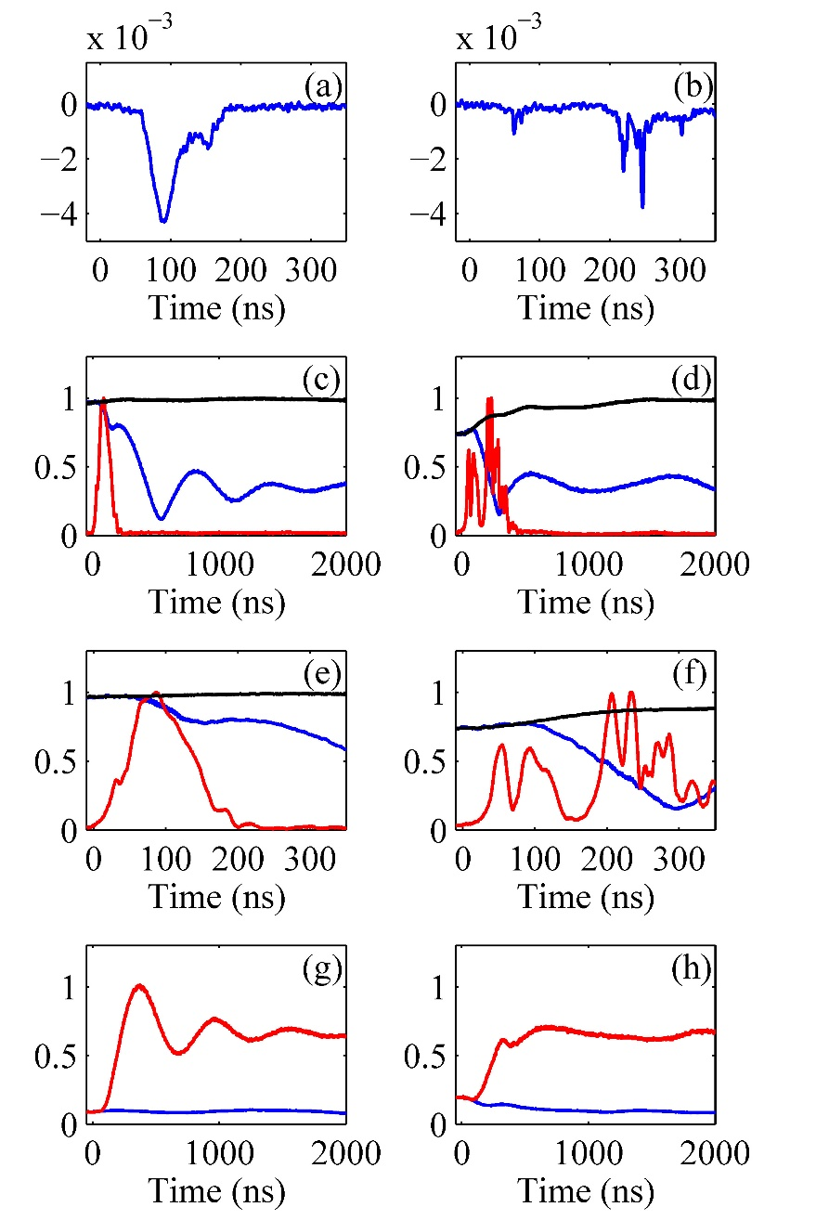
RF breakdown without the laser trigger
Lower BD current
Single-BD (~30%) and multi-BD (~70%)
Excitation of 8.6 GHz HOM and collapse of the fundamental mode
40~140 ns delay of collapse of the fundamental mode
BD occurred in the half cell, but away from the axis
Notes:
There are two special points of this plot.
First, the delay of collapse of fundamental mode and two orders of magnitude lower of BD current imply the breakdown occurred on the half cell but away from the axis.

Slide 26
Comments on Laser triggered BB study
Controllable RF breakdown in a cavity can be achieved.
For multi-BD, the excitation of the HOM caused by the 2nd BD is always near the end of the fundamental mode collapse
Power flow from the full cell due to unbalanced energy after the 1st BD causes the 2nd BD in the half cell
Summary:
We are attempting to explore parameters inter-dependent for RF breakdown in a cavity, and a few tools have been developed for field emission studies. Hope to have more data and the nature will manifest itself.

