Slide 1
Coupling Impedance Measurements of Extraction Kicker in CSNS/RCS
Liu Yu Dong, Huang Liang Sheng, Wang Sheng
2014-8-14

Slide 2
Contents
Introduction to the Extraction Kicker in CSNS/RCS
Longitudinal impedance measurements
  coaxial-wire method
  twin-wire method
  simulation results on longitudinal impedance
Transverse impedance measurements
  twin-wire method
  Wire loop method
  simulation results on transverse impedance
  Summary

Slide 3
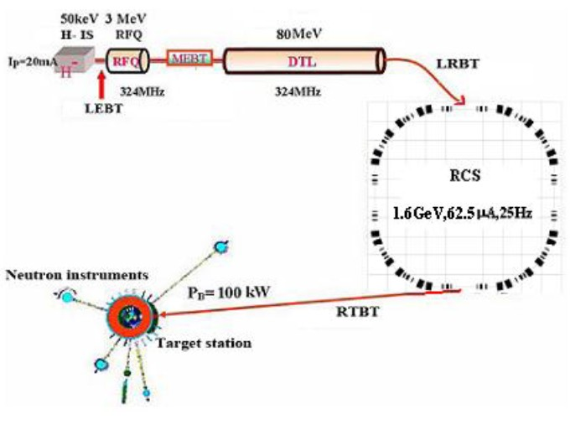
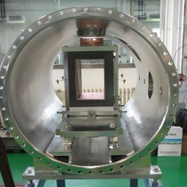
Brief Introduction on Extraction Kicker in CSNS/RCS
eight extraction kickers will be installed in this long drift region
No | kicker 1 | kicker2 | kicker3-4 | kicker5-6 | kicker7-8
Strength (T) | 0.0558 | 0.0559 | 0.0526 | 0.0571 | 0.0609
Angle(mrad) | 2.6 | 2.2 | 2.99 | 2.9 | 2.76
Length(m) | 0.4 | 0.32 | 0.45 | 0.41 | 0.36
Top time(ns) | >550 | >550 | >550 | >550 | >550
width(mm) | 155 | 212 | 155 | 157 | 168
Gap(mm) | 136 | 144 | 153 | 141 | 132
Rise time(ns) | ≤250 | ≤250 | ≤250 | ≤250 | ≤250
Notes:
本页题目 CSNS/RCS

Slide 4
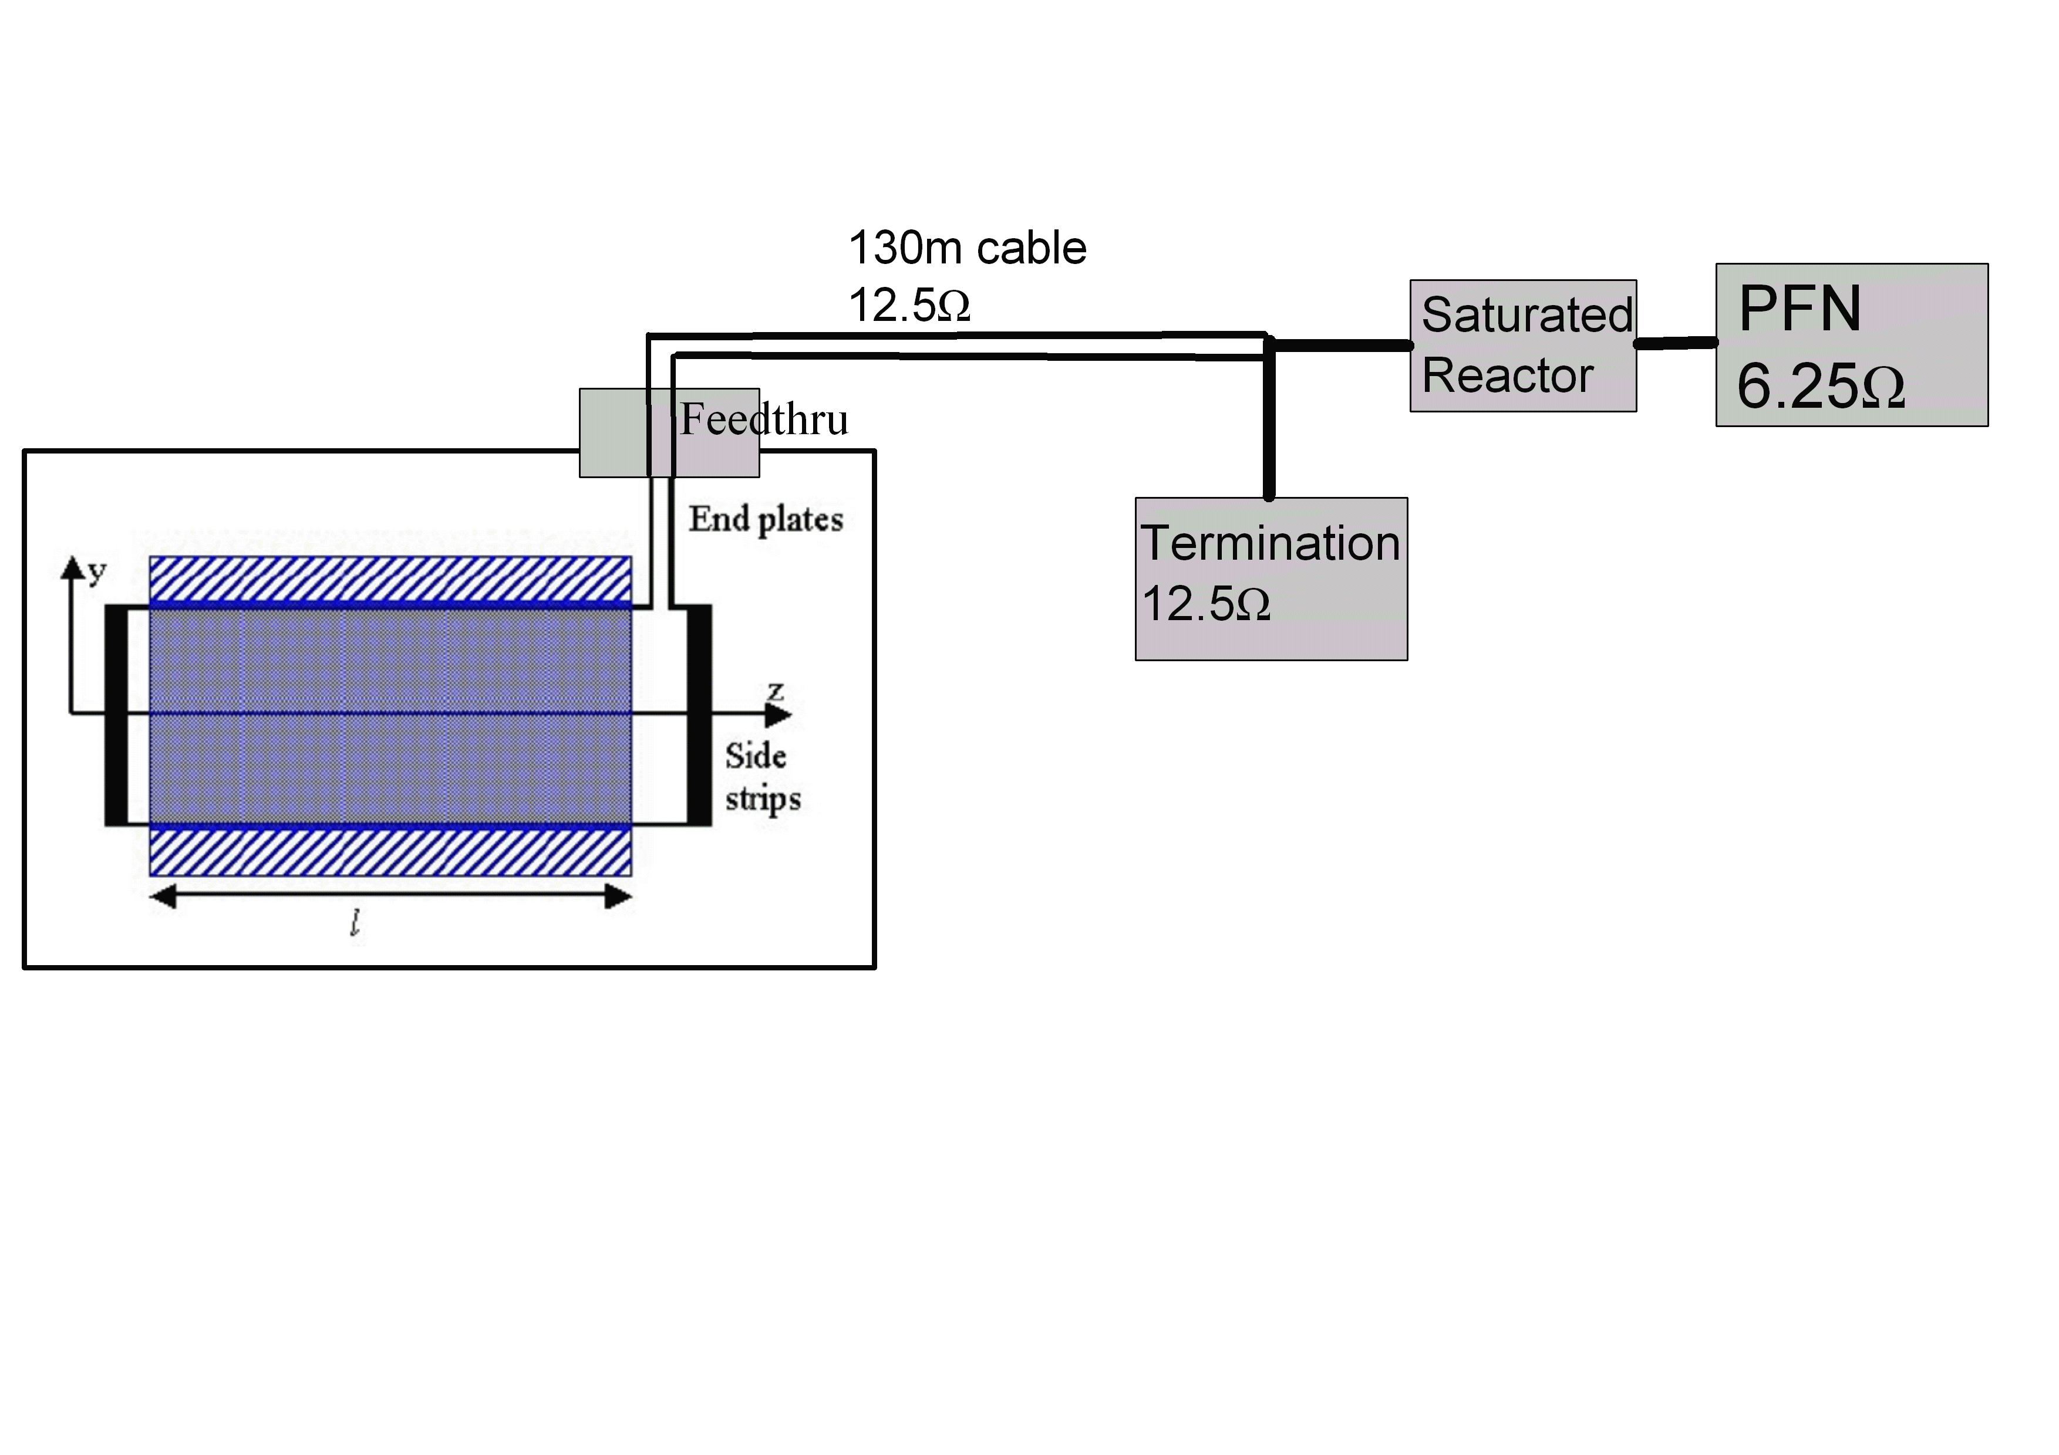
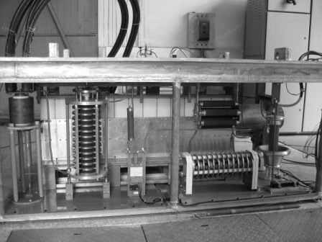
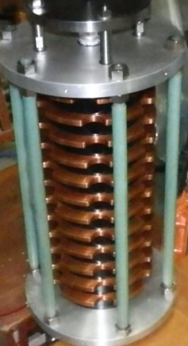
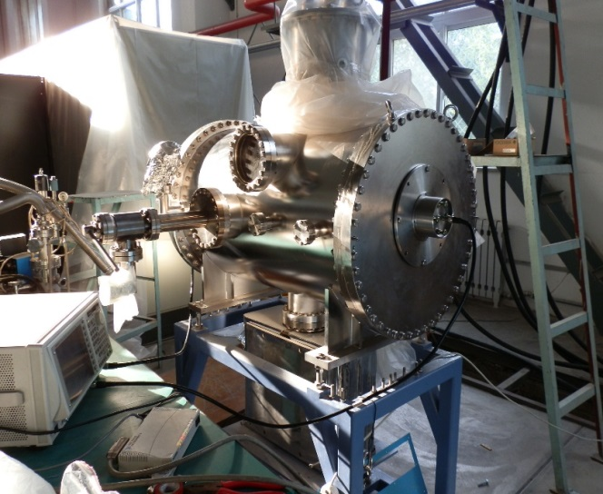
The schematic view of CSNS/RCS kicker system

Slide 5
longitudinal impedance measurements by coaxial-method
For matching 50Ω of the VNA to R_{c} of the reference line, a resistor R_{s} is connected serially at the end of the test line.
~320Ω
characteristic impedance of the reference pipe with the radius of beam pipe radius b~125mm and wire radius a~0.25mm
The longitudinal coupling impedance can be found from the measured transmission coefficients S₂₁ as
S_{21, DUT} , S_{21, REF} are the forward scatter coefficient of the DUT and the REF.

Slide 6
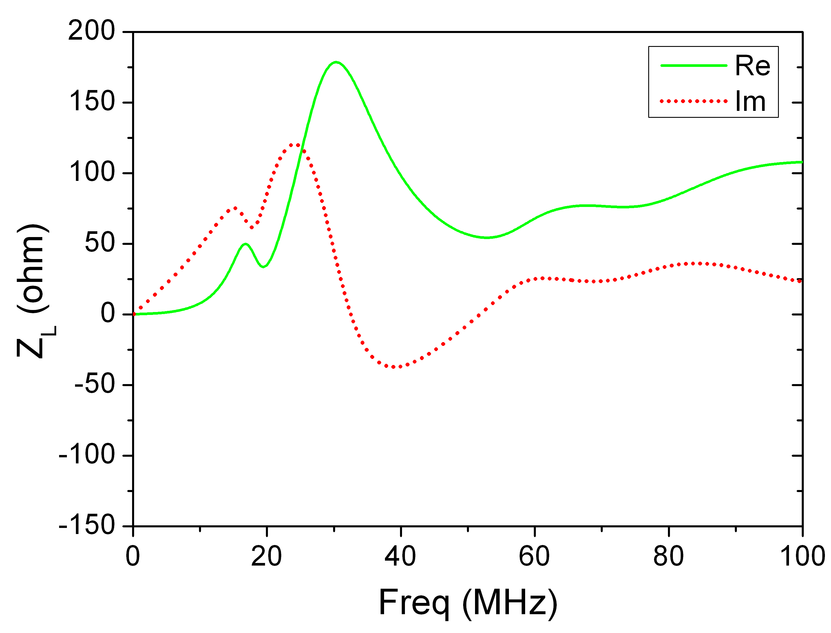
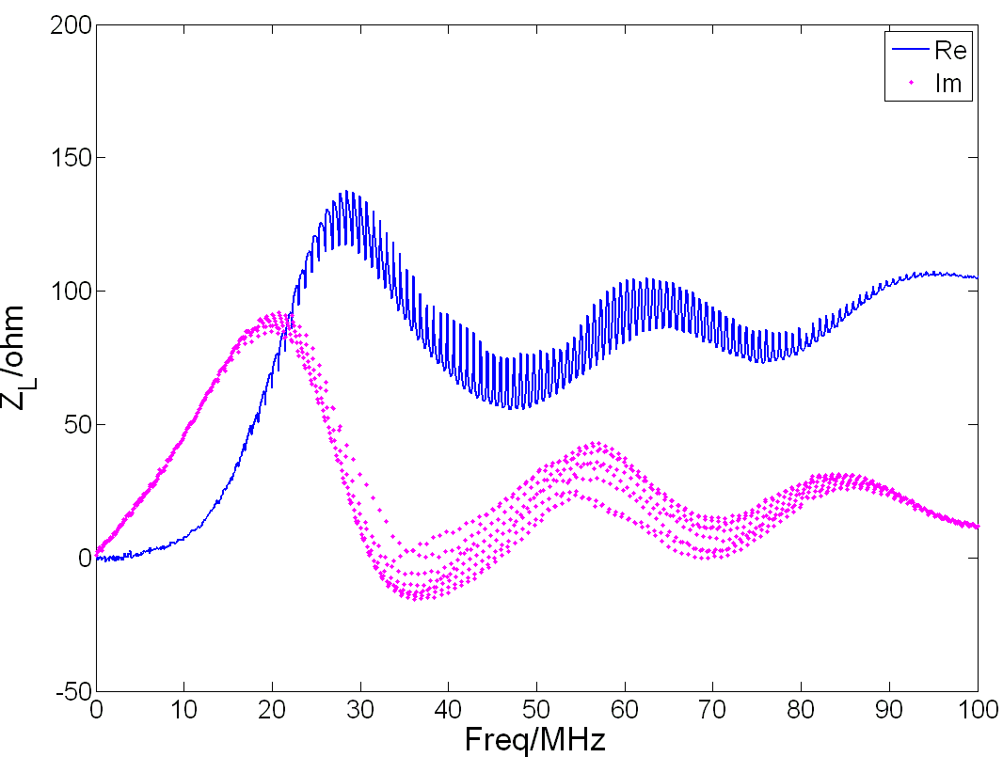
Caused window ferrite
Caused by Busbar gap
without connection with cable, PFN
with connection with cable, PFN
Where does the oscillation come from?

Slide 7
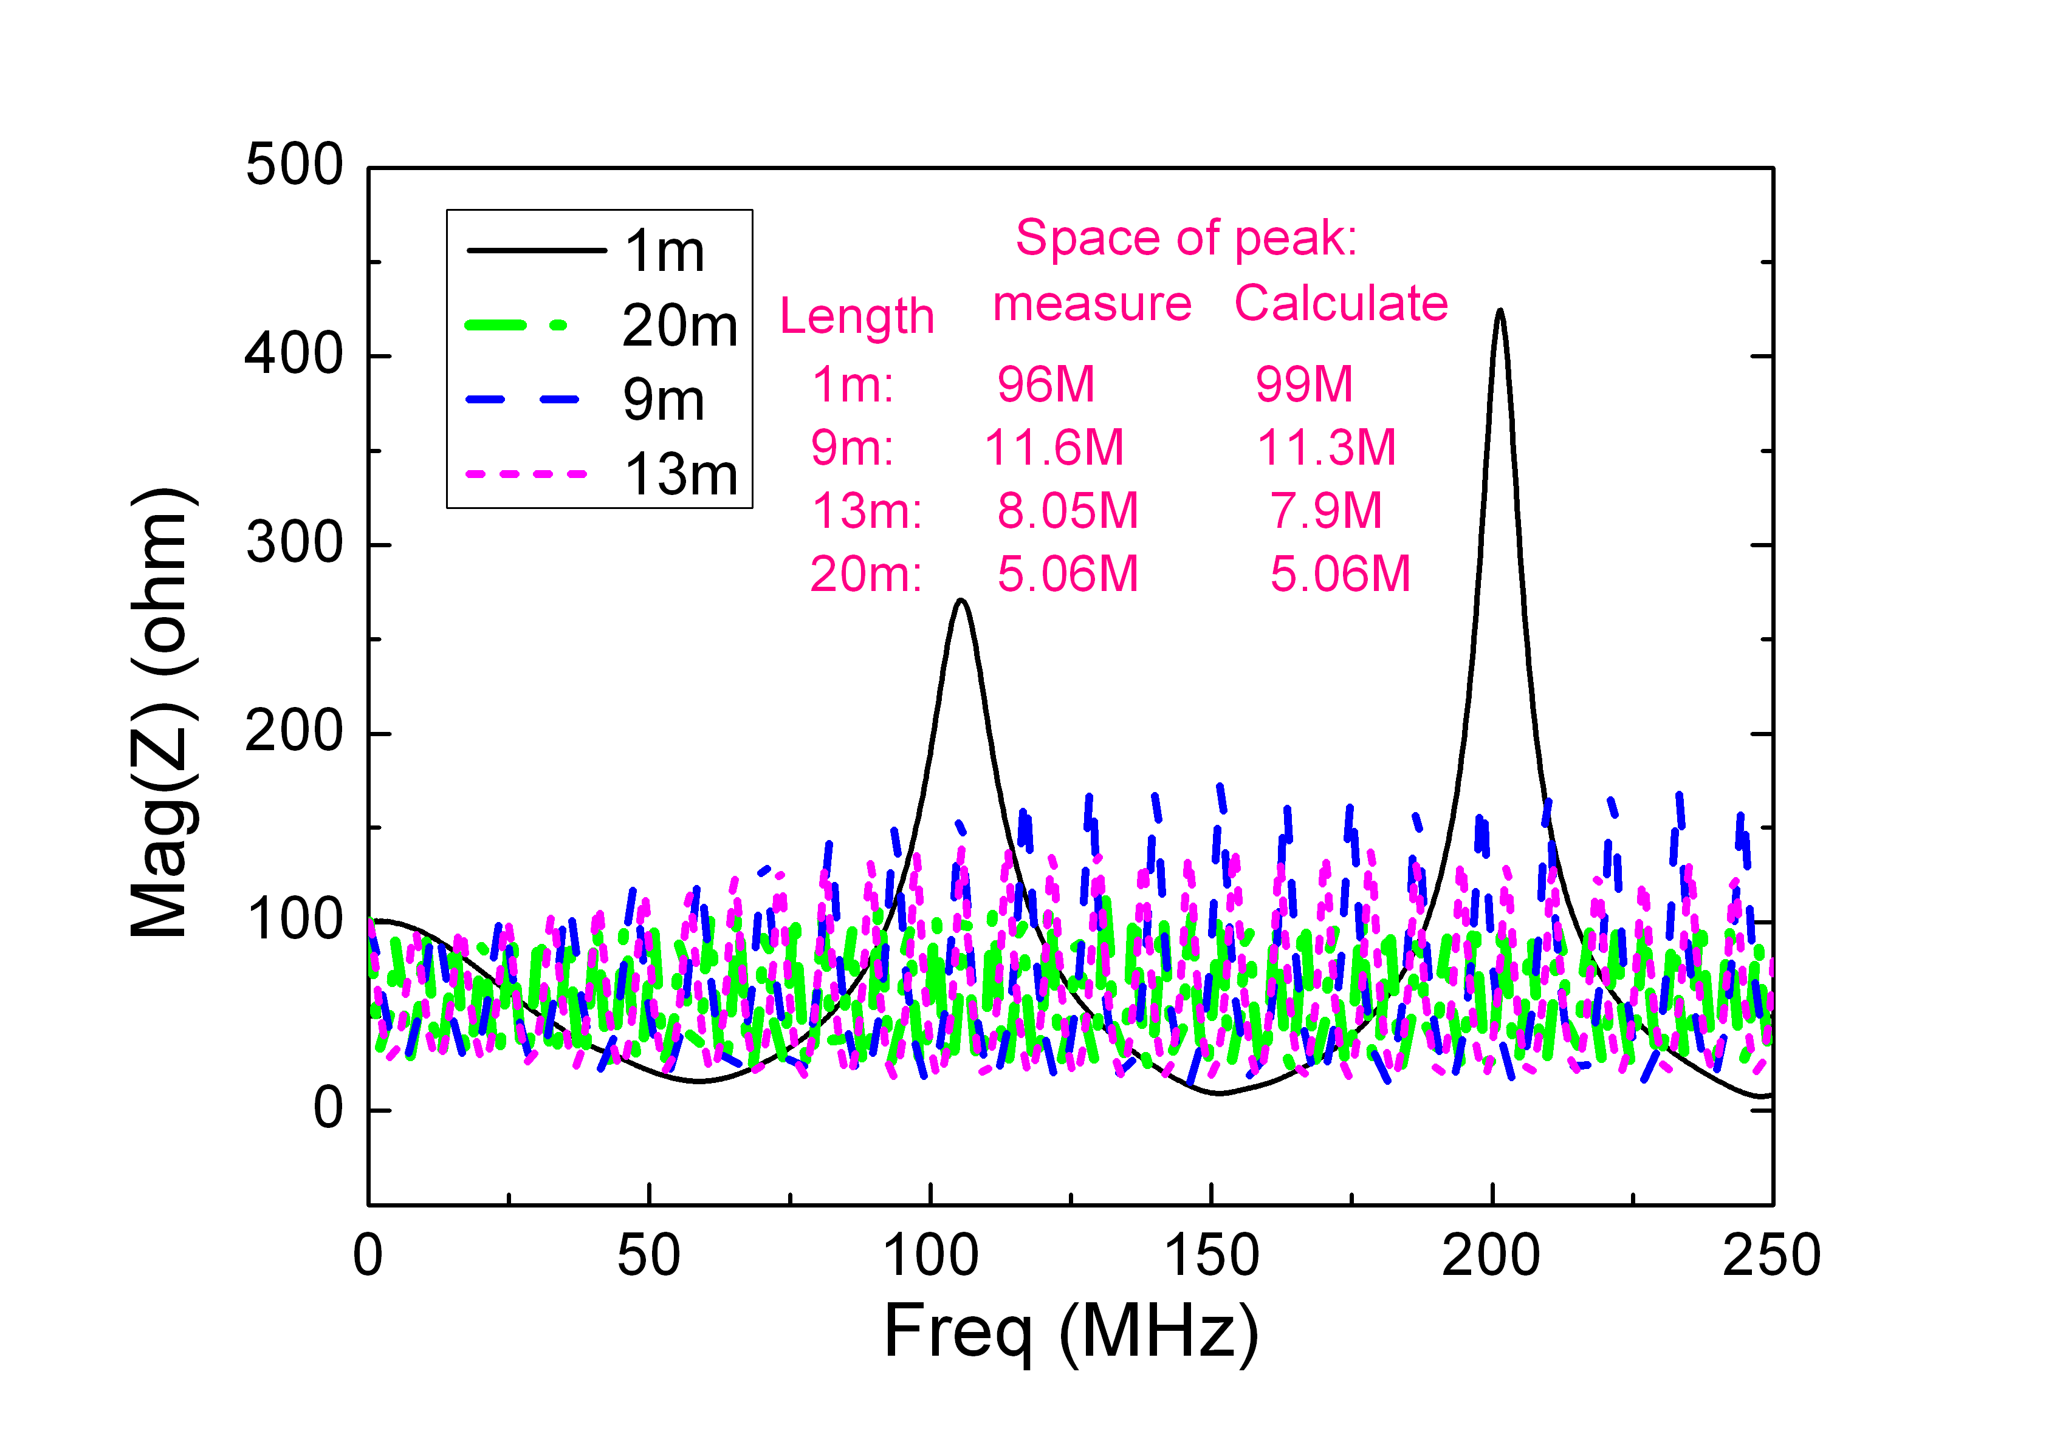
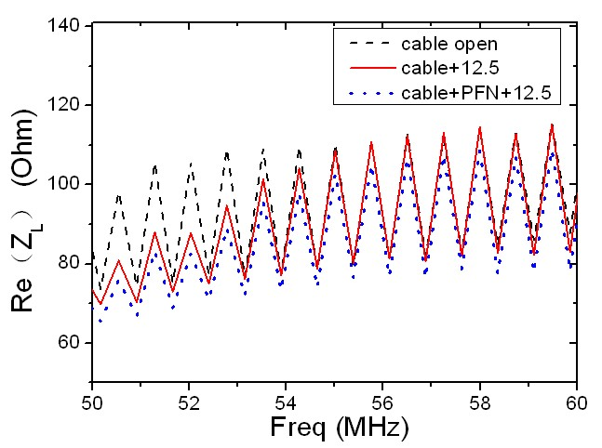
The oscillation come from the mismatching between the cable and PFN.
Δf: 0.74MHz=3e8/(130*2*1.6)
The signal oscillation in different cable length with unmatched terminal
Notes:
左边这幅图是50Ω不同长度的电缆末端接100Ω的电阻，认为形成不匹配，用网络分析仪测量发射峰与理论计算值的比较，说明震荡的来源，右边是测量了kicke电缆和PFN端口的3种情况连接情况。

Slide 8
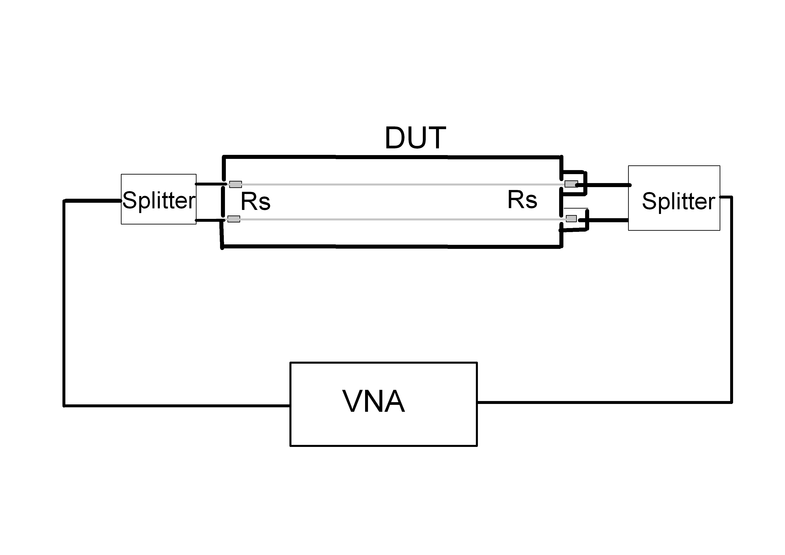
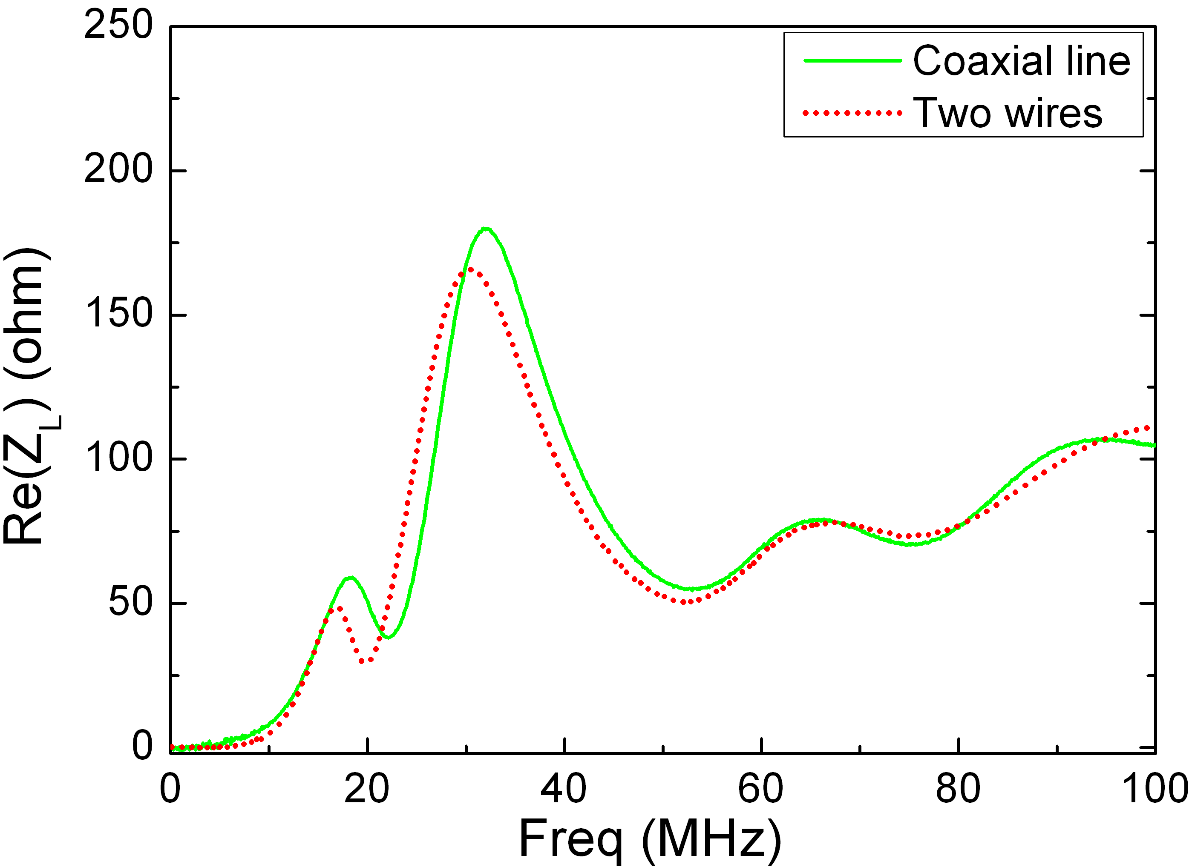
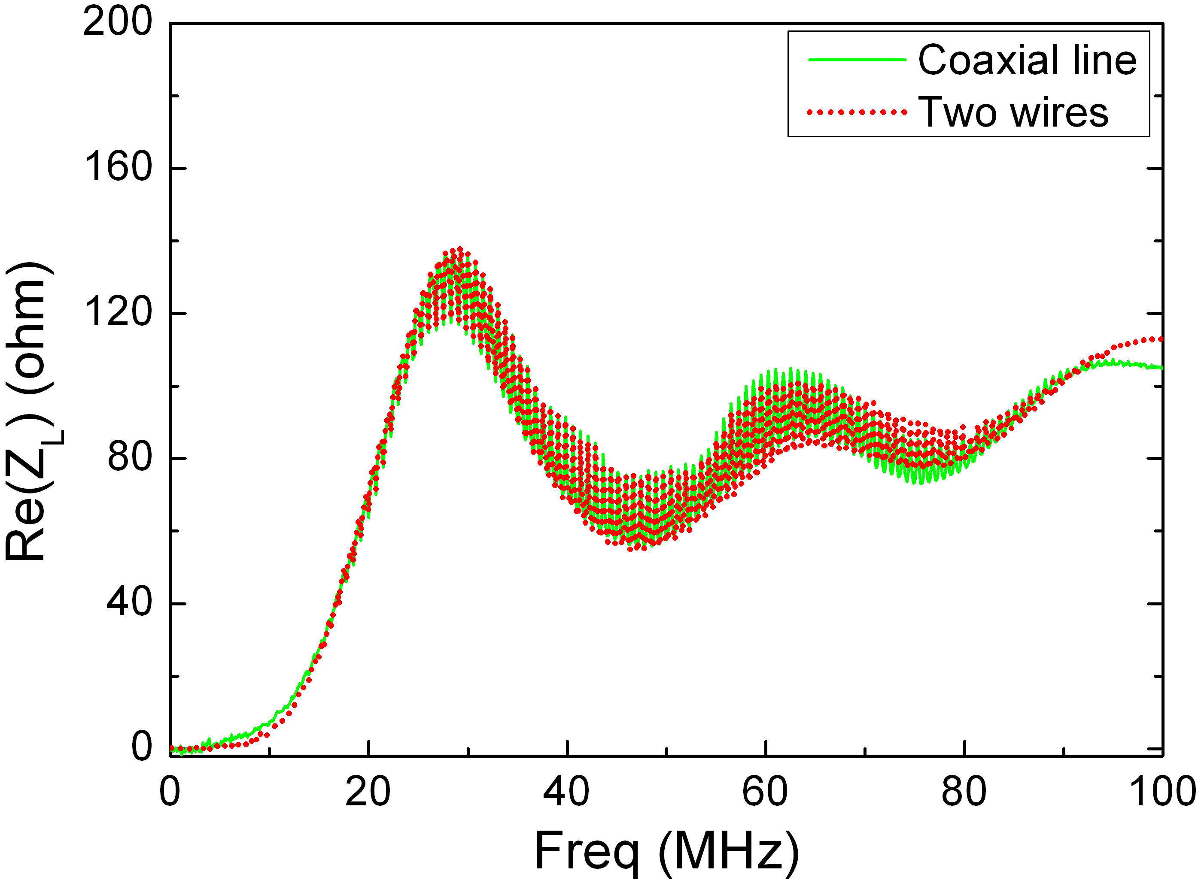
  Twin-wire method for longitudinal impedance measurements
The characteristic impedance of the reference pipe with twin-wire is
The common mode signal splitted by splitter transmitted in the twin wire
~440Ω
The matching resistor R_{s}~390 Ω
without connection with cable, PFN
connection with cable, PFN
Notes:
我认为应着重提一些纵向共模阻抗测量是比较新的方法，测量实例较少。这里可以突出将一下splitter是同相功分器，要求输出两路信号等幅等时行要好。这里的splitter和横向测量不同

Slide 9
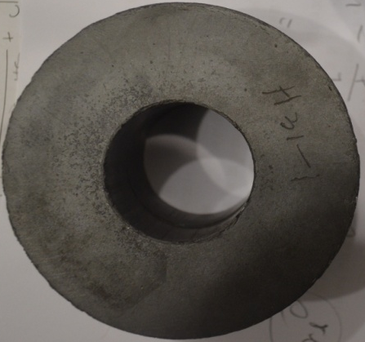
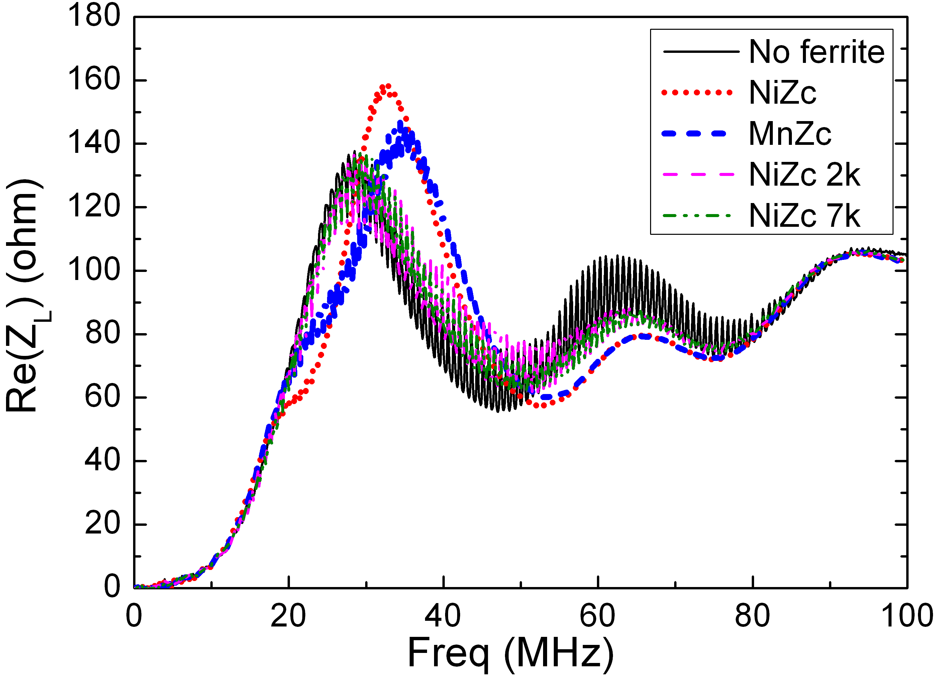
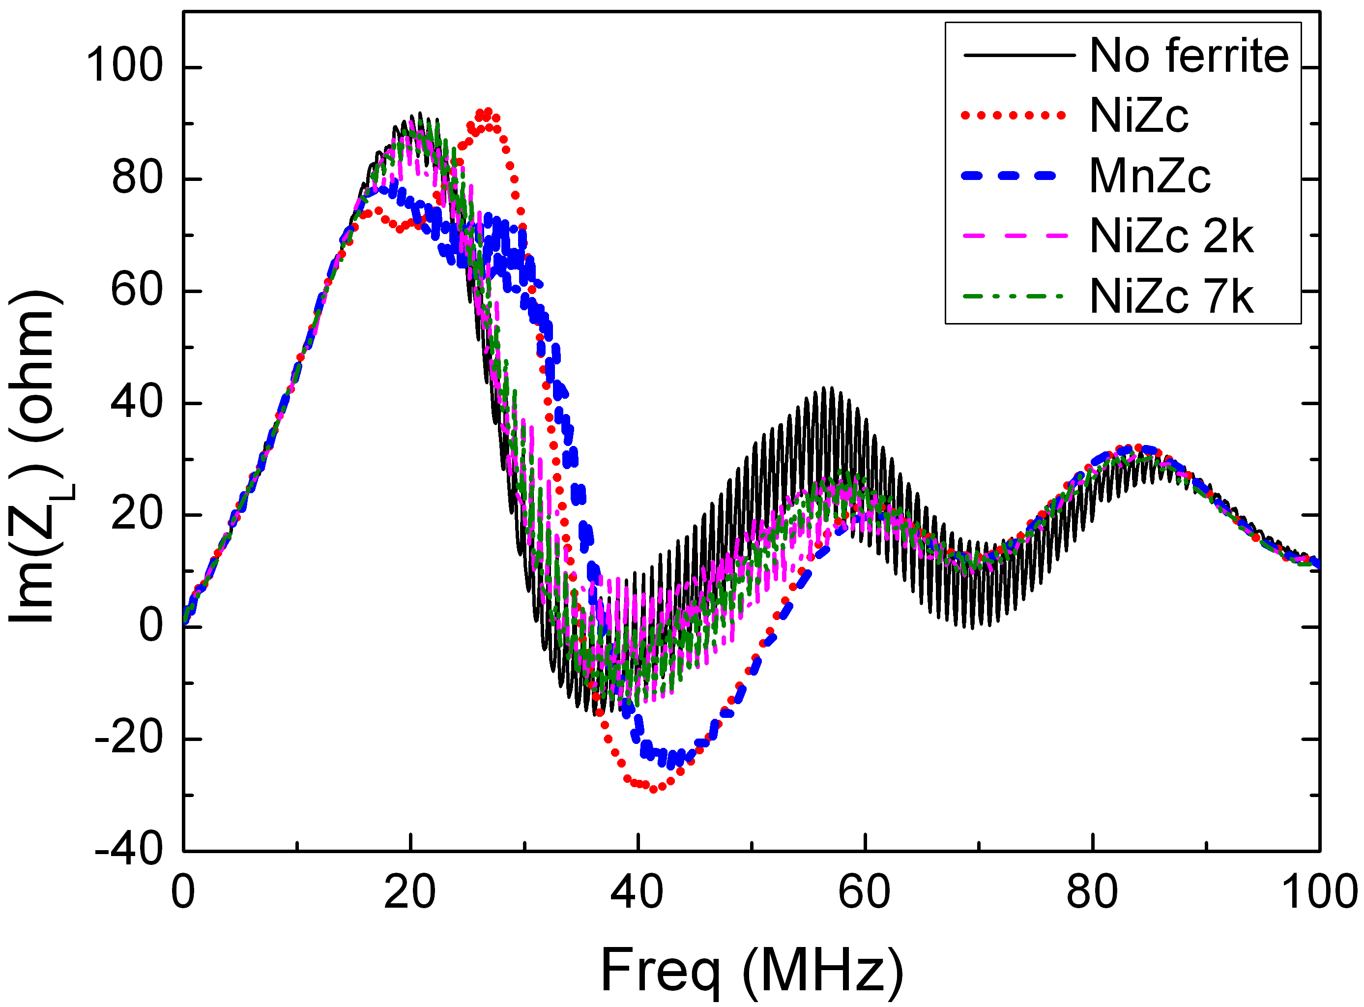
Restrain the oscillation
Ferrite Rings are used to absorb the reflection between cable and PFN.
Inn. dia.=20mm,
Out. dia.=97mm
Length=20mm

Slide 10
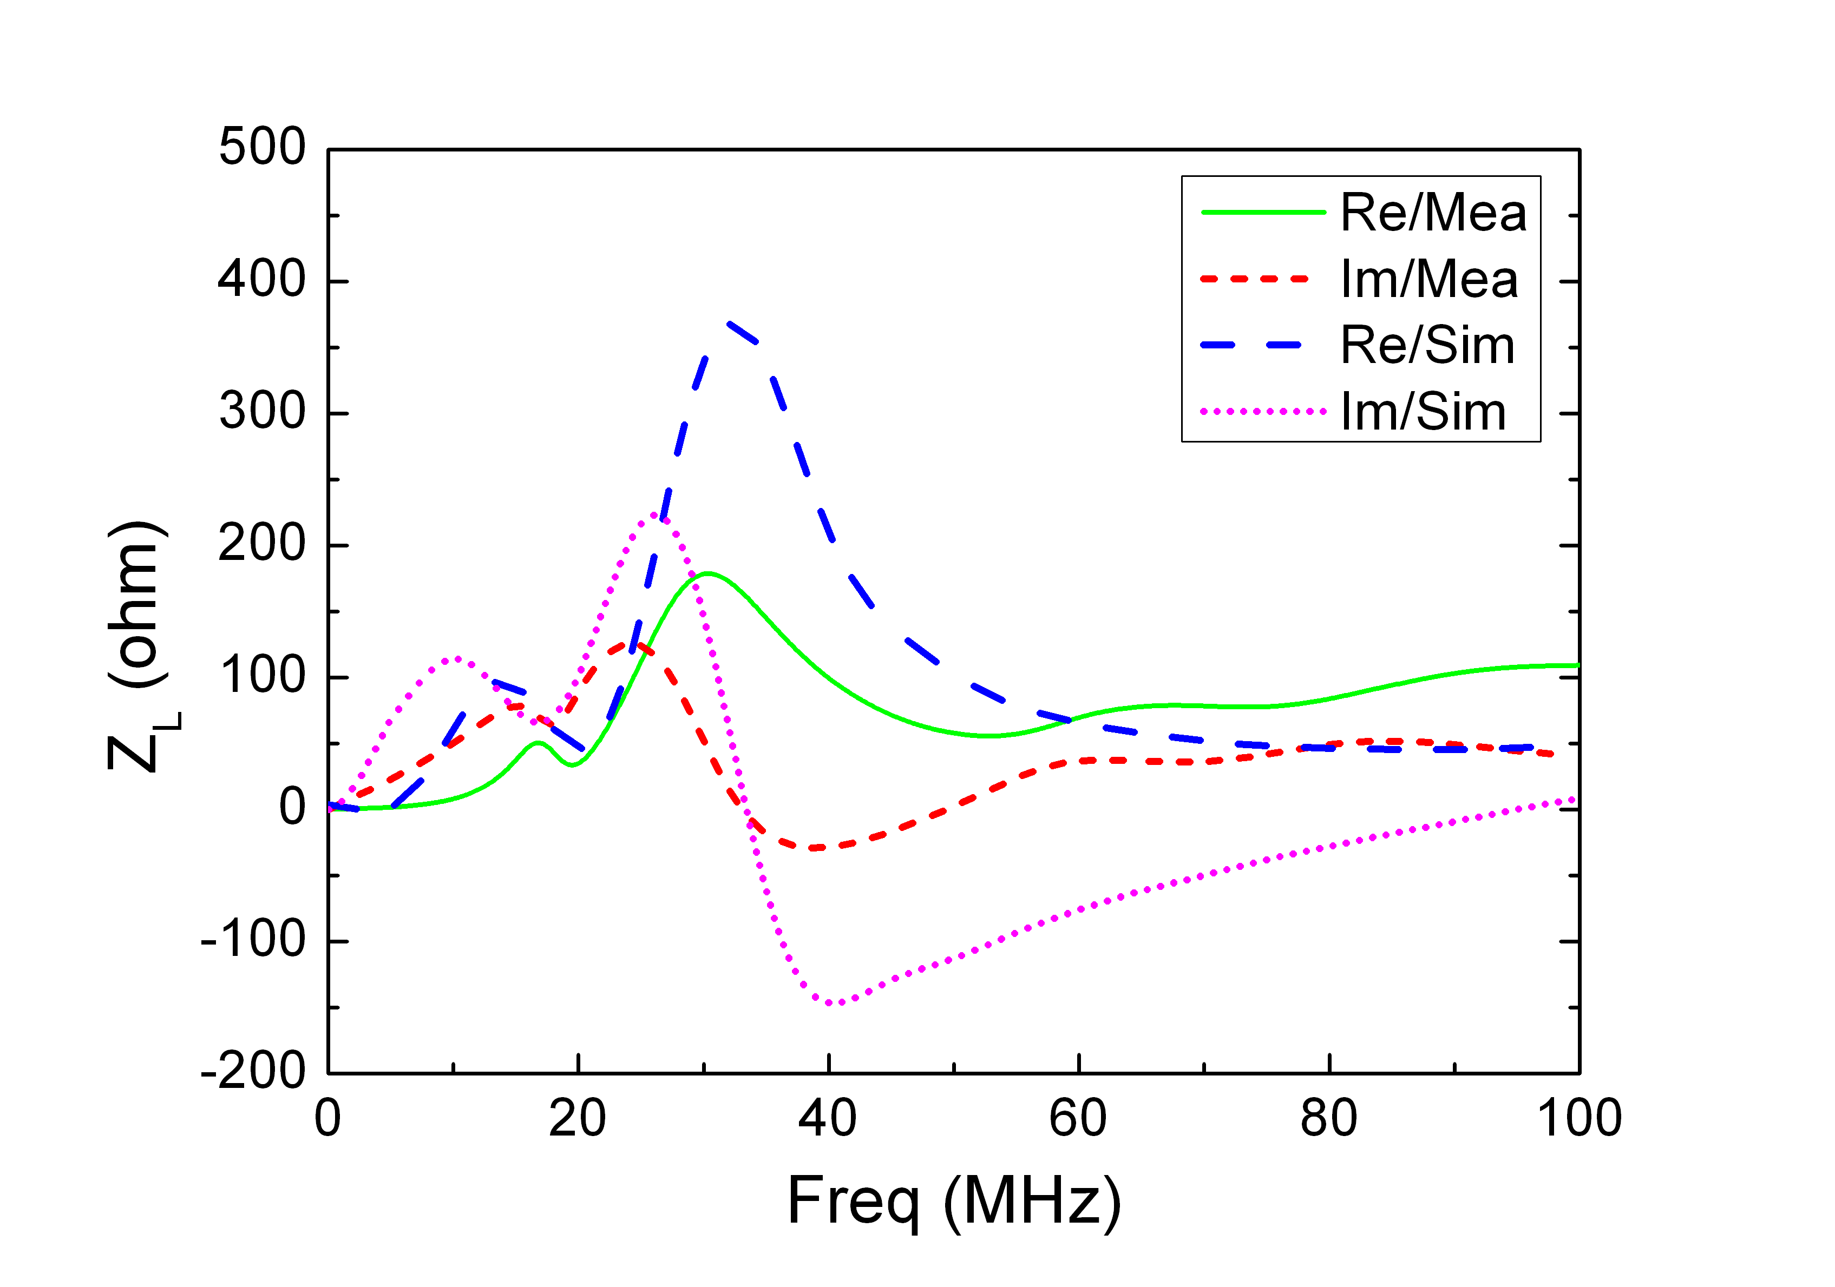
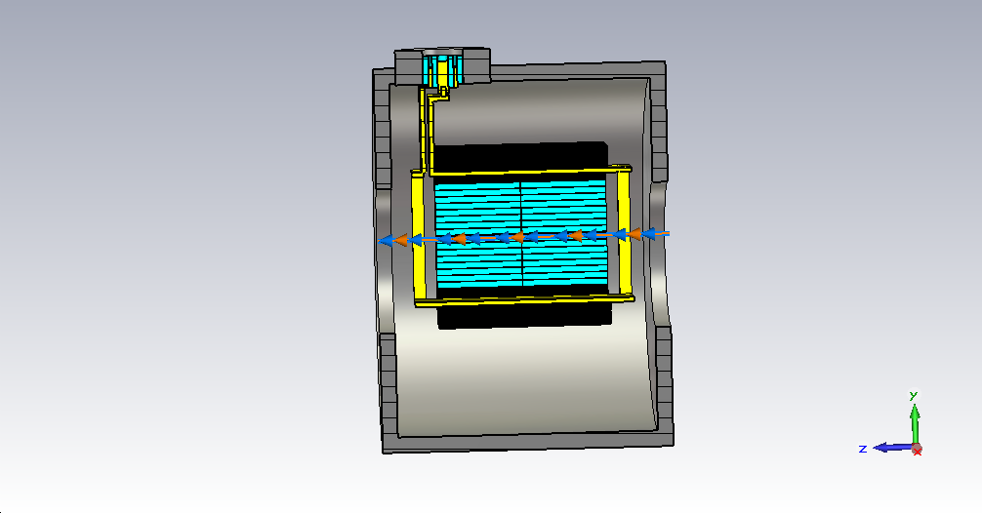
  Simulation on longitudinal impedance
CST Setting
    Meshcells: 2,667,168
    Boundary conditions
    x/y: electric
    Z: open
    Wakefield solver length: 40m

Slide 11
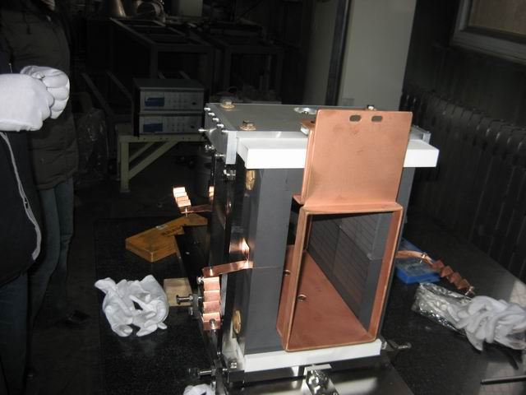
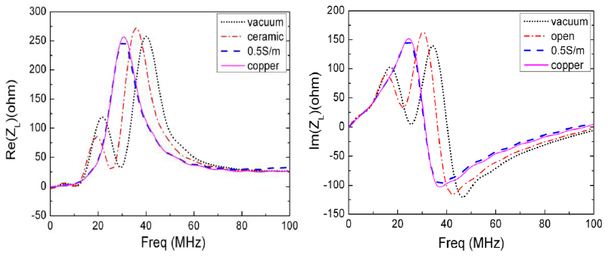
  Simulation for different Busbar gap
The first peak is decided by the Gap

Slide 12
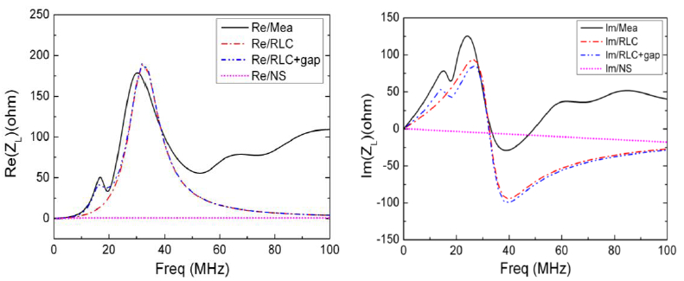
RLC model for ferrite longitudinal impedance
R,Q and ω_{R} is decided by the shape and materials
The gap impedance fitted by RLC model

Slide 13
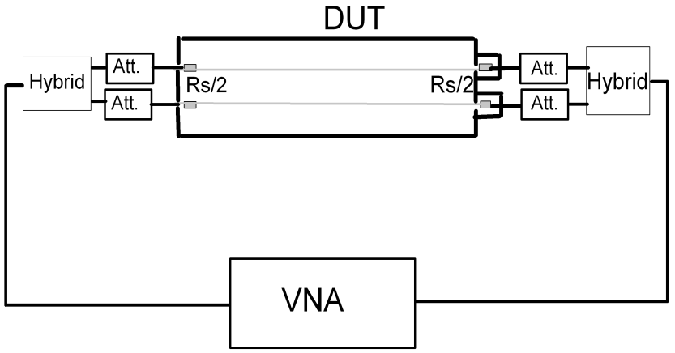
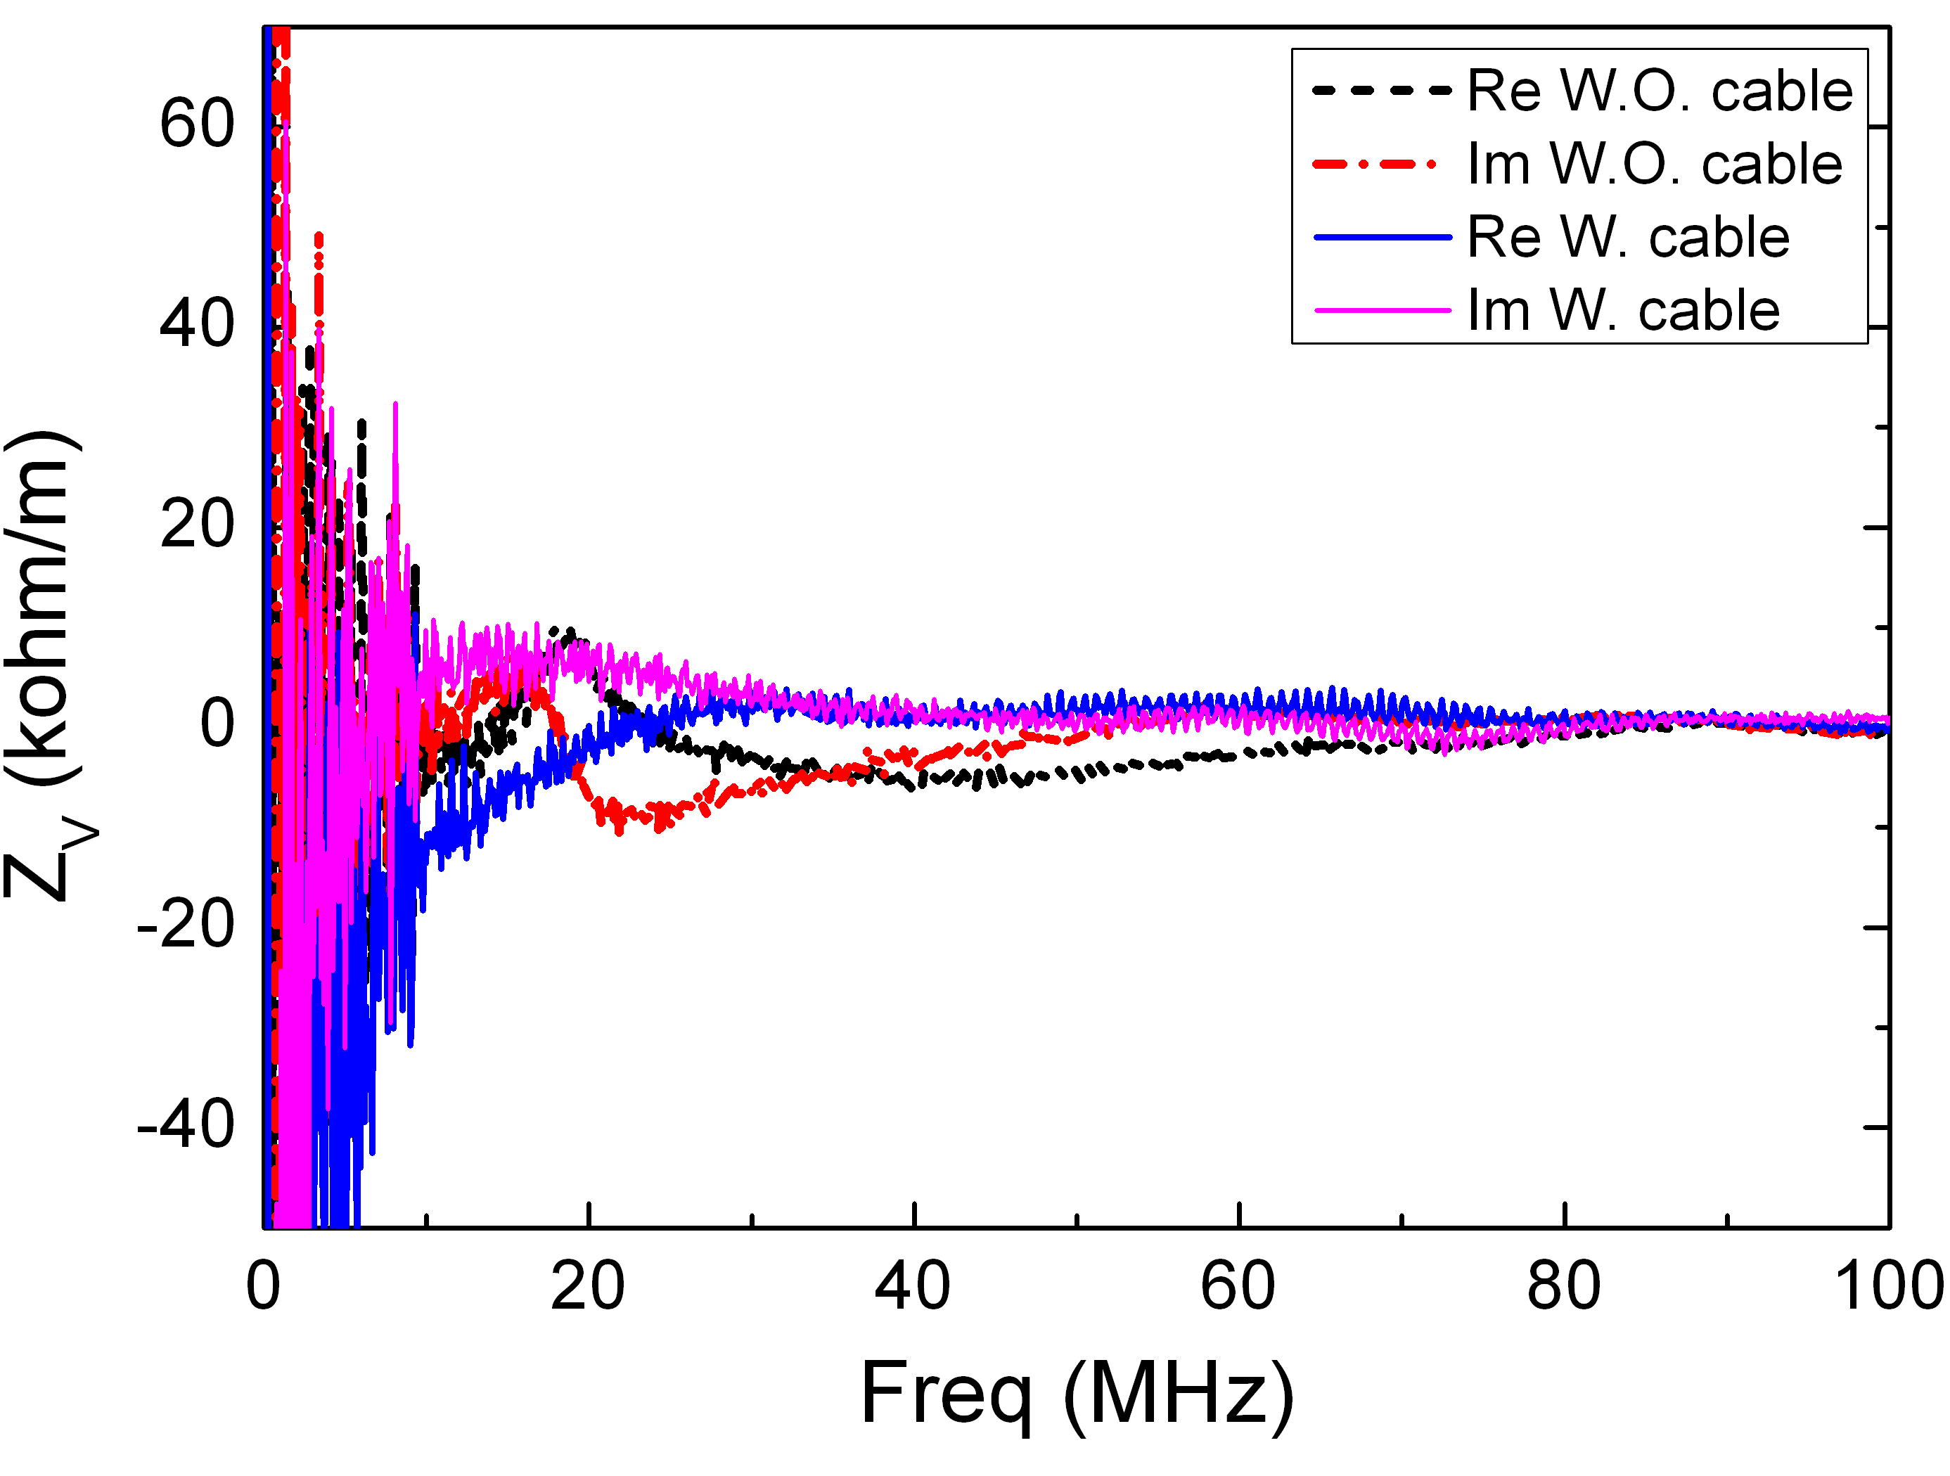
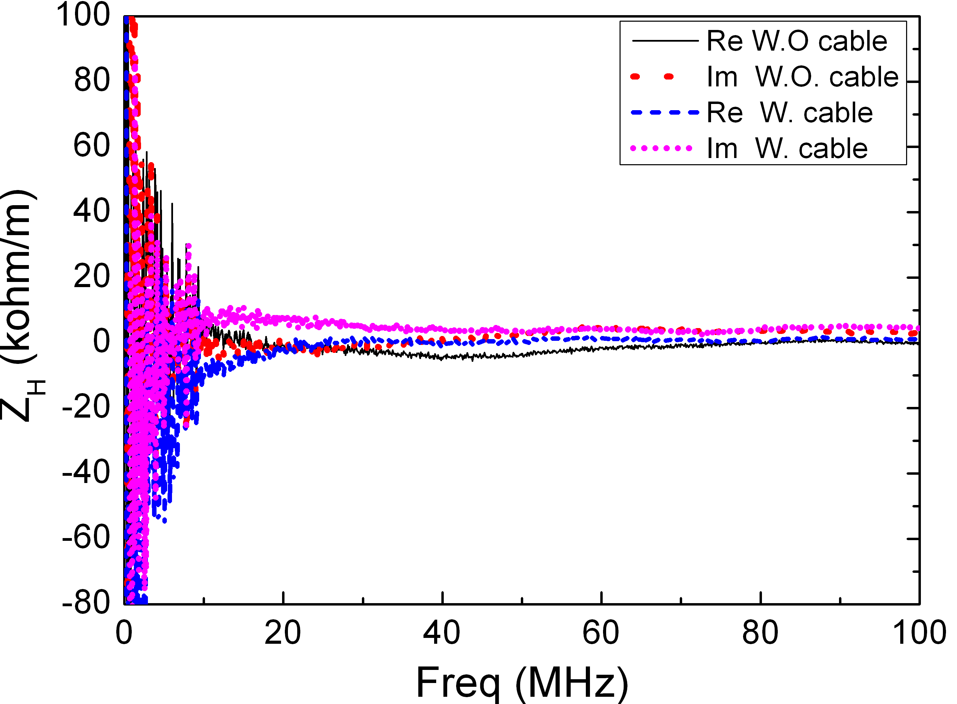
Transverse impedance measurements (Two Wires )
R_{s}=250 Ω
Horizontal
Vertical
Caused by the gap

Slide 14
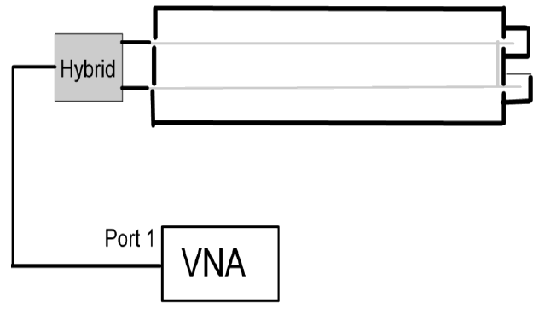

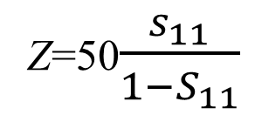
Impedance peak caused by Busbar gap is observed in transversely without connection with cable. The oscillation from the mismatch between cable and PFN appears with cable and PFN on
The measured impedance below 10 MHz, even 20MHz is inaccuracy because of the two-wires method.
A wire loop will substitute the dual-parallel wire to get more accuracy signal.
Z=50$\frac{s_{11}}{1−S_{11}}$
Notes:
图有变化

Slide 15
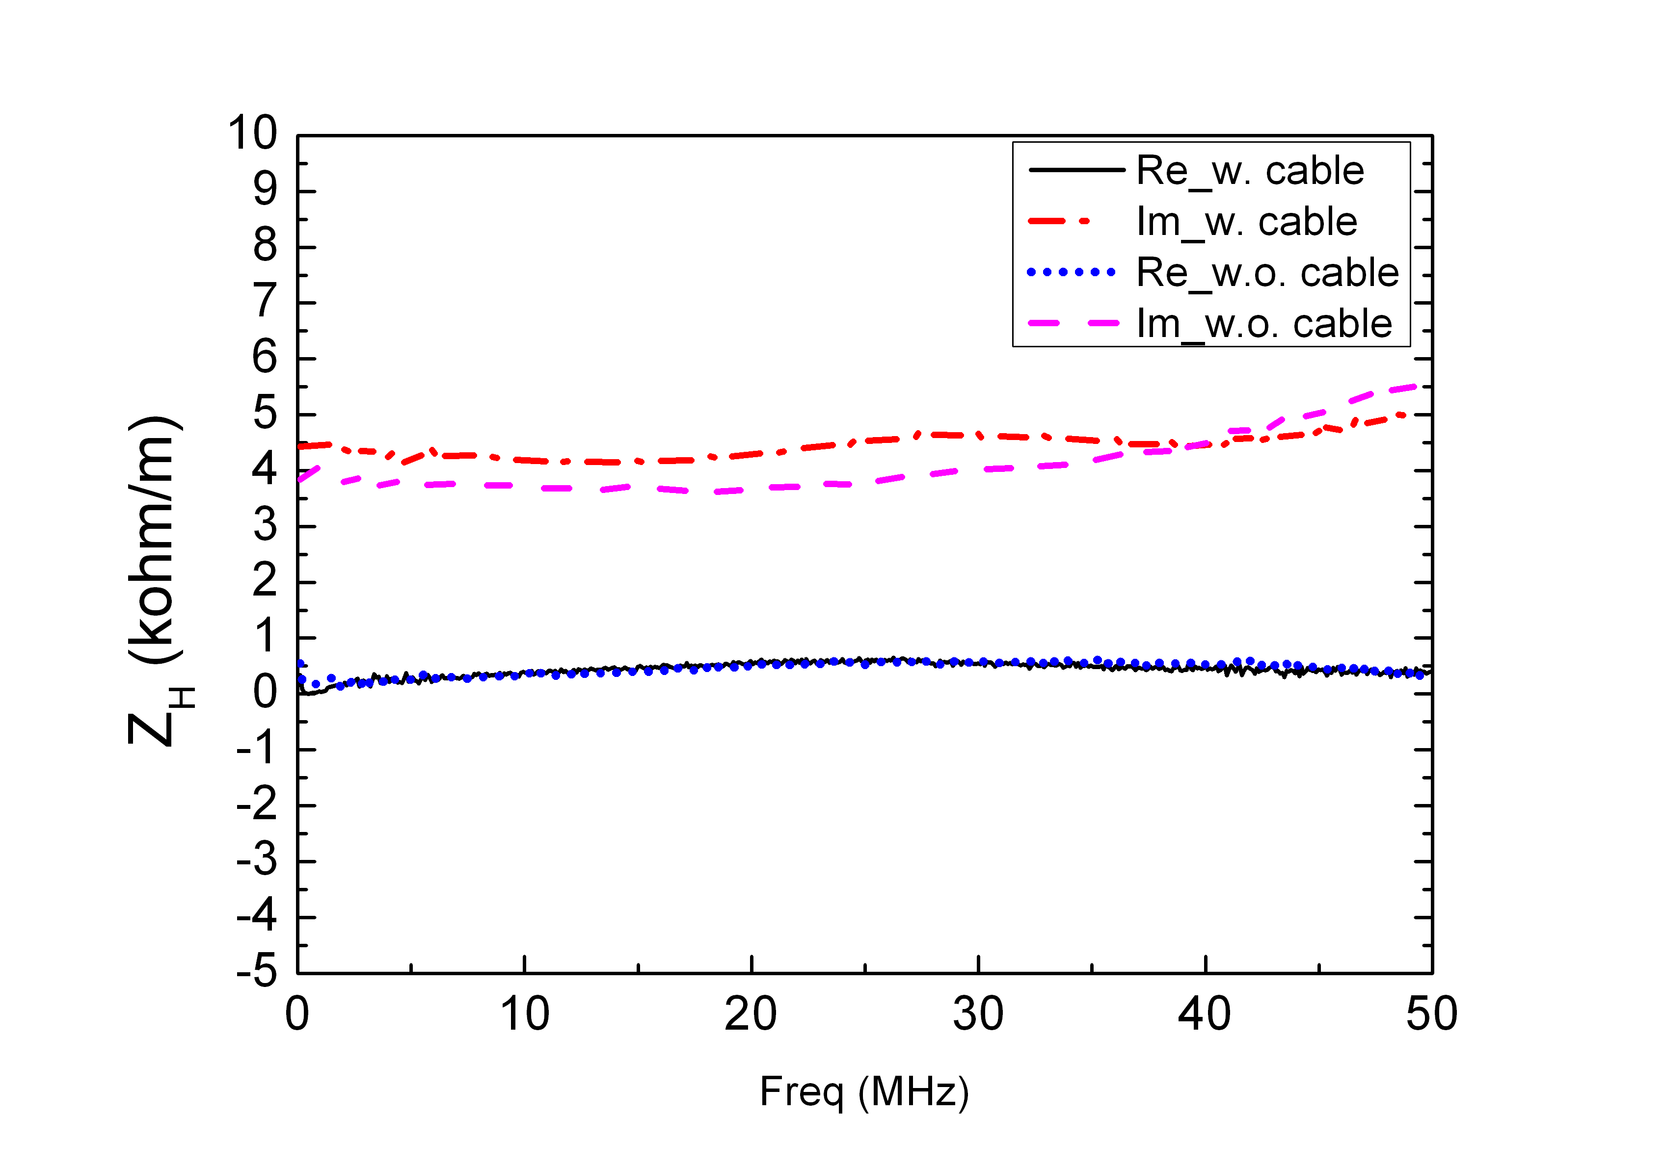
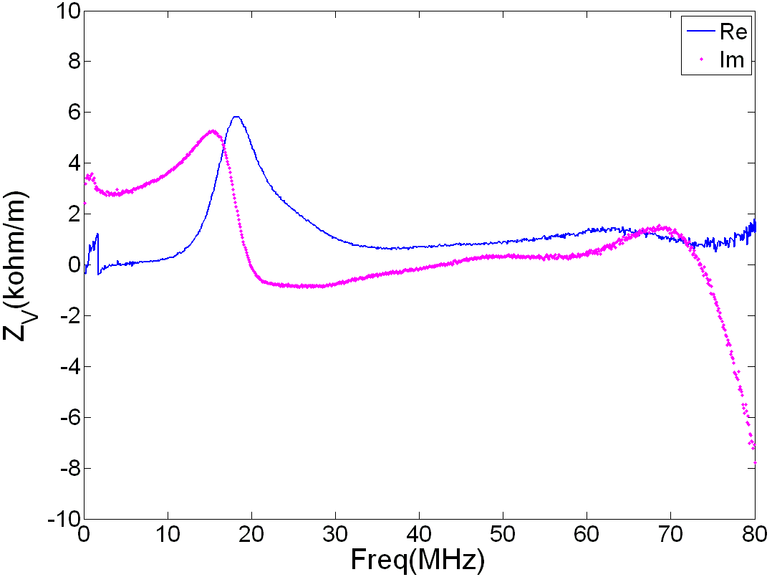
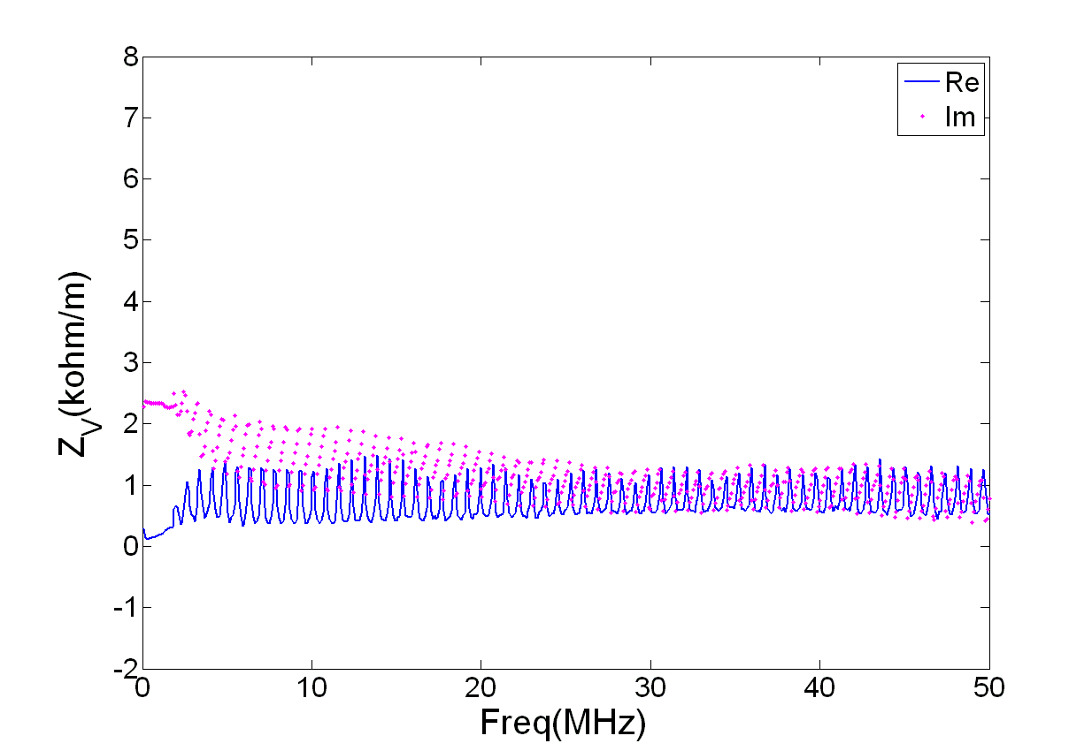
Transverse impedance measured by wire loop
Caused by the inductance of the wire loop.
Notes:
Loop法测量结果在>60MHz不好，是因为Loop电感引起的震荡

Slide 16
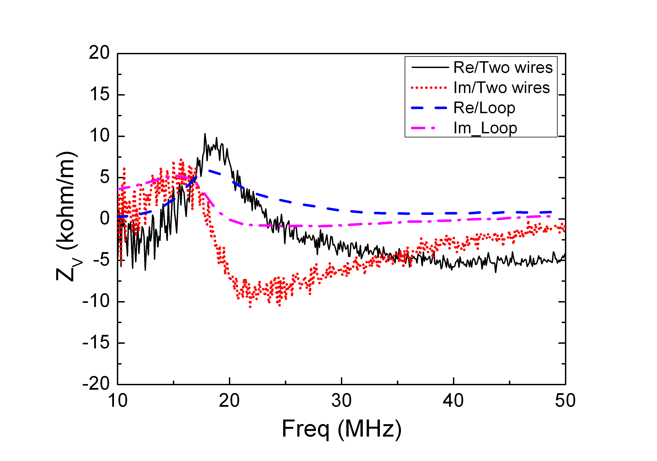
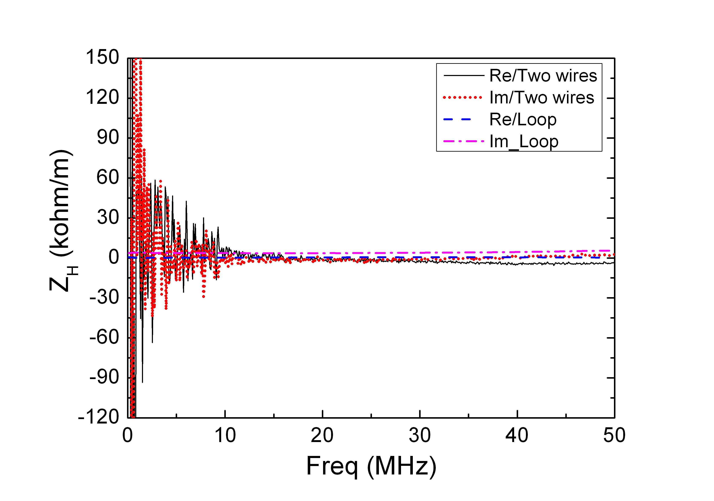
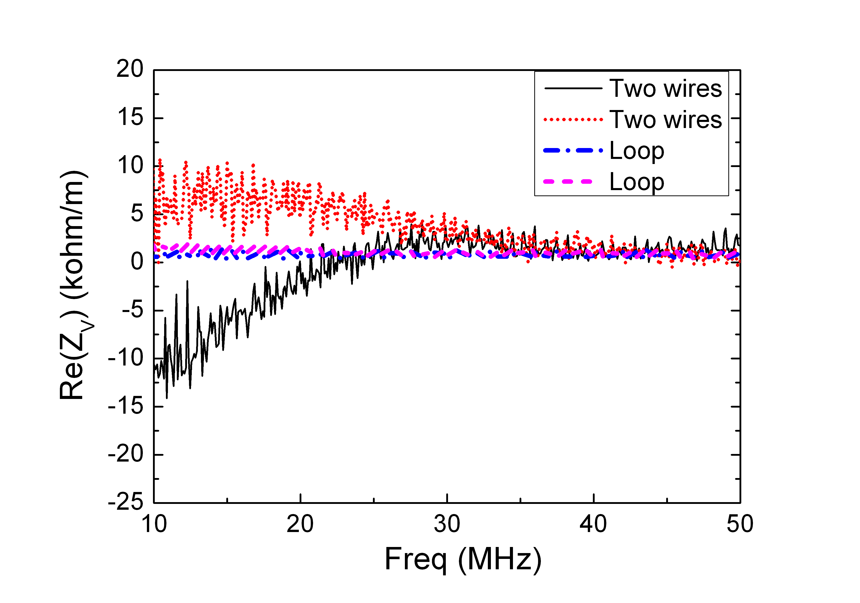
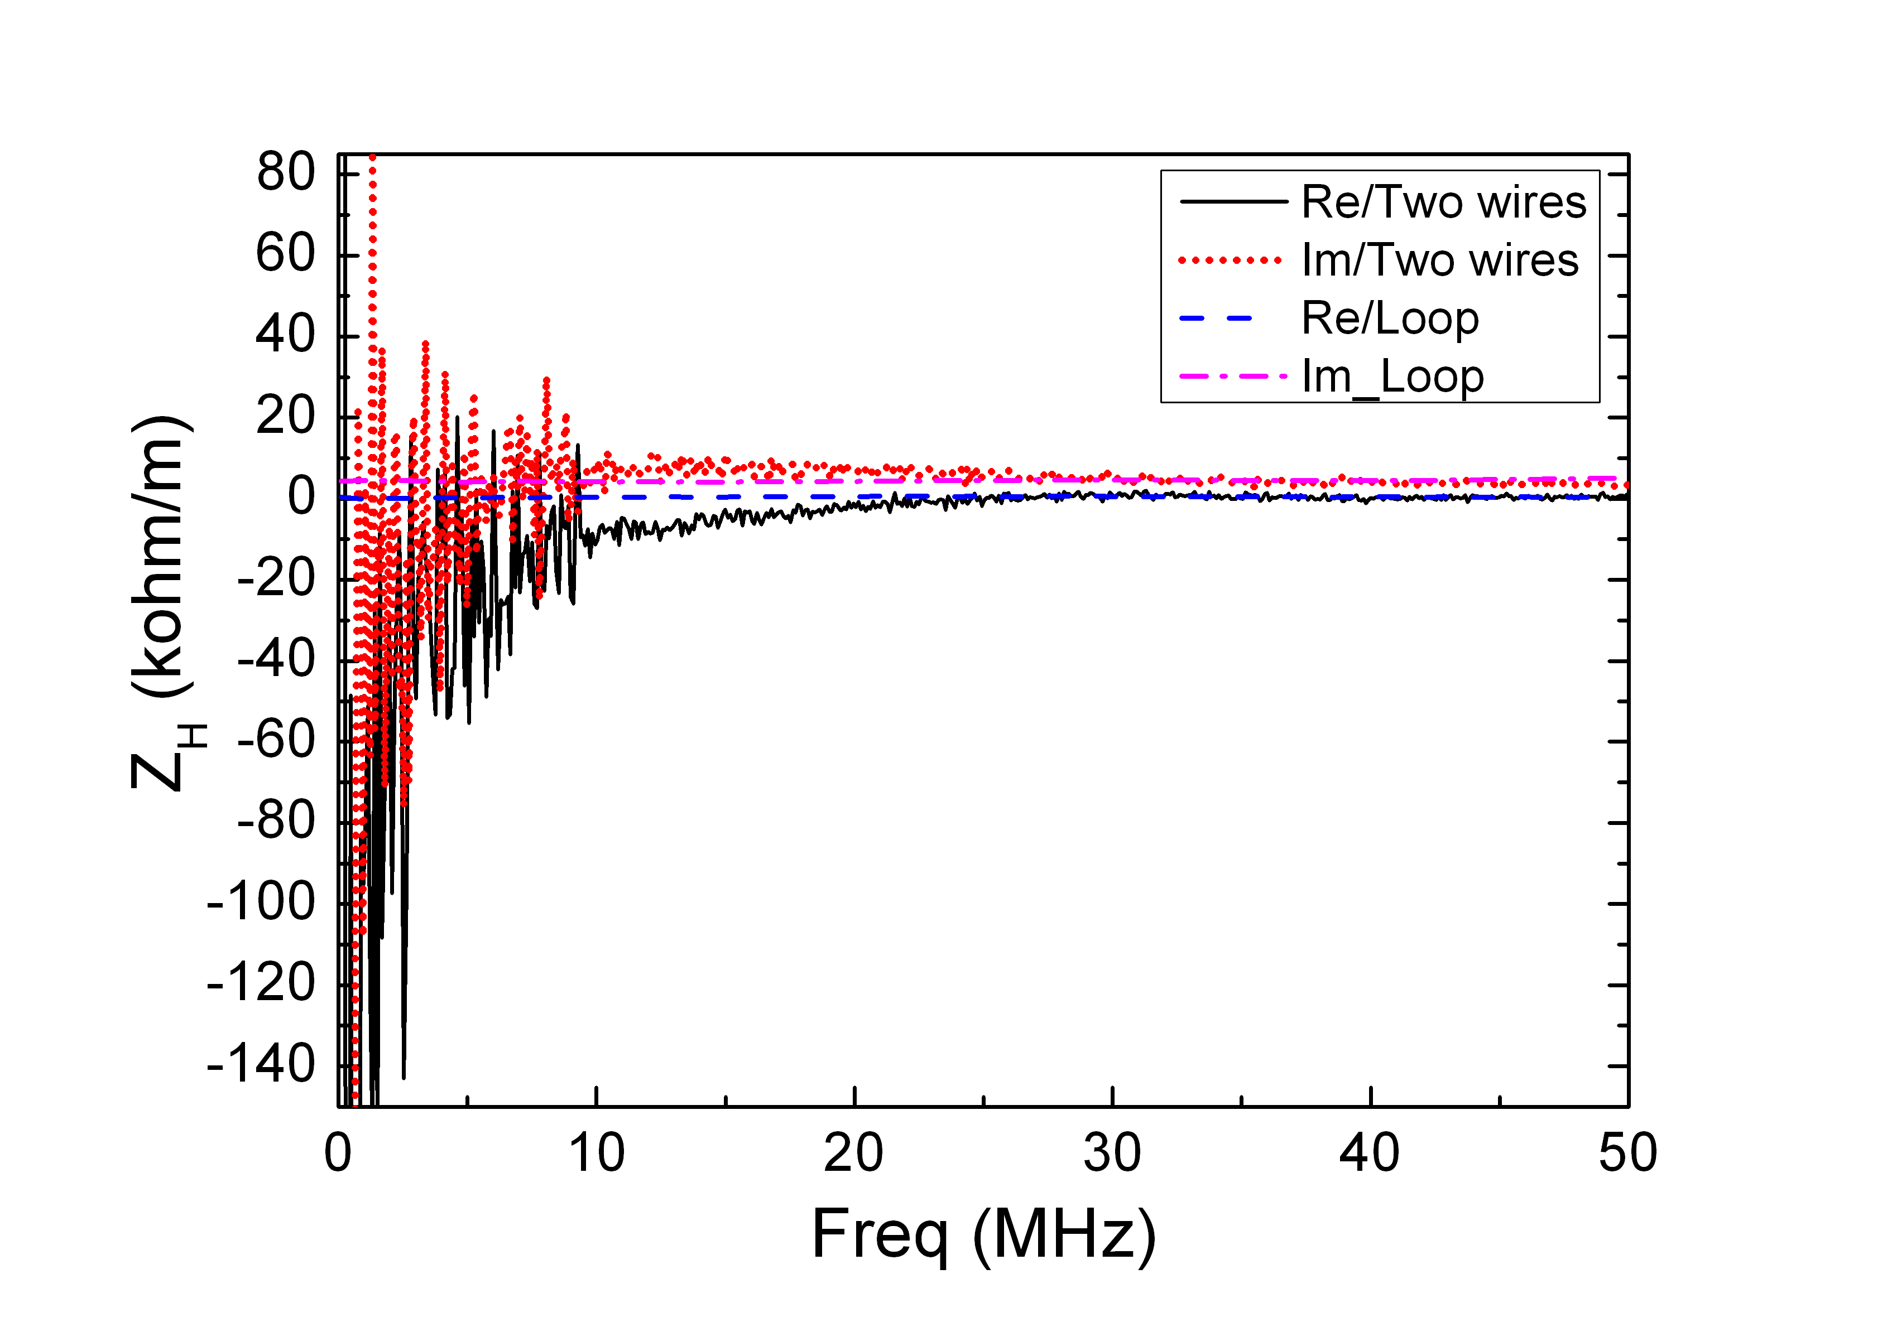
Comparison between two methods (two-wires and loop)
W. O. cable
W. O. cable
W. cable
W. cable

Slide 17
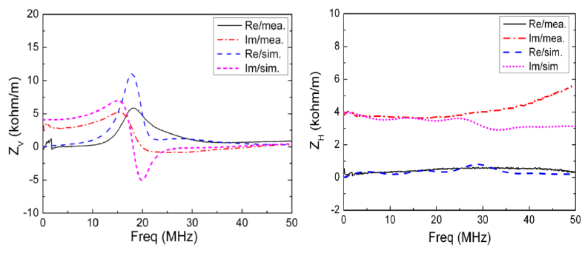
Simulated transverse impedance
Notes:
本页图有变化，模拟和测量在低频下符合也较好。峰值主意是gap的贡献，窗形铁氧体会影响峰值频率，所以对峰也有贡献。不过这句话似乎应该在下一页？

Slide 18
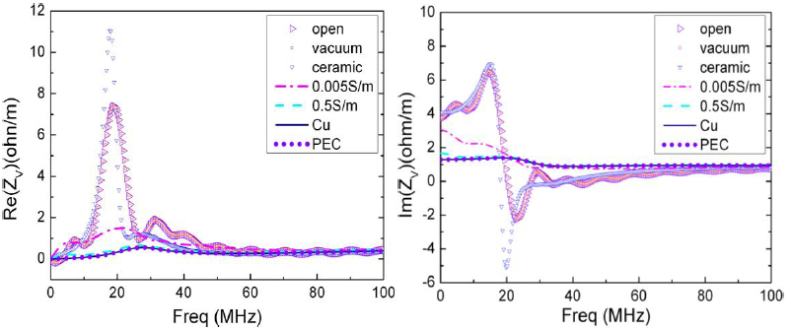
The vertical impedance in different gap condition

Slide 19
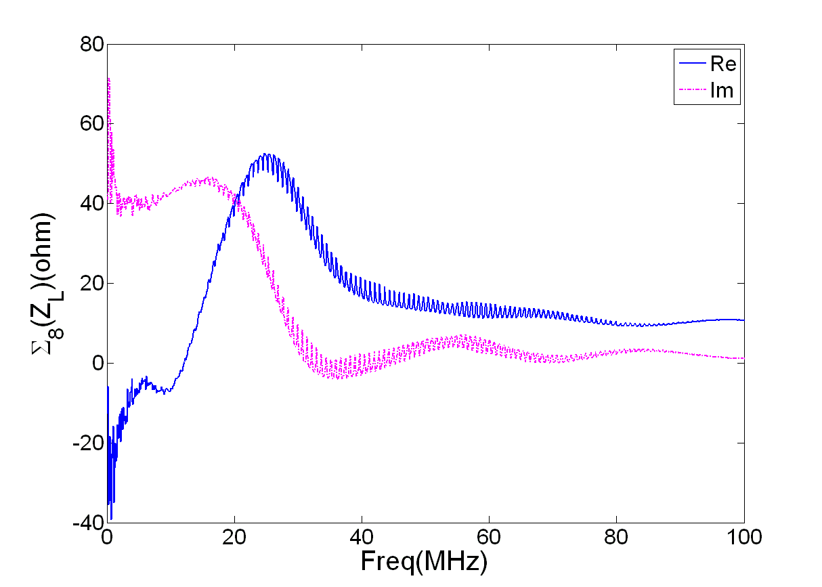
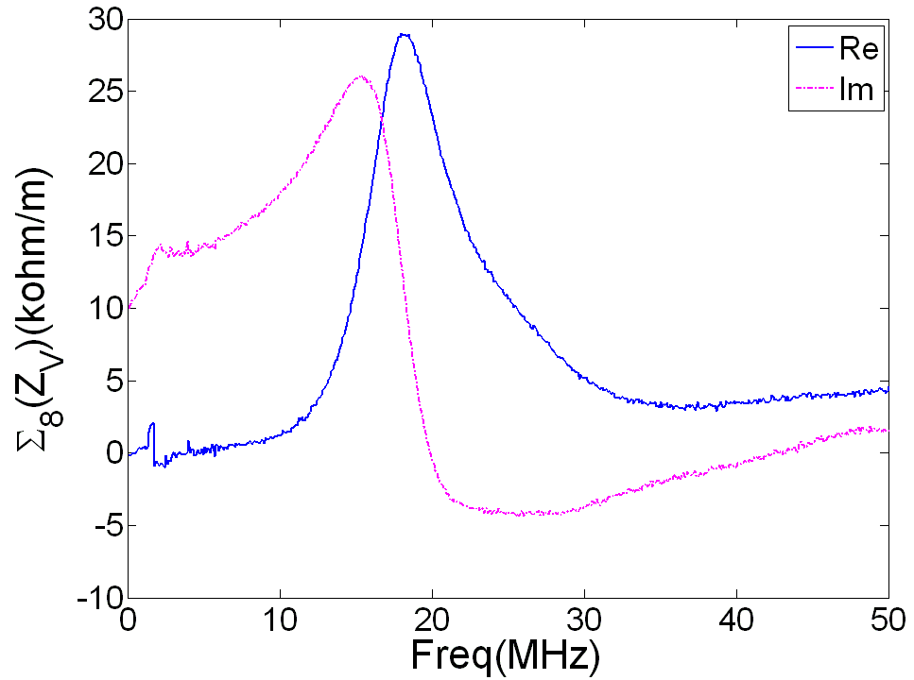
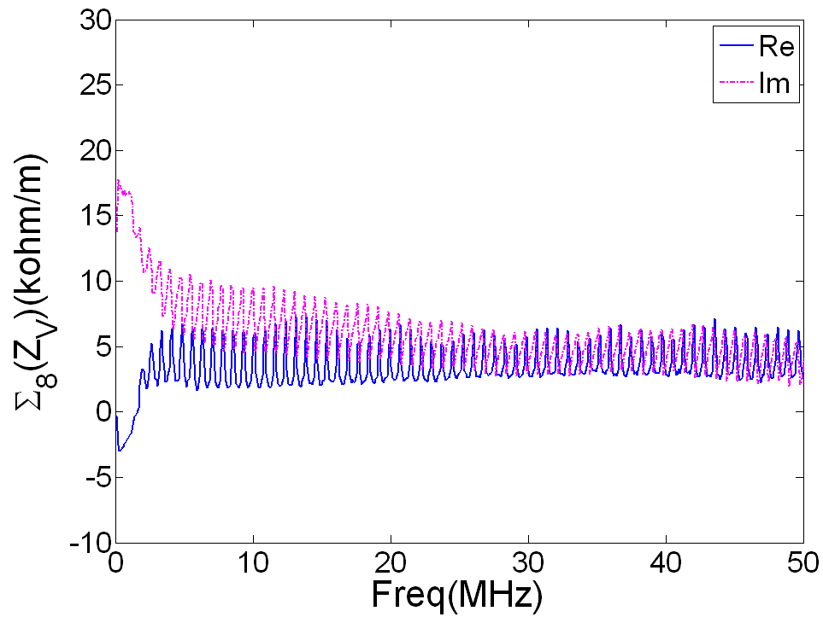
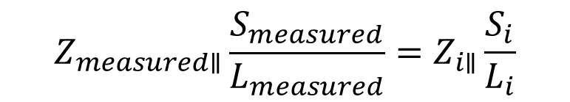
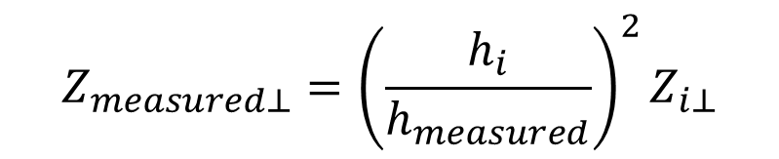
The total Impedance for Kicker System (8 kickers)
$$Z_{measured∥}\frac{S_{measured}}{L_{measured}}=Z_{i∥}\frac{S_{i}}{L_{i}}$$
$$Z_{measured⊥}={{\left(\frac{h_{i}}{h_{measured}}\right)}^{2}Z}_{i⊥}$$

Slide 20
Summary
  In impedance measurement system, a series of resistors is substitute for the matching transition which is proved to be reliable for vacuum component with big size.
  Longitudinal impedances for kicker with and without cable are measured by coaxial transmission line and two wires (common mode), and two methods results agree well.
  For transverse impedance, because of the low measurement accuracy for impedance below 20MHz with two wires, Loop method is used to measure transverse impedance.
  The mismatch between cable and PFN is a serious oscillation source in the kicker system which may become the restriction for beam stability.
  The average total impedance of kicker system (with 8 kickers) can be estimated about Z//~53+j47Ω; Z_{H}~5+j10kΩ; Z_{V}~3+j22kΩ.
Notes:
有待深入的工作：一是得到kicker总阻抗的scaling law，二是gap阻抗模型，三是震荡对束流的影响。

Slide 21
Thank you for your attention !

