Slide 1
Muon Detectors at LHC Exp.
Chunhua Jiang
IHEP Beijing
Aug.25,2014

Slide 2
Outline
Muon
Elements of muon spectrometers
  absorbers and magnets
  tracking detectors
  Trigger chambers
Examples of muon detectors: ATLAS and CMS

Slide 3
Muon
Discovered by Anderson and Nedermeir in
1936 in cosmic rays.
Since that time muon parameters are well Defined
  Charge +/- 1
  Mass 105.658389 MeV
  Lifetime 2.19703 µsec
  Decay (100%) eνν
  No strong interaction

Slide 4
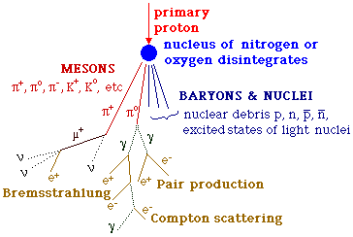
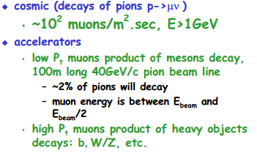
Muon
Major sources of muons

Slide 5

Why we detect muons?
Muons are easy to detect with high accuracy and low backgrounds: no strong interaction
Long lifetime
Lepton decay channels for many of heavy objects are clean and have low backgrounds:
Many of new particles searches contain muon(s) as final detectable particles

Slide 6
Muon Identification
Detection of muons consists of two major steps:
  identification
  muon parameters measurement
The direct way for identification is to compare parameters of particle in question with known values:
  mass
  charge
  Lifetime
  decay modes
Typical method for a few GeV muons is to measure momentum and velocity of a particle

Slide 7
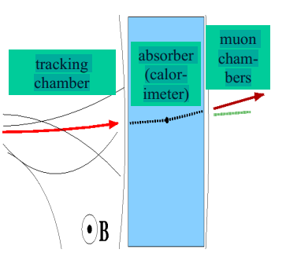
Muon Identification
Velocity is measured by:
  Time of flight
  Cherenkov, TRD
For high energy (above a few GeV)muons identification is based on low rate of interaction of muons with matter:
  If charged particle penetrates large amount of absorber with
  minor energy losses and small angular displacement such particle
  is considered a muon

Slide 8
Muon Lifetime
Muon lifetime is 2.2 µsec, tc=0.7km
Decay path:
  p, GeV/c Decay path, km
  1 7 <- cosmics
  10 70 <- b-quarks
  100 700 <- muon collider
For most high energy physics applications muon can be considered “ stable” particle

Slide 9
Instrumentation of Muon Detectors
Major parts of muon detector:
  absorber/magnet
  tracking detectors
  (electronics, DAQ, trigger, software)
  Absorbers:
  most common is steel: high density (smaller size),
  not expensive, could be magnetized
  -- concrete, etc.
  Magnets:
  dipole magnets in fixed target or solenoid
  magnets in colliders:
    “ a few hundreds ” m³ in volume
    field ~2T(ATLAS), 4T(CMS)
    cryo and/or high energy consumption

Slide 10
Muon Tracking Detectors
There are two major requirements for muon tracking detectors:
  coordinate accuracy
  Large(~1000m2) area
· Other considerations include:
  resolution time
  sensitivity to backgrounds
  segmentation (triggering)
  aging
  cost
Two most common types of detectors:
  scintillation counters
  gas wire detectors ---LHC

Slide 11
Main Muon Detectors
1.scintillator-too expensive
–good segmentation & multiple layers (to get a track) needed
– a layer or two with coarse segmentation is often added to get precise timing(~hundreds $/Kg)
2.Gas Dectors ，drift chambers –perfect(LHC exp)
–relatively inexpensive
–uncomplicated , easy to build
–good positon precision
typical for muon chmbers: hundred µm

Slide 12
Scintillation Counters
Used before/after absorber for muon identification/triggering, rarely for momentum measurement
Typical size 0.1m x 1m x 1cm
Muon deposits ~2MeV of energy in a counter, which converts into 20-200 photo electrons for a typical phototube
Major parameters of scintillation counters
  very fast ~1ns
  easy to make of any size
  inexpensive in operation(no gas )
  due to high muon energy deposition (big sinal) less sensitive to backgrounds
expensive per m2
  coordinate resolution is Sigmax>1cm??
  Not used at LHC exps

Slide 13
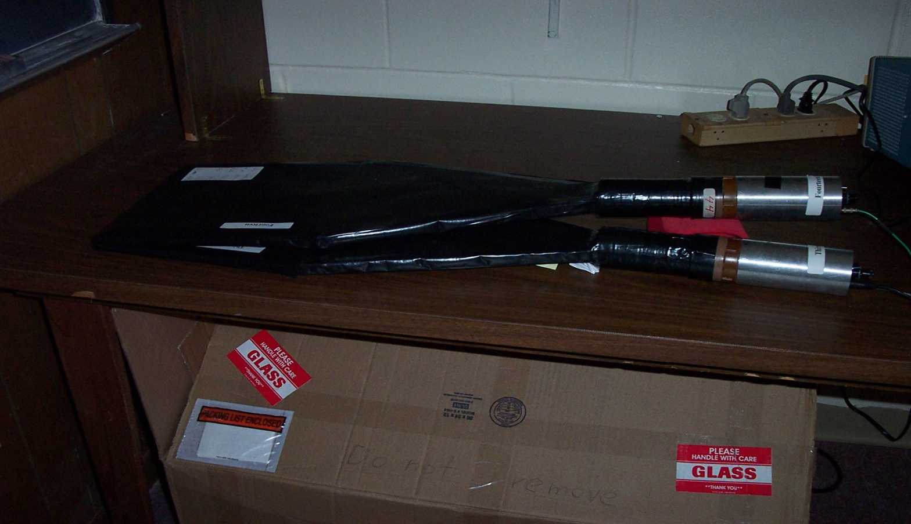
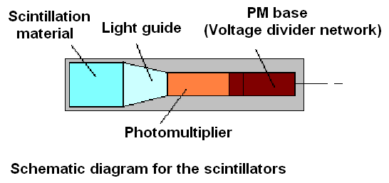

Slide 14
Gas Wire Chambers
Used at LHC Exp.
1.Single wire Chamber
Monitor Drift Tube(MDT)
Drift Tube chamber(DT)
2.Multiwire Chamber
Cathode Strip Chamber(CSC),
Thin Gap Chambers(TGC)

Slide 15
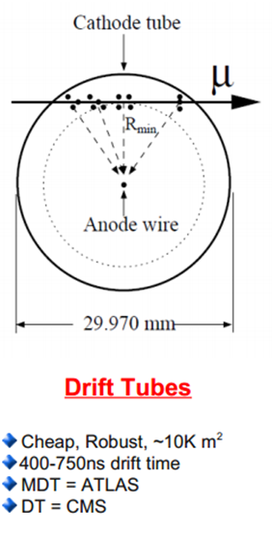
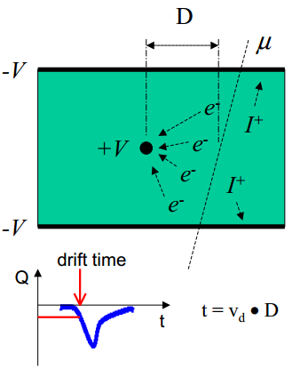
Drift Tube(DT),MDT----Single Wire Ch.
single wire drift chamber
– charged particle ionizes gas
– primary ionization electrons
drift toward anode (sense) wire
low E field
– as they approach the wire they
speed up and create an
avalanche of charge (high E
field)
– charge produces a pulse as it
hits the wire
– drift time gives the distance from wires

Slide 16
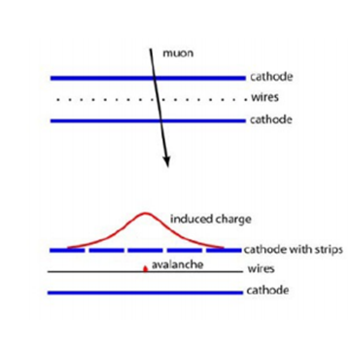
Drift chambers(multiwire)
Cathord Strip Chamber (CSC), TGC
Muon creates 1 electron-ion pair/30eV of
Deposited energy,100 pairs/cm of gas
Electrons in electric field drift to the
small diameter anode wire
Gas amplification(~10⁶⁾ occurs near
Anode wire providing detectable signal
(~1µA)(X,Y coordination)

Slide 17
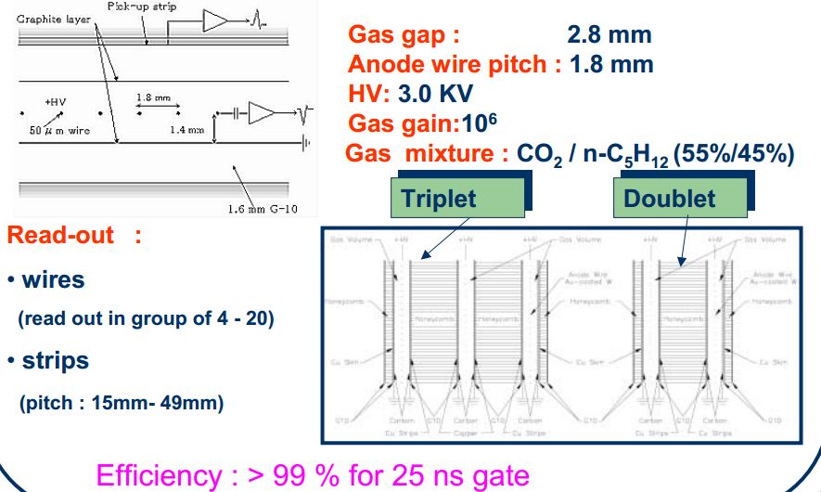
Thin Gap Chamber(TGC)

Slide 18
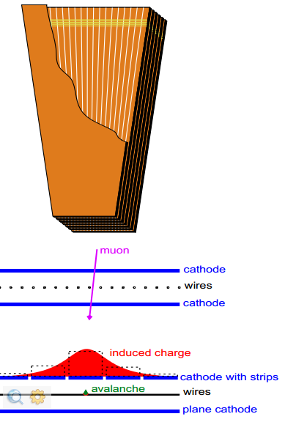
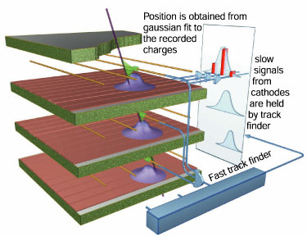
Cathode Strip Chamber(CSC)
Up to 3.4 m long, 1.5 m wide
6 planes per chamber
9.5 mm gas gap (per plane)
50 µm wires spaced by 3.2 mm
60 ns maximum drift-time per plane
5 to 16 wires ganged in groups
Wiresmeasurer
6.7 to 16.0 mm strip width
Strips run radially to measureφ
150µm resolution for chambers
(75µminstation1 small chambers)
Gas: Ar(40%)+CO2(50%)+CF4(10%)
HV ~3.6 kV
B-field up to 3 T in station1

Slide 19
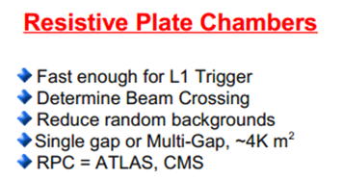
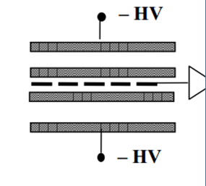
Trigger Gas detector
Resistance Plate Chambers (RPC,MRPC)
2gaps with common pick-up
Gap width:2mm
Bakelite thickness:2mm
Bakelite bulk resistivity: 1-2X10¹⁰ Ωcm
Gas mixture:C2H2F4(95%),i-C2H10(5%)
High Voltage:8.5-9.0kV
Mode of operation:avalanche
3ns time resolution
X,Y strips read out
Position resolution depends on strip size
Use Glas plate, multi gap— MRPC, Time Resolution ~50ps
Thick of glas plate:0.5mm,gap:0.2-0.3mm

Slide 20
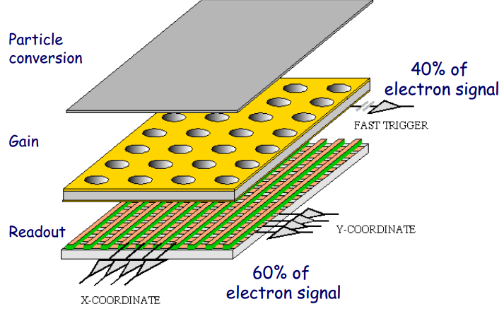
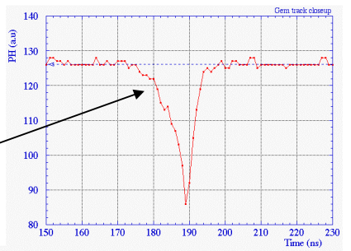
GEM(Gas Electron Multiplier)
Fast signal 20ns(full width)

Slide 21

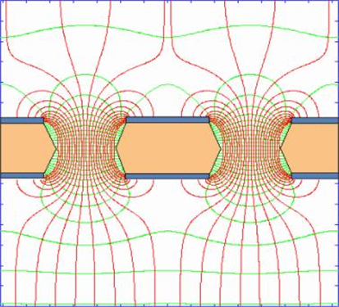


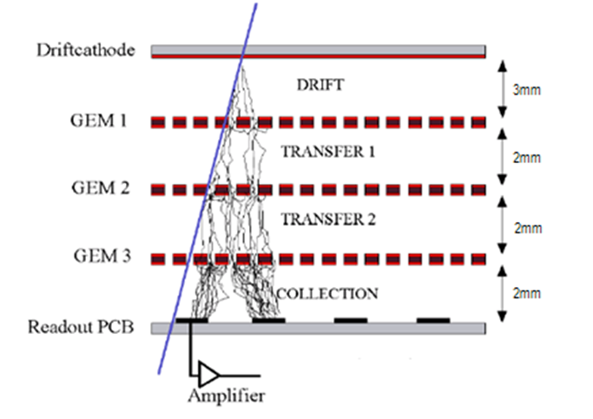
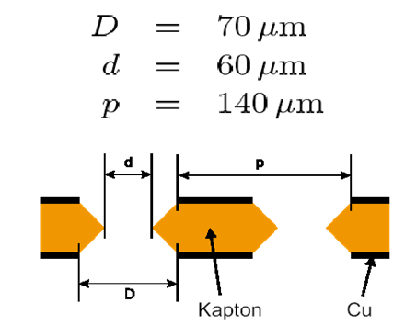
Gas Electron Multiplier
GEM detector is a Micro Pattern Gaseous Detector (MPGD)
V=const.
GEM foil under electron microscope
~400 V
μ⁻
e⁻
Typical geometry:
5 µm Cu on 50 µ m Kapton
70 µm holes at 140 mm pitc
.
Gas Gain ~ O(10⁴)

Slide 22
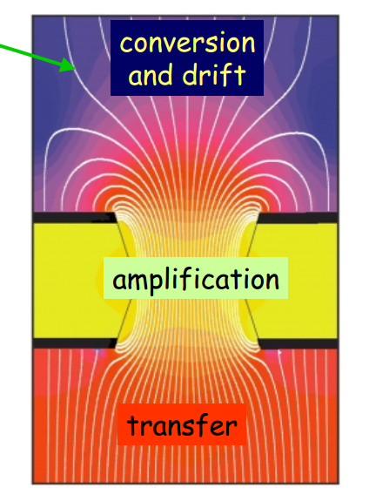
GEM Detector
Priciple:
By applying a potential
difference between the
two copper sides an
electric field as high as
100 kV/cm is produced
in the holes acting as
multiplication channels.
Filed lines
transfer
amplification
conversion
and drift
Potential difference ranging
between 400 – 500V
Upgrade of CMS Endcap Muon
Chance for you to join

Slide 23
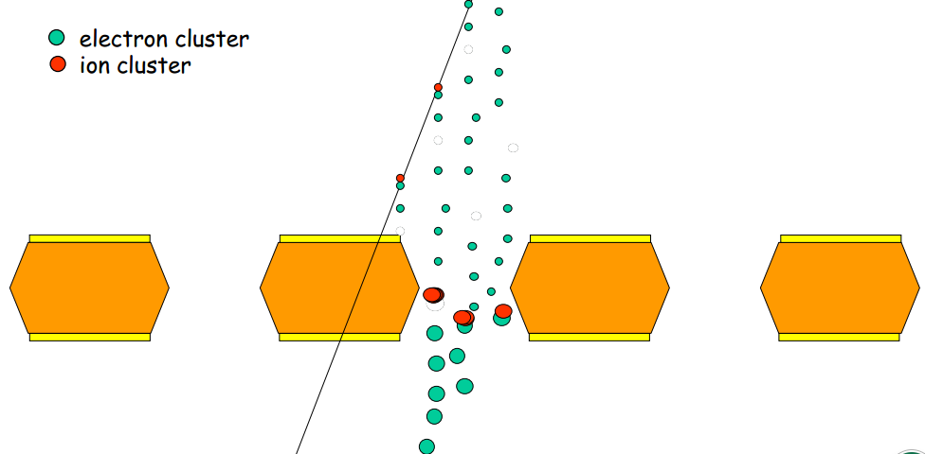
GEM
6ns
A thin polymer foil, metal-coated on both sides, is chemically pierced by a high density of holes.
On application of a voltage
gradient, electrons released on the top side drift into the hole, multiply in avalanche and transfer the other side.
Proportional gains above
10³are obtained in most common gases.

Slide 24
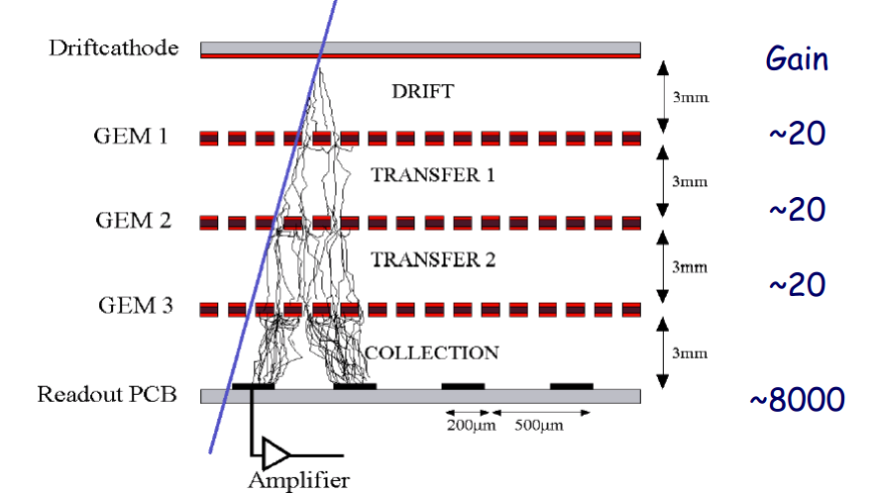
Tripple GEM

Slide 25
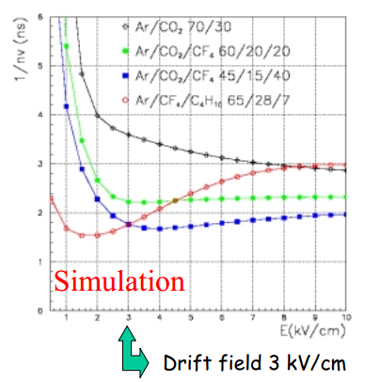
GEM
Gas Mixtures
1 Ar/CO2 70/30;
2. Ar/CO2/CF4 60/20/20;
3. Ar/CO2/CF4 45/15/40;
4. Ar/CF4/C4H10 65/28/7;
Drift field 3 kV/cm
Given
n: the number of clusters
per unit length;
v: the electron drift velocity
in the drift gap;
The 1/nv term is the main
contribution to the intrinsic
time resolutionof this kind of

Slide 26
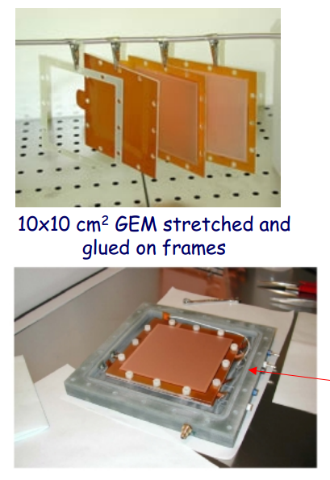
GEM Advantages
Rate Capability ~ up to 0.5 MHz/cm2
Station Efficiency ~ 99% in a 25 ns time window(*)
Cluster Size ~ 1.2 for a 10x25 mm² pad size
Radiation Hardness ~ 6 C/cm2 in 10 years(for G ~ 10 ⁴)
The triple-GEM prototype
assembled inside a gas tight box

Slide 27
Alignment of Tracking Detectors
In order to measure muon tracks with high precision, exact location of wires (cells) is required:
  temperature variations
  movement (“ sink” ) of heavy objects
  complications due to detectors sizes and lack of space (hermeticity)
Major ways of alignment:
  passive - detectors location is determined before the run by (optical) survey and these data are used for data analysis: ~0.5-1mm
  active - continuing monitoring of chambers locations by system of sensors (lasers beams, etc.): <0.1mm
  self calibration - muon tracks are used to determine final location of detector elements

Slide 28
LHC Exp. Muon Detectors
ATLAS(Largest Detector))
CMS(Heaviest Detector)

Slide 29
ATLAS Muon Detectors
The ATLAS muon spectrometer
1. Monitored Drift Tubes Chambers (MDT)
2. Cathode Strip Chambers (CSC)
3. Resistive Plate Chambers (RPC)
4. Thin Gap Chambers (TGC)

Slide 30
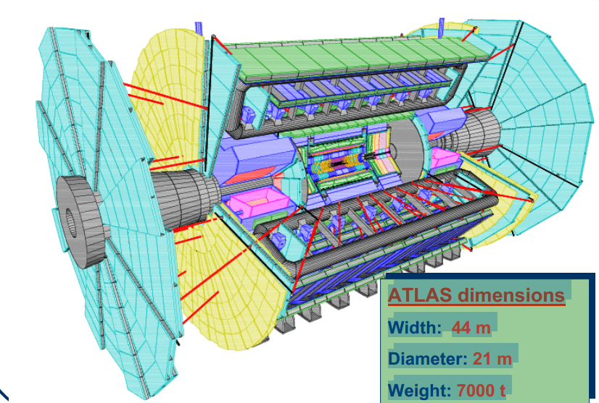
Elements of muon spectrometers

Slide 31
ATLAS Muon Spectrometer
ATLAS high resolution stand-alone µ spectrometer features:
Three large super-conducting air-core toroids equipped with gas
detectors to perform independently:
µ high-precision tracking
MDT at |η| < 2 (Barrel)
CSC at 2 < |η| < 2.7
µ Pt trigger selection
bunch-crossing identification ( requires very good time resolution)
µ second coordinate measurements
RPC at |η| < 1.05
TGC at 1.05 < |η| < 2.4

Slide 32
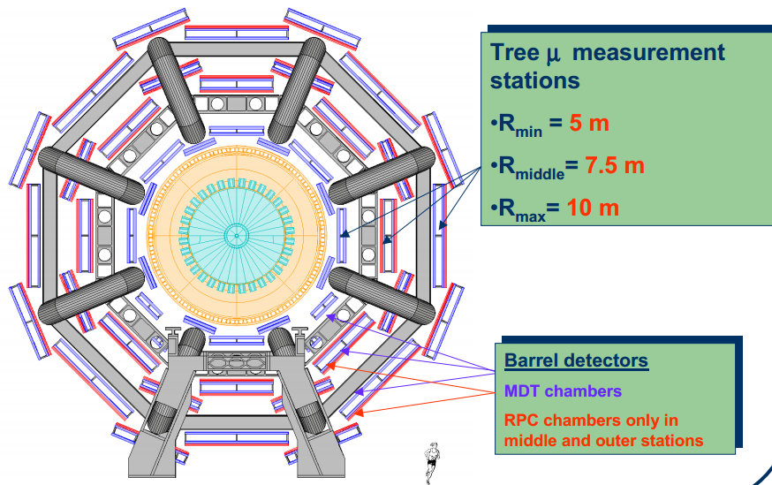
ATLAS Barrel Muon detectors

Slide 33
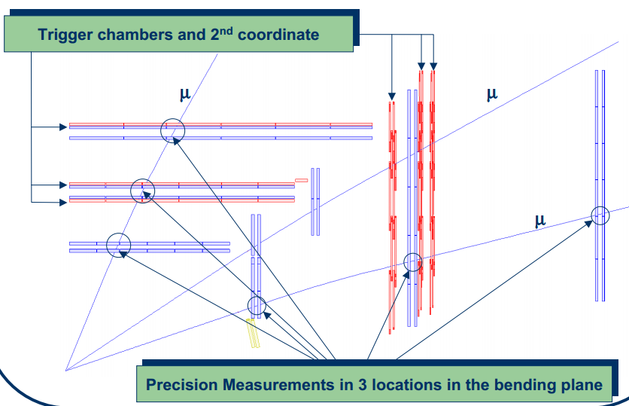
Muon Measurement scheme

Slide 34
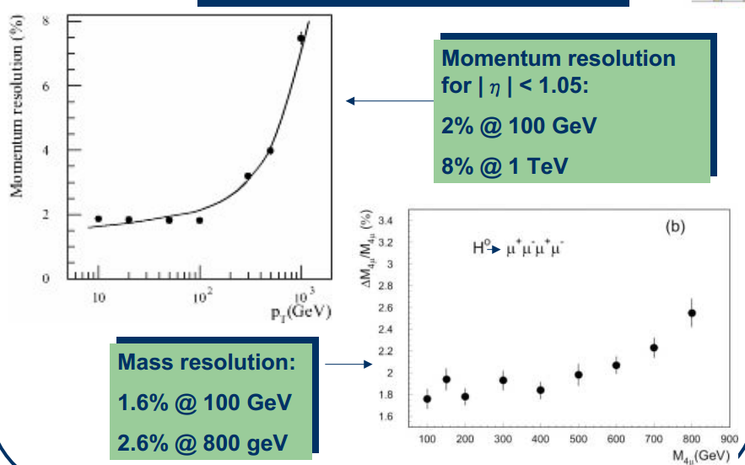
ATLAS

Slide 35
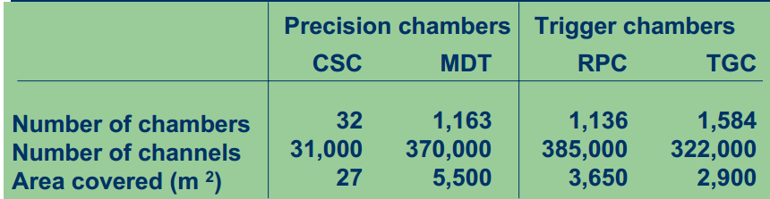
ATLAS Muon detectors

Slide 36
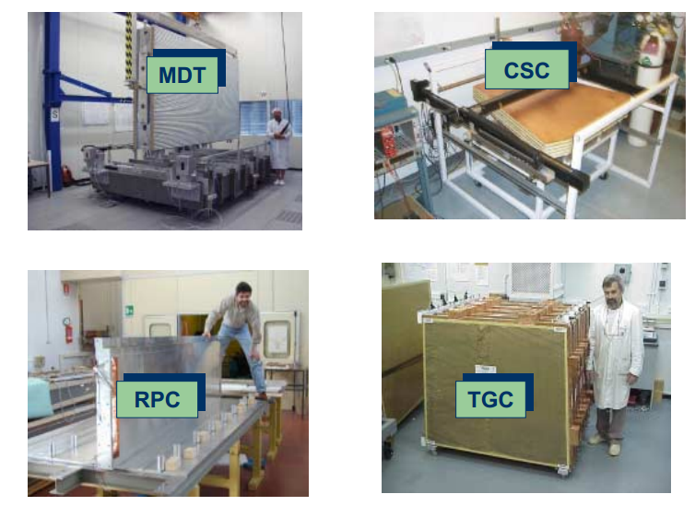
ATLAS Muon construction

Slide 37
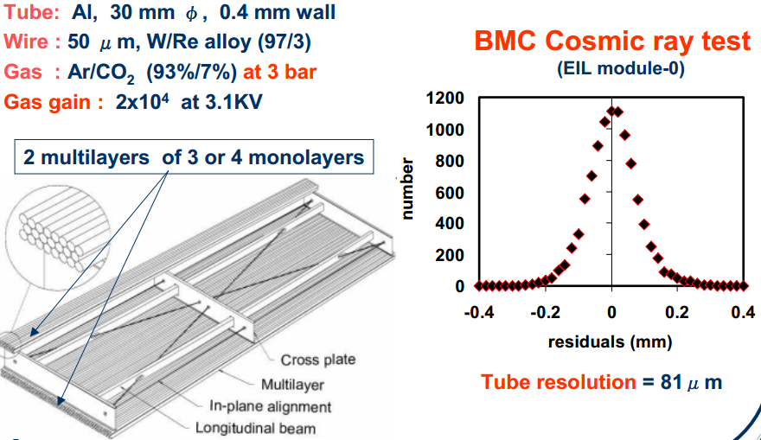
ATLAS MDT(IHEP)

Slide 38
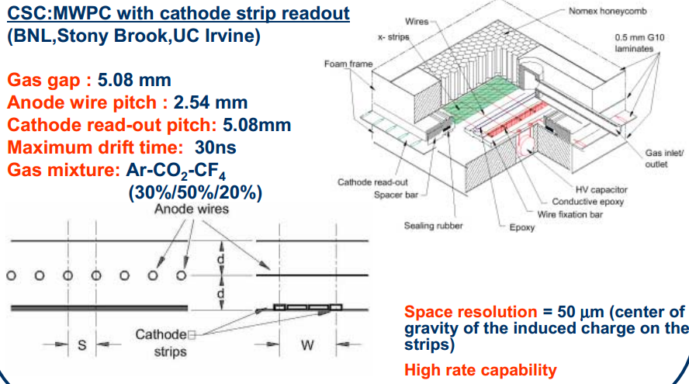
ATLAS CSC

Slide 39
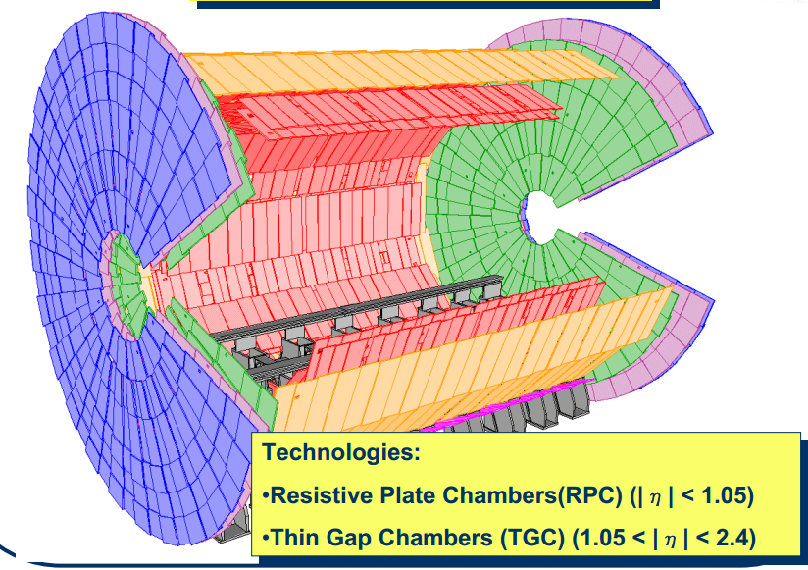
ATLAS Muon Trigger Detectors

Slide 40
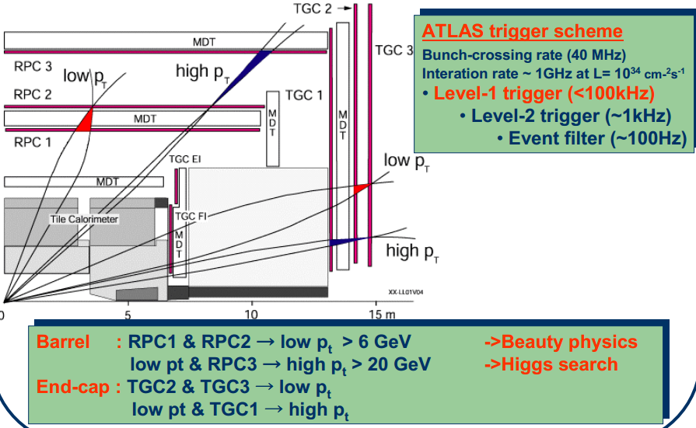
RPC(Barrel) & TGC(Endcap) shandongUV

Slide 41
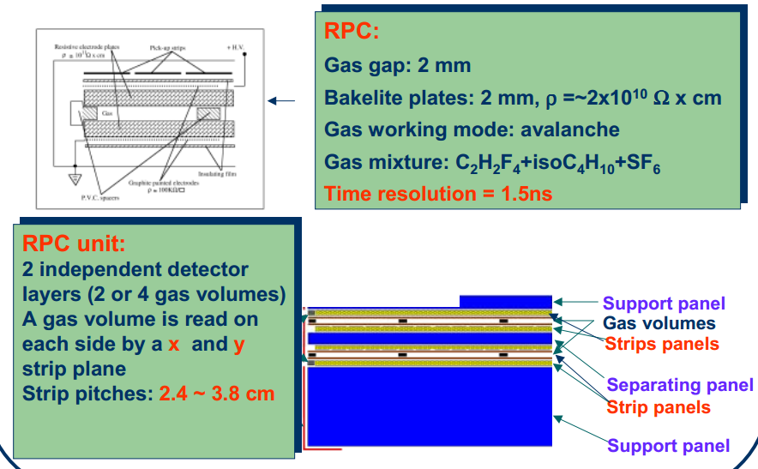
ATLAS RPC

Slide 42
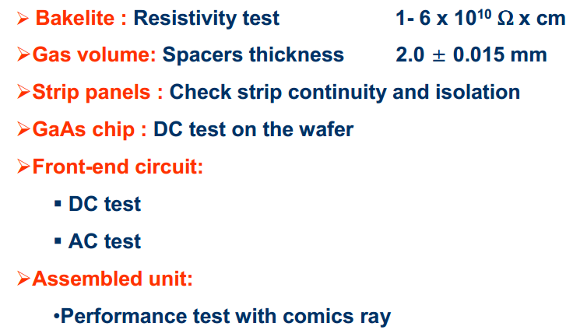
ATLAS RPC

Slide 43
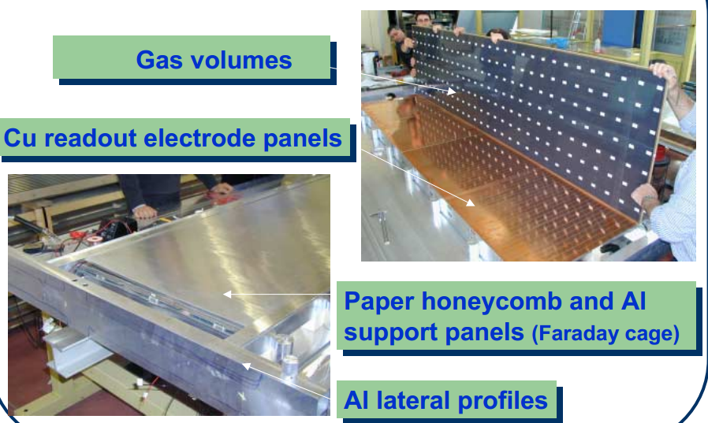
ATLAS RPC

Slide 44
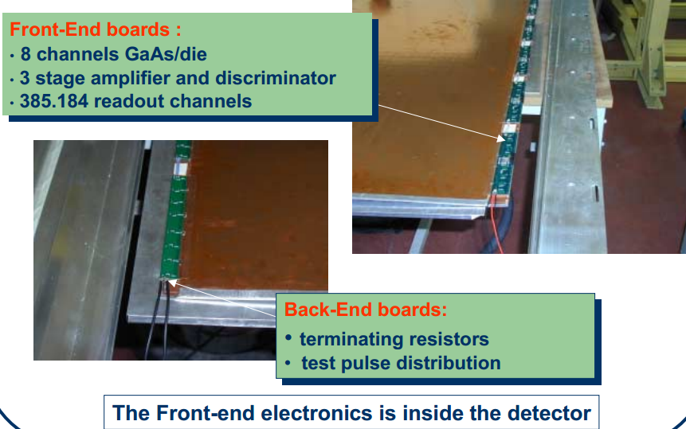
ATLAS RPC

Slide 45
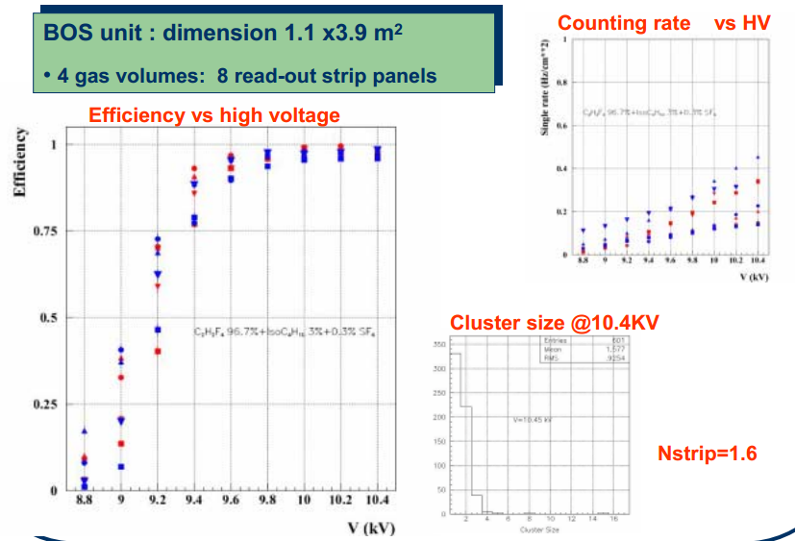
ATLAS RPC CosmicRay test

Slide 46
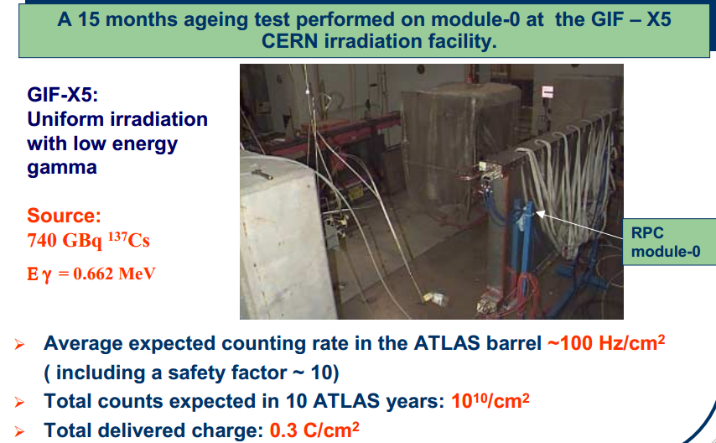
ATLAS RPC Aging test

Slide 47
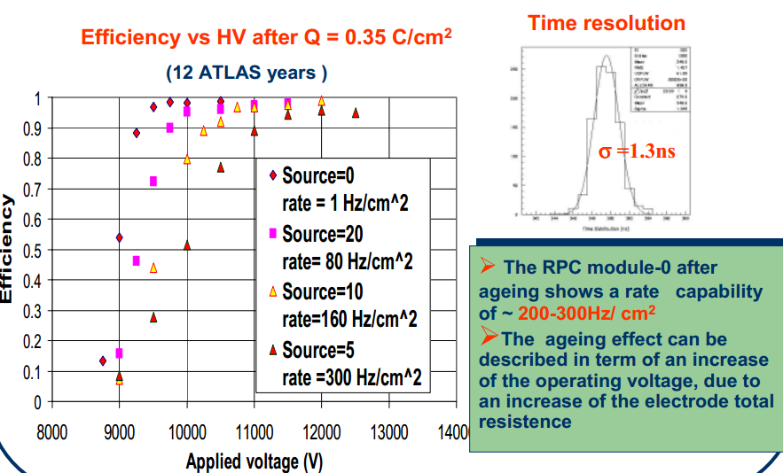
Aging Test(CNT)

Slide 48
ATLAS TGC chambers

Slide 49
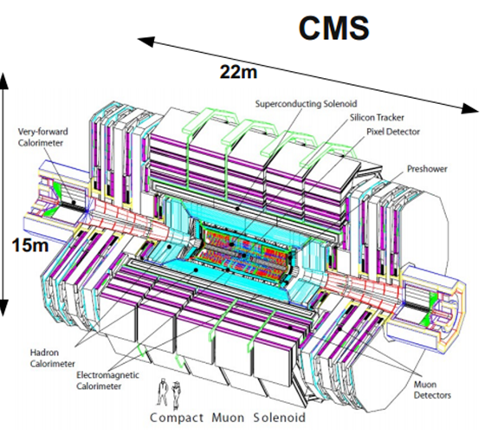
CMS spectrometer
12000t,world heaviest

Slide 50
CMS Muon
1. Drift Tubes (DT) Barrel (Traditional tech)
Central coverage: |η|< 1.2
Measurement and triggering
12 layers each chamber: 8 inφ,4in z
2. Cathode Strip Chambers (CSC) Endcap
Forward coverage: 0.9 < |η|< 2.4
Measurement and triggering
6 layers each chamber: each withφ,z
3. Resistive Plate Chambers (RPC) Barrel and Endcap
Central and Forward coverage: |η|< 2.1
Redundancy in triggering
2 gaps each chamber, 1 sensitive layer
CSC&RPC desined for High B

Slide 51
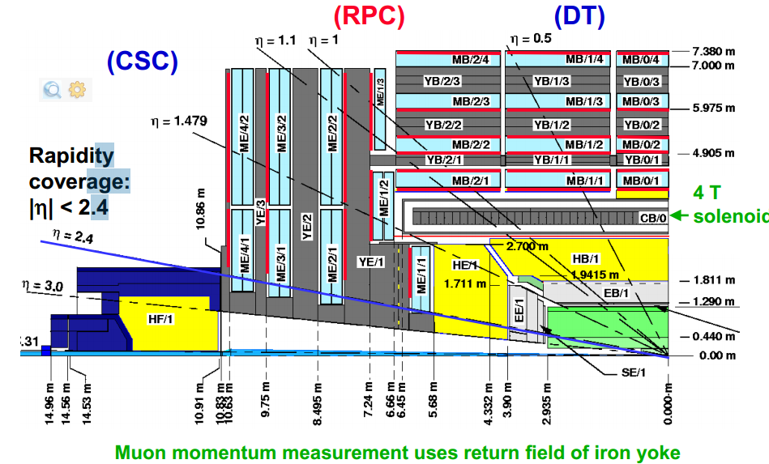
CMS Muon

Slide 52
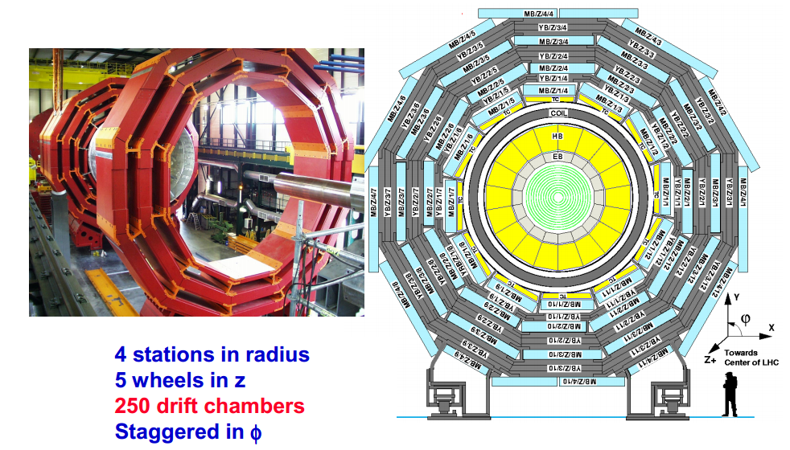
CMS Barrel Muon(DT)

Slide 53
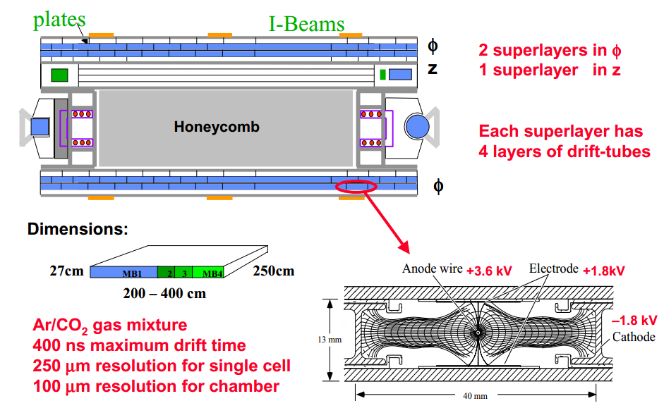
CMS Drift Tube Chamber

Slide 54
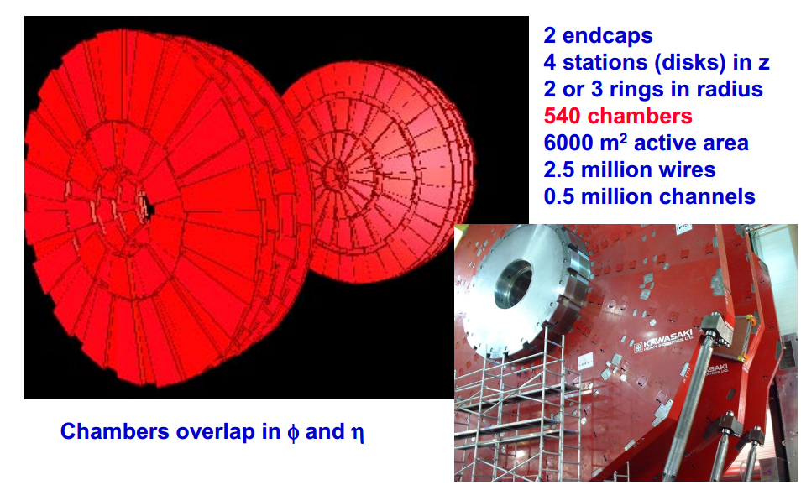
CMS Endcap Muon CSC

Slide 55
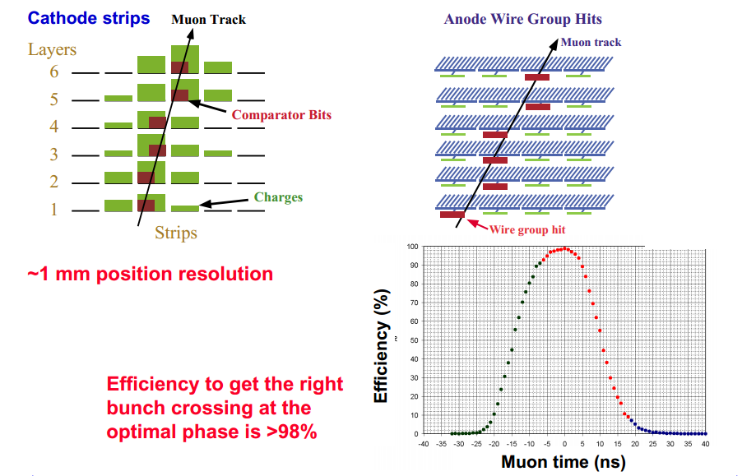
CMS CSC

Slide 56
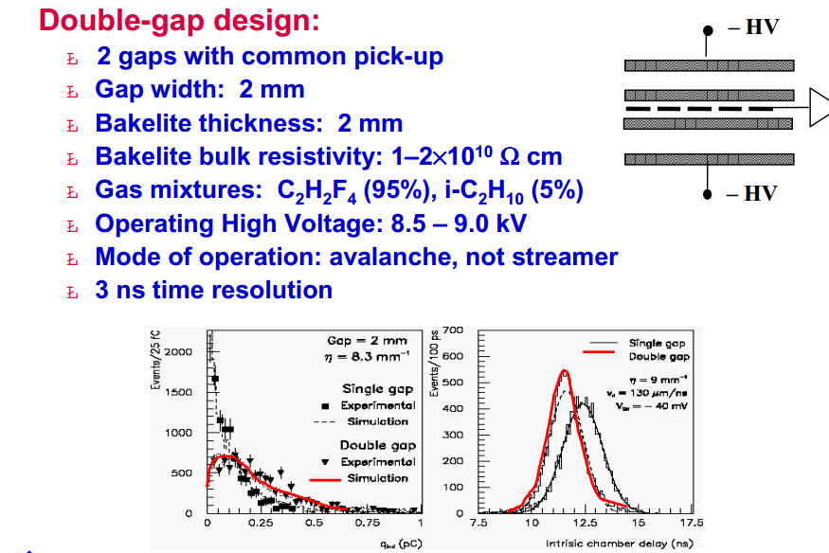
CMS Muon RPC

Slide 57
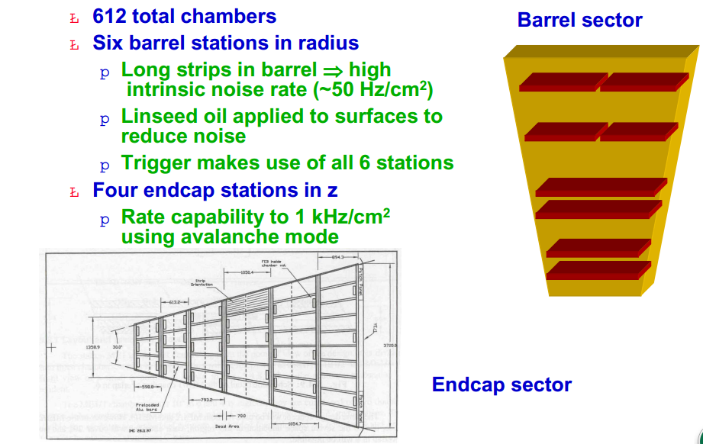
CMS RPC(PKU)

Slide 58
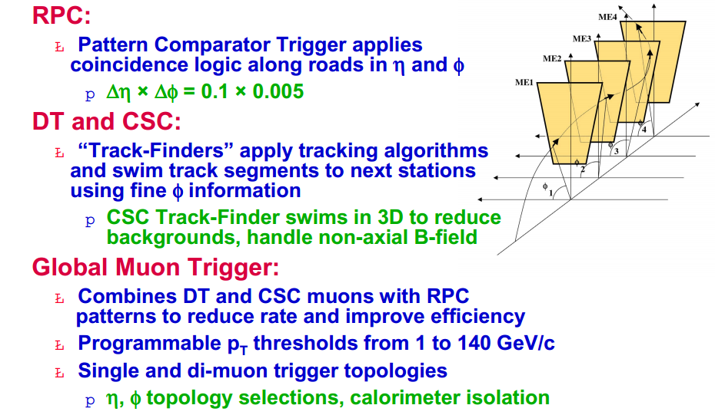
CMS L1 trigger

Slide 59
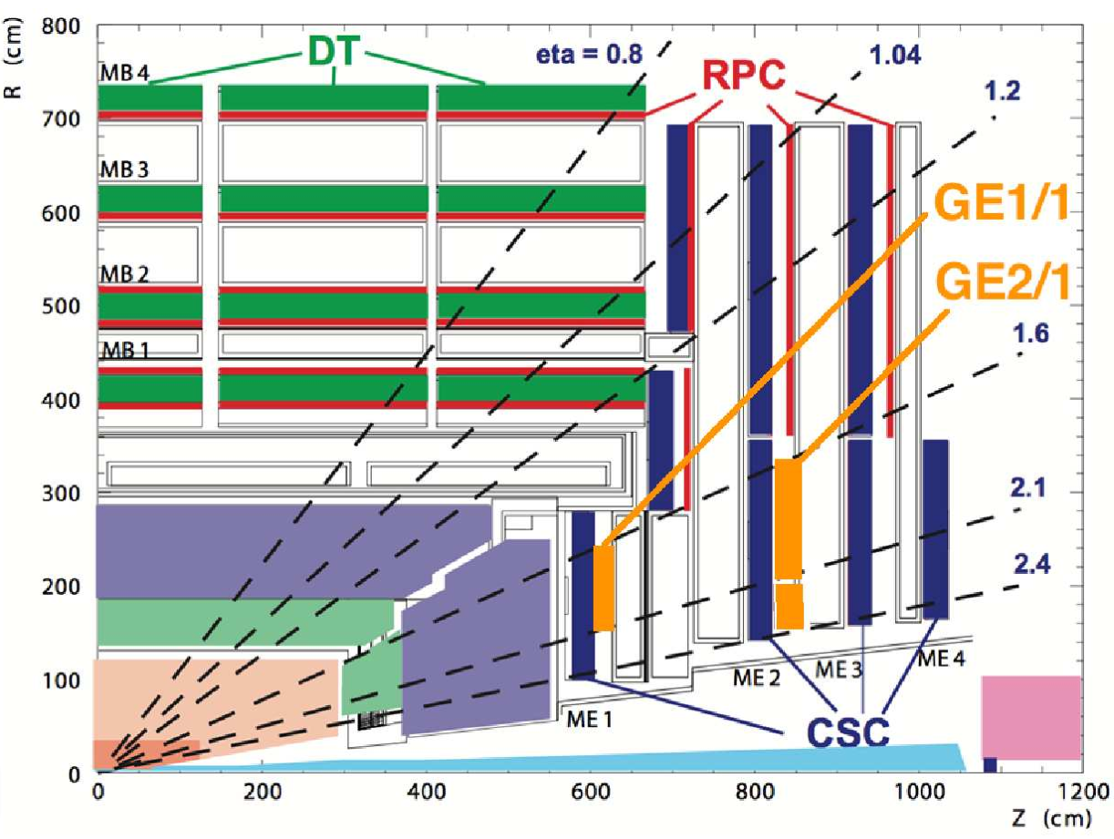

CMS Muon Upgrade GEM
The currently un-instrumented high-η RPC region of the muon endcaps presents an opportunity for instrumentation with a detector technology that could sustain the radiation environment long-term and be suitable for operation at the LHC and its future upgrades into Phase II: GEM Detectors

Slide 60
CMS Muon Sum
CMS has nearly hermetic and redundant muon coverage
over the region |η| < 2.4 using 3 detector technologies
P_{T} Resolution:
~10% standalone measurement
~2% when combined with tracker
Chinese IHEP and PKU contribute to the construction with 1%Of the total cost, mainly on construction of Muon detectors,CSC & RPC
Upgrade GEM&MRPC is going now

Slide 61
LHC Muon Detection - Summary
Muon detection is based on ability of muon to penetrate thick absorbers with minor energy losses
Due to the size of muon systems (~10³m2) gas detectors are used
Precision determination of detectors location is achieved via alignment

Slide 62
几点人生体会与同学们共 勉
抓住机遇：
八年从事建造中国第一条核潜艇09-1（七十年代）
三十六年从事中国的高能物理实验-BES,首次测到对撞Luminorsity，HERA-B, CMS
90后有着前人没有的好机遇,好时代
>立足脚下,踏踏实实做事,打好基础
软硬件都要强,理论和实验都要拿得起来.
>进入高能事业,你就有更宽的视野和更多的见识

Slide 63

Higgs Discovery
80后顶大梁

Slide 64

IHEP CSC at CERN/CMS

Slide 65


IHEP CMS Group weocome you to join us soon!

Slide 66

Join us at CERN!

