Slide 1
Study of the cryogenic THGEM-GPM for the readout of scintillation light from liquid argon
Xie Wenqing(谢文庆), Fu Yidong(付逸冬), Li Yulan(李玉兰)
Department of Engineering Physics, Tsinghua University
2014-07
Notes:
大家好，今天我报告的题目是用于读出液氩闪烁光的低温THGEM-GPM

Slide 2
Outline
Background
Test of PTFE-THGEM
Test of CsI photocathode
Performance of GPM
Feasibility Analysis of THGEM-GPM in CDEX
Conclusion
Notes:
我的报告将分为以下几个部分：首先介绍课题的背景，然后依次介绍对基于PTFE，也就是聚四氟乙烯的THGEM的测试，然后是CsI光电阴极的测试，之后将CsI光电阴极镀在THGEM表面，对GPM整体进行测试。然后我会对将基于THGEM的GPM应用于CDEX实验的可行性进行研究。最后，我会整体进行一个小结。

Slide 3
Outline
Background
Test of PTFE-THGEM
Test of CsI photocathode
Performance of GPM
Feasibility Analysis of THGEM-GPM in CDEX
Conclusion
Notes:
首先是背景介绍。

Slide 4
Background
Recent years, it is one of the frontier problems of particle physics to distinguish rare events from relatively high radiation background.
Cryogenic liquid scintillation detectors, such as liquid argon detector and liquid xenon detector, have been widely used in rare event experiments.
Notes:
近年来，从相对较高的本底中分辨出稀有事件，已经成为了粒子物理的前沿课题之一。而低温液体闪烁探测器，包括液氩探测器和液氙探测器，在这些稀有事件探测中获得了广泛的应用。

Slide 5
Background
Detection of neutrinos - ICARUS（Imaging Cosmic And Rare Underground Signals）
LAr TPC，LAr & PMT : start time of electron drift
Search for 0ν2β decay-GERDA（GERmanium Detector Array）
GERDA Phase II, LAr & PMT : veto detector
Search for dark matter-CDEX（China Dark matter EXperiment）
LAr & PMT : veto detector
Notes:
在中微子探测实验中，意大利的ICARUS实验中使用液氩TPC，用PMT探测液氩发出的闪烁光定出电子漂移时间零点；
在探测双β衰变的实验中，德国的GERDA实验利用液氩和PMT构成反符合探测器；
在暗物质实验中，中国锦屏地下实验室中的中国暗物质实验CDEX同样使用液氩和PMT作为反符合探测器。

Slide 6
Background
Liquid argon detectors have been widely used in rare event experiments, which have raised new requirements:
High stability at cryogenic condition (87K - 120K)
Low radiation background
Direct detection of 128nm VUV
Large active area
Low price
Notes:
低温液体闪烁探测器由惰性液体闪烁体和光电读出器件两个部分组成，液氩探测器中的闪烁体就是液氩本身。
而稀有事件探测实验对液氩探测器的光电读出器件提出了要求：
首先，它需要能够在液氩温度附近稳定工作；其次，要求光电读出器件本身有一个较低的辐射本底水平；另外，最好能够直接探测128nm的液氩闪烁光，并且可以将有效面积做得尽可能大，并且有一个合理的价格

Slide 7
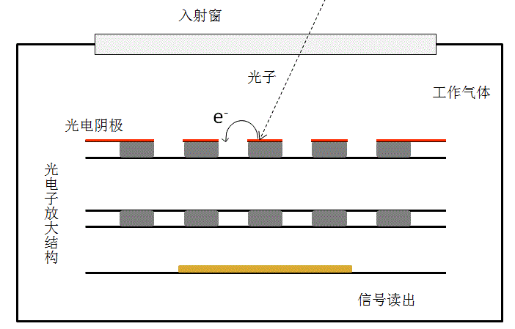
Background
GPM（Gaseous PhotoMultiplier）
Gas-filled detector (different from PMT)
Two main composition:
Photoelectric device
Electron multiplying device
Notes:
GPM是气体光电倍增器的简称，它是一种气体探测器，包含两个主要部分：一是光电转换介质，将入射的光子通过光电效应转换为电子；一是光电子放大结构，将上一步得到的光电子进行倍增并读出。在本课题中，GPM充当的是液氩探测器的光电读出器件部分。

Slide 8
Outline
Background
Test of PTFE-THGEM
Test of CsI photocathode
Performance of GPM
Feasibility Analysis of THGEM-GPM in CDEX
Conclusion
Notes:
接下来是对基于PTFE研制的THGEM进行的测试。

Slide 9
PTFE-THGEM
Material
G-10 & FR-4:
Common used material for THGEM
Composed of woven fiberglass cloth with an epoxy resin binder
PTFE (Polytetrafluoroethylene, Teflon)：
High chemical stability, good insulation, high anti-aging capacity, be able to work from -190℃ to 250℃, be able to suffer a sudden change in temperature
Composed of C and F, which has low radioactivity
Notes:
目前THGEM使用最多的基材是G-10和FR-4，它们都是常规的印刷电路板常用的材料。主要是由环氧树脂加上填充剂以及玻璃纤维所做出的复合材料，有一定的放射性；本课题选择的材料是PTFE，即聚四氟乙烯，它俗称塑料王，耐温性能优异，可以在-190℃～250℃下长期工作，允许骤冷骤热；全部由轻元素碳和氟组成，放射性较小，这对应用于稀有事件实验具有很大的优势。

Slide 10
PTFE-THGEM
The radioactivity of PTFE is from the contamination in produce procedure. And the radioactivity of FR-4 comes from woven fiberglass.
With the content of Th and U far less than K, only the radioactivity of ⁴⁰K is counted
The radioactivity of PTFE is rather low, it is very suitable for rare event experiments.
Notes:
FR-4中的放射性主要来自K-40，PTFE中放射性主要来自生产过程中的污染,PMT使用的是手册中的值。可以看出PTFE的放射性要远远低于FR-4材料。

Slide 11
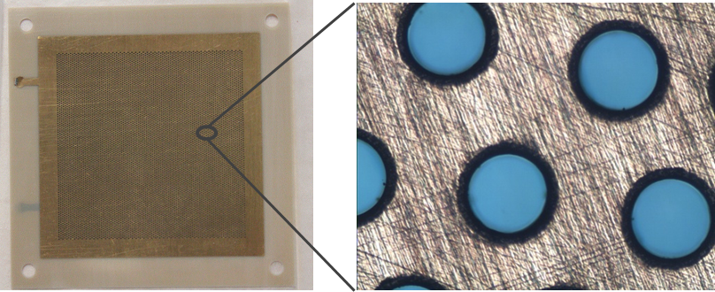
PTFE-THGEM
Notes:
我们制作的PTFE-THGEM是来自国科大谢一刚教授和刘倩老师他们实验组的，在此对他们表示感谢。我们制作了多批不同尺寸的THGEM，经过实验，选择这一种尺寸进行研究。

Slide 12
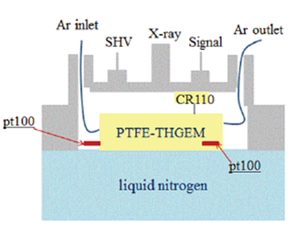
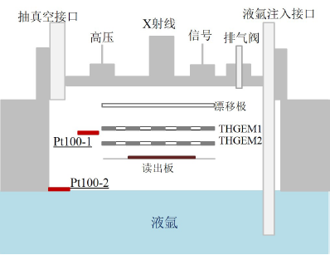
PTFE-THGEM
outer gas-supplement mode
inner gas-supplement mode
Schematic diagram of the PTFE-THGEM test experiment
Notes:
我们进行了两种模式的低温实验，左边是外供气模式，由液氮提供低温，外部提供氩气作为工作气体；右边是内供气模式，低温和工作气体都由液氩提供。外供气模式的优势在于可以灵活选择工作气体，缺点在于系统较复杂。而内供气模式优势在于系统简单，能较容易读出液氩闪烁光，但缺点在于难以保证工作气体的纯度。

Slide 13
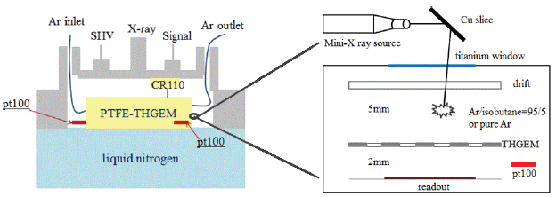
PTFE-THGEM
Schematic diagram of the PTFE-THGEM test experiment (outer gas-supplement mode)
Notes:
接下来是在低温下外供气模式的实验结果。使用的放射源是用X光机打Cu靶产生的8.09KeV的特征X射线，使用的工作气体是纯度为5个9的氩气。

Slide 14
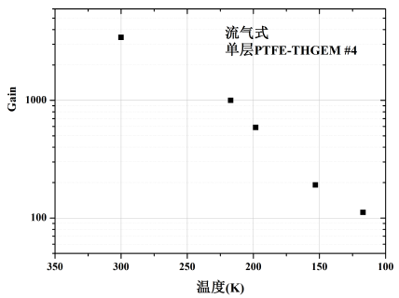
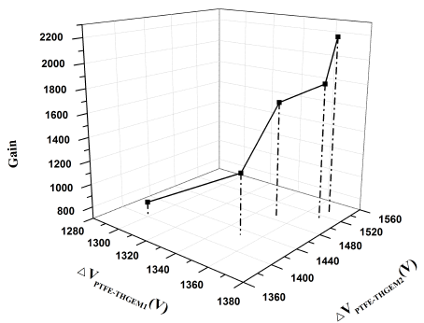
PTFE-THGEM
T=132K
Gain of the single PTFE-THGEM detector (outer gas-supplement mode) as a function of temperature
Gain of the double PTFE-THGEM detector (outer gas-supplement mode) as a function of ΔV_{THGEM}
Notes:
在外供气模式下，使用单层PTFE-THGEM在120K的温度下增益仍然达到了100。如果使用双层THGEM，在132K温度下最高达到了2200的增益。

Slide 15
PTFE-THGEM
Schematic diagram of the PTFE-THGEM test experiment (inner gas-supplement mode)
Notes:
下面是内供气模式的实验结果。使用的液氩纯度依然为5个9，射线源依然为Cu的特征X射线。

Slide 16
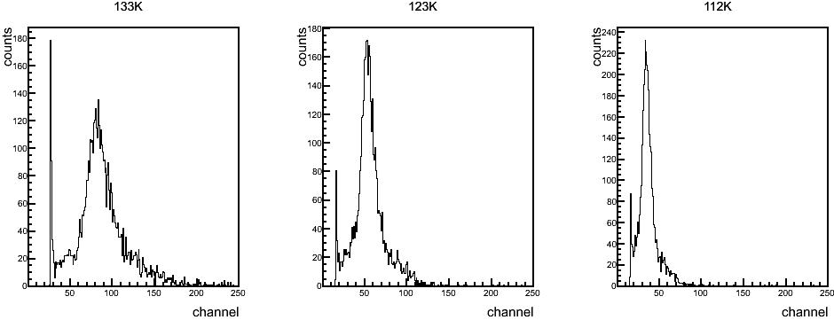
PTFE-THGEM
Energy spectrum of the 8.09 keV X-ray at different temperatures (sealed mode)
Gain of the double PTFE-THGEM detector (inner gas-supplement mode) as a function of temperature
Notes:
左上角的图是不同温度下测到的能谱，从左到右温度不断降低，能谱也不断左移，表明增益不断降低；
右边的图是低温下双层THGEM的增益随温度变化图，在100K的温度下测到了1500左右的增益。

Slide 17
Outline
Background
Test of PTFE-THGEM
Test of CsI photocathode
Performance of GPM
Feasibility Analysis of THGEM-GPM in CDEX
Conclusion
Notes:
接下来是关于CsI光电阴极测试的部分。

Slide 18
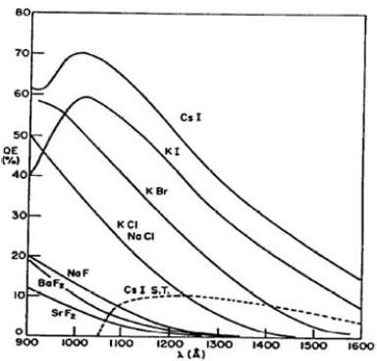
CsI
High quantum efficiency (QE) @ 128nm
High stability
Resistance to VUV radiation
QE versus wavelength for reflective alkali halide photocathodes^{[1]}
[1] Breskin A. NIMA 1996, 371(1–2):116 – 136
Notes:
CsI光电阴极在液氩闪烁光这个波段在碱金属卤化物中具有最高的量子效率，并且稳定性高不易潮解，我们选择它作为这个课题中的光电阴极。

Slide 19
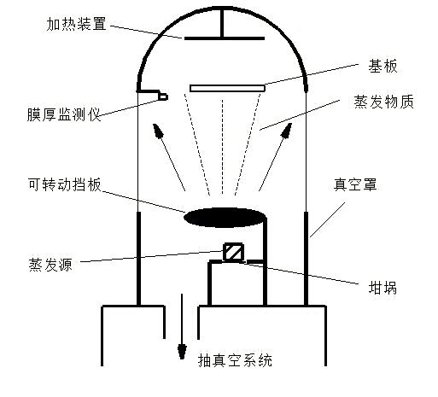
CsI
Before deposition, heat up the base board to 60℃
After the deposition process, keep the board at a temperature of 70℃ for 3h in vacuum, in order to increase the anti-aging capacity of CsI film
Notes:
CsI的镀膜方式我们选择真空蒸镀。在镀膜前，我们会将基板加热到60℃，在镀膜后，我们会在真空中进行3个小时，70℃的热处理，增强CsI膜的稳定性。我们一共测试了三种基板，第一种为FR-4材料，作对比用，另外两种为PTFE材料，其表面镀的金属层略有不同。

Slide 20
CsI
Doing surface analysis with an AFM (Atomic Force Microscope):
Get the height distribution of both CsI film and the base board, test the surface roughness value R_{a}
Measure the thickness of CsI film
Notes:
我们使用原子力显微镜AFM对镀好的CsI膜进行表面分析，得到它的表面粗糙度，以及厚度。需要指出的是，有文献指出较粗糙的表面一般会有较大的QE值。

Slide 21
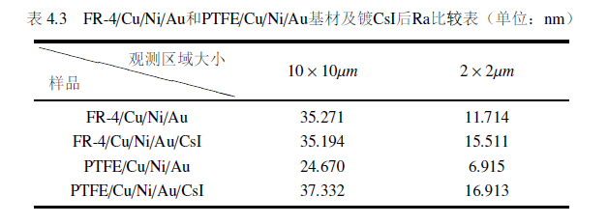
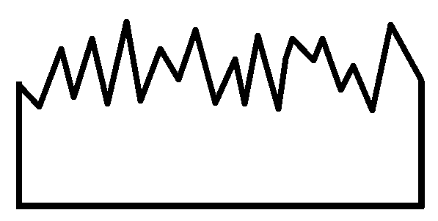
CsI
PTFE
FR-4
Notes:
从我们的实验结果可以看出，PTFE表面镀的CsI膜粗糙度要比FR-4高。而如下图所示，较粗糙的表面可能具有较高的QE值，如果光电效应在同一深度发生，左边较粗糙的表面光电子逃逸所需的长度较短。这一点，我们将通过QE测量的实验进行验证。

Slide 22
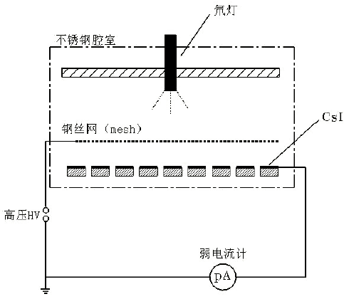
CsI
A maximum QE of 14% was achieved in room temperature
Thickness is not crucial for QE values
The CsI films deposited on PTFE base boards have larger QE than these deposited on FR-4 base boards
Notes:
左边的图是常温下的QE测试装置，使用氘灯照射，并测量出CsI光电发射所产生的光电流，就可以计算出QE值。从右图的结果可以看出，在膜的厚度不同时，PTFE上镀的膜都要比FR-4上的QE高。且膜的厚度对QE值的影响不大。

Slide 23
CsI
When continuous irradiated by VUV photons, the photoelectron decreased quickly
The aging of FR-4 is 3-4 times faster than PTFE
The CsI film deposited on PTFE is more stable than that on FR-4 when deposited by VUV photons
PTFE
FR-4
Notes:
这一页是CsI膜的老化特性研究。从左下角的图可以看出，随着氘灯的不断照射，CsI膜的光电流不断下降，但PTFE上镀的CsI膜老化速度要明显慢于FR-4。

Slide 24
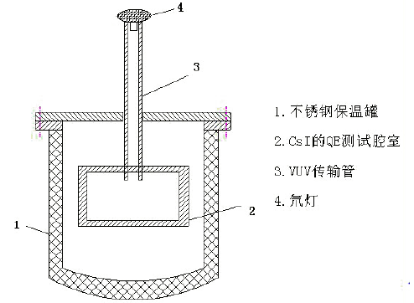
CsI
The QE of CsI film decreased slowly as the decrease of temperature
The QE at 103K is ~6.7%
Notes:
常温下测出CsI的QE之后，我们继续在低温下探索它的特性。左边是低温下测量CsI膜QE的装置图，由于氘灯不能承受低温环境，我们使用一个传输管将常温的氘灯与低温环境相连。右边的图是测出的QE随温度变化图。可以看出随着温度的下降，QE值不断下降，在103K的时候下降到了约7%。

Slide 25
Outline
Background
Test of PTFE-THGEM
Test of CsI photocathode
Performance of GPM
Feasibility Analysis of THGEM-GPM in CDEX
Conclusion
Notes:
接下来是对GPM整体的测试。

Slide 26
GPM: X-ray test
Schematic diagram of the GPM radiation experiments with X-ray source
Notes:
在THGEM的上表面镀上CsI膜，就形成了可以探测液氩闪烁光的GPM。我们首先进行的是X光测试，X光从侧面打入液氩并沉积能量，发出闪烁光传递到CsI表面，被GPM探测到。实验使用的是纯度为5个9的液氩。

Slide 27
GPM: X-ray test
Explore the work conditions of GPM
AA
Demarcate the extraction efficiency of photoelectrons
$η_{ex}$=65.9%@113K
The QE of CsI film is ~16.8%，the proportion of areas deposited with CsI film is 73.3%
The total quantum efficiency of GPM for the incidence photon $η_{2}$=8.1%
Notes:
从左边的图可以看出，最终测出的光电流随X光管管电流变化的线性度很好，可以说明GPM工作正常。我们还用X光实验测出了GPM对入射光子的总量子效率，为接下来的α源实验做准备。

Slide 28
GPM: α source test
Schematic diagram of the GPM radiation experiments with X-ray source
Notes:
这是α源实验的装置图，我们将一枚241Am源放入液氩内，测量它沉积能量发出的闪烁光。与X射线实验不同，α粒子射程较短，闪烁光产生的位置比较固定，所以在能谱上可以看到一个明显的峰。这个实验使用的也是5个9的液氩。

Slide 29
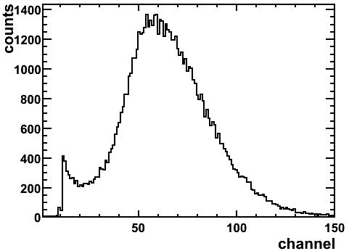
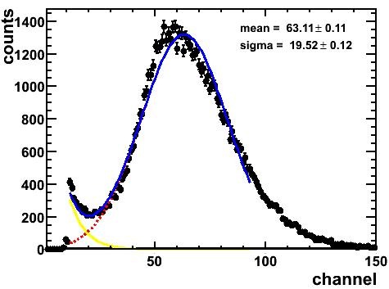
GPM: α source test
Energy spectrum of ²⁴¹Am recorded by THGEM-GPM (left) and the fit to the spectrum (right).
Notes:
这是α实验测到的能谱，可以看到有一个明显的峰位。

Slide 30
GPM: α source test
Source：²⁴¹Am
yield of scintillation light in LAr n_{p0} = 4×10⁴/MeV, impurity leads to an attenuation to 29.3%
transmission efficiency of photons arrive at the mesh of GPM η₁=0.83%（simulated by Geant4）
transmission efficiency of the mesh is 60.6%
the number of photons arrive at the surface of CsI n₁=263
total quantum efficiency of GPM η₂=8.1%，the number of photo-electrons n_{e0}=263×8.1%=21
deposit energy in LAr
yield
128nmVUV
transmission efficiency
transfer into GAr
$$η_{1}$$
geometric factors
Photoelectric conversation on CsI
quantum efficiency of GPM $η_{2}$
$$×$$
photoelectron transfer into the hole of THGEM
electron multiply/ signal readout
Notes:
接下来是对整个物理过程的分析。综合考虑沉积能量造成的闪烁光产额，闪烁光传输到CsI表面的效率，GPM对闪烁光的总量子效率，可以得出到达CsI表面的光子数为263个，最终进入孔中倍增的光电子数为21个。

Slide 31
GPM: α source test
FWHM $△E=E×η=\sqrt{△E_{α}^{2} + △E_{S}^{2} + △E_{NE}^{2} }$
uncertainty of energy of $α$ source
statistical fluctuation
electronic noise
$$E=\frac{E_{0}}{n_{0}}×n_{1}$$
$${△E}_{s}=2.355\sqrt{(1+0.68)∙E∙w}$$
$$w=E/{n_{e0}}$$
$$△E_{α}=E×η_{α}$$
${△E}_{NE}=6.32$keV
equal to 745 ENEs
又，$\frac{n×η_{2}×G}{ENC}≥3$ n≥19
Notes:
对能谱展宽进行分析，扣除α源带来的展开，载流子涨落带来的展宽后，在信噪比大于3的情况下，得到GPM系统可以探测的最小入射光子数为19个。

Slide 32
Outline
Background
Test of PTFE-THGEM
Test of CsI photocathode
Performance of GPM
Feasibility Analysis of THGEM-GPM in CDEX
Conclusion
Notes:
接下来是对THGEM-GPM在CDEX中应用的可行性讨论。

Slide 33
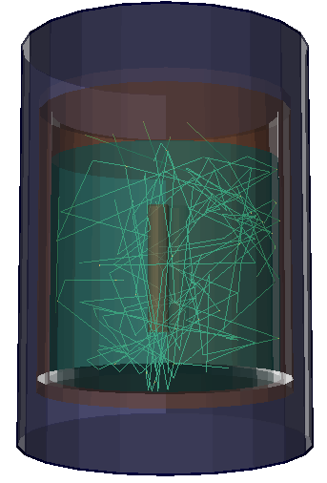
Feasibility Analysis of THGEM-GPM in CDEX
In ideal conditions (reflection coefficient of Cu wall to be 1, absorption length of LAr to be 66cm), the proportion of photons transmitting into GAr is 16%
If the active area of GPM is large enough, all the photons transmitting into GAr can transfer to the surface of GPM
With the low threshold of THGEM-GPM system being 19, the energy threshold of the system in CDEX-10 is demarcate to be 3keV
Notes:
如果将CDEX模型中器壁对闪烁光的反射率，以及液氩中的吸收长度都使用最理想的值，且我们的GPM做得足够的大。从前面得出的GPM最小探测阈值19个入射光子，可以得出应用于CDEX中可以测到的最小能量为3个keV。

Slide 34
Feasibility Analysis of THGEM-GPM in CDEX
The impurities in liquid argon have a significantly negative effect in the yield of scintillation light and the absorbing of scintillation light in liquid argon. It will be very important to purify the liquid argon in CDEX
With argon as the working gas of the detector, impurities have an positive effect to increase the effective gain
Works should be done on the best proportion of impurities
Notes:
但液氩中的杂质会对闪烁光进行吸收，使得可探测的能量阈值升高；如果减少液氩中的杂质，THGEM上加的高压将必须降低，增益会因此减小，从而影响GPM的性能。故液氩的纯度需要做一个权衡。

Slide 35
Outline
Background
Test of PTFE-THGEM
Test of CsI photocathode
Performance of GPM
Feasibility Analysis of THGEM-GPM in CDEX
Conclusion
Notes:
最后是一个小结。

Slide 36
Conclusion
A new kind of THGEM with a low radiation background was developed using PTFE
A gain of 1500 was achieved at ~100K using PTFE-THGEM
The QE of CsI films deposited on PTFE was larger than those deposited on FR-4
A better aging property of CsI films deposited on PTFE was observed than those deposited on FR-4
Energy spectrum of ²⁴¹Am was recorded by THGEM-GPM
The low threshold of GPM for the detecting of the incidence photons was tested to be 19
The feasibility of applying the system in CDEX was discussed
Notes:
我们研究了一种用新材料PTFE制成的低本底THGEM；
双层PTFE-THGEM在100K的温度下测得了1500的增益；
镀在PTFE基材上的CsI膜在QE值和老化特性方面都要优于传统的FR-4材料；
我们使用THGEM-GPM测出了一个241Am放射源的能谱；
通过对能谱的分析得出THGEM-GPM系统对入射光子的探测阈值为19；
最后我们还讨论了THGEM-GPM用于中国暗物质实验CDEX的可行性。

Slide 37
Thanks!
Notes:
谢谢大家，欢迎提问

Slide 38
GPM系统X光机照射实验
实验中GPM的温度为113K
MAXWELL计算电场，将CsI表面划分为若干个1μm见方的网格
光电阴极对160nm紫外线的QE为6.7%，对应于128nm的QE约16.8%

Slide 39
THGEM-GPM系统应用于CDEX可行性分析-2
CDEX-10高纯锗探测器记录的本底能谱（模拟结果）
数据来源：苏健，2012CDEX年会报告
低温下CsI老化曲线
CDEX本底来源：宇宙射线、岩石及混凝土的放射性、氡以及屏蔽材料和元件的放射性
CDEX本底沉积能量产生的全部光子均照射到CsI上，其QE老化至初始值的92%需要上千年

Slide 40
GPM: α source test
The number of photons emitted in the liquid argon n₀ can be calculated as follows:
n₀=E₀×n_{p0} (1)
E₀ - the energy of α source (4.516MeV)
n_{p0} - yield of scintillation light (4×10⁴/MeV)
Notes:
略讲

Slide 41
GPM: α source test
the number of photons that arrive at the surface of CsI n₁ can be calculated as follows:
n₁=n₀×η₀×η₁×η_{m}
=E₀×n_{p0}×η₀×η₁×η_{m} (2)
η₀ - total attenuation coefficient of the yield of scintillation light (29.3% for this experiment)
η₁ - transmission efficiency of photons arrive at the mesh of GPM (0.83% by Geant4)
η_{m} - transmission efficiency of the mesh (60.6%)

Slide 42
GPM: α source test
the number of initial photoelectron prior to multiplication n_{e0} can be calculated as follows:
n_{e0}=n₁×η₂
=E₀×n_{p0}× η₀×η₁×η_{m}×η₂ (3)
η₂ - total quantum efficiency of GPM for the incidence photon (8.1%)

Slide 43
GPM: α source test
The width of the spectrum at half height $ΔE$ can be calculated using the following formula:
$∆E=E×η=\sqrt{ΔE_{α}^{2}+ΔE_{s}^{2}+ΔE_{ne}^{2}}$ (4)
$∆E_{α}$,$∆E_{s}$ and $∆E_{ne}$ are the broadening of the spectrum owing to the fluctuations of $α$ energy, signal and the electronic noise, respectively.

Slide 44
GPM: α source test
$∆E_{α}$ and $∆E_{s}$ can be calculated using the following formulas:
E=E₀×n₁/n₀ (5)
ΔE_{α}=E×η_{α} (6)
$ΔE_{s}=2.355\sqrt{(1+0.68)×E×w}$ (7)
w=E/n_{e0} (8)
η_{α} - energy resolution of the energy spectrum of α source (8.36%)

Slide 45
GPM: α source test
Based on formulas (3) - (8), ΔE_{ne} is calculated to be 6.32keV, which is equal to 745 noise electrons
With inequality $\frac{n_{1}×η_{2}×G}{ENE}≥3$
Gain of THGEM detector G = 1500
Low threshold of GPM for the detecting of the incidence photons is calculated to be 19

