Slide 1
Managing the survey activities during the Long Shut-down 1
Dominique Missiaen

Slide 2
Agenda
Outline
  Introduction
  Why a so huge measurement and maintenance campaign ?
  Scheduled work
  Manpower estimate
  Planning
  Quality assurance
  Main results
  Conclusion

Slide 3
Introduction
The LS1
  Long Shut-Down 1
    the first shut-down after the start of the LHC in 2009
    RUN1 took place between November 2009 and February 2013
      The energy of the LHC was 2*4.5 TeV, center of mass
      After the incident of 2008, it was well known that the splices in the interconnection of the cryo-magnets were the weak point
    The aim for RUN 2 is to run at 2*6.5 (7 TeV is the ultimate)
      The splices have to be repaired
      This is the main justification for the LS1 and for its duration
    It started in March 2013 and will stop at the end of 2014

Slide 4
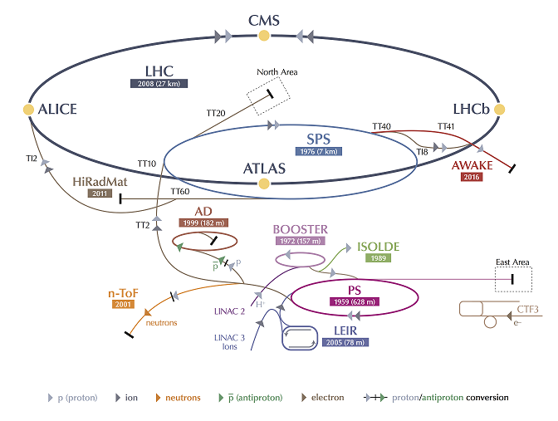
Introduction
The CERN accelerator complex
  The injector’s complex
    Linac2
    PS Booster
    PS ring
    TT2 and TT10
    SPS
    TI2 and TI8
  The LHC
  4 main LHC detectors

Slide 5
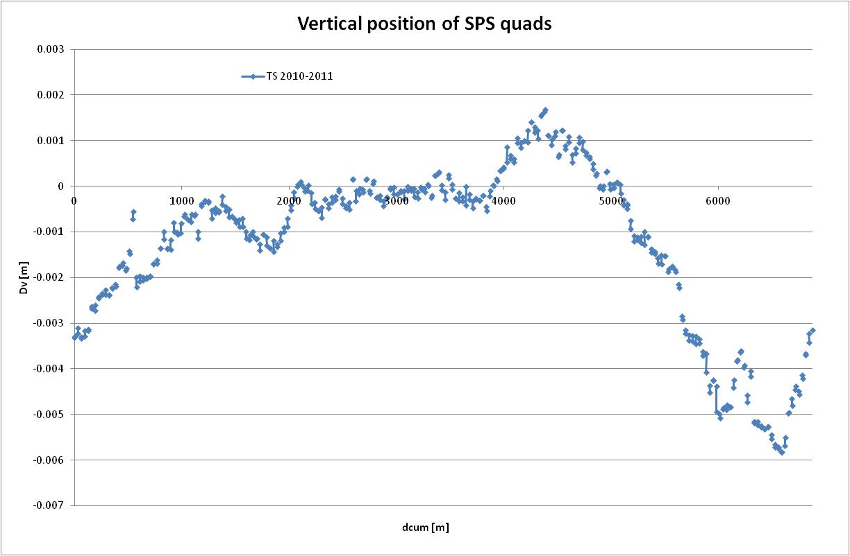
Why a so huge measurement and maintenance campaign ?
Survey measurements to be refreshed
  The previous survey of most of the machines were a bit “old”
    PS Ring (2005)
    SPS (2005 for the Horizontal measurements)
  The “hole” of the sextant 6 of the SPS
  The TI8 line is new civil engineering structure
    (80% of quads were realigned in 2009)
  The experimental caverns of ATLAS and CMS are also new CE structures
  The hole of the sector 78 of the LHC
Crossing points
Some unstabled areas are well known

Slide 6
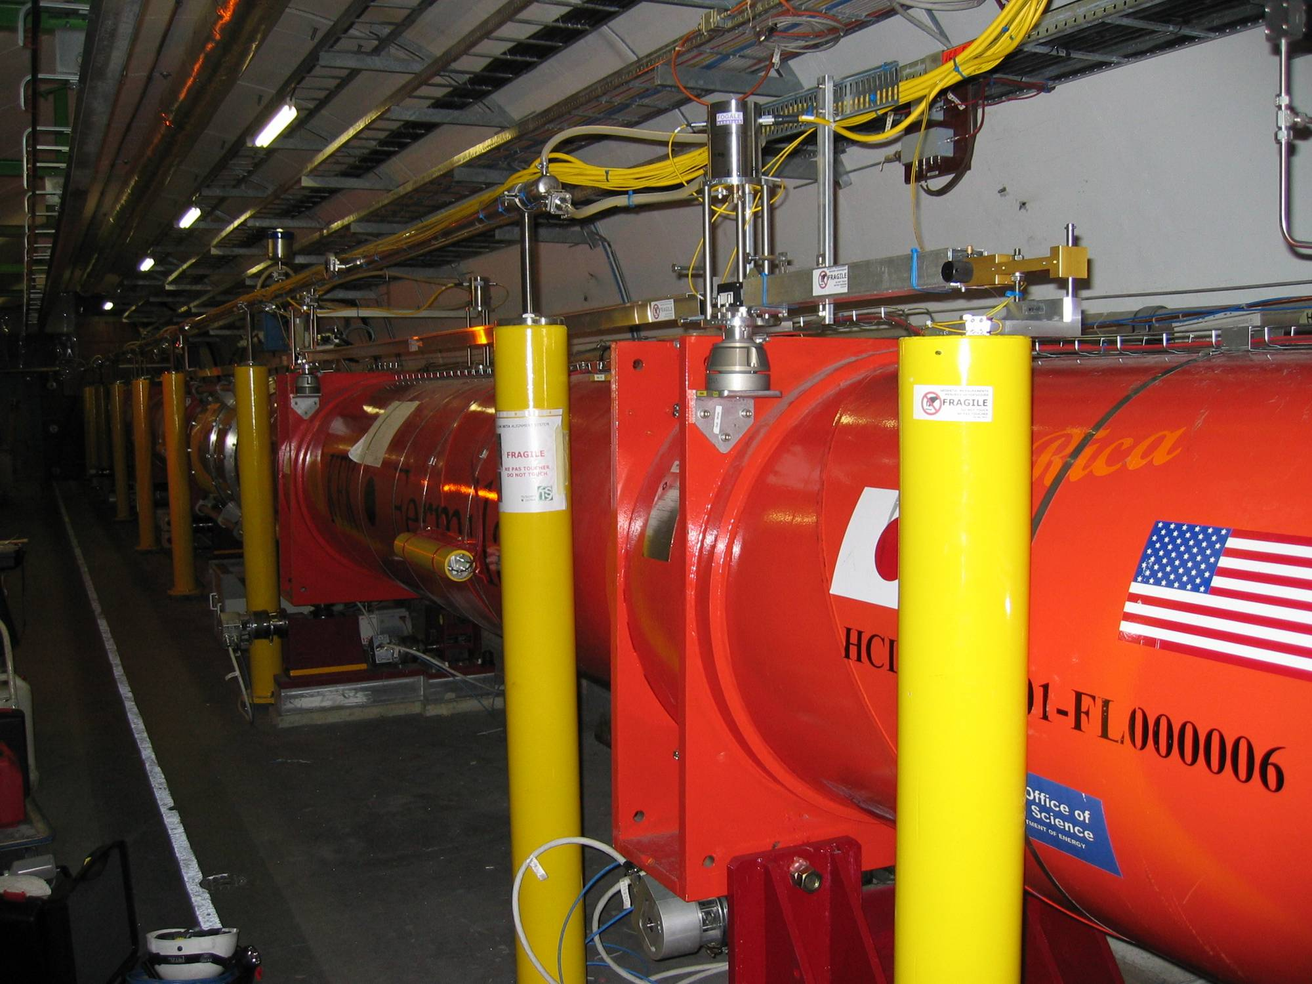
Why a so huge measurement and maintenance campaign ?
Request from the Operation team
  Problem to steer the beam in the SPS in the sextant 6
  The PS Booster is a bit difficult to run
    Many voluntary displacements were done
    It will be connected to the LINAC4 in 2018 and need more accurate realignment
  the permanent monitoring system of the low b quadrupoles has to be maintained after 4 years of run (HLS, WPS), installation of validation systems
Maintenance of equipment

Slide 7
Why a so huge measurement and maintenance campaign ?
A smooth LHC has to be given to the physics
Sect. | Vertical (mm) |  | Horizontal (mm)
 | After 1st smoothing | End of Run 2008 | After 1st smoothing | End of run 2008
12 | 0.10 | 0.16 | 0.11
23 | 0.12 | 0.16 | 0.11
34 | 0.11 | 0.17 | 0.11 | 0.23
45 | 0.11 | 0.13 | 0.19
56 | 0.10 | 0.13 | 0.20
67 | 0.10 | 0.14 | 0.20
78 | 0.11 | 0.15 | 0.11 | 0.21
81 | 0.11 | 0.14 | 0.10
  Few LHC measurements were available
    In vertical all sectors
      After 1st alignment (2007-2008)
      End of run 2008
    In Horizontal, only two sectors
      After 1st alignment (2007-2008)
      End of run 2008
    Extrapolation shows a degradation of
      In V : 0.05 mm in 1.5 year
      In H : 0.11mm in 1.5 year
      In 10 years, in H dr 0.35mm, 20 magnets > 1.00 mm

Slide 8
Work scheduled
The work can be divided into 3 main categories
  Maintenance survey
    To measure and correct any degradation of the alignment in order to ensure a good alignment during the next run of the machine (PS, PSB, SPS, TI2 and 8, LHC)
    This activity is mainly triggered by the Survey team or the Operation one.
  Survey upon request
    After installation or reinstallation of equipment or detectors (18 magnets exchanged in LHC, 20 collimators, BPM, etc)
    During opening and closure of the experiments
    Installation of new detectors and beam pipes
  Maintenance of permanent monitoring systems
    Around the low beta quadrupoles
    In Atlas and CMS areas

Slide 9
Manpower
Estimate
  Amount of work is too important to be done by CERN staff members only (21)
Areas | Time needed (man/months) | Period (months) | Man
PS and PSB | 26 | 11 | 2.3
SPS and TLs | 53 | 15 | 3.5
LHC | 99 | 21 | 4.7
Experiments | 210 | 21 | 10
total |  |  | 20.5
  More than 20 staff missing
    13 from a manpower contractor
    4 from experiments collaboration
    2 Project Associates from University
    2 mechanical technicians

Slide 10
Manpower
Strategy
  Only the work well described in procedures and repetitive is given to the contractor
  Experimental Collaborations staff, PJAS and technicians will be integrated directly inside teams with CERN staff members
  In very rare case the contractor staff is integrated inside CERN staff team
  CERN staff to participate to the repetitive measurements campaing and doing the “exotic alignments”
  Most of them don’t know the specific CERN techniques and instruments
    CERN trains a permanent team of 3 persons
    The others staffs are trained by the permanent team
    Collaboration and PJAS arrived a couple of months between the beginning of LS1 and were trained by CERN staff
Training

Slide 11

Planning
The injector’s complex activity took place in 2013
while the main LHC actitivity was scheduled in 2014

Slide 12
Planning
Even if a dedicated team co-ordinated the work, some difficulties appeared
  The amount of work to be realised without any extension of LS1
  Survey after installation has to be done quickly for vacuum connection
  Many co-activities discovered once in the tunnel
  In the LHC, the survey team has to measure at a difficult period
    When the magnets are at 1.9K to avoid further mechanical constraints
    Difficulty to access the tunnel
    Coactivity with electrical tests
  One CERN staff at 30% was dedicated to planning activity (daily)
Some sectors of the LHC have to be measured at the same time in V and H (at least 4 teams, a lot of equipment needed, staff to supervise field work and data treatment)

Slide 13

Quality control
Work done by the contractor is described in details inside procedures
  Instruments provided by CERN
  Methodology finalised by CERN
  Conditions of the measurements
  Contractor has to check the quality of his work using the CERN adjustment software (LGC++) using a minimum of constraints
  This validation triggers the payment of the work on a lump sum basis !
CERN staff
  Realises the final calculation and decides on the final adjustment (fixed points, corridors, etc)
  Insert the new position in the database
  Determines the magnets to be realigned using the Rabot (Plane) software

Slide 14
Results
PS -PSB
In the horizontal, it appears that the PS is smaller by 4mm wrt its nominal shape and wrt the previous measurements > to be studied
The PSB has been measured in H and V
  After a careful study by the physics people, 40 magnets were realigned
The transfer lines linking the PS to the SPS were measured and realigned as well

Slide 15
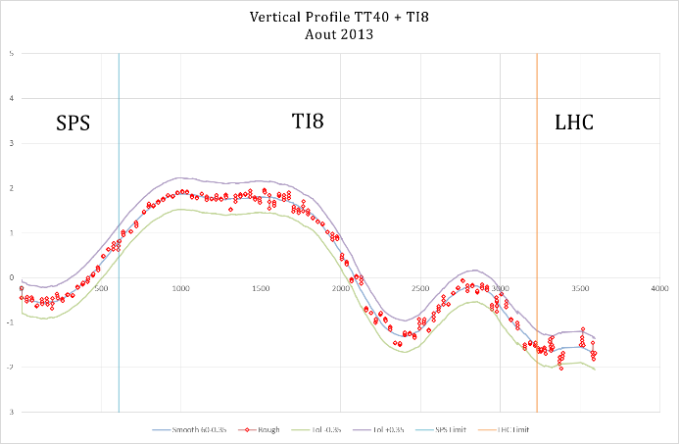
Results
The SPS
  Full measurement of all the components
  Realignment of 40% of quads in H and V and all dipoles and pick-ups
  TI2
    200m completely realigned
    For the rest of the line : only quads were measured and 30% realigned
  TI8
    All components measured
    35% of quads realigned, dipoles and pick-ups realigned accordingly
The TI2 and TI8 transfer lines

Slide 16
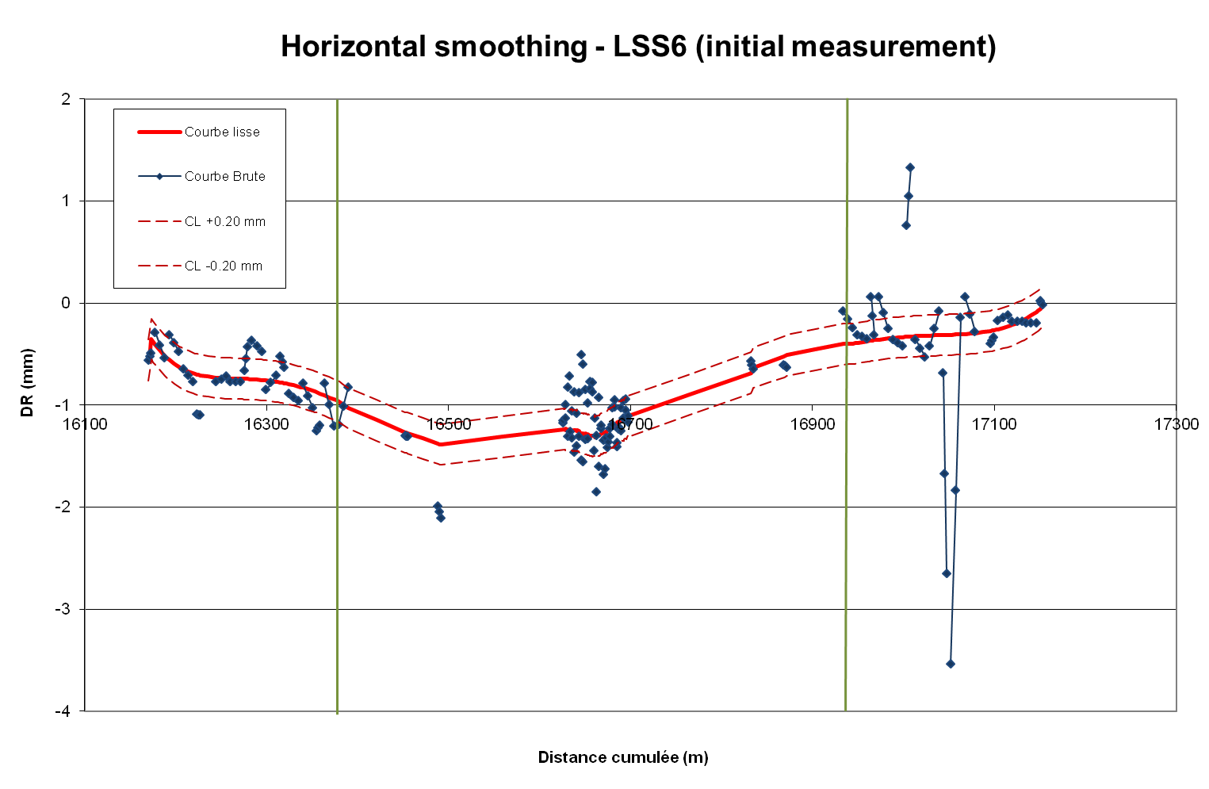
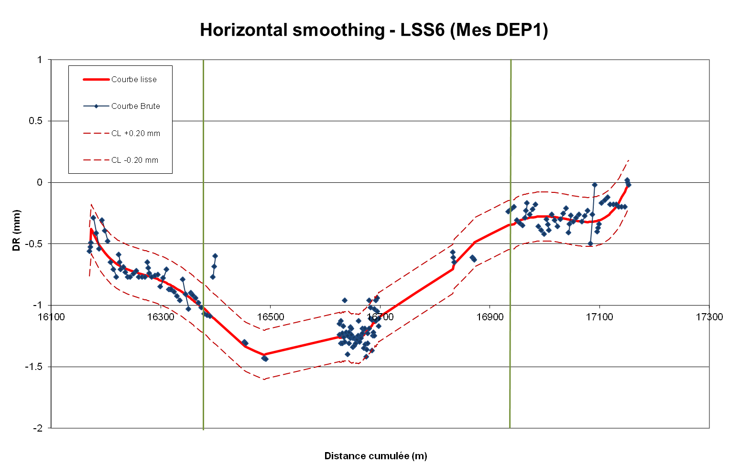
Results
LHC
The fast levelling closed below 5 mm
  New determination of the deep references
  New shape of the LHC magnets after 4.5 years of run and before the repair of the splices
All the Long Straight Sections were measured and realigned in V and H
  Direct levelling
  ecartometry

Slide 17
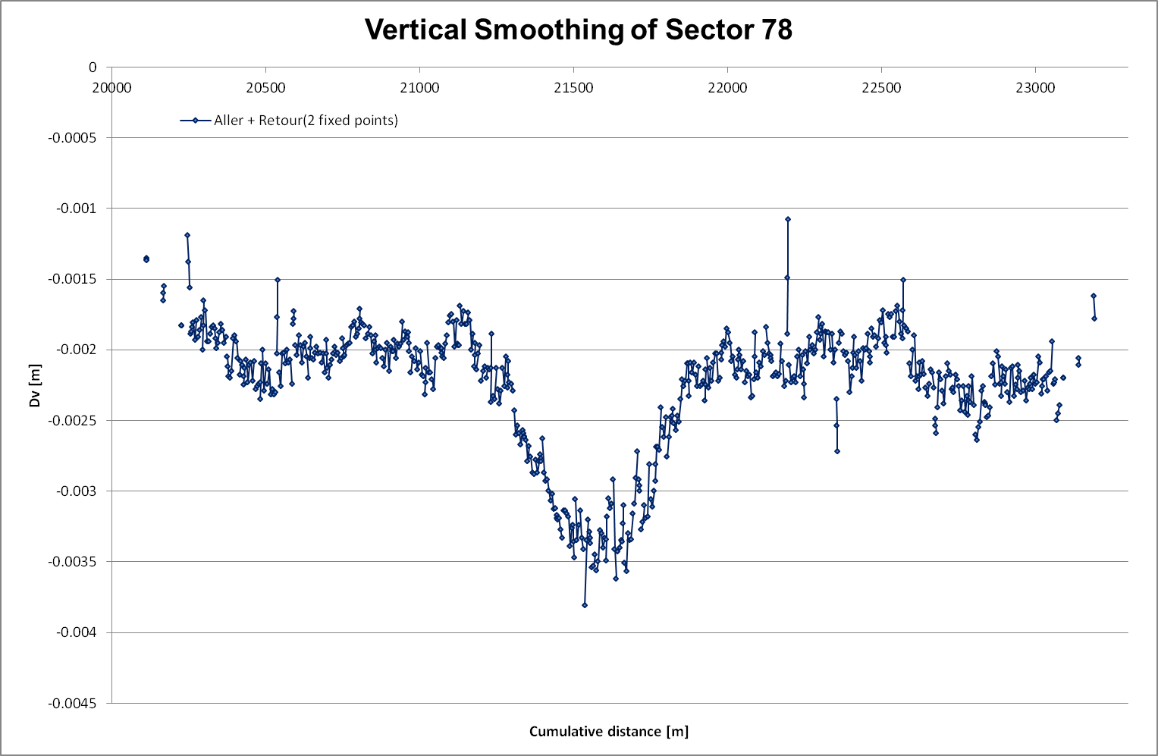
Results
LHC
The ARCS are in the process of being measured
  Direct levelling
  ecartometry
  6/8 done in V
  2/8 done in H
  To be finished by the end of the year

Slide 18
Results
Experiments
The networks of the 4 LHC caverns were remeasured and linked to the network of the accelerator
Survey tasks for the following :
  the extraction of the beam pipes of the four experiments;
    their re-installation in ALICE and in CMS;
    their replacement by new ones in ATLAS and in LHCb;
  the addition of new detectors modules in ALICE;
  the important upgrade of the ATLAS central part
  the construction and positioning of the new YE4 endcap disks of CMS
  the LHCb dipole magnet consolidation
Installation of a monitoring system based on BCAMs for ATLAS (ADEPO) and LHCb

Slide 19
Maintenance
Permanent monitoring of low beta quads
monitoring systems (WPS and HLS)
  Validation for data consistency after the run
  Disassembly for modification
  Sensors cleaning and control
  Validation before the restart
installation of remote qualification systems, such as an automated filling / purging station for the hydrostatic levelling system, a wire displacer system for the control of the stretched wire reference and a wire break sensor
installation of load sensors in the jacks of the triplets in order to have an additional control parameter during remote positioning

Slide 20
Conclusions
During the LS1, almost all the 60 kms of beam lines have been measured and realigned when needed
Experimental caverns survey and monitoring of opening/closure of detectors were done
Maintenance of the permanent monitoring was done as well as installation of new systems
  With only 21 staff members (25% new comers) and 20 external staff
  Within 20 months

Slide 21
Conclusions
It was really ambitious … but we are on the point to succeed because
  It was well prepared
    Started at least 2 years in advance
  It was well co-ordinated
    One staff at 30% was mandatory
  There was a strong involvment of everybody. Thanks to all of them
LS2 is scheduled in 2018 …. It is tomorrow
  Before, all the analysis of the measurements and comparisons have to be done
  All the «small projects and studies» are going to take place (see my poster)

Slide 22
THANK you for your attention

