Slide 1

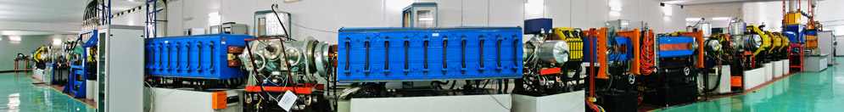

The Comparison of API T3 and Leica AT401 in the Test and Survey
The 13th international Workshops on Accelerator Alignment (IWAA),IHEP,2014
CAI .Guozhu
MAN. Kaidi
Institute of Modern Physcis,CAS

Slide 2
Outline
Different techniques of distance and angle;
Metrology results;
Survey results;
Conclusion
The 13th international Workshops on Accelerator Alignment (IWAA),HEP,2014

Slide 3
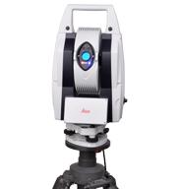
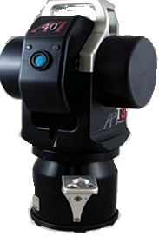

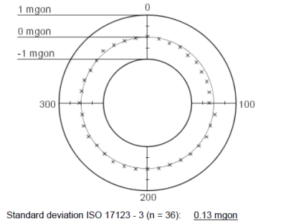
1.Different techniques of distance and angle
Leica AT401 API T3
The tracker is the spherical measurement systemt with two angles and one distance,but…
Distance measurement with laser Interferometer Mode and ADM
ADM
Absolute Angle Encoders
Relative Angle Encoders
The 13th international Workshops on Accelerator Alignment (IWAA),IHEP,2014

Slide 4
Typical Laser Tracker:
For example, Angle accuracy VS Distance accuracy at 10m length
Distance accuracy(IFM ): ±0.5μm/m, 5μm in 10m;
Angle accuracy : ±1 arcsecond,48 μm in 10m.
Above results in 2sigma
>>
ρ=206265
The 13th international Workshops on Accelerator Alignment (IWAA),IHEP,2014

Slide 5
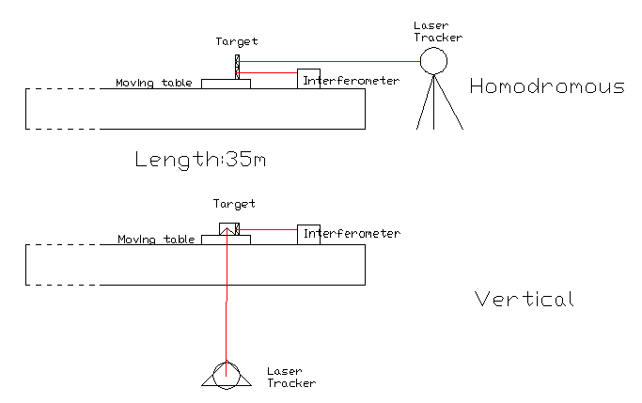
2.Calibration in CHANGCHENG Institute of Metrology & Measurement
Dual-frequency interferometer uncertainty：1X10⁻⁸，k=2
The homodromous and vertical moving the target with the interferometer was designed to calibrate distance and angle accuracy on the testing bench.
The 13th international Workshops on Accelerator Alignment (IWAA),IHEP,2014

Slide 6
Leica AT401 API T3
Leica AT401
API T3
VS
mm
Comparison in Distance
Comparison in Angle
m
The 13th international Workshops on Accelerator Alignment (IWAA),IHEP,2014

Slide 7
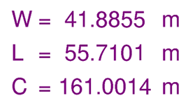
Layout of the Hirfl-CSR(Heavy ion research facility in lanzhou-Cooling Storage Ring)
3.Survey in the CSR
(128.8m)
The 13th international Workshops on Accelerator Alignment (IWAA),IHEP,2014

Slide 8
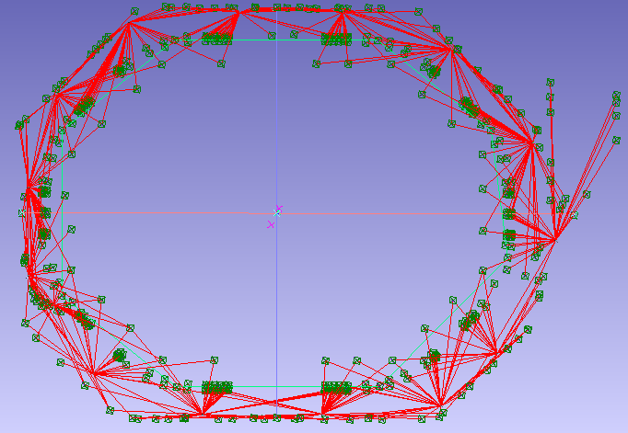
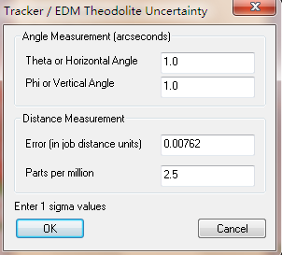
Survey in the CSRm
The CSRm control network with the total 345 points in 15 stations one by one, used bundle adjustment to link the both adjacent stations and closed loop.
Instrument:API T3，temperature：26°C，
Time：2010.8.6
The 13th international Workshops on Accelerator Alignment (IWAA),IHEP,2014

Slide 9
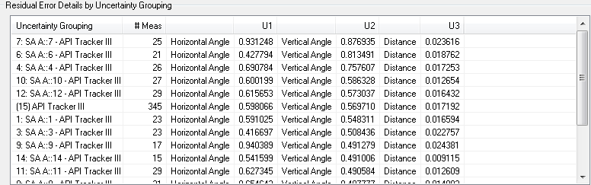
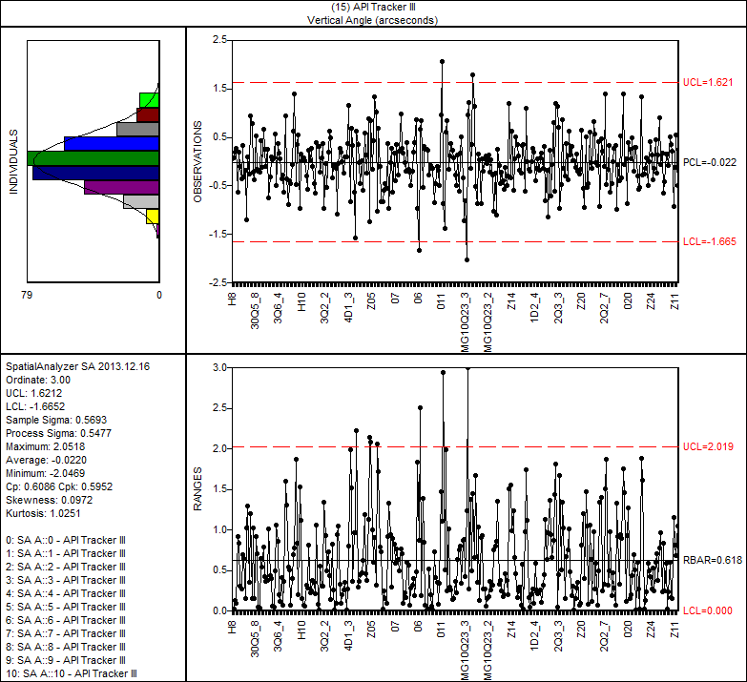
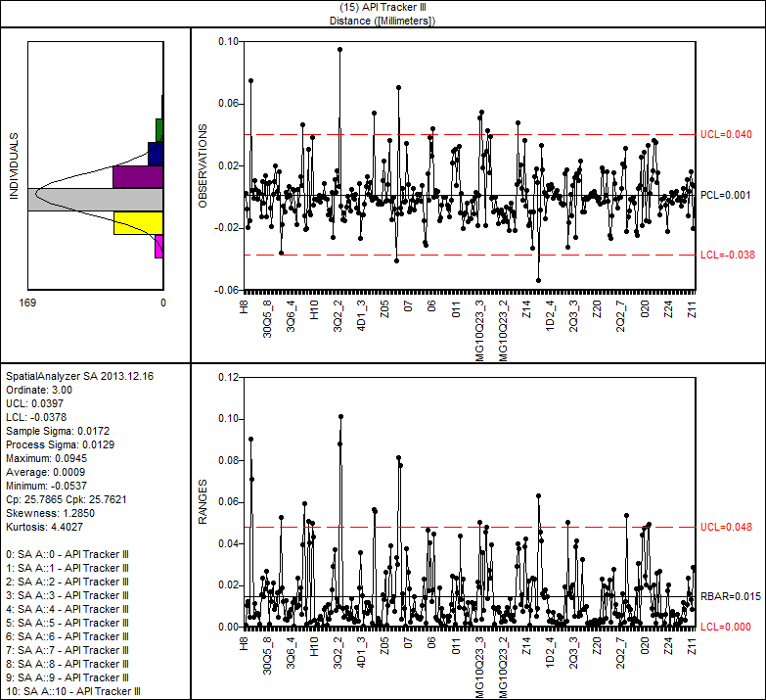
Analysis of instrument residual errors in SA
Horizontal Angle is 0.6 arcsecond
Vertical Angle is 0.57 arcsecond
Distance is 0.017mm
The 13th international Workshops on Accelerator Alignment (IWAA),IHEP,2014

Slide 10
Location uncertainty(6 parameters) in the network(T3).
Ins | Ux | Uy | Uz | URx | URy | URz
T0 | 0.023 | 0.043 | 0.120 | 2.88 | 1.44 | 0.72
T1 | 0.025 | 0.050 | 0.117 | 2.88 | 1.44 | 0.72
T2 | 0.041 | 0.049 | 0.094 | 2.52 | 2.16 | 1.08
T3 | 0.048 | 0.035 | 0.092 | 1.8 | 2.52 | 0.72
T4 | 0.051 | 0.022 | 0.136 | 1.44 | 2.88 | 0.72
T5 | 0.043 | 0.027 | 0.118 | 1.8 | 2.88 | 0.72
T6 | 0.038 | 0.039 | 0.087 | 2.52 | 2.88 | 0.72
T7 | 0.027 | 0.048 | 0.110 | 2.52 | 1.8 | 0.72
T8 | 0.028 | 0.048 | 0.111 | 2.88 | 1.8 | 0.72
T9 | 0.025 | 0.049 | 0.135 | 2.52 | 1.8 | 0.72
T10 | 0.040 | 0.048 | 0.097 | 2.52 | 2.52 | 0.72
T11 | 0.051 | 0.040 | 0.094 | 2.16 | 2.88 | 0.72
T12 | 0.051 | 0.026 | 0.167 | 1.44 | 2.88 | 0.72
T13 | 0.057 | 0.028 | 0.167 | 1.8 | 2.88 | 1.08
T14 | 0.035 | 0.043 | 0.108 | 2.88 | 1.8 | 0.72
The statistic results of all the instruments shows the Uz,URx,Ury is bigger than other, the reason maybe is the shape of the network or the performance of the tracker.
The 13th international Workshops on Accelerator Alignment (IWAA),IHEP,2014

Slide 11
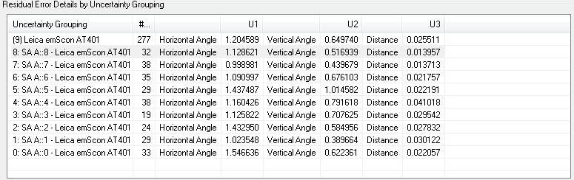
Survey in the CSRe with AT401
The CSRe control network with 10 stations one by one, and closed loop too.
Time：2013.8
Instument:AT401，temperature：25°C，
The 13th international Workshops on Accelerator Alignment (IWAA),IHEP,2014

Slide 12
Location uncertainty in the network(AT401 in survey CSRe).
Inst | Ux | Uy | Uz | URx | URy | URz
T0 | 0.01 | 0.02 | 0.05 | 1.08 | 1.08 | 0.36
T1 | 0.01 | 0.02 | 0.06 | 1.08 | 1.44 | 0.36
T2 | 0.03 | 0.02 | 0.04 | 1.08 | 1.8 | 0.36
T3 | 0.03 | 0.02 | 0.06 | 1.08 | 2.52 | 0.72
T4 | 0.02 | 0.02 | 0.04 | 2.16 | 1.44 | 0.72
T5 | 0.01 | 0.02 | 0.07 | 2.52 | 1.44 | 0.72
T6 | 0.01 | 0.02 | 0.07 | 1.08 | 1.44 | 0.36
T7 | 0.02 | 0.01 | 0.03 | 0.72 | 1.44 | 0.36
T8 | 0.02 | 0.02 | 0.05 | 0.72 | 1.44 | 0.36
The results are same as the survey in the CSRm with T3.
So it is the weakness in height measurement by tracker in the ring survey network,leveling is necessary was proved again!
The 13th international Workshops on Accelerator Alignment (IWAA),IHEP,2014

Slide 13
All previous CSRm survey list:
Year | Inst | Stations | Points | Overall error(mm) | Up-mean(mm) | Uh(“) | Uv（“） | Ud（mm）
2010.8 | T3 | 15 | 345 | 0.03 | 0.13 | 0.6 | 0.57 | 0.017
2011.4 | T3 | 15 | 320 | 0.03 | 0.17 | 0.63 | 0.63 | 0.020
2011.8 | AT401 | 13 | 270 | 0.047 | 0.25 | 1.5 | 0.49 | 0.038
2012.8 | T3 | 14 | 297 | 0.067 | 0.20 | 1.12 | 1.16 | 0.076
2013.7 | AT401 | 14 | 356 | 0.07 | 0.12 | 2.0 | 0.6 | 0.038
2013.8 | T3 | 14 | 393 | 0.06 | 0.07 | 0.8 | 1.28 | 0.032
1,Overall error <=0.07mm,and uncertainty average is about 0.2mm;
2,The performance of AT401 is stable, althought the distance performance is worse than T3;
3,The stablity of T3 needs to be pay attention to do field check and calibration need to be done usually!
The 13th international Workshops on Accelerator Alignment (IWAA),IHEP,2014

Slide 14
4.Conclusion
T3 is outstanding distance performance along the laser emission direction.
AT 401 is the equivalent of 3D performance with T3 in the network surveying.
Both AT 401 and T3 is the low accuracy in height measurement of the ring control network.
The 13th international Workshops on Accelerator Alignment (IWAA),IHEP,2014

Slide 15

Lanzhou City
Thanks for attention very much!
The 13th international Workshops on Accelerator Alignment (IWAA),IHEP,2014

