Slide 1
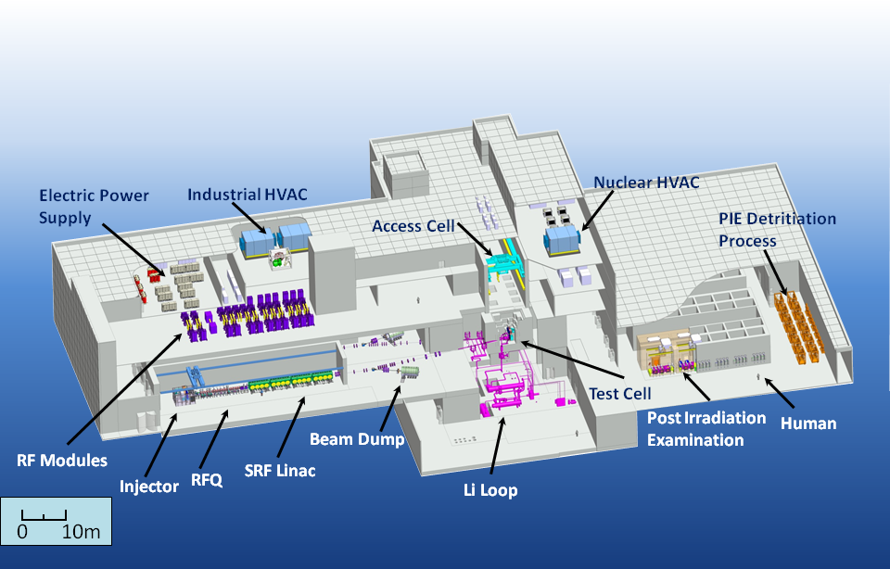
Alignment of LIPAC
the Linear IFMIF Prototype Accelerator: requirements and current status
F. Scantamburlo et al.
(IFMIF/EVEDA Project Team)
IWAA 2014 - Beijing

Slide 2
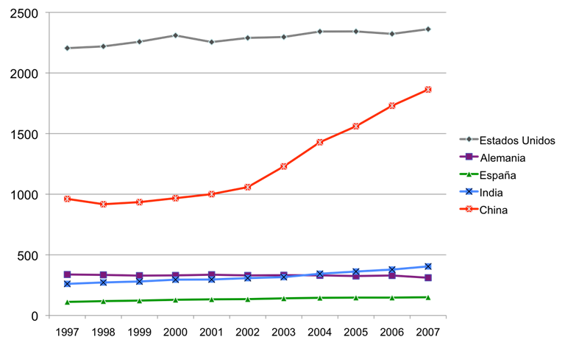
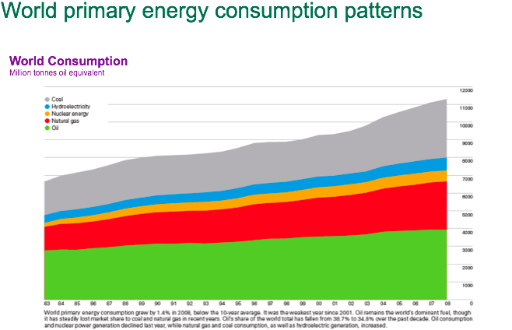
World energy scenario
In 2 years,
the growth of energy consumption in China was greater than total consumption in Germany
80% of world energy generated
from fossil fuels
Medium term Problems
Greenhouse effect
Resources are finite
FUSION ENERGY WILL BECOME A SOLUTION

Slide 3
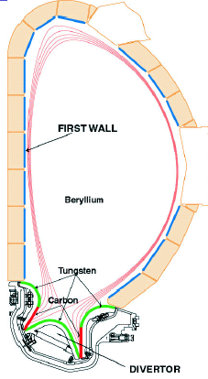
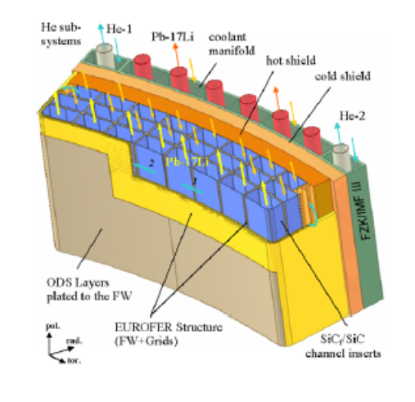
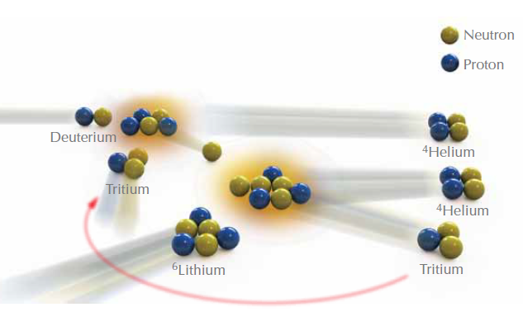
Neutrons in first wall
ITER first wall will present
<2 dpa at the end of its operational life
In a Fusion power plant
~150 dpa within 5 years are expected
Transmutation energies threshold
of Fe >3 MeV yield α-particles
He induced embrittlement
Section of Vacuum Vessel
of a Tokamak
The first wall
of the reactor vessel shall
absorb neutrons energy
and
breed tritium

Slide 4
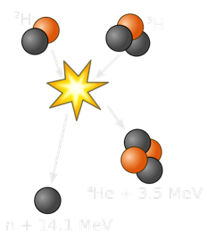
14 MeV beyond transmutation thresholds
The accumulation of gas in the materials lattice is intimately related with the neutron energy
⁵⁶Fe(n,α)⁵³Cr
(incident n threshold at 2.9 MeV)
and
⁵⁶Fe(n, p)⁵⁶Mn
(incident n threshold at 0.9 MeV)
Noble gases are not dissolved in metals
Swelling and embrittlement of materials takes place

Slide 5
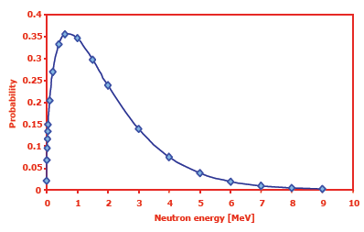
Fission and spallation sources no fusion n relevant
Existing neutron sources
do not provide the needed answers
Fission reactors n average energy ~2 MeV
Spallation sources present a wide spectrum
with tails in the order of hundreds of MeV
Generation of light isotopes in the order of ppm
Watt
Distribution
(fission n spectrum)
No efficient
p⁺ or α-particle generation

Slide 6
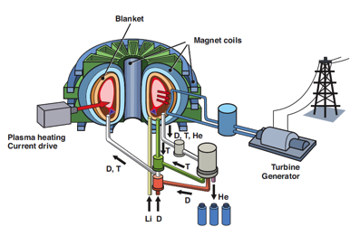
Do we need Fusion relevant n source?
Understanding the degradation of physical properties
of the materials critically exposed to 14.1 MeV n flux
is a key parameter for all machines after ITER to allow
accomplishment of the design
and
facility licensing
Material scientists need experimental data
given the number of variables playing a primary role
in materials degradation
neutrons flux
neutrons spectrum
neutrons fluence
material temperature,
thermo-mechanical history and microstructure
mechanical loading
lattice kinetics…
In ITER ~3 dpa at its end of life
In a Fusion Power plant ~30 dpa/year
ITER expects ~2 dpa
at the end of its operational life
A fusion power plant ~30 dpa/year

Slide 7

Broader Approach Agreement
IFMIF/EVEDA
A fruitful Japanese- European
International collaboration
(Broader Approach Agreement)
with 7 countries involved
with the respective main research labs in Europe
and main universities in Japan

Slide 8
IFMIF/EVEDA
IFMIF
International Fusion Materials Irradiation Facility
EVEDA
Engineering Validation & Engineering Design Activities
Article 1.1 of Annex A of the BA Agreement
mandates IFMIF/EVEDA
…to produce an integrated engineering design of IFMIF and the data necessary for future decisions on the construction, operation, exploitation and decommissioning of IFMIF, and to validate continuous and stable operation of each IFMIF subsystem
Signed in February 2007
Entered into force on June 2007

Slide 9
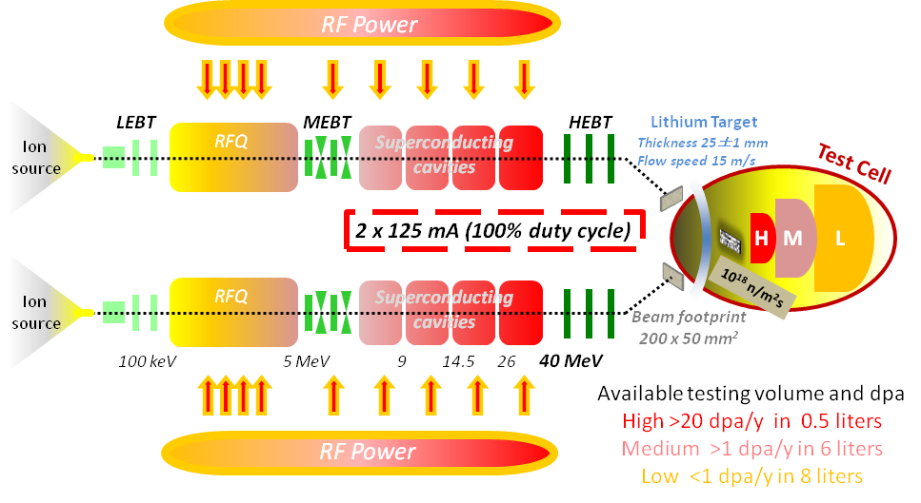
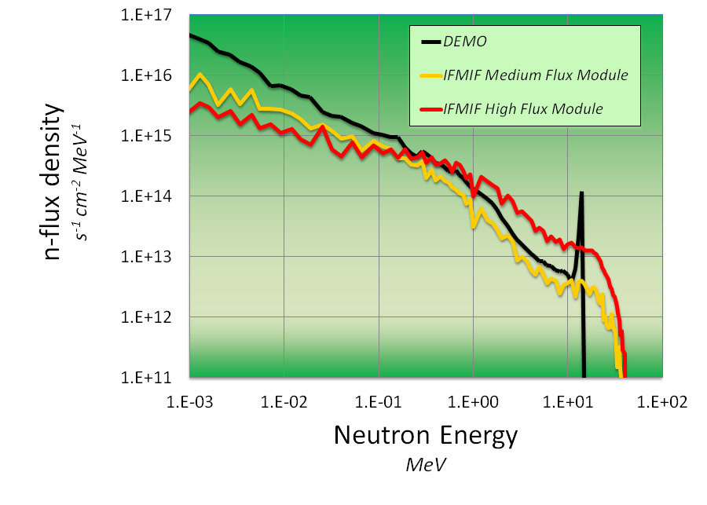
IFMIF concept
Deuterons at 40 MeV
collide on a liquid Li screen
flowing at 15 m/s
A flux of 10¹⁸ n·m⁻²s⁻¹
is stripped
with a broad peak
at 14 MeV
Availability of facility >80%
International Fusion Materials Irradiation Facility

Slide 10
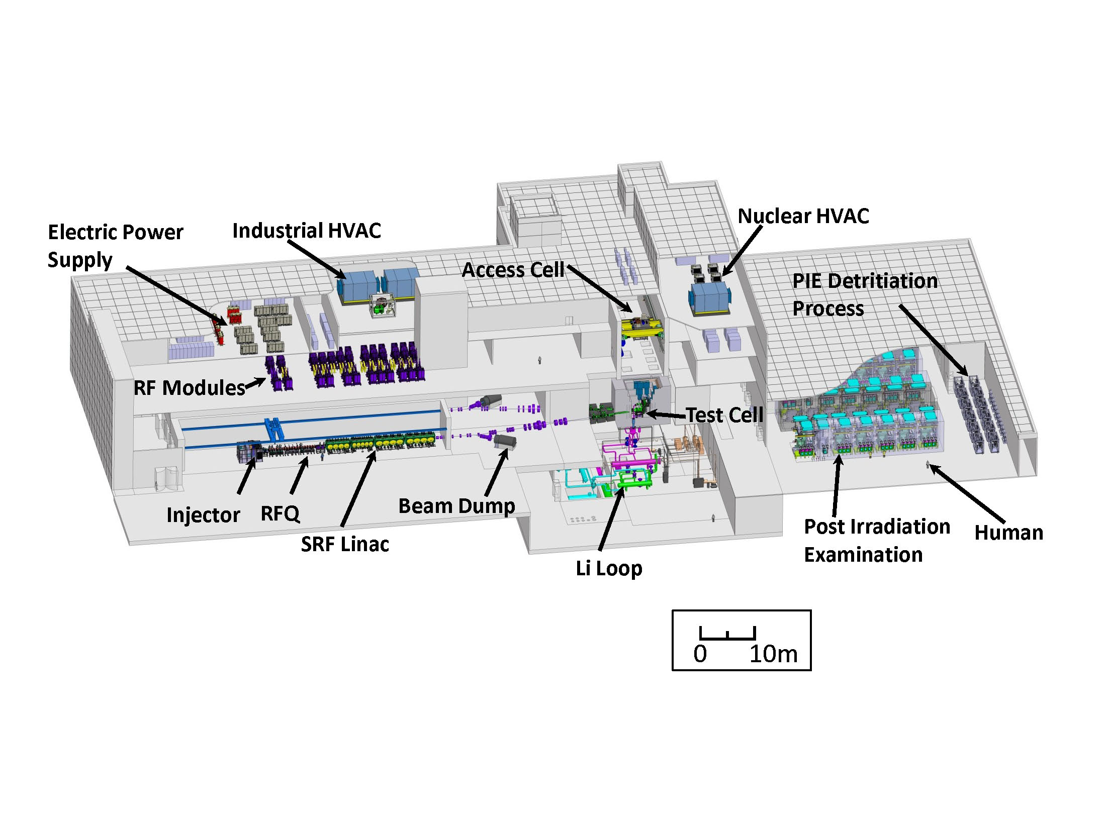
Engineering Validation Activities (EVA) Phase
The Design of IFMIF is broken down in 5 facilities
Accelerator Facility
Lithium Target Facility
Test Facility
Post-irradiation and Examination Facility
Conventional Facilities
Objective of Validation activities

Slide 11
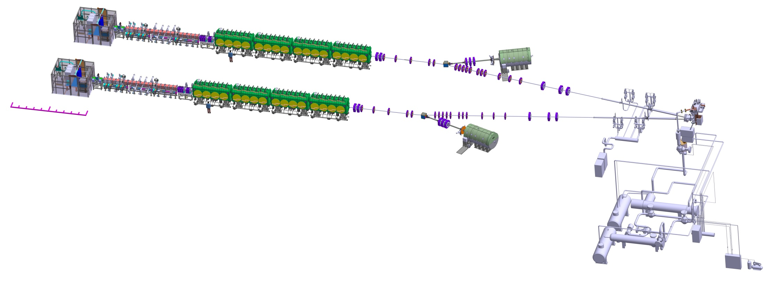
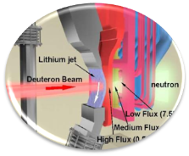


Accelerator facility of IFMIF
2 x 5 MW beams
10 m
the highest intensity
the highest beam power
the highest space charge
the longest RFQ
Individual availability of >90%
10
D⁺ source
CW 140 mA
100 keV
RFQ
175 MHz
5 MeV
SRF Linac
HWR 175 MHz
40 MeV
2 accelerators, 2 x 125 mA, 2 x 5MW
Beam shape
200 x 50 mm²

Slide 12
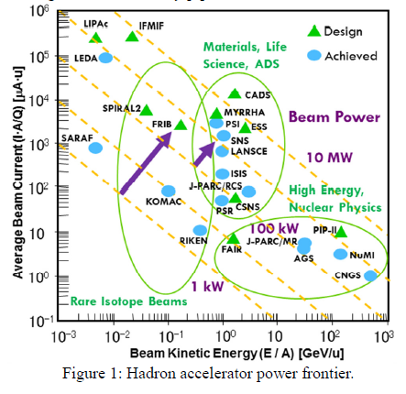
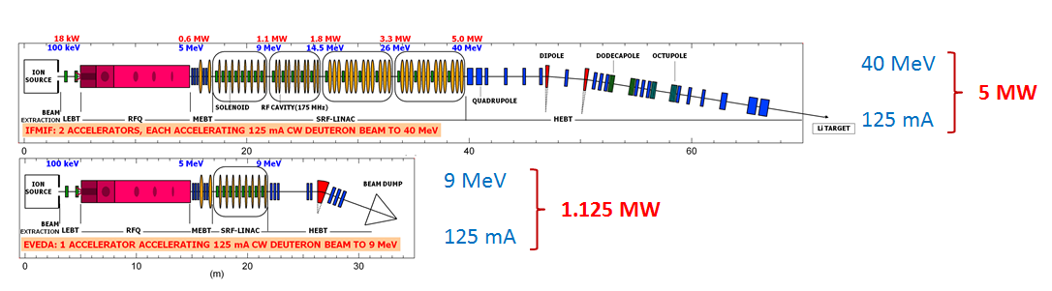
Linear IFMIF Prototype Accelerator - LIPAc
  Features of IFMIF vs LIPAc
  d⁺ accelerator
  125 mA CW
  5 MW vs 1.125 MW
  Space charge issues
  Low energy/high power
  So are LIPAc as IFMIF
  within present accelerator technology
WEI, J. et al., The very high intensity future, IPAC 2014, Dresde, www.jacow.org
NGHIEM, P.H.P. et al., The IFMIF-EVEDA Challenges in Beam Dynamics and their Treatment, Nucl. Inst. Meth. 654 (2011) 63–71

Slide 13
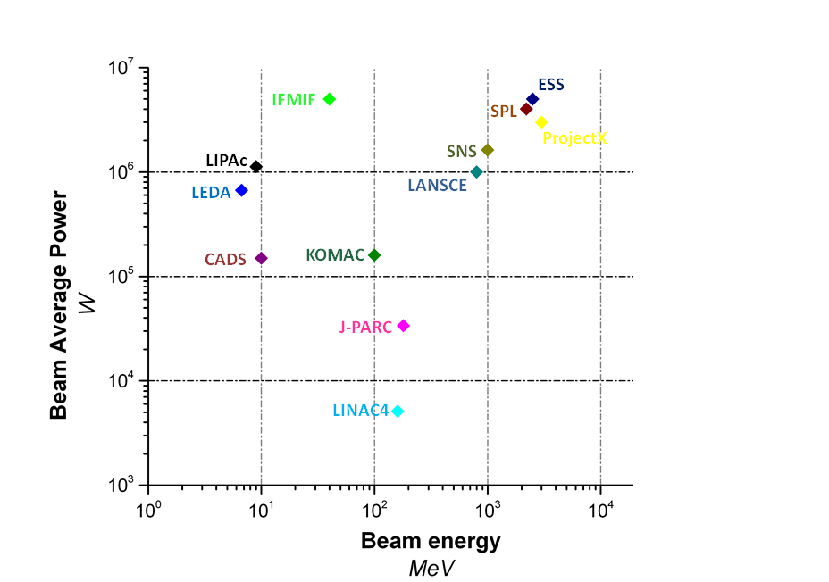

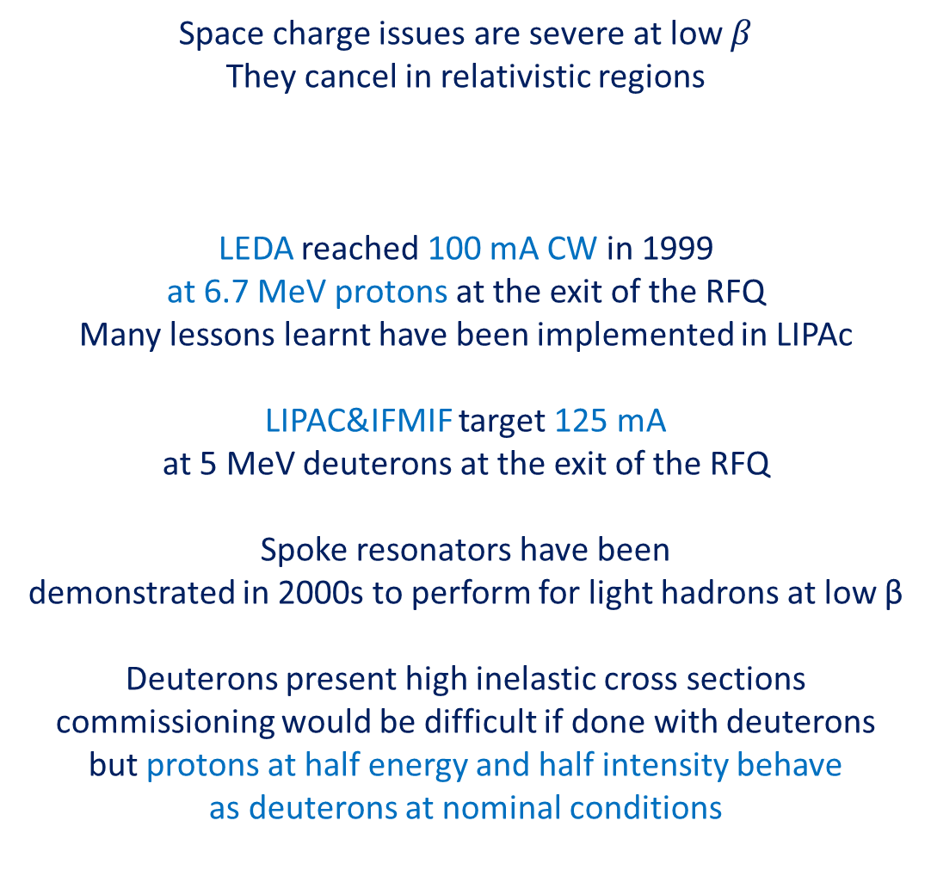
Features of LIPAc
Space charge issues are severe at low $β$
They cancel in relativistic regions
LEDA reached 100 mA CW in 1999
at 6.7 MeV protons at the exit of the RFQ
Many lessons learnt have been implemented in LIPAc
LIPAC&IFMIF target 125 mA
at 5 MeV deuterons at the exit of the RFQ
Spoke resonators have been
demonstrated in 2000s to perform for light hadrons at low β
Deuterons present high inelastic cross sections
commissioning would be difficult if done with deuterons
but protons at half energy and half intensity behave
as deuterons at nominal conditions
SCANTAMBURLO, F. et al., LIPAc, the 125 mA/9 MeV CW deuteron IFMIF’s prototype accelerator: what lessons have we learnt from LEDA?, IPAC2014

Slide 14
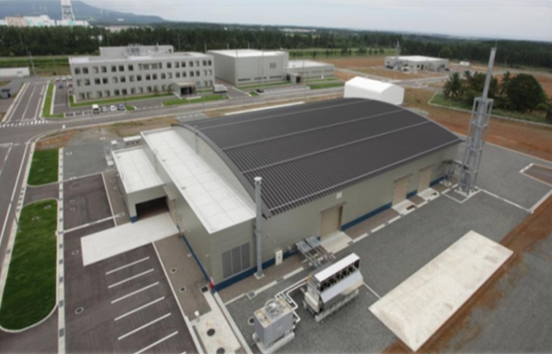
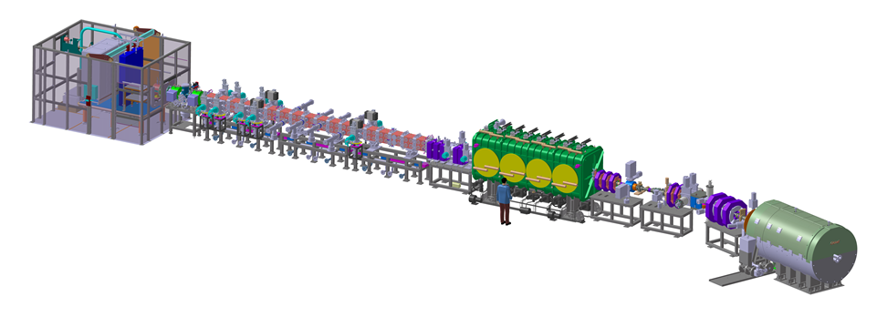
Accelerator facility validation
★
Rokkasho
Installed and commissioned in Rokkasho
★
Oarai
Injector + LEBT
CEA Saclay
RFQ
INFN
JAEA Tokai
SRF Linac
CEA Saclay
CIEMAT Madrid
MEBT
CIEMAT Madrid
HEBT
CIEMAT Madrid
BD
CIEMAT Madrid
36 m
Diagnostics
CEA Saclay
CIEMAT Madrid
RF Power
CIEMAT Madrid
CEA Saclay
SCK Mol

Slide 15
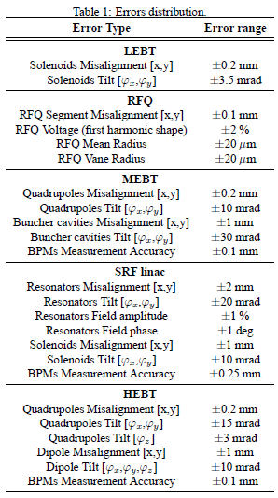
Why accurate alignment in LIPAc is important?
LEDA reached 100 mA @ 6.7 MeV at the exit of the RFQ
with protons in CW in 1999:
beam losses mainly due to beam halo
Beam dynamics calculation on IFMIF accelerator
indicates feasibility of nominal performance
125 mA @ 5 MeV at the exit of the RFQ + SC accelerating stages
The alignment/learning the position of some components
in ± 0.1 mm respect the beam axis is indispensable to:
ramp up correctly the current,
contain beam losses to 1 W/m to allow hands-on maintenances
N. Chauvin et al., Start-To-End beam dynamics simulations for the prototype accelerator of the IFMIF/EVEDA Project, IPAC 2011
P. Nghiem et al., “A catalogue of losses for a high power, high intensity accelerator”, Laser and Particle Beams (2014), 32, 461–469.

Slide 16
Beam halo physics
Beam halo is known to be a major cause
of beam loss and activation
in high current hadron Linacs
LEDA reached 100 mA at 6.7 MeV with protons
and demonstrated that beam halo is due to resonances between individual particles and beam core oscillations
through optical mismatches in transition regions
Installation & commissioning key aspects
Precise alignment
Halo-matching approach
J. Wei, The very high intensity future, IPAC 2014
C.K. Allen et al., Beam Halo Measurements in high current Proton Beams, Phys. Rev. Lett. 89, 214802
P. Nghiem et al., The IFMIF-EVEDA Challenges in Beam Dynamics and their Treatment, Nucl. Inst. Meth. 654 (2011) 63–71

Slide 17
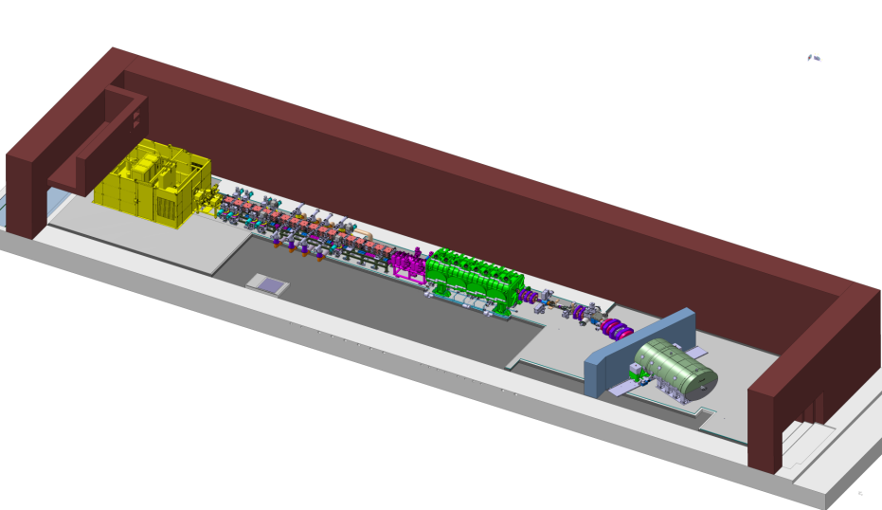
LIPAc Alignment requirements
Accuracy assembly requirements
to meet beam halo requirements
are on the limit
of instrumentation performances
35 m
± 0.1 mm
Linear IFMIF Prototype Accelerator
LIPAc

Slide 18
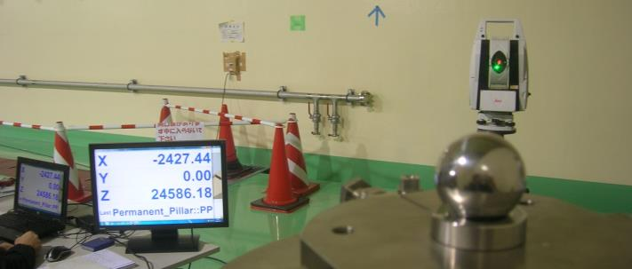
Instrumentation and software
LEICA AT401 Laser Tracker:
  One of the most accurate tracker in the market (MPE angle accuracy ±(16μm+5μm/m), MPE distance accuracy: ±10 μm, level accuracy: ± 1 arcsec);
  Portability
Spatial Analyzer Ultimate metrology software:
  Experience of F4E ITER Metrology team
  Capability of estimate the uncertainty of measurements through USMN algorithm
  Capability of simulations of measurements to optimize measurement process;
  Verification of instrument performance in the real environment

Slide 19
Metrology objective
According to ISO and NIST, GUM,
the measurements must be accompanied
with their uncertainty
To asses device position tolerance range +/- 0.1 mm in the assembly hall
ITER metrology handbook:
Target measuring uncertainty
< 0.02 mm in the assembly hall

Slide 20
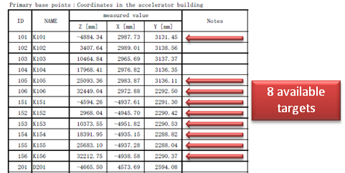
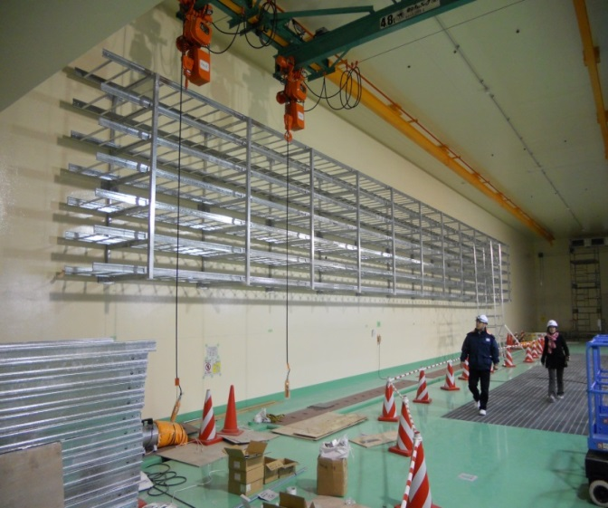
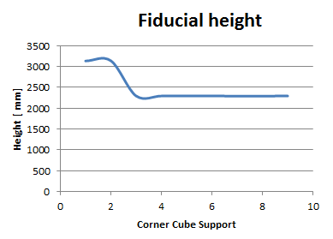
Former original existing Network
According to Spatial Analyzer Simulation made by F4E
the uncertainty of locating the tracker would be
0.13 mm
which was not compatible
with the tolerance range to be assessed
+/- 0.1 mm

Slide 21
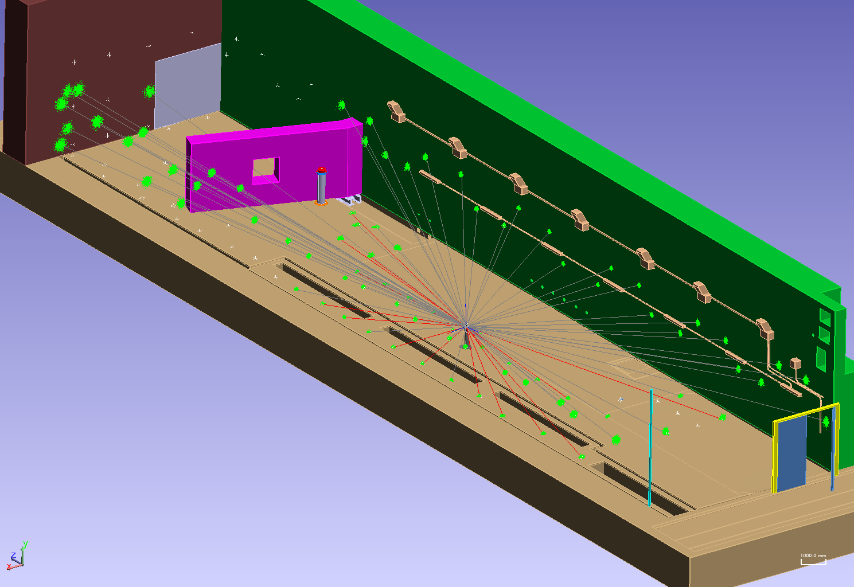
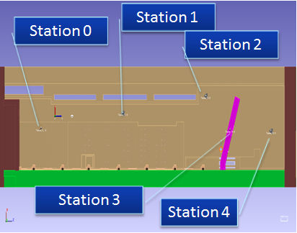
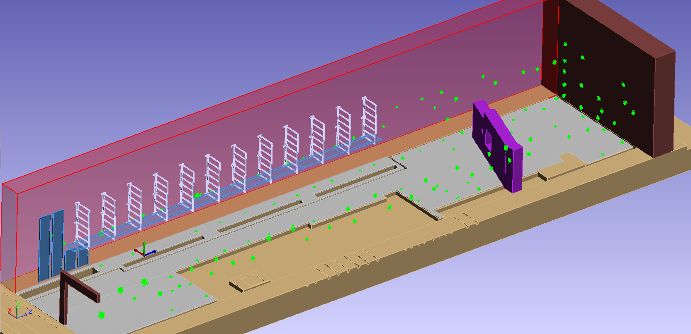
New network design - simulations
Placement of 120 new fiducials surveyed 5 times by 5 station will limit
measurement uncertainties <0.02 mm with the laser tracker Leica AT401 suitably located
in the accelerator hall during all future alignment tasks

Slide 22
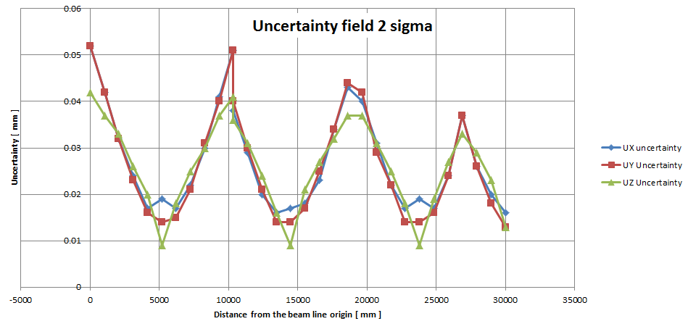
New network design - simulations
Uncertainty field evaluation
along the beam line
after USMN 1000 samples @ 2 σ
Target
uncertainty
Laser Tracker stations

Slide 23
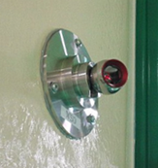
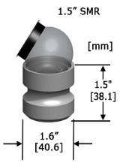
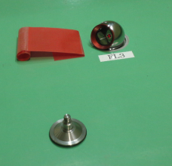
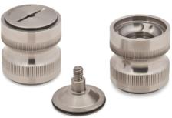
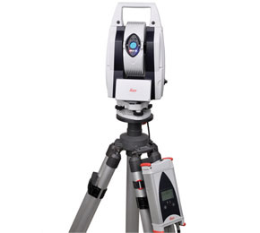
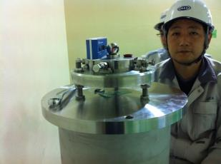
Upgrade of the alignment network - survey
50 Floor nests
69 Wall supports ad hoc machined
1 datum Pillar with
Micro-adjustable screws
Leica AT 401

Slide 24
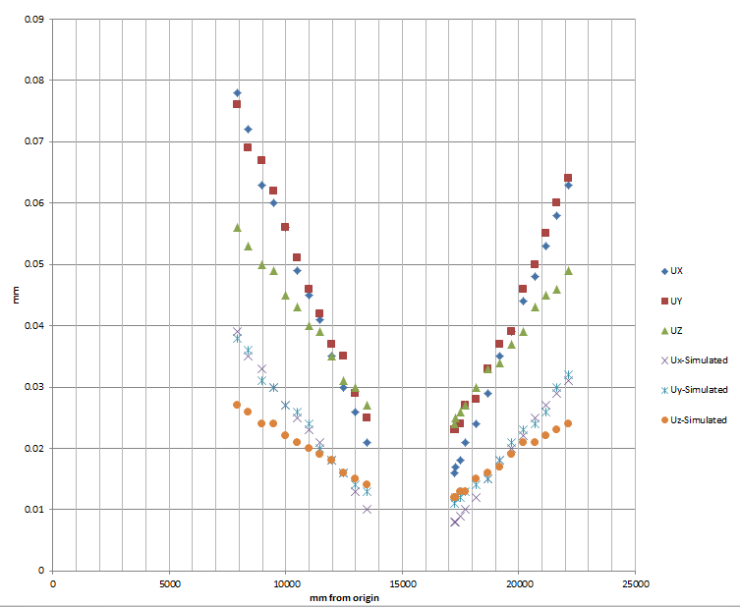
Real vs simulated measurements Uncertainty plot

Slide 25
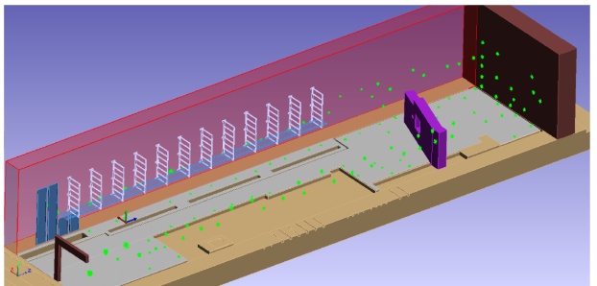
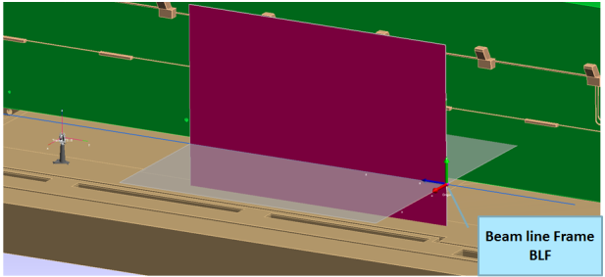
Beam Line Coordinate Frame (BLF)
The BLF is intrinsically defined by the coordinate of the
130 network fiducials
Horizontality has been improved using the AT401 levelling capabilities

Slide 26
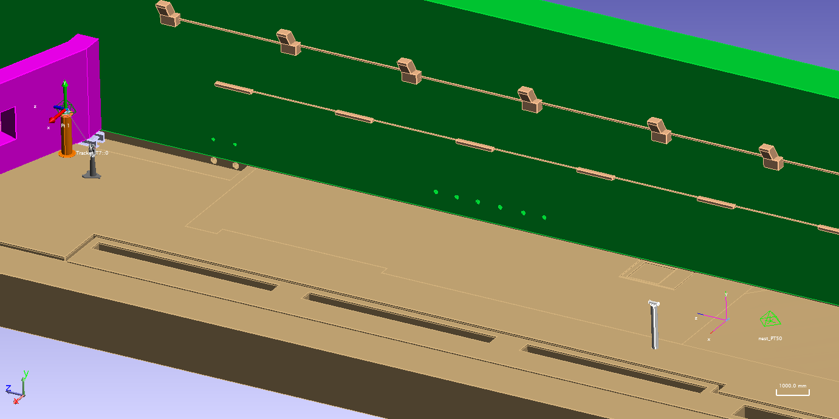
Global Coordinate Frame (GCF)
Since the beam line frame is not materialized
we retained worth to materialize a coordinate frame
in the accelerator vault to make quick checks
of the impact on the alignment of exceptional events (i.e. an earthquake)
The origin is placed on a particular floor fiducial.
The position of a reference on a pillar has been adjusted
to obtain an axis parallel to the beam line

Slide 27
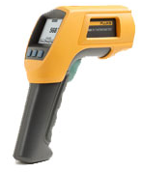
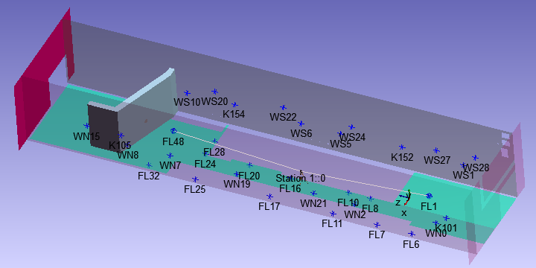
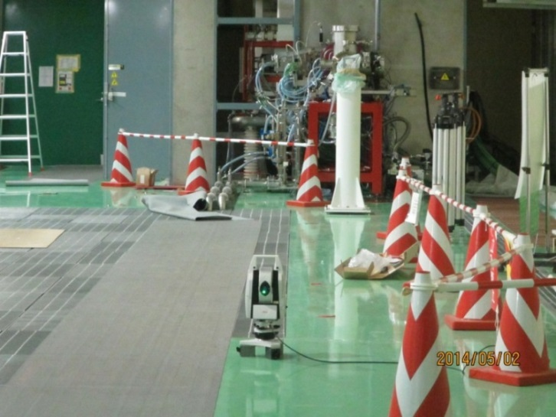
Effect of thermal expansion of the building
Rokkasho enjoys hard winters and hot summers
we established a simple procedure to study and eventually compensate
the effect of thermal expansion of the building:
Weekly measurement by LT the distance between two particular points on the floor
almost aligned with the beam line
Weekly measurement of the air temperature in the vault and external temperature
Weekly measurement thermometer the temperature of the floor on 30 points evenly spread
Monitoring will continue on a period including at least one winter and one summer

Slide 28
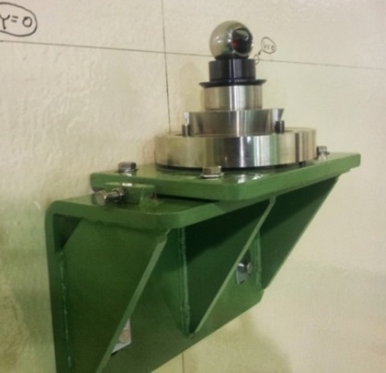
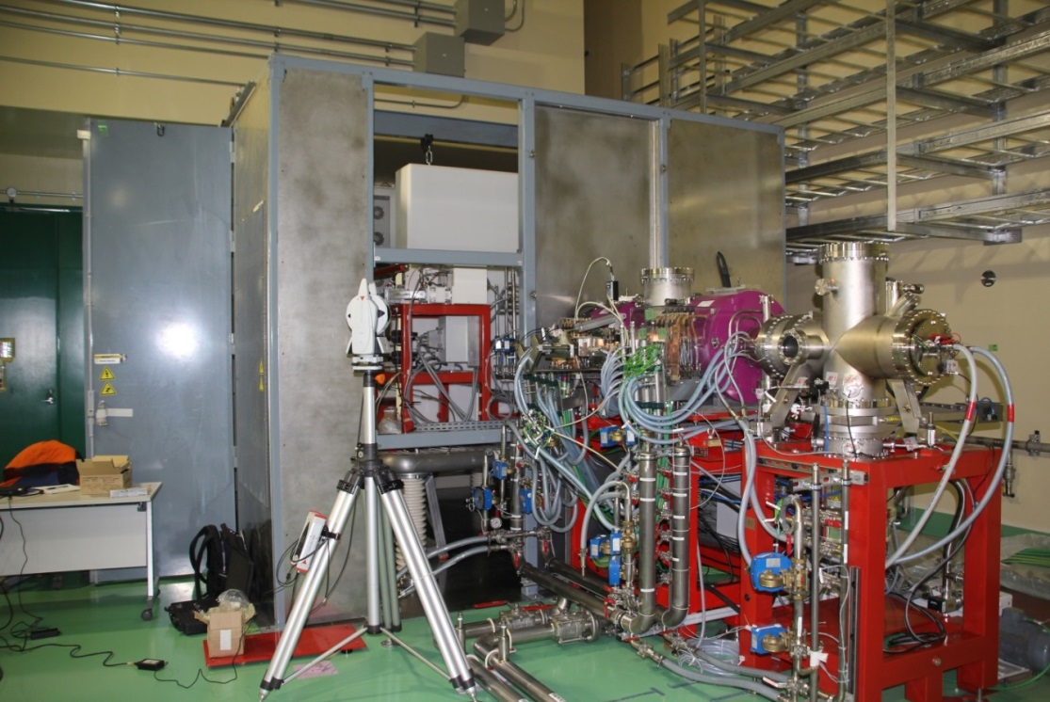
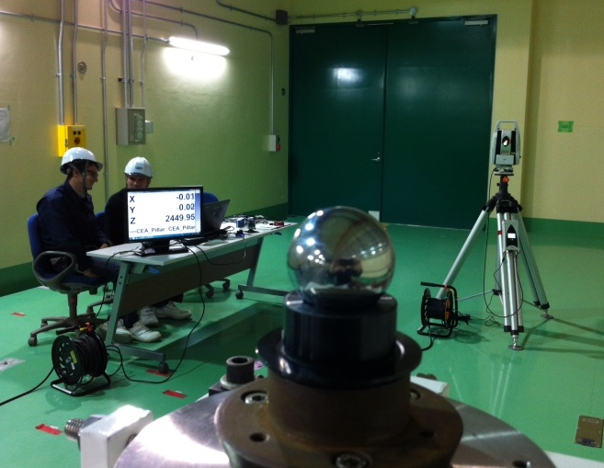
Injector alignment
The injector and the LEBT have been successfully assembled and aligned with TH system in May 2014
Differentely from the other components which will be fiducialized in Europe before delivery in Rokkasho
the Injector and the LEBT were fiducialized
by AT401 after TH alignment.

Slide 29
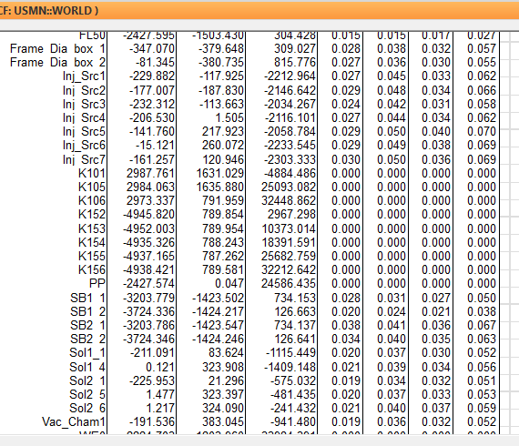
Injector alignment
With good success!
Max uncertainty 0.04 mm

Slide 30
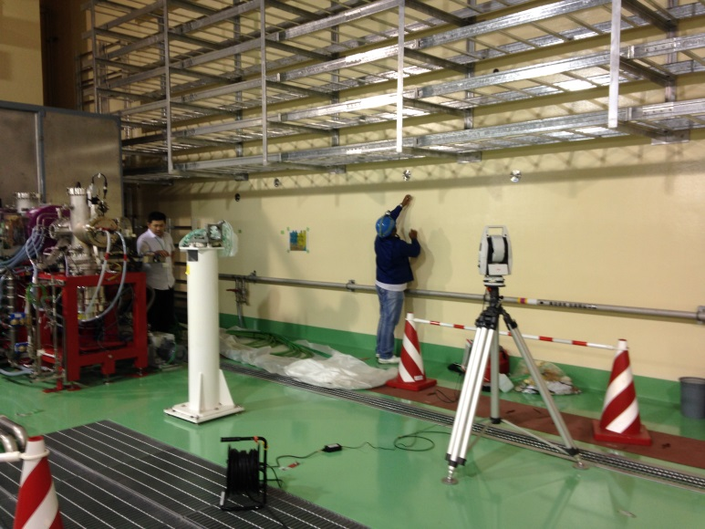
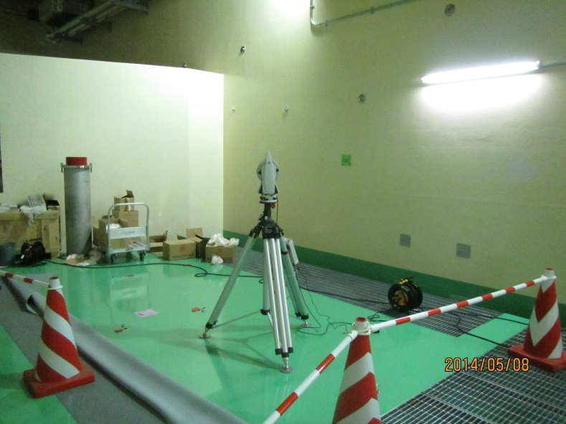
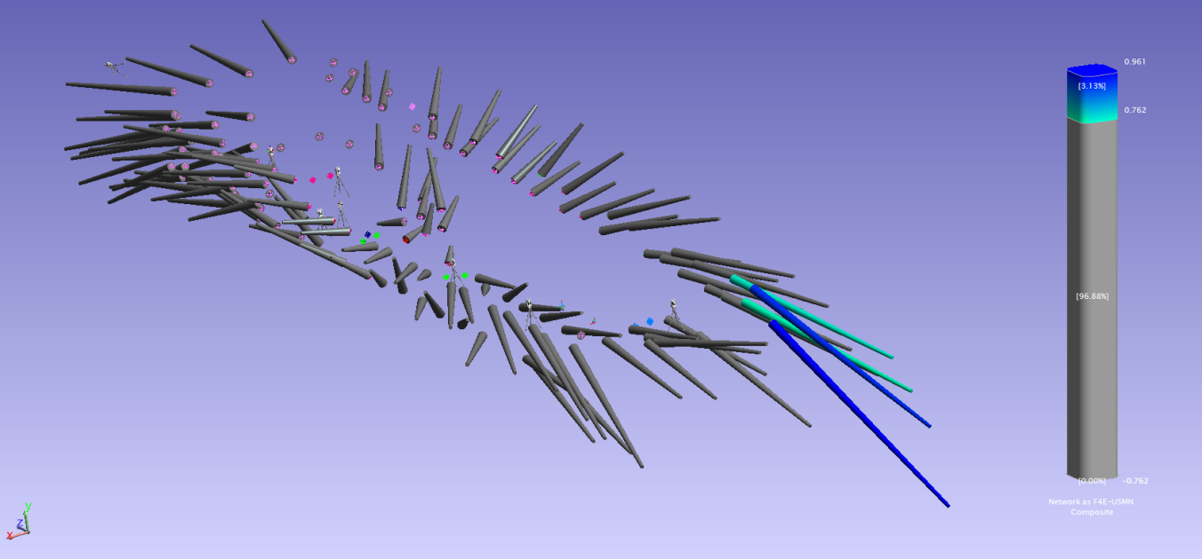
Redefinition of the network
An update of the network has been performed in August 2014
movements of the building
not related to the thermal expansion
did not allow anymore locating the instrument within the target uncertainty
RMS< 0.025 mm
A deviation of 0.05 mm in transversal (X axis) and vertical (Y axis)
of the beam line has been registered

Slide 31
Conclusions
SA software with USMN has been a key factor for the definition of the network in the accelerator hall
Simulation tool demonstrated to be very effective to plan, organize and optimize measurement campaigns
Thermal expansion study is ongoing
Efficient alignment actions have been in place and we are ready for the alignment of the components coming in the coming months

Slide 32

L. Semeraro, A. Lo Bue, L. Poncet, F4E
T. Morishita, H. Sakaki, H. Shidara, JAEA
THANK YOU!!!

Slide 33
Thank you for your attention

