Slide 1
Alignment of the 12 GeV CEBAF Accelerator
Christopher Curtis
Thomas Jefferson National Accelerator Facility,
Newport News , Virginia, USA

Slide 2
Jefferson Lab Site c.2006

Slide 3
Jefferson Lab Site 2014

Slide 4
CEBAF 12 GeV Upgrade
New Hall
Upgrade arc magnets
and supplies
Add 5 cryomodules
N. Linac
E.Arc
20 existing cryomodules
CHL upgrade
S. Linac
Add arc
20 existing cryomodules
W.Arc
Add 5 cryomodules
Enhanced capabilities
in existing Halls

Slide 5
CEBAF 12 GeV Upgrade - Linacs

Slide 6
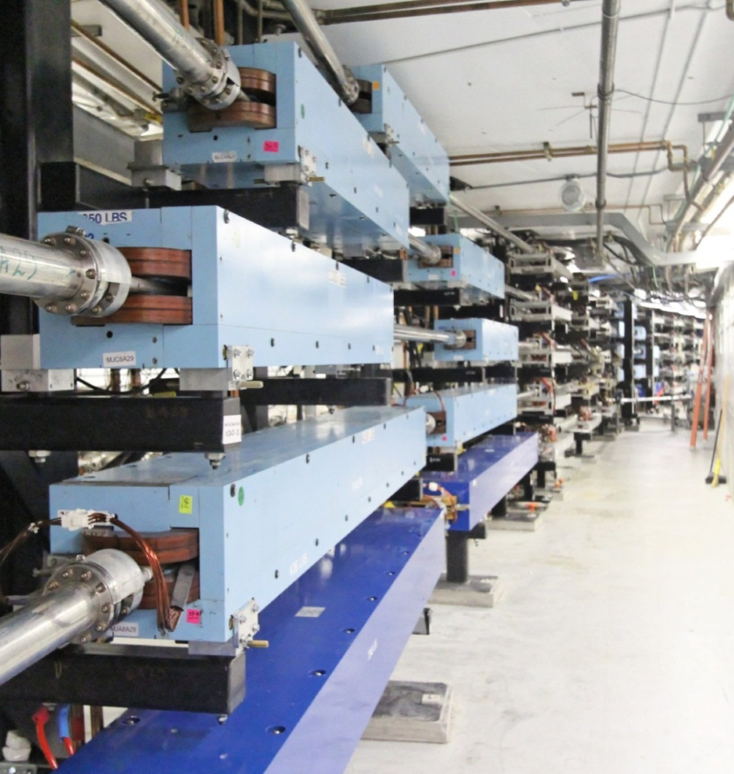
CEBAF 12 GeV Upgrade - Arcs
Steel Added
Arc 10

Slide 7
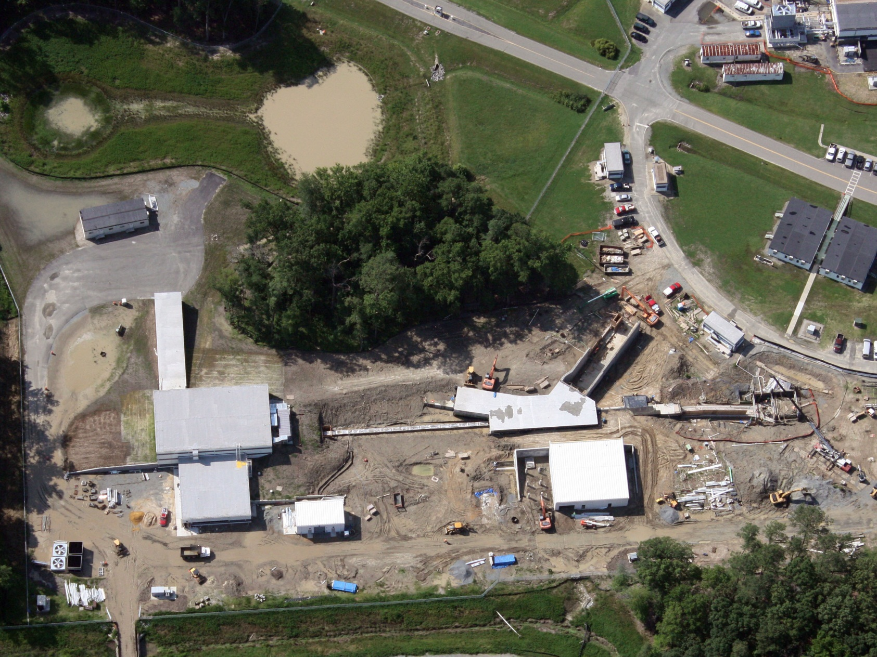
Hall D Complex – July 2011
Tagger Area
Beam Line
Hall D
N. Linac
Cryo Plant

Slide 8
Hall D Tagger & Service Building – May 2011
Tagger Area
Service Bldg
Electron Beam Dump
Photon Beam Pipe to Hall D

Slide 9
Survey Network for Construction
Penetrations
Penetrations

Slide 10
Preliminary Accelerator Survey Network
Network Survey Results - 2008
Laser Tracker – Free Stationed

Slide 11
“Skeleton” Survey Network
2009
Theodolites – Force Centered

Slide 12
Current Survey Network
Network Survey Results - 2012

Slide 13
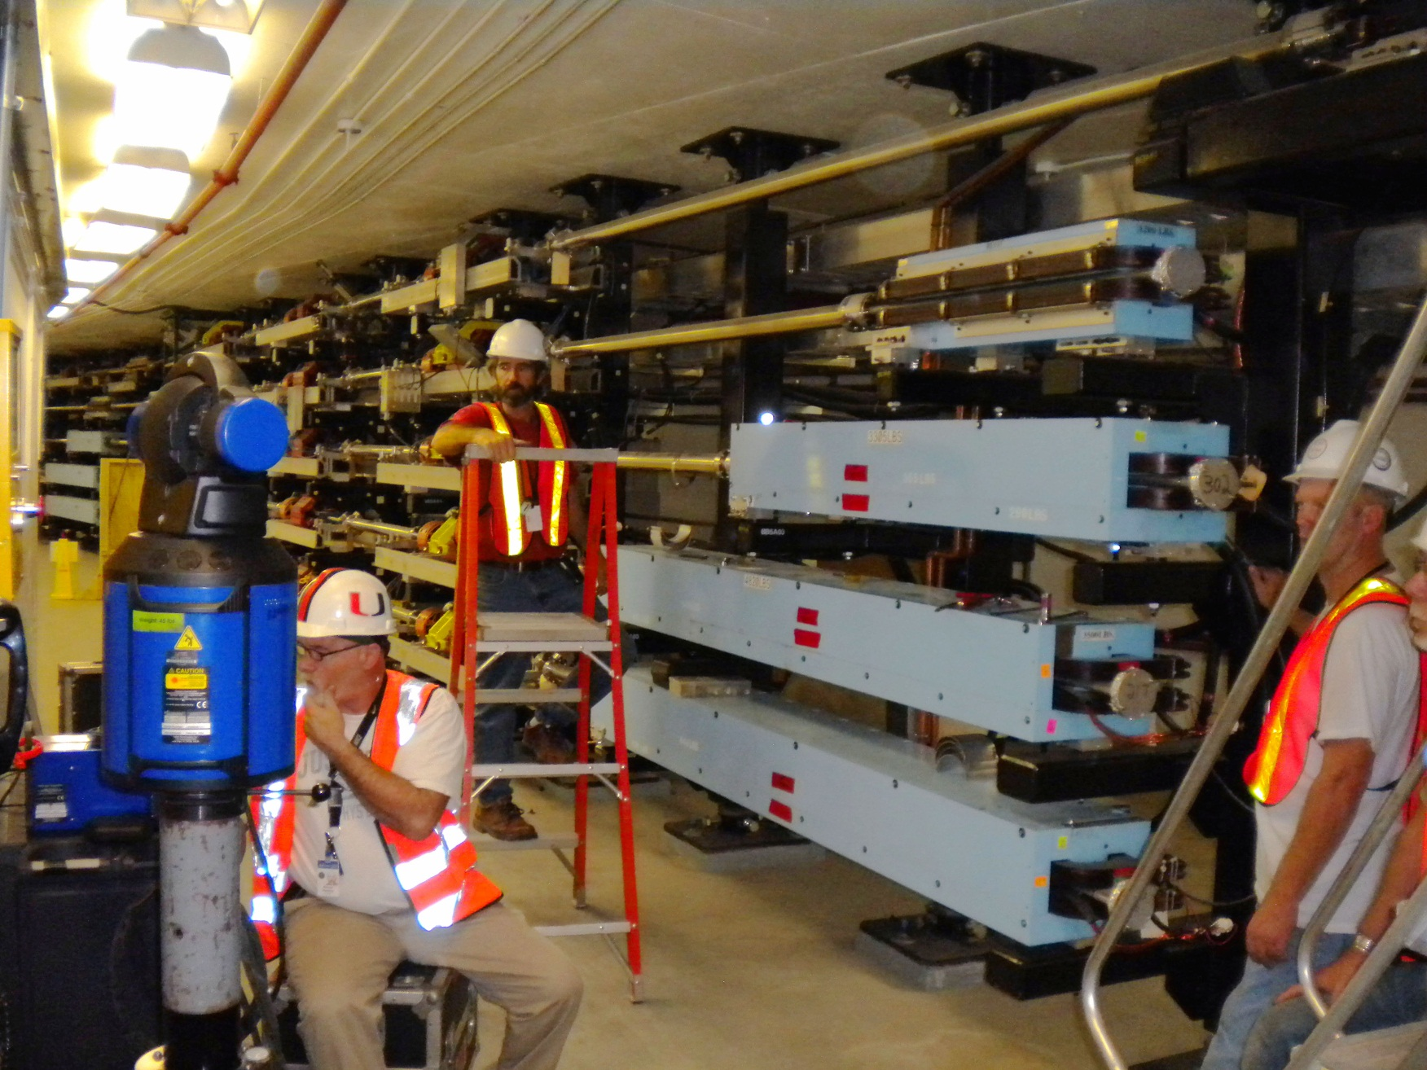
Dipole Alignment in East Arc

Slide 14
Instrument Station Variations
Differences between individual instrument stations and final solution (4 stations) for dipole stack #4 (9 magnets)
Average Differences (9 mags) | DZ | DX | DY
Center Stations | 0.04 mm | 0.05 mm | 0.01 mm
Upstream Stations | 0.02 mm | 0.23 mm | 0.03 mm
Downstream Stations | 0.11 mm | 0.15 mm | 0.06 mm
Maximum Differences | DZ | DX | DY
Center Stations | 0.08 mm | 0.10 mm | 0.05 mm
Upstream Stations | 0.09 mm | 0.37 mm | 0.05 mm
Downstream Stations | 0.19 mm | 0.20 mm | 0.13 mm

Slide 15
Linac Distances
 | Mar-13
North Linac | Avg Dist. | Diff 2012
HNL0030-420 | 361.57716 | +2.1 ppm
HNL0030-455 | 390.39103 | +3.2 ppm
HNL0060-420 | 340.35929 | +2.6 ppm
HNL0060-455 | 369.17304 | +3.6 ppm
Avg. Temp | 21.0
 | NL Avg: | +2.9 ppm
South Linac
HSL0010-420 | 376.56254 | +3.2 ppm
HSL0010-445 | 395.75880 | +4.0 ppm
HSL0040-420 | 354.99806 | +5.6 ppm
HSL0040-445 | 374.19450 | +6.9 ppm
Avg. Temp | 20.7
 | SL Avg: | +4.9 ppm
NOTE: Average temp of 2012 distance measurements: 29.0 (5ppm on 350m is 1.75mm)

Slide 16
East Arc Control
Overall scale factor -26ppm

Slide 17
Observed Network Changes
Linacs Expand
Arcs Contract

Slide 18
Modified Alignment Procedure
GOAL: Smooth alignment using 2012 network
Magnets were adjusted from a center station, and re-shot from upstream and downstream stations
The threshold for adjusting magnets into position was reduced to less than 0.1mm
All visible control was measured and used in the survey
Instrument stations were located to ensure an overlap from one section to the next

Slide 19
March 2014 Commissioning
Initially single pass operations
Multi pass operations showed 2 cm short per pass for each of the first 3 passes
Path length for 1 pass = 1312 m giving 15 ppm
Path length in Arcs = 506 m giving 40 ppm

Slide 20
April 2014 Measurements
Measurement of all survey control points in east arc
Measurement of quads and dipoles at mid point and end of the east arc
Measurement of long distances in each linac

Slide 21
East Arc Control
Overall scale factor -8ppm

Slide 22
East Arc Control
Overall scale factor -26ppm

Slide 23
April 2014 Results
Comparison to June 2012 Network survey
 | Mar-13 | Apr-14
7par scale factor | -25.7 ppm | -7.6 ppm
"Traverse" 2012 | 243.70899 m | 243.70899 m
Traverse length | 243.70020 m | 243.70654 m
Traverse length diff. | -8.79 mm | -2.45 mm
Avg. Sampled Temperature | NA | 29.8

Slide 24
Linac Distances
 | Mar-13
North Linac | Avg Dist. | Diff 2012
HNL0030-420 | 361.57716 | +2.1 ppm
HNL0030-455 | 390.39103 | +3.2 ppm
HNL0060-420 | 340.35929 | +2.6 ppm
HNL0060-455 | 369.17304 | +3.6 ppm
Avg. Temp | 21.0
 | NL Avg: | +2.9 ppm
South Linac
HSL0010-420 | 376.56254 | +3.2 ppm
HSL0010-445 | 395.75880 | +4.0 ppm
HSL0040-420 | 354.99806 | +5.6 ppm
HSL0040-445 | 374.19450 | +6.9 ppm
Avg. Temp | 20.7
 | SL Avg: | +4.9 ppm
Apr-14
Avg Dist. | Diff 2012
361.57648 | +0.2 ppm
390.39026 | +1.3 ppm
340.35846 | +0.2 ppm
369.17222 | +1.4 ppm
26.8
NL Avg: | +0.8 ppm
376.56169 | +0.9 ppm
395.75802 | +2.0 ppm
354.99650 | +1.2 ppm
374.19290 | +2.6 ppm
25.5
SL Avg: | +1.7 ppm
NOTE: Average temp of 2012 distance measurements: 29.0 (5ppm on 350m is 1.75mm)

Slide 25
May / Aug 2014 Measurements
Measurement of all survey control points and 5 quad stacks in east arc
Measurement of long distances in each linac
Measurement of all survey control points and 5 quad stacks in west arc
Measurement of distances between penetrations on the surface

Slide 26
East Arc Control
Distance between penetrations
Overall scale factor -3ppm

Slide 27
May / Aug 2014 Results
Comparison to June 2012 Network survey
 | Mar-13 | Apr-14 | May-14 | Aug-14
E. Arc 7par scale factor | -25.7 ppm | -7.6 ppm | -2.9 ppm | -2.3 ppm
E. Arc "Traverse" 2012 | 243.70899 m | 243.70899 m | 243.70899 m | 243.70899 m
E. Arc Traverse length | 243.70020 m | 243.70654 m | 243.70835 m | 243.70795 m
E. Arc Traverse length diff. | -8.79 mm | -2.45 mm | -0.64 mm | -1.04 mm
Avg. Sampled Temperature | NA | 29.8 | 29.5 | 28.7
N. Linac Average Distance | +2.9 ppm | +0.8 ppm | -0.3 ppm | -0.6 ppm
S. Linac Average Distance | +4.9 ppm | +1.7 ppm | -0.3 ppm | -0.9 ppm

Slide 28
West Arc Control
Overall scale factor -5ppm

Slide 29
West Arc Results
Comparison to June 2012 Network survey
 | May-14 | Aug-14
7 par scale factor | -5.2 ppm | -3.8 ppm
"Traverse" 2012 | 244.01590 m | 244.01590 m
Traverse length | 244.01288 m | 244.01304 m
Traverse length diff. | -3.02 mm | -2.86 mm
Avg. Sampled Temperature | 28.9 | 30.0

Slide 30
Conclusion
Virtually all elements of CEBAF were re-aligned for 12 GeV upgrade
Final network measured June 2012 - Accelerator was its warmest
Final alignment started March 2013 - Accelerator at its coldest
Accelerator expands and contracts unevenly
Accelerator has now expanded back to about its 2012 values
But 2cm path length difference is currently unexplained
Further measurements are planned:
increased thermometry
beam based measurement
additional surveys
By better understanding the cause, we may be able to determine if the correction devices employed by accelerator operations to date, will be sufficient to compensate for this effect in the future.

