Slide 1
Research Development of Vibrating Wire Alignment Technique for HEPS
WU Lei,WANG Xiaolong, LI Chunhua, QU Huamin
Mechanical Group, Accelerator Division
Institute of High Energy Physics
13th International Workshops on Accelerator Alignment,Beijing,Oct13-17,2014

Slide 2
HEPS overview
High Energy Photon Source（HEPS)
Energy: 5GeV
Circumference: 1296m
Lattice: 7BA
Emittance:<0.1nm·rad
quadrupole
3.8m
sextupole
3.8m
One of 48 typical cells

Slide 3
specifications
HEPS Alignment Tolerances
tolerances | Magnet to Magnet | Girder to Girder
Horizontal | ±0.03mm | ±0.05mm
Vertical | ±0.03mm | ±0.05mm
beam direction | ±0.5mm | ±0.5mm
Roll angle | ±0.2mrad | ±0.5mrad
It is difficult to achieve the required accuracy using magnet fiducialization, coupled with traditional optical survey. so we consider using vibrating wire alignment technique to meet the tolerance ±0.03mm between magnet to magnet on one girder.

Slide 4
Application Status(1)
Application examples of vibration wire:
Cornell University
CESR
Magnetic center finding of superconducting quadrupoles placed inside the cryostat.
Solenoid magnetic center finding.
Undulator magnets characterization.
SLAC
LCLS
Fiducialize the quadrupoles between undulator segment.
CERN
Solenoid magnetic center finding

Slide 5
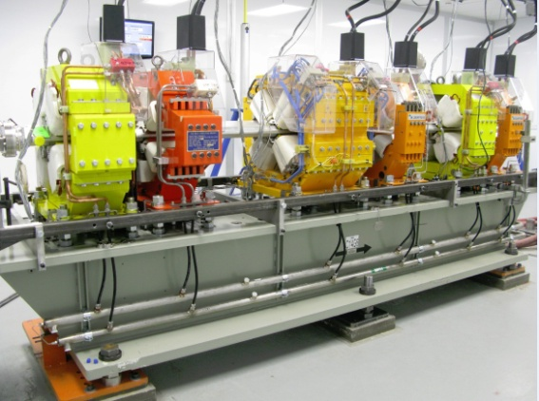
Application Status(2)
PSI
Swiss Free Electron Laser
Magnetic axis of quadrupoles finding.
BNL
NSLS-II
Alignment of multipole magnets on one girder.
`
The magnet alignment requirements in HEPS is similar to NSLS-II,
So the vibrating wire alignment in NSLS-II has been used as our
reference.

Slide 6
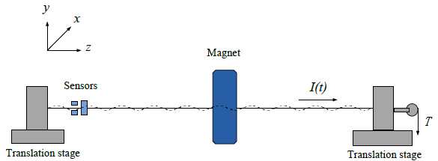
Principle of Vibrating wire
Based on measurement of the magnetic axis to align the magnets. Further evolution of the pulsed wire method.
A single conducting wire is stretched through the magnet aperture and driven by an alternating current.
Transversal vibrations are continuously excited by periodic Lorentz Force.
By matching current frequency to one of the resonant modes of wire, the vibration amplitude and sensitivity are enhanced and the magnetic induction intensity at the wire position can be calculated.
Move the wire across the aperture in horizontal(x) or vertical direction(y), the magnetic induction intensity distribution can be gotten and the magnetic axis can be found.

Slide 7
Research Development for HEPS
Finished research work:
Derivation of basic theory
Design of test bench model
Design of sag measurement scheme
Calculation of vibrating amplitudes
Design of the sensor circuit and sensor calibration
Design of data acquisition and control system

Slide 8
Derivation of Basic Theory
Analyze the motion of a section of
wire dz. According to Newton’s law
, differential equation of the motion in
the y-z plane is:
homogeneous solution:
particular solution due to gravity:
particular solution due to Lorentz Force:
dz

Slide 9
Test Bench Model
The difference between fixed end and free end bench is the fixed way of the wire. The wire is fixed and located by V notch at the fixed end bench.
At the free end bench, the wire is pulled by weights through a pulley.
The quadrupole and sextupole will be borrowed from BEPCII. They are 105Q and 130S.
The magnet support girder is 5.4 meters. Two parallel guideways are installed above the girder in order to move magnets conveniently. By move the magnets along the guideways, the magnetic center would be detected in different place along the girder.

Slide 10
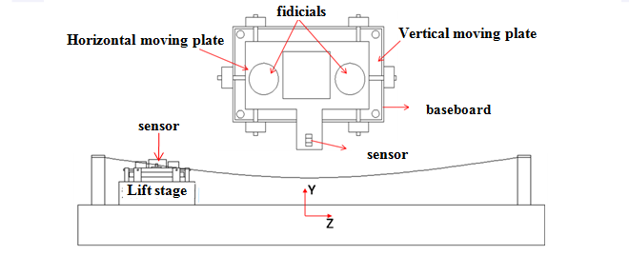
Sag Measurement Scheme
For a 7m long wire, sag is unavoidable because of self-weight.
To find the vertical magnetic center, accurate sag correction is essential.
Establish a coordinate system relative to the wire, measuring sag at different place along the wire(z direction).
Using laser tracker and NIVEL200 to adjust the position and orientation of the sensor.
Using sensor to measure the vertical position of the wire.

Slide 11
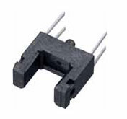
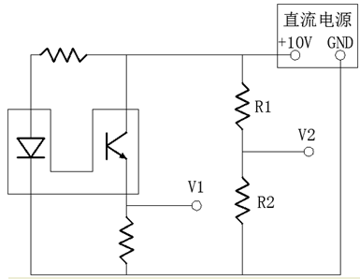
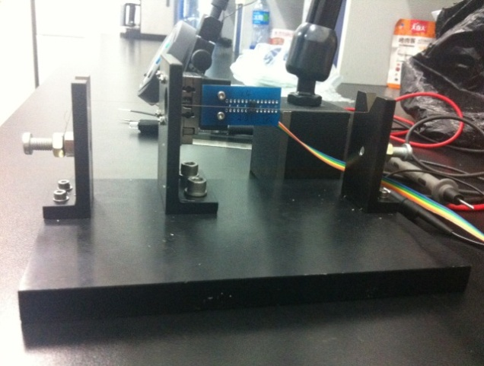
Sensor Circuit and Calibration(1)
GP1S094HCZ0F is a transmissive photointerrupter
with opposing emitter and detector in a molding
that provides non-contact sensing.
Function: detect the wire vibration amplitudes y_{d}(z,t) change over time due to Lorentz Force.
RD=280Ω
DC Power
+13V
Re=18KΩ
Sensor circuit
Sensor output test bench
Calibration:By changing the position of the sensor relative to the wire on the sensor output test bench, a series of points which are the output voltages were gotten. Because the sensor received different optical signals when the wire at different locations, so the output voltages are different.

Slide 12
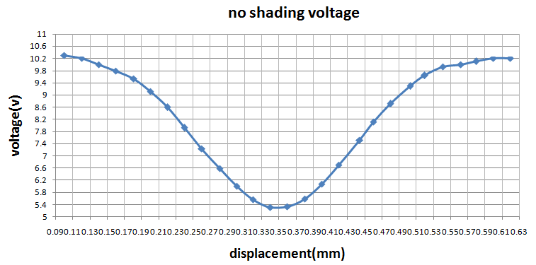
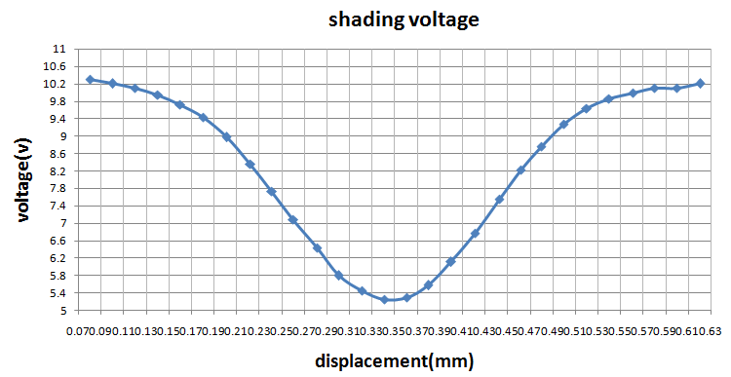
Sensor Circuit and Calibration(2)
outputs of one of the four Sensors
No shading voltage
 | Left linear region |  | Right linear region
Voltage(V) | 9.1 | 6 | 5.56 | 9.27
Voltage difference(V) | 3.1 |  | 3.71
Displacement(mm) | 0.2 | 0.3 | 0.38 | 0.50
Displacement difference(mm) | 0.1 |  | 0.12
voltage/displacement(mV/μm) | 31 |  | 30.92
shading voltage
 | Left linear region |  | Right linear region
Voltage(V) | 9.45 | 5.8 | 5.58 | 9.27
Voltage difference(V) | 3.65 |  | 3.69
Displacement(mm) | 0.18 | 0.3 | 0.38 | 0.50
Displacement difference(mm) | 0.12 |  | 0.12
voltage/displacement(mV/μm) | 30.42 |  | 30.75
There are two linear output parts. In each part, the wire displacement is about 0.12mm. One part will be chosen as the workspace.
There was little difference in the output voltages between covering the sensor with light shield and exposing the sensor in the lab light. But the voltages were more stable when the sensor was covered.
The sensitivity of the sensor is approximately 30mV/μm.

Slide 13
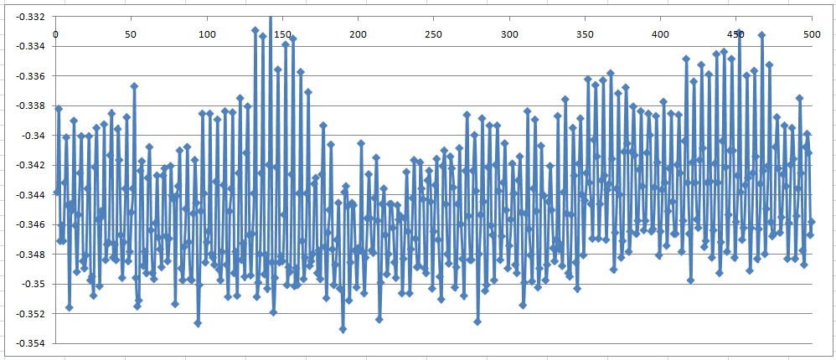
Sensor Circuit and Calibration(3)
The output voltages of the sensor were acquired by NI data acquisition devices. In every test position, a series of datum were acquired. The sampling frequency is 500Hz,and the sampling time is 1s.
The experimental results show that in each position the difference between the maximum and minimum voltages is approximately 20mV， less than the voltage change caused by 1 micron displacement of the wire.

Slide 14
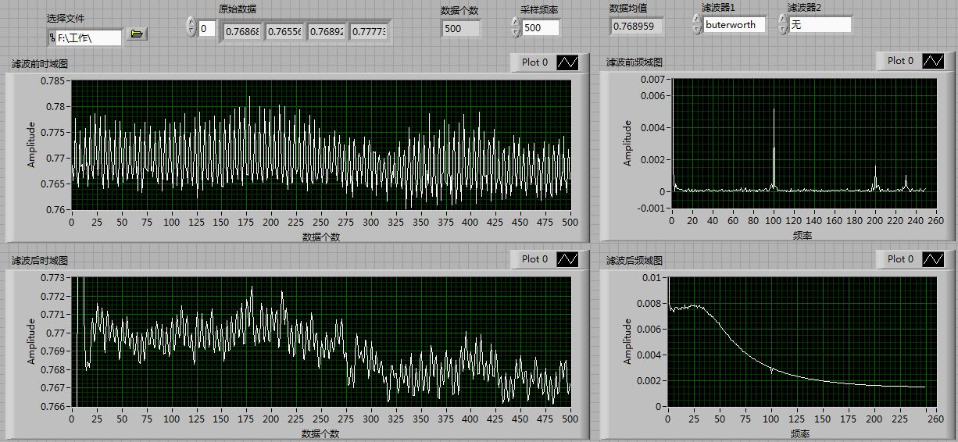
Sensor Circuit and Calibration(4)
In one test position, the measures of variation reduced from 20mV to 6mV after filtering. The stability has improved significantly. So adding filters to the circuit and DAQ program is under consideration.

Slide 15
Calculation of Vibrating Amplitudes
According to the basic theory, the vibration amplitudes is:
Vibration amplitudes should be controlled within the voltage linear output part. And it also should be make full use of this region. According to the measurement, the linear region widths about 0.12mm. We designed the wire vibration amplitudes ±0.045mm.
Quadrupole magnetic center measurement:
Parameter specification:
I0 wire current amplitude GLQ quadrupole integrated gradient LQ quadrupole length
μ mass per unit length ωn harmonic frequency α damping constant l wire length
n resonance order j l / zmagnet
Δy distance between magnetic center relative to the wire in y direction

Slide 16
Calculation of Vibrating Amplitudes
sextupole magnetic center measurement:
B”lQ sextupole integrated gradient
Δx distance between magnetic center relative to the wire in x direction
According to the distance between the magnetic center and wire, the distance between wire end and magnet, the distance between wire end and sensor ,and magnetic field gradient, the AC current can be calculated. We use this method to estimate the AC current in the wire according to the previous magnetic survey datum.

Slide 17
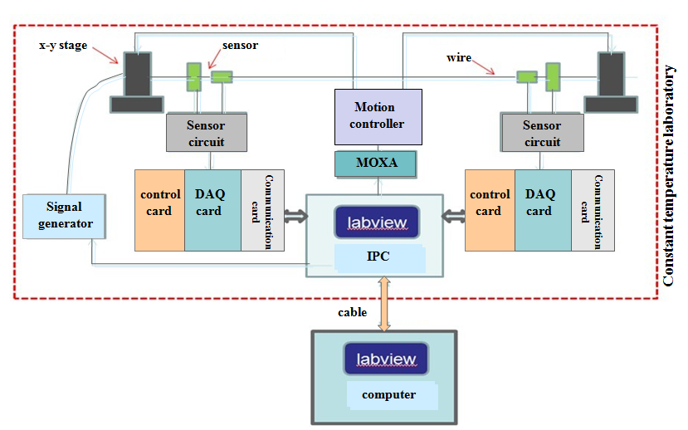
Data Acquisition and Control System
DAQ card NI PXI-6122:
16-bit A/D，input signal ranges (selectable by channel) ±10, ±5, ±2.5, ±1.25V
4 differential analog inputs ,
simultaneous sampling,
500KS/s per channel
Function: simultaneous sampling the 2 sensors and 1 driving current signals
Datum will be transported to the IPC by the communication card
PXIe- 8360, PCIe-8362
IPC also controls the movement of 2 x-y stages.
Using LabVIEW software to do data acquisition and data process.

Slide 18
Following Research Plan
2014.10-2014.12 3 months
draw the mechanical engineering drawings of the test bench, set the manufacturing specifications.
purchase outsourcing equipments.
write the LabVIEW program of the control system.
2015. 01-2015.03 3 months
manufacture the test bench.
2015.04-2015.06 3 months
Set up the whole vibrating wire test bench.
2015.07-2015.09 3 months
Carry out vibrating wire experiment to acquire the test datum, and analyse the experimental results.

Slide 19
Conclusion
The alignment tolerance of multipoles on a long girder in HEPS should be better than 30 microns.
Vibrating wire alignment technique is appropriate to achieve the required accuracy.
Complete the theoretical research of vibrating wire, and some research schemes were made, and complete the test bench model.
Mechanical engineering drawing of test bench is under drawing, the data acquisition program is under writing. A lot of works still need to be done in the following months.

Slide 20
Thank you for your attention！

