Slide 1
Performance of the Iris diaphragm laser alignment system of the SPring-8
C. Zhang
JASRI / SPring-8
IWAA2014, October 13-17, 2014, IHEP, Beijing

Slide 2
Contents
& laser-iris alignment system
& Where to use this system
& System’s components and adjustment
& Stability and resolution tests
& Accuracy estimation
& Measurement verification

Slide 3

Iris and Airy pattern
Airy pattern
Plane wave
Iris
R
λ
2a
z >> a² /λ
From Wikipedia
R = 0.61λz /a

Slide 4
SPring-8 storage ring magnets
Chasman-Green lattice of 48 cells :
Bending : 2 , Multipole : 17 on three girders
Alignment accuracy achieved:
Between girders : 50 μm (σ)
On girder : 20 μm (σ)

Slide 5
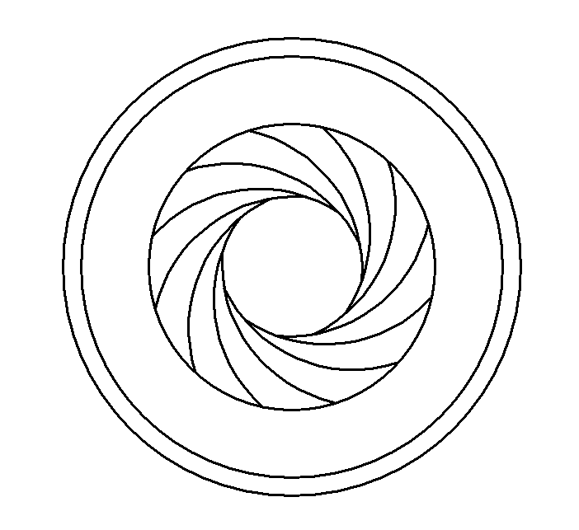
Iris diaphragm laser alignment system of the SPring-8
fiber-coupled diode laser
Iris diaphragms with remote control
CCD camera with CameraLink I/F
open
Close
(iris)
open
open
10 m

Slide 6
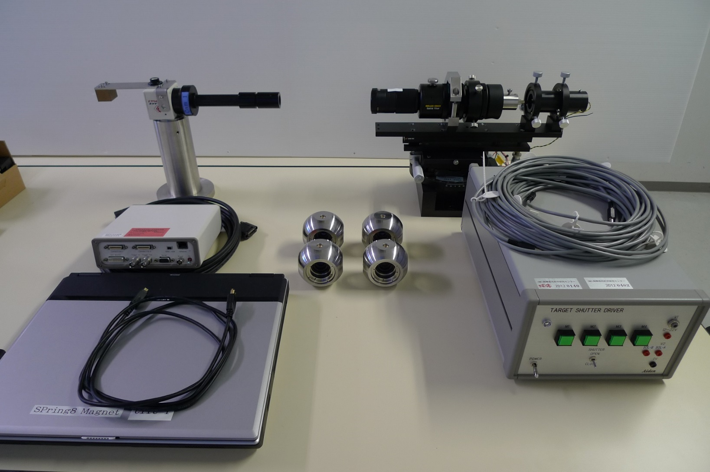
Iris diaphragm laser alignment system of the SPring-8
CCD camera
laser head
controller
targets
and
controller

Slide 7
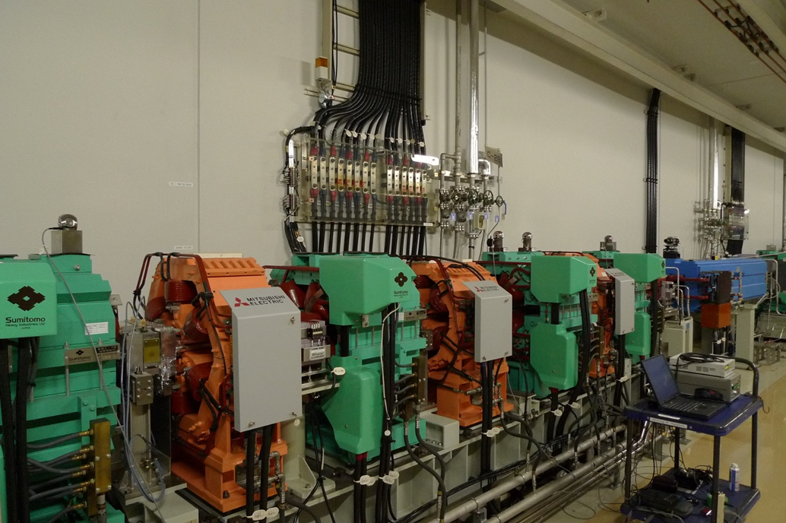
Alignment of the magnets on common girder
target
laser
controller

Slide 8
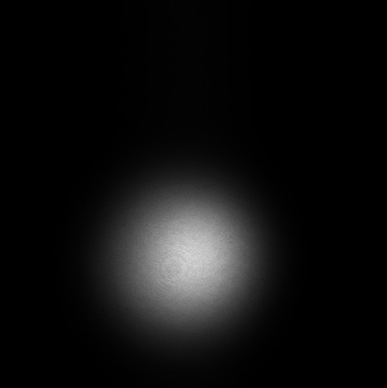
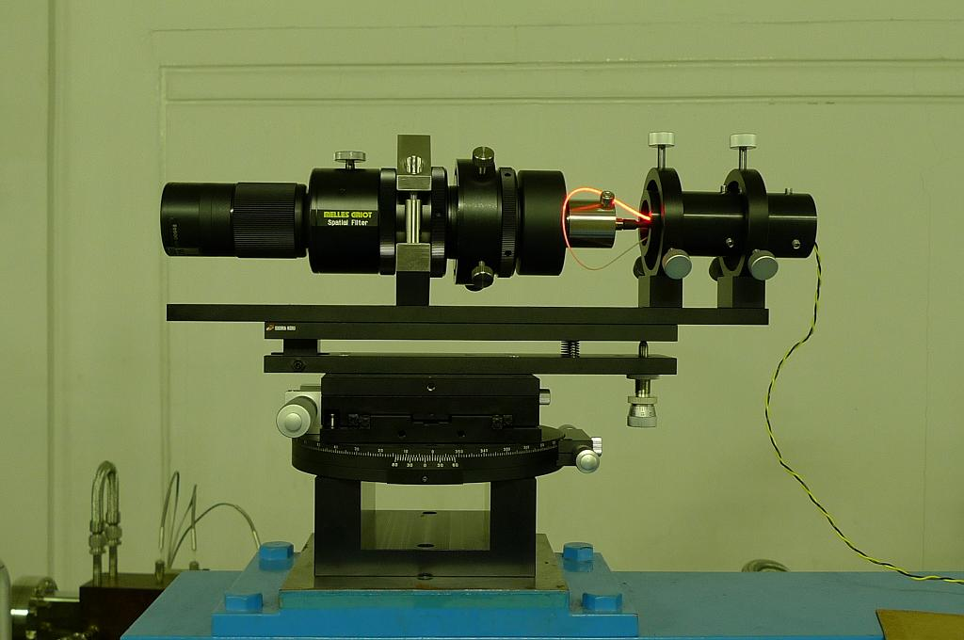
Laser and CCD camera
Laser and CCD camera
3.5mW fiber-coupled diode laser, beam size: 4.7mm
CCD size: 15x15mm², pixel size: 7.4μm, total of 4Mpixel
Expander
Collimator
S.M.fiber
Diode laser

Slide 9
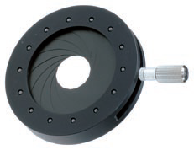
Commercial Iris diaphragm and center reproducibility
Commercial iris diaphragm reproducibility
Large than ±2μm (σ), getting worse when used at larger caliber
Blades
Base plate
Actuating
ring
20mm

Slide 10
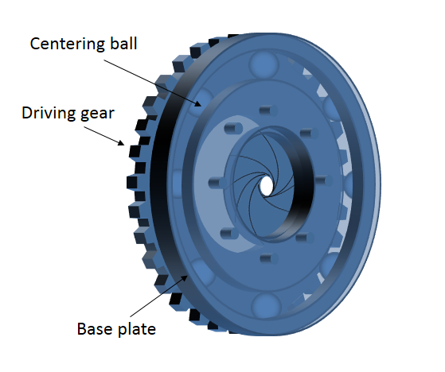
SPring8 Iris diaphragm and center reproducibility
100-times measurement for the center positions of four targets
Reproducibility is well under ±1μm (σ).

Slide 11
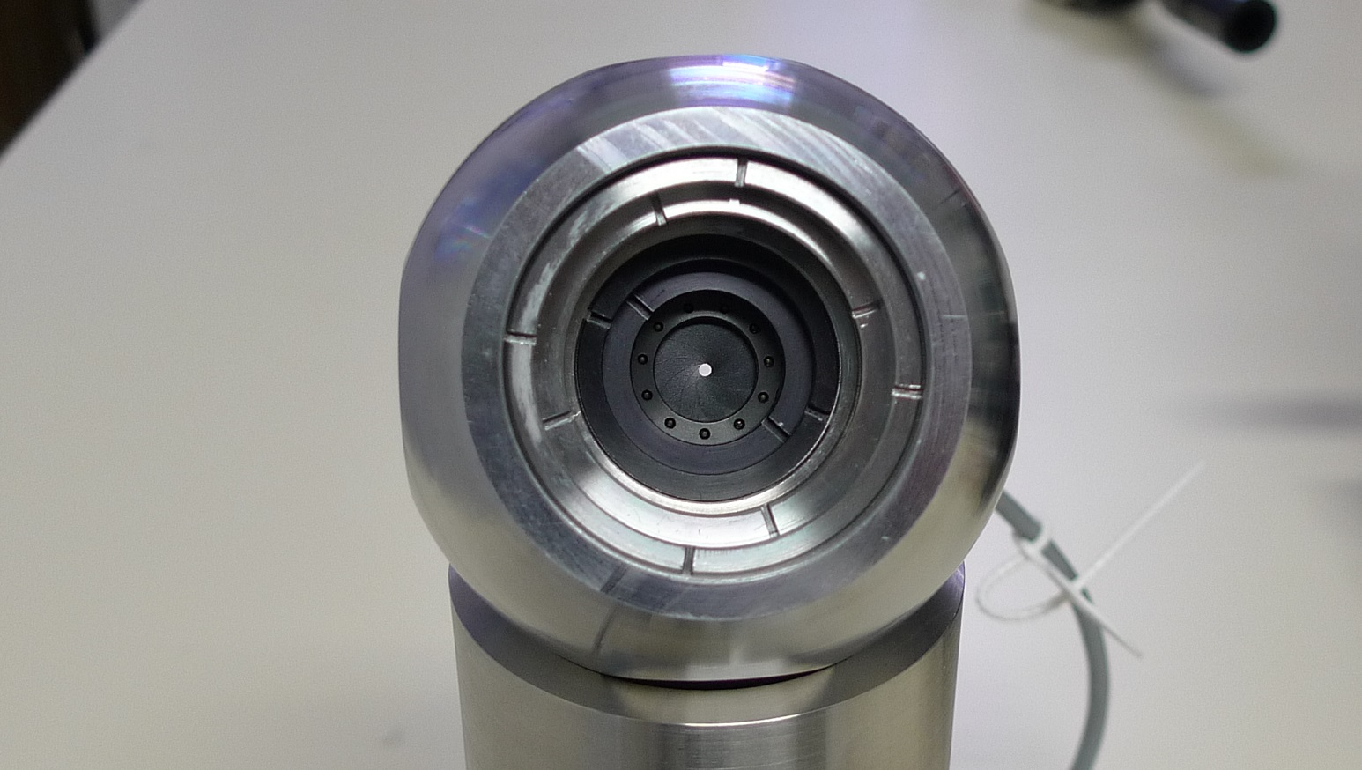
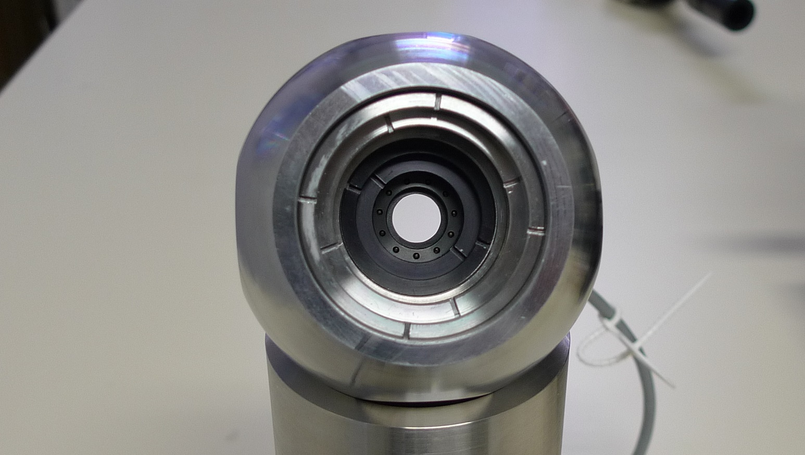
Iris diaphragm target

Slide 12
Iris diaphragm target

Slide 13
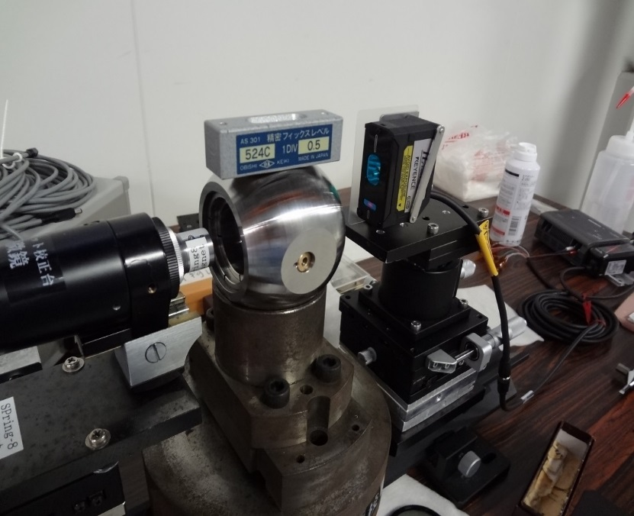
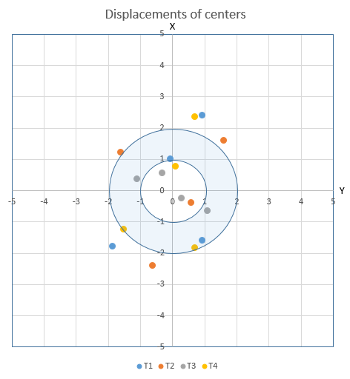
Target center displacement
Adjustment of target centers in Z direction with a displacement sensor, and XY with laser –iris system.
Diameters of irises are set to 1, 1.6, 1.6, 2.0 (mm) respectively.
Displacement of Δz is 5μm, and Δx, Δy: 2μm.
Δz, φ
Δx, Δy

Slide 14
Laser beam profiles
Laser size measured in tunnel of cell30.
Varied from 4.4 to 6 mm. Distance covers 50m
2m 45m
Distance from laser (m)

Slide 15
Laser beam pointing stability
8 hours stability, measured in tunnel, with air conditioner, cooling water stopped.
Drifts of both directions are small, Fluctuations are under ±2 μm (σ) in 8 meters.

Slide 16
Laser beam fluctuations for the irises
Fluctuations of the laser beams for the four targets
Under ±2 μm (σ), proportional to the distance from iris to camera

Slide 17
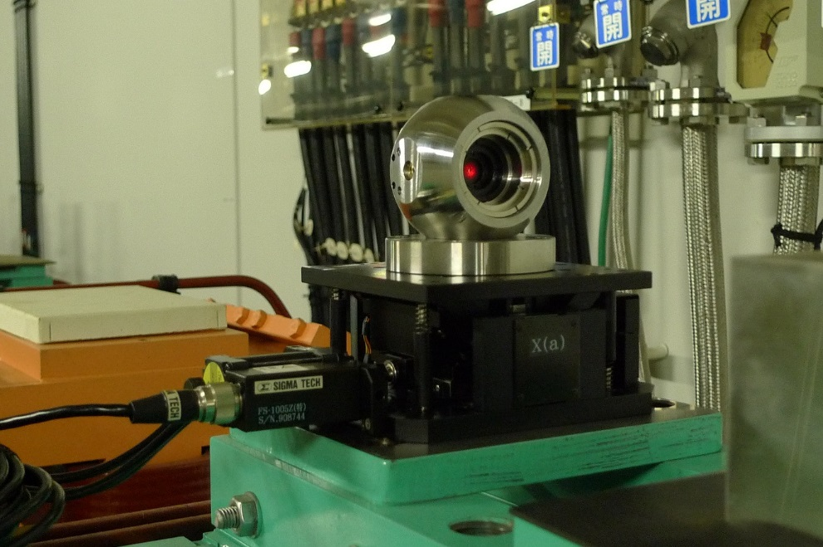
Camera resolution
The camera was set on a precise stage, and was moved in 1μm step. distance to laser ~2 m.
Quantity of camera indication is 1μm in a probability of 90%.
Set camera Instead of target

Slide 18



Estimation of measurement accuracy
Measurement accuracy is estimated ±7 μm (2σ)
@in tunnel, air conditioner, cooling water stopped.
1.5
2
0.7
2
Laser fluctuation
at measurement pt
Laser fluctuation at ref. pt
Center reproducibility
Displacement of center

Slide 19
Measurement verification on B-girder
Relative positions of 4 magnets were measured 10 times, setting targets again every time.
Measurement reproducibility was within ±7μm w.r.t the average.

Slide 20
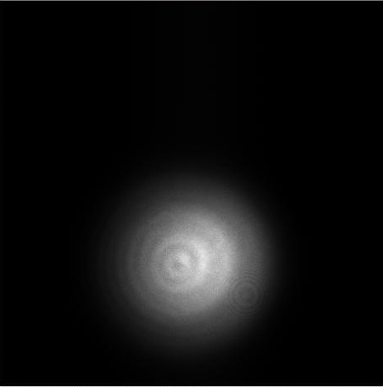
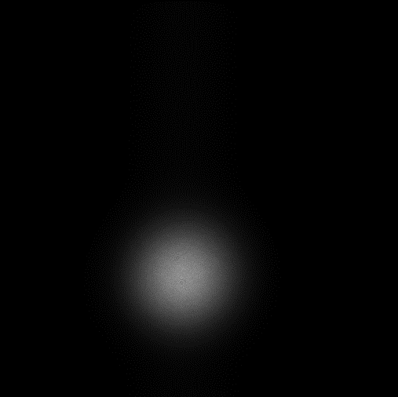
About laser beam size
6.2mm Beam size is tested a little large to a φ12mm pathway because it is seen diffraction patterns
The beam is reduced to 4.7mm afterward
6.2mm
4.7mm

Slide 21
Conclusion
An iris diaphragm laser alignment system is developed. The system is composed of a diode laser head, CCD camera and four iris diaphragm targets. Performance of this system was examined and it is verified that the system has a measurement accuracy of ±7μm (2σ) in 8 meters range. This reaches the aim of our intention at first, 10μm (2σ) in 10 meters.

Slide 23
