Slide 1
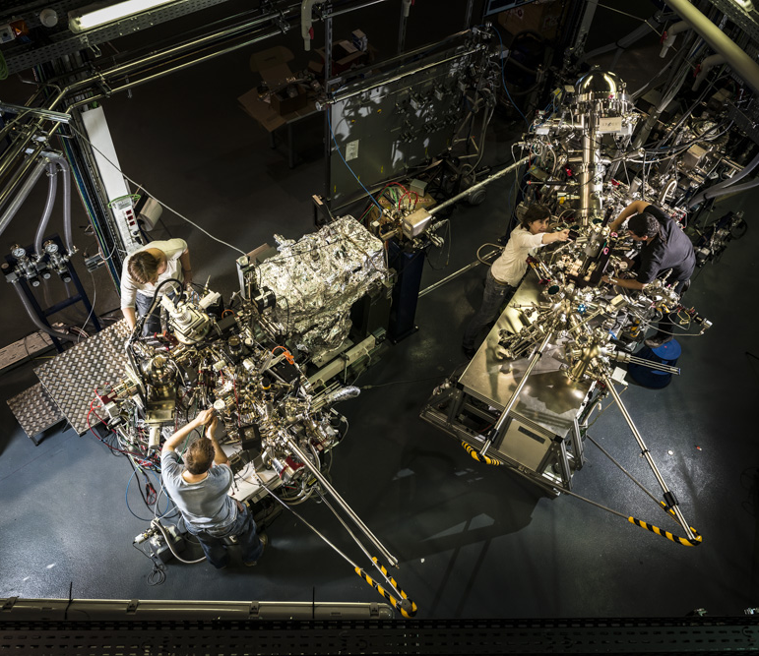

NAPP Photon Beam Entrance Alignment
Marta Llonch
IHEP, 2014 October
CELLS-ALBA, 08290 Cerdanyola del Vallès, Spain
Marta Llonch
www.cells.es
2014 October
Notes:
Thank you. Good morning, I´m Marta Llonch from ALBA Synchrotron light source, in Barcelona and I´m the Survey and Alignment group leader since the last year 2013.
Todays presentation aims to introduce you in a concrete ALBA beamline (CIRCE) and explain you one of our fiducialization and alignment processes used for its End station.

Slide 2
Contents
2
1. Introduction
1.1 ALBA Synchrotron Light facility
2. BL 24 – CIRCE Photoemission Spectroscopy and Microscopy
2.1 NAPP Near ambient Pressure Photoemission.
2.2 Photon Beam Entrance.
3. ALBA Survey and Alignment
3.1 Instrumentation
3.2 Software
4. PBE Fiducialization
5. PBE Alignment
6. Final results
7. Summary
8. Acknowledgments
Marta Llonch
www.cells.es
2014 October
Notes:
The contents in our presentation are the following
First of all, I will give you some general information about our Synchrotron and its seven operative beamlines and next, some data about CIRCE (one of our beamlines), its doube end station branches and our working branch, which is called NAPP.
After the beamline presentation, we will get into the NAPP Photon Beam Entrance component, the one this presentation talks about.
The used instruments in the fiducialization and alignment will be also showed, and after the general introduction, we will show you step by step the carried fiducialization procedure.
The PBE alignment characteristics, error budget and the final results once the component is placed in the theoretical position.
To finish with the presentation, there will be a summary slide and final aknowledgments.

Slide 3

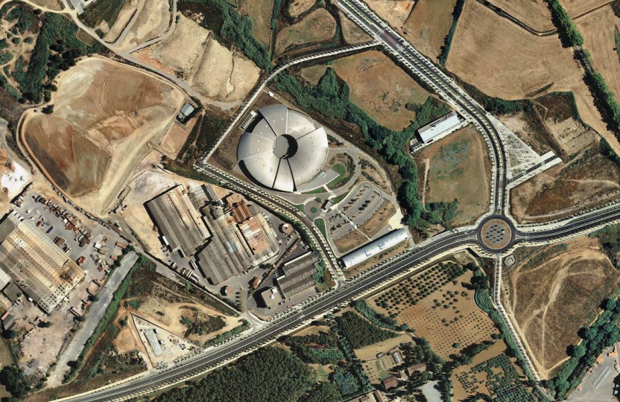
1. Introduction
1.1 ALBA Synchrotron Light facility
3
ALBA is a 3rd generation Synchrotron Light facility located in Cerdanyola del Vallès, (Barcelona).
The whole installation was finished in 2009.
In 2010 the facility was inaugurated.
Since early 2012 ALBA has been hosting official users.
Marta Llonch
www.cells.es
14/05/2014
Notes:
Ok, so let´s begin,
As the most of you may know, the ALBA Synchrotron light source is located in Spain, more exactly, near Barcelona.
The construction was finished in 2009 and it was inaugurated in 2010.
Since 2012 we have been hosting official users from universities and other research institucions.

Slide 4
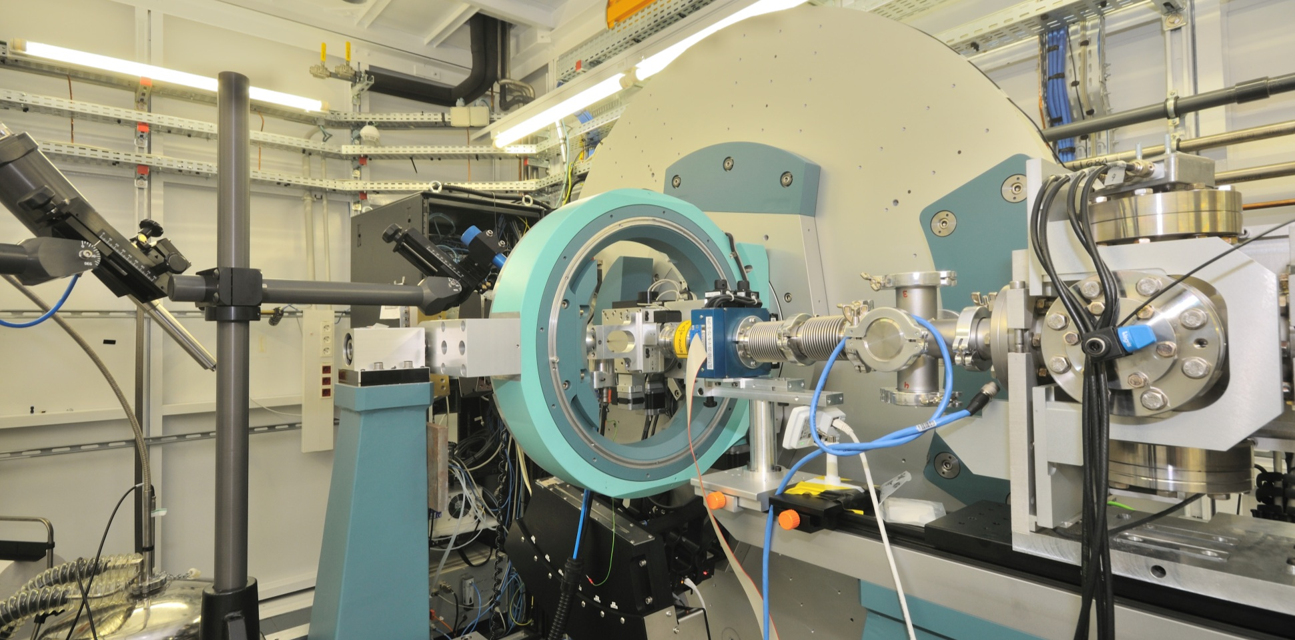

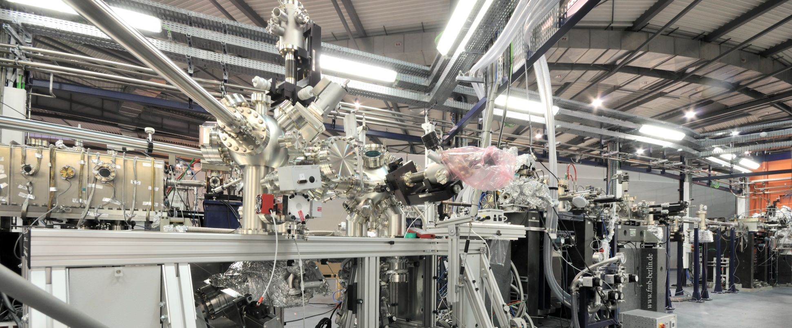
1. Introduction
1.1 ALBA Synchrotron Light facility
4
The ALBA Synchrotron light source is a 3GeV storage ring able to work in top up mode which delivers X-Ray beams to seven beamlines, already in operation.
BL29 - BOREAS
BL04 - MSPD
Resonant Absorption and Scattering
Materials Science and Powder Diffraction Beamline
BL09 - MISTRAL
BL24 - CIRCE
Soft X-Ray Microscopy
Photoemission Spectroscopy and Microscopy
BL11 - NCD
BL22 - CLAESS
Non-Crystalline Difraction
Core Level Absorption & Emission Spectroscopies
BL13 - XALOC
Macromolecular Crystallography
Marta Llonch
www.cells.es
14/05/2014
Notes:
Currently, ALBA counts with seven finished operative beamlines . To know a bit each one, here we have their names and its main caracteristic.
MSPD, for materials Science and Powder diffraction.
MISTRAL, for Xray microscopy.
NCD, Non crystaline diffraction.
XALOC, for Macromolecular crystallography.
CLAESS, Absorption and emission spectroscopy.
CIRCE, for Photoemission spectroscopy and Microscopy, this is the beamline we will talk about.
And fianllly BOREAS, for Resonant Absorbtion and Scattering.

Slide 5
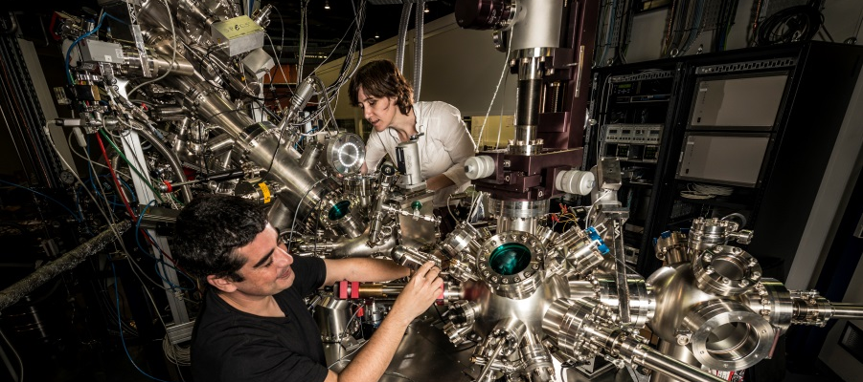
2. BL 24 – CIRCE Photoemission Spectroscopy and Microscopy
5
CIRCE: Soft X-Ray beamline that counts with two different end stations, Photoemission Electron Microscopy (PEEM) and Near Ambient Pressure Photoemission (NAPP).
TECHNICAL SPECIFICATIONS
Photon energy: | 100 - 2000 eV
Polarization: | Variable
Energy resolution: | ~ 8000
Photon flux | ~ 10¹³ ph/s
Beam spot size at PEEM position (VxH) (FWHM): | variable, min 3.2 x 36 um²
Beam spot size at NAPP position (VxH) (FWHM): | ~ 20 x 100 um²
14/05/2014
www.cells.es
2014 October
Marta Llonch
www.cells.es
Marta Llonch
Notes:
Ok, let´s start with some data about our case of study. The CIRCE beamline, is a soft X-ray beamline which is dedicated to photoemission experiments. The beamline is composed by two independent branches with two different endstations, one of them is called PEEM (which means, photoemission electron microscopy) and the other one is called NAPP (which means near ambient pressure photoemission.
As you can see in the squeme, a pair of deflecting mirrors can direct the beam to one branch or the other.
The beamline source, is a Pure Permanent Magnet helical undulator capable of delivering polarized light in any direction.
In addition, here you have some CIRCE technical specifications.

Slide 6
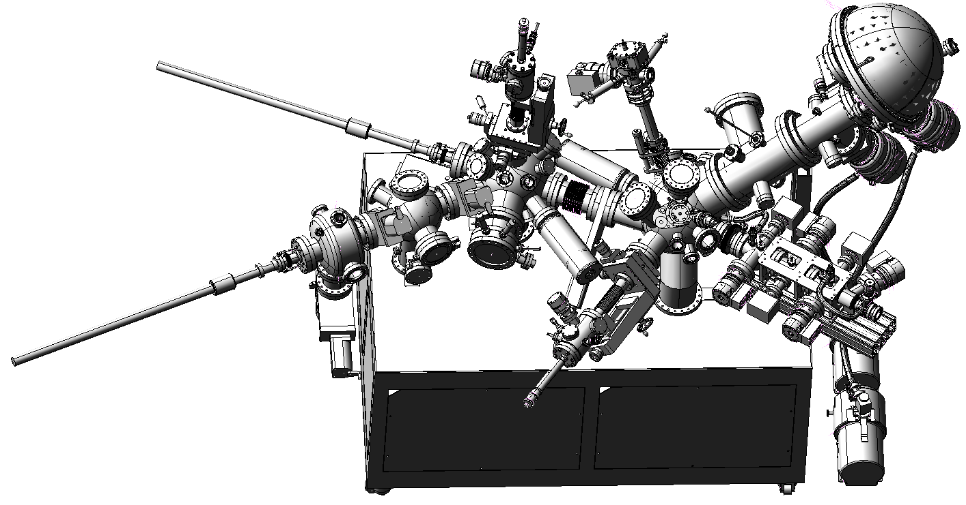
2. BL 24 – CIRCE Photoemission Spectroscopy and Microscopy
2.1 NAPP Near ambient Pressure Photoemission
6
The Near Ambient Pressure Photoemission (NAPP) is an Ultra High Vacuum setup equipped with a hemispherical electron energy analyzer.
Analyzer
Photon Beam Entrance
Can operate from UHV up to 25 mbar.
.
Includes a differential pumping system.
Sample spot smaller than 100µm.
Allows to get information during some reactions (catalysis, fuel cells, batteries, corrosion…).
Preparation chamber
Analyzer chamber
X­­-Ray entrance­
Marta Llonch
www.cells.es
2014 October
Notes:
Ok, one of this two CIRCE branches, is NAPP (near ambient pressure photoemission).
This is an Ultra High Vacuum setup that is equiped with a hemispherical electron analyzer. This analyzer can operate from UHV up to 25mbar thanks to a differential pumping system which ensures a pressure difference of 10⁹. In the right image you can see the NAPP end station different parts. First of all, the hemispherical analyzer, the preparation and the analyzer chamber and finally the Photon Beam entrance, which counts with this differential pumping system to separate the beamline and the sample vacuum.
The NAPP branch requieres the maximum possible flux in a sample spot smaller than 100um.
Finally, some endstation applications could be to get information during some processes like catalisys, fuel cells, batteries or corrosion…

Slide 7
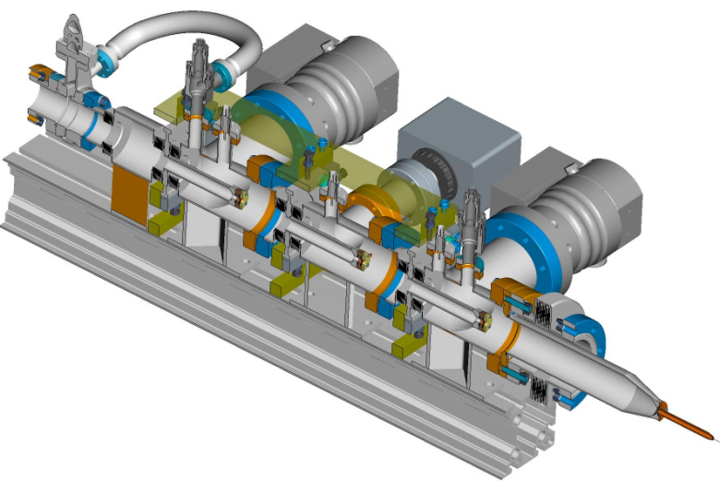
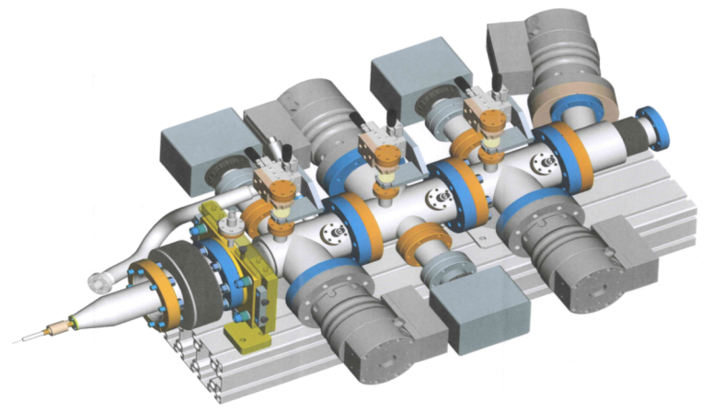
2. BL 24 – CIRCE Photoemission Spectroscopy and Microscopy
2.2 Photon Beam Entrance.
7
Compactness and pumping efficiency.
Apertures positions adjustable from the outside.
Pressure difference (analysis chamber - beamline) 9 orders of magnitude.
3
OUR GOAL: Align the apertures within the ±0.1mm !!
1
Location | Aperture size (mm) | P (mbar)
Analysis chamber | - | 2.5 x 10+1
1 | 0.3 | 4.1 x 10–3
2 | 1.5 | 1.7 x 10–5
3 | 2 | 1.2 x 10–7
4 | 3 | 1.6 x 10–9
4
2
14/05/2014
www.cells.es
2014 October
Marta Llonch
www.cells.es
Marta Llonch
Notes:
The NAPP Photon Beam Entrance allow to create differnet vacuum areas thanks to a differential pumping system. This system includes a set of independently adjustable apertures and cavities that can be differentially pumped and externally aligned thanks to four pairs of Vernier micrometers, for vertical and horizontal movements.
In the section image, you can see the four apertures, which have different sizes, from 0.3 for the capillary, up to 3mm for the last aperture, and also the pressure difference about 9 orders of magnitude.
Regarding to the adjustable apertures, one of our main targets, will be to align this holes within the +0.1mm.

Slide 8
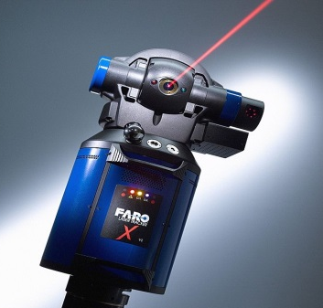
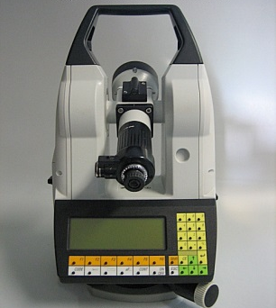
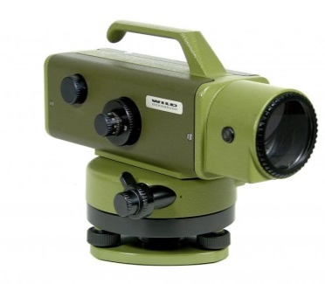
3. ALBA Survey and Alignment
3.1 Instrumentation.
8
Laser tracker: for network measurement, fiducialization, installation, alignment…
Reproducibility of a 3D coordinate (2σ)
0 – 2.5m : 12μm
Theodolite: for the PBE apertures alignment (optically), fiducialization.
Angular measurement: Standard deviation 1σ: +0.5”
Optical Level: help to check the apertures position and measure the holes diameter.
Standard deviation (1km two way levelling) : +0.2mm
14/05/2014
www.cells.es
2014 October
Marta Llonch
www.cells.es
Marta Llonch
Notes:
The Photon Beam Entrance apertures, as we have seen, should be aligned. And the component axis and the exterior references should be put in relation. To begin with the fiducialization process, we show you the chosen instrumentation in order to keep the requested tolerance.
First of all, the FARO Xi Laser tracker that will be used for the network measurement, the fiducialization (measure the mechanical axis…), and the final allignment with a reproducibility of a 3D coordinate (2sigma) of 12um in the nearness of the instrument.
Secondly, the Theodolite, wchich will be used for the PBE apertures alignment (optically).
And finally, the precision optical level, WILD N3, wchich will help us to check the apertures positions and measure the holes dimensions.

Slide 9
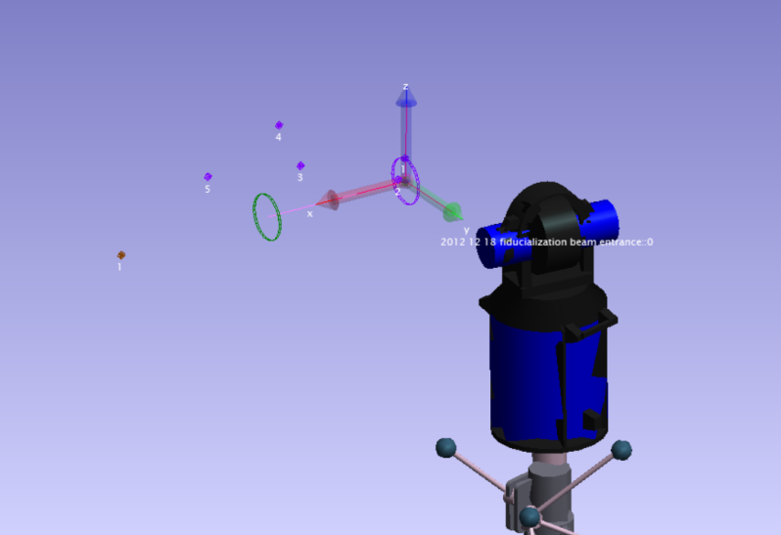
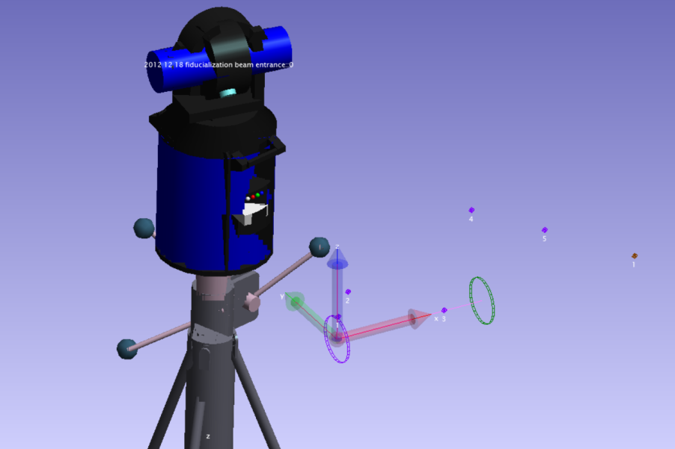
3. ALBA Survey and Alignment
3.2 Software.
9
Spatial Analyzer
For connect the instrumentation.
For monitoring measurements.
For calculate geometries (cylinders…) or lines (axis).
14/05/2014
www.cells.es
2014 October
Marta Llonch
www.cells.es
Marta Llonch
Notes:
For the instrument connection, the mesurements monitoring and the geometries calculus, we have used Spatial Analyzer, by New River Kinematics.

Slide 10
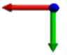
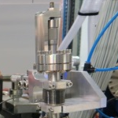
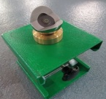
4. PBE Fiducialization
10
The object is to put in relation the PBE beam axis with the exterior reference points to make easier the later component alignment. In addition, the apertures will be aligned before the component is positioned in its final location to allow a light beam pass through it.
2
The mechanical centerline will be defined by the end flanges scanned by the Laser Tracker and symbolized by two references.
4
A lantern is placed in the opposite side to symbolize the light beam passing through the apertures.
1
PBE supported in such a way that the mechanical axis is horizontal with
respect to the local gravity.
6
The WILD Precision Level will help us to check the apertures position optically.
3
The theodolite is put above the line and its telescope aligned in horizontal and vertical planes with respect to the PBE system datum.
5
Focusing and observing the apertures, we adjust the vertical and horizontal micrometers until the hole is centered in the theodolite axis.
7
The micrometers values are taken and the capillary and the fiducial marks measured with Laser Tracker.
Fiducialization setup top view
14/05/2014
www.cells.es
2014 October
Marta Llonch
www.cells.es
Marta Llonch
Notes:
Ok, lets begin with the fiducialization procedure. The main idea is to put in relation the PBE beam axis and the component external references and that way make easier the final alignment. During the fiducialization process, we will also align the four apertures in order to allow the Xray beam pass through it.
First of all, will be necessary to place the component in a way that the mechanical axis will be horizontal with respect to the local gravity.
After that, we will define the component mechanical axis thanks to the extreme flanges scann done by the Laser tracker, and we will represent it by a pair of reference points.
The references, which symbolize the mechanical axis, will be used to place the theodolite aligned in horizontal and vertical planes with respect to the PBE datum.
To help us with this work, we will put a lantern in the opposite side to symolize the light beam.
Focusing and observing the appertures with the theodolite, we will adjust the vertical and horizontal micrometers until the hole is centered int the theodolite axis.
The WILD precision level help us to check the positions optically.
And finally, we will take the micrometers values and the laser tracker will measure the fiducial marks with respect the axis.

Slide 11
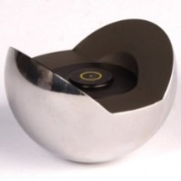
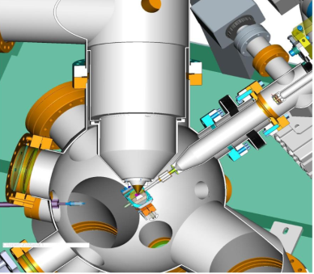
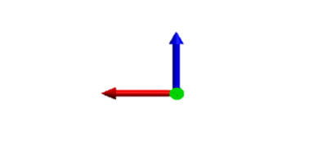
5. PBE Alignment
11
A specific NAPP mirrors configuration, allow to work in order zero beam (white beam):
The white beam is materialized by two spherical optical targets.
This will be our destination axis.
Is needed to stablish a destination coordinate system.
Taking as common point, between the source and destination point group, the capillary aperture and its coordinate system.
Focusing point
Capillary
Distance M4d to focusing point (DM4-f): 1750mm
Distance focusing point to capillary aperture: 15mm
Focusing point
Analyzer tip
DM4-f
Capillary aperture
●
NAPP branch
M4d
XSd
GR
M1
β=35.3°
XSa
Focusing point
M3a
M3d
M2
M4a
PEEM branch
14/05/2014
www.cells.es
2014 October
Marta Llonch
www.cells.es
Marta Llonch
Notes:
Once the PBE has been fiducializated, we have to prepare the component alignment in the beamlite site.
In this case, the NAPP branch is able to work in order zero beam (which means white and visible beam) thanks to a specific mirrors configuration.
Taking advantatge of this, we can place two reference points which materialize the beam direction.
These two points will represent our destination axis.
Now, its necessary to stablish a destination coordinate system, that we will place in a common point (between the source and destination data). This common point will be the capillary aperture. In one hand , we know the distance between the M4 mirror and the endstation focusing point, and in the other one, we know that the distance between the focusing point and the capillary aperture is about 15mm, so in the capillary point, we create the destination coordinate system.

Slide 12
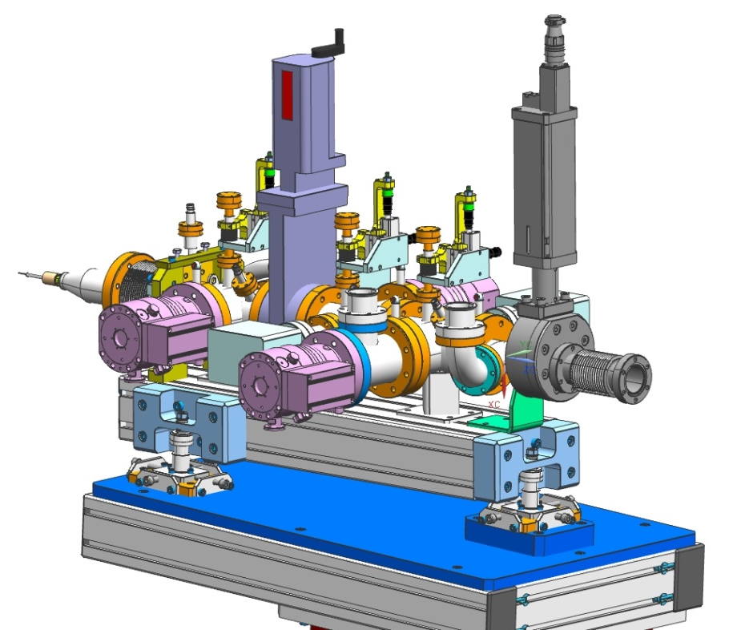
5. PBE Alignment
12
The measured set of fiducial marks is used to align the PBE with respect to the capillary coordinate system.
F4
F5
F3
F2
F1
Error estimation, 1 sigma:
FARO Laser Tracker ˂ 2.5m ±15μm
PBE fiducials reproducibility ± 15μm
LEICA TM5100A ± 35μm
(Network best fit (10-15m) ± 30μm)
Total ± 40 μm (50 μm)
Results (using capillary coord. Syst)
 | F1 |  | F2 |  | F3 |  | F4 |  | F5
Source positions | x | -866.24 | x | -789.05 | x | -633.17 | x | -501.39 | x | -313.86
 | y | 0.22 | y | 92.64 | y | -91.52 | y | 17.22 | y | 0.72
 | z | 60.35 | z | 60.26 | z | 60.69 | z | 241.53 | z | 146.08
Final positions (after PBE alignment) | x | -866.19 | x | -789.01 | x | -633.15 | x | -501.36 | x | -313.81
 | y | 0.26 | y | 92.66 | y | -91.53 | y | 17.23 | y | 0.78
 | z | 60.31 | z | 60.21 | z | 60.63 | z | 241.51 | z | 146.04
∆ | x | -0.05 | x | -0.04 | x | -0.02 | x | -0.03 | x | -0.05
 | y | -0.04 | y | -0.02 | y | -0.01 | y | -0.01 | y | -0.06
 | z | 0.04 | z | 0.05 | z | 0.06 | z | 0.02 | z | 0.04
Photon beam entrance alignment reference points identification
Requested accuracy: Better that ±0.1mm
14/05/2014
www.cells.es
2014 October
Marta Llonch
www.cells.es
Marta Llonch
Notes:
With respect to this new destination coordinate system, we will place the whole component using the mesured set of fiducial marks.
But, first, lets have a look to the error budget (1sigma) that we sums about plus minus 29 microns.
In the values table, we can see the alignment results and the fiducial coordinates in the source and final position (once the component has been aligned). The differences values are here and, taking in account the error budget estimation, we can say that the NAPP Photon beam entrance has been aligned with an accuracy within the plus minus 0.1mm.
In the image, you can see the identification of each fiducial point and also the component adjustment systems for vertical and horizontal movements.

Slide 13
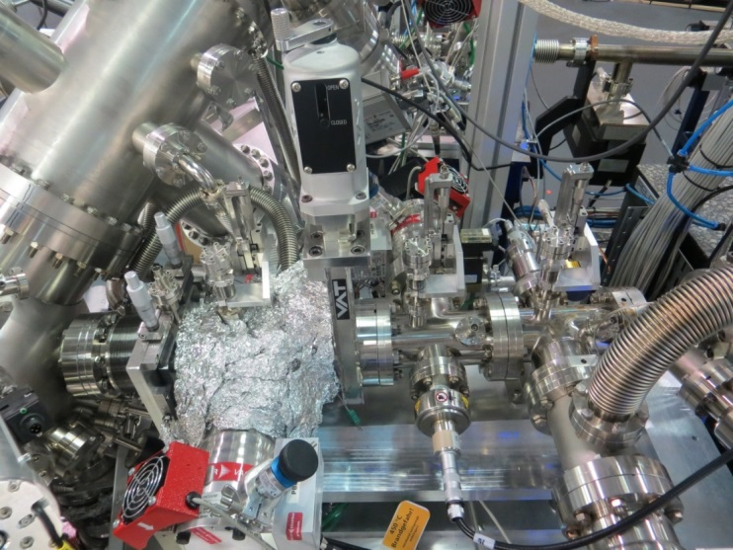
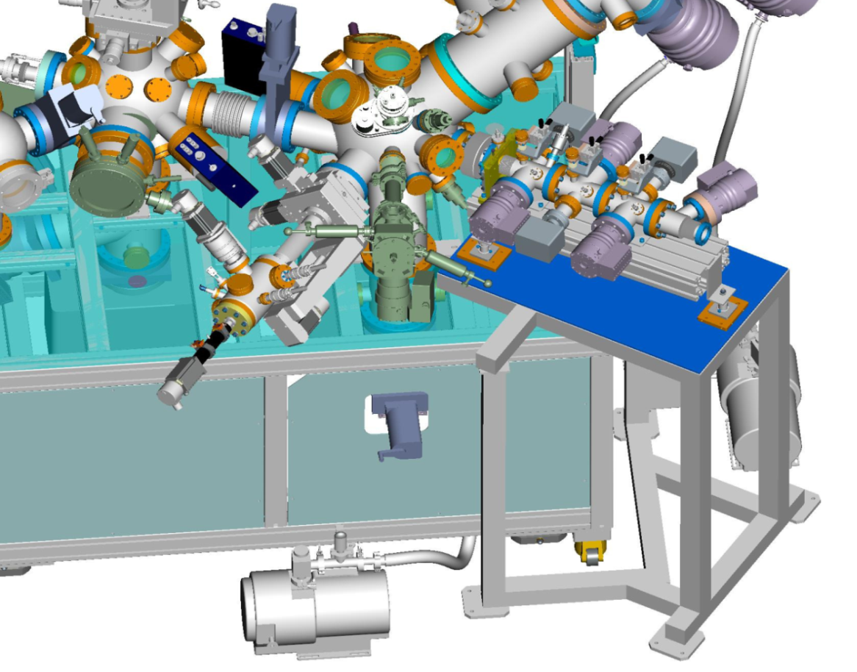
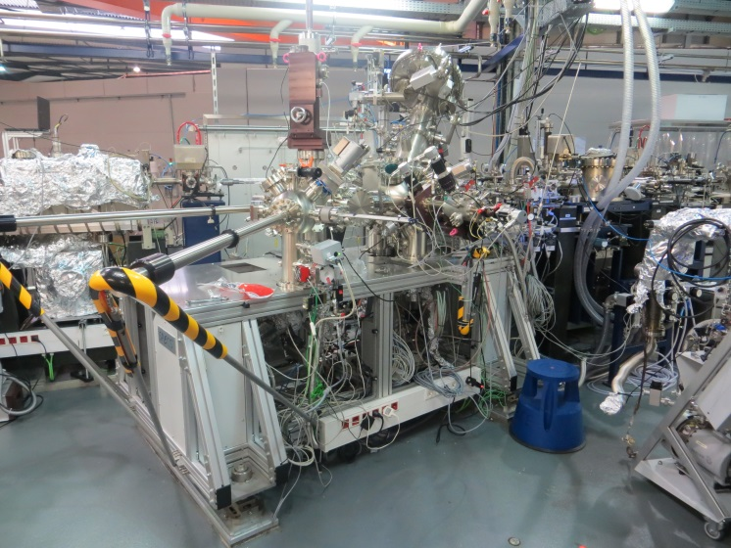
5. PBE Alignment
13
Beam entrance stage mounted to analysis chamber with frame
14/05/2014
www.cells.es
2014 October
Marta Llonch
www.cells.es
Marta Llonch
Notes:
In the next images we can see the Photon Beam entrance installed and aligned within the beamline in the 3D model and also some images once the component is placed.

Slide 14
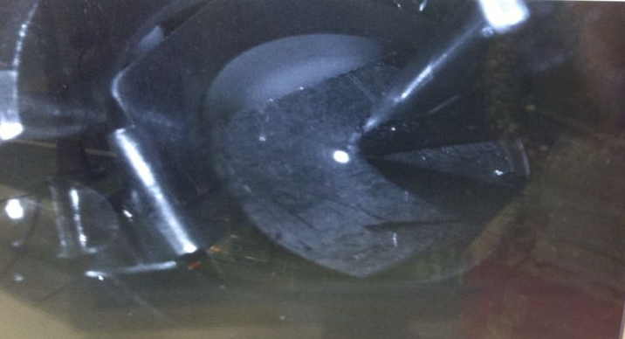
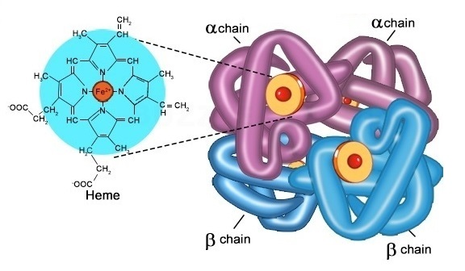
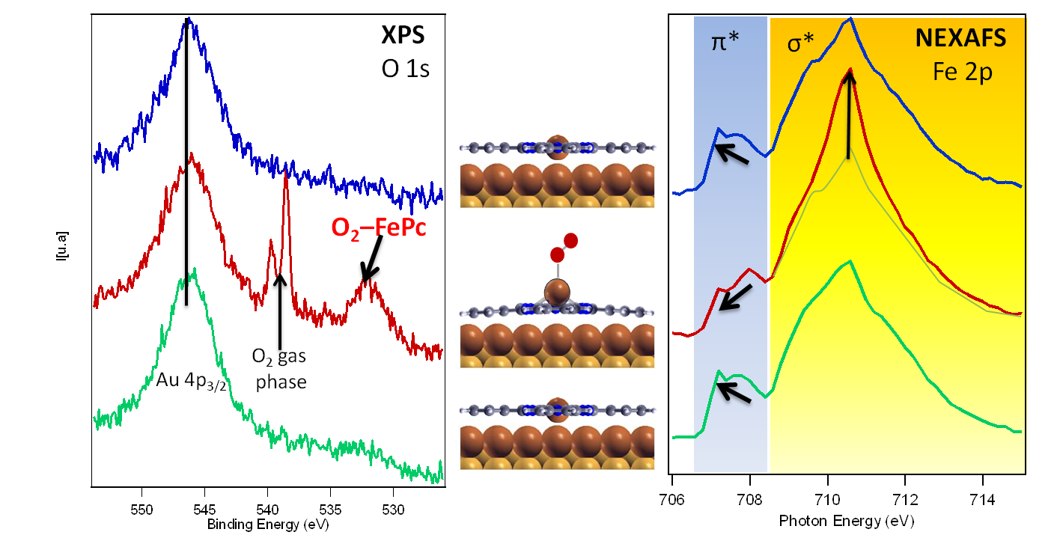
6. Final results
14
December 2012
Photon Beam Entrance final alignment.
Analyzer tip
Beam direction
End 2013
NAPP is opened to hosting official users.
About 7 groups of researchers.
Beam (order zero) reaching the sample.
A total amount of 9 experiments:
ESR – Ethanol Steam Reforming
Breathing chemistry
C2H5OH + 3 H2O → 6 H2 + 2 CO2
Submitted for best experiment of 2013 @ ALBA
…
RhPd/CeO₂ NPs
14/05/2014
www.cells.es
2014 October
Marta Llonch
www.cells.es
Marta Llonch
Notes:
As final results, we can demonstrate that the order zero beam reaches the sample inside the analyzer chamber. In December 2012, the Photon Beam Entrance is finally aligned, and since end of 2013, the NAPP branch is oppened to hosting official users, about 7 researchers groups have made until 9 experiments, for the moment. Some of them could be the Ethanol Steam Reforming or the breathing chemistry, which was submitted for best experiment of 2013 by ALBA.

Slide 15
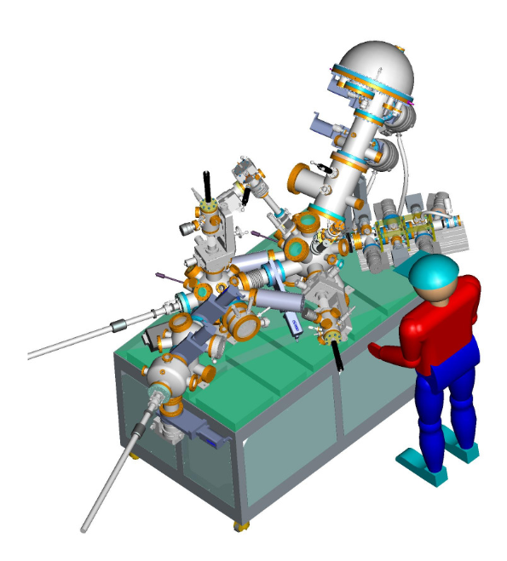
7. Summary
15
NAPP beamline branch needs a differential pumping system.
The End station PBE has four adjustable apertures which should be aligned in a fiducialization process.
A special instruments setup allow us to align the apertures and define the main axis. In addition, a set of fiducial marks is measured.
The PBE alignment is carried by defining the destination axis thanks to the order zero beam.
Since end 2013, NAPP branch hosts official users and near 10 experiments have been developed.
14/05/2014
www.cells.es
2014 October
Marta Llonch
www.cells.es
Marta Llonch
Notes:
To finish with the presentation, here you have a few summary sentences

Slide 16
8. Acknowledgments
16
Jon Ladrera, ALBA Survey and Alignment group member.
Carles Colldelram, ALBA Engineering Transversal section head.
Fabien Rey, Former head of ALBA Survey and Alignment group, and current ESS Survey and Alignment group leader
Virginia Pérez, CIRCE - NAPP scientist.
Carlos Escudero, CIRCE - NAPP scientist.
14/05/2014
www.cells.es
2014 October
Marta Llonch
www.cells.es
Marta Llonch
Notes:
And finally, I dont want to finish my presentation without saying thanks to my Survey and Alignment group partner, Jon Ladrera, to Carles Colldelram, my boss which is the ALBA engineering transversal section head, to Fabien Rey, my old Alignment group partner, who has showed me a lot of things and now is working in the European Spallation Source, and finally to the beamline scientists to provide me with lots of information (Virginia Pérez and Carlos Escudero).

Slide 17
17
Thank you for your attention!
14/05/2014
www.cells.es
2014 October
Marta Llonch
www.cells.es
Marta Llonch

