Slide 1
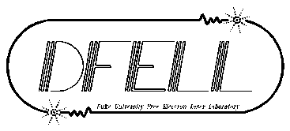
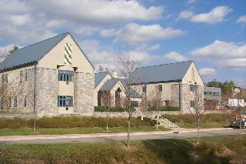
Alignment and long Term Stability of
Duke Free Electron Laser Switchyard
M. Emamian Duke Free Electron Laser Laboratory (DFELL) Durham, NC USA 27708
Mark Emamian IWAA2014 10-15-2014

Slide 2
Alignment and long Term Stability of
Duke Free Electron Laser Switchyard
A Brief History of the Duke FEL Laboratory (DFELL)
1989 Moved to Duke University
1991 Construction of 5300 Sq.m DFELL Was Completed
1994 Was First Commissioned
1995 Added 2 OK4 Undulators
Produced First UV Laser
1998 Added 1300 Sq.m Annexed Experimental Building
2000 Produced First High Intensity Gamma Rays
2006 Added a Booster Ring and 2 OK5 Undulators
2012 Added 2 More OK5 Undulators with the Switchyard Design
Mark Emamian IWAA2014 10-15-2014

Slide 3
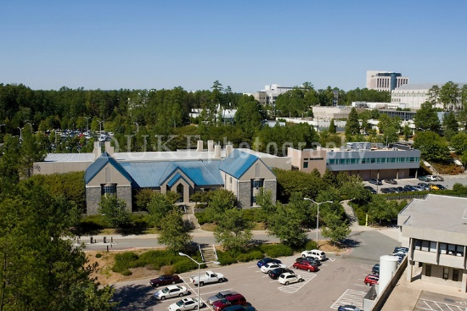
Alignment and long Term Stability of
Duke Free Electron Laser Switchyard
DFEL is housed in a 5300 sq. meter facility with a 1300 sq. meter experimental laboratory (Keck) annexed to the main area
Mark Emamian IWAA2014 10-15-2014

Slide 4
Alignment and long Term Stability of
Duke Free Electron Laser Switchyard
Mark Emamian IWAA2014 10-15-2014

Slide 5
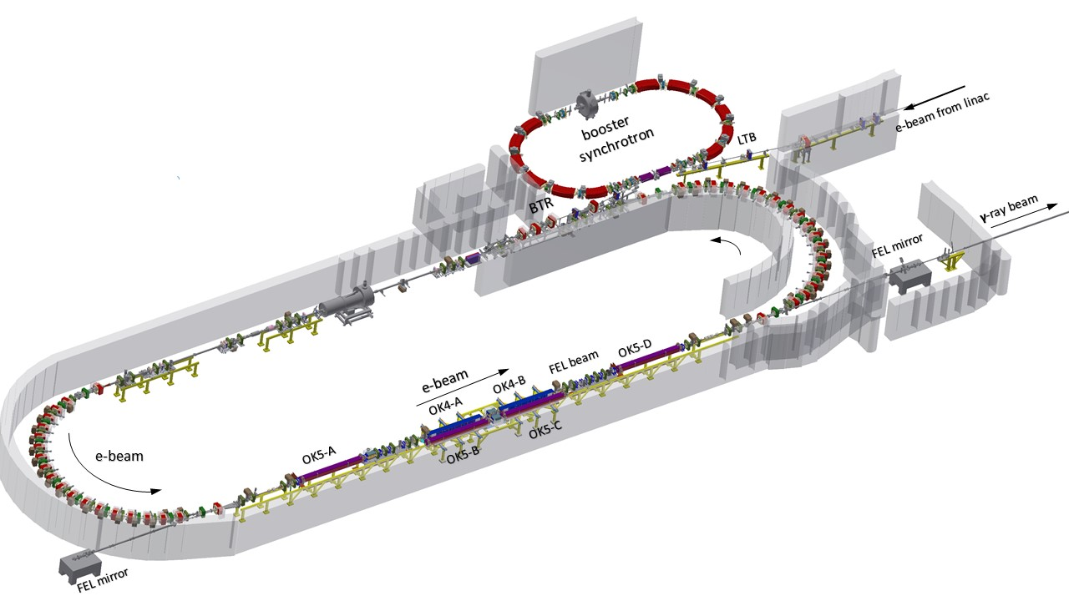
Alignment and long Term Stability of
Duke Free Electron Laser Switchyard
Mark Emamian IWAA2014 10-15-2014

Slide 6
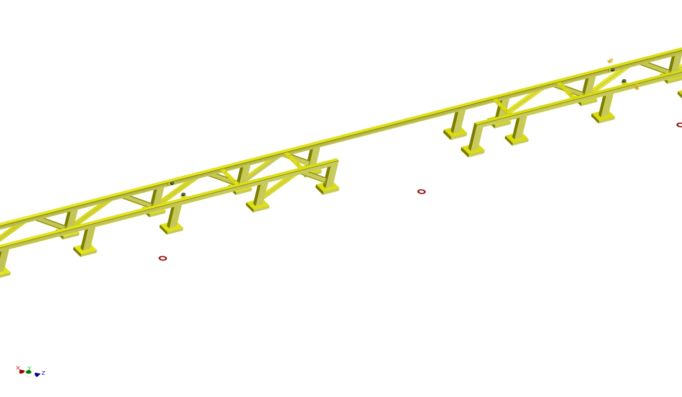
Alignment and long Term Stability of
Duke Free Electron Laser Switchyard
Mark Emamian IWAA2014 10-15-2014

Slide 7
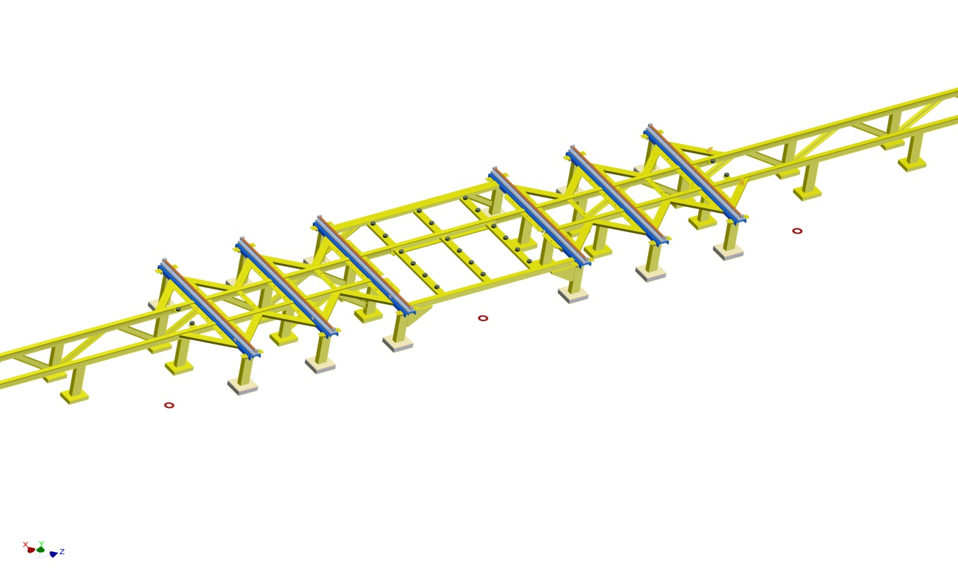
Alignment and long Term Stability of
Duke Free Electron Laser Switchyard
Mark Emamian IWAA2014 10-15-2014

Slide 8
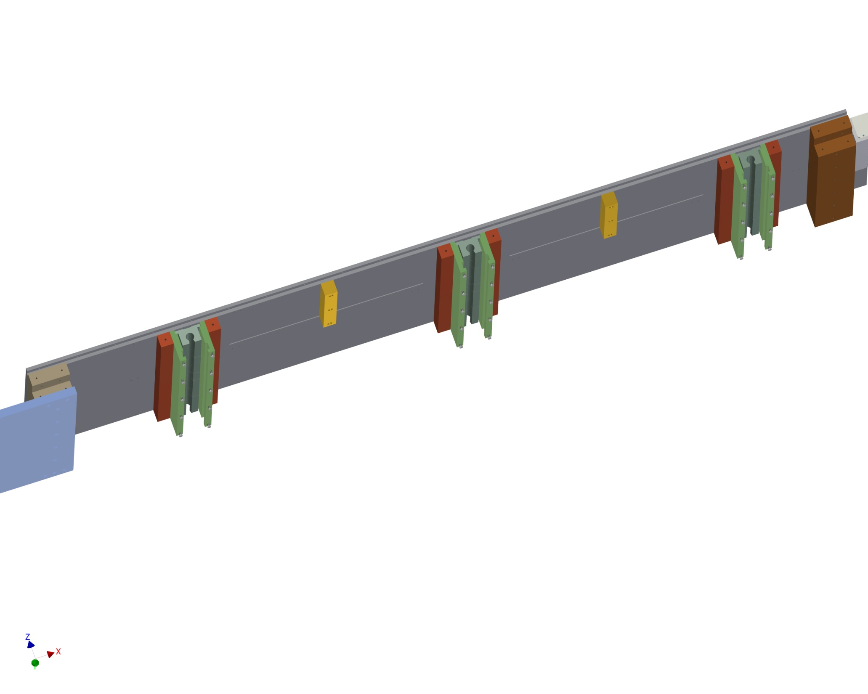
Alignment and long Term Stability of
Duke Free Electron Laser Switchyard
Mark Emamian IWAA2014 10-15-2014

Slide 9
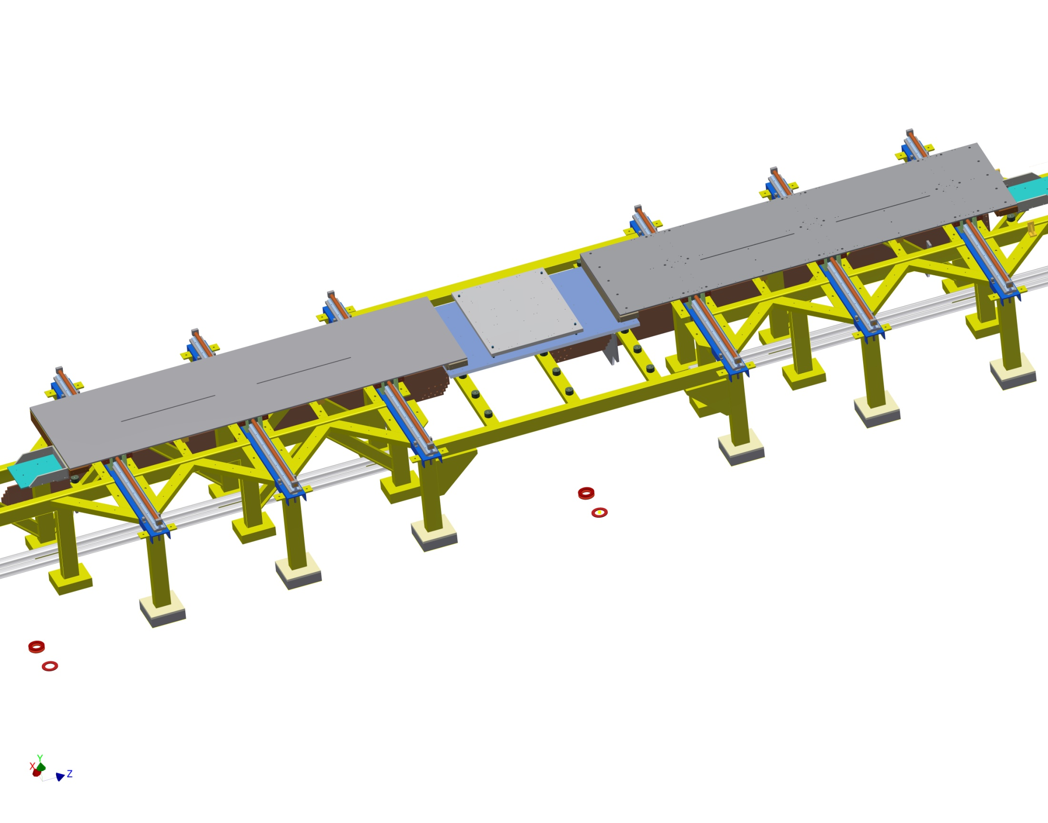
Alignment and long Term Stability of
Duke Free Electron Laser Switchyard
Mark Emamian IWAA2014 10-15-2014

Slide 10
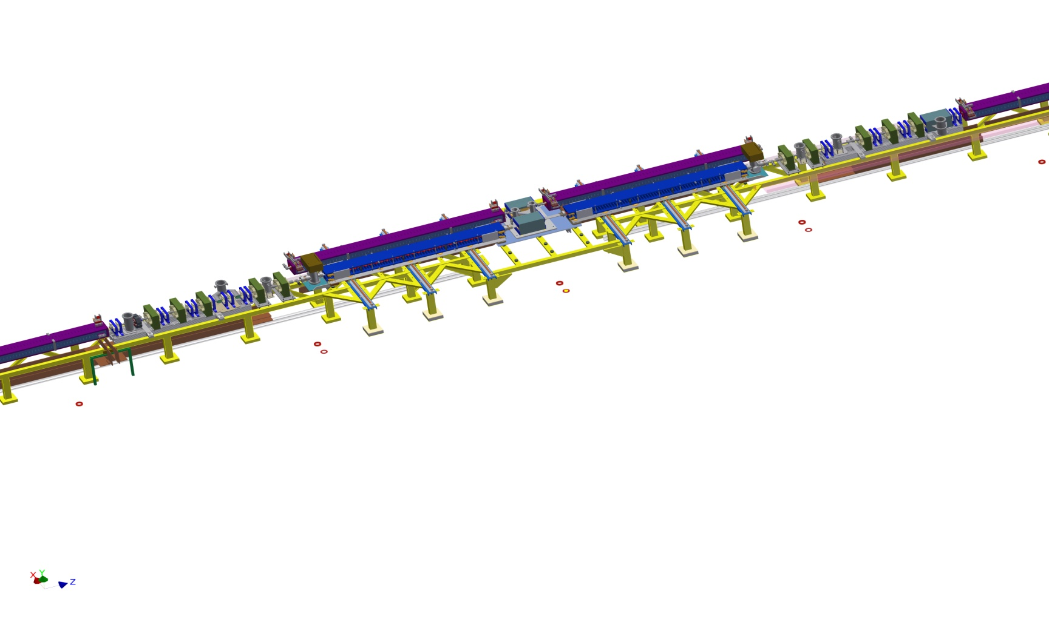
Alignment and long Term Stability of
Duke Free Electron Laser Switchyard
Mark Emamian IWAA2014 10-15-2014

Slide 11
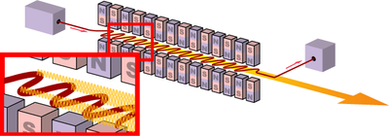
Alignment and long Term Stability of
Duke Free Electron Laser Switchyard
Planar Undulator
wavelength of the emitted radiation:
Helical Undulator
Mark Emamian IWAA2014 10-15-2014

Slide 12
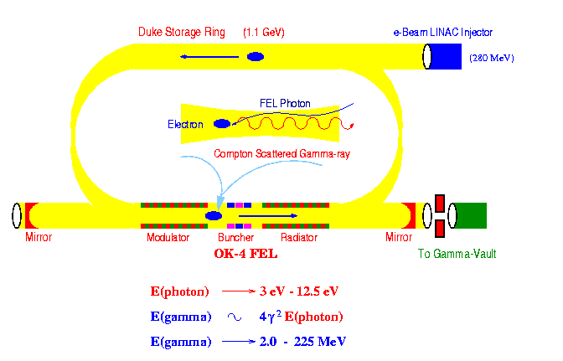
Alignment and long Term Stability of
Duke Free Electron Laser Switchyard
Mark Emamian IWAA2014 10-15-2014

Slide 13
Alignment and long Term Stability of
Duke Free Electron Laser Switchyard
End of Presentation
Thank You!
Mark Emamian IWAA2014 10-15-2014

