Slide 1
Laser beam trajectory measurement with a CCD camera
Georg Gassner

Slide 2
Motivation
Determine angle of a reflective surface by measuring the trajectory of an incoming laser beam and its reflection of the surface.
Reflected beam
Reflective Surface
δ
Incoming beam
δ

Slide 3
Laser trajectory measurement
Principle
Determine points on the laser trajectory at two different locations

Slide 4
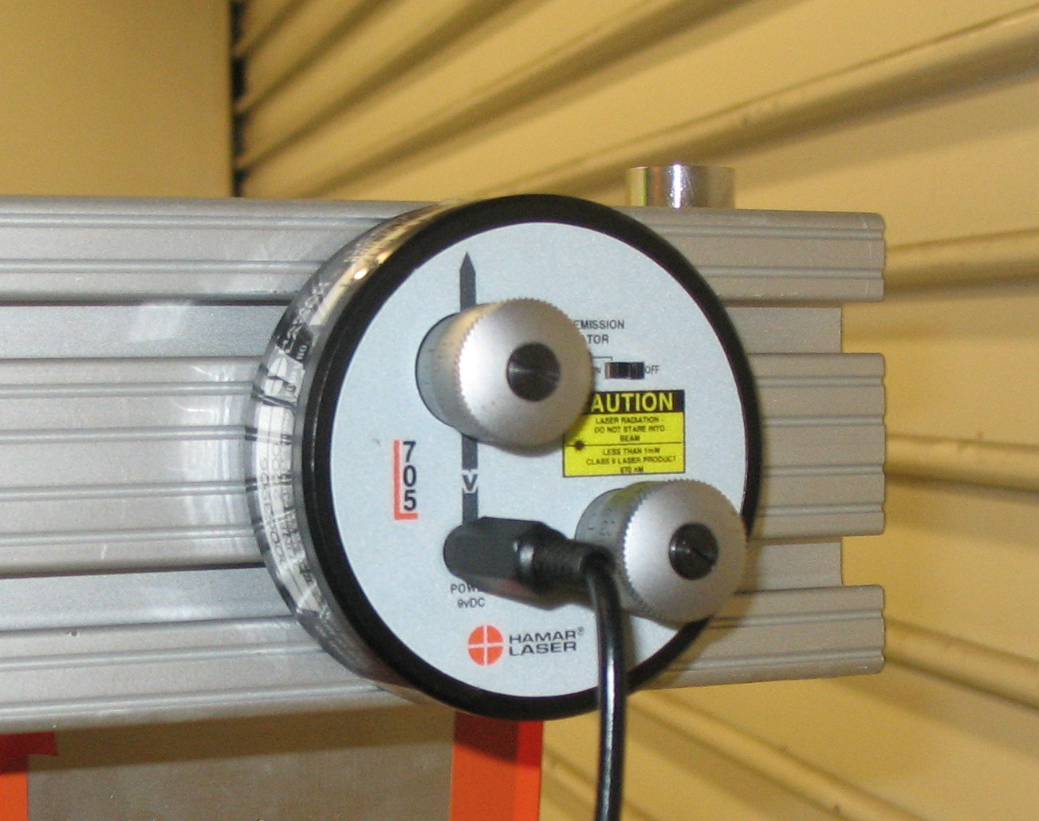
Hardware - Laser
Laser (Hamar L-705 Bore Laser Alignment System)
<1mW Cw
670nm
Beam Stability:
10µrad/hr/degC

Slide 5
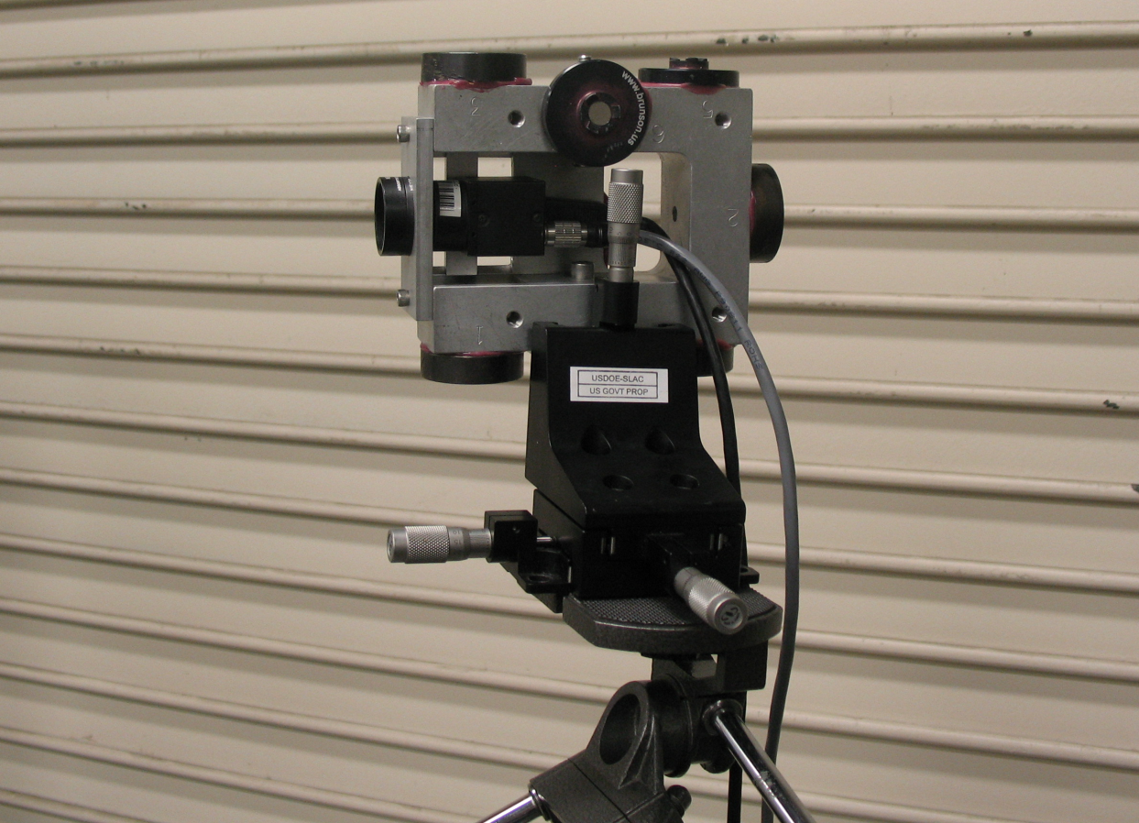
Hardware
Point Grey - FL2-20S4M-C
1624x1224 pixel
4.4µm pixel size
Natural Density
Filter (OD=2)
Newport Stages
12.7mm travel
XZ

Slide 6
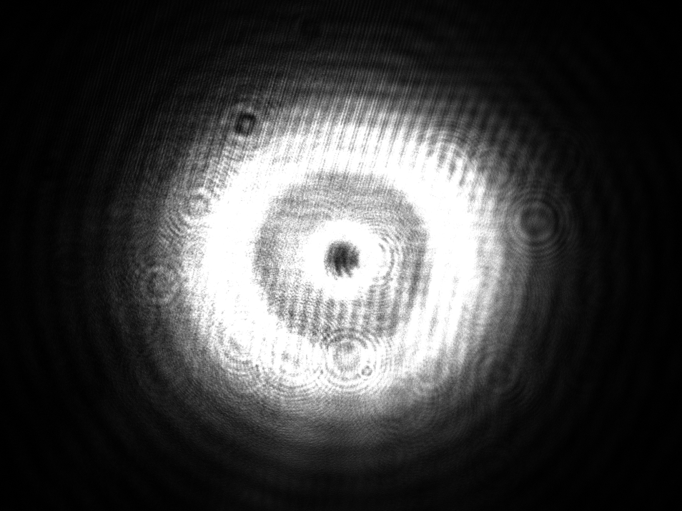
Measurement System
Camera
Laser
Retro reflectors
Screen shot
Computer
Screen

Slide 7
Fiducialization
Relative position of fiducials on CMM.
Offset determination by setting the camera up on a laser line and measuring at different orientations to the laser line.
Mapping with laser tracker.

Slide 8
Solve Least Squares Problem
Numeric Approach
Calculate Orientation of Camera relative to CMM data with a six par transformation for every setup.
Iteratively change offsets (Δx, Δy, Δz) apply transformation parameters and fit new line to the data.
Calculate distance of the individual camera positions to the estimated line and find minimum of $\sum_{i=1}^{num setups}{{dist}_{i}}$.
Standard deviation single shot: 30µm

Slide 9
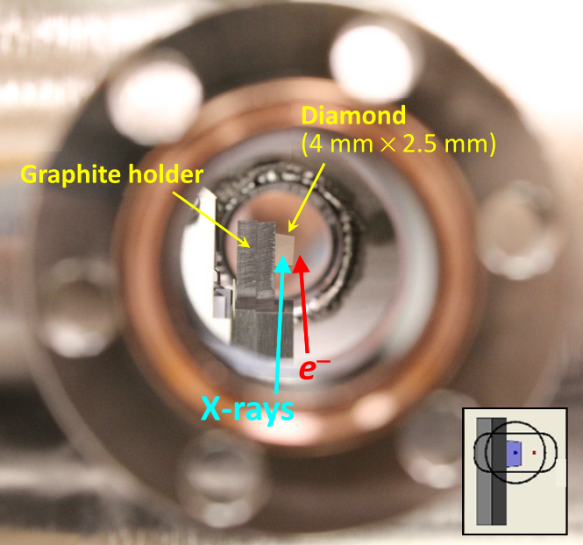
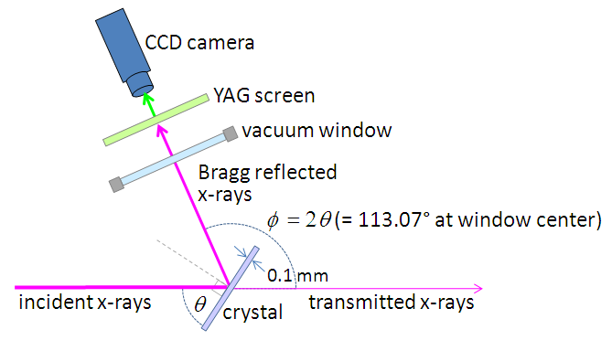
Application: HXRSS (1)
Align a crystal at a nominal orientation without touching it.

Slide 10
Application – HXRSS (2)
Bench Top alignment in the lab by mapping the camera at 3 different locations for the incoming beam and 3 different locations for the outgoing beam

Slide 11
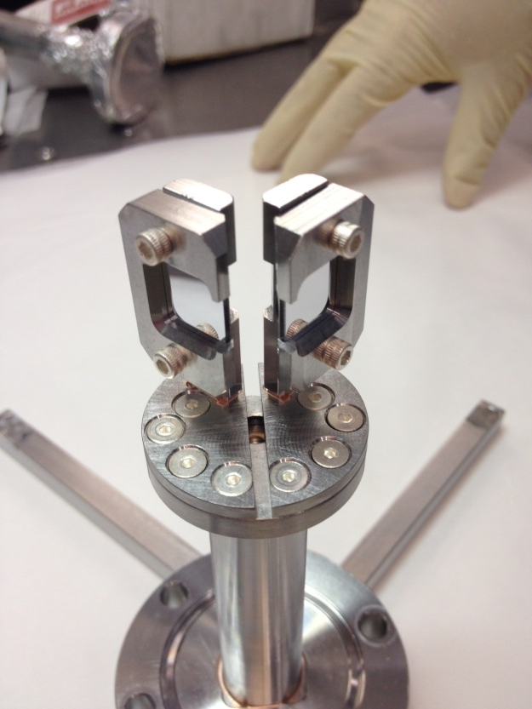
Application: Mirror tool for e-gun diagnostic
Benchtop alignment of two mirrors with laser and CCD camera

Slide 12
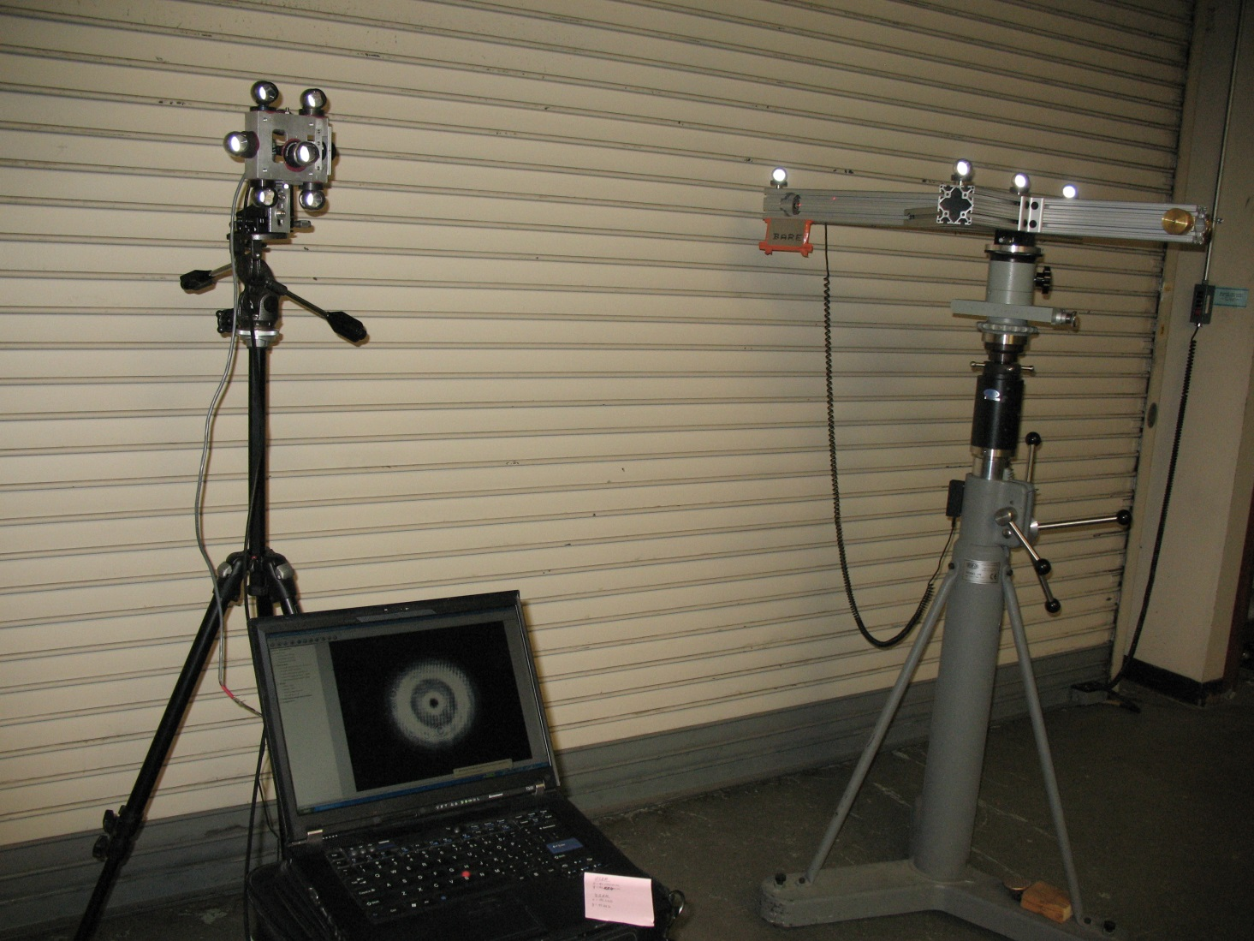
Aligning the laser to simulate beam
Laser
Two rotation stages
Translation stage
Precision Lift

Slide 13
Laser Fiducialization
Map Camera at 3 different locations
Map cross structure fiducials
Fit line through calculated camera positions
Camera Positions
Fiducials
Laser Tracker

Slide 14
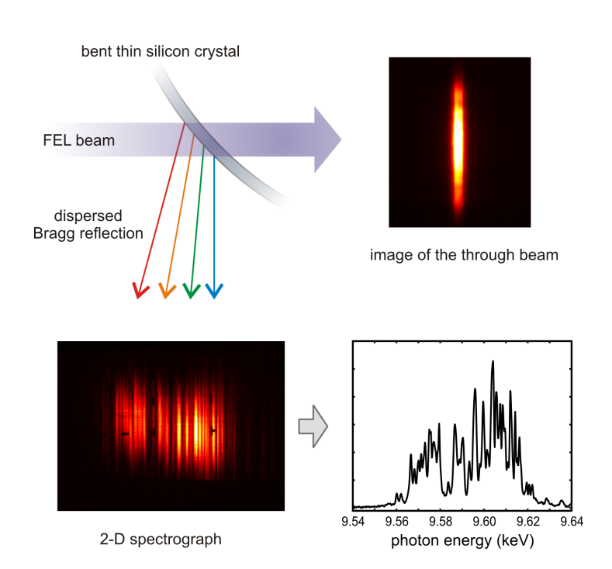
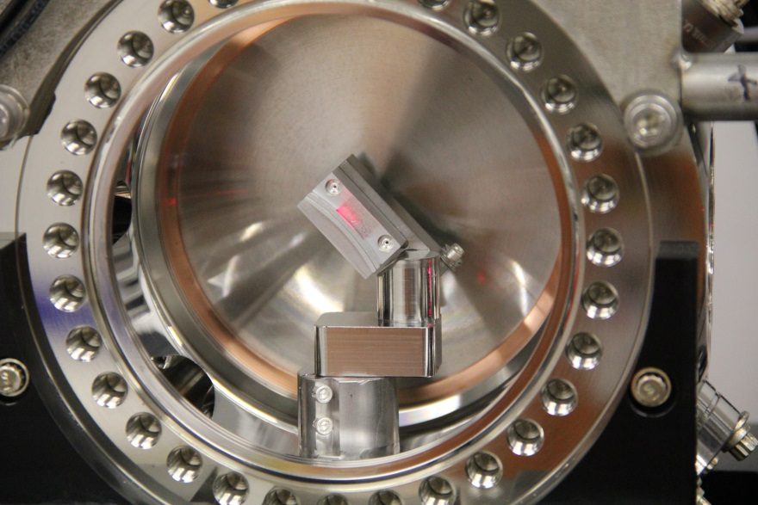
Application: Thin crystal spectrometer (1)
In-situ replacement of bent crystal (5x15mm).
Alignment of Laser to be in-line with x-ray beam

Slide 15
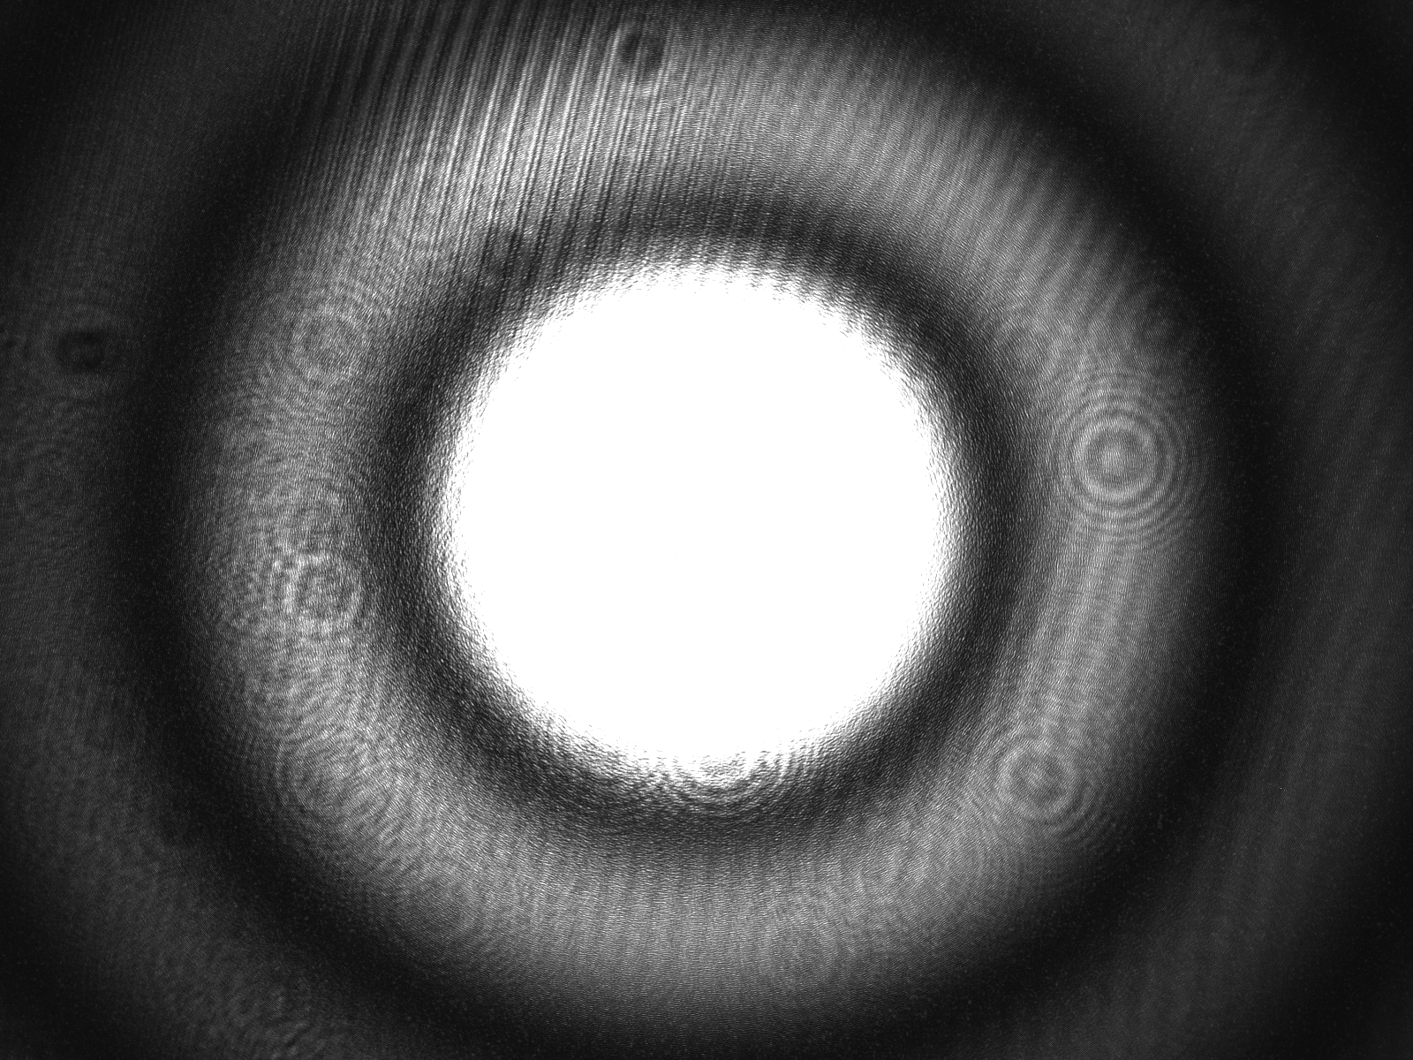
Pinhole
To reduce the beam diameter we used a 0.8mm pinhole:
Pro: simple
Con: bigger beam
divergence
compared with lens
system

Slide 16
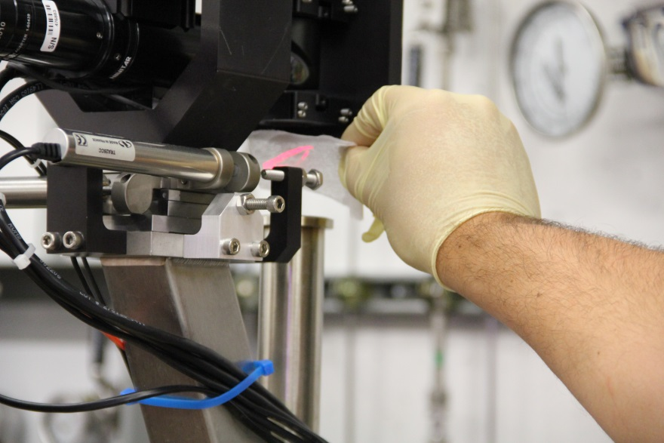
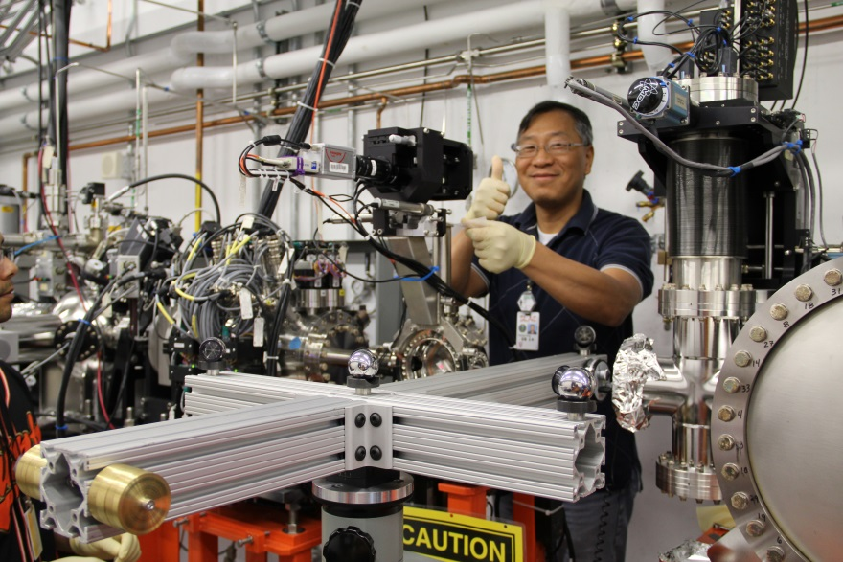
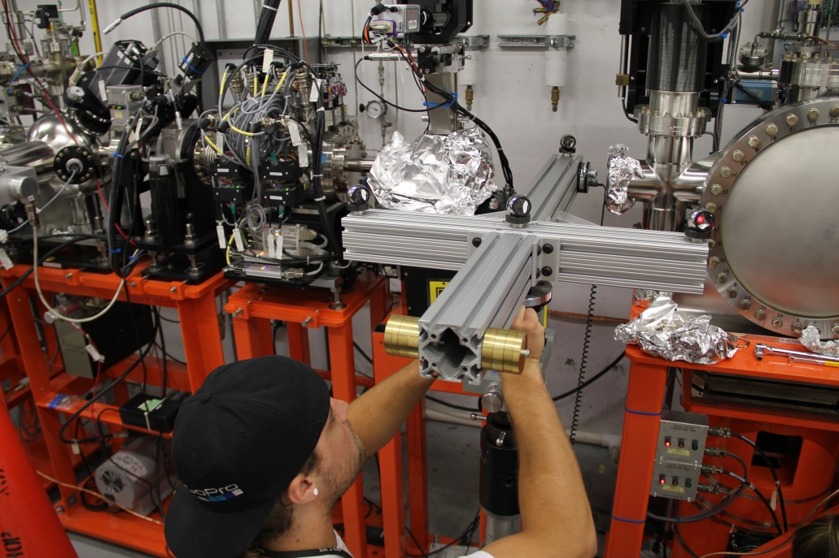
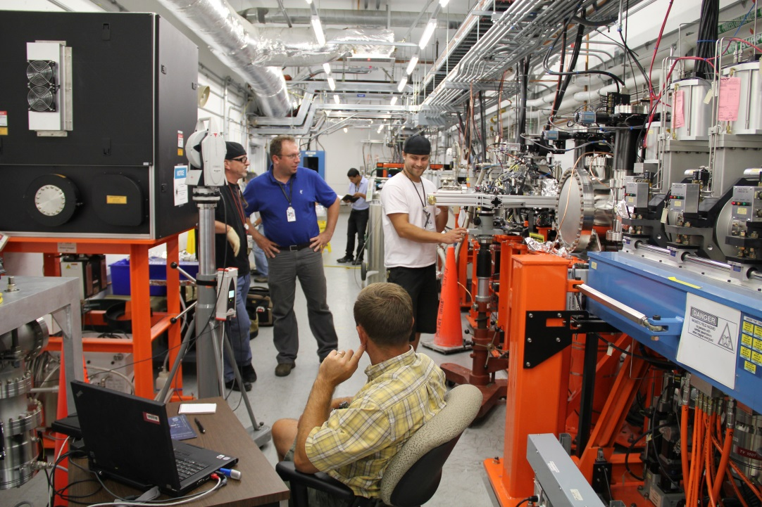
Application: Thin crystal spectrometer (2)
Align the laser in place of the x-ray beam
Manually manipulate the crystal until centered on the camera.

Slide 17
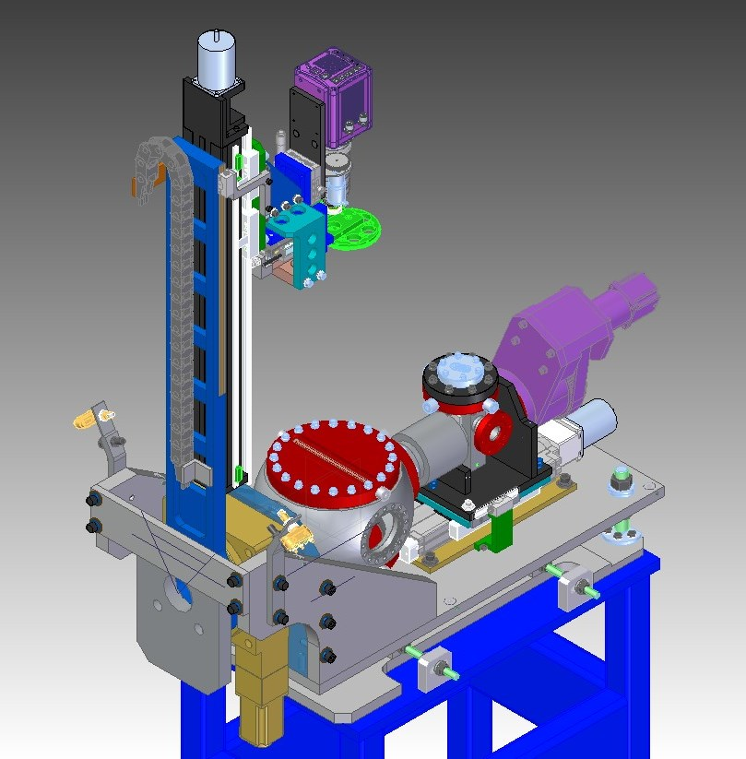
Variable Energy Spectrometer (1)
Detector sub-assy.
Chamber sub-assy.
Crystal sub-assy.
Detector Arm sub-assy.

Slide 18
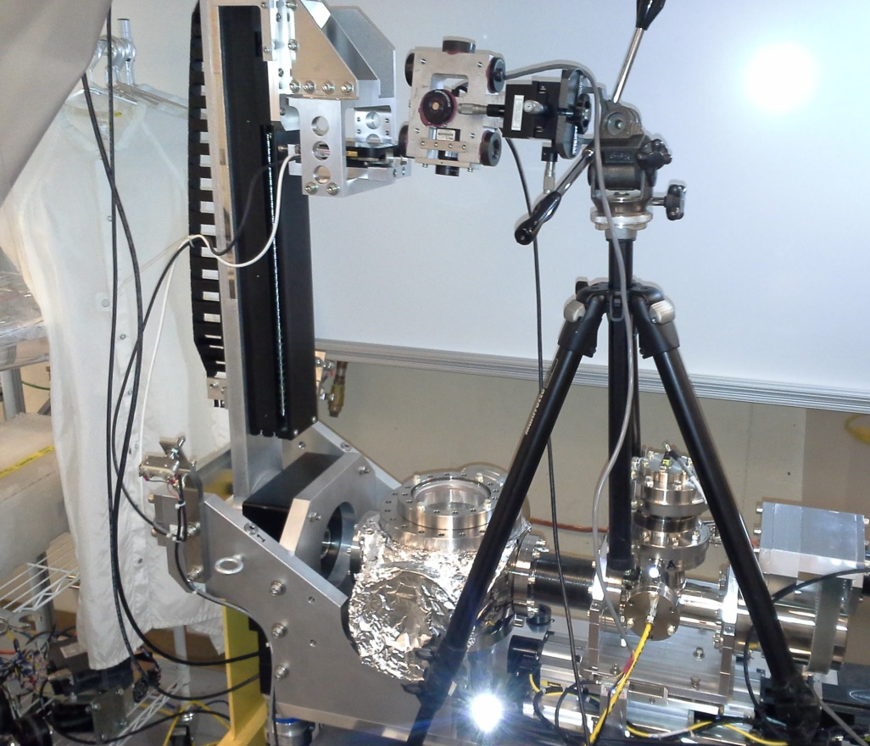
Variable Energy Spectrometer (2)
Establish local coordinate system
Setup laser to emulate beam
Calculate z and y position by intersecting in and outgoing line

Slide 19
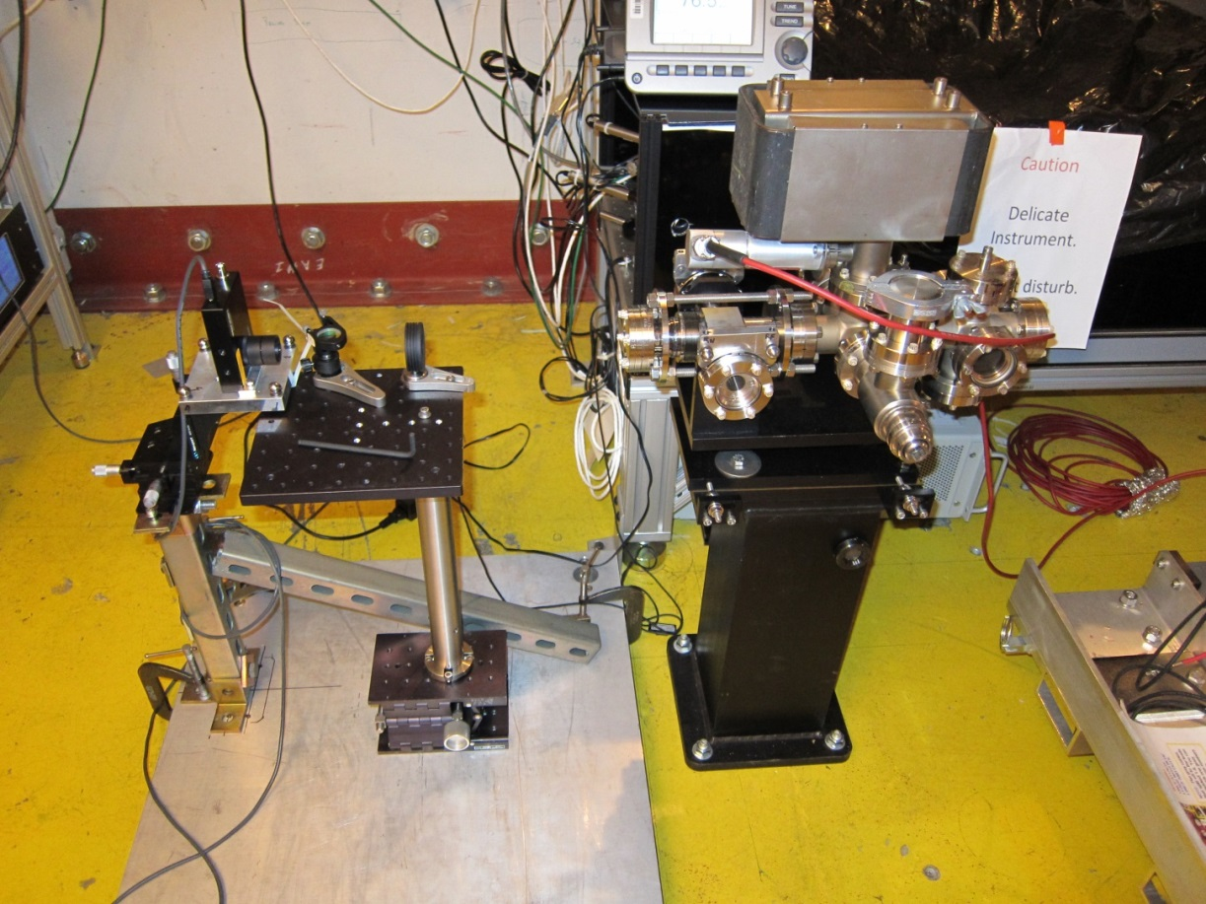
E-gun setup
Place the Spiricon camera at the desired cathode location relative to the mirror chamber.
Replace camera
with gun

Slide 20
Summary
Most components of the system are available at labs.
Laser beam trajectory measurements with a camera can achieve about 50µm point accuracy when used in combination with a Leica AT401.

