Slide 1
Research on laser tracker measurement accuracy and data processing
Liang Jing
IHEP,CHINA
2014.10

Slide 2
Outline
  1. Accuracy test experiment for laser tracker
    In the transversal direction
    In the longitudinal direction
    In the vertical direction
  2. Repeatability stastistics of laser tracker in BEPCII
    Layout of BEPCII storage ring control network
    BEPCII control network measurement scheme
    Repeatability stastistics from 2007-2010
  3. Three dimension distance network adjustment
    Theoretical basis
    Simulation result
    4. Summary

Slide 3
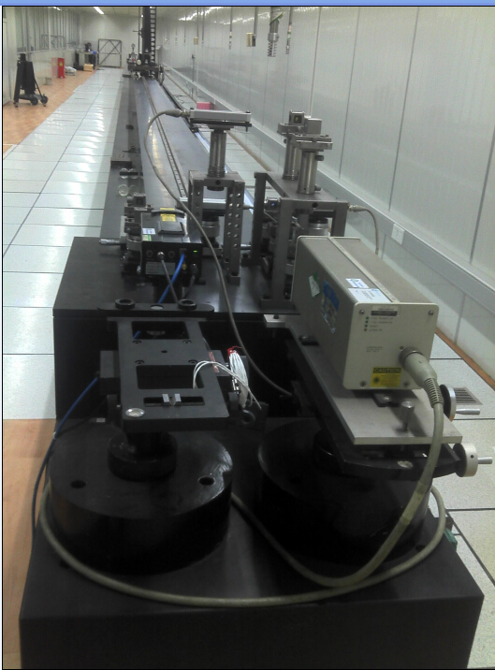
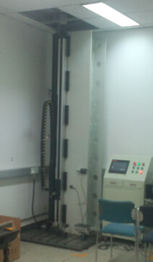
1. Accuracy test experiment for laser tracker
We used the instrument calibration device of Changcheng Institute of Metrology & Measurement to carry out the laser tracker accuracy test experiment . A laser interferometer in the device is as the standard and gives the reference lengths in horizontal and vertical direction . we tested the laser tracker accuracy in the transversal, longitudinal and vertical direction.
Horizontal calibration device:30m
vertical calibration device:3m

Slide 4
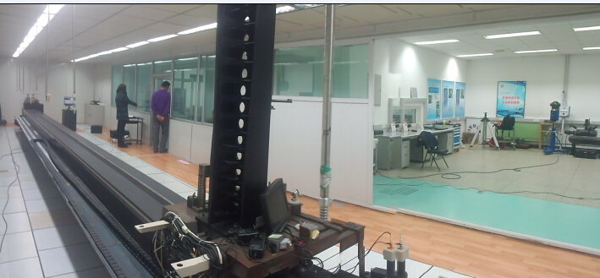
1. Accuracy test experiment for laser tracker
----in the transversal direction
The laser tracker stationed away from the horizontal device 9m and 3m separately. The target moves along the guide rail ,from the difference between the laser tracker measuring distance and the standard distance given by laser interferometer, we can calculate the laser tracker accuracy in the transversal direction.
Laser tracker
guide rail
target
3m/9m

Slide 5
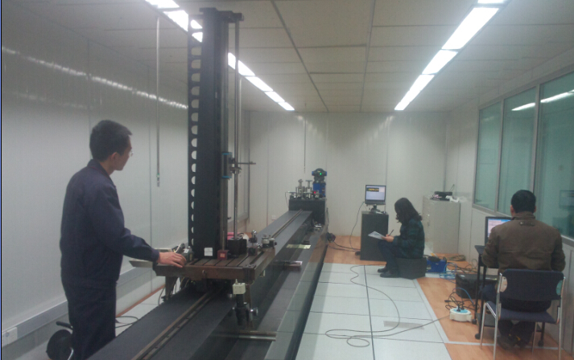
1. Accuracy test experiment for laser tracker
----in the longitudinal direction
The laser tracker stationed on one side of the guide rail. The target moves along the guide rail ,from the difference between the laser tracker measuring distance and the standard distance given by laser interferometer, we can calculate the laser tracker accuracy in the longitudinal direction.
Laser tracker

Slide 6
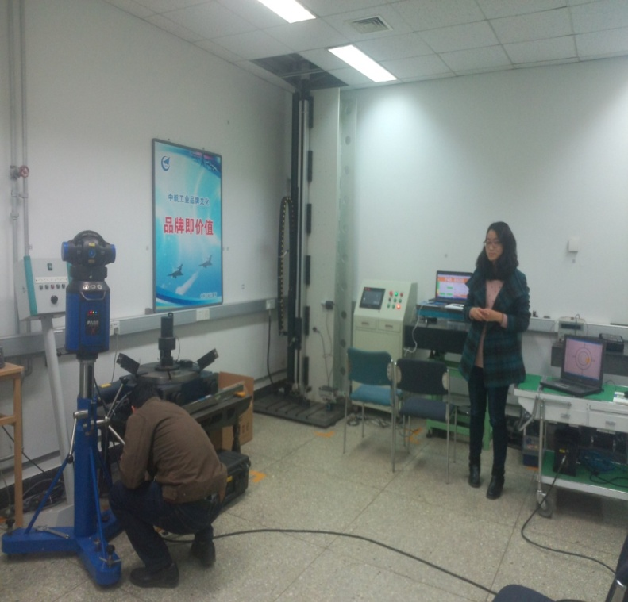
1. Accuracy test experiment for laser tracker
----in the vertical direction
The laser tracker stationed away from the vertical device 9m and 3m separately. The target moves along the guide rail in the vertical direction, from the difference between the measuring distance and the standard distance, we can calculate the laser tracker accuracy in the vertical direction.
guide rail
Laser tracker
3m/9m

Slide 7
1. Accuracy test experiment for laser tracker
----the result of test experiment
We measured 270 distances using Faro Xi laser tracker, the RMS of difference is shown as follow.
It is more accurate in the longitudinal direction, the RMS of difference is 4.3 µm. It is mostly influenced by distance measurement error in the longitudinal direction, and in the two other direction mostly influenced by angle measurement error.
Laser tracker : Faro Xi
Direction | Distance of laser tracker to guide rail | Measurement range | RMS of difference
transversal | 9m | 4m | 22.1µm
 | 3m | 8m | 17.9µm
longitudinal | 0.3m | 32m | 4.3µm
vertical | 9m | 2m | 11.1µm
 | 3m | 2m | 17.3µm

Slide 8
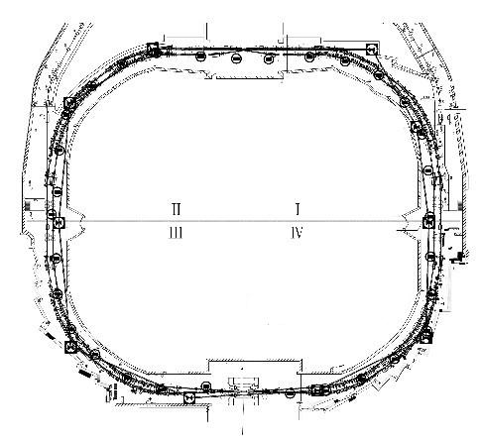
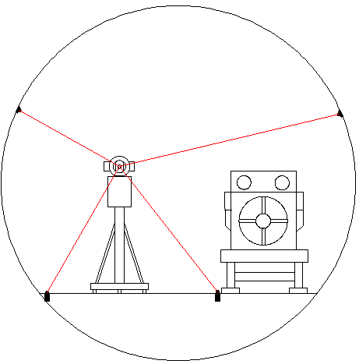
2. Repeatability stastistics in BEPCII storage ring
----layout of tunel control network
BEPCII storage ring tunnel is about 240 m in circumference. Control point sections are set with the interval of 6 m along the tunnel. In each section, there are four control points, two on the floor, one on the inner wall and one on the outer wall.
There are 67 control point sections along tunnel, totally 268 control points.

Slide 9
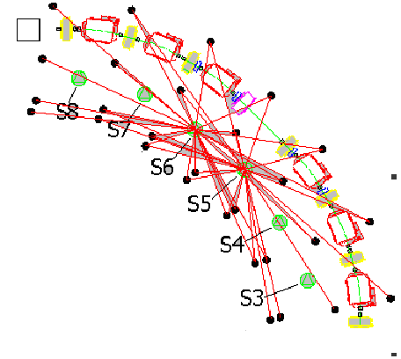
2. Repeatability stastistics in BEPCII storage ring
----measurement scheme
We used laser tracker to carry out control network survey by free station method. The measuring station is set between every two neighboring sections.
Each station laser tracker should measure 30 points and the number of common control points between neighboring stations is 25.It is more than 30 plus the magnet pionts.
Laser tracker

Slide 10
    2. Repeatability stastistics in BEPCII storage ring
    ----repeatability stastistics from 2007-2010
Using the common points of neighboring stations , we can translate neighboring coordinate system to the same coordinate system to calculate the slantwise distance, horizontal angle and vertical angle difference of neighboring stations.
Repeatability stastistics of laser tracker in BEPCII storage ring from 2007-2010 is shown as follows.
Z
P
r
O
β
X
Y

Slide 11
    2. Repeatability stastistics in BEPCII storage ring
    ---- slant distance Repeatability stastistics

Slide 12
    2. Repeatability stastistics in BEPCII storage ring
    ---- horizontal angle Repeatability stastistics

Slide 13
    2. Repeatability stastistics in BEPCII storage ring
    ---- vertical angle Repeatability stastistics

Slide 14
1. Accuracy test experiment for laser tracker
----
    2. Repeatability stastistics in BEPCII storage ring
    ---- Repeatability stastistics result
From the graph above, the maximum slant distance deviation is 0.2mm. the maximum horizontal and vertical angle deviation are 90” and 30”. Distance measurement of laser tracker is more stable.
RMS of Repeatability is shown as follows. 2” and 3”in 10m measurement range amount to 0.1mm and 0.15mm, distance measurement repeatability is better than angle measurement.
year | slant distance Repeatability （mm） | horizontal angle Repeatability (″) | vertical angle Repeatability (″)
2010 | 0.045 | 2.02 | 2.82
2009 | 0.066 | 2.293 | 4.01
2008 | 0.097 | 3.257 | 2.35
2007 | 0.16 | 3.057 | 3.838

Slide 15
    3. Three dimension distance network adjustment
Laser tracker distance measurement accuracy and repeatability are better than angle measurement. We consider only use distance measurement in data processing to reduce measuring error. So three dimension distance network adjustment program is on progress.

Slide 16
    3. Three dimension distance network adjustment
    ---- theoretical basis
Assume S_{ij} to be the distance from station(L_{i}) to point (P_{j}), the station(L) coordinates are , (i=1，…，m), point (P) coordinates are , (j=m+1，…，m+n)，so the observation equation is：
we can get error equation from linearized observation equations :

Slide 17
    3. Three dimension distance network adjustment
    ---- theoretical basis
The error equation coefficient are：
Where:
are the approximate coordinates of stations.
are the approximate coordinates of points.
are the approximate measuring distances:

Slide 18
    3. Three dimension distance network adjustment
    ---- theoretical basis
三、激光干涉测距三维网平差技术
Matrix form of error equation :
According to the least square method, the equation can be solved :

Slide 19
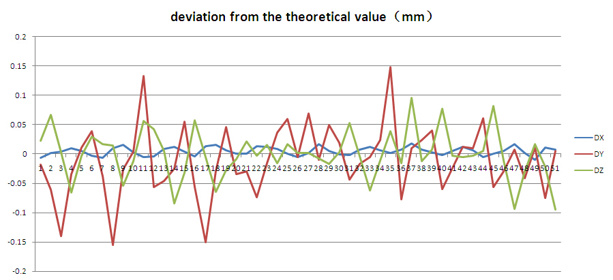
    3. Three dimension distance network adjustment
    ---- simulation result
三、激光干涉测距三维网平差技术
We simulate a Linac control network which consist of 55 points to test the program. Random error from -0.1mm to 0.1mm is added to simulation measurements, and the deviation of adjustment result to the theoretical value is shown as follows , the average deviation is 0.03mm. The precision evaluation results are from -0.1mm to 0.1mm.

Slide 20
Summary
  1.From the laser tracker test experiment, it is more accurate in the longitudinal direction. Distance measurement has higher accuracy than angle measurement.
  2. Repeatability stastistics of laser tracker in BEPCII storage ring from 2007-2010 shows that distance measurement repeatability is better than angle measurement repeatability.
  3. Three dimension distance network adjustment program is on progress ,simulation results are correct. More test will be done, such as using actual measurement data.

Slide 21
Thank you！

