Slide 1
Celebrating IWAA’s Anniversary
13th International Workshop on Accelerator Alignment
Notes:
Good morning
I am honored to be speaking here at the beginning of the 13th incarnation of our workshop.
It is exciting to have the workshop for the first time here in China, a country with such a long history. Your ancestors had already built dynasties when many of ours were still gatherers and hunters.
But I am not here to talk about Chinese history, although I will talk about the past, but only IWAA’s past.
The idea for this talk occurred to me, when I recently started clearing my office. I don’t want to leave all my junk for my successor to dump. Wading through piles of old documents, I found a letter I had written in 1989 to my then peers, Michel Mayoud at CERN and Franz Löffler at DESY.
Next slide

Slide 2
Letter to M. Mayoud & F. Löffler
Notes:
The three of us had discussed many times how we could create a forum to exchange ideas. We all knew we needed such an exchange. This was the time when physicists started to talk about “micron” dimensioned tolerances when we still were struggling to achieve the “sub-millimeter” tolerances. And before moving on into the micron world, we still had to solve many problems in the then present world, e.g. moving data analysis from mainframes to PCs or Unix workstations, creating data bases instead of using files stored on tapes or even punch cards, and many more. Instead for each of us reinventing the wheel over again, we wanted to find a way to cross fertilize our ideas.
And as you recall, the late 80ties was pre-internet, no email or messaging, and first generation of personal computers without a graphical user interface, i.e. pre-Windows and pre-Mac. We still used typewriters and wrote letters send by mail. And additionally, long distance and especially transcontinental telephone calls were way too expensive for longer conversations. In other words, communication compared to today, was really slow.
So, 25 years ago, in January of 1989, I took the initiative and suggested to create a workshop type meeting to discuss our technical problems and to exchange ideas. And voilà, IWAA was born.

Slide 3
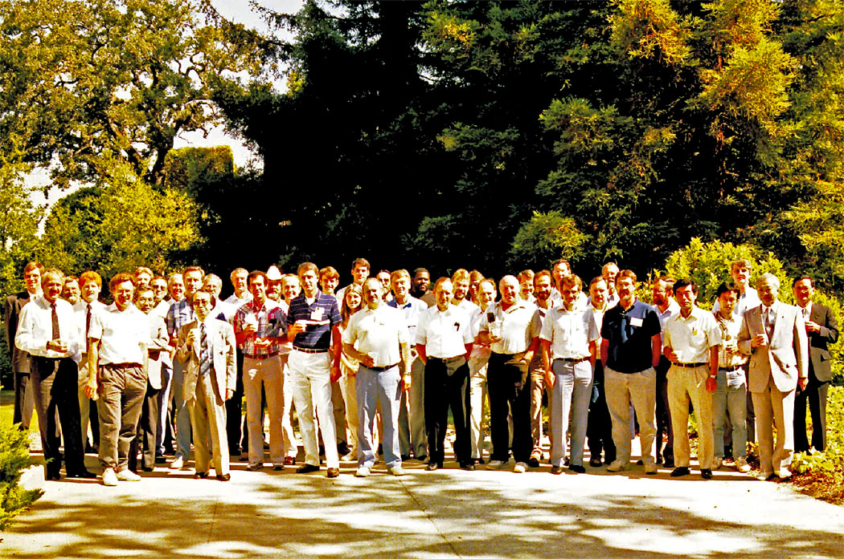
1st International Workshop On Accelerator Alignment
31 July – 2 August 1989, SLAC
Notes:
This is the group picture of the first workshop. Let me only say, time flies!

Slide 4
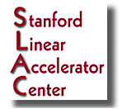
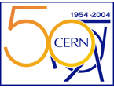
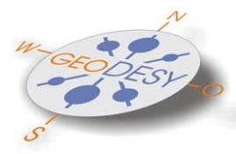
SLAC 1989
DESY 1990
CERN 1993
KEK 1995
ANL 1997
ESRF 1999
Spring8 2002
CERN 2004
SLAC 2006
KEK 2008
DESY 2010
FNAL 2012
IHEP 2014
IWAA Homepage: http://www-conf.slac.stanford.edu/iwaa/default.htm
Notes:
This slide shows the IWAA history condensed onto one page.
After the third workshop, we changed the schedule to a two year rhythm and a rotation sequence from the Americas to Europe to Asia.

Slide 5
Notes:
You might wonder, why did I delve into the past?
Because the first workshop happened 25 years ago; 2014 marks the 25th anniversary of IWAA, it is time to celebrate!
Thank you to all who have attended the past workshops to make IWAA the success it is. The fact that the workshop is still here after such a long time only shows that it is still relevant. And with your continued participation, it will continue for a long time.

Slide 6
13th International Workshop on Accelerator Alignment
at
Notes:
Back to today, let the 13th workshop begin.

