Slide 1

Welcome to IHEP

Slide 2
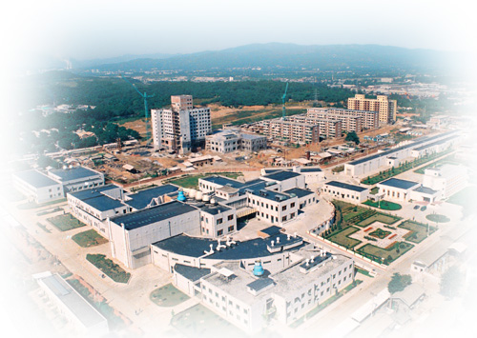
Introduction of IHEP:
History,Status and Future Plan
Qing Qin
Institute of High Energy Physics
13th IWAA,
Oct. 14, 2014

Slide 3
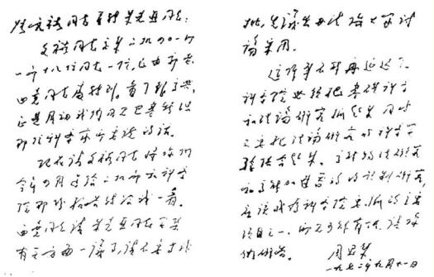
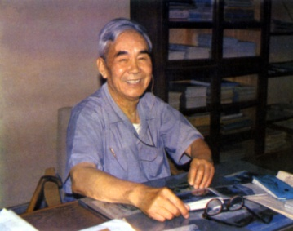
History
May,1950 | Institute of Modern Physics
October,1953 | Institute of Physics
July ,1958 | Institute of Atomic Energy
February ,1973 | Institute of High Energy Physics
ZHANG Wenyu

Slide 4
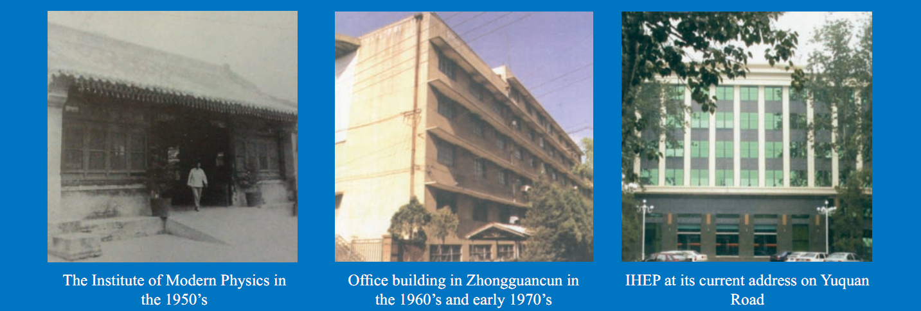
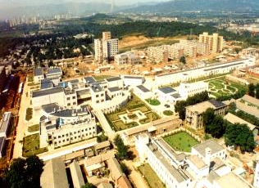
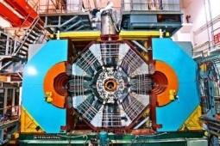
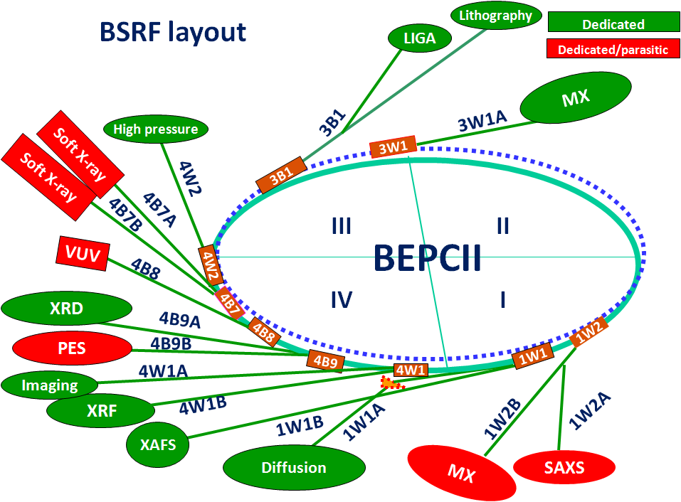
History

Slide 5
Organization
Experimental Physics Center
Particle Astrophysics Center
Theoretical Physics Division
Accelerator Center
Multidisciplinary Research Center
Center for Nuclear Technology Applications
Computing Center
Research
( 7 )
Science Committee
Director’s Office
Department of Human Resources
Department for Research & Planning
Center for Large Facility Management
Department of Financial Affairs
Department of Assets
Department of postgraduate Education
Office for Technology Transfer and Management
Department of Supporting Services
Retired Staff Office
IHEP
Staff
Congress
Directors
Administration
( 10 )
Academic Degree Committee
Support
( 3 )
Utility Operation Division
Library and Information Services Division
Machine Shop
Employee: ~ 1500
Students： ~ 400
Visitors: ~ 400
Budget： ~ 1.2 B
RMB/yr
Dongguan Branch

Slide 6
Main research Disciplines
Particle Physics
HEP Exp. Based on Accelerators
Particle Astrophysics & Neutrino Exp.
Particle Detection and Electronics
Particle Physics Theory
Science
Accelerator Physics and Technologies
Technology
High Luminosity Electron Accelerator
High Intensity Proton Accelerator
Applied Research and Technology Transfer
Radiation Technologies and Applications
Scientific infrastructure for multi-disciplinary studies
Synchrotron Radiation Techniques & Applications
Neutron Scattering Techniques & Applications
Nuclear Analytical Techniques & Applications

Slide 7
Large science facilities
IHEP serves as the backbone of China’s large science facilities
In operation
  Beijing Electron Positron Collider (BEPCII)
  Beijing Spectrometer (BESIII)
  Beijing Synchrotron Radiation Facility (BSRF)
  Yangbajing Cosmic Ray Observatory: ASγ & ARGO
  Daya Bay Neutrino Experiment
Under construction
  China Spallation Neutron Source (CSNS)
  Hard X-ray Modulation Telescope(HXMT)
  Accelerator-driven Sub-critical System (ADS)
  Jiangmen Neutrino Underground Observatory (JUNO)
Under planning
  HEPS, LHAASO, XTP, HERD, CEPC …

Slide 8
HEP: Current and Future Projects
 |  | Current | Future
Accelerator-based | Precision frontier | BESIII | International: ILC CEPC ➔ SppC
 |  | International projects: Belle II、PANDA、COMET
 | Energy frontier | CMS、ATLAS
Non-accelerator-based | underground | Daya Bay | JUNO
 |  | EXO
 | surface | ASγ | LHASSO
 | Space | AMS | HERD XTP
 |  | HXMT

Slide 9
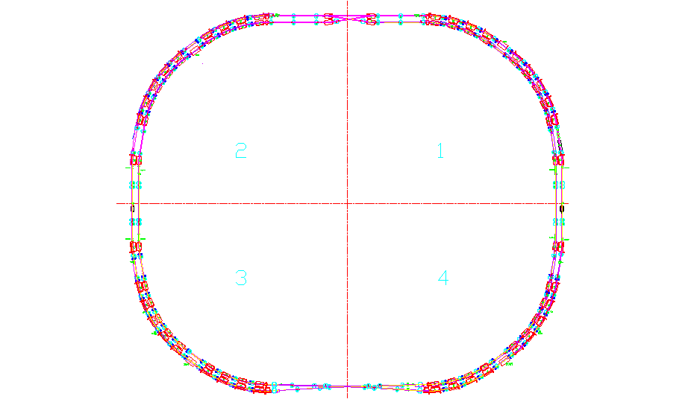
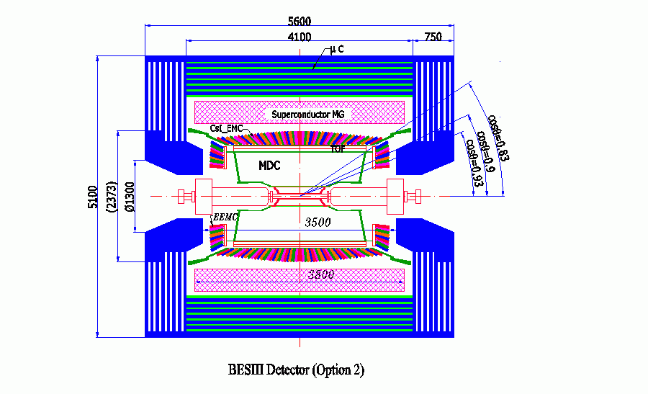
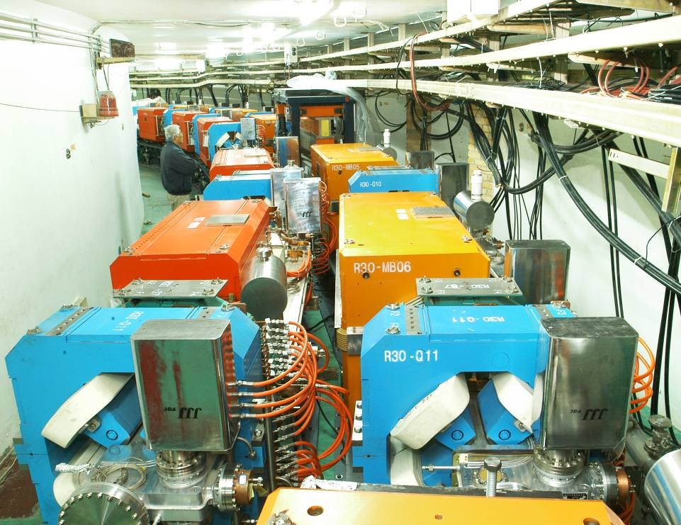
A high lumi. e⁺e⁻ collider at the τ-c energy region
BEPCII/BESIII: Operational since 2009
BEPCII
BEPC
CESRc
DORIS I
SPEAR
ADONE

Slide 10
Future: CEPC+SppC
Thanks to the discovery of the low mass Higgs boson, and stimulated by ideas of Circular Higgs Factories in the world, CEPC+SppC configuration was proposed in Sep. 2012
e+
IP1
e-
LTB
High Energy Booster(7.2Km)
Medium Energy Booster(4.5Km)
e+ e- Linac
(240m)
BTC
BTC
Low Energy Booster(0.4Km)
Proton Linac
(100m)
IP4
IP3
Booster(50Km)
CEPC Collider Ring(50Km)
IP2
LTB : Linac to Booster
BTC : Booster to Collider Ring
SppC Collider Ring(50Km)

Slide 11
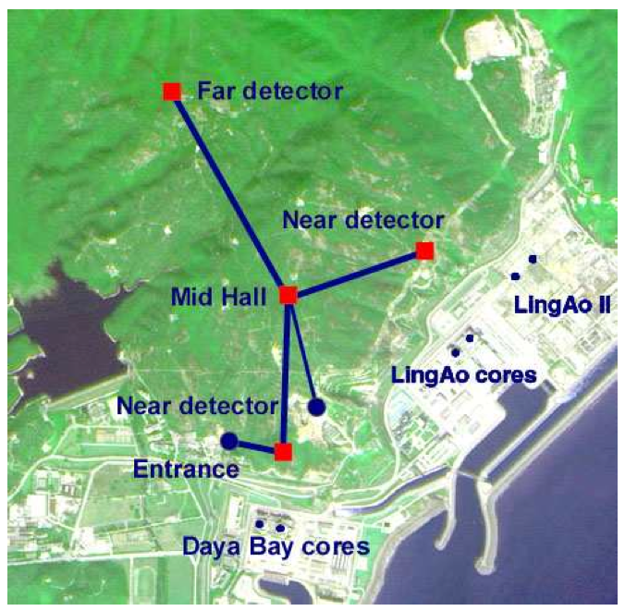
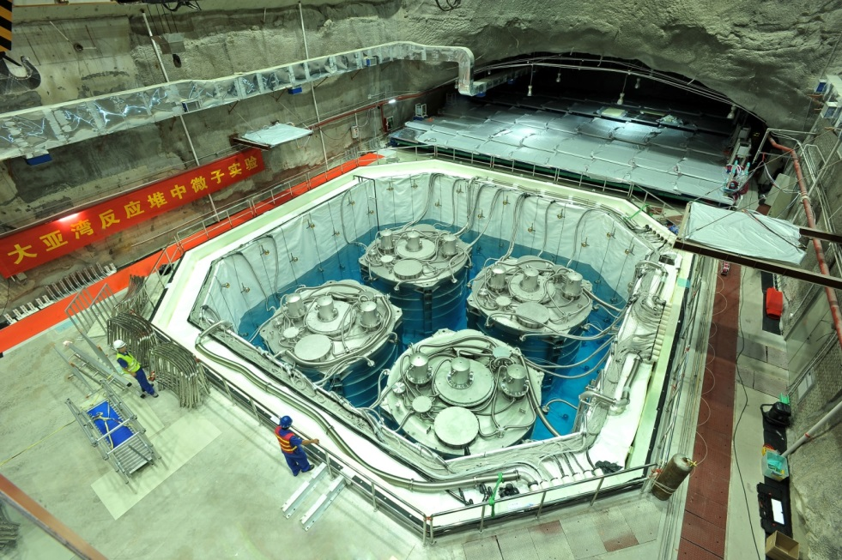
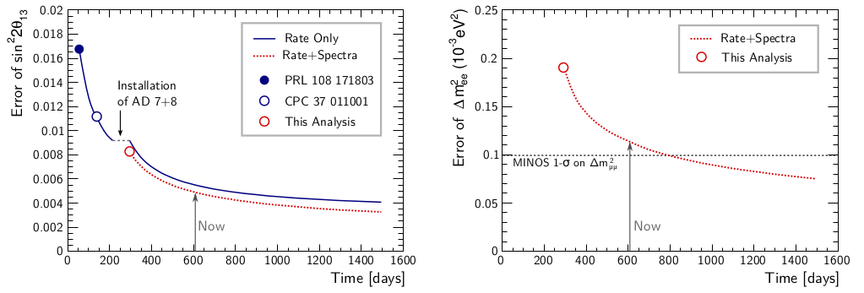
Daya Bay reactor neutrino experiment
Data taking will continue until about 2017

Slide 12
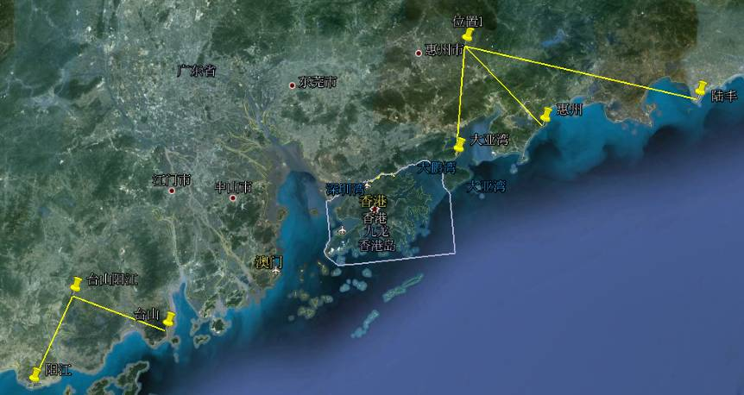
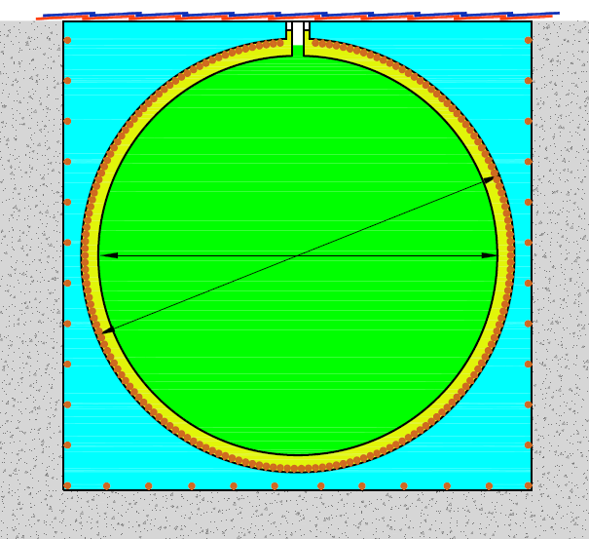
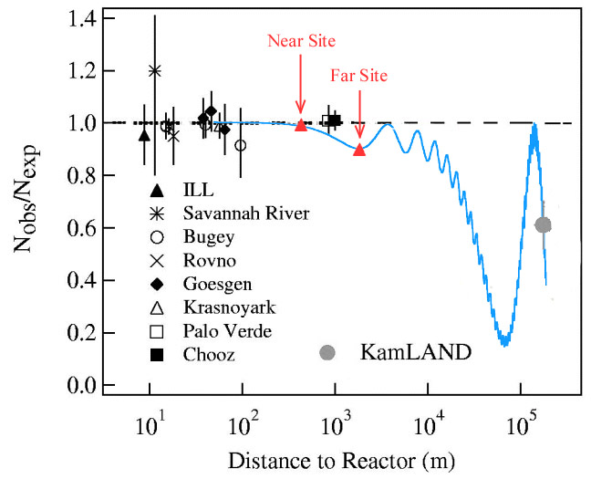
Next Step: JUNO for Mass Hierarchy
Daya Bay
60 km JUNO
Previous site
20 kt LS
Lufeng
Huizhou
Daya Bay
Mass hierarchy
Precision mixing parameters
Supernova neutrinos
Geoneutrinos
Sterile neutrinos
…
Current site
Hong Kong
Taishan
Yangjiang
The only one based on reactor: independent of CP phase
Construction: 2015-2020

Slide 13
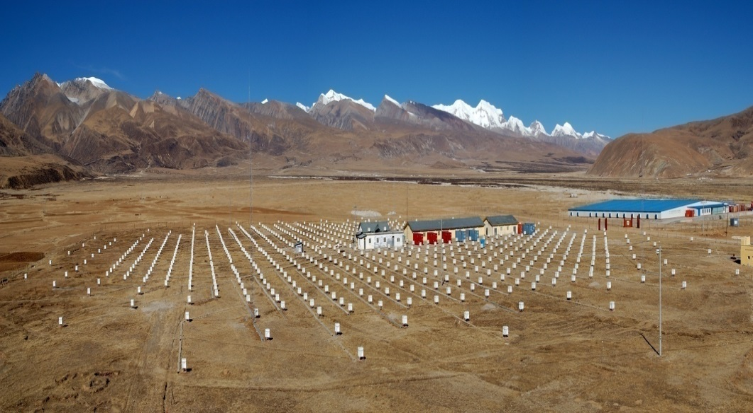
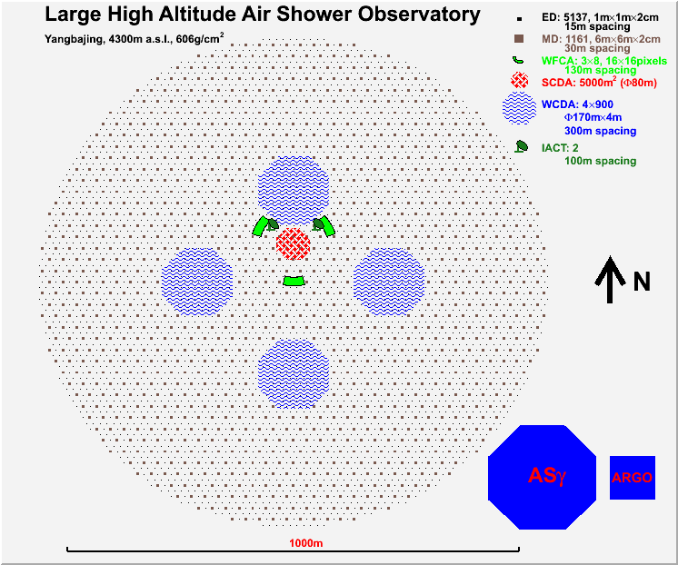
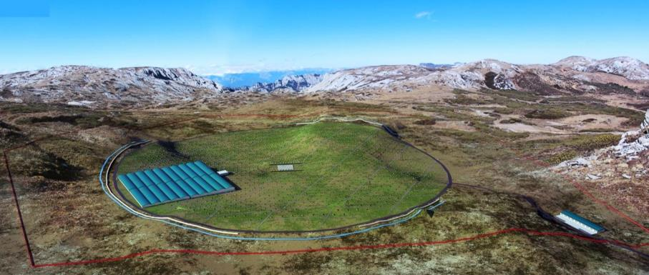
From ASγ/ARGO to LHAASO
Site: Sichuan, Altitude ~ 4400 m
Start construction: 2015 ?
International collaboration: China, France, Italy, …

Slide 14
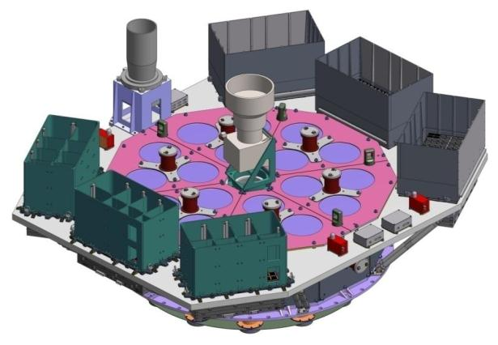
Current Space Program
ME
Hard X-ray modulated telescope (HXMT):
  Total mass：1021kg; Power: 350 W
  to be launched in 2015
Gamma-ray burst polarization (POLAR):
  onboard China’s Spacelab: TG-2
  An international collaboration: China, Switzerland, France, Poland
  Launch time ~ 2015
SVOM
  Redefined program: On board Chinese spacecraft
  A collaboration of China and France
  to be launched in 2017-2018
AMS
LE
HE

Slide 15
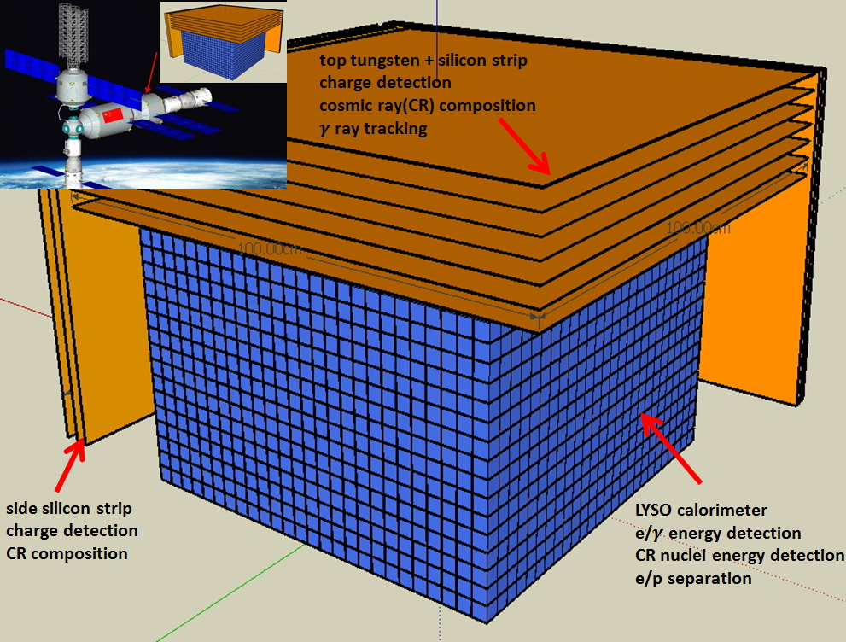
High Energy cosmic Radiation Detection (HERD) onboard the China’s Space Station
Science
  Dark matter search: γ from 0.1 – 10,000 GeV
  Spectral and composition measurements of CRs between 300 GeV to PeV
  Complementary to LHAASO: directly measured composition & spectrum in space
Status
  Mission concept selected
  Design concept reviewed
  Technical review for mission selection soon
  Groups from China，Italy，Switzerland，Sweden,…
  Launch in ~2020 (?)
PWO or BGO
 | X0(λ) | ∆E/E for e | e/p sep | e GF m²sr@ 200GeV | p GF m²sr@100TeV
HERD (2020) | 55(3) | 1% | 10⁻⁶ | 3.1 | 2.3
Fermi (2008) | 10 | 12% | 10⁻³ | 0.9 | --
AMS02 (2011) | 17 | 2% | 10⁻⁶ | 0.12 | --
DAMPE (2015) | 31 | 1% | 10⁻⁴ | 0.3 | --
CREAM (2015) | 20(1.5) | -- | -- | -- | 0.2
Notes:
15

Slide 16
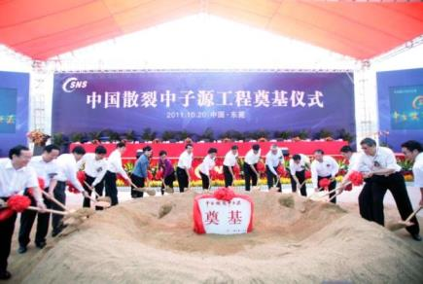
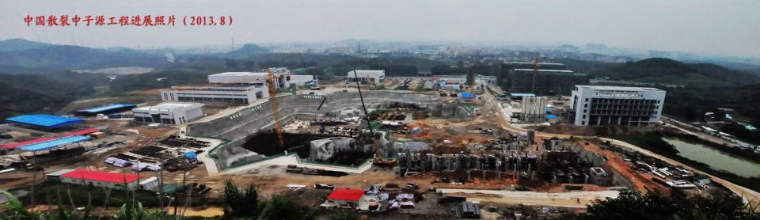
CSNS
Phase I： 100 kW Phase II： 500 kW
Start time: 2011 Completion time: 2017
Started: mass production of equipment, LINAC installation
Completed: target station & spectrometer engineering design, Civil construction of office

Slide 17
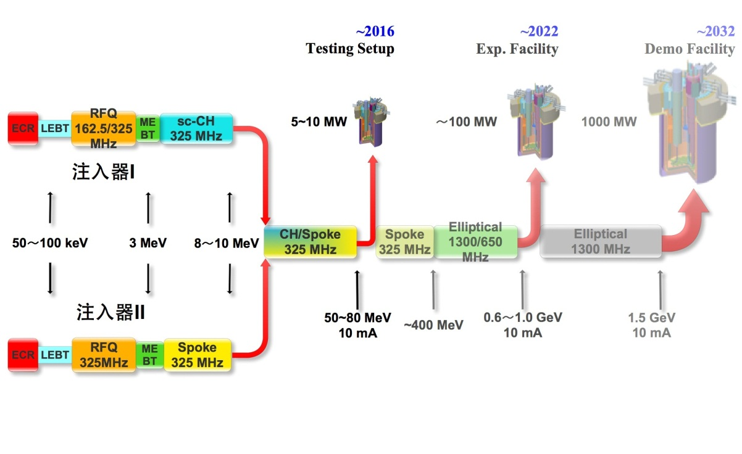
ADS R&D
Currently for injectors
CW RFQ with a high intensity
Very Low beta SC cavities
High beam power （CW）
Very high stability
Very low beam loss：<1W/m

Slide 18
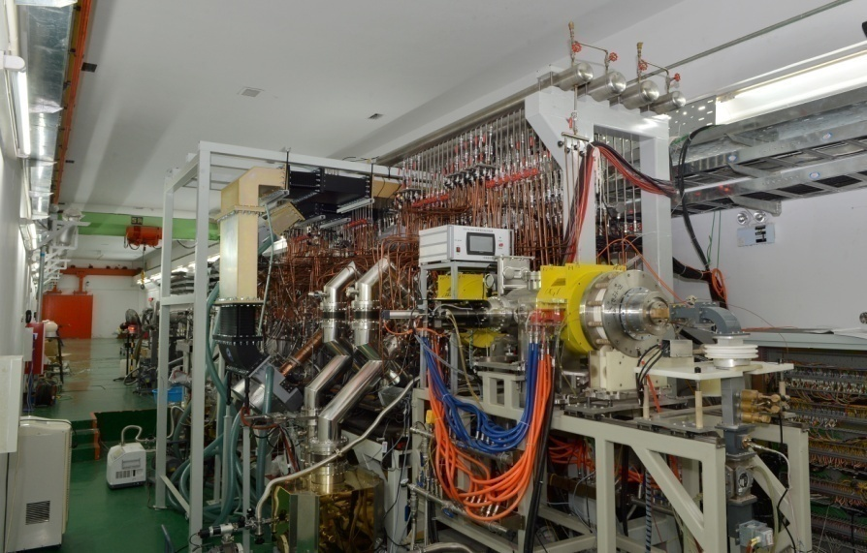
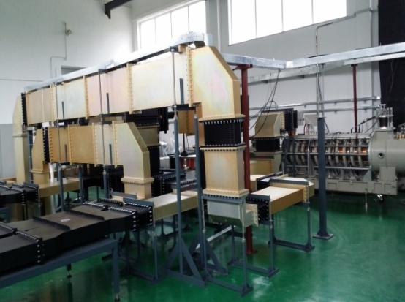
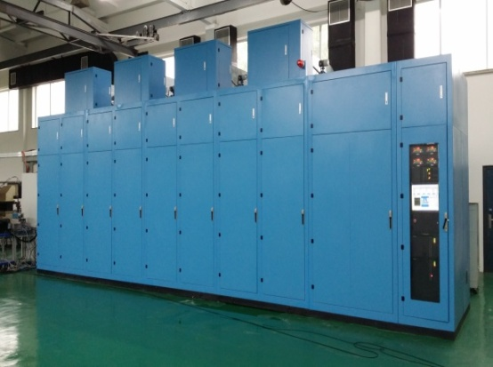
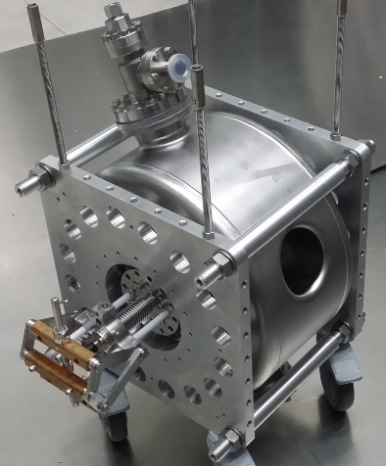
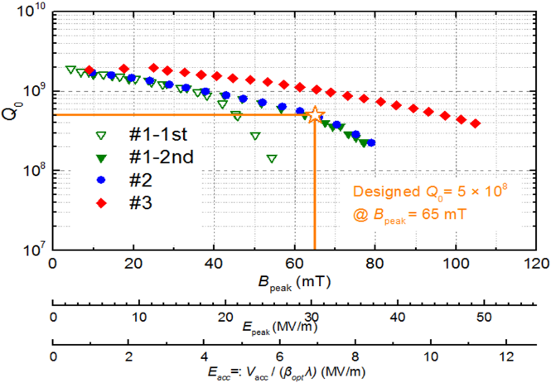
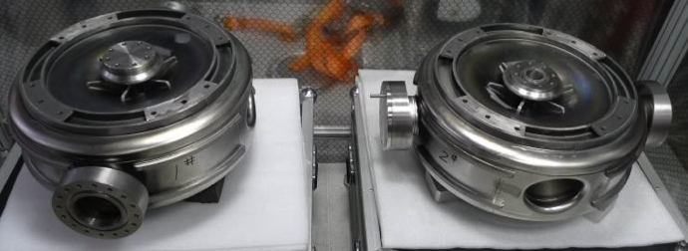
325MHz klystron and power supply
CW 600 kW
325MHz RFQ
First successful beam commissioning:
  3.2MeV/11mA (duty: 90%), Transmission:>90% , Beam power: 31kW!
First successful development of very low β SC cavities (Spoke012) for ADS.
Very good test results of Spoke021
Q₀=5×10⁸，B_{peak}=98/mT；
Max.E_{peak}=50MV/m.

Slide 19
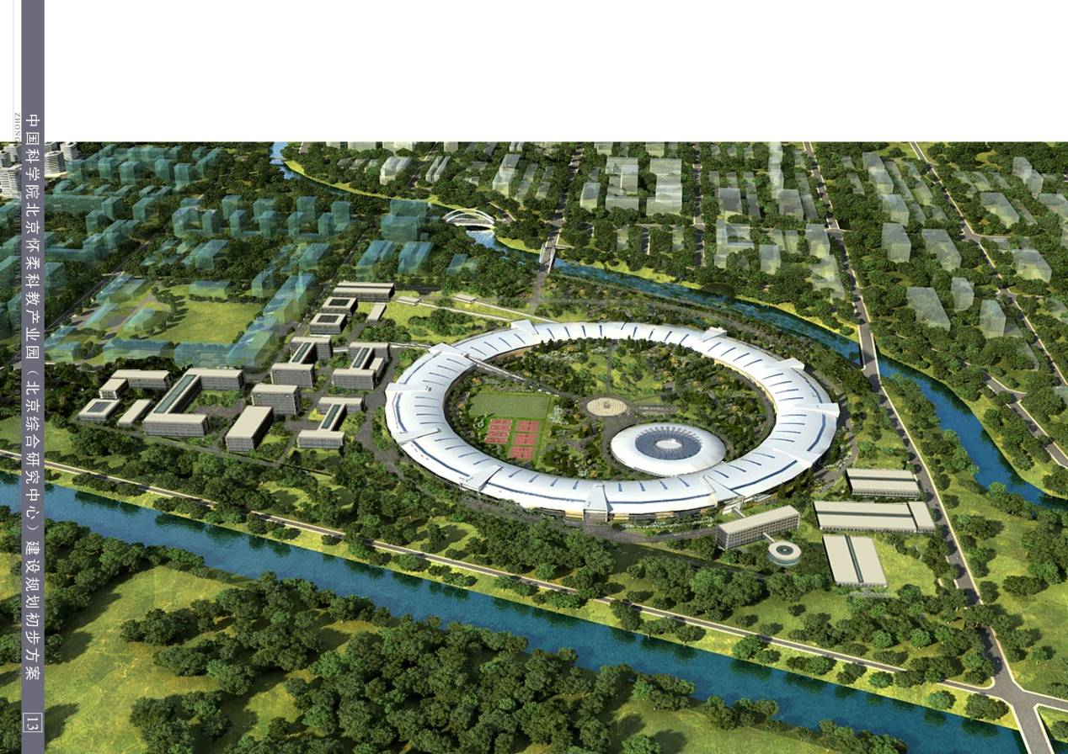
BSRF: planning for future
用户的学科分布
BSRF： 3 months operation in specific mode；6 months parasitic mode. Every year ~500 experiments.
HEPS R&D: a new machine with ~1300 m circumference. R&D projects under government review

Slide 20
Large Projects at IHEP
Daya Bay
JUNO
JUNO
BESIII
CEPC
CEPC
SppC
SppC
ASγ/ARGO
LHAASO
LHAASO
HXMT
HXMT
construction
HERD
HERD
operation
XTP
XTP
CSNS
ADS
HEPS
2020
2030
2040
2050

Slide 21
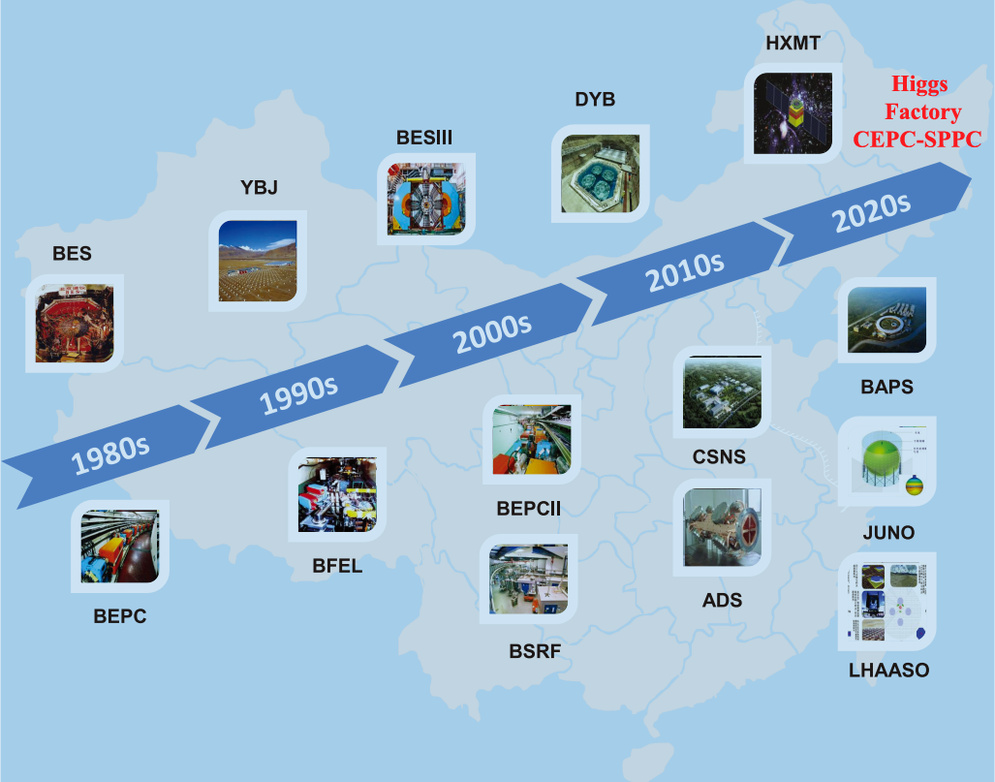
Way to the future
HEPS

Slide 22
Summary
First-class physics results have been obtained by the BESIII, Daya Bay and other experiments, and more will come.
BEPCII will continue its luminosity ramp-up, CSNS and HXMT will be put into operation in a few years, while ADS R&D will make breakthroughs on some key technologies.
New particle physics program, such as JUNO and LHAASO will start soon, while XTP/HERD will take more efforts to get support.
New light sources, such as HEPS and ERL+FEL, are under preparation, and hopefully will get support soon.
CEPC as a Higgs factory, is hoped to be the next HEP project.
Multi-disciplinary research, mainly based on large facilities shall be advanced significantly. Major efforts are needed.

Slide 23
Enjoy IWAA2014
Enjoy your time in Beijing

