Slide 1
Alignment of Superconducting Undulators at the APS
Jaromir M. Penicka
for the APS SCU team
IWAA2014 Beijing, October 13-17, 2014

Slide 2
Outline
Introduction
SCU design overview
SCU0 Assembly and fiducialization
Cooling displacement compensation
Alignment in the APS storage ring
Final beam-based alignment and monitoring
Summary

Slide 3
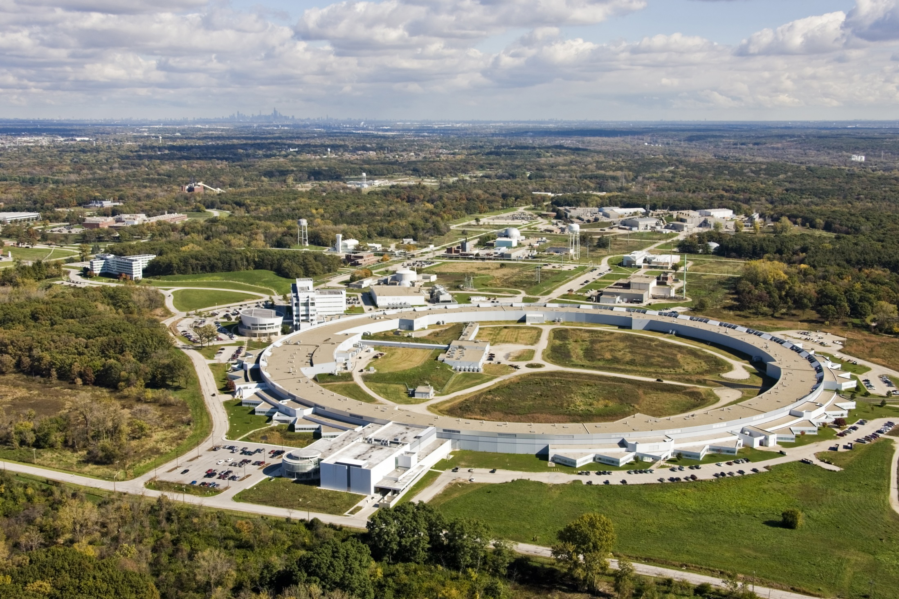
Advanced Photon Source (APS)

Slide 4
SCU0 team
Y. Ivanyushenkov (ASD)
Technical Lead and Commissioning Co-Lead
K. Harkay (ASD-AOP) Commissioning Co-Lead
Commissioning Team
L. Boon (ASD-AOP)
M. Borland (ASD-ADD)
G. Decker† (ASD-DIA)
J. Dooling (ASD-AOP)
L. Emery† (ASD-AOP)
R. Flood (ASD-AOP)
M. Jaski (ASD-MD)
J. Lang (ASD-ESH/QA)
J. Lang (XSD-ADD)
F. Lenkszus (AES-CTL)
D. Robinson (XSD-MM)
V. Sajaev* (ASD-AOP)
K. Schroeder (ASD-AOP)
N. Sereno* (ASD-DIA)
H. Shang (ASD-AOP)
R. Soliday (ASD-AOP)
X. Sun (ASD-DIA)
A. Xiao (ASD-AOP)
A. Zholents (ASD-DD)
Core Team
Management: E. Gluskin*(ASD-MD)
Simulation: R. Dejus (ASD-MD)
S. Kim (ASD-MD)
R.L. Kustom (ASD-RF)
Y. Shiroyanagi (ASD-MD)
Design: D. Pasholk (AED-DD)
D. Skiadopoulos (AES-DD)
E. Trakhtenberg (AES-MED)
Cryogenics: J. Fuerst (ASD-RF)
Q. Hasse (ASD-MD)
J. Kaluzny (ASD-RF)
Measurements: M. Abliz (ASD-MD)
C. Doose (ASD-MD)
M. Kasa (ASD-MD)
I. Vasserman (ASD-MD)
Controls: B. Deriy (ASD-PS)
M. Smith (AES-CTL)
Tech. support: S. Bettenhausen (ASD-MD)
K. Boerste (ASD-MD)
J. Gagliano (ASD-MOM)
M. Merritt (ASD-MD)
J. Terhaar (ASD-MD)
Budker Institute Collaboration
(Cryomodule and Measurement System Design)
N. Mezentsev
V. Syrovatin
V. Tsukanov
V. Lev
FNAL Collaboration
(Resin Impregnation)
A. Makarov
UW-Madison Collaboration
(Cooling System)
J. Pfotenhauer
D. Potratz
D. Schick
Technical Support
R. Bechtold (AES-MOM) D. Capatina (AES-MED)
J. Collins (AES-MED) P. Den Hartog* (AES-MED)
R. Farnsworth* (AES-CTL) G. Goeppner* (AES-MOM)
J. Hoyt (AES-MOM) W. Jansma (AES-SA)
J. Penicka* (AES-SA) J. Wang* (ASD-PS) S. Wesling (AES -SA)
Former management: E. Moog† (ASD-MD)
Associate Project Manager: M. White (APS-U)
*Group Leader † Former group leader

Slide 5
SCU cryostat

Slide 6
SCU0 cryostat structure

Slide 7
SCU0 and SCU1 parameters
Parameter | SCU0 | SCU1
Electron beam energy | 7.0 GeV | 7.0 GeV
Photon energy at 1st harmonic | 20-25 keV | 12-25 keV
Undulator period | 16 mm | 18 mm
Magnetic gap | 9.5 mm | 9.5 mm
Magnetic length | 0.33 m | 1.14 m
Cryostat length | 2.06 m | 2.06 m

Slide 8
Alignment Tolerances*
Alignment Tolerance | X [mm] | Y [mm]
Magnetic structure | ±0.150 | ±0.150
SCU0 vacuum chamber relative to the magnetic structure | N/A | ±0.150
SCU0 vacuum chamber relative to the U33 ID chamber | ±0.150 | ±0.150
* K. Harkay et al., “APS-U Superconducting Undulator Physics Requirements Document,” Technical Report APS_1425203, APS, 2011.

Slide 9
The Challenge of Alignment?
How to align an object suspended by Kevlar
That changes temperature by 300 degrees K
And is encapsulated like this?

Slide 10
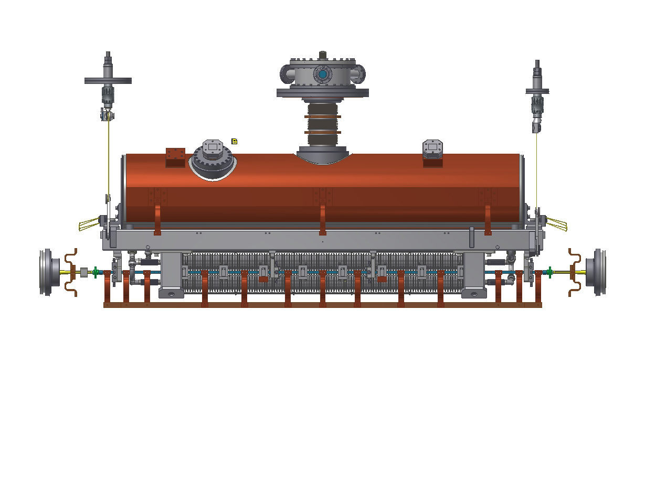
Cold Mass

Slide 11
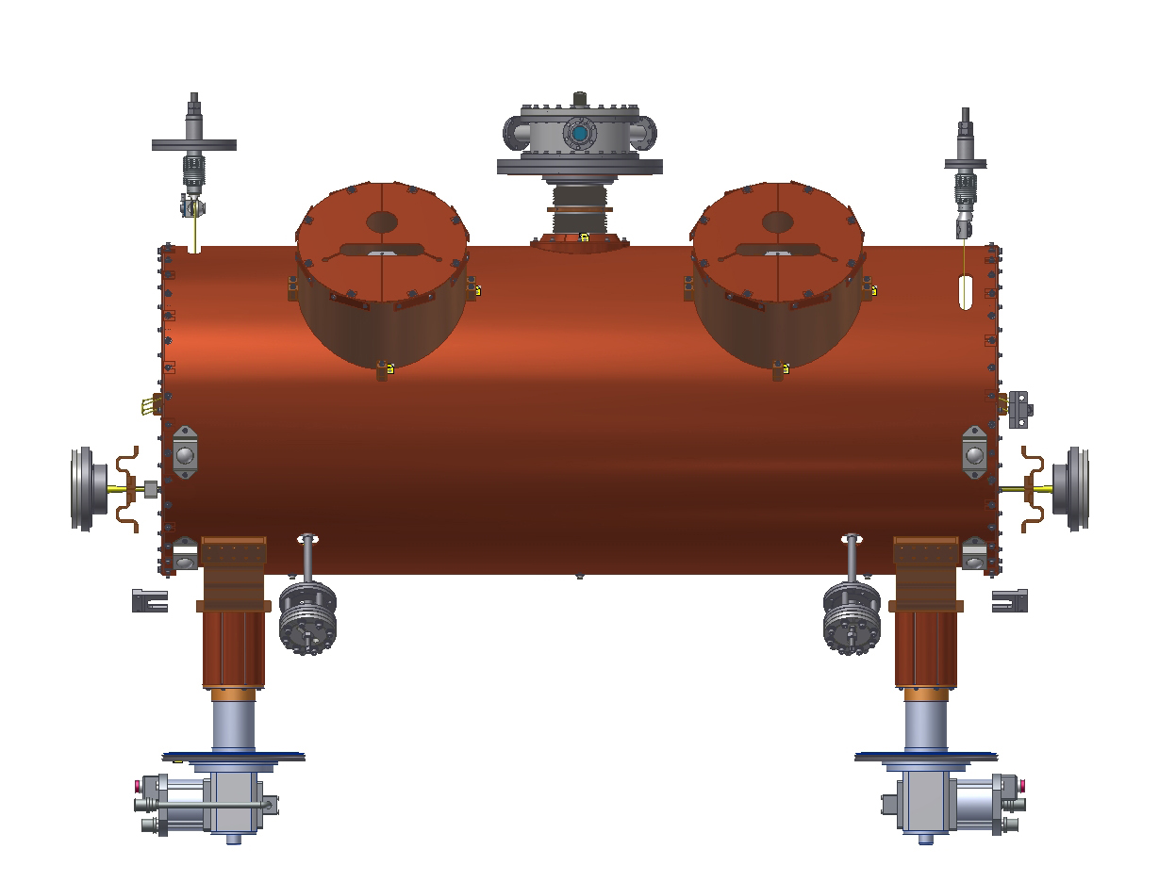
20 K Radiation Shield

Slide 12
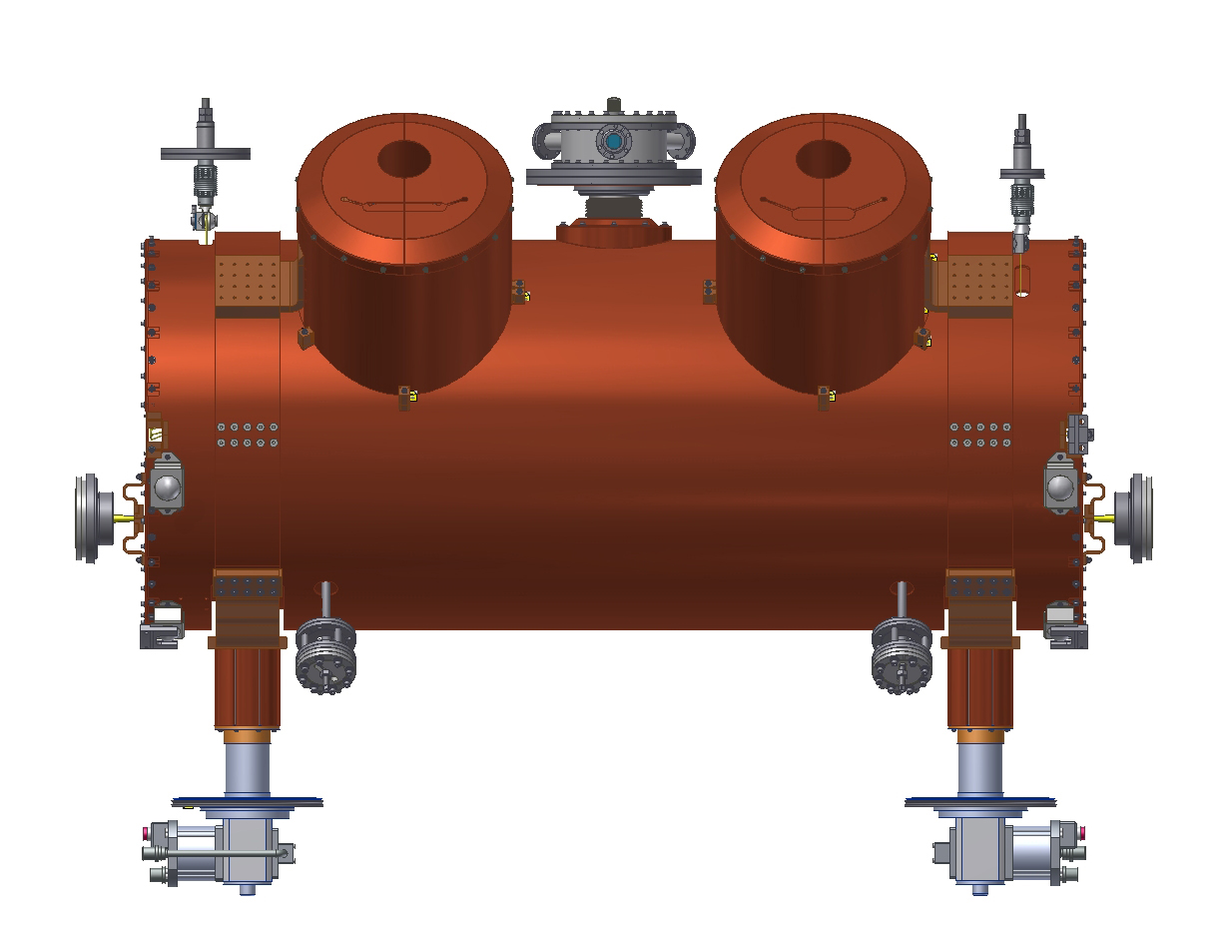
60 K Radiation Shield

Slide 13
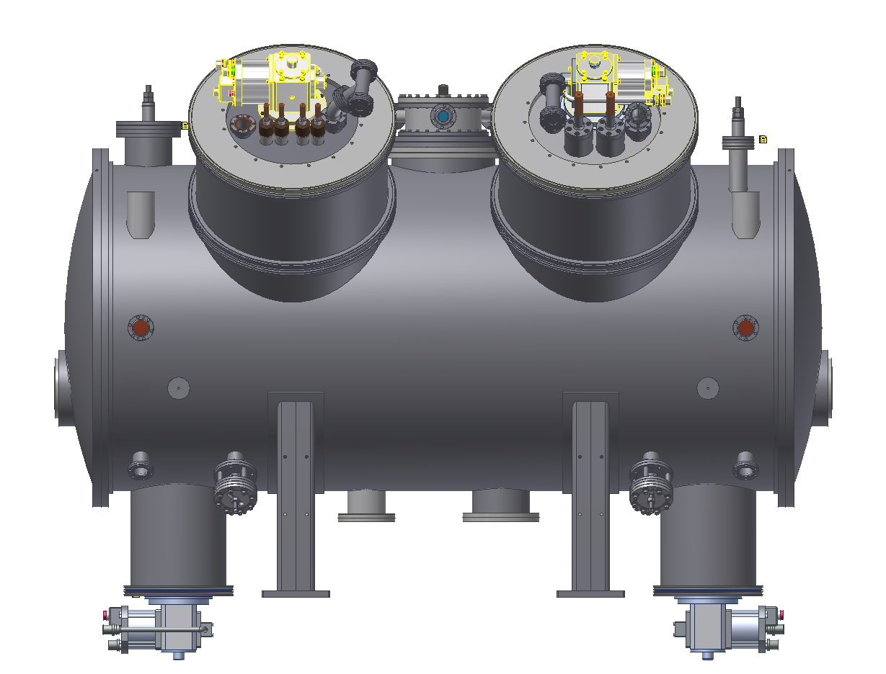
Vacuum Vessel

Slide 14
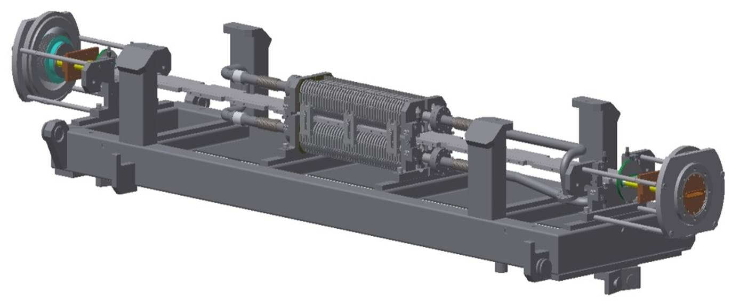
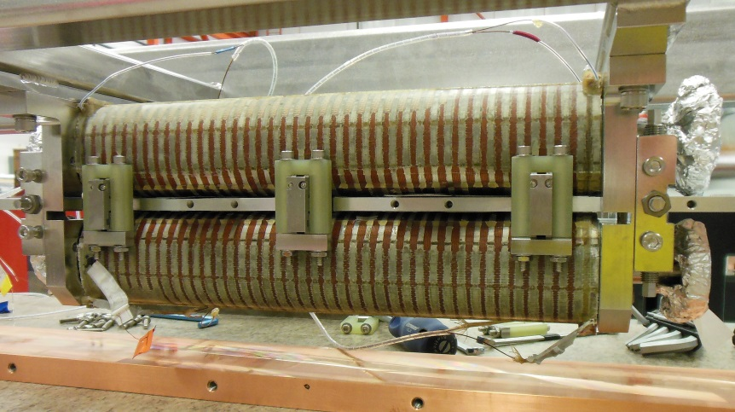
Cold Mass Assembly
Support frame – magnet structure – vacuum chamber
Conventional optical tooling methods
Tolerance ±75 microns in X,Y achievable

Slide 15
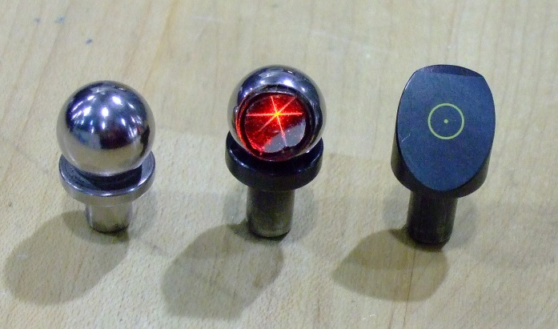
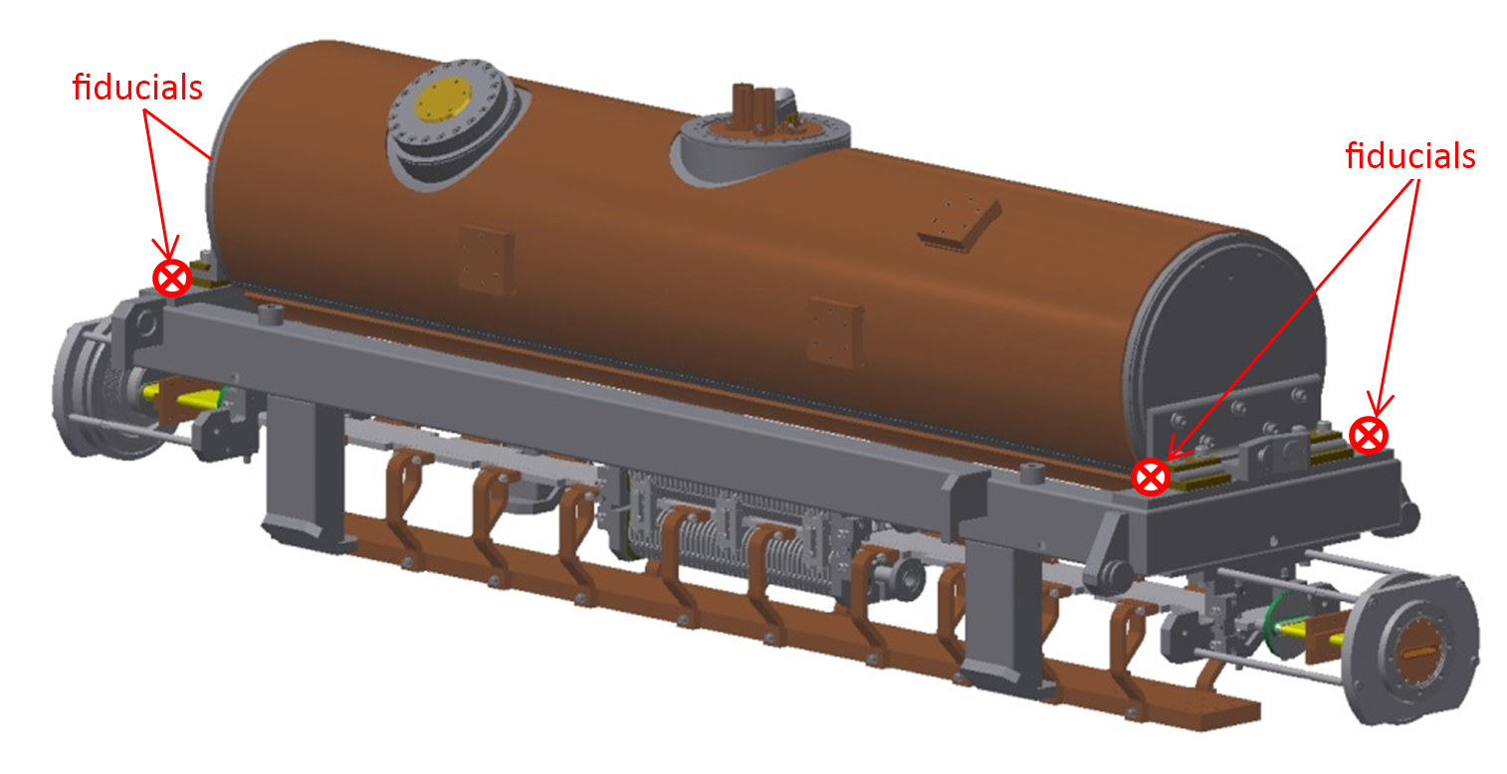
Cold Mass Fiducialization
Optical Tooling
Articulating CMM (FARO)

Slide 16
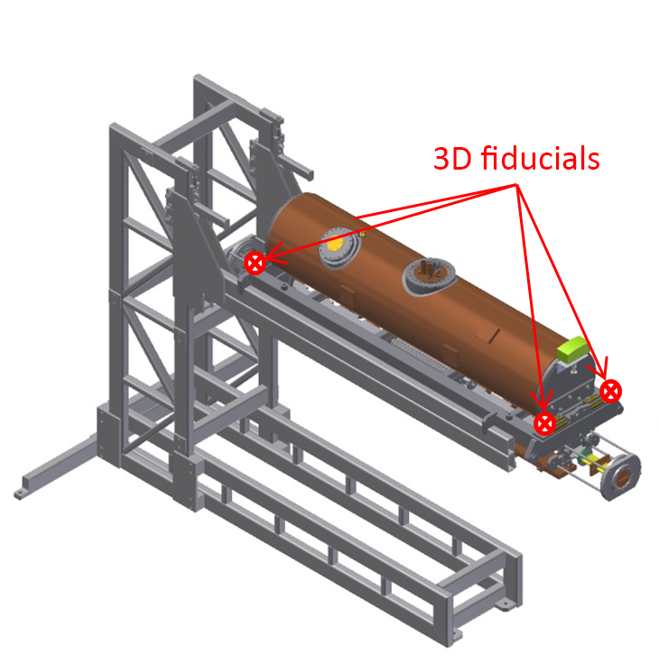
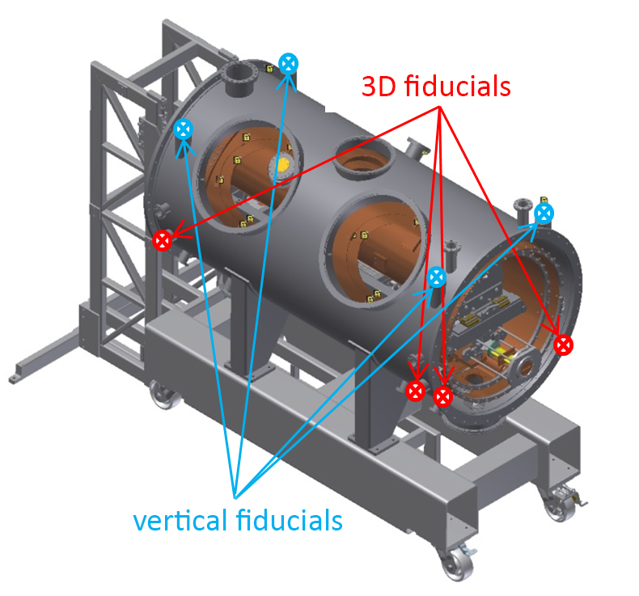
Cold Mass - Vacuum Vessel Assembly

Slide 17
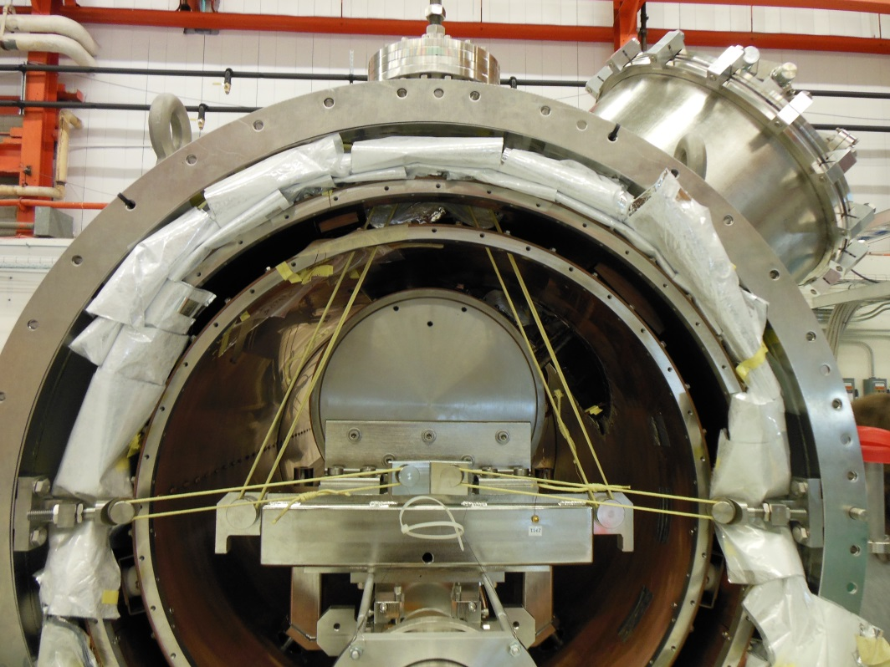
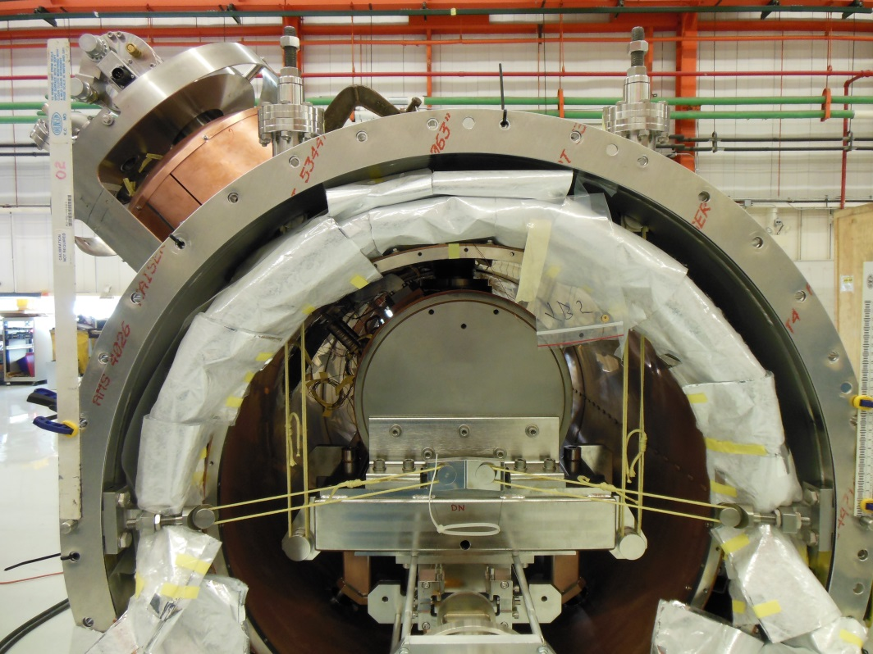
Kevlar band suspension system
The alignment of the cold mass within the vacuum vessel assembly was accomplished by adjusting the Kevlar suspension bands .
The coordinates of the vacuum vessel and cold mass fiducials were monitored with the laser tracker and N3 optical level.
Upstream end
Downstream end

Slide 18
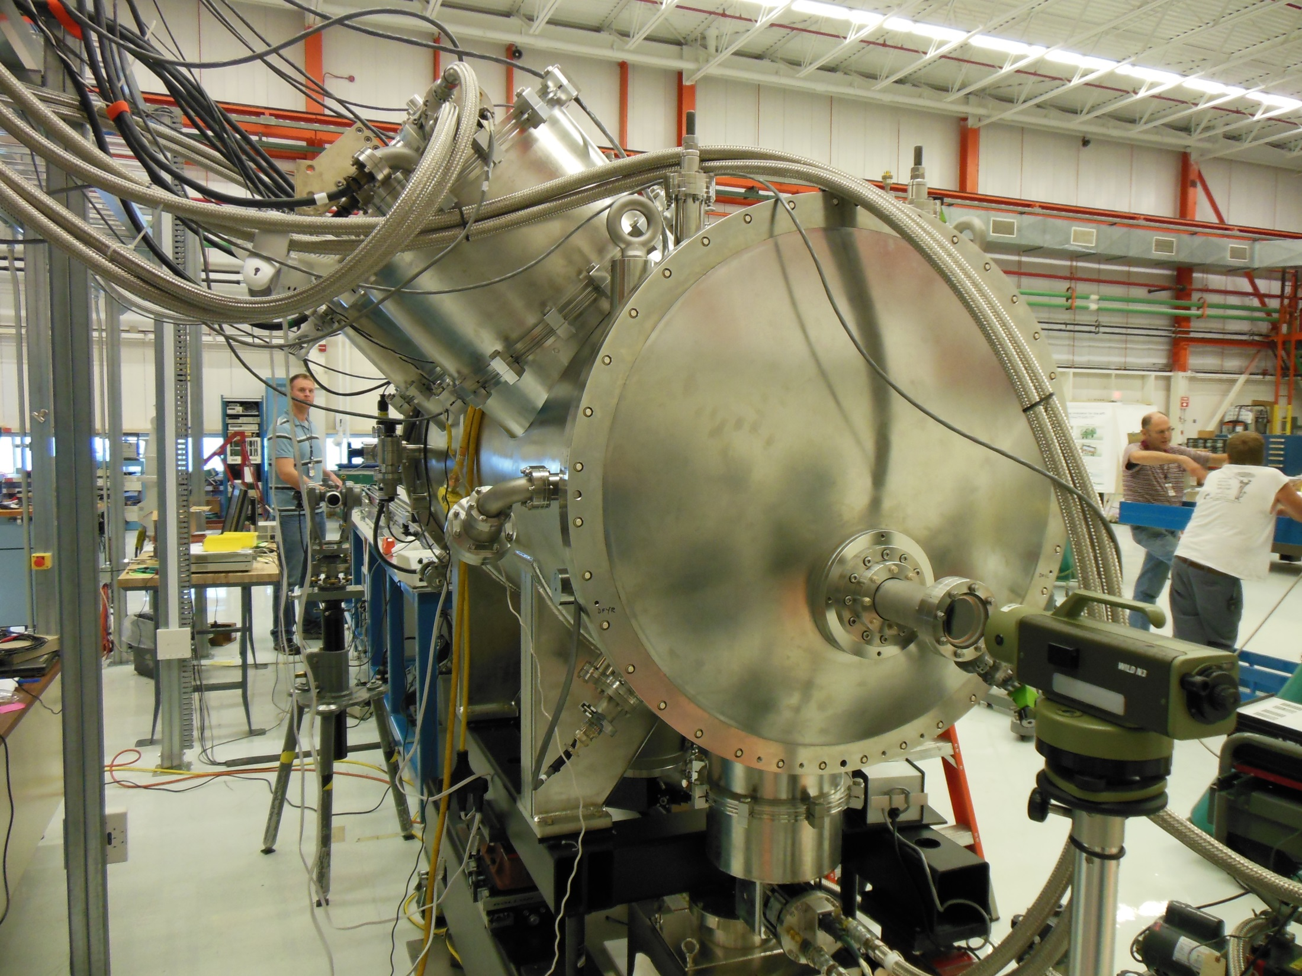
Cooling Displacement Test

Slide 19
Cooling Displacement Test
The seven pairs of spherical targets were placed in the beam chamber at predefined locations .
The pairs of sphere targets were "spring-loaded" with stiff wire to engage the cylindrical profile of the chamber in the horizontal plane.
By observing the top and bottom edges of the spheres by N3 optical level the vertical position of the beam chamber was measured during the cool-down and warm-up cycle.
Spherical target inside the prototype of the SCU0 vacuum chamber photographed through the alignment scope of the optical level.

Slide 20
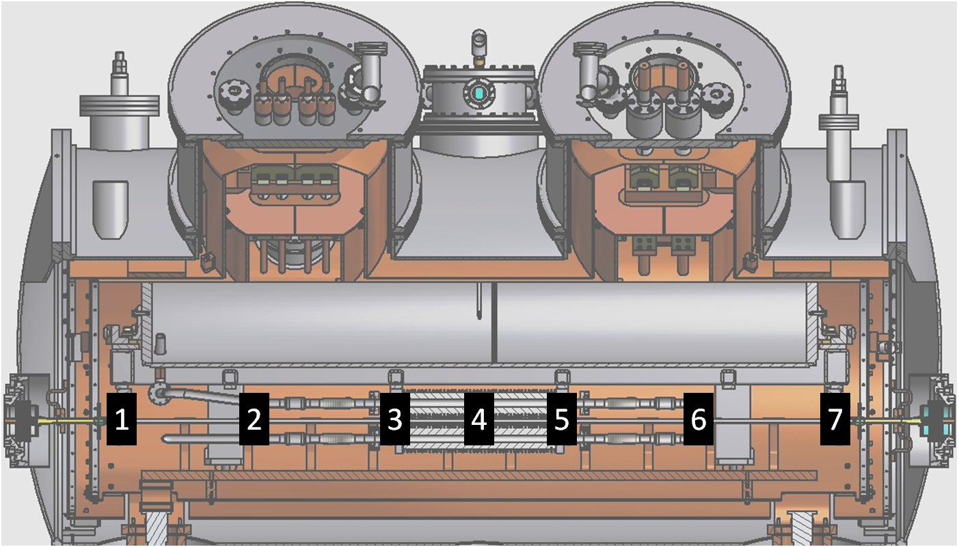
Location of Spherical Targets
Positions 1, 3, 5, and 7 are at the beam chamber support locations.
Courtesy M. Kasa

Slide 21
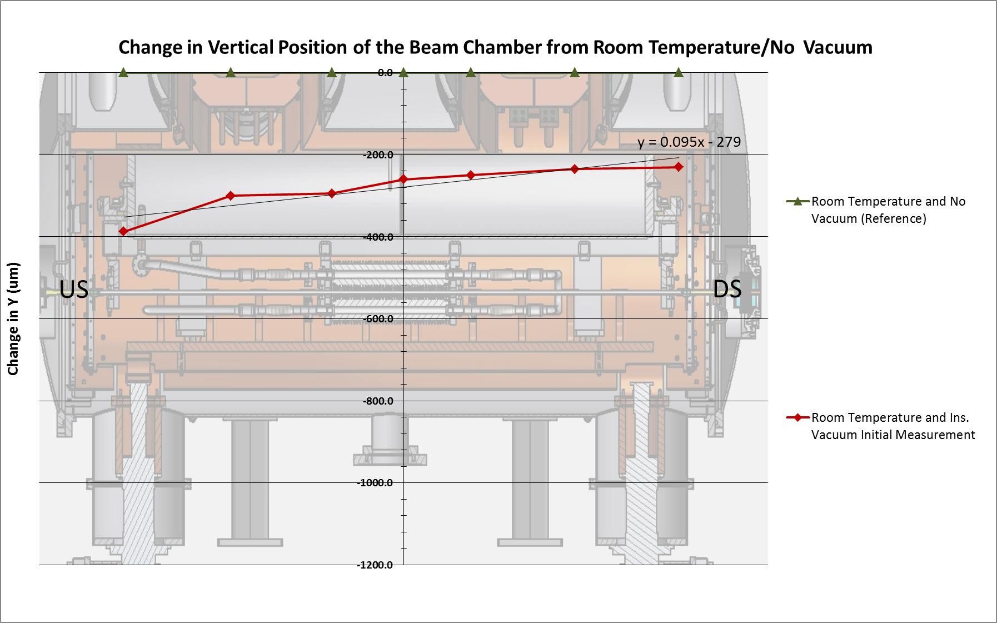
Cool-down and Warm-up Cycle
Courtesy M. Kasa

Slide 22
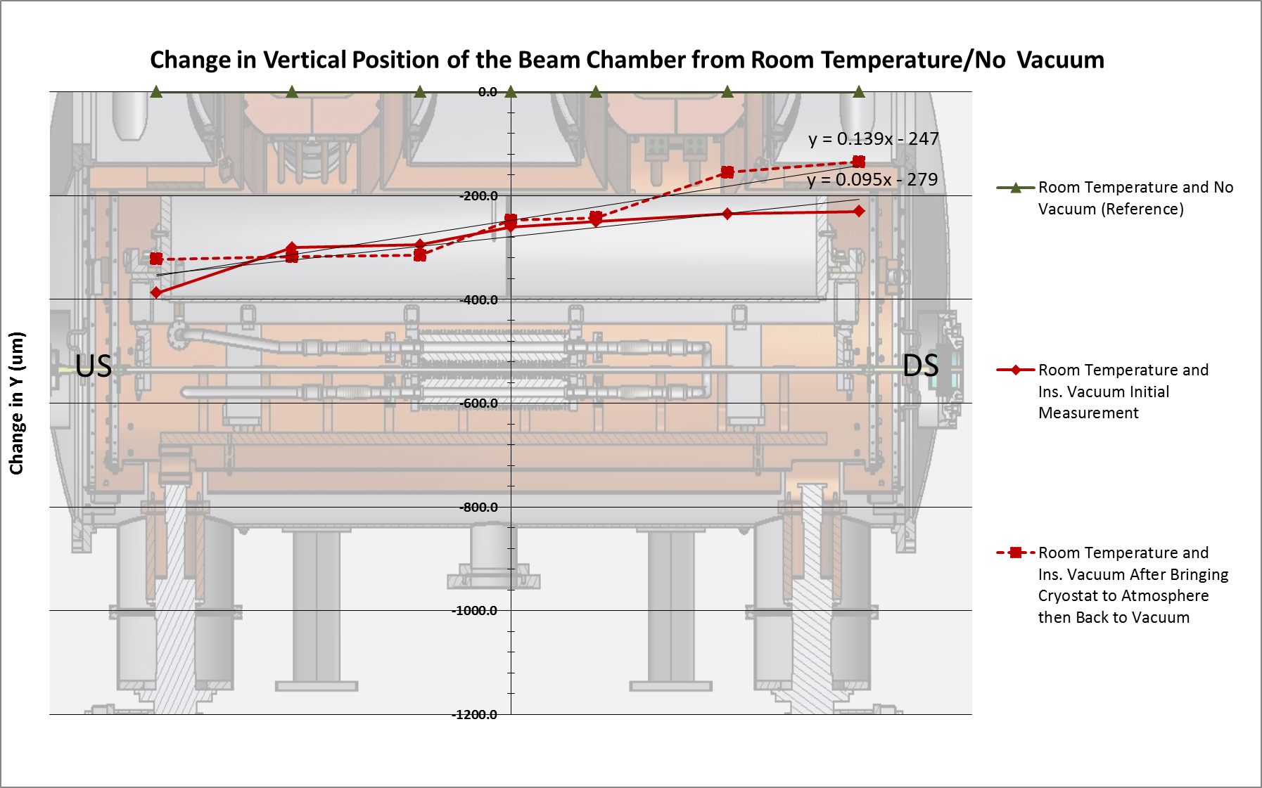
Cool-down and Warm-up Cycle
Courtesy M. Kasa

Slide 23
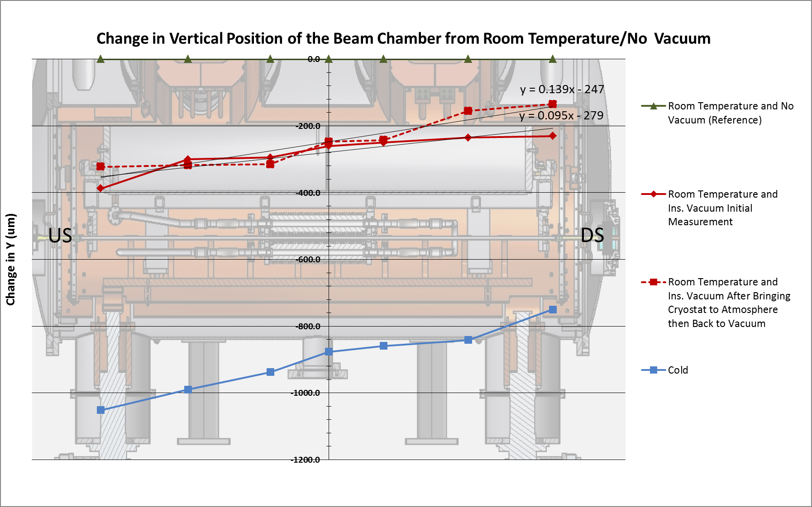
Cool-down and Warm-up Cycle
Courtesy M. Kasa

Slide 24
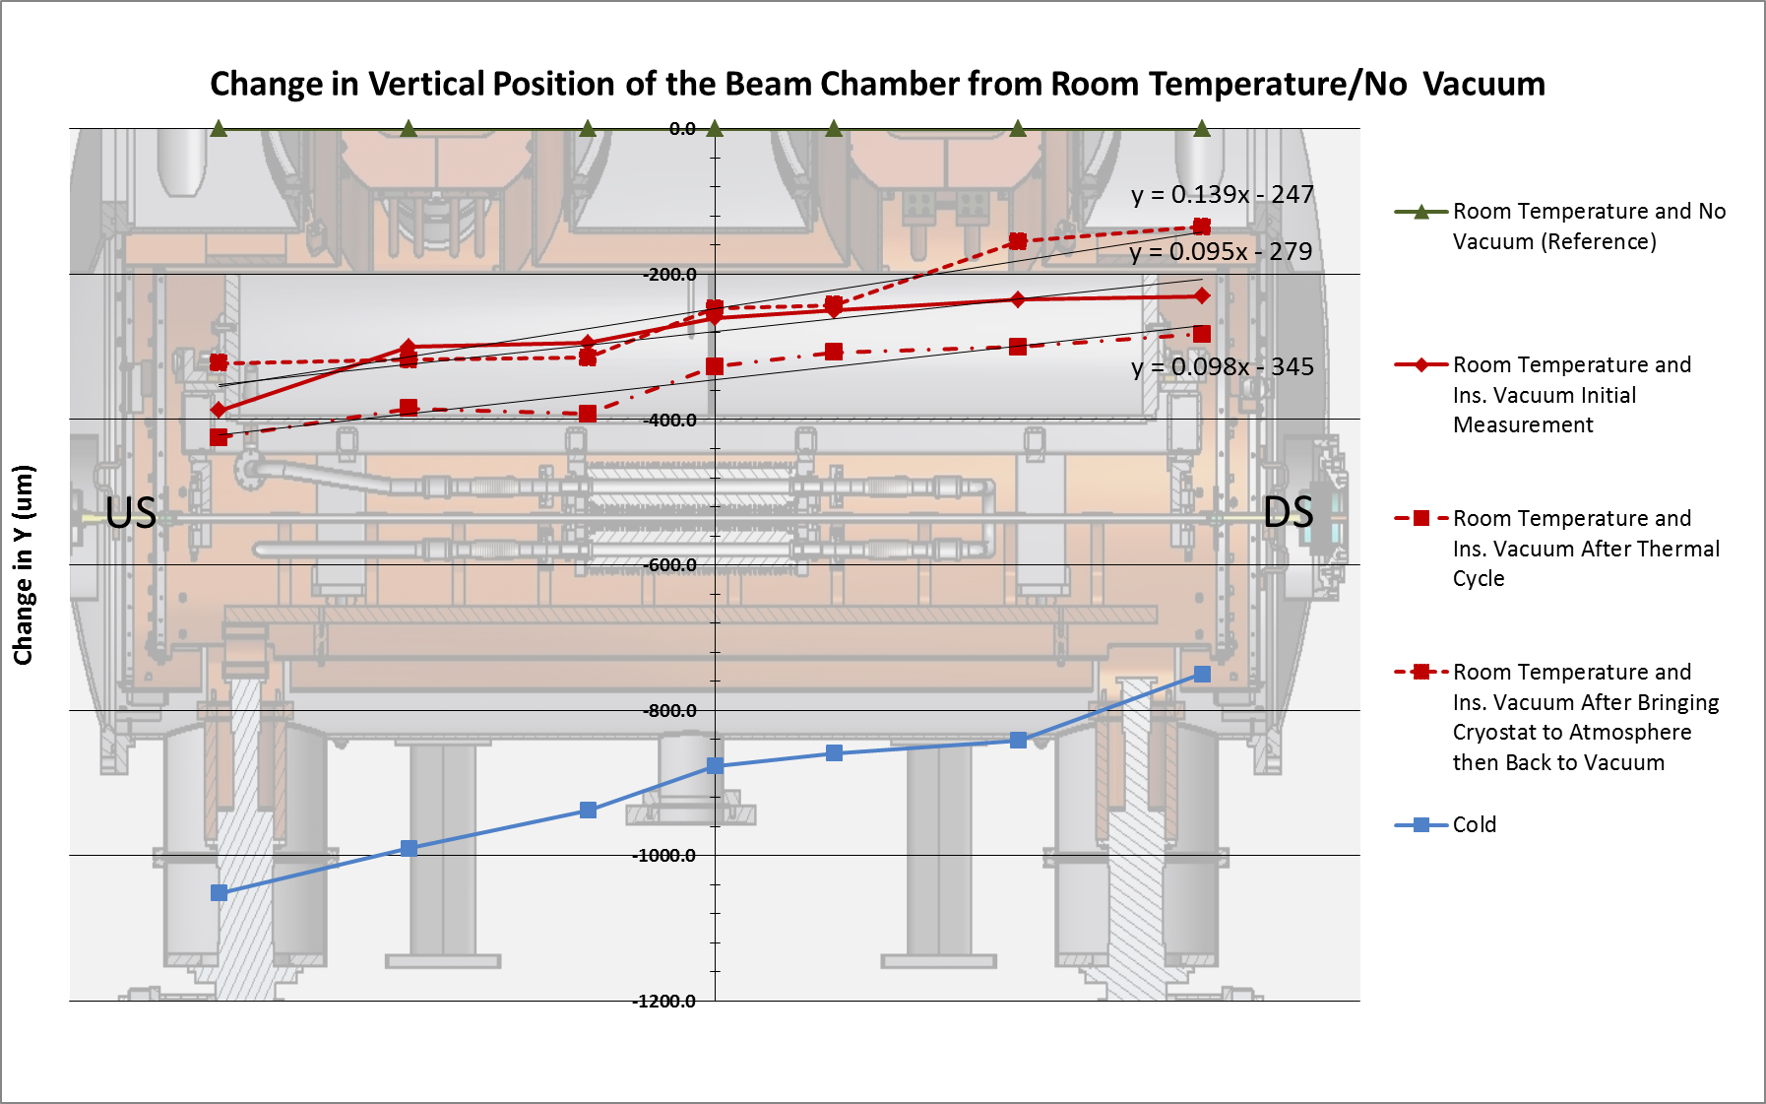
Cool-down and Warm-up Cycle
Courtesy M. Kasa

Slide 25
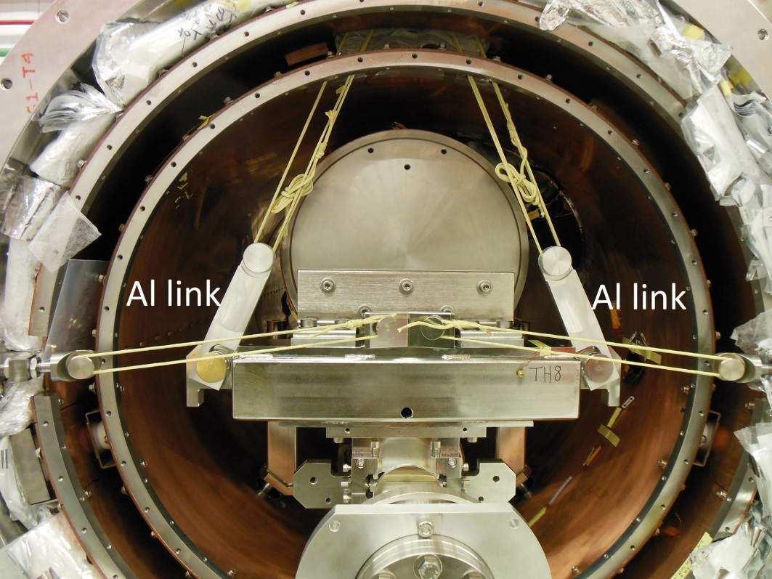
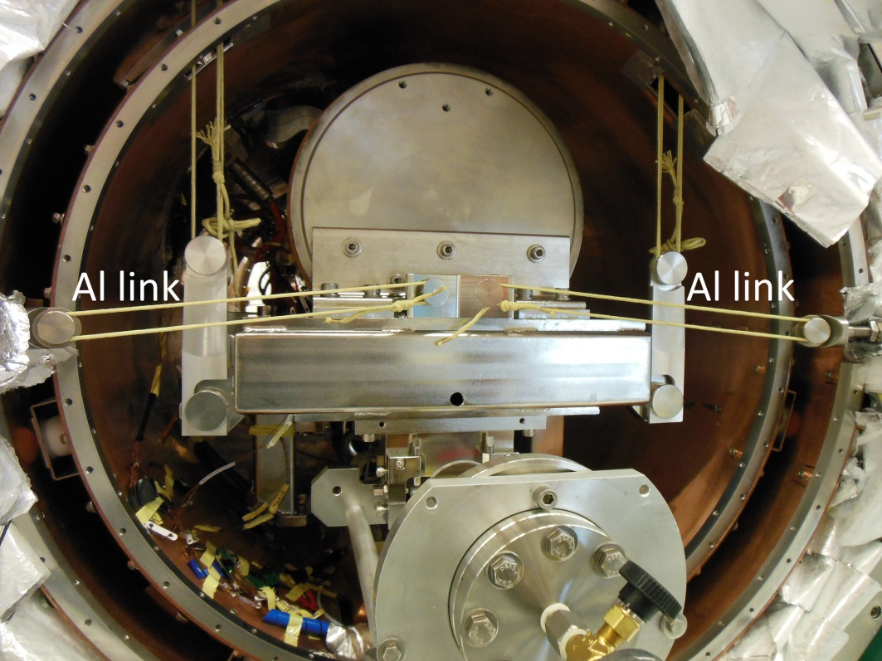
Aluminum Links Compensation
To eliminate displacement of the beam chamber/magnets assembly during the cooling process the Kevlar strings were modified with the aluminum links.
The length of the aluminum links was calculated to compensate for the thermal elongation of Kevlar and thermal contraction of stainless steel part as well as mechanical elongation of the Kevlar caused by pressure difference.
Upstream end
Downstream end

Slide 26
SCU magnetic measurement
Mitigation of the thermal shift verified during the next cool-down warm-up cycle.
Beam chamber monitoring was incorporated into the magnetic measurement procedure.
Warm (~300K) carbon fiber tube holding Hall probe or 4 mm wide Integral coil or fiber optic alignment target
Cold (20K) Al beam chamber
Warm (~300K) Ti guiding tube
Y
X
Vacuum
Air
Courtesy C. Doose

Slide 27
Alignment in the APS storage ring
The SCU0 was installed in SR sector 6, downstream of a half-length ID chamber with 7.5 mm vertical aperture.
An optical level and precision transit-square were utilized to position the SCU0 at its ideal location.
A laser tracker oriented to the storage ring control network was used to provide a redundant quality assurance check.
Beam-based alignment was foreseen as a necessary final step to confirm and fine tune the position of the SCU0 after cool-down.

Slide 28
Beam-based Chamber Alignment
Chamber alignment critical to protect SCU0 from excessive beam-induced heat loads.
Novel beam-based alignment using thermal sensors mounted on the SCU0 beam chamber was developed at APS.*
Electron beam steering vertically and thermal sensor minima determine the vertical center of the SCU0 chamber with respect to the user beam orbit with 0.100 mm accuracy.
Vertical center of chamber with respect to the user beam orbit. Sensors 2-6, January 2013 data.
* K. Harkay et al.

Slide 29
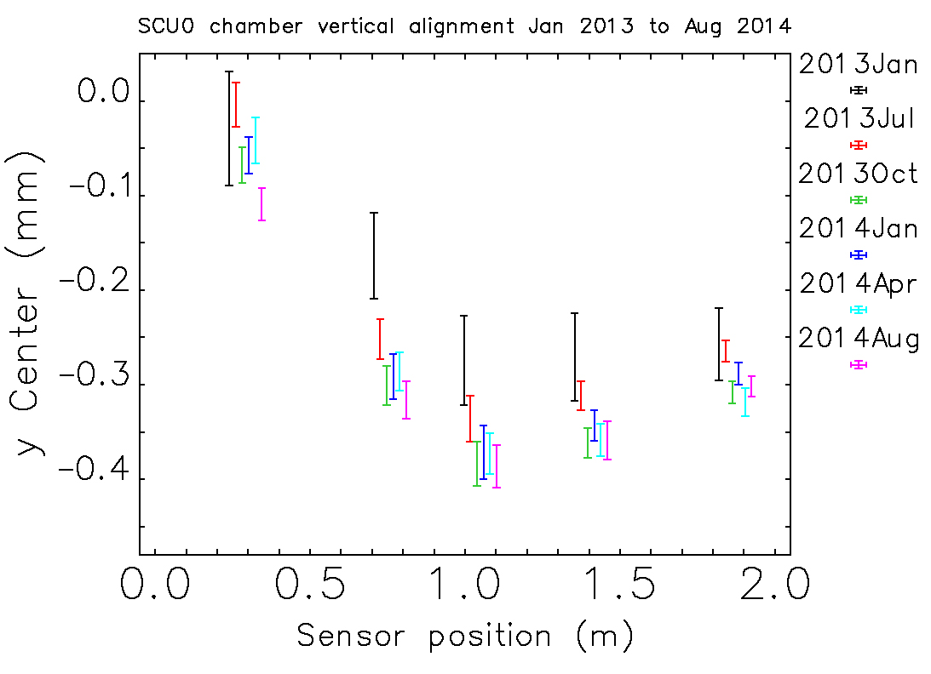
Chamber alignment stability
Courtesy K. Harkay

Slide 30
Realignment of SCU0
Courtesy K. Harkay

Slide 31
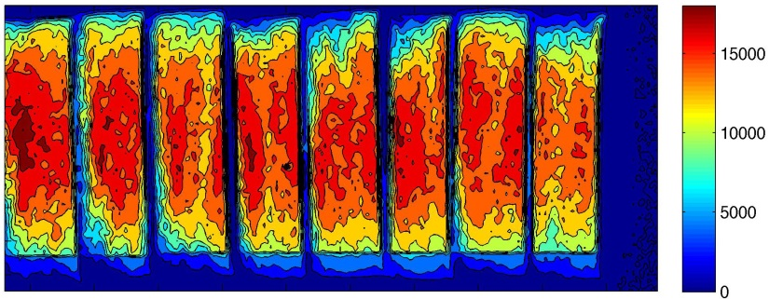
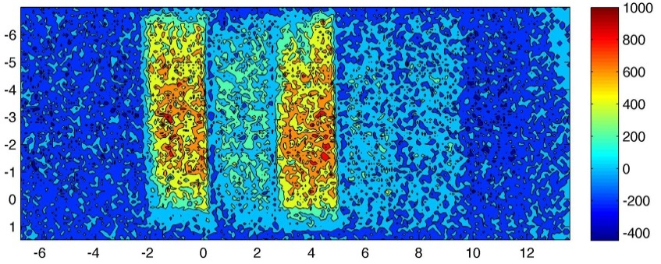
User experiments with SCU0
Diffraction pattern of 10-fold axis in new GdCd magnetic quasicrystal
Fluorescence mapping from nuclear fuel pellets
ThO₂
ThO₂
UO₂ 3.12
UO₂ 1.15
UO₂ 3.39
UO₂ 0.92
UO₂ 0.33
ThO₂
rods
8 x 25 mm
Th Image
U Image
Cover image for August 2013 issue of Nature Materials features image taken with SCU0.
A. Goldman et al., Nature Mat. 12, 714 (2013)
Uranium and Thorium fluorescence maps of mock fuel pellets encased in Zirconium.
G.J. Havrilla et al. to be published

Slide 32
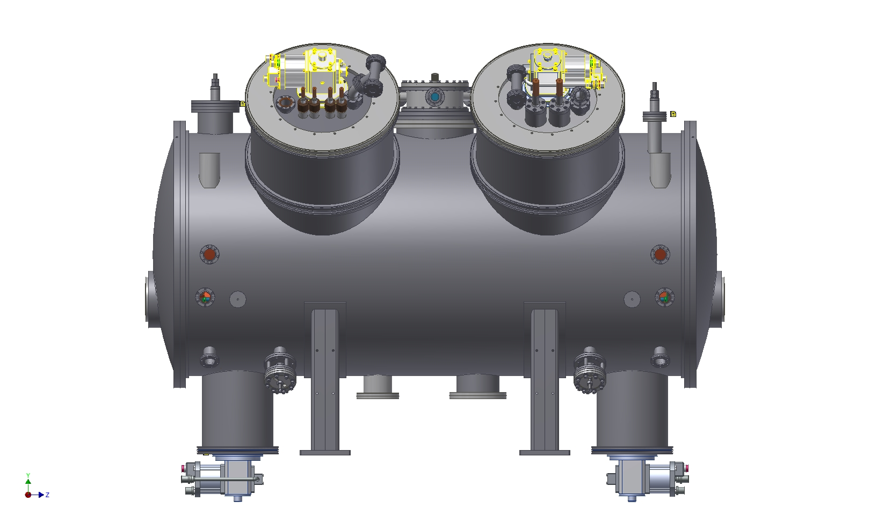
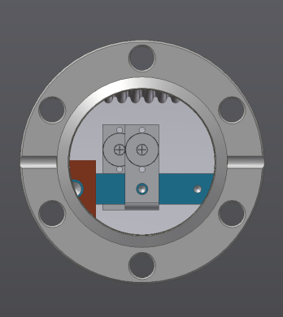
SCU1 improvements for alignment
Added beam chamber viewports.
Permanent fiducial cups in place of bushings.
Improved Kevlar bands (no braiding, no knots).

Slide 33
Summary
The first prototype superconducting undulator was successfully installed and aligned in the APS storage ring and has reliably delivered 80 – 100 keV photons to APS users for the last 19 months.
A new spherical bead target technique was implemented for quantifying thermal shift of the SCU0 beam chamber.
A unique suspension system combining Kevlar string with aluminum links was designed to eliminate any displacement of the chamber during the cooling of the SCU0.
A novel beam-based measurement method using thermal sensors mounted on the SCU0 beam chamber was developed for fine alignment and stability monitoring.
Significant knowledge was gained from the SCU0 installation, and many improvements are being implemented in the assembly and alignment of the next superconducting undulator, SCU1.

Slide 34
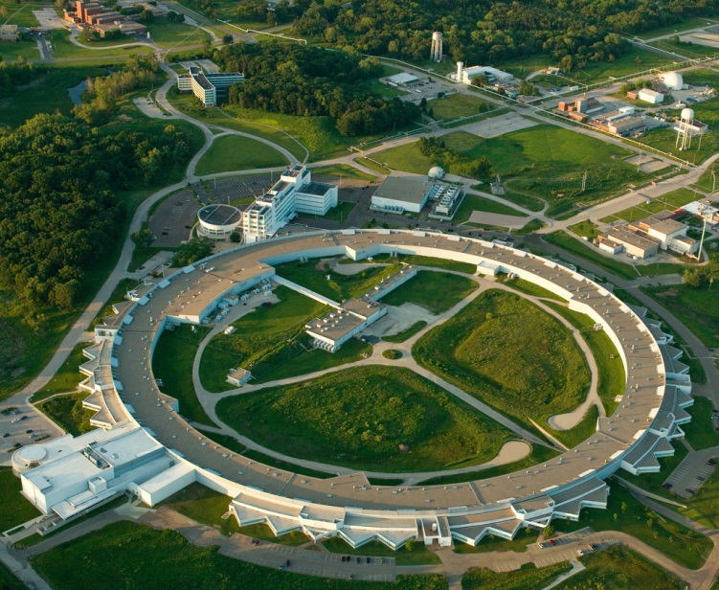
感謝您的關注
Thank you for your attention

