Slide 1
Preparing the SPS complex alignment for future LHC runs
Patrick Bestmann
IWAA 2014 IHEP, Beijing, China 13-17.10.2014

Slide 2
Outline
  Introduction
  Long Shutdown 1
  Measurement and alignment strategy
  Planning
  Vertical alignment SPS ring
  Horizontal alignment of the SPS ring
  TI2 & TI8 Transfer lines
  TT10 Transfer line

Slide 3
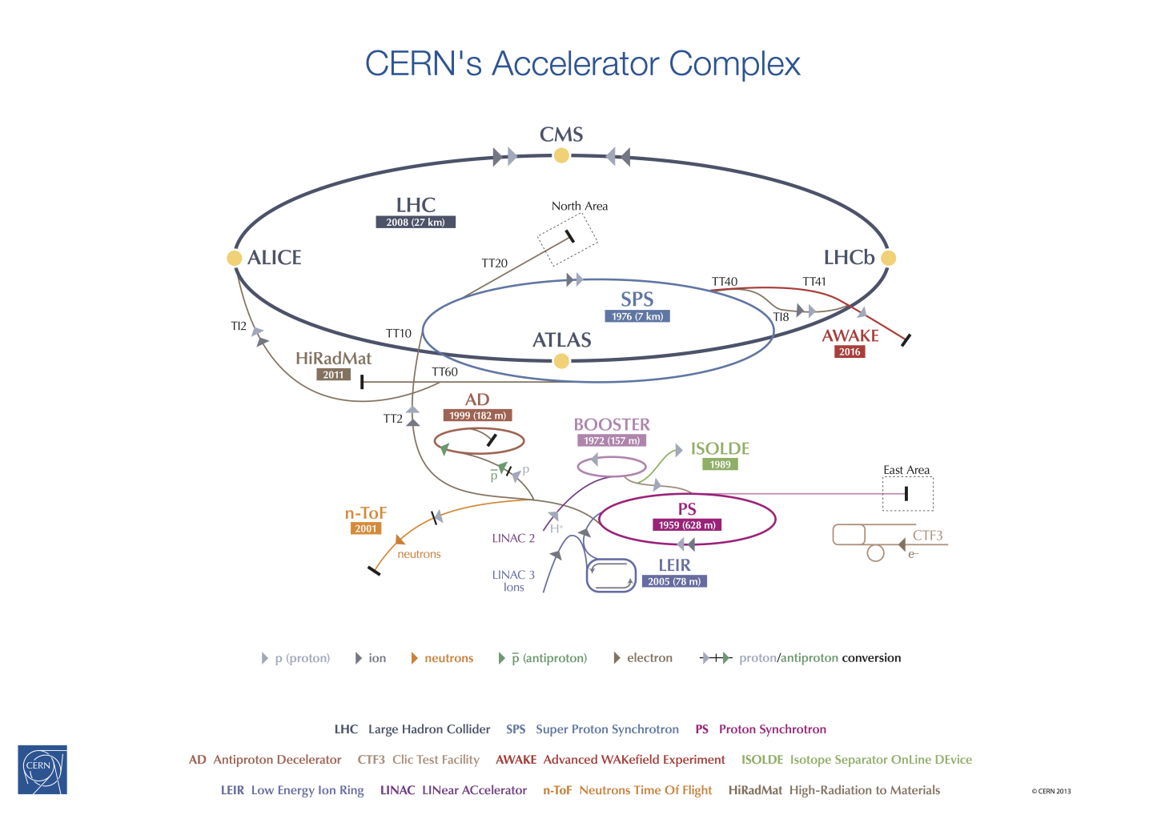
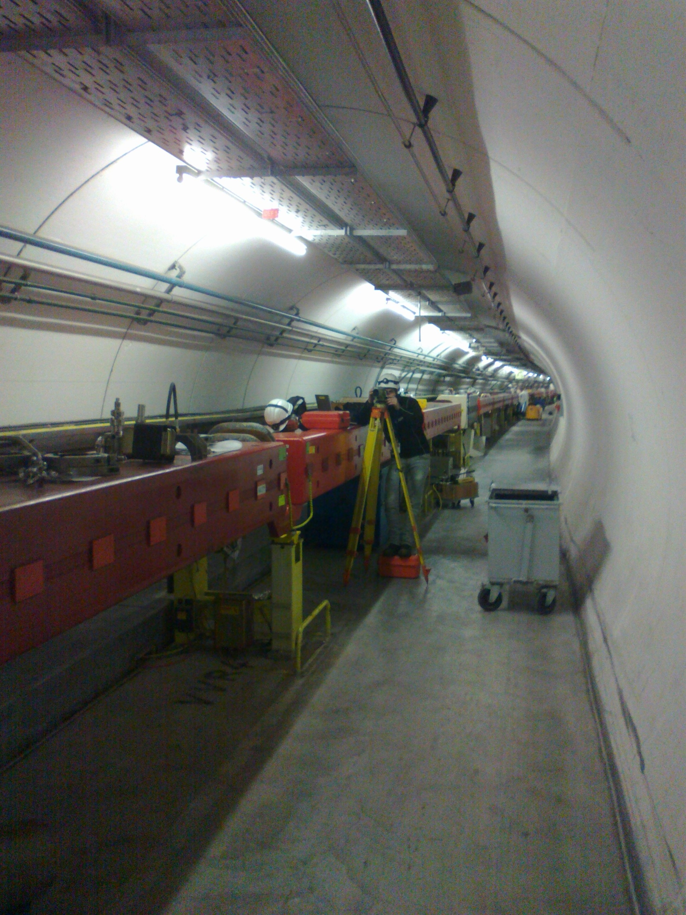
Introduction

Slide 4
CERN LS1
Initially intended for the LHC consolidation
Start of LHC Injector Upgrade Project
  Working towards Higher Luminosity
  LHC injectors need to push their boundaries to deliver the needed beam quality
15 Month of SPS shutdown is the unique opportunity to improve the alignment in the whole complex

Slide 5
Strategy
SPS ring Levelling + alignment 6 w
SPS Sextant 6 Realignment H+V 8 w
SPS Quads horizontal survey 6 w
SPS Quads horizontal alignment 4 w
SPS Dipole + intem. Alignement H+V 20 w
TI2 Transfer line survey and alignment 6 w
TI8 Transfer line survey and alignment 20 w
TT10 Transfer line survey and alignment 12 w
Change of Magnets / Upgrades and installation

Slide 6
Planning
OBSOLETE

Slide 7
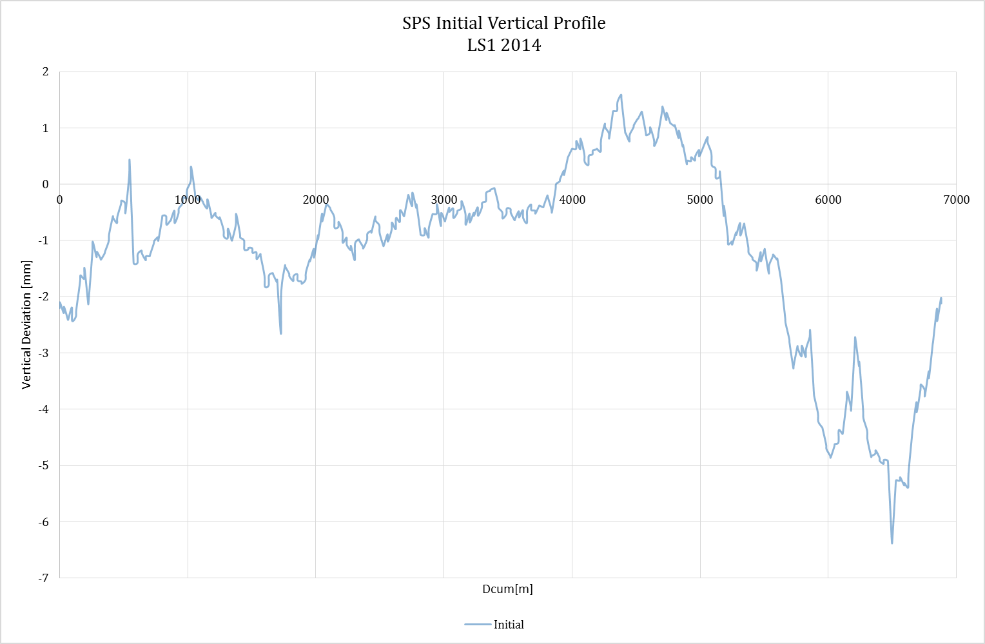
SPS vertical profile
Measured and corrected every year
6.9km, DNA03 double run with1800 observations
LHC
Notes:
LHC 40 m underneath
One single LGC adjustment for the whole ring
Datum fixed on the two deep references

Slide 8
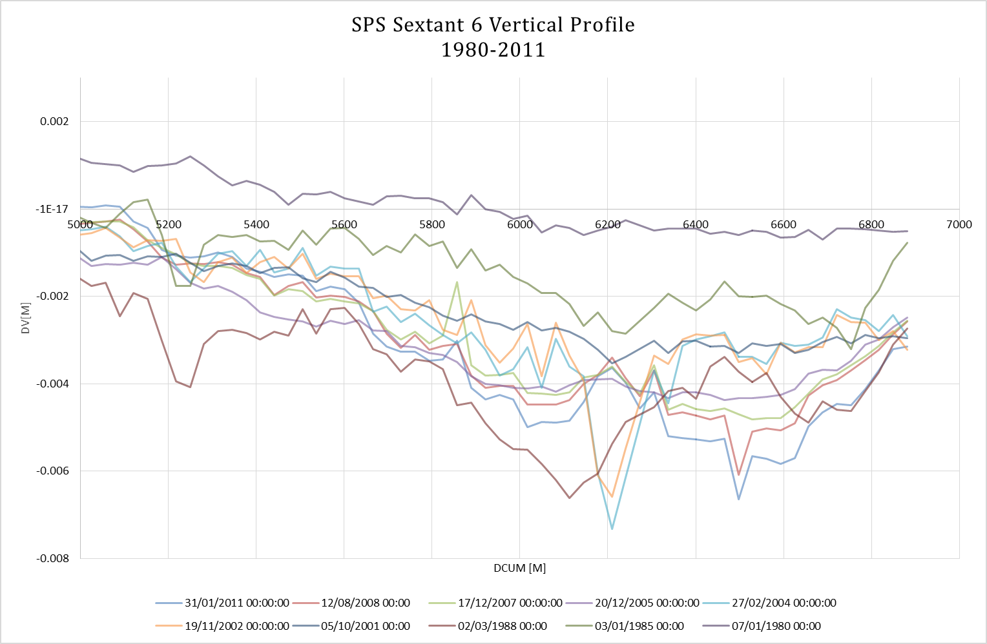
Sextant 6
Cumulated ground movements have build a sharp excursion in the vertical profile
Limiting aperture and performance of the machine

Slide 9
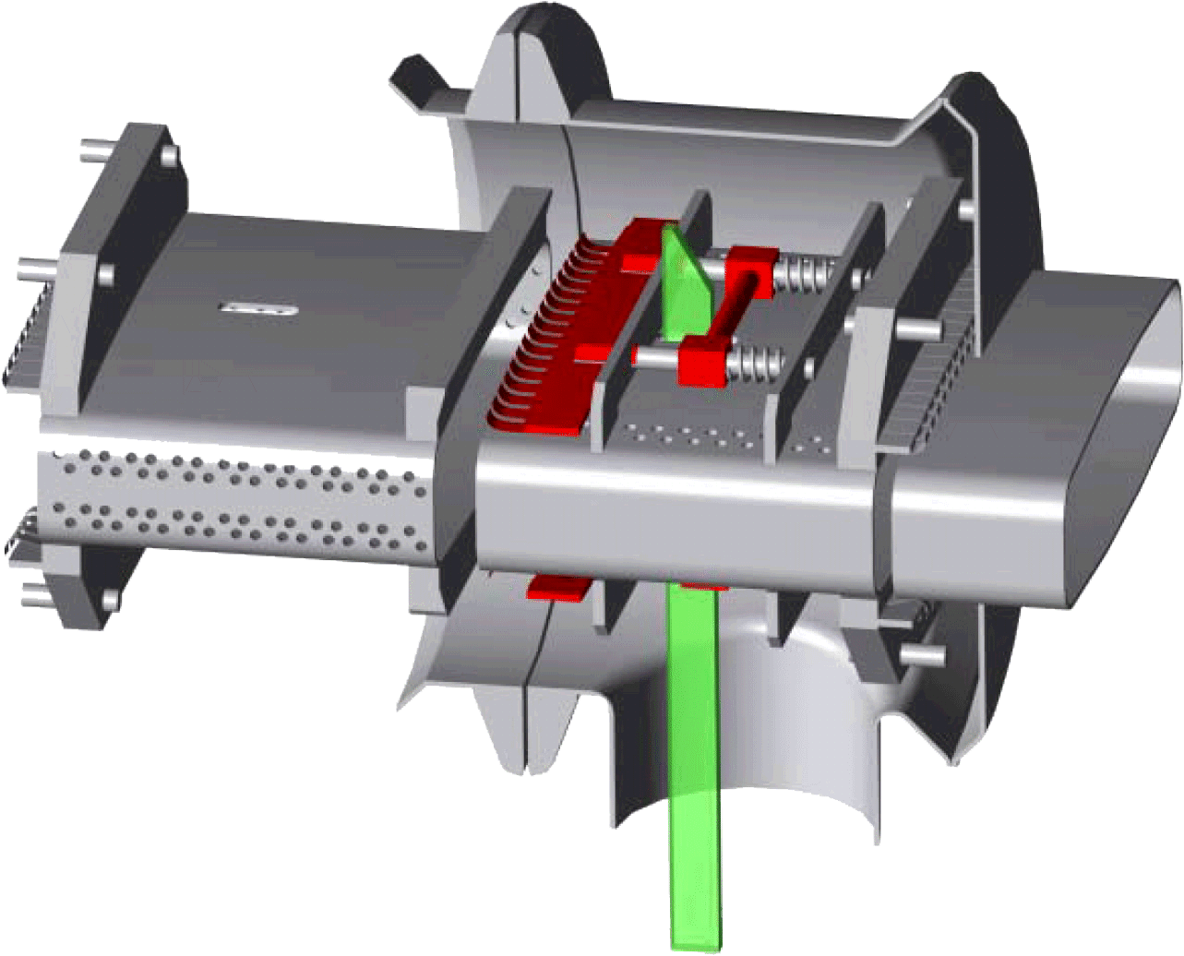
Sextant 6 constraints
Jacks were at the end of the range
Exchange of PU Jacks and additional shimming
TI2 extraction in the center of excursion
Interconnects were kept closed
Restricts roll angle and transversal offsets
Delicate load transfer to jacks
Double actuator hydraulic
Independent adjustment of volume and pressure
Notes:
3,5mm smooting +10mm shimms
200m of Ti2 also fully realigned

Slide 10
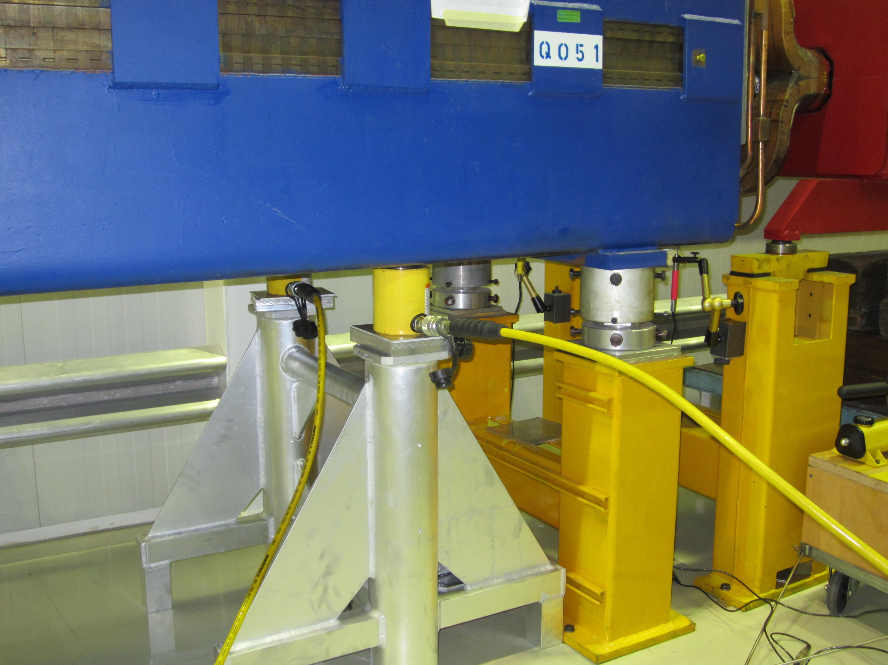
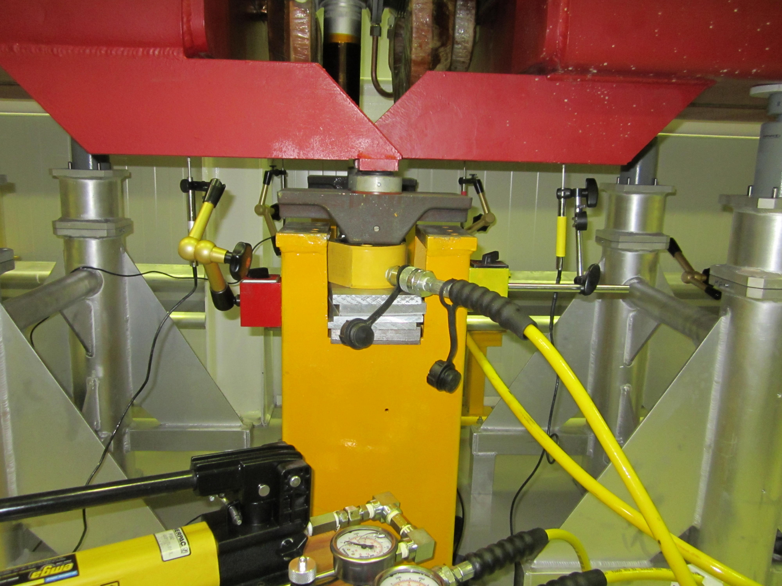
New handling equipment

Slide 11
Strategy
3 Step approach to keep track
  Relative vertical displacements for focussing Quadrupoles
    Reference measurement
    Lifting with exchange of jacks and shims
    Realignment to new vertical, but initial horizontal position
  Alignment of defocussing quadrupoles using the focussing as reference
  Alignment of all intermediate components

Slide 12
Strategy
SPS FoDo Lattice
QF
MB
MB
MB
MB
QD
MB
MB
MB
MB
QF
QD
MB
MB
QD
MB
MB
MB
MB
QF
QF
MB
MB
MB
MB
MB
QD
MB
MB
MB
MB
MB
Notes:
SPS lattice is making things very straight forward
From a practical point of view very handy

Slide 13
Calculation & Alignment
One single LGC adjustment for the whole ring
Datum fixed on the two deep references
Smooth curve approximation
Two batches of corrections for QF and QD magnets
Relative displacements with two control measurements

Slide 14
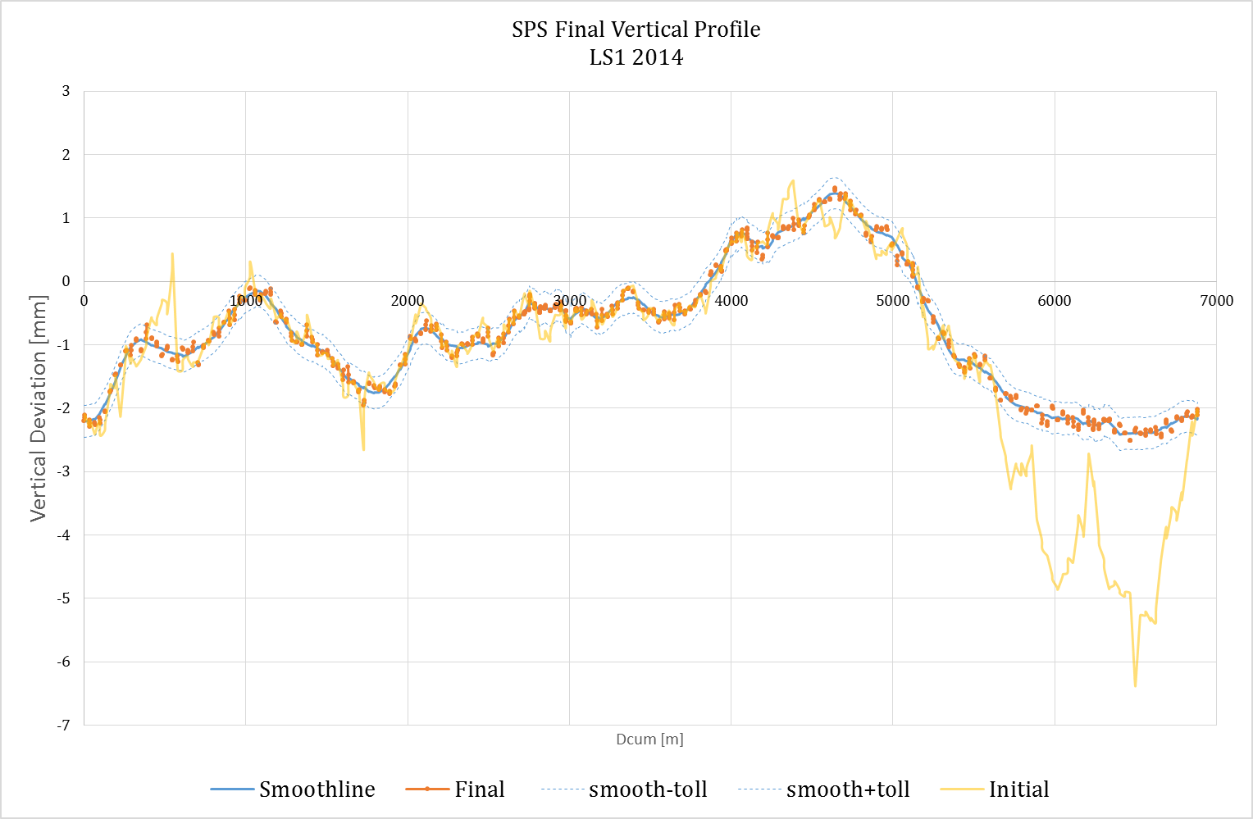
Results
92 Quadrupole Magnets aligned

Slide 15
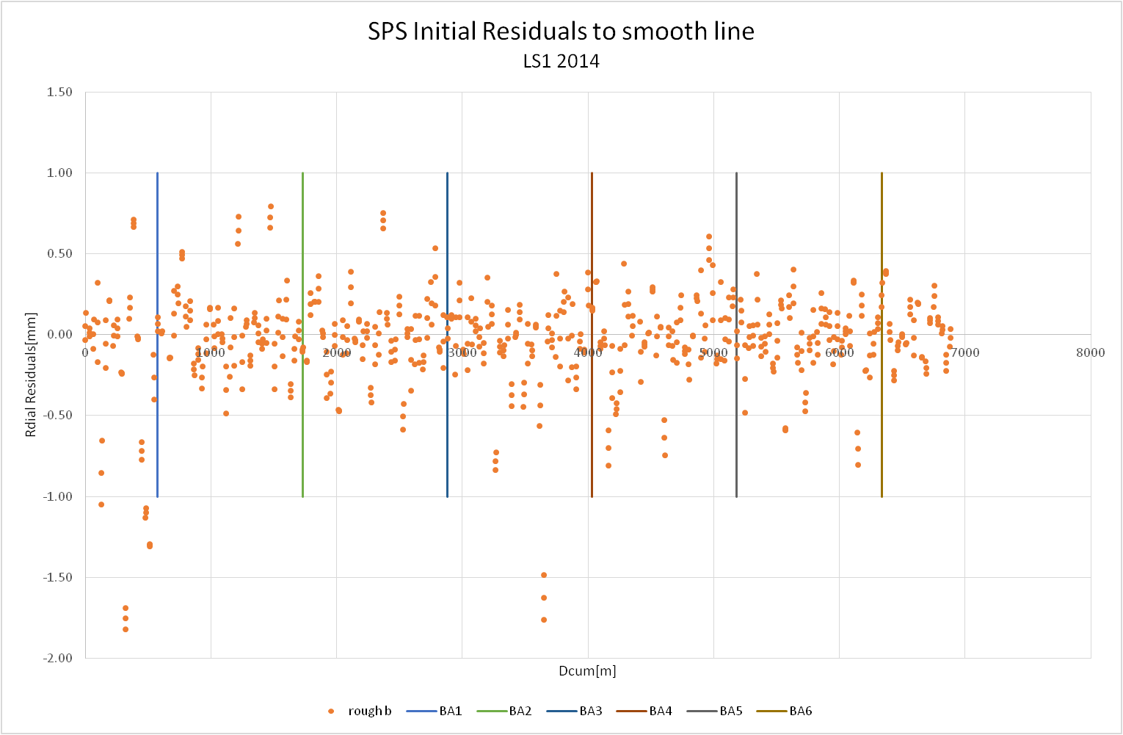
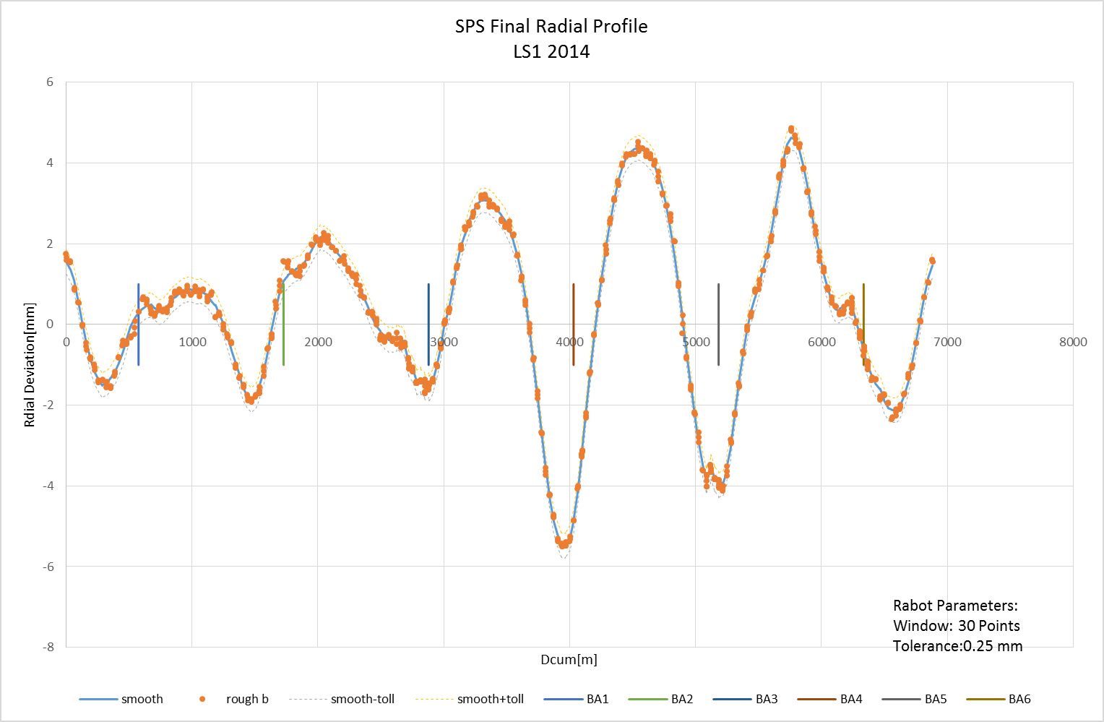
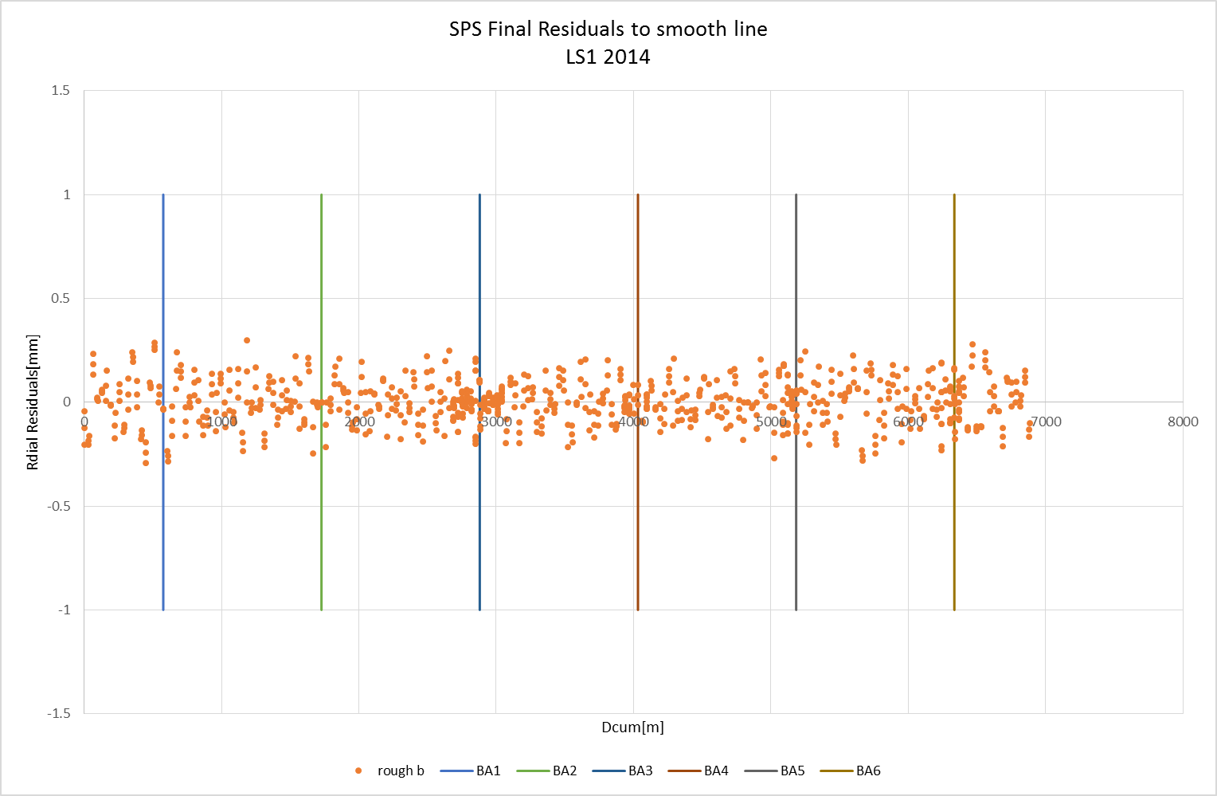
SPS Horizontal profile
Wire offset measurements
Datum fixed on one Point with radial corridors for some straight sections

Slide 16
Beam Based Alignment
Very final adjustments to Orbit
Corrector Magnets not strong enough at 450GeV
Measurements done by the operation team during each startup
Cumulated 40 volontary displacements
Change from Q26 to Q20 Optics
All displacements deleted during LS1
Two iterations done with 10 Magnets in V and 10 in Horizontal direction
Notes:
Starting from 100GeV the correctors are not strong enough anymore.
The only way to correct the orbit is a physical displacement of the magnets.
Displacement of a quadrupole to introduce dipole component.

Slide 17
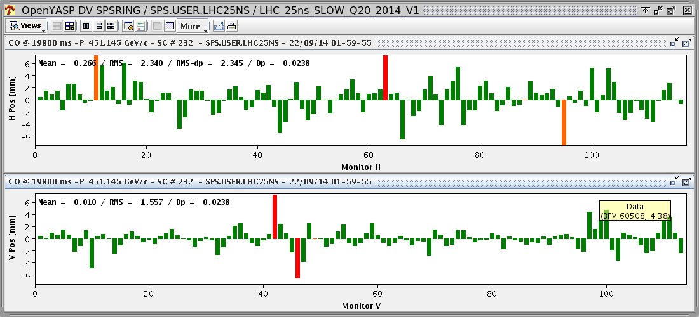
Q20 Orbit
finished

Slide 18
Transfer Lines TI2 & TI8
Geologically unstable
Full realignment of TI8 in both planes
Only Quadrupoles of TI2 in both planes
Strategy is basically the same as the one for the SPS or LHC
Notes:
Quiete recent constructions

Slide 19
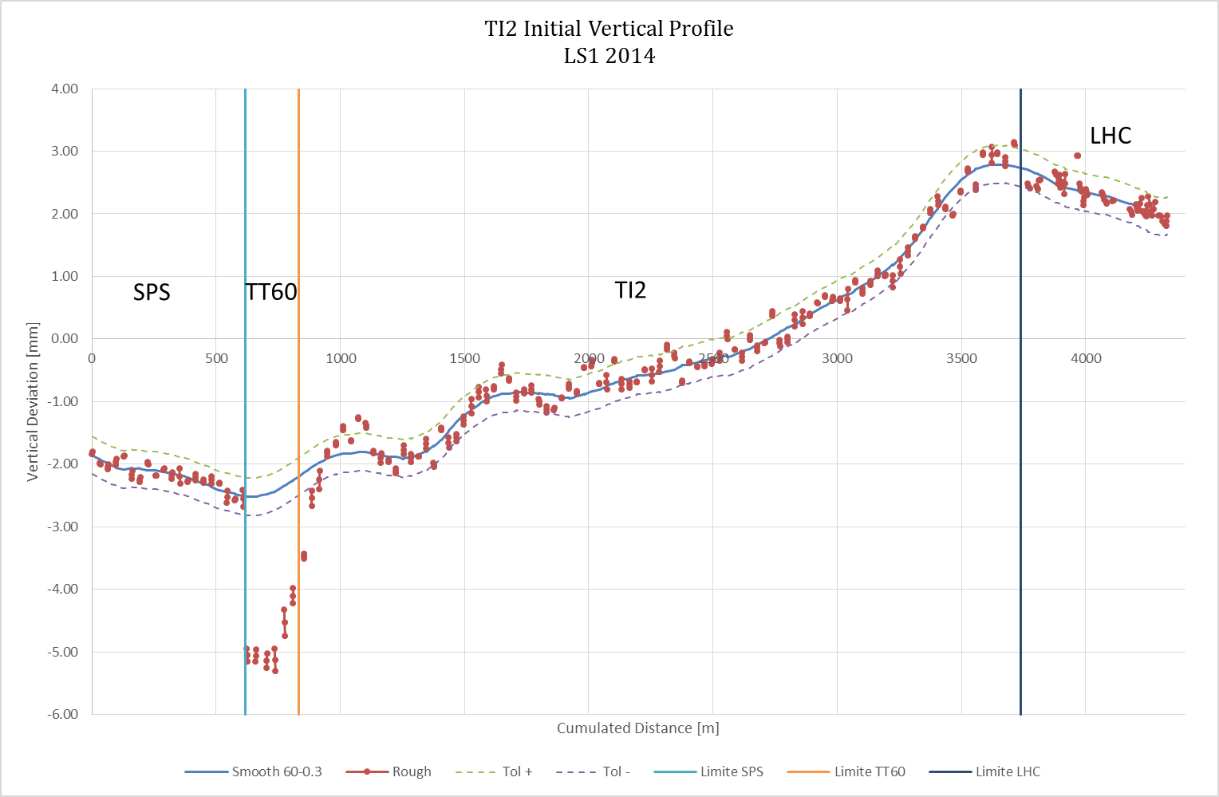
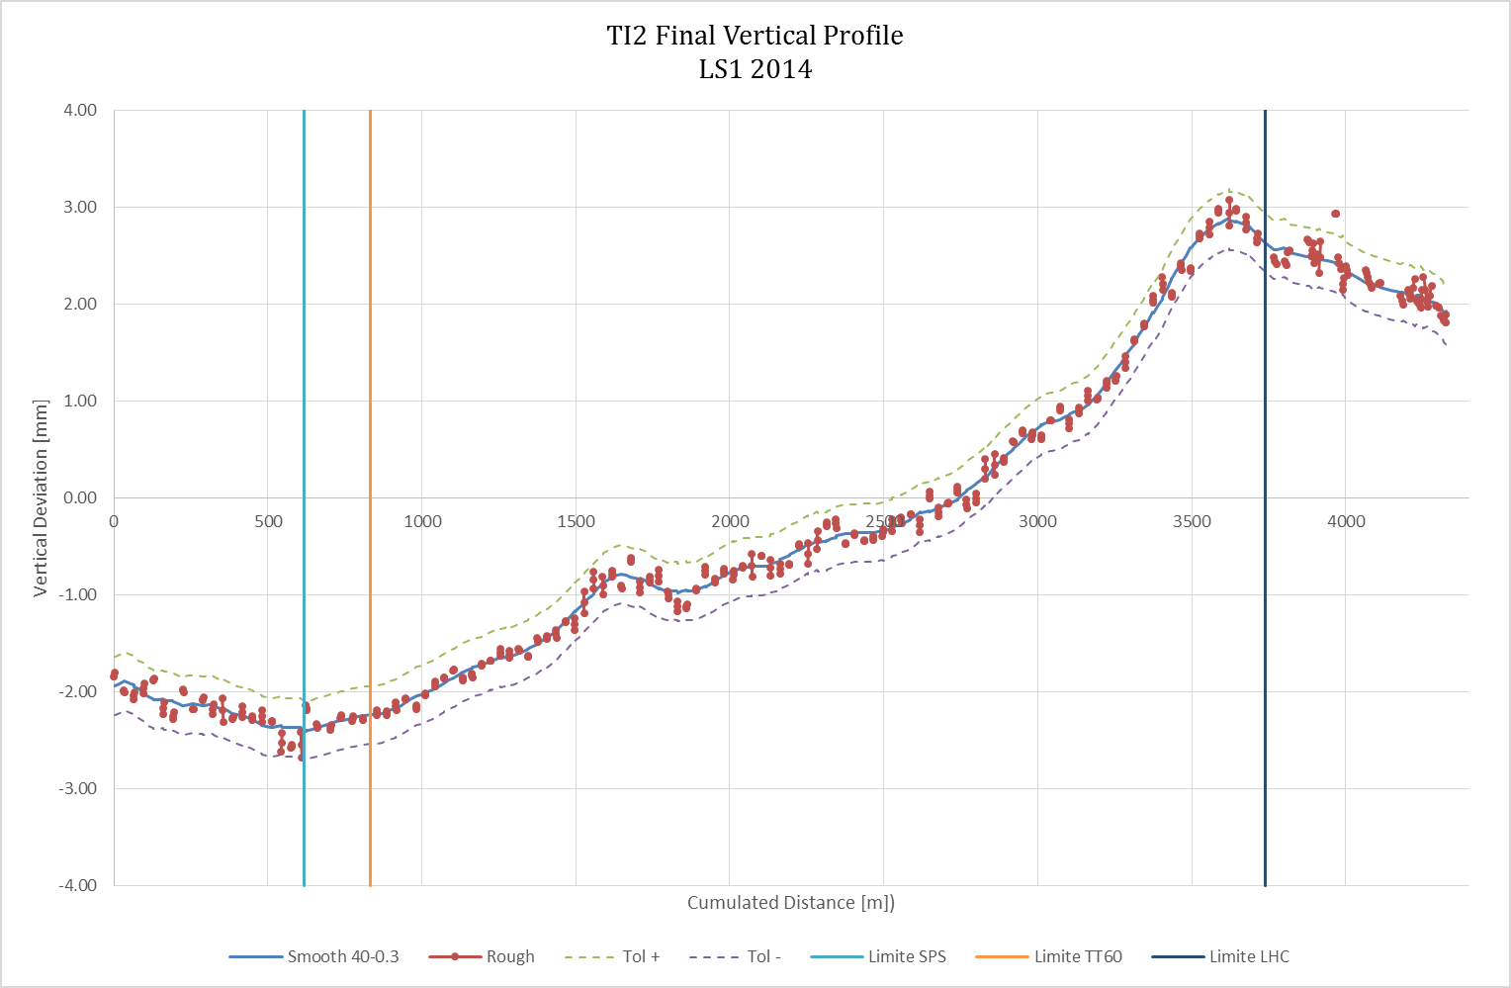
TI2 Vertical Profile

Slide 20
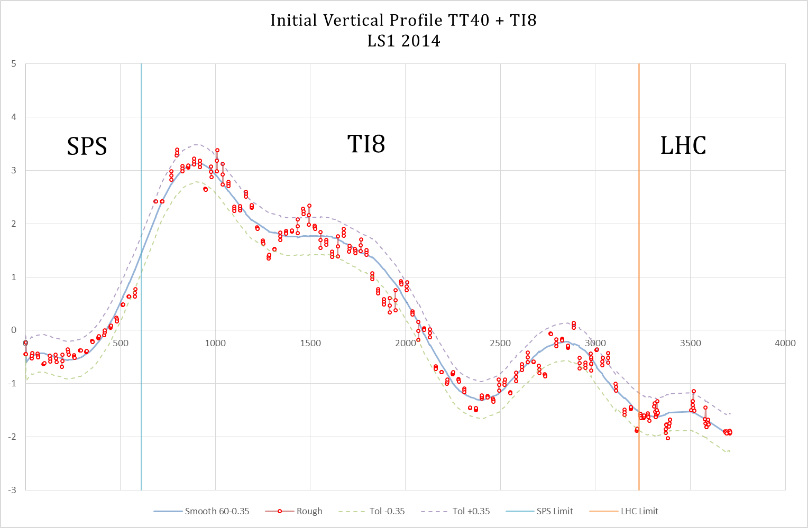
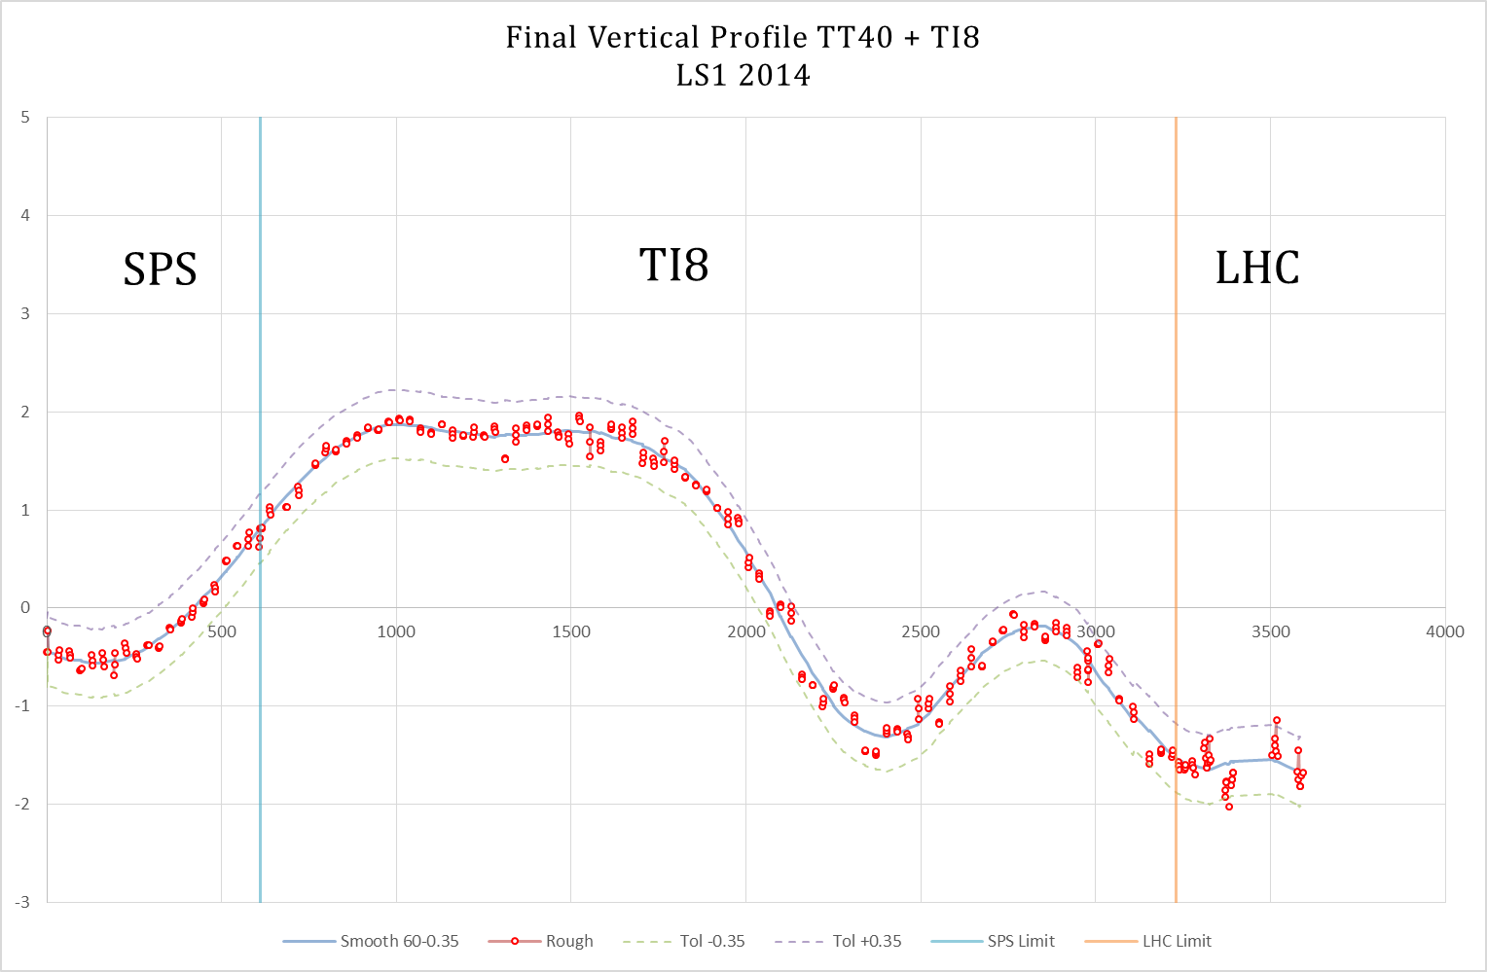
TI8 Vertical Profile

Slide 21
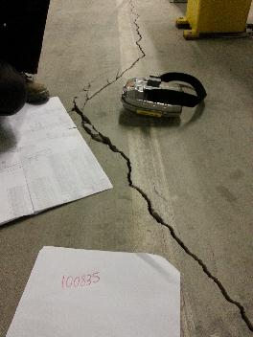
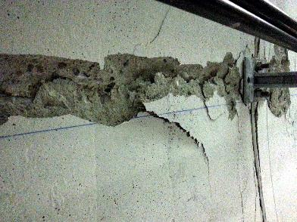
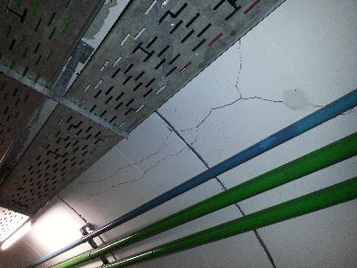
TT10 Transfer line
Delivering beam from PS to SPS complex
Showed invert heave plus compression racks in the crown and tension/shear cracks at the level of the shoulder

Slide 22
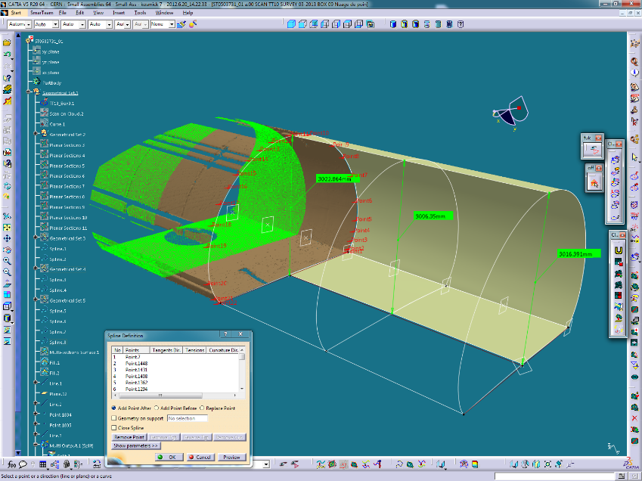
Measurements
Notes:
Is it still moving?
Installation of monitoring profiles
It is stable since april 2013
All stress was released by the cracks

Slide 23
Work Zone

Slide 24
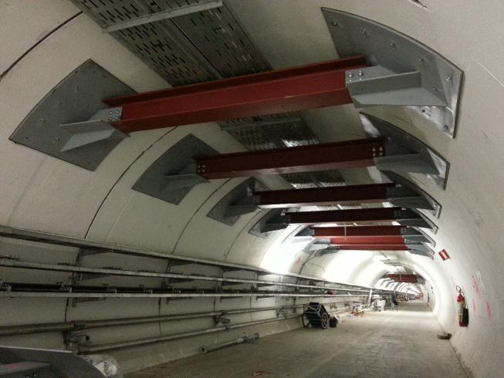
Reinforcements

Slide 25
Future Monitoring
Regular monitoring of Profiles
Installation of new Network points all along TT10
Installation of a fiber optic permanent monitoring system

Slide 26
With contributions of
Philippe Dewitte, James Ridewood, Richard Francis Morton, Stephan Cettour Cave

