Slide 1
Other Issues
Yoshiyuki Morita
KEK

Slide 2
Outline
Three important issues
Tuner system
  Many excellent tuner designs
  One can select an appropriate design
  Look at various tuner designs
Operating experience
  RF trip rate
  Maintenance work to keep a low trip rate
  Performance degradation
Performance recovery
  Needed or desired in the long term operation
  low risk, low cost and short period of time
  Horizontal HPR
  Recovery examples

Slide 3
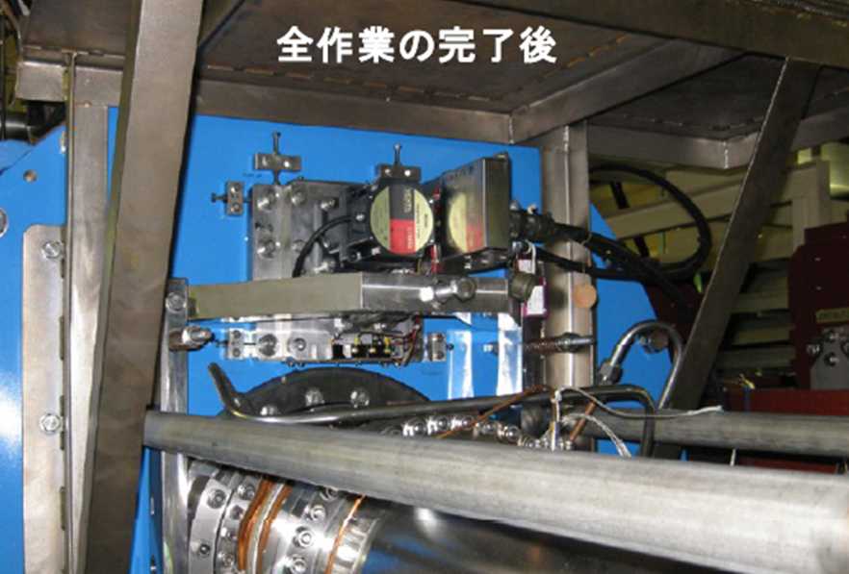
Frequency tuners
Frequency tuner of SRF cavity for SuperKEKB

Slide 4
Frequency tuner
Functions
  Tune the cavity at an operating frequency
  Detune the cavity to compensate beam loading
  Detune the cavity far away when not used for operation
  Stabilize the RF amplitude and phase
Frequency tuner designs
  Have advanced significantly
  Many excellent designs
  Select an appropriate design
    Mass production
      Compact and cost efficient
    Long term usage
      Reliable and long life

Slide 5
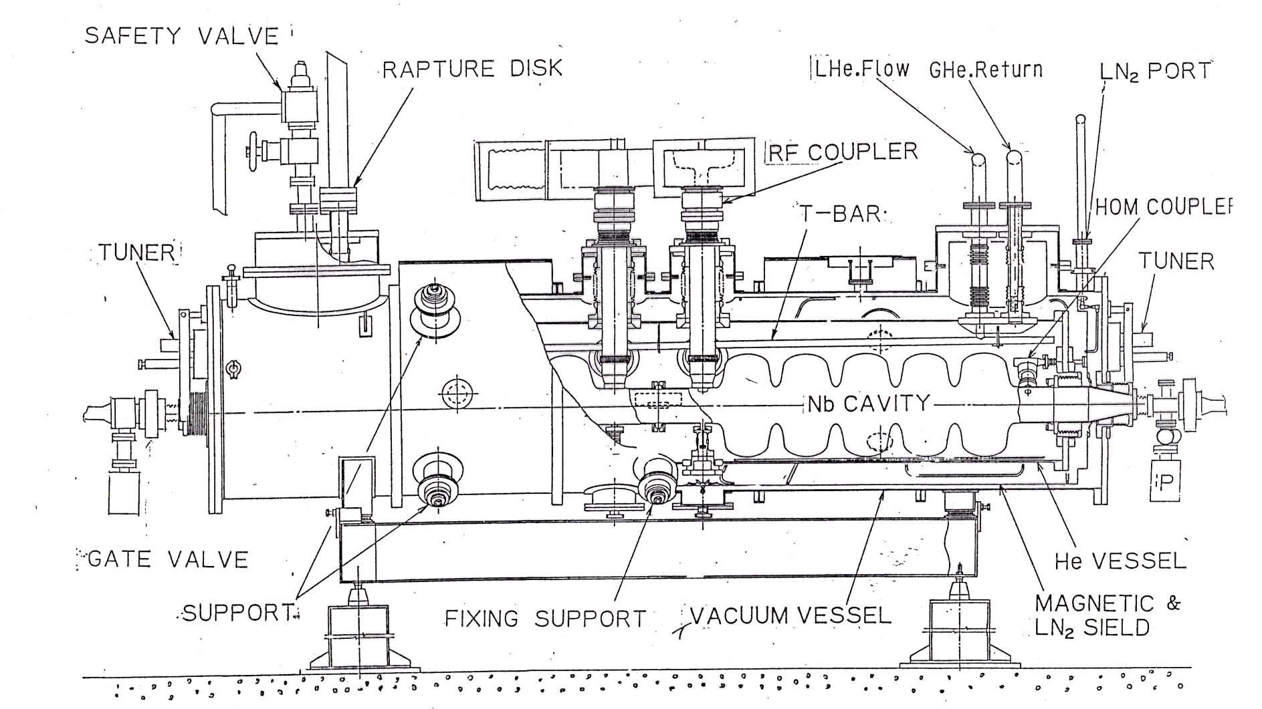
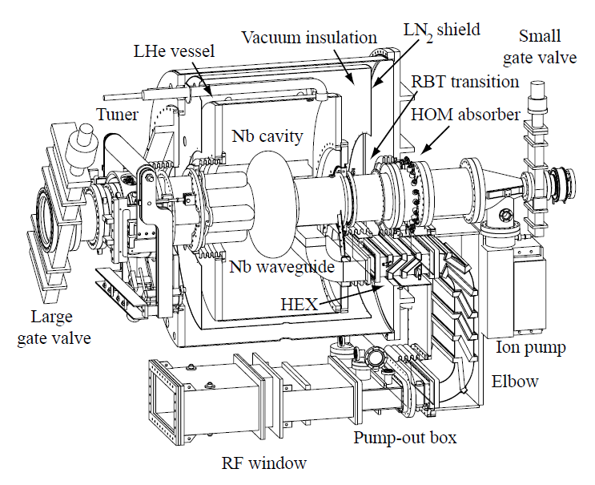
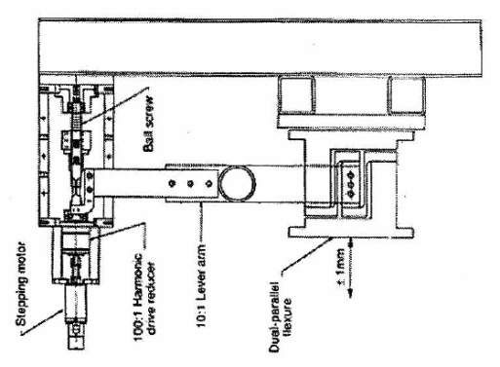
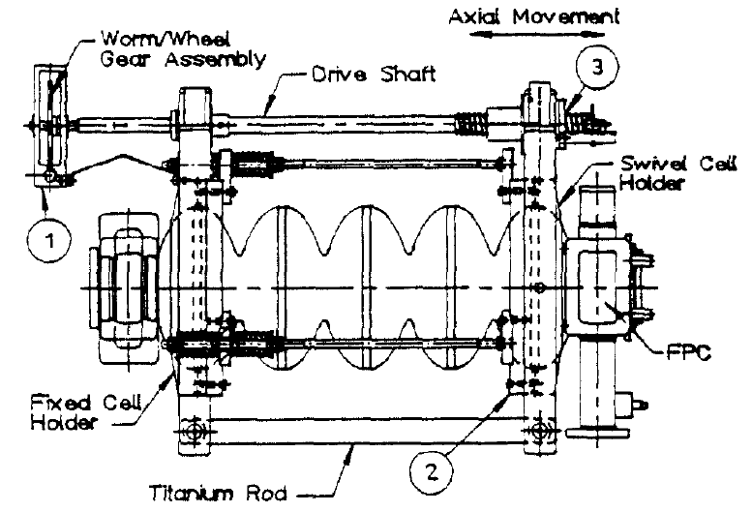
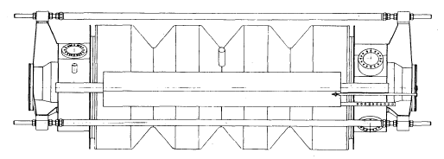
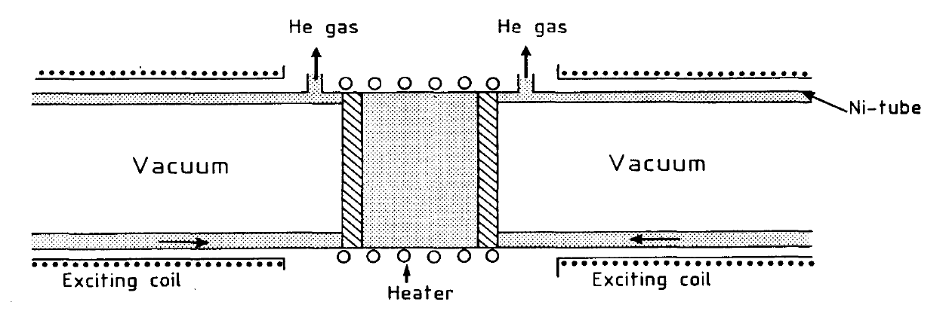
Tuners at an early stage
TRISTAN tuner at KEK
CESR at Cornell Univ.
Lever arm (x2) mechanism with stepping motor driver
Piezoactuator subtuner
Flex hinge (no backlash)
Stepping motor driver
Three Ni bars with
He gas cooling and coil heater
Magnetostrictive subtuner
CEBAF at JLAB
LEP at CERN
Drive shaft with stepping motor driver

Slide 6
Summary of tuners at an early stage
H Padamsee, RF Superconductivity for Accelerators
 | CEBAF 5-cell x 1.5GHz | TRISTAN 5 -cell x 508 MHz | CESR III Single cell x 500 MHz | LEP II 4 -cell x 325 MHz
Main tuner | Drive shaft | Lever arm (x2) with a screw jack | Flex hinge (no backlash) | Three Ni bars, inside (no backlash)
Driver | Stepping motor | Stepping motor | Stepping motor | He gas cooling and coil heating
Sub tuner |  | Piezoactuator 55μm/1600V |  | Magnetostrictive ±1kHz
Sensitivity (kHz/mm) | 500 | 80 | 320 | 40
Frequency range (kHz) | 400 | 800(10 mm) | 600 | 50 (10Hz/s)
Precision (Hz) | 2 | 20 | 10
Bandwidth (Hz) | 220 | 500 | 2500 | 80

Slide 7
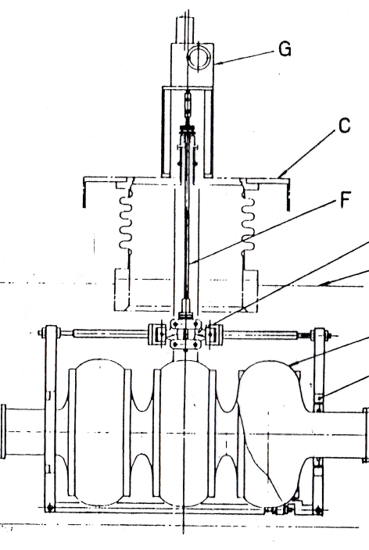
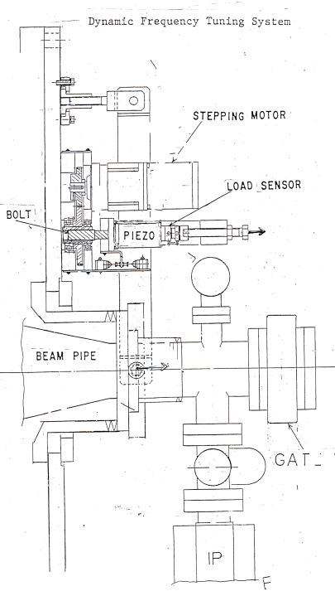
Tuner development for TRISTAN cavity at KEK
3-cell test cavity in 1984
  Scissor jack and piezostack
5-cell test cavity in 1985
  Screw jack and piezostack
TRISTAN 5-cell cavity from 1986 to 1995
  Lever arm (x2) with screw jack and piezostack

Slide 8
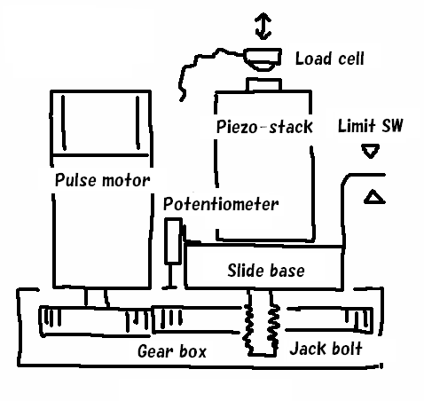
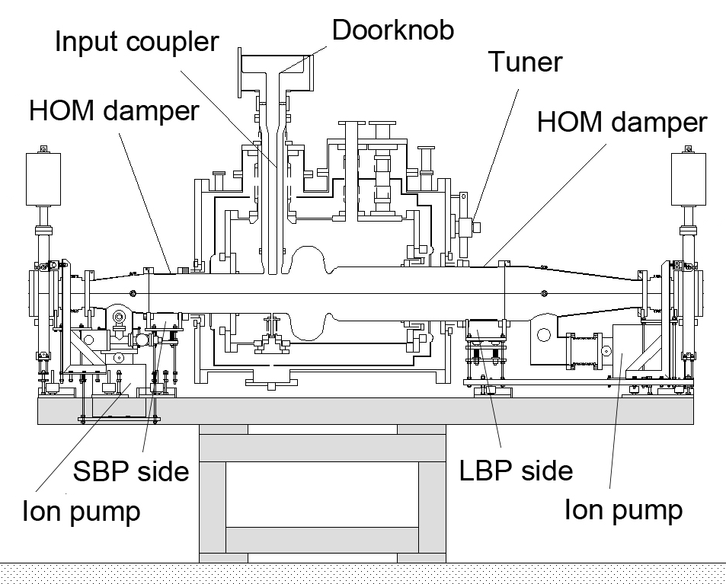
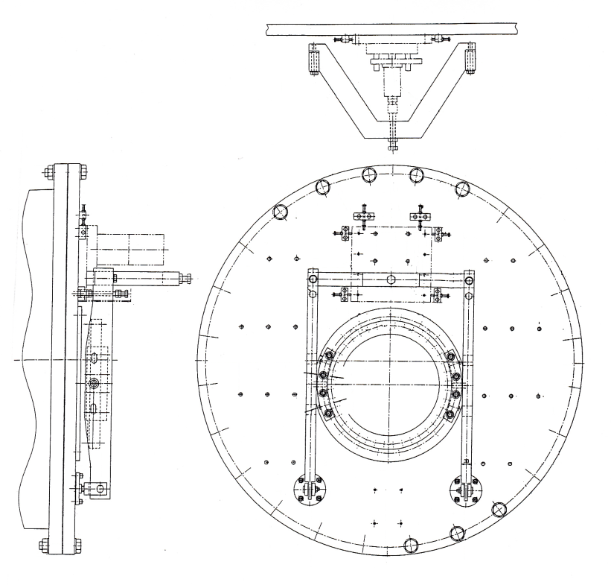
KEKB and SuperKEKB Tuner
Tuner driver
KEKB single cell cavity (1998-2010)
    Same tuner drivers used
    Lever arm(x0.5)
  SuperKEKB
    Tuner drivers renewed
    piezostacks, stepping motors, harmonic gears, etc.
Stepping motor
&
Harmonic gear
Tuner driver
Lever arm

Slide 9
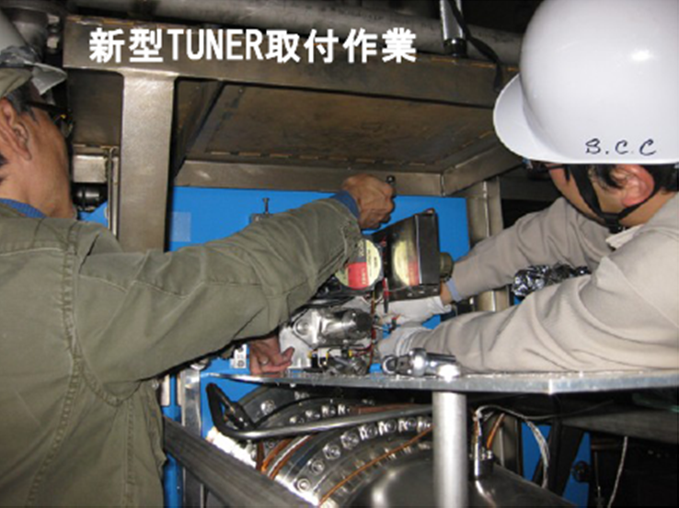
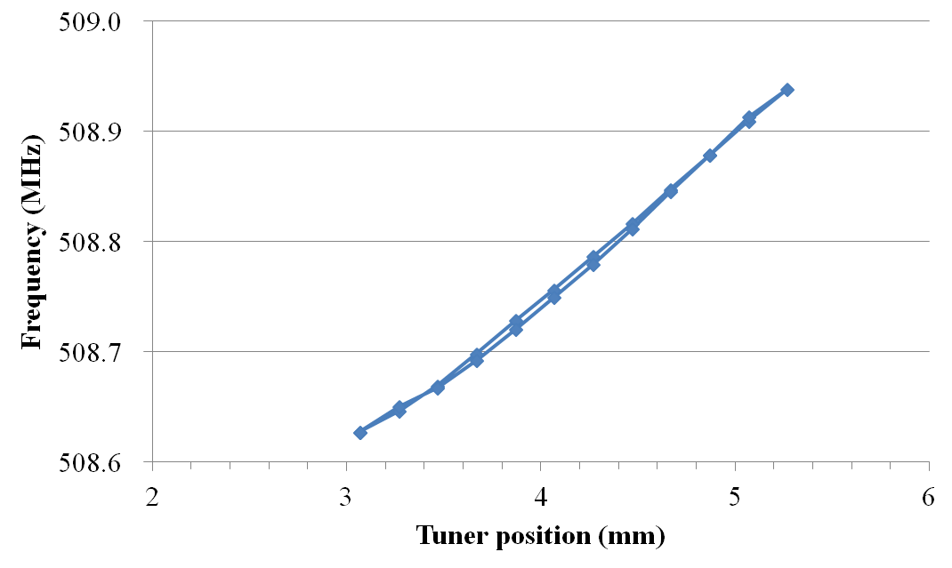
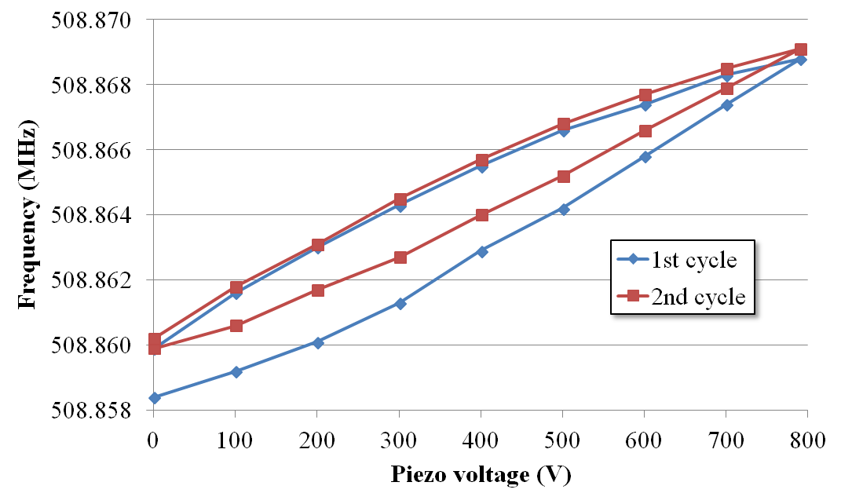
Renewed driver and its response
Screw jack response
Δf: 256 kHz (160kg)
Setting the renewed tuner
 | SuperKEKB
Frequency (MHz) | 509 MHz
Bandwidth (Hz) | 10000 Hz (Qe=5E4)
Main tuner | Lever arm (x0.5)
Tuner driver | Stepping motor
Sub tuner Stroke | Piezoactuator 64 (55) μm/800V (1600V)
Sensitivity | 400 kHz/mm
Frequency range (kHz) | 400 KHz
Stiffness | 400 kg/mm
Piezo response
Δf: 8.9 kHz (800 V)
KEKB

Slide 10
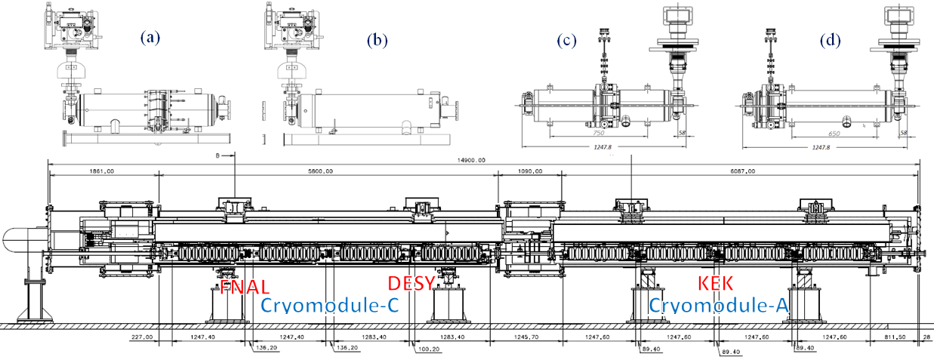
STF(Superconducting RF Test Facility) at KEK
Eiji Kako, S1-Glogal
3 tuners attached to the S1-Global cavity string at KEK
Blade tuner by INFN Milan
Double lever tuner by Saclay/DESY
Slide jack tuner by KEK
Between tank pads
Outside the pads
Coaxial blade tuner
Lateral Saclay/DESY tuner
KEK slide-jack tuner

Slide 11
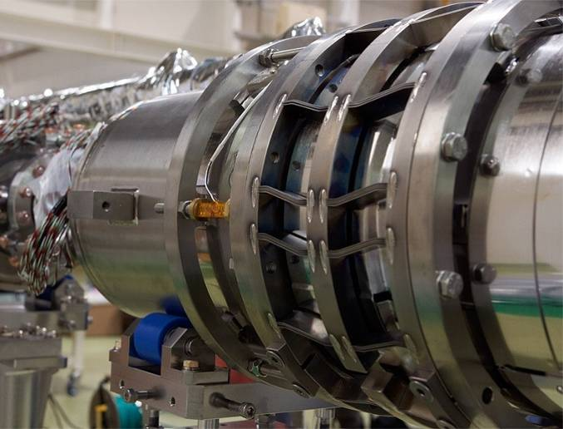
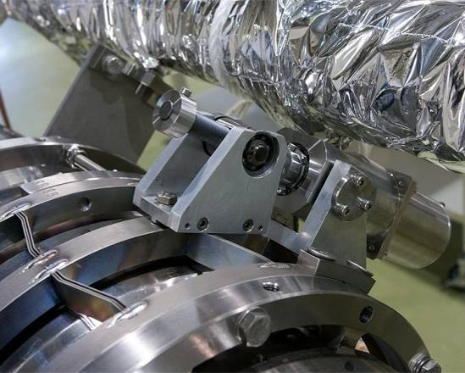
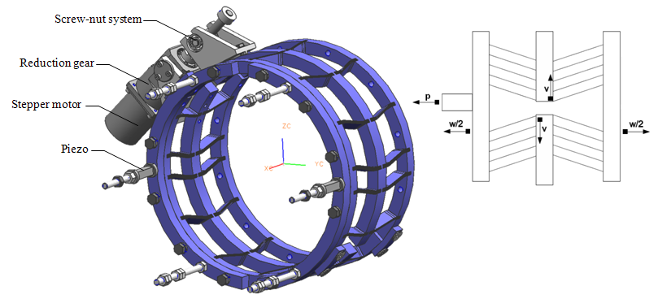
Coaxial blade tuner
Eiji Kako, S1-Glogal
Developed by INFN Milan
Azimuthal motion transferred to longitudinal strain
Zero backlash
CuBe threaded shaft used for a screw nut system
Stepping motor and gear combination driver
Two piezo actuators for fast action
All components in cold location

Slide 12
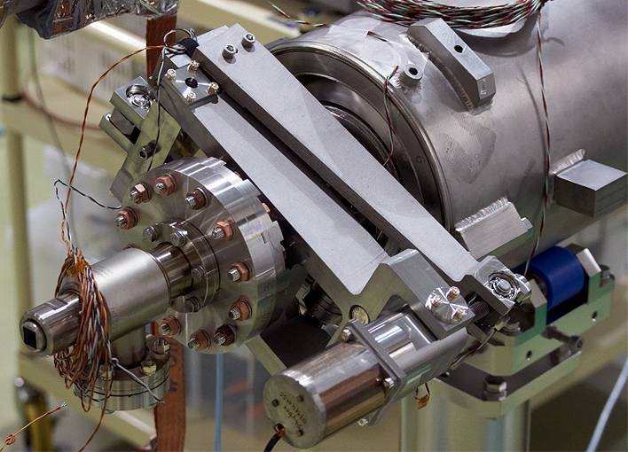
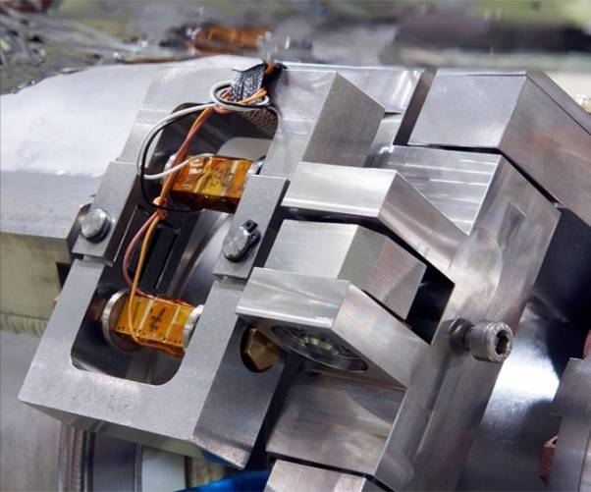
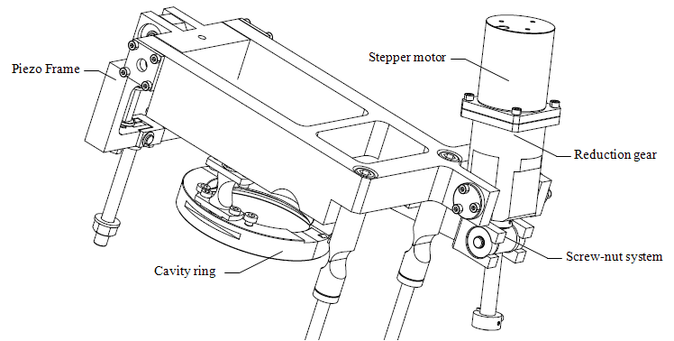
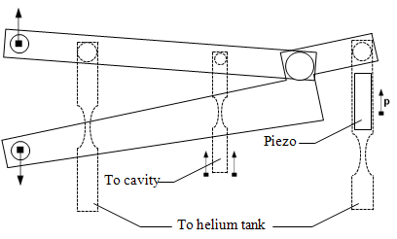
Saclay/DESY tuner
Eiji Kako, S1-Glogal
Developed by DESY based on the Saclay design
Double lever system (leverage 1.25)
Cold stepping motor and gear combination
Screw nut system
Two piezo actuators for fast action in a preloaded frame
All components in cold location

Slide 13
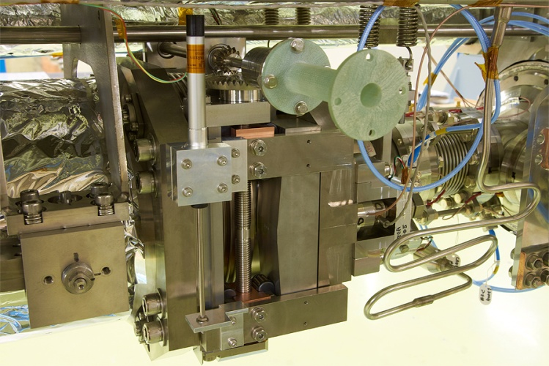
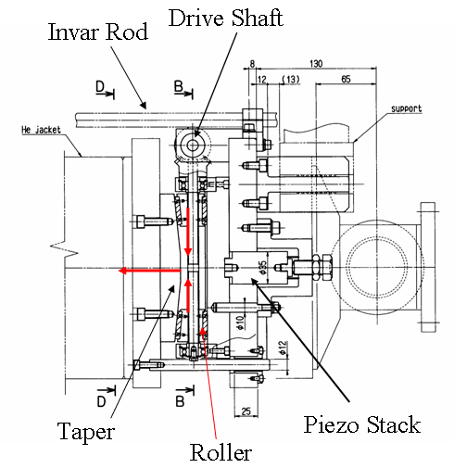
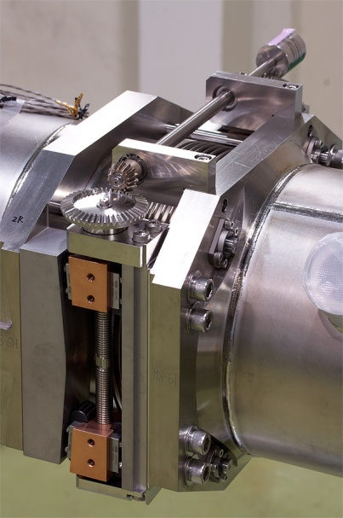
KEK slide-jack tuner
Eiji Kako, S1-Glogal
Developed by KEK for the STF project
Slide-jack mechanism
Single high voltage piezo actuator for fast action
Warm stepping motor

Slide 14
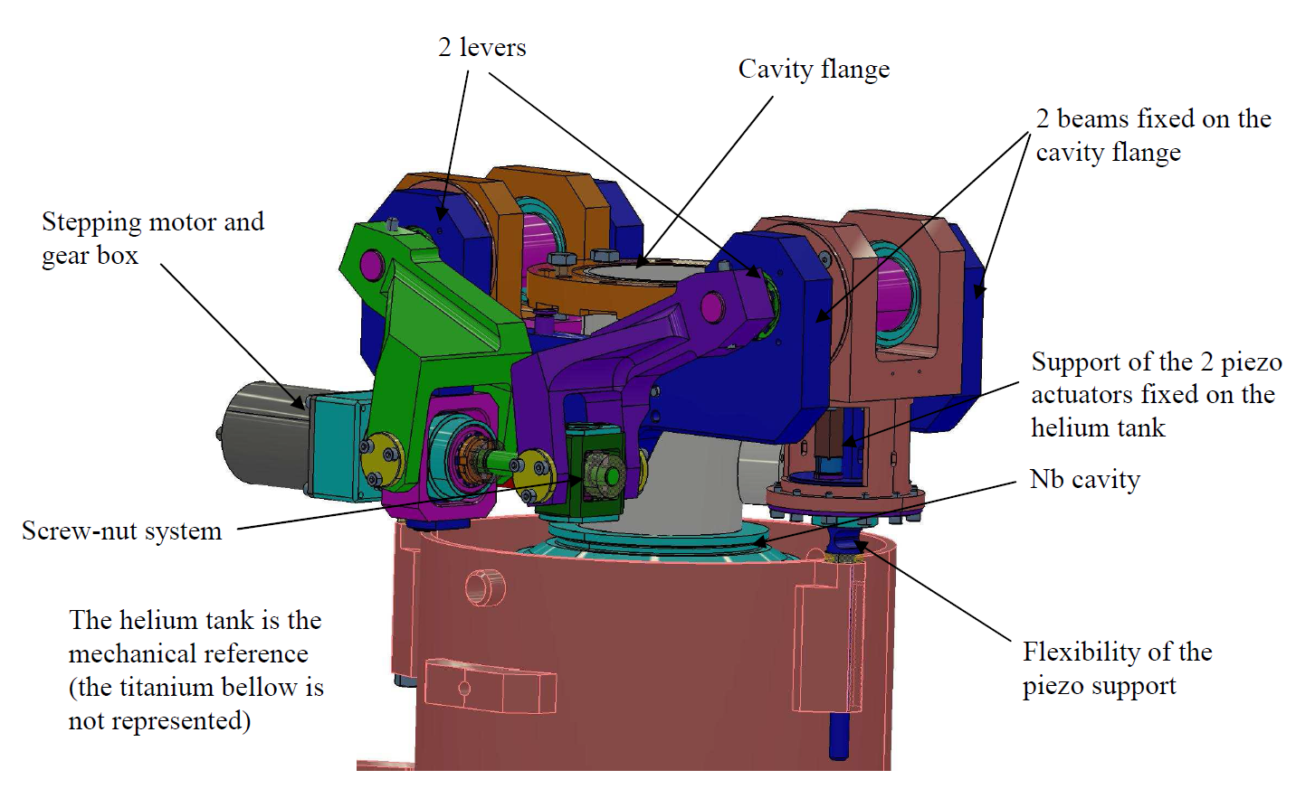
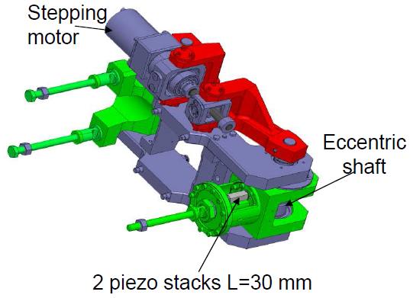
Other excellent tuner designs
Pierre Bosland
https://www.cells.es/old/ESLS-RF/ESLS-RF/2007/07-ESLS07-PBosland.pdf
Saclay new tuner
Two levers and eccentric shafts mechanism
±460 kHz tuning range
4 nm resolution (1.2Hz)
1.4 kHz piezo tuning range
All cold components
Compact
Disadvantage: maintainability

Slide 15
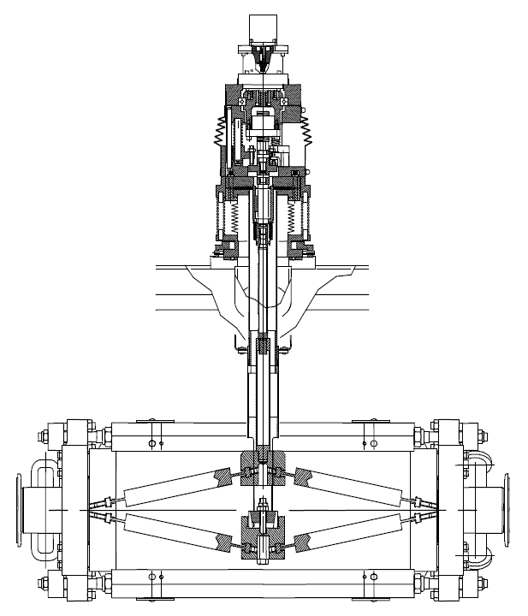
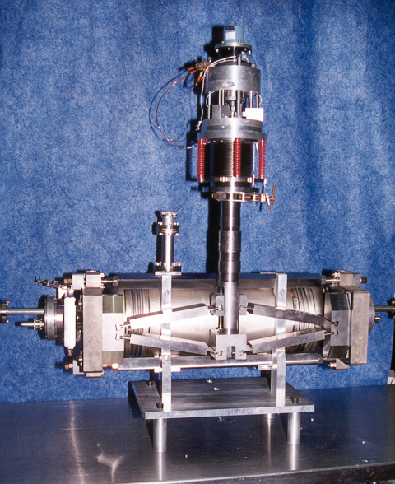
Other excellent tuner designs
Jean Delayen
http://uspas.fnal.gov/materials/08UMD/Tuning_Systems.pdf
Proceedings of the 1999 Particle Accelerator Conference, New York, 1999
CEBAF upgrade tuner
Scissor jack mechanism
Range: ±200 kHz
Warm drive unit in air pressure
Warm three piezoactuators
Low voltage (150 V)
50 μm stroke

Slide 16
Summary table
 | S1-global tuner Blade (INFN) | S1-global tuner DESY/Sacray type | S1-global tuner KEK type | Saclay | CEBAF upgrade
Frequency (MHz) | 1300 | 1300 | 1300 | 1300 | 1500
Bandwidth (Hz) | 210 x 2 |  |  |  | 75
Loaded Q | 3.1x106
Main tuner | Coaxial blade | Double lever Leverage 1:17 | Slide jack | Two levers and eccentric shafts | Scissor jack
Driver location | Cold, vacuum | Cold, vacuum | Warm, air | Cold, vacuum | Warm, air
Piezoactuator | Double thin-layer(0.1mm) 10x10x40mm3, 55 μm at RT/200V | Double thin-layer(0.1mm) 10x10x40mm3, 55 μm at RT/200V | Single Thick layer(2mm) Φ35x78mm 40 μm at RT/1000V | Double | Three >550Hz 50 μm/150V
Sensitivity | 1.5Hz/step | 1 HZ/step | 3 Hz/step
Frequency range (kHz) | 600 | 500 | 900 | ±460 | ±200
Stiffness (105 N/mm) | 30 kN/mm | 40 kN/mm | 290 kN/mm

Slide 17
Summary of tuner designs
Many excellent tuner designs
  Select an appropriate design
  Lever system with motor driver and piezo stack combination
    has been applied for long time
    Reliable mechanics
Need to choose warm or cold location
  Cold location makes the tuner compact
  Warm locations makes the maintenance easy
Long lifetime
  TRISTAN-KEKB tunes have long life time (~30 years old)
  Will be still used for SuperKEKB

Slide 18
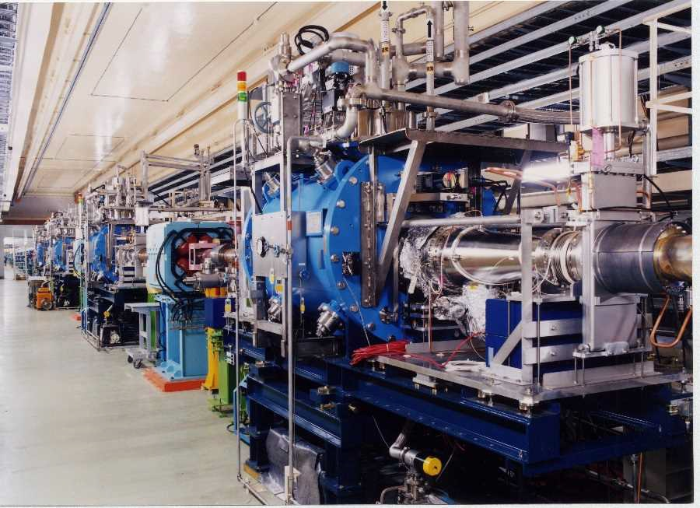
Operating experience
SRF cavities for KEKB

Slide 19
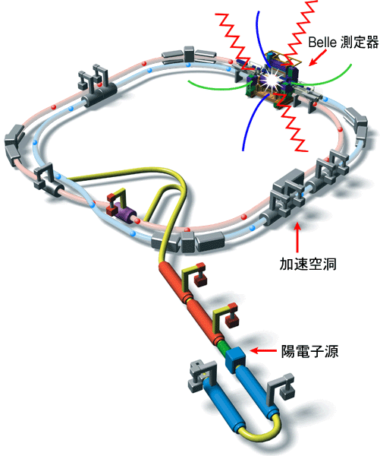
Overview of KEKB e⁺e⁻ collider
e⁺e⁻ asymmetric energy ring collider for B meson physcs
Circumference of 3 km
Double ring collider
  LER: Positron beam of 3.5 GeV
  HER: Electron beam of 8 GeV
Operated from 1998 to 2010
Achieved luminosity:
Peak: 2.1x10³⁴ /cm2/s
Integrated: 1040 /fb
SC-RF (HER)
Belle
NC-RF (LER)
KEKB
LER | HER
Positron | Electron
3.5 GeV | 8 GeV
2 A | 1.4 A
NC-RF (HER)
Linac

Slide 20
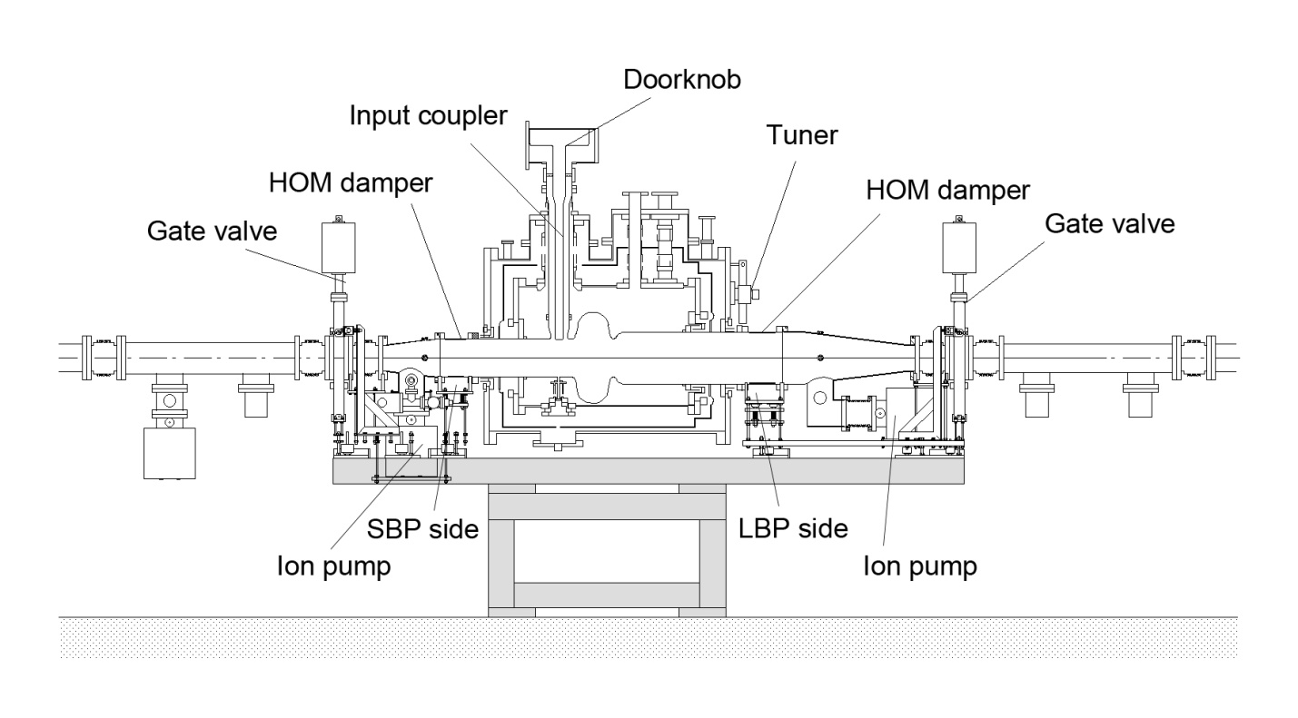
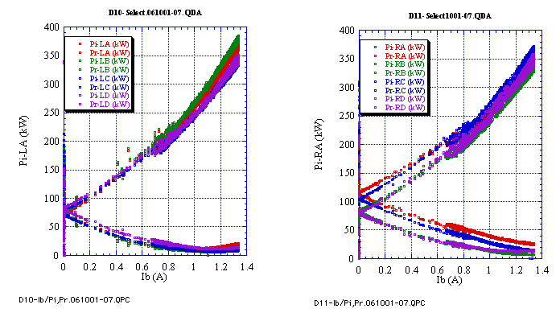
SRF accelerating cavities
SRF cavity for KEKB
Hybrid system of SRF(8) and NC(12) for HER
Top up injection and no ramping
SRF cavity description
  509 MHz single cell cavity
  Operating voltage: 1.2-1.5 MV
  Beam current: 1.4A
  Delivered RF power: 350-400 kW/cav
  QL=7x10⁴ → 5x10⁴ (FY2004-2005)
  Total HOM power: 16 kW/cav
Input and reflected RF powers
Cavity parameters
Parameter | Achieved
No. of cavities | 8
RF voltage (MV) | 1.2-2
Beam current (A) | 1.4
RF power (kW) | 350-400
HOM power (kW/cav) | 14-16

Slide 21
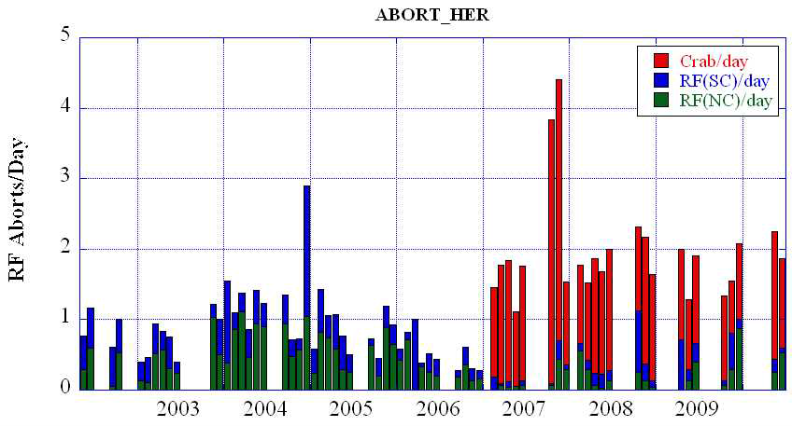
RF trip statistics
RF trip statistics from 2002 to 2010
RF trips of the SRF cavities are mainly due to discharging in the cavity or input coupler
Trip rate is 0.5 times /day for 8 cavities
0.1 times/day in 1A operation
Crab crossing
0.8~1.2A
1~1.4A
Top up injection

Slide 22
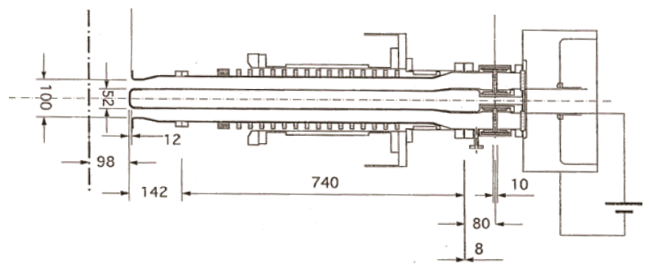
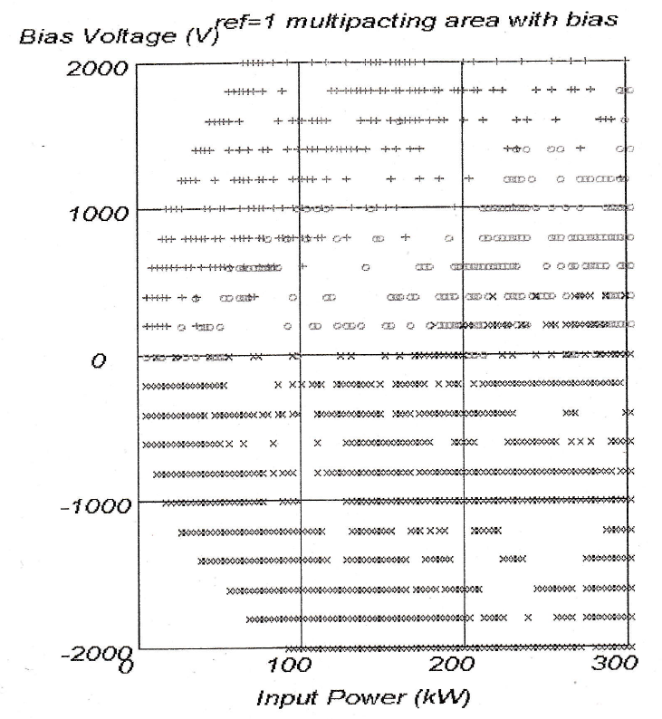
Maintenance work
During the warm-up (two times a year)
  Safety inspection for safety valves and pressure gauges
  Greasing of the screw jack of the tuner system
  Coupler RF conditioning with voltage biasing every before cool down
After the cool down
  Cavity RF conditioning up to 2~2.3 MV
During the regular maintenance stop every two or three weeks
  Cavity RF conditioning up to 2~2.3 MV
MP map
KEKB input coupler
+:Inner
o:Inner-outer
Coupler conditioning with voltage biasing
RF power up to 300 kW in full reflection condition
With voltage biasing up to ± 2000 V
x:Outer

Slide 23
Troubles
More than 20 heat cycles
  Cooling rate 3K/h
  Leakage of insulation vacuum: 2
  Leakage at indium seal: 5
    Re-assembled with no additional surface treatment: 3
    Re-torqued volts of the indium flange:2
  Leakage at HOM damper flange: 1
  Leakage at IP connector: 1
  Piezostack broken: 1
Operation phase | Installed place | Cavity ID | Leaked at
Cool-down | D11B | CA-B03 | He vessel, no influence on cavity vacuum pressure
Cool-down | D11A | CA-B02 | He vessel, no influence on cavity vacuum pressure
Warm-up | D10A | CA-B06 | Indium seal of LBP, resealed in clean room
Cool-down | D11C | CA-B04 | Indium seal of LBP, resealed in clean room
Cool-down | D10C | CA-B08 | Indium seal of LBP, resealed in clean room
Beam operation | D11A | CA-B02 | HOM damper flange, HOM damper exchanged Exchanged with CA-B01 in June 2006
Warm-up | D10A | CA-B06 | Indium seal of SBP or LBP, re-torqued
Summer shutdown | D11A | CA-B01 | Ion pump connector, re-torqued
Cool-down | D11B | CA-B03 | Indium seal of SBP or LBP, re-torqued Exchanged with CA-B02 in Nov. 2010

Slide 24
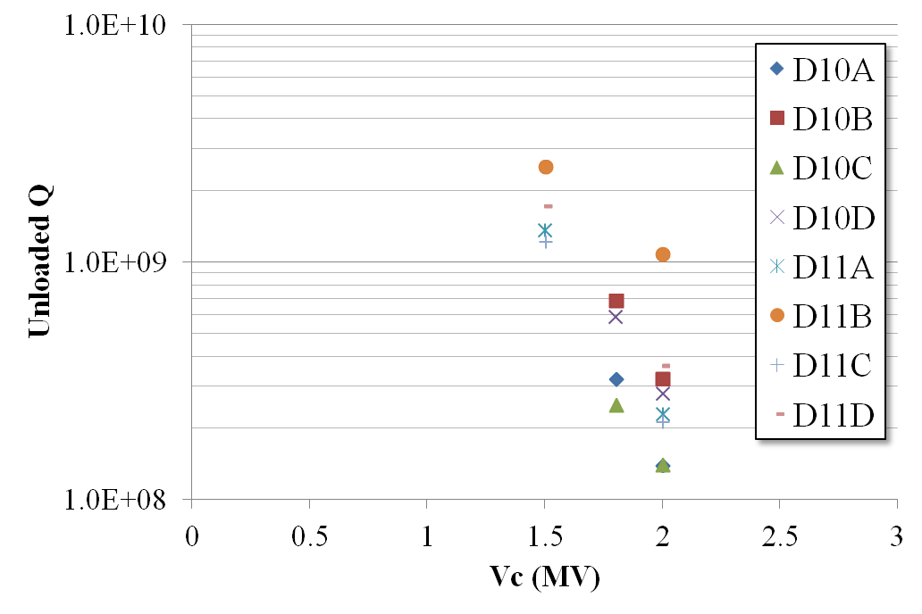
Degradation of cavity performance
The achievable voltages decreased from 2.5-3 MV to 2-2.5 MV
  All cavities can provide more than 2 MV after 10 years of operation
  Unloaded Q factors at 2 MV(Eacc=8Mv/m) degraded from ~2x10⁹ to 1.4-4x10⁸ with strong field emission
Vacuum trouble
  D11C cavity degraded from a vacuum trouble (air dust contamination)
Air exposure
  Re-assembling of indium seals
  Exchange of input coupler gaskets for coupling adjustment
Degraded Q at 2 MV
Q degradation
2004.7.8 HPC gasket exchanged
2001.1Leak
2001.7 installed
2005.7 Leak
2005.8.31 installed

Slide 25
Summary of operating experience
Operating experience
  Trip rate
    0.5 times/day for 8 cavities at ~1.4 A
    0.1 times/day at 1 A
  Maintenance work to keep low trip rate
    Warm-up: twice a year
    Regular RF conditioning for cavities: every 2-3 weeks
    Coupler conditioning: every before cool-down with voltage biasing
    Greasing of tuner jack once a year
  Performance degradation after 10 years of operation
    Can provide 2 MV
    Unloaded Q factors degraded from 2x10⁹ to 1.4-4x10⁸

Slide 26
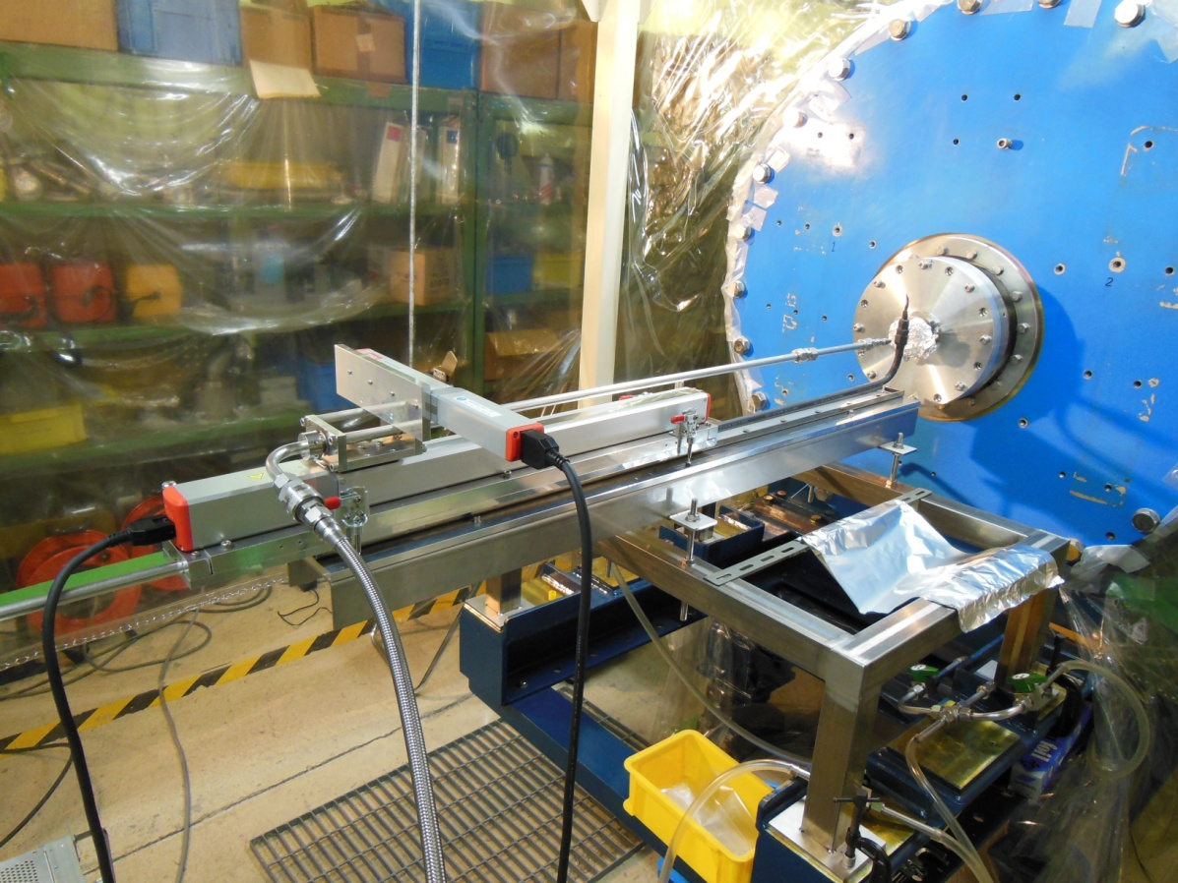
Performance recovery
Setup of the HHPR apparatus

Slide 27
Motivation of developing HHPR for performance recovery
RF Performance of SRF cavities degraded in the long term operation at KEKB
  Present degradations are still acceptable for SuperKEKB (1.5MV)
  Further degradations make the operation difficult
  Performance recovery is desired
HPR is effective to clean the particle contamination
  Low risk, low cost and short period of time
We developed horizontal insertion of HPR nozzle
  Applicable to cryomodule

Slide 28
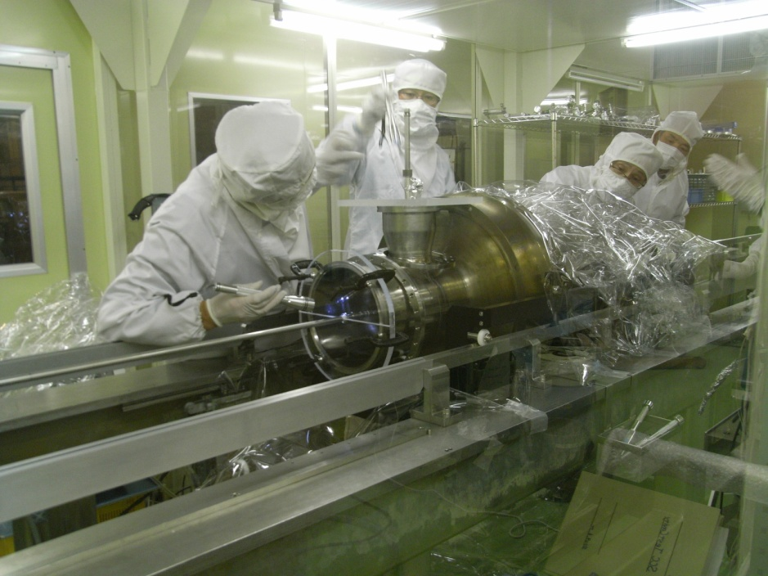
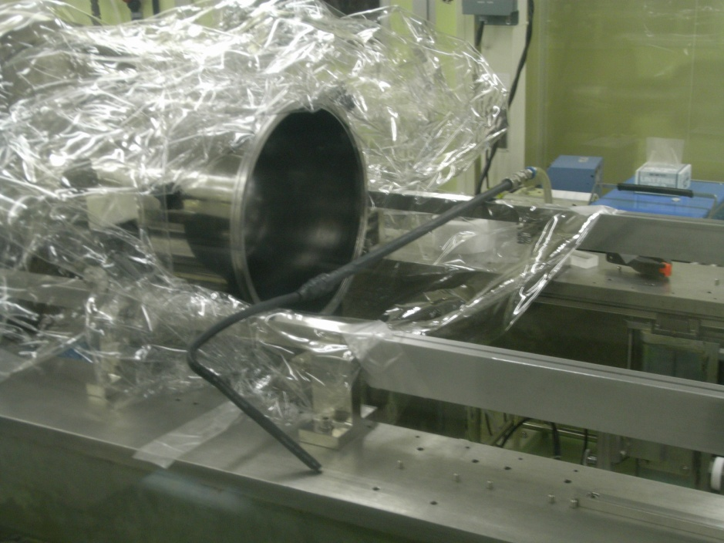
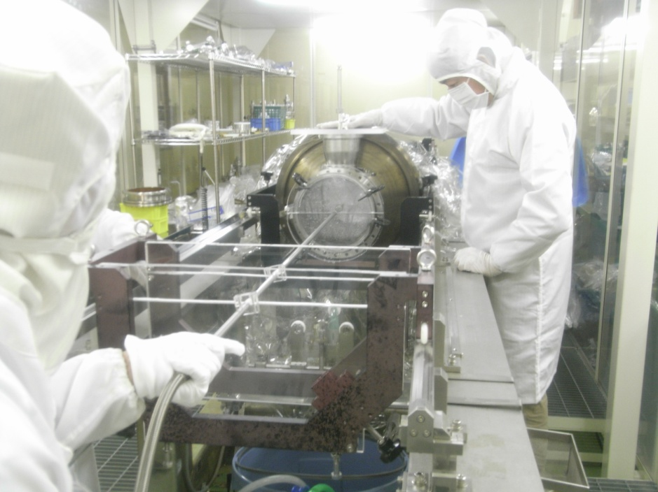
Horizontal HPR R&D using prototype test cavity
Horizontal HPR was applied to our test cavity in the clean room
Large BP
Test cavity
Small BP
Horizontal insertion of HP water pipe
Water evacuation pipe
(connected to aspirator)
High pressure rinsing
HHPR parameters (manual operation)
Water Pressure | 6 MPa
Nozzle | Stainless steal Φ0.54mm x 6
Driving speed | 0.33 mm/sec (cell) 0.66 mm/sec (BP)
Rotation speed | 12⁰/sec
Rinsing time | 20 min
Manually operated

Slide 29
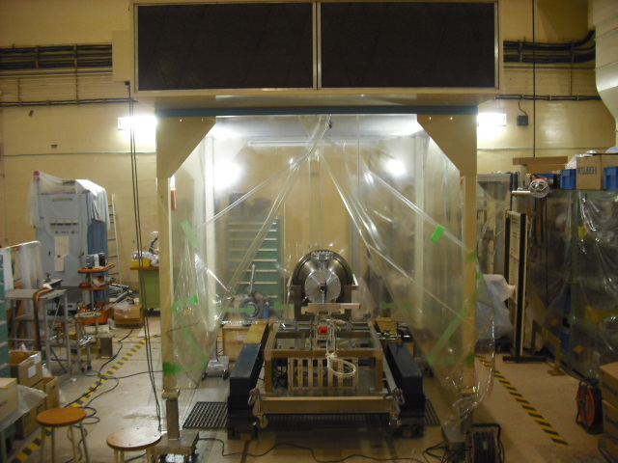
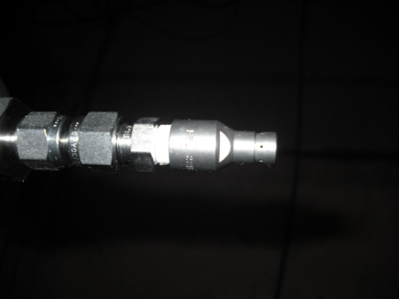
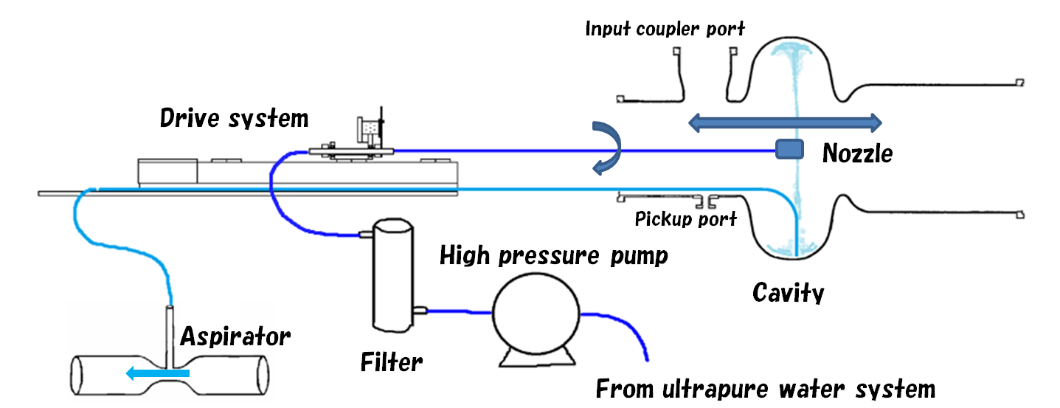
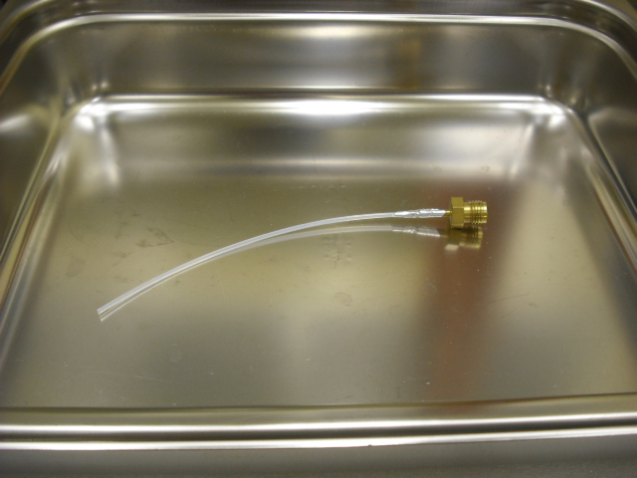
Improvements of HHPR for application to cryomodule
HHPR in clean booth at assembly area
Developed automatic nozzle driving system
Water evacuation by an aspirator pump
After HHPR
  Evacuated with residual water
HHPR parameters (automatic operation)
Water Pressure | 7 MPa
Nozzle | Φ0.54mm x 6
Driving speed | 1 mm/sec
Rotation speed | 6⁰/sec
Rinsing time | 10-15 min
Stainless steel nozzle
Teflon tube to aspirate water in pickup port

Slide 30
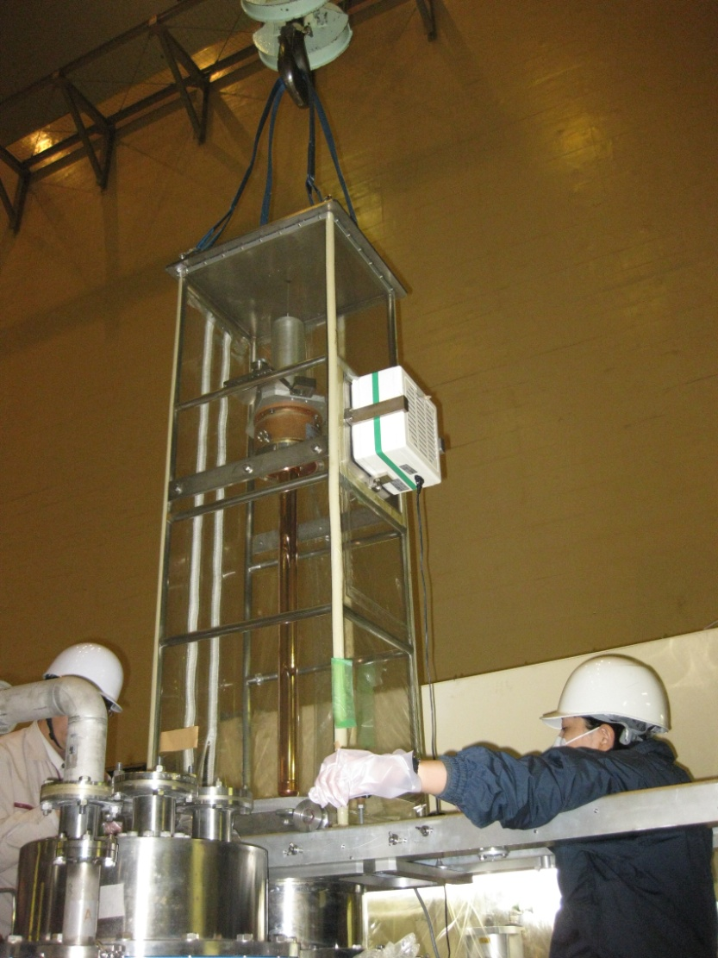
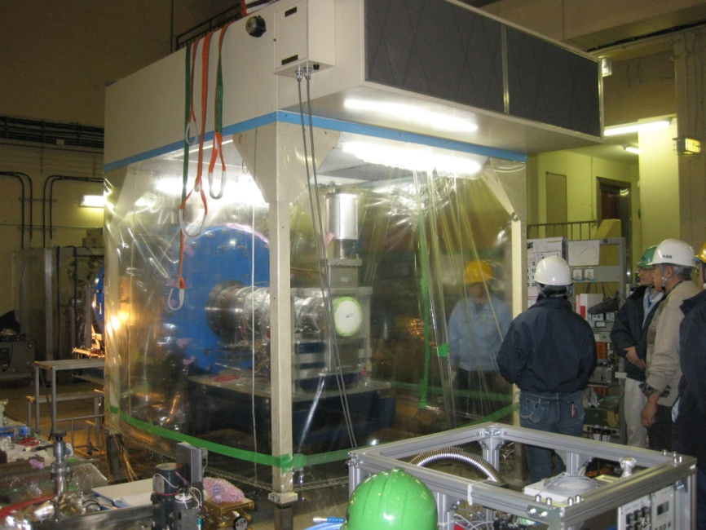
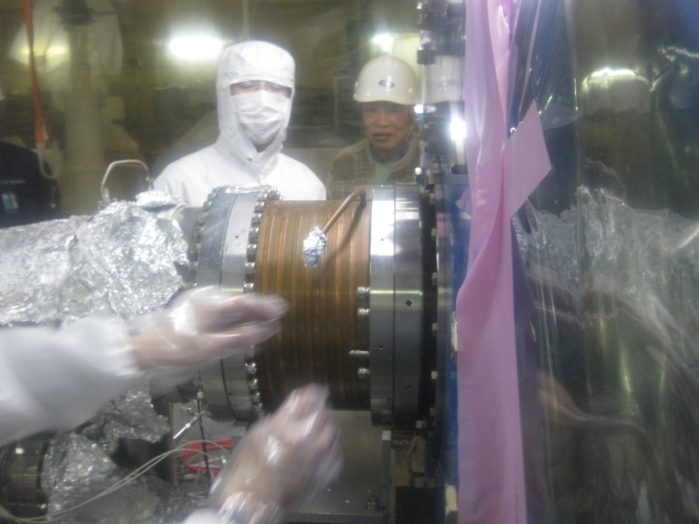
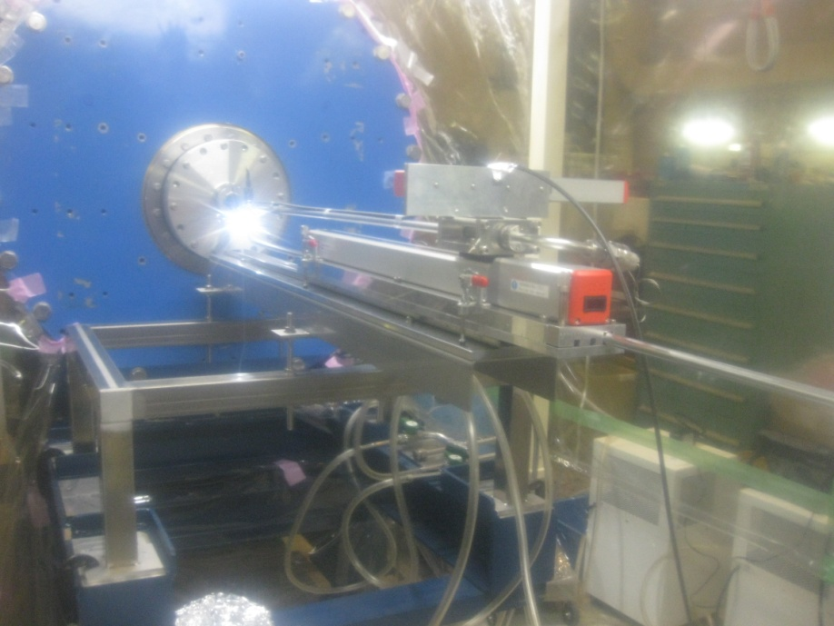

HHPR application to degraded cavity module
Taking out the inner conductor of the HPC
End beam pipes and HOM dampers were dismounted
Before we applied HHPR, HPC and HOM dampers were dismounted in a clean booth.
Setting the HHPR apparatus

Slide 31






HHPR application to degraded cavity module
Rinsed area: cell and iris
Rinsing time: 15 min
Opening the dummy flange
Water jets
Automatic drive
High pressure water pump
Aspirator pumps
Evacuation after HHPR

Slide 32


HPT results: Qo measurements
Leaked D11B cavity significantly degraded after re-assembling
HHPR applied to D11B
Qo sufficiently recovered after HHPR
The D11B cavity was installed in the tunnel (the D11C cavity was replaced)
HHPR applied to D11C
The RF performance drastically recovered
D11B
D11C

Slide 33
Summary 1
Many excellent tuner designs
Can select a suitable mechanism
  Reliable
  Compact
  Cost efficient
  Easy for maintenance
Need to select cold or warm locations
Lever system and piezoactuator
  Familiar mechanism
  Reliable
  Long life
    TRISTAN/KEKB driver: 28 years old
    Will be used for SuperKEKB

Slide 34
Summary 2
Operational experience
  0.5 trip/day for 8 cavities at 1.4A operation
  Maintenance work to keep low trip rate
    Warm up
    RF conditioning of cavity
    Coupler conditioning with voltage biasing
    Adjustable coupling desired
    Greasing of tuner once a year
  Performance degradation
    KEKB cavities can provide 2 MV after 10 years of operation
    Unloaded Q factors degraded with field emission
Performance recovery
  Needed in the long term operation
  Low risk, low cost and short period of time
  Horizontal HPR developed
  HHPR applied to tow degraded cavities
  Those cavities recovered successfully
Performance recovery after HHPR
D11B
Trip rate during KEKB operation
Q degradation at 2 MV
D11C

Slide 35
Backup

Slide 36

Input coupler conditioning before cool-down
The input coupler has to be conditioned with fully reflected RF powers up to 300 kW before cool-down. This conditioning took longer time than usual. RF trips occurred many times below 120 kW by the vacuum pressure rise. Conditioning with minus biasing, especially at -600V, reduced the vacuum pressure rise and increased input RF powers. Multipacting at the outer conductor would be the cause of the vacuum pressure rise.
KEKB input coupler
MP map
Conditioning history
+:Inner
o:Inner-outer
x:Outer

Slide 37


