Slide 1
Beam-Beam Effects in the CEPC
K. Ohmi(KEK), D. Shatilov(BINP), Y. Zhang*(IHEP)
zhangy@ihep.ac.cn
Presented in The 55th ICFA Advanced Beam Dynamics Workshop on
High Luminosity Circular e⁺e⁻ Colliders – Higgs Factory.
Oct. 9-12, 2014. Beijing China

Slide 2
Outline
Introduction
Simulation Results(Tune/Luminosity/Lifetime)
Dynamic Effect
Error Tolerance
Parameter Optimization
Effect of Beam Tilt
Summary

Slide 4
Beam-beam parameter in early machines
J. Seeman, “Observations of the beam–beam interaction”, 1985

Slide 5
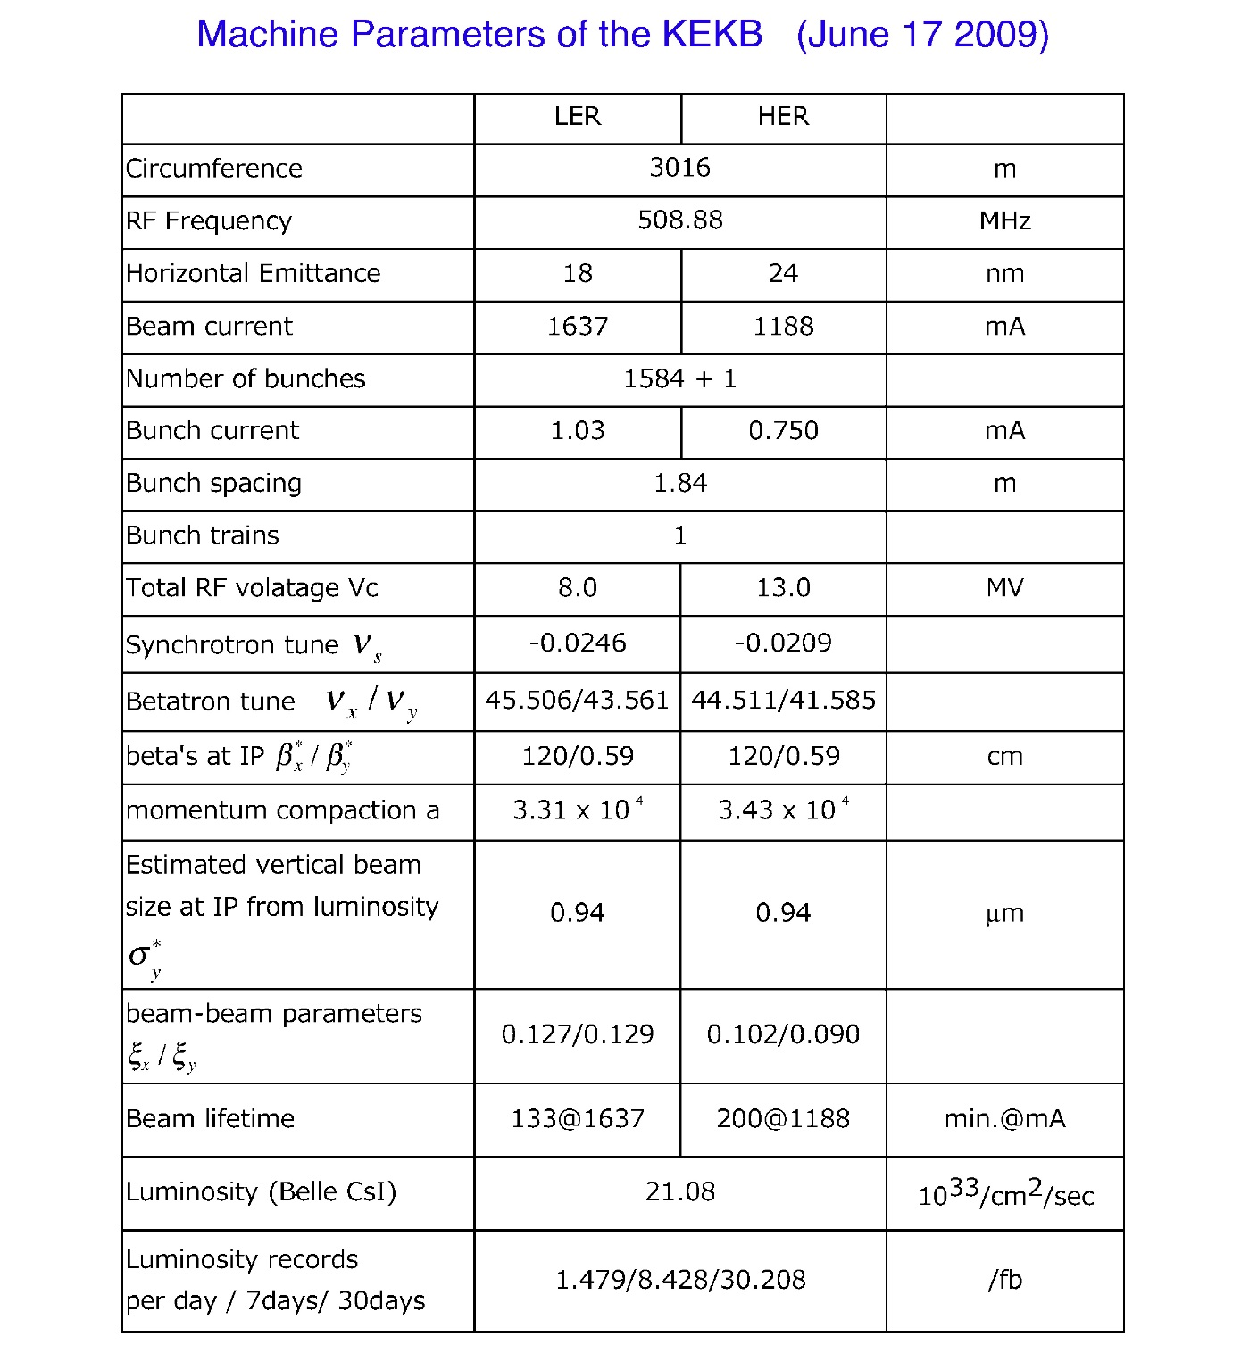

$$ξ_{y}\sim 0.1$$

Slide 6
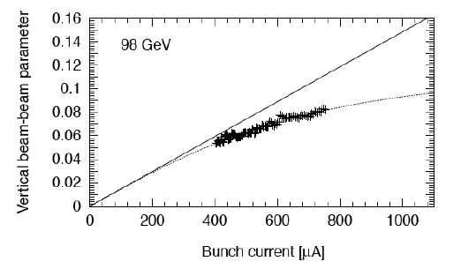
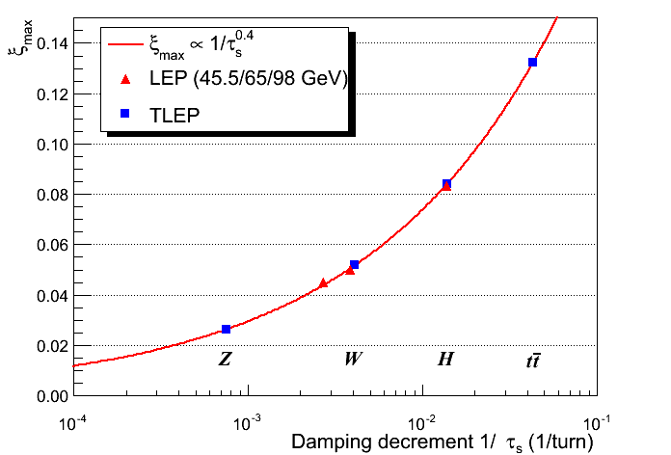
Beam-Beam Parameter at LEP2
Vertical Beam-Beam Parameter measured at LEP2
http://tlep.web.cern.ch/content/accelerator-challenges
R. Assmann

Slide 7
Main Parameters of CEPC
(ver. 140416)

Slide 8
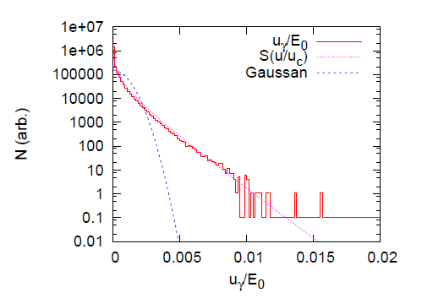

Analysis of Beamstrahlung Effect
The bending radius coming from the beam-beam force is estimated as *
$$\frac{1}{ρ_{x}}≈\frac{1}{ρ_{y}}≈\frac{N_{p}r_{e}}{γσ_{z}σ_{x}}$$
$$ρ_{x}≈ρ_{y}≈37.4m≪6000m$$
The characteristic energy of the synchrotron radiation is expressed by
$u_{c}=\frac{3ℏcγ^{3}}{2ρ}≈\text{0.15}\text{GeV}$， about 0.1 percent of 120GeV
* A. Bogomyagkov, E. Levichev, and D. Shatilov, Phys. Rev. ST Accel. Beams 17, 041004 (2014)
Courtesy of K. Ohmi

Slide 9
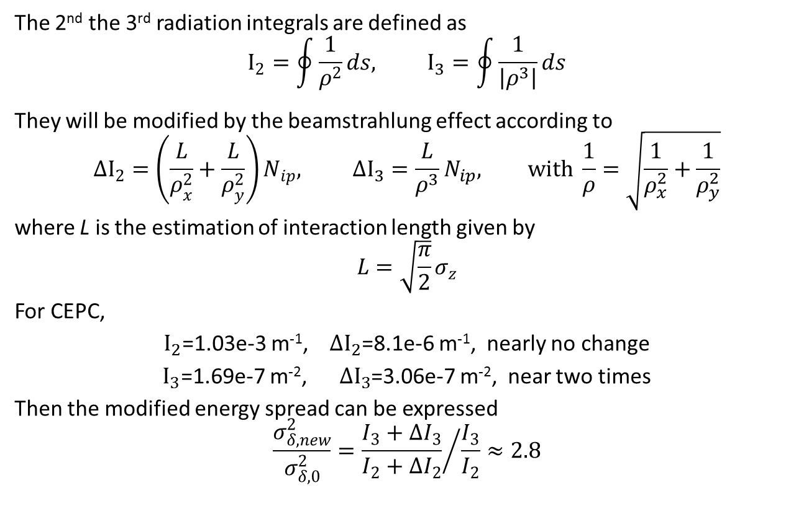
Analysis of Beamstrahlung Effect (Cont.)
The 2nd the 3rd radiation integrals are defined as
$$I_{2}=\oint{\frac{1}{ρ^{2}}}ds, I_{3}=\oint{\frac{1}{\left|ρ^{3}\right|}ds}$$
They will be modified by the beamstrahlung effect according to
$$∆I_{2}=\left(\frac{L}{ρ_{x}^{2}}+\frac{L}{ρ_{y}^{2}}\right)N_{ip}, ∆I_{3}=\frac{L}{ρ^{3}}N_{ip}, with \frac{1}{ρ}=\sqrt{\frac{1}{ρ_{x}^{2}}+\frac{1}{ρ_{y}^{2}}}$$
where L is the estimation of interaction length given by
$$L=\sqrt{\frac{π}{2}}σ_{z}$$
For CEPC,
$I_{2}$=1.03e-3 m⁻¹, ${∆I}_{2}$=8.1e-6 m⁻¹, nearly no change
$I_{3}$=1.69e-7 m⁻², ${∆I}_{3}$=3.06e-7 m⁻², near two times
Then the modified energy spread can be expressed
$$\frac{σ_{δ, new}^{2}}{σ_{δ,0}^{2}}={\frac{I_{3}+∆I_{3}}{I_{2}+∆I_{2}}}/{\frac{I_{3}}{I_{2}}}≈2.8$$

Slide 10
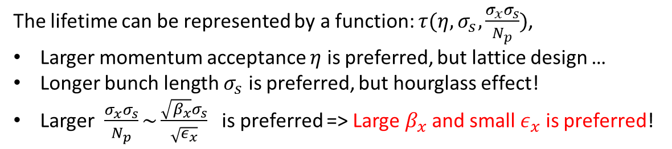
Beamstrahlung lifetime
arxiv, 1311.1580, 2013
The lifetime can be represented by a function: $τ(η, σ_{s}, \frac{σ_{x}σ_{s}}{N_{p}})$,
Larger momentum acceptance $η$ is preferred, but lattice design …
Longer bunch length $σ_{s}$ is preferred, but hourglass effect!
Larger $\frac{σ_{x}σ_{s}}{N_{p}}\sim \frac{\sqrt{β_{x}}σ_{s}}{\sqrt{ε_{x}}}$ is preferred => Large $β_{x}$ and small $ε_{x}$ is preferred!

Slide 11
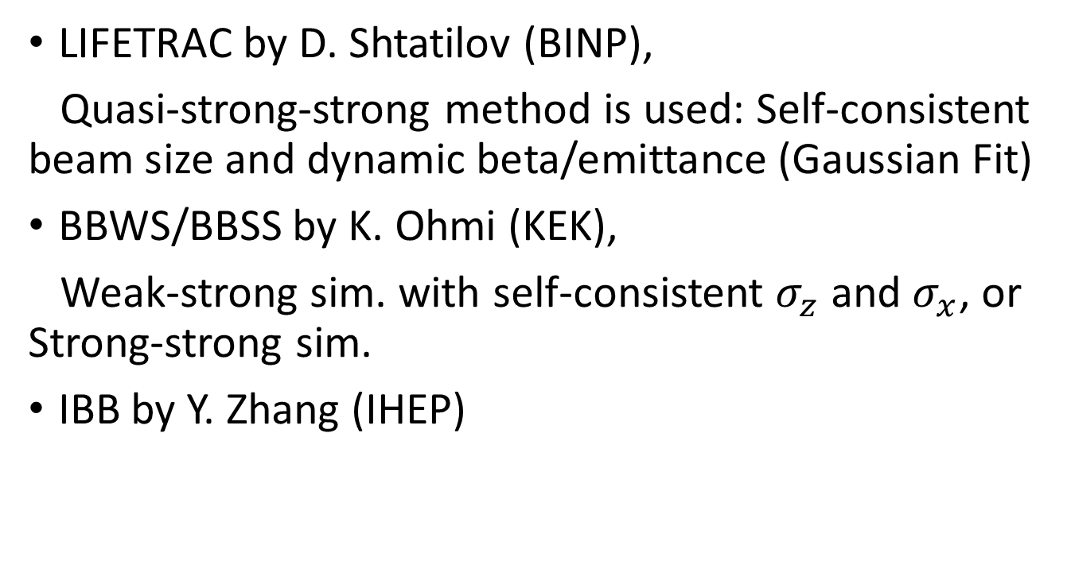
Simulation Codes
LIFETRAC by D. Shtatilov (BINP),
Quasi-strong-strong method is used: Self-consistent beam size and dynamic beta/emittance (Gaussian Fit)
BBWS/BBSS by K. Ohmi (KEK),
Weak-strong sim. with self-consistent $σ_{z}$ and $σ_{x}$, or Strong-strong sim.
IBB by Y. Zhang (IHEP)

Slide 12
Tune Scan
BBWS

Slide 13
Choice of Working Point
（0.54, 0.61)
BBWS

Slide 14
Luminonisty/Beam Sizes evaluated by Strong-Strong Simulation
Courtesy of K. Ohmi
BBSS

Slide 15
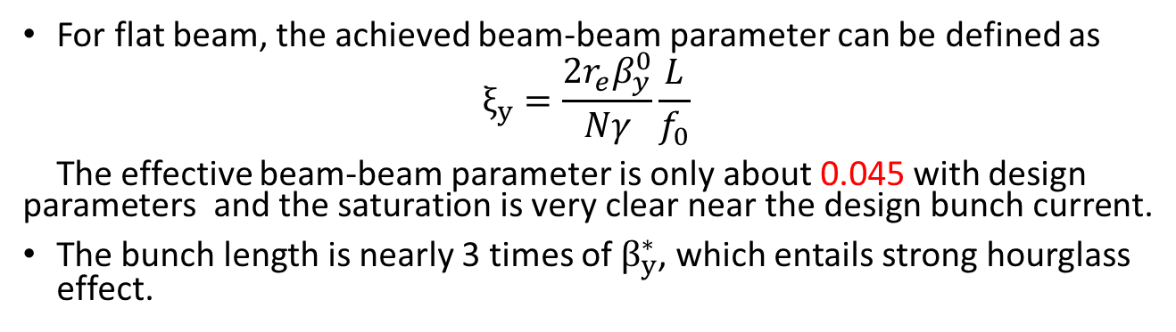
Luminosity versus bunch current
For flat beam, the achieved beam-beam parameter can be defined as
$$ξ_{y}=\frac{2r_{e}β_{y}^{0}}{Nγ}\frac{L}{f_{0}}$$
The effective beam-beam parameter is only about 0.045 with design parameters and the saturation is very clear near the design bunch current.
The bunch length is nearly 3 times of $β_{y}^{∗}$, which entails strong hourglass effect.
LIFETRAC

Slide 16
Beam-Beam Parameters evaluated with Equilibrium Beam Parameters
LIFETRAC

Slide 17
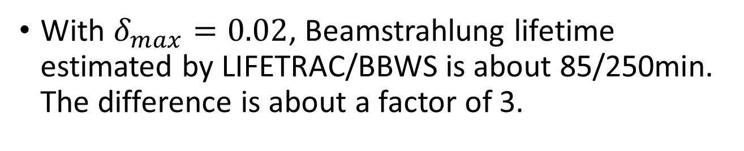
Beamstrahlung Lifetime
LIFETRAC
BBWS
With $δ_{max}=0.02$, Beamstrahlung lifetime estimated by LIFETRAC/BBWS is about 85/250min. The difference is about a factor of 3.

Slide 18
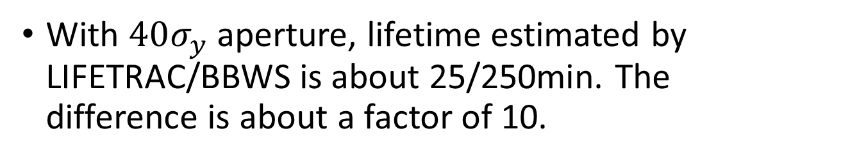
Lifetime limited by vertical dynamic paerture
With $40σ_{y}$ aperture, lifetime estimated by LIFETRAC/BBWS is about 25/250min. The difference is about a factor of 10.

Slide 19
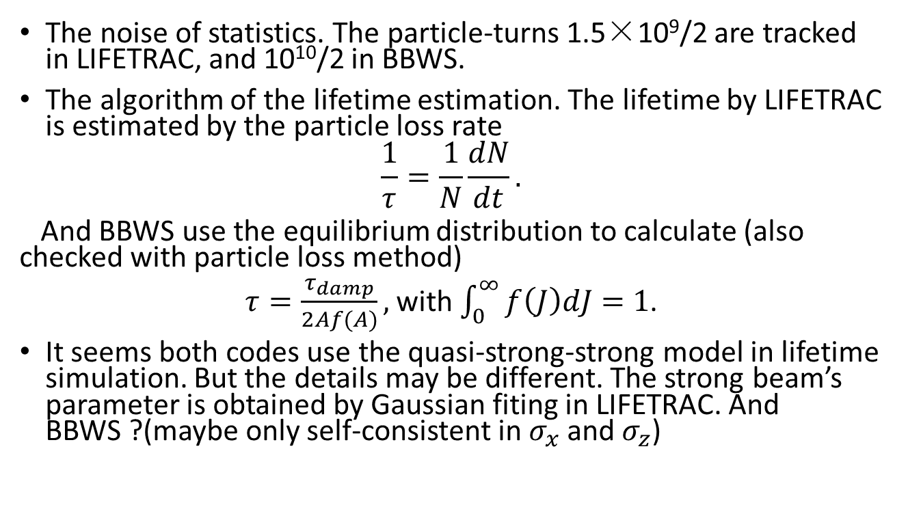
The lifetime difference may come from
The noise of statistics. The particle-turns 1.5×10⁹/2 are tracked in LIFETRAC, and 10¹⁰/2 in BBWS.
The algorithm of the lifetime estimation. The lifetime by LIFETRAC is estimated by the particle loss rate
$$\frac{1}{τ}=\frac{1}{N}\frac{dN}{dt}.$$
And BBWS use the equilibrium distribution to calculate (also checked with particle loss method)
$τ=\frac{τ_{damp}}{2Af(A)},$ with $\int_{0}^{∞}{f\left(J\right)dJ}=1$.
It seems both codes use the quasi-strong-strong model in lifetime simulation. But the details may be different. The strong beam’s parameter is obtained by Gaussian fiting in LIFETRAC. And BBWS ?(maybe only self-consistent in $σ_{x}$ and $σ_{z}$)

Slide 20
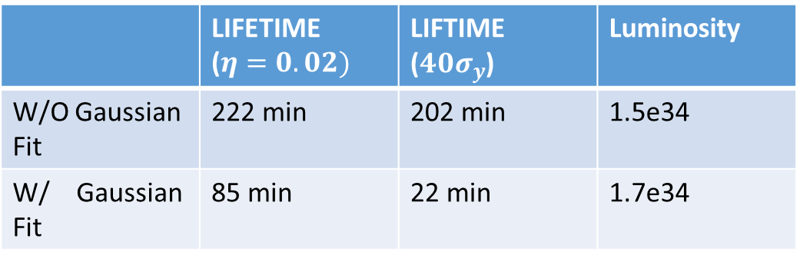
Gaussian fit in Lifetrac
 | LIFETIME ($η=0.02)$ | LIFTIME ($40σ_{y}$) | Luminosity
W/O Gaussian Fit | 222 min | 202 min | 1.5e34
W/ Gaussian Fit | 85 min | 22 min | 1.7e34

Slide 21
Turn-by-turn change of energy distribution
Courtesy of K. Ohmi
marco-particle number: 10⁷
Equilibrium
Though the tail is accumulated, the number of particles out of ±10σ are less. The beam loss just after injection does not seem serious.

Slide 22
Beam halo distribution
There is no long tail in X!

Slide 23
Asymmetric Beam Current e- beam is lost to a half intensity
Luminosity and beam sizes
BBSS
Courtesy of K. Ohmi

Slide 24
Asymmetric Beam Current one beam is lost to a half intensity
Beam halo distribution and lifetime
BBWS
Courtesy of K. Ohmi

Slide 25
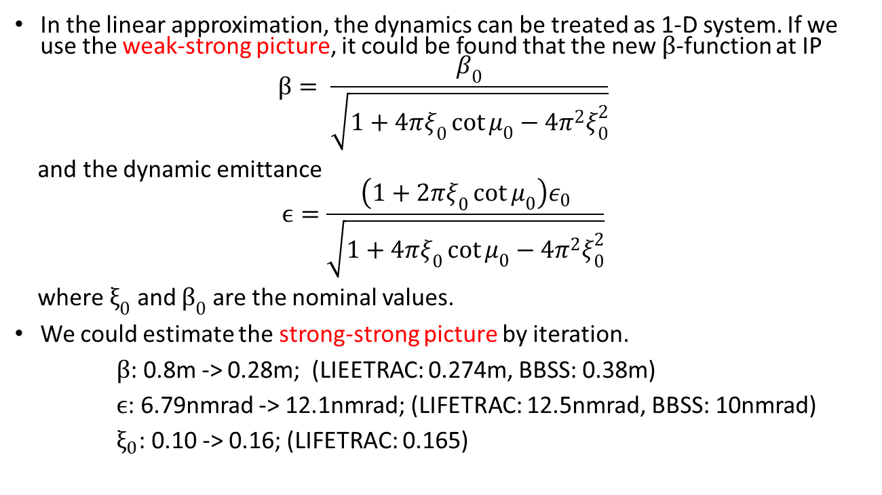
Analysis of Dynamic Effect
In the linear approximation, the dynamics can be treated as 1-D system. If we use the weak-strong picture, it could be found that the new $β$-function at IP
$$β= \frac{β_{0}}{\sqrt{1+4πξ_{0}\cot{μ_{0}}−4π^{2}ξ_{0}^{2}}}$$
and the dynamic emittance
$$ϵ=\frac{\left(1+2πξ_{0}\cot{μ_{0}}\right)ε_{0}}{\sqrt{1+4πξ_{0}\cot{μ_{0}}−4π^{2}ξ_{0}^{2}}}$$
where $ξ_{0}$ and $β_{0}$ are the nominal values.
We could estimate the strong-strong picture by iteration.
$β$: 0.8m -> 0.28m; (LIEETRAC: 0.274m, BBSS: 0.38m)
$ϵ$: 6.79nmrad -> 12.1nmrad; (LIFETRAC: 12.5nmrad, BBSS: 10nmrad)
$ξ_{0}$: 0.10 -> 0.16; (LIFETRAC: 0.165)

Slide 26
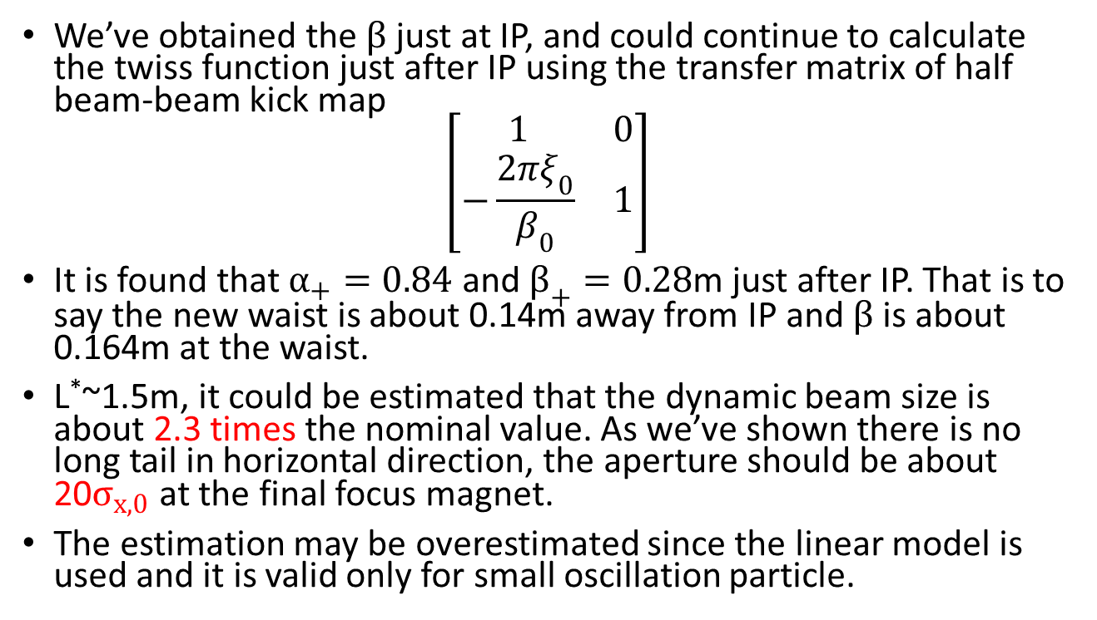
Analysis of Dynamic Effect (Cont)
We’ve obtained the$β$just at IP, and could continue to calculate the twiss function just after IP using the transfer matrix of half beam-beam kick map
$$\left[\begin{matrix}1 & 0 \\ −\frac{2πξ_{0}}{β_{0}} & 1\end{matrix}\right]$$
It is found that $α_{+}=0.84$ and $β_{+}=0.28$m just after IP. That is to say the new waist is about 0.14m away from IP and $β$ is about 0.164m at the waist.
L*~1.5m, it could be estimated that the dynamic beam size is about 2.3 times the nominal value. As we’ve shown there is no long tail in horizontal direction, the aperture should be about 20$σ_{x,0}$ at the final focus magnet.
The estimation may be overestimated since the linear model is used and it is valid only for small oscillation particle.

Slide 27
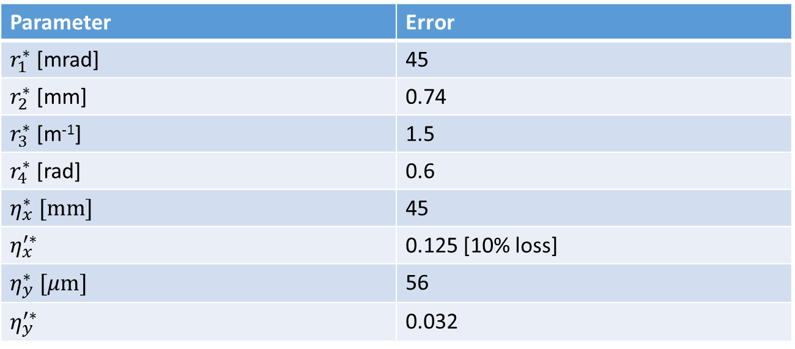
Error Tolerance with 20% luminosity degradation
Parameter | Error
$r_{1}^{∗}$ [mrad] | 45
$r_{2}^{∗}$ [mm] | 0.74
$r_{3}^{∗}$ [m⁻¹] | 1.5
$r_{4}^{∗}$ [rad] | 0.6
$η_{x}^{∗} [mm]$ | 45
$η_{x}^{′∗}$ | 0.125 [10% loss]
$η_{y}^{∗} [μm]$ | 56
$η_{y}^{′∗}$ | 0.032

Slide 28
Effective beam-beam parameter due to finite bunch length

Slide 29

Different $β_{y}^{∗}$ - luminosity
Geometrical beam-beam tune shift
Geometrical and Simulated luminosity
BBSS
Courtesy of K. Ohmi

Slide 30
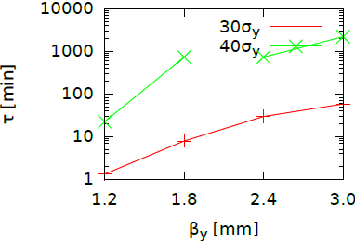

Different $β_{y}^{∗}$ - lifetime
LIFETRAC

Slide 31
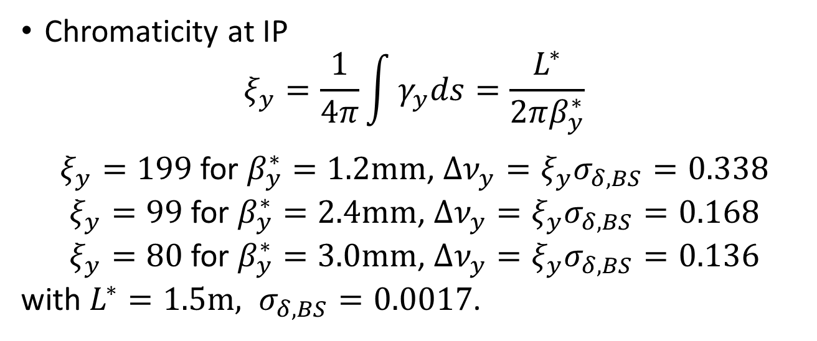

Different $β_{y}^{∗}$ - Chromaticity
Chromaticity at IP
$$ξ_{y}=\frac{1}{4π}\int{γ_{y}ds}=\frac{L^{∗}}{2πβ_{y}^{∗}}$$
$ξ_{y}=199$ for $β_{y}^{∗}=1.2mm$, $Δν_{y}=ξ_{y}σ_{δ,BS}=0.338$
$ξ_{y}=99$ for $β_{y}^{∗}=2.4mm$, $Δν_{y}=ξ_{y}σ_{δ,BS}=0.168$
$ξ_{y}=80$ for $β_{y}^{∗}=3.0mm$, $Δν_{y}=ξ_{y}σ_{δ,BS}=0.136$
with $L^{∗}=1.5m, σ_{δ,BS}=0.0017$.

Slide 32
Beam tilt due to transverse wakefield
Courtesy of N. Wang
The bunch tail receives a transverse kick due to transverse impedance.
The kick for a particle at longitudinal position z is calculated by,
Horizontal pretzel orbit： x_{b}=5mm
Vertical closed orbit： y_{b}=1mm

Slide 33
(D. Zhou, K. Ohmi, A. Chao, IPAC2011, p.601)
(B. Zotter, EPAC1992, p.273)
The impedance is assumed to be localized at one point in the ring → Distributed impedance will reduce this effect.
Average beta function is used instead of that at the location of impedance → Smaller beta function can reduce this effect.
Courtesy of N. Wang
Notes:
“To obtain an accurate estimate, we will need to know the SuperB impedances, and to know the distribution of these impedances.”
33

Slide 34
Collision with beam tilt
Y
We could insert a broad band impedance model in the beam-beam simulation code. But now, we only estimate the beam tilt effect using a crab crossing model.

Slide 35
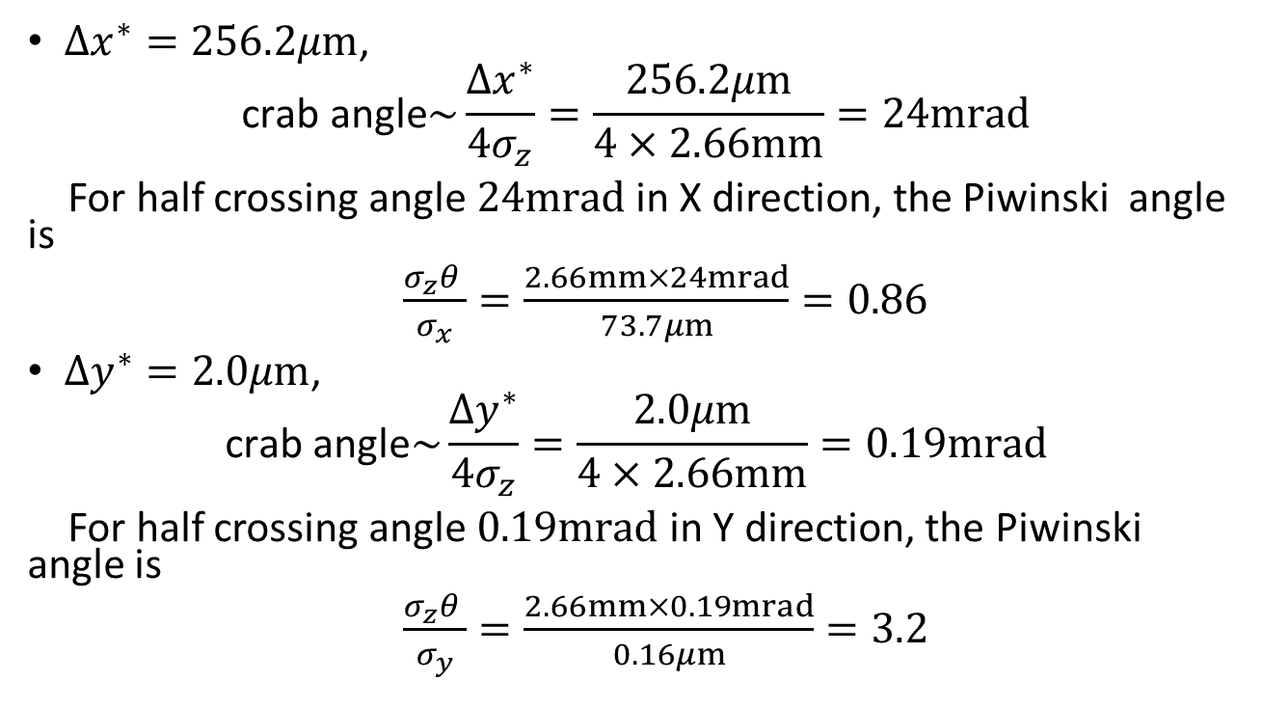
“Crab angle” of beam tilt
$Δx^{∗}=256.2μm$,
$$\text{crab} \text{angle}\sim \frac{Δx^{∗}}{4σ_{z}}=\frac{256.2μm}{4×2.66mm}=24mrad$$
For half crossing angle $24mrad$ in X direction, the Piwinski angle is
$\frac{σ_{z}θ }{σ_{x}}=\frac{2.66mm×24mrad}{73.7μm}=0.86$
$Δy^{∗}=2.0μm$,
$$\text{crab} \text{angle}\sim \frac{Δy^{∗}}{4σ_{z}}=\frac{2.0μm}{4×2.66mm}=0.19mrad$$
For half crossing angle $0.19mrad$ in Y direction, the Piwinski angle is
$\frac{σ_{z}θ }{σ_{y}}=\frac{2.66mm×0.19mrad}{0.16μm}=3.2$

Slide 36
Simulation of beam tilt with crab angle

Slide 37
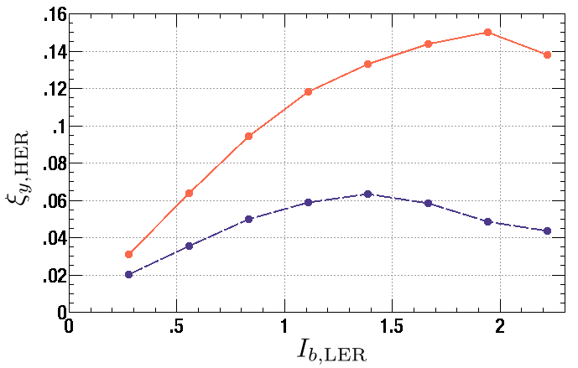
Discussion on beam tilt
Is it possible to suppress the luminosity loss coming from beam tilt by tuning the crossing angle with electrostatic separator or just use a crab cavity to weaken the tilt at IP?
Head-on (crab)
22mrad crossing angle
KEKB

Slide 38
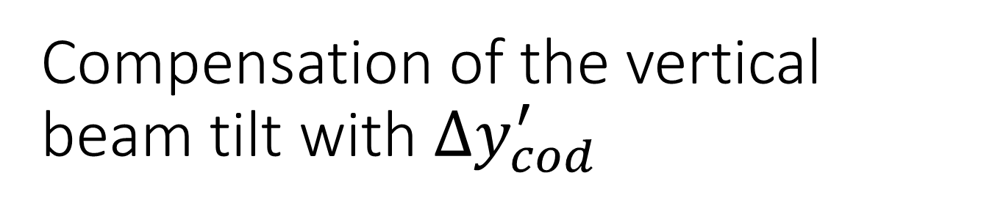
Compensation of the vertical beam tilt with $Δy_{cod}^{′}$

Slide 39
Maybe another case of Collision with beam tilt
Y

Slide 40
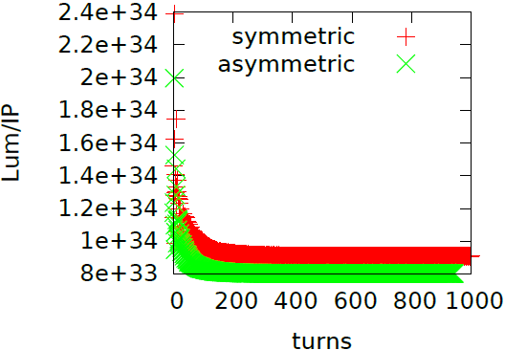
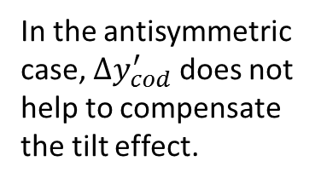
Simulation of beam tilt with antisymmetric crab angle
0.1mrad in Y
In the antisymmetric case, $Δy_{cod}^{′}$ does not help to compensate the tilt effect.

Slide 41
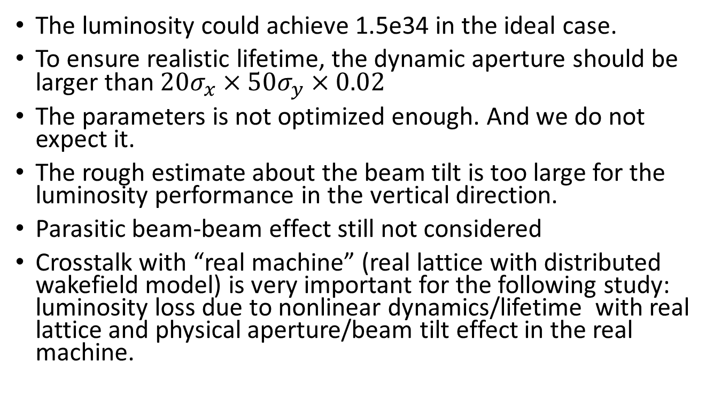
Summary & Discussion
The luminosity could achieve 1.5e34 in the ideal case.
To ensure realistic lifetime, the dynamic aperture should be larger than $20σ_{x}×50σ_{y}×0.02$
The parameters is not optimized enough. And we do not expect it.
The rough estimate about the beam tilt is too large for the luminosity performance in the vertical direction.
Parasitic beam-beam effect still not considered
Crosstalk with “real machine” (real lattice with distributed wakefield model) is very important for the following study: luminosity loss due to nonlinear dynamics/lifetime with real lattice and physical aperture/beam tilt effect in the real machine.

