Slide 1



Shielding of the Electronics in the Tunnel
L.S. Esposito, M. Brugger, F. Cerutti, A. Ferrari, R. Losito

Slide 2
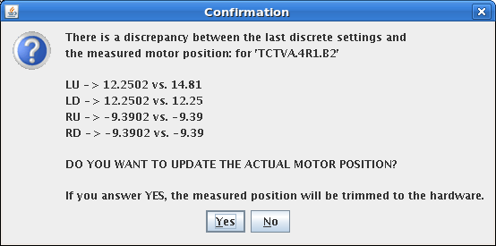
What are we talking about?
memory bit flit in collimator controls

Slide 3
What are we talking about?
CNGS 2007 physics run, 8 10¹⁷ p.o.t. delivered ( ≈2% of a nominal CNGS year )
Gy per 4.5 10¹⁹ p.o.t.
Predicted dose levels
in agreement with measurements
Electronics
Ventilation Units
CV,crane,
fire
Single event upsets in ventilation electronics caused ventilation control failure and interruption of communication

Slide 4
Outline
Introduction to Radiation to Electronics (R2E)
  Radiation environment and sources
  Radiation effects
  Radiation levels
Case study for FCC-ee
Conclusions

Slide 5
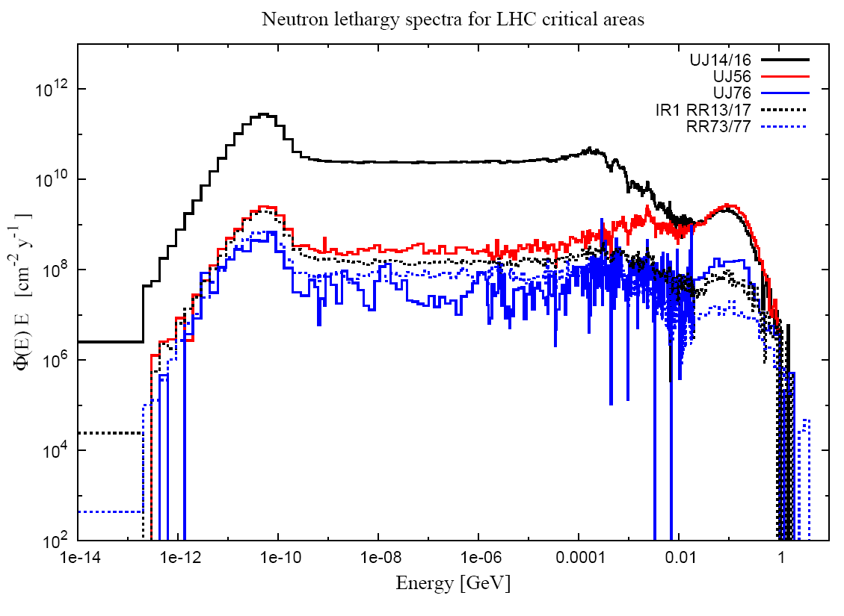
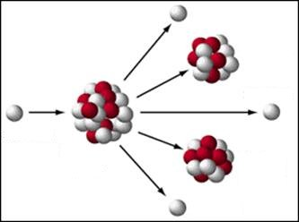
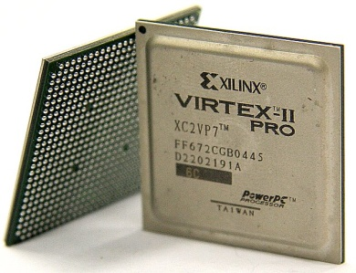
Ingredients for R2E studies
ELECTRONIC
COMPONENTS
RADIATION
ENVIRONMENT
PHYSICS
MODELS
RADIATION EFFECTS
ANALYSIS
TESTS
MITIGATION

Slide 6
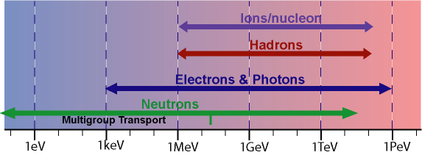
High-Energy Particle Interactions

Slide 7
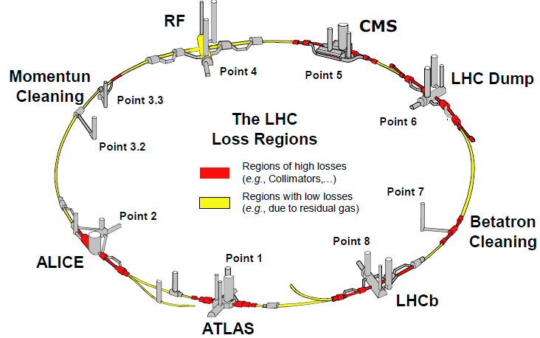
Radiation Areas and Sources
Source of Radiation
Direct Losses
  collimators and collimator like objects injection, extraction, dump
  levels scale with beam intensity
Collisions
  around experimental areas
  scale with luminosity
Beam-Residual-Gas
  all areas along the ring
  scales with both intensity and residual gas density

Slide 8
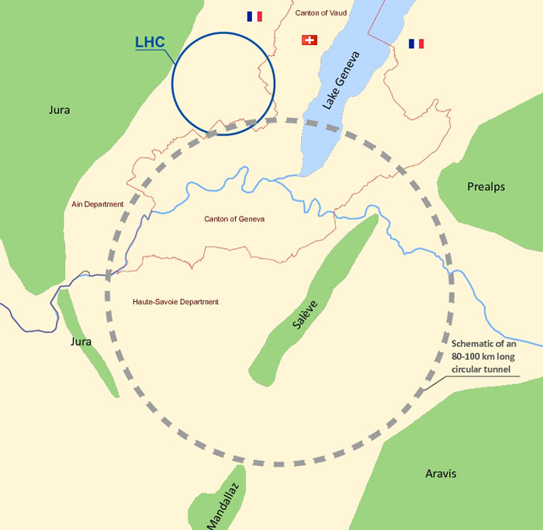
Radiation source for lepton machine
  Synchrotron Radiation
  along bending dipole
  scales with beam intensity and energy
An outline plan for a future tunnel in Geneva that could house a 80–100 km particle collider. (Courtesy: CERN)

Slide 9
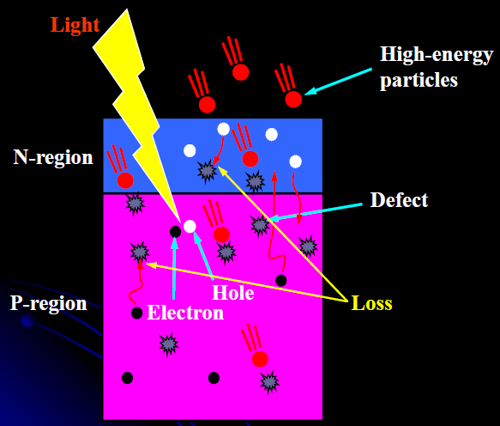
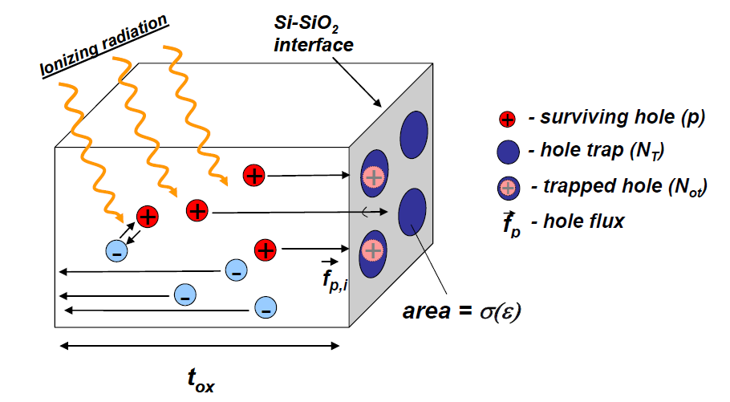
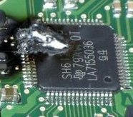
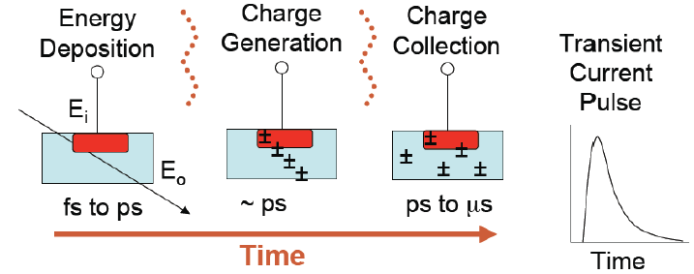

Electronics: Radiation Effects
TID. Total Ionizing Dose
DD. Displacement damage
SEE. Single event effect
Stochastic
Immediate effects
Bit flip, rupture…
EFFECTS
SEE
DD
TID
Single Events
Cumulative
Effects with time
Critical for injection lines
From performance worsening… to damage

Slide 10
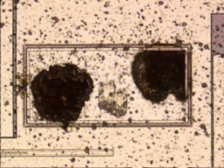
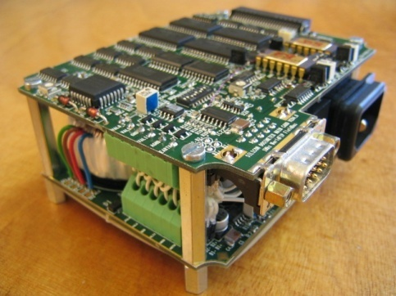
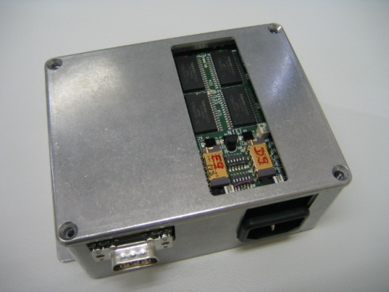
Radiation Physics/Effects/Monitoring
radiation damage in semiconductors
nuclear cascade
Single Events
h > 20 MeV
Effect in
the Device
Radiation Field
h, e,.. > 100 KeV
Displacement
Dose
EM cascade
Radiation Monitor
SEU counter
Measurement
Radfet
PIN Diodes

Slide 11
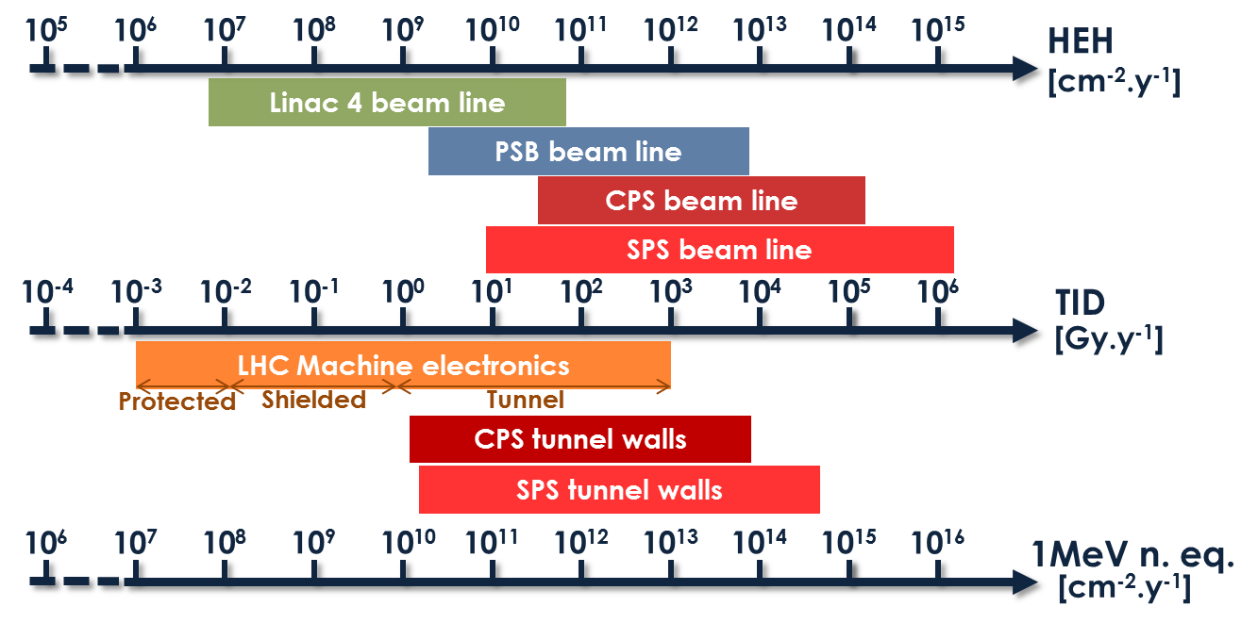
CERN Radiation Levels
Sea Level
Avionic
ISS
Space & Deep Space
R2E
Single-Event
Effects
CNGS
Failure
Material
Damage
R2E
Cumulative Damage
LHC + Experiments
COTS Systems
Hardened Electronics
Electronics
Custom Boards with COTS
Damage

Slide 12
Mitigation Options
RELOCATION
SHIELDING
RAD-TOL DESIGN
CIVIL ENGINEERING

Slide 13
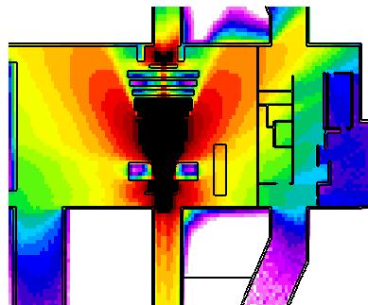
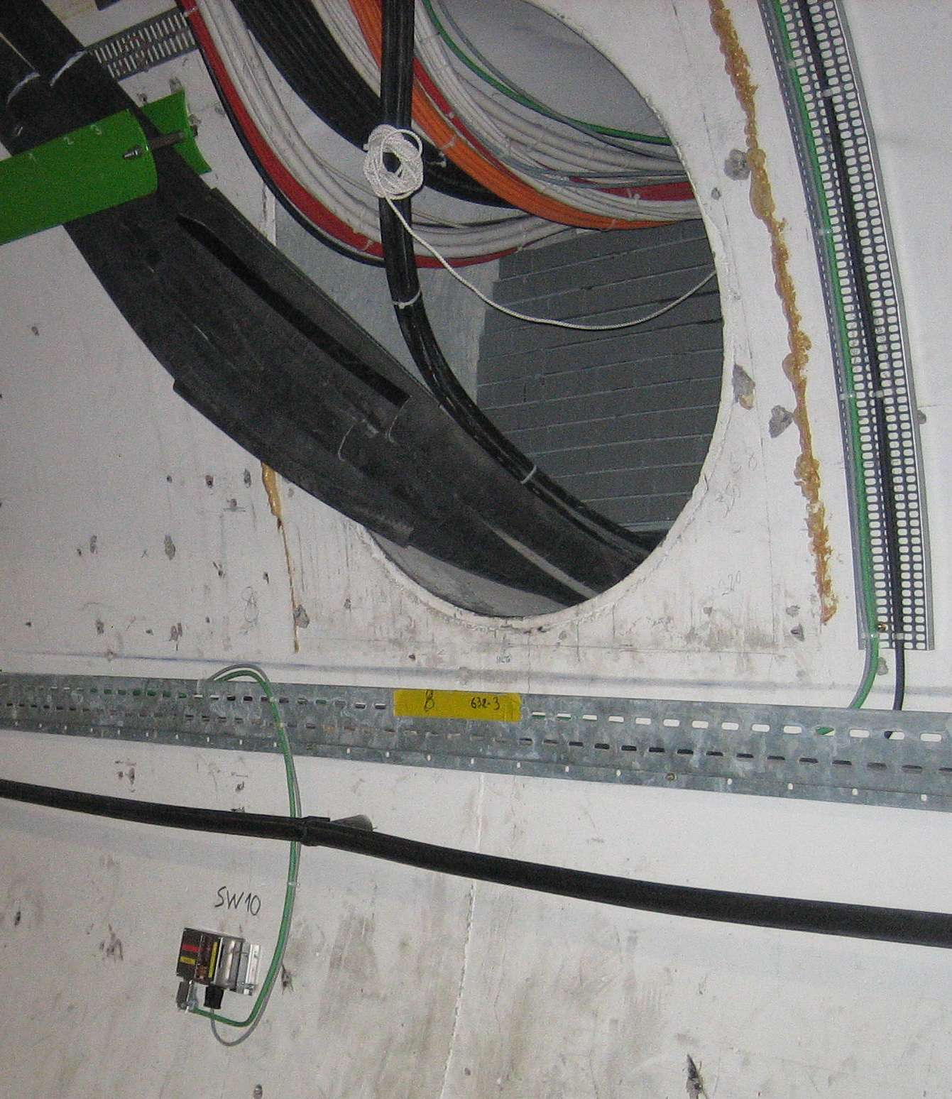
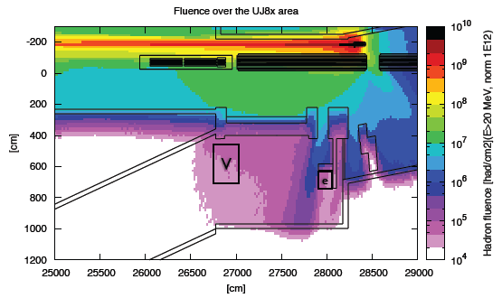
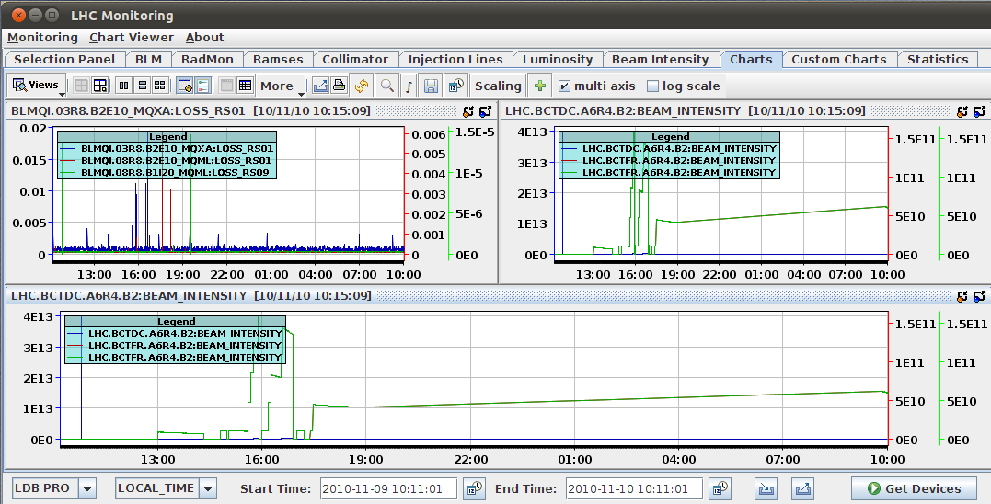
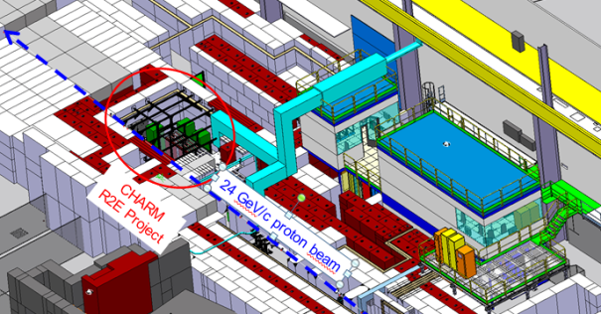
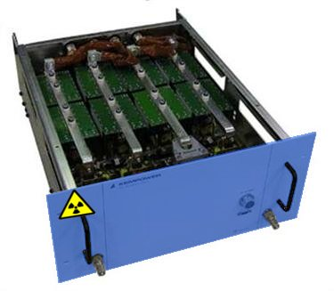
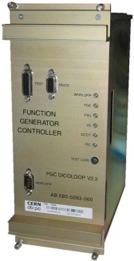
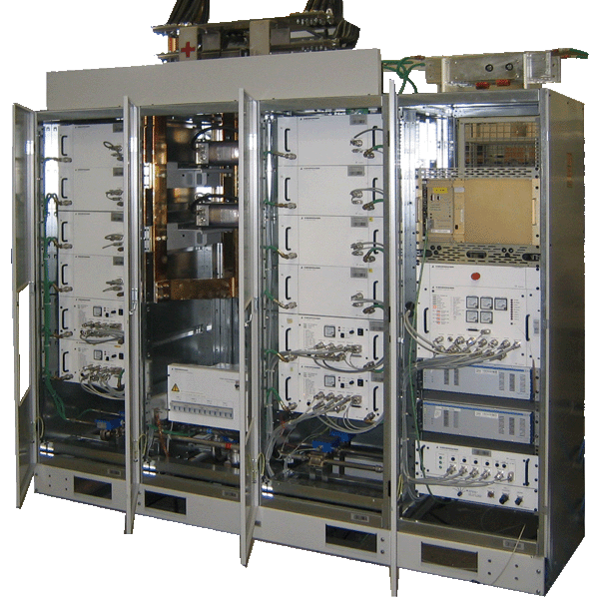
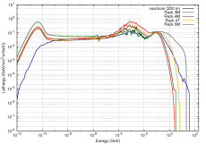
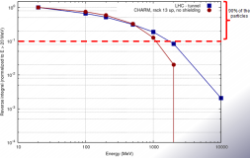
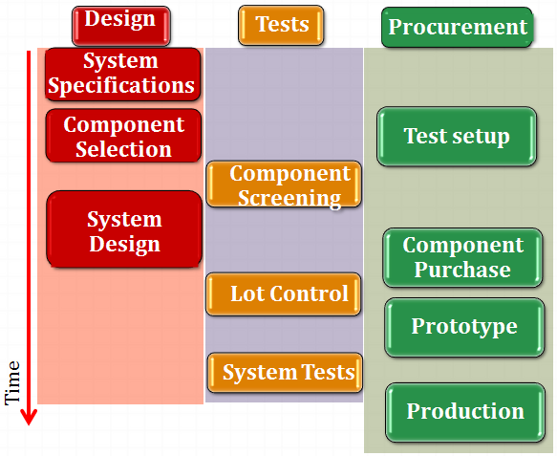
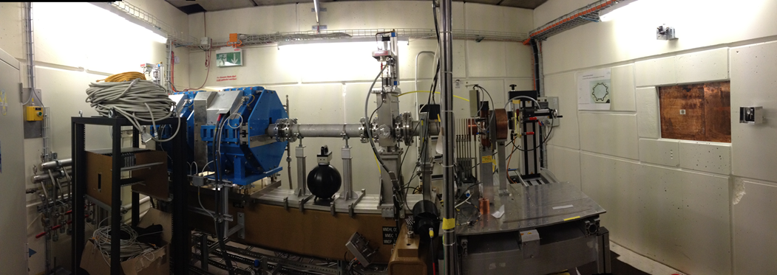
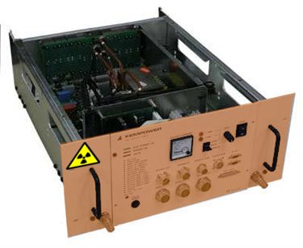
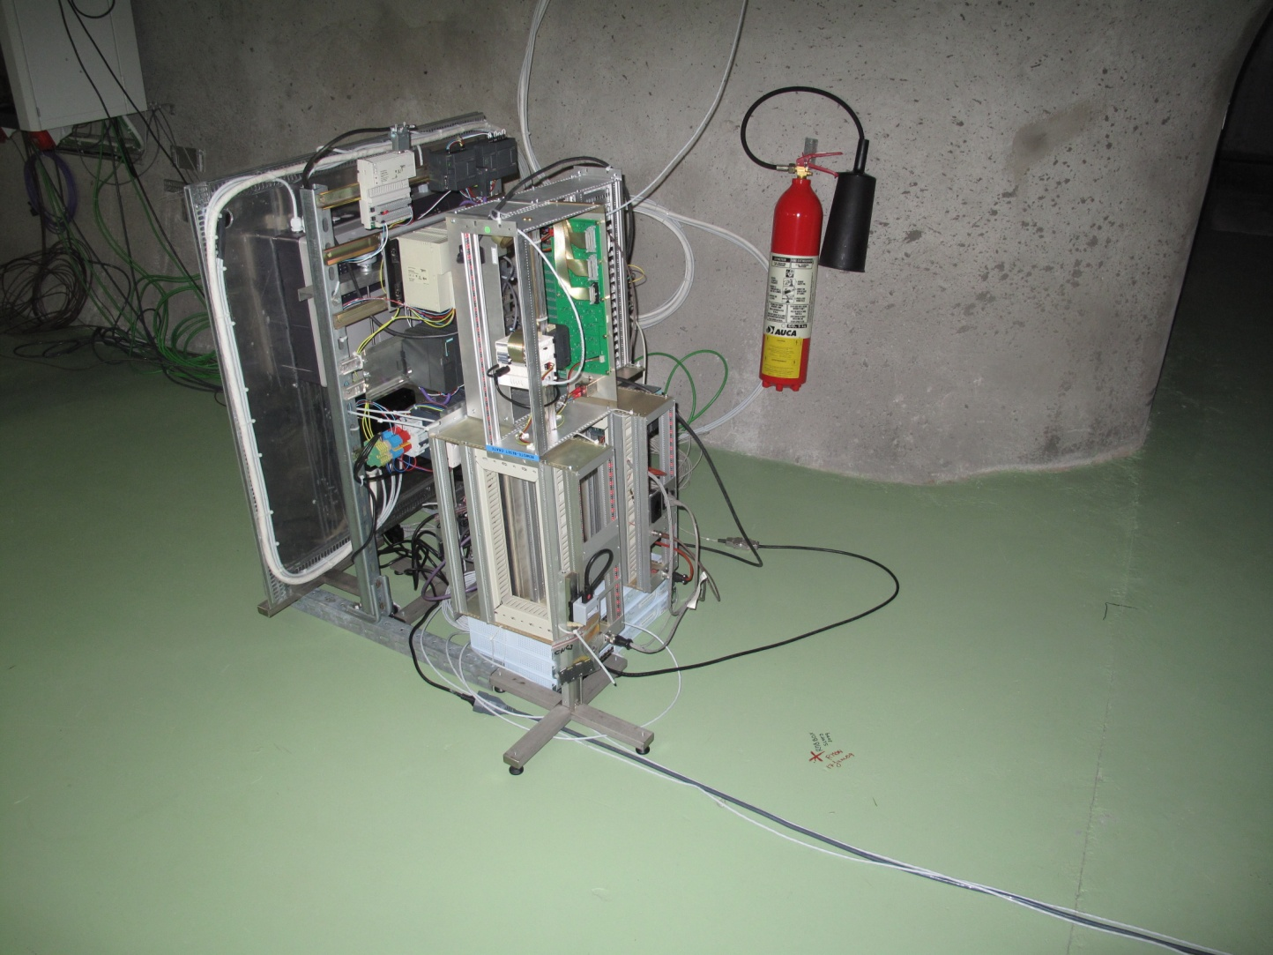
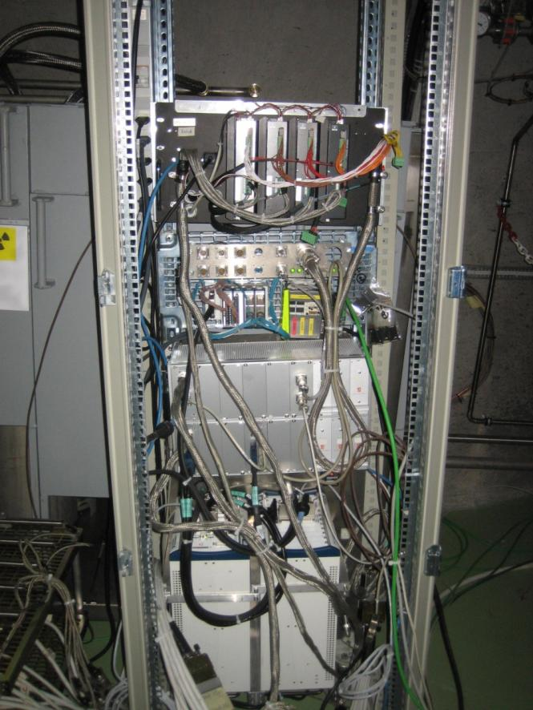
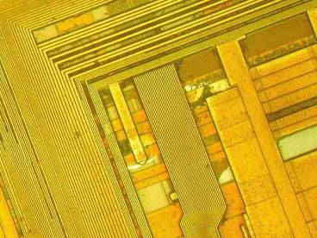
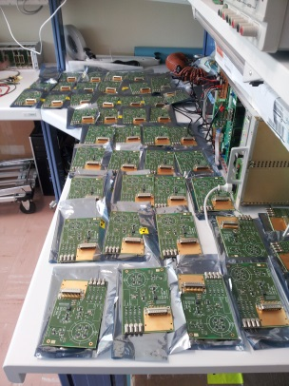
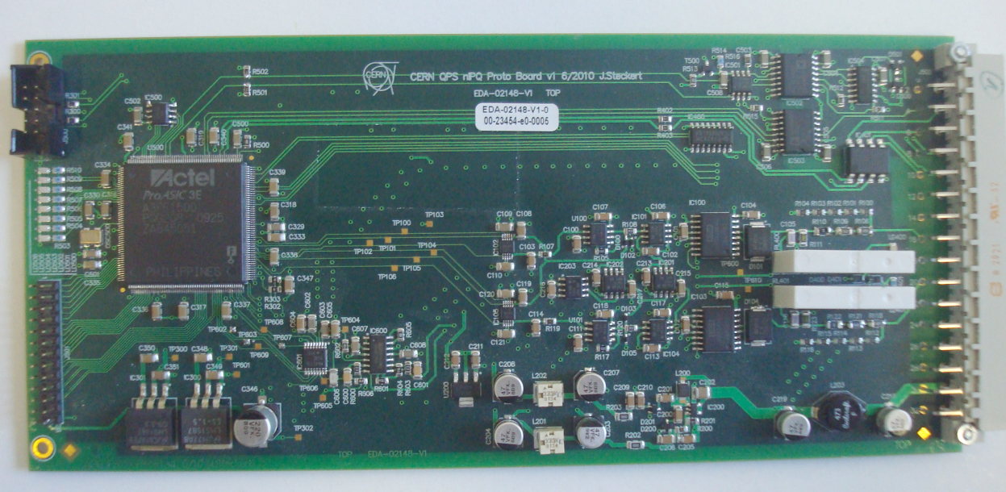
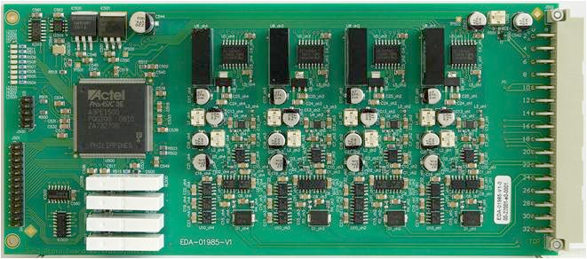
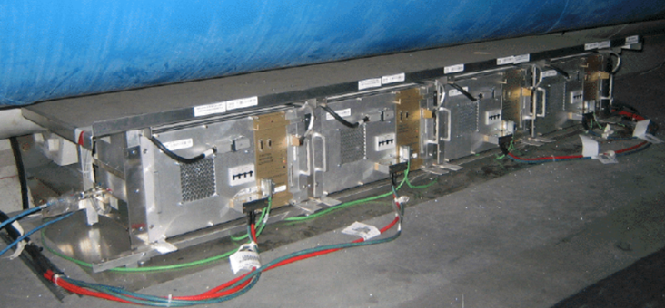
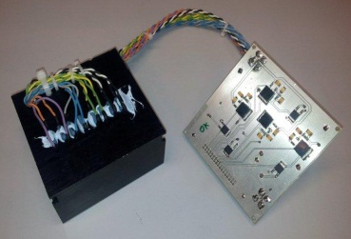
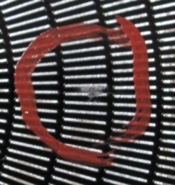
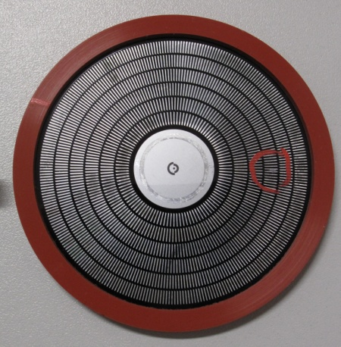
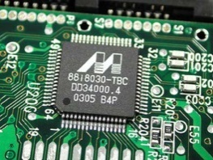
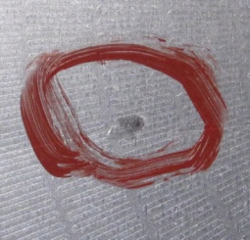
R2E Project Building Blocks
Radiation Monitoring
Calculations
Test Facilities
Developments
Radiation Tests
Production & Implementation

Slide 14
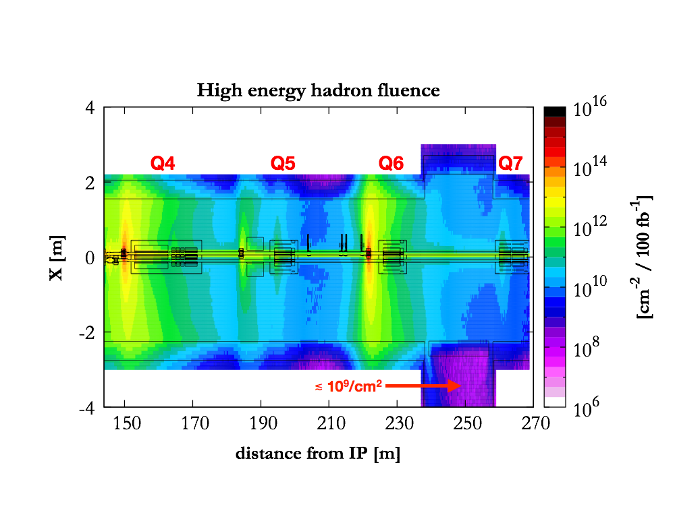
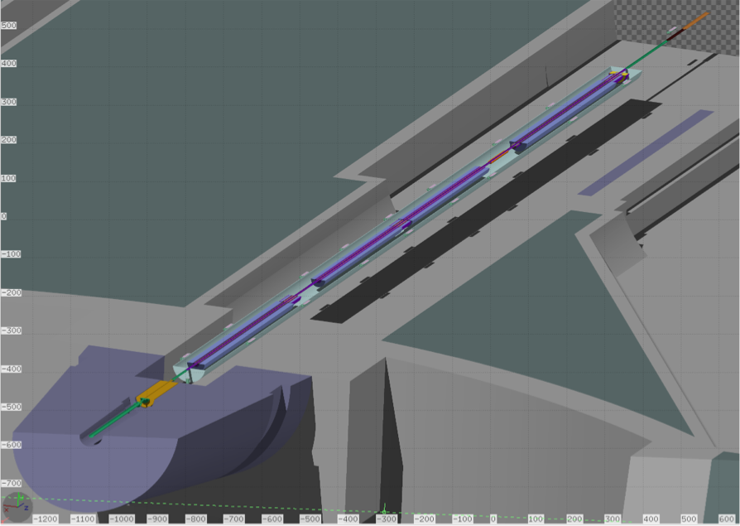
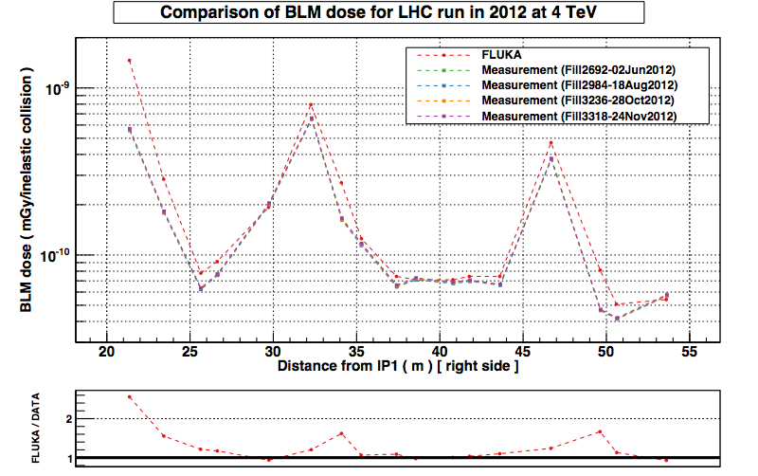
Selected energy deposition studies for LHC
FLUKA model for LHC right P1
 | Hadron > 20 MeV [cm⁻²]
 | RM08S | RM09S
FLUKA | 6.1×10⁸ | 3.0×10⁷
DATA | 4.56×10⁸ (25 upsets) | 4.32×10⁷ (25 upsets)
The agreement is within 30%!!!
Courtesy of N.V. Shetty, EN-STI-EET, CERN
Normalized at total integrated luminosity in 2012 operation

Slide 15
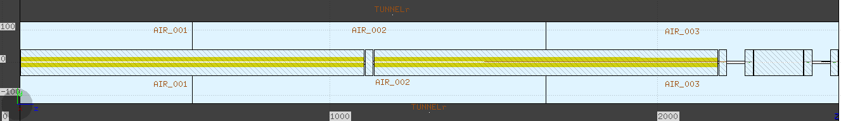
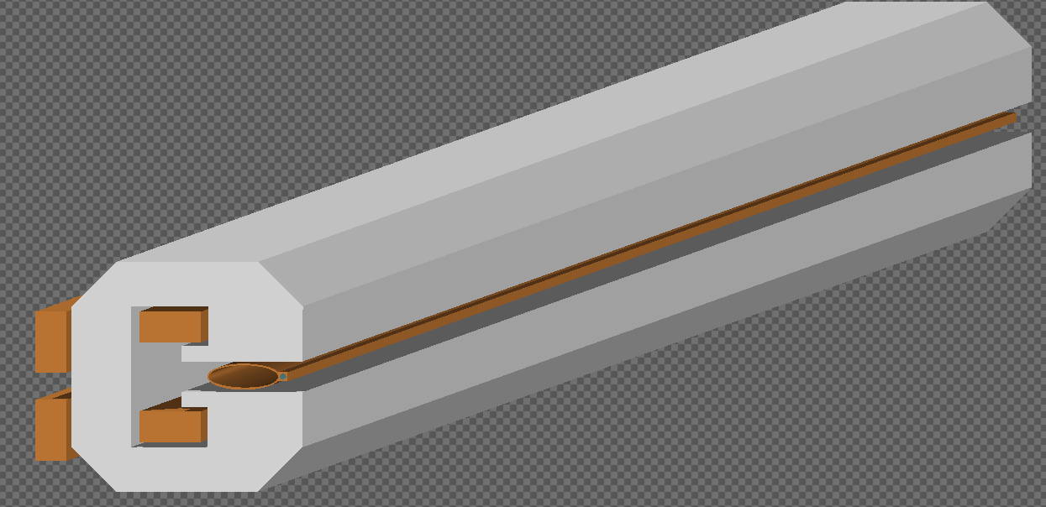
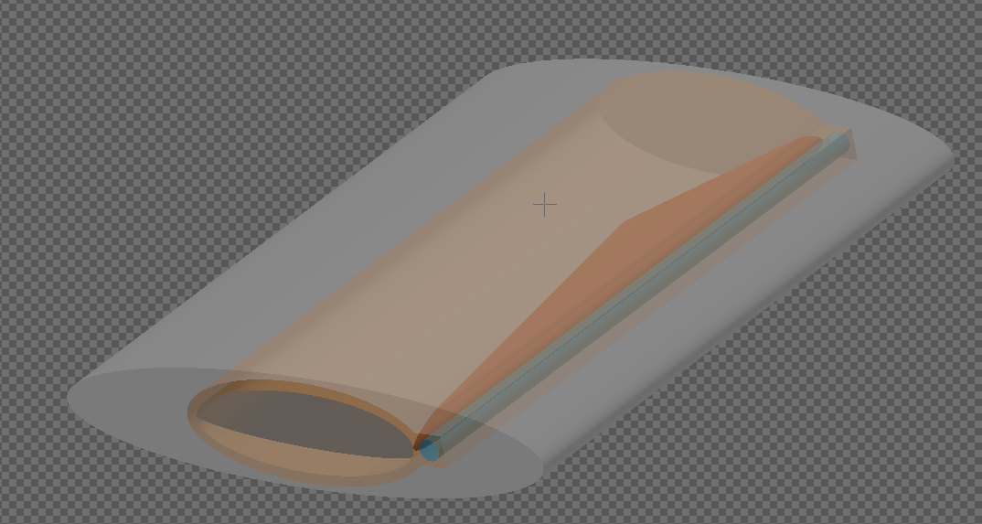
FCC arc cell model in FLUKA
1.5 m
Q
To be considered as a case study of a possible FCC cell
10.5 m dipole
Iron + plastic
24 cm absorber
25 mm
Copper (2mm tube)
water cooling
Lead
Ref: L.Lari et al., IPAC2014, THPRI011

Slide 16
Synchrotron radiation: generalities

Slide 17
Synchrotron radiation: FCC-ee case
E>100 eV
99.99964% of the total power
95.75% of the photon amount
<E>=395 keV
ΔE= 8.5 GeV/turn (dE/ds=1.375 keV/cm in the dipoles)
P = 8.5 x I[mA] MW = 8.5 x 10mA = 85 MW in the whole accelerator
(dP/ds= 1.375 x I[mA] W/cm in the dipoles)

Slide 18
Radiation field in the FCC tunnel
Neutrons from photo-nuclear interactions

Slide 19
SEE
SEEs to be considered (depending on the location), but nothing which is not unsolvable

Slide 20
NIEL
Dominated by e.m. component
Not to be considered as limiting factor

Slide 21
TID
Above 100 kGy, electronics damage must be considered
  optical fibers might degrade
  cables can get problems
  some organic materials are to be avoided
Notes:
§ PMMA (Plexiglas) < 50 kGy
§ Butyle based Caoutchoucs < 30 kGy
§ Perfluoro-ethylène-propylène (FEP) < 30 kGy
§ Acetal Resins (POM) (Delrin) < 10 kGy
§ PTFE (Teflon) < 1 kGy

Slide 22
Radiation levels in FCC-e⁺e⁻
FCC-e⁺e⁻
LHC + Experiments
FCC-e⁺e⁻
FCC-e⁺e⁻
COTS Systems
Hardened Electronics
Electronics
Custom Boards with COTS
Damage
22

Slide 23
Conclusions
R2E represents a crucial issue to be taken into account as design criterion of any high energy and intensity machine
The R2E project at CERN allowed to create a diffuse knowledge and expertise covering all the aspects of radiation hardening
A case study for HF-e+e- was presented
TID effect has to be mitigated through a carefully shielding design

Slide 24
Backup

Slide 25
Relevant FLUKA capabilities
Sophisticated low energy photon transport including polarization effects for Compton, photoelectric and coherent scattering, and full account for bound electron effects: already available in FLUKA since several years
New: dedicated “generic” source for SR radiation accounting for:
  Spectrum sampling
  Polarization as a function of emitted photon energy
  Angular distribution
  Arbitrary orientation emitting particle vs magnetic field
  Photon emission along arcs/helical paths

Slide 26
Energy deposition on FCC elements
normalized to
10 mA beam current
24 cm absorber
25 mm
Lead

Slide 27
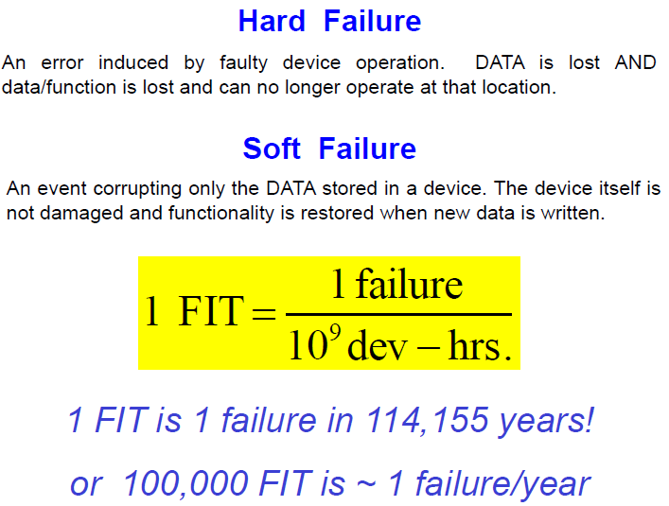
Reliability & Radiation
Notes:
FIT = Failure In Time

Slide 28
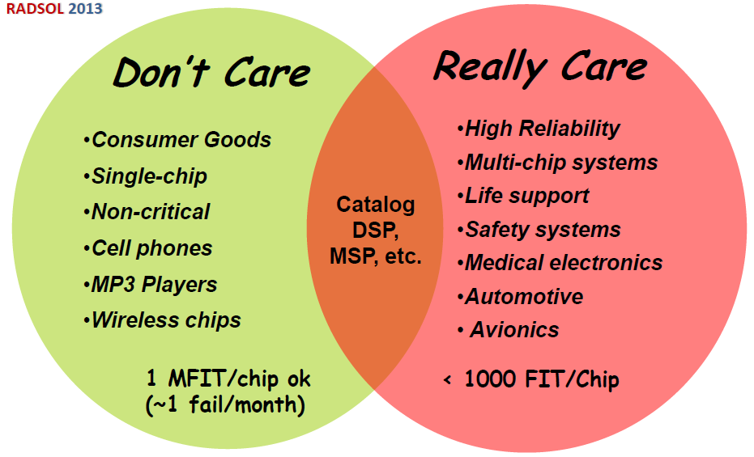
Required Reliability
© R. Baumann
LHC: few thousand electronic units exposed
Aim: less than one radiation induced failure per operational week
Reliability in FIT: -> aiming for few FITs/SYSTEM!
Per Chip? (better don’t do it)

Slide 29
R2E Qualification Steps
Radiation tests are part of any new development
Rad constraints to be considered from day-0
REQUIREMENTS
Electrical/system
Radiation environment and effects
Timeline
DESIGN
Specifications
Selection
Design
TEST
System
Component
Qualification
PROCUREMENT
Test boards
Prototype
Production
Complexity
Time
10-Oct-14

Slide 30
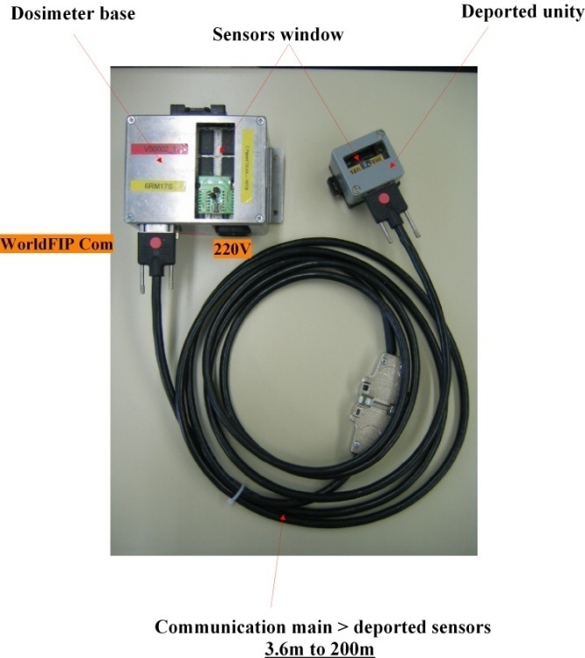
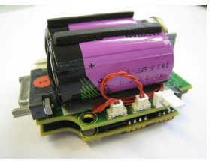


RadMon System in the LHC
Online (through WorldFIP) and
Standalone version
Deported unit (for TID/1MeV)
3 types of sensors:
  RadFets (NMRC) for TID
  PIN diodes (Siemens) for 1MeV n eq.
  SRAMs for high-E hadron fluence
  (SEEs)
System of ~400 online radiation monitors
Several detailed calibration campaigns
  thermal neutron response and intermediate
  energy (few MeV) neutrons
  additional RadFet calibration (& batch) tests
  Additional 1MeV verifications

Slide 31




Test Facilities
Standard facilities
  PSI. Proton beam
  (>15 tests per year, see 2013 list)
  CEA, Fraunhofer. Displacement
  damage (few tests per year)
  Fraunhofer. Co-60. Total Ionizing
  dose (blanket contract:>10/y)
In-house
  (CNRAD, H4IRRAD)
  CHARM (soon operational)
    A unique test facility for CERN
    and external institutes/groups/customers
  Co-60 (under construction)
Coordination and Operation
    >20 equipment groups affected
EFFECTS
SEE
DD
TID
PSI
Co60 source
CEA

