Slide 1
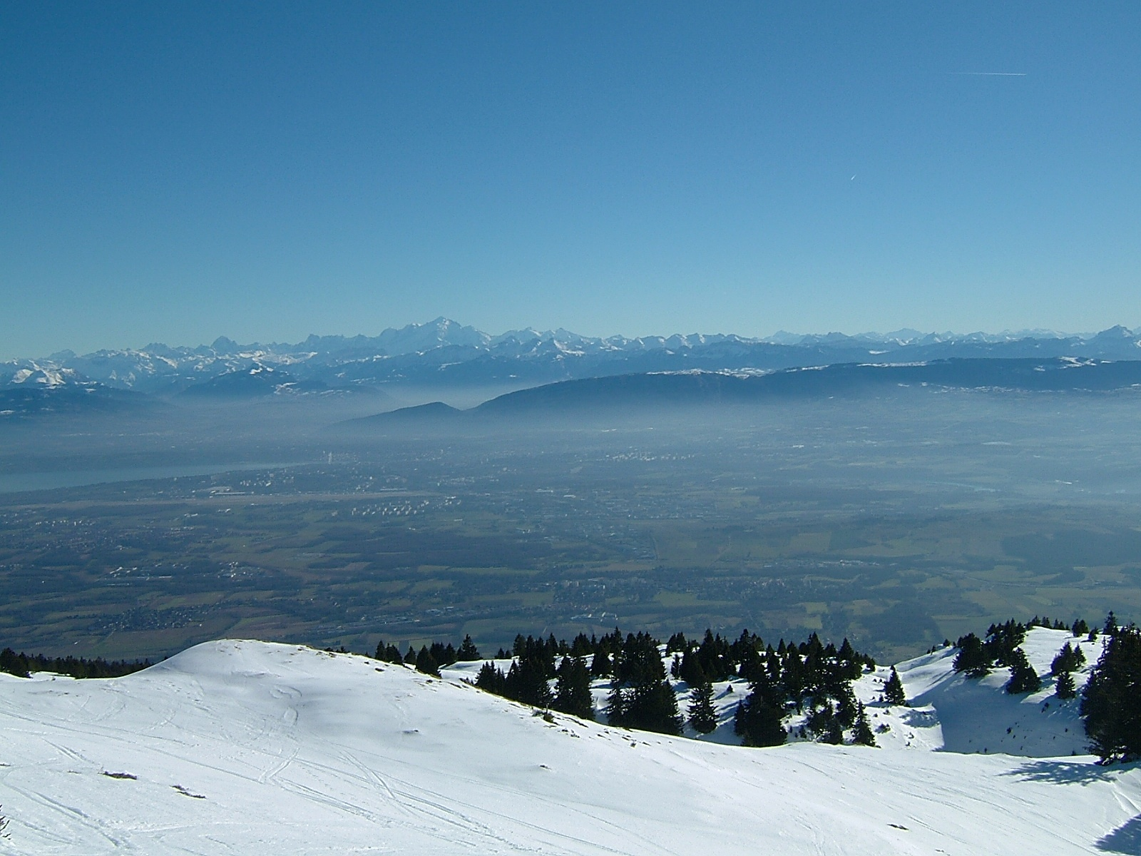


Overview FCC-ee
Frank Zimmermann for the FCC team
Thanks to Michael Benedikt, Alain Blondel, Bastian Harer, Bernhard Holzer, Giovanni Iadarola, Max Klein, Mike Koratzinos, Katsunobu, Oide, Philippe Lebrun, Roman Martin, Kazuhito Ohmi, Daniel Schulte, Rogelio Tomas, Jörg Wenninger, Uli Wienands,..
Work supported by the European Commission under Capacities 7th Framework Programme, Grant Agreement 312453

Slide 2
circular colliders & storage rings
…
CESR
BEPC
LEP
Tevatron
LEP2
HERA
DAFNE
PEP-II
KEKB
BEPC-II
LHC
SuperKEKB (soon)
3rd generation light sources
since 1960 ~30 ring colliders successfully built & operated
1992 ESRF, France (EU) 6 GeV
ALS, US 1.5-1.9 GeV
1993 TLS, Taiwan 1.5 GeV
1994 ELETTRA, Italy 2.4 GeV
PLS, Korea 2 GeV
MAX II, Sweden 1.5 GeV
1996 APS, US 7 GeV
LNLS, Brazil 1.35 GeV
1997 Spring-8, Japan 8 GeV
1998 BESSY II, Germany 1.9 GeV
2000 ANKA, Germany 2.5 GeV
SLS, Switzerland 2.4 GeV
2004 SPEAR3, US 3 GeV
CLS, Canada 2.9 GeV
2006: SOLEIL, France 2.8 GeV
DIAMOND, UK 3 GeV
ASP, Australia 3 GeV
MAX III, Sweden 700 MeV
Indus-II, India 2.5 GeV
2008 SSRF, China 3.4 GeV
2009 PETRA-III, Germany 6 GeV
2011 ALBA, Spain 3 GeV
+ many more e± storage-ring light sources (with ever smaller transverse emittance)
well understood technology &
typically exceeding design performance
within a few years

Slide 3
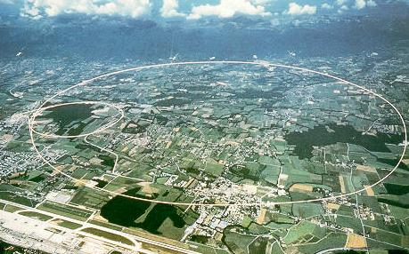
LEP – highest energy e⁺e⁻ collider so far
maximum c.m. energy 209 GeV
maximum synchrotron radiation power 23 MW

Slide 4
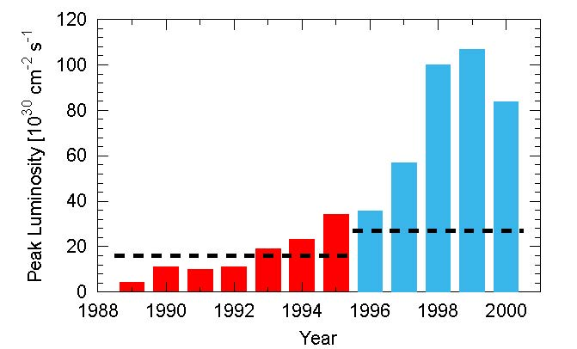
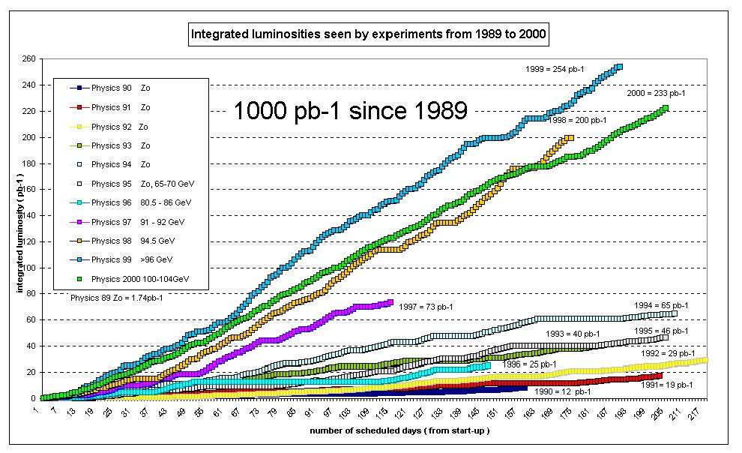
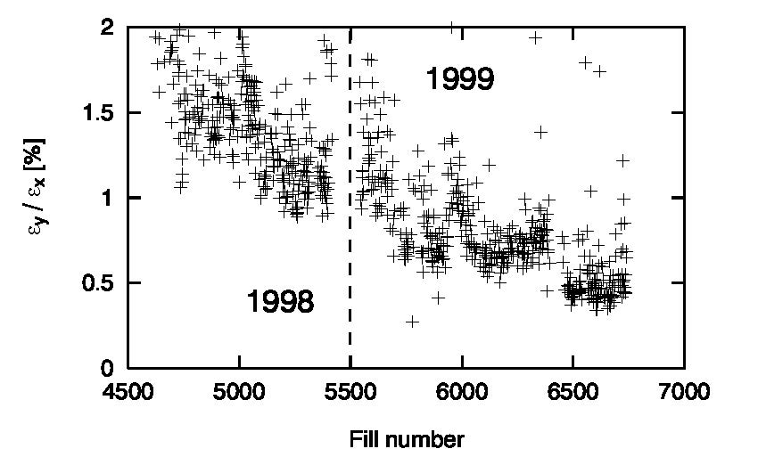
LEP achievements
integrated luminosity
peak
luminosity
even better at higher energy
emittance ratio ε_{x}/ε_{y}
R. Assmann
Chamonix XI & APAC’01

Slide 5
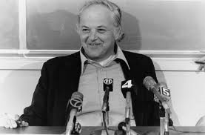
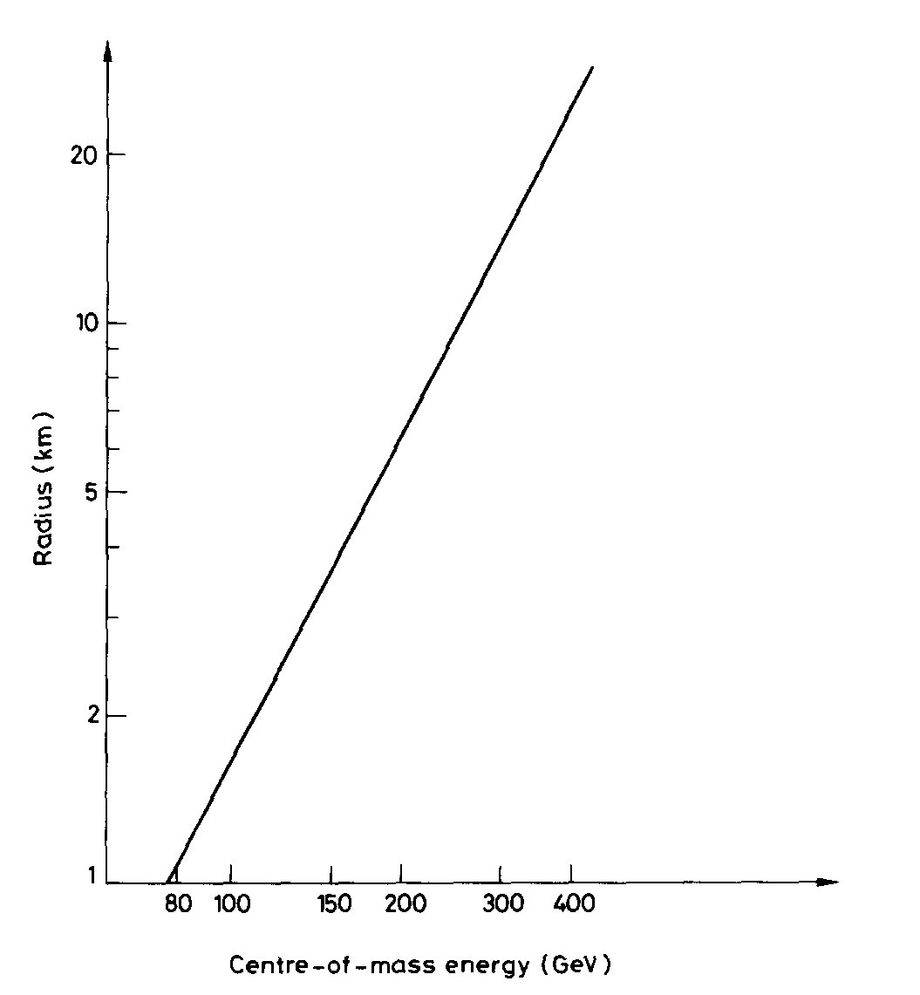
an early proposal
“An e⁺-e ⁻ storage ring in the range of a few hundred GeV in the centre of mass can be built with present technology. ...would seem to be ... most useful project on the horizon.”
(original LEP proposal, 1976)
Burt Richter
1976
300 GeV c.m.
↔
~90 km
cost-optimized
circumference
B. Richter, Very High Energy Electron-Positron Colliding Beams for the Study of Weak Interactions, NIM 136 (1976) 47

Slide 6
LEP3 &TLEP studies 2011-2013
A. Blondel, F. Zimmermann, “A High Luminosity e⁺e⁻ Collider in the LHC Tunnel to study the Higgs Boson,” arXiv:1112.2518v1, 24.12.2011
K. Oide, “SuperTRISTAN - A possibility of ring collider for Higgs factory,”
KEK Seminar, 13 February 2012
1st EuCARD LEP3 workshop, CERN, 18 June 2012
A. Blondel et al, “LEP3: A High Luminosity e+e- Collider to study the Higgs Boson,” arXiv:1208.0504, submitted to ESPG Krakow
P. Azzi et al, “Prospective Studies for LEP3 with the CMS Detector,”
arXiv:1208.1662 (2012), submitted to ESPG Krakow
2nd EuCARD LEP3 workshop, CERN, 23 October 2012
P. Janot, “A circular e⁺e⁻ collider to study H(125),” PH Seminar, CERN, 30 October 2012
ICFA Higgs Factory Workshop: Linear vs Circular, FNAL, 14-16 Nov. ’12
A. Blondel, F. Zimmermann, “Future possibilities for precise studies of the X(125) Higgs candidate,” CERN Colloquium, 22 Nov. 2012
3rd TLEP3 Day, CERN, 10 January 2013
4th TLEP workshop, CERN, 4-5 April 2013
5th TLEP workshop, 25-26 July 2013, Fermilab
6th TLEP workshop, CERN, 16-18 October 2013, CERN

Slide 7
European Strategy Update 2013
“CERN should undertake design studies for accelerator projects in a global context, with emphasis on proton-proton and electron-positron high-energy frontier machines.”
http://cds.cern.ch/record/1567258/files/esc-e-106.pdf
strategy adopted by the CERN Council

Slide 8
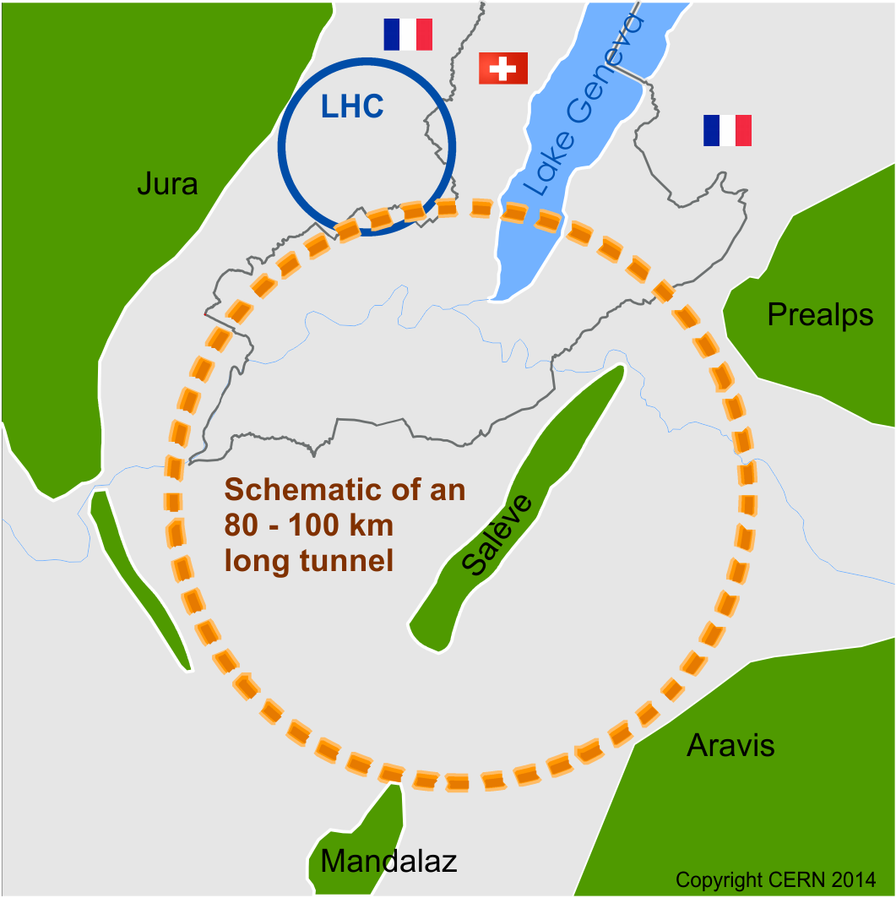
Future Circular Collider Study - SCOPE
CDR and cost review for the next ESU (2018)
Forming an international collaboration to study:
pp-collider (FCC-hh) → defining infrastructure requirements
80-100 km infrastructure in Geneva area
e⁺e⁻ collider (FCC-ee) as potential intermediate step
p-e (FCC-he) option
~16 T ⇒ 100 TeV pp in 100 km
~20 T ⇒ 100 TeV pp in 80 km
M. Benedikt

Slide 9
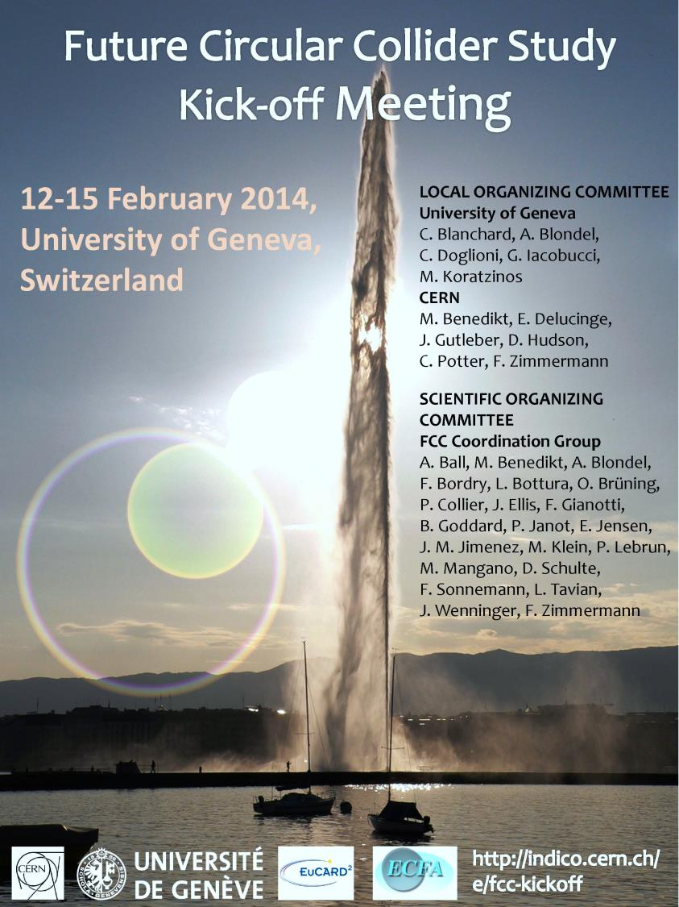

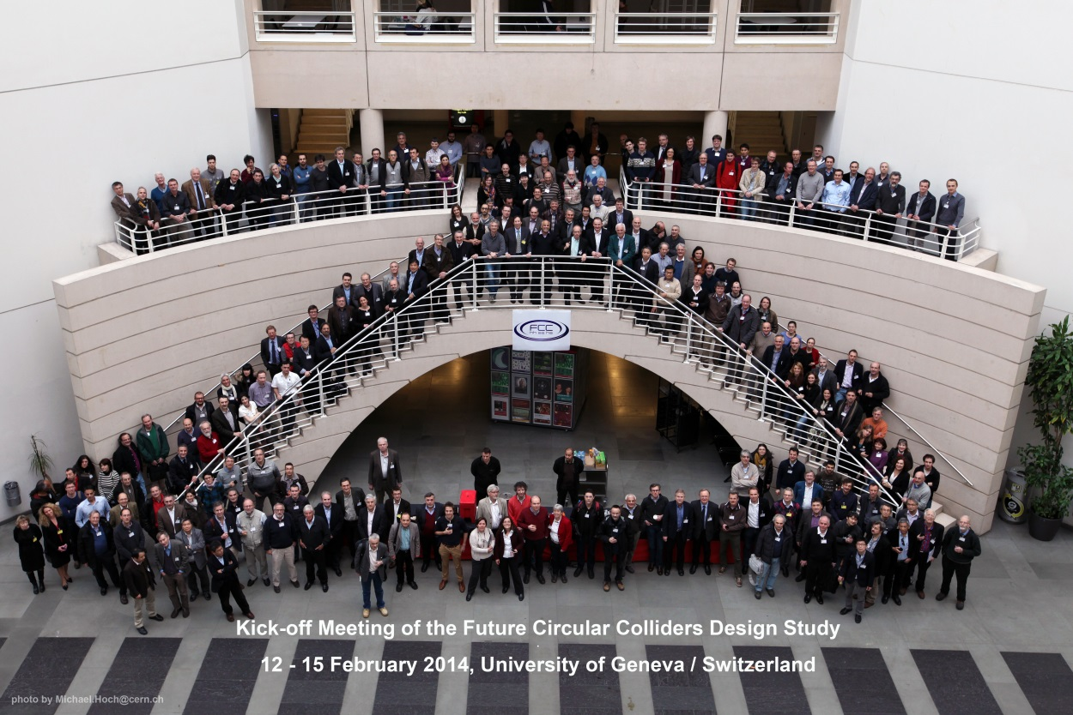
FCC Kick-off Meeting
University of Geneva
12-15 February 2014
>340 participants
http://indico.cern.ch/e/fcc-kickoff
http://cern.ch/fcc

Slide 10
FCC Structure
CERN DG
Collaboration Board
Steering Committee
Advisory Committee
Study
Coordination Group
Hadron Collider Physics Experiments
Lepton Collider
Physics Experiments
e-p
Physics Experiments Machines
Hadron
Injectors
Hadron
Collider
Lepton
Injectors
Lepton
Collider
Accelerator
R&D
Technologies
Infra-structures
Operation
Costing Planning
R. Heuer

Slide 11
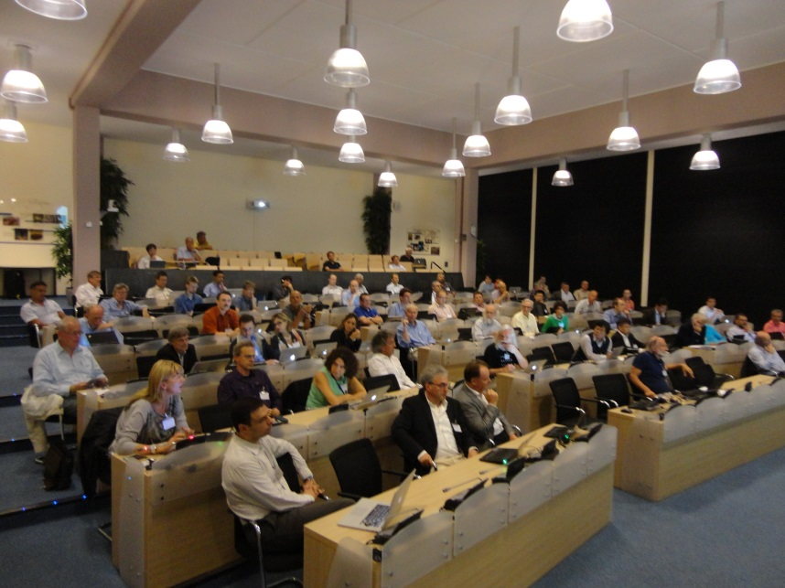
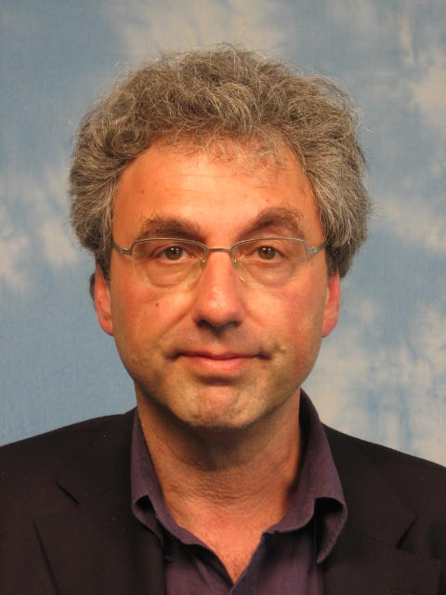
FCC Collaboration Board
preparatory meeting 9-10 September 2014 at CERN (~80 participants, 1 / inst.)
Leonid “Lenny” Rivkin (EPFL & PSI) unanimously elected as interim Collaboration Board Chair

Slide 12
FCC Study Coordination Group
Study Coordination
M. Benedikt, F. Zimmermann
Hadron Collider Physics and Experiments
F. Gianotti, A. Ball, M. Mangano
Lepton Collider Physics and Experiments
A. Blondel, J. Ellis, P. Janot
e-p Physics, Experiments, IP Integration
M. Klein, O. Bruning
Hadron Injectors
B. Goddard
Hadron Collider
D. Schulte, M. Syphers, J.M. Jimenez
Lepton Injectors
Y. Papaphilippou (tbc)
Lepton Collider
J. Wenninger, U. Wienands, J.M. Jimenez
Accelerator R & D Technologies
M. Benedikt, F. Zimmermann
Infrastructures and Operation
P. Lebrun, P. Collier
M. Benedikt
Costing Planning
F. Sonnemann, P. Lebrun

Slide 13
physics requirements for FCC-hh
highest possible pp luminosity at 100 TeV
  present baseline L=5x10³⁴ cm⁻²s⁻¹ (as for HL-LHC)
  higher luminosity appears possible
    with implications for pile up, bunch spacing, shielding, cost, …
also heavy-ion collisions & ion-proton collisions
2-4 experiments (like LHC, two special purpose detectors)
proton polarization? (demonstrated at RHIC, but.. )

Slide 14
parameter | LHC | HL-LHC | FCC-hh
c.m. energy [TeV] | 14 |  | 100
dipole magnet field [T] | 8.33 |  | 16 (20)
circumference [km] | 36.7 |  | 100 (83)
luminosity [10³⁴ cm⁻²s⁻¹] | 1 | 5 | 5 [→20?]
bunch spacing [ns] | 25 |  | 25 {5}
events / bunch crossing | 27 | 135 | 170 {34}
bunch population [10¹¹] | 1.15 | 2.2 | 1 {0.2}
norm. transverse emitt. [μm] | 3.75 | 2.5 | 2.2 {0.44}
IP beta-function [m] | 0.55 | 0.15 | 1.1
IP beam size [μm] | 16.7 | 7.1 | 6.8 {3}
synchrotron rad. [W/m/aperture] | 0.17 | 0.33 | 28 (44)
critical energy [keV] | 0.044 |  | 4.3 (5.5)
total syn.rad. power [MW] | 0.0072 | 0.0146 | 4.8 (5.8)
longitudinal damping time [h] | 12.9 |  | 0.54 (0.32)
FCC-hh baseline parameters defined in EDMS No. 1342402, FCC-ACC-SPC-0001
- preliminary -
Cms energy
Luminosity

Slide 15
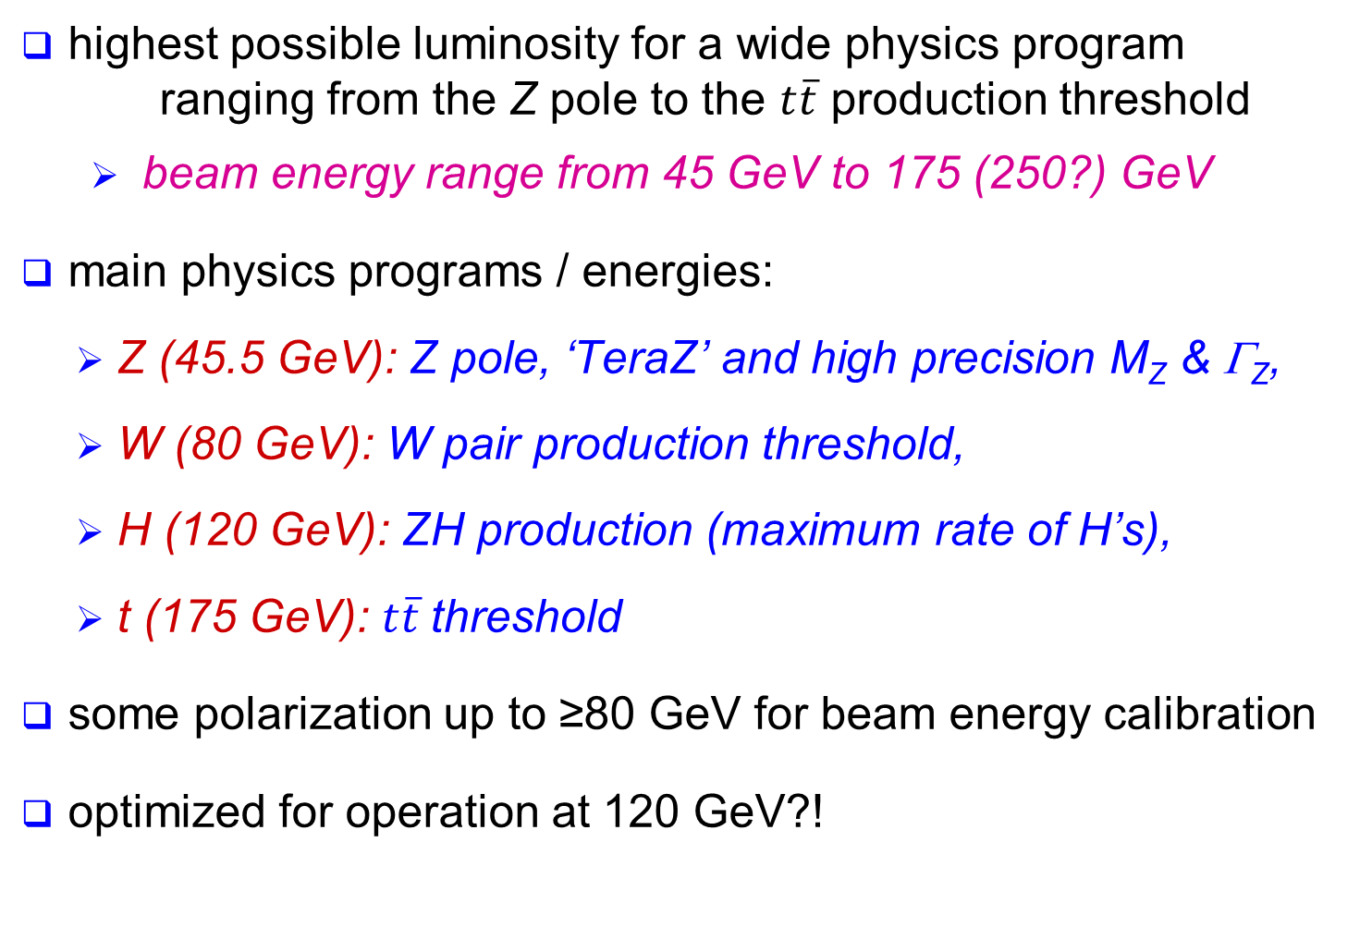
physics requirements for FCC-ee
highest possible luminosity for a wide physics program ranging from the Z pole to the $t\overline{t}$ production threshold
  beam energy range from 45 GeV to 175 (250?) GeV
main physics programs / energies:
  Z (45.5 GeV): Z pole, ‘TeraZ’ and high precision M_{Z} & Γ_{Z},
  W (80 GeV): W pair production threshold,
  H (120 GeV): ZH production (maximum rate of H’s),
  t (175 GeV): $t\overline{t}$threshold
some polarization up to ≥80 GeV for beam energy calibration
optimized for operation at 120 GeV?!

Slide 16
parameter | LEP2 | FCC-ee
 |  | Z | Z (c.w.) | W | H | t
E_{beam} [GeV] | 104 | 45 | 45 | 80 | 120 | 175
circumference [km] | 26.7 | 100 | 100 | 100 | 100 | 100
current [mA] | 3.0 | 1450 | 1431 | 152 | 30 | 6.6
P_{SR,tot} [MW] | 22 | 100 | 100 | 100 | 100 | 100
no. bunches | 4 | 16700 | 29791 | 4490 | 1360 | 98
N_{b} [10¹¹] | 4.2 | 1.8 | 1.0 | 0.7 | 0.46 | 1.4
ε_{x} [nm] | 22 | 29 | 0.14 | 3.3 | 0.94 | 2
ε_{y} [pm] | 250 | 60 | 1 | 1 | 2 | 2
β∗_{x} [m] | 1.2 | 0.5 | 0.5 | 0.5 | 0.5 | 1.0
β∗_{y} [mm] | 50 | 1 | 1 | 1 | 1 | 1
σ∗_{y} [nm] | 3500 | 250 | 32 | 84 | 44 | 45
σ_{z,SR} [mm] | 11.5 | 1.64 | 2.7 | 1.01 | 0.81 | 1.16
σ_{z,tot} [mm] (w beamstr.) | 11.5 | 2.56 | 5.9 | 1.49 | 1.17 | 1.49
hourglass factor F_{hg} | 0.99 | 0.64 | 0.94 | 0.79 | 0.80 | 0.73
L/IP [10³⁴ cm⁻²s⁻¹] | 0.01 | 28 | 212 | 12 | 6 | 1.7
τ_{beam} [min] | 434 | 298 | 39 | 73 | 29 | 21
the large number of bunches at Z, W & H requires 2 rings
FCC-ee baseline parameters defined in EDMS No. 1346081, FCC-ACC-SPC-0003 (Rev. 2.0)
short lifetimes due to high luminosity → continuous injection (top-up)

Slide 17
parameter | LEP2 | FCC-ee
 |  | Z | Z (c.w.) | W | H | t
E_{beam} [GeV] | 104 | 45 | 45 | 80 | 120 | 175
beam-beam par. ξ_{y}/IP | 0.06 | 0.03 | 0.175 | 0.06 | 0.093 | 0.092
current [mA] | 3.0 | 1450 | 1431 | 152 | 30 | 6.6
P_{SR,tot} [MW] | 22 | 100 | 100 | 100 | 100 | 100
no. bunches | 4 | 16700 | 29791 | 4490 | 1360 | 98
N_{b} [10¹¹] | 4.2 | 1.8 | 1.0 | 0.7 | 0.46 | 1.4
ε_{x} [nm] | 22 | 29 | 0.14 | 3.3 | 0.94 | 2
ε_{y} [pm] | 250 | 60 | 1 | 1 | 2 | 2
β∗_{x} [m] | 1.2 | 0.5 | 0.5 | 0.5 | 0.5 | 1.0
β∗_{y} [mm] | 50 | 1 | 1 | 1 | 1 | 1
σ∗_{y} [nm] | 3500 | 250 | 32 | 84 | 44 | 45
σ_{z,SR} [mm] | 11.5 | 1.64 | 2.7 | 1.01 | 0.81 | 1.16
σ_{z,tot} [mm] (w beamstr.) | 11.5 | 2.56 | 5.9 | 1.49 | 1.17 | 1.49
hourglass factor F_{hg} | 0.99 | 0.64 | 0.94 | 0.79 | 0.80 | 0.73
L/IP [10³⁴ cm⁻²s⁻¹] | 0.01 | 28 | 212 | 12 | 6 | 1.7
τ_{beam} [min] | 434 | 298 | 39 | 73 | 29 | 21

Slide 18
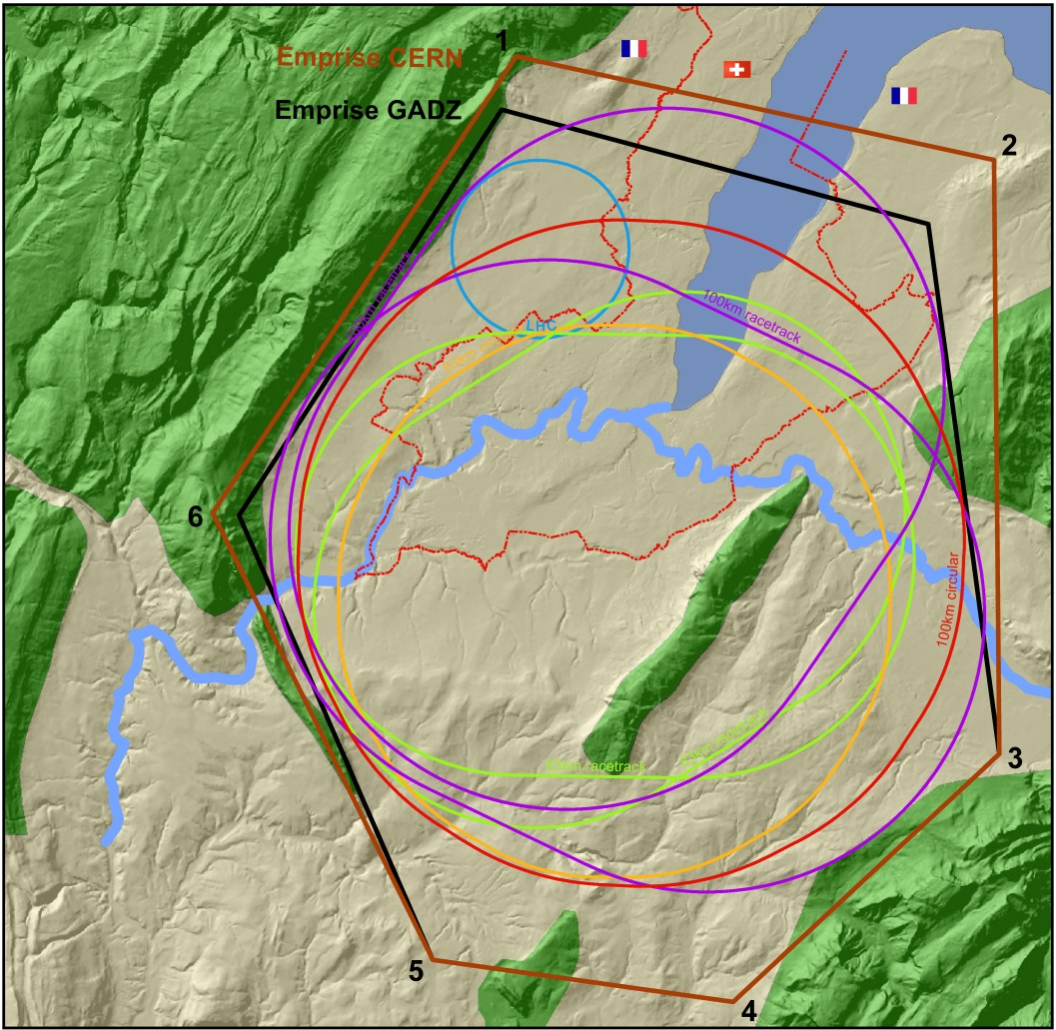
layout: geology, FCC-hh, …
various shapes considered
geology in the Geneva basin favours a circular layout
J. Osborne,
P. Lebrun, B. Harer,
et al.
addt’l constraints due to required compatibility with hadron collider, e.g. length of straights, geometry for IR, dispersion suppressors, collimation etc.

Slide 19
layout & optics at 120 & 175 GeV
Lattice V12b-s
arc cell
BPM
Corrector
Q
Q
S
B
B
Q
S
B
B
layout
B = bending magnet, Q = quadrupole, S = sextupole
FODO cell optics
cell length 50 m
full ring optics
100
80
m
60
n
i
x
t
e
b
40
Circumference: 100 km
Arc length: 2 × 3.4 km
Straight section: 1.5 km
20
0
0
2
4
6
8
10
12
s in km
B. Harer, B. Holzer

Slide 20
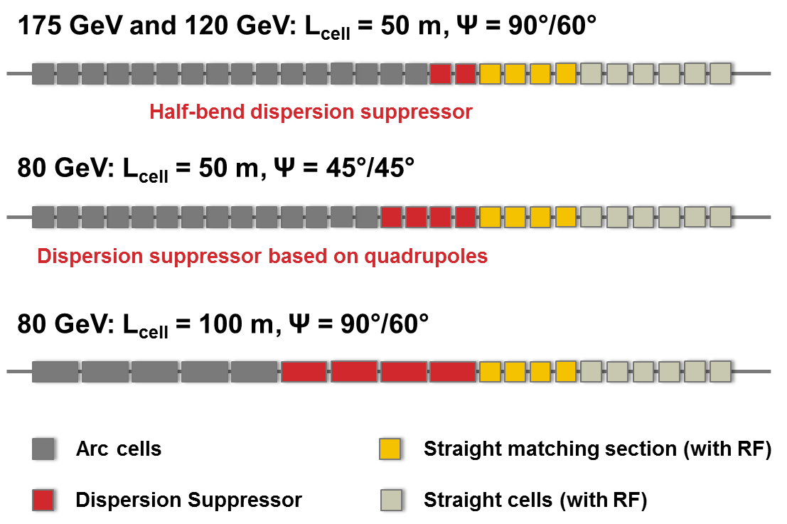
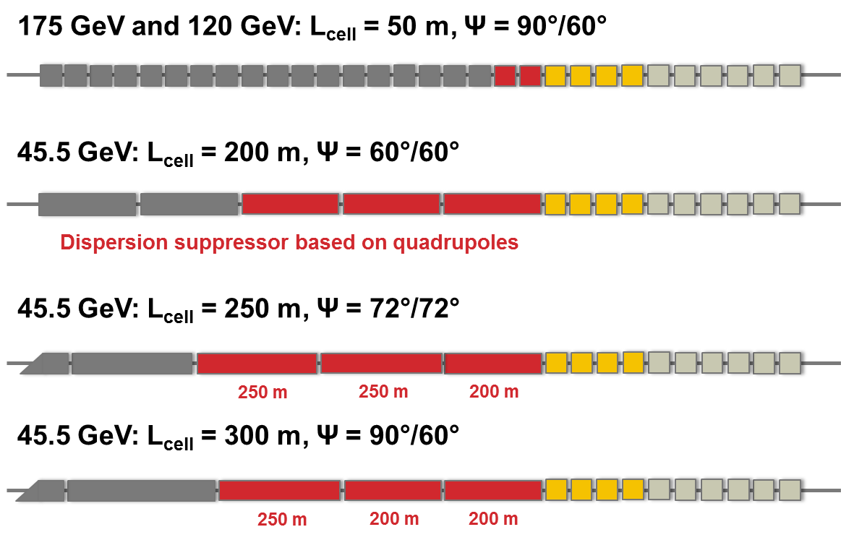
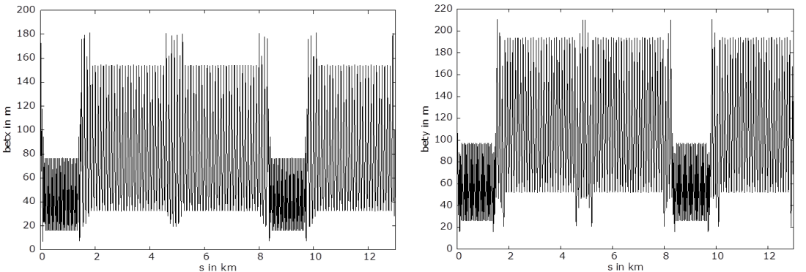
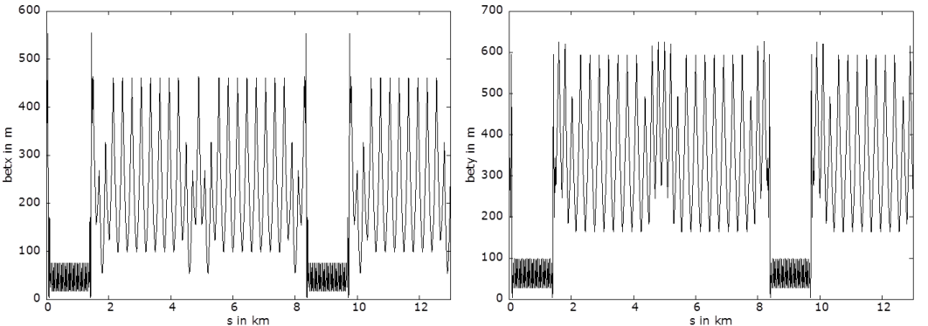
optics 175 & 120 → 80 & 45.5 GeV
80 GeV
45.5 GeV
example: 100 m cell length
example: 300 m cell length
B. Harer, B. Holzer
all emittances ε_{x} ≤ 0.5 baseline

Slide 21
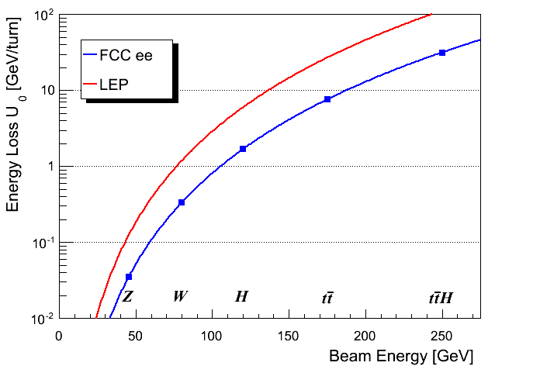
SR power & RF voltage
The maximum synchrotron radiation (SR) power P_{SR} is set to 50 MW per beam – design choice ⇔ power dissipation.
  defines the maximum beam current at each energy.
  Note that a margin of a few % is required for losses in straight sections.
  ρ = 3.1 km
V_{RF} ~35 GV
V_{RF} ~10-11 GV
  ρ = 11 km
J. Wenninger

Slide 22
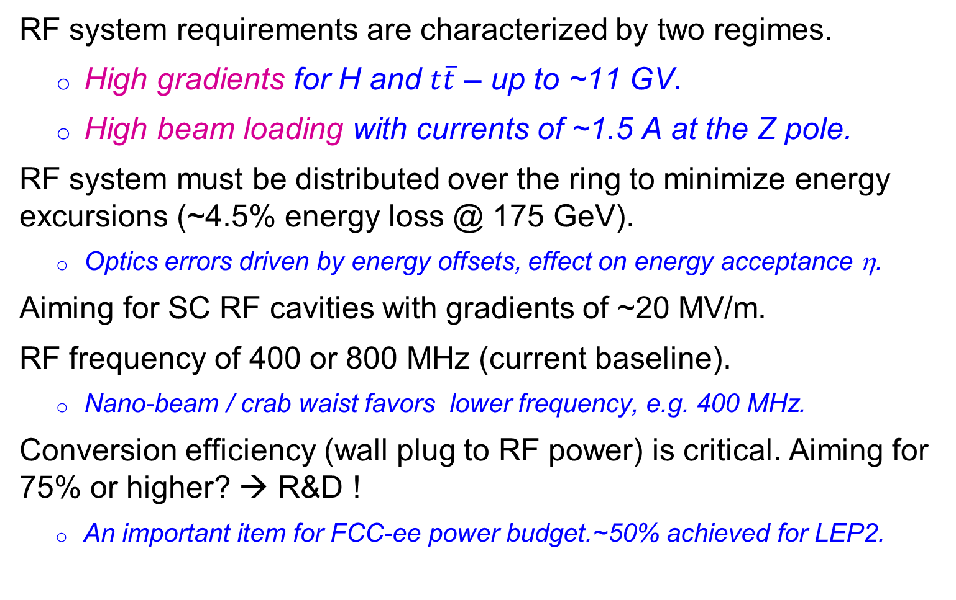
SC RF System
RF system requirements are characterized by two regimes.
  High gradients for H and $t\overline{t}$ – up to ~11 GV.
  High beam loading with currents of ~1.5 A at the Z pole.
RF system must be distributed over the ring to minimize energy excursions (~4.5% energy loss @ 175 GeV).
  Optics errors driven by energy offsets, effect on energy acceptance η.
Aiming for SC RF cavities with gradients of ~20 MV/m.
RF frequency of 400 or 800 MHz (current baseline).
  Nano-beam / crab waist favors lower frequency, e.g. 400 MHz.
Conversion efficiency (wall plug to RF power) is critical. Aiming for 75% or higher? → R&D !
  An important item for FCC-ee power budget.~50% achieved for LEP2.
J. Wenninger, A. Butterworth, E. Jensen, et al.

Slide 23
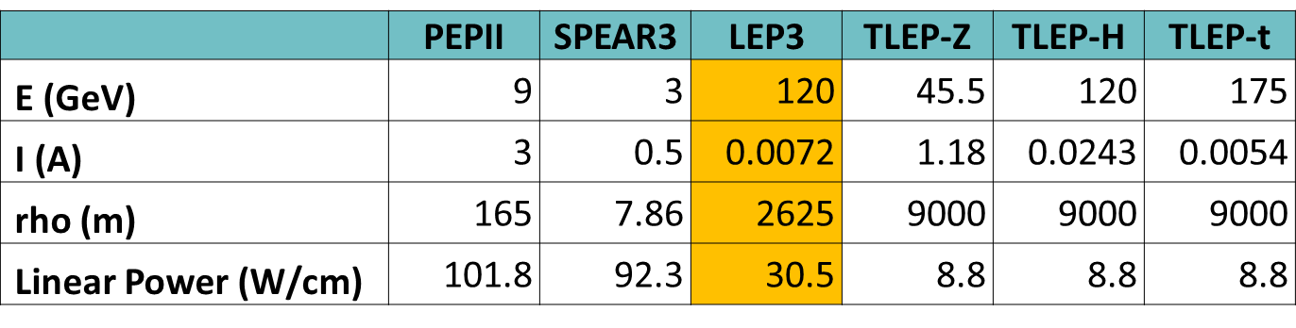
synchrotron radiation: heat load
FCC-ee (TLEP) has >10 times less SR heat load per meter than PEP-II or SPEAR! (though higher photon energy)
N. Kurita, U. Wienands, SLAC
SR heat per meter lower than for many operating rings

Slide 24
shielding 100 MW SR at 175 GeV
total power deposition w/o & w absorbers
FLUKA geometry layout for half FODO cell, dipole details, preliminary absorber design incl. 5 cm external Pb shield
longit. peak-dose profile w/o & w absorbers
(10 mA, 10⁷ s)
L. Lari, F. Cerutti, A. Ferrari, A. Mereghetti

Slide 25
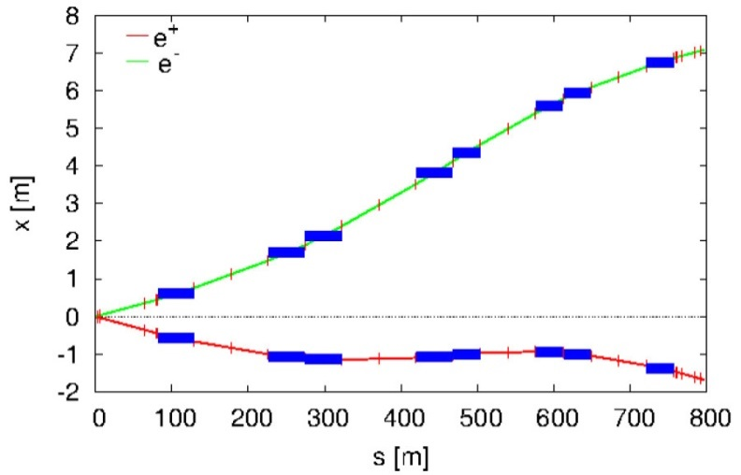
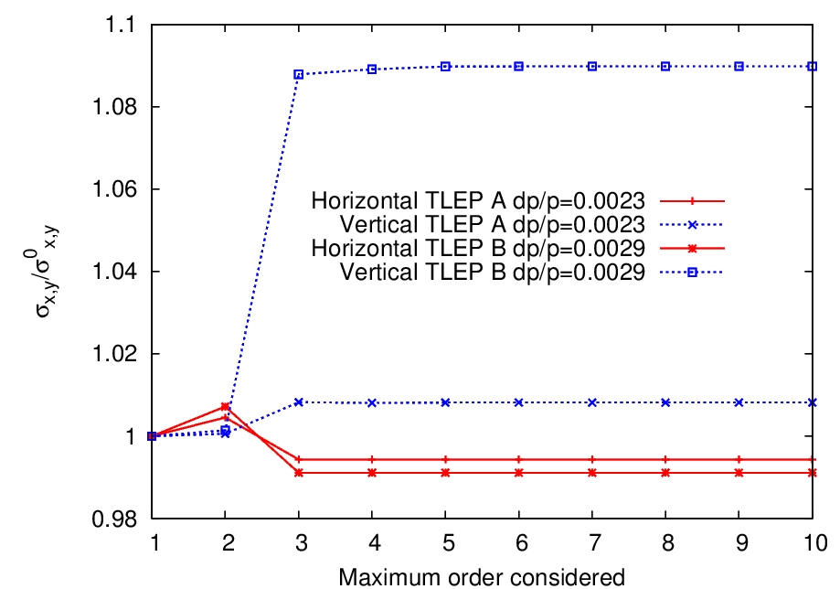
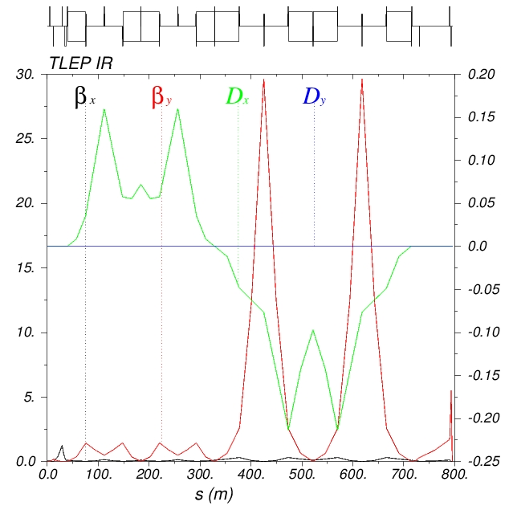
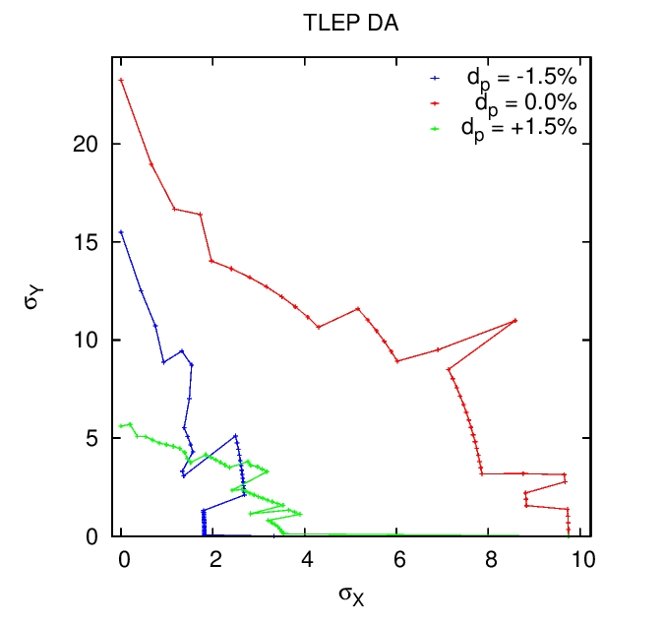
FCC-ee IR design #1
e± beam line layout
higher-order optimization for different values of σ_{δ}
dynamic aperture for
different values of δ
modular IR optics with vertical & horizontal chromaticity correction
H. Garcia, L. Medina, R. Tomas

Slide 26
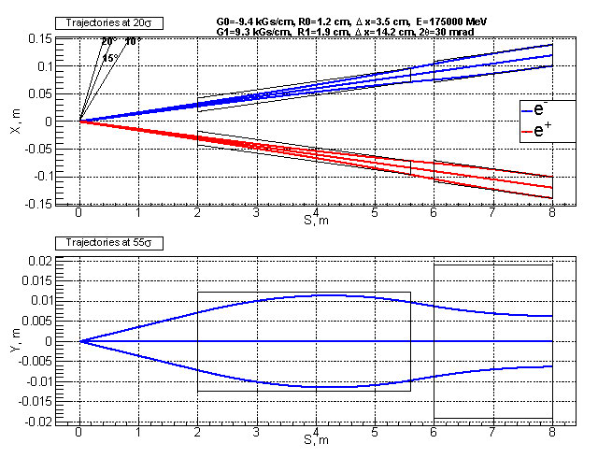
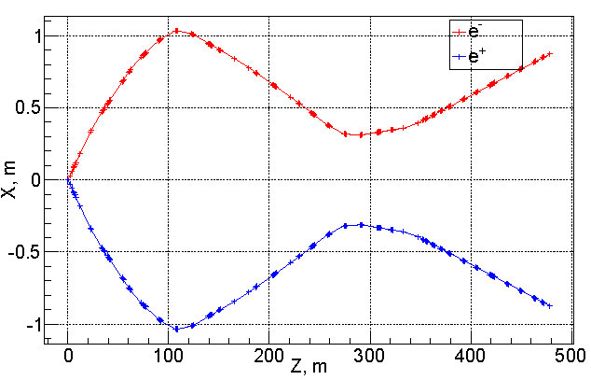
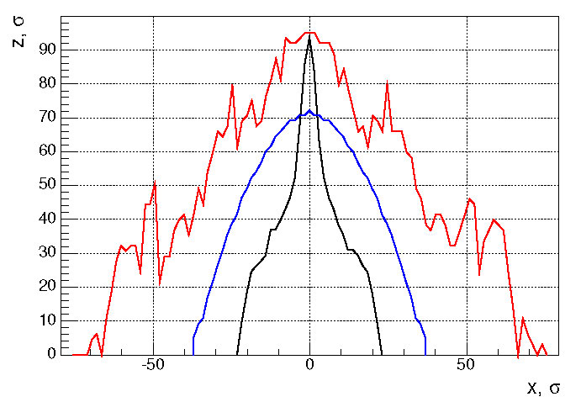
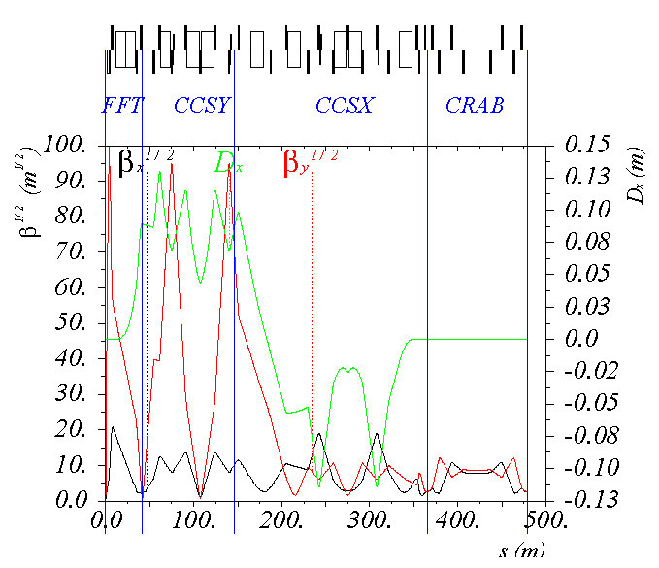
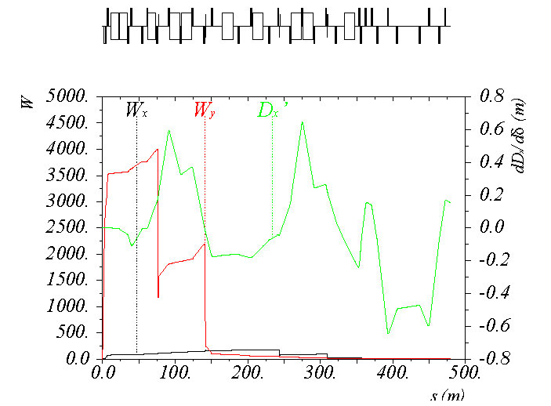
FCC-ee IR design #2
dynamic aperture
trajectories from IP through FF quads
e± beam line layout
red – sextupoles, kinematic, fringes, blue – only thick crab sextupoles, black – everything.
modular IR optics including crab waist
chromatic functions & nonlinear dispersion
A. Bogomyagkov, E. Levichev, P. Piminov

Slide 27
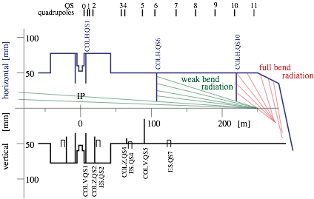
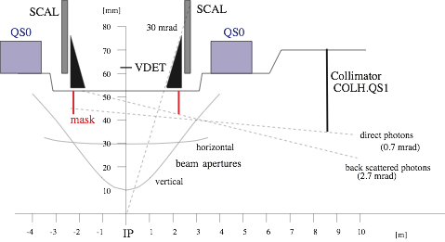
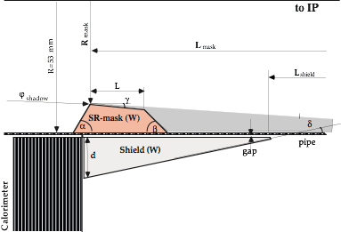
Machine Detector Interface
Challenge : maximize performance (integrated luminosity) for experiments with tolerable experimental conditions.
Minimize synchrotron radiation in the IR region :
Bends as weak as possible and as far as possible from IP
Quads have to be strong and close to IP
- minimize offset from quad axis
- be careful with vertical halo/tails
SR Monte Carlo : H.B. CERN-OPEN-2007-018 integrated in G4
LEP example of an optimized IR
~100 collimators to reduce MIB
no direct or singly reflected γ to exp.
H. Burkhardt, M. Boscolo
developing generic tools for FCC IR studies

Slide 28
luminosity
H ≤ 1
Hour-glass
F ≤ 1
Crossing angle
2Φ
Beam-beam parameter
J. Wenninger

Slide 29
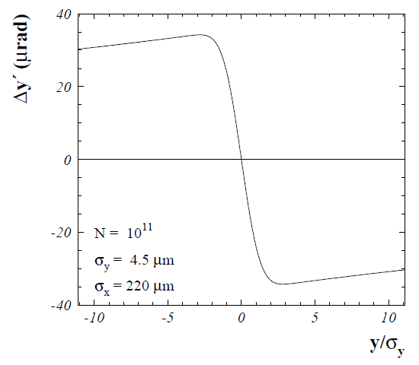
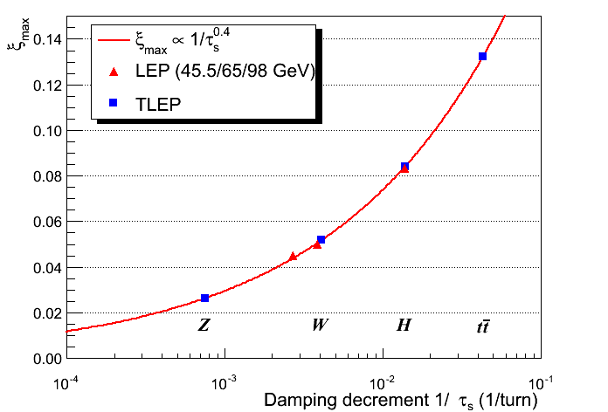
beam-beam parameter
beam-beam parameter ξ measures strength of field sensed by the particles in a collision
beam-beam parameter limits are empirically scaled from LEP data (also 4 IPs)
R. Assmann & K. Cornelis, EPAC2000
In reasonable agreement with first simulations for FCC ee
The beam-beam limit may be raised significantly with Crab-Waist schemes !
J. Wenninger, R. Assmann, S. White, K. Ohmi, D. Shatilov, et al.

Slide 30

beamstrahlung
hard photon emission at the IPs, ‘Beamstrahlung’, can become lifetime / performance limit for large bunch populations (N), small hor. beam size (σ_{x}) & short bunches (σ_{s})
e
γ
e
ρ : mean bending radius at the IP (in the field of the opposing bunch)
η : ring energy acceptance
lifetime expression by V. Telnov, modified version by A. Bogomyagkov et al
to ensure an acceptable lifetime, ρ×η must be sufficiently large
  flat beams (large σ_{x}) !
  bunch length !
  large momentum acceptance of the lattice: 1.5 – 2% required.
    LEP: < 1% acceptance, SuperKEKB ~ 1-1.5%.
J. Wenninger, et al

Slide 31
beam-beam limits: 2 regimes
beamstrahlung
lifetime (300 s) w. η=2.0%
FCC-H
FCC-t
beamstrahlung
lifetime w. η=1.5%
ε_{y} = 2 pm,
β_{y}* = 1 mm
M. Koratzinos, A. Bogomyagkov, E. Levichev, D. Shatilov, K. Yokoya, V. Telnov, K. Oide, …

Slide 32
beamstrahlung lifetime
FCC-ee, E_{beam} =175 GeV (most critical case)
formula of
A. Bogomyagkov
simulation
by K. Ohmi
formula of
V. Telnov
calculations include dynamic β* function
M. Koratzinos, K. Ohmi,
V. Telnov, A. Bogomyagkov, E. Levichev, D. Shatilov

Slide 33
IR parameters
smallest possible β* desired; target β*_{y} = 1 mm; so small a value of β* requires local chromaticity correction
  design inspired by linear collider IR;
  additional complexity that beam does not pass the IR only once → effects of optical aberrations critical
  bending magnets close to the IP → SR fan !
distance between IP and front-face of first quadrupole currently set to L* ≥ 2 m (SuperKEKB ~1 m)
  detector acceptance, luminosity measurement,… .
  combination of very small β_{y}* and required large energy acceptance is challenge for optics design !
J. Wenninger, R. Tomas,…

Slide 34
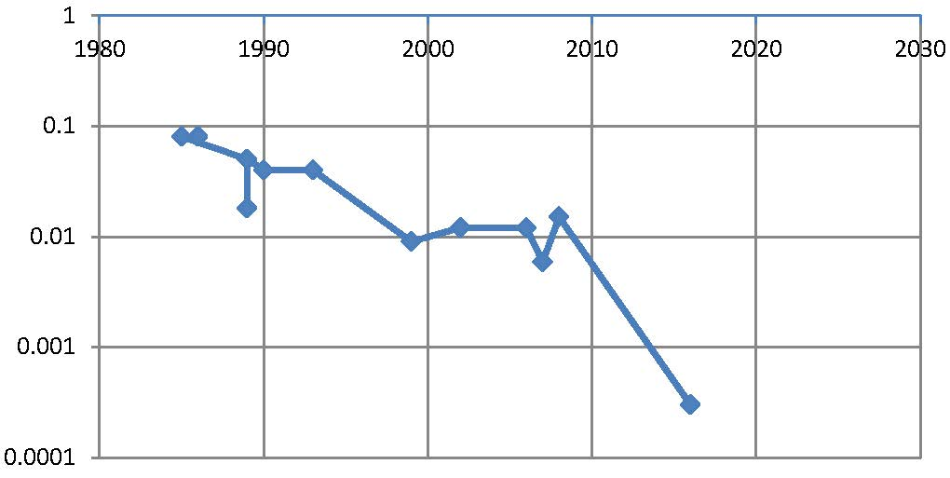
β* evolution
β* [m]
year
SPEAR
PEP, BEPC, LEP
PETRA
TRISTAN
DORIS
CESR-c, PEP-II
BEPC-II
CESR
DAFNE
KEKB
6 mm
FCC-ee
SuperKEKB
1 mm
0.3 mm
SuperKEKB will be an FCC-ee demonstrator for certain optics aspects !

Slide 35
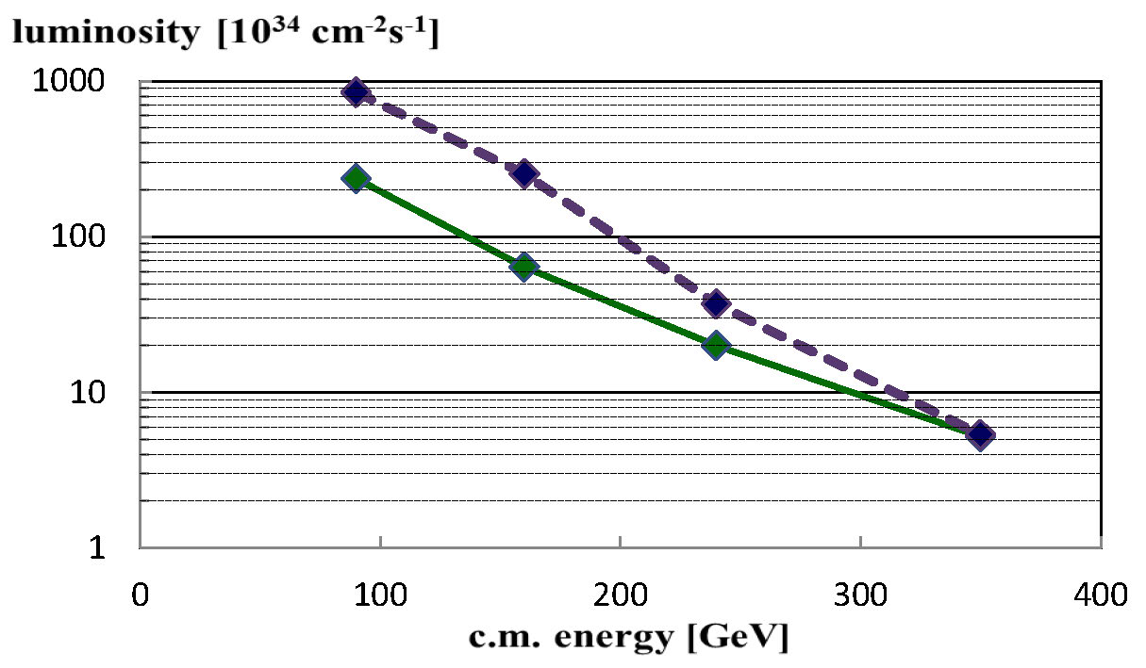

FCC-ee luminosity vs energy
crab waist & improved parameters
baseline
Z
W
H
$$t\overline{t}$$
A. Bogomyagkov, E. Levichev, D. Shatilov

Slide 36
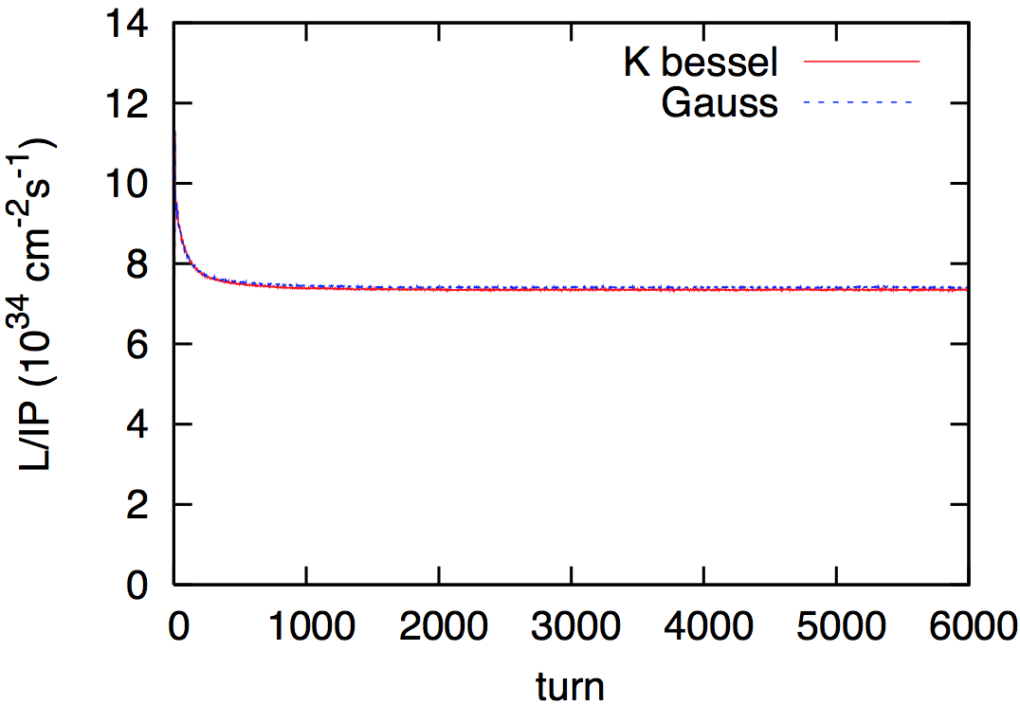
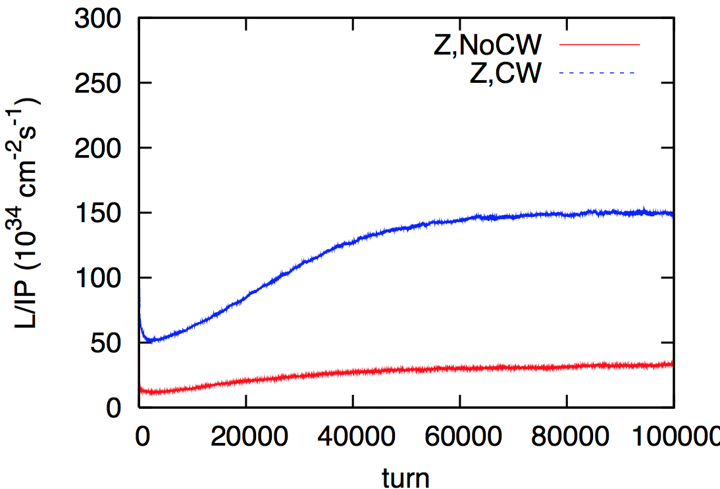
beam-beam performance checks
BBSS strong-strong simulation
w beamstrahlung
FCC-ee in Higgs production
mode (240 GeV c.m.):
L≈7.5x10³⁴ cm⁻²s⁻¹ per IP
design
BBWS weak-strong simulation
w beamstrahlung
crab waist
FCC-ee in crab-waist mode
at the Z pole (91 GeV c.m.):
L≈1.5x10³⁶ cm⁻²s⁻¹ per IP
baseline design
K. Ohmi,
A. Bogomyagkov, E. Levichev, P. Piminov

Slide 37

SuperKEKB = FCC-ee demonstrator
beam commissioning will start in 2015
K. Oide et al.
top up injection at high current
β_{y}* =300 μm (FCC-ee: 1 mm)
lifetime 5 min (FCC-ee: ≥20 min)
ε_{y}/ε_{x} =0.25% (similar to FCC-ee)
off momentum acceptance (±1.5%, similar to FCC-ee)
e⁺ production rate (2.5x10¹²/s, FCC-ee: <1.5x10¹²/s (Z cr.waist)
SuperKEKB goes beyond FCC-ee, testing all concepts

Slide 38
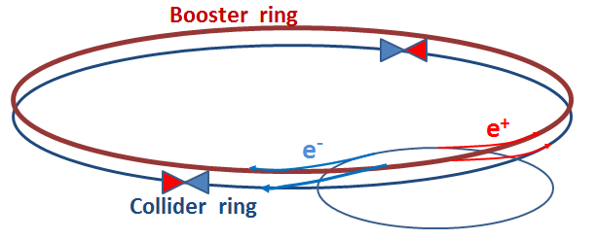
FCC-ee injection
beside the collider ring(s), a booster of the same size (same tunnel) must provide beams for top-up injection
  same size of RF system, but low power (~ MW)
  top up frequency ~0.1 Hz
  booster injection energy ~20 GeV
  bypass around the experiments
injector complex for e⁺ and e⁻ beams of 10-20 GeV
  Super-KEKB injector ~ almost suitable
A. Blondel

Slide 39
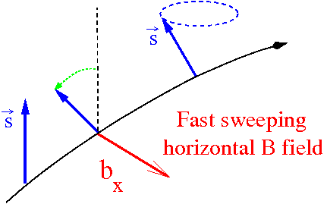
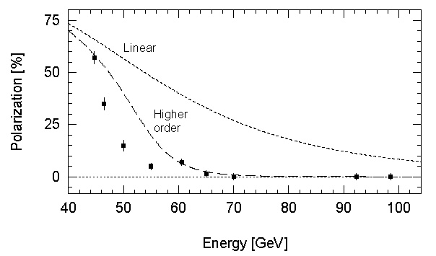
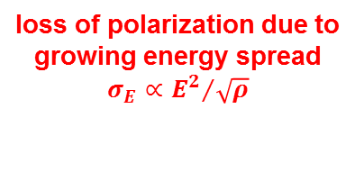
polarization
two primary interests:
accurate energy calibration using resonant depolarization ⇒ measurement of M_{Z}, Γ_{Z}, M_{W}
  great feature of circular machines, δM_{Z}, δΓ_{Z} ~ 0.1 MeV
physics with longitudinally polarized beams
  transverse polarization must be rotated into the longitudinal plane at the IP using spin rotators (see e.g. HERA)
Precession frequency ∝ E
scaling from LEP observations :
polarization expected up to the WW threshold !
loss of polarization due to growing energy spread
$$σ_{E}∝{E^{2}}/{\sqrt{ρ}}$$
LEP
integer spin resonances are spaced by 440 MeV:
energy spread should remain below ~ 60 MeV
A. Blondel, S. Mane, U. Wienands, J. Wenninger, et al.

Slide 40
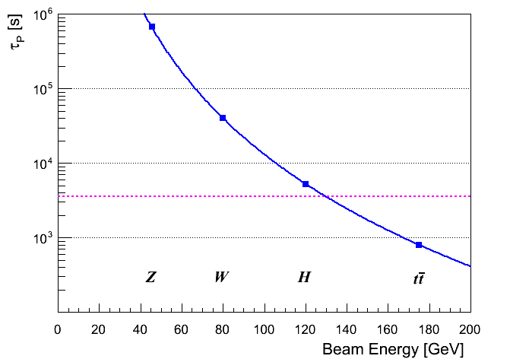
polarization build up
transverse polarization build-up (Sokolov-Ternov) is slow at FCC-ee (large bending radius ρ)
build-up is ~40 times slower than at LEP
τ_{p} ≈190 hours @ Z
wigglers may lower τ_{p} to ~12 h, limited by σ_{E} ≤ 60 MeV and power
  due to power loss the wigglers can only be used to pre-polarize some bunches (before main injection)
1 hour
≈ OK for energy calibration (few % P sufficient)
longitudinal polarization: levels of ≥ 40% required on both beams; excellent resonant compensation needed
  expected to be difficult, requires spin rotators or snakes, most likely only possible at lower intensity and lower luminosity
E. Gianfelice
simulations with SLIM, PETROS, SITF
A. Blondel, U. Wienands, J. Jowett, R. Rossmanith, J.Wenninger

Slide 41
HEP Timescale
1980
1985
1995
2000
2005
2010
2015
2020
2025
2030
2035
1990
Construction
Physics
Upgr
LEP
Design
Proto
Construction
Physics
LHC
Design
Construct
Physics
HL-LHC
Future Collider
Design
Proto
Construction
Physics
25 years
Today
FCC CDR & Cost

Slide 42
conclusions
great history of colliders & collider designs
real FCC-ee design work has started
great progress since kick-off in February
wide study scope, many interesting questions
emphasis shifting to optimization and choice between alternatives
many technologies also need work (magnets, SRF, collimators, vacuum system,…)
witnessing a lot of enthusiasm and excitement
colleagues contributing from around the world
more partners & contributions welcome!

Slide 43

First FCC Week
Conference
Washington DC
23-27 March 2015
http://cern.ch/fccw2015
++...
hoping to see you there!
draft poster

Slide 44
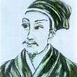
“A journey of a thousand miles begins with a single step.”
Confucius (551–479 BC)
谢谢 !

Slide 45
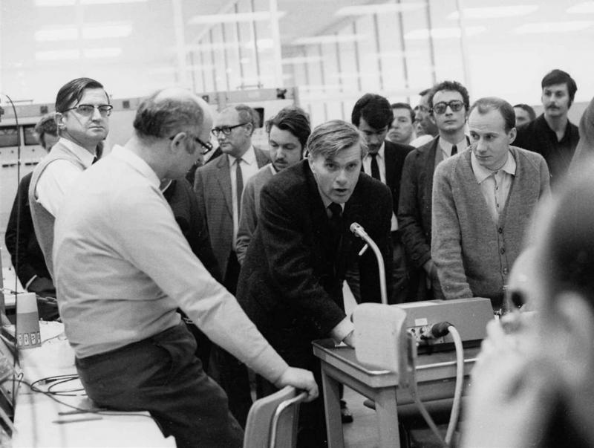
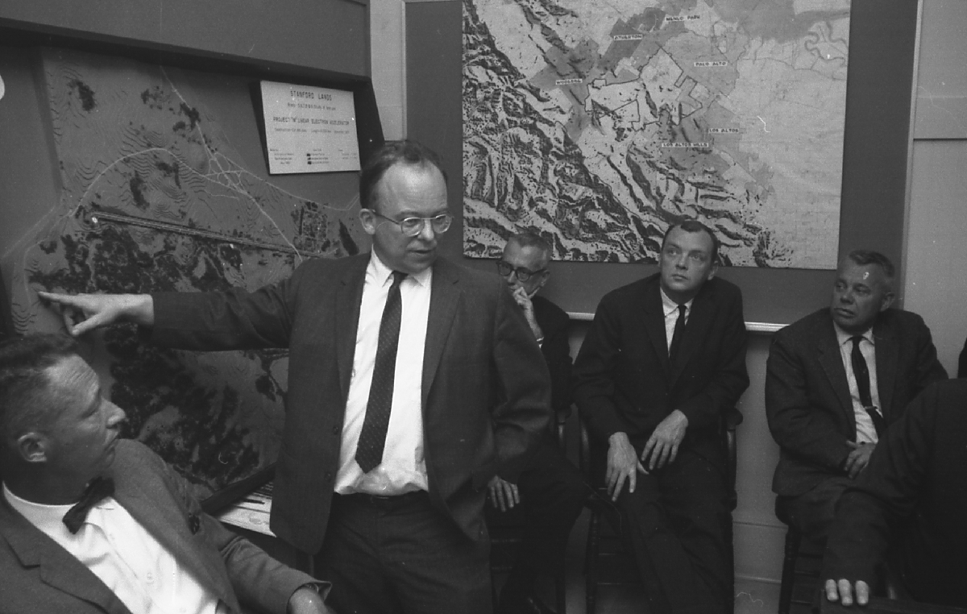
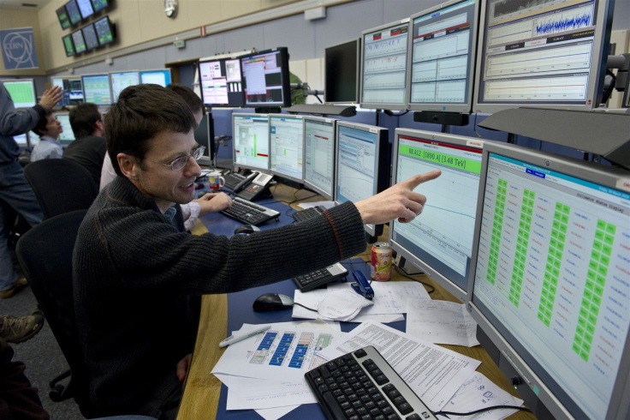
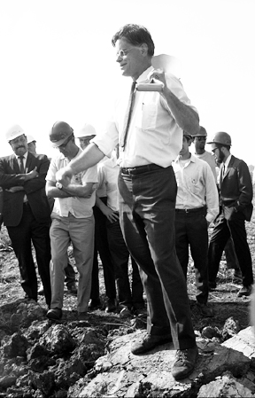
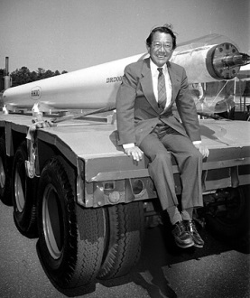


… surely great times ahead!

