Slide 1
Possible Applications of Wave-Beam Interaction for Energy Measurement and Obtaining of Polarization at FCCee
55th ICFA Advanced Dynamics Workshop on High Luminosity Circular e+e- Colliders – Higgs Factory (HF2014)
Evgeni Levichev , Sergei Nikitin
BINP, Novosibirsk
12 October 2014

Slide 2
Content
Waveguide Compton monitor of beam energy
Beam energy monitoring is required in the Z and W mass measurement experiment at FCCee with application in the intervals between the precision energy calibrations using the resonant depolarization technique. The reason is a long-term instability of guide field and violations of a storage ring geometry due to temperature changes and tidal effects. In the tt experiments the Compton scattering may be considered as a main method for beam energy determination because of growing problems with obtaining spin polarization at energies >100 GeV. The present CBS monitors at low energies uses 10 micron lasers. In the FCCee case one needs to apply the centimeter wavelengths for reliable measurement of scattered photon spectrum. An idea of Waveguide Compton monitor looks like obvious but it has not been studied before.
Laser method for obtaining beam polarization
Sokolov-Ternov polarization time in the 80 km FCCee ring is very large: 150 h at 45.6
GeV. It makes the task of obtaining polarization directly in Main Ring or in Injector Ring
rather difficult. Two methods are known using interaction of beam with circularly
polarized photons to obtain polarization in e+e- storage rings in the cases when other
methods are ineffective. They are briefly discussed in regard to FCCee.
    Very preliminary!

Slide 3
CBS beam energy monitor problem
CBS beam energy monitor at VEPP-4M:
λ_{laser}=10 μm,
2.5 ×10⁻⁵ accuracy @ 3 ×10 ⁻⁴ beam energy spread,
CBS gamma quanta energy ≈6 MeV @ E_{beam} =1.85 GeV.
Question of possibility to apply a similar CBS monitor at 45-175 GeV FCCe+e- turns on the issue of the use of significantly longer wavelengths of incident waves providing a limit of scattered photon energy of the order of 5 MeV which is feasible for detecting (N.Muchnoi).
Accounting such limitation we should take
the wavelength λ>8mm!

Slide 4
Compton kinematic relations
Head-on wave (laser CBS monitor at VEPP-4M) ω’=4γ²ω, θ₁=π, θ₂=0
90° intersection ω’=2γ²ω, θ₁=π/2, θ₂=0
Arbitrary collision angle θ₁ ω’=2γ²ω(1+sinϕ), θ₁=π/2+ϕ, θ₂=0
Collision at small angles “in the rear hemisphere” ω’≈γ²ωα², θ₁=α<<1, θ₂=0

Slide 5
Partial plane waves in waveguide
Waveguide Wave Power
a wavelength related to frequency of driving signal
, ν_{ph} , a phase velocity (ν_{ph}>c)
- a waveguide mode period

Slide 6
Base example of round waveguide for FCCe+e-
a=4 cm, diameter
λ_{cr} =6.82 см, critical wavelength of lowest mode(H₁₁);
λ=5.5 cm, working wavelength (5.45 GHz);
5.24 cm, critical wavelength of next nearest mode (E₀₁) →
mono-wave condition fulfilled;
ϕ=36° so collision angle θ₁≠180° but 127° →
CBS energy spectrum edge goes down as compared with “head on” case,
E_{edge}(ϕ) /E_{edge}(π/2) =(1+sin ϕ)/2=0.795, ratio of edge energies

Slide 7
Problem of waveguide size uncertainty
Critical wavelength λ_{cr}=3.41a/2 (H₁₁) depends on transverse sizes of waveguide (a, diameter) so CBS spectrum edge does that too!
Use of waveguide CBS for beam energy measurement of, for instance, 10⁻⁴ accuracy is not possible without knowledge of waveguide size of same accuracy accounting variation of sizes along wave-beam interaction region
Way to avoid this obstacle is proposed in the next slide

Slide 8
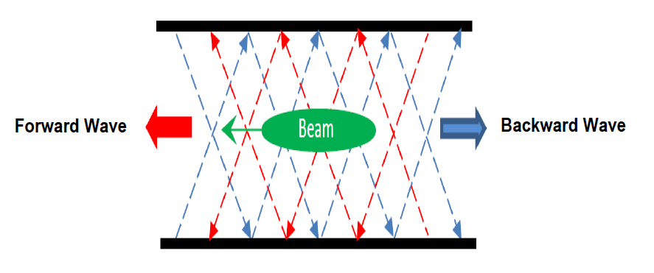
Backward and Forward waveguide waves for CBS edge measurement
Measure CBS spectrum edges at BW and FW to find their ratio
Calculate
Determine beam energy from
Knowledge of waveguide size is not at all required!
To example above (λ=5.5 cm ): R=k₂/k₂*=(1+sinϕ)/(1-sinϕ)=3.9

Slide 9
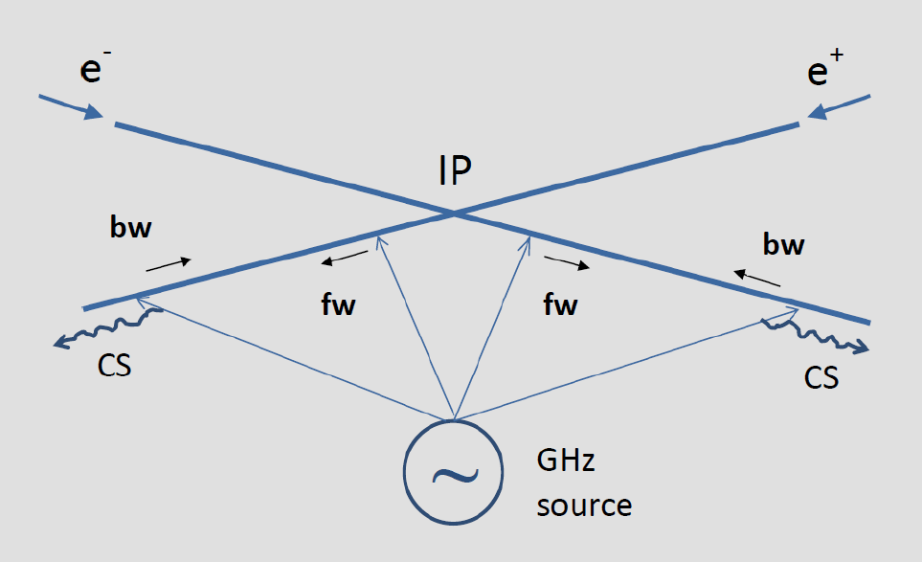
Waveguide Compton monitor of FCCee beam energy
Spectrum edge at λ=5.5 cm (5.45 GHz) for the set of FCCe+e- energy:
0.55 MeV, E=45 GeV (Z)
2.21 MeV, E=90 GeV (W)
3.93 MeV, E=120 GeV (H)
8.35 MeV, E=175 GeV (t)

Slide 10
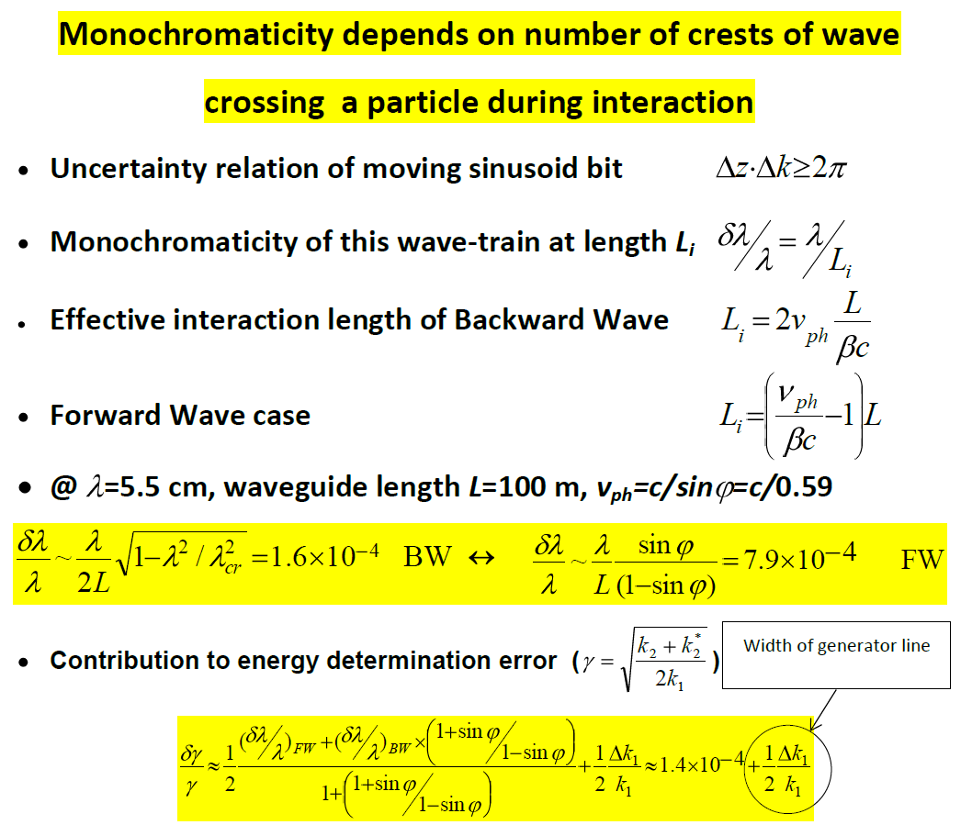
Monochromaticity and effective length of interaction

Slide 11
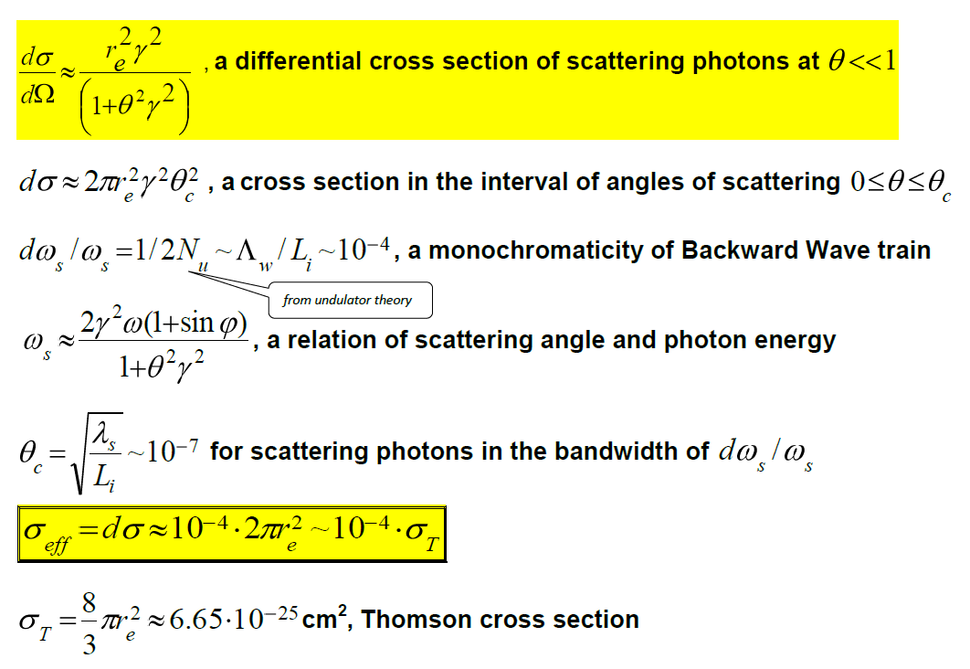
Relation between scattering angle and monochromaticity bandwidth

Slide 12
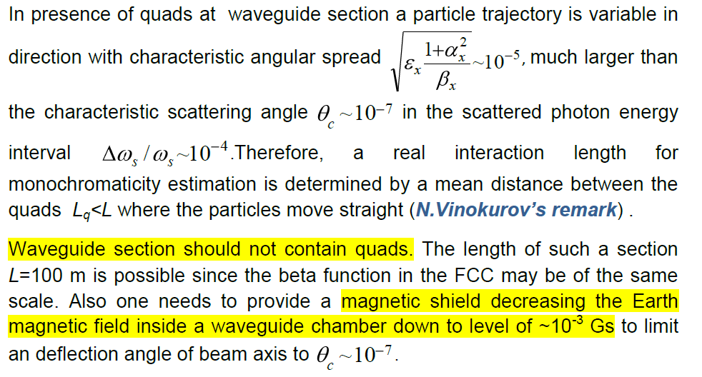
Spectrum widening due to quads

Slide 13
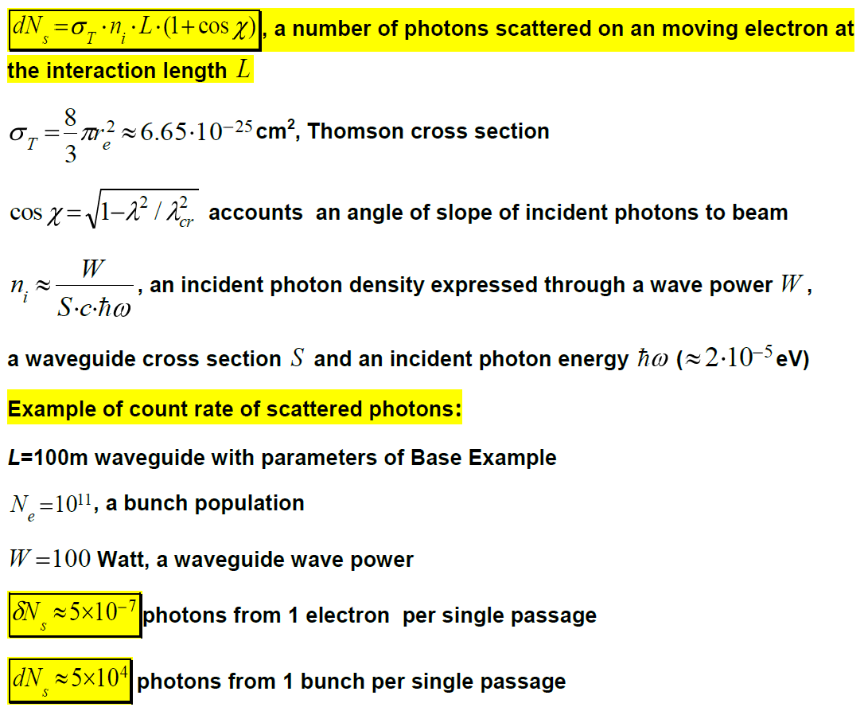
Estimate of scattering photon number

Slide 14
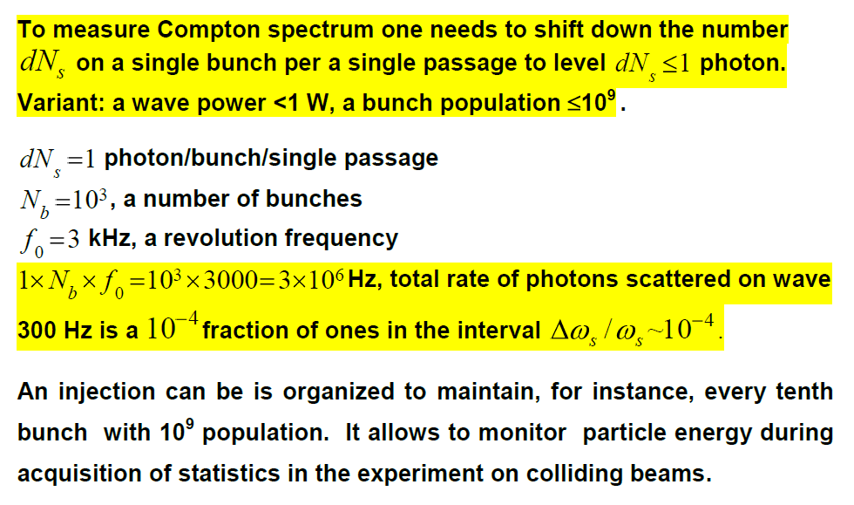
Total statistics of scattered photons

Slide 15
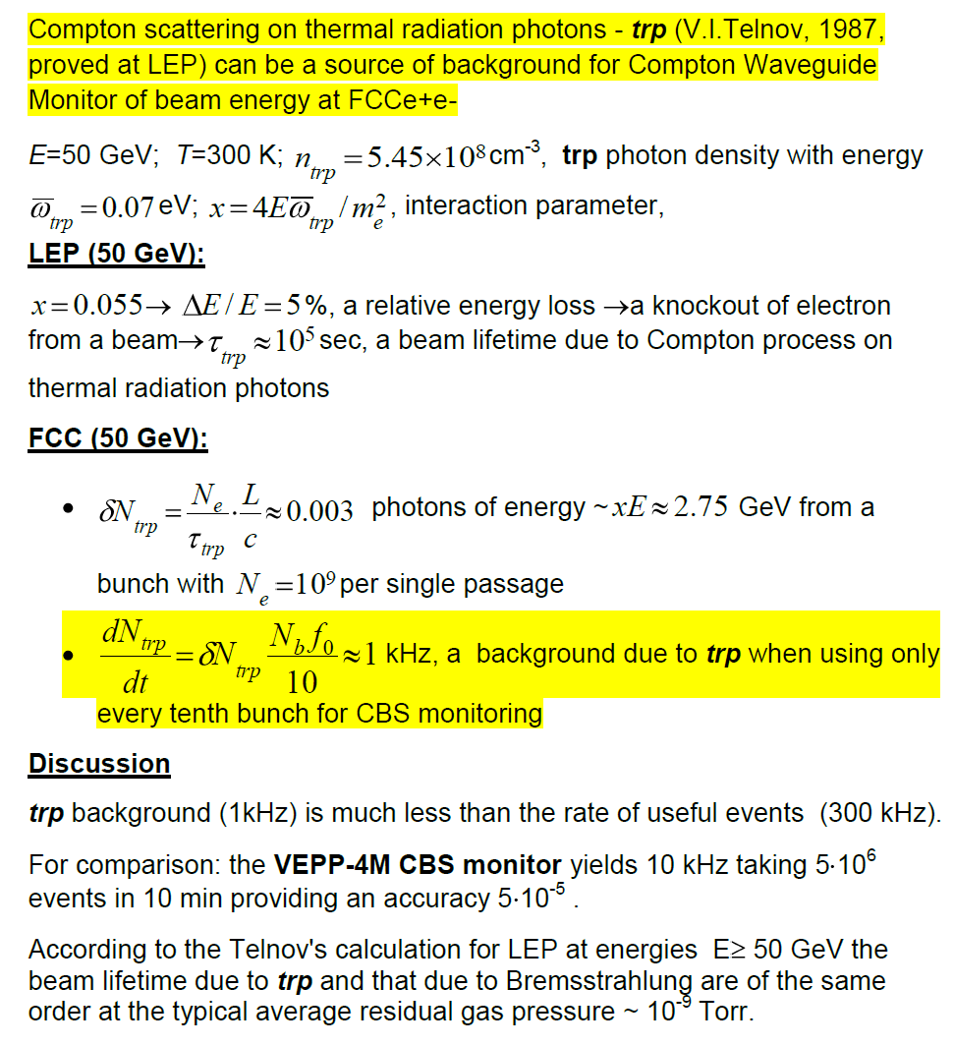
Estimate of Background

Slide 16
Discussion on Waveguide Compton monitor
Not very good
Large length of section (up to L=100 m) without quads (not yet so bad since a corresponding scaling factor, beta-function, can be similarly large)
Permalloy shield along the full length of the waveguide section to decrease Earth’s field
…
…but bearable
Good
Differential method of BW and FW with accuracy (related to inmonochromaticity degree ∝ L) ~ 10⁻⁴
High total rate of taking useful statistics in monitor detector ~300 kH with significant exceeding over background related to thermal radiation photons and Bremsstrahlung. For comparison: VEPP-4M CBS monitor yields 10 kHz taking 5×10⁶ events for point (10 min)
Small power of C-band source required (preliminary estimate: ~1 W and lower)
Possibility to monitor energy during a main experiment (with a partial loss in luminosity - 10%)
…

Slide 17
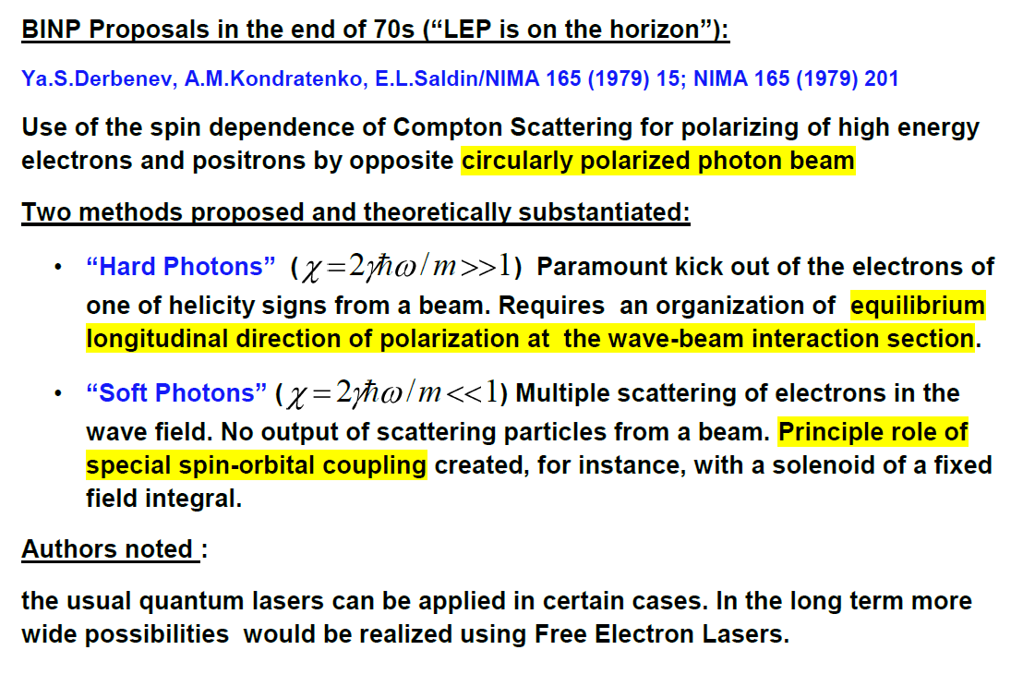
Circularly polarized photons for obtaining of polarization in super high energy e+e- storage rings

Slide 18
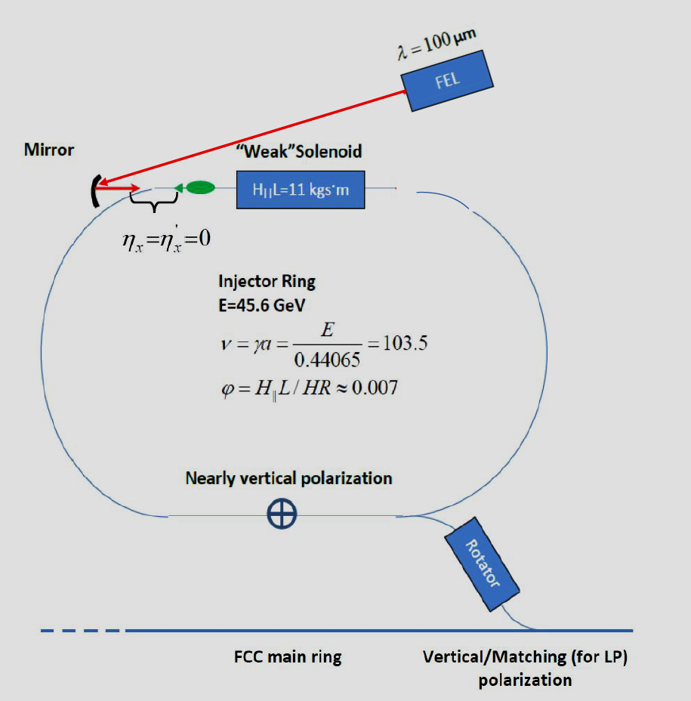
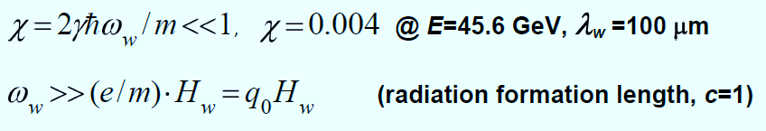
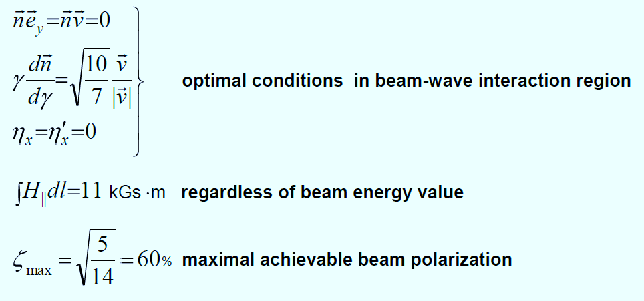
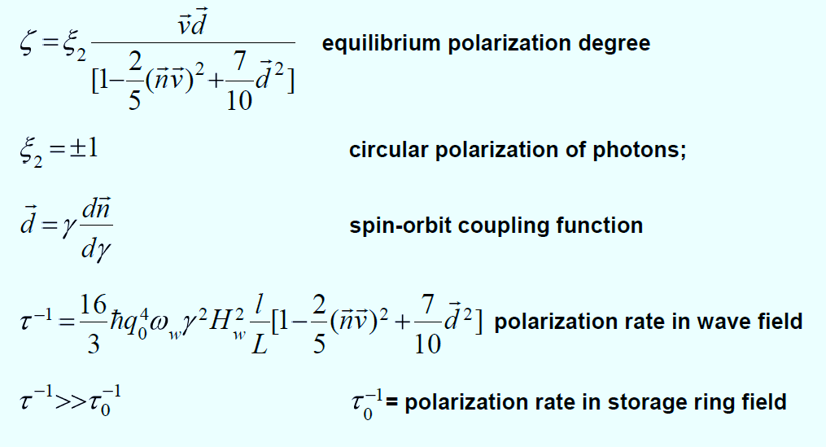
Soft Photon for FCCee

Slide 19
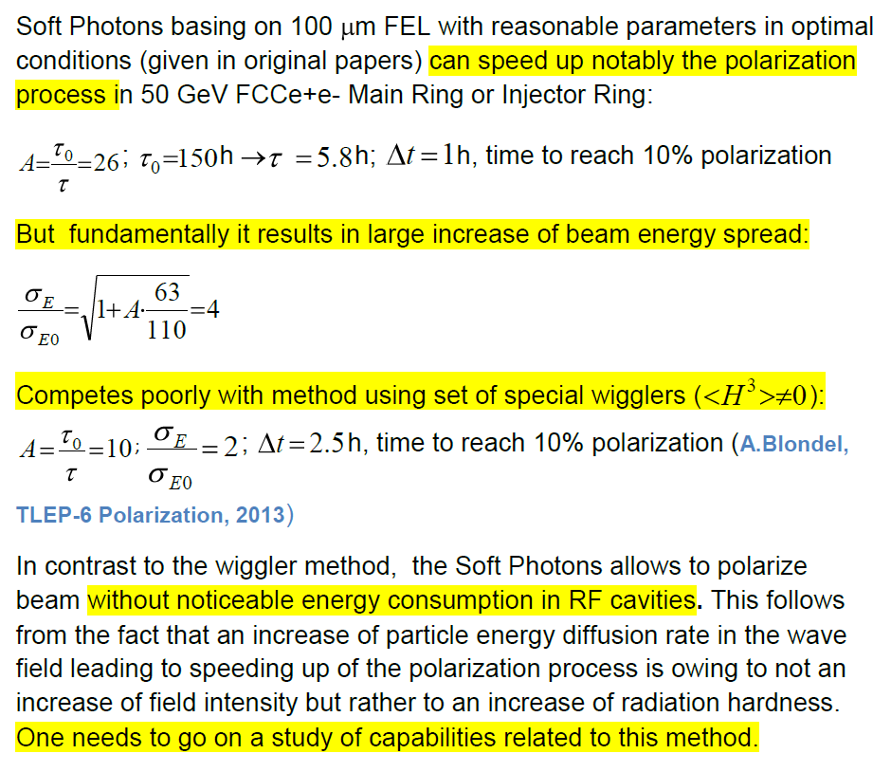
Remark on Soft Photons

Slide 20
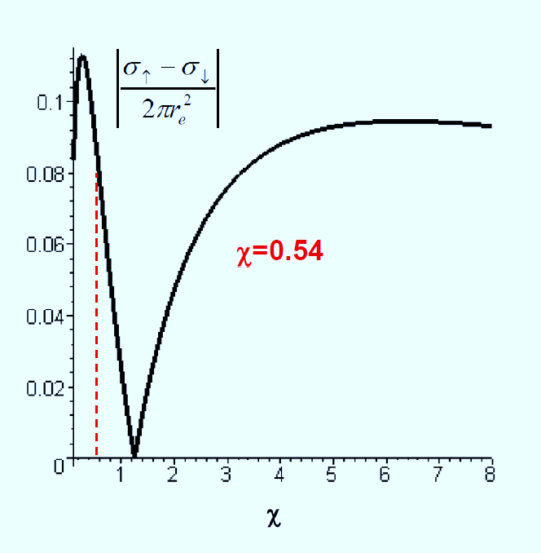
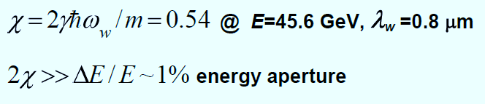
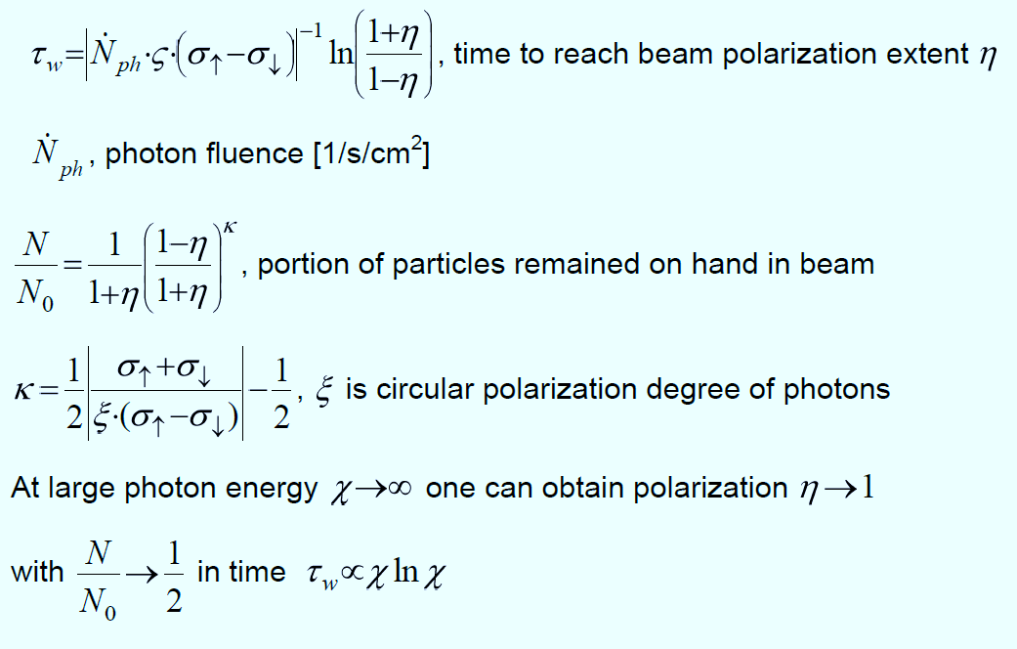
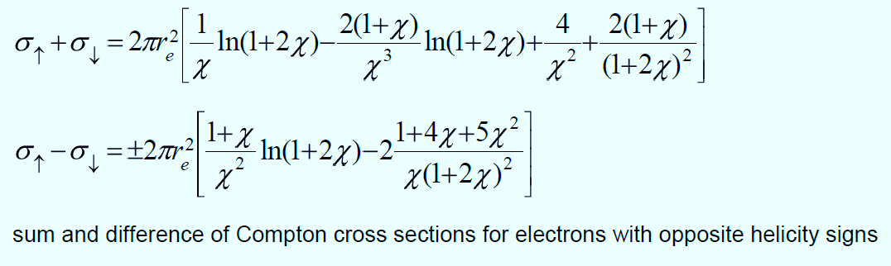
Hard Photons at first sight
Laser
Wish to obtain the larger polarization and to keep more of the particles
contradicts a wish to make the polarization process shorter in a time.

Slide 21
Summary
Possibility to apply the Compton scattering of a waveguide wave to measure a beam energy in the FCCee has been considered for the first time. The two wave concept of the Waveguide Compton beam energy monitor has been proposed allowing to diminish uncertainties related to variation of the waveguide transverse sizes. Preliminarily, the method looks promising because provides a reasonable accuracy of order of 10⁻⁴ with high registration efficiency at low wave power.
One needs to consider competitive schemes to realize the known ideas to use an incident circularly polarized wave for obtaining beam polarization at FCCee.

Slide 22
Acknowledgments
Authors are grateful to N.Vinokurov, I.Koop, G.Kurkin, N.Muchnoi, V.Telnov and G.Tumaikin for discussions
Thank you for attention!

Slide 23
Reserved

Slide 24
Soft Photon for FCCee

Slide 25
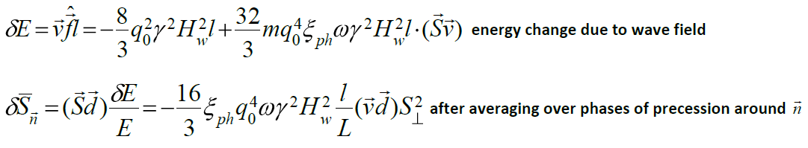
On Soft Photon mechanism
Change of spin motion integral, spin projection on axis of precession, occurs due to radiation. There are direct action of field of radiation on spin (quantum theory) and also indirect one – through perturbation of particle trajectory related to change in energy that is called ‘spin-orbit coupling” and takes into account effect of variation in particle momentum on precession axis d=γ∂n/∂γ (quasi-classical approach).
Polarizing effect of Soft Photons is purely based on indirect action. There is interferential part in field of radiation induced by motion of charged particle with spin and magnetic moment. This part modulated at spin precession frequency yields building-up of polarization. Because of circular polarization of wave with frequency much larger than Larmor one a spin contribution into radiation friction depends on projection of spin on velocity v and so longitudinal projection of d=γ∂n/∂γ in wave-beam interaction region is determinative (A.M.Kondratenko, Doct. Dissertation , 1982):
In case of SR a spin orbit coupling only adds to main polarizing mechanism by Sokolov-Ternov since interference contribution into SR depends on spin projection on field vector. First, spin dependence of SR power was observed at VEPP-4(Novosibirsk) in 1983.
In both cases, fluctuations of radiation lead to depolarization effect of spin-orbit coupling (terms with (γ∂n/∂γ)² )

