Slide 1

Lessons learned from the B-Factories and implications for a high-luminosity circular e+e- Higgs factory
Y. Funakoshi
2014 10.12
HF2014@IHEP

Slide 2
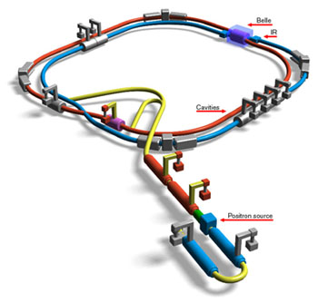
KEKB B-Factory
Crab cavities
1 for each ring
Superconducting cavities (HER)
Belle detector
e-
KEKB B-Factory
♦World-highest Peak Luminosity
    2.11 x 10³⁴cm⁻²s⁻¹
    Twice as high as design value
e+
ARES copper cavities (HER)
ARES copper cavities (LER)
TRISTAN tunnel
♦World-highest Integrated Luminosity
  Total: 1040fb⁻¹ as of June 30th 2010
8 GeV e- 3.5 GeV e+ Linac
♦Crab crossing (φ = 11 mrad)
e+ target
♦Skew-sextupole magnets
The KEKB operation was terminated at the end of June 2010 for the
upgrade toward SuperKEKB. The commissioning of SuperKEKB will
start in autumn in 2015.

Slide 3
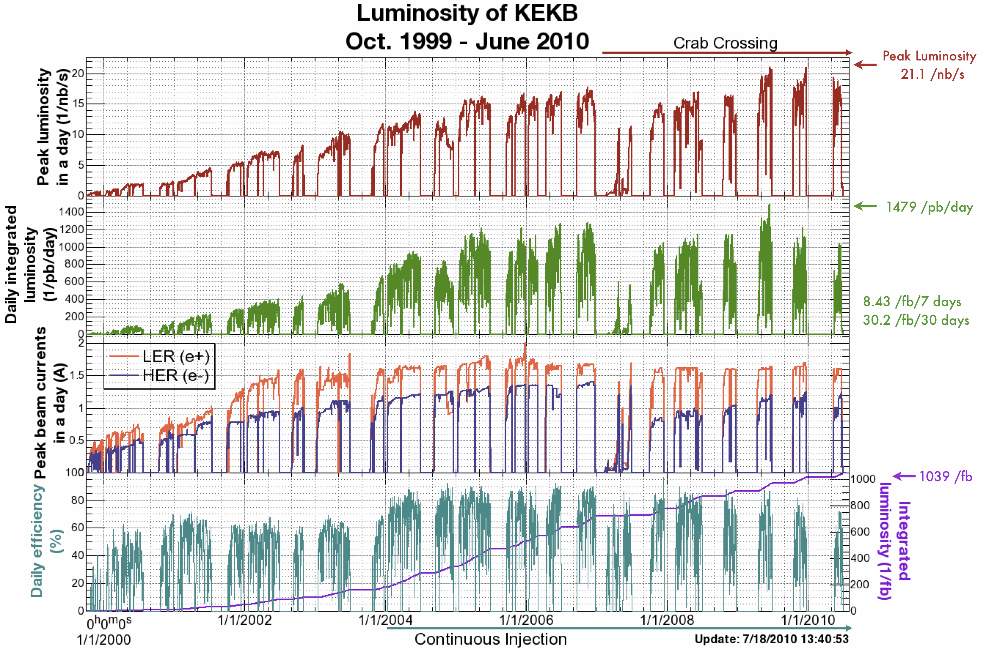
skew-sextupoles
1040

Slide 4
Comparison of parameters
 | KEKB Design | KEKB Achieved : with crab | SuperKEKB Nano-Beam
Energy (GeV) (LER/HER) | 3.5/8.0 | 3.5/8.0 | 4.0/7.0
β_{x}* (cm) | 30/30 | 120/120 | 3.2/2.5
β_{y}* (mm) | 10/10 | 5.9/5.9 | 0.27/0.30
ε_{x} (nm) | 18/18 | 18/24 | 3.2/4.4.6
φ(mrad) | 11 | 11 -> 0 (crab) | 41.5
ξ_{y} | 0.052 | 0.129/0.090 | 0.0881/0.0807
σ_{z} (mm) | 4 | ~ 6 | 6/5
I_{beam} (A) | 2.6/1.1 | 1.64/1.19 | 3.6/2.6
N_{bunches} | 5000 | 1584 | 2500
Luminosity (10³⁴ cm⁻² s⁻¹) | 1 | 2.11 | 80
Power (MV) |  | ~45 | ~71

Slide 5
contents
Electron clouds
BPM
  Optics corrections
  Day-night effect
Collision feedback
Luminosity tuning

Slide 6
electron clouds

Slide 7
Electron clouds at KEKB
Performance degradation
  Beam size enlargements dependent on beam currents in LER (positron ring).
  Specific luminosity degradation corresponding to the beam size enlargements of positron
Counter-measure
  Solenoid winding all around the positron ring
Diagnostic tools
  Sideband measurement system
  RFA(Retarding Field Analyzer)
  Bunch-by-bunch measurement system

Slide 8
Almost all parts of the drift
spaces have been covered with
solenoids.
In summer 2005, we installed
solenoids in 88 quadruple
magnets out of 461.

Slide 9
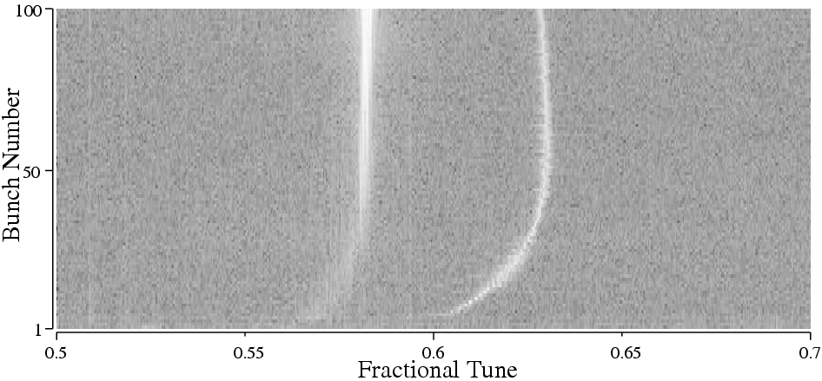
Fourier power spectrum of BPM data
V. Tune
Sideband Peak
LER single beam, 4 trains, 100 bunches per train, 4 rf bucket spacing
Betatron oscillation sidebands in bunch-by-bunch spectra may provide
direct evidence of a fast head-tail motion in a positron beam.

Slide 10
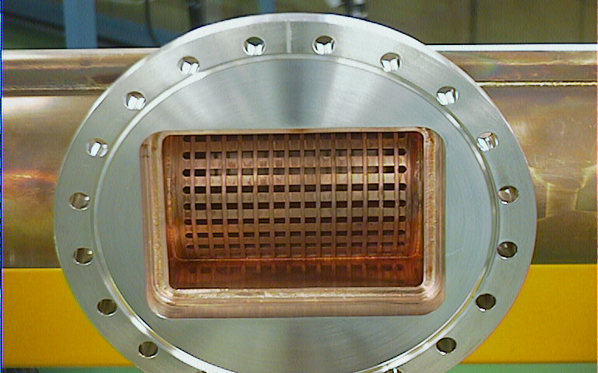
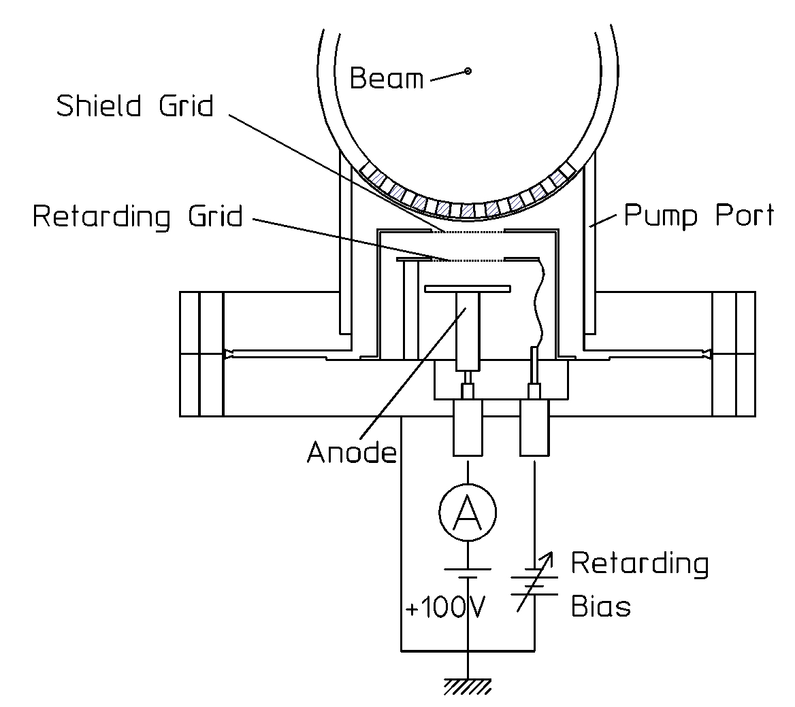
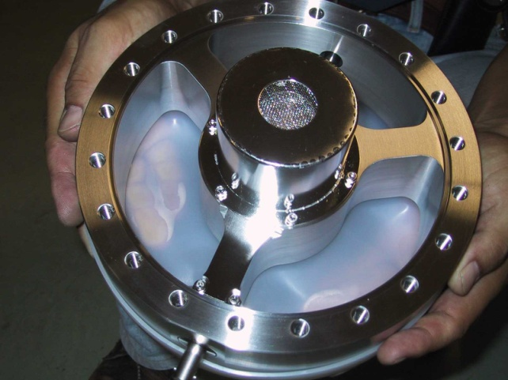
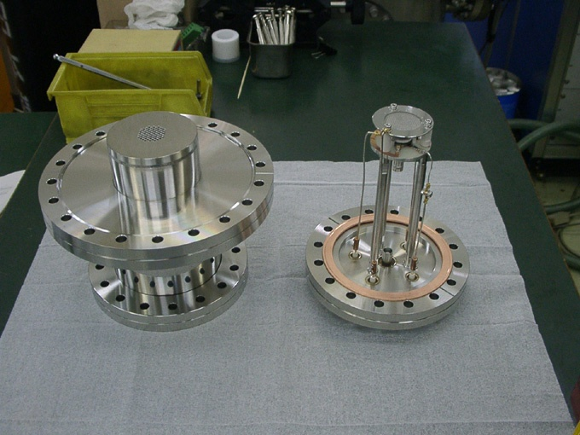
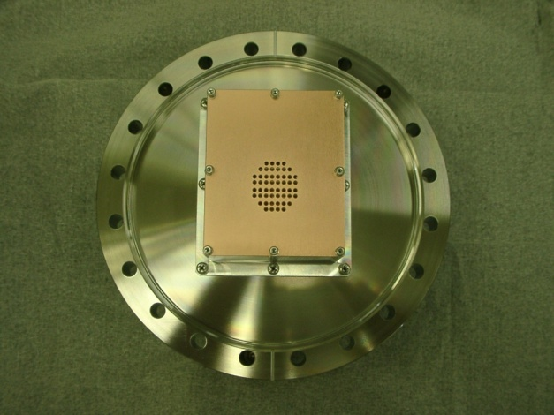
Estimation of the electron cloud density in a drift space
RFA for a drift space
Retarding field analyzer (RFA) type electron monitors are set at pump ports of KEKB LER.
Pump port of KEKB LER
Conceptual drawing of the monitor.
Electron Monitor
(with modified flange)
Monitor with a micro channel plate (MCP) for quick response measurement
HAMAMATSU F4655-12
Recent design

Slide 11
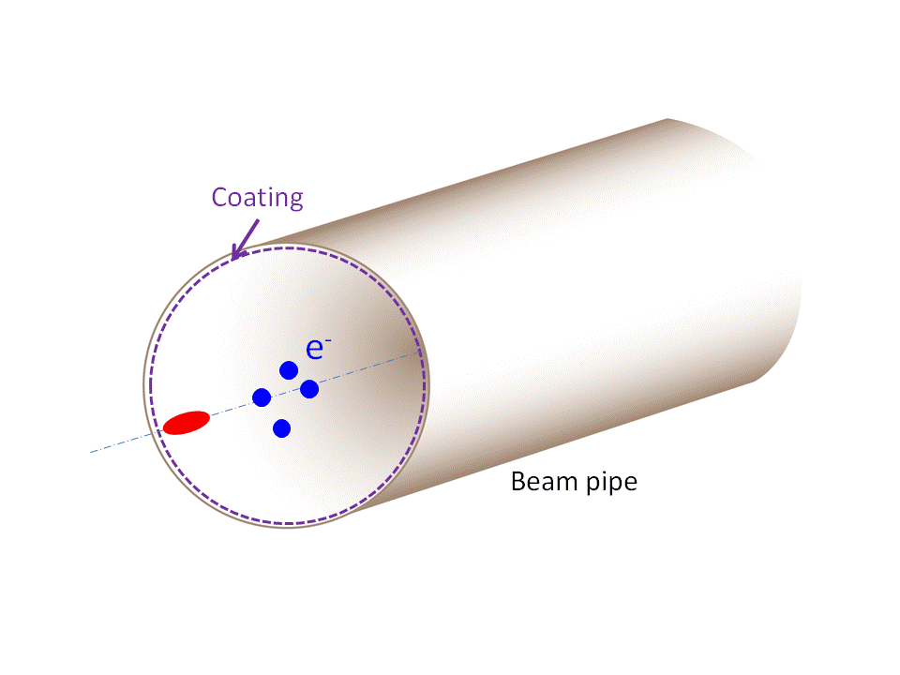
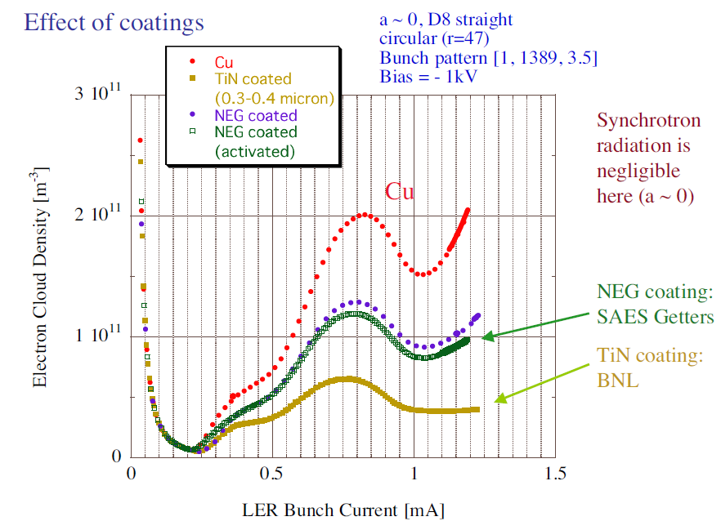
TiN coating
Surfaces with low SEY (TiN or NEG coating, etc.)
Effective to reduce secondary electron emission
δ_{max} (Max. SEY) ~ 1.0 was achieved
TiN: Technology is well established. Comparable or better than NEG coating.
Available in magnets
  by K. Kanazawa

Slide 12
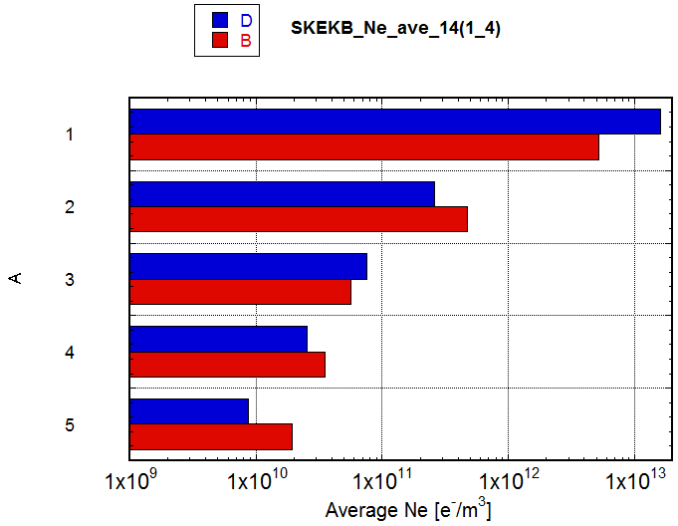
Expected electron density at SuperKEKB
n_{e} after applying countermeasures: estimated from experiments (Red)
Compared with results of CLOUDLAND (Blue)
  δ_{max}=1.2, Solenoid field=50G (→n_{e}=0), Antechamber; photoelectron yield =0.01 (1/10)
n_{e} of approx. 1/5 of the target value is expected.
Condition | ne [m⁻³]
Circular Cu chamber [KEKB beam pipe] | 5.2E12
+Solenoid at Drift (1/50) | 4.7E11
+Antechamber (1/5)+TiN (3/5) | 5.7e10
+Electrode in Wiggler (1/100) | 3.5e10
+Groove in Bend (1/4) | 2.0E10
Target value ne: ~1x10¹¹
KEKB~3x10¹¹
If the latest simulation result on the threshold is true, there is a margin of a factor 25!
Y. Suetsugu

Slide 13
Bunch-by-bunch specific luminosity
~5%
Difference in averaged specific luminosity: ~5%
Electron clouds still restrict the KEKB
performance severely!
Bunch-by-bunch Luminosity by ZDLM
Average of all bunches in the equivalent
buckets in the train.
J. Flanagan

Slide 14
Experiences on electron clouds at KEKB
Counter-measure
  Winding solenoid coils in the drift space in the ring
Tools for analyzing phenomena
  Bunch-by-bunch measurement system has been important
    Bunch-by-bunch BPM
    Bunch-by-bunch luminosity monitor
  RFA monitor has been used to measure electron cloud density

Slide 15
BPMs

Slide 16
BPM at KEKB
BPM for closed orbit measurements
  equipped at every quadruple magnets (~470 BPMs for each ring)
  position resolution: ~ 1 μm (@ 30mA)
  orbit correction and optics corrections for routine beam operation is done with these BPMs
    global orbit correction: every ~20 sec.
    Optics correction: every two weeks (after regular maintenance time)
    BPM gain mapping (using beams): typically once a month
    Quad BPM (BPM offsets relative to quadrupoles): typically once a year
Turn-by-turn BPMs
  38 BPMs for each ring (monitor heads are common for COD measurements)
  used for orbit measurements after long-shut down (before beam accumulation)
  used for machine studies

Slide 17
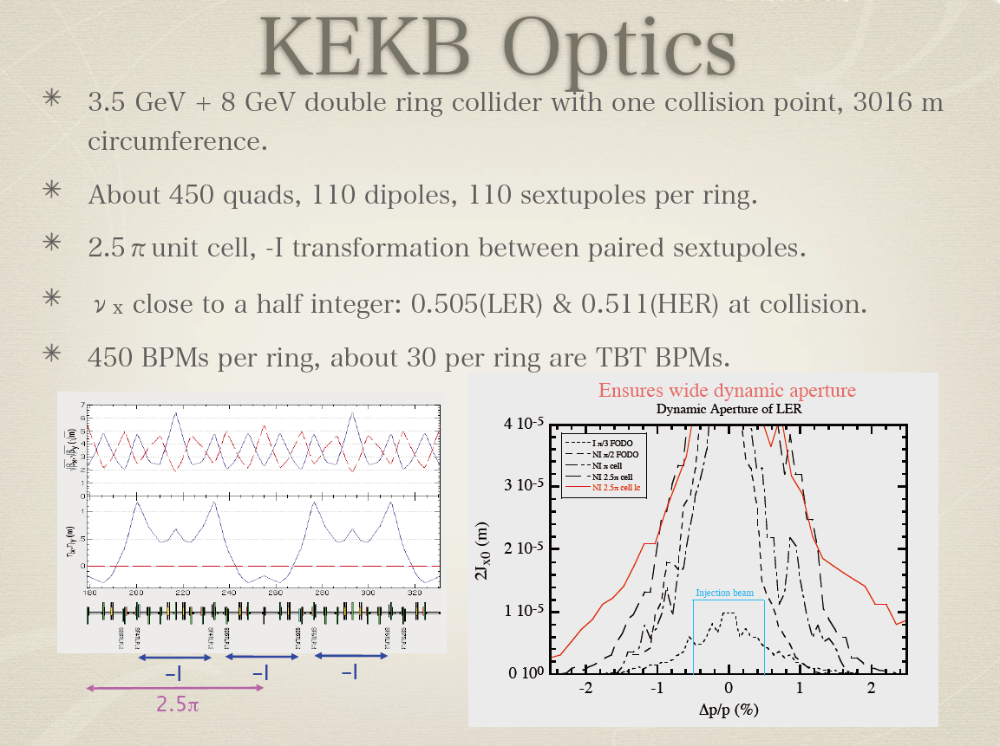

Slide 18
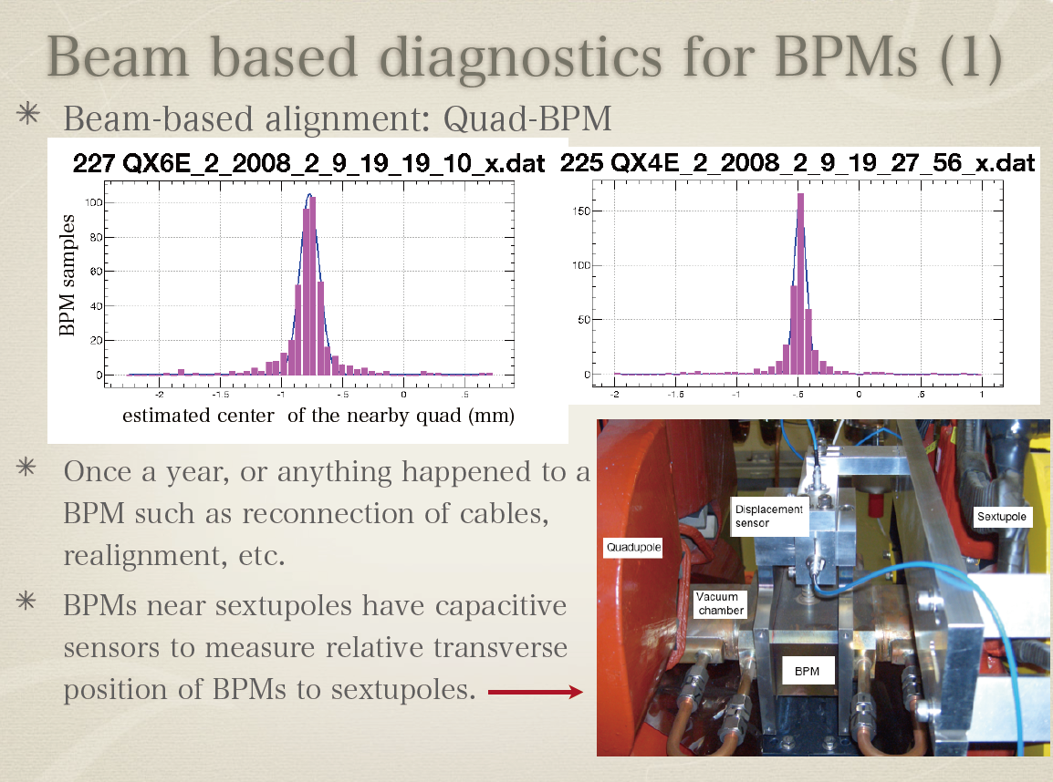

Slide 19
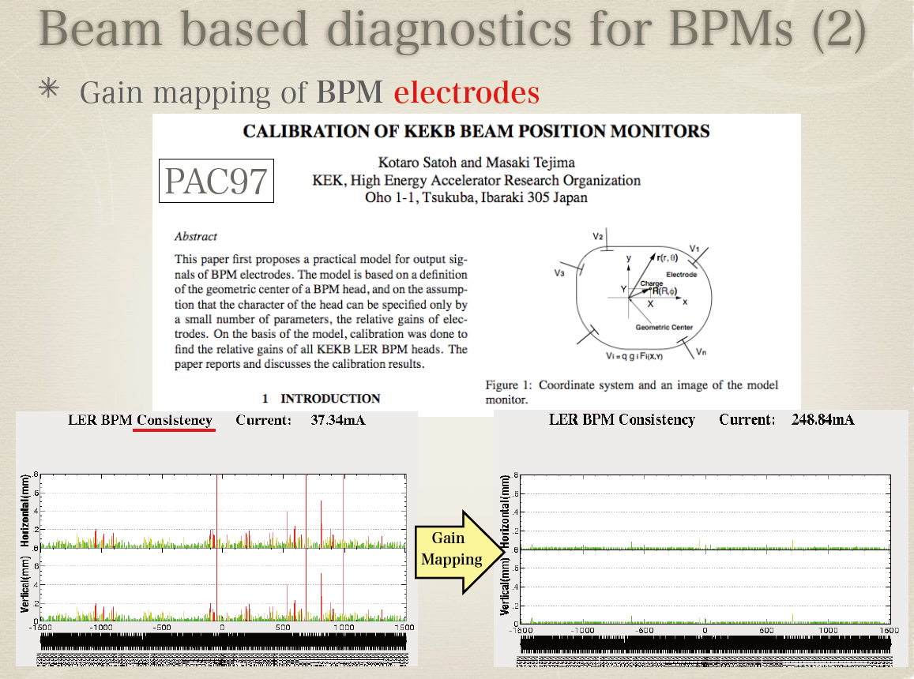

Slide 20
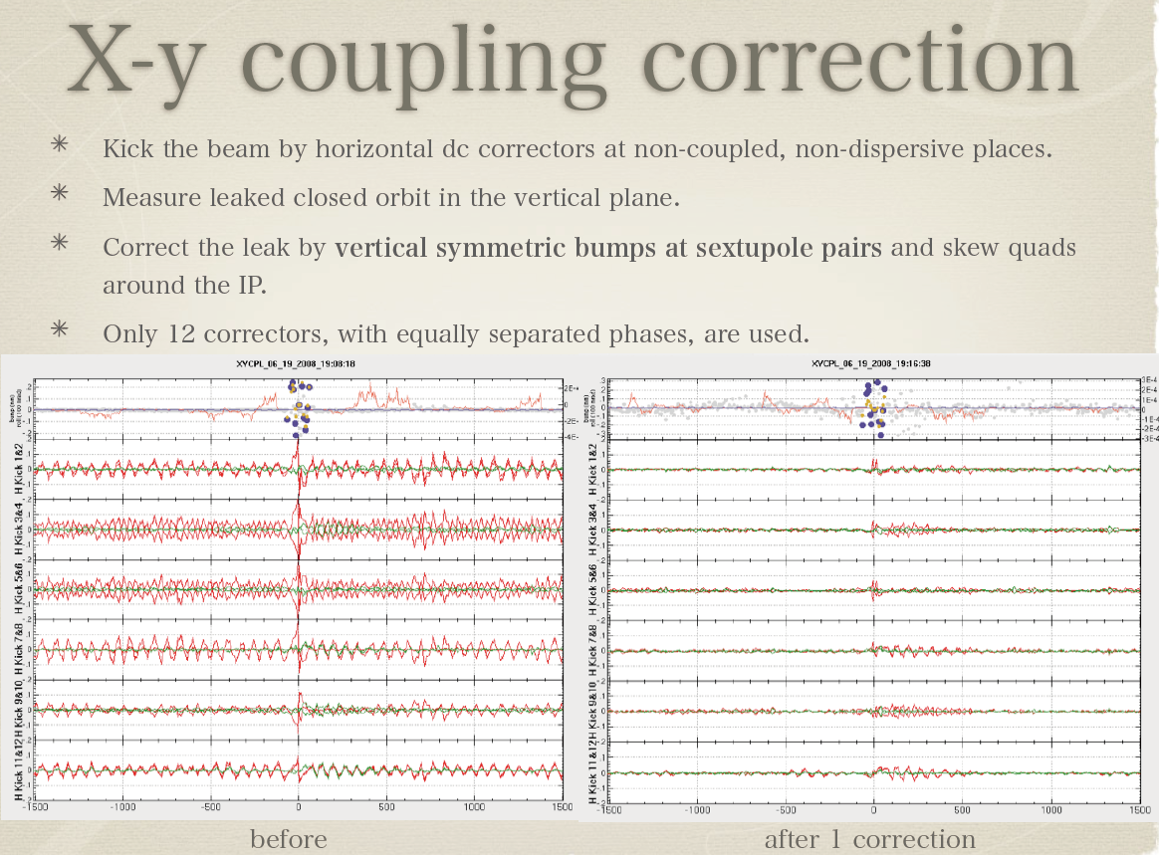

Slide 21
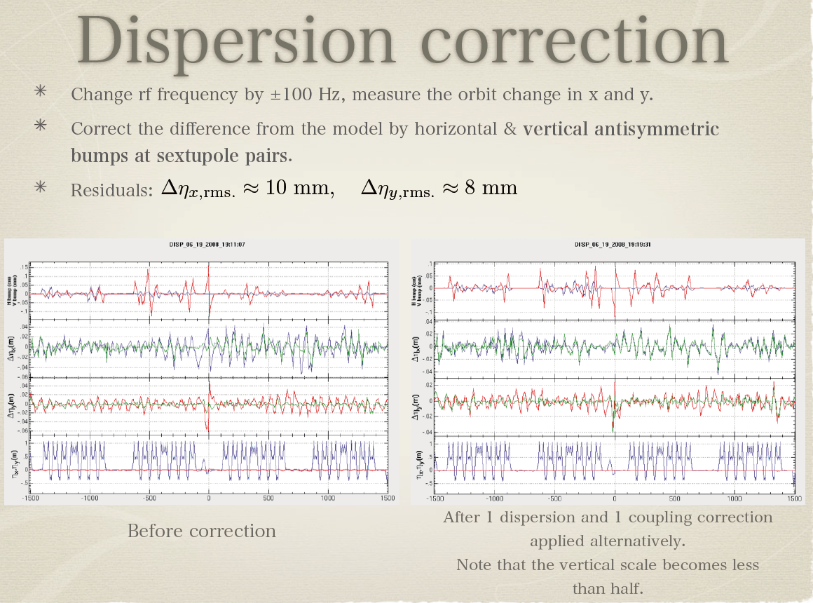

Slide 22
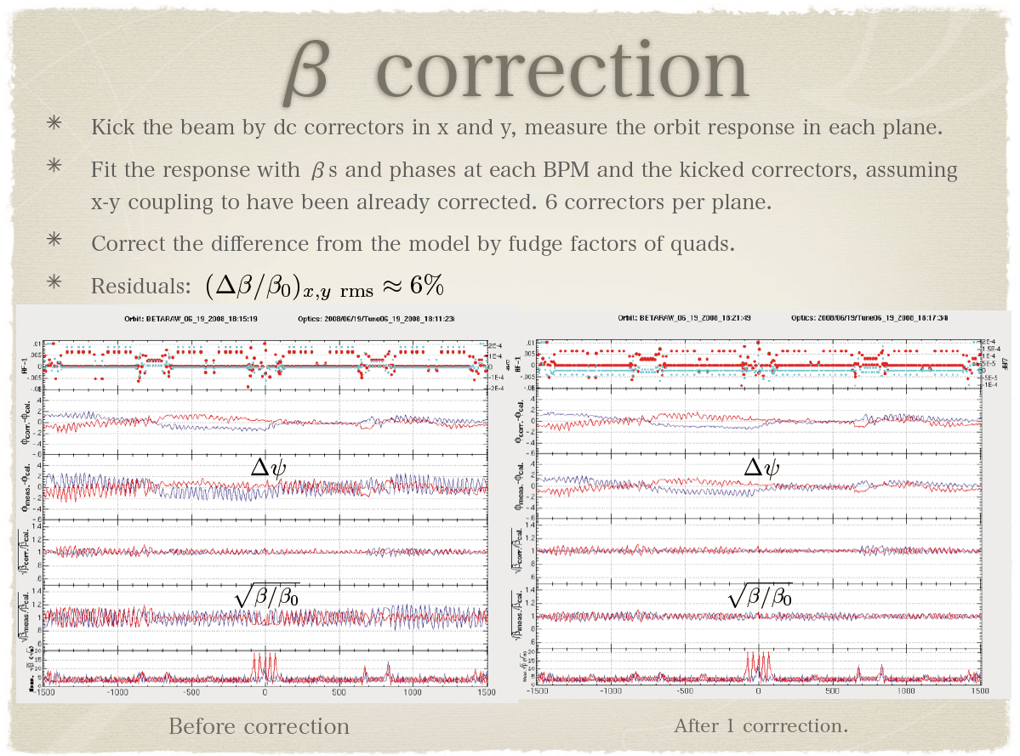

Slide 23
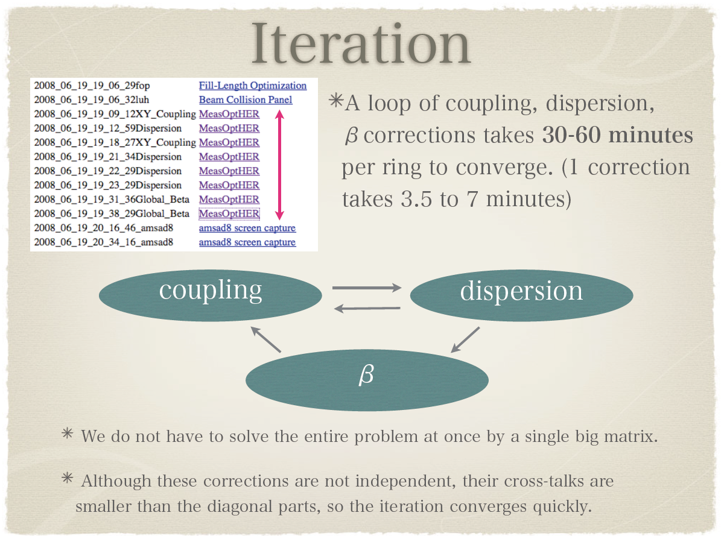

Slide 24
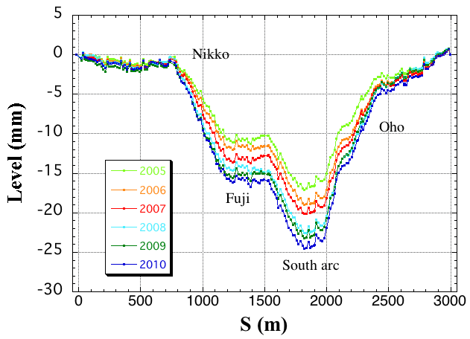
Deformation of KEKB tunnel
In the construction period of KEKB (1998), all magnets were aligned on a horizontal plane.
The tunnel deformation has been well compensated by frequent optic corrections.

Slide 25
Day-night change of luminosity
The problem became first conspicuous in March 2003.
The problem became serious in spring 2005.
Observations:
  The KEKB luminosity degrades in the daytime by about 20% at the worst.
  The luminosity degradation seems to depend on temperature difference between day and night.
  The effect is not remarkable in winter or on a rainy day.
  When the luminosity degrades, the HER beam blowup is observed.
  Tuning on the x-y coupling parameters at IP is somewhat effective to mitigate the degradation, although its effectiveness is insufficient.

Slide 26
Efforts to solve the problem
BPM consistency
3 electrodes -> beam position
-> 4 sets of beam position
BPM consistency
  RMS of 4 beam position data
Efforts toward solving the problem
  Many efforts had been devoted in vain.
    Such as spraying water on the building where the Belle detector is located.
  Finally we found the reason for the problem:
    We found that the BPM consistency also showed day-night difference.
    A part of BPM cables go through the outside of buildings and were affected by the temperature change.
    Orbit corrections based on inaccurate BPM readings seemed to bring the optics deformation and result in the luminosity degradation.
Countermeasure
  Installation of thermal insulator sheets for the BPM cables in the outside.
  The BPM consistency difference (day-night) was reduced by 30 or 50 %.
  The day-night difference in the luminosity almost disappeared.

Slide 27
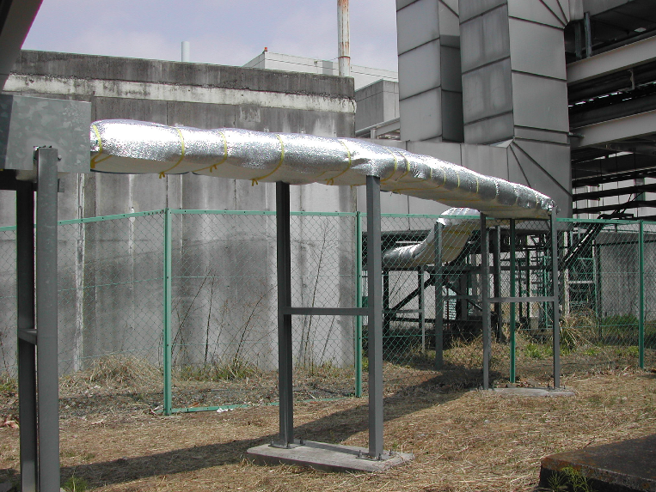
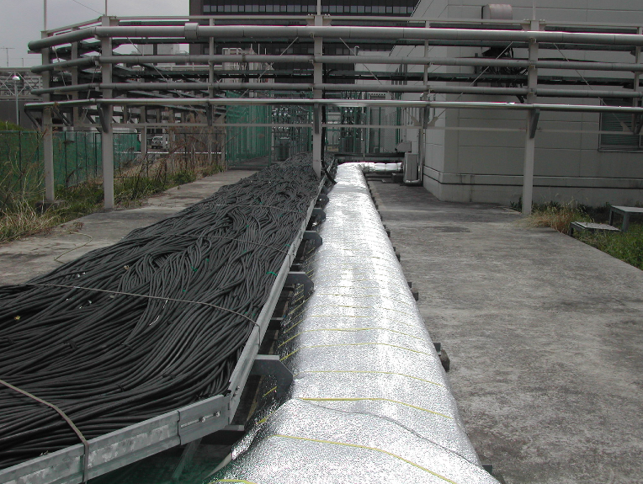
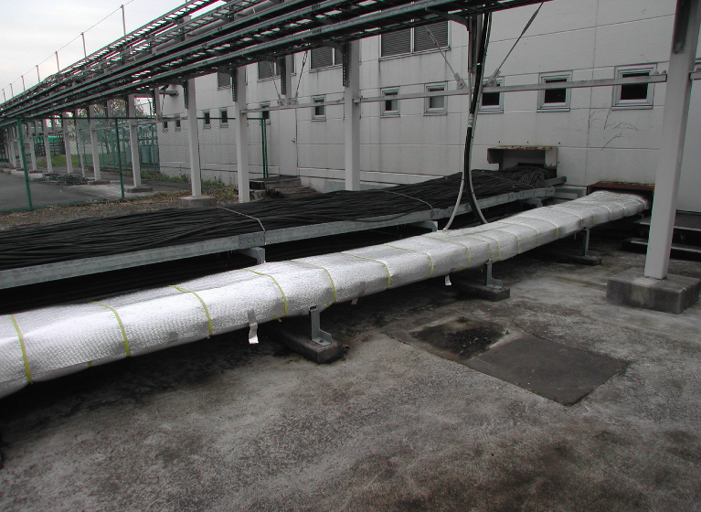
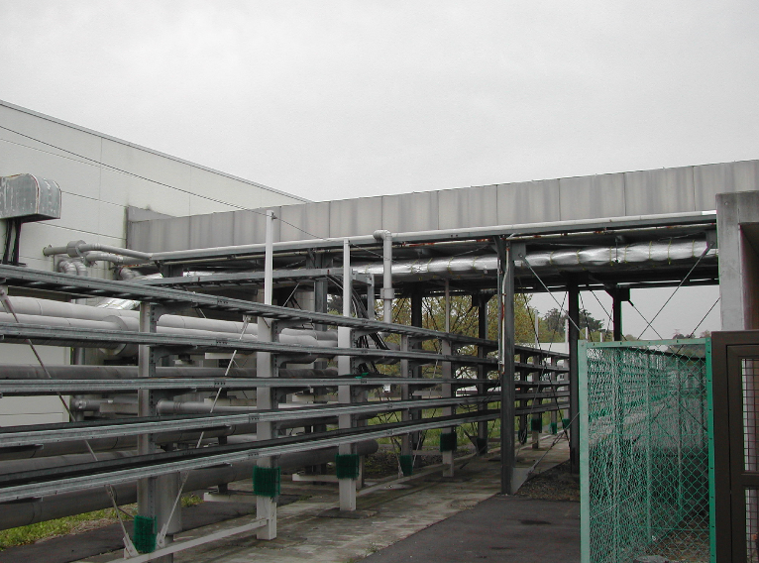
Installation of thermal insulator sheets
2005/04/22
M. Tejima
LC4
D06
D03
LC2

Slide 28
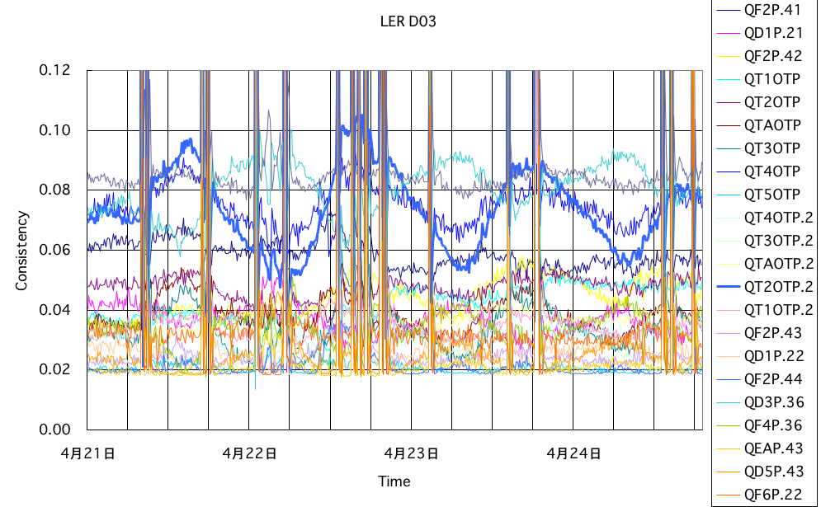
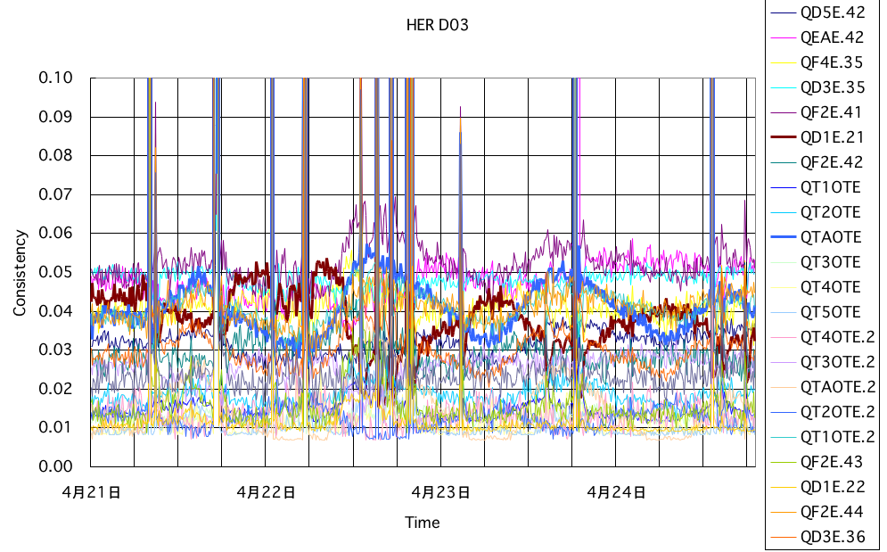
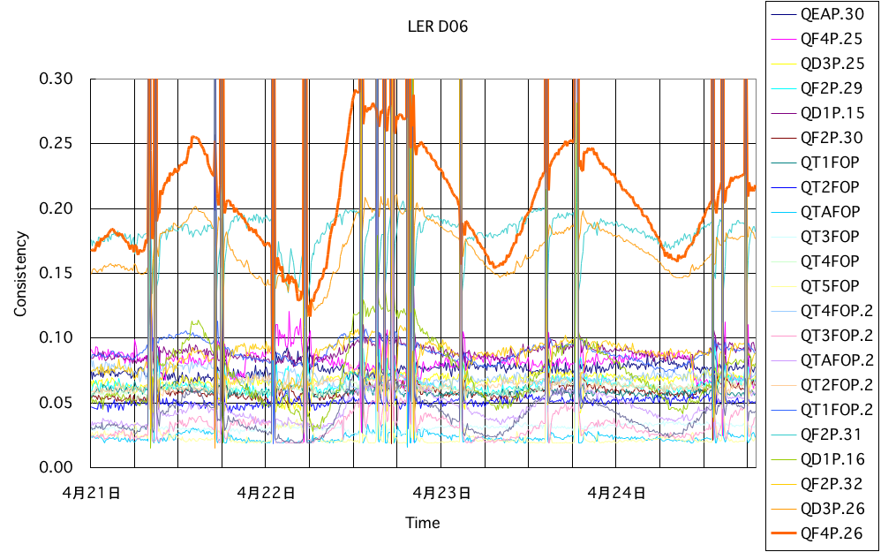
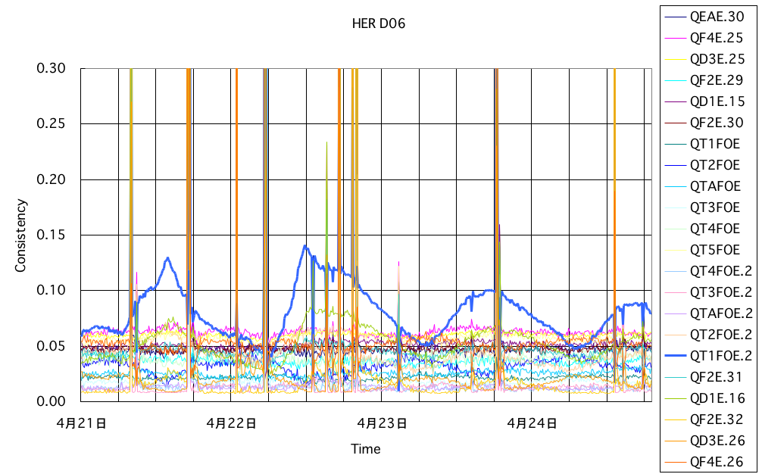
Effectiveness of thermal insulator sheets
LER D03 BPM consistency
HER D03 BPM consistency
Consistency [mm]
sheets
sheets
LER D06 BPM consistency
HER D06 BPM consistency
sheets
sheets

Slide 29
Experiences of optics corrections at KEKB
Corrections based on the COD measurement
  KEKB did not have many turn-by-turn BPMs
  Global COD correction was done continuously every ~20 seconds.
  Optics corrections were done every 2 weeks.
    Method of iteration of x-y coupling, dispersions and β-beating was used.
    The methods worked very well even with the large tunnel deformation based on BPM measurements.
    However, when the BPMs give the incorrect values, the luminosity tuning has a trouble such as the day-night problem which KEKB encountered.
    It seems that the BPM gain mapping and Quad-BPM tuning are very important at high luminosity machines.

Slide 30
Collision feedback

Slide 31
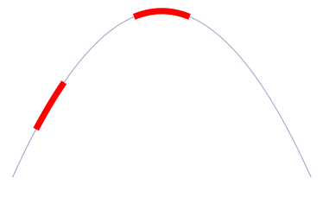
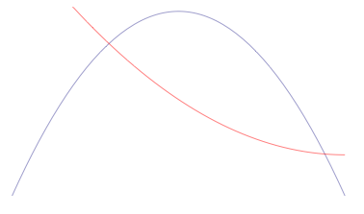
Orbit feedback at IP :Algorism
Beam-beam deflection (SLC, KEKB vertical)
Luminosity feedback (dithering)(PEP-II)->SuperKEKB
Beam size feedback (KEKB horizontal)
Δy at IP=
~5nm ~1/10σ_{y}*
BPM
Δy at BPM= ~1.4μm
SupeKEKB case
IP
BPM
When we shake the beam at around the peak of
the luminosity, there appears twice of the
frequency of the dithering frequency, while the
dithering frequency component becomes minimum.
Luminosity
y
Luminosity
At KEKB before installation of crab cavities,
the vertical beam of LER was used for the
horizontal orbit feedback at IP.
Beam size
σ_{y} (LER)
x

Slide 32
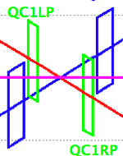
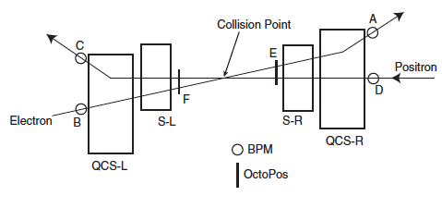
Sensitivity of detection of beam-beam kick
Comparison between KEKB
and SuperKEKB
BPMs at SuperKEKB should
have 4 times higher
sensitivity than KEKB.
-> ~1μm resolution with 1kHz
 | KEKB | SuperKEKB
β_{y}* | 5.9mm | 0.27mm
ε_{y} | 0.15nm | 8.6pm
 | 1.59 x 10⁻⁴ | 1.78 x 10⁻⁴
 | 2.0m | 0.5m
BPM (~ 50cm from IP)
SuperKEKB
KEKB
A,B,C,D: BPM ~2.4m fromIP

Slide 33
IP machine parameters
 | KEKB |  | SuperKEKB
 | LER | HER | LER | HER
ε_{x} | 18nm | 24nm | 3.2 | 5.0
ε_{y} | 0.15nm | 0.15nm | 8.6pm | 13.5pm
κ | 0.83 % | 0.62% | 0.27% | 0.25%
β_{x}* | 120cm | 120cm | 32mm | 25mm
β_{y}* | 5.9mm | 5.9mm | 0.27mm | 0.31mm
σ_{x}* | 150μm | 150μm | 10μm | 11μm
σ_{x}’* | 120μrad | 120μrad | 450μrad | 320μrad
σ_{y}* | 0.94 μm | 0.94μm | 48nm | 56nm
σ_{y}’* | 0.16mrad | 0.16mrad | 0.18mrad | 0.22mrad
iBump horizontal offset |  | +/- 500μm |  | +/- 50μm
iBump vertical offset |  | +/- 150μm |  | +/- 30μm
iBump vertical angle |  | +/- 0.4mrad |  | +/- 40μrad
Effective σ_{x}* |  |  | 249μm | 207μm
Δy_{BPM} corresponding to σ_{y}*/10 | ~5.0μm |  | ~1.3μm
~1/20
~1/20
~1/20
~1/4

Slide 34
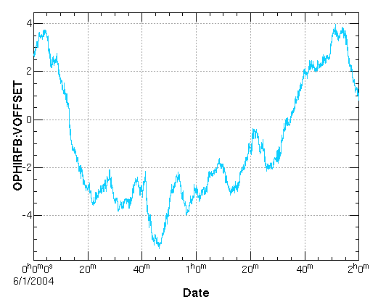
History of vertical offset with the orbit feedback on (KEKB observation)
~9μm
σ_{y}* : 1 ~ 2μm -> Orbit feedback is vital at KEKB.
BPM resolution ~ 2μm. Repetition time of orbit measurement: 1~4 seconds.
Repetition time of orbit feedback: ~> 1 second (software feedback)

Slide 35
Some experiences of IP orbit feedback at KEKB
In double ring colliders such as KEKB, an orbit feedback system for maintaining the beam orbits around IP is vital.
  Without such a system, we cannot maintain the luminosity even for a short period.
With the system based on BPM measurement, we could prevent luminosity loss due to orbit change almost completely.
One of the problems with the system was the stability of the target values of the feedback.
  To trace their changes, we frequently (typically once an 8-hour shift) had to do the target scan for optimum values.
  The origin of the target change was thought to be mechanical movement of the BPMs or the QCS magnets.
    We experienced that the target changes greatly after beam aborts.
    Our observations have shown that heating of vacuum chambers brings sizable mechanical movement of the vacuum chamber and BPMs (and even of the quadrupole magnets).
    Counter-measures: Reinforcement of the cooling power of the IR vacuum chambers, displacement sensors for BPMs, introduction of continuous beam injection scheme

Slide 36
SuperKEKB IP orbit feedback system
Vertical (based on BPM measurement)
  Offset: beam-beam deflection
    Low emittance and low-β -> Vibrations of final focus quadrupoles become problems?
    Coherency of vibrations of magnets for electron and positron is important.
  Angle (crossing angle): BPM measurement
Horizontal (dithering system)
  Offset:
    very small beam-beam parameter -> dithering system
    collaboration with SLAC and LAL
  Angle (crossing angle): no feedback

Slide 37
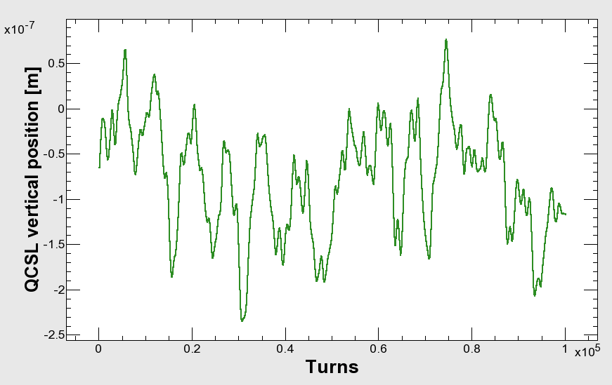
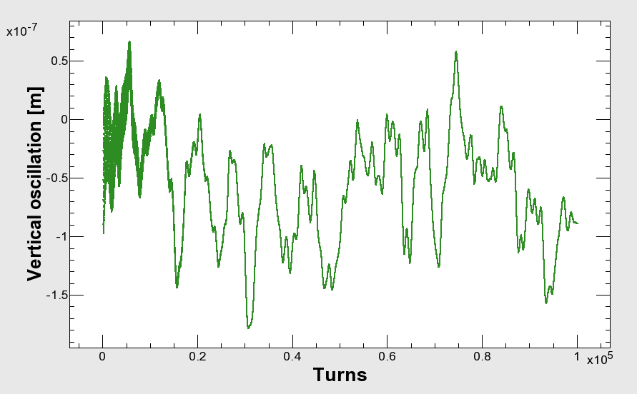
QCSL(KEKB) vertical position oscillation (measurement) and orbit change (tracking) at SuperKEKB HER
QCSL vertical position
(measurement)
Vertical orbit at IP
(tracking simulation)
200nm -> ~4σ_{y}*
If the QC1L magnets of SuperKEKB vibrates with the same amplitude
of the QCSL of the KEKB, the orbit change at IP amounts to 4σ_{y}*.

Slide 38
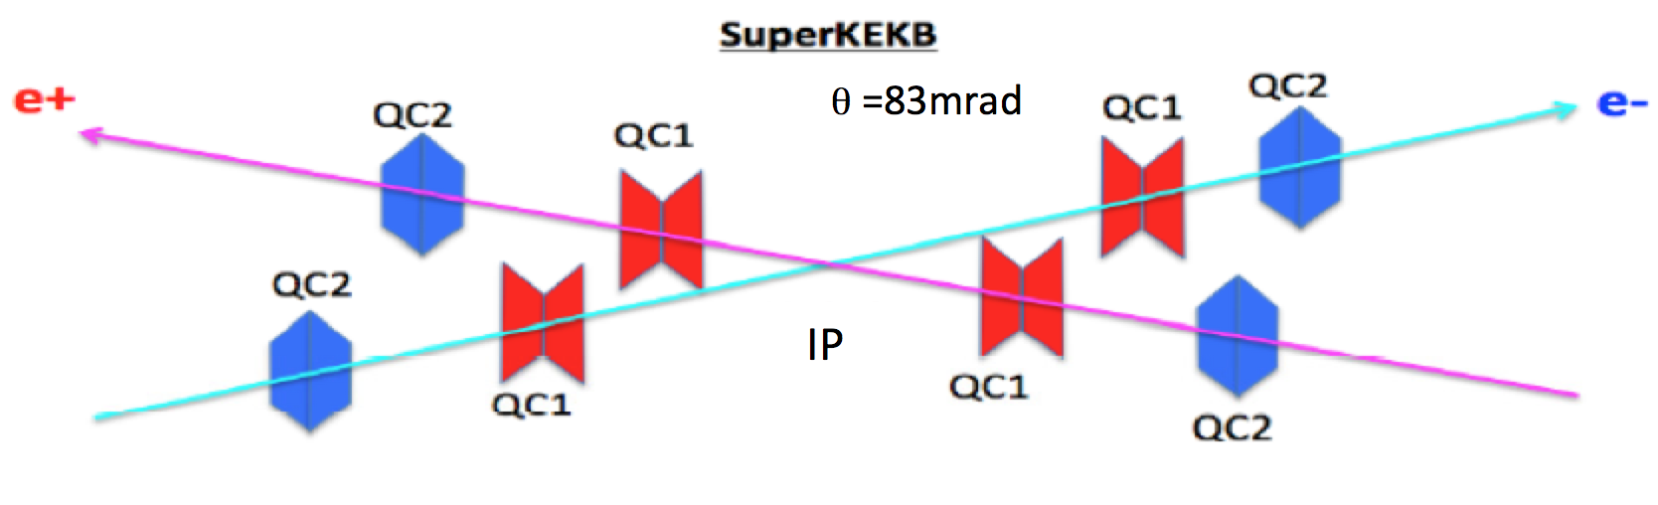
Countermeasures
Reinforcement of supports for QCS magnets
Rely on the coherency of the oscillation of QC1P and QC1E (QC2P and QC1E).
Fast orbit feedback

Slide 39
Orbit change at IP with 1μm offset of QCS magnets
Lattice : sler_1689, sher_5769
 |  | K1 (/m) | Distancefrom IP [m] | β_{Q} [m] max. | β_{IP}[mm] | Δψ_{y}/2π | COD@IPfor 1μm Q-offset [μm]
QC1L (V) | LER | -1.721 | 0.920 | 2897.7 | 0.27 | 0.24995 | -0.734
 | HER | -1.206 | 1.165 | 5834.8 | 0.3 | 0.24995 | -0.768
QC1R (V) | LER | -1.712 | 0.930 | 2897.8 | 0.27 | 0.24995 | -0.736
 | HER | -1.140 | 1.172 | 5895.0 | 0.3 | 0.24995 | -0.730
QC1L (H) | LER | 1.721 | 0.920 | 153.0 | 32 | 0.24364 | 0.867
 | HER | 1.206 | 1.165 | 310.7 | 0.3 | 0.24616 | 0.901
QC1R (H) | LER | 1.712 | 0.930 | 156.9 | 32 | 0.24372 | 0.882
 | HER | 1.140 | 1.172 | 305.5 | 0.3 | 0.24619 | 0.857
>
>
>
>
V:1μm (QC1 offset) <-> ~0.7μm orbit change at IP
H:1μm (QC1 offset) <-> ~0.9μm orbit change at IP
COD
Horizontal orbit vibration due to QC1 vibration (~ <1Hz) ~< 0.2 μm

Slide 40
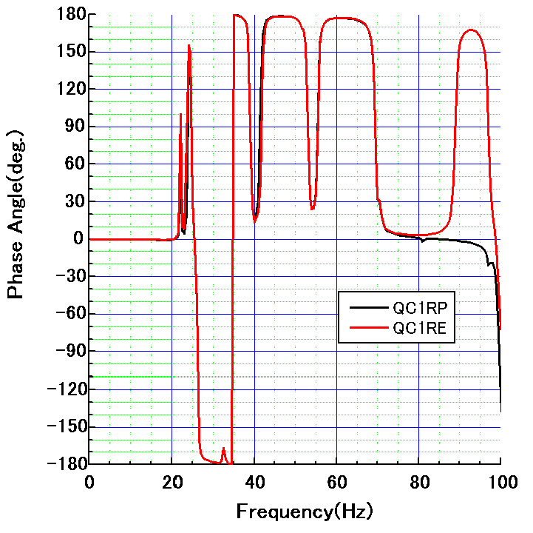
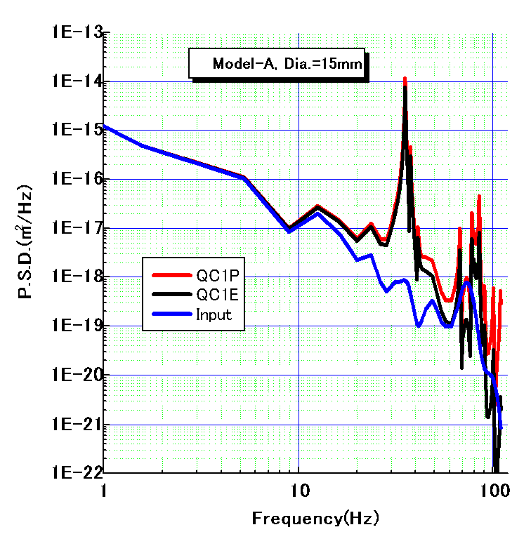
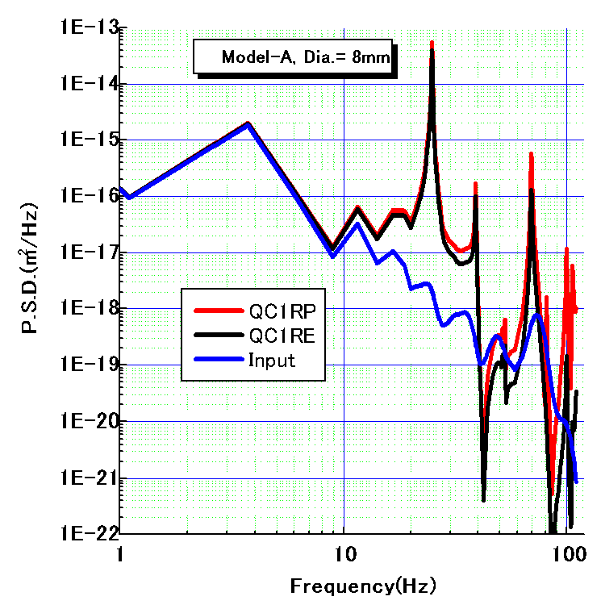
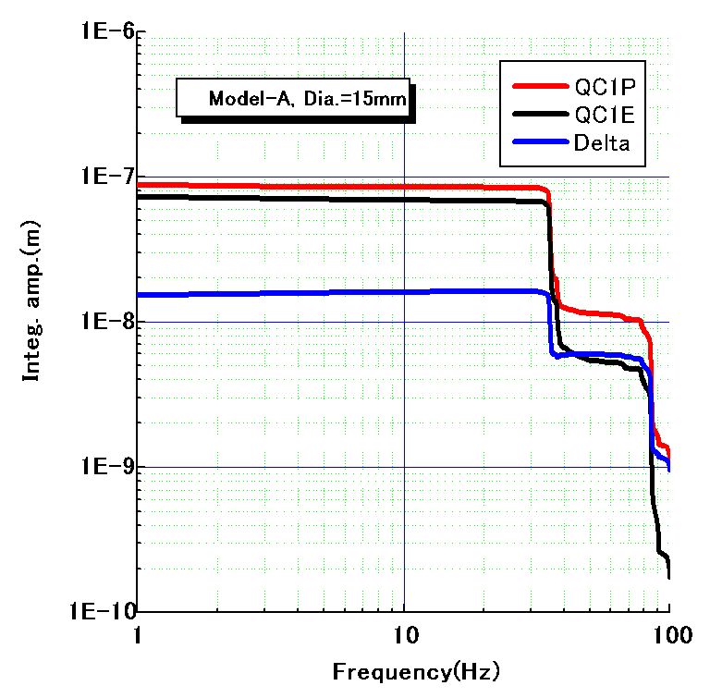
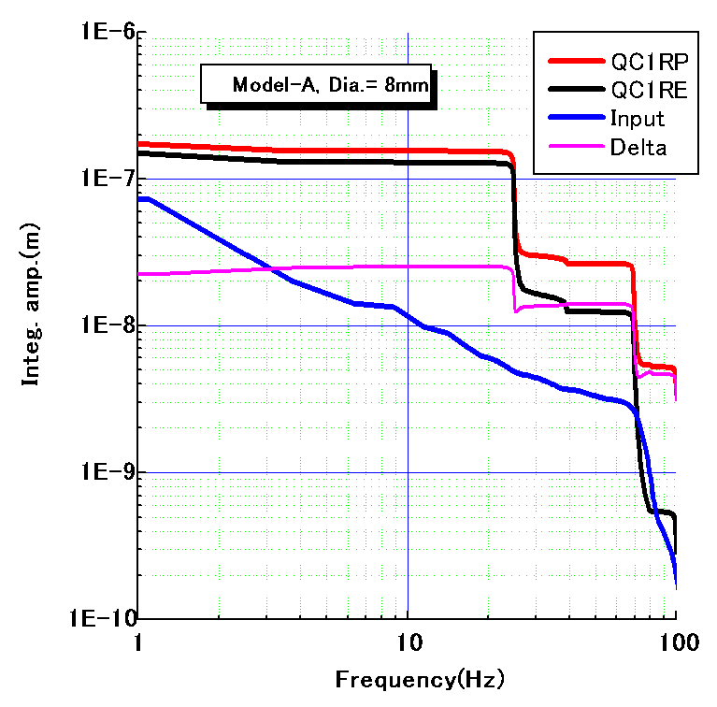
Model-A
Right side of IP
Left side of IP
Oscillation phases of
QC1RP and QC1RE.
25nm@20Hz
14nm@50Hz
Simulation on QCS vertical vibrations

Slide 41
Estimation of QCS vibration and luminosity degradation
1000
100
10
1
0.1
(vertical)
Integral amplitude (nm)
Measured
ground motion
(input data)
Phase (deg.)
25 nm@25 Hz
H. Yamaoka
QC1RP and QC1RE vibrate with the same phase,
but the orbit difference vibrates with an amplitude of ~25 nm at 25 Hz…
Luminosity degradation (based on beam-beam simulation by K. Ohmi)
Frequency (Hz) | 24.85 | 38.93 | 69.34 | 99.60
Δy_{IP*}^{rms} (nm) | 18.63 | 1.72 | 8.29 | 3.14
L/L₀^{average} (%) in case of model-A (and F) | 95.4 (96.1) | 99.8 (99.8) | 99.7 (99.8) | 99.7 (99.8)

Slide 42
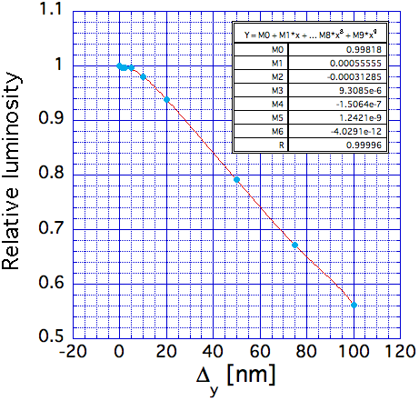
Beam-Beam simulation results
K. Ohmi
static orbit offset at IP
Vertical offset of 20nm leads to 6 % degradation of luminosity.

Slide 43
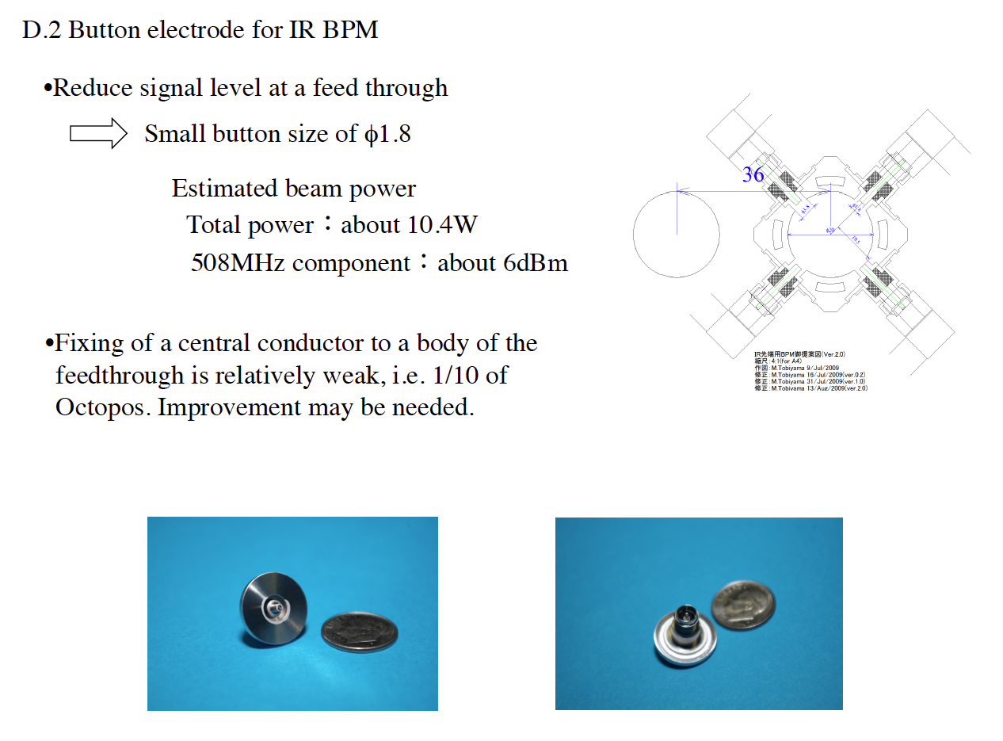

Slide 44
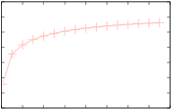
Rejection gain evaluation of the fast feedback system (SuperKEKB)
plant
1st order lag
(delay = 0.21ms)
H. Fukuma
delay
3 clocks
reference
+
PID
+
D
Ga
Ge
−
+
monitor out
PID tuning
Ziegler-Nichols
ps & magnet
1st order lag
(delay = 0.1ms)
disturbance
M
monitor LPF(FIR)
Fs = 32kHz
Group delay of LPF =0.4ms
10
0
− 10
− 20
− 30
− 40
− 50
− 60
Result shows
−16.7dB@25Hz is expected.
Amplitude of Δy_{IP*}^{rms} @25Hz will be
reduced from 19 nm to 2.8 nm.
Rejection gain (dB)
0 20 40 60 80 100 120 140 160
Frequency (Hz)

Slide 45
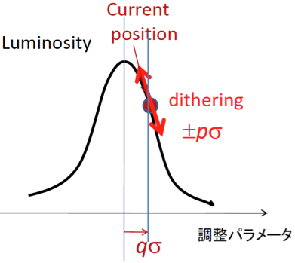
Feedback scheme in horizontal direction (x)
Beam-beam kick will not be a sensitive parameter for monitoring collision, as beam-beam parameter ξx is so small:
        ξx ~ 0.0028(e+), 0.0012(e-)
        (↔ ξy ~ 0.0881(e+), 0.0807(e-))
Beams are not so much deflected in horizontal direction.
⇒The Luminosity dither is being considered, which was used for PEP-II successfully.
When two beams overlap, the luminosity drops on either side of the peak, giving modulation at 2ω_{dith}.
Off center, there is additional modulation at the fundamental.
Dithering simulation by U. Wienands and S.Uehara:
Max. dithering amplitude, which corresponds to 10 % drop of the peak luminosity should be prepared.
Δx

Slide 46
Luminosity dither system for horizontal feedback
(+ vertical offset and angle)
  (1) Fast luminosity monitor (ZDLM): S. Uehara and P. Bambade (LAL).
(2) Electronics to discriminate dither signals:
  Lock-in amplifiers and/or digital technic are considered.
(3) Beam pipes: made of stainless steel for magnetic field penetration.
(4) Air-core dithering coils:
    - Dithering coils will be installed into 8 locations.
    - Dither frequency: 60~100 Hz is chosen to avoid power line interference.
    - Kick angle of dither coils: to generate ±50 μm horiz. bump.
    - Design work, production and field measurement are under way at SLAC.
(5) Power supplies for actuating coils: commercial bipoler PS (± 65 V, ± 5 A).
(6) Iron-core steering magnets at HER for orbit correction.

Slide 47
Luminosity tuning

Slide 48
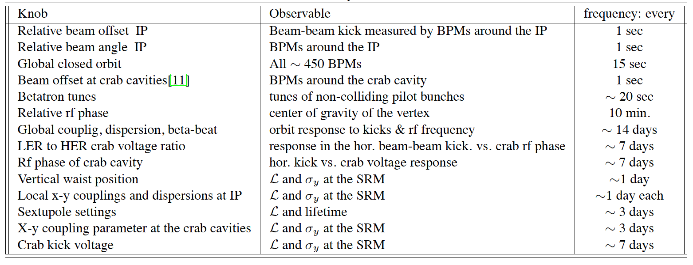
Tuning knobs for luminosity at KEKB
chromaticity of x-y coupling at IP
L and σy at the SRM
~3days
Many tuning parameters used to be tuned one-by-one by scans with only observing the luminosity and the beam sizes.
There was a possibility that we could not reach an optimum set of parameters with this method.
A method of parameter search based on downhill simplex method was developed in 2007, which can search 12 parameters simultaneously. The speed of the luminosity tuning became faster. However, with this method the achievable luminosity was not improved.

Slide 49
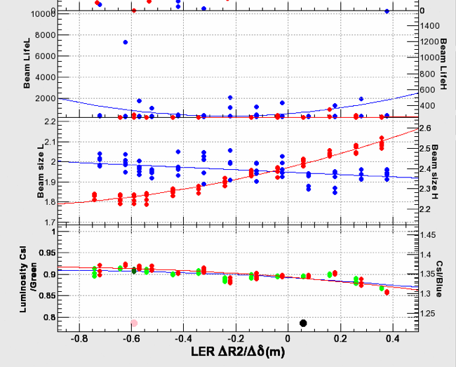
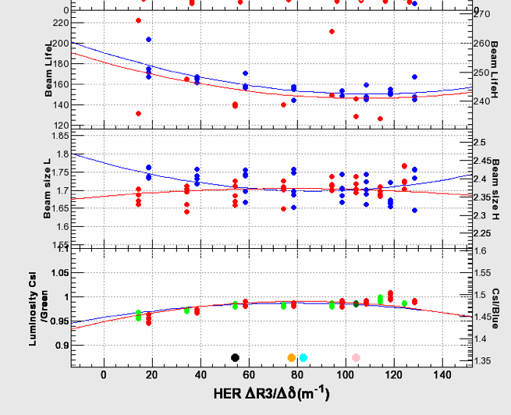
Examples of scan of chromatic x-y coupling at IP
Machine operators did this kind of scans almost always even during physics run.
Luminosity: end cap CsI calorimeter, update very ~ 40 sec
SRM: beam size monitor (SR-interferometer)
Luminosity monitor and beam size monitor were essentially important at KEKB.

Slide 50
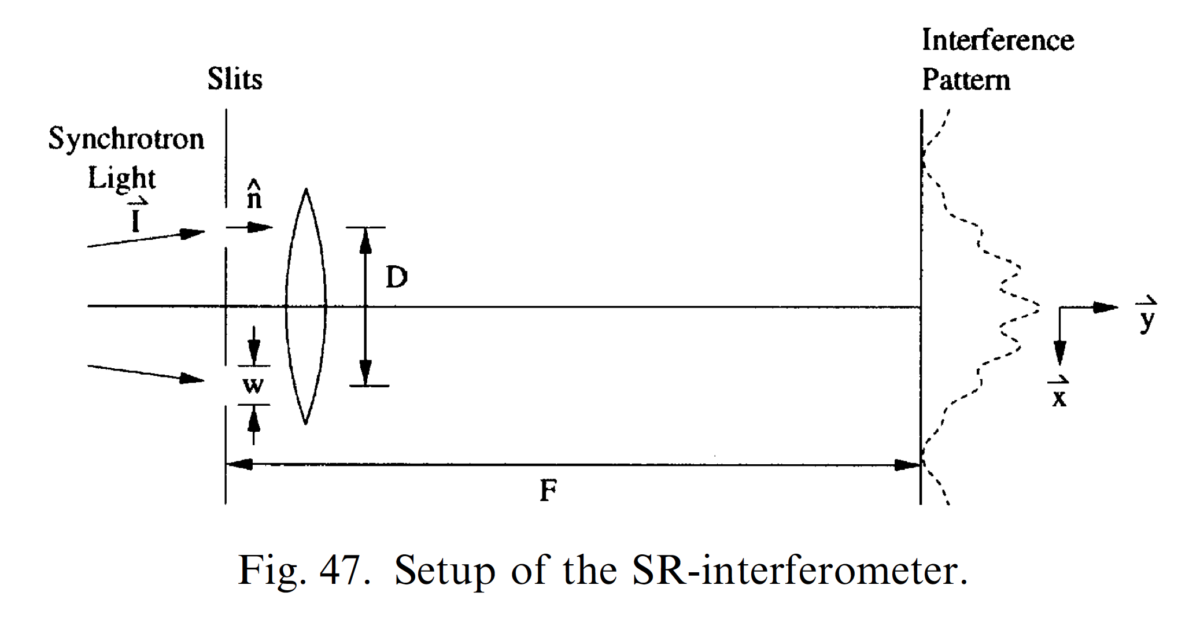
measurement speed: ~ 5Hz
typical vertical size: ~2μm@IP <- ~150μm at source point

Slide 51
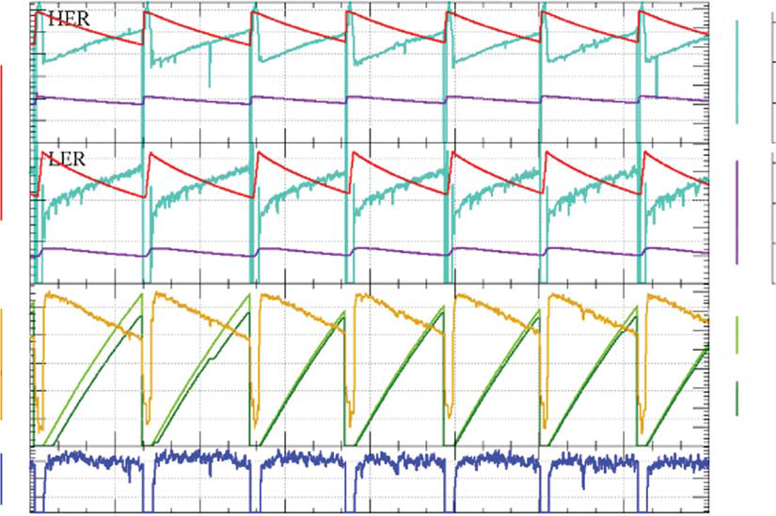
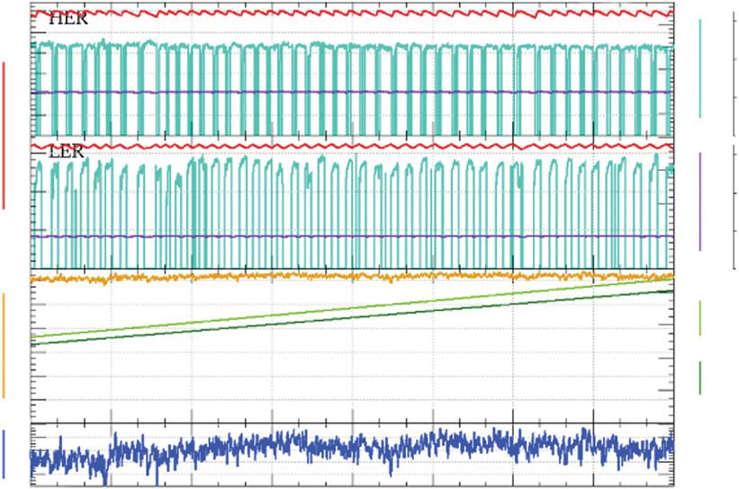
Continuous injection
At SuperKEKB, the continuous injection (top-up injection) is indispensable, since the beam lifetime is very short.
  Max. 50 Hz (e- + e+)
  Azimuthal VETO (at KEKB not azimuthal 3.5msec after injection)
8 hours
8 hours
Before continuous injection
After continuous injection
Gain in integrated luminosity at KEKB: ~30%
Beam operation became stable with this scheme.

Slide 52
Luminosity tuning at KEKB
The KEKB luminosity has been increased by many and continuous parameter scans.
  The operation did almost always (even in physics run) such scans. (scan, scan, scan…)
  An introduction of downhill simplex method speeded up the parameter search. However, the achievable luminosity was not increased with this method.
Most of the luminosity tuning used the luminosity monitors and the beam size monitor (SR interferometer) as observables. Reliability of those monitors were important.
The continuous injection scheme (top-up injection) made the luminosity tuning easier through more stable beam conditions.

Slide 53
References
KEKB achievement
  T. Abe et al., Prog. Theor. Exp. Phys. (2013) 2013 (3), 03A001
KEKB beam instrumentation
  M. Arinaga et al., Prog. Theor. Exp. Phys. (2013) 2013 (3), 03A007
  M. Arinaga et al., Nucl. Instrum. Methods Phys. Res., Sect. A 499, 100 (2003).
KEKB commissioning
  T. Abe et al., Prog. Theor. Exp. Phys. (2013) 2013 (3), 03A010
Optics corrections at KEKB
  H. Koiso et al., Prog. Theor. Exp. Phys. (2013) 2013 (3), 03A0019
Orbit feedback at KEKB
  Y. Funakoshi et al. , Phys. Rev. ST AB, 10, 101001 (2007).

Slide 54
spare slides

Slide 55
Beam spectrum measurements
Bunch Oscillation Recorder (BOR)
  Digitizer synched to RF clock, plus 20-MByte memory.
  Can record 4096 turns x 5120 buckets worth of data.
  Calculate Fourier power spectrum of each bunch separately.
Inputs:
  Feedback BPMs
    6 mm diameter button electrodes
    2 GHz （4xf_{rf}) detection frequency, 750 MHz bandpass
  Fast PMT
    Used in initial studies, agreed with BPM data

Slide 56
Final Summary
Found sideband-betatron separation dependence on ν_{s}.
Found sideband appearance threshold dependence on ξ_{y}.
  Sizes of above 2 effects seem consistent with head-tail theory.
Found no apparent threshold dependence on σ_{y0}.
  Under study
Found cases where specific luminosity remains suppressed even below sideband threshold
  Possible indication of incoherent effects
Found specific luminosity is lower at tail of LER bunch than at head, when electron cloud density is high.
  Possible indication of blow-up towards tail of bunch
Found cases where sidebands disappear or almost disappear
  Conditions similar to those where luminosity is highest (low ν_{y}, V. FB gain).
Found examples where sideband line seems to have split off from the betatron line near the head of the train.
  Never clearly observed before

Slide 57

Example of KEKB luminosity tuning knobs

Slide 58


Slide 59


Slide 60

Locations for the dithering coils
8 locations for the dithering coils in LER around IP.
ZDS1LP
ZDS1RP
ZDS2LP
ZDS2RP
ZDS4LP
ZDS3LP
ZDS3RP
ZDS4RP

Slide 61


Slide 62

Effect of mis-alignment of SX and Q
HER(Quad rotation)
  Coupling term: .0010816287630558967
  Dispersion term: 3.748599954860665e-05
HER(Sextu vertical misalignment)
  Coupling term: .044995709319378976
  Dispersion term: .0045765442050508375
Notes:
（３）南アークはPSの建物の下を通っている。他は開削して埋め戻しているがここは添付資料にあるようについたてをつくって埋め戻している（添付資料の１頁目：IWAA2012山岡さんの発表より）。
トンネルの下にちゃんと埋め戻し土が入って行かなかったのではないか。

Slide 63


Slide 64
Downhill Simplex Method
H. Koiso
Method of Minimization
{1, 2, 3} 1(best)<2(next-to-the worst)<3(worst)
Evaluate 3_{R}
If 3_{R}<1,
  If 3_{E}<3_{R}, {1, 2, 3_{E}} : Expand , if not, {1, 2, 3_{R}} : Reflect
If 1<3_{R}<2, {1, 2, 3_{R}} : Reflect
If 2<3_{R}<3, Reflect 2 proposed by A. Hutton
  If 3_{C+}<3_{R,} {1, 2, 3_{C+}} : Contract+ , if not, {1, 2, 3_{R}} : Reflect
If 3<3_{R}, Reflect 2
  If 3_{C-}<3, {1, 2, 3_{C-}} : Contract- , if not, {1, 2_{S}, 3_{S}} : Shrink/Reflect2
Expand
1
Reflect
Shrink
Contract+
Contract-
3
2

Slide 65

2005/June/06

Slide 66

2005 4/1 - 5/11
3.77 spacing
3.5 spacing
Lower beam current
Due to frequent X Aborts
D7E Detune
D4C in operation
Maintenance
Maintenance
No Day-night effect
Day-night effect
Belle Solenoid Down
Install thermal insulator
Sheet for BPM cables
Nikko Refrigerator Trouble

