Slide 1
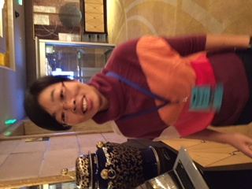
WG7 Summary: Collective Effects
John Byrd and Xu Gang, conveners
One talk from Na Wang (IHEP) on CEPC Collective Effects.

Slide 2
Collective Effects in Higgs Factories
All impedance effects proportional to beam induced voltage
Peak bunch current for SB effects. Average current for MB effects.
V = I R
BB or narrowband impedance
E
E
Large E helps everything. Rad damping goes with E³.
All instabilities for Higgs Factories appear to be below radiation damping threshold.

Slide 3
Effect of Pretzels: Beam tilt
Requires more analysis.

Slide 4
FCC-eeH is a custom boutique. FCC-eeZ is a factory!
The parameters of FCC-eeZ (1.4 A) put it into the class of flavor factories (B/Phi/t-c Factories) with high beam current, heavy beam loading, etc.
All flavor factories have gone to single-cell RF systems to enable sufficient damping of HOMs.
Beam loading compensation requires detuning of fundamental mode more than one rotation harmonic. For a 100 km ring, this could be big.
Parasitic impedances can have “glowing” results.

Slide 5
TBD
Focus on collective effects for FCC-eeZ to determine quantitative scale of collective effects.
Required Q_{ext} in SCRF
Consider F_{rf} as part of study.
Feasibility of FB systems for controlling Robinson-type and MB instabilities.
Consider collective FX in boosters. CepC has almost no radiation damping at injection energy.

