Slide 1
PHYSICS MOTIVATIONS AND REQUIREMENTS
as introduction and for discussion
NB see this morning’s plenary talk for motivations
NBB this talk is speculative towards the end.

Slide 2
-- Luminosity
-- Energy
-- Precision
-- (longitudinal) Polarization
-- running scenarios

Slide 3
Luminosity:
Motivation:
1. discovery potential for rare processes.
example is sterile neutrinos (few events per 10^13 Z)
other examples: Z,H→ μτ , eτ, γγγ, πZ, πW, etc. etc.
FCNC top decays, single top etc...
2. statistically limited processes
Higgs decays and in particular invisible width
more luminosity is always welcome....
is there a ‘but’ ...?

Slide 4
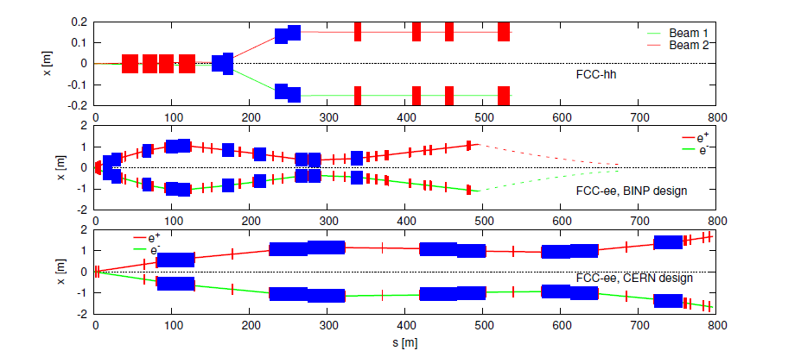
But ...
IR design needs to be consistent with experimentation
all the bending required for short L* IP and separate pipes
will produce SR against which detectors need to be shielded.

Slide 5
Luminosity comes at a cost -- still needs to be measured!
MDI essential. Needs to understand eachother, not just set contraints.

Slide 6
IP design
needed:
-- R&D for making the final focus quad as small as possible
-- Expt. Physicists: how close to beam need to go?
at LEP:
lumi measurement made to ± 610⁻⁴ (exp.syst.)
matches statistics of 10⁷ Z decays.
at FCC-ee:
can we do so much better in systematics that we
need so many Bhabhas?

Slide 7
IP design (II)
needed:
-- synchrotron radiation calculation
to shield/design beam elements and experiments
-- ensure that acceptance reaches Δp/p ≈ 2%
-- and keep high luminosity!

Slide 8
Pile-up ?
Even with 2.5 10¹² Z decays per year,
60 kHz of Z decays per IP ➔
100km → bunch crossing rate of 3kHz x N_bunches
30MHz bunch crossing.
1 event every 500 bunch crossings. →
0.002 event /bc at the Z with max. lumi.
pile-up very rare
(should be calculated for precise/rare processes)

Slide 9
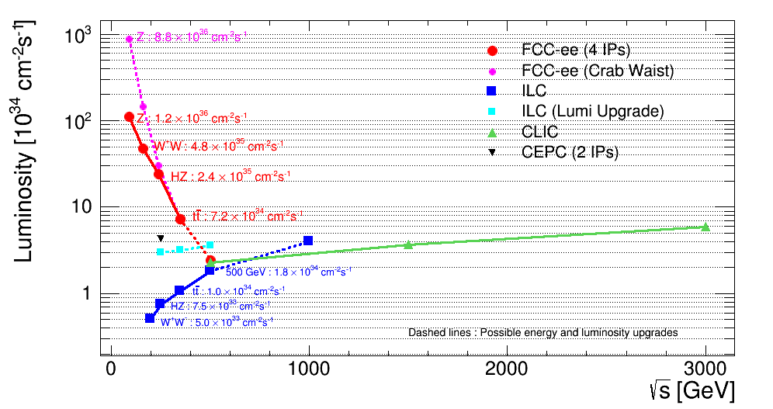
Energy and distribution of luminosity
across the possible points

Slide 10
Z peak physics
-- precision measurements see table →
Z mass and width have stat. errors << systematics
➔ 1/100 of luminosity would be enough.
this constitutes a very interesting ‘first run’
requires transverse polarization + precise E_{b} calibration!
need to understand precision of the method at keV level
also first evaluation of what could be gained with higher
statistics for other precision measts (asymmetries, Rb, Rhad etc..)
Z,W masses are ‘PDG’ historic measurements
-- rare decay searches
require full statistics (5 years)
need to keep precise E_{b} calibration to be evaluated.

Slide 11
A Sample of Essential Quantities:
X | Physics | Present precision |  | TLEP stat Syst Precision | TLEP key | Challenge
M_{Z} MeV/c2 | Input | 91187.5 ±2.1 | Z Line shape scan | 0.005 MeV <±0.1 MeV | E_cal | QED corrections
Γ_{Z} MeV/c2 | Δρ (T) (no Δα!) | 2495.2 ±2.3 | Z Line shape scan | 0.008 MeV <±0.1 MeV | E_cal | QED corrections
R_{l} | α_{s ,} δ_{b} | 20.767 ± 0.025 | Z Peak | 0.0001 ± 0.002 - 0.0002 | Statistics | QED corrections
N_{ν} | Unitarity of PMNS, sterile ν’s | 2.984 ±0.008 | Z Peak Z+γ(161 GeV) | 0.00008 ±0.004 0.001 | ->lumi meast Statistics | QED corrections to Bhabha scat.
R_{b} | δ_{b} | 0.21629 ±0.00066 | Z Peak | 0.000003 ±0.000020 - 60 | Statistics, small IP | Hemisphere correlations
A_{LR} | Δρ, ε_{3 ,}Δα (T, S ) | 0.1514 ±0.0022 | Z peak, polarized | ±0.000015 | 4 bunch scheme | Design experiment
M_{W} MeV/c2 | Δρ, ε_{3 ,} ε_{2,} Δα (T, S, U) | 80385 ± 15 | Threshold (161 GeV) | 0.3 MeV <1 MeV | E_cal & Statistics | QED corections
m_{top} MeV/c2 | Input | 173200 ± 900 | Threshold scan | 10 MeV | E_cal & Statistics | Theory limit at 100 MeV?

Slide 12
WW threshold
-- main goal: m_{w} see table ➔
-- exact need for statistics to be revisited in view of
systematics. (maybe factor 2 --not a factor 100)
-- require polarization for E_{b} calibration
-- σ_{E} ∝ E²/√ρ → more difficult for smaller machine
-- improvements in orbit measurement?

Slide 13
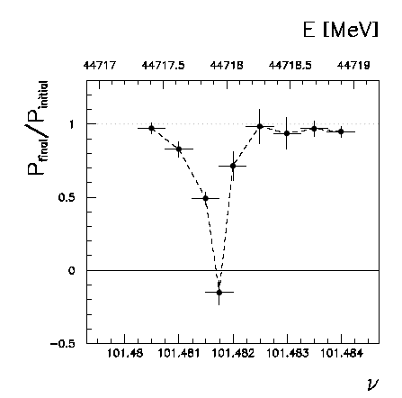
Beam polarization and E-calibration @ FCC-ee
Precise meast of E_{beam} by resonant depolarization
~100 keV each time the meast is made
At LEP transverse polarization was achieved routinely at Z peak.
instrumental in 10⁻³ measurement of the Z width in 1993
led to prediction of top quark mass (179+- 20 GeV) in March 1994
Polarization in collisions was observed (40% at BBTS = 0.04)
At LEP beam energy spread destroyed polarization above 60 GeV
σ_{E} ∝ E²/√ρ ➔ At FCC-ee transverse polarization up to at least 80 GeV
to go to higher energies requires spin rotators and siberian snake
FCC-ee: use ‘single’ bunches to measure the beam energy continuously
no interpolation errors due to tides, ground motion or trains etc…
<< 100 keV beam energy calibration around Z peak and W pair threshold.
Δm_{Z} ~0.1 MeV, ΔΓ_{Z} ~0.1 MeV, Δm_{W} ~ 0.5 MeV

Slide 14
Higgs physics at 240 GeV
want highest possible statistics.
beam energy calibration from e+e- → Zγ events
method is delicate, needs to be studied
no need for transverse polarization (?)
usefulness of longitudinal polarization limited (?)
(?) = someone should check
pile-up, Bhabha statistics, etc.. less of a problem
Shielding against SR important
(looking for ‘invisible decays’)
need to understand/measure beam energy spread

Slide 15
top threshold, 350 GeV
--top quark mass measurement
--statistics on e+e- → Hνν channel
(significant for H→ WW precision)
want highest possible statistics.
beam energy calibration from e+e- → Zγ events
usefulness of longitudinal polarization limited (?)
(?) = someone should check
pile-up, Bhabha statistics, etc.. less of a problem
need to understand/measure beam energy spread

Slide 16
Precision
beam position:
some analyses require good follow up of IP coordinates
→ beam position monitors to be recorded as needed
energy calibration:
detailed systematics of resonant depolarization should
be studied as well as its relationship with E_{CM}
-- is energy of colliding beam same as ‘single bunches’
especially in presence of beamstrahlung?
-- is spin tune equivalent to average beam energy
-- relation btw collision energy and average beam energy? (saw-toothing)

Slide 17
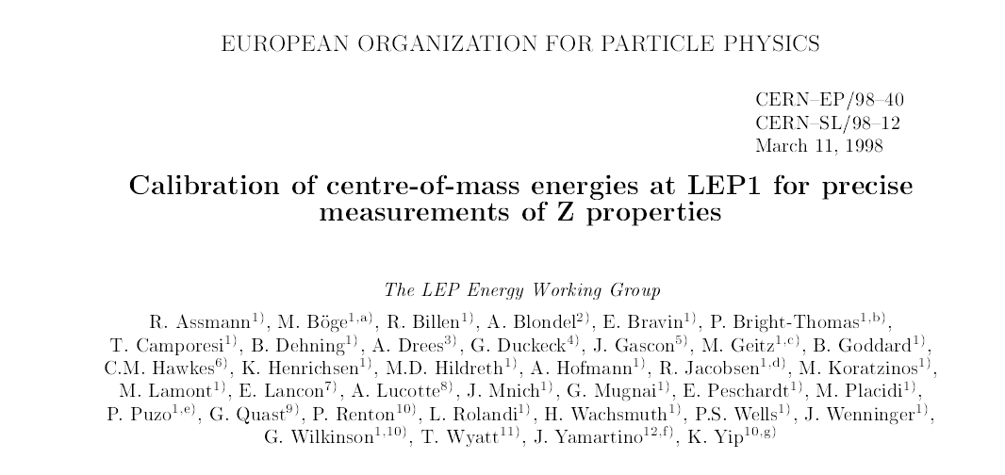

Slide 18
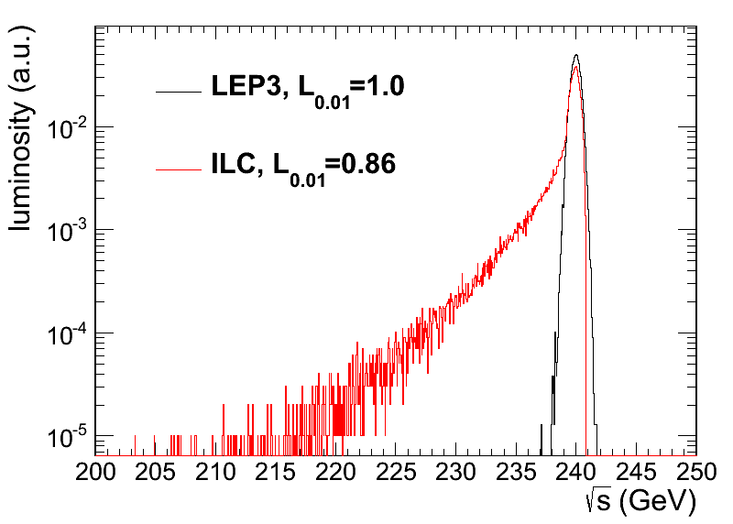
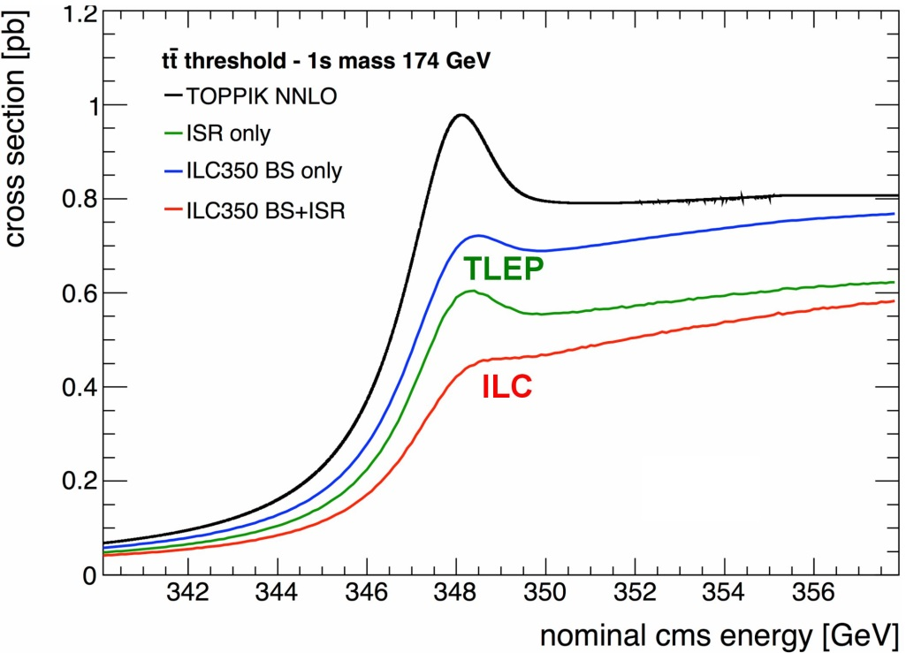
BEAMSTRAHLUNG
Luminosity E spectrum
Effect on top threshold
➔
TLEP operates at Beamstrahlung limit, this is a dominant factor for accelerator design.
Beamstrahlung @TLEP is benign for physics: particles are either lost or recycled on a synchrotron oscillation
➔ some increase of energy spread
but little change of average energy (HOW MUCH?)
Little EM background in the experiment.

Slide 19
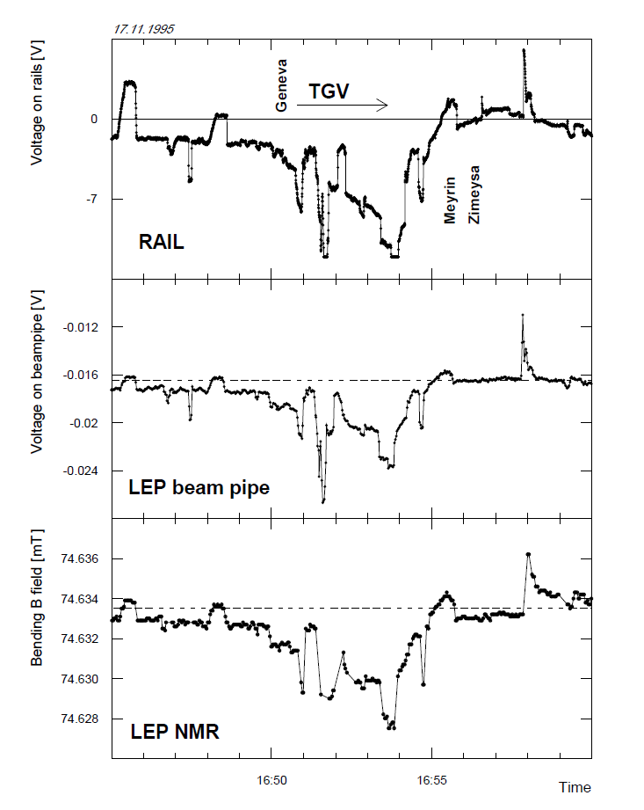
60ppm in 5 minutes!

Slide 20
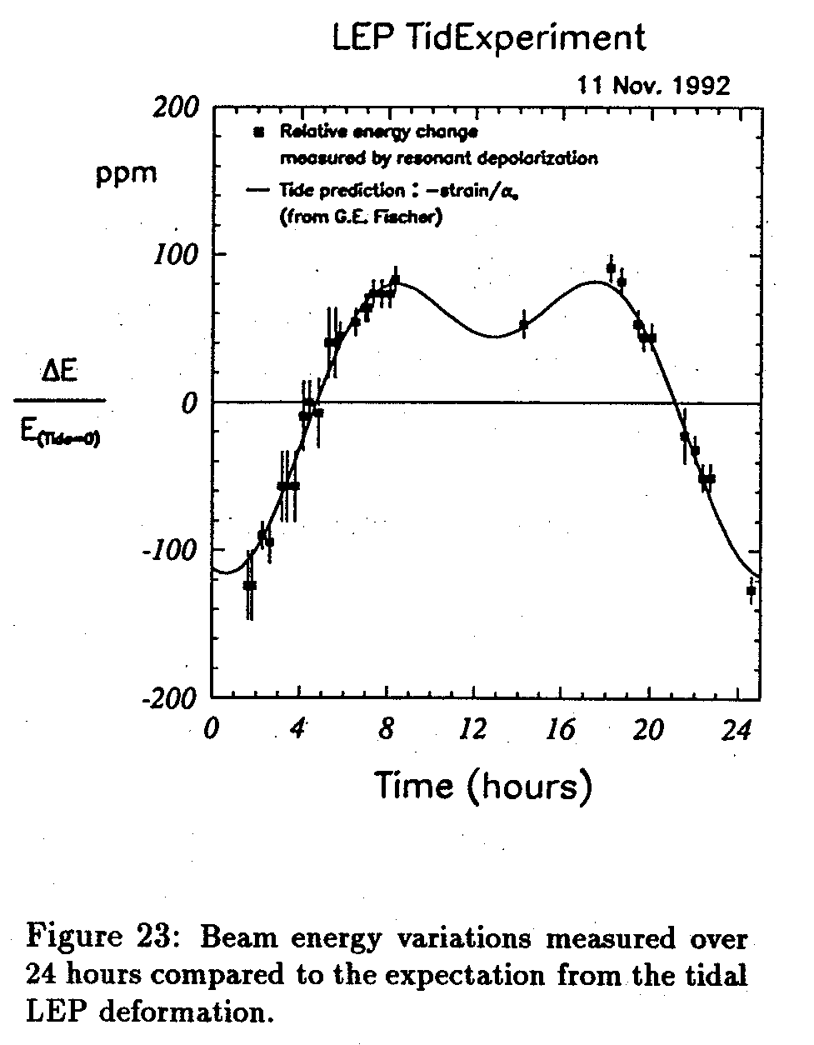
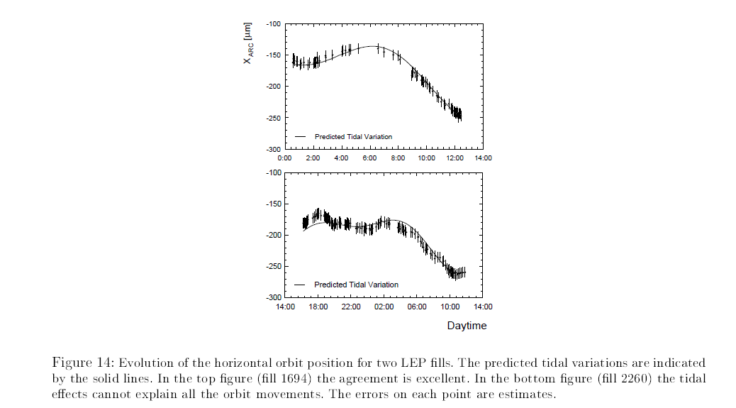
Tide correction...
are orbit measurements enough?

Slide 21
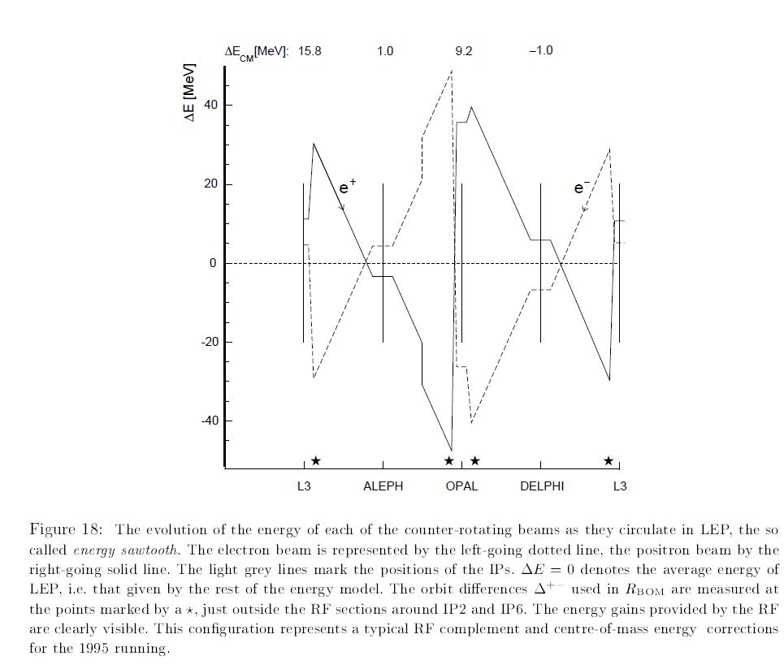
saw toothing
uneven RF volts cause energy shift wrt average

Slide 22
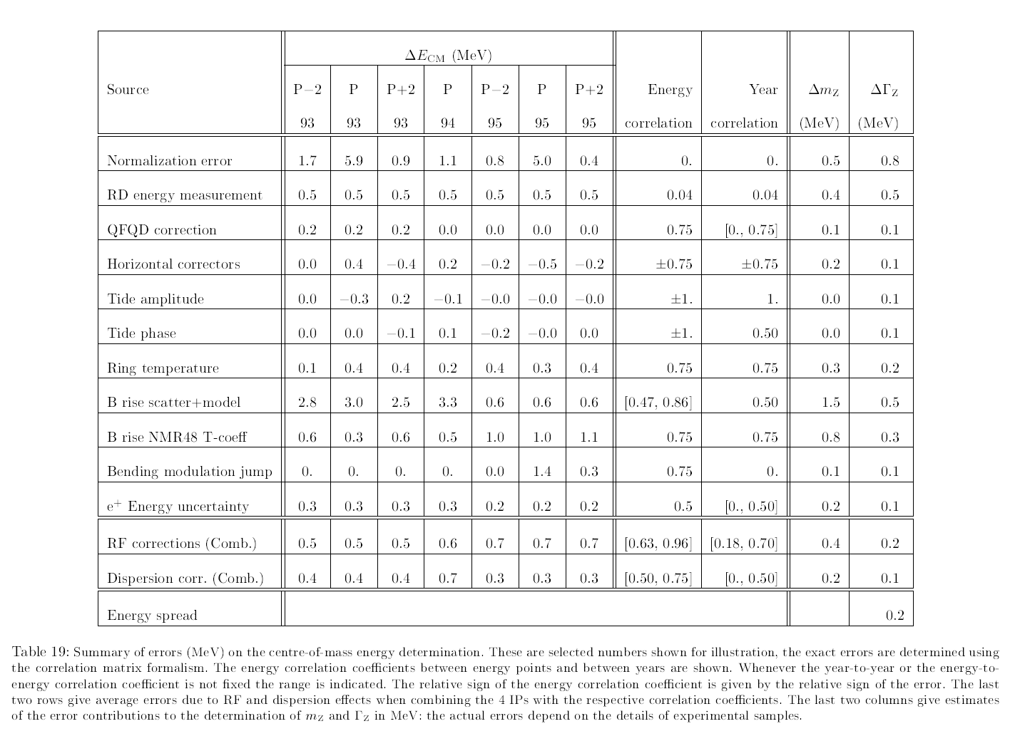
Most of these systematics, but not all, vanish with ‘single’ bunches calib.

Slide 23
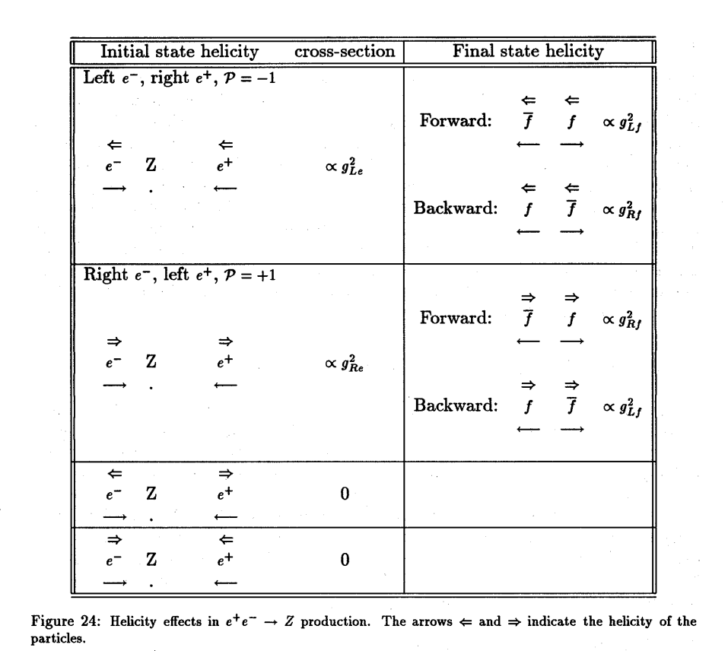
(longitudinal) Polarization
Famously useful for the longitudinal polarization asymmetry
of the Z boson
just measure Z couplings
to electrons (sinθ_{W}^{eff} ) from ratios
of total cross-sections upon
flipping the spins
-- systematics can be reduced
by using various combinations
-- need depolarization
of individual bunches

Slide 24
Do we need longitudinal polarization?
-- a statistical and systematic matter that requires
a dedicated study
-- can be compensated by statistics since
1) polarization is never 100%
2) same couplings govern final state forward backward
asymmetries and polaritation
nevertheless SLC with e- polarization of 75% and 500’000 Z
measured sinθ_{W}^{eff} half as well as LEP with 20MZ.
(eq. factor 20 in statistics)
to be reviewed.

Slide 25
Should we need longitudinal polaarization
➔ design spin rotators
at Z energy some hope to use the arcs to establish
transverse pol in the arcs, rotate in the straight.
at Higher energy need ‘siberian snake’... which maybe
can be made with spin rotators.

Slide 26
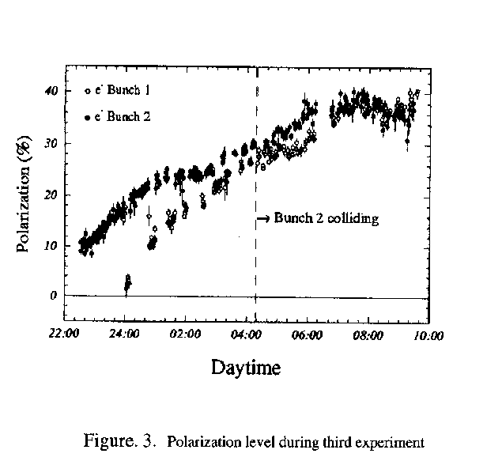
PAC 1995
LEP:
This was only tried 3 times!
Best result: P = 40% , ξ*_{y}= 0.04 , one IP
TLEP
Assuming 4 IP and ξ*_{y}= 0.01 ➔
reduce luminositiy somewhat, 10¹¹ Z @ P=40%

Slide 27
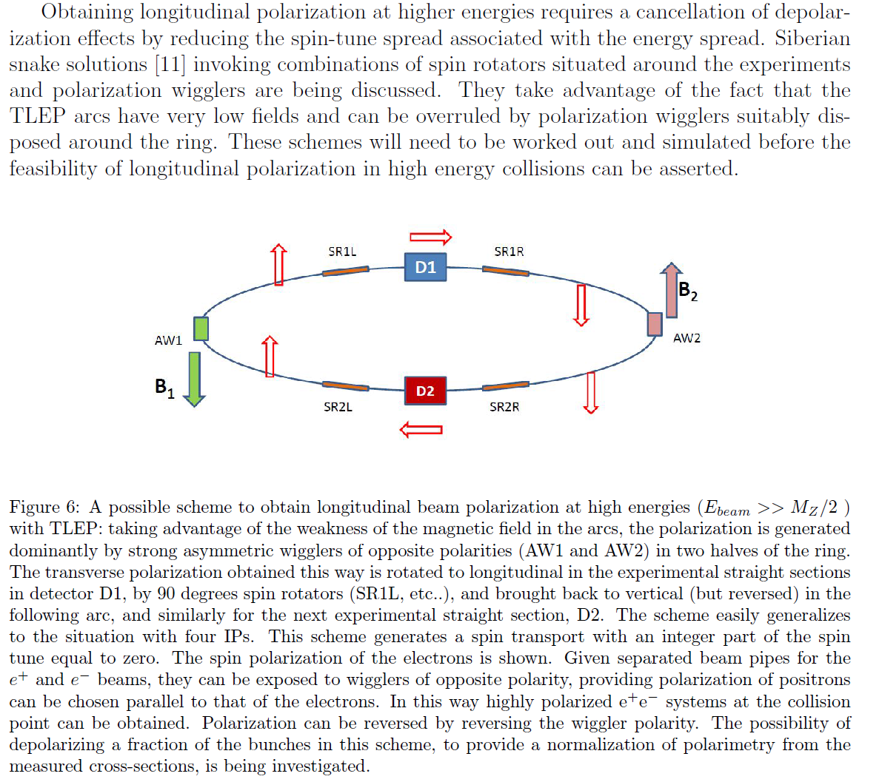
AB, U. Wienands)

Slide 28
Running scenarios

Slide 29
A possible TLEP running programme (07/2013)
1. ZH threshold scan and 240 GeV running (200 GeV to 250 GeV)
5+ years @2 10^35 /cm2/s => 210^6 ZH events
++ returns at Z peak with TLEP-H configuration
for detector and beam energy calibration
2. Top threshold scan and (350) GeV running
5+ years @2 10^35 /cm2/s ➔ 10^6 ttbar pairs ++Zpeak
3. Z peak scan and peak running , TLEP-Z configuration ➔ 10¹² Z decays
→ transverse polarization of ‘single’ bunches for precise E_beam calibration
2 years
4. WW threshold scan for W mass measurement and W pair studies
1-2 years ➔ 10^8 W pairs ++Zpeak
5. Polarized beams (spin rotators) at Z peak 1 year at BBTS=0.01/IP => 10¹¹ Z decays.
Higgs boson HZ studies
+ WW, ZZ etc..
Top quark mass
Hvv Higgs boson studies
Mz, Γ_{Z} R_{b} etc…
Precision tests and
rare decays
M_{W}, and W properties
etc…
A_{LR}, A_{FB}^{pol} etc

Slide 30
The previous was determined by ‘interest’ and as of 2013
Will consider ‘staging scenarios based on
-- gradual increase of MW
or
-- gradual increase of GVolts .... or both.
-- gradual increase of difficulty
-- physics priorities of the moment.
e.g. now with increased Z luminosity we seem to want
even more of it!

Slide 31
Understand that RF cavity system should be, if possible.
-- common to both beams at the top energy
-- separate for e+ and e- at low energy
following scheme explains how this could work
for the case of two IPs without moving the RF
Large saw-toothing would indicate that it is better to separate beampipes at all energies ➔ design dual magnets&pipes

Slide 32
Example of Bunch Train scheme for RF management at TLEP
L
X
A
ES
IP
ES
RF
RF
L
or:
X
ES
IP
ES
RFBP
RF
ES
RF
RF
ES
L
Total length of ring = 8L + 8A
Total length of each of two buch trains 2A+L
IP = Interaction Point
ES = Electrostatic Separator followed by quadrupole or split field dipole
RFBP: possible RF bypass for one or the other beam activated by dipoles.

Slide 33
MONOCHROMATORS?

Slide 34
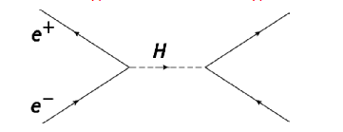
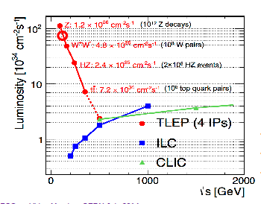
For those who like challenges:
Higgs s-channel production at √s = m_{H}
In theory, with L_{int}~6 ab-1 (4 exps./year)
FCC-ee running at H pole mass
➔ 10⁴ events per year.
Very difficult because huge background
and beam energy spread ~ 10 x Γ_{H}
limits or signal? monochromators?
Aleksan, D’Enterria, Woijcik

Slide 35
need to gain a factor of ~8
➔ monochromator?

