Slide 1




Choice of circumference, minimum & maximum energy, number of collision points, and target luminosity
M. Koratzinos
ICFA HF2014, Thursday, 9/10/2014

Slide 2
Preface
I have taken my ‘mandate’ from the title of the talk as literally as possible, so I will talk about circumference, energy, number of IPs and their relationship to luminosity.
The version of the CEPC design I have might not be the latest one. I am using the one of the 16/4/2014.
I will be comparing it with the latest published FCC-ee design parameters (version 1.1)
A recent note (CERN-ACC-NOTE-2014-0066) contains most of the concepts.

Slide 3
Relevant material
M. Koratzinos, “TLEP: a first step on a long vision for HEP”, ISHP, IHEP, Beijing, 16 August 2014.
M. Koratzinos, “Performance limitations of circular colliders: head-on collisions”, CERN-ACC-NOTE-2014-0066.
J. Wenninger et al., “Future Circular Collider Study Lepton Collider Parameters,” CERN EDMS no. 1346082, 2014. (V1.1 now)
R. Assmann and K. Cornellis, “The beam-beam limit in the presence of strong synchrotron radiation damping,” CERN-SL-2000_046 OP.

Slide 4
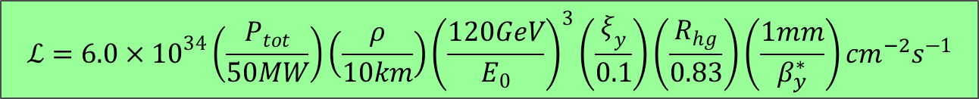
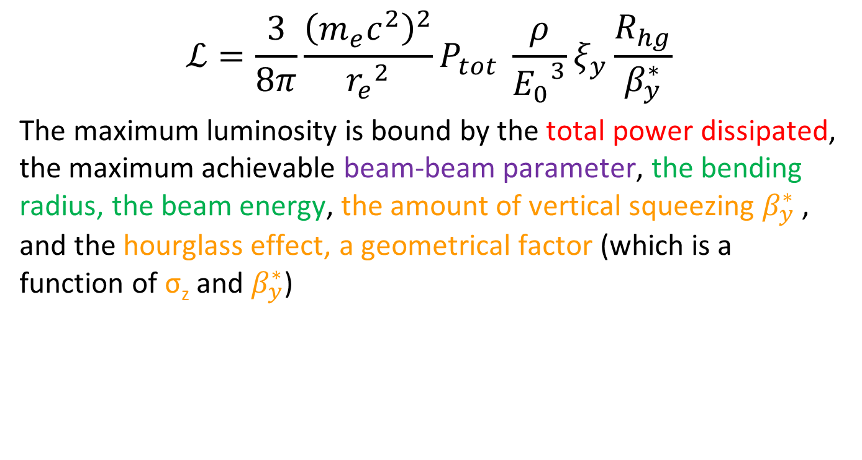
Luminosity of a circular lepton collider
$$ℒ=\frac{3}{8π}\frac{{\left(m_{e}c^{2}\right)}^{2}}{{r_{e}}^{2}}P_{tot} \frac{ρ}{{E_{0}}^{3}}ξ_{y}\frac{R_{hg}}{β_{y}^{∗}}$$
The maximum luminosity is bound by the total power dissipated, the maximum achievable beam-beam parameter, the bending radius, the beam energy, the amount of vertical squeezing $β_{y}^{∗}$ , and the hourglass effect, a geometrical factor (which is a function of σ_{z} and $β_{y}^{∗}$)
(head-on collisions)
$$ℒ={6.0×10}^{34}\left(\frac{P_{tot}}{50MW}\right)\left(\frac{ρ}{10km}\right){\left(\frac{120GeV}{E_{0}}\right)}^{3}\left(\frac{ξ_{y}}{0.1}\right)\left(\frac{R_{hg}}{0.83}\right)\left(\frac{1mm}{β_{y}^{∗}}\right){cm}^{−2}s^{−1}$$

Slide 5
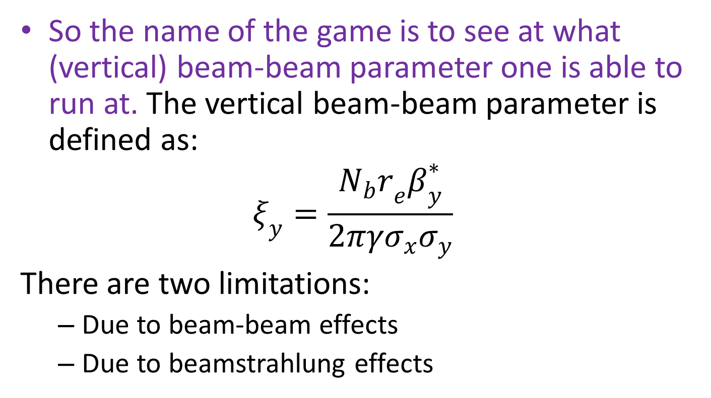
Beam-beam parameter
So the name of the game is to see at what (vertical) beam-beam parameter one is able to run at. The vertical beam-beam parameter is defined as:
$$ξ_{y}=\frac{{N_{b}r}_{e}β_{y}^{∗}}{2πγσ_{x}σ_{y}}$$
There are two limitations:
  Due to beam-beam effects
  Due to beamstrahlung effects

Slide 6
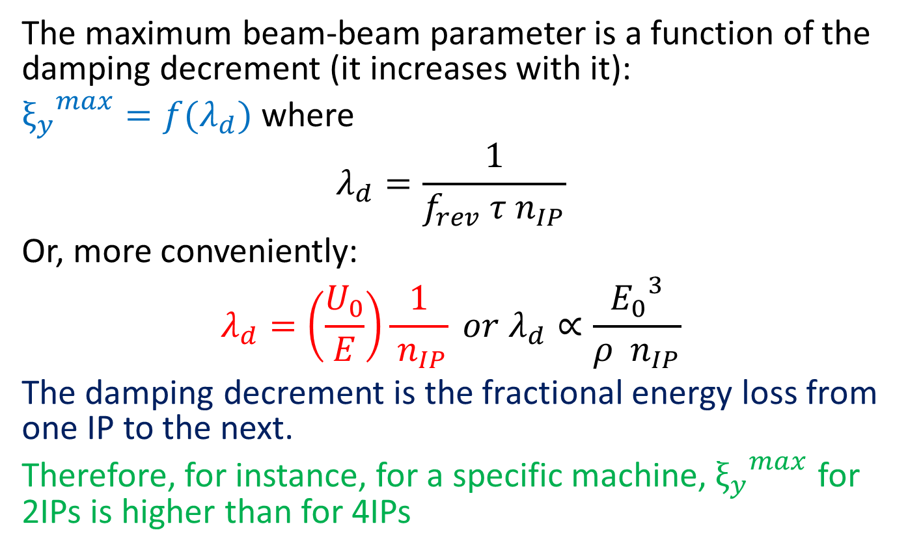
Maximum beam-beam parameter
The maximum beam-beam parameter is a function of the damping decrement (it increases with it):
${ξ_{y}}^{max}=f(λ_{d})$ where
$$λ_{d}=\frac{1}{f_{rev} τ{ n}_{IP}}$$
Or, more conveniently:
$$λ_{d}=\left(\frac{U_{0}}{E}\right)\frac{1}{{ n}_{IP}} or{ λ}_{d}∝\frac{{E_{0}}^{3}}{ρ { n}_{IP}}$$
The damping decrement is the fractional energy loss from one IP to the next.
Therefore, for instance, for a specific machine,${{ ξ}_{y}}^{max}$ for 2IPs is higher than for 4IPs

Slide 7
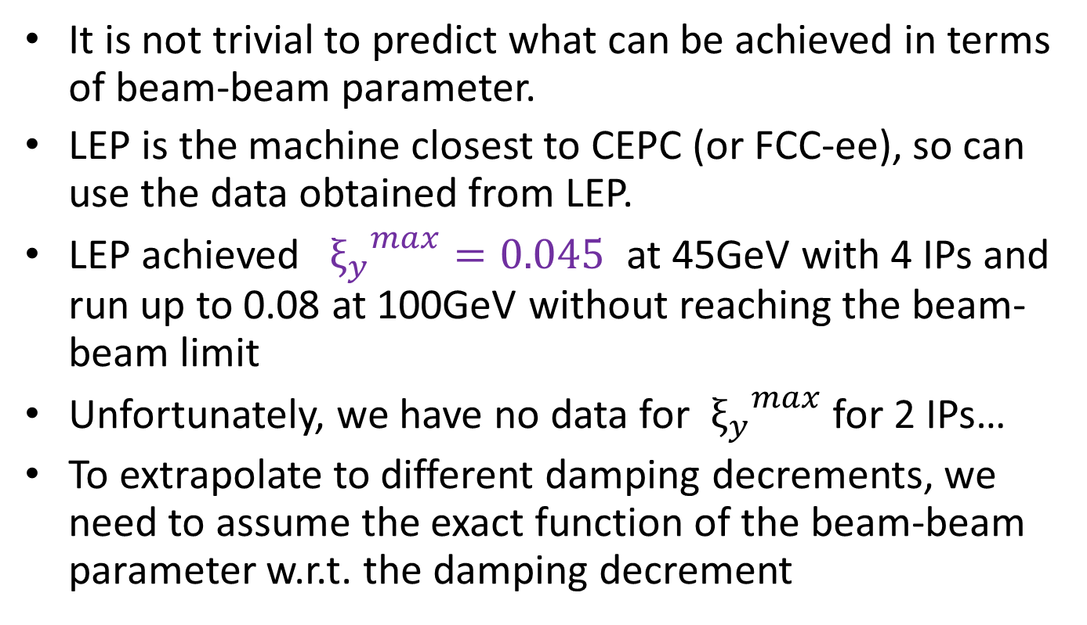
Maximum beam-beam parameter
It is not trivial to predict what can be achieved in terms of beam-beam parameter.
LEP is the machine closest to CEPC (or FCC-ee), so can use the data obtained from LEP.
LEP achieved ${{ ξ}_{y}}^{max}=0.045$ at 45GeV with 4 IPs and run up to 0.08 at 100GeV without reaching the beam-beam limit
Unfortunately, we have no data for ${{ ξ}_{y}}^{max}$ for 2 IPs…
To extrapolate to different damping decrements, we need to assume the exact function of the beam-beam parameter w.r.t. the damping decrement

Slide 8
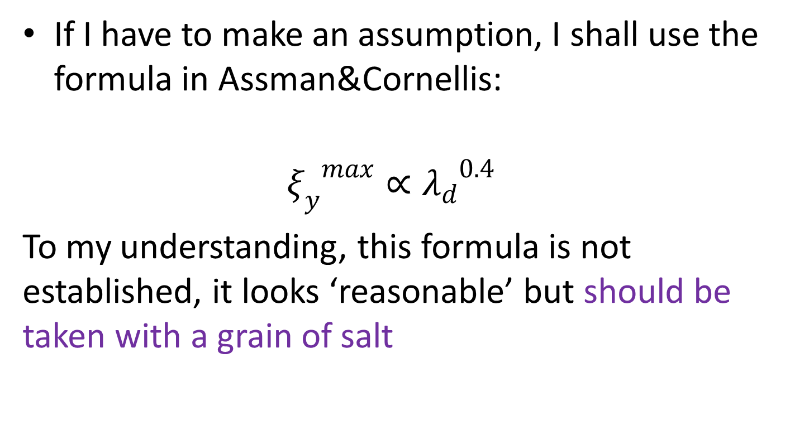
Beam-beam parameter extrapolation
If I have to make an assumption, I shall use the formula in Assman&Cornellis:
$${ξ_{y}}^{max}∝{λ_{d}}^{0.4}$$
To my understanding, this formula is not established, it looks ‘reasonable’ but should be taken with a grain of salt

Slide 9
Beamstrahlung
Beamstrahlung is the interaction of an incoming electron with the collective electromagnetic field of the opposite bunch at an interaction point.
Main effect at circular colliders is a single hard photon exchange taking the electron out of the momentum acceptance of the machine.
If too many electrons are lost, beam lifetime is affected.
This is something that affects future colliders and was not seen at LEP.

Slide 10
Comparison with simulation
There exist two analytical calculations (By Valery Telnov and Anton Bogomyagkov) and (at least) a thorough simulation by K. Ohmi
Agreement at momentum acceptances of 1.5%-2% is reasonable – within a factor of 5

Slide 11
The two regimes
At low energies, the beam-beam limit dominates, at high energies the beamstrahlung limit does. For FCC-ee we get:
At 120 GeV, FCC-ee is beam-beam dominated whereas at 175GeV Beamstrahlung dominated – losing between 20% and 50% of potential performance compared to the beam-beam limit

Slide 12
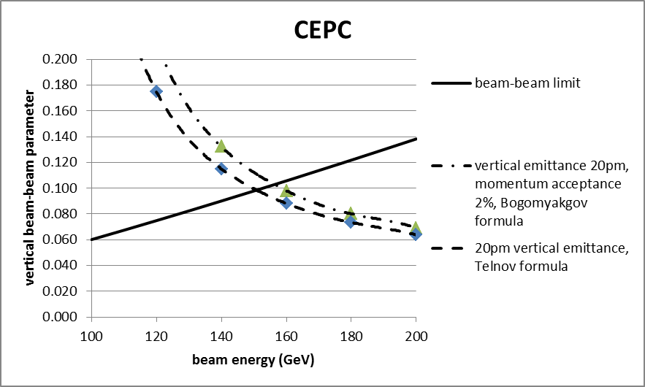
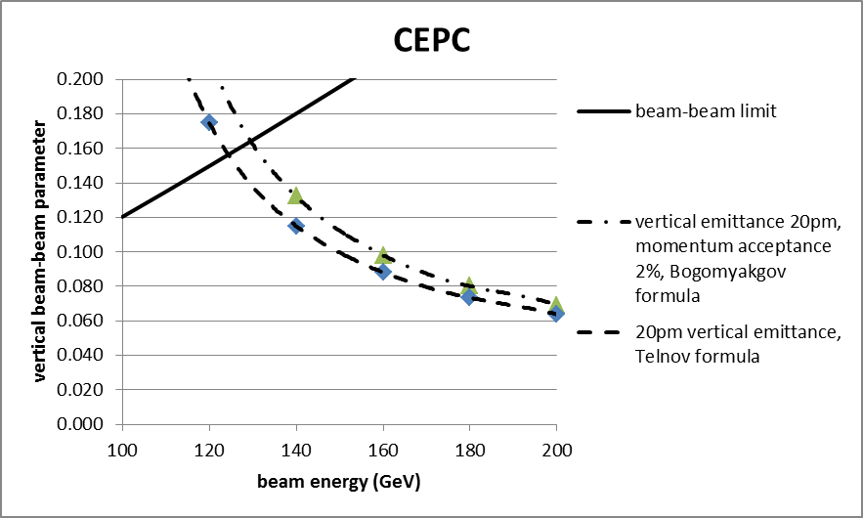
CEPC – the two limitations
The current CEPC design is conservative – vertical emittance is a factor of 10 larger than FCC-ee
Current CEPC design on left; extrapolating from FCC-ee anticipated xi_y on right. In both cases, 120GeV running is limited by beam-beam
A point of caution: the CEPC design I am using has different xi_x and xi_y values

Slide 13
Optimization
And now we can talk about optimization…
The fact that the CEPC is b-b dominated means that there is no need for lower emmitances.
However, the choice of the beam-beam parameter is very conservative compared the FCC-ee ( by a factor of 2!)
[Current xi_y = 0.075 for 2 IPs. This corresponds to xi_y = 0.045 at FCC-ee with 4 IPs. FCC-ee uses 0.09 at 120GeV]
If I blindlly use the more aggressive FCC-ee ideas for the achievable beam-beam parameter, I can increase the beam-beam parameter of CEPC by a factor of two leading to 80% higher luminosity
E | Xi_y | Sigma_z | Lumi | improvement
120GeV | 0.075 | 2.7mm | 1.8E34
120GeV | 0.15 | 3.8mm | 3.2E34 | 80%
Sigma_z is always the equilibrium bunch length, taking into account the RF and Beamstrahlung contributions

Slide 14
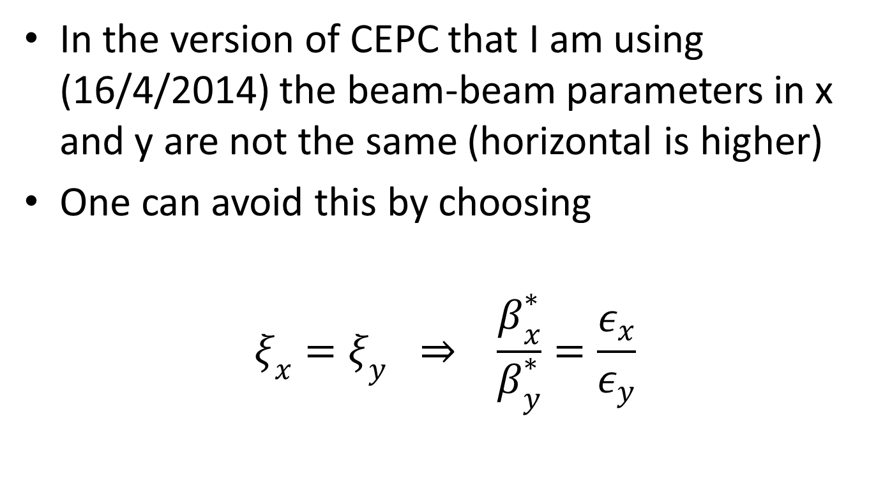
Horizontal beam-beam parameter
In the version of CEPC that I am using (16/4/2014) the beam-beam parameters in x and y are not the same (horizontal is higher)
One can avoid this by choosing
$$ξ_{x}=ξ_{y} \underset{⇒}{} \frac{β_{x}^{∗}}{β_{y}^{∗}}=\frac{ε_{x}}{ε_{y}}$$

Slide 15
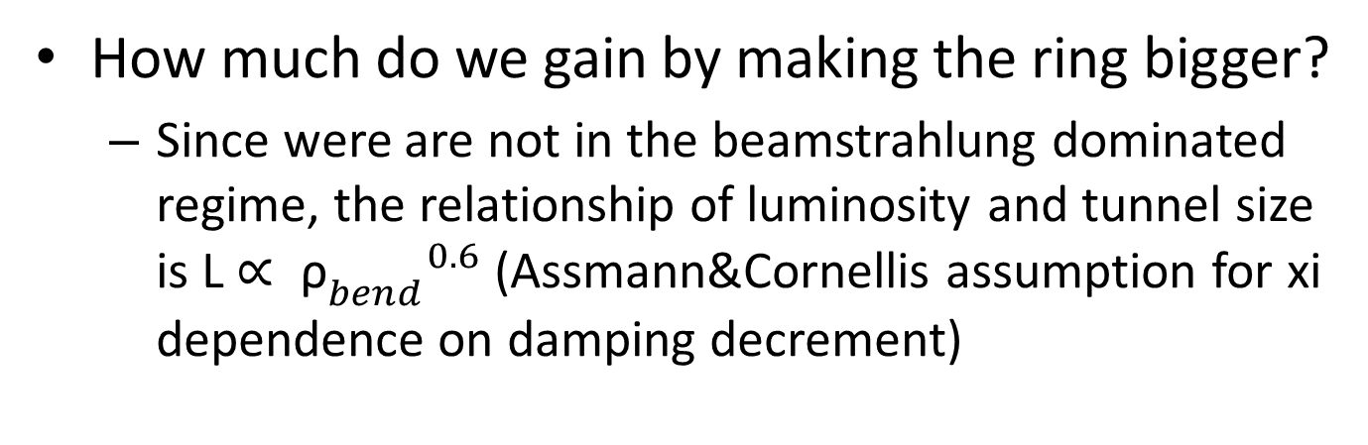
Ring diameter
How much do we gain by making the ring bigger?
  Since were are not in the beamstrahlung dominated regime, the relationship of luminosity and tunnel size is L $∝ {{\text{ρ}}_{bend}^{}}^{0.6}$ (Assmann&Cornellis assumption for xi dependence on damping decrement)
Ring size | Xi_y | Sigma_z | lumi | improvement
53000m | .075 | 2.7mm | 1.8E34
70000m | .067 | 2.7mm | 2.2E34 | 20%
The gain is modest, so the choice of tunnel diameter will (also) depend on other parameters, like:
Possibility to run at 175GeV – becomes easier with a larger ring
The pp option later on

Slide 16
Number of IPs
Here there is a net gain. Going from 2 to 4 experiments increases the performance by about 50%
Again, the assumption of the relationship between the beam-beam parameter and the damping decrement is as in the Assmann/Cornellis paper
(The gain is not 100% as the damping decrement is reduced by a factor of two)
E | IPs | Xi_y | lumi | Lumi*n_IP | improvement
120GeV | 2 | 0.075 | 1.84E34 | 3.68
120GeV | 4 | 0.057 | 1.40E34 | 5.60 | 53%

Slide 17
Minimum energy
To be able to run at 45GeV and profit from high luminosity, the number of bunches increases dramatically to O(20,000) (if I simply extrapolate the 120GeV design).
Blowing up the horizontal and vertical emittances reduces the number of bunches without affecting luminosity (but there is a limit to the increase)
The FCC-ee design has a factor of 15/30 for the horizontal/vertical emittance when comparing the 175GeV setup and the 45GeV setup.
Due to BS, bunch length (energy spread) increases also as we go to lower energies and larger number of electrons per bunch

Slide 18
Running at 45GeV
The damping decrement of CEPC at 45GeV is the exactly the same as LEP at 45GeV (twice the diameter but half the interaction points)
So we can safely assume a xi_y of 0.045 is achievable, like at LEP
scheme | Power | No. of bunches | Xi_y | Sigma_z | Lumi
Extrapolating from 120GeV | 50MW | 15500 | 0.045 | 1.1 | 2.7E35
Increasing emittances by 20 | 50MW | 780 | 0.045 | 2.7 | 2.1E35
Reducing no. of bunches by 5 | 10MW | 160 | 0.045 | 2.7 | 0.4E35
150 bunches might be manageable with a single beam pipe – to be proven!
Like this, the CEPC has ~14 times smaller performance than the advertised performance of FCC-ee at 45GeV and 4 experiments
Can we be more clever/ more bold and accommodate more bunches?

Slide 19
Running at 175GeV
Here the points to note are a large energy loss per turn and running in the BS-dominated regime
Energy loss is 13.6GeV. This needs an RF system twice as big as that of FCC-ee, that is around 1200m.
Possible performance (my extrapolation):
E | E_loss | ε_x/ε_y | Xi_x/xi_y | No. bunches | Lumi×IPs
CEPC-175 | 13.6 | 7nm/10pm | 0.12/0.12 | 7 | 0.8E34×2
FCC-ee-175 | 7.6 | 2nm/2pm | 0.09/0.09 | 98 | 1.8E34×4
A factor of 5 less compared to FCC-ee

Slide 20
Conclusions
Circular colliders are great machines!
Making different choices one can end up either with a CEPC-like machine (single beam-pipe, modest circumference, 2 experiments) or with a FCC-ee-like machine (two beam pipes, large circumference, larger cost, 4 experiments)
It will be an exciting design study for both machines!

Slide 21
End

