Slide 1




Challenges and Status of the FCC-ee lattice design
Bastian Haerer (CERN, Geneva; KIT, Karlsruhe), Bernhard Johannes Holzer (CERN, Geneva)

Slide 2
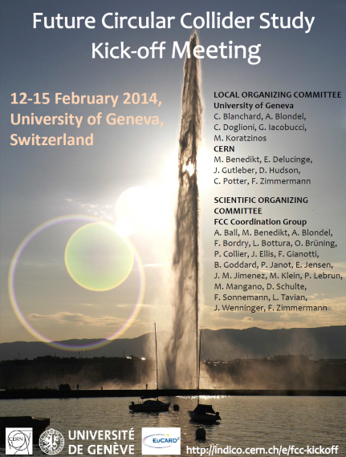
Future Circular Collider Study
New 80-100 km storage ring
FCC-hh (=long-term goal):
High-energy hadron collider
Push the energy frontier to 100 TeV
FCC-ee (TLEP):
e⁺/e⁻-collider as intermediate step
FCC-he
Hadron-lepton collider option
Deep inelastic scattering

Slide 3
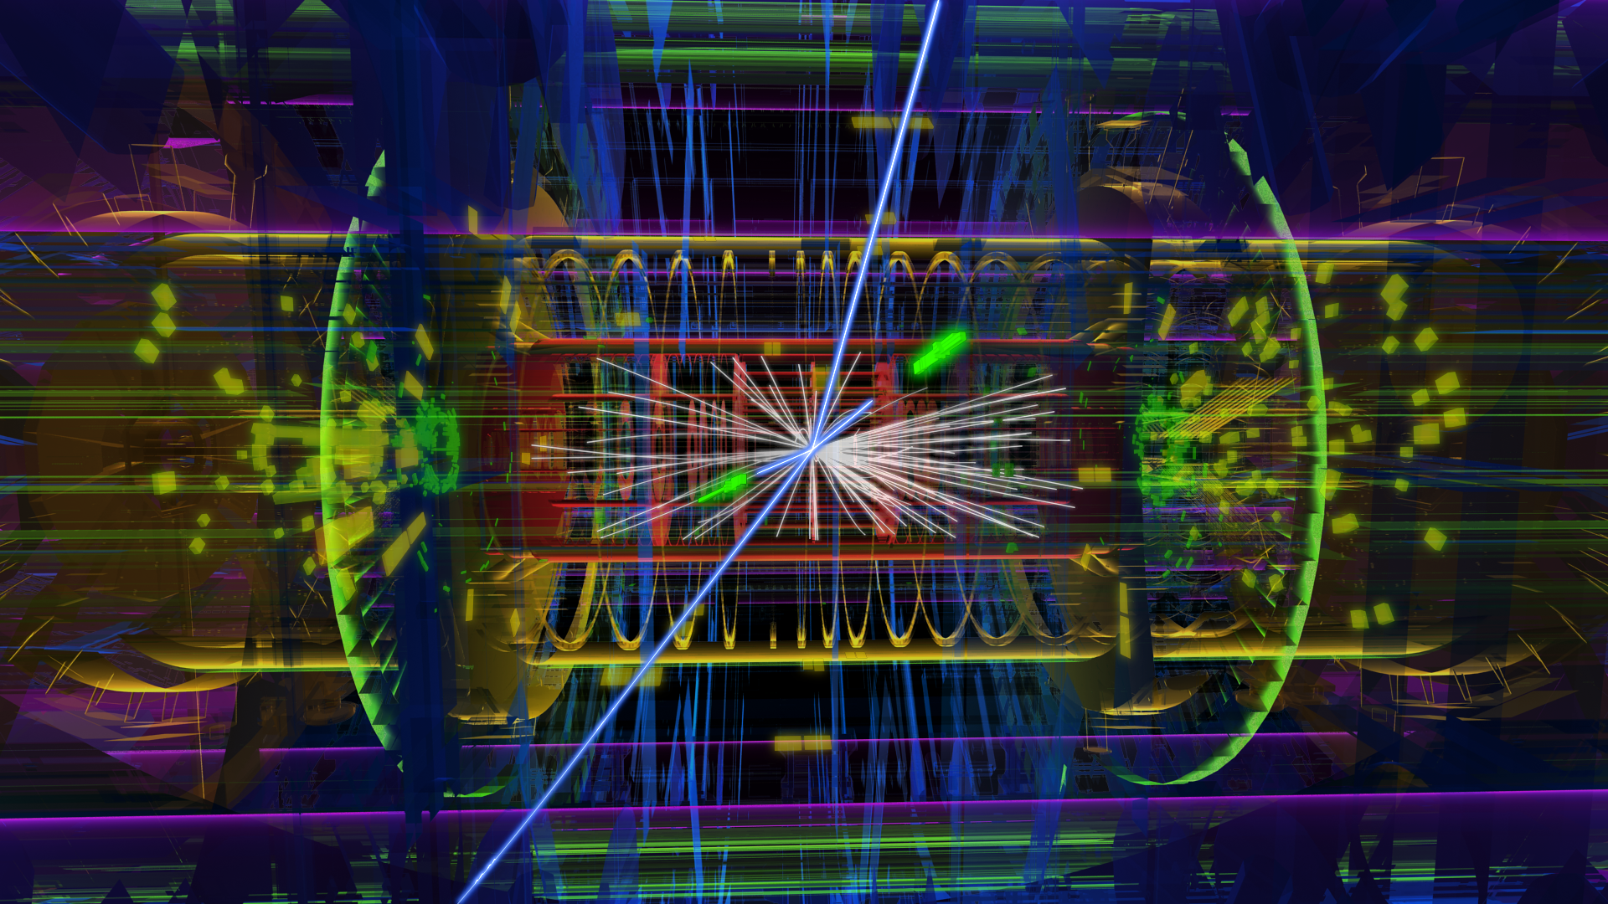
What is our goal?
ATLAS event display: H → e⁺ + e⁻ + μ⁺ + μ⁻

Slide 4
Physics goals of FCC-ee
Provide highest possible luminosity for a wide physics program ranging from the Z pole to the tt production threshold.
  Beam energy range from 45 GeV to 175 GeV
Main physics programs / energies (+ scan around central values):
  Z (45.5 GeV): Z pole, high precision of M_{Z} and Γ_{Z,}
  W (80 GeV): W pair production threshold,
  H (120 GeV): H production,
  T (175 GeV): tt threshold.
All energies quoted refer to BEAM energies

Slide 5
Main challenge: the parameter list
Design & optimize a lattice for 4 different energies
Interaction region layout for a large number of bunches
Horizontal emittance is increasing with reduced energy
Extremely small vert. beta* (β_{y}* = 1 mm)
High chromaticity
Challenging dynamic aperture
High synchrotron radiation losses include sophisticated absorber design in the lattice
 | Z | W | H | tt
Beam energy [GeV] | 45.5 | 80 | 120 | 175
Beam current [mA] | 1450 | 152 | 30 | 6.6
Bunches / beam | 16700 | 4490 | 1330 | 160
Bunch population [10¹¹] | 1.8 | 0.7 | 0.46 | 0.83
Transverse emittance ε Horizontal [nm] Vertical [nm] | 29.2 0.06 | 3.3 0.007 | 0.94 0.0019 | 2 0.002
Momentum comp. [10⁻⁵] | 18 | 2 | 0.5 | 0.5
Betatron function at IP β* Horizontal [mm] Vertical [mm] | 500 1 | 500 1 | 500 1 | 1000 1
Energy loss / turn [GeV] | 0.03 | 0.33 | 1.67 | 7.55
Total RF voltage [GV] | 2.5 | 4 | 5.5 | 11

Slide 6
The FCC-ee Layout
100 km circumference
12 arcs (2 x 3.4 km)
12 long straight sections (1.5 km)
→ RF installations
4 mini-beta insertions
2 rings side-by-side
RF
RF
RF
RF
IP
RF
RF
IP
IP
RF
RF
RF
IP
RF
RF
RF

Slide 7
FODO cell for 175 GeV
Layout already considers max. dipole length, drift spaces for absorbers, flanges etc.
BPM
Corrector
Q
Q
S
B
B
Q
S
B
B
0.15 m
0.5 m
10.5 m
1.5 m
0.65 m
0.65 m
0.55 m
50 m
B = bending magnet, Q = quadrupole, S = sextupole
N_{dipoles} = 6528 (384 half bend) (LHC: 1232) ρ ≈ 10.6 km
N_{quadrupoles} = 4704 (LHC: 478) θ = 0.99 mrad
B = 55 mT

Slide 8
FODO cell for 175 GeV
L = 50 m
Ψ = 90°/60°
β_{x,max} = 76.9 m
β_{y,max} = 96.6 m
D_{x,max} = 12.7 cm
MADX Emit:
ε_{x} = 1.00 nm
U₀ = 7.72 GeV
β_{x,y}(m)
D_{x}(m)
Baseline parameters: ε_{x} = 2.00 nm
U₀ = 7.55 GeV

Slide 9
Emittance in electron storage rings
C_{g} = 3.832 × 10⁻¹³ m, J_{x} = damping partition number, γ = Lorentz factor,
θ = bending angle, F = numerical factor controlled by the lattice design

Slide 10
Emittance in electron storage rings
Analytic calculation: ε_{x} = 1.04 nm
MADX Emit: ε_{x} = 1.00 nm ✔

Slide 11
120 GeV
If the beam energy will be decreased from 175 GeV to 120 GeV the beam emittance is expected to shrink!
F(Ψ=90°) = 2.976, γ(175 GeV) = 342466, γ(120 GeV) = 234834
Analytic calculation: ε_{x} = 0.491 nm
MADX Emit: ε_{x} = 0.488 nm ✔
Baseline parameter: 0.5 × ε_{x} = 0.47 nm (ε_{x} = 0.94 nm)
We can keep the 175 GeV optics for 120 GeV beam energy!

Slide 12
45.5 GeV and 80.0 GeV
80.0 GeV: γ = 156556
Baseline parameter: 0.5 × ε_{x} = 1.65 nm (ε_{x} = 3.30 nm)
Analytic calculation: ε_{x} = 0.218 nm
45.5 GeV: γ = 89041
Baseline parameter: 0.5 × ε_{x} = 14.60 nm (ε_{x} = 29.20 nm)
Analytic calculation: ε_{x} = 0.071 nm
How can the beam emittance be increased?

Slide 13
Changing the emittance for lower energies
There are two different possibilities:
Changing of the cell length
Larger emittance: increase cell length
2 × L_{cell}, 3 × L_{cell}, 4 × L_{cell, …}
Recabeling of quadrupoles necessary
Dispersion suppressors need to be adjusted

Slide 14
1) Changing of the cell length
L_{cell} = 50m
L_{cell} = 100m
L_{cell} = 150m

Slide 15
Changing the emittance for lower energies
There are two different possibilities:
Change the phase advance Ψ of the FODO cell
No recabeling of hardware necessary
Dispersion suppressors need to be adjusted
Sextupole scheme? → 45°, 60°, 72°, 90°, …
Only within certain limits possible: 40°<Ψ<135°
Court. B. Holzer

Slide 16
Feasible Lattice Changes
80 GeV beam energy:
Cell length L | Phase advance Ψ | Emittance ε_{x}
Baseline parameter: | 2 × | 1.65 nm
50 m | 45° | 1.50 nm (Teng)
100 m | 90° | 1.74 nm (Teng)
45.5 GeV beam energy:
Cell length L | Phase advance Ψ | Emittance ε_{x}
Baseline parameter: | 2 × | 14.60 nm
200 m | 60° | 13.56 nm (Teng)
250 m | 72° | 15.91 nm (Teng)
300 m | 90° | 15.24 nm (Teng)

Slide 17
Objectives
Introduce dispersion suppressors based on quadrupoles
→ Geometry must stay the same
Beta functions in dispersion suppressor and matching sections should stay in the same order of magnitude as in the arcs
Keep straight sections the same
→ Space is limited
→ No change of optics for injection, IR, etc. necessary

Slide 18
Lattices for 80 GeV
175 GeV and 120 GeV: L_{cell} = 50 m, Ψ = 90°/60°
Half-bend dispersion suppressor
80 GeV: L_{cell} = 50 m, Ψ = 45°/45°
Dispersion suppressor based on quadrupoles
80 GeV: L_{cell} = 100 m, Ψ = 90°/60°
Arc cells
Straight matching section (with RF)
Dispersion Suppressor
Straight cells (with RF)

Slide 19
80 GeV: 1) Ψ=45°
β_{x,y}(m)
D_{x}(m)
β_{x,y}(m)
D_{x}(m)
Dispersion suppressors are supported by 2 quadrupoles of the arc.
Using 4 additional quadrupoles instead of 2 reduces the betafunction in the dispersion suppressor.

Slide 20
80 GeV: 1) Ψ=45°
FCC-ee baseline parameter: 0.5 × ε_{x} = 1.65 nm
Analytical calculation: ε_{x} = 1.50 nm
MADX Emit: ε_{x} = 1.47 nm

Slide 21
80 GeV: 2) 100 m cell length
β_{x,y}(m)
D_{x}(m)
β_{x,y}(m)
D_{x}(m)
3 FODO cells
Dispersion suppressor

Slide 22
80 GeV: 2) 100 m cell length
FCC-ee baseline parameter: 0.5 × ε_{x} = 1.65 nm
Analytical calculation: ε_{x} = 1.74 nm
MADX Emit: ε_{x} = 1.70 nm

Slide 23
Lattices for 45.5 Gev
175 GeV and 120 GeV: L_{cell} = 50 m, Ψ = 90°/60°
45.5 GeV: L_{cell} = 200 m, Ψ = 60°/60°
Dispersion suppressor based on quadrupoles
45.5 GeV: L_{cell} = 250 m, Ψ = 72°/72°
250 m
250 m
200 m
45.5 GeV: L_{cell} = 300 m, Ψ = 90°/60°
250 m
200 m
200 m

Slide 24
45.5 GeV: 200 m cell length
FCC-ee baseline parameter: 0.5 × ε_{x} = 14.6 nm
Analytical calculation: ε_{x} = 13.6 nm
MADX Emit: ε_{x} = 12.5 nm

Slide 25
45.5 GeV: 250 m cell length
FCC-ee baseline parameter: 0.5 × ε_{x} = 14.6 nm
Analytical calculation: ε_{x} = 15.9 nm
MADX Emit: ε_{x} = 14.5 nm

Slide 26
45.5 GeV: 300 m cell length
FCC-ee baseline parameter: 0.5 × ε_{x} = 14.6 nm
Analytical calculation: ε_{x} = 15.2 nm
MADX Emit: ε_{x} = 14.2 nm

Slide 27
Next steps
Introduction of misalignments and coupling
Which lattice is most stable?
How much does horizontal emittance increase?
Calculation of the distorted orbit and vertical emittance
Which software is reliable for those calculations?
State-of-the-art chromaticity correction scheme
Investigate light source lattices for colliders

Slide 28
Résumé I
The baseline parameter provide a variety of challenges for the lattice design
→ A lattice with highest flexibility is needed
To achieve the emittance baseline parameters the lattice has to be modified
Two possible alternatives:
→ Changing of the cell length
→ Changing of the phase advance

Slide 29
Résumé II
Different beam optics were determined to obtain the required emittances for all 4 energies.
For 175 GeV and 120 GeV beam energy the same lattice can be used
For 80 GeV and 45.5 GeV several lattices with different cell length and phase advance were implemented
This is just the very first design!
Misalignment studies, chromaticity correction scheme

Slide 30

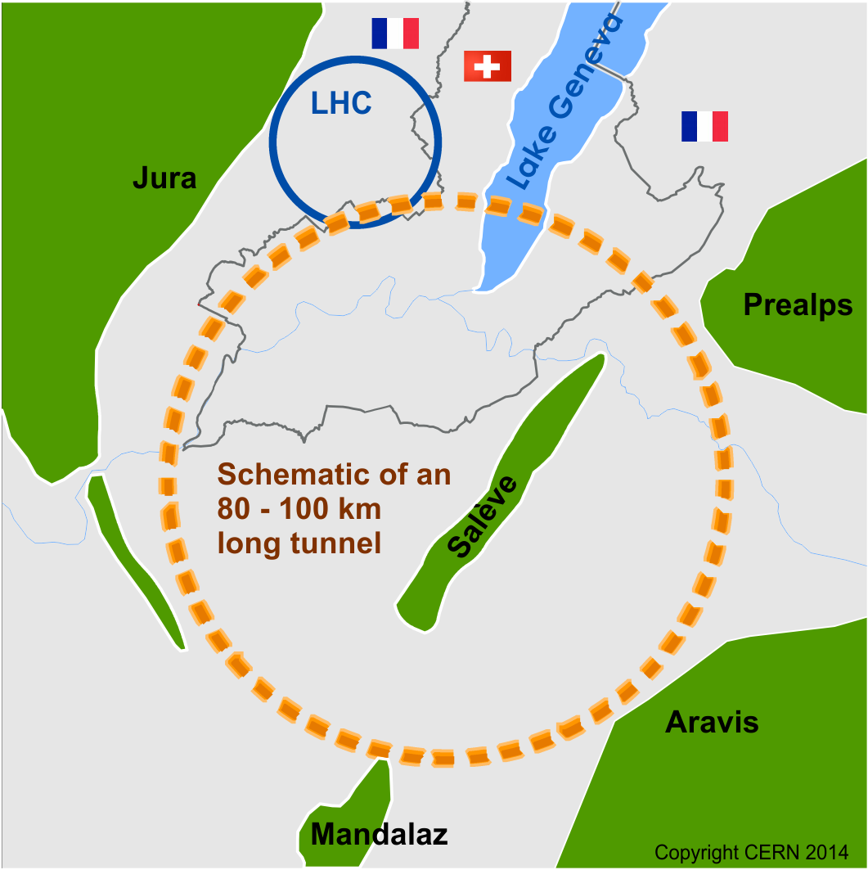
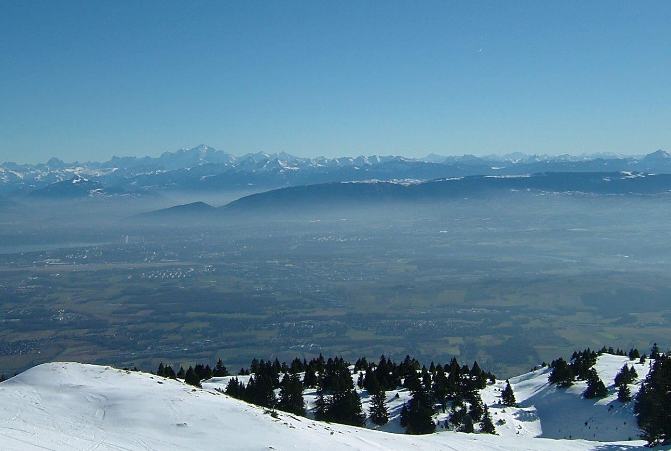
Thank you for your attention!

Slide 31
Energy sawtooth
12 RF sections
4 RF sections
Energy loss per turn: U₀ = 7.72 GeV

Slide 32
80 GeV: important parameters
Cell length in arc (m) | 50 | 100 | Baseline
Phase advance in arc cell | 45°/45° | 90°/60° | parameter
Horizontal emittance (nm) | 1.47 | 1.70 | 2 x 1.65
Energy loss per turn (MeV) | 337.03 | 337.03 | 330
Momentum compaction (10⁻⁵) | 1.99 | 2.22 | 2
Max. hor. beta function in arc (m) | 141.47 | 181.54 | -
Max. vert. beta function in arc (m) | 141.68 | 211.05 | -
Max. dispersion in arc (m) | 0.41 | 0.58 | -

Slide 33
45.5 GeV: important parameters
Cell length in arc (m) | 200 | 250 | 300 | Baseline
Phase advance in arc cell | 60°/60° | 72°/72° | 90°/60° | parameter
Horizontal emittance (nm) | 12.5 | 14.5 | 14.2 | 2 x 14.6
Energy loss per turn (MeV) | 35.3 | 35.3 | 35.3 | 30
Momentum compaction (10⁻⁴) | 1.69 | 1.86 | 1.81 | 1.8
Max. hor. beta function in arc (m) | 366.51 | 465.71 | 554.00 | -
Max. vert. beta function in arc (m) | 407.92 | 477.70 | 626.43 | -
Max. dispersion in arc (m) | 4.02 | 4.87 | 4.56 | -
RMS beam size σ_{x} in arc* (mm) | 2.1 | 2.6 | 2.8 | -
*

