Slide 1
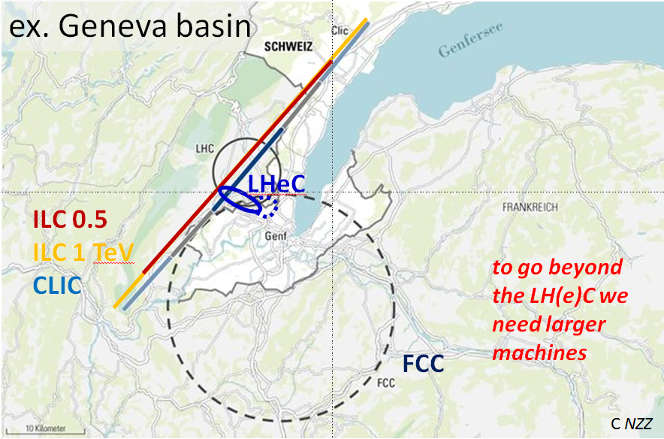
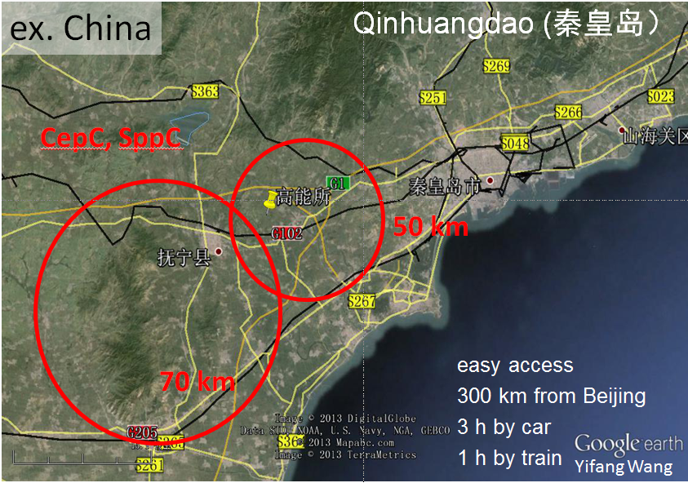
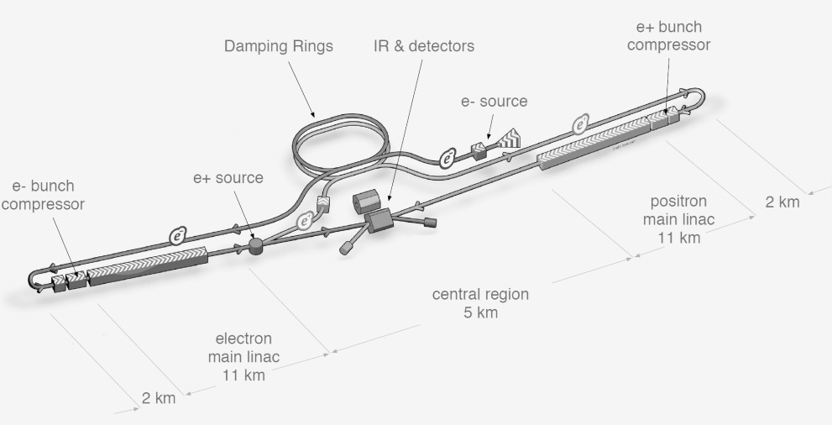
Energy for Innovation and Innovation in Energy
HEP Future:
To Be or
Not To Be …
Toward Sustainable Colliders
Green

Slide 2
Some of the high energy frontier future infrastructures
ee 240 GeV, pp 50-90 TeV
pp 100 km 100 TeV
ILC, Japan
ee 500 GeV-3 TeV
ee 250 GeV – 1 TeV

Slide 3
Content
Energy consumption: a burning hot parameter
HEP future: Sustainability:
efficiency and renewable energies
Energy is HEP at core

Slide 4
Colliders hot parameters
Detailed studies on:
  Beam Energy
  Luminosity:
    Emittance
    spot size
    Bunches (nb, charge,…)
  Chromaticity
  Energy spread
  Beam purity at IP
  Stability
  Reliability and availability
  …
But P_{AC}: AC wall-plug power figures are often: missing, partial or poorly documented

Slide 5
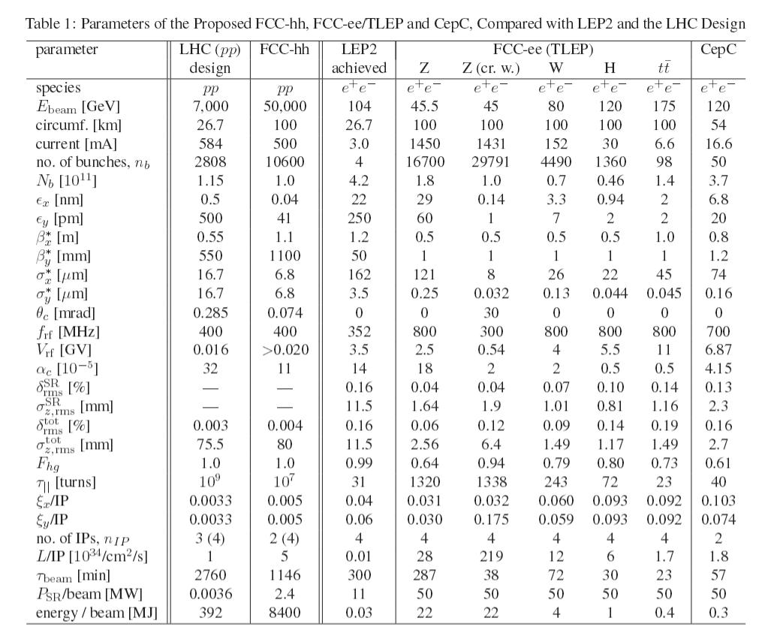
IPAC 2014, F. Zimmermann et al.

Slide 6

P_{AC}: wall-plug power
Future projects:
  P_{AC} often forgotten
  A technical detail on the back burner
In celebrated books: no mention
Past projects:
  Difficult to get the estimated/measured figures.
One reason: Difficult to compute/estimate
  Component by component (RF, Cryo, electronics, air cond., water cooling, ….)
  General formulae and approximations
However P_{AC} is a key parameter to select
a technology or a project.

Slide 7
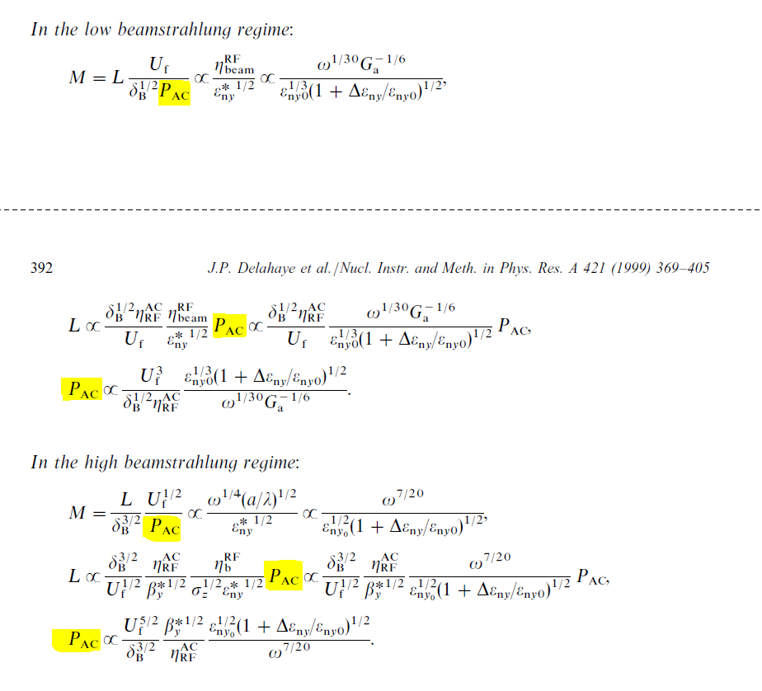
Scaling laws for e+/e- linear colliders
J.P. Delahaye, G. Guignard,T. Raubenheimer, I. Wilson
U_{f}= E_{beam}
δ_{B} =% loss by beamstrahlung
η^{AC}_{RF}=wall plug power to beam power
Would be nice to compare with actual data..

Slide 8
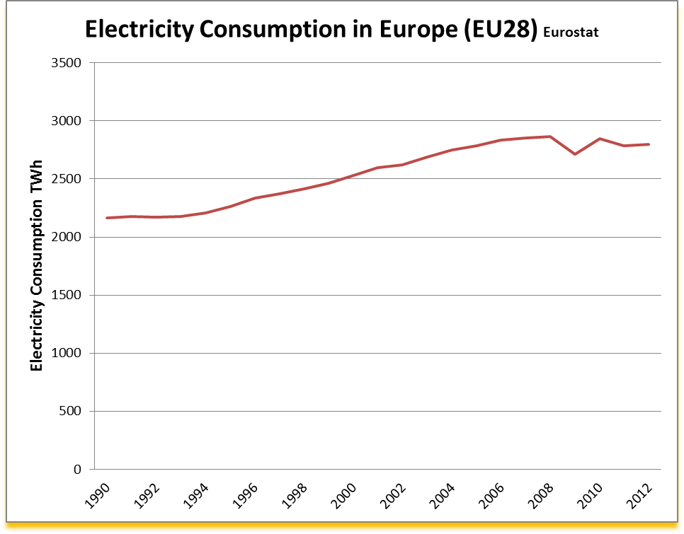
High-Energy Physics is all about Energy
From eV to TeV
Great saving achieved: technology improvement, operation optimization, disruptive technology shift:
}
Fix target to colliders exp.
NC to SC magnets
Warm to cold RF (SC cavities)
Circular (e+e-) to linear
Reducing Energy Consumption
Next paradigm shift for higher energies ?
(Acceleration in plasma (laser, proton), crystal channels, muon colliders, … ??)
Scaling with CM energy, the next colliders linear or circular:
  Will consume more energy
  And more, relatively to other consumers
    People are saving, industry is saving
    Sustainable energy are part of people life
Energy will be more expensive
Environmental issues
HEP got to be involved

Slide 9
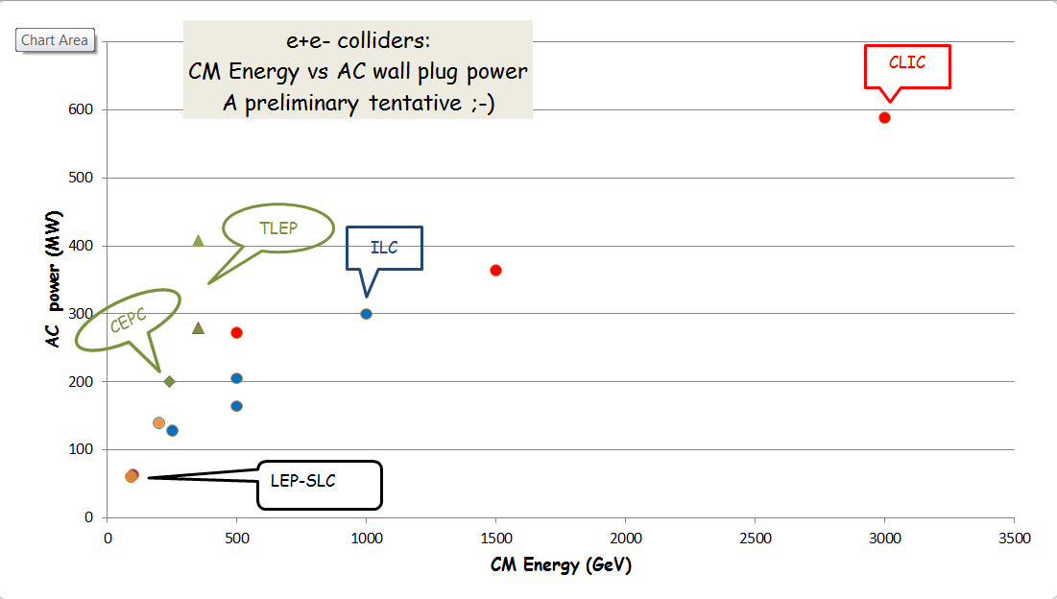
e+/e- Colliders: P_{AC} vs E_{CM}

Slide 10
Power and Energy
LHC-CERN ~ 180 MW → 1.3 TWh/year ~ 50% Geneva canton electricity consumption
FCC-ee : 354 MW @ 350 GeV (top ring and pre-injection not included)
FCC-hh : 468 MW @ 100 TeV (pre-injection NOT included (+100 MW ??) (P. Collier)
ILC: 164MW @ 500GeV – 300MW @ 1TeV (TDR)
Experiment, Computing, Buildings => 180 MW @ 500 GeV, 320 MW @ 1 TeV.
TDR takes an even larger margin: 300 MW 500 MW
ILC 500 GeV 18% of Iwate prefecture electricity consumption, Morioka (300,000)
ILC 1 TeV 32%
180$/MWh 2011 for industry (JP OECD 2013 report, special discount?, price volatility (2024))
CERN (2011, 70 $/MWh), ESS (Sweden, 110 $/MWh)
Yearly electricity running cost: 500 GeV ~ 210 M$
1 TeV ~ 380 M$

Slide 11
P_{AC}, E_{AC}, EC_{AC} are technology driven
P_{AC} (200-600 MW): AC plug power: good but partial indicator
E_{AC} (1-4 TWh/year): Yearly Energy Consumption
  Storage colliders: Beam lifetime
  Downtime energy consumption (cryogenics)
EC_{AC} (~70-400 M€):Yearly Running Cost for electricity
  Site negotiation with the utility company (
  High tariff period technical management
  Critical days shutdown: Standby and short time restart, beam condition reproducibility, …
Energy Consumption/year and Running cost/year are better indicators
Both depend also on technology

Slide 12
K/W: Knowledge per Watt
Reducing entropy
100% of the energy is lost in heat waste
  Contrary to industry which provides products or services
Reducing entropy:
  Industrial watts decrease entropy (temporarily) by building objects or providing services.
  Research reduces knowledge entropy by building structured theories (e.g. Maxwell equations) … much more rewarding … ☺
the K/W plot
  Not only CM energy/Watt
  Luminosity/Watt
  Nb Higgs + top + …/Watt
  Higgs coupling accuracy, top mass precision/Watt
  ….
What is the best figure of merit to assess a technology ?

Slide 13
For HEP, Energy Consumption is a major issue
HEP future depends on how and how much we will address this concern:
Bridging Accelerator and Energy R&D: to keep added complexity small
  must be well structured
  On parallel tracks and staged to minimize interferences
  Bring in Energy R&D specific budget
Decrease running cost and increase operation flexibility
Contributing to the society (Energy, Environment)
Escaping from Energy obsolescence:
Concord supersonic travel, incandescent light bulb, vacuum tube computers, printed paper, … not simply due to energy consumption, but still …
Recent new initiatives

Slide 14




Energy for Sustainable Science
23-25 October 2013
CERN
Campus and building management
Co-generation
Computing energy management
Energy efficiency of the facilities
Energy management, quality, storage
Energy management technologies developed in Research Facilities
Waste heat recovery

Slide 15
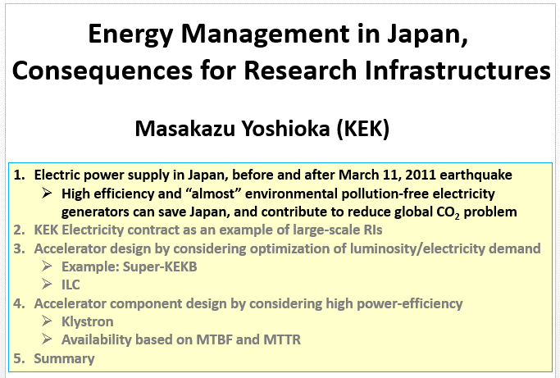
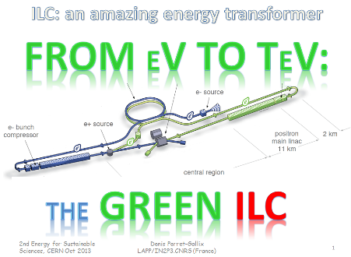
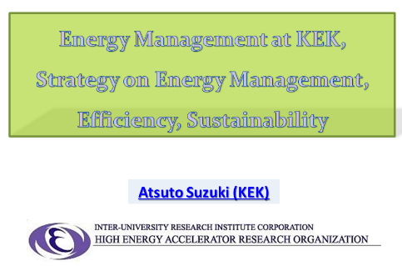
The Green-ILC initiative
Linear Collider WS
Tokyo Nov. 15 2013
A. Suzuki (KEK)

Slide 16
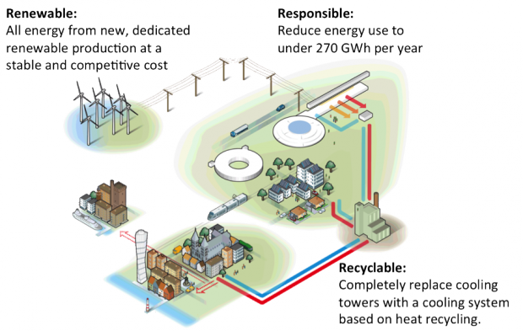
European Spallation Source - 4R neutron source
ESS Energy Design report
http://europeanspallationsource.se/sites/default/files/20130131_ess_edr.pdf
Reliable
stable electricity and
cooling supplies
Wind Power: 100 MW
Machine: 278 GWh/y
Cooling: 265 GWh/y

Slide 17

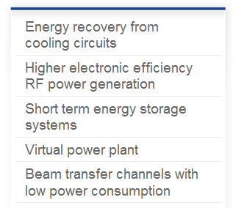
EnEfficient WG
ESS, T. Parker
CERN, E. Jensen
KIT, M. Sanders
GSI, J. Stadlmann
GSI, G. Spiller
Make it global (ICFA ?)

Slide 18
The Green-ILC initiative
Revisiting all ILC components with a focus on:
Energy Saving: improving efficiency
Energy Recovery and Recycling
Operational saving
Study of renewable energies in the ILC framework:
Renewable energies production and use
Energy Storage and conversion to electricity
Energy Management and Distribution: Local Smart Grid
Green-ILC, a first step toward Sustainable Colliders

Slide 19
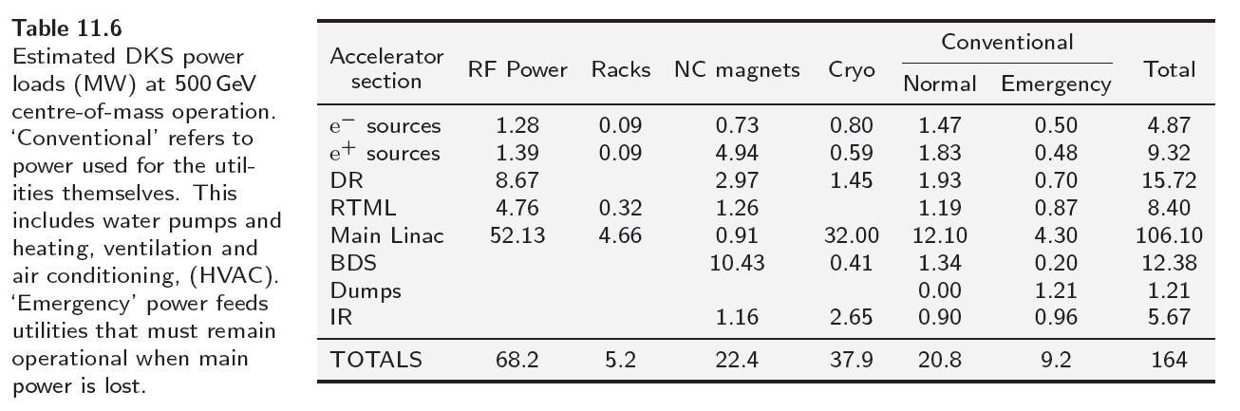
ILC baseline energy budget
164 MW @ 500 GeV
MW
Rank: 1 6 3 2 4 5
% : 42 3 15 23 13 5
Wall-plug to beam power efficiency is 9.6 %

Slide 20
Green ILC (1)
Energy Saving
  On components:
  RF high efficiency (power converter/modulator (90%), klystron (65%), waveguides, power couplers)
  Cryogenics: High efficiency cryocooler and system optimization
    LN2 precooling and energy storage
  NC magnets
  ILC Lattice optimization
  On operation
  Power reduction during idle periods:
    system on standby and energy saving mode, More effective if made on design
    Long running period (fewer, but longer shutdown due to cryo)
  Increase reliability (to avoid down time)

Slide 21
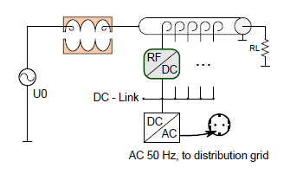
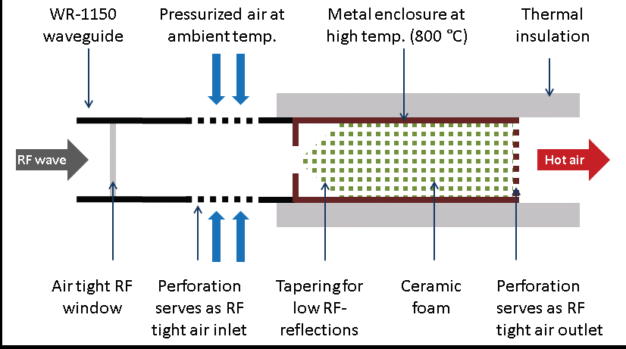
Recover non-used RF power: Smart RF loads
Idea 1) – reconvert to DC power!
Idea 2) – use high-T loads!
1) http://accelconf.web.cern.ch/AccelConf/IPAC10/papers/wepd090.pdf
2) http://accelconf.web.cern.ch/AccelConf/IPAC2012/papers/thppc023.pdf

Slide 22
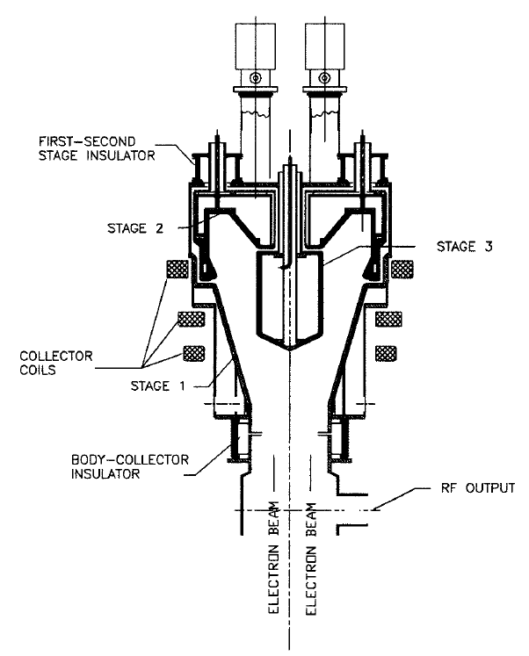
ITER Gyrotron depressed collector
110 GHz, 1 MW
Multi-stages Depressed Collector
Efficiency increased from: 30-35% to 60%
Amarjit Singh et al.
IEEE TRANSACTIONS ON PLASMA SCIENCE, VOL. 27, NO. 2, APRIL 1999
ILC Multi-Beam Klystron
From 6 beams → 30 beams …. ??
IOT Inductive Output tubes (multi-beam)
Solid State Sys. see the 100 kW (350 MHz) of LINAC 4

Slide 23
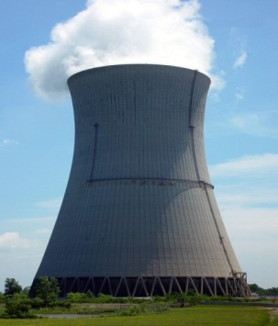
Green ILC (2)
Energy Recovery and Recycling
Heat waste from the water cooling systems:
  Increase output temperature: Carnot cycle more efficient with higher temperature gradient
    Produce electricity, Sterling engines and heat pumps, thermoelectricity, …
    Heat/cool nearby cities, green houses, fish farms, drying industry,…
  Recycling efficiency ? Cooling efficiency ? Saving/investment ratio ?
  Many applications to industry
Beam dumps energy recovery
  2 main full power beam dumps, 5.3 (@500 GeV) - 13.6(@1 TeV) MW, pressurized water (155 °C) + activation
  1 BD photons 0.3 MW, water at 190 °C
  How to recover, store and recycle this energy ?, stirling engines, heat pumps, molten salts, LN2
  Other ideas: Plasma deceleration dumping, Energy Recovering Linac

Slide 24
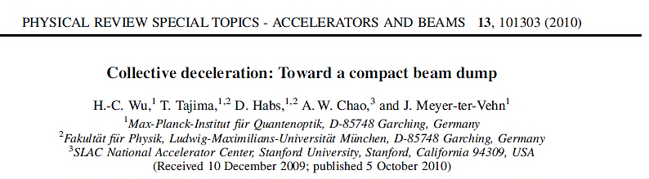
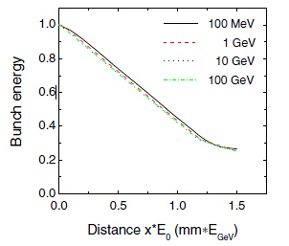
Plasma Deceleration Dumping
Linear Collider WS
Tokyo Nov. 15 2013
A. Suzuki (KEK DG)
Use Collective Fields of Plasmas for Deceleration
10 cm for 100 GeV
The deceleration distance in the underdense plasma is 3 orders of magnitude smaller than the stopping in condensed matter.
The muon fluence is highly peaked in the forward direction.

Slide 25
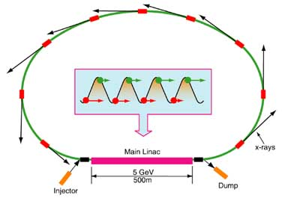
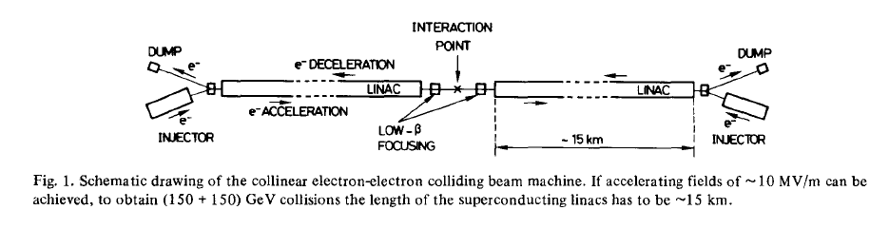
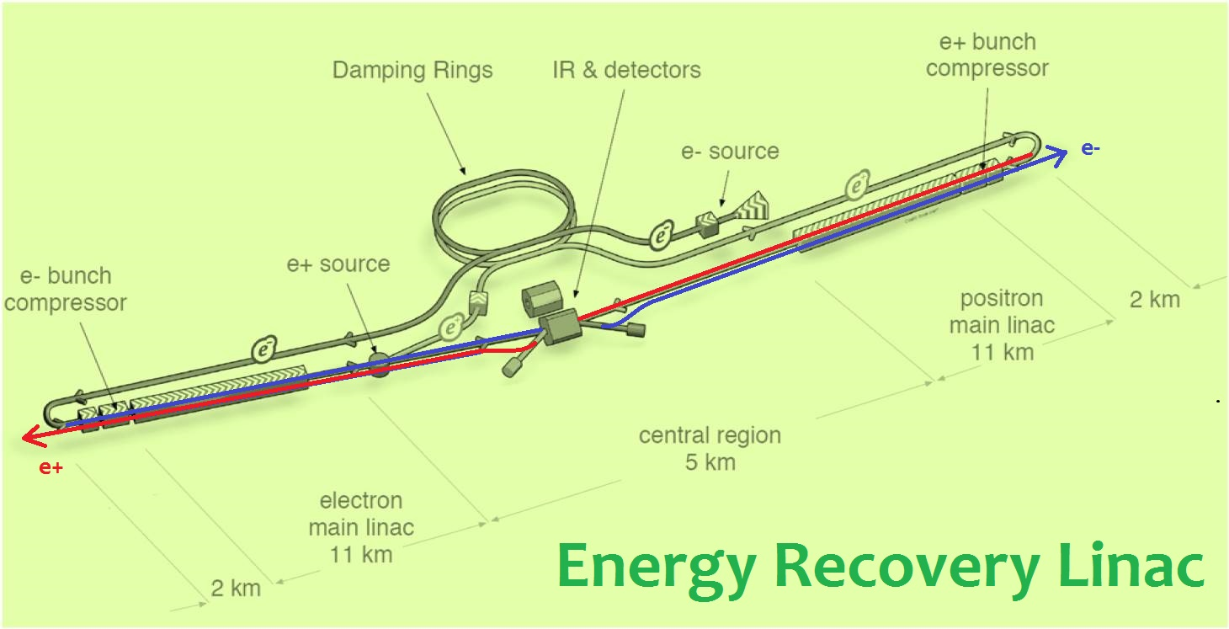
ILC-ERL
You should be joking!
U. Amaldi, Phys. Lett, 61B,v3 1976
or CLIC concept

Slide 26
How much will we save ?
10, 20, 30% great !!!
Will it be enough for the highest energies ???
Probably not
HEP must reach sustainability
Sustainability is efficiency and renewable energy

Slide 27
Green ILC (3)
Sustainable Energies
Energy Production:
  Study the pros/cons of various sources: solar, wind, geothermal, sea, …, smr,…
    Availability, Price, Flexibility, Potential for improvement, Environmental impact
  Find the best energy mix to cover ILC specific needs ? 24/7, long shutdowns, …
  Match ILC component to the energy sources specifics:
    RF power converter: PhotoVoltaic, fuel cells (DC)
    Cryocooler or asynchronous liquefactors ?
Energy Storage: HEP, experts in some of these technologies
  Liquid Helium, Nitrogen, SMES(Sc Magnetic Energy Storage), Flywheel, Pumped hydro, Compressed air, Batteries, …
Distribution: Local Smart GRID:
Full scale multi-sourced, AC/DC, GRID management and control
  Smooth and rapid switching between energy sources, including conventional supply
  Energy Monitoring, Management and forecast: production, storage and backup

Slide 28
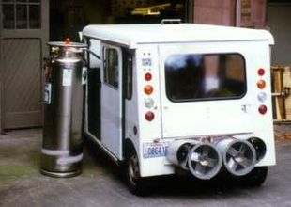
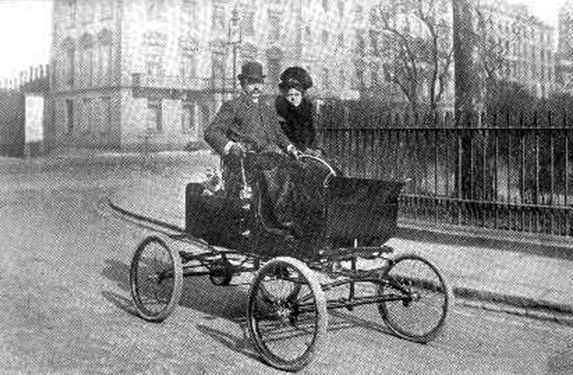
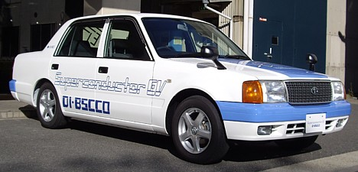
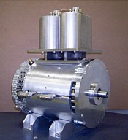
Example: An LN₂ Economy for ILC
  The ILC cryogenics is consuming ~ 40 MW (25% of ILC AC power)
    In current design all cooling is done with LHe. LN2 as a primary coolant -> 20 MW
    LN2 cooling: HTc (MgB2) power transmission lines, NC magnets, electronics/computers,
    LN2 could be used to recycle low grade heat waste or/and high temp. beam dumps
    And produce electricity with high-pressure gas turbine (70% efficiency)
  LN2 could be produced by sustainable energies
    Close to or at the ILC site (wind, solar, geothermal energy)
    Wind energy: from electricity or direct compression
    Byproducts: liquid oxygen, argon, capture C0₂, …
  LN2 Energy storage
First LN2 car
Sumimoto
Liquid air energy network

Slide 29
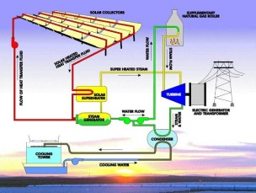
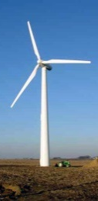
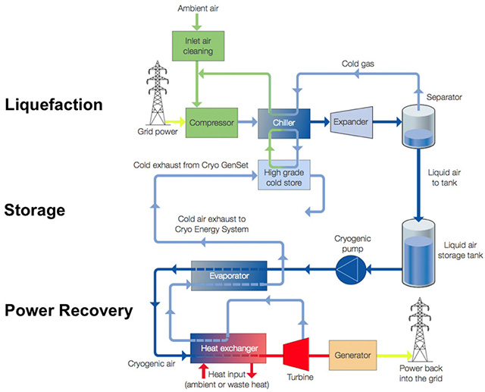
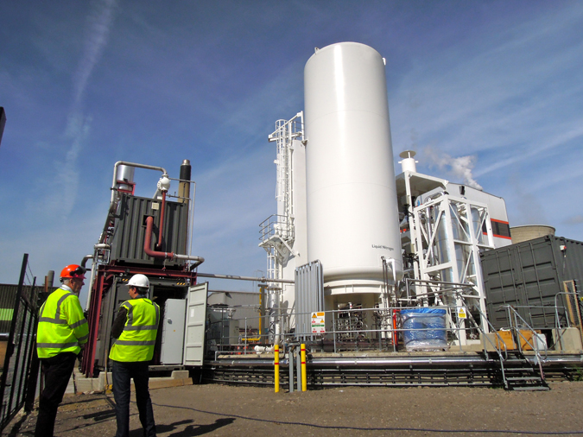
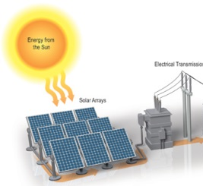
LN2 as energy storage
Highview Power Storage (UK)
ILC heat waste
Expected Efficiency up to 70% using heat waste (~ 115 ⁰C)

Slide 30
Global Energy Center

Slide 31
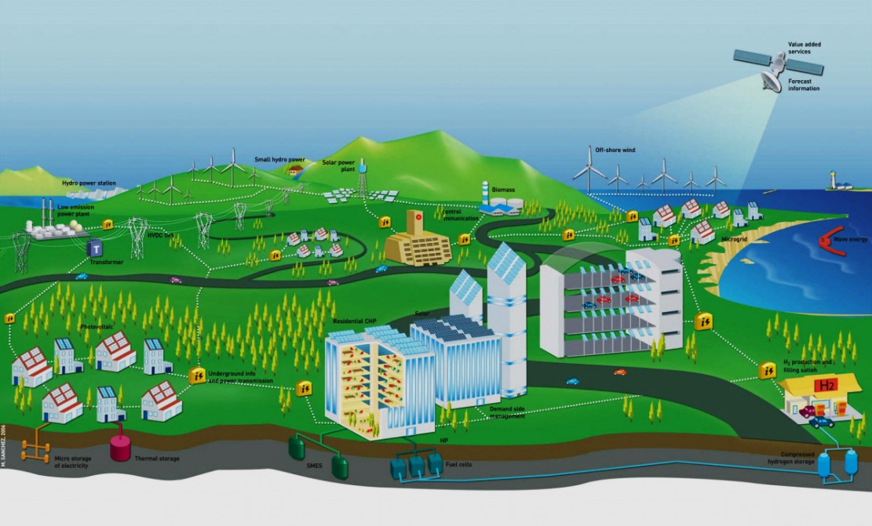
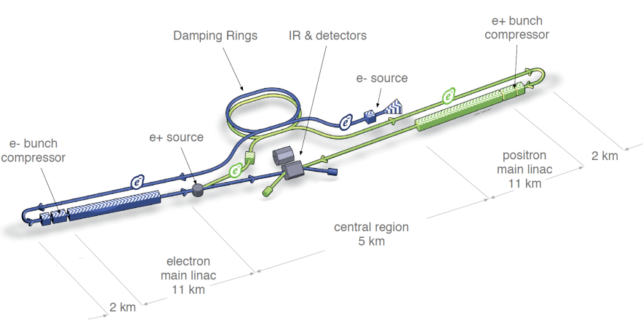
Global organization for Green ILC
ILC Energy Center
ILC High-Energy
Research Center
ILC Sustainable Energy Research Center
Industry
Fundamental Research
Basic Research
HEP Applications
Application R&D
Pilot Power plant for ILC
Electrons, photons, neutrons factories
HPC/GRID Computing
Energy storage tech.
High-Energy community
Energy community

Slide 32

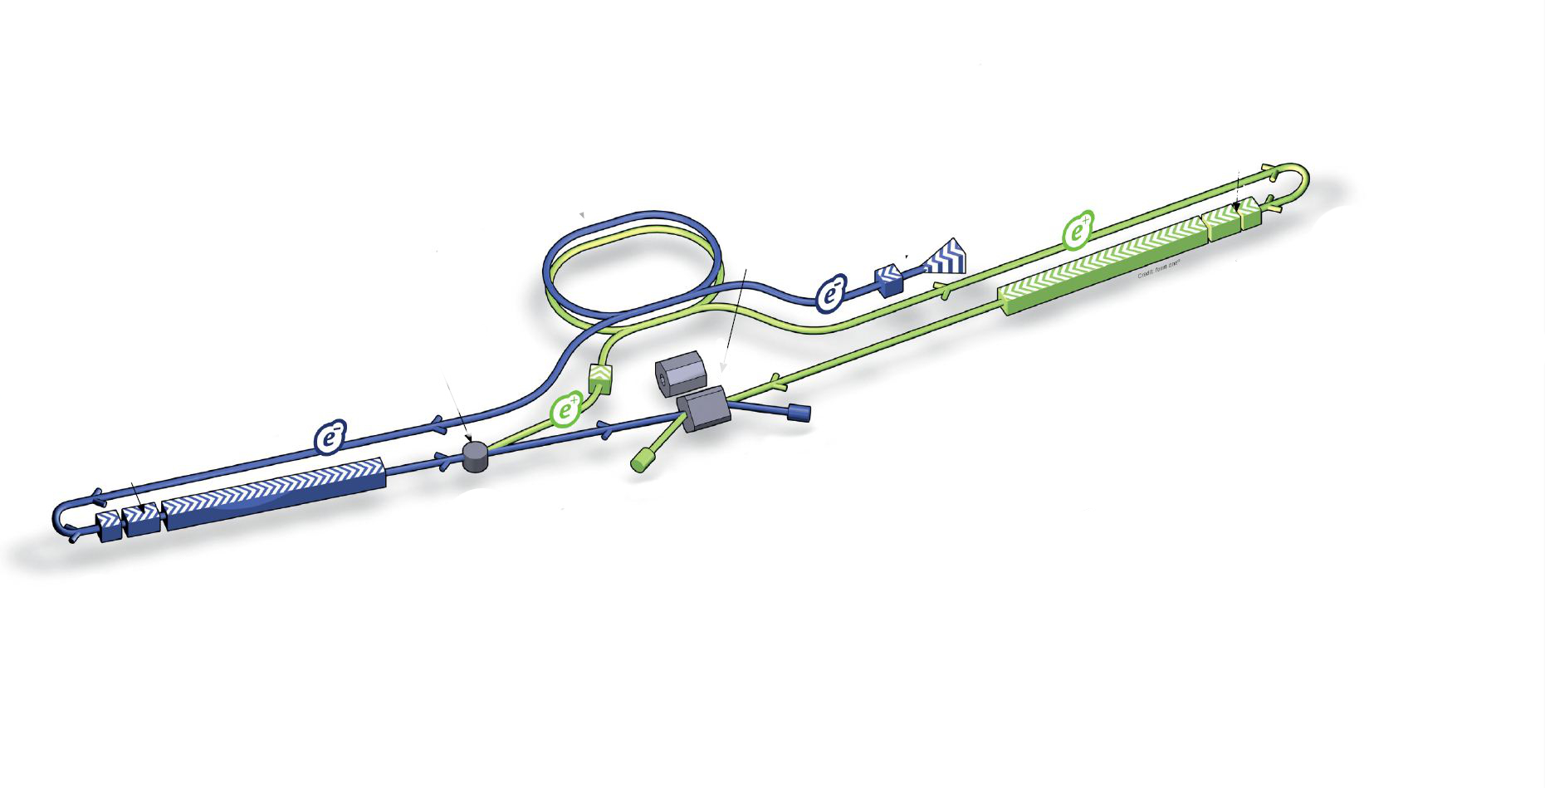

The “ILC Energy Center”
Forecast and data management
Hydro storage
Wind turbine
Off-shore wind
Solar Power Plant
Biomass
Geothermal Plant
Smart GRID
Wave/stream energy
Photovoltaic and thermal
Photovoltaic
He, H2 storage
Courtesy of:

Slide 33
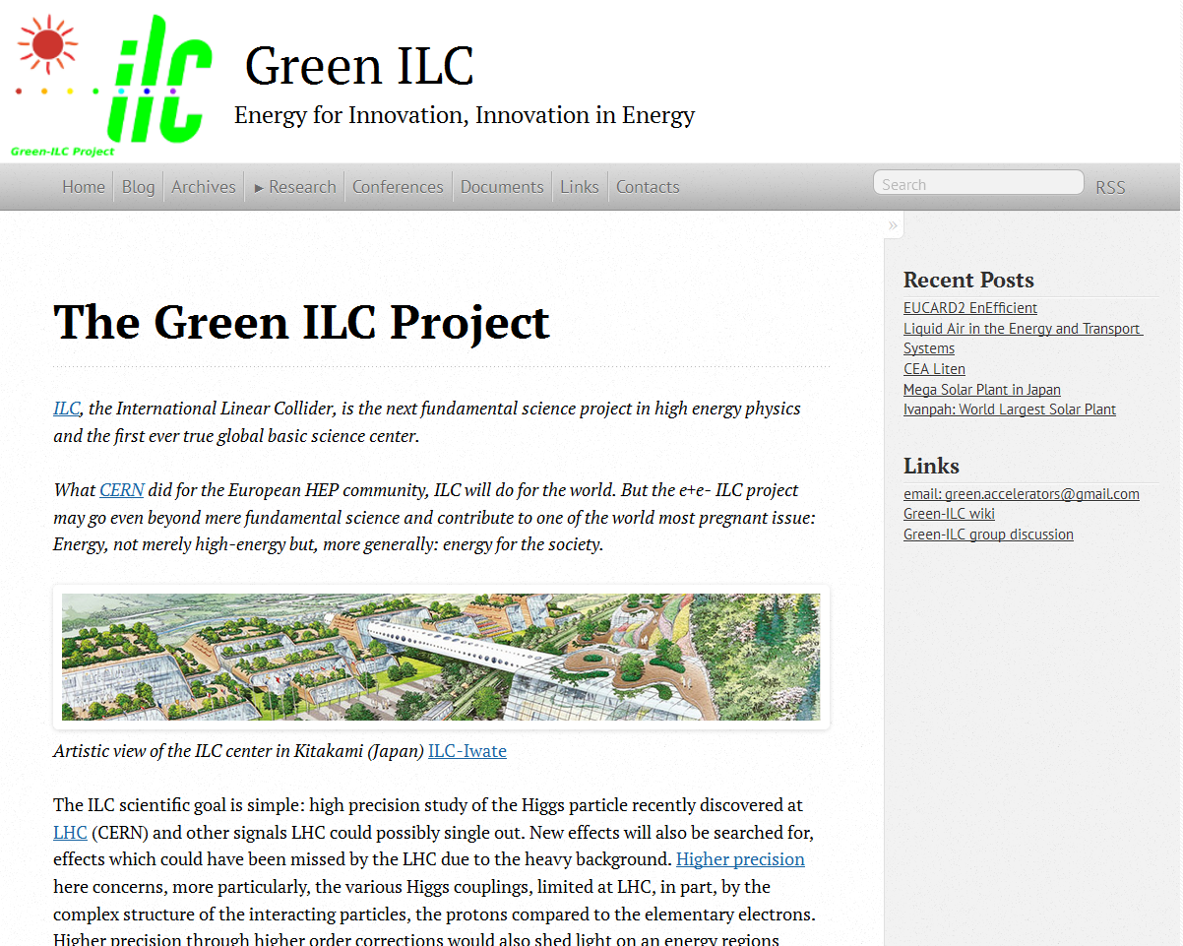
http://green-ilc.in2p3.fr

Slide 34
Messages
Energy consumption is a burning hot parameter
  Linked to many scientific, technological, financial, societal, political issues
  Could be a no-go for some projects
  Not a taboo or worst a technical detail: must be bluntly addressed
Future of HEP: Saving, recovery, recycling: a must, but not enough for sustainability,
→ renewable energy
  Follow and contribute to energy/environment civilization shift
  Storage, a master word, needed for recycling and renewable energies.
  E.g. LN₂ economy
Energy R&D is core to HEP Research
  HEP is all about energy, HEP needs energy.
  Must structure a Global effort:
    Build on existing initiatives: Green-ILC, EUCARD2 EnEfficient, Sustainable Science Workshop,…
    Collaboration with Energy R&D and Industry (Japan AAA Green-ILC)
    ICFA could take initiative: sustainable accelerator panel
  Next global infrastructure should be seen as an “Energy Center”
  Make HEP a bright future and bring benefit to the society
Let’s do it the smart way

Slide 35
Thank you for your attention

Slide 36
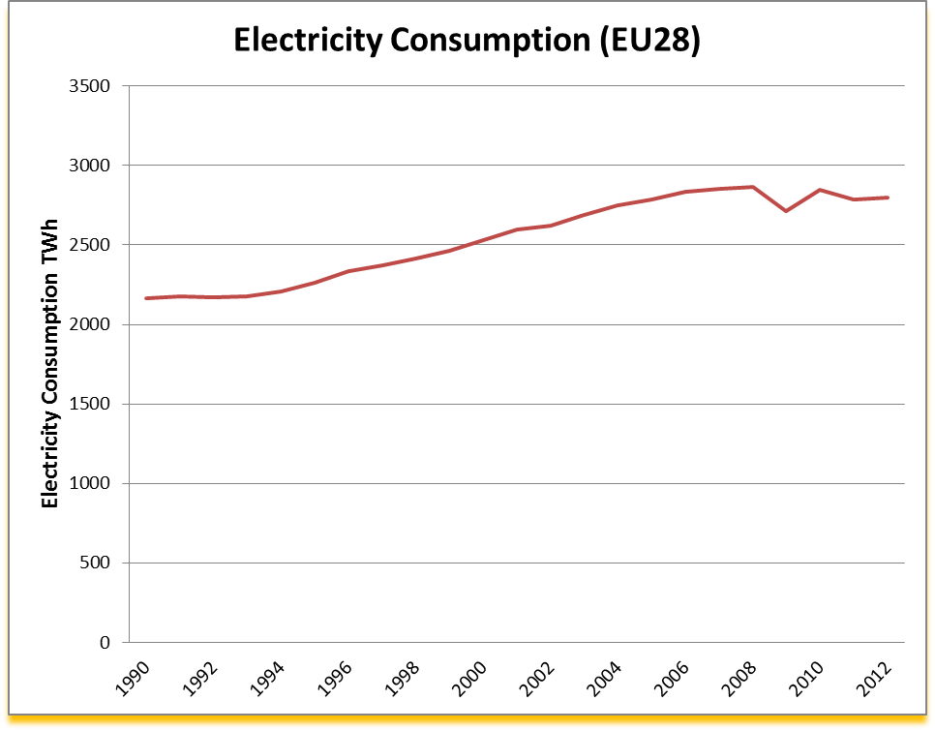

Slide 37
Green-ILC Roadmap
Identify the energy saving, recycling and recovery potentials for all major ILC components.
Base-line and Advanced-line on more innovative technologies.
  ILC Design modifications:
    What can be implemented in the design before request for tenders ?
    What advanced R&D should be carried out before future extensions ?
  Implementation timeline (minimum impact of the ILC planning)
  Budget assessment: additional spending and saving
Design a global sustainable energy program for ILC
  Get the “Energy research” community and organization and the “Industry leaders” involved in a network.
  Propose a global governance scheme for the “ILC Energy Center”
  Form an additional budget for the “Sustainable Energy Center” (no ILC money)
  Identify short term renewable energy pilot plants with build-in upgradability
  Identify basic energy researches in line with the ILC project
Green-ILC project report by 2015

Slide 38
Timeline for a sustainable ILC
Gradual and Multi-Staged e.g.
As a backup to the conventional power supply (diesel engines)
To cover buildings energy through recycling and storage (electricity and heating) (zero energy )
To cover some parts of the ILC: computers (fuel cells), water cooling, part of the cryo plants
To power more of the previous components
To power some of the klystrons
All 500 GeV ILC electrical supply
  Conventional power supply is now in backup mode
Get ready for the 1 TeV
7 MW
10 MW
10-20 MW
30-40 MW
100 MW
170 MW
+150 MW

Slide 39
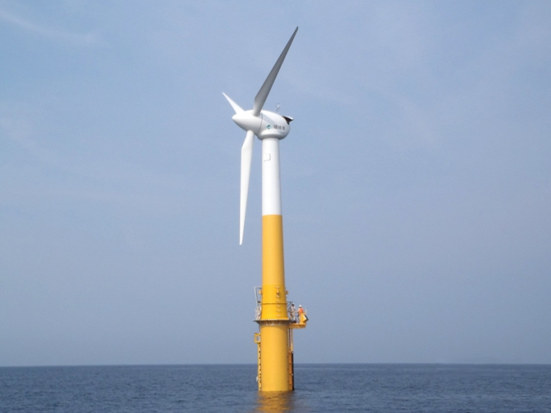
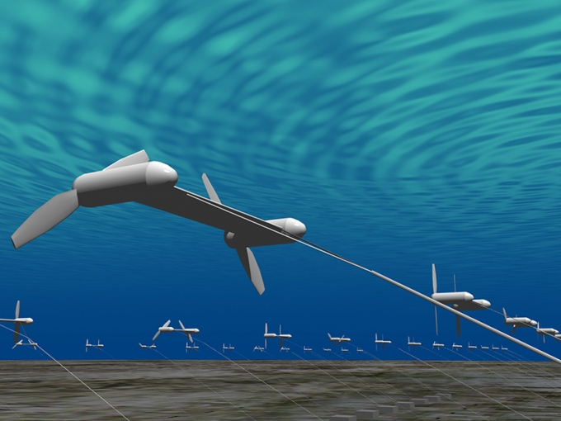
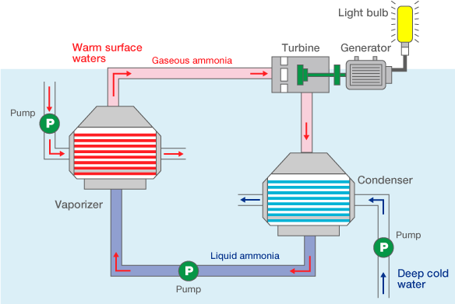
Wind/Marine Energy
2 MW Goto island prototype
Tidal and marine stream
2.3 GW installed, none failed after 3/11
Wind Projects
6 floating 2MW wind turbines off Fukushima
up to 80 in 2020
Sea temperature gradient

Slide 40
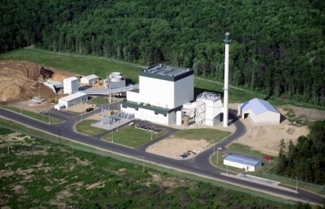
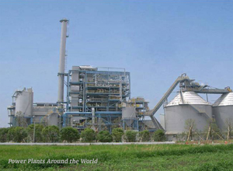
Biomass/biofuels Energy
Idemitsu Kosan Co. 5 MW
Miyasaki, Nishinippon Env. Energy co. 11.7 MW
Installed 2.3 GW (2011)
very little progress since 2011
Many sources including:
Rice, fishery and agricultural wastes
Algae
Other cattle and human wastes
Co-generations heat and electricity

Slide 41
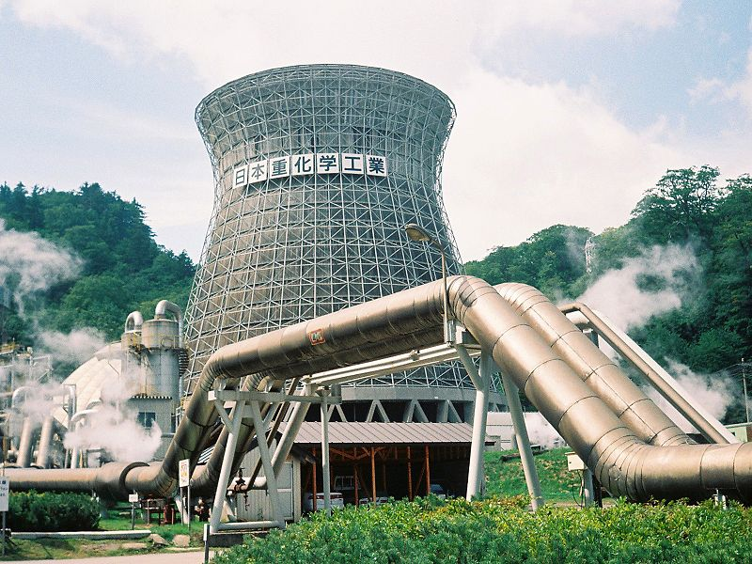
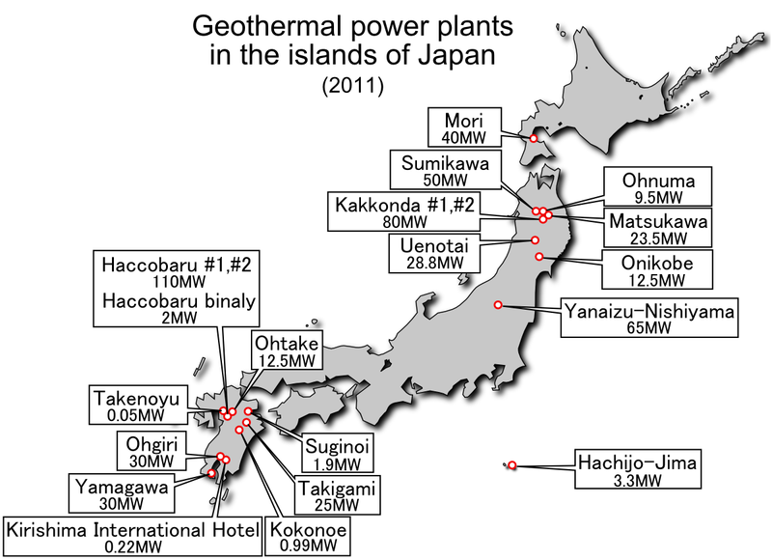

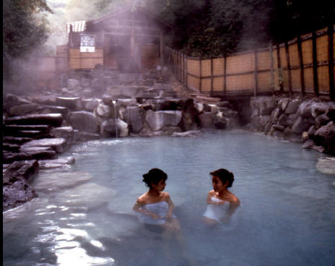
Geothermal Energy
9.5MW 1967 Matsukawa
Installed 2011 : 0.5 GW.
Geothermal potential sources : ~ 20 GW
No substantial progress since 2011
But:
Avoid National Parks
Get agreement with the onsen industry
No Fracking

Slide 42
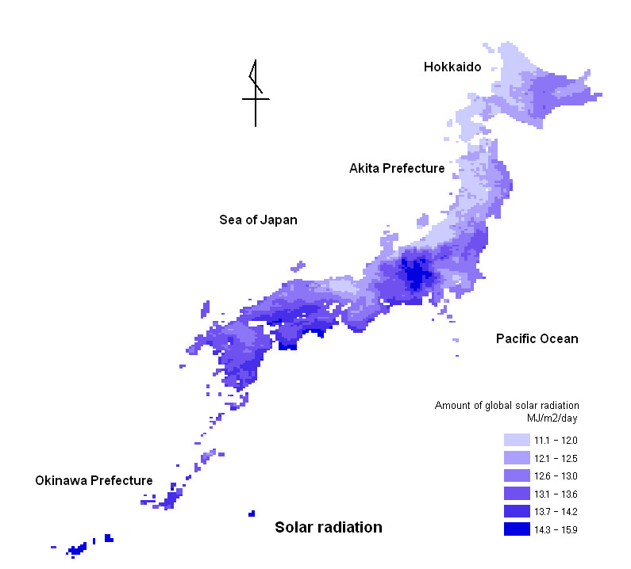
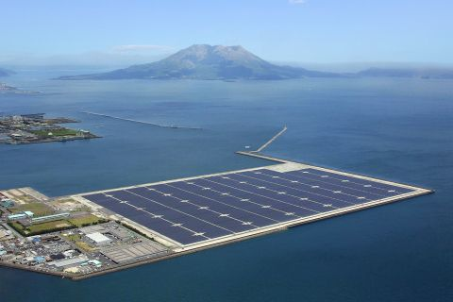
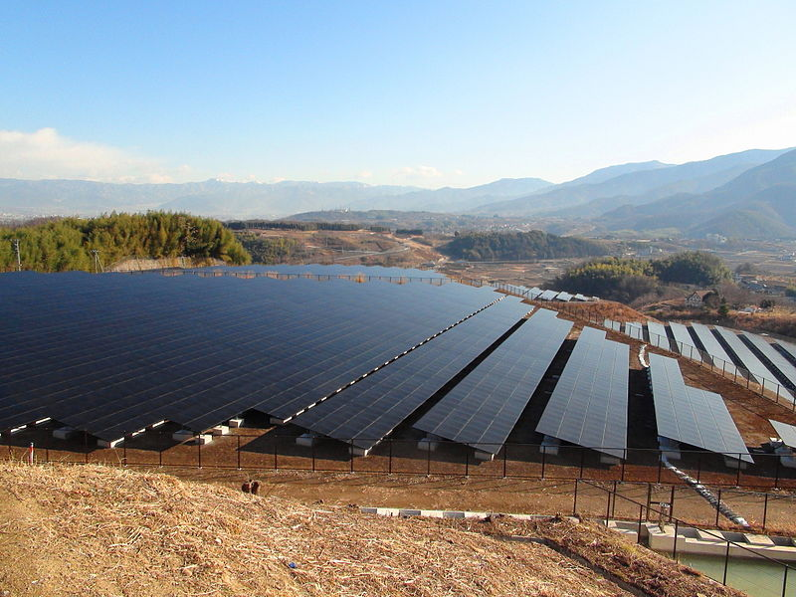
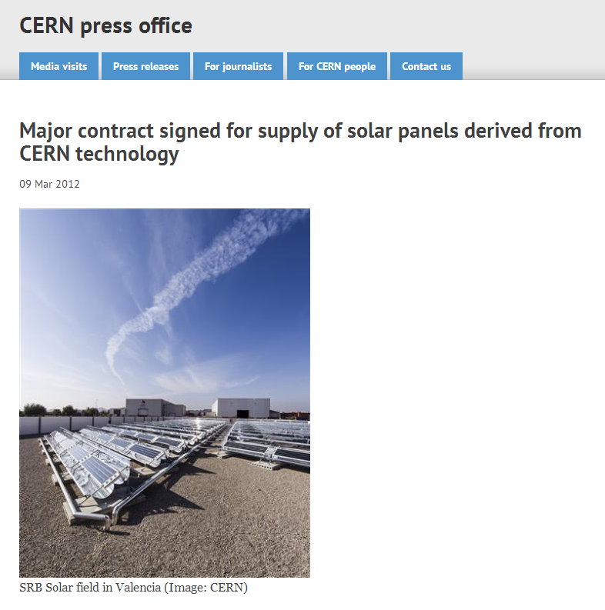
Photovoltaic and Thermal Solar energy
70 MW in Kagoshima started Nov. 7 2013
10 MW Komekurayama 30 km Fuji-san (TEPCO)
Installed: 8.5 GW
Projects:
341 MW in Hokaido
100 MW Minami Soma
2009 Target Japanese gov.
28 GW of solar PV capacity by 2020
53 GW of solar PV capacity by 2030
10% of total domestic primary energy demand
met with solar PV by 2050
Solar thermal Energy
C. Benvenuti
CERN Physicist

Slide 43
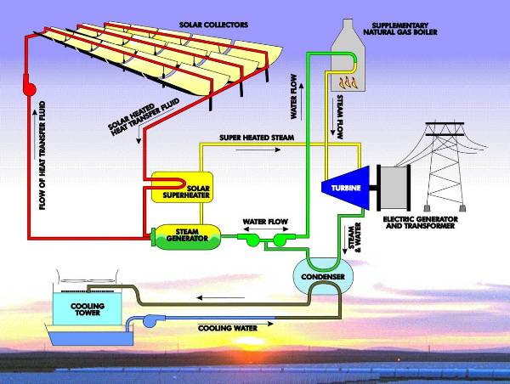
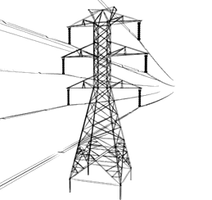





LN2 Electrical Production and Transport
OR …..
Grid/ILC
Solar thermal
Solar PV
Wind,
Geothermal, biomass
Electricity
Make LN2
By Cryo Pipeline
Longest LNG ~ 5 km
HTc SC power line (project)
by 20 Km long section

Slide 44







LN2 process cycle
Cryocooler may save 50% electrical power
Cooling NC magnets
HTc power Transmission lines
Cooling electronics and computers
Compressor/liquefier inside
LN2
Energy storage
LO2, LAr, SCO2
LN2
heat waste
Dry ice
Turbine → electrical generator
To Industry
For Cooling or Sequestration
N2 gas applications
Electricity Back to ILC/GRID
i.e. Drying and preservation industry
Air cleaning !!!

