Slide 1

An experimental perspective on very high-energy colliders
Alan Barr
Notes:
Experimentalists love high energy machines
People like working together

Slide 2
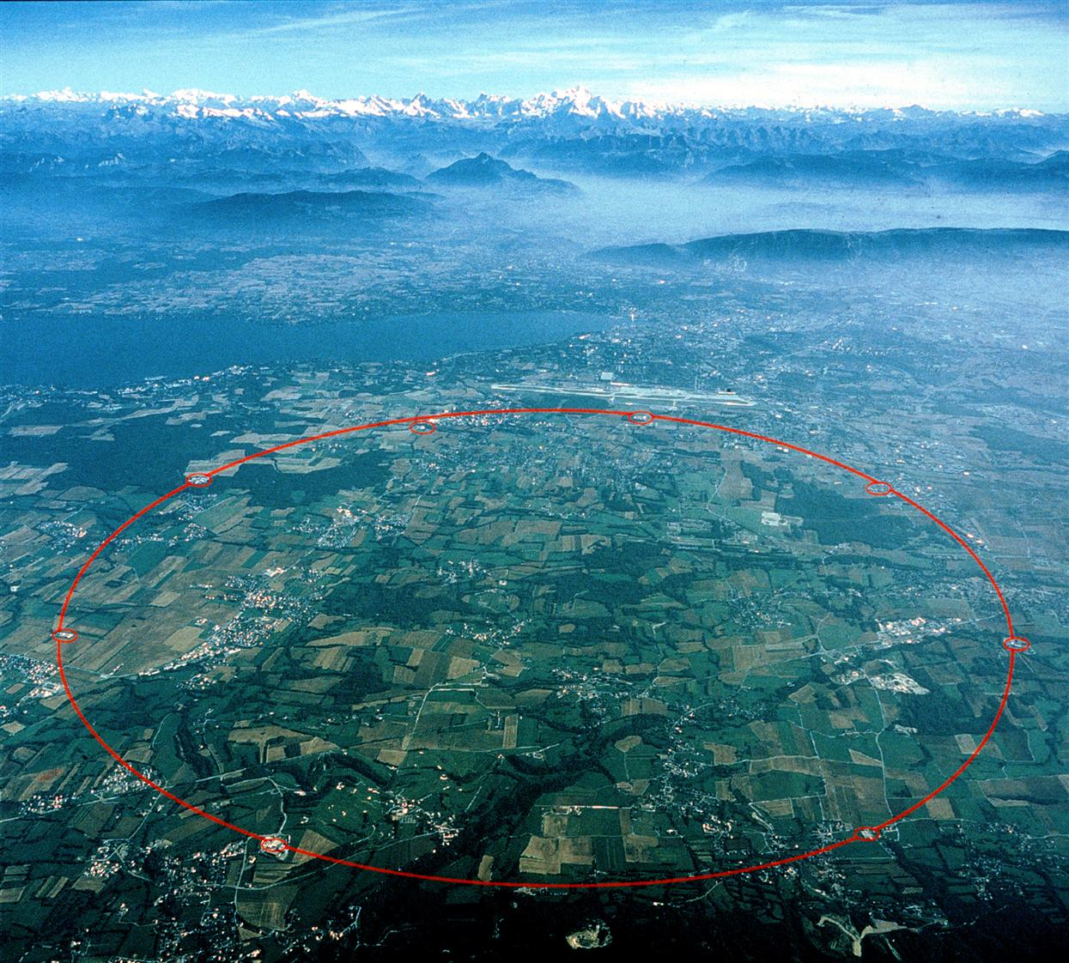

Slide 3
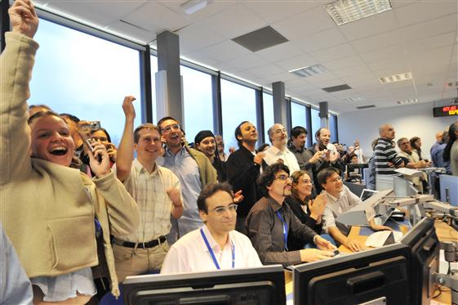
Experimentalists at a collider
Notes:
High energy colliders make experimentalists happy
Have not discovered dark matter.
Have not discovered higgs.
Have not achieved world’s highest energy collisions.
Have not achieved collisions at all.

Slide 4
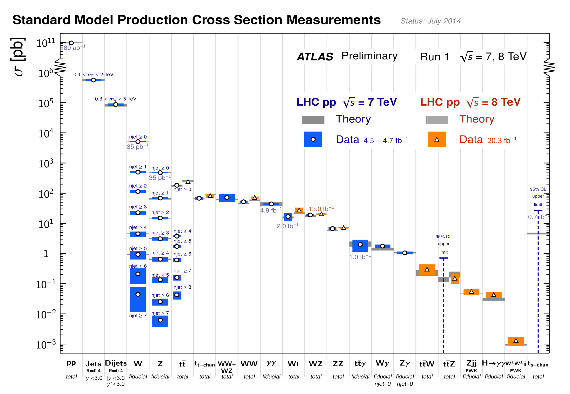
It’s great having a big programme…
Notes:
Experimentalists love the range of physics that can be followed
Number of papers (ATLAS, CMS, LHCb, ALICE)
Number of CONF notes

Slide 5
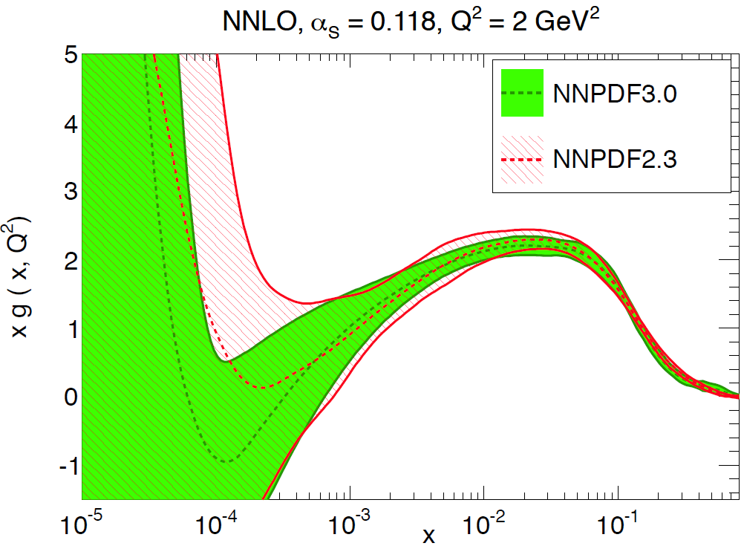
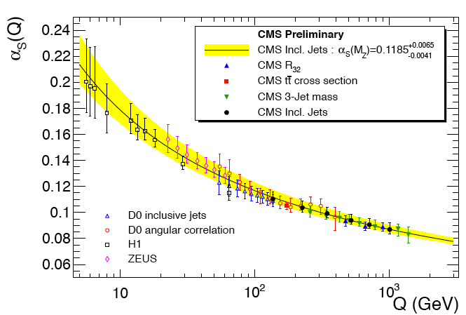
Strong interactions
Non-perterbative
Perturbative
Gluon PDF with
unprecedented
accuracy
Multiple consistent
measurements of αs

Slide 6
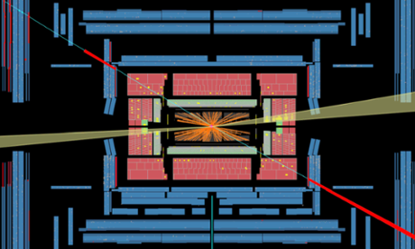
Weak interactions
3.6 σ evidence for electroweak W±W± scattering
Notes:
Experimentalists love a challenge
Boosted states….

Slide 7
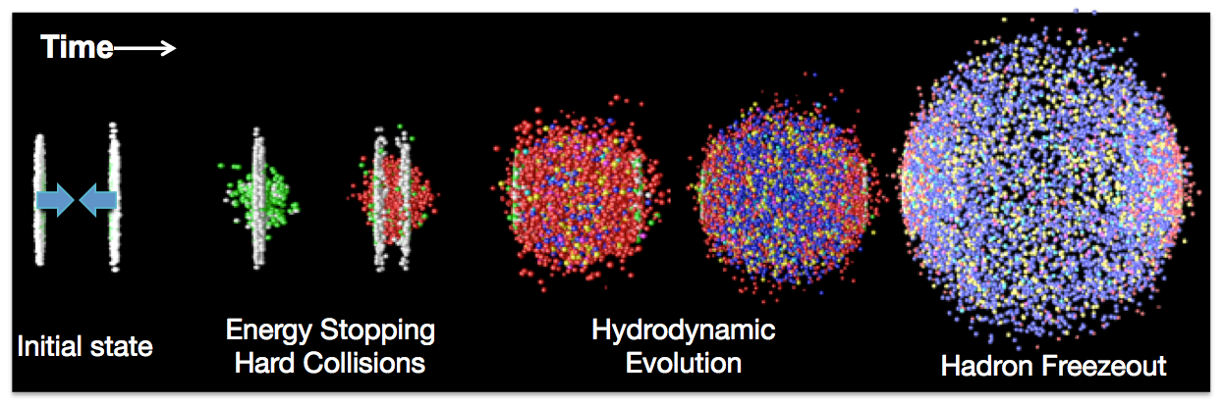
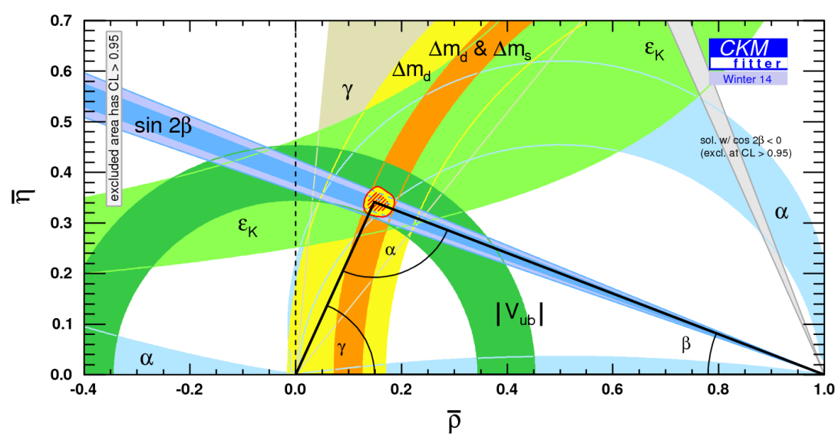
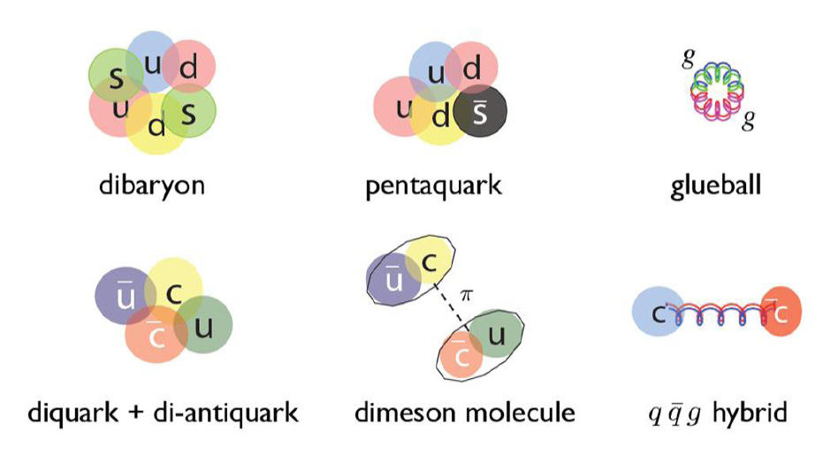
Strong dynamics
Flavour
Exotic hadrons

Slide 8
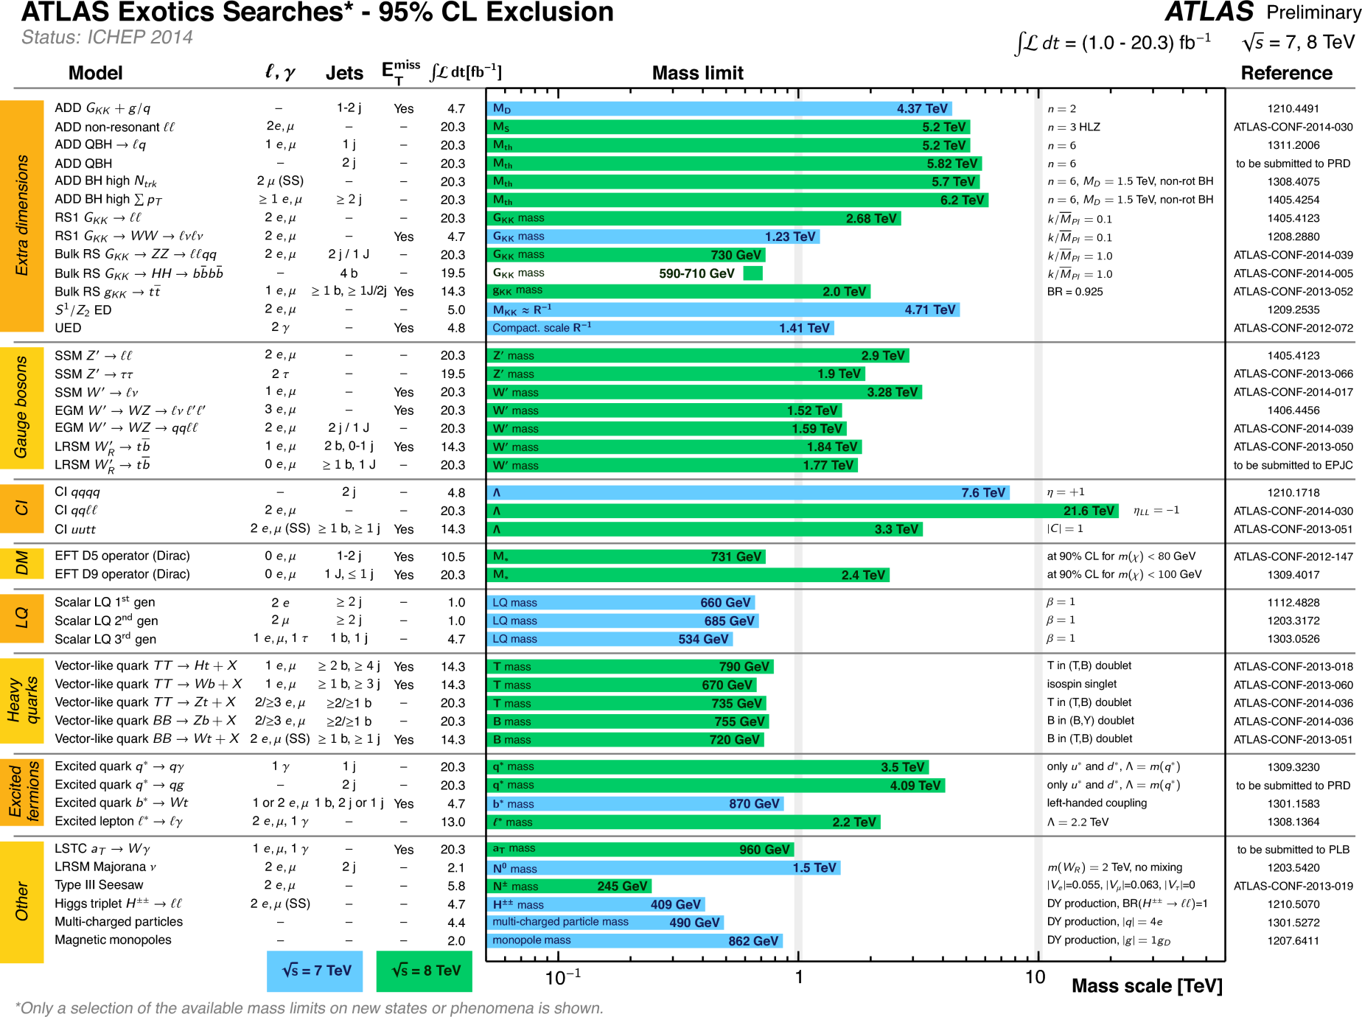
Searching for surprises
Notes:
We love this

Slide 9
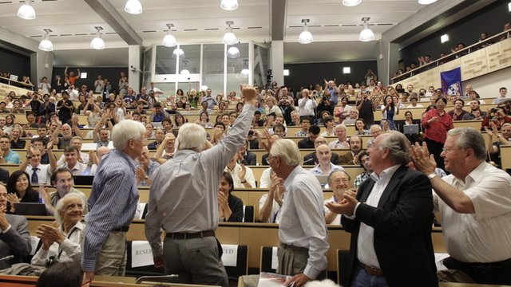
The world’s attention…
Notes:
The world loves discovery machines
The energy frontier remains the discovery frontier
Kids on the street ask about Higgs bosons, Dark Matter, extra dimensions
Science is cool!

Slide 10
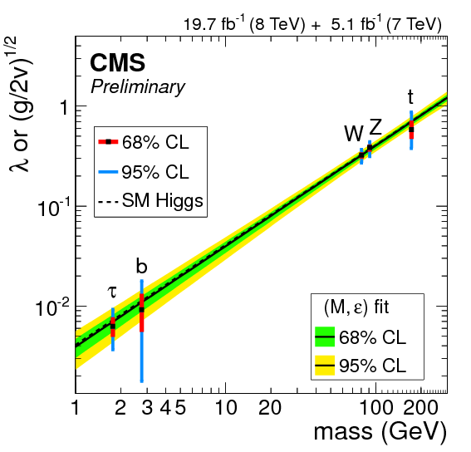
H(125) discovery & more…
Mass
Parity
Spin
SM Couplings
Uniqueness
Naturalness
Exotic Couplings
Self Couplings

Slide 11
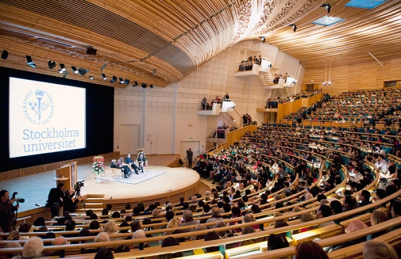
EPS Conference, 2013

Slide 12
EPS Conference, 2013
What’s next?

Slide 13
The high energy future
Walker, ICHEP, July 2014

Slide 14
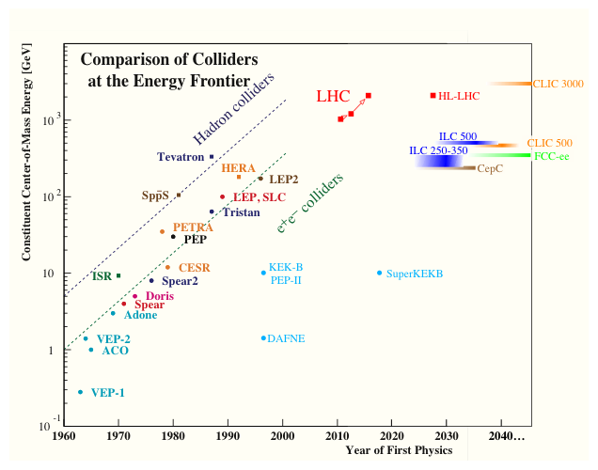
The high energy future
e⁺e‑ Linear Colliders
HE e⁺e‑ Storage Rings
Notes:
But no funding!

Slide 15
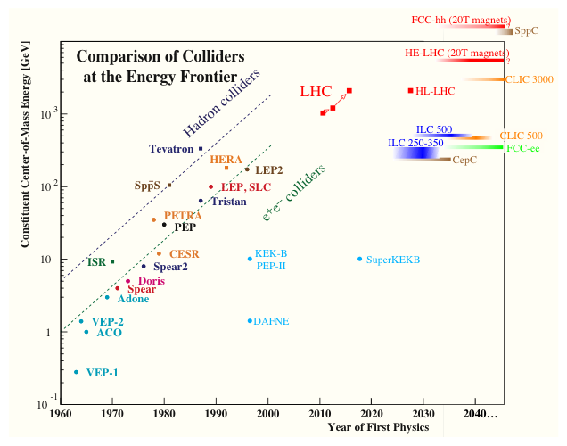
The high energy future
e⁺e‑ Linear Colliders
HE e⁺e‑ Storage Rings
HE pp Colliders
Notes:
But no funding!

Slide 16
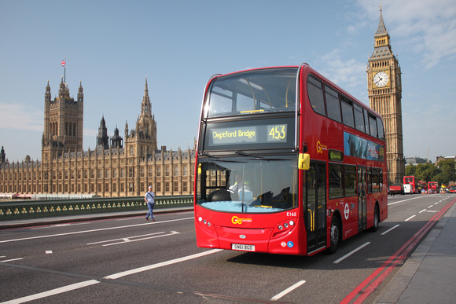
Making a statement
A bigger collider?

Slide 17
Pillars of a “100 TeV” pp machine
Weak bosons in jets
Boosted objects
Dark Matter
Naturalness
Flavour
Proton structure
Physics above the EW
phase transition
Precision top physics
Vacuum potential
Precision Higgs tests
Strongly coupled matter
Notes:
The three pure ones of the Taoist trinity

Slide 18
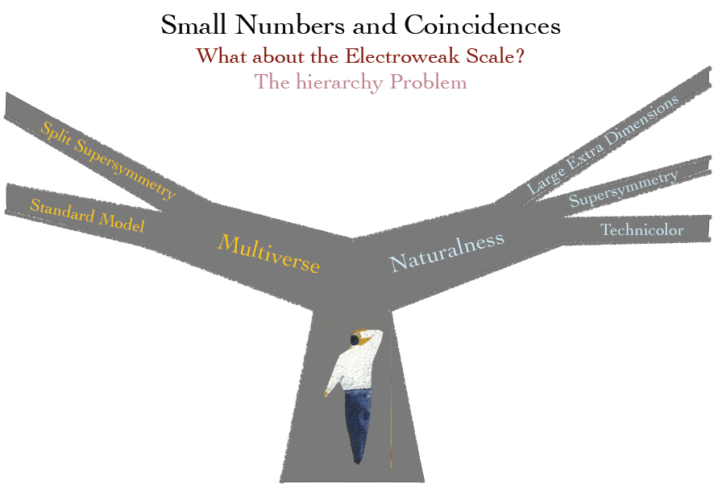
Naturalness
Savas Dimopoulus, CFHEP, 1st workshop

Slide 19

Naturalness – an experimental perspective
Notes:
Don’t know what the solution is
But we have good motivation to keep looking just around the next corner…

Slide 20
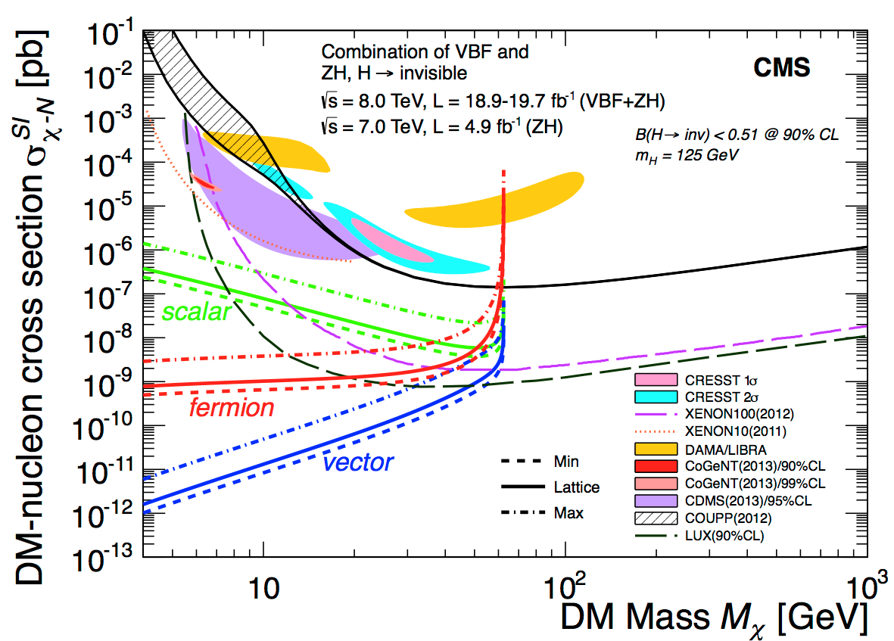
Dark Matter

Slide 21
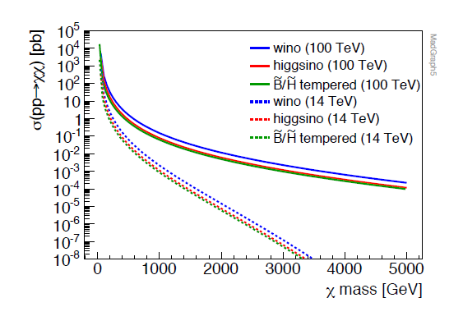
The advantages of energy
Liantao Wang, 1st CFHEP Symposium on circular collider physics, Feb. 24, 2014

Slide 22
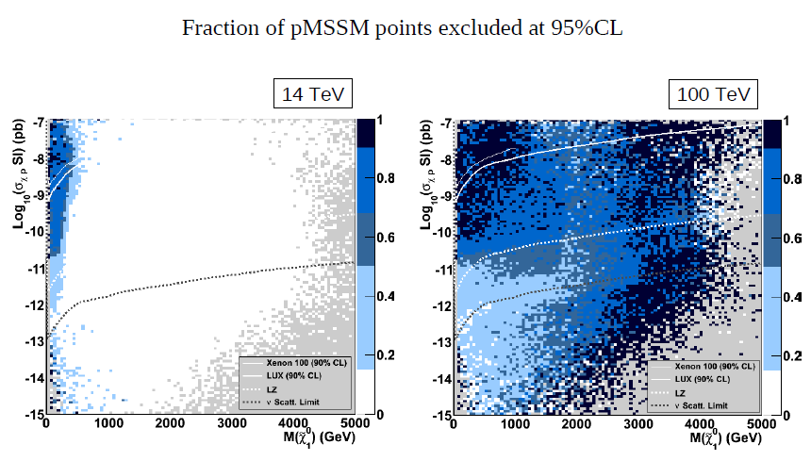
Bino-like points?
Not uncommon, and hard
➔ Experimental challenge (i.e. GOOD!)

Slide 23
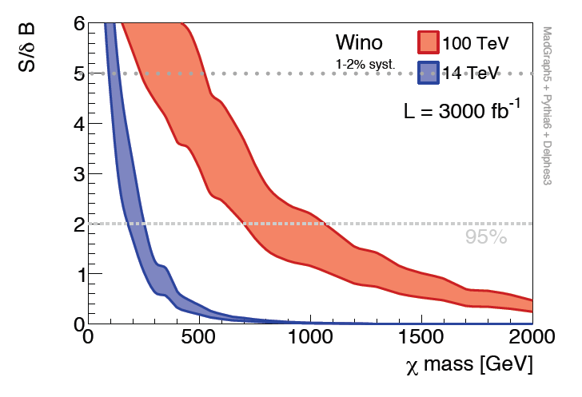
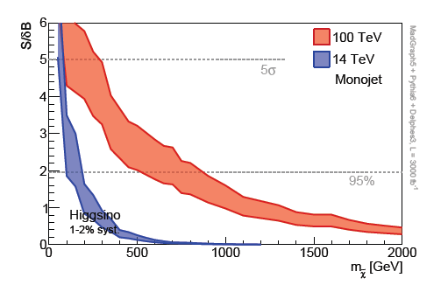
Wino
Higgsino
1 – 2 % systematic
1 – 2 % systematic
Dominated by systematic error of background
Challenge to experimentalists
GOOD!
Matthew Low and Lian-Tao Wang

Slide 24
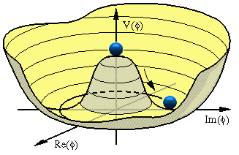
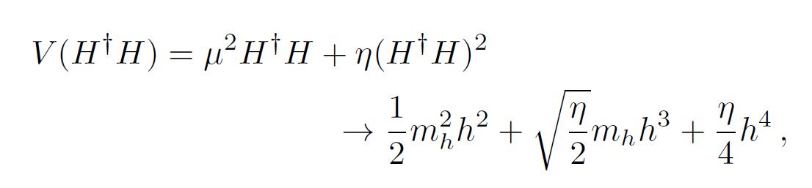
Vacuum potential
The VACUUM is a
region of space
filled with HIGGS FIELD
Notes:
Plots from my Higgs self-coupling talk

Slide 25
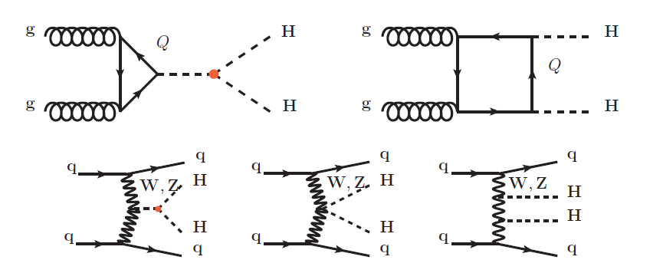



Vacuum potential
σ_{SM} (14 TeV) ~ 34 fb
$$bbττ \sim 60\%$$
AJB et al.
Phys. Lett. B 728 (2014) 308
$$bbγγ \sim 40\%$$
V. Barger et al
(HL-LHC)
3/ab
Phys. Lett. B 728 (2014) 433.
$$bbWW \sim 100\%$$
D. E. Ferreira de Lima et al.
arXiv:1404.7139
hhh coupling precision @ LHC
Review: Baglio, 1407.1045

Slide 26
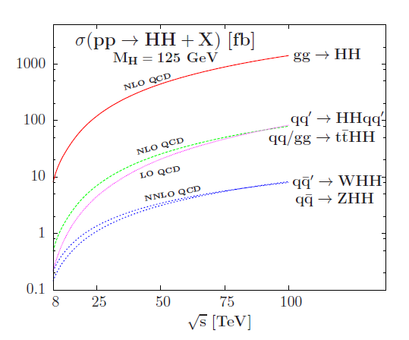
Some extra energy helps a lot
Baglio et al, arXiv:1212.5581
Review: Baglio, 1407.1045

Slide 27
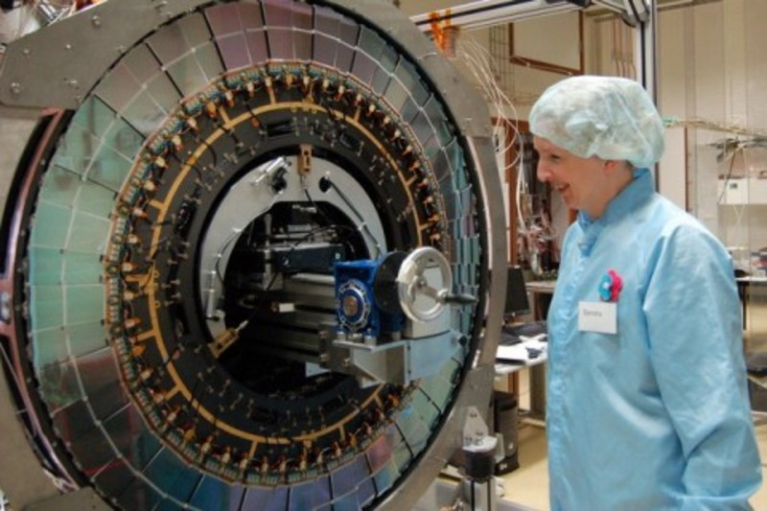
We love making difficult things

Slide 28
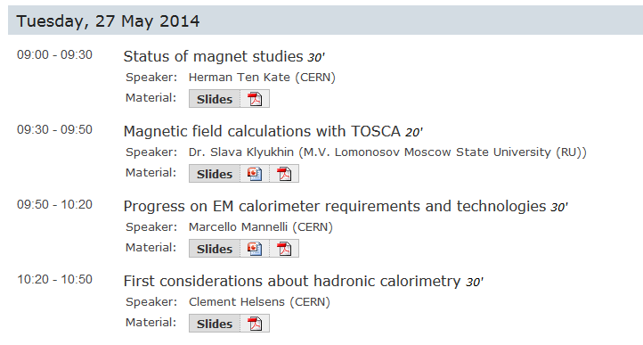
First thoughts on a detector for a 100 TeV machine
FCC Workshop @ CERN, 27 May 2014
For technologies, see also
Phil Allport, ICHEP 2014

Slide 29
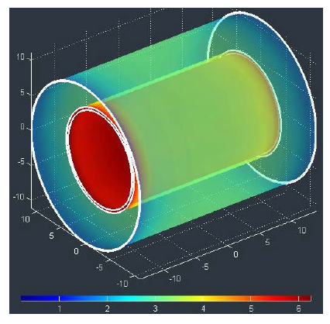
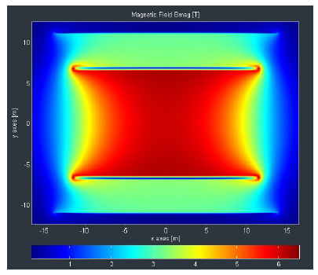
Magnets…
Herman ten Kate
FCC Workshop @ CERN, 27 May 2014
See also Phil Allport, ICHEP 2014

Slide 30
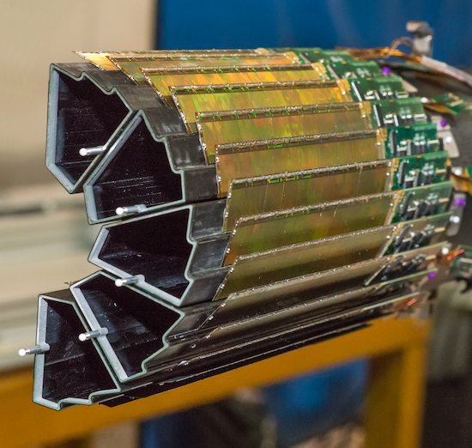
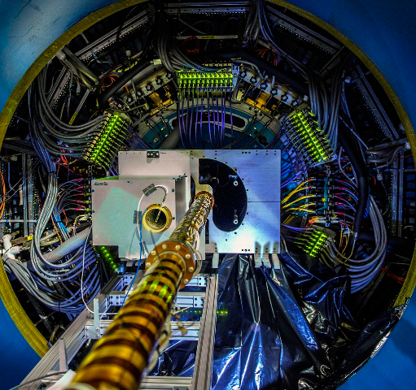
Tracker…
STAR CMOS Tracker
Rad-hard CMOS could revolutionise tracker technology
Notes:
ALICE CMOS tracker:
Mean X/X0 = 0.282%

Slide 31
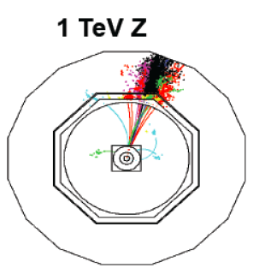
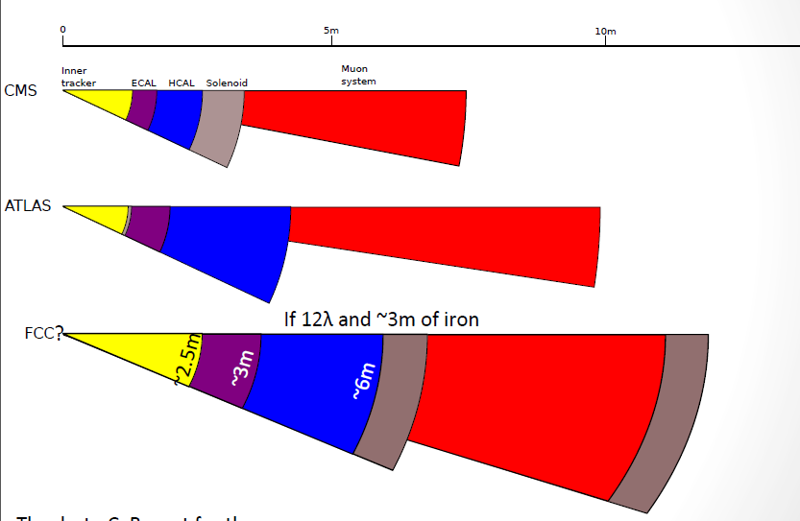
Calorimeter…
Tracking ECAL
HCAL deep enough to
prevent punch-through
ΔE/E ~ 16%/√E ⊕ 1.1%
ΔE/E ~ 35-60%/√E ⊕ 3%
Clement Helsens, Steinar Stapnes: FCC workshop, CERN, May 2014

Slide 32
Dedicated detectors
Fixed target?
Forward?
Late decaying?
Beam dump?

Slide 33
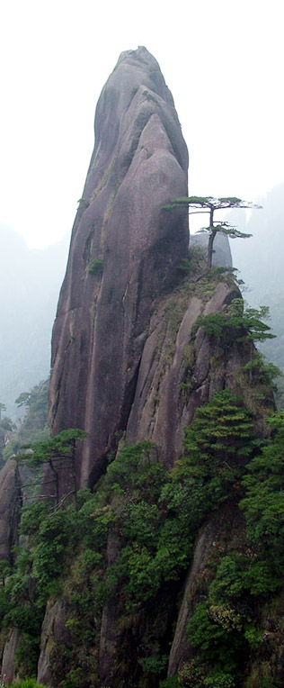
Conclusion
Particle physics needs a strong vision for the future
A very high energy hadron-hadron collider is extremely compelling
  Naturalness
  Dark Matter
  Vacuum potential
Such a machine will certainly lead the world
  And educate a large number of very happy experimentalists

