Slide 1


Introduction on CEPC Accelerator Design Status
H. Geng
for the CEPC accelerator design group
IHEP, CAS, China
2nd CFHEP Symposium on circular collider physics

Slide 2
Contents
Introduction
CEPC accelerator design
Pre-CDR status
Summary

Slide 3
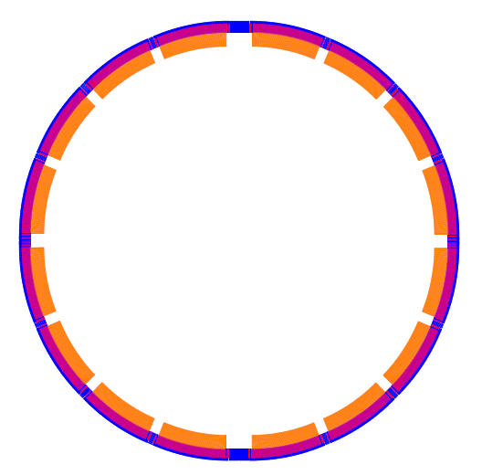

Introduction
Critical parameters for CEPC:
IP1
Circumference: 50 km
SR power: 50 MW/beam
16*arcs
2*IPs
8 RF cavity sections (distributed)
6 straights (for injection and dump)
Filling factor of the ring: ~80%
RF
RF
RF
RF
RF
RF
RF
RF
IP2

Slide 4
Topics under study for CEPC
Topics which are currently under study and will be include in pre-CDR for CEPC (the main ring):
Machine parameters
Lattice design
Interaction region
Beam instability
Beam-beam effects
Synchrotron radiation
Injection and beam dump
Background and collimation
Polarization
----------- Guo Yuanyuan et. al
----------- Geng Huiping et.al
----------- Wang Dou et. al
----------- Wang Na et. al
----------- Zhang Yuan et. al
----------- Ma Zhongjian et. al
----------- Cui Xiaohao et. al
----------- Yue Teng
----------- Duan Zhe

Slide 5
Other Topics …
Technical systems:
Injectors:
SC RF systems
Cryogenic system
Magnets
Vacuum
Power supply
Instrumentation
Control system
Radiation shielding
Survey and alignment
e+ and e- sources
Linac
Booster
Possible upgrade:
SppC
ep
eA

Slide 6
International participation (April, 2014)
Visitors name | Period | Topics
Dick Talman | April 13th –May 15th | Parameters and other topics
Armen Apyan | April 1st –April 30th | GuineaPig and CAIN
Yoshihiro Funakoshi | April 1st-April 15th | Parameter, injection and others
Dmitry Shatilov | April 1st- April 16th | Beam-beam simulation
Kazuhito Ohmi | April 16th-April 30th | Beam-beam simulation
Yunhai Cai | April 16th –April 30th | Lattice and FFS
Yuhong Zhang | April 16th-April 30th | Electron proton collider

Slide 7
CEPC parameter list
Parameter | Unit | Value | Parameter | Unit | Value
Beam energy [E] | GeV | 120 | Circumference [C] | km | 50.0
Number of IP[N_{IP}] |  | 2 | SR loss/turn [U₀] | GeV | 2.96
Bunch number/beam[n_{B}] |  | 50 | Bunch population [Ne] |  | 3.52E+11
SR power/beam [P] | MW | 50 | Beam current [I] | mA | 16.89
Bending radius [ρ] | m | 6200 | momentum compaction factor [α_{p}] |  | 4.00E-05
Revolution period [T₀] | s | 1.67E-04 | Revolution frequency [f₀] | Hz | 5995.85
emittance (x/y) | nm | 6.9/0.021 | β_{IP}(x/y) | mm | 800/1.2
Transverse size (x/y) | μm | 74.30/0.16 | ξ_{x,y}/IP |  | 0.097/0.069
Beam length SR [σ_{s.SR}] | mm | 2.12 | Beam length total [σ_{s.tot}] | mm | 2.42
Lifetime due to Beamstrahlung | min | 80 | lifetime due to radiative Bhabha scattering [τ_{L}] | min | 53.98
RF voltage [V_{rf}] | GV | 6.87 | RF frequency [f_{rf}] | GHz | 0.7
Harmonic number [h] |  | 116747 | Synchrotron oscillation tune [ν_{s}] |  | 0.196
Energy acceptance RF [h] | % | 5.71 | Damping partition number [Jε] |  | 2
Energy spread SR [σ_{δ.SR}] | % | 0.13 | Energy spread BS [σ_{δ.BS}] | % | 0.07
Energy spread total [σ_{δ.tot}] | % | 0.15 | n_{γ} |  | 0.21
Transverse damping time [n_{x}] | turns | 81 | Longitudinal damping time [n_{ε}] | turns | 40
Hourglass factor | Fh | 0.704 | Luminosity/IP [L] | cm⁻²s⁻¹ | 1.77E+34

Slide 8
Sketch of CEPC
Critical parameters for CEPC:
Circumference: 50 km
SR power: 50 MW/beam
16*arcs
2*IPs
8 RF cavity sections (distributed)
6 straights (for injection and dump)
Filling factor of the ring: ~80%
IP1
RF
RF
RF
RF
RF
RF
FODO cells with phase advances of 60/60 degrees have been chosen as the basic structure of CEPC lattice.
RF
RF
IP2

Slide 9
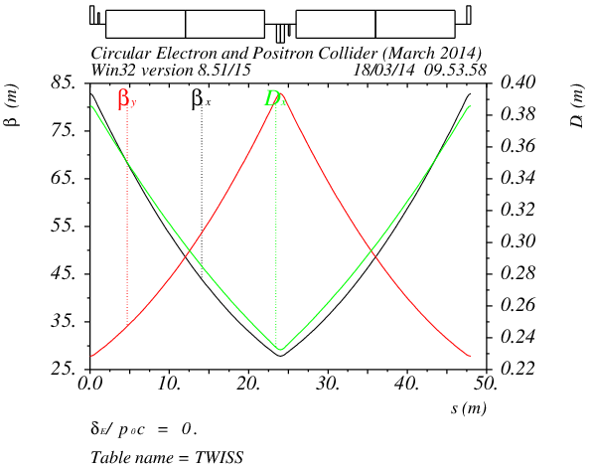
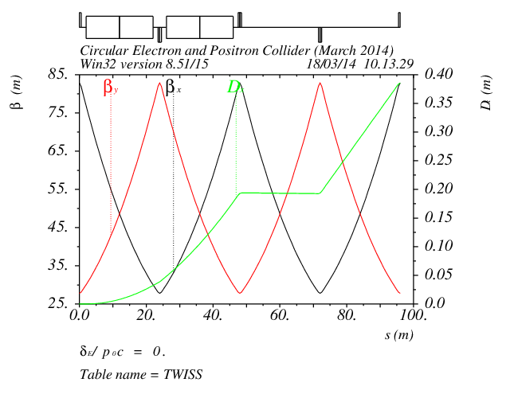
Lattice of arc sections
Length of FODO cell: 48m
Phase advance of FODO cells: 60/60 degrees
Dispersion suppressor on each side of every arc
Length: 96m

Slide 10
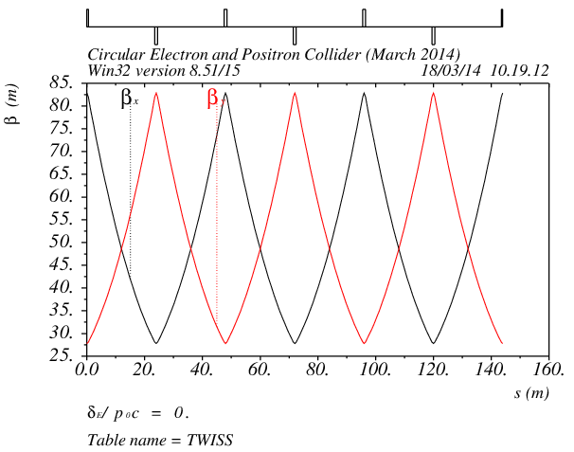
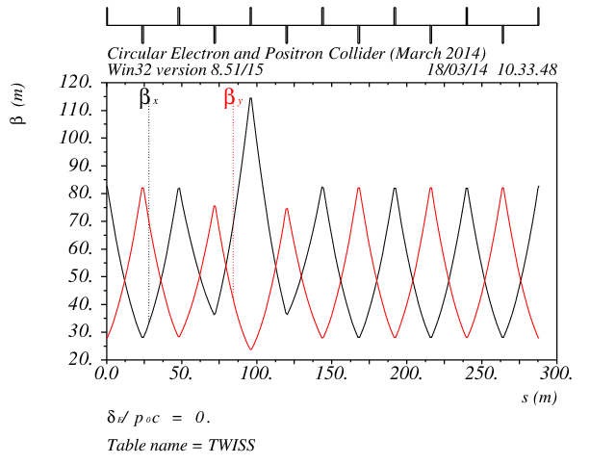
Lattice of straight sections
Length straight: 144m
Phase advance of FODO cells: 60/60 degrees
FFS is temporarily replaced by FODO cells
Length of each IP section: 576m
Used for workpoint adjustment

Slide 11
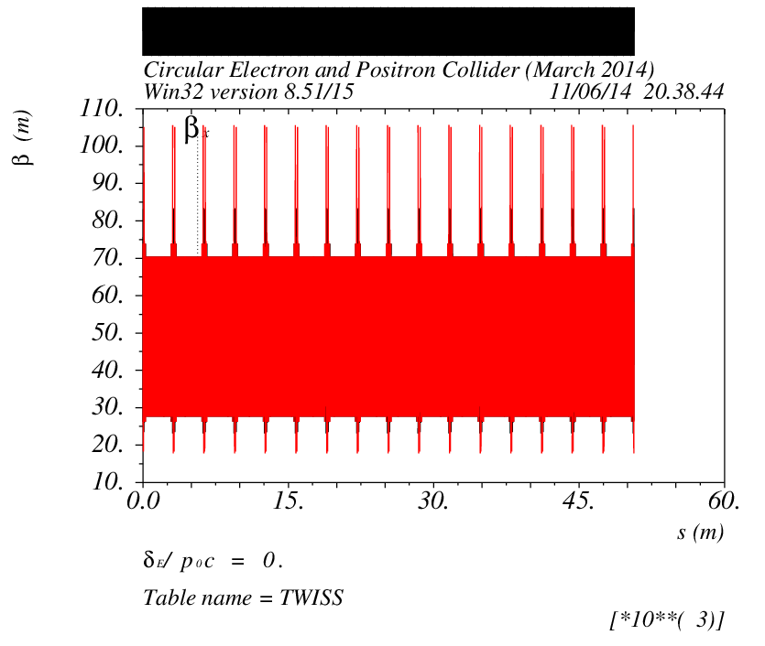
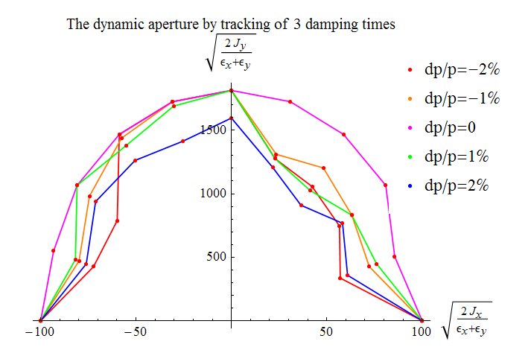
Dynamic aperture of the MR
2 families of sextupoles are used for chromaticity correction
Working point of the ring (.08,.22)
Achieved dynamic aperture： ~100σ_{x}/1500σ_{y}

Slide 12
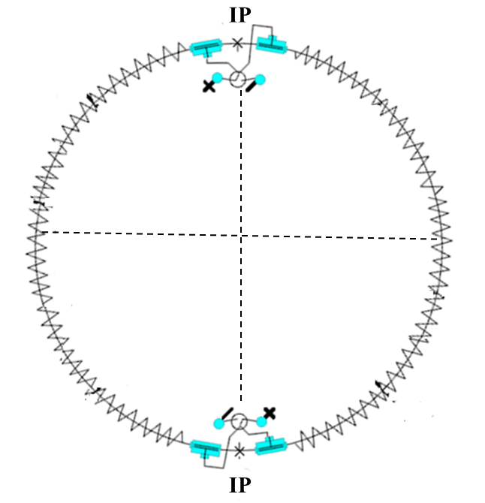
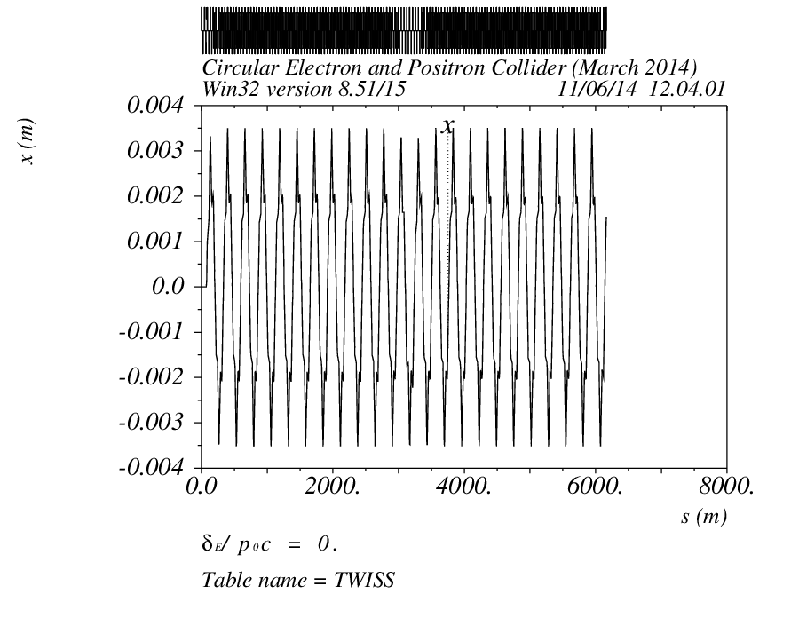
Pretzel scheme
Use 2 pairs of electrostatic separators
Beam separated at horizontal plane with orbit offset of 5σ_{x}
Maximum bunch number: 96

Slide 13
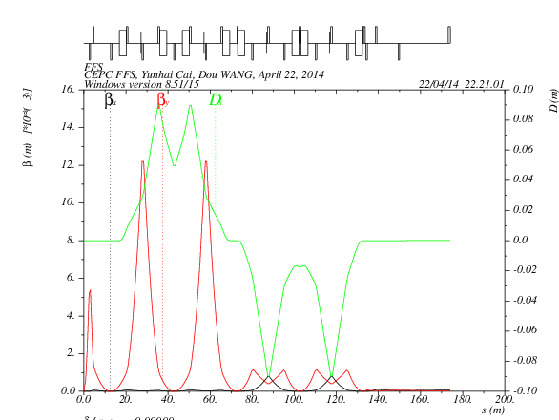
FFS design
IP
Half Quad of dispersion suppressor
betaX*=0.8m
betaY*=0.0012m
L*=2.5m
FFS entrance condition:
DX=DPX=0
αx=αy=0
betax=84m
betaY=28m
Total length: 170 m
We use the same method as Yunhai’s example to make a new design of CEPC FFS.

Slide 14
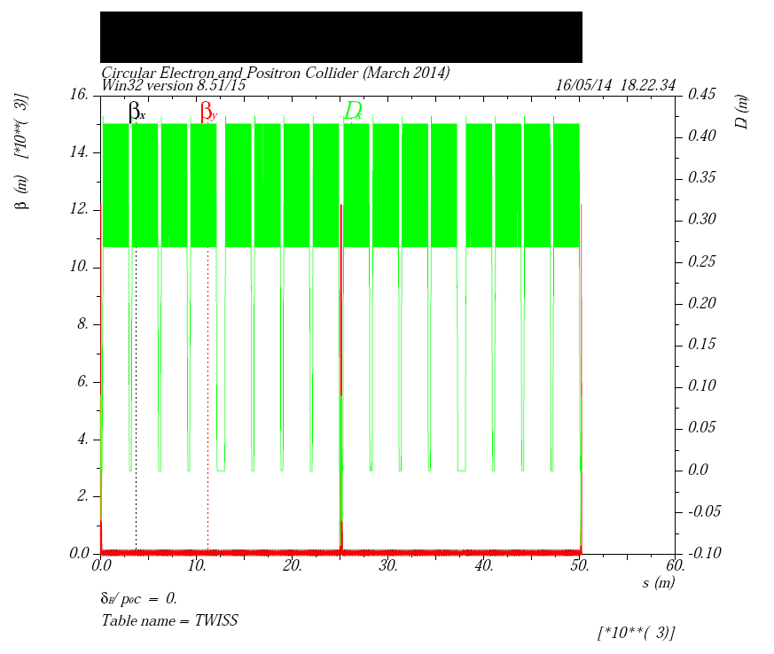
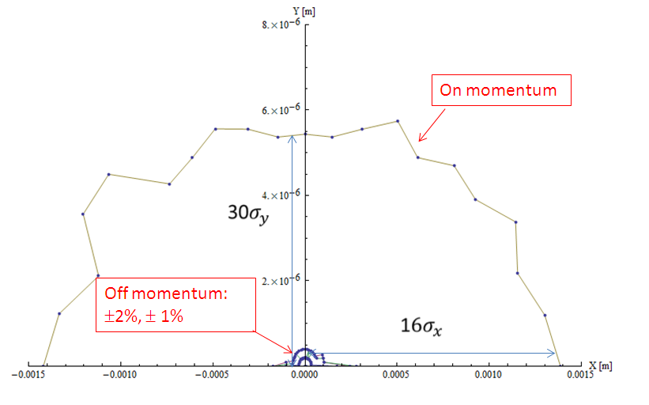
Lattice of the whole ring
Dynamic aperture: 16σx/ 30σy for on momentum particles

Slide 15
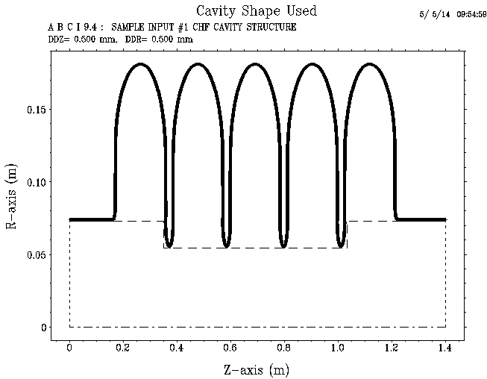
Impedance budget
Resistive wall impedance is calculated with analytical formulas
Impedance of the RF cavities is calculated with ABCI
Object | Contributions
 | R [kΩ] | L [nH] | k_{loss} [V/pC] | |Z///n|_{eff} [Ω]
Resistive wall (Al) | 16.8 | 214.4 | 552.1 | 0.0075
RF cavities (N=378) | 40.1 | -- | 1313.6 | ---
Total | 56.9 | 214.4 | 1865.7 | 0.0075

Slide 16
Single-bunch effects
Parameter | Symbol, unit | Value
Beam energy | E, GeV | 120
Circumference | C, km | 53.6
Beam current | I₀, mA | 16.6
Bunch number | n_{b} | 50
Natural bunch length | σ_{l0}, mm | 2.58
Emittance (horz./vert.) | ε_{x}/ε_{y}, nm | 6.79/0.02
RF frequency | f_{rf}, GHz | 0.7
Harmonic number | h | 125208
Natural energy spread | σ_{e0} | 1.5E−3
Momentum compaction factor | α_{p} | 4.15E−5
Betatron tune | ν_{x}/ν_{y} | 179.08/179.22
Synchrotron tune | ν_{s} | 0.206
Damping time (H/V/s) | τ_{x}/τ_{y}/τ_{z}, ms | 14/14/7

Slide 17
Longitudinal microwave instability
  Keil-Schnell criterion:
  The threshold of the longitudinal impedance is |Z///n| < 0.026 Ω.
Pseudo-Green function wake (σz=0.5mm)
Steady-state bunch shape

Slide 18
Coherent synchrotron radiation
  σ_{z}ρ^{1/2}/h^{3/2}=35.2 (=> CSR shielded)
  The threshold of bunch population for CSR is given by
  The CSR threshold in BAPS is N_{b,Th} = 1.5×10¹³ >> N_{b} = 3.7×10¹¹.
  CSR is not supposed to be a problem in BAPS.
(K. Bane, Y. Cai, G. Stupakov, PRST-AB, 2010)
Space charge tune shift
Δν_{y} = −1.8e−4, Δν_{x} = −5.2e−6

Slide 19
Transverse mode coupling instability (TMCI)
  The threshold of transverse impedance is |Z⊥| < 11.7 MΩ/m.
  The equivalent longitudinal impedance is 0.18 Ω, which is much larger than that of the longitudinal instability.
Eigen mode analysis
  Considering only resistive wall impedance
  Beam current threshold:
  I_{b}^{th}=0.76mA (I₀th=38mA)

Slide 20
Multi-bunch effects
Transverse resistive wall instability
with ω_{pn} = 2πf_{rev} × (pn_{b} + n + ν_{x,y})
The growth rate for the most dangerous instability mode is 36 Hz (τ=28 ms) in the vertical plane with mode number of μ = 21.
The growth time is higher than the transverse radiation damping time.
The resistive wall instability is not supposed to happen in the main ring!
Growth rate vs. mode number in the vertical plane

Slide 21
Electron cloud instability
 | KEKB | SuperKEKB | SuperB | CEPC
Beam energy E, GeV | 3.5 | 4.0 | 6.7 | 120
Circumference L, m | 3016 | 3016 | 1370 | 53600
Number of e⁺/bunch, 10¹⁰ | 3.3 | 9 | 5.74 | 37.1
Emittance H/V ε_{x}/ε_{y}, nm | 18/0.36 | 3.2/0.01 | 1.6/0.004 | 6.79/0.02
Bunch length σ_{z}, mm | 4 | 6 | 5 | 2.58
Bunch space Lsp, ns | 2 | 4 | 4 | 3575.8
Single bunch effect
Electron freq. ω_{e}/2π, GHz | 35.1 | 150 | 272 | 191.4
Phase angle ω_{e}σ_{z}/c | 2.94 | 18.8 | 28.5 | 10.4
Threshold density ρ_{e,th}, 10¹²m⁻³ | 0.7 | 0.27 | 0.4 | 1.15
Multi-bunch effect
p-e per meter n_{γ}, p/(m) | 5.0E8 | 1.5E9 | 3.6E9 | 1.1E10
Characteristic frequency ω_{G}, MHz | 62.83 | 87.2 | 69.6 | 5.92
Phase angle ω_{G}L_{sp}/c | 0.13 | 0.35 | 0.28 | 21.2
Threshold density for the single bunch effect is considerable high.
The phase angle for the multi-bunch effect is about two orders higher, so the electrons are not supposed to accumulate and the multipacting effects is low.

Slide 22
Beam ion instability
Ion trapping
  With uniform filling pattern, the ions with a relative molecular mass larger than A_{x,y} will be trapped.
Fast beam ion instability
  With uniform filling, the growth time considering ion oscillation frequency spread is 11ms, which is lower than the damping time.
  Fast beam ion instability could occur with uniform filling.
  The ions will not be trapped by the beam.

Slide 23
Beam lifetimes caused by different
sources in CEPC
  Quantum lifetime
  Radiation Bhabha lifetime
  Simulated by BBBREM

Slide 24
Beam lifetimes caused by different
sources in CEPC
  Beam-gas lifetime
  Touschek lifetime

Slide 25
CEPC Beam-beam simulation (Ohmi)
The current main parameters has been checked with beam-beam simulation, proved the reasonability.

Slide 26
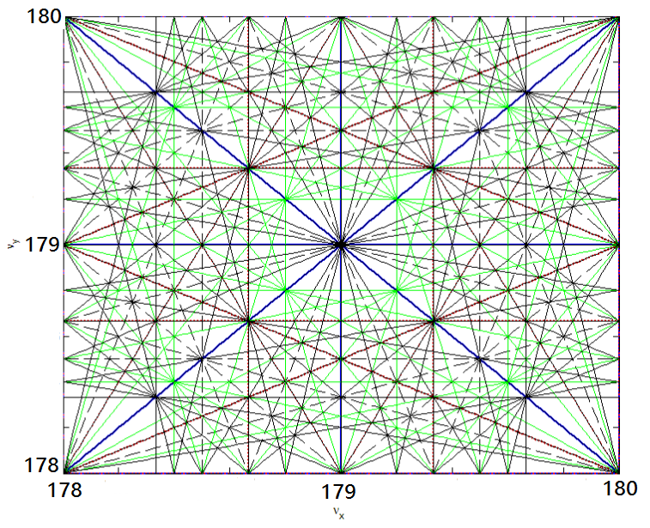
Tune diagram of CEPC lattice
According to Ohmi’s simulation results, we choose the Work point: (179.08, 179.22)

Slide 27
CEPC Magnets’ specifications

Slide 28
Parameters Related to RF System
 | Symbol | Value
Frequency(MHz) | f_{RF} | 700
Voltage(GV) | V_{RF} | 6.87
Cavity Numbers | N_{cav} | 433
Synchrotron phase(deg) | φ_{s} | 154.01
Power/cavity (kW) | P₀ | 231
RF power(MW) | P_{RF} | 108
Klystron Numbers (1MW ) | N_{kly} | 109
Operating temperature(K) | T | 2
Quality factor (10¹⁰) | Q₀ | 2
R/Q (Ω) | R/Q | 470
Total loss on cavity(kW) | P_{c} | 11.08
2K heat load(kW) | W_{2K} | 14.1
5K heat load (kW) | W_{5K} | 3.7
80 Kheat load (kW) | W_{80K} | 47.1

Slide 29
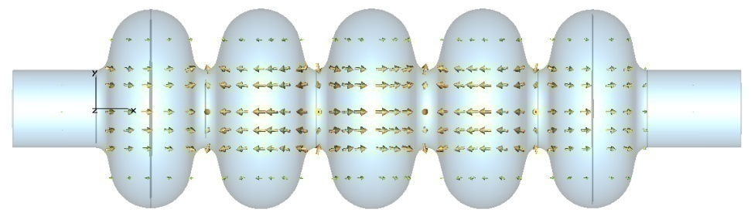
Cavity design
Frequency(MHz) | f_{RF} | 700
Gradient(MV/m) | Eacc | 15MV/m
Operating voltage | Vc | 15.885MV
Cell NO. | Ncell | 5
Effective length | Lc | 1059mm
Equator diameter(mm) | D | 386.2
Iris diameter (mm) | riris | 150
Module length(m) | Lmodule | 7
Module NO. (4 cavities/ module) | Nmodule | 109
R/Q(Ω) | R/Q | 492.904
Quality factor (2K) | Q₀ | Q₀=2*10¹⁰
RF coupler Q_{ext} | Q_{ext} | 2.22*10⁶

Slide 30
RF System Distribution
Total number of module: 109
4 cavities/module, 7m/module
Total length: 7m*109=763m
8 RF districts
14module/district*5+13module/district*3
Length of district: 98m&91m
Klystron number:109
1klystron/module

Slide 31
CEPC RF System Cryogenic Loss
CEPC four 5-cell 700 MHz cavity string (moderate technical challenge):
  HOM coupler (modes below cut-off frequency < ~ kW; or larger beam pipe, no cut-off); extra cryogenic load to be calculated.
  HOM damper at room temperature (4.9 kW each damper); HOM damper at 80-100 K (forbidden by cryogenics load: 80 K cryo efficiency 16 W/W)
Beam current (mA) | 16.60
P_{c} / cavity (W) | 25.6
P_{c} (kW) | 11.08
P_{HOM} / cavity (kW) | 4.9
P_{HOM total} (MW) | 2.1
SR power(MW/2 beam) | 100
RF-beam power efficiency | 95%
RF source efficiency | 65%
2K efficiency W/W | 700
5K efficiency W/W | 200
80K efficiency W/W | 16
Cryogenic safty factor | 1.5
2K AC power (MW) | 14.8
5K AC power (MW) | 1.1
80K AC power (MW cold HOM absorber) | 50.8
80K heat load (MW) (HOM coupler and warm absorber) | 0.1
Cryogenic AC power (MW) (cold HOM absorber scheme) | 67
Cryogenic AC power (MW) (HOM coupler and warm absorber scheme) | 16
RF AC power (MW) | 165.2
Total AC power(MW cold absorber) | 232.2
Total AC power(MW warm absorber) | 181.2

Slide 32
CEPC booster Layout
e+
IP1
e-
LTB
e+ e- Linac
(240m)
BTC
BTC
Booster(50Km)
CEPC Collider Ring(50Km)
IP2
LTB : Linac to Booster
BTC : Booster to Collider Ring

Slide 33
Booster bypass design
Booster: Outer of Collider
CEPC

Slide 34
The outer-ring bypass computation
BYPASS:
BPO1 , -DIS, DIS, BPO2
RING : IP1, -BPI, -ARC1, -STR, 6*SUP, ARC1, BPI, IP2,
IP2, -BPI, -ARC1, -STR, 6*SUP, ARC1, BPI, IP1

Slide 35
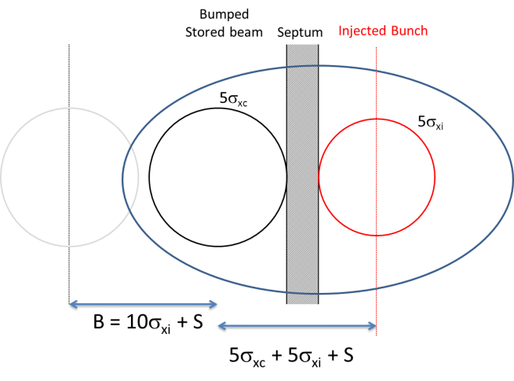
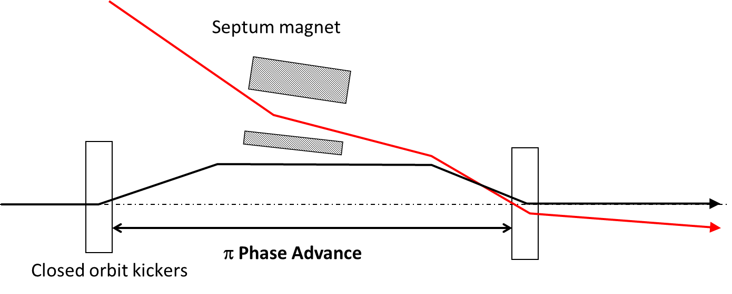
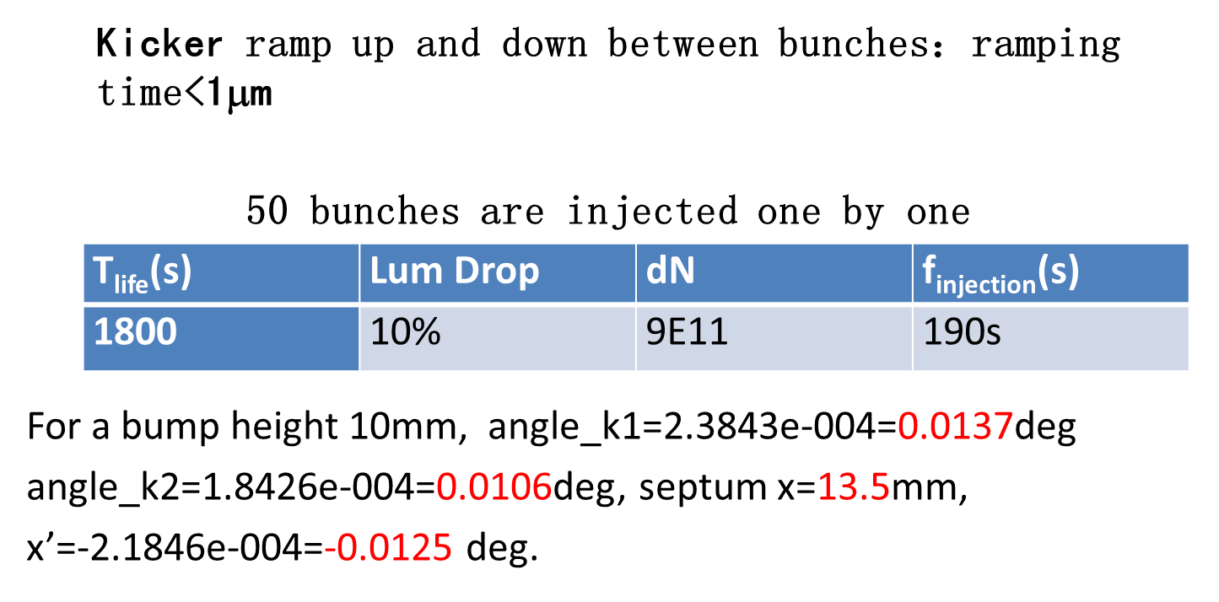
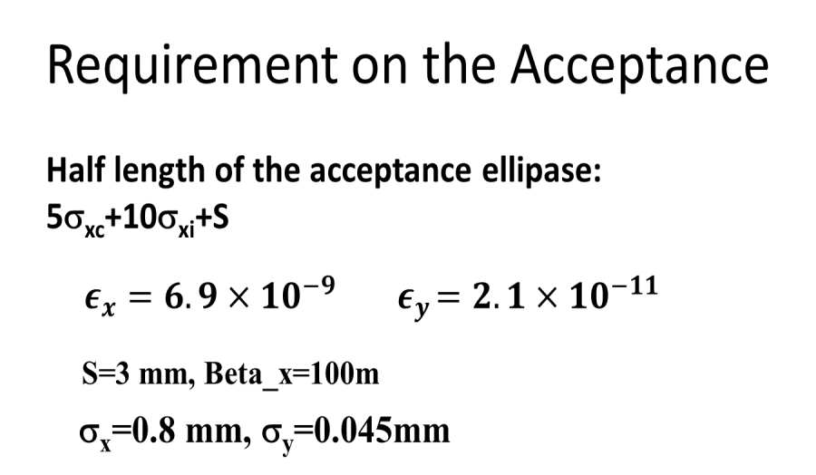
CEPC Injection Scheme
1. Betatron Injection
2.Two Kicker Bumps

Slide 36
Injection linac
Beam energy:
E_{linac} = 6GeV
Energy Spread:
s_{E}<1×10⁻³；
Bunch population:
N_{bunch, booster}=(5%× N_{bunch,collider})/0.9=2×10¹⁰
Bunch structure:
f_{rep}= 50-100Hz, Dt=0.7 ns,
Emittance:
Depending on aperture selection of the booster. A=Y²/b_{max}. Y=16mm, b_{max}=130m, A～2 mm⋅mrad, e～0.05A～0.1 mm ⋅ mrad
Polarized beams?

Slide 37
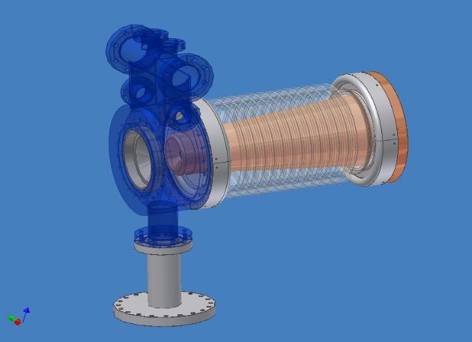
Electron Source
Unpolarized Conventional Electron Source
High Voltage = 150 kV
Beam Radius ~ 3.0mm (at gun anode, beam current is 6.0A)
BII Electron Gun

Slide 38
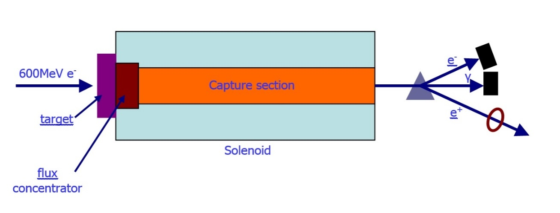
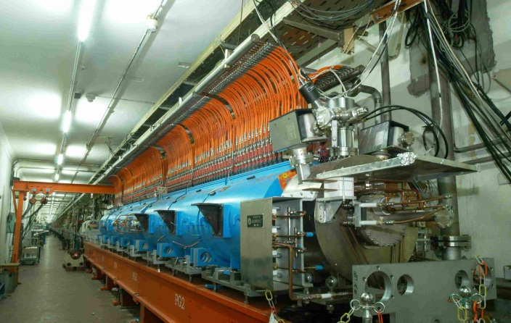
Positron Source
Unpolarized Positron Source
Conventional Positron Source
For BII
Electron beam at Target 240MeV, 8A
Positron beam 80mA
For CEPC
Electron energy at Target 600MeV
BII Positron Source

Slide 39
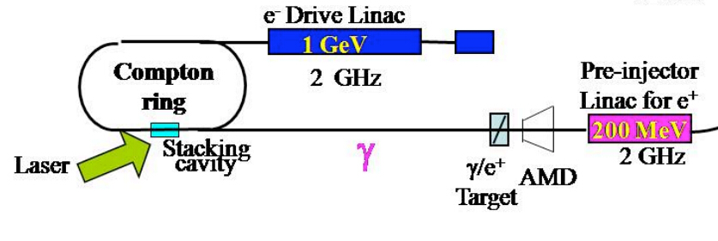
Positron Source
Polarized Positron Source (R&D)
Compton scattering based polarized positron source
Polarization for positron is very difficult.
Both scheme are very challenging.
Choose some key technologies R&D

Slide 40
Upgrade to SppC
Main Parameter List for SppC (version 1)
By Valkovich, Xiao Ming, Su Feng, Gao Jie, Tang Jingyu, Chou Weiren
2014.05.09
Parameter | LHC | HL-LHC | HE-LHC | FCC-hh | SppC | Unit
Main parameters
Circumference | 26.7 | 26.7 | 26.7 | 100/83 | 50 | km
Beam energy | 7 | 7 | 16.5 | 50 | 31.7 | TeV
Lorentz gamma | 7459 | 7459 | 17581 | 53277 | 33779
Dipole field | 8.33 | 8.33 | 20 | 16/20 | 20 | T
Dipole curvature radius |  |  |  |  | 5280.8 | m
Arc filling factor | 0.79 | 0.79 | 0.79 | 0.79 | 0.79
Total dipole magnet length |  |  |  |  | 33180 | m
Arc length |  |  |  |  | 42000 | m
Total straight section length | 4224 | 4224 | 4224 | 16800 | 8000 | m
Energy gain factor in collider rings |  |  |  |  | 15
Injection energy | 0.45 | 0.45 | 〉1.0 | 3.3 | 2.1 | TeV
Number of IPs |  |  |  | 2+2 | 2
Revolution frequency | 11.26 | 11.26 | 11.26 | 3 | 6 | kHz

Slide 41
SppC Layout
High Energy Booster(7.2Km)
Medium Energy Booster(4.5Km)
Low Energy Booster(0.4Km)
Proton Linac
(100m)
IP4
IP3
SppC Collider Ring(50Km)

Slide 42
SppC injector complex (Yuhong Zhang)
Low Energy Booster
Medium Energy Booster
Proton Linac
High Energy Booster
 | Peak Energy (GeV) | Energy boosting (E_{ext}/E_{inj}) | Dipole field (T) | Circumference (km) | Length/Radius (m)
Electron linac | 6 |  |  |  | 240
Proton linac | 1 |  |  |  | 100
Low energy booster | 16 | 16 | 0.1 ➔ 1.6 | 0.4 | 64
Medium energy booster | 250 | 15.6 | 0.1 ➔ 1.6 | 4.5 (7.2) | 716(1146)
High energy booster | 3000 | 12 | 1 ➔ 12 | 7.2 | 1146
Collider ring | 35000 | 11.7 | 1.7 ➔ 20 | 50 | 7962

Slide 43
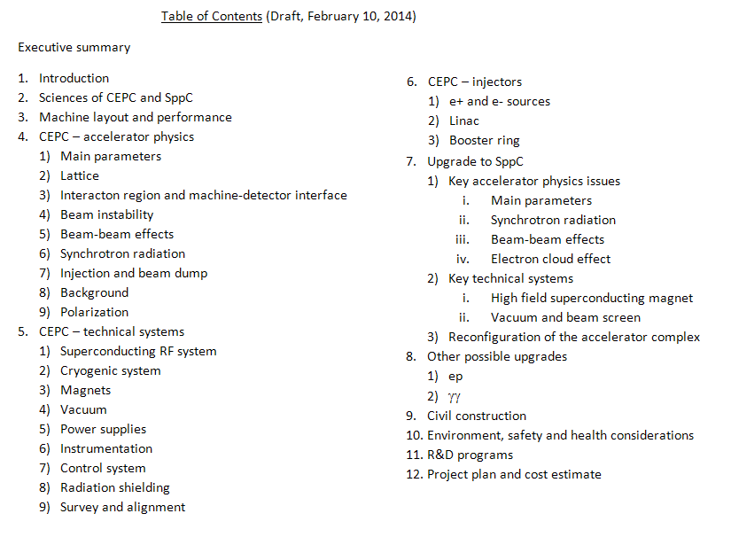
Pre-CDS status
Finished the draft
Writing
Preparing

Slide 44
CEPC-SppC Schedule (Preliminary)
CEPC
  Pre-study, R&D and preparation work
    Pre-study: 2013-15 ➔ Pre-CDR by 2014
    R&D: 2016-2020
    Engineering Design: 2015-2020
  Construction: 2021-2027
  Data taking: 2030-2036
SPPC
  Pre-study, R&D and preparation work
    Pre-study: 2013-2020
    R&D: 2020-2030
    Engineering Design: 2030-2035
  Construction: 2036-2042
  Data taking: 2042 -

Slide 45
Summary
International efforts have been given to the CEPC accelerator design
Many different topics have been investigated
Most parts of the Pre-CDR are in writing or have finished writing the first draft
Pre-CDR is expected to be finished on time
Thank you for your attention !

