Slide 1


IHEP R&D Plan of
High Field Accelerator Magnet Technology for CEPC-SppC
Qingjin XU
Institute of High Energy Physics (IHEP)
Chinese Academy of Sciences (CAS)
Beijing, China
20140912

Slide 2
CEPC-SppC
CEPC is an 240-250 GeV Circular Electron Positron Collider, proposed to carry out high precision study on Higgs bosons, which can be upgraded to a 70 TeV or higher pp collider SppC, to study the new physics beyond the Standard Model.
e+
IP1
e-
LTB
SppC HE Booster
e+ e- Linac
BTC
BTC
SppC ME Booster
Proton Linac
SppC LE Booster
IP4
IP2
CEPC Booster
50/100 km in circumference
CEPC Collider Ring
IP3
SppC Collider Ring

Slide 3
Timeline (dream)
CEPC
  Pre-study, R&D and preparation work
    Pre-study: 2013-15
      Pre-CDR by the end of 2014 for R&D funding request
    R&D: 2016-2020
    Engineering Design: 2016-2020
  Construction: 2021-2027
  Data taking: 2028-2035
SppC
  Pre-study, R&D and preparation work
    Pre-study: 2013-2020
    R&D: 2020-2030
    Engineering Design: 2030-2035
  Construction: 2035-2042
  Data taking: 2042 -
Y.F. Wang
Guideline for the magnet R&D!

Slide 4
CEPC main parameters
(Very Preliminary)
Parameter | Unit | Value | Parameter | Unit | Value
Beam energy [E] | GeV | 120 | Circumference [C] | km | 50.0
Number of IP[N_{IP}] |  | 2 | SR loss/turn [U₀] | GeV | 2.96
Bunch number/beam[n_{B}] |  | 50 | Bunch population [Ne] |  | 3.52E+11
SR power/beam [P] | MW | 50 | Beam current [I] | mA | 16.89
Bending radius [ρ] | m | 6200 | momentum compaction factor [α_{p}] |  | 4.00E-05
Revolution period [T₀] | s | 1.67E-04 | Revolution frequency [f₀] | Hz | 5995.85
emittance (x/y) | nm | 6.9/0.021 | β_{IP}(x/y) | mm | 800/1.2
Transverse size (x/y) | μm | 74.30/0.16 | ξ_{x,y}/IP |  | 0.097/0.069
Beam length SR [σ_{s.SR}] | mm | 2.12 | Beam length total [σ_{s.tot}] | mm | 2.42
Lifetime due to Beamstrahlung | min | 80 | lifetime due to radiative Bhabha scattering [τ_{L}] | min | 53.98
RF voltage [V_{rf}] | GV | 6.87 | RF frequency [f_{rf}] | GHz | 0.7
Harmonic number [h] |  | 116747 | Synchrotron oscillation tune [ν_{s}] |  | 0.196
Energy acceptance RF [h] | % | 5.71 | Damping partition number [Jε] |  | 2
Energy spread SR [σ_{δ.SR}] | % | 0.13 | Energy spread BS [σ_{δ.BS}] | % | 0.07
Energy spread total [σ_{δ.tot}] | % | 0.15 | n_{γ} |  | 0.21
Transverse damping time [n_{x}] | turns | 81 | Longitudinal damping time [n_{ε}] | turns | 40
Hourglass factor | Fh | 0.704 | Luminosity/IP [L] | cm⁻²s⁻¹ | 1.77E+34

Slide 5
SppC main parameters
(Very Preliminary)
Parameter | Value | Unit
Circumference | 52 | Km
Beam energy | 35 | TeV
Dipole field | 20 | T
Injection energy | 2.1 | TeV
Number of IPs | 2 (4)
Peak luminosity per IP | 1.2E+35 | cm⁻²s⁻¹
Beta function at collision | 0.75 | m
Circulating beam current | 1.0 | A
Max beam-beam tune shift per IP | 0.0065
Bunch separation | 25 | ns
Bunch population | 2.0E+11
Arc SR heat load | 45.8 | W/m
Notes:
This table has been changed.

Slide 6
High field accelerator magnets for SppC
SppC needs thousands of high field dipoles and quadrupoles installed along a tunnel 50-70 km in circumference
Aperture diameter of the main dipole / quadrupole: 50 mm
Field strength of the main dipole: 20 Tesla
Field quality: 10⁻⁴ at the 2/3 aperture radius
Distance between the two beam pipes: determined by the magnetic optimization of the main dipole (300 ~ 400 mm)
Outer diameter of the magnet: 800 mm
Outer diameter of the cryostat: 1400 mm (in a 7 m diameter tunnel)
Total magnetic length of the 20 Tesla main dipole: ~ 33 km in a 50 km circumference

Slide 7
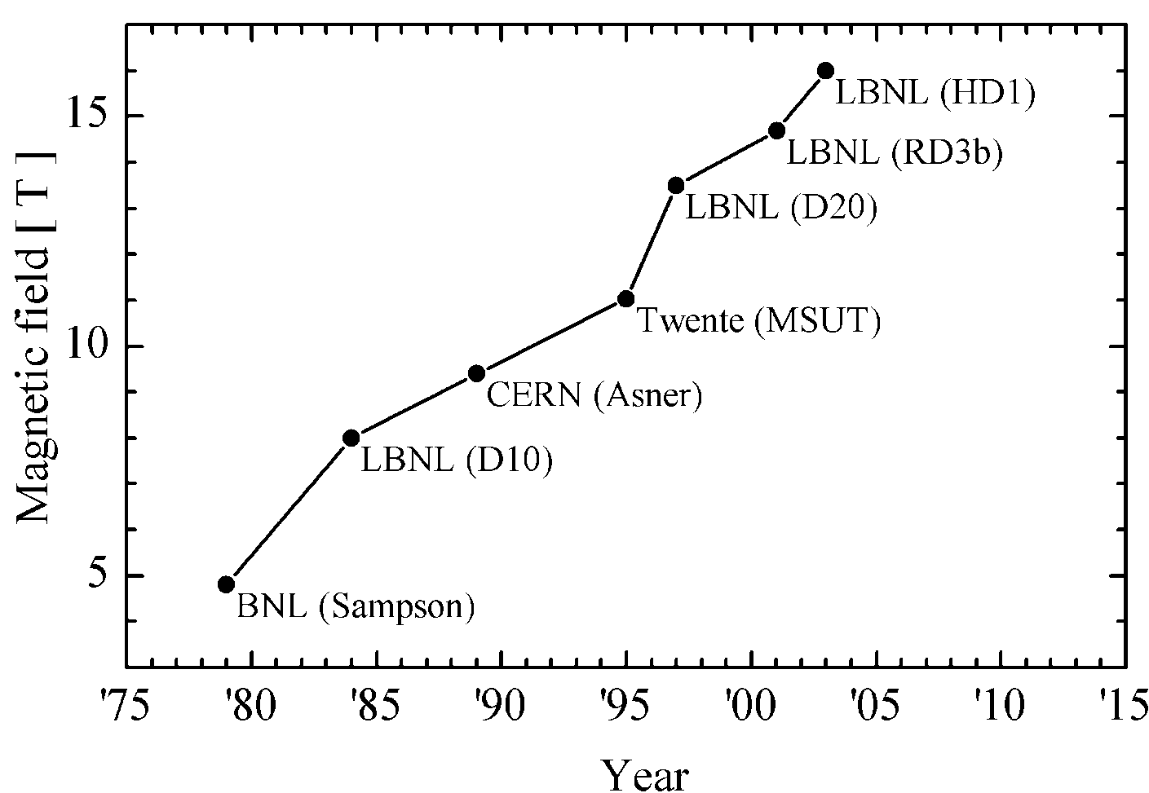
Status of high field accelerator magnet R&D
Nb₃Sn dipole magnetic field records:
16 T achieved without real aperture (HD1 @ LBNL, 2003)
14 T achieved with single-aperture (HD2e @ LBNL, 2007)
10 T achieved with twin-aperture (RD3C @ LBNL, 2002)
Current highest operational field 8.3 T (LHC main dipole)
SppC 20 T
Bi-2212
(YBCO)
Nb₃Sn
(no bore)
(no bore)
IHEP
(LHC NbTi dipole 8.3 T)
LBNL(RD3C)
(Two 35 mm bore)
NbTi
GianLuca Sabbi (LBNL)

Slide 8
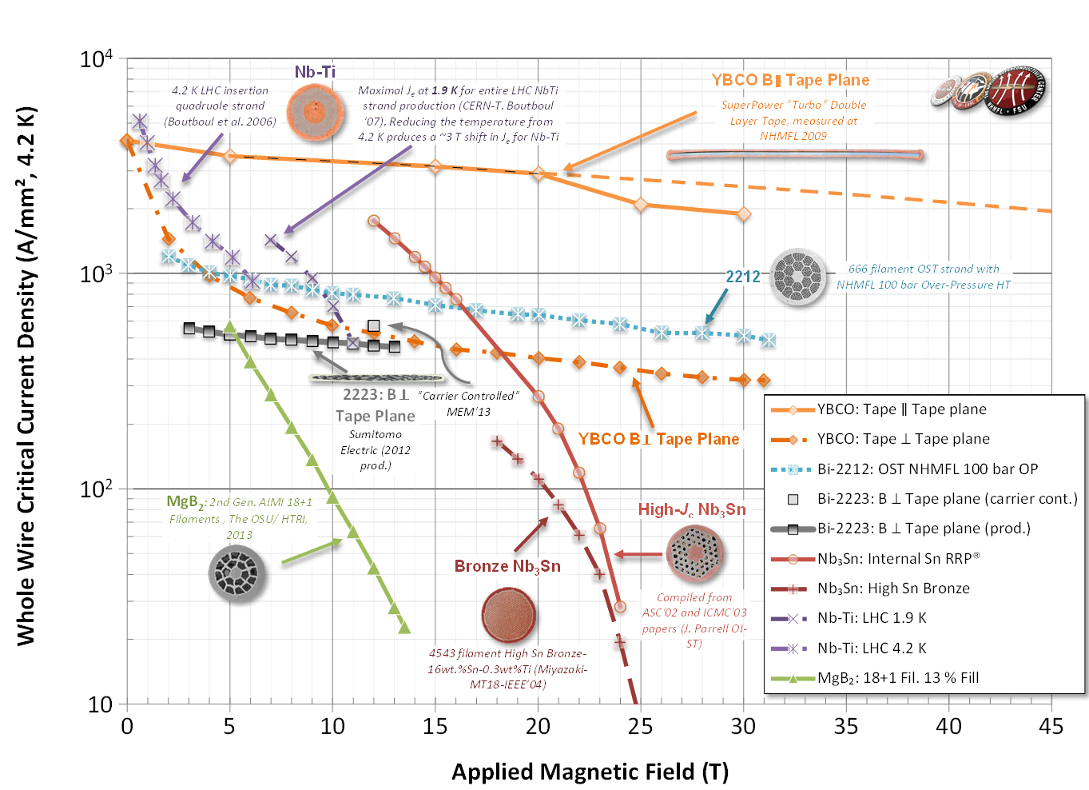
Status of high field accelerator magnet R&D
WHOLE WIRE critical current density of main superconductors @ 4.2 K
Peter Lee, 2014
500 A/mm²
NbTi:
11 T @ 1.9K
Nb₃Sn (Nb₃Al)
17 T @ 4.2 K

Slide 9
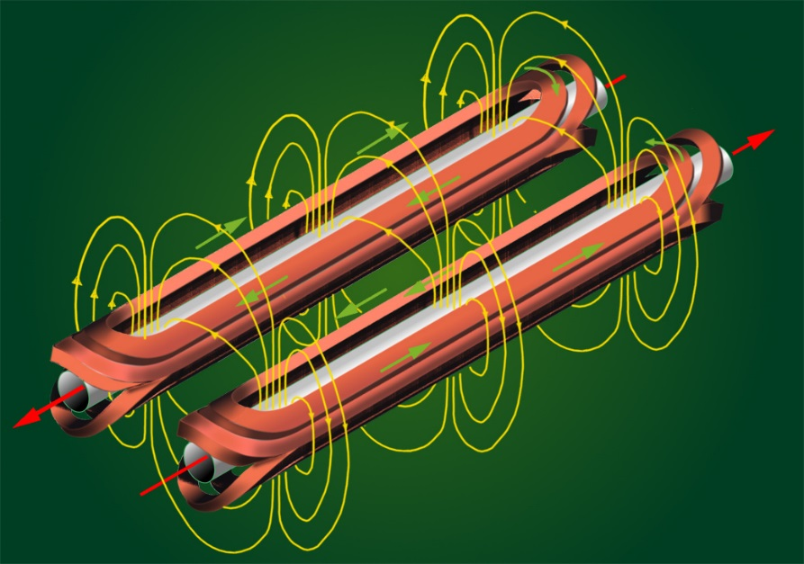
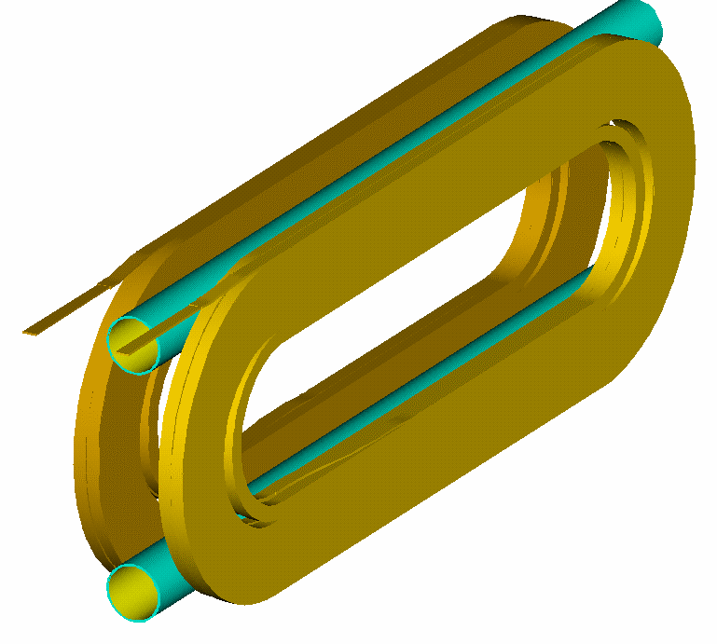
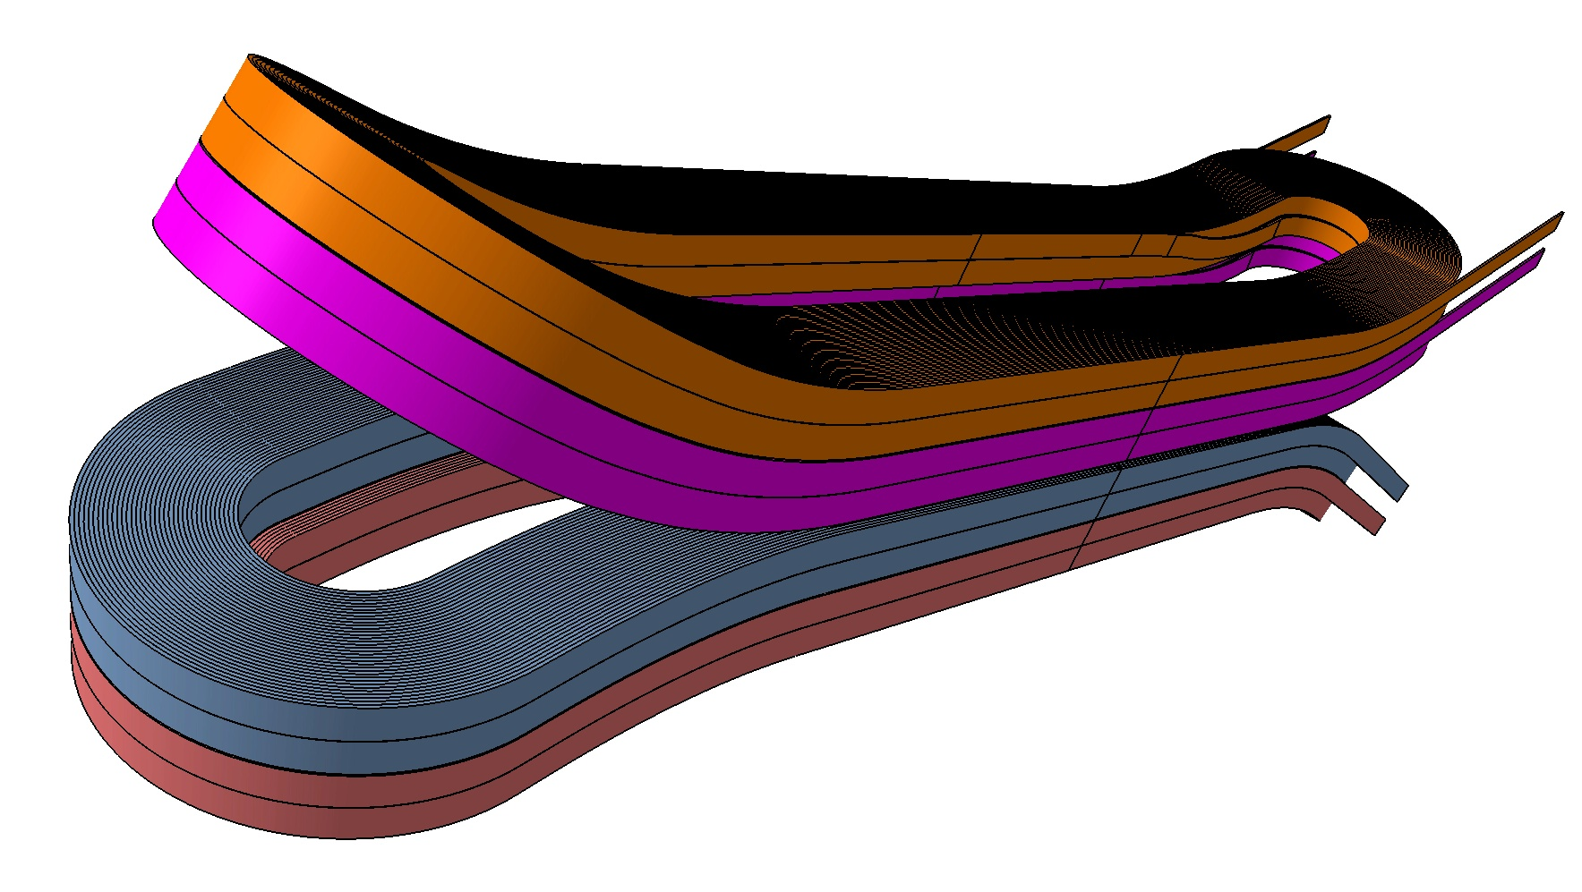
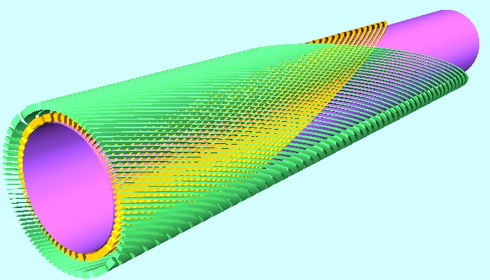
Coil structures for high field dipole
Cos-theta type
Common coil type
Block type
Canted cos-theta type

Slide 10
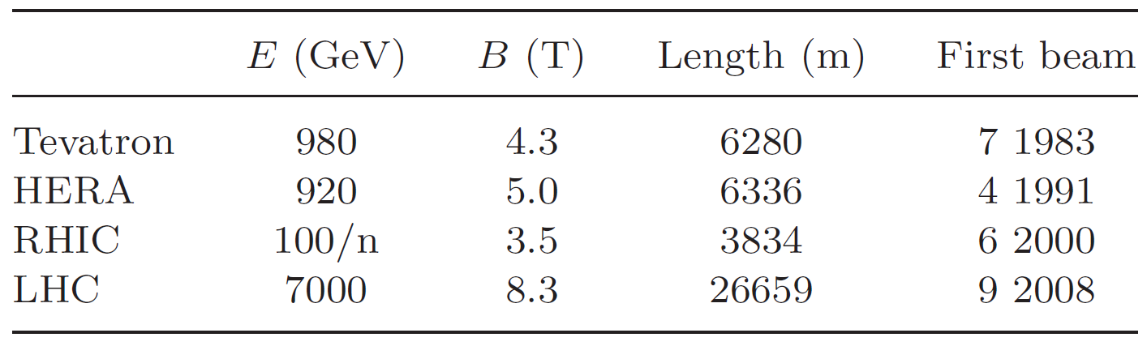
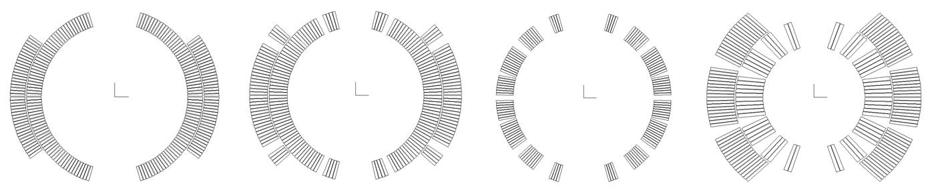
Four Colliders using SC Magnets
Tevatron
HERA
RHIC
LHC
All cosine theta, all NbTi
Weiren Chou, Next steps in the Energy Frontier--‐ Hadron Colliders, Aug. 2014

Slide 11



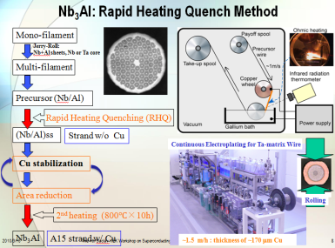
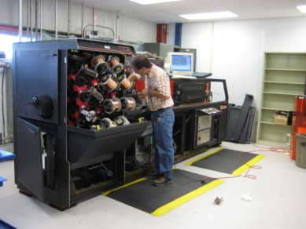
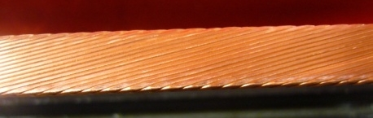
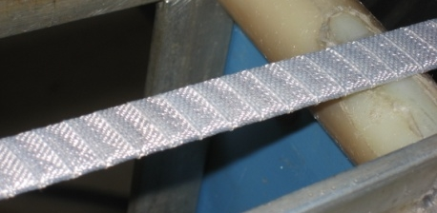
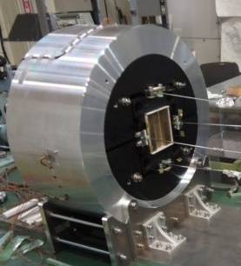
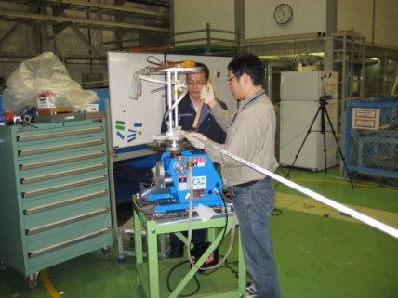
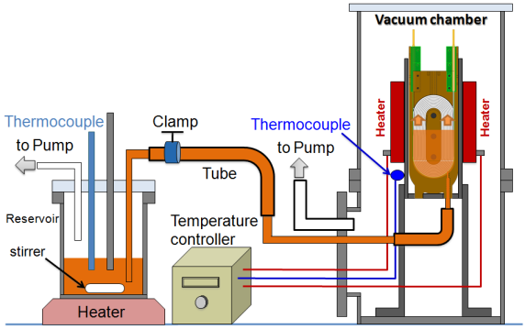
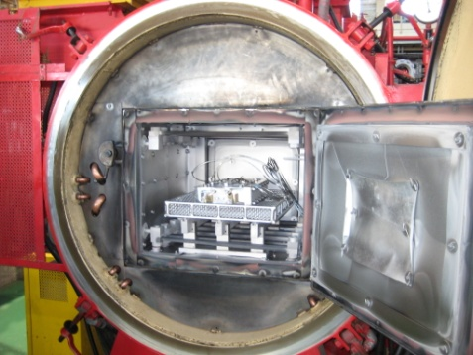
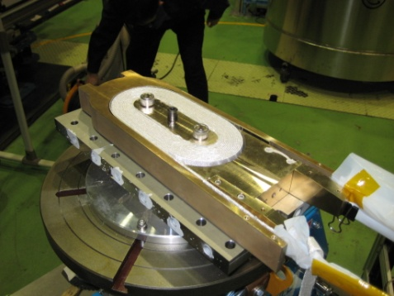
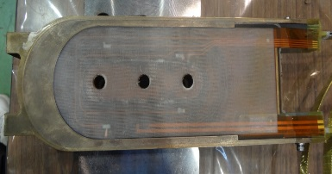
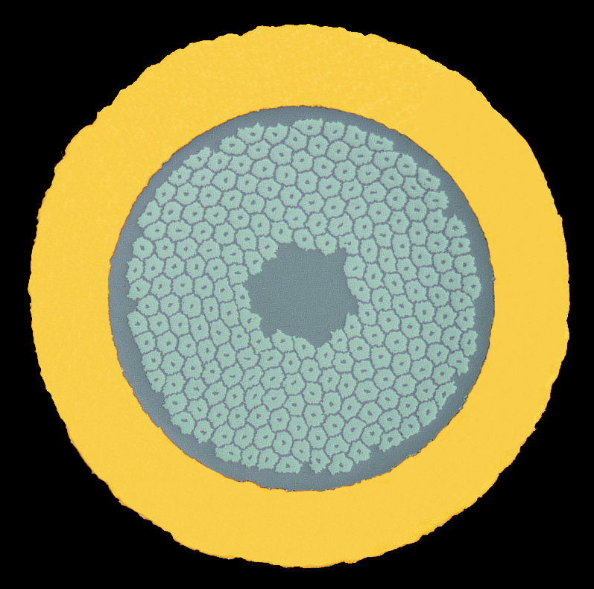
Fabrication procedures of Nb₃Al/Nb₃Sn
high field accelerator magnets
RHQ method to fabricate Nb3Al wire
Cross section of the Nb3Al wire
Cabling machine at Fermi lab
Nb3Al Rutherford cable
Ceramic tape insulation
Final assembly & test
Key points:
* Wind & React or React & Wind?
Conductor mechanical properties
Insulation
Difficulties of heat reaction of coils
* Shell based structure
Coil winding
Epoxy impregnation (CTD-101K)
800 °C & 10 hours heat treatment
Coil pack assembly
Coil pack after impregnation

Slide 12
Challenges and R&D focus of the 20 T accelerator magnets
J_{c} of Superconductors: Thousands of tons of Nb₃Sn and HTS is needed to fabricate the high field magnets for SppC. Further increase of J_{c} is expected to reduce the cost.
HTS coils for accelerator magnets (especially tape conductors): field quality, quench protection, fabrication method, …
Twin aperture 20 T dipole/quadrupole with 10⁻⁴ field quality and 800 mm outer diameter: cross-talk between two apertures, iron saturation effect, magnetization effect.
High level magnetic force in superconducting coils at 20 T: magnetic force proportional to the square of the field! Mechanical support structure; Strain management in coils.

Slide 13
R&D plan of the 20 T accelerator magnets
(Preliminary)
2015-2020: Development of a 12 T operational field Nb₃Sn twin-aperture dipole with common coil configuration and 10⁻⁴ field quality; Fabrication and test of 2~3 T HTS (Bi-2212 or YBCO) coils in a 12 T background field and basic research on tape superconductors for accelerator magnets (field quality, fabrication method, quench protection).
2020-2025: Development of 15 T Nb₃Sn twin-aperture dipole and quadrupole with 10⁻⁴ field uniformity; Fabrication and test of 4~5 T HTS (Bi-2212 or YBCO) coils in a 15 T background field.
2025-2030: 15 T Nb₃Sn coils + HTS coils (or all-HTS) to realize the 20 T dipole and quadrupole with 10⁻⁴ field uniformity; Development of the prototype SppC dipoles and quadrupoles and infrastructure build-up.

Slide 14
R&D plan of the 20 T accelerator magnets
(2015 - 2020)
Development of a 12 T operational field twin-aperture Nb₃Sn dipole magnet with 10⁻⁴ field quality
Magnetic design: Coil structure (common coil, block type, cos-theta type, CCT type); Field quality (iron saturation, filament magnetization); Mechanical structure (shell-based structure, collar structure); Management of stain level in coils.
High Jc Nb₃Sn R&D and production: Further increasing Jc and long length production (based on collaboration with related institutes or companies).
Development of Rutherford cabling machine in China (based on collaboration with related institutes or companies).
R&D of the advanced insulation materials for high field magnets (based on collaboration with related institutes or companies).
Establish fabrication equipment and procedures for high field Nb₃Sn coils (coil winding, heat reaction, conductor joint, epoxy impregnation).
Establish test facility for high field accelerator magnets (field measurement, quench protection, power supply, cryostat, …)

Slide 15
R&D plan of the 20 T accelerator magnets
(2015 - 2020)
Fabrication and test of 2~3 T Bi-2212 coil in a 12 T background field
Bi-2212 conductor R&D and production: further increasing Jc, reaction process optimization, long length production and cost reduction(based on collaboration with related institutes or companies).
Establish fabrication equipment and procedures for high field Bi-2212 coils (heat reaction, conductor joint, …).
Quench protection study of Bi-2212 high field coils.
Basic research on YBCO superconductor for accelerator magnets
YBCO conductor R&D and production: Angular dependence of Jc, long length and stable production and cost reduction (based on collaboration with related institutes or companies).
Establish fabrication equipment and procedures for high field Bi-2212 coils (field quality optimization, cabling, joint,…).
Quench protection study of YBCO high field coils.

Slide 16
20 T magnet working group in China
IHEP (Institute of High Energy Physics, Chinese Academy of Sciences)
Superconducting Magnet Engineering Center：10+ years R&D and production of superconducting solenoids for particle detectors and industries.
Accelerator Center Magnet Group：30+ years R&D and production of conventional accelerator magnets.
+ me (from Apr. 2014): 10+ years R&D on superconducting magnets including 6 years on high field/ large aperture accelerator magnets at KEK & CERN.
NIN (Northwest Institute for Non-ferrous Metal Research) & WST (Western Superconducting Tech. Co.)
NIN: Advanced Bi-2212 R&D. Significant progress in past several years.
WST: Qualified Nb₃Sn supplier for ITER. High J_{c} Nb₃Sn R&D.
Tsinghua U. & Innost (Innova Superconductor Tech. Co.)
10+ years R&D and production of Bi-2223. Modification of production lines for Bi-2212 is under discussion.
Shanghai JiaoTong U.& SST (Shanghai Superconductor Tech. Co.)
YBCO R&D and production. Significant progress in past several years.
And other related institutes in China
CHMFL (High Magnetic Field Laboratory of the Chinese Academy of Sciences) Nb₃Sn CICC conductor & high field solenoids; advanced insulation materials;…

Slide 17


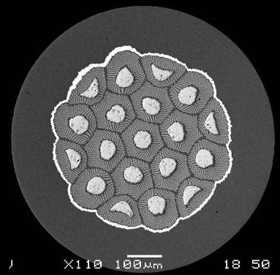
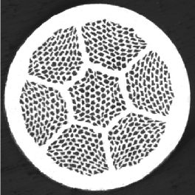


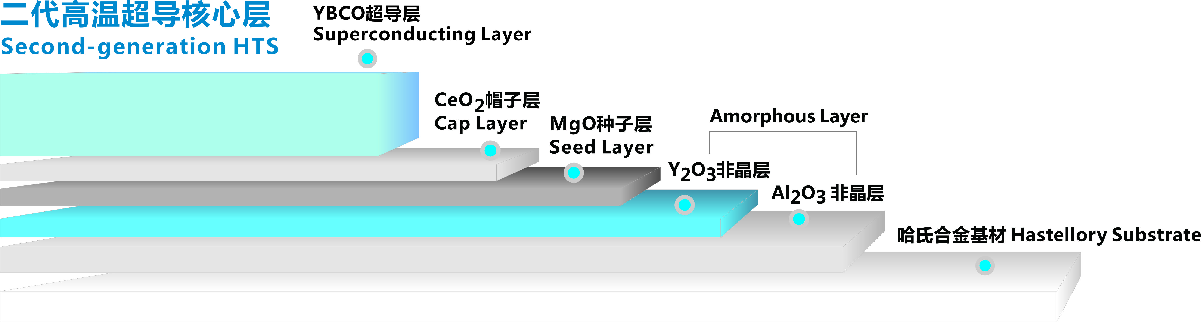

20 T magnet working group in China
High J_{c} Nb₃Sn
HTS Bi-2212
HTS YBCO
HTS Bi-2223

Slide 18
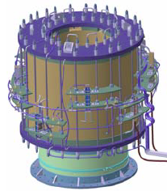
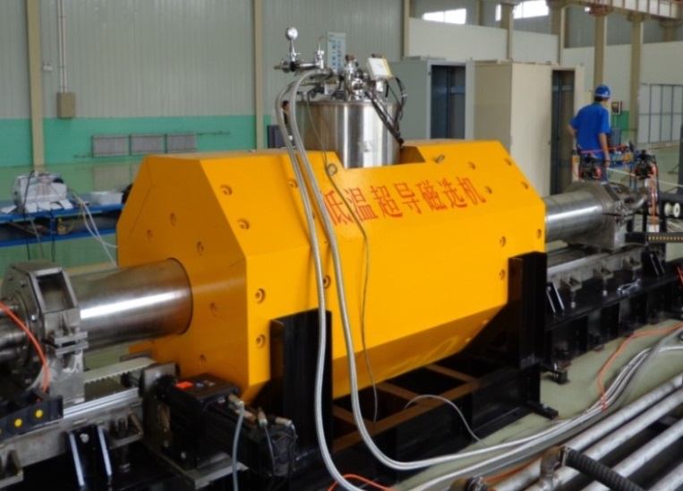
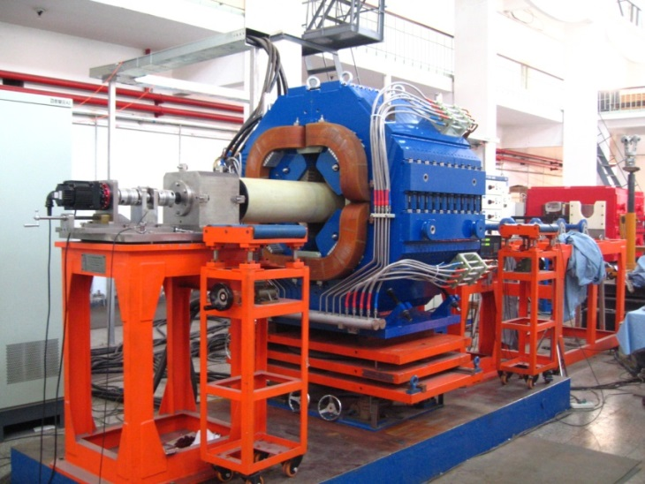
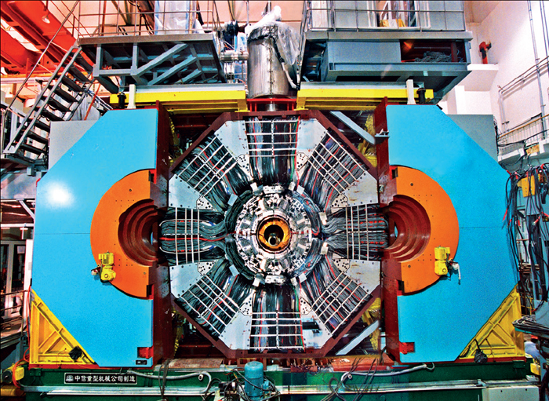
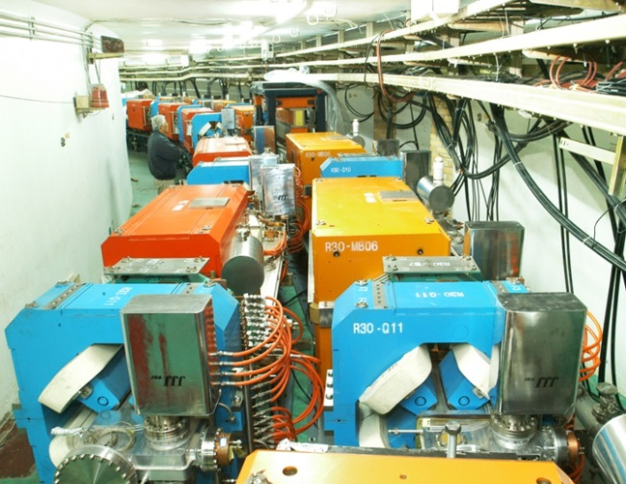
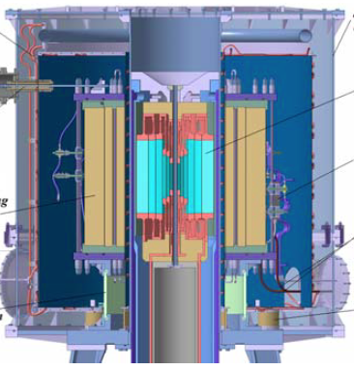
20 T magnet working group in China
IHEP
CHMFL
Superconducting magnetic separator (2012)
25Hz AC quadruple for CSNS(2013)
11 T Nb₃Sn solenoid (ongoing)
BESIII Superconducting solenoid (2006)
Conventional magnets for BEPCII (2005)
11 T Nb₃Sn + 29 T Cu insert
(ongoing)

Slide 19
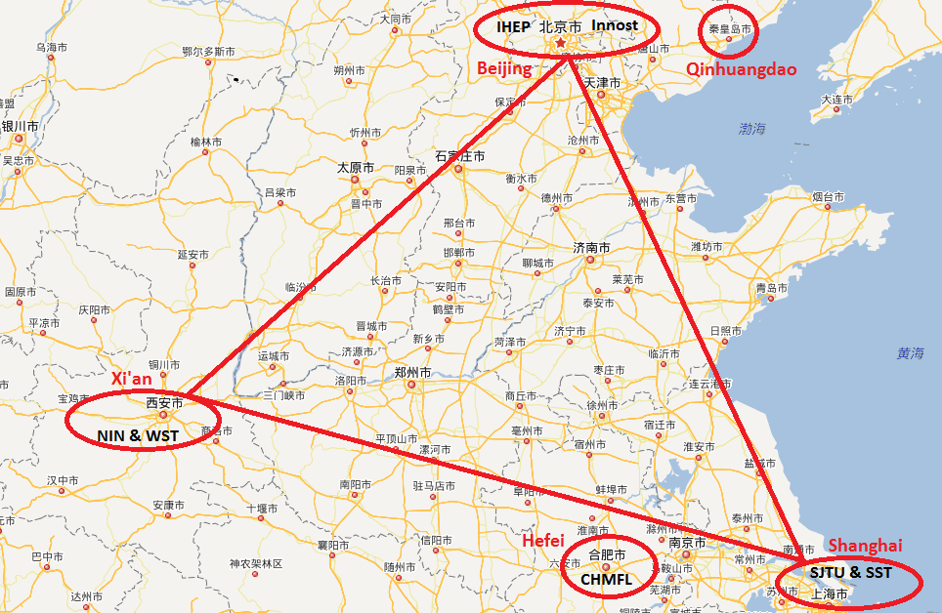

20 T magnet working group in China

Slide 20
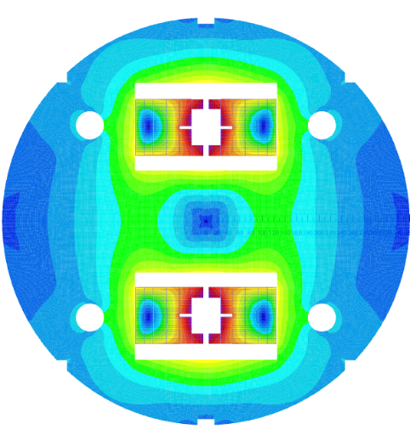
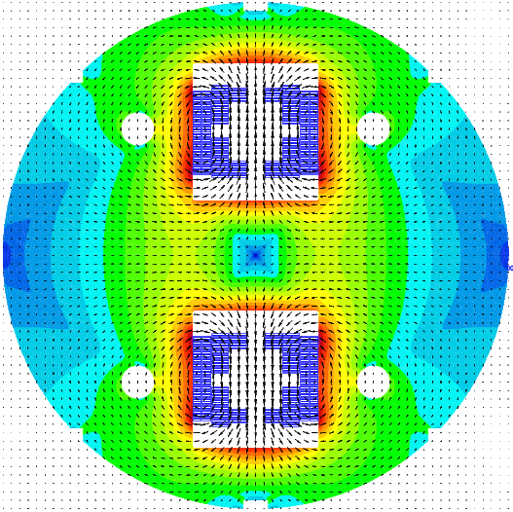
Conceptual design study of the 20 T dipole
(Preliminary)
A 12 T Nb₃Sn common coil dipole for R&D
Maximum space for beam pipes: 2 * Φ60 mm
20 T Nb₃Sn + HTS dipole for SppC
Maximum space for beam pipe: 2 * Φ50 mm
Nb₃Sn
HTS
Nb₃Sn
Nb₃Sn
HTS
Nb₃Sn
Top: Nb3Sn dipole with 12 T operational field and 10⁻⁴ field quality at 2/3 aperture radius; Right: Nb3Sn + HTS common coil dipole with 20 T operational field and 10⁻⁴ field uniformity; the outer diameter is 800 mm .

Slide 21
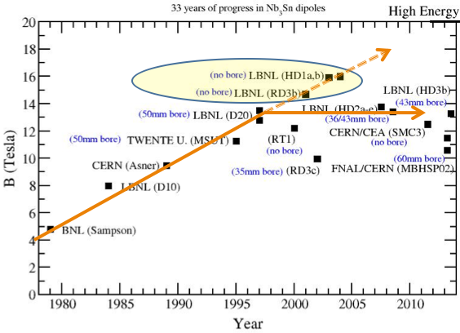
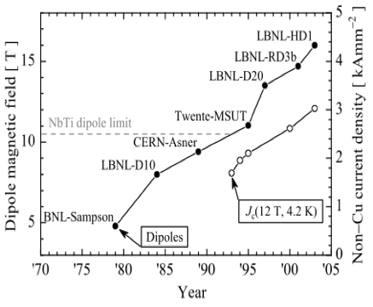

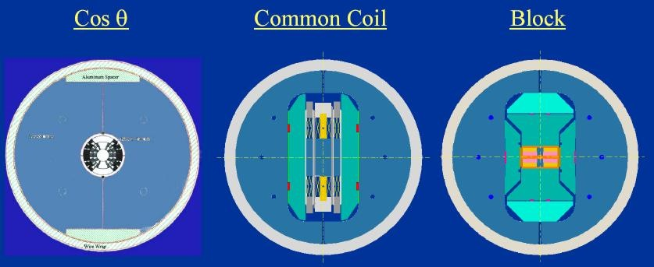

LBNL holds Nb₃Sn dipole magnet records in 3 configurations
… but are hitting a wall at ~14T with a realistic bore
➯ Need a new paradigm
Why we start with the common coil ?
Bruce Strauss, August 26, 2013, Fermilab
Field performance is correlated with Conductor performance
Incorporating bore reduces peak field attained
Detailed investigation suggests limitation is mechanical:
  Stresses approach 200MPa (Nb₃Sn limit)
  Shear stresses / interface stress issues
D20
RD
HD
Courtesy of Soren Prestemon (LBL)

Slide 22

International Collaboration
Meeting at ASC on future circular collider magnets
(Wednesday, 13 August 2014, Charlotte, NC)
  Magnet People in world wide labs agreed to
  “Share the target and work jointly”
  on high field SC magnet R&D for future accelerators
IHEP

Slide 23
Summary
SppC needs thousands of 20 T accelerator magnets to bend and focus the high energy proton beams (beam energy is proportional to the magnet field).
Current status of the high field magnet technology: 16 T achieved without real aperture, 14 T achieved with single-aperture, 10 T achieved with twin-aperture. Current highest operational field 8.3 T (LHC main dipole)
To achieve the challenging 20 T accelerator magnets, a 10~15 years long term R&D is required. A preliminary R&D roadmap has been provided.
A working group for SppC high field magnet R&D has been organized, which includes the main related institutes and companies in China.
Funding application is ongoing to carry out the R&D of this critical technology for CEPC-SppC.

Slide 24
谢谢
Thanks

