Slide 1
Status and Activities
The CEPC-SppC Study Group
XinChou Lou
Institute of High Energy Physics
Beijing, China
On Behalf of the CEPC-SppC Study Group

Slide 2
Outline
The CEPC-SppC Study Group – a brief reminder
Progress and Status
    Theory
    Accelerators: CEPC, SPPC
    Detector
    Simulation and physics reach
    Civil engineering & support
    Communication, outreach and education
    Training and professional development
preCDR – status, issues and schedule
At this workshop – focus is on preCDR
Summary

Slide 3
Reminder:
CEPC-SppC Study Group

Slide 4
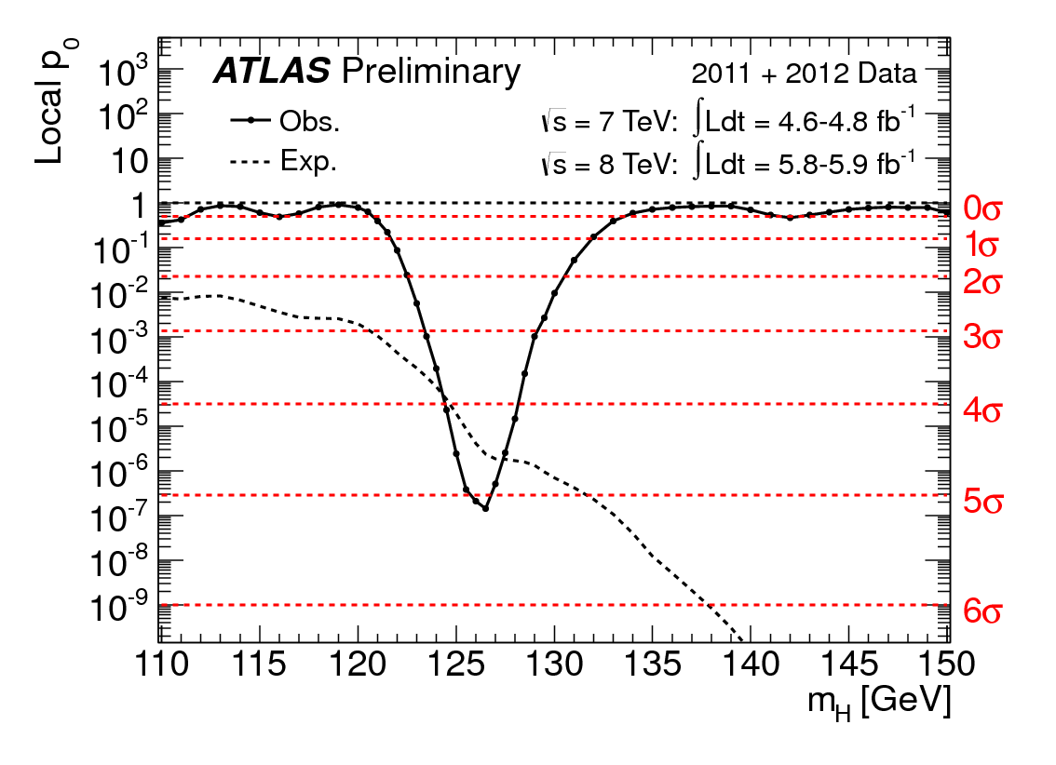
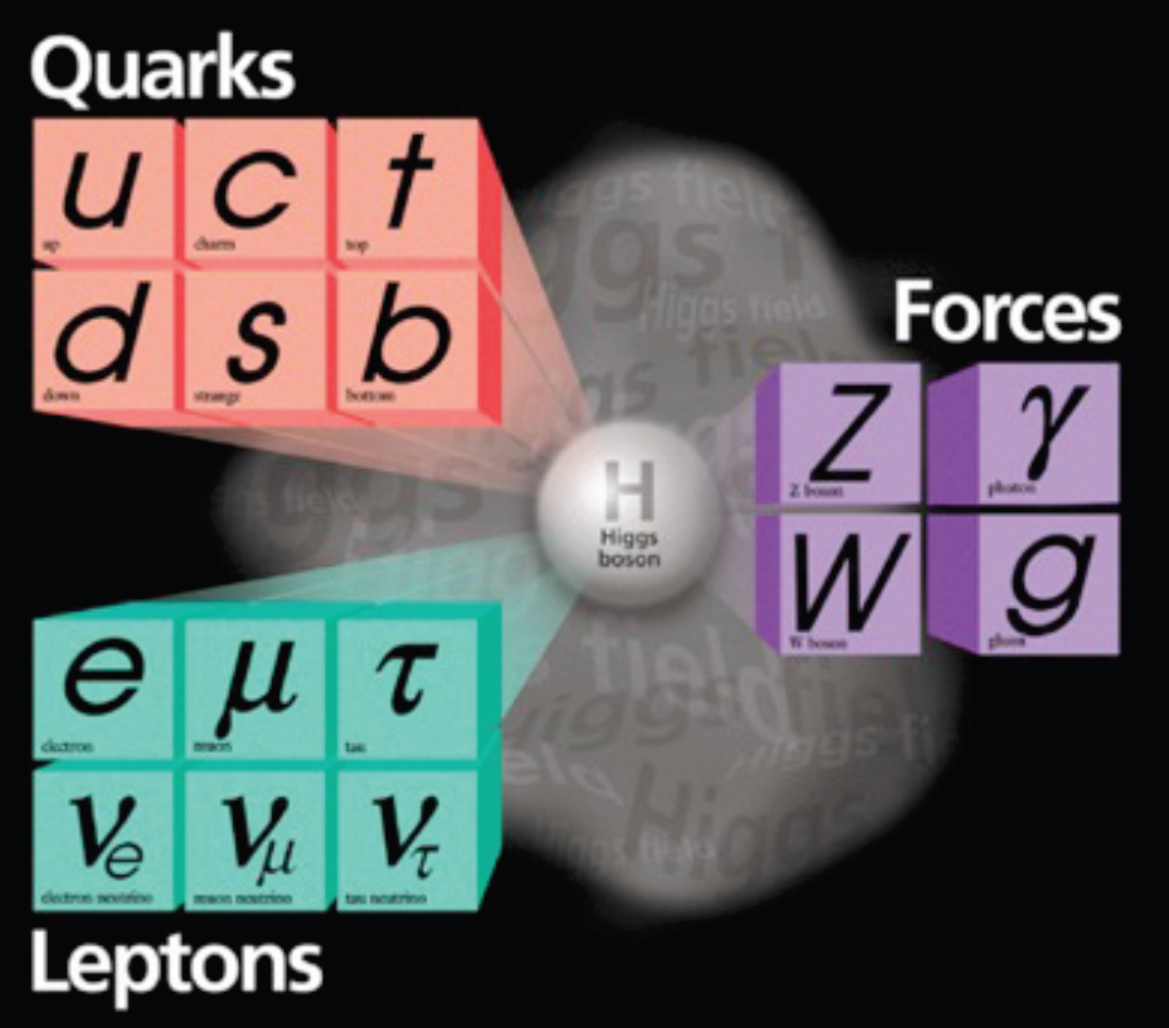
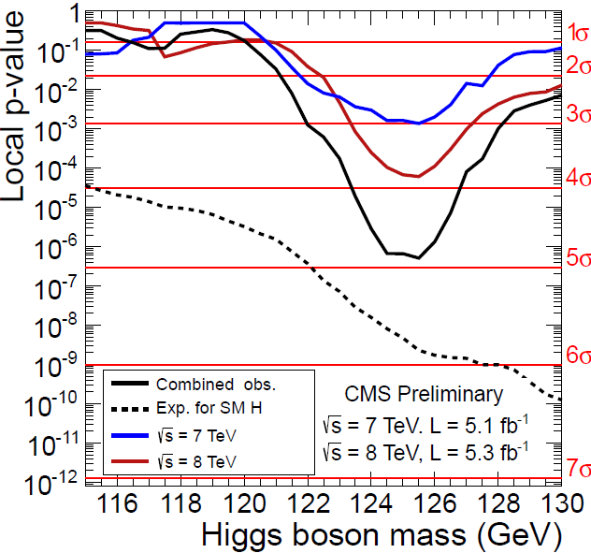
CEPC
“low Higgs mass makes the circular e⁺e⁻ collider as a viable option”
a new fundamental particle: light, weakly coupling H:
M_{h}=125-126 GeV, Γ<1 GeV, spin 0 (first)
July 4, 2012
5σ
4.9σ
What is it? How does it behave? New physics?

Slide 5
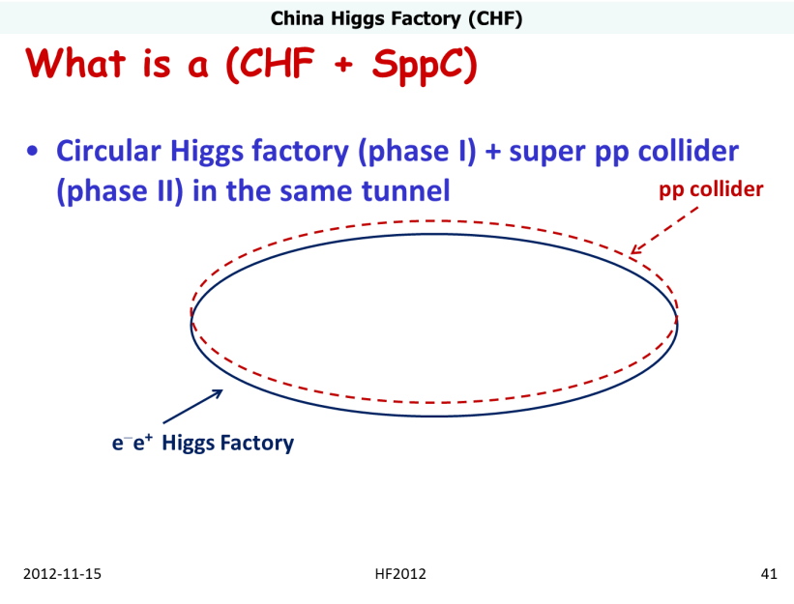
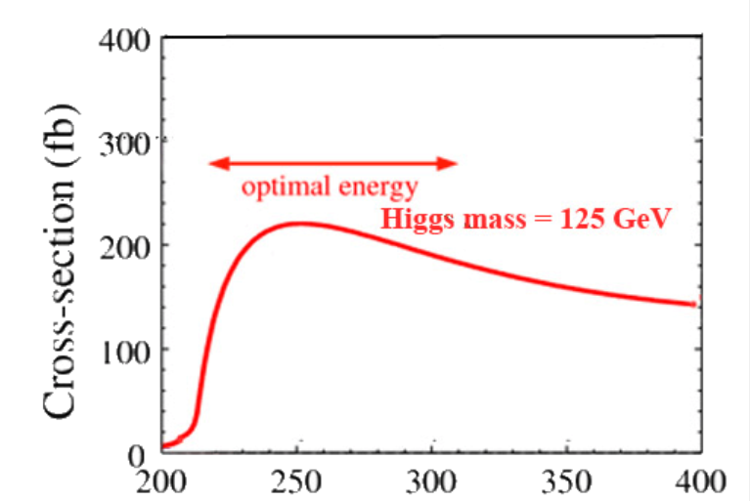
CEPC-SppC
Phase 1: e⁺e⁻ Higgs (Z) factory
E_{cm}≈240GeV, luminosity ~2×10³⁴ cm⁻²s⁻¹, can also run at the Z-pole
精确测量希格斯玻色子性质， Z玻色子精确测量
Phase 2: a discovery machine; pp collision with E_{cm} ≈ 50-100 TeV; ep option
物理目标是发现BSM新物理
e⁺e⁻ → ZH
Q. Qin
  BEPCII后中国粒子物理加速器候选项之一
E_{cm}(GeV)

Slide 6
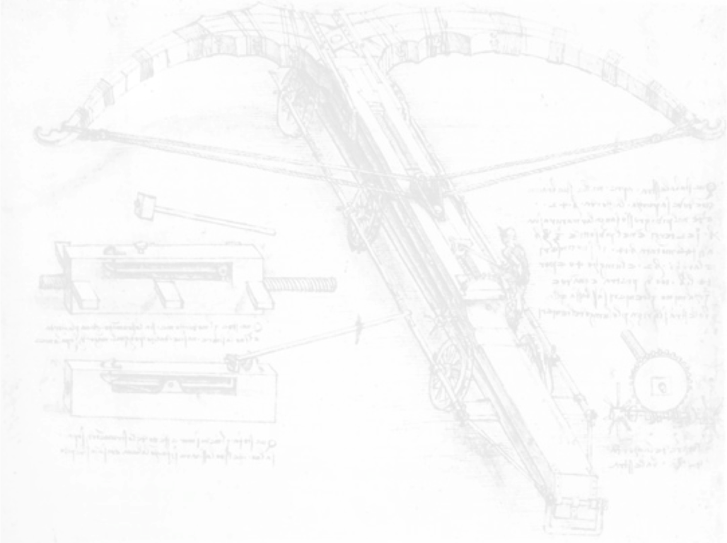
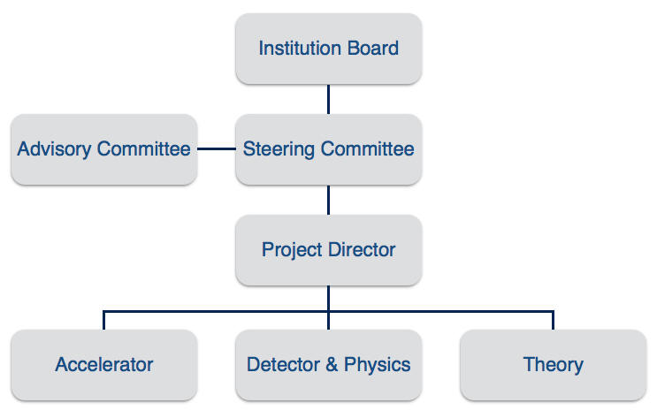
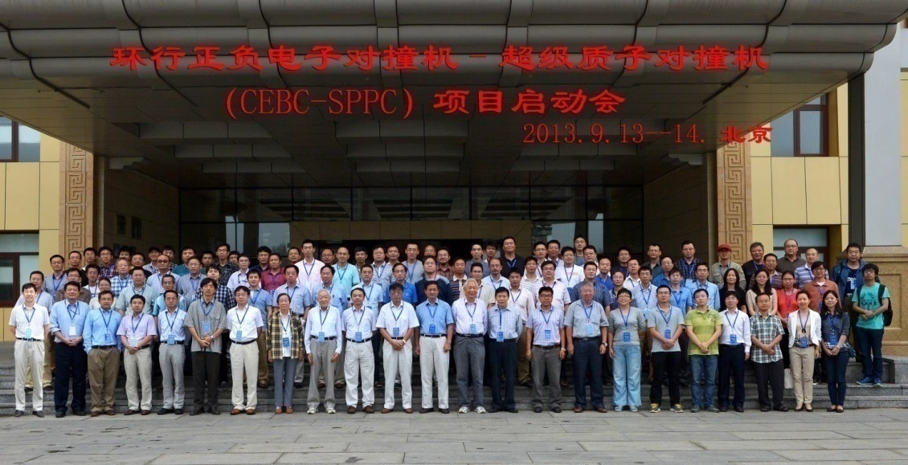
Organization
Institution Board and Steering Committee formed in the kick-off meeting in September 2013; conveners appointed for the three working groups: Accelerator, Theory and Detector & Physics
  Find out more: http://cepc.ihep.ac.cn/index.html
International workshops and regular group meetings to coordinate efforts
Schools and hand-on tutorials to train students – important to inspire more young people to directly participate in the activities
Office of Engineering and Support at IHEP
appointed by IHEP director Y. F. Wang on April 15, 2014

Slide 7
CEPC Organization alignment of IHEP groups
detector-
simulation
engineering
& support
CEPC
物理与探测器组
理论组
顶点探测器
理论计算
增强器
功率源
直线加速器
同步辐射及防护
控制系统
准直
束测系统
加速器物理
高频系统
低温系统
磁铁系统
电源系统
机械系统
真空系统
径迹探测器
量能器
缪子探测器
探测器磁铁
理论模拟
数据处理
物理模拟及软件
计算系统
土建及通用
超导磁铁
触发与数据获取
同步辐射装置
accelerator
theory
加速器
at IHEP
groups and leaders
are required to take
up real CEPC R&D

Slide 8
Preliminary Conceptual Design Report (preCDR)
初步概念设计
Getting preliminary answers to critical questions
Identify critical physics, technologies & tools for R&D
Develop estimates for R&D costs
Document ready for 13th 5 Year Plan (2015)

Slide 9
Status and Progress
THEORY

Slide 10
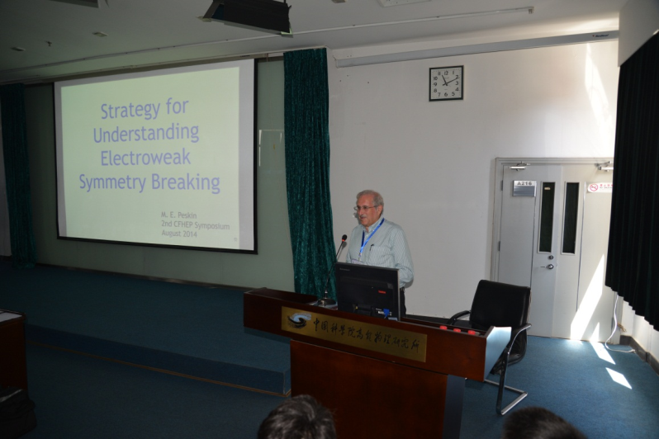
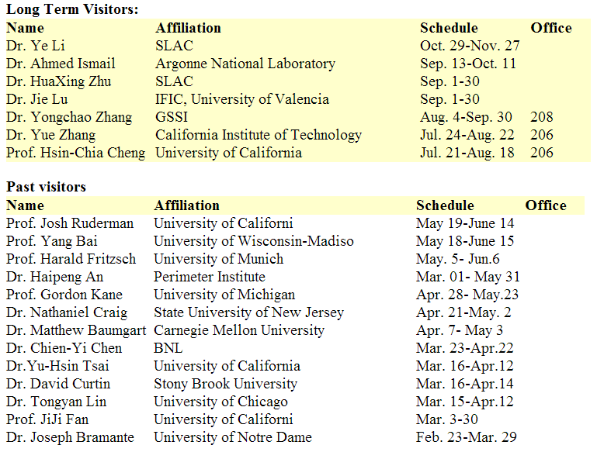
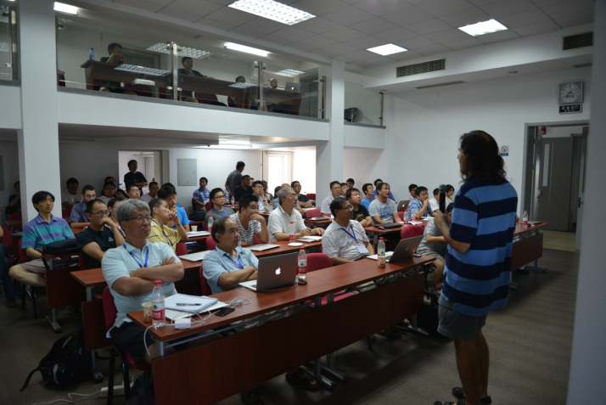
Internationalization
Center for Future High Energy Physics (CFHEP) established on 17 December 2013, with Prof. Nima Arkani-Hamed as its first director
Many theorists and accelerator physicists have come to IHEP and worked together with local members on related topics
Intended to invite experts in all relevant fields → More are welcome!
a glimpse of visitors, not complete

Slide 11
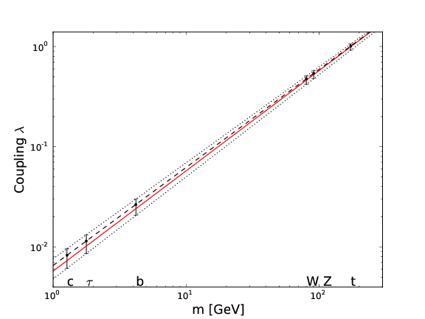
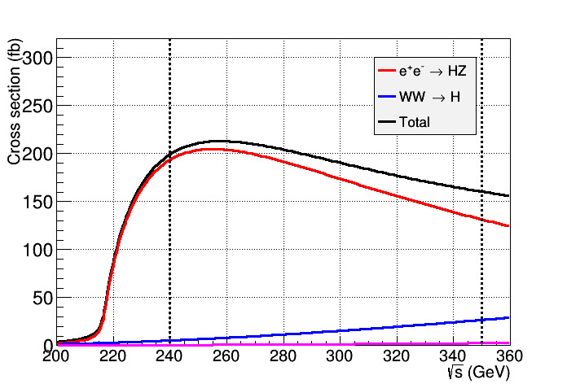
Theory
Precise measurements of the Higgs properties as a Higgs Factory and similar to ILC@250 GeV
  Mass, J^{PC}, couplings, etc. → (sub-)percentage accuracy
Precise measurements of Electroweak Symmetry-Breaking parameters (machine operated at Z-pole/WW threshold)
  and etc. + searches for rare decays

Slide 12
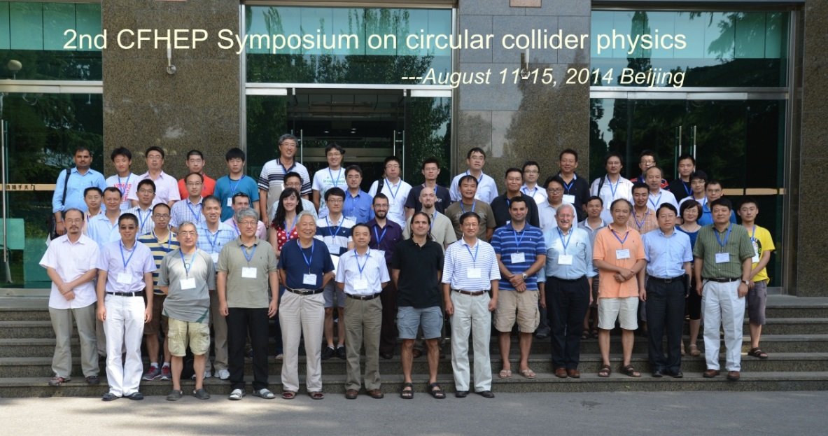
Theory
very rich physics at CEPC
SM tests (conveners: Qing-hong Cao/Li-lin Yang/Zhao Li/Chong Sheng Li)
Higgs Physics (Hong-jian He/Shou-hua Zhu/Tao Liu)
BSM: SUSY (Tianjun Li/Jin-min Yang)
BSM: Non-SUSY (Qi-shu Yan/Jing Shu/Wen-Gan Ma/Yi Liao/Wei Liao)
Flavor Physics (Cai-Dian Lu/Zong-Guo Si)
TeV Cosmology (Xiao-jun Bi/Yu-Feng Zhou)
Heavy Ion (Xin-nian Wang/Qun Wang)
MC tools (Qi-shu Yan/Jian-Xiong Wang)
2014/5/19, TeV Working group Workshop, Guangzhou, open discussion on CEPC/SPPC, and round-table meeting for preCDR
2014/6/15, Mini-workshop on LHC physics, Xi-an, round-table meeting for preCDR
2014/8, 2nd CFHEP symposium at IHEP
S.H. Zhu

Slide 13
Status and Progress
ACCELERATORS

Slide 14
CEPC Accelerator Baseline Design
LINAC | to generate and accelerate electrons to 6 GeV
Booster | to accelerate electrons to 120 GeV
Main Ring | to accumulate electrons to 16.9 mA, FODO lattice, single ring with the Pretzel scheme …
e+
IP1
e-
LTB
e+ e- Linac
(240m)
BTC
BTC
Booster(50Km)
CEPC Collider Ring(50Km)
IP2

Slide 15
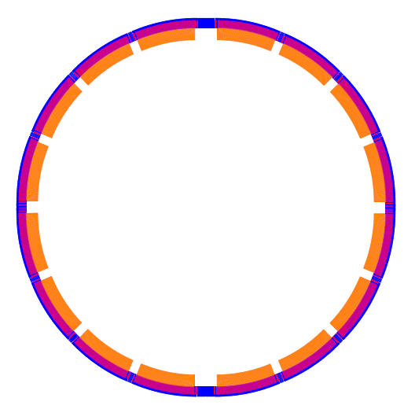
CEPC Accelerator Baseline Design
aerial view of CEPC
Circumference: 53.6 km
SR power: 50 MW/beam
16 arcs
2 IPs
8 RF cavity sections (distributed)
6 straight sections (for injection and beam dump)
Filling factor of the ring: ~80%
IP1
RF
RF
RF
RF
CEPC
RF
RF
RF
RF
IP2
Q. Qing

Slide 16
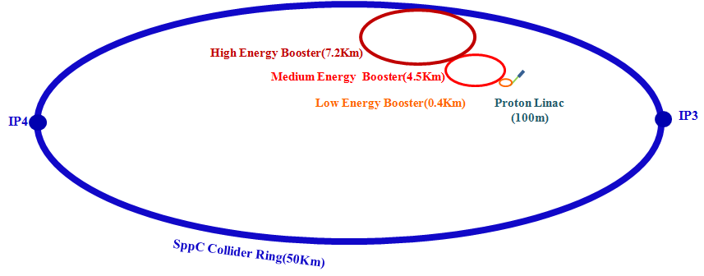
SppC Accelerator Design considerations
Proton-proton collider luminosity
Main constraint: high-field superconducting dipole magnets
  50 km: B_{max} = 12 T, E = 50 TeV
  50 km: B_{max} = 20 T, E = 70 TeV
  70 km: B_{max} = 20 T, E = 90 TeV

Slide 17
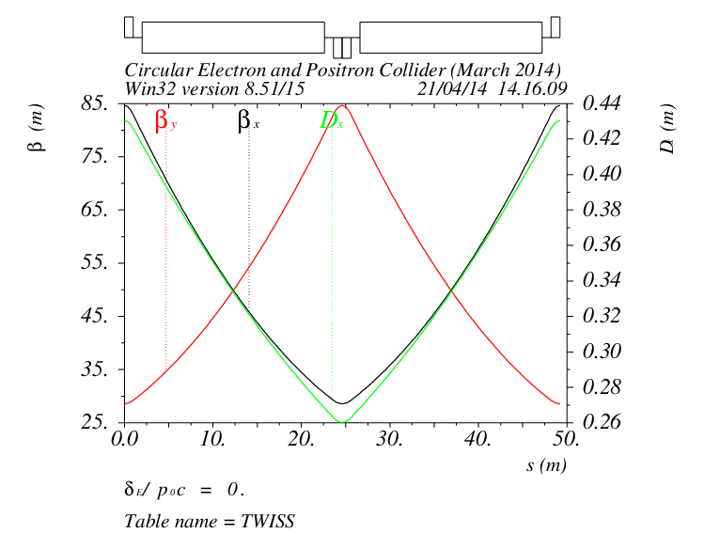
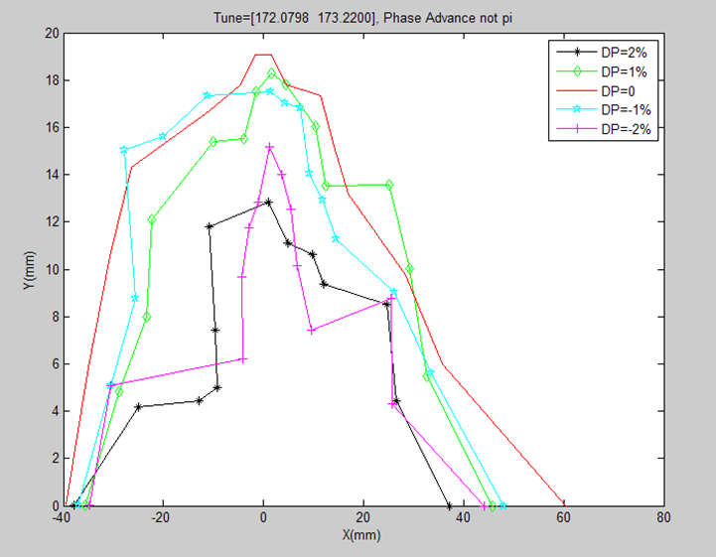
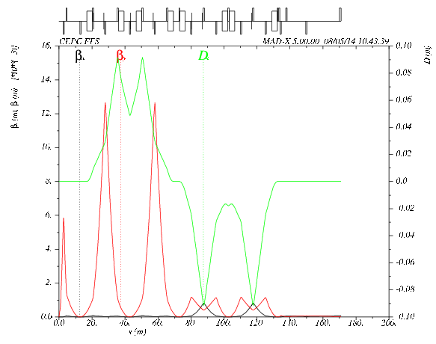
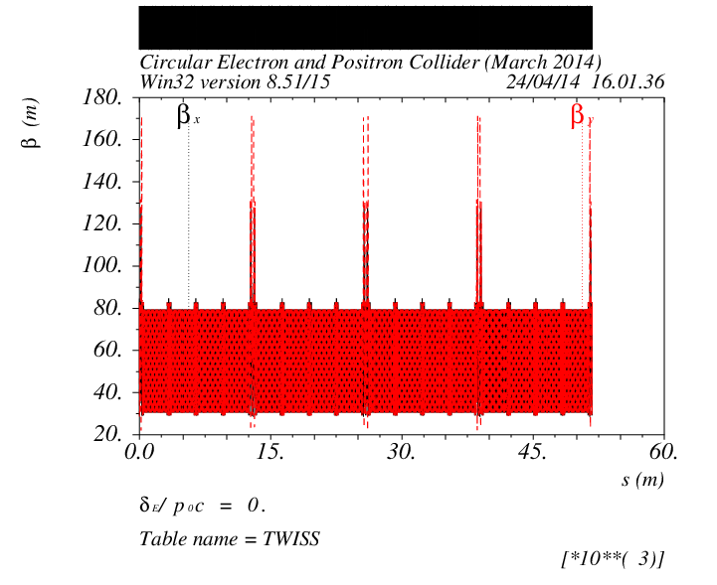
CEPC Accelerator Baseline Design
Lattice design for CEPC ring
Q. Qing

Slide 18
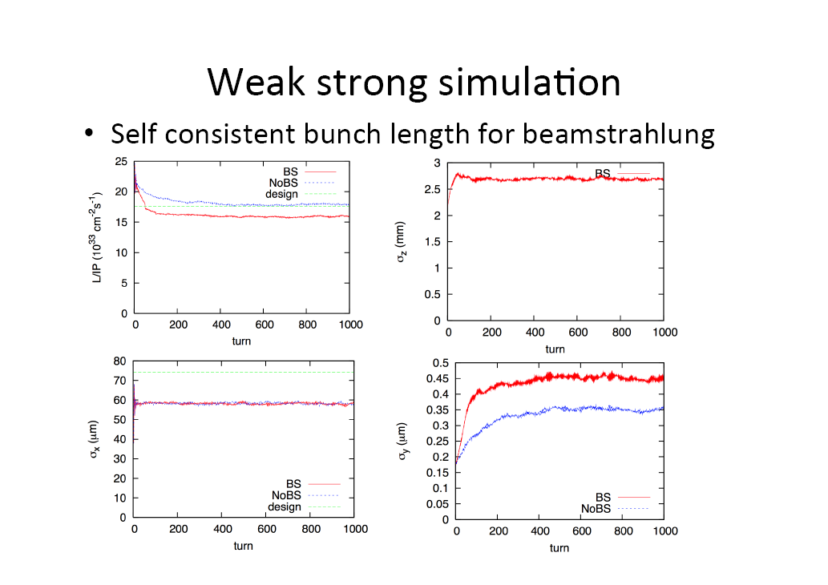
Beam-beam study for CEPC
Courtesy of K. Ohmi .

Slide 19
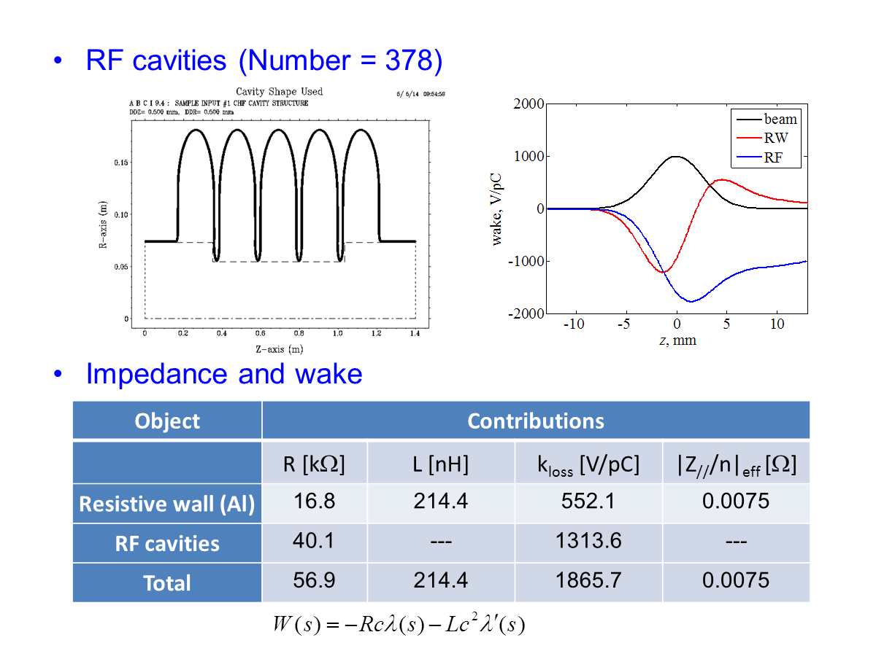
Instability study for CEPC
Q. Qing

Slide 20
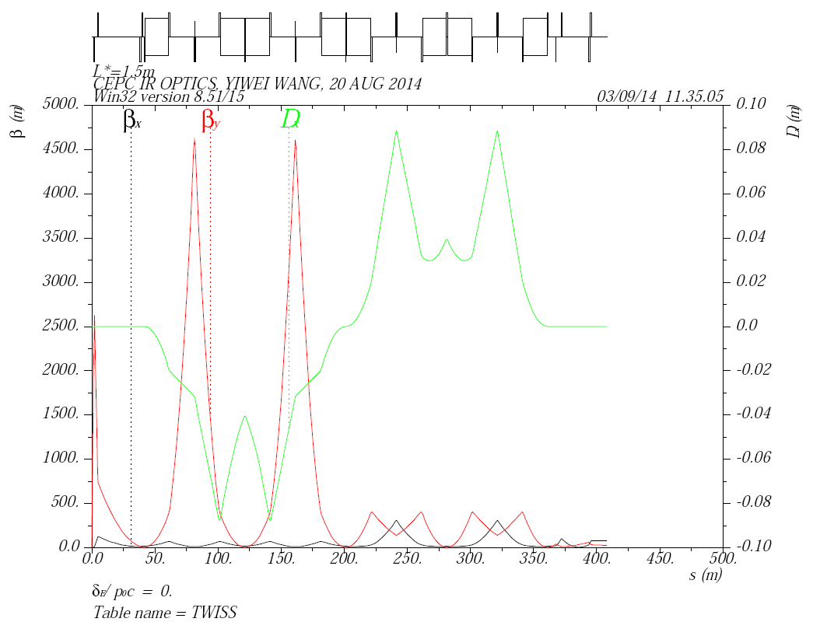
IR optics with L*=1.5m
betx*=0.8m, bety*=1.2mm, L*=1.5m
IP
FT
CCY
CCX
MT
The key issue of pre-CDR
is to have a working FFS in CEPC with enough off-momentum dynamic apertures
Key collaboration issue now, for example
FT: final telescopic transformer
CCY: chromatic correction section y
CCX: chromatic correction section x
MT: matching telescopic transformer
J. Gao

Slide 21
R&D plan of the 20 T accelerator magnets
(Very Preliminary)
2015-2020: Development of a 12 T operational field Nb₃Sn twin-aperture dipole with common coil configuration and 10⁻⁴ field quality; Fabrication and test of 2~3 T HTS (Bi-2212 or YBCO) coils in a 12 T background field and basic research on tape superconductors for accelerator magnets (field quality, fabrication method, quench protection).
2020-2025: Development of a 15 T Nb₃Sn twin-aperture dipole and quadrupole with 10⁻⁴ field uniformity; Fabrication and test of 4~5 T HTS (Bi-2212 or YBCO) coils in a 15 T background field.
2025-2030: 15 T Nb₃Sn coils + HTS coils (or all-HTS) to realize the 20 T dipole and quadrupole with 10⁻⁴ field uniformity; Development of the prototype SppC dipoles and quadrupoles and infrastructure build-up.
a long term plan for SC 20T magnets is being developed
will be a world wide effort

Slide 22
Status and Progress
DETECTOR

Slide 23
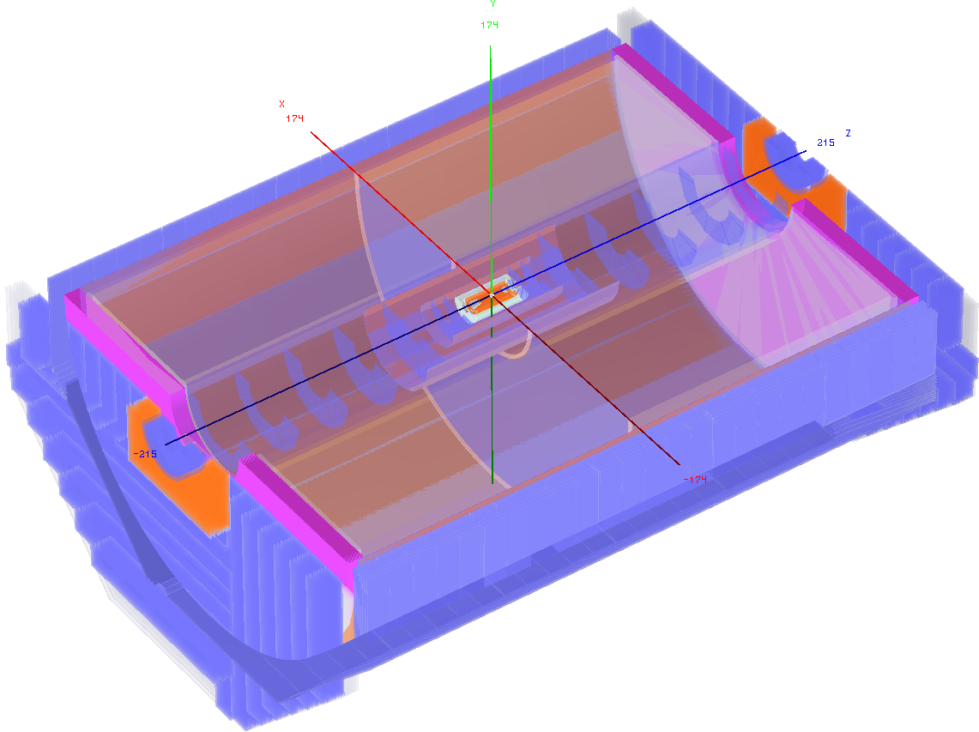
CEPC Detector considerations
ILD-like detector with additional considerations (incomplete list):
Shorter L* (1.5/2.5m) → constraints on space for the Si/TPC tracker
No power-pulsing → lower granularity of vertex detector and calorimeter
Limited CM (up to 250 GeV) → calorimeters of reduced size
Lower radiation background → vertex detector closer to IP
…
Similar performance requirements to ILC detectors
  Momentum: ← recoiled Higgs mass
  Impact parameter: ← flavor tagging, BR
  Jet energy: ← W/Z di-jet mass separation
Sub-detector groups consider design options, identify challenges, plan R&D

Slide 24
CEPC Detector considerations
At IHEP – Sub-detector groups have been formed
– began to consider design options, identify challenges, plan R&D
CEPC Detector | 顶点探测器（VTX） | 欧阳群
 | 径迹探测器（TPC） | 祁辉荣
 | 量能器（电磁+强子） calorimeters | 胡 涛
 | 缪子探测器 (muon)
 | 探测器磁铁 (magnet) | 朱自安
 | 物理模拟与软件组 Simulation + SW | 阮曼奇
 | 计算系统 Computing-network | 李卫东
 | 触发与数据获取系统 Trigger & DAQ | 朱科军

Slide 25
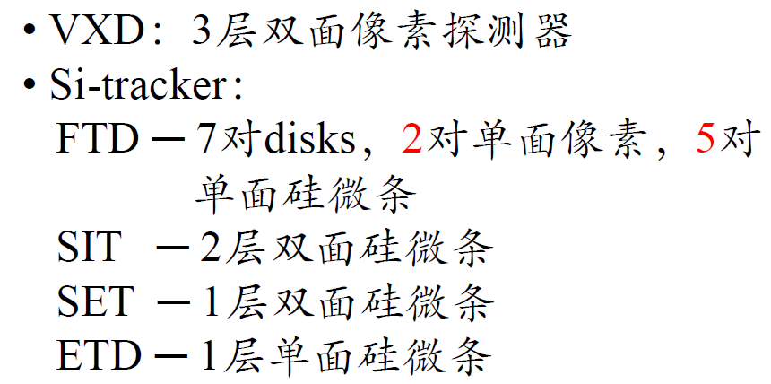
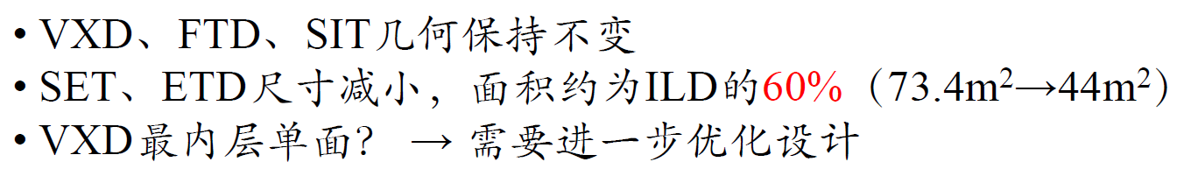
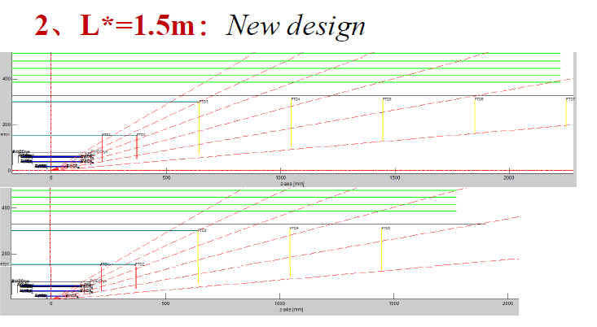
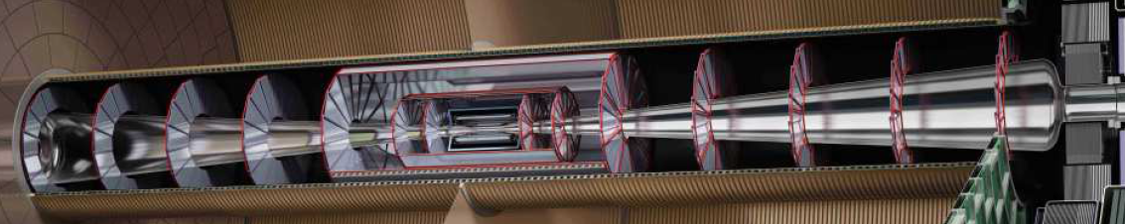
CEPC Detector
vertex detector consideration
Ouyang Qun
Preliminary study reveals radiation background likely lower than ILC → placing the vertex detector closer to IP to improve c-tagging
Without power-pulsing, it is difficult to remove heat sufficiently with air-cooling, possible solutions:
  Extra cooling material/larger pixel size → degraded performance
  Innovative readout architecture with lower power consumption or novel cooling technology (e.g. micro-channel cooling)

Slide 26
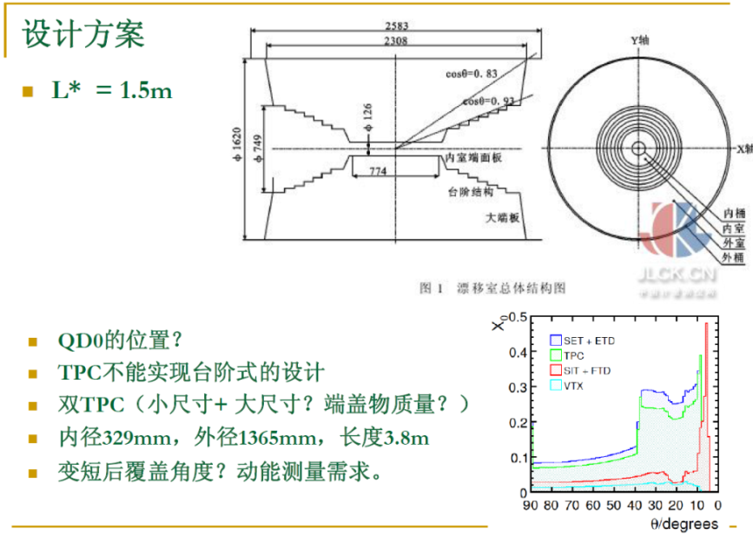
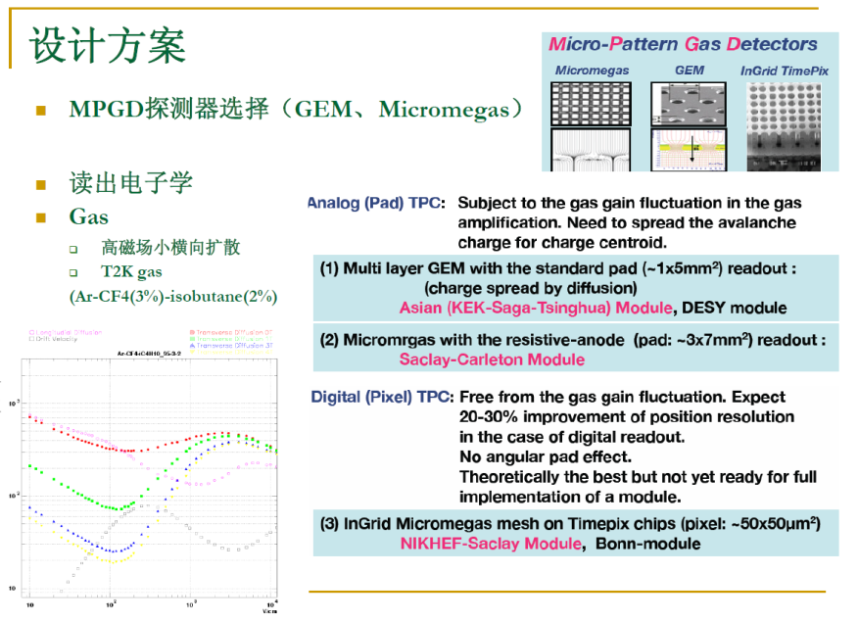
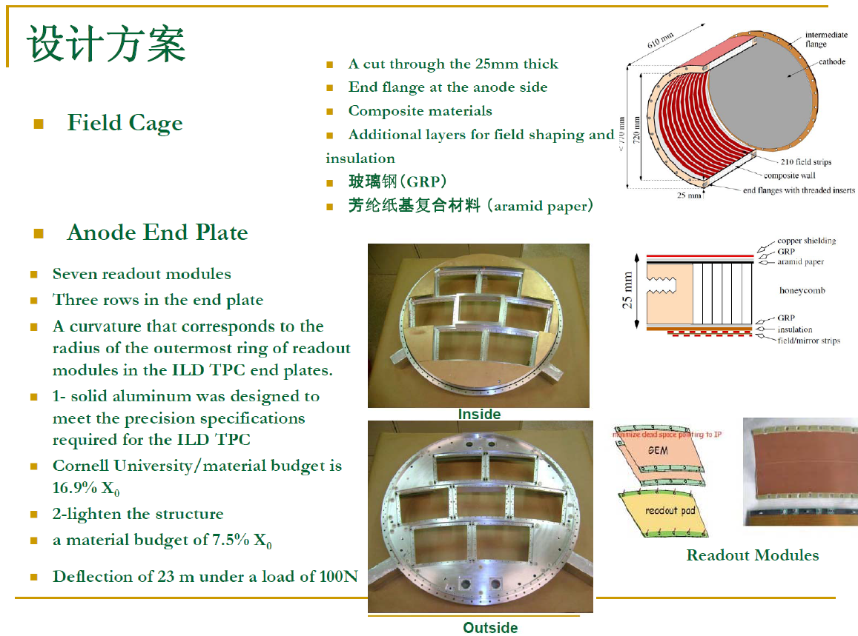
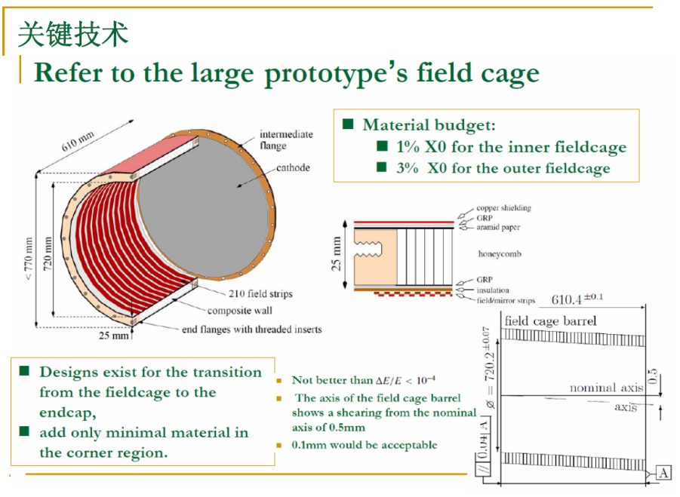
CEPC Detector
TPC considerations
H.R Qi

Slide 27
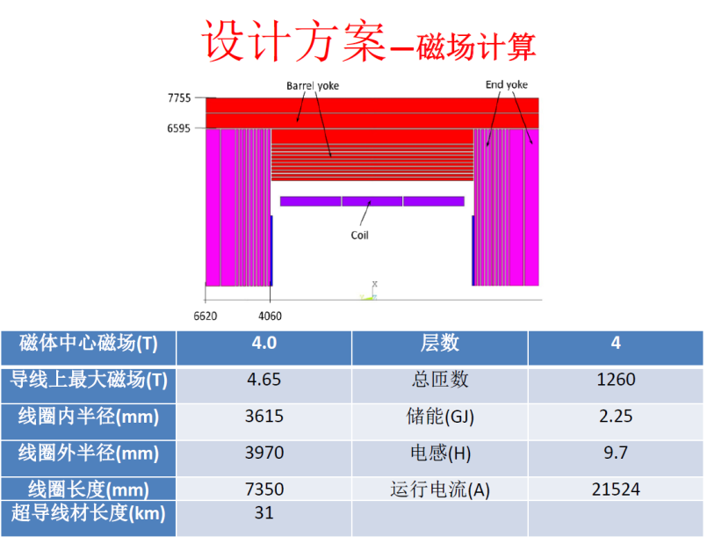
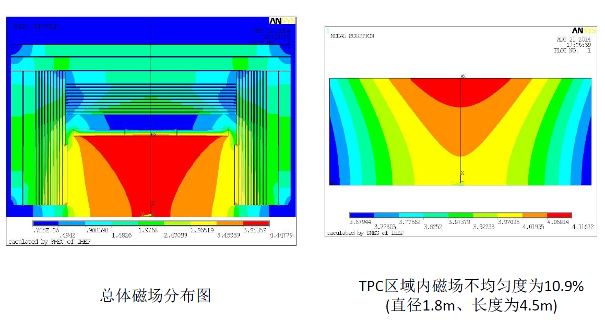
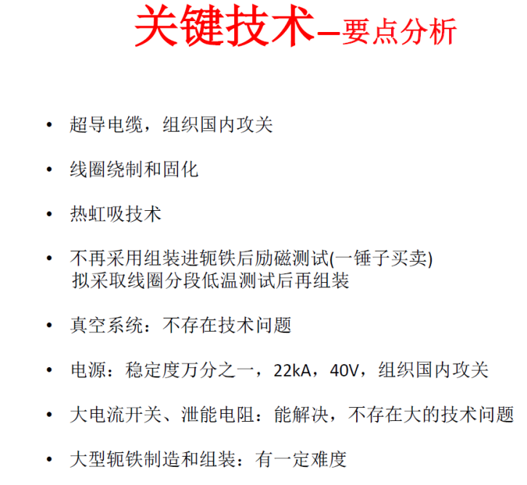
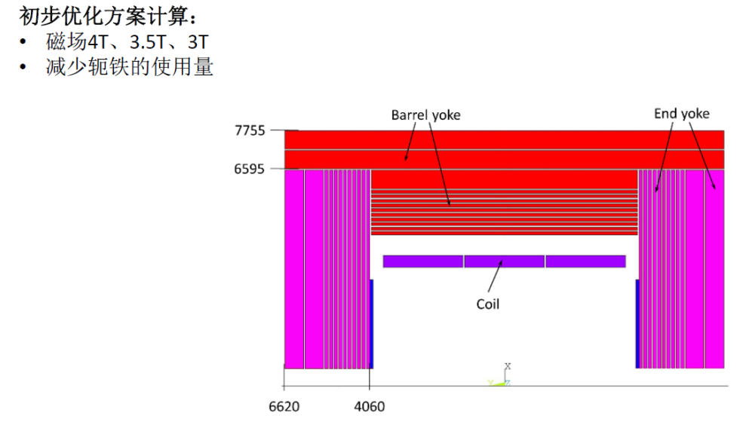
CEPC Detector
Detector magnet
Z. A. Zhu

Slide 28
Status and Progress
SIMULATION & PHYSICS REACH

Slide 29
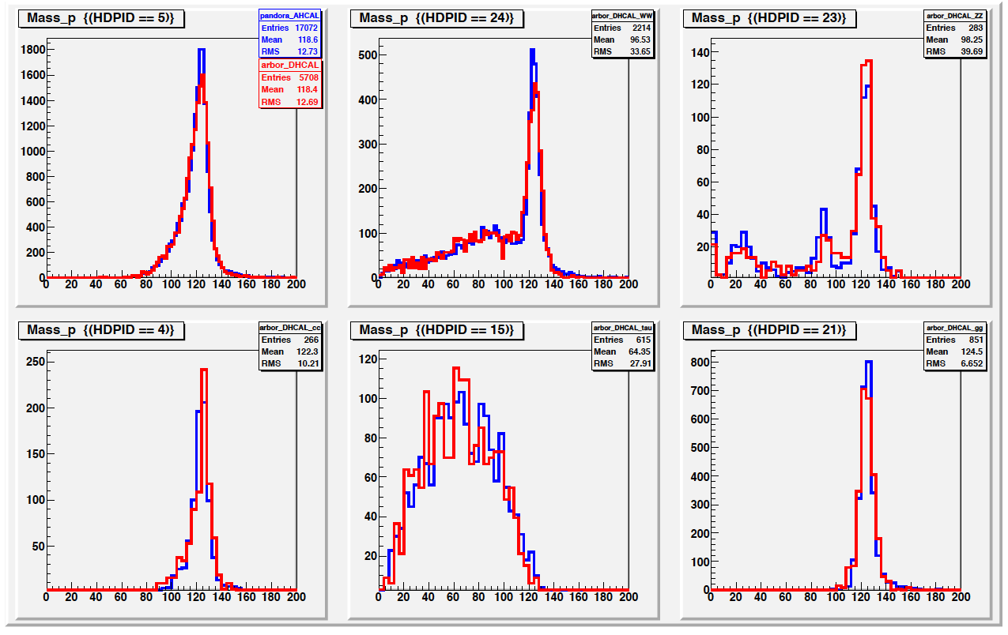
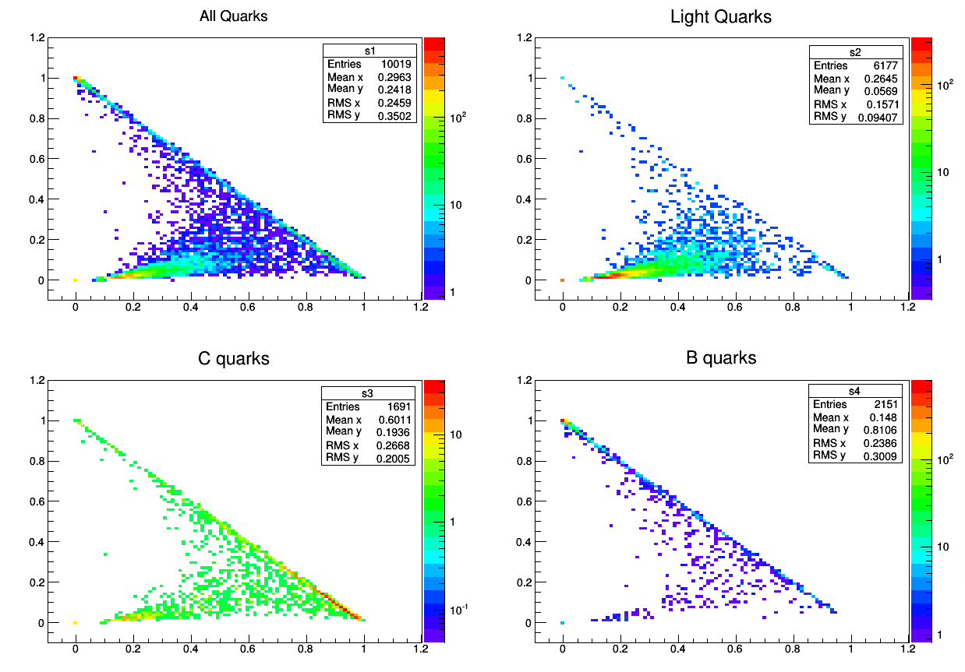
Recent highlight: A full simulation - reconstruction chain is ready
Geometry: modified as we want
Full Reconstruction: validated at default geometry, adjusting to new geometries
Sample:
  Higgs Signal (o(100 k) ): Full Simulated, reconstructed and Validated
  Background:
    ILC Reconstructed DST file
    Fast simulated
We will process to background Full Simulation once we got enough computing resource
Gang Li

Slide 30
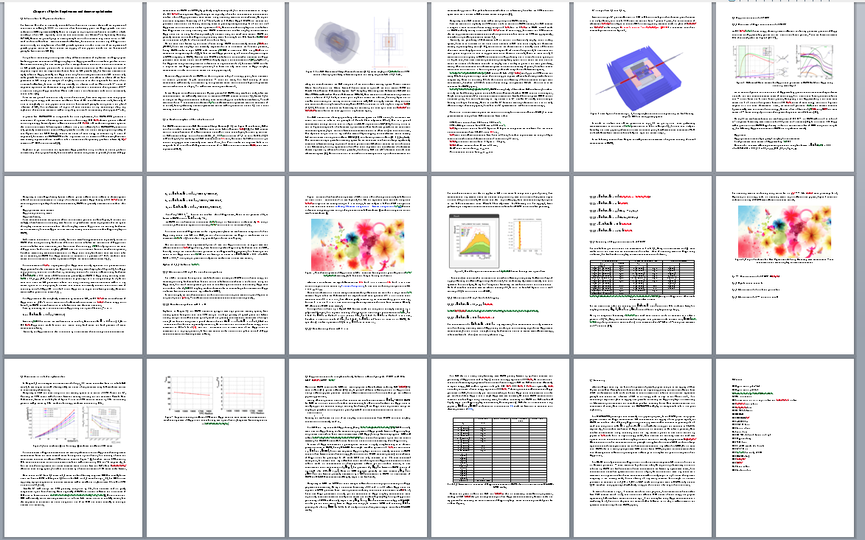
Pre CDR: Skelton of Simulation
Gang Li

Slide 31
Status
Fast Simulation | Full Simulation | Full Reconstruction | Analysis
ILD
cepc_v0
ILD
  All reconstruction chain validated
  Half analysis processed to Full Simulation: limited by Computing power, background uses ILD official DST sample/Fast simulation
cepc_v0:
  Need to adjust the reconstruction chain to New geometry
  Calibration constant, Track Fragments merging, PFO matching, Flavor tagging parameters
Gang Li

Slide 32
Higgs analysis at CEPC
 | CEPC @ 5 ab⁻¹ | Current Status | Responsable & perspective
mH (Model Independent) | 8 MeV | 12 MeV (μμH) | IHEP, CCNU
σ(ZH) | 0.7 % | 1.2 % | IHEP, CCNU
Higgs CP |  | Theoretically Investigated | THU, HKU
Δ(σ*Br)/(σ*Br)
ZH, H→bb | 0.4% | 0.22% (qqH channel) | SJTU, IHEP
H→cc | 2.1% | 2.2 – 2.8% | SJTU, IHEP
H→gg | 1.8% | 1.8 – 2.4% | SJTU, IHEP
H→WW* | 1.3% |  | IHEP, PKU
H→ττ | 1.2% | Efforts initialized | IHEP, USTC
H→ZZ* | 5.1% |  | SDU
H→γγ | 8% | ~ 12% (vvH) | WhU, IHEP
H→μμ | ? |  | UCAS, IHEP
H→Inv. | 0.3% |  | IHEP, HKU, HKUST
vvH, H→bb | 3.8% |  | PKU, IHEP
Optimistic Perspective
By the end of 2014
To be validated by Full Simulation
Fast Simulation Level
Gang Li
Jianmin Qian (Michigan), Yaquan Fang (IHEP) apply
statistical and ILC tools to exract errors on H coupling

Slide 33
Status and Progress
CIVIL ENGINEERING & SUPPORT

Slide 34
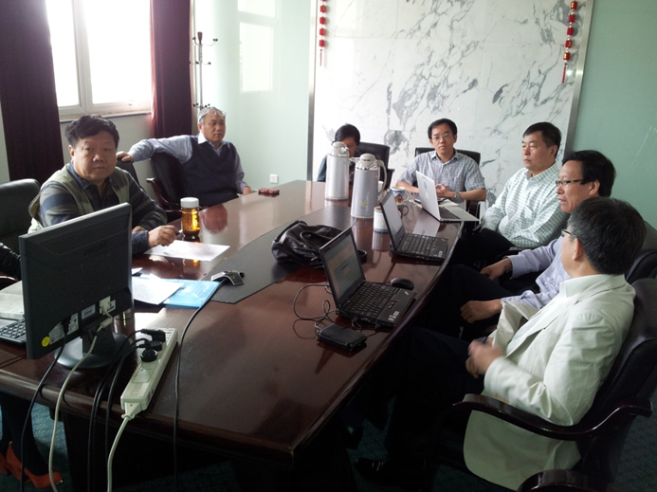
Office of Engineering and Support at IHEP
appointed by IHEP director Y. F. Wang
on April 15, 2014
CEPC工程办（筹）--2014年4月15日
主任：赵京伟
成员：赵京伟、许同舟、钟元元、鄢 芬
主要职责：
1、组织项目评审的准备工作，协调所内外各项工作。包括档案整理、会议记录、各类文件的收集、会议组织等；选址现场考察、对外联络、舆情调研等。
2、负责与科学院、发改委的沟通，推动向发改委申报“十三五”重大科技基础设施计划（预研）。
3、负责CEPC项目的宣传（国内与国际），在现有英文网站的基础上，建设/维护中英文网站，收集材料、介绍进展、收集国内外动态、研究美国SSC的教训和经验、重大科技基础设施对社会发展的影响、面向公众的科普。
veterans and very experienced
professionals
“enormous amount of effort & progress”
F. Yan

Slide 35
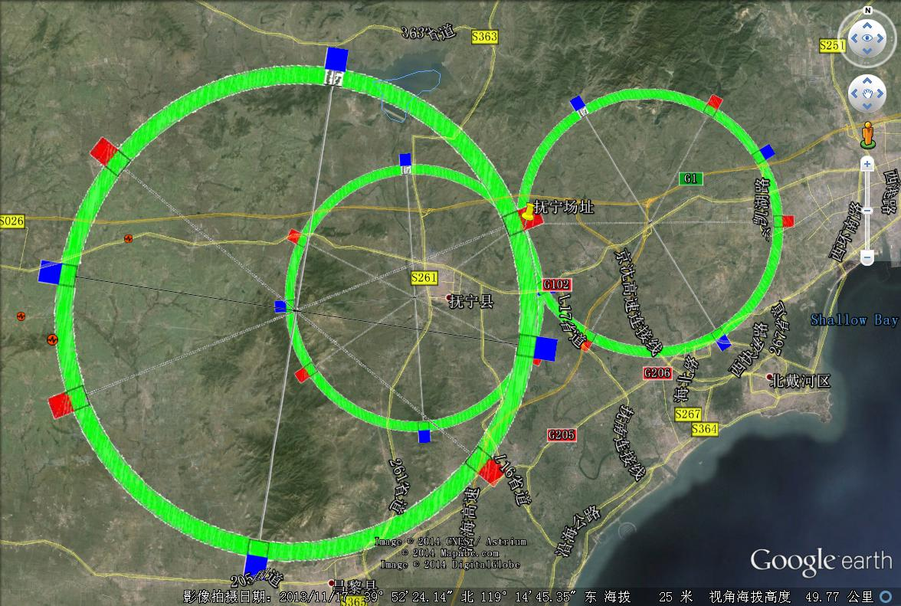
秦皇岛选址初勘情况 QingHuangDao site investigation
Office of Engineering and Support at IHEP
根据近期现场考察，包括地面竖井、实验大厅位置和地面环境，50公里环的地面状况良好，适合工程展开。70-100公里环的地面可能会遇到山区及人居等复杂情况。
F. Yan

Slide 36
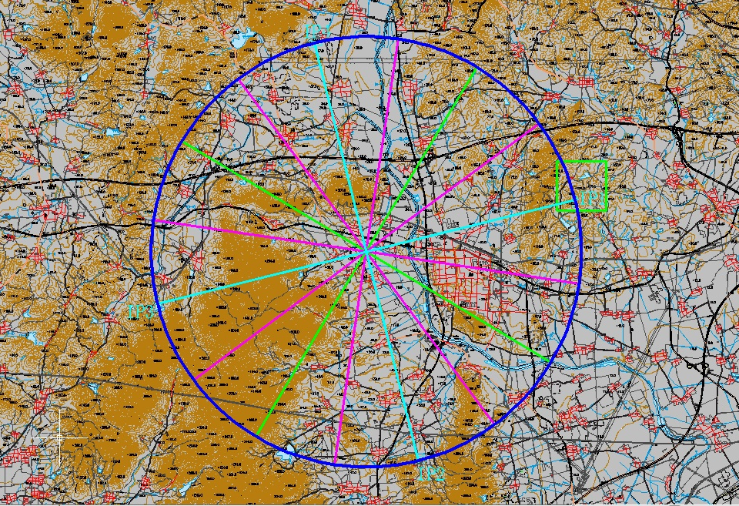
Onsite field survey Sept. 4-5, 14
IP4：刘各庄村西，距湾子-曹东庄公路约930m，有村道相通，东部有洋河灌溉引水渠，该点地表覆盖黄土夹碎石，估计厚度2m左右，下部基岩为太古代片麻岩和片岩。拟在此处布置一个钻孔。基本为农田。
位于洋河左岸，青龙-乐亭公路边，表层为第四系冲洪积砾砂土及砂砾石，下部基岩为太古代片麻岩。
位于谢家沟以北约400m，距抚宁-聂口公路320m，京哈高速以北280m，表层少量残坡积，下部基岩为侏罗纪下花园组长石岩屑砂岩及粉砂岩、泥岩互层，估计30~50m以下为太古代片麻岩。
位于寒江峪村东北约1km，交通不便，基岩为太古代片麻岩，表层全、强风化。
苏官营村西北约950m，苏家沟村东北约750m，交通不便。地表少量薄层残坡积覆盖，下部基岩为太古代片麻岩和片岩。
大黄金山村西约600m，距榆林甸-沿海公路约430m，距小黄金山村-曹西庄村村道约680m，交通不便。地表少量薄层残坡积覆盖，下部基岩为太古代片麻岩和片岩。
IP1：陆庄村西北约1km，英山河村南约800m，东部约700m有陆庄-王营县道，基岩为太古代片麻岩，表层全、强风化，局部有少量侏罗纪下花园组长石岩屑砂岩与泥岩。位于高能所5千亩地范围内。
白家拨子村西，102国道北约220m。地表少量薄层残坡积覆盖，下部基岩为太古代片麻岩和片岩。目前竖井位置有民宅。
位于抚宁西部兔儿山中，山区交通不便，距津秦客运专线约600m，岩性为中生代斑状二长花岗岩、花岗岩。
龙虎庄村南约300m，102国道北380m，基岩为太古代片麻岩，表层全、强风化。基本为农田，附近有少量房屋建筑。
IP2：政庄北，距津秦客运专线约1km，有村道相通。东部黄土覆盖，估计厚度小于10m，西部为中生代斑状二长花岗岩。周围民宅较多。
位于赵家庄和崔铁营村之间洋河河道，河道下部为第四系冲洪积砂砾石，估计厚度15~20m，下部基岩为太古代片麻岩，本处估计覆盖层为全线路最深处，因此拟在此处布置一个钻孔。竖井位于洋河，需调整位置，周围村庄较多。
位于滑石后水库大坝西南约1200m，距坟坨-滑石后村道约760m，山区交通不便，岩性为中生代斑状二长花岗岩、花岗岩。
IP3：位于小所各村南约900m，小所各南山北，距京秦铁路660m，场址南部为一小水库，水库北部为溢洪道。该处地表仅覆盖薄层残坡积，下部基岩为太古代片麻岩和片岩。周围基本为农田，调整洞线时应注意尽量避开铁路、水库溢洪道等。
滑石后水库
五各庄村-滑石后水库之间，五各庄村-滑石后水库村道南约280m。表层为含砾黄土状土，厚度估计小于5m，下部基岩为中生代斑状二长花岗岩。附近有炉料加工厂及核电厂拟选场址。
大新庄村北约900m，沿沟屯村西南约1200m，距津秦客运专线约450m。该处基岩裸露，岩性为侏罗纪张家口组角砾凝灰岩、熔结凝灰岩及流纹岩。基本为农田，附近有一砖厂。
F. Yan
Notes:
36
36

Slide 37
建筑物总体布局说明 CEPC Facilities & Tunnels
基本条件
  主环（与增强器共环）
    隧道长度：53.6km
    直线段：16段
      高频段：8段 L=176m
      对撞区：2 段 L=700m
      （预留2段，700m？）
      正负电子注入、废束引出位置？
    弧区：16段
      B铁偏转半径：6.094 km
      L=3043m
  实验大厅 ： 2个，预留2个
  注入器
    直线加速器隧道 : L = 500m
    输运线隧道 : L = ？m
F. Yan

Slide 38
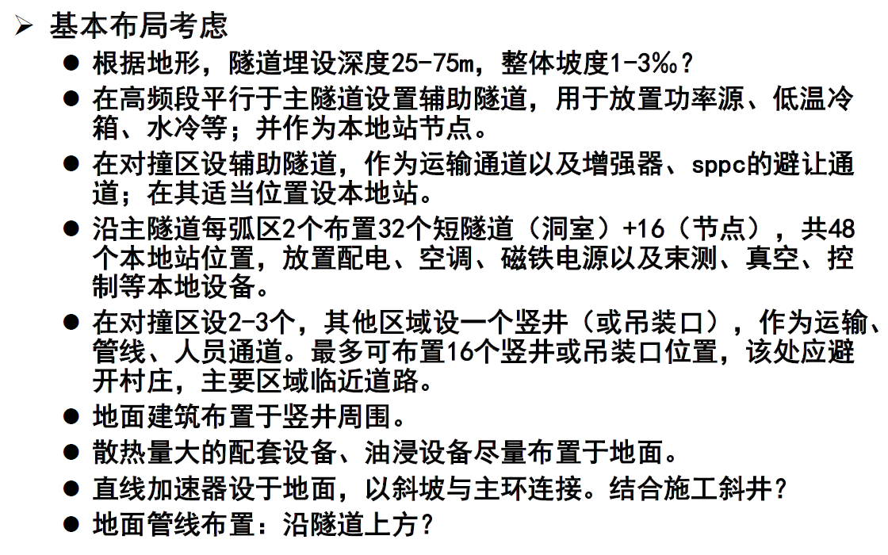
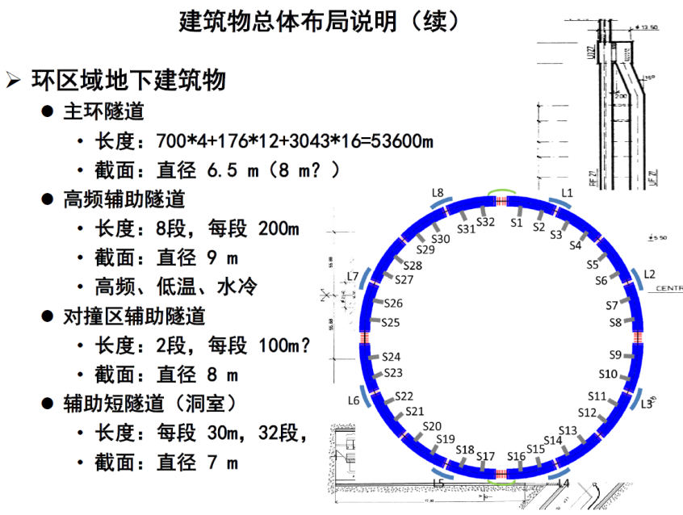
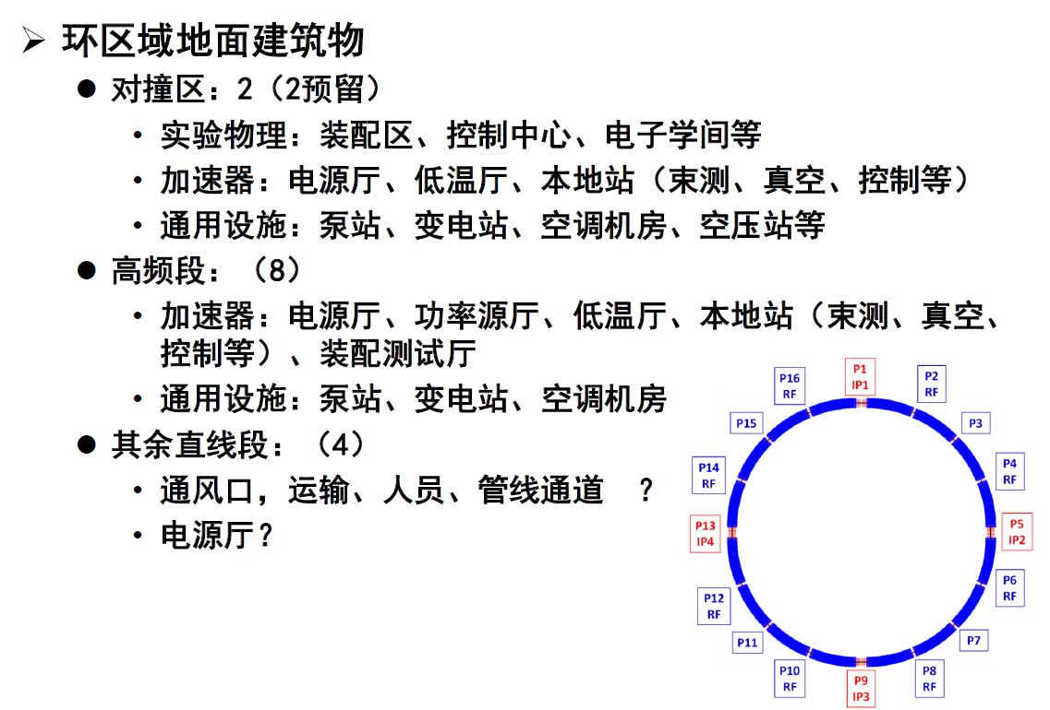
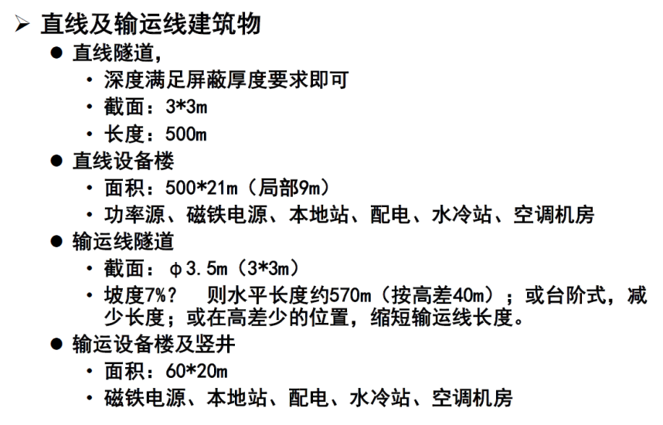
CEPC Facilities & Tunnels
地下隧道建设 –施工方法，防、排水，
通风，辐射防护，电子仪器厅，….
地面设施 – 实验厅，供电，制冷，消防，
交通，竖井，access points,
其他 – 节能减排，工期，整体造价
works closely with accelerator group and engineering company Huanghe
F. Yan

Slide 39
近期完成的工作
Office of Engineering and Support at IHEP
对外联络
  组织赴陕西省、广州梅州等地现场考察，秦皇岛市地勘工作联络；
  与相关省市领导进行了初步接触，得到了积极响应。
“十三五”重大科技基础设施计划（预研）的申报及准备工作
  正在组织编制申请书。
Exploration of more site options;
communication with local governments
Preparation for CEPC R&D funding application
F. Yan

Slide 40
近期完成的工作 tasks completed
Office of Engineering and Support at IHEP
资料收集与整理
  CEPC参数表
  CEPC学科带头人
  CEPC组织构架、人员队伍及需求
  CEPC关键技术研发及应用
  CEPC初步经费估算与R&D费用
  CEPC建议引起的巨大国际反响
对外宣传
  编写、打印、提供及发放宣传资料；
  组织CEPC中英文网站的完善工作；
    中文网站地址：www.ihep.cas.cn/dkxzz/cepc
    英文网站地址：cepc.ihep.ac.cn
F. Yan
F. Yan

Slide 41
Status and Progress
COMMUNICATION, OUTREACH & EDUCATION

Slide 42
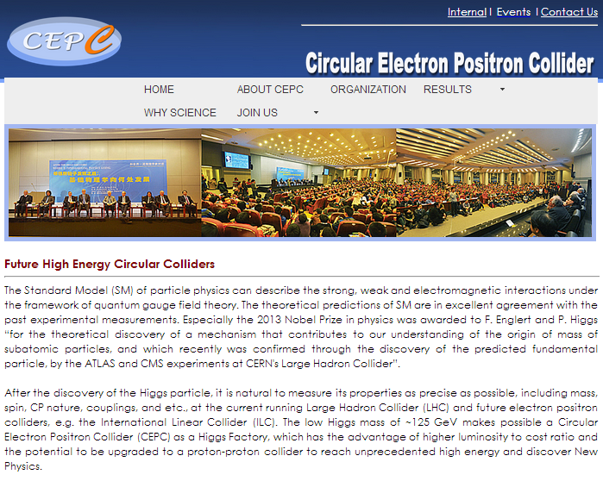
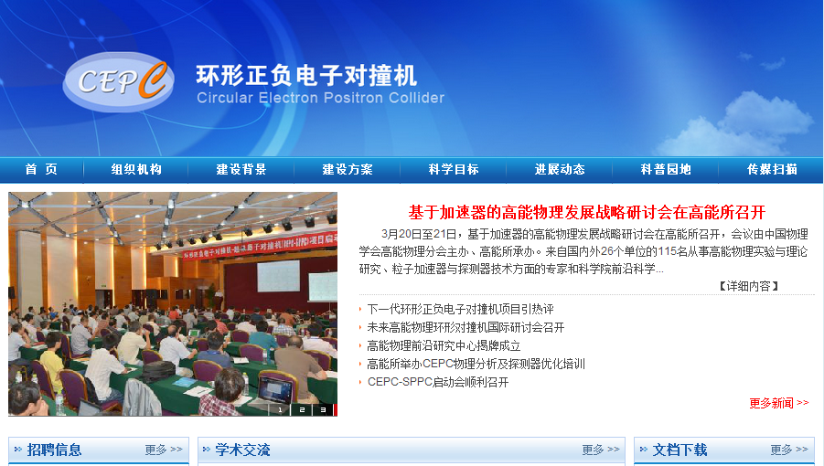
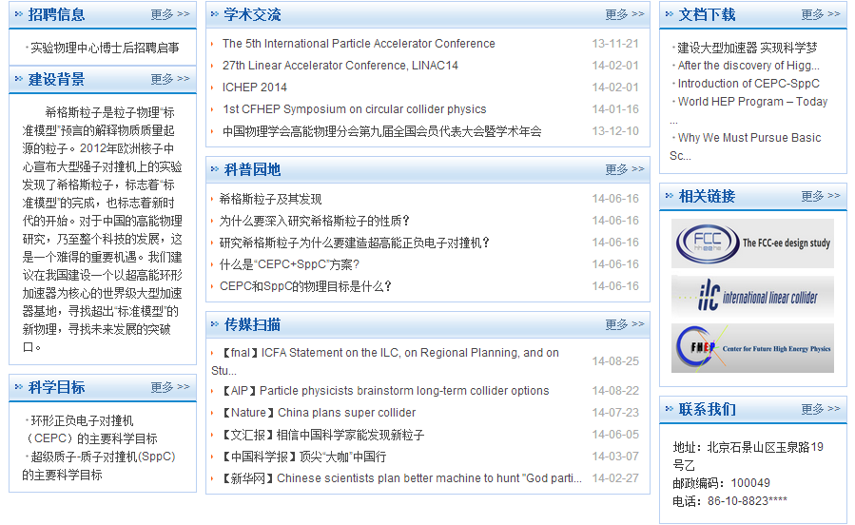
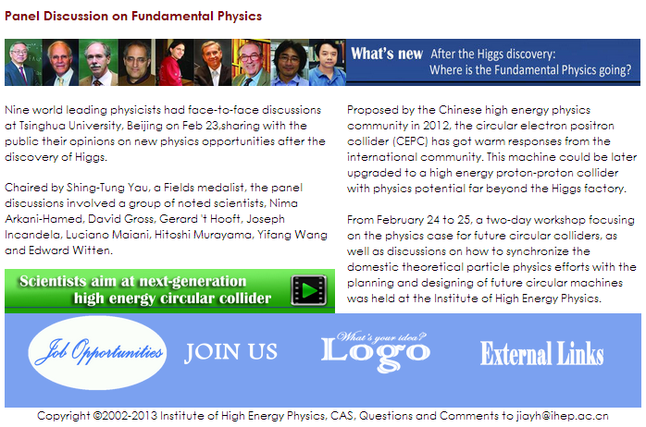

Communication: CEPC Web site (English, Chinese)
Y. Y. Zhong

Slide 43


Communication
ICFA Statement (July 6, 2014)
ICFA endorses the particle physics strategic plans produced in Europe, Asia and the United States and the globally aligned priorities contained therein. Here, ICFA reaffirms its support of the ILC, which is in a mature state of technical development and offers unprecedented opportunities for precision studies of the newly discovered Higgs boson. In addition, ICFA continues to encourage international studies of circular colliders, with an ultimate goal of proton-proton collisions at energies much higher than those of the LHC.
Nature – China plans super collider
Proposals for two accelerators could see country become collider capital of the world
http://www.nature.com/news/china-plans-super-collider-1.15603

Slide 44





Communication: World Wide Effort
IHEP-KEK Annual Meeting
SLAC 100 TeV Workshop

Slide 45




CEPC宣传资料
Outreach & education
～ 30000字
～ 6700字
～ 27000字
～ 5600字
CEPC建议
引起巨大国际反响
CEPC
大事记
高能物理的
社会效益
未来的
希格斯工厂
～10000字
进行中
进行中
Y. Y. Zhong

Slide 46




Y. Y. Zhong

Slide 47


公众宣传

Slide 48
Status and Progress
TRAINING & PROFESSIONAL DEVELOPMENT

Slide 49


Training and Professional development for CEPC
We need more professionals to undertake the CEPC-SppC project to good completion
Training young people to address manpower shortage
also International Summer school on TeV
Experimental Physics at IHEP, August 2014
Professional development for current staff and faculty
Recruitment: postdocs and staff at IHEP
Increase the size of HEP graduate students in China (quality, too)
……
CEPC software training at IHEP,
October 2013
CEPC software training at Nankai
August 2014
高能所卓越中心成立，提高博士后待遇

Slide 50
preCDR 初步概念设计
STATUS, ISSUES & SCHEDULE

Slide 51
Preliminary Conceptual Design Report (preCDR)
preCDR (by end of 2014)
  main physics topics and motivations;
  initial collider design(s);
  detector technologies and conceptual configuration
  core physics sensitivity (initial)
  site requirement, reality check on civil engineering
  crude cost estimates
  Identify critical physics, technologies & tools for R&D
  Develop estimates for R&D costs; …..
Established persons in charge of the preCDR writing
  Theory – Hong-jian He（Tsinghua), Shouhua ZHU（PKU） and
  Nima Arkani-Hamed （Princeton）
  Accelerator – Weiren CHOU（Fermi Lab), Qing QIN (IHEP), Jie GAO (IHEP)
  Detector & Simulation – Yuanning GAO（Tsinghua), Shan JIN
  Civil Engineering & Support – Jingwei ZHAO (IHEP)
  Introduction & Summary – Xinchou LOU (IHEP)
A major undertaking driven by
domestic schedule

Slide 52
preCDR documentation preparation and reviews
Writing & editing
  Condensation or integration of large volume of work;
  Coherency
  High quality
Review & revision
  Internal or preparatory review by Chinese scientists
  Formal review by committees consisting of Chinese and international experts
  Revision and improvement by incorporating review results
Chinese edition
  Required for domestic use (CAS, government, funding agencies)
  Plan a compact version
  Aim at completion by Chinese New Year, 2015
A CEPC editorial board will be formed to
work on this part – please help if asked
WGs suggest names and times
for the review – please tell me by 9.20

Slide 53


Slide 54
THEORY Preliminary Conceptual Design Report
Higgs Physics
  Introduction
  Theoretical Overview
  Prospects for Higgs Measurements at the LHC
  Higgs Physics at the CEPC
  High Energy Upgrades: the SppC
SM Physics
Beyond Standard Model: Supersymmetry
Beyond Standard Model: Alternatives
Flavor physics
TeV Cosmology
  Dark matter
  Electroweak baryognesis
Heavy Ion Physics
Monte Carlo Tools

Slide 55
preCDR: theory
Status
Framework fixed:
Executive summary + subgroup reports, 50-100 pages
International contributions
regular updates of all each sessions
document repository being filled
Issues
Convincing physics ideas
How to balance the time for routine research work and preCDR writing
How to combine domestic and oversees efforts
Meeting the schedule
S.H. Zhu

Slide 56
preCDR: accelerator - CEPC
 | CEPC - accelerator physics | persons
4.1 | Main parameters | Guo Yuanyuan, Geng Huiping, Wang Dou, Xiao Ming, Gao Jie
4.2 | Lattice | Geng Huiping, Wang Dou, Guo Yuanyuan, Wang Na, Wang
 |  | Yiwei, Xiao Ming, Peng Yuemei, Bai Sha, Su Feng, Xu Gang , Duan Zhe, Gao Jie
4.3 | IR and MDI | Wang Dou, Geng Huiping, Wang Yiwei, Bai Sha, , Gao Jie
4.4 | Beam instability | Wang Na, Wang Yiwei
4.5 | Beam-beam effects | Zhang Yuan, Guo Yuanyuan, Wang Dou, Xiao Ming, Gao Jie
4.6 | Synchrotron radiation | Ma Zhongjian, Geng Huiping
4.7 | Injection and beam dump | Cui Xiaohao, Su Feng, Xu Gang
4.8 | Background | Yue Teng
4.9 | Polarization | Duan Zhe
Visitors from other labs in the world participate the preCDR joint works
J. Gao

Slide 57
preCDR: accelerator - SppC
Upgrade to SppC | Leading person/pages
Introduction | 3
Science reach | Ruan Manqi/1
Design goals | Tang Jingyu/1
Overview of the SppC facility | Tang Jingyu/1
Key accelerator physics issues | 10
Main parameters | Tang Jingyu/3
Synchrotron radiation | Tang Jingyu/1
Beam-beam effects | Xiao Ming-Gao Jie/2
Electron cloud effect | Liu Yudong/2
Beam loss and collimation | Su Feng/1; Ye Zou/1
Key technical systems | 5
High field superconducting magnet | Xu Qingjin/3
Vacuum and beam screen | Dong Haiyi/1; Zhu Kun/1
Other technical challenges | Tang Jingyu/0.5
Reconfiguration of the accelerator complex | 4
Injector chain | Tang Jingyu/2
Integration of CEPC and SppC | Zhang Yuhong/2
J. Y. Tang

Slide 58
preCDR: civil engineering
进展
  开展两次项目讨论会，各系统提出相关设计方案、关键技术和R&D预算，具体设计方案还需进一步深化；
  9月份各工作组形成初稿。
计划
  建立编辑小组，负责preCDR的整体编辑工作；
  确定preCDR内外部评审小组成员；
  10月中旬至11月中旬各工作组开展preCDR内部评审活动；
困难
  各工作组、各系统进展参差不齐。
  项目关键技术及其进步、形成产业化等，对降低设备造价和社会效益将产生重要影响。需要进一步发掘和动员企业界参与。
措施
  制定详尽计划，明确时间节点，工程办按照计划结合时间节点监督进展情况，确保各项工作按计划完成。

Slide 59
At this workshop
preCDR & PREPARATION FOR REVIEWS

Slide 60


At This Workshop preCDR is the focus
Sept. 12
band together for 135 funding,
manpower, organization and
business decisions, preCDR institute
list
⇒
⇒
Sept. 13
editorial board, review committees,
schedule refinement, author-institute
list…..
executive decisions and planning

Slide 61
Summary
Tremendous efforts have been made, real progress in all fronts
I present only a cross section of the overall picture,
and could not touch many development due to time limit
Many very capable and smart people have joined us
We are getting better organized but the challenges are many
Let’s make good use of this workshop to move forward and to
position ourselves to complete the important work we laid out

Slide 62
BACKUP SLIDES

Slide 63
CEPC组织结构
CEPC Organization –
Institutional Board:
chairman: GAO Yuanning (Tsinghua U); 1 rep. per institution
deputy chairman: GAO Jie (IHEP)
Steering Committee:
chairman WANG Yifang (IHEP);
Project directors: LOU Xinchou (IHEP), QIN Qing (IHEP)
Working groups:
  Theory (Conveners: HE Hong-jian, ZHU Shouhua)
  Accelerator (Conveners: QIN Qing, GAO Jie)
  Detector (Conveners: JIN Shan, GAO Yuanning)
Monthly Steering Committee + Conveners meetings
2-3 workshops per year

Slide 64

Detector design: ILD → cepc_v0
CEPC Detector
no power-pulsing - continuous
Geometry changes
  TPC Radius 1808 → 1365 mm
  TPC Half Z 2350 → 1900 mm
  HCAL Layer Num: 48 → 40 (?)
  ECAL Layer Num: 30 → 16 (?)
  ECAL/HCAL Cell Size: 5/10 mm → 20 mm
  B Field: 3.5 T → 3 T (?)
  L*: 3.5 m → 1.5 m
Validation:
  How much luminosity we can achieve with L* = 1.5 m ???
Simulation: Geometry implemented
Gang Li

