Slide 1
Distributed Computing for CEPC
YAN Tian
On Behalf of Distributed Computing Group, CC, IHEP
for 4th CEPC Collaboration Meeting, Sep. 12-13, 2014

Slide 2
Outline
Introduction
Experience of BES-DIRAC Distributed Computing
Distributed Computing for CEPC
Summary

Slide 3
Introduction
Part I

Slide 4
Distributed Computing
Distributed computing plays an import role in discovery of Higgs
Large HEP experiments need plenty of computing resources, which may not be afforded by only one institution or university
Distributed computing allow to organize heterogeneous resources (cluster, grid, cloud, volunteer computing) and distributed resources from collaborations

Slide 5
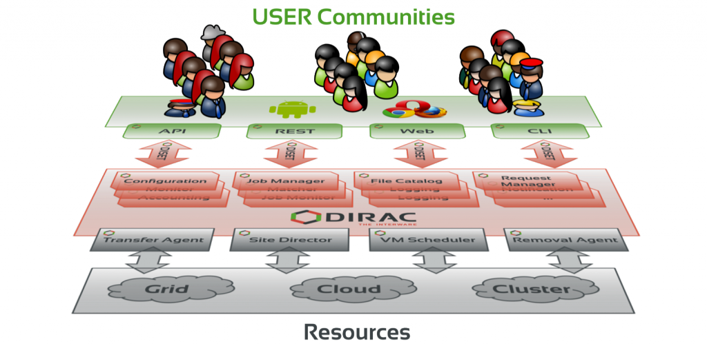
DIRAC
DIRAC (Distributed Infrastructure with Remote Agent Control) provide a framework and solution for experiments to setup their own distributed computing system.
It’s widely used by many HEP experiments.
DIRAC Users | CPU Cores | No. of Sites
LHCb | 40,000 | 110
Belle 2 | 12,000 | 34
CTA | 5,000 | 24
ILC | 3,000 | 36
BES 3 | 1,800 | 8
etc …

Slide 6
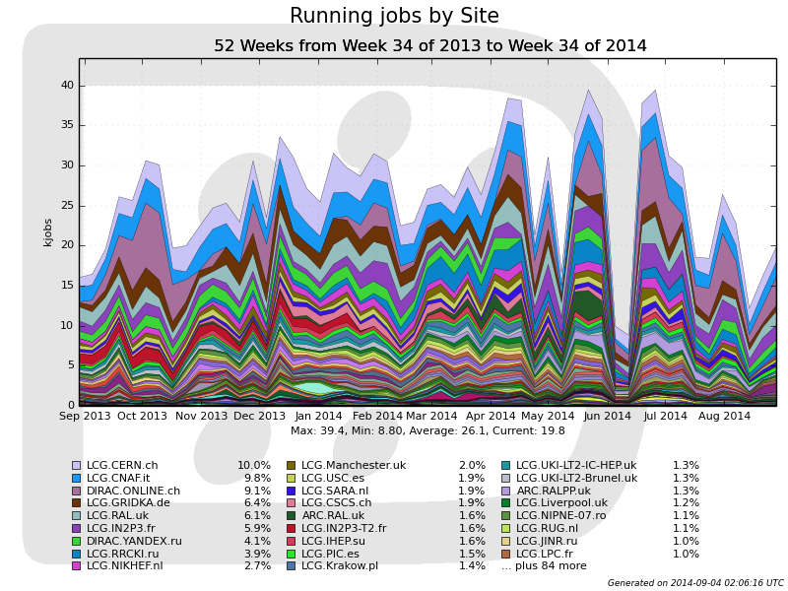
DIRAC User: LHCb
first user of DIRAC
110 Sites
40,000 CPU cores

Slide 7
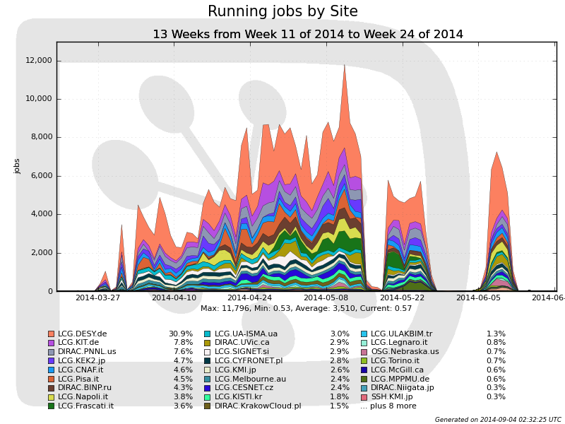
DIRAC User: Belle II
34 Sites
12,000 CPU cores
Plan to enlarge to ~100,000 CPU cores

Slide 8
Experience of BES-DIRAC distributed computing
Part II

Slide 9
BES-DIRAC: Computing Model
Detector
IHEP Data Center
DIRAC Central SE
(Storage Element)
Raw data
dst &
ramdomtrg
MC dst
All dst
MC prod.
analysis
CPU
Storage
Cluster Site
Grid Site
Cloud Site
analysis
local Resources
local Resources
local Resources

Slide 10
BES-DIRAC: Computing Resources List
# | Contributors | CE Type | CPU Cores | SE Type | SE Capacity | Status
1 | IHEP | Cluster + Cloud | 144 | dCache | 214 TB | Active
2 | Univ. of CAS | Cluster | 152 |  |  | Active
3 | USTC | Cluster | 200 ~ 1280 | dCache | 24 TB | Active
4 | Peking Univ. | Cluster | 100 |  |  | Active
5 | Wuhan Univ. | Cluster | 100 ~ 300 | StoRM | 39 TB | Active
6 | Univ. of Minnesota | Cluster | 768 | BeStMan | 50 TB | Active
7 | JINR | gLite + Cloud | 100 ~ 200 | dCache | 8 TB | Active
8 | INFN & Torino Univ. | gLite + Cloud | 264 | StoRM | 50 TB | Active
 | Total |  | 1828 ~ 3208 |  | 385 TB
9 | Shandong Univ. | Cluster | 100 |  |  | In progress
10 | BUAA | Cluster | 256 |  |  | In progress
11 | SJTU | Cluster | 192 |  | 144 TB | In progress
 | Total |  | 548 |  | 144 TB

Slide 11
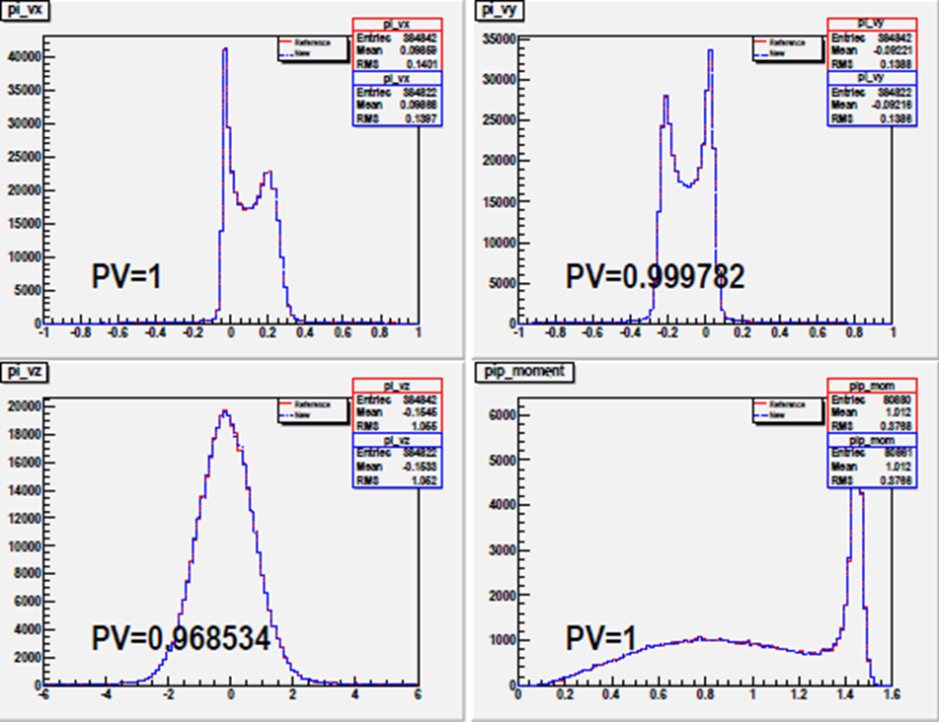
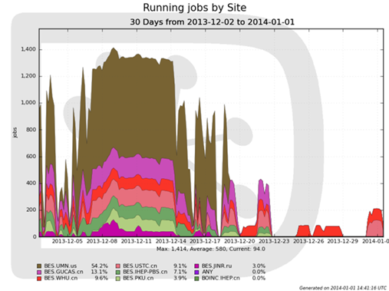
BES-DIRAC: Official MC Production
# | Time | Task | BOSS Ver. | Total Events | Jobs | Data Output
1 | 2013.9 | J/psi inclusive (round 05) | 6.6.4 | 900.0 M | 32,533 | 5.679 TB
2 | 2013.11~2014.01 | Psi3770 (round 03,04) | 6.6.4.p01 | 1352.3 M | 69,904 | 9.611 TB
Total |  |  |  | 2253.3 M | 102,437 | 15.290 TB
keep run ~1350 jobs for one week
in 2nd batch: Dec.7~15
Physical validation check of 1st production
Job running @ 2nd batch of 2nd production

Slide 12
BES-DIRAC: Data Transfer System
Developed based on DIRAC framework to support transfers of:
BESIII randomtrg data for remote MC production
BESIII dst data for remote analysis
Feature
allow user subcription and central control
integrate with central file catalog, support dataset based transfer
support multi thread transfer
Can be used by other HEP experiments who need massive remote transfer

Slide 13
BES-DIRAC: Data Transfer System
Data transfered from March to July 2014, total 85.9 TB
Data Type | Data | Data Size | Source SE | Destination SE
DST | xyz | 24.5 TB | IHEP | USTC
 | psippscan | 2.5 TB | IHEP | UMN
Random trigger data | round 02 | 1.9 TB | IHEP | USTC, WHU, UMN, JINR
 | round 03 | 2.8 TB | IHEP | USTC, WHU, UMN
 | round 04 | 3.1 TB | IHEP | USTC, WHU, UMN
 | round 05 | 3.6 TB | IHEP | USTC, WHU, UMN
 | round 06 | 4.4 TB | IHEP | USTC, WHU, UMN, JINR
 | round 07 | 5.2 TB | IHEP | USTC, WHU
high quality ( > 99% one-time success rate)
high transfer speed ( ~ 1 Gbps to USTC, WHU, UMN; 300Mbps to JINR):
Data | Source SE | Destination SE | Peak Speed | Average Speed
randomtrg r04 | USTC, WHU | UMN | 96 MB/S | 76.6 MB/s (6.6 TB/day)
randomtrg r07 | IHEP | USTC, WHU | 191 MB/s | 115.9 MB/s (10.0 TB/day)

Slide 14
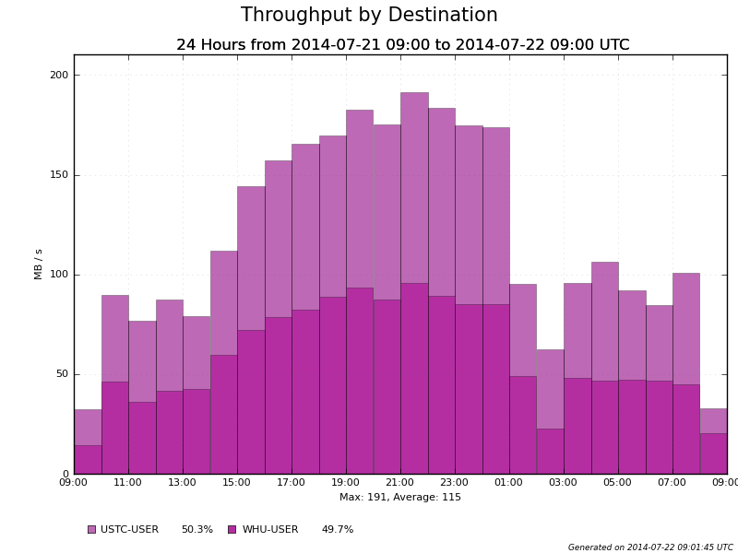
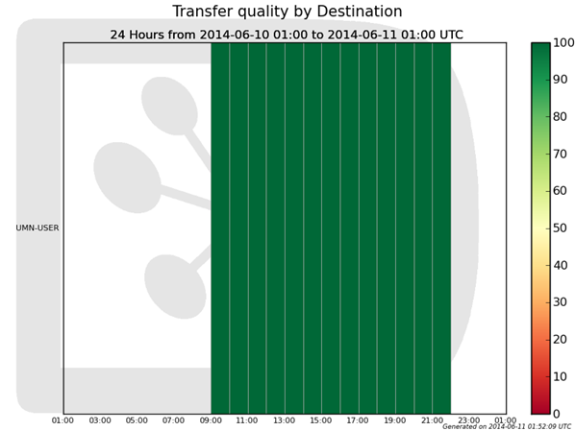
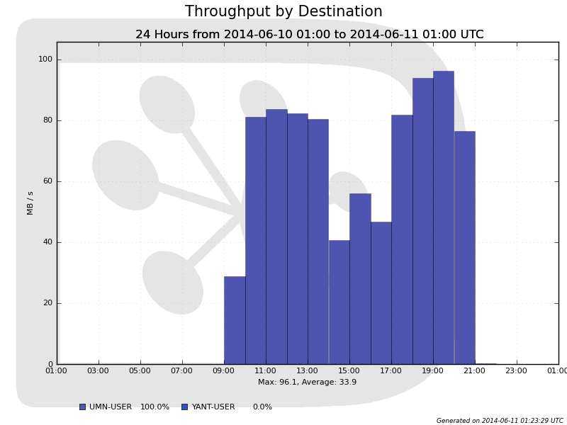
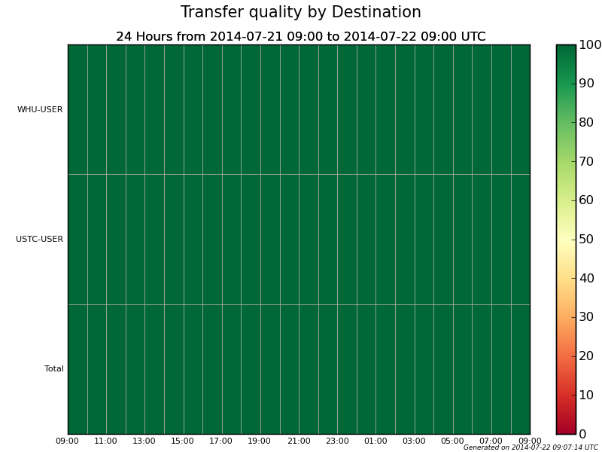
IHEP→USTC, WHU
@ 10.0 TB/day
one-time
success > 99%
USTC, WHU→UMN
@ 6.6 TB/day

Slide 15
Cloud Computing
Cloud is a new resource to be added in BESIII distributed computing
Advantages:
make sharing resources among different experiments much easier
easy deploment and maintance for site
allow site easily support diffrerent experiment’s requiremnts(OS, software, lib, etc.)
users can freely choose whatever OS they need
same computing environment in all site
Recent testing shows cloud resource is usable for BESIII
Cloud resources are also successfully used in CEPC testing

Slide 16
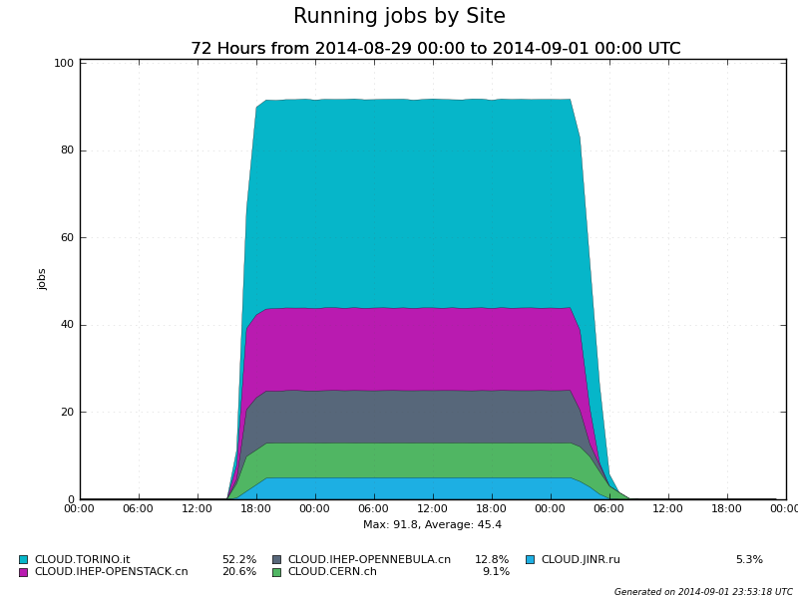
Recent Testing for Cloud
Cloud Resources for Test
Site | Cloud Manager | CPU Cores | Memory
CLOUD.IHEP-OPENSTACK.cn | OpenStack | 24 | 48 GB
CLOUD.IHEP-OPENNEBULA.cn | OpenNebula | 24 | 48 GB
CLOUD.CERN.ch | OpenStack | 20 | 40 GB
CLOUD.TORINO.it | OpenNebula | 60 | 58.5 GB
CLOUD.JINR.ru | OpenNebula | 5 | 10 GB
913 test BOSS jobs
simulation + reconstruction
psi(4260) hadron decay, 5000 events each
100% successful
Test Jobs Running on Cloud Sites
Performance
Execution Time

Slide 17
Distributed computing for CEPC
part III

Slide 18
A Test Bed Established
Software deploy and Job flow
IHEP Lustre
CEPC software installed here
*.stdhep input data
*.slcio output data
BES-DIRAC Servers
CVMFS
Server
DB mirror
WHU SE
IHEP DB
BUAA Site
OS: SL 5.8 Remote
IHEP PBS Site
OS: SL 5.5
IHEP Cloud Site
WHU Site
OS: SL 6.4
Remote
IHEP Local Resources

Slide 19
Computing Resources & Software Deployment
Resources List of this Test Bed
Deploy CEPC software by CVMFS
Contributors | CPU cores | Storage
IHEP | 144
WHU | 100 | 20 TB
BUAA | 20
Total | 264 | 20 TB
CVMFS: CERN Virtual Machine File System
A network file system based on HTTP
optimized to deliver experiment software
software are hosted on web server
in client side, load data only on access
CVMFS is also used in BES III distributed computing
264 CPU cores, shared with BES III
20 TB dedicated SE capacity, for test is OK, but it’s not enough for production
CEPC detector simulation need 100k CPU days every year.
We need more contributors!
CVMFS
Server
web proxy
work node
Repositories
Cache
load data only on acess

Slide 20
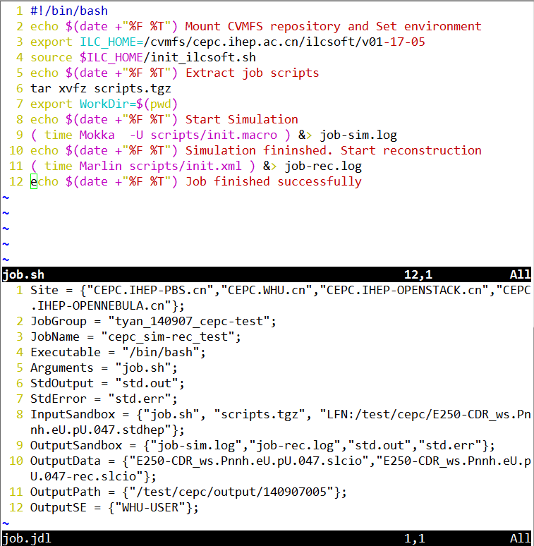
CEPC Testing Job Workflow
Submit a test job step by step:
upload input data to SE
prepare job.sh
(3) prepare a JDL file: job.jdl
(4) submit job to DIRAC
(5) monitoring job status in web portal
(6) Download output data to Lustre
For user job:
In future, a frontend need to be developed to avoid details.
User only need to provide some configuration parameters to submit jobs

Slide 21
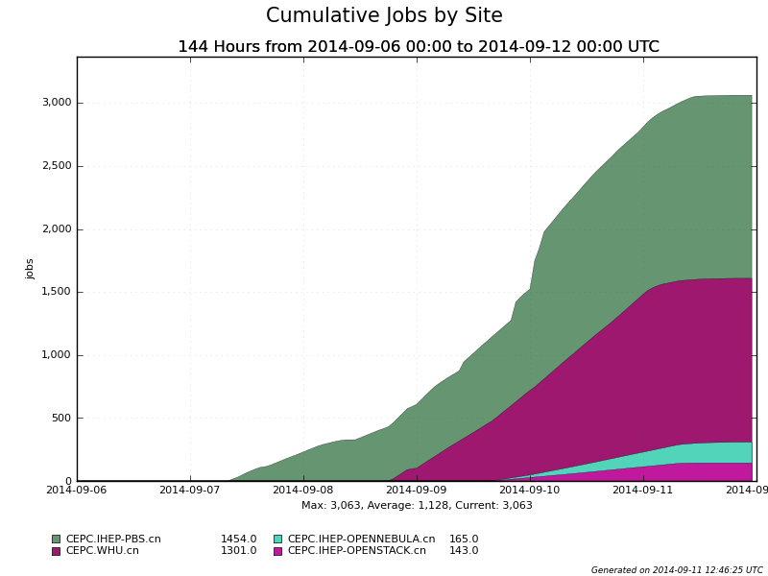
Testing Jobs Statistics (1/4)
3063 jobs
process: nnh
1000 events/job
full sim. + rec.

Slide 22
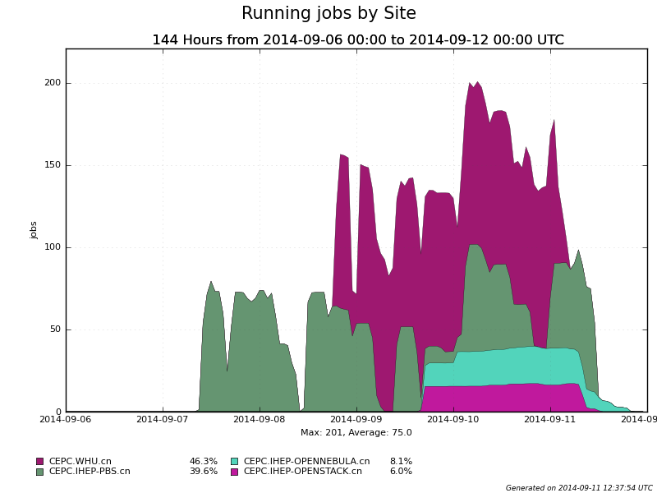
Testing Jobs Statistics (2/4)
2 cluster sites:
IHEP-PBS
WHU
2 cloud sites:
IHEP OpenStack
IHEP OpenNebula

Slide 23
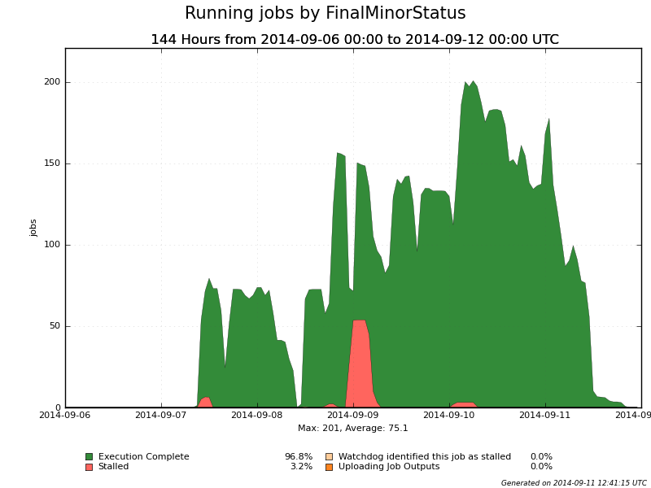
Testing Jobs Statistics (3/4)
96.8 % Success
3.2% job stalled because of PBS node down and network maintenance

Slide 24
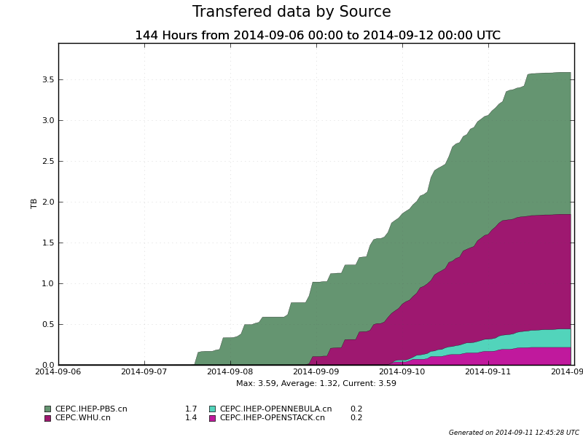
Testing Jobs Statistics (4/4)
3.59 TB output data uploaded to WHU SE
1.1 GB output/job
larger than typical BESIII job

Slide 25
To Do List
Further physics validation on current test-bed
Deploy remote mirror MySQL database
Develop frontend tools for physics users to deal with massive job splitting, submission, monitoring & data management
Provide multi-VO suport to manage BESIII&CEPC sharing resources if needed
Support user analysis

Slide 26
Summary
BESIII distributed computing has become a supplement to BESIII computing
CEPC simulation has been successfully done on CEPC-DIRAC test bed
Successful tests show that distributed computing could contribute resources to CEPC computing in early stage and even in future

Slide 27
Thanks
Thank you for your attention!
Q & A

