Slide 1

Superconducting RF Cavity and Power Source for CEPC
SUN Yi (孙毅), ZHAI Jiyuan (翟纪元), ZHOU Zusheng
(周祖圣) , ZHENG Hongjuan (郑洪娟) , GAO Jie (高杰)
IHEP
The 4th International Workshop on Future High Energy Circular Colliders
September 12-13, 2014, Shanghai

Slide 2
Outline
CEPC SRF system overview
Design criteria with New Technology
Cavity design
  RF power source
Technical challenges (HOM, coupler, industrialization)
Summary

Slide 3
CEPC SRF System
Layout and Parameters

Slide 4
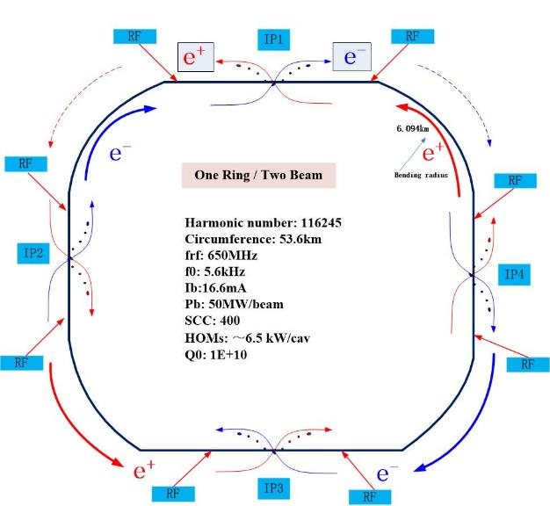
CEPC SRF System Layout
8 RF sections
In each ~ 150m section
Main ring:
- 12 x 8m cryomodules
- 650 MHz 5-cell SRF cavity
- 4 cavities / cryomodule
Booster:
- 4 x 12m cryomodules
- 1.3 GHz 9-cell SRF cavity
- 8 cavities / cryomodule
Superconducting RF Cavity
~ 20 x CW gradient
less disruption to beam
100s times more efficient
LLRF benefits
compared to normal conducting

Slide 5
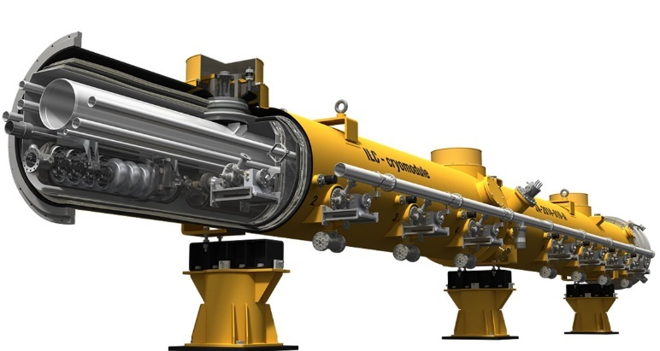
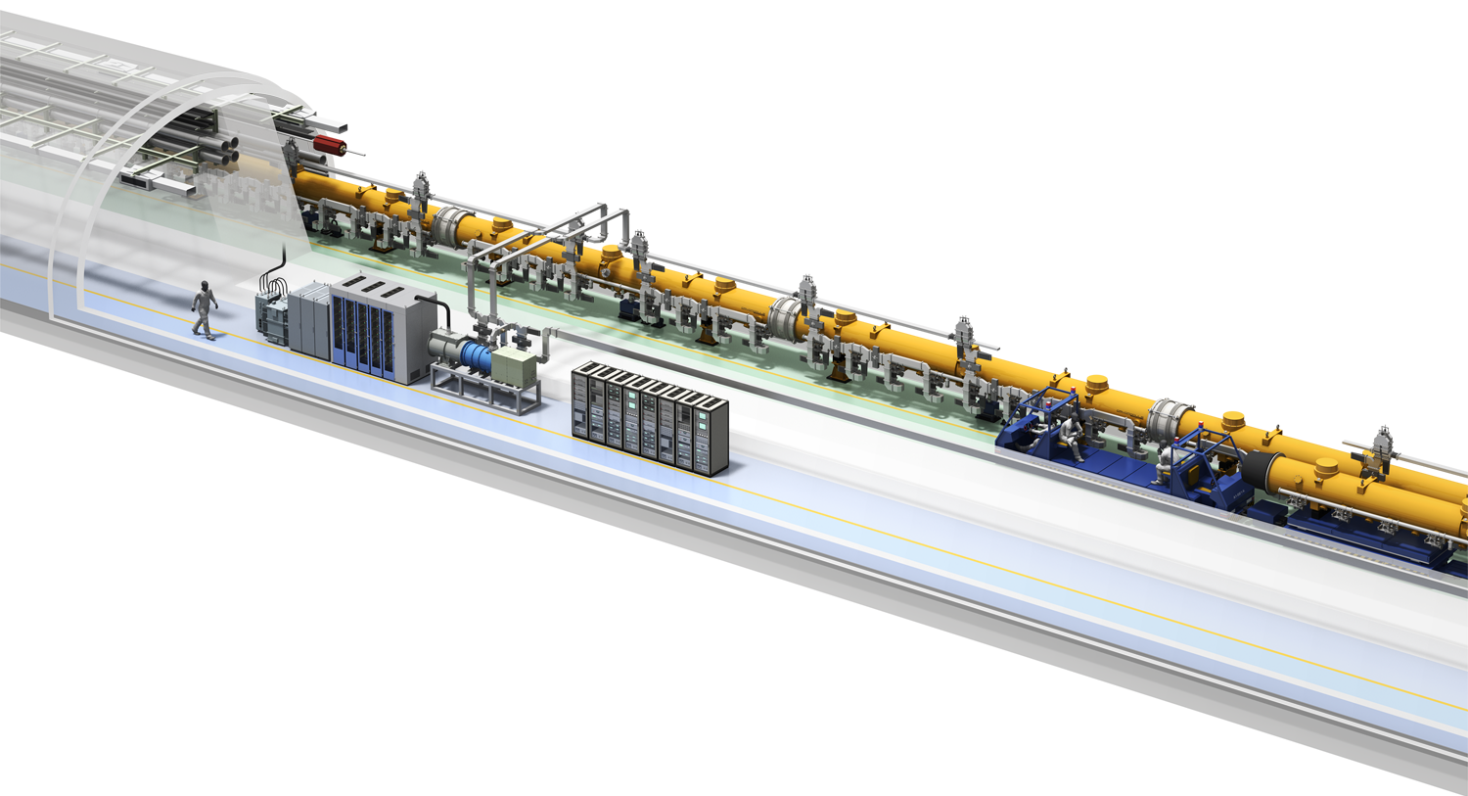
SRF Cryomodule

Slide 6
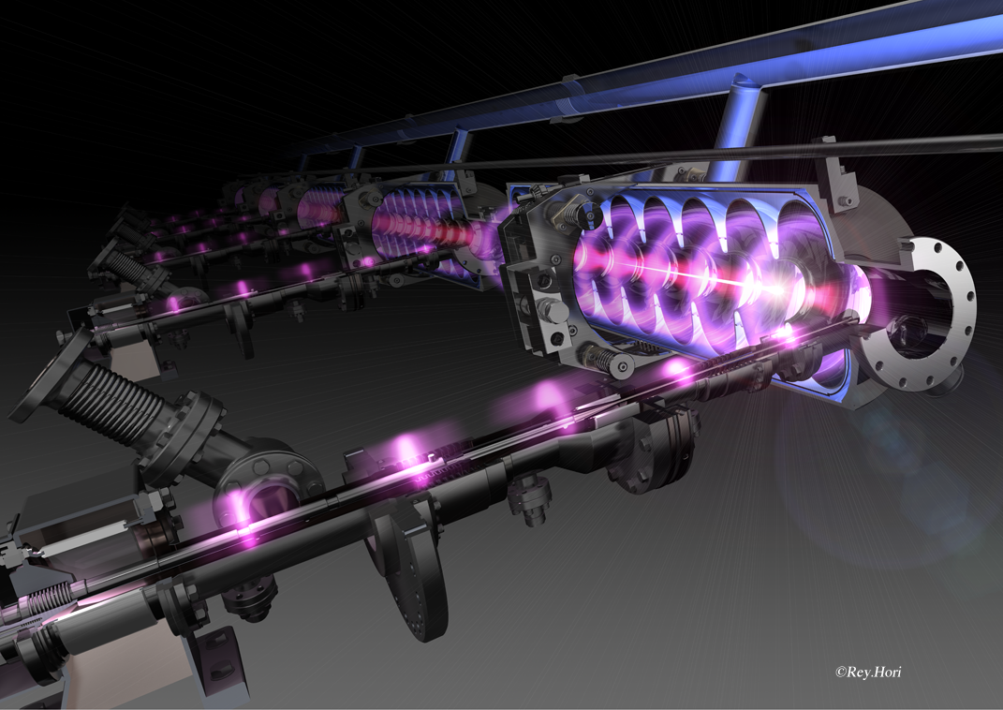
2 K superfluid liquid helium
Frequency tuner (fast and slow)
RF power coupler (with ceramic windows)

Slide 7
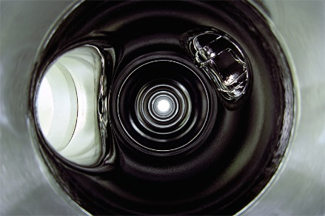
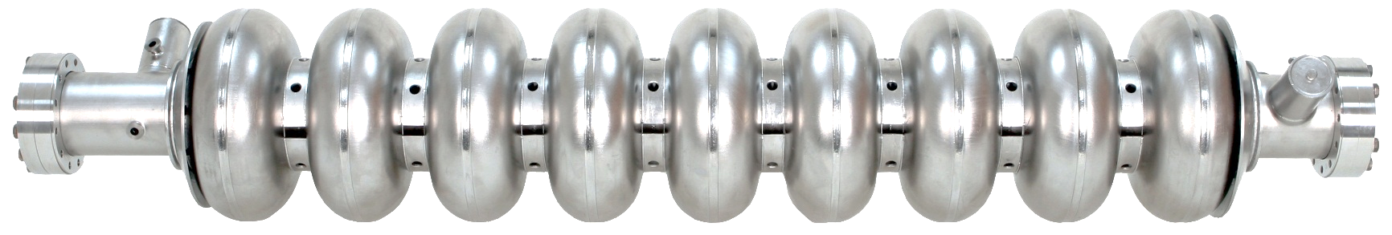
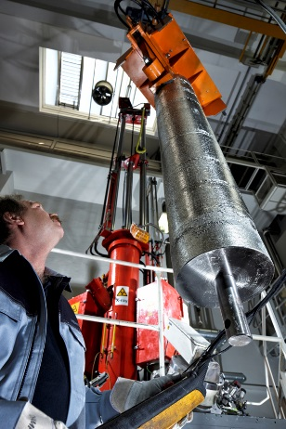
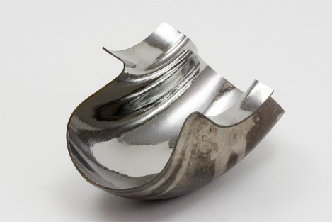
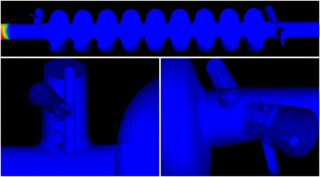
Superconducting Cavity and HOM Damper
High purity Niobium
more expensive than Silver
HOM damping, R/Q: HOM impact to the beam
Q ~ HOM power extracted or damping time

Slide 8
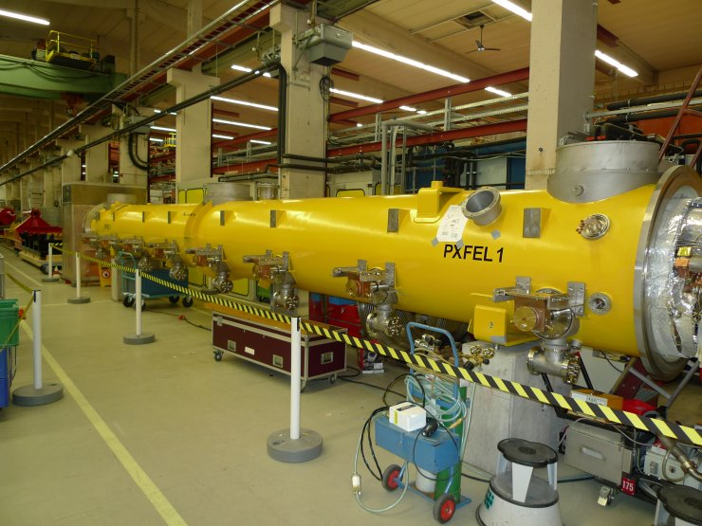
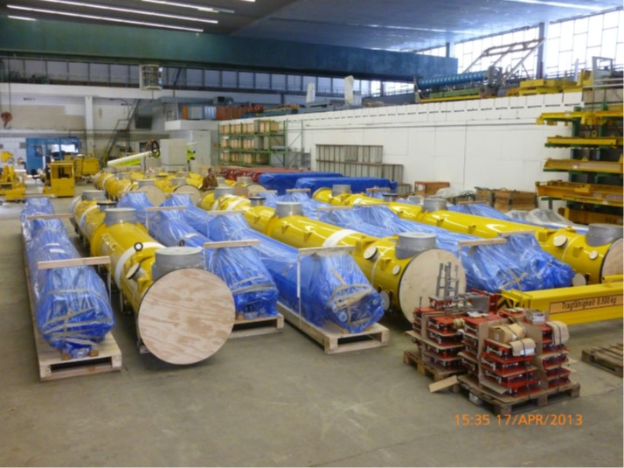
IHEP Cryomodules for Euro-XFEL
(60 12-meter-long modules)

Slide 9
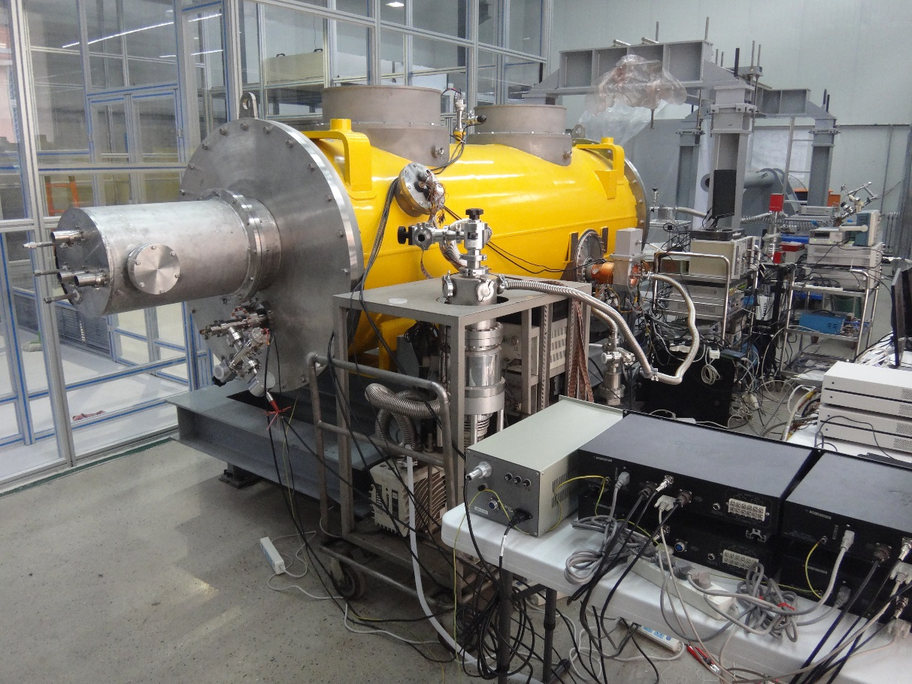
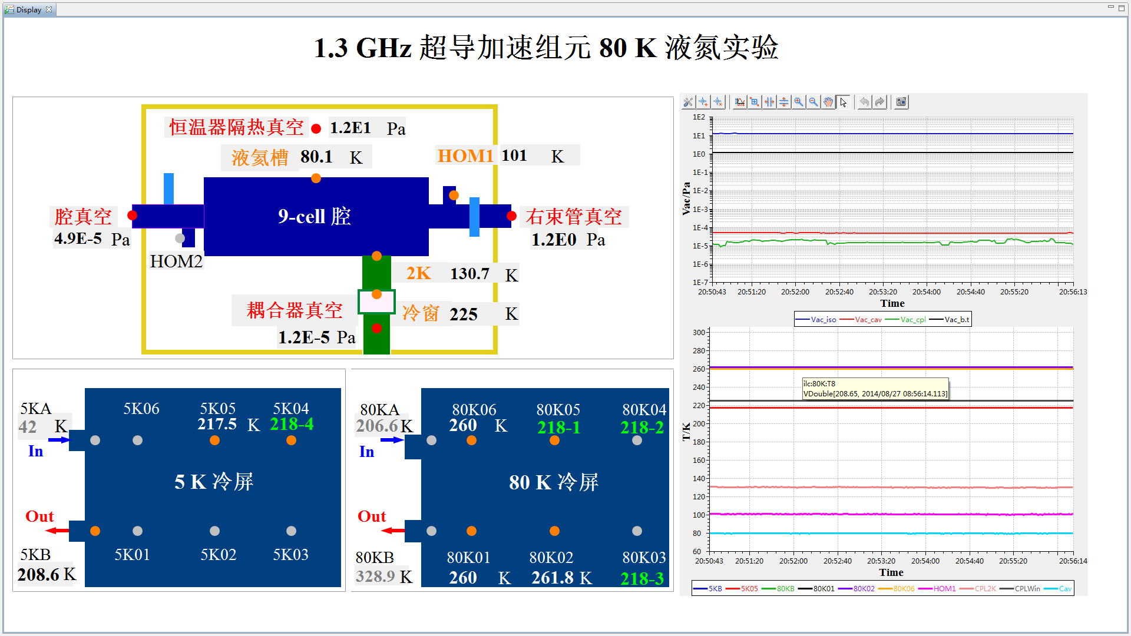
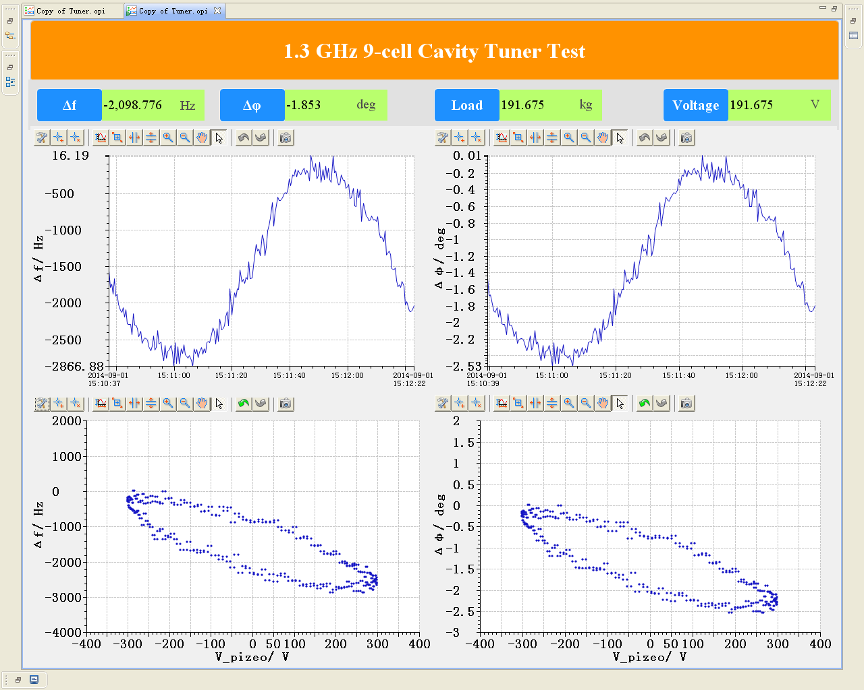
IHEP 1.3GHz 9-cell Cavity Module
Final assembly and liquid nitrogen 80K cooling down experiment

Slide 10
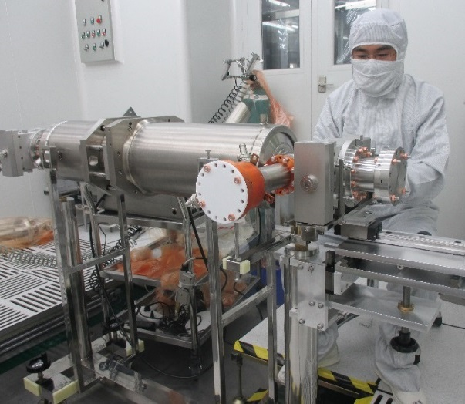
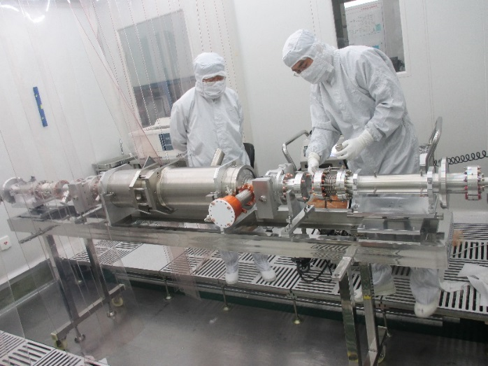
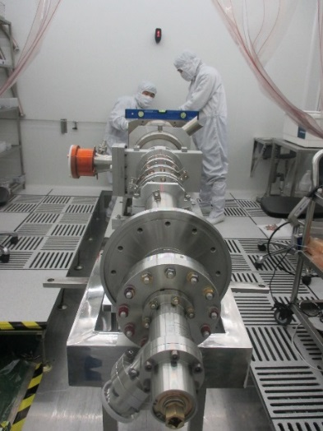
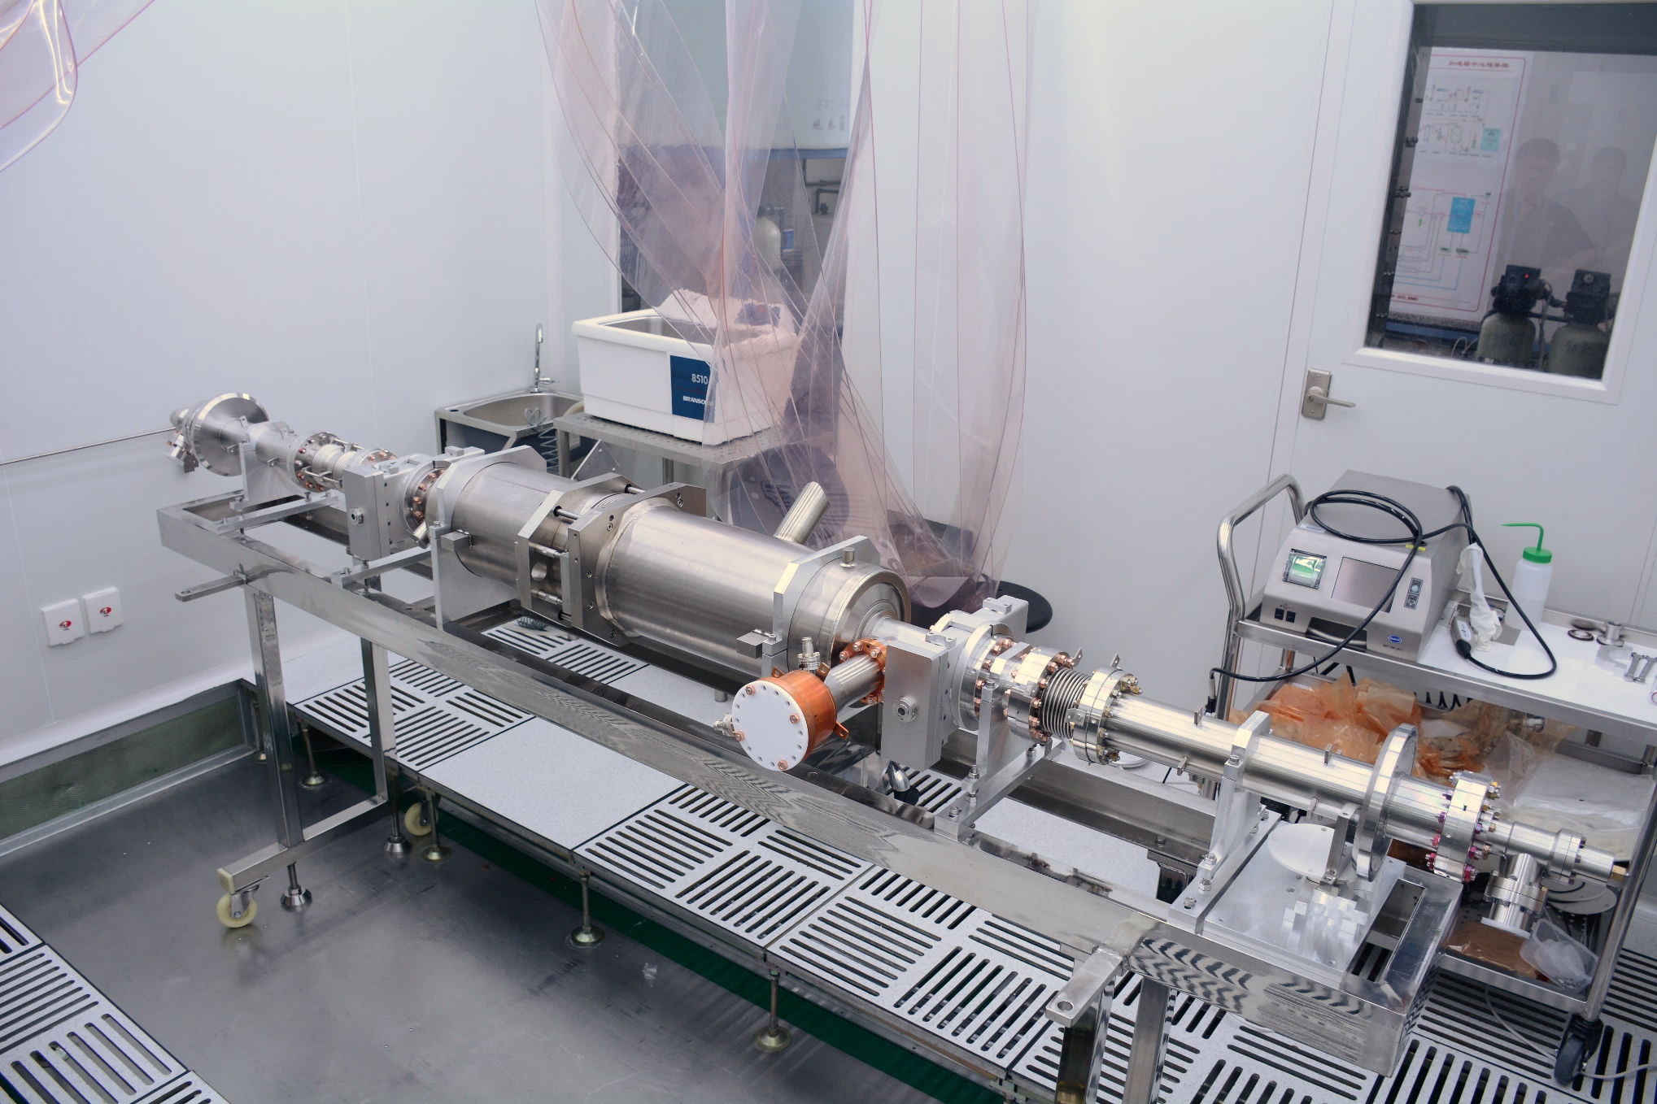
Cleanroom Assembly

Slide 11
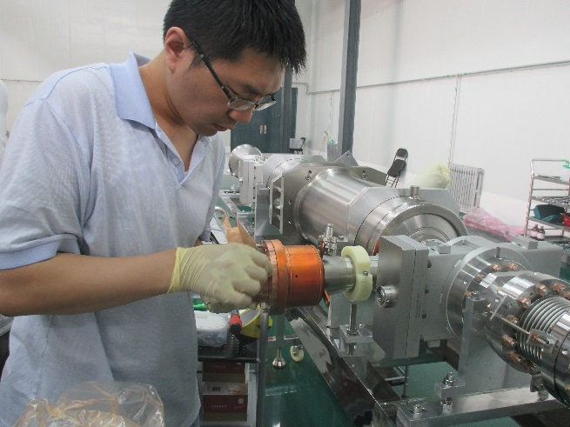
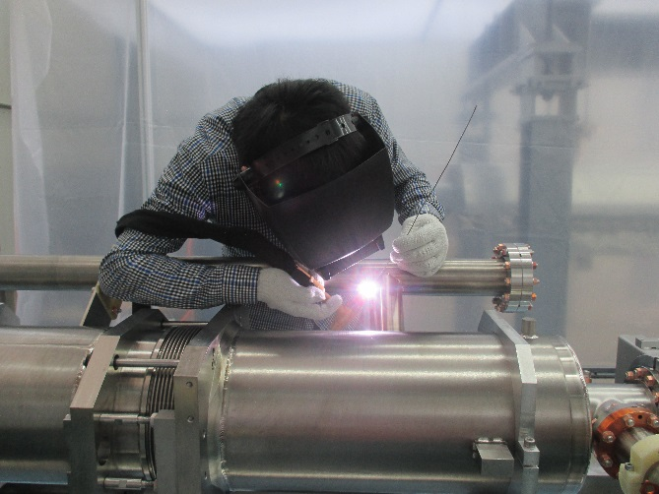
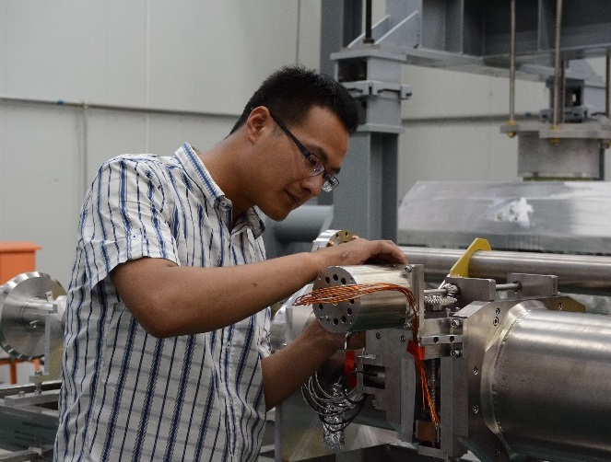
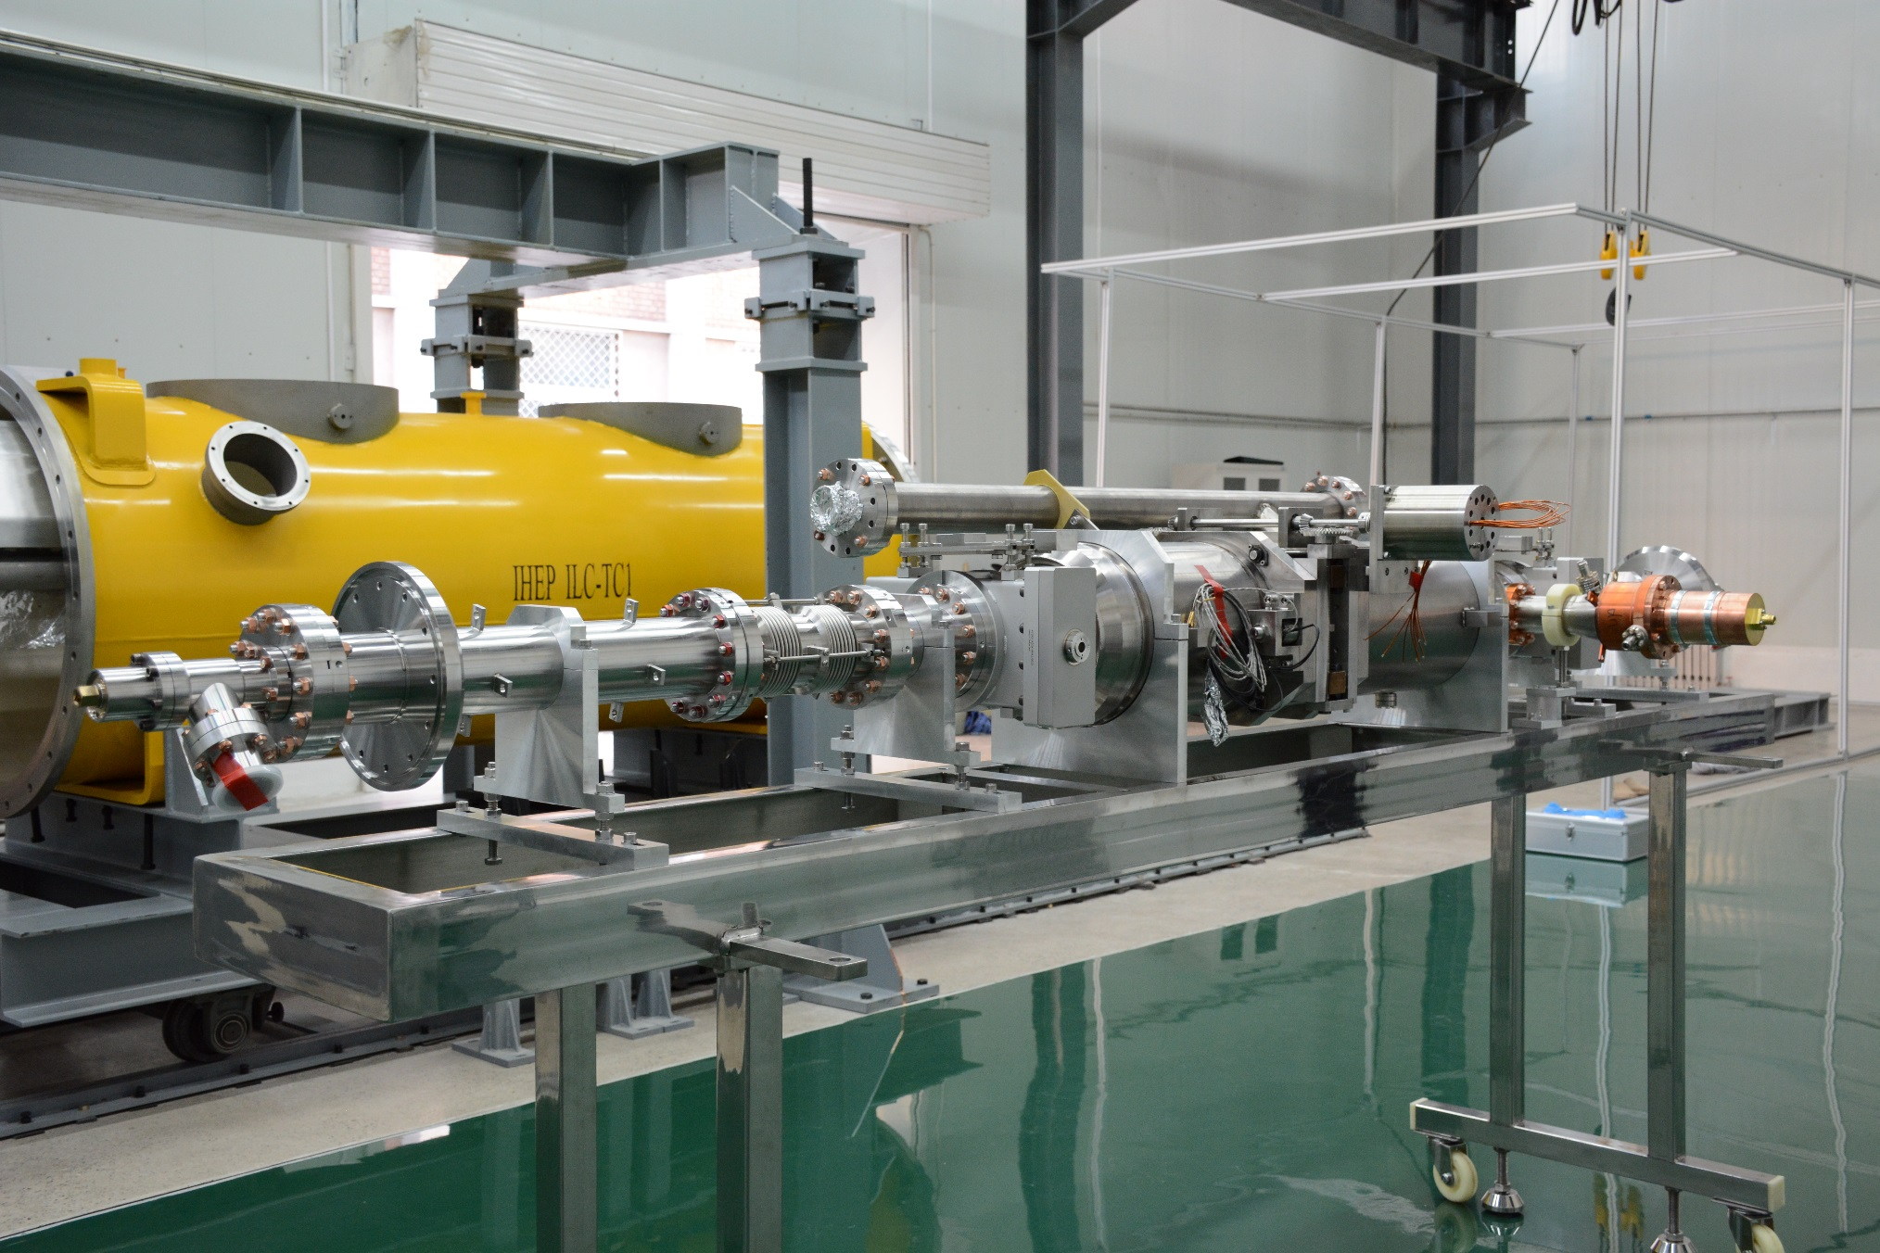
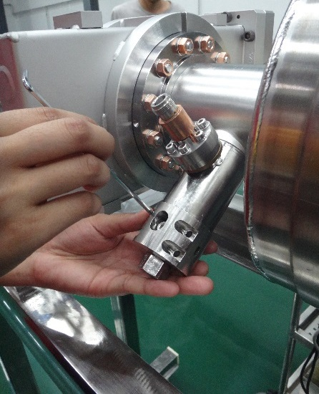
Coupler, 2K pipe, Tuner, HOM coupler

Slide 12
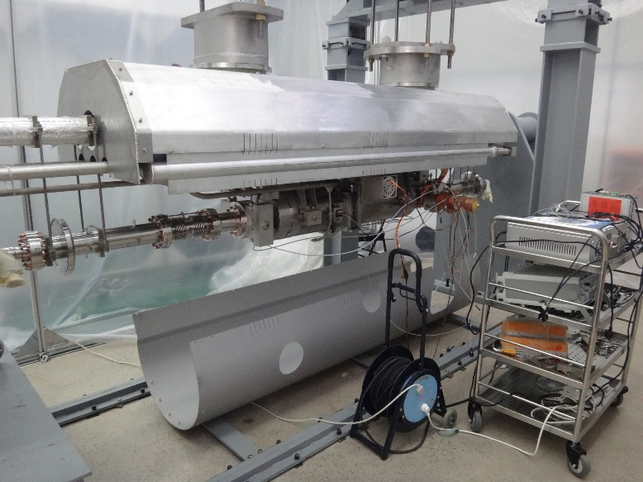
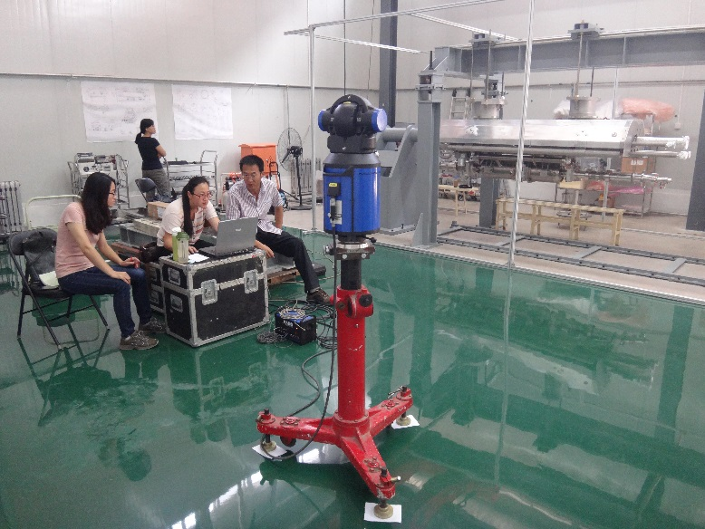
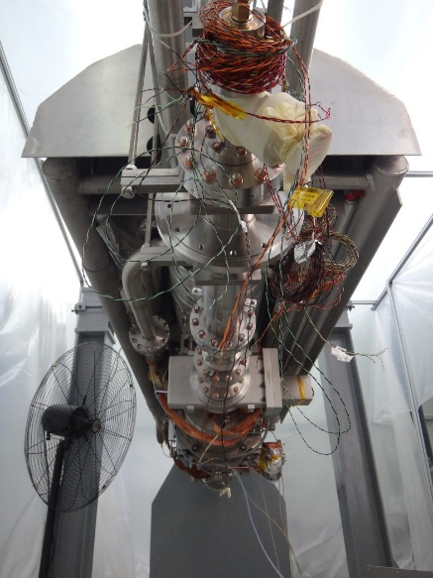
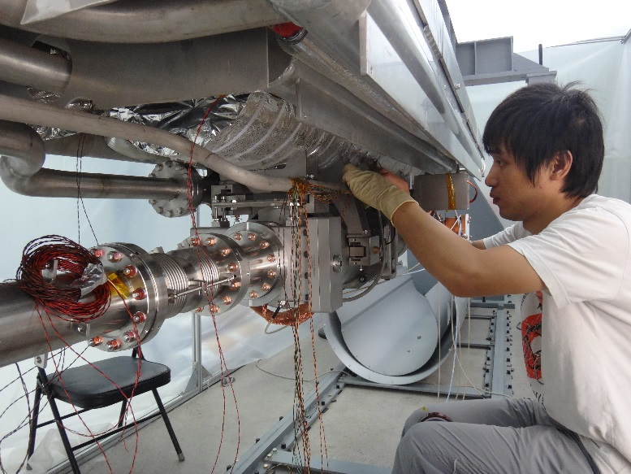
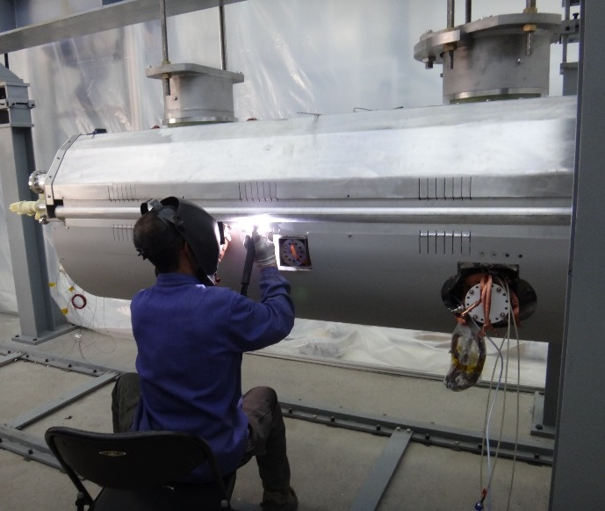
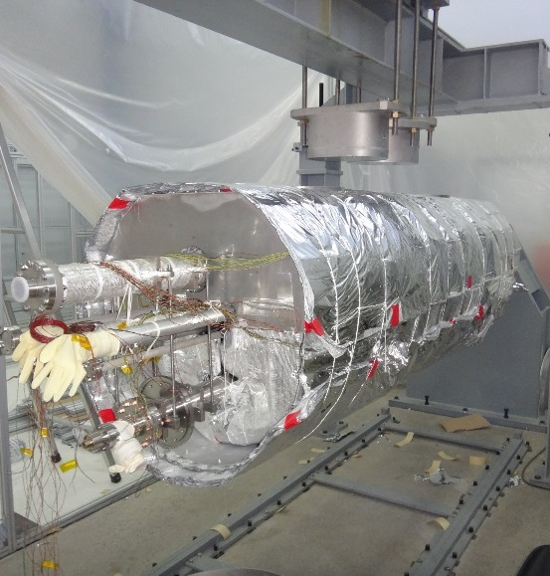
Cold Mass Assembly & Cavity Alignment

Slide 13
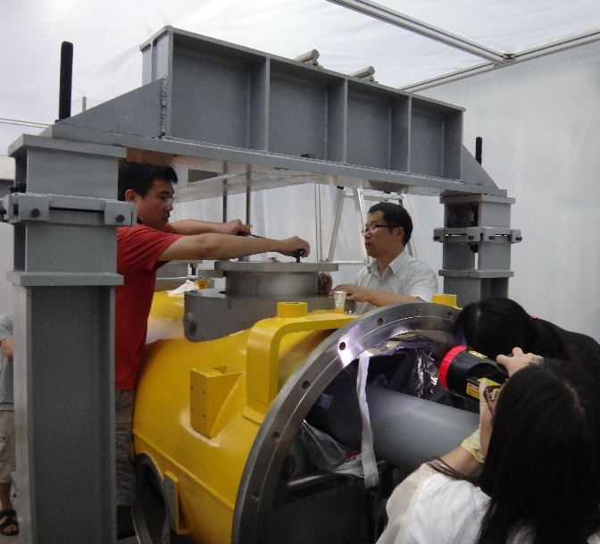
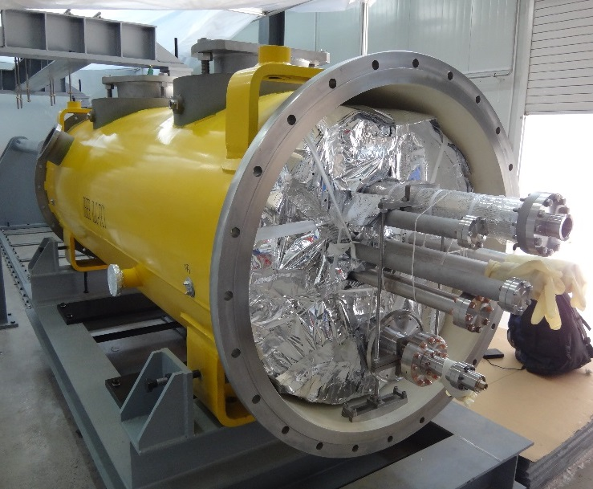
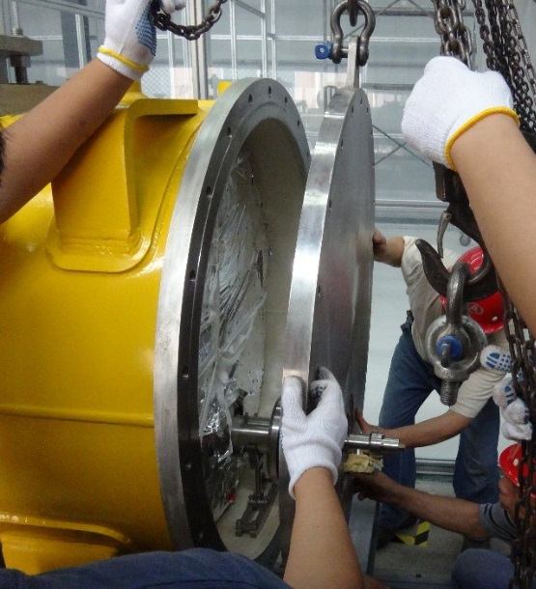
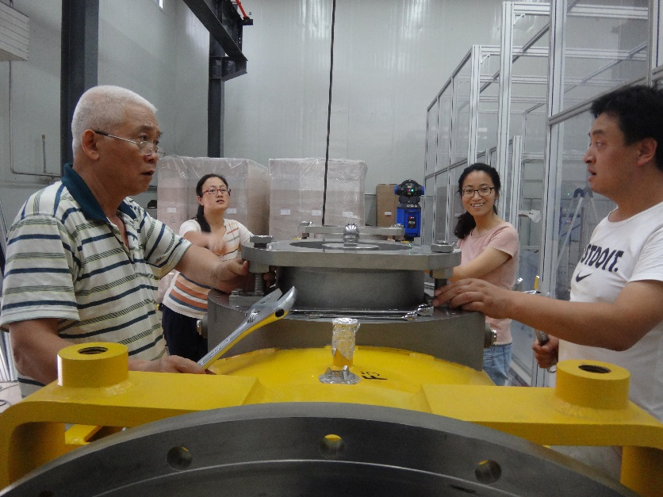
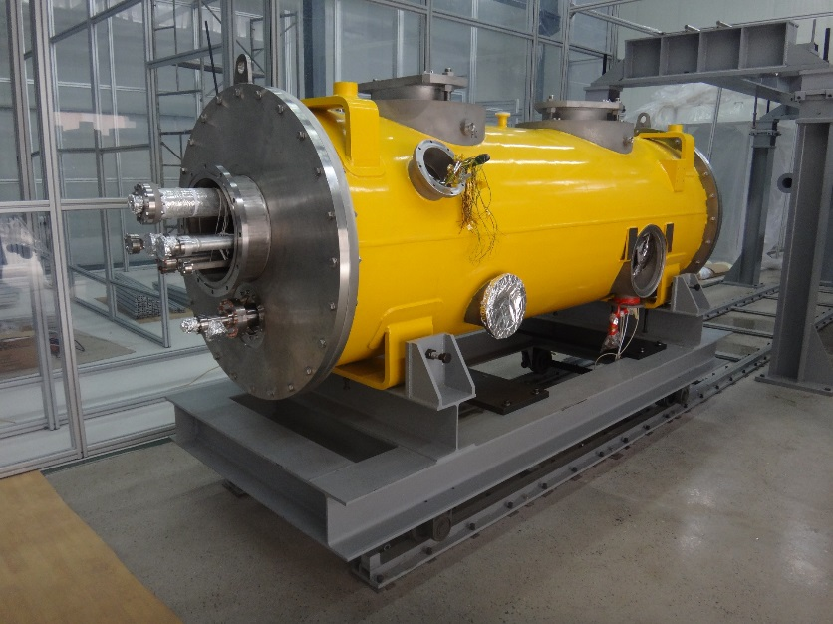
Vacuum Vessel Assembly and Alignment

Slide 14
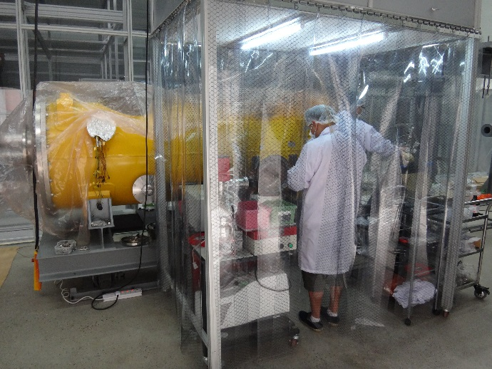
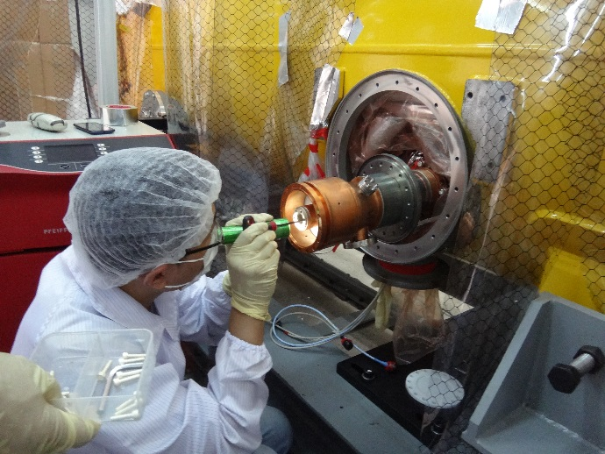
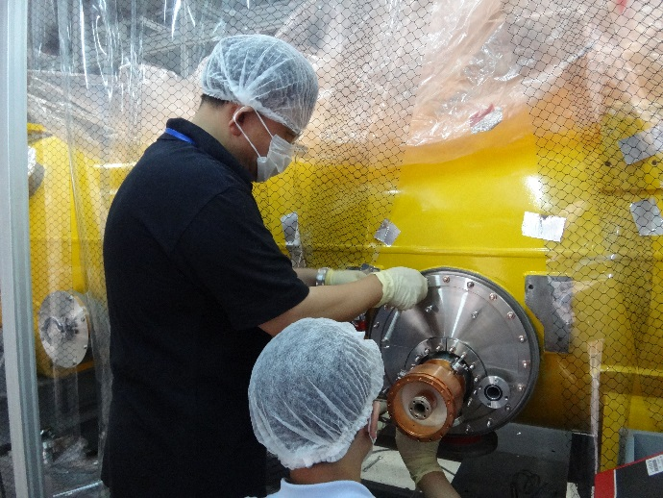
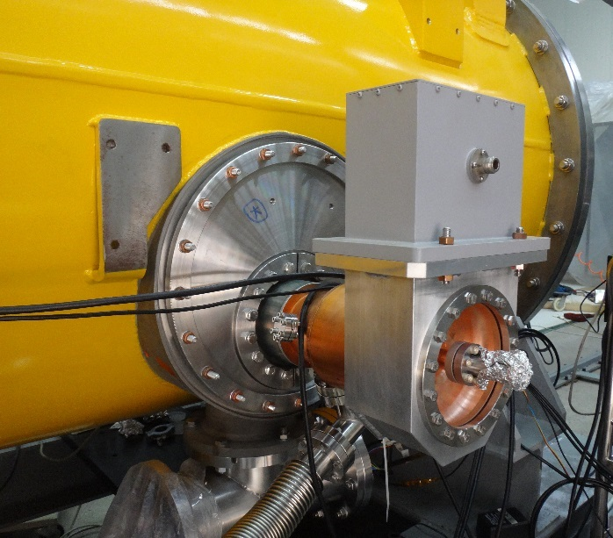
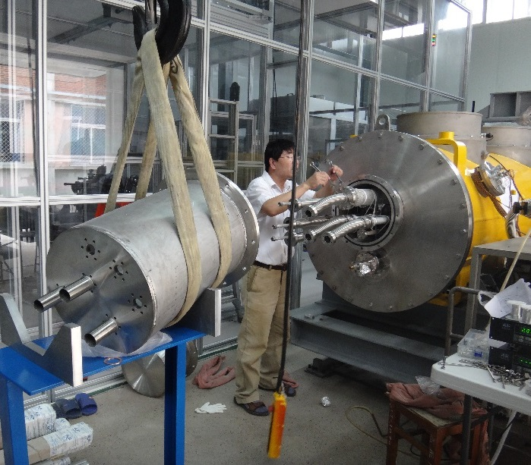
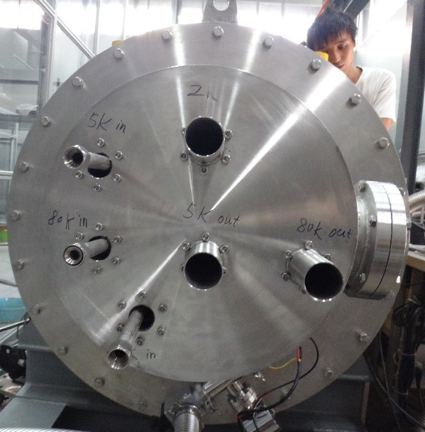
Warm Coupler and Interfaces

Slide 15
CEPC SRF System Parameters
Parameters | CEPC-Collider | CEPC-Booster | LEP2
Cavity Type | 650 MHz 5-cell Nb N-doped | 1.3 GHz 9-cell Nb N-doped | 352 MHz 4-cell Nb/Cu sputtered
Cavity number | 384 | 256 | 288
V_{cav} / V_{RF} | 18 MV / 6.87 GeV | 20 MV / 5.04 GeV | 12 MV / 3.46 GeV
E_{acc} (MV/m) | 15.5 | 20 peak | 6 ~ 7.5
Q₀ | 2(3)E10 @ 2K | 2E10 @ 2K | 3.2E+9 @ 4.2K
Cryo AC power (MW) | 20 | 2.5 (15% DF) | 6.1
Cryomodule number | 96 (4 cav) | 32 (8 cav) | 72 (4 cav)
RF input power / cav (kW) | 260 | 20 peak | 125
RF source number | 384 (300 kW kly) | 256 (25 kW SSA) | 36 (1.2 MW/8 cav)
RF AC power (MW) | 200 (260 installed) | 2.4 (15% DF) | 85
HOM damper power (W) | 26 k (ferrite+hook) | 5 (hook) (15% DF) | 300 (hook)

Slide 16
What’s NEW in CEPC SRF?
Breakthrough N-doping High Q Technology
  major discovery at FNAL in 2013, immediately used in LCLS-II
  save billions for CEPC, and SRF linacs (ADS, XFEL, ERL, ILC)
Most advanced Cavity Production and Preparation technique
  ILC-standard electro-polishing and high pressure rinsing process
  semiconductor-grade clean room assembly of 8~12 m cavity string
  world largest SRF infrastructures and talent pool for future accelerators
Most powerful, but remarkably power efficient accelerator
  create new technologies to power the beam & extract huge parasitic loss
  increase RF+Cryo AC to beam power efficiency > 50 %

Slide 17
What’s NEW in CEPC SRF?
Big jump from LEP2/BEPCII to CEPC
  10 ~ 30 x Q₀
  2 ~ 3 x E_{acc}
  3 ~ 8 x Cryogenic efficiency
Develop new Thin Film material as alternative for dramatically high Q (10¹¹) and high gradient (100 MV/m)
  completely change the landscape and application of SRF
  huge decrease in cryo plant cost and power consumption
  open up the route to green linear collider of > 3 TeV
  SRF science at IHEP

Slide 18
Design Criteria and Parameter Choice with New Technology

Slide 19
CEPC SRF System Design Criteria
￥
RF AC < 200 MW ?
PS Efficiency
￥
↑
η↑, τ_{BS} ↑, σ_{z}↓
Cavity Material
ρ = 6.1 km
q_{b} = 60 nC
P_{SR} 100 MW
f₀ = 5.6 kHz
V_{rf} 6.87 GeV
U₀ = 3 GeV
I = 33.3 mA
N_{b} = 50
Nb/Cu
↑
Thin Film
P_{coupler} < 300 kW
￥
H
Nb₃Sn/Nb
N_{cavity}
V_{c}
Q_{L}
↓
H
↓
Bulk Nb
N-dope
Impedance T.H.
N_{cell}
H
￥
L_{c}
f_{rf}
↓
C
↓
↓
H
R_{s}
T
HOM Power
E_{acc}
E_{p} B_{p}
↓
R_{iris}
H
↓
Q₀
2 K
↓
↑
Mode Propagate
HOM Q_{L}
HOM R/Q, k
H
R/Q
G
4.2 K
↓
↑
↑
HOM Damping
￥
H
Cavity Shape
￥
↓
V_{c}
N_{cav/module}
Dynamic Cryo Load
￥
Ferrite
Hook
WG
H
Cryo AC < 20 MW ?
N_{module}
Low loss
Large iris
H: handling or LLRF control

Slide 20
RF Frequency Choice
Energy acceptance (lower frequency)
Bunch Length (higher frequency)
HOM impedance and power (lower frequency, beam aperture)
Cavity size and cost (higher frequency)
Booster current 1/20 of collider (higher frequency)
Collider RF frequency harmonic of the booster
Use mature tech and synergy with other projects (ILC, XFEL, ADS…)
Thus
CEPC collider RF frequency = 650 MHz
CEPC booster RF frequency = 1.3 GHz
But, booster has lower energy and radiation damping =>
Analyze beam instability caused by the 1.3 GHz cavity (WANG Na’s talk)

Slide 21
Cavity Number and Gradient Choice
Within the reasonable gradient, main ring cavity number is limited by the input coupler power handling capability.
If coupler power ~ 156 kW (BEPCII level)
  640 cavities, 10.7 MV (5-cell 9.3 MV/m, if 4-cell 11.6 MV/m)
  4 cav / mod, 160 cryomodules, 20 mod / RF section
If coupler power ~ 260 kW (KEKB 380 kW, LHC 300 kW)
  baseline
  384 cavities, 18 MV (5-cell 15.5 MV/m, if 4-cell 19.5 MV/m)
  4 cav / mod, 96 cryomodules, 12 mod / RF section
  KEKB and LHC coupler number ~ 10

Slide 22
Coupler Power Handling Capability
Impact on Main Ring Cost and Risk
Coupler Power (kW) | E_{acc} (MV/m) | Cavity # | Module Cost (Billion CNY)
156 | 9.3 | 640 | 2.6
260 | 15.5 | 386 | 1.5
330 | 19.7 | 302 | 1.2
4M CNY / cavity (including coupler, tuner , LLRF, cryomodule, etc)
Balance and optimize: coupler high power yield and operation risk, module and power distribution cost reduction, cavity operation margin risk, cryogenic installation and operation cost (due to Q-drop, field emission, gradient change), ring impedance …

Slide 23
650 MHz Cavity Q₀ Choice
Q₀ | Installed 4K equiv. (kW) | Cryo installed power (MW) | Cryo-system Cost (Billion CNY)
3.0E+10 | 76 | 16 | 1.6
2.0E+10 | 95 | 20 | 2.0
1.0E+10 | 155 | 34 | 3.4
5.0E+09 | 273 | 60 | 6.0
E_{acc} = 15.5 MV/m, 384 cavities, 21M CNY / kW 4K equiv. cryo-system
Note: ILC 500GeV machine installed cryo AC power 45 MW

Slide 24
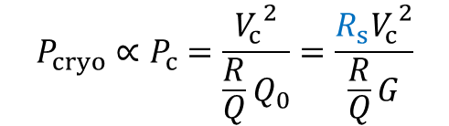


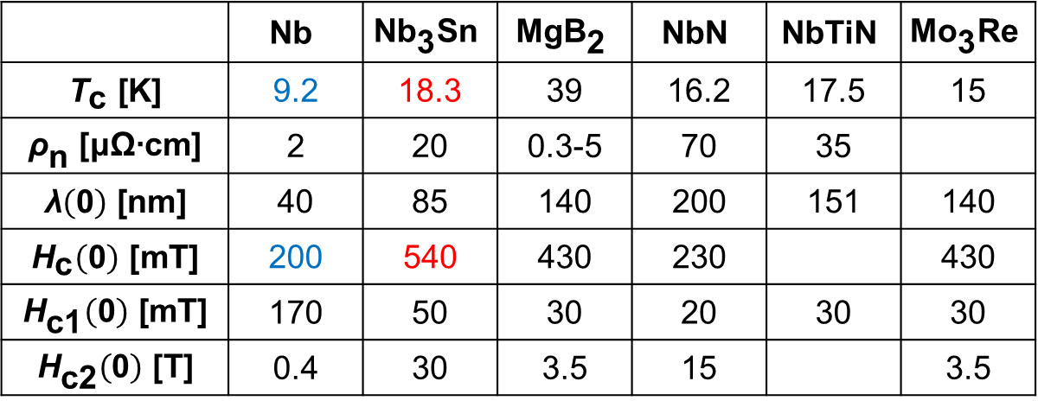

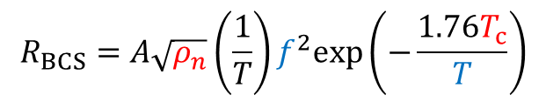
Theoretical limit of Cavity Gradient and Q
$$E_{acc}∝\frac{H_{c}}{λ}$$
$$Q_{0}=\frac{G}{R_{s}}$$
$$R_{s}=R_{BCS}+R_{res}+R_{m}$$
$$R_{BCS}=A\sqrt{ρ_{n}}\left(\frac{1}{T}\right)f^{2}exp\left(−\frac{1.76T_{c}}{T}\right)$$
$$P_{cryo}∝P_{c}=\frac{{V_{c}}^{2}}{\frac{R}{Q}Q_{0}}=\frac{{{R_{s}V}_{c}}^{2}}{\frac{R}{Q}G}$$
$$R_{m}=0.3 (nΩ)∗B_{ext} (mG)\sqrt{f(GHz)}$$
Possible Superconducting Material for RF Cavity (s-wave only)
 | $$\text{Nb}$$ | $${\text{Nb}}_{\text{3}}\text{Sn}$$ | $$\text{Mg}{\text{B}}_{\text{2}}$$ | $$\text{NbN}$$ | $$\text{NbTiN}$$ | $${\text{Mo}}_{\text{3}}\text{Re}$$
$${\text{T}}_{\text{c} }\text{[}\text{K}\text{]}$$ | 9.2 | 18.3 | 39 | 16.2 | 17.5 | 15
$${\text{ρ}}_{\text{n} }\text{[}\text{μΩ}\text{∙}\text{cm}\text{]}$$ | 2 | 20 | 0.3-5 | 70 | 35
$$\text{λ}\left(\text{0}\right) \text{[}\text{nm}\text{]}$$ | 40 | 85 | 140 | 200 | 151 | 140
$${\text{H}}_{\text{c}}\left(\text{0}\right) \text{[}\text{mT}\text{]}$$ | 200 | 540 | 430 | 230 |  | 430
$${\text{H}}_{\text{c}\text{1}}\left(\text{0}\right) \text{[}\text{mT}\text{]}$$ | 170 | 50 | 30 | 20 | 30 | 30
$${\text{H}}_{\text{c}\text{2}}\left(\text{0}\right) \text{[}\text{T}\text{]}$$ | 0.4 | 30 | 3.5 | 15 |  | 3.5
↑
↓
↓
↑

Slide 25
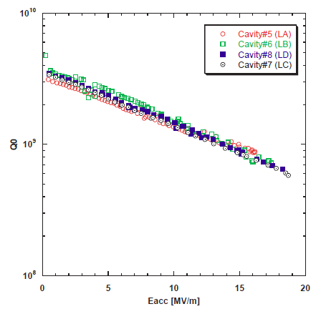
LEP-II sputtered 352 MHz 4.2K
KEKB bulk 500 MHz 4.2K
extrapolated
CEPC sputtered 650 MHz 4.2K
Q = 8E8 at 10 MV/m, too low!
600 cavities
CEPC bulk 650 MHz 4.2K
Q = 5E8 at 15 MV/m
If very clean, Q=1E9 at 15 MV/m
~ 4 times cryo-plant cost and power
~ 1.6 times cavity cost
~ + billions of CNY
~ 5 times cryo-plant cost and power
~ + billions of CNY
Baseline for Main Ring
384 cavities
η (4.2K/2K) = 3.6
CEPC bulk 650 MHz 2K
Q = 2E10 at 15 MV/m
even Q=1E10 still gain a lot
How to guarantee 2E10 or even higher at 2K?
Can we increase thin film Q at 4.2K?
Beyond normal recipe and Nb

Slide 26
FNAL 650 MHz Cavity
CEPC
Bp/Eacc=3.75
CEPC cavity with large iris Bp/Eacc = 4.2
Melnychuk, IPAC2014

Slide 27
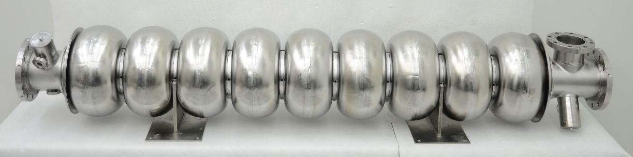
IHEP 1.3 GHz and 650 MHz Cavity
1.3 GHz 9-cell cavity vertical test (VT) in 2013. In module horizontal test (HT), the cavity performance will have degradation.
 | ILC TC-1 | CEPC
VT E_{acc} | 20 MV/m | 22 MV/m
VT Q₀ | 1.4E10 | 3E10
HT E_{acc} | 18 MV/m | 20 MV/m
HT Q₀ | 1E10 | 2E10
ADS 650 MHz β=0.82 5-cell cavity
Vertical test soon

Slide 28
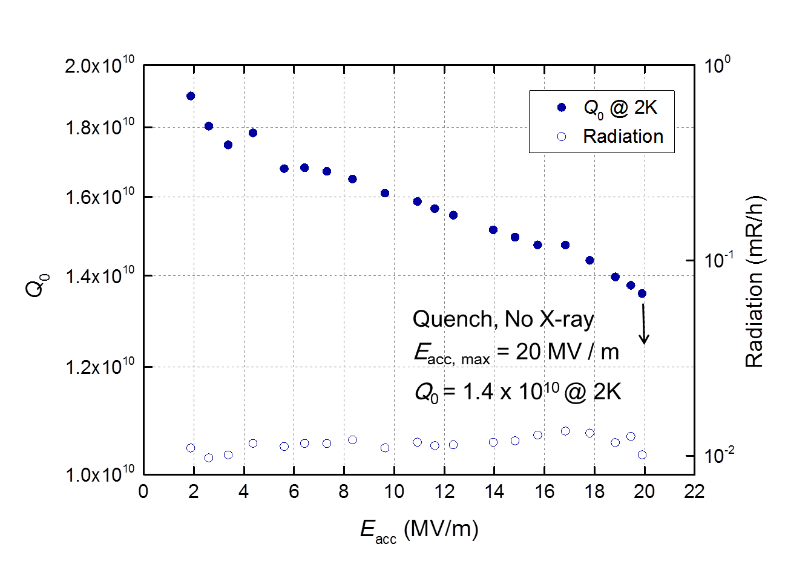
Cavity Q performance with
“ILC standard” surface processing recipe
IHEP 1.3GHz 9-cell Cavity test at 2013
theoretical limit

Slide 29
Nb N-Doping and Flux Expulsion
Two major discoveries at Fermilab
Nitrogen doping to lower the BCS surface resistance
  Lower than the previously perceived “theoretical limit”
  Example at 16 MV/m: Q > 3x10¹⁰ by doping vs Q ~ 1.5x10¹⁰ with the standard ILC/XFEL cavity processing
  Also lowers residual
Effective magnetic flux expulsion by fast/high thermal gradient cooldown around Tc, drastically affects the Meissner effect and achieve record low residual resistances
  Example: Q = 2.7x10¹¹ in 27 mG ambient field (only 2 W is needed to excite 15 MV/m e-field for CEPC 5-cell cavity)
  Relax very tight magnetic shield for high Q operation, otherwise high Q is not usable in real accelerator

Slide 30
2x higher Q leads to a factor of 2 decrease in required refrigeration => 1 cryoplant less => 50-100M$ in capital costs + 10s of M$ in operational costs

Slide 31
LEP-II sputtered 352 MHz 4.2K
KEKB bulk 500 MHz 4.2K
extrapolated
CEPC sputtered 650 MHz 4.2K
Q = 8E8 at 10 MV/m, too low!
600 cavities
CEPC bulk 650 MHz 4.2K
Q = 5E8 at 15 MV/m
If very clean, Q=1E9 at 15 MV/m
~ 4 times cryo-plant cost and power
~ 1.6 times cavity cost
~ + billions of CNY
~ 5 times cryo-plant cost and power
~ + billions of CNY
Baseline for Main Ring Cavity
384 cavities
η (4.2K/2K) = 3.6
CEPC bulk 650 MHz 2K
Q = 2E10 at 15 MV/m
even Q=1E10 still gain a lot
How to guarantee 2E10 or even higher at 2K?
Can we increase thin film Q at 4.2K?
Beyond normal recipe and Nb

Slide 35
Nb₃Sn Impact on CEPC 650 MHz cavity
Coupler 156kW, 600 cavities, 10MV/m, 4.2K, Q=4E10 (R_{BCS}~f ² )
  Cryogenic power 1/10 of the baseline, save ~ 1.6B CNY
  But 200 more cavities ~ add 0.8B, so net save 0.8B
  If further R&D to 15 MV/m, 4.2K, 4E10, save 1.6B
In ideal case, Nb₃Sn 25MV/m, 4.2K, 4E10, coupler 420kW, 140 less cavities save 0.6B + cryo save 1.6B = 2.4B
Seems not big amount for CEPC, but for a 7GeV CW XFEL or ERL, save 1/3~1/2 capital cost and 2/3 power consumption
Problem with Nb₃Sn at high field is its low thermal conductivity compared to Nb (1/1000). Overheating. R&D needed.

Slide 36
CEPC SRF Cavity Design

Slide 37
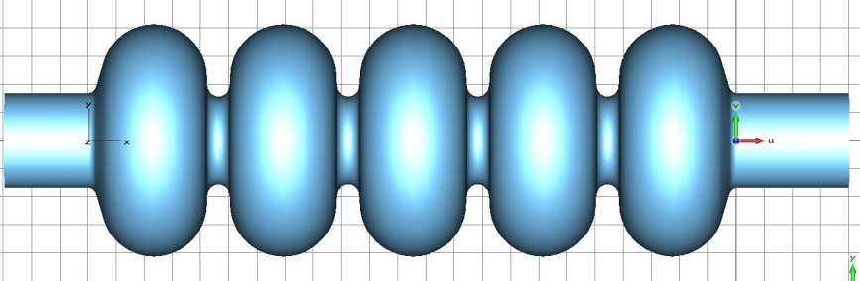
650 MHz 5-cell Cavity
Need further shape optimization, especially for the HOM properties
 | internal | Left end half cell | Right end half cell
Riris(mm) | 77.96 | 84.46 | 84.46
Alpha(deg) | 2.24 | 16.727 | 16.39
A(mm) | 94.4 | 92.1 | 91
B(mm) | 94.4 | 92.1 | 91
a(mm) | 20.03 | 13.76 | 13.71
b(mm) | 22.09 | 21.14 | 20.29
L(mm) | 115 | 114 | 113
D(mm) | 206.6 | 206.6 | 206.6
flatness | 2.17%
coupling | 3.04%
Ep/Eacc | 2.43
Hp/Eacc [mT/(MV/m)] | 4.23

Slide 38
650 MHz 5-cell Cavity Parameters
Parameter | Symbol | Unit | Value
RF frequency | f_{RF} | MHz | 650
RF voltage | V_{RF} | GV | 6.87
Cavity gradient | E_{acc} | MV/m | 15.6
Effective length (five cells) | L_{eff} | m | 1.147
Cavity voltage | V_{c} | MV | 18
Number of cavities |  |  | 384
Cavities in one cryomodule |  |  | 4
Cryomodule length |  | m | 8
Number of cryomodules |  |  | 96
R/Q | R/Q | Ω | 514
Geometry factor | G | Ω | 268
Iris diameter |  | mm | 156
Quality factor | Q₀ |  | 2~3×10¹⁰
External Q of input coupler | Q_{ext} |  | 2.4×10⁶
RF power per cavity | P_{in} | kW | 260
Cavity longitudinal loss factor※ | k∥ | V/pC | 1.87
Cavity transverse loss factor※ | k⊥ | V/pC m | 10
18 MV/m for vertical test
3~4×10¹⁰ for Vertical Test
※ σ_{z} = 2.66 mm

Slide 39
650 MHz Cavity Impedance Budget

Slide 40
650 MHz 5-cell Cavity HOMs
Monopole Mode | f (GHz) | R/Q (Ω) * | Q_{L} Limit
TM011 | 1.173 | 84.8 | 2.54E+5
TM020 | 1.427 | 54.15 | 3.28E+5
Dipole Mode | f (GHz) | R/Q (Ω/m)** | Q_{L} Limit
TE111 | 0.824 | 832.23 | 1.13E+4
TM110 | 0.930 | 681.15 | 1.39E+4
TE122 | 1.232 | 544.5 | 1.73E+4
TM112 | 1.440 | 101.53 | 9.3E+4
* k_{∥mode} = 2πf ·(R/Q) / 4 [V/pC]
** k_{⊥mode} = 2πf ·(R/Q) / 4 [V/(pC·m)]

Slide 41
1.3 GHz 9-cell Cavity Parameters
Parameter | Symbol | Unit | Value
RF frequency | f_{RF} | GHz | 1.3
RF voltage | V_{RF} | GV | 5.04
Cavity gradient | E_{acc} | MV/m | 20
Effective length (nine cells) | L_{eff} | m | 1.038
Cavity voltage | V_{c} | MV | 20
Number of cavities |  |  | 256
Cavities in one cryomodule |  |  | 8
Cryomodule length |  | m | 12
Number of cryomodules |  |  | 32
R/Q | R/Q | Ω | 1036
Geometry factor | G | Ω | 270
Iris diameter |  | mm | 70
Quality factor | Q₀ |  | 2×10¹⁰
External Q of input coupler | Q_{ext} |  | 1×10⁷
RF power per cavity | P_{in} | kW | 20
Lorentz force detuning factor | k_{L} | Hz/(MV/m)² | 1
Cavity longitudinal loss factor※ | k∥ | V/pC | 5.8
Cavity transverse loss factor※ | k⊥ | V/pC m | 25
Over-coupled for larger BW
※ σ_{z} = 3.89 mm

Slide 42
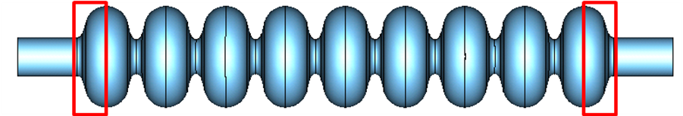
1.3 GHz 9-cell Cavity HOMs
Monopole Mode | f (GHz) | R/Q (Ω) * | Q_{L} measured
TM011 | 2.450 | 156 | 58600
TM012 | 3.845 | 44 | 240000
Dipole Mode | f (GHz) | R/Q (Ω/m)** | Q
TE111 | 1.739 | 4283 | 3400
TM110 | 1.874 | 2293 | 50200
TM111 | 2.577 | 4336 | 50000
TE121 | 3.087 | 196 | 43700
* k_{∥mode} = 2πf ·(R/Q) / 4 [V/pC]
** k_{⊥mode} = 2πf ·(R/Q) / 4 [V/(pC·m)]

Slide 43
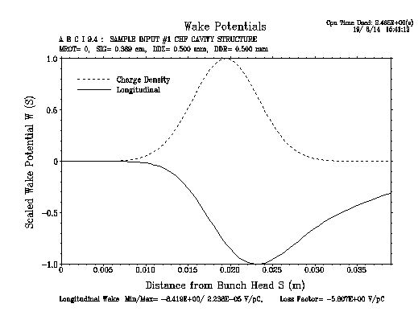
1.3 GHz Cavity Impedance Budget
R per cavity is 267 Ω
Transverse impedance threshold
Cavity Impedances close to the budget upper limit,
more serious at low energy. But HOM frequency spread will relax it.

Slide 44
  RF Power Source

Slide 45
Booster RF Power Source
256 1.3GHz 9-cell cavities, 20 MV/m, 20 kW
Solid State Amplifier (SSA)
1.3 GHz 25 kW, one per cavity
mature technology, 80 CNY/W
SSA 2M + LLRF 0.4M + distribution 0.4M
Booster PS unit cost: 2.8M CNY
Booster PS total cost: 0.72B CNY
Installed RF AC Power 6.4 MW
Average RF AC Power ~ 1 MW (15% DF)
ELBE 2×10 kW SSA combined @IPAC2014

Slide 46
Main Ring RF Power Source
384 650MHz 5-cell cavities, 15.5 MV/m, 260 kW
300 kW CW Klystron
R&D on 300kW SSA (based on ADS 650MHz 150kW SSA)
 | Klystron | SSA
Total efficiency | 50% | 40%
Beam power (MW) | 100 | 100
AC power (MW) | 200 | 250
AC power required (MW) 30% redundant, refer to BNL | 260 | 325
  Note: total AC power of 250 GeV center-of-mass ILC : 100 MW
  and Beijing city peak power load: 20000 MW (1 kW per person)

Slide 47
Power Source Choice and R&D
Main ring klystron PS unit cost: 300kW Klystron 3M CNY + PSM 2.5M+ LLRF0.4M + power distribution 2.5M = 8.4M CNY
Main ring klystron power source total: 3.36B CNY
Main ring SSA PS unit cost: 300kW SSA 12M CNY(40 CNY/W) + LLRF0.4M + power distribution 0.5M = 12.9M CNY
Main ring SSA power source total: 5.16B CNY
Klystron as baseline for CEPC main ring
Increase power efficiency!
R&D to reduce the klystron & SSA unit cost

Slide 48
SRF Technical Challenges

Slide 49
HOM Power of the Collider
 | CEPC Collider | LEP2
Loss factor (HOM) V/pC | 3.29 | 0.66 |  | below cut-off | above cut-off
 |  |  |  | 0.22 | 0.44
HOM power per cavity | 6.51 kW | Operation 66nC 2*4 bunches | 300W | 100 W | 200 W
 |  | Design 100nC 2*36 bunches | 6.6kW | 2.2 kW (LHC 1 kW) | 4.4 kW
1 ~ 2 kW extracted by the HOM coupler technically possible (LEP and LHC) |  |  |  | KEKB | 16 kW
 |  |  |  | SuperKEKB | 40 kW
Add the broad band loss, 4 cavity module will generate ~ 40 kW HOM power
A small fraction of power extracted by HOM coupler, most HOM power propagates in the cavities and finally go outside of the module.

Slide 50
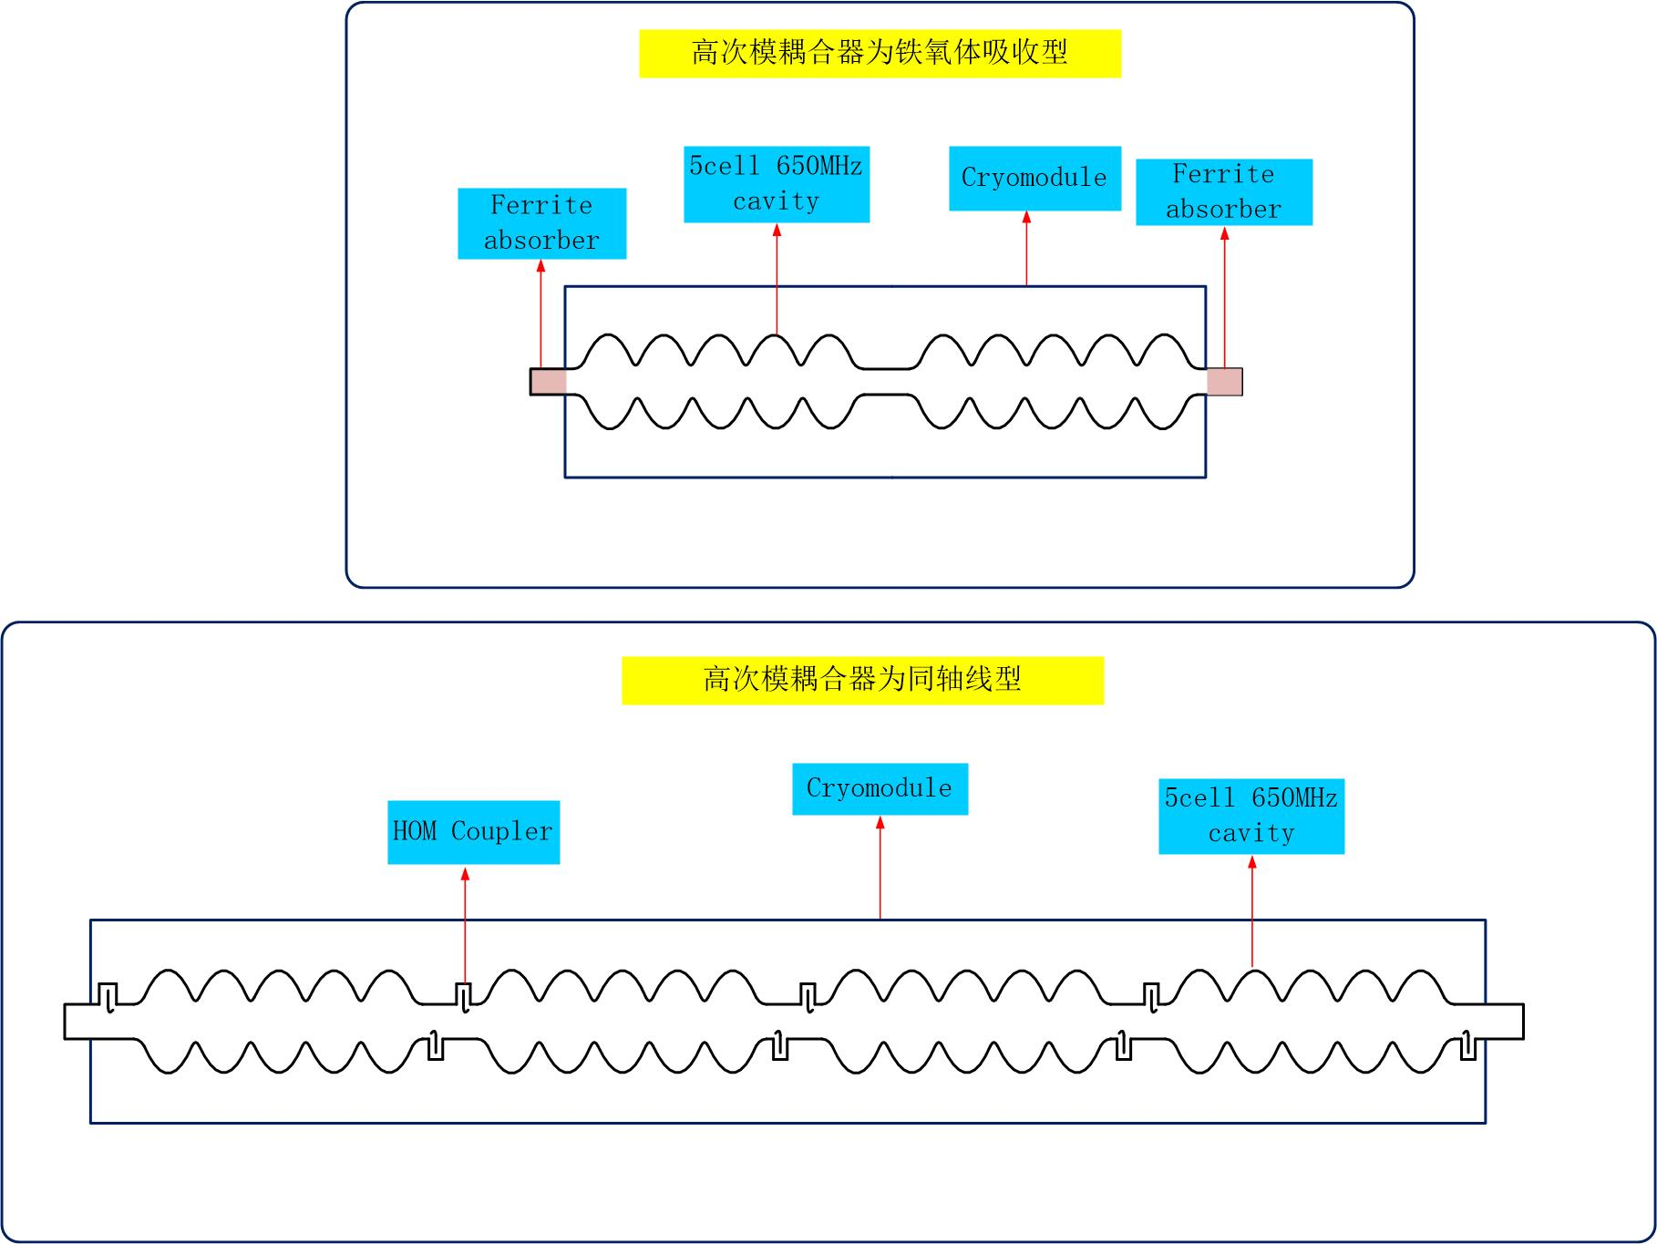
HOM Damping Scheme (hook and ferrite)
CESR
KEKB
Ferrite Outside
Waveguide?
Hot topic in HF2014
LEP-2 & SOLEIL, BNL
Hook => + Ferrite
For the propagating HOM power, how much is absorbed by the couplers, waveguides and outside absorbers and how much within the cryos at 2K? )

Slide 51




BEPCII Spare Module and HOM Damper
Ferrite: 6 kW HOM power absorption
7.7 MV/m

Slide 52

Input Coupler Power Clean Assembly
For high Q cavity without field emission, two windows for clean assembly (cold+warm or warm+warm) , or one warm window assembly in cleanroom.
Cold window cooling is challenging.
Or two couplers per cavity?

Slide 53




IHEP Power Couplers for SC Cavity
500 MHz
BEPCII spare
420 kW CW TW
1.3 GHz
ILC
1 MW pulse TW
162.5 MHz
China ADS HWR
20 kW CW TW
325 MHz
China ADS Spoke
10 kW CW TW

Slide 54





SRF Infrastructures & Industrialization
FNAL SRF Lab
Zanon facility for XFEL cavity production

Slide 55





SRF Facilities in JLab TEDF
JLAB SRF LAB
Chemistry, cavity treatments, and support areas
R&D
Advanced Conceptual Design 4/1/09
Cavity and cryomodule cryo/RF testing
Cleanroom
Cryomodule assembly
Fabrication
New

Slide 56




COI: Center-of-Innovation Building at KEK
2012 supplementary-budget: model facility for ILC assembly & Testing
STF building
COI building construction area
COI building

Slide 57



COI: Center-of-Innovation Building
As a model facility for ILC assembly & Testing
Clean-room
He Cryogenics
EP(vertical-EP)
Cavity Testing(4-cavities-test)
Cryomodule Assembly(cantilever)
Cryomodule Testing
Vertical-EP
Cantilever

Slide 58



Cavity Automatic Tuning,
Processing and Testing

Slide 59






Cavity Surface High Resolution Inspection and Precise Local Repairing

Slide 60




Cryomodule Assembly and Testing

Slide 61
Key Findings
Only with the two large scale, well-equipped and well-run SRF labs at Fermilab/Argonne and Jlab can US LCLS-II project realize in 6 years.
  The same for Europe to build XFEL, and KEK in Japan to host ILC.
  CEPC SRF scale: 3 x cavities (larger size, coupler & HOM power), 8 x cryo plants, 60 x RF power than LCLS-II.
These new SRF labs or technology will never exist if without previous 30-year large SRF projects, and especially 8-year ILC GDE endeavor.
Collaborate with industry from very beginning to ensure technology transfer, quality control and mass production in tight schedule.

Slide 62
Summary
CEPC SRF system: unique challenge and opportunity for China & world SRF accelerator community.
New breakthrough technologies: cavity processing & material for very high quality factors; push frontiers of SRF.
Very high power handling capabilities of HOM Damper & Input Coupler: hard limits to machine design and performance.
RF power source: major part of CEPC capital cost and power. We need a green machine.
Synergy with R&D and industrialization: CADS & PIP-II (650 MHz, high power RF source and coupler, high Q), Euro-XFEL, LCLS-II, ERLs & ILC (1.3 GHz, high Q, HOM), FCC etc.

Slide 63

“The best weapon was endurance.”
Run for your life, Nature, Vol 487, 19 July 2012
“Running is essential to the molecular memory of who we are.”

Slide 64
Back up

Slide 66
Right SRF Material Should Provide:
(1) Low surface resistance, including low residual resistance at T → 0;
(2) An s-wave Cooper pairing state with a full superconducting gap on the entire Fermi surface;
(3) A high lower critical magnetic field Hc₁ at which the weakly dissipative Meissner state is destroyed due to penetration of vortices;
(4) A high superheating magnetic field which definesthe theoretical limit of the SRF breakdown;
(5) High thermal conductivity to transfer the rf dissipated power through the cavity wall;
(6) Grain boundaries transparent to high rf screening currents in polycrystalline cavities;
(7) Comparatively simple chemical composition, so that the material is not contaminated by nonsuperconducting second phases, and the superconducting properties are not degraded by local chemical nonstoichiometry;
(8) Good mechanical properties and malleability to minimize crack formation during cavity manufacturing (forging, deep drawing, etc.)

Slide 67
Theoretical Q Limit of Nb and Nb/Cu
 | f / MHz | T / K | R_{BCS} / Ω | R_{m} (10 mG) / Ω | R_{s} / Ω | Q at zero field
LEP sputtered | 352 | 4.2 | < 39 | > 1.8 | 40.8 | 7 E9
KEKB/BEPCII bulk | 500 | 4.2 | 78.8 | 2.1 | 80.9 | 3.2 E9
CEPC bulk or sputtered | 650 | 4.2 | 133.1 | 2.4 | 135.5 | 2 E9
 |  | 2 | 2.7 | 2.4 | 6.1 | 4.4 E10
CEPC bulk | 1300 | 2 | 10.9 | 3.4 | 14.3 | 1.9 E10
Due to medium field Q-slope and field emission, Q will drop, especially the Nb/Cu sputtered cavity.

Slide 74
One Window Couplers
Lab | Project/ Coupler | Window | Freq [MHz] | Aver Power test/oper [kW] | Peak Power test/oper [kW] | Qty | Years of oper.
KEK | Tristan | Disk | 500 | 200/70 | CW | 16 | 10
KEK /IHEP | KEKB /BEPCII | Disk | 508 500 | 800/400 420/150 | CW | 10 2+2 | 10 7+0
DESY | HERA | Cylindrical | 500 | 80 | CW | 16 | 17
CERN | LEP II | Cylin | 352 | 565/100 | CW | 288 | 7
CERN | LHC (var.) | Cylin | 400 | 350 | CW | 16 | 6
CERN | APS | Cylin | 352 | 80 | CW | 20 | 18
CERN | ESRF | Cylin | 352 | 100 | CW | 16 | 19
KEK | ADS | Disk | 972 | 165 | 2000/350 | 4 | 0
ORNL | SNS | Disk | 805 | 45 | 1000/350 | 81 | 9
IPN | ESS spoke | Disk | 352 | spec 15 | spec 335 | ..28 | design
CEA | ESS ellip | Disk | 704 | spec 54 | spec 1100 | ..180 | design
CERN | SPL | Disk and Cyli | 704 | 40 spec 100 | 1000 | .. 246 | 0

Slide 75
One Window Couplers
Lab | Project / Coupler | Window | Freq [MHz] | Average Power test/oper [kW] | Peak Power [kW] | Qty | Years of oper.
CEA | IFMIF | Disk | 175 | spec 200/153 | CW | 8+ | 0
LPSC | SPIRAL2 QWR | Disk | 88 | 20/12 | CW | 2..12+14 | 0
ANL | FRIB QWR (var.) | Disk | 80.5 | 4 | CW | ..112 | 0
MSU | FRIB HWR (var.) | Disk | 322 | 8/spec. 14 | CW | ..222 | 0
IHEP | CADS HWR | Disk | 162.5 | 20 / 15 | CW | 4+8 | 0
IHEP | CADS Spoke | Disk | 325 | 10 / 10 | CW | 6+3..103 | 0
IHEP | CADS | Disk | 650 | spec 120 | CW | ..113 | design
FNAL | PX | Disk | 325 | spec 30 | CW | 3..52 | 0
FNAL | PX | Disk | 650 | spec 120 | CW | ..>100 | design
BNL | ERL SRF Gun | Disk | 704 | 125/spec500 | CW | 2 | 0
KEK | cERL inj. | Disk | 1300 | 40/5 spec 180 | CW | 6 | 1
HZB | BERLinPro inj. gun | Disk | 1300 | spec 130 | CW | 2 | design

Slide 76
Two Windows Couplers
Lab | Project Coupler | Window | Freq. [MHz] | Average Power test/oper [kW] | Peak power [kW] | Qty | Years of oper.
LANL | APT (var.) | Disk + Disk | 700 | 1000/510 | CW | 2 | 0
DESY | TTFIII/XFEL | Cyl + Cyl | 1300 | 4.5 | 1100 | 32..+ 800 | 15
LAL | TTF V (fix) | Cyl + Cyl | 1300 | 4.0 | 2000 | 2 | 0
KEK/IHEP | STF1 (fix) | Disk + Disk | 1300 | 3 | 1200 | 4/2 | 1
KEK | STF2 | Disk + Disk | 1300 | 3 | 1200/450 | 2+16 | 1+0
KEK | Capacitive Coupled (fix) | Demountable Disk | 1300 | 5 | 2000 | 2 | 0
Cornell | ERL-inj. | Cyl + Cyl | 1300 | 61/40 | CW | 12 | > 1
HZB | TTFIII CW | Cyl + Cyl | 1300 | 8/spec.10 | CW | 1 | 0
Cornell | ERL-ML(fix) | Cyl + Cyl | 1300 | 5 | CW | 4 | 0
KEK | cERL-ML | Disk + Disk | 1300 | 43/15(4.5) | CW | 2 | 1
SLAC | LCLS-II | Cyl + Cyl | 1300 | sepc 6 | CW | .. | design

Slide 78
CW Klystrons in the Market
Frequency (MHz) | Power (kW)
 | CPI | THALES | TOSHIBA
400 |  | 180/250/300/800
476 | 1200
499 | 800
500 | 70/100/800 | 180/250/300/800 | 165
500.08 |  |  | 180
508.6 |  |  | 1200
700 | 1000
704 | 1000
805 |  | 180/250/300/800

Slide 79

法国SOLEIL光源 4*190KW 全固态机SSA
单机3千多模块组成、每模块350W no HV, no Vacuum
运行九年, 年均替换约50模块
ESRF七台150kW替换了klystron
Beam operation since 2005

Slide 80

One PS feeds one cavity or 4 cavities
Cavity trip may result in the machine interlocked and beam loss.
One SSA feeds one cavity, beam can sustain in a cavity trip.

Slide 81

LEP-II 1.2 MV Feeds 8 cavities (352MHz)
HV
vacuum
4MW
Lifetime
1E+4hrs
650MHz
1.2MW
Kly. tube
research?
Price?
20RMB/w?
1.2MW
125kW/cav

