Slide 1

Progress of CEPC CALO/MUON system
Boxiang Yu
On behalf of CEPC Calor Group
2014 CEPC workshop of Shanghai Jiao Tong University (SJTU)
2014-09-12

Slide 2
Outline
CEPC Calor system Introduction;
The progress of Pre-CDR;
The progress of ScECAL, THGEM-DHCAL and MUON
（ The talk of SiW ECAL and RPC-DHCAL will be given by Imad，Vincent and Lei ）

Slide 3
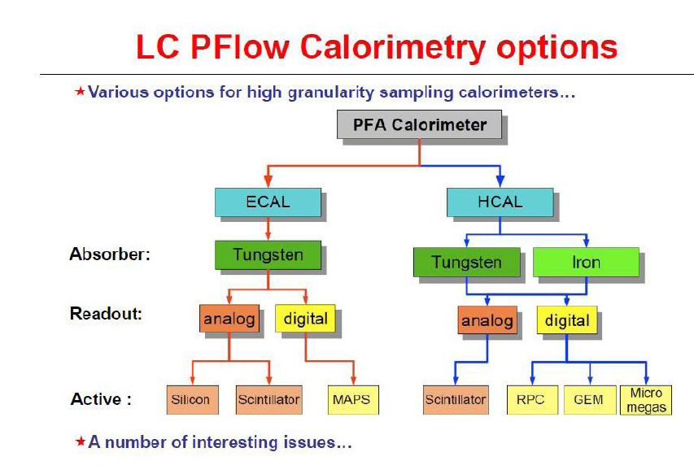
We need a PFA Calor system.

Slide 4
Progress of CEPC-Calor pre-CDR
2nd draft is ready for circulating
(current 29 pages for CALOR, 8 pages for Muon)
Introduction and general layout to calorimeters
ECAL for Particle Flow Approach (Two options)
  Scintillator Tungsten Sandwich - Zhigang Wang(IHEP)
  Silicon Tungsten Sandwich – Vincent. Balagura, J.-C Brient, V. Boudry (IN2P3)
HCAL for Particle Flow Approach (Three options)
  SDHCAL (RPCs) – Imad LAKTINEH (IPNL) , Ran Han (NCEPU)
  DHCAL (RPCs) – Lei Xia (ANL/SJTU)
  DHCAL (ThGEM) – Boxiang Yu (IHEP)
Muon system – Yuguang Xie (IHEP), Qinming Zhang (XJTU)
Calorimeter Calibration and Alignment (included in sub-detector option)
Front-End Readout System (included in sub-detector option)
Power and Cooling System (included in sub-detector option)
Cost Estimation (included in sub-detector option)

Slide 5
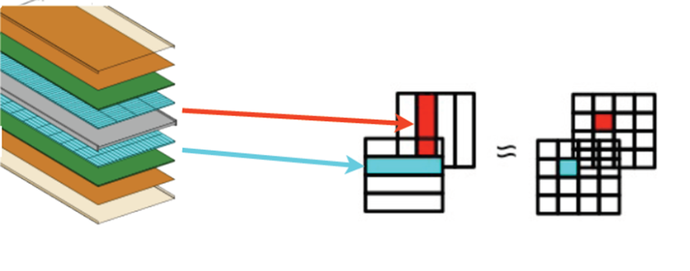
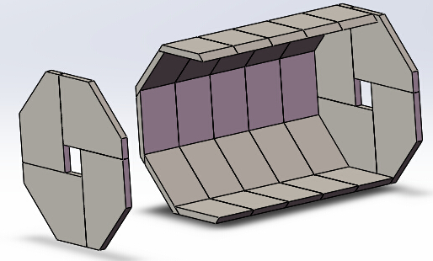
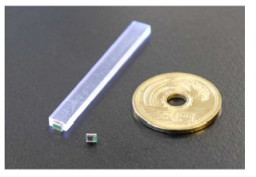
The progress of ScECAL（By Zhigang）
From ILD TDR
Layer structure
2mmx5mmx5cm
Structure of the ScECAL
PS and SiPM
A scintillator-tungsten sandwich sampling calorimeter (ScECAL) is proposed to build a fine-segmented calorimeter in a stable, robust and cost effective way.
A super-layer is made of a tungsten plate (3 mm thick), scintillator strips (2 mm thick), and a readout/service layer (2 mm thick). The thickness of a super-layer is 7 mm.

Slide 6
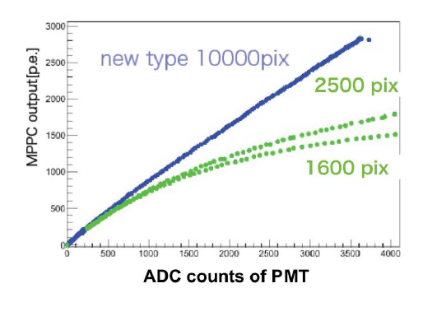
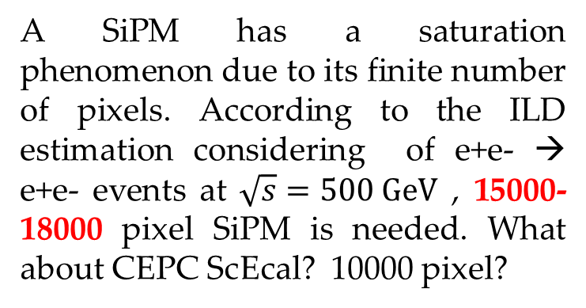
Simulation result
25 layers is an optimized option for CEPC energy, it is a balance between performance and cost.
σ/E of e⁻ energy
Energy resolution Vs thickness
A SiPM has a saturation phenomenon due to its finite number of pixels. According to the ILD estimation considering of e+e- → e+e- events at $\sqrt{s}=500 GeV$ , 15000-18000 pixel SiPM is needed. What about CEPC ScEcal? 10000 pixel?
Linearity of SiPM

Slide 7
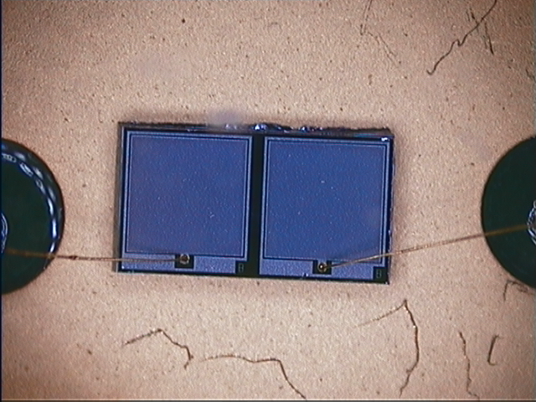
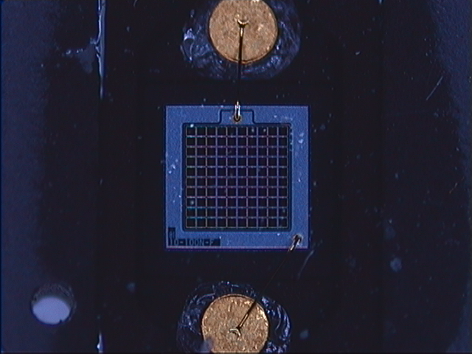
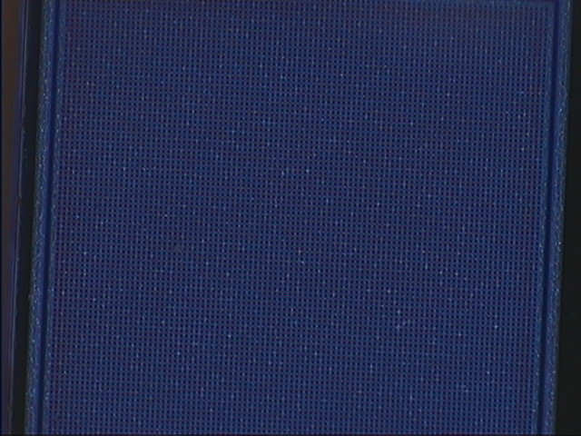
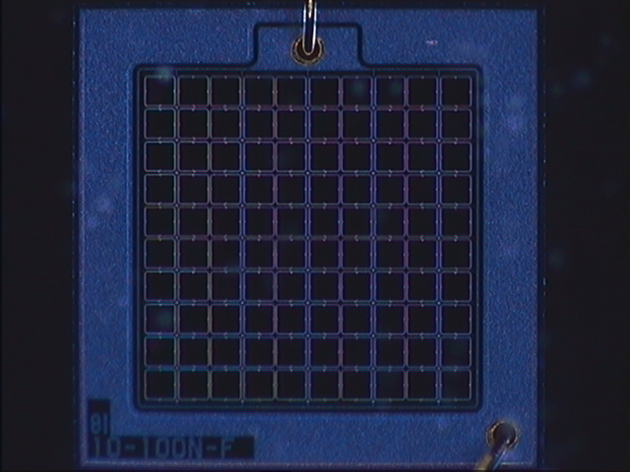
BNU SiPM Vs Hamamatsu MPPC
BNU is Beijing Normal University
BNU SiPM
MPPC
BNU SiPM: 1mm*1mm Hamamatsu MPPC: 1mm*1mm
Pixel size: 10um*10um Pixel size: 100um*100um
10000 pixel 100 pixel

Slide 8
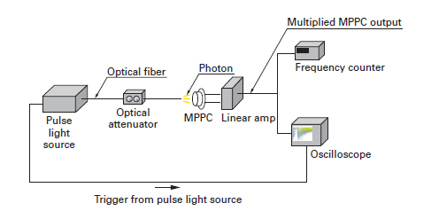
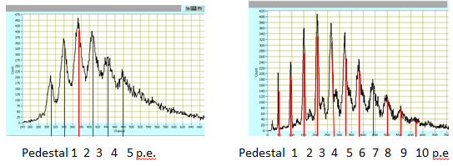
Pulse height spectrum distribution
Temperature: 25 ⁰C,
Humidity: 30%,
Voltage:
BNU SiPM: 27.5V
Hamamatsu MPPC: 71.5V
ADC
MPPC
Gain: 7.8×10⁴
~2×10⁵(BNU report)
Gain: 2.2×10⁶

Slide 9
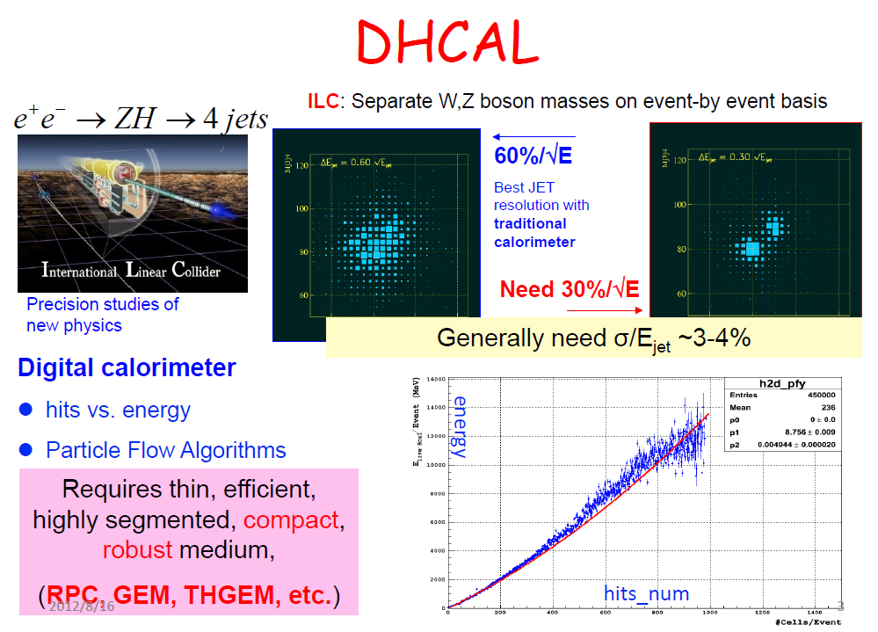
The progress of THGEM-DHCAL
From CALICE

Slide 10
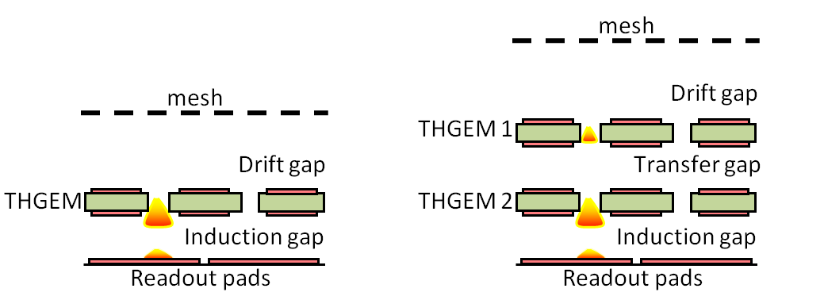
THGEM DHCAL research of RD51
RD51 research WELL-THGEM DHCAL;
The beam studies showed a single-THGEM structure operating at a low gain (~1×10³) can run at 96% efficiency with low discharge probability (10⁻⁶ or lower).
The particular configuration tested, which can still be optimized, had a total thickness of 5.5 mm within the requirement of the ILC-DHCAL.
KPiX readout electronics
Discharge Probability

Slide 11
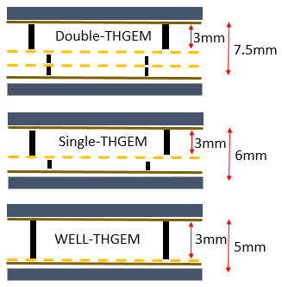
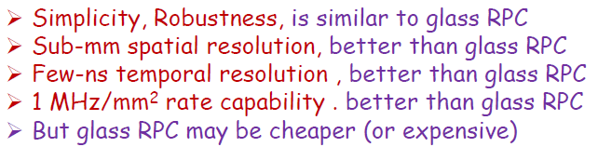
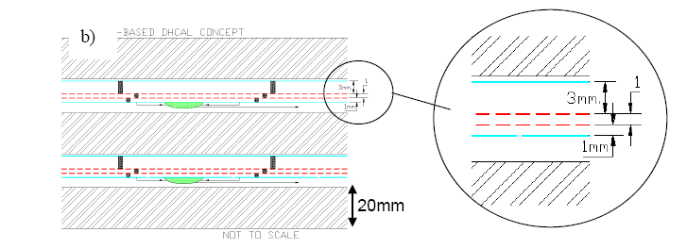
Structure of THGEM-DHCAL
three structure can be selected;
  Double THGEM;
  Single-THGEM;
  WELL-THGEM;
WELL-THGEM is the-best selection.
  thinner, high gain, lower discharge
Including electronics
40cm×40cm THGEM
Structure of GEM-DHCAL

Slide 12
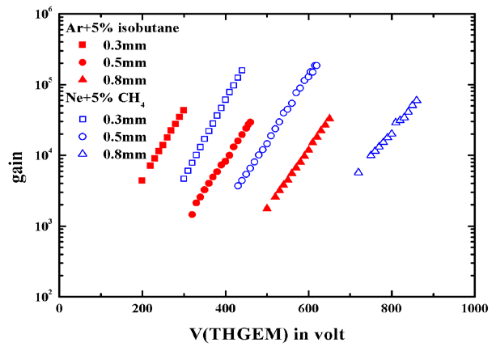
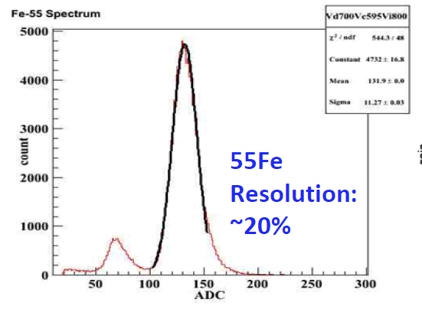
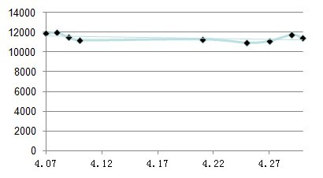
IHEP&UCAS THGEM detector performance study
Maximum gain of double THGEM reach to 2×10⁵(using Neon);
Long time stability;
High energy resolution;
Gain with voltage
1 month Gain Stability

Slide 13
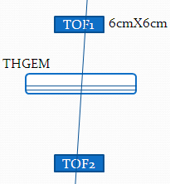
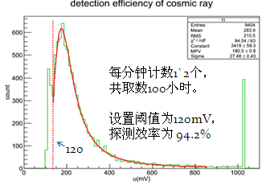
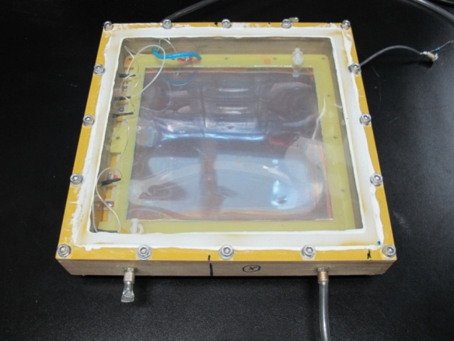
THGEM detector experiment
Double THGEM cosmic ray test
Cosmic ray test，measure the detection efficiency of 16cmX16cm THGEM detector;
Detection efficiency reach to 94.2% with 4mm drift gap detector.
16cmX16cm THGEM detector

Slide 14
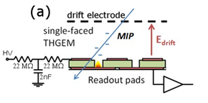
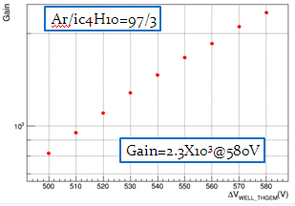
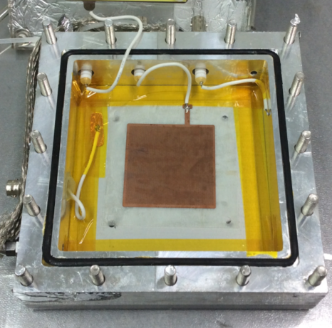
WELL-THGEM detector Research (UCAS, GXU)
A WELL-THGEM detector was constructed;
Some performance was measured;

Slide 15
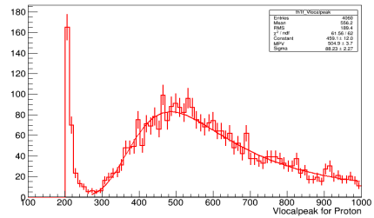
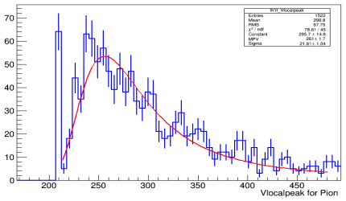
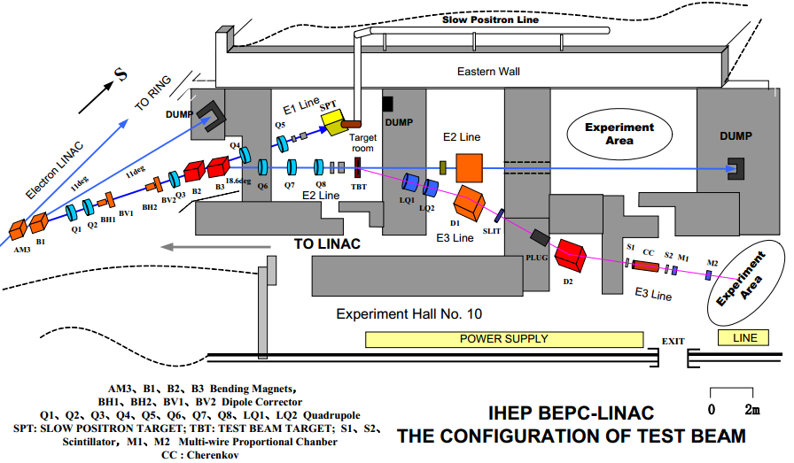
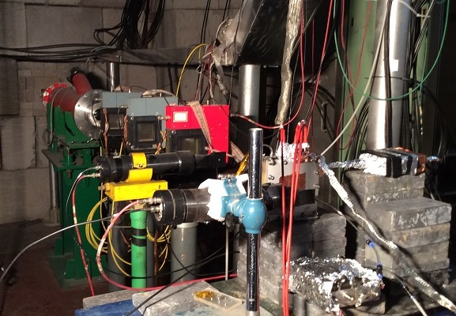
Beam test of THGEM and WELL-THGEM
Using π, p beam，WELL-THGEM and single THGEM was test;
Beam-test result show detection efficiency of π is >95%， detection efficiency of proton is >96% ，WELL-THGEM is better。
Proton
500 MeV/c
Pion
WELL-THGEM

Slide 16
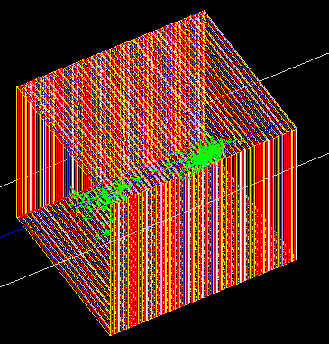
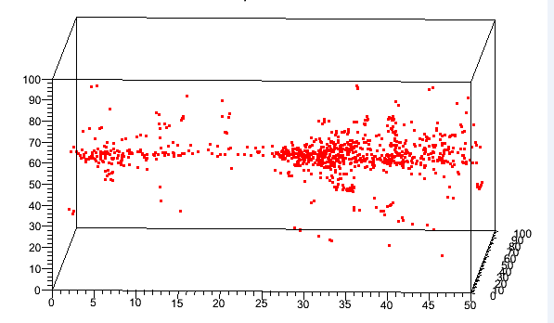
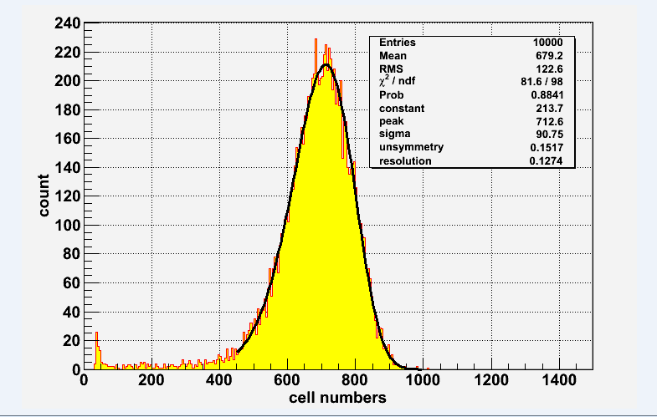
THGEM-DHCAL fast simulation
Fast simulation result of THGEM-DHCAL
QGSP_BERT physics list was used;
Layer numbers for simulation: 30, 40, 50
1m*1m*40 Layers
1x1cm2-50 Layers-100GeV π+

Slide 17
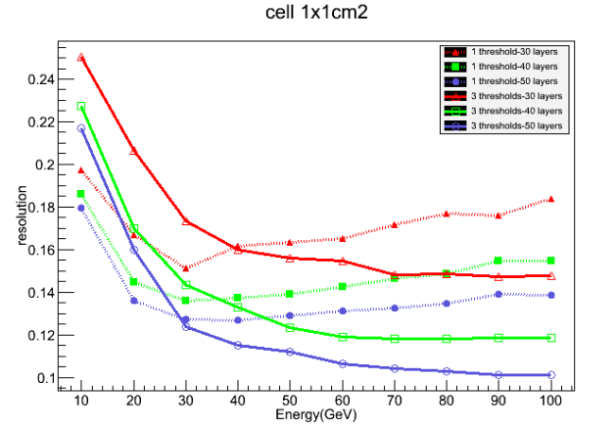
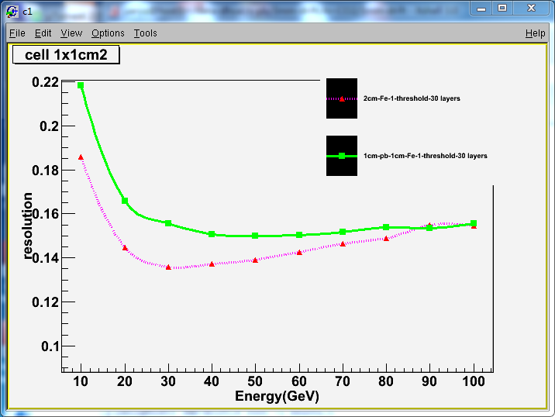
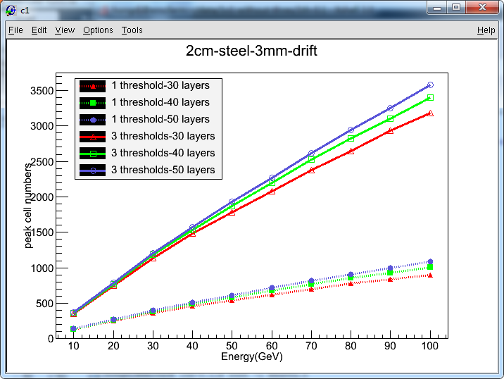
Very preliminary result
Absorber: 2cm stainless steel
Drift gap: 3mm
Ecell = 1, 5 and 10MIPs (the thresholds typically placed at 0.5, 2 and 8 MIPs)
σ/E of Pi⁺ energy
One layer absorber: 20mm stainless steel
Need: 40layers, 4.7λ_{I}
σ/E of Pi⁺ energy
Absorber:
2cm ss
1cm Pb+1cm ss

Slide 18
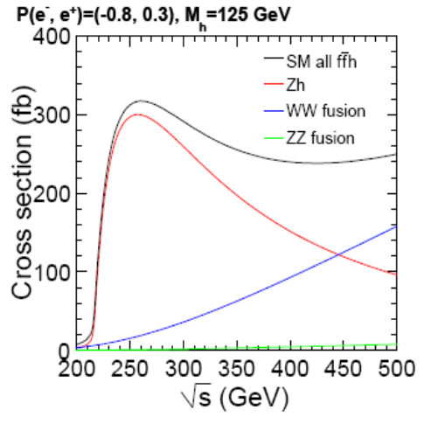
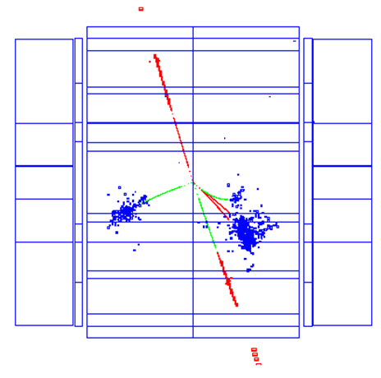
The progress of MUON system (By Yuguang)
We have fine-segmented ECAL and HCAL. So we may Identify the muon from the analysis of ECAL and HCAL data。
Do we need a muon system？
Functions:
the muon identifier, to separate the muons from hadrons(pions);
the solenoid flux return yoke;
Physics requirement( need discussion):
Main channel of muon production
Production peak of e+e→Zh @√s = 250GeV

Slide 19
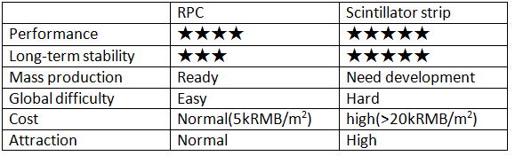
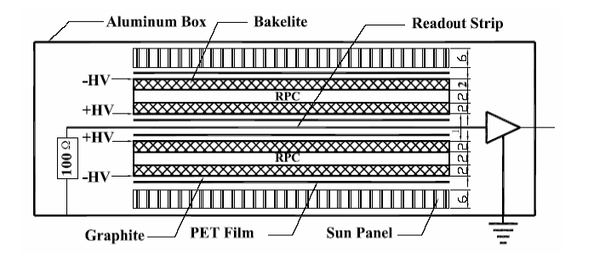
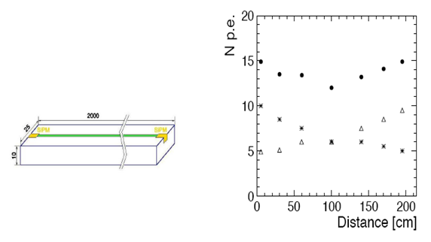
Technologies( not decided )
1. RPC
( glass RPC,
bakelite RPC)
2. Scintillator strip
The cross section of BESIII RPC module
Scintillator strip option
IHEP had produced and applied more than 4500m² bakelite RPCs for BESIII and Dayabay.

Slide 20
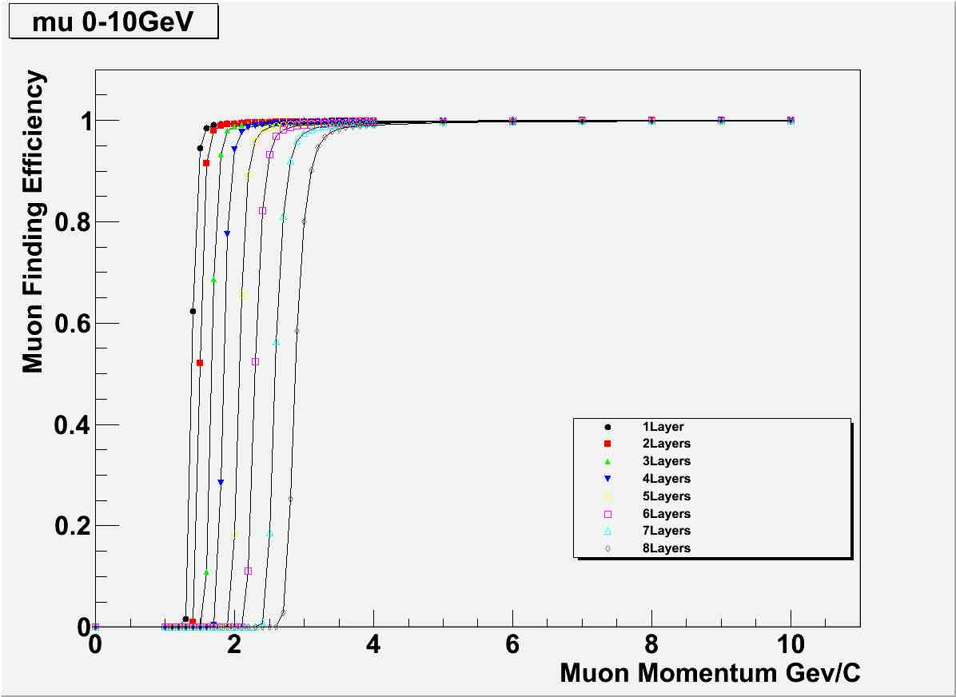
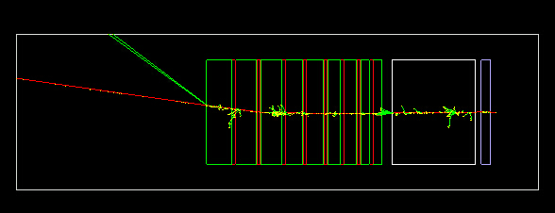
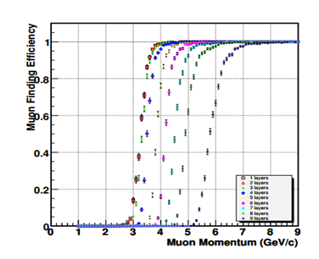
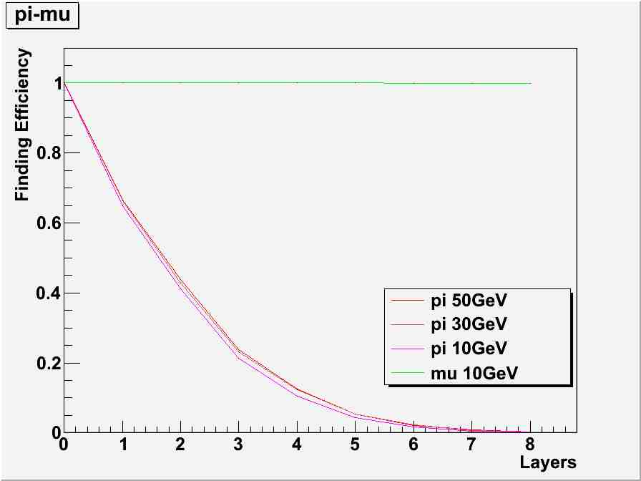
Simulations( stand-alone)
Our results
Configuration I for simulating the finding efficiency
Not magnetic fields
Equivalent absorber is simple
Momentum should be > 4GeV
Plastic Scintillator 3cm×8layers
Steel 8/8/12/12/16/16/20/20/24cm, Sum=136cm(~8λ)
gap 0.5cm
absorbers before mu detector
  9cm tungsten for ECAL
  80cm steel for HCAL
Refs

Slide 21
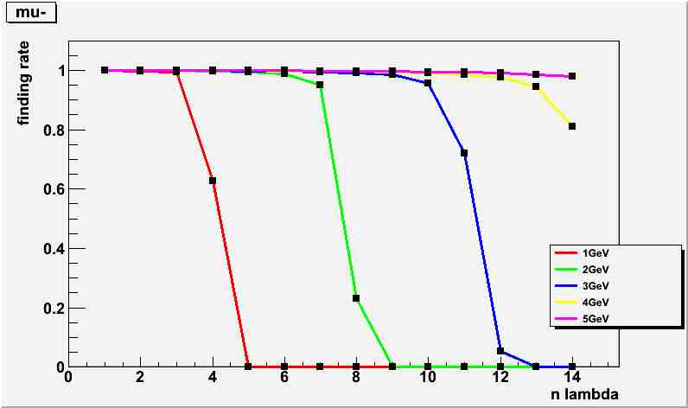
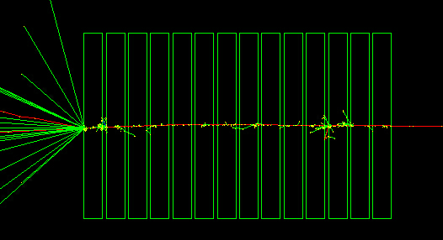
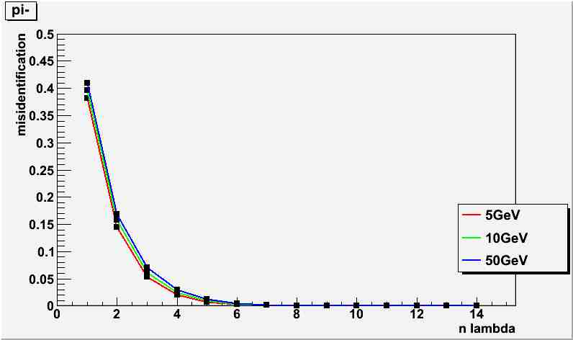
Configuration II for simulating the mu/pi identification
Absorber: W(tungsten)。
Layers: 14
Each layer: 1λ
The simulation results validate that 8 λ absorber thickness and 8 detection layers are reasonable. The muon finding efficiency by 8 layers is >95% for mu >6GeV, and the pi misidentification rate is <1% if absorber thickness > 6 λ.

Slide 22
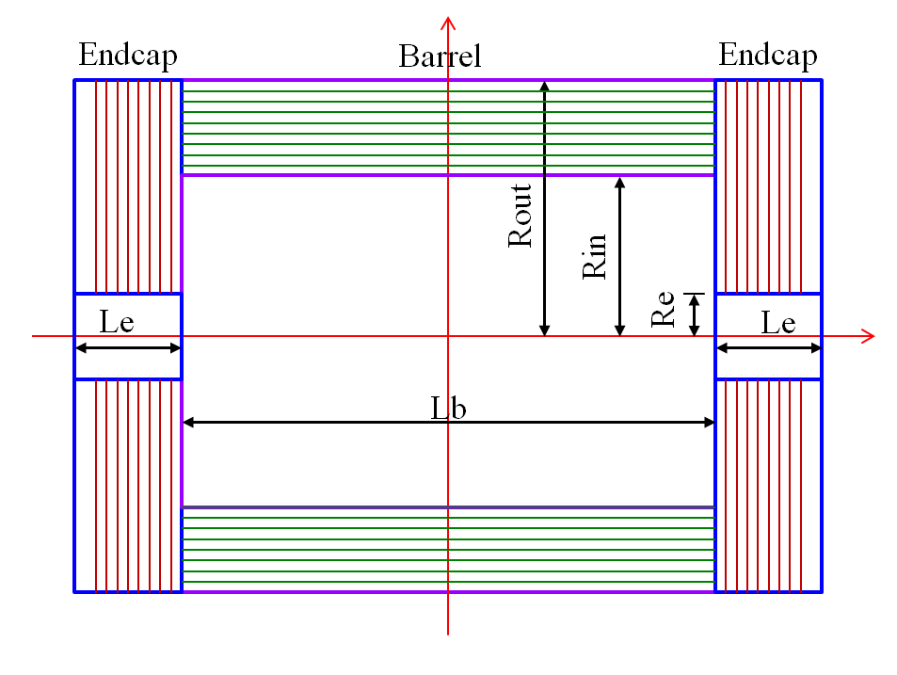
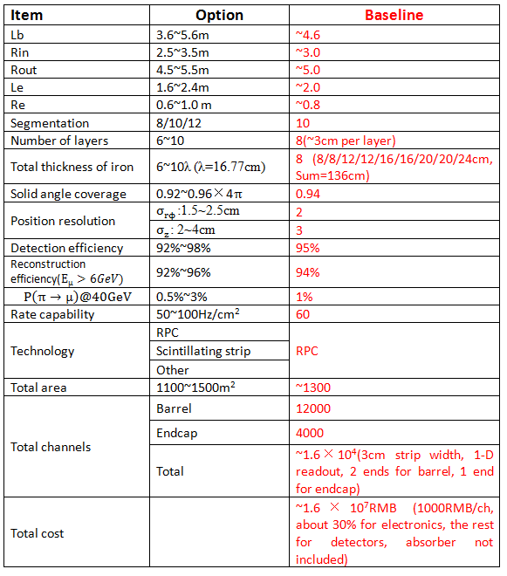

Baseline design(preliminary)
The layout of the muon system.
The segmentation options of the muon system

Slide 23
Summary and Future Plan
CEPC pre-CDR (29pages for CALO, 8 pages for Muon)
  DHCAL (ThGEM) – available (4 Institutions, 5 people)
  SDHCAL (RPC) – available (2 Institutions, 4 people)
  DHCAL (RPC) – available (3 Institutions, 5 people)
  ECAL(SciW) – available (1 Institution, 2 people)
  ECAL (SiW) – available (1 Institution, 3 people)
  Muon system – available (2 Institutions, 2 people)
CEPC-Calo simulations (standalone)
  DHCAL simulation, ECAL simulation
Using simulation studies to determine ECAL/HCAL geometry, sensors and absorbers, number of layers etc. key parameters and integrate in CEPC baseline detector design
Circulating and improving the draft of pre-CDR

Slide 24
Thanks！

Slide 25
Backup

Slide 26
Cost estimation of SciEcal ( 2mmx5mmx5cm)
Tungsten: 123$/kg(quote from manufacture).
SiPM: 1$/pc (Based on extrapolation).
ASIC: 0.25$/ch
PCB: 2600$/m2.
  According to the structure of the SciEcal, the cost of it is list as below:
Tungsten + carbon parts: 15300 k$
Module realization: 1400 k$
Scintillators: 850 k$
SiPM: 8500 k$
Readout ASIC: 2000 k$
Readout Board: 20000 k$
Readout System: 5160 k$
Cables, connectors: 830 k$
Power supplies: 3400 k$
Cooling: 3150 k$
Total: 370 M RMB

Slide 27
Cost estimation of THGEM-DHCAL ( 1x1 cm²)
Item | Cost(k US Dollar) | Comment
Stainless steel | 5,200 | 1100 tons absorber
Module mechanics | 2,000 | Estimation from ILD
THGEM cassettes | 9,000 | 1800/m²，WELL-THGEM
ASIC | 16,500 | 0.3USD/ch，55M ch
Readout Board | 10,800 | Estimation from ILD
Readout system | 3,200 | Estimation from ILD
Power supply | 300 | Estimation from ILD
Gas System | 900 | Estimation from ILD
Cooling System | 1,000 | Estimation from ILD
Assemble | 3,500 | Estimation from ILD
total | 52,400 | 325 M RMB

Slide 28



The progress of Pre-CDR
ECAL (one option)
  ECAL based on Scintillator-Tungsten (by Zhigang Wang)
HCAL (three options):
  GRPC-SDHCAL by Ran Han
  GRPC-DHCAL by Lei Xia
  THGEM-DHCAL by Boxiang Yu
Muon (two options):
  Scintillators Strips or RPC Muon by Yuguang Xie
Reconstruction of RPC-SDHCAL
From Ran
BNU SiPM: 1mm*1mm
Prototype of DHCAL
Structure of THGEM-DHCAL
MUON-RPC(Yuguang)

Slide 29



Slide 30


